Slide 1


DA for L2 Product Harmonization
Across Multiple GEO Sensors
Brian McDonald, Ph.D.
Program Lead, Atmospheric Composition Modeling
NOAA Chemical Sciences Laboratory
TEMPO DART Team Meeting
(June 16, 2026)
Daven Henze
(CU Boulder)

Slide 2
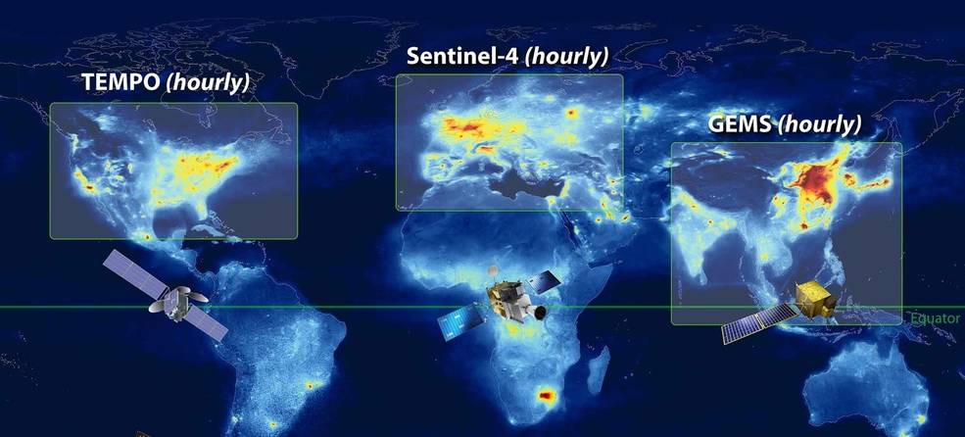
Geostationary Ring of Air Quality Satellites

Slide 3
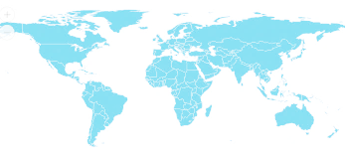




Geostationary Ring of Meteorological Satellites
Satellites In Operation
GOES-R
Imager
LM
GOES-R
Imager
LM
MSG
Imgr
MSG
Rapid
MSG
Imgr
Elk-L
Imgr
I-3DR
Imgr
Sndr
FY2
Imgr
FY4
Imgr
Sndr
LM
GK2A
Img*
GK2B
AC*
OC
H8/9
Img*
*US developed
Instrument
Planned
Satellites
GEO-I
Imager
LM
GEO-S
Sounder
GEO-I
Imager
LM
MTG-I
Imgr
LM
MTG-S
Sndr
AC
MTG-I
Rapid
LM
I-3DS
Imgr
Sndr
FY4
Imgr
Sndr
LM
GK3
Sndr
GK3
Imgr
H10
Imgr*
Sndr*
New Capabilities
GK3
Sndr

Slide 4
Overview of Talk
How ready are our modeling & DA systems for ingesting multiple GEO and LEO sensors?
Satellite needs for L2 atmospheric composition products
Ongoing developments with atmospheric chemistry and composition models
Challenges with joint assimilation of multiple species

Slide 5
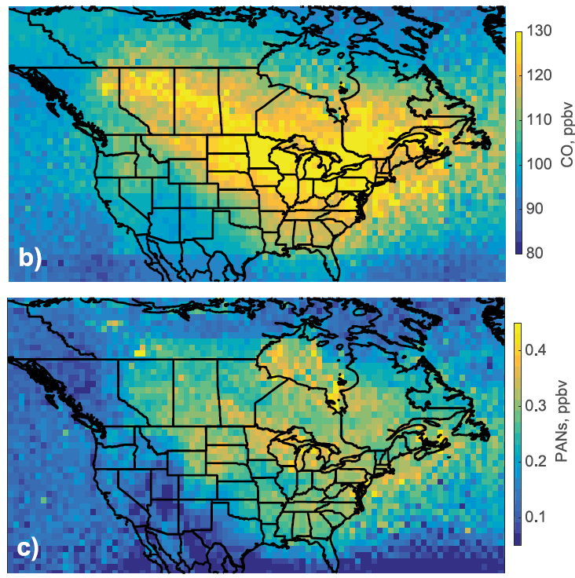
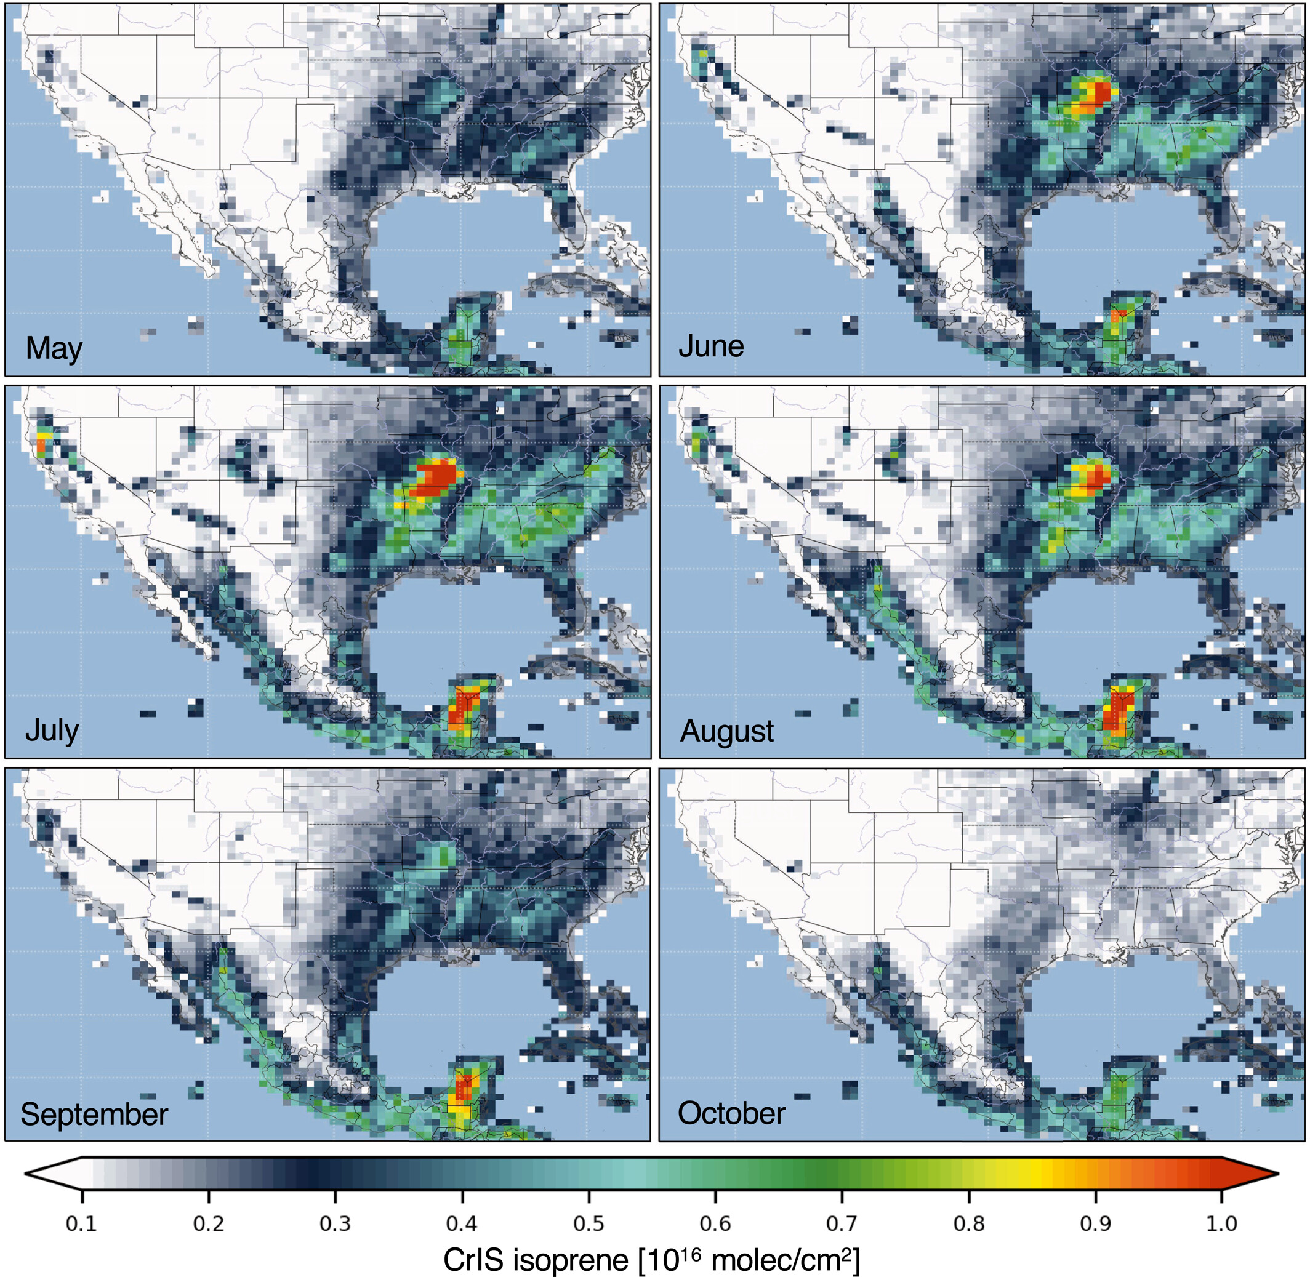
Infrared Sounder Expands Atmospheric Chemistry Species
Canadian Wildfires of 2023
Biogenic Isoprene (2012 – 2020)
Cooper et al. (GRL, 2024)
Wells et al. (JGR-Atmos., 2022)

Slide 6


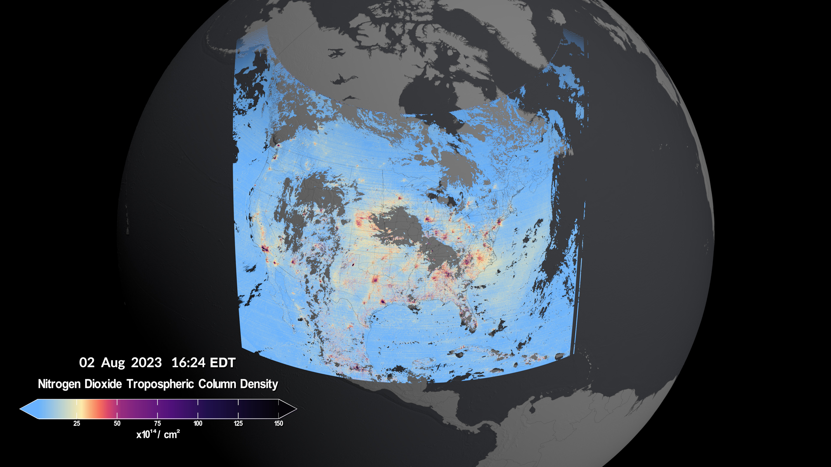
Key TEMPO retrievals for air quality research:
O₃
NO₂
CH₂O
C₂H₂O₂
SO₂
AOD
Top of aerosol layer
AEROMMA-STAQS group photo in Dayton, OH
Credit: NASA's Scientific Visualization Studio; Data provided by the Smithsonian Astrophysical Observatory| Harvard & Smithsonian.
Visualizers
Cindy Starr (Global Science and Technology, Inc.)
Kel Elkins (USRA) and Trent L. Schindler (USRA)
Scientists
Caroline Nowlan and Xiong Liu
Center for Astrophysics | Harvard & Smithsonian

Slide 7
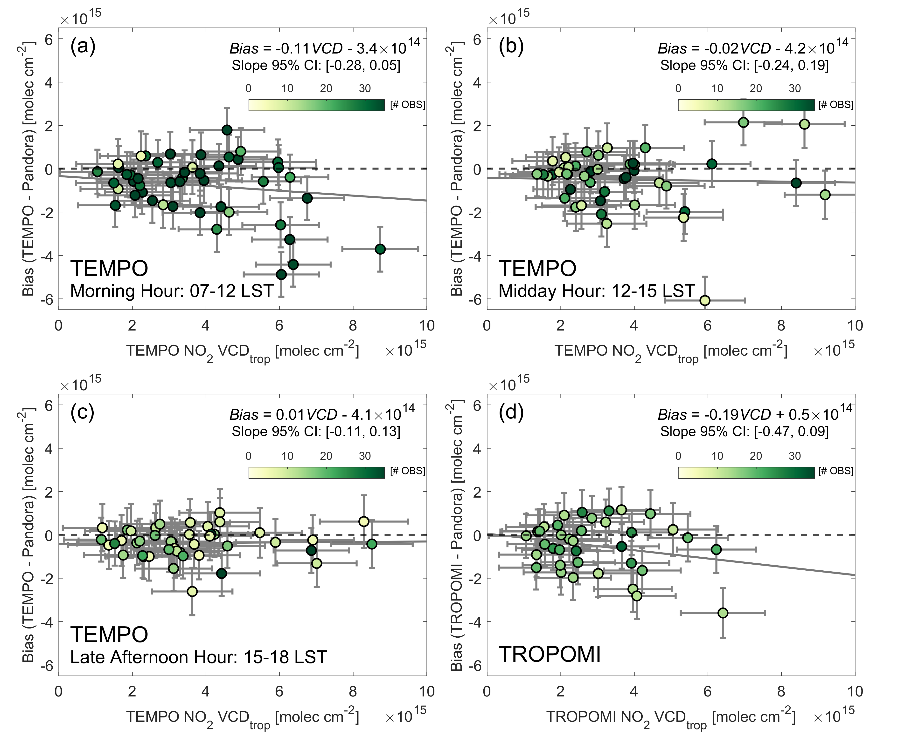
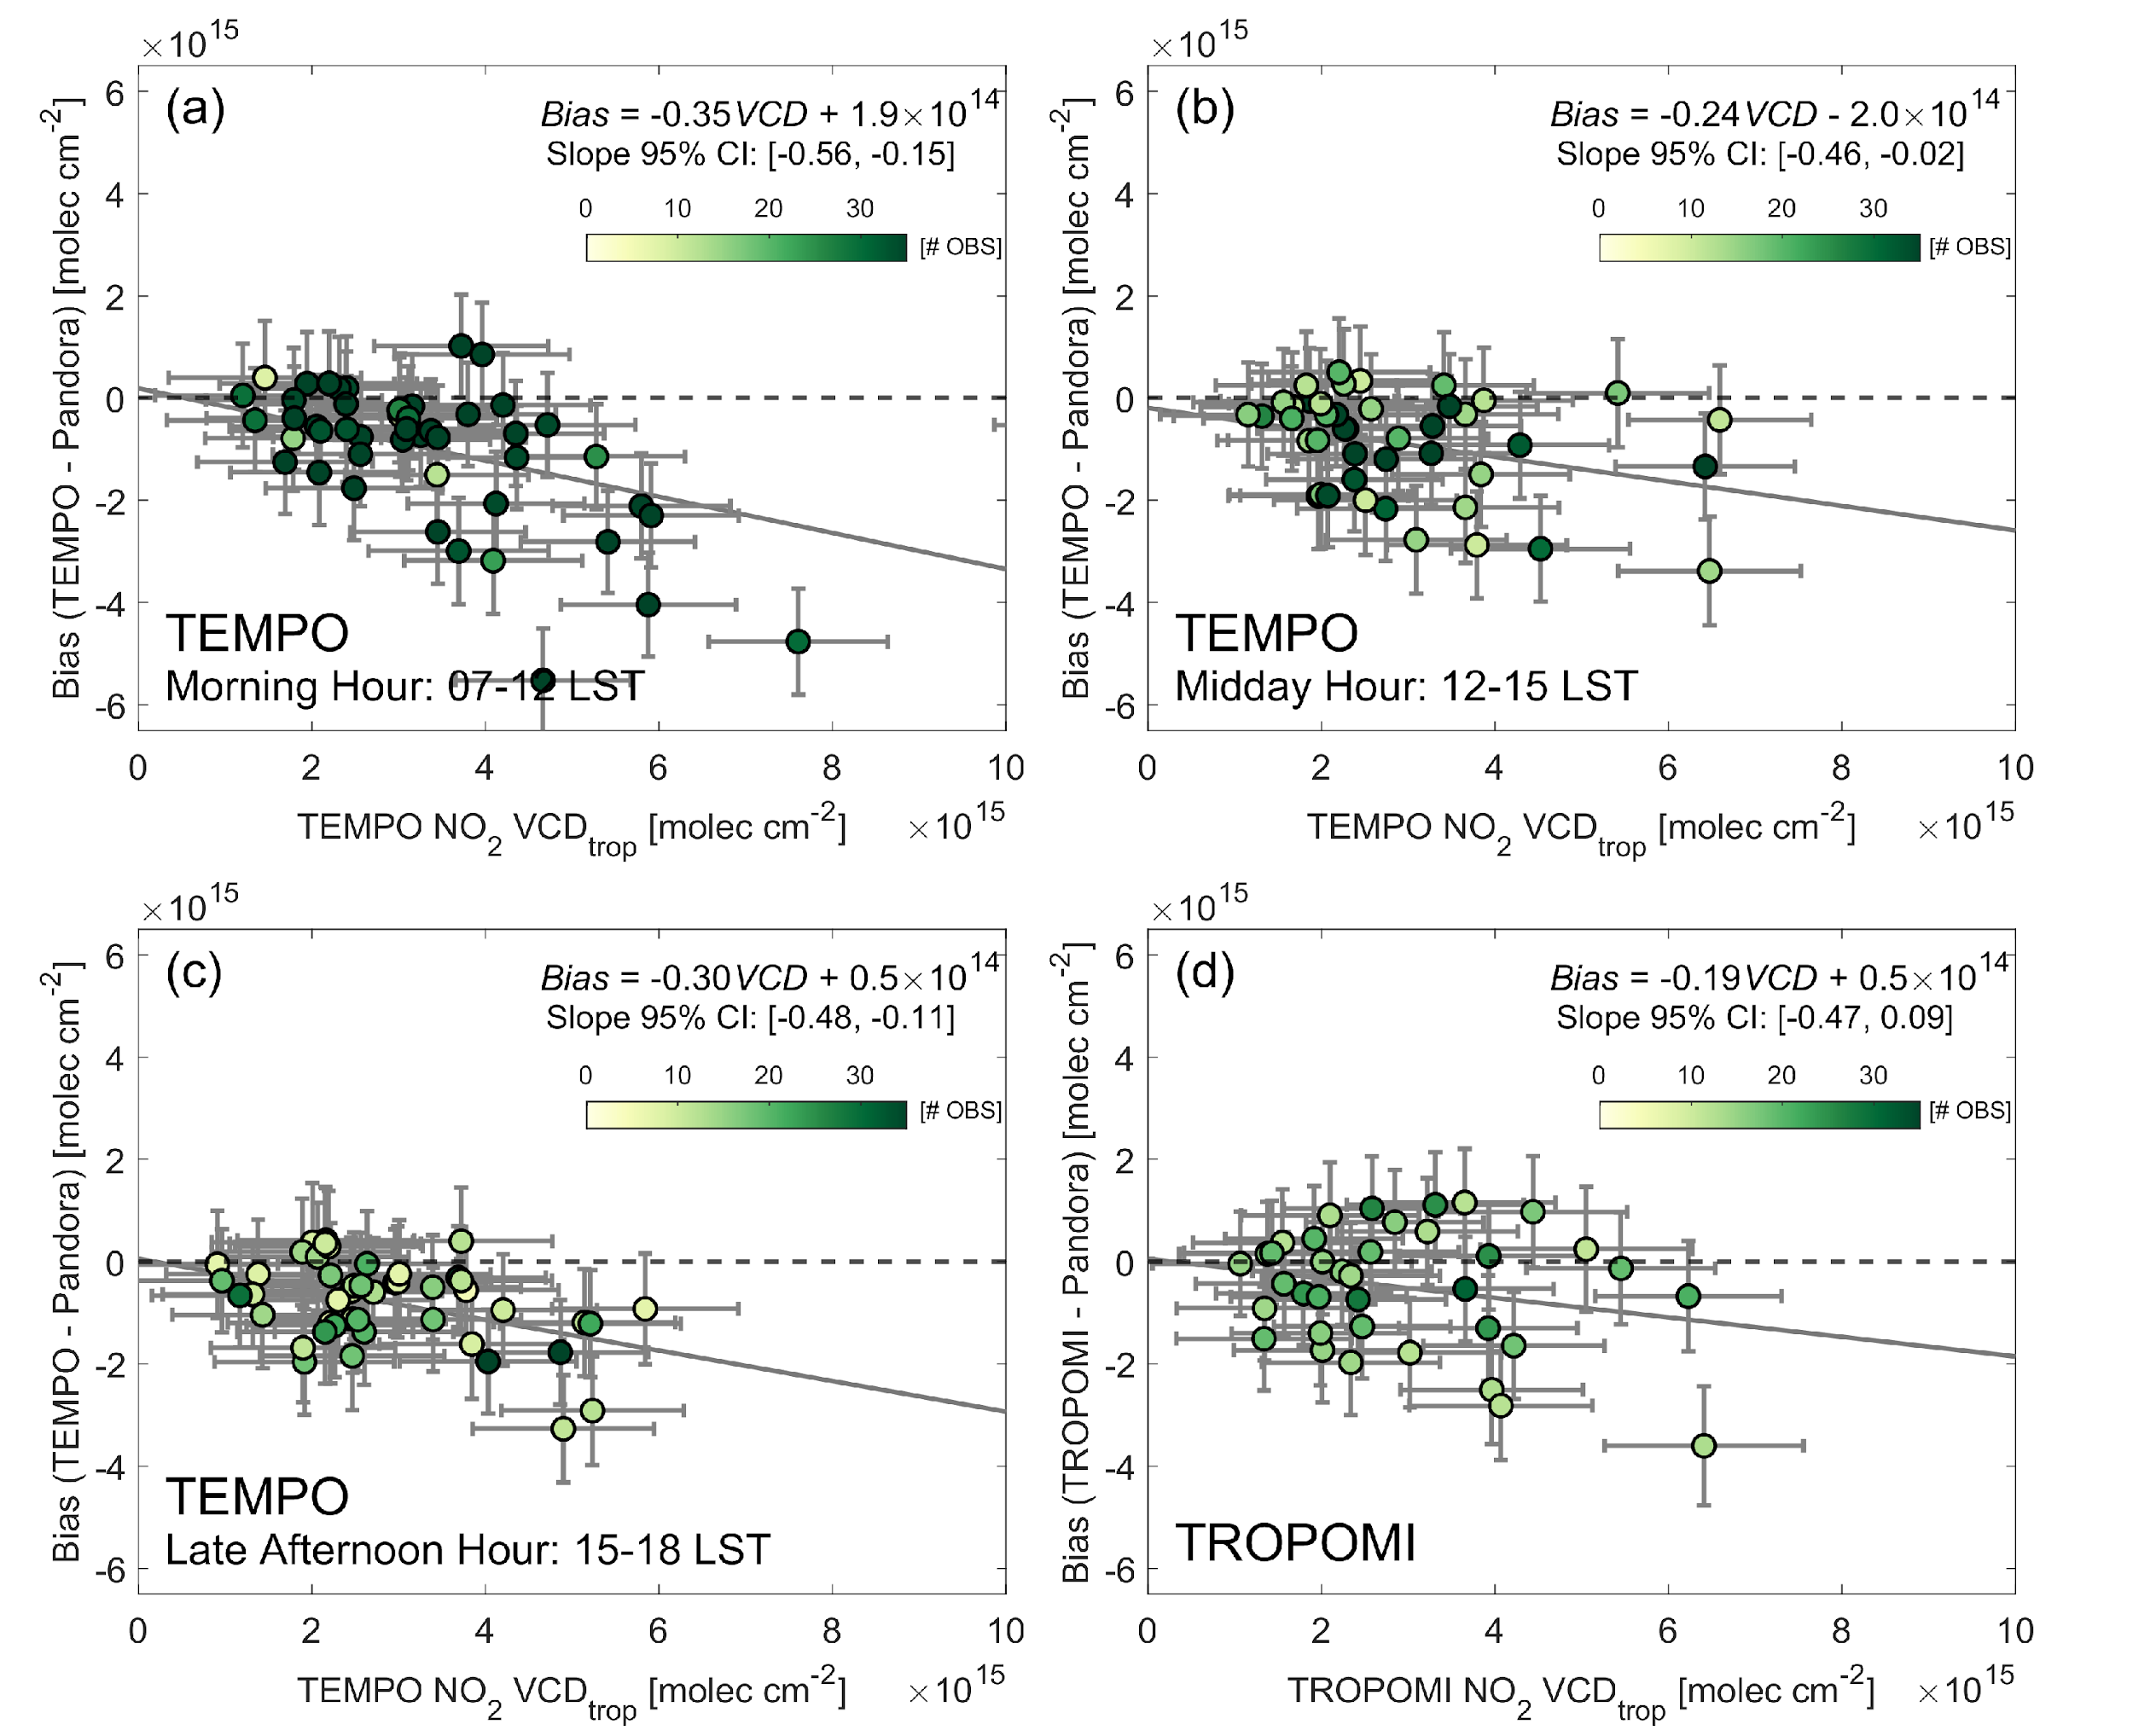
Need for Bias Correction of Satellite Data Prior to DA
TEMPO NO₂ V3
TEMPO NO₂ V4
Hsu et al. (JGR-Atmos., 2026)
Hsu et al. (in preparation)

Slide 8



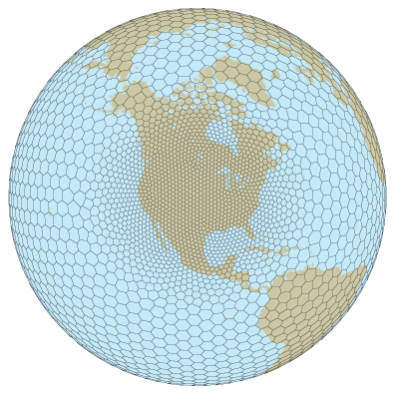

Next Generation Global to Regional Refinement Capability
MPAS: CheMPAS-A, UFS-Chem
FV3: GEOS-Chem, UFS-Chem

Slide 9




Next Generation Atmospheric Chemistry Infrastructure
Accelerate development of CheMPAS-A and UFS-Chem to advance global-to-regional modeling and chemical data assimilation

Slide 10
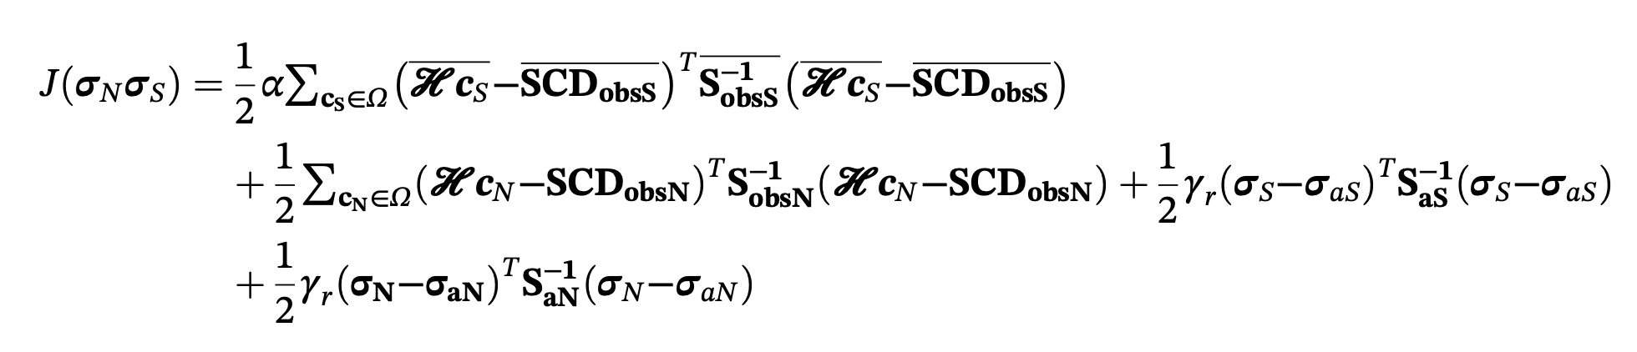
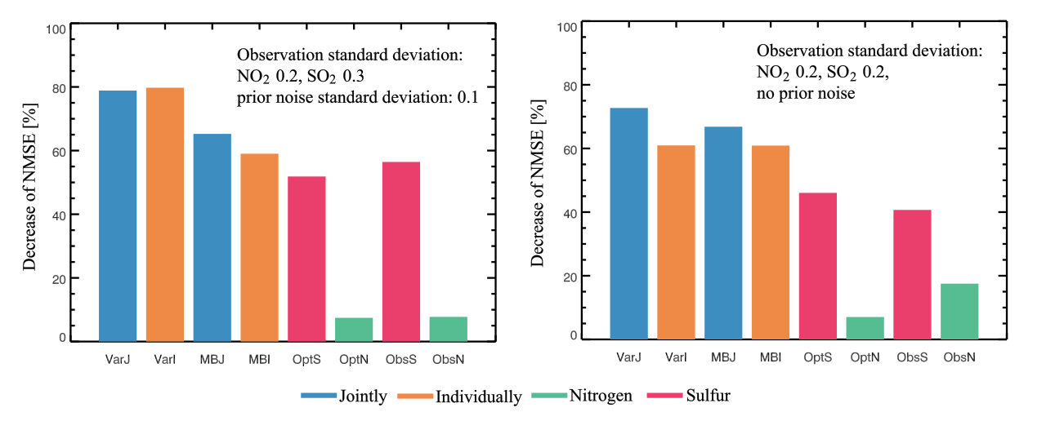
Factors Impacting Assimilation of Multiple Satellite Datasets
Different instruments require different error treatment, averaging, and weighting:
e.g. Cost function in joint assimilation of OMI NO₂ and SO₂ (Qu et al., 2019):
monthly average SO₂ VCDs
daily NO₂ VCDs
scaling factor to adjust for different volume of NO₂, SO₂ data
Noise from one species can project into error for co-assimilated species:
Boxed results on the left: summed error reduction for single-species inversions (orange) exceeds the joint (blue) because large SO₂ errors degrade the NO_{x} performance. On the right: the reverse is true if SO₂ observation error is the same as NO₂ observation error (Qu et al., 2019)

Slide 11
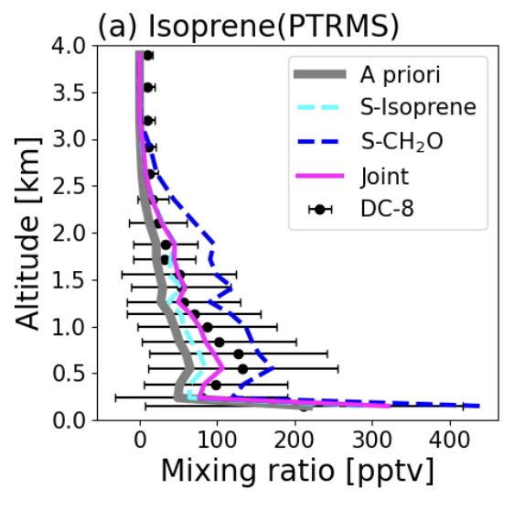
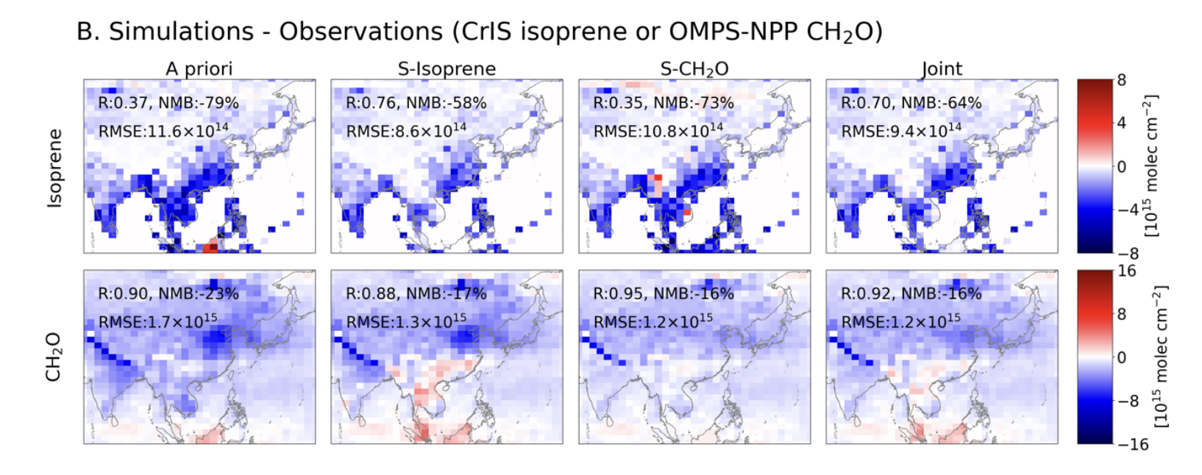
Joint Assimilation is Sometimes an Improvement / Compromise
HCHO (OMPS) + ISOP (CrIS) joint assimilation in KORUS-AQ (Choi et al., 2025)
Improvement:
Aircraft isoprene the best in the joint assimilation (right)
Compromise:
HCHO(UV/Vis) + ISOP(IR) useful for KORUS-AQ (Choi et al., 2025)
The lowest residual error is for the observed species in the single species inversions, but the other species performs better in a joint inversion than when not assimilated.

Slide 12
Summary
Continue development of L2 Products from Infrared Sounder (prepare for GeoXO GXS)
Continued need for evaluation and bias-correction of L2 Products
Next generation meteorological and chemistry models offer great promise, still need more testing and evaluation at high-resolution regional scales
Joint assimilation is sometimes an improvement, sometimes a compromise

