Slide 1

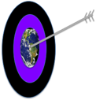

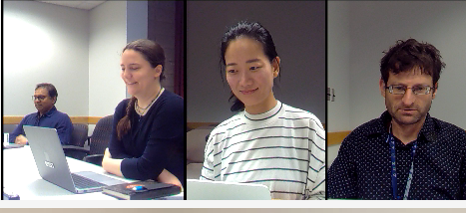

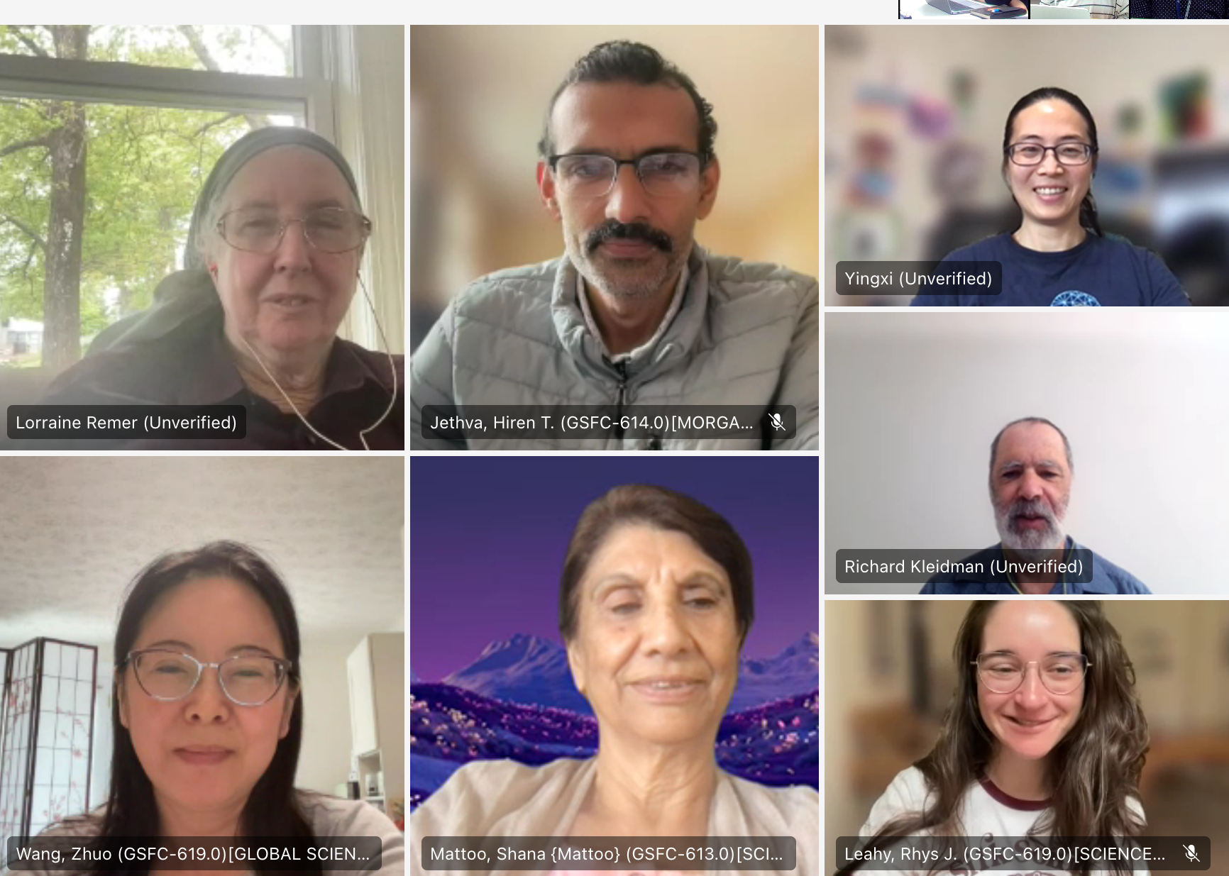


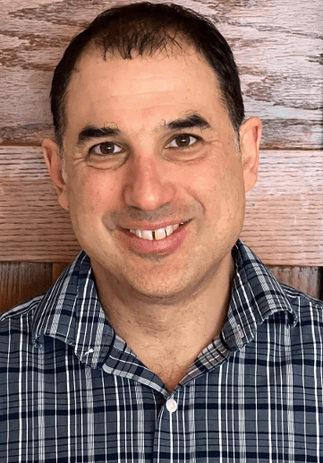
GEO-LEO Imager AOD using the Dark Target Algorithm
Robert C. Levy (NASA Goddard Space Flight Center
and the MEaSUREs Dark Target Aerosol Team
Plus some “comparison” slides with TEMPO product provided by Mijin Kim.
(Teams meetings in 2024)

Slide 2
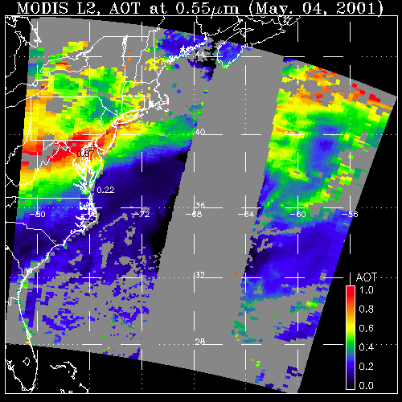
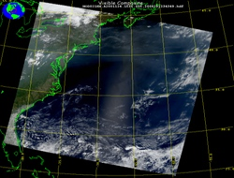

Dark Target Aerosol retrieval Algorithm
(developed for MODIS & ported to VIIRS)
What a sensor observes
Attributed to aerosol (AOD)
May 4, 2001; 13:25 UTC
Level 1 “reflectance”
May 4, 2001; 13:25 UTC
Level 2 (L2) “product”
Established by Kaufman, Tanré, Remer, et al (1997)
Modified by Remer, Levy, Gupta, Sawyer, Shi et al (2005, 2010, 2013, 2015, 2020, etc.)
DT
LAND
OCEAN
GLINT
AOD
1.0
0.0
Requires: Observations of spectral reflectance in selected bands between ”blue” and “SWIR” wavelengths (other bands help with cloud/surface masking and filtering)
Retrieves: AOD at 0.55 μm, spectral AOD (AE), cloud-cleared reflectances, diagnostics, Quality Assurance and Confidence
Notes:
Note that now there are many more algorithms for MODIS, including Deep Blue (retrieves over bright surfaces using a 0.412 micron channel that land surface is much darker), Also MAIAC, which uses multi-day observations to separate quickly changing aerosols from slowly changing land surfaces

Slide 3
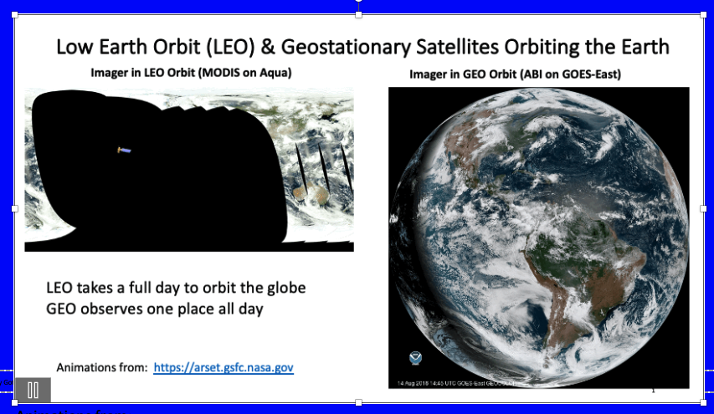
EXPAND with Geostationary (GEO) to observe rapid changes

Slide 4
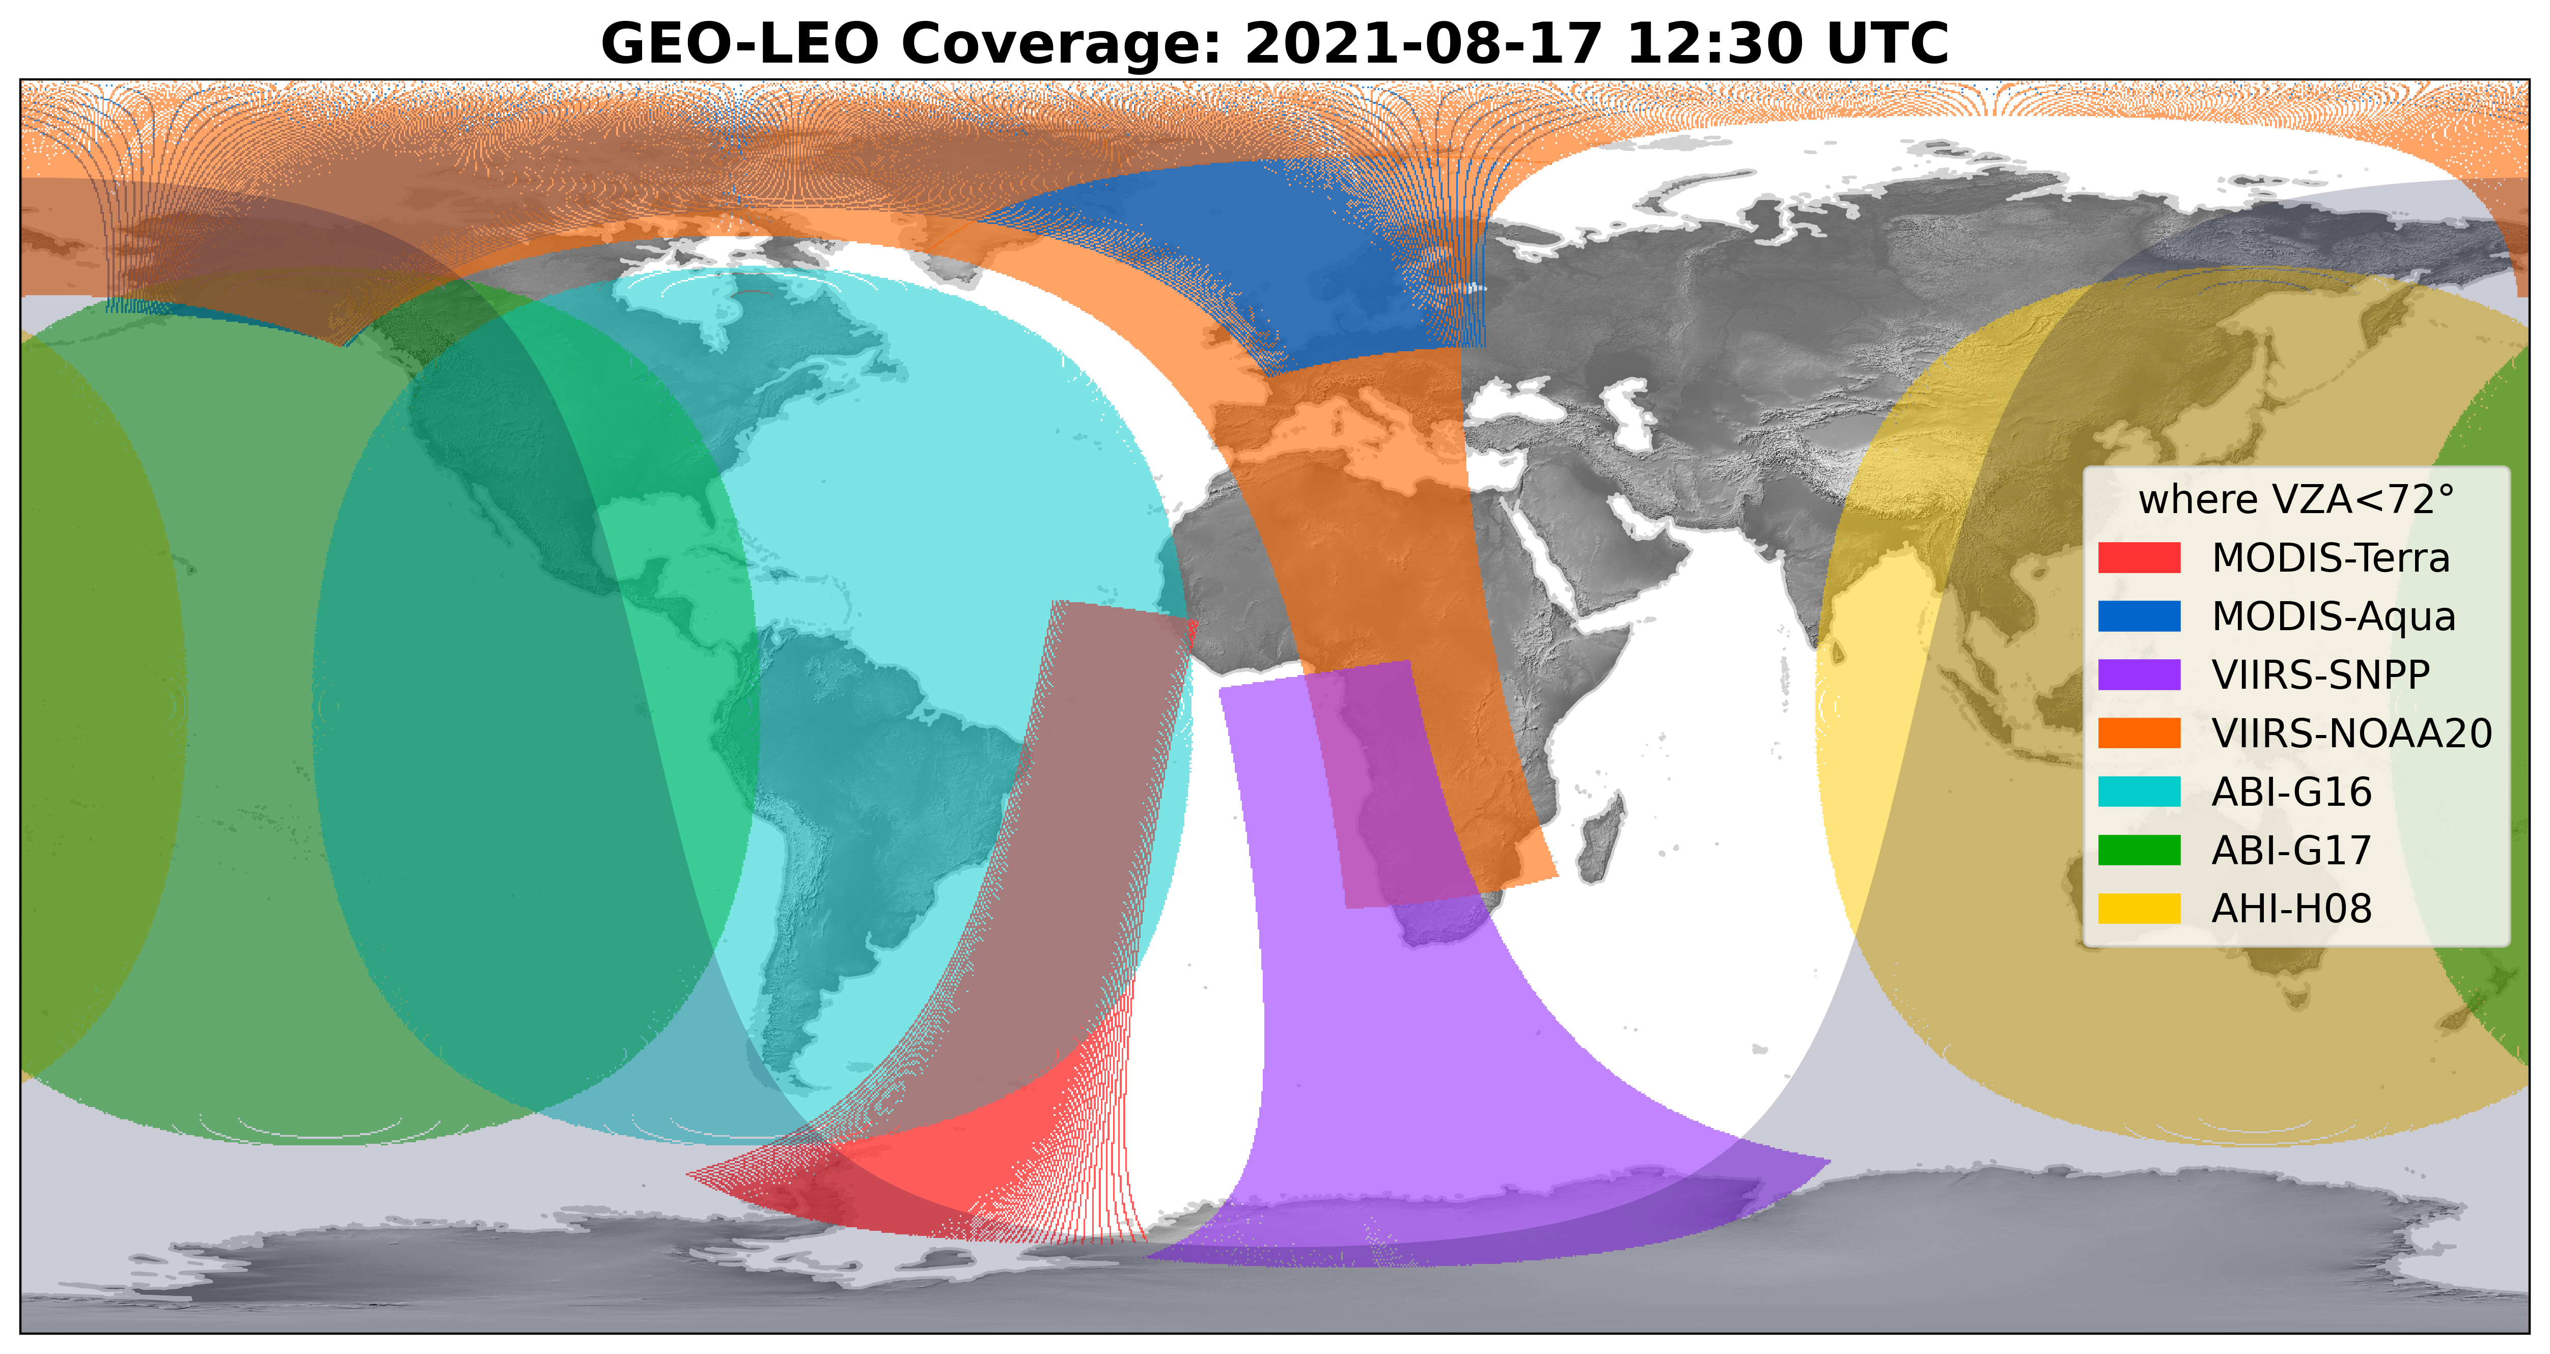
Can we apply DT to different platforms and combine into a single product?
Circa 2017
_SNPP
AHI = Advanced Himawari Imager (Japan)
ABI = Advanced Baseline Imager (U.S.)
A coordinated GEO-Ring
Notes:
Back in 2017

Slide 5
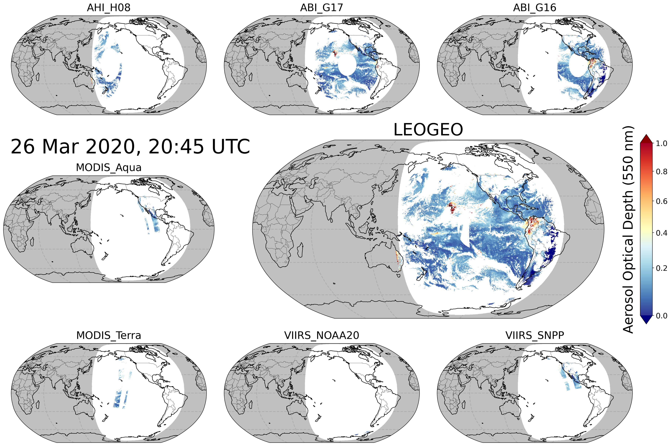
XAERDT: A joint GEO-LEO aerosol product
A NASA “MeASUREs” (Making Earth Data Useful -2017) project
Level 2: 4 sensors / 8 platforms
  MODIS on Terra & Aqua
  VIIRS on Suomi-NPP & NOAA-20
  ABI on GOES-East & -West
  AHI on Himawari-8 & 9
  AODs, Reflectance, QA
Level 3:
  30-minute intervals
  Global 0.25° x 0.25° grid
  Mean, StDev, Counts, etc.
  Merge on 0.25 grid
  Data available for 2019-2022 through NASA-EarthData
https://ladsweb.modaps.eosdis.nasa.gov/missions-and-measurements/applications/geoleo/

Slide 6
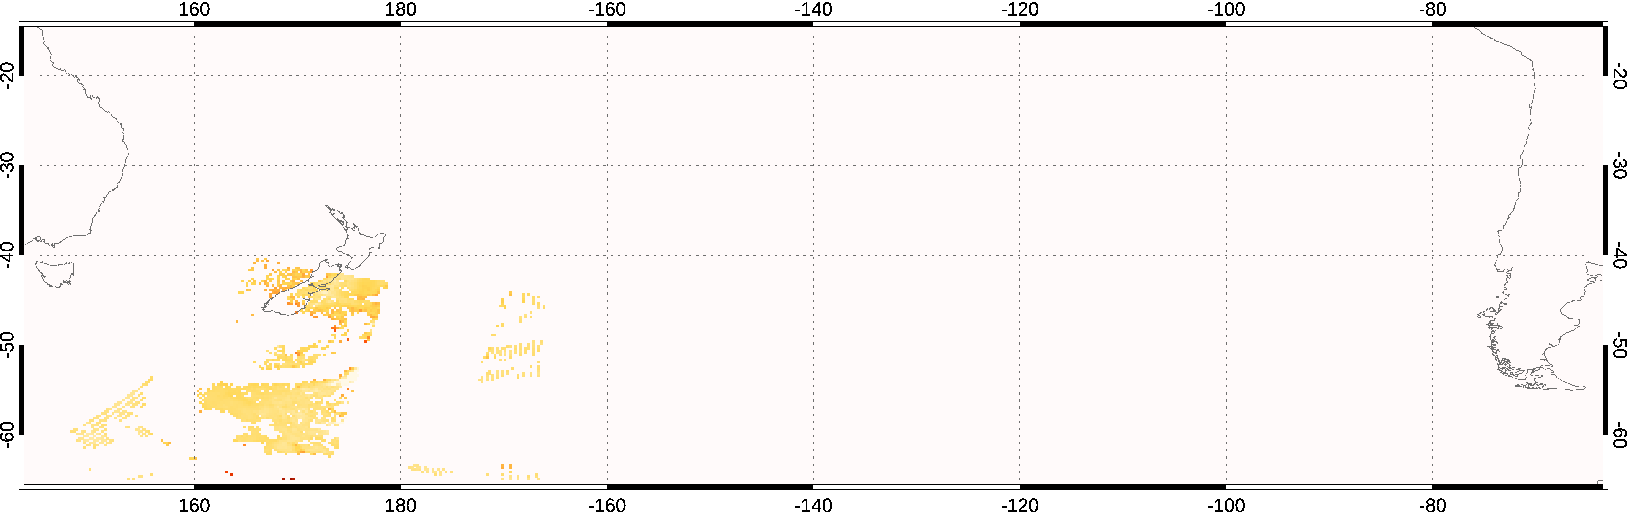
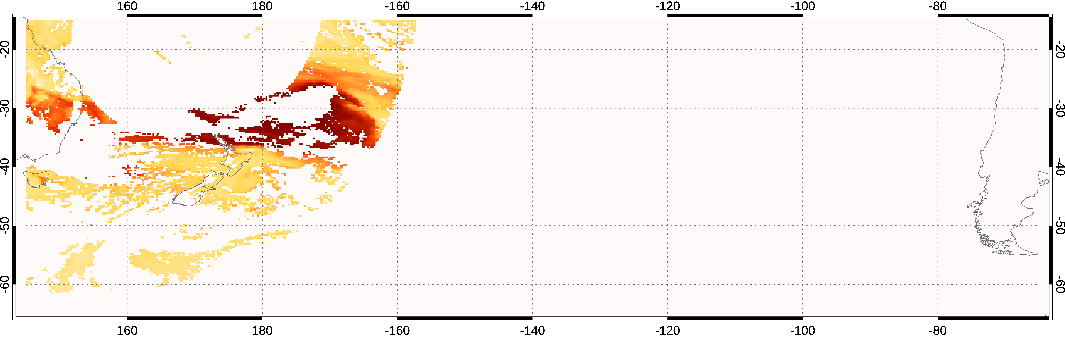
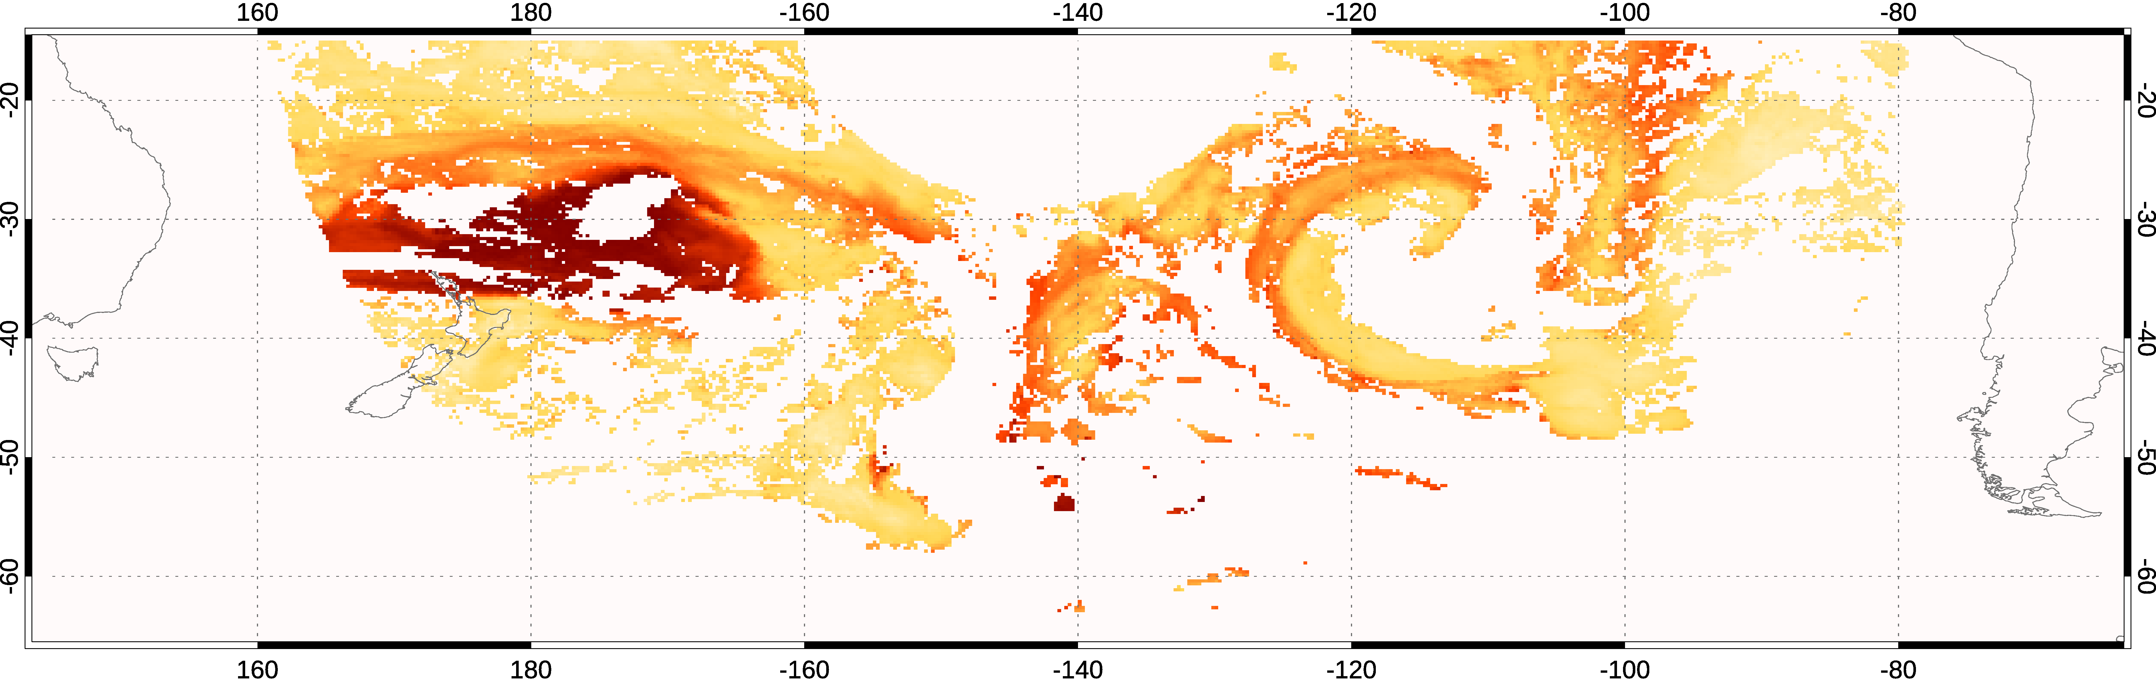
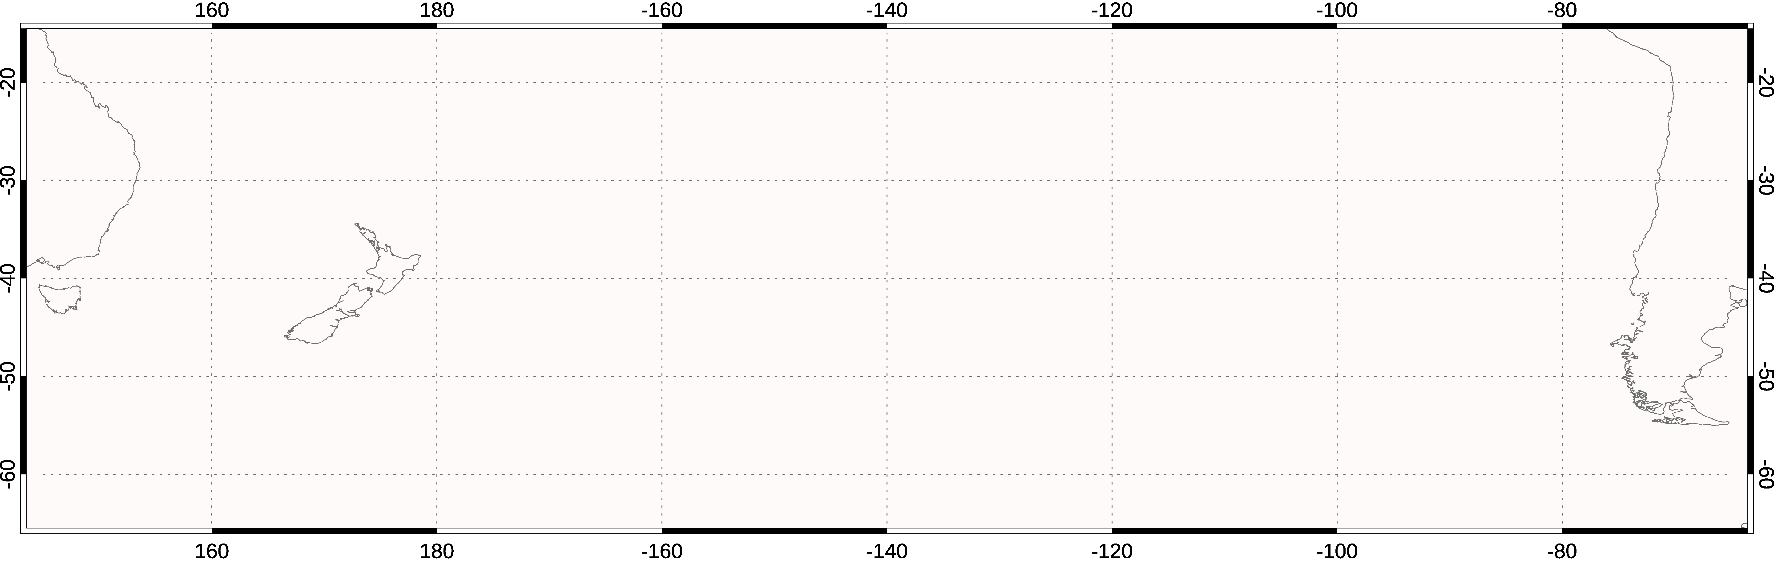
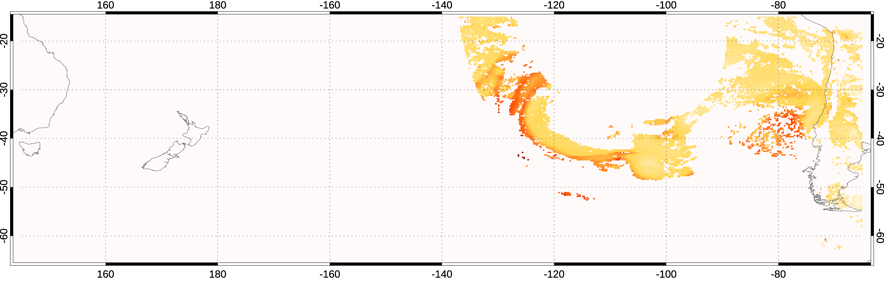
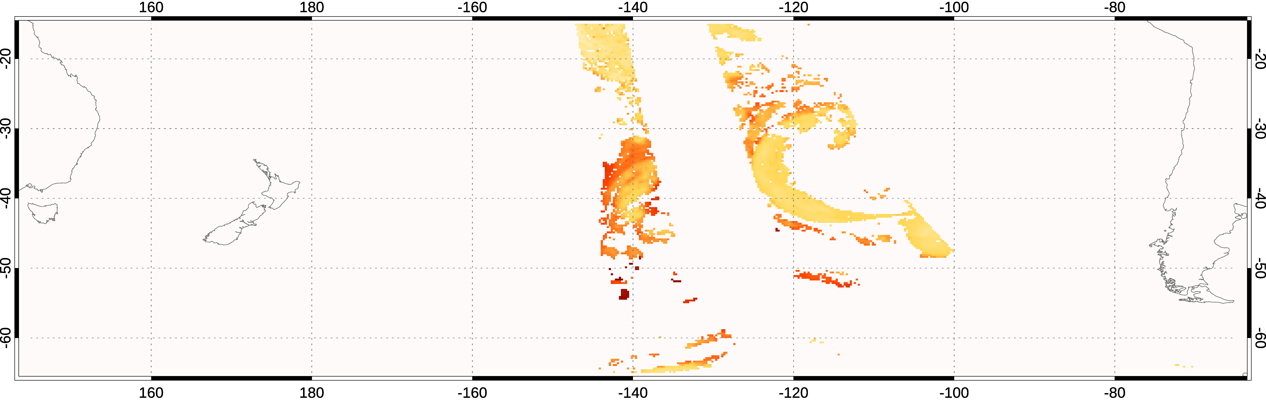
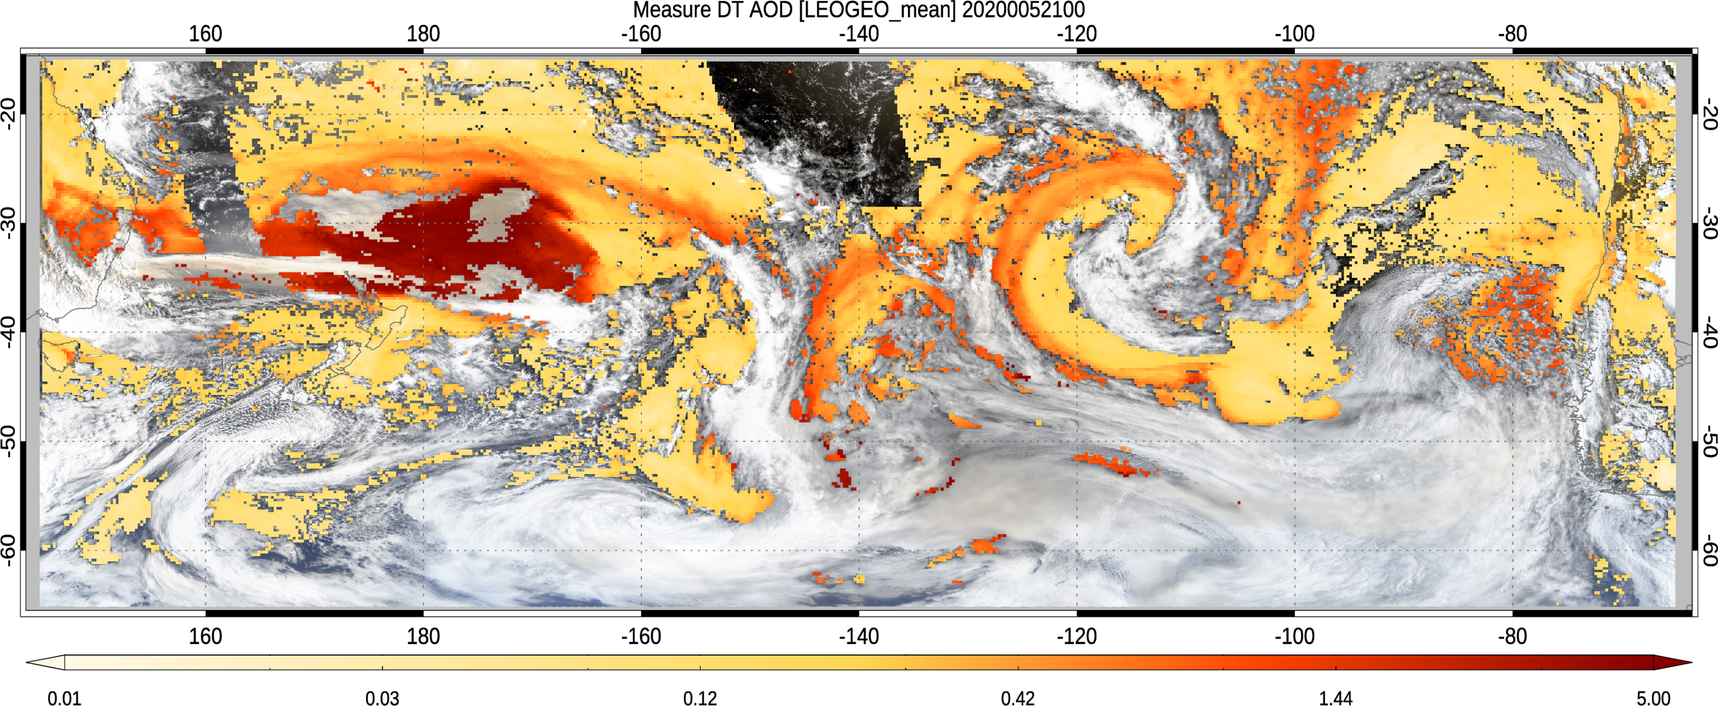
Example: Australia bushfires on January 5, 2020
MODIS_Terra
(:00, :05)
All Level 2 AOD retrievals 21:00 – 21:29 UTC
AHI_H08
(:00, :10, :20)
LEO Level 2
GEO Level 2
All L2 retrievals are consistent
MODIS_Aqua
(:25)
ABI_G17
(:00, :10, :20)
AOD
0.01 0.03 0.1 0.3 1.0 3.0
VIIRS _SNPP
(:00, :06)
ABI_G16
(:00, :10, :20)
S. America
Australia
MERGED GEO+LEO

Slide 7
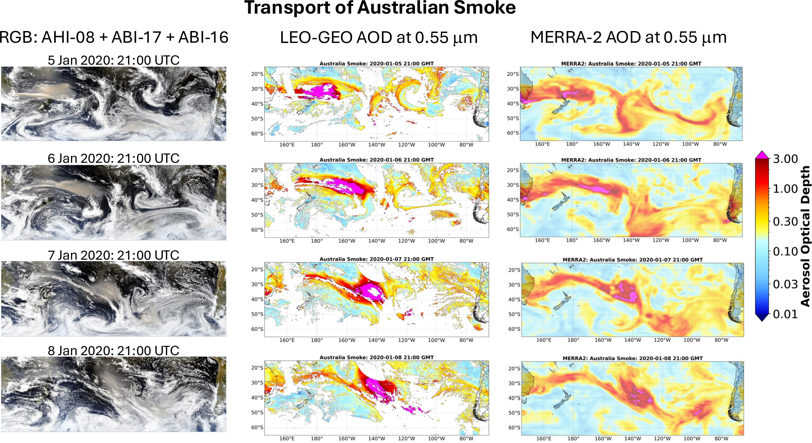
Track movement. Compare with models! (5-8 Jan 2020)
Final paper accepted/proof for JGR-atmospheres, 2026

Slide 8
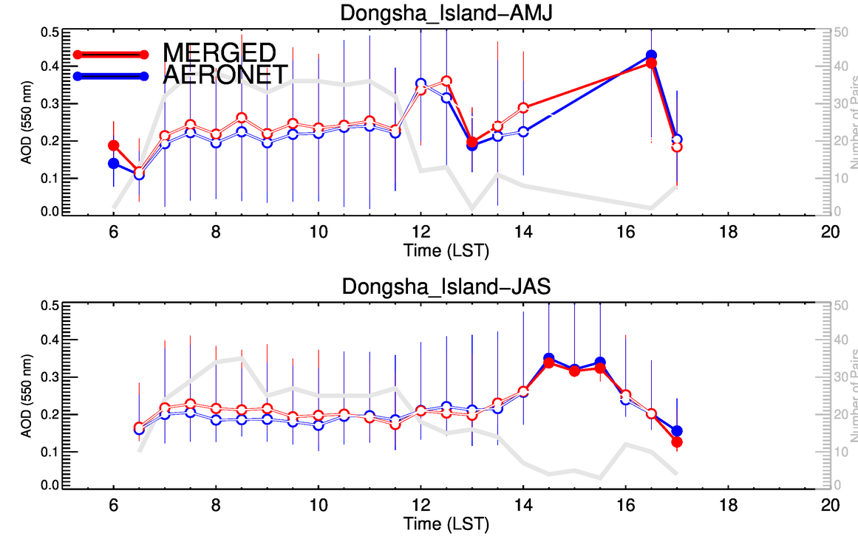
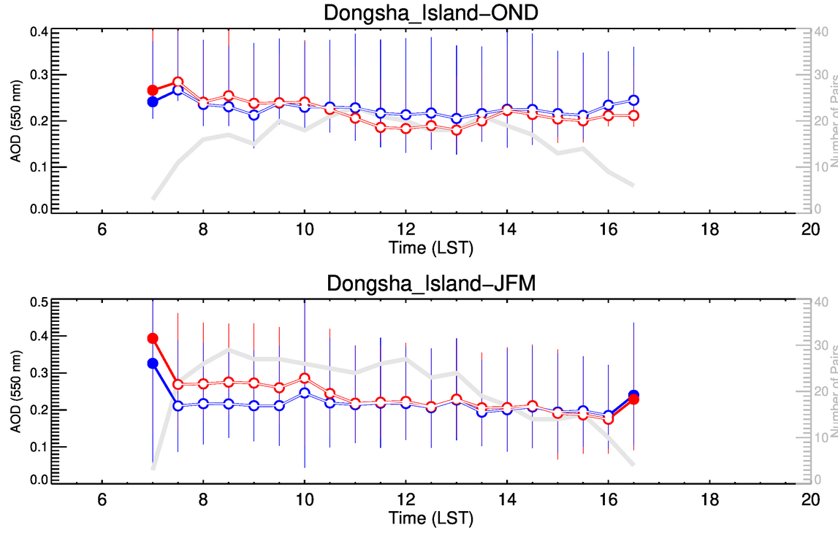
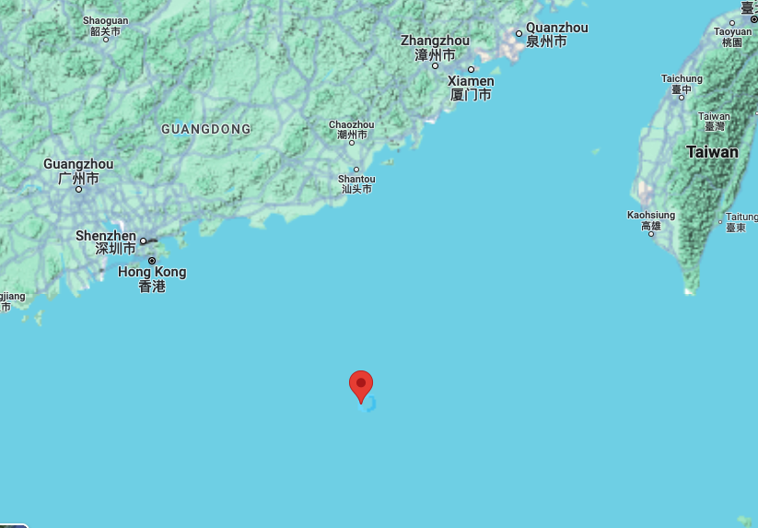
L3 GEO-LEO : Learn diurnal cycle
Dongsha_Island (Dongsha, Taiwan)
Lat/Long = (20.70° N, 116.73°) Z = 5.0 m
P. Gupta et al., 2025

Slide 9
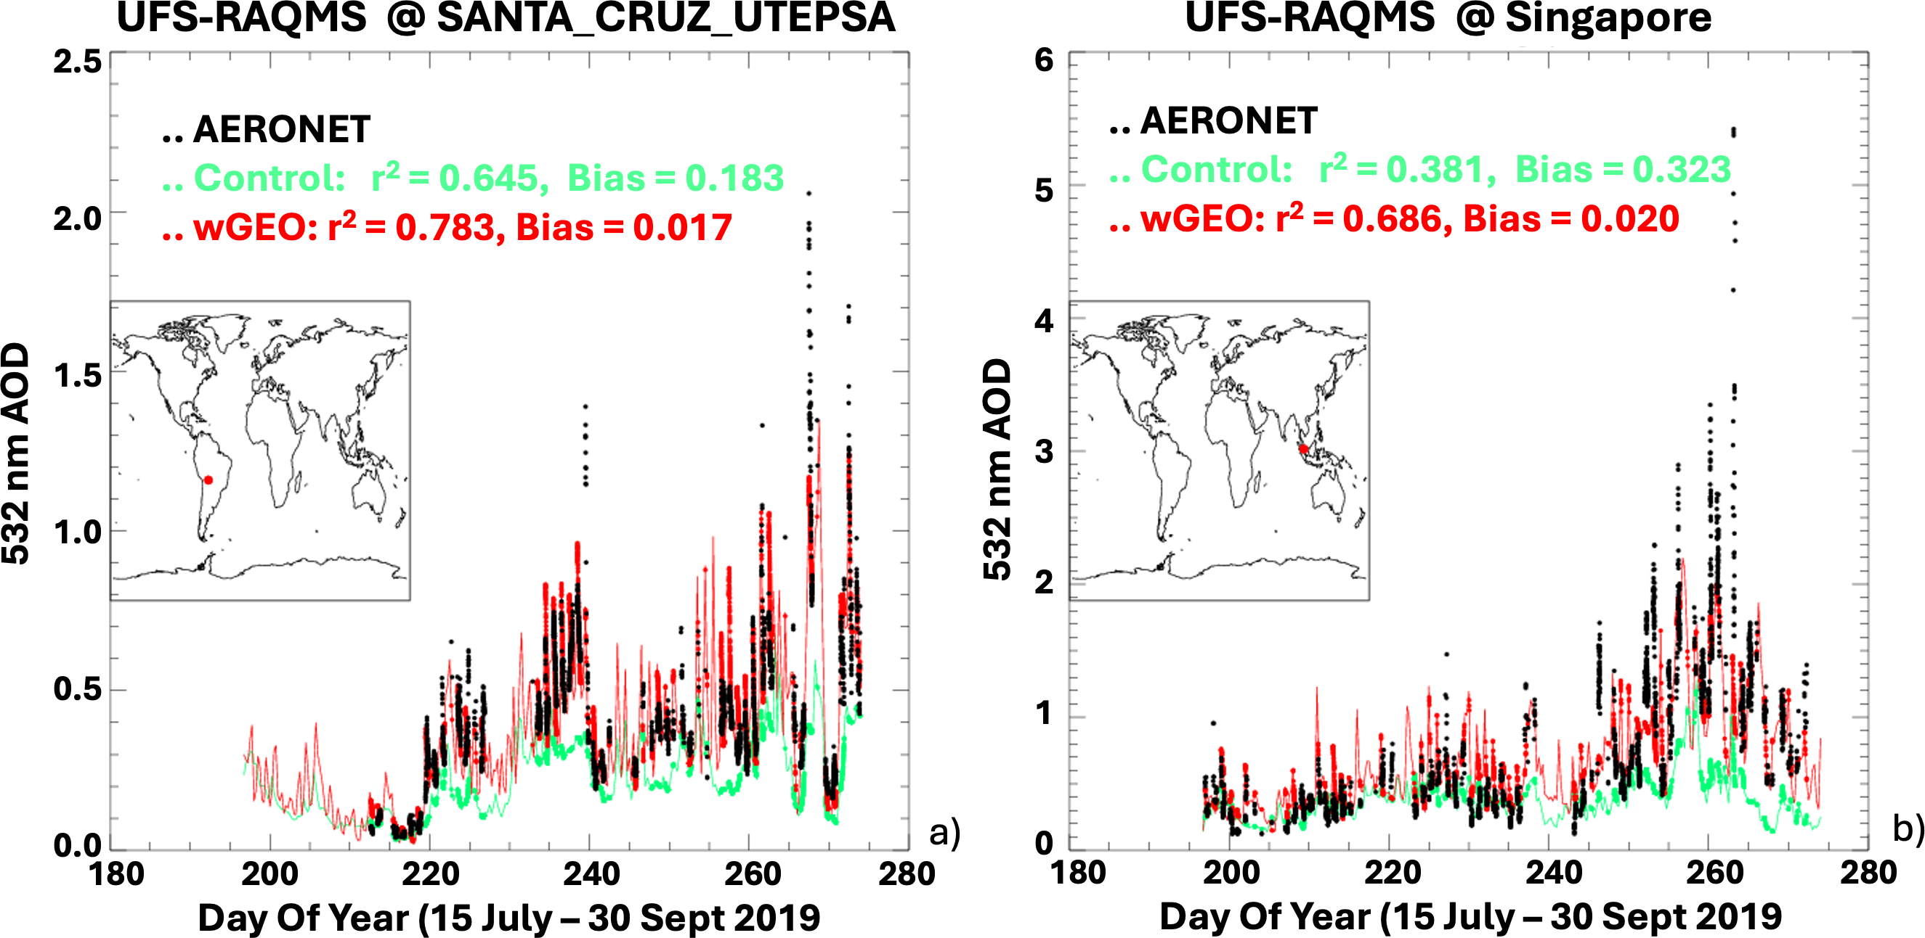
L3 GEO-LEO : Improves assimilation efforts
R. Brad Pierce @ Wisconsin

Slide 10
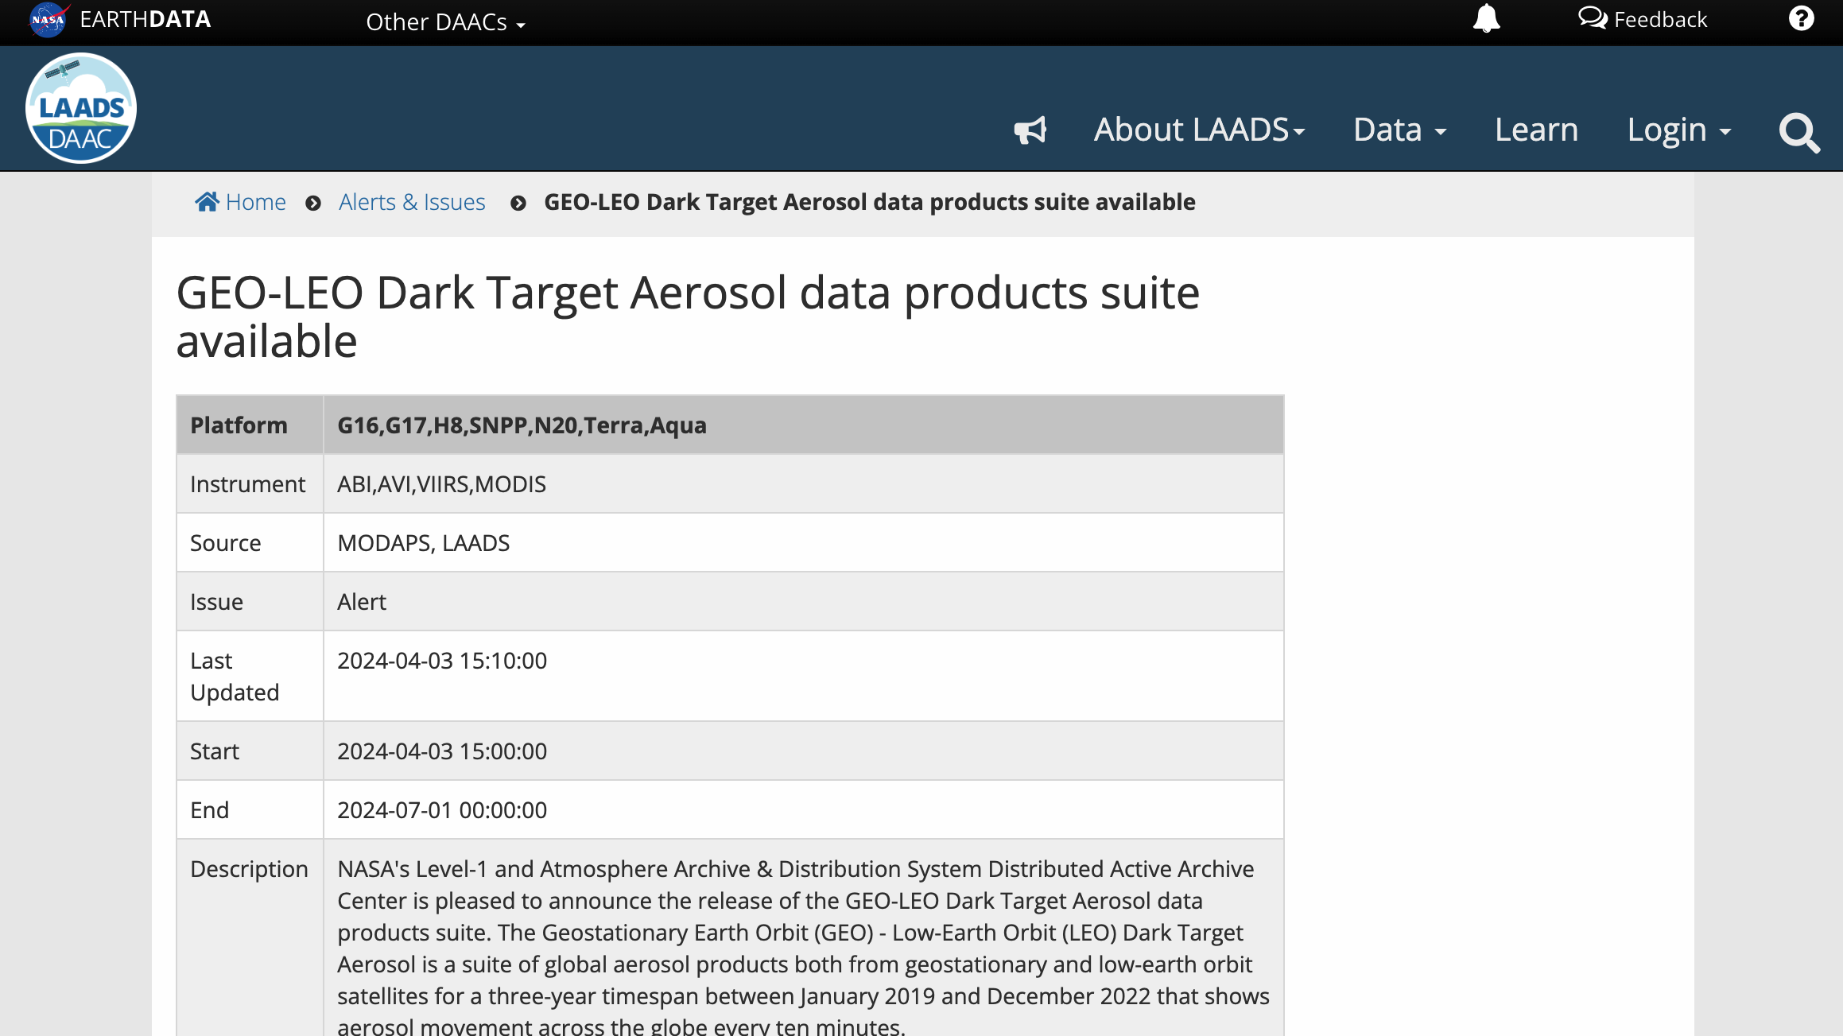


Level 2 (all sensors) and Level 3 merge now online
https://ladsweb.modaps.eosdis.nasa.gov/missions-and-measurements/applications/geoleo/
Link to LAADS_DAAC “Webinar”

Slide 11
Some fun: Compare GEO-LEO with TEMPO
August 19, 2023 (Smoke events)
GEO and LEO Level 2 and Level 3 Merge run offline (not included in 2019-2022 archive)
TEMPO Level 2 AOD data from Amy Huff/STAR (accessed September 2025)
GEO - LEO merge is 30 minutes (e.g. up to 3 ABI/AHI Full Disk Images, and 6 granules/each for MODIS and/or VIIRS)…
… whereas TEMPO disk image takes about 50 minutes. This means they don’t quite line up. But close enough….

Slide 12
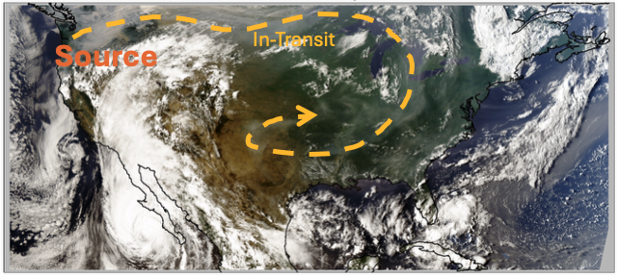
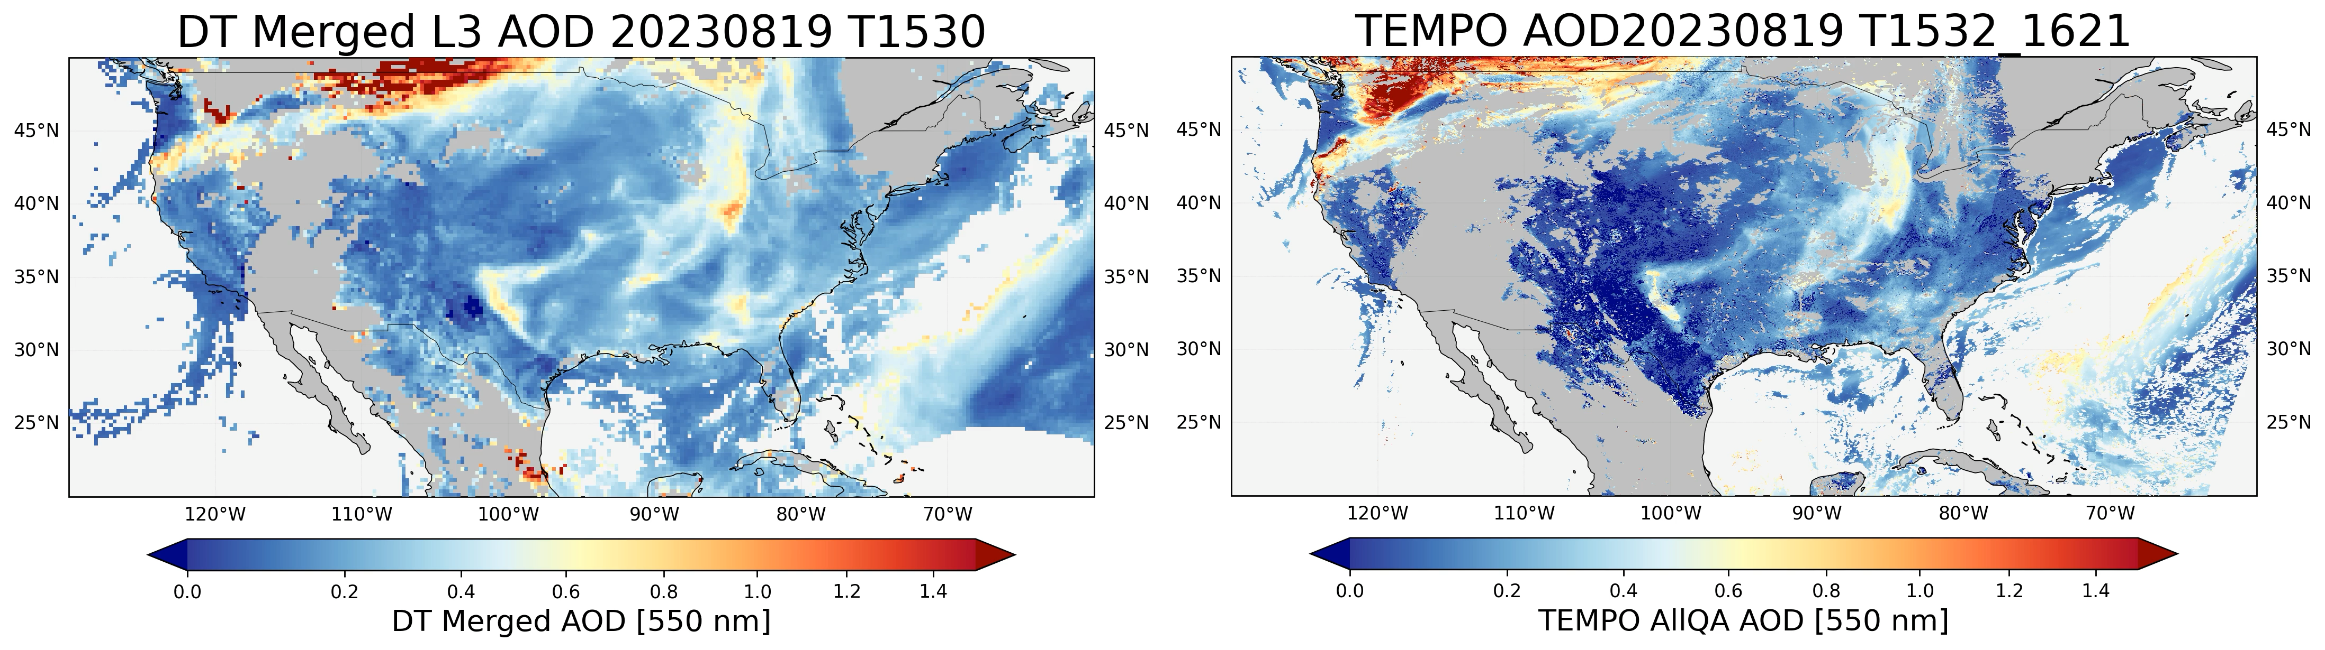
DT LEOGEO AOD and TEMPO AOD
ABI GOES16 True Color Image, 22 UTC
Recirculation
Notes:
Both DT and TEMPO are AllQA AOD. Movies.

Slide 13
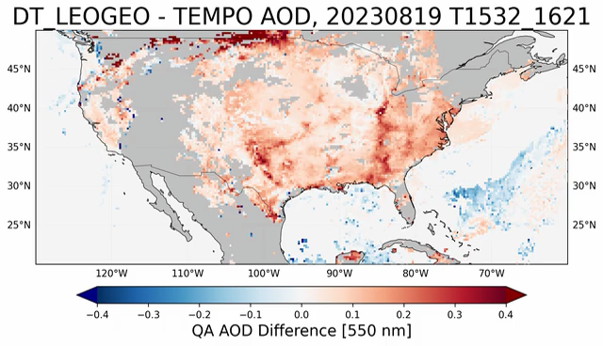
Comparison (DT GEOLEO – TEMPO)
Data Quality: Both use QA-filtered AOD.
Spatial Grid: TEMPO AOD is gridded at 0.25 degrees.
Matching: TEMPO granules are time-matched with the corresponding GEOLEO product.
Generally, DT is higher AOD than TEMPO, especially for the highest AOD cases over land
Over ocean, DT has lower AOD near noon but higher AOD in later afternoon.
Angle dependencies?
Some differences in sampling, with DT overall being more likely to retrieve.

Slide 14
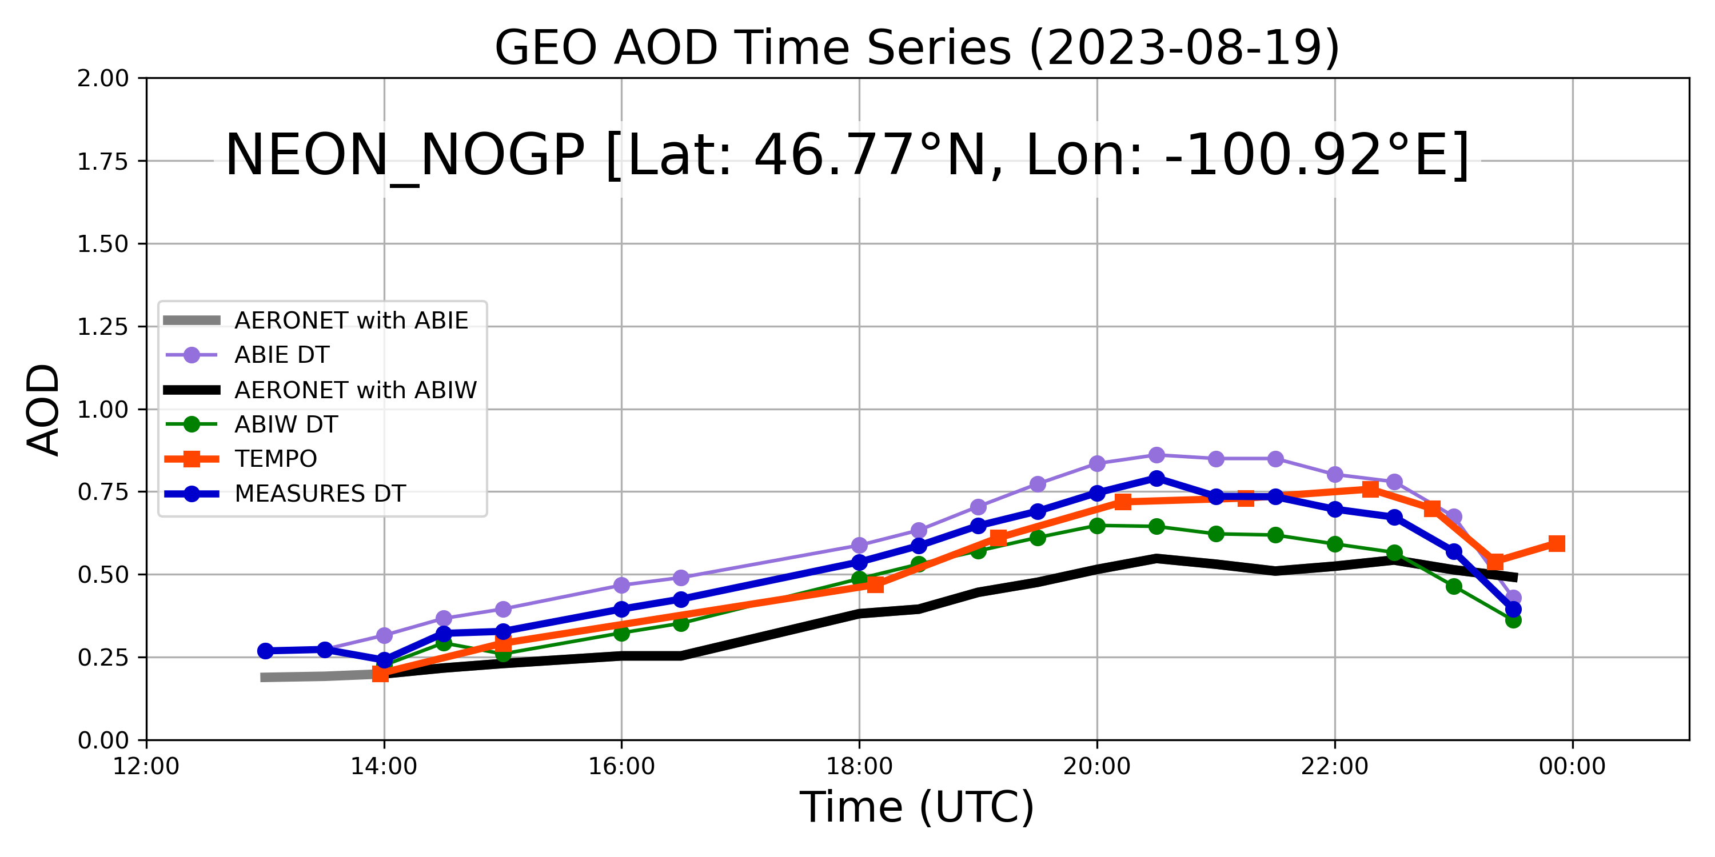
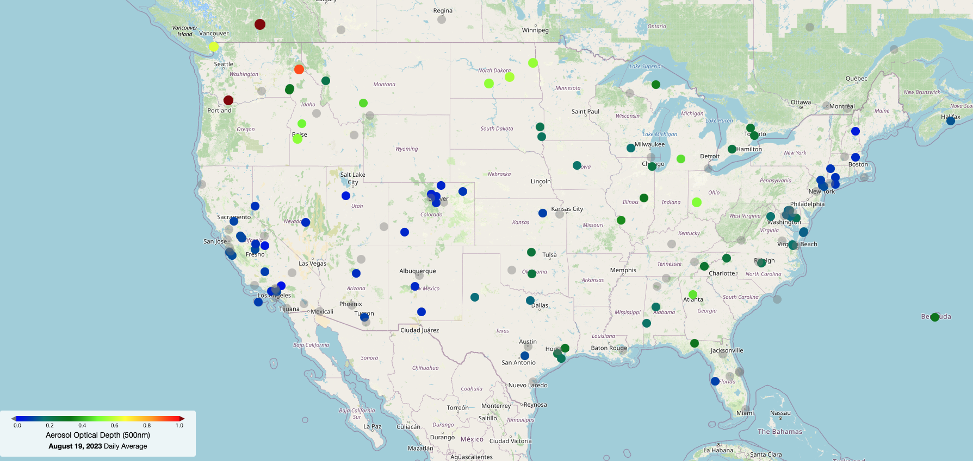
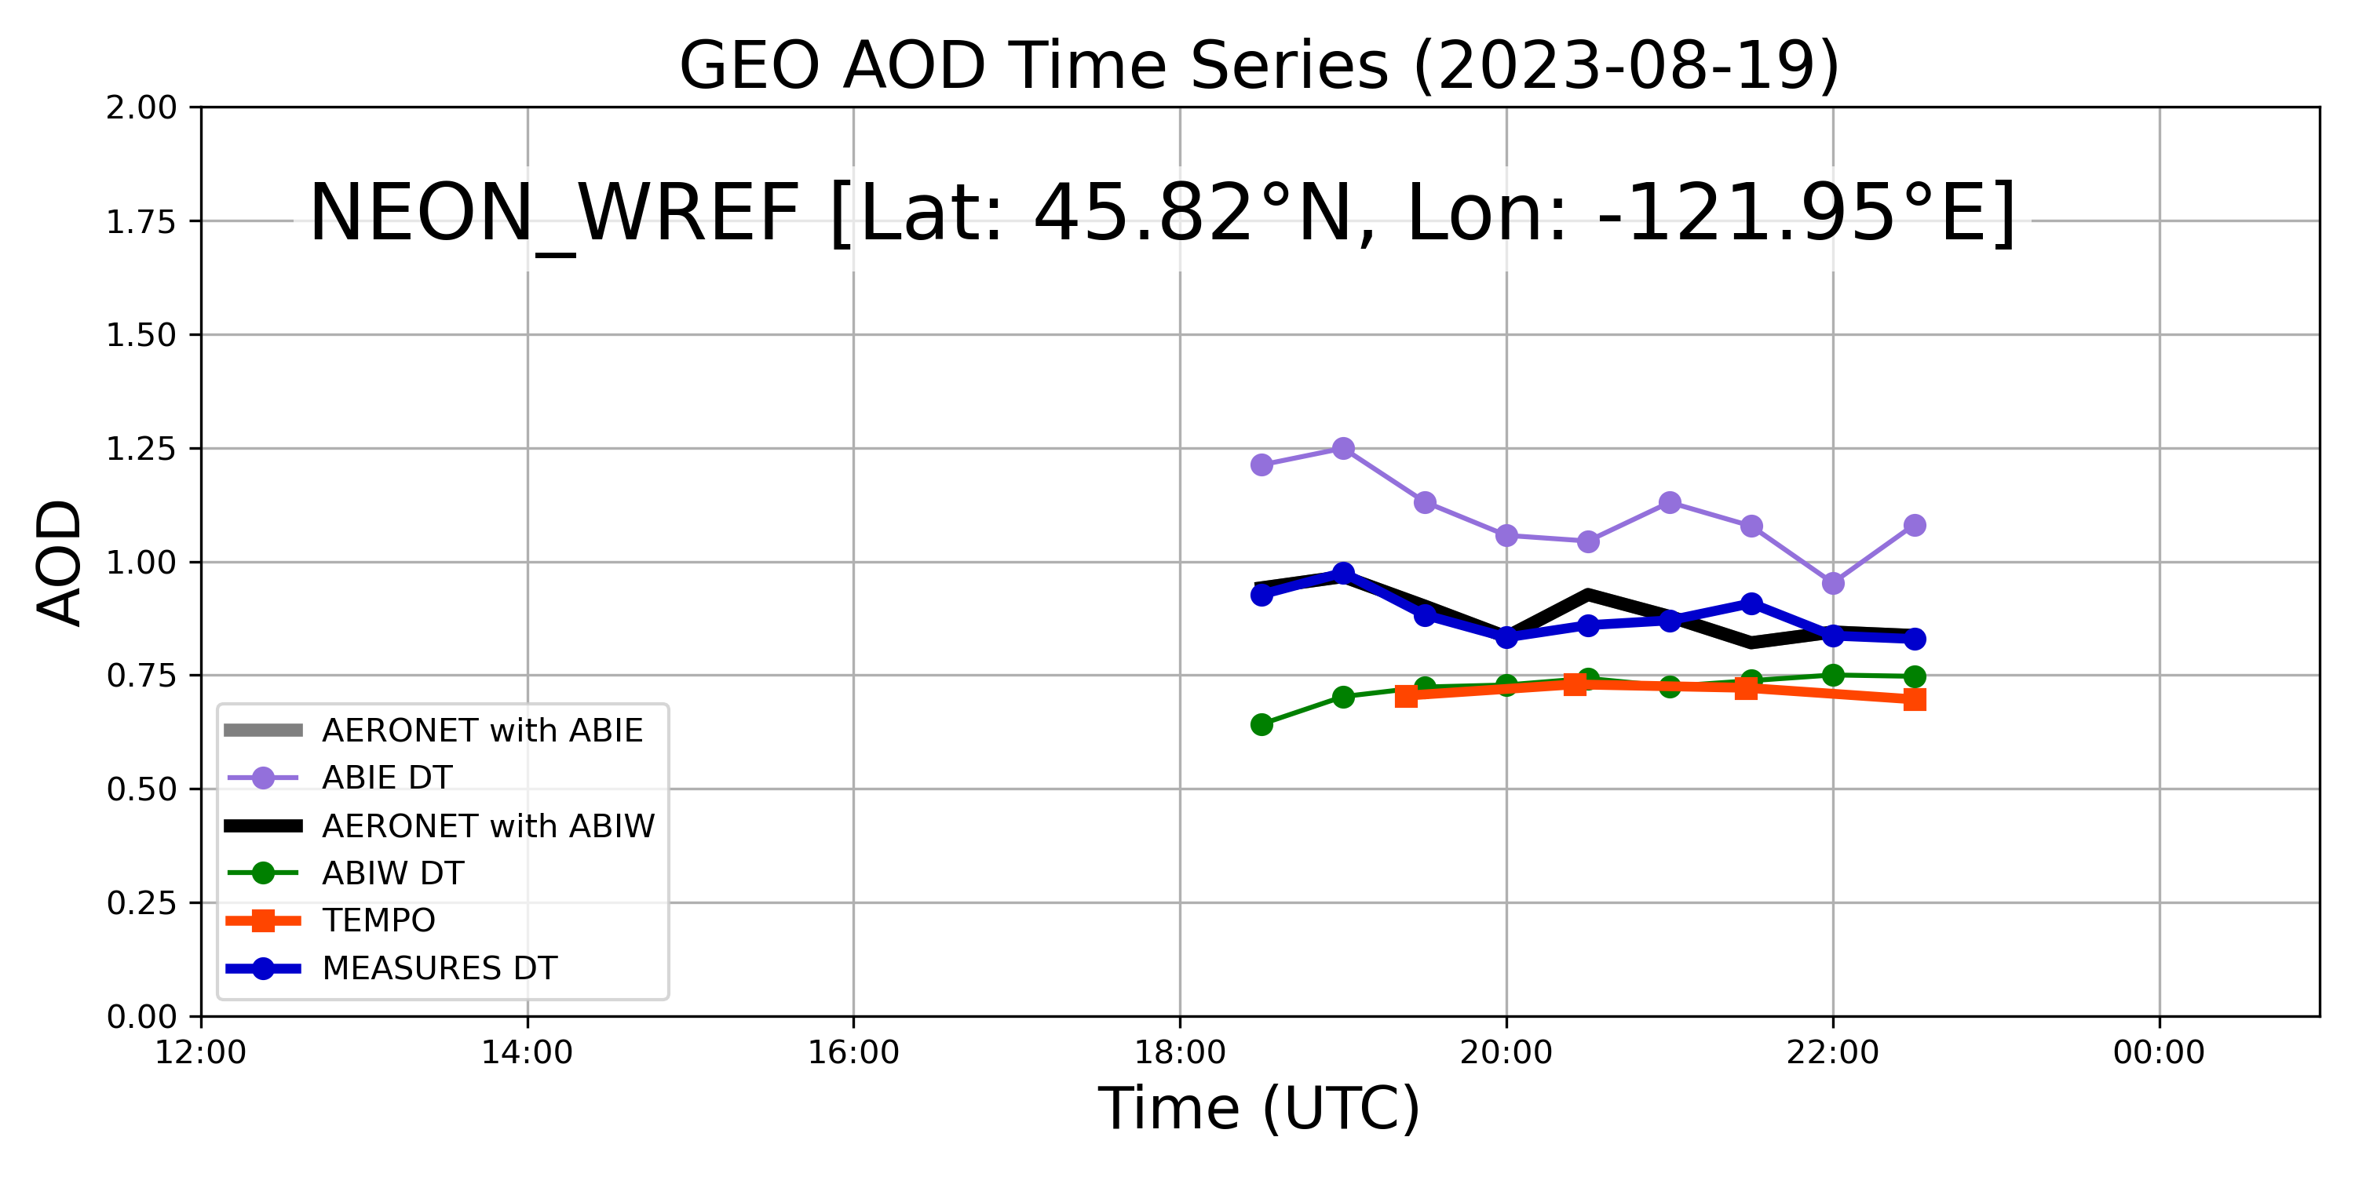
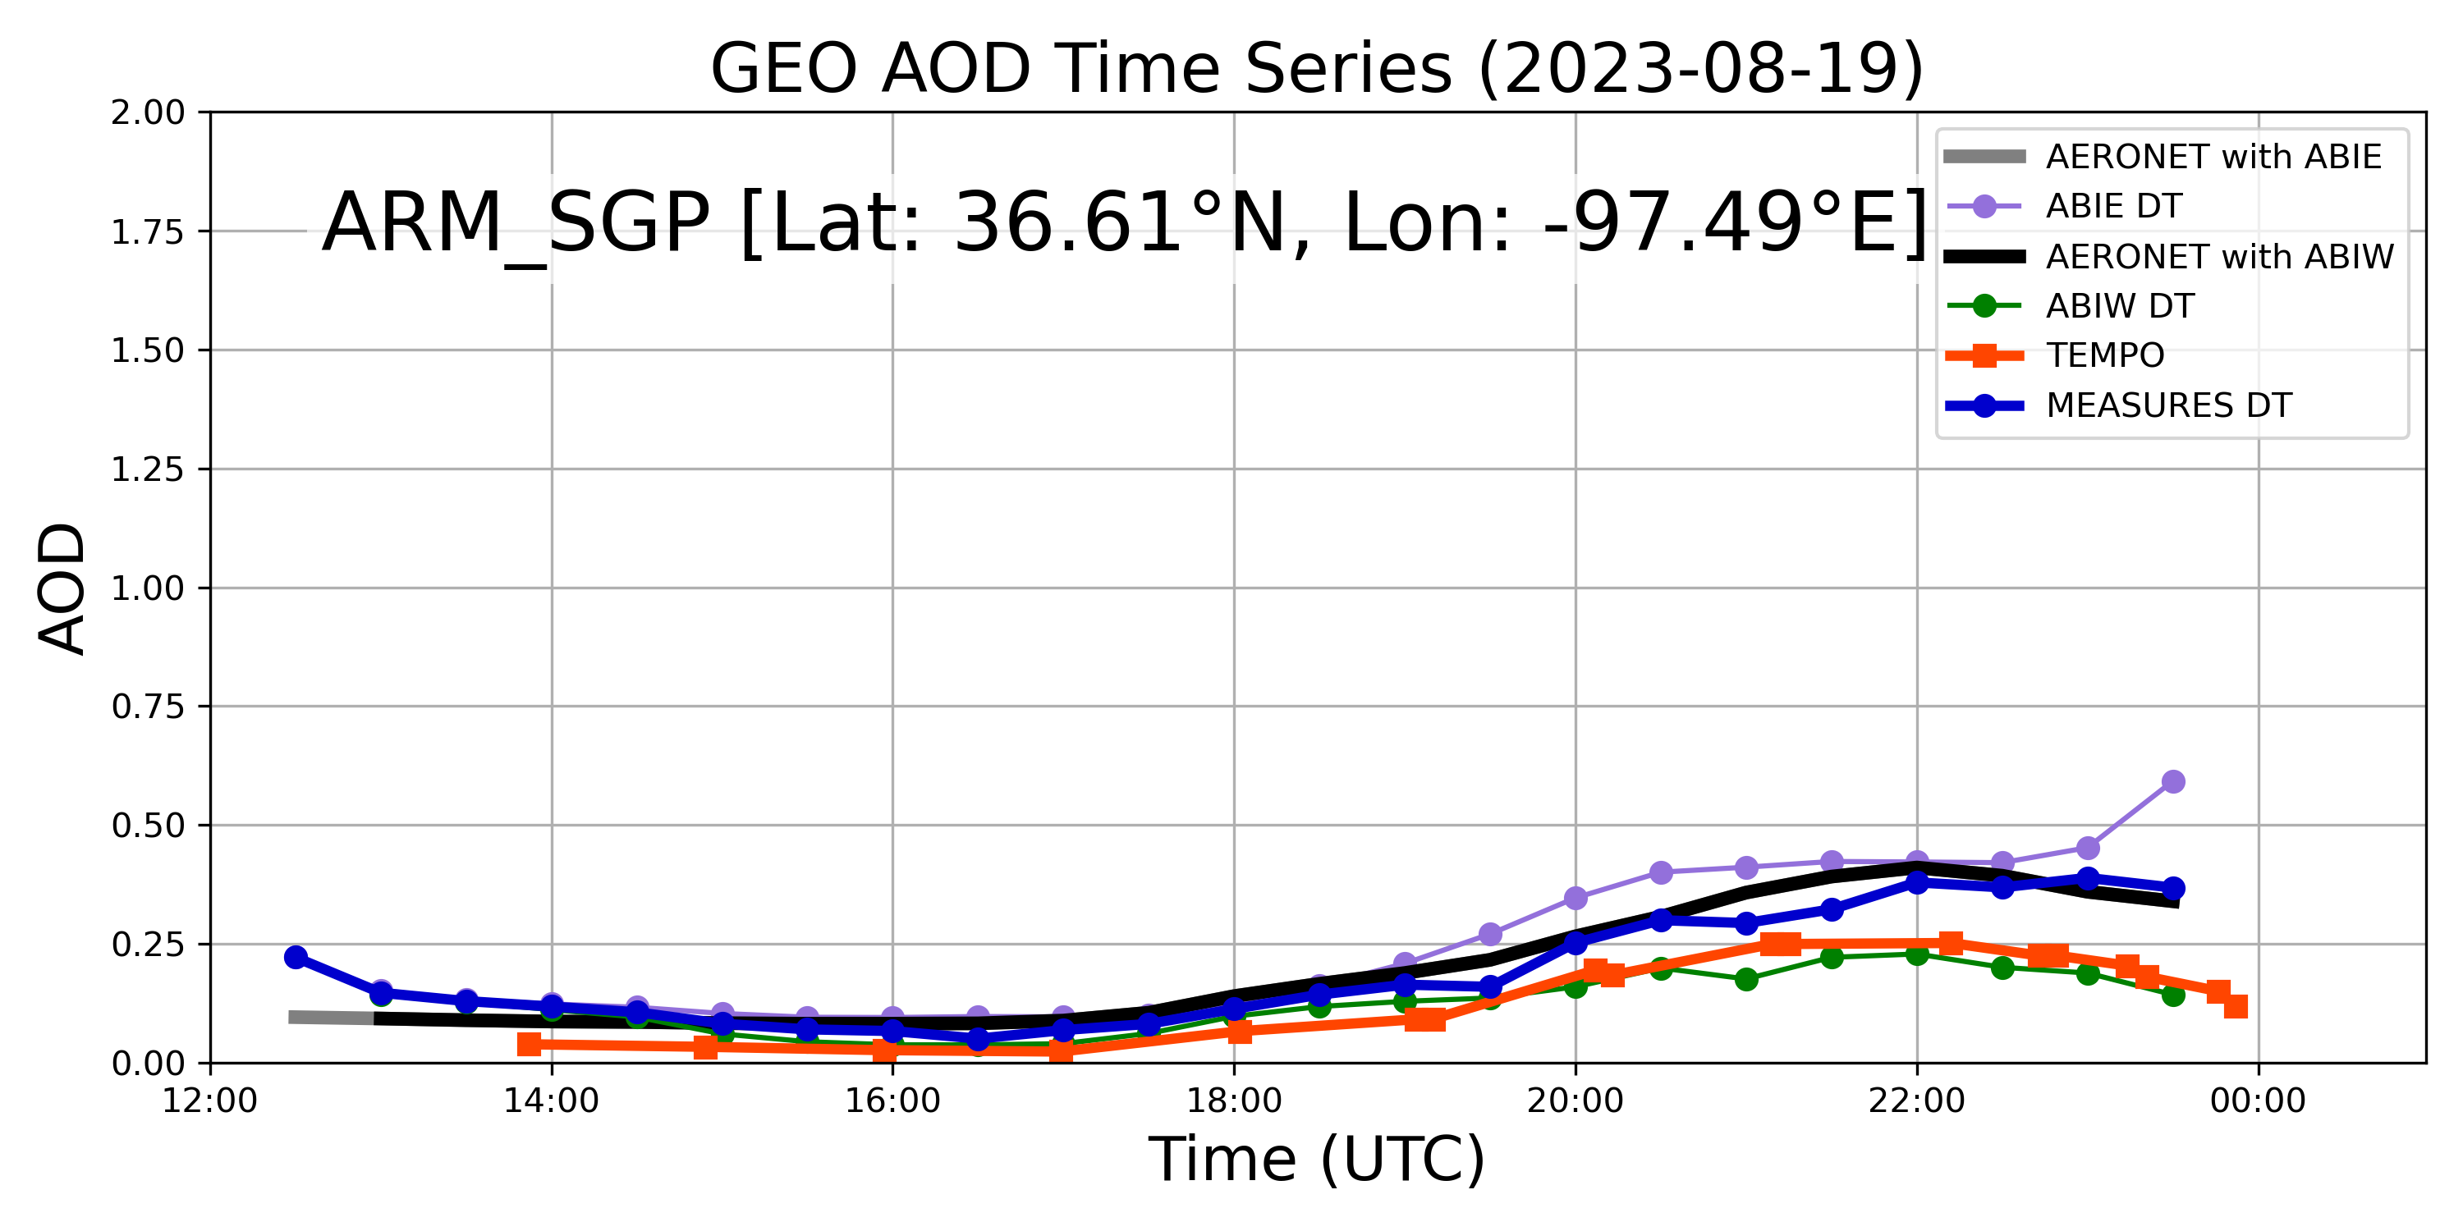
AERONET Daily Average AOD [500 nm]
Captured from AERONET Data Visualization
https://aeronet.gsfc.nasa.gov/new_web/aeronet_map_tool/index.html
DT ABIs, GEOLEO merged L3 + TEMPO L2
AERONET : 30min average
TEMPO, DT : 25 km radius average

Slide 15
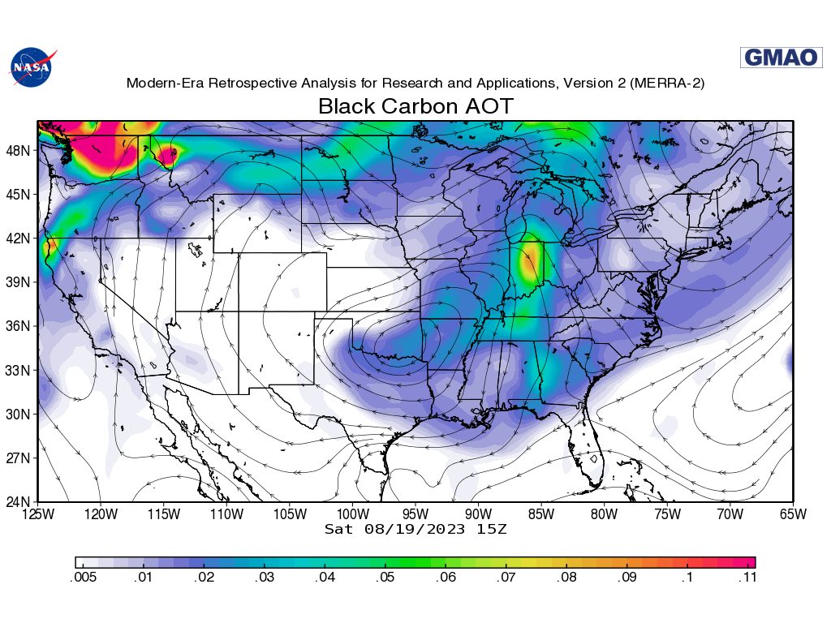
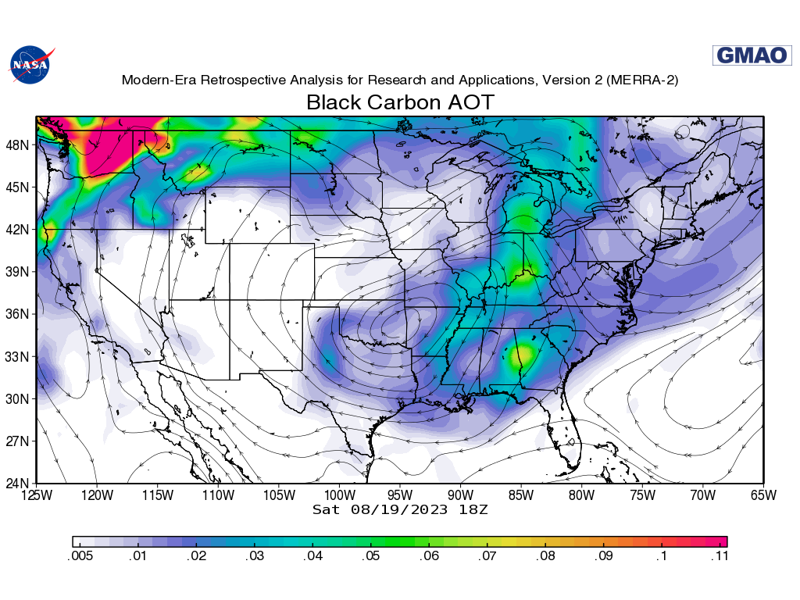
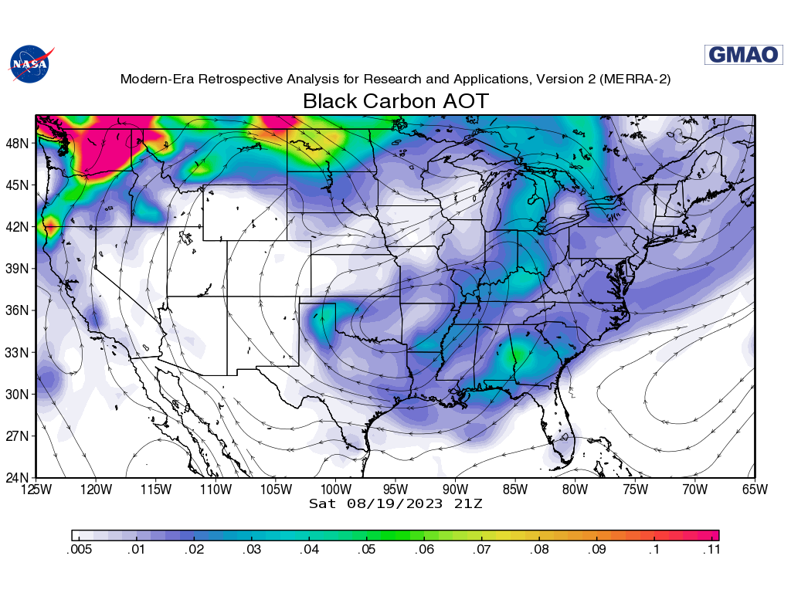
GMAO Atmospheric Composition Maps, Black Carbon AOD
https://fluid.nccs.nasa.gov/reanalysis/chem2d_merra2/
15 Z 18Z 21Z

Slide 16
Conclusions
NASA’s MEaSUREs supported development of a GEO-LEO aerosol product using “consistent” implementation of the Dark Target (DT) retrieval algorithm.
L2, L3 and L3-merge products (at HH and QD) are available for period 2019-2022 through NASA’s EarthData archive, and a paper has been accepted.
(not shown) AODs from GEO-LEO DT products have biases and issues mostly “consistent” with known performance of DT on MODIS or VIIRS. Likely to have high-bias over land.
GEO-LEO snapshots & animations are useful for observing aerosol transport that can be compared with models.
With approximately hour repeat, TEMPO’s AOD & other aerosol products provide detail of CONUS+ region.
For a particular case of August 19, 2023 (smoke transport and re-circulation), we compare TEMPO and GEO-LEO.
  Overall, they show the “same world” but with different choices of satisfactory retrieval conditions (clouds/no clouds, etc.). GEO-LEO is overall much more likely to “retrieve”.
  GEO-LEO is offset high compared to TEMPO, which is probably expected given the known GEO-LEO offset.
  Both GEO-LEO (merge product) and TEMPO show some skill at observing the diurnal cycle at 3 sites on this day.
Future? Consistent algorithms on entire GEO-Imager Ring (+ LEO), and consistent algorithms on entire GEO-Compositional Ring (+LEO)? Joint GEO-LEO (Imager) + GEO-LEO (Spectrometer)??

Slide 17

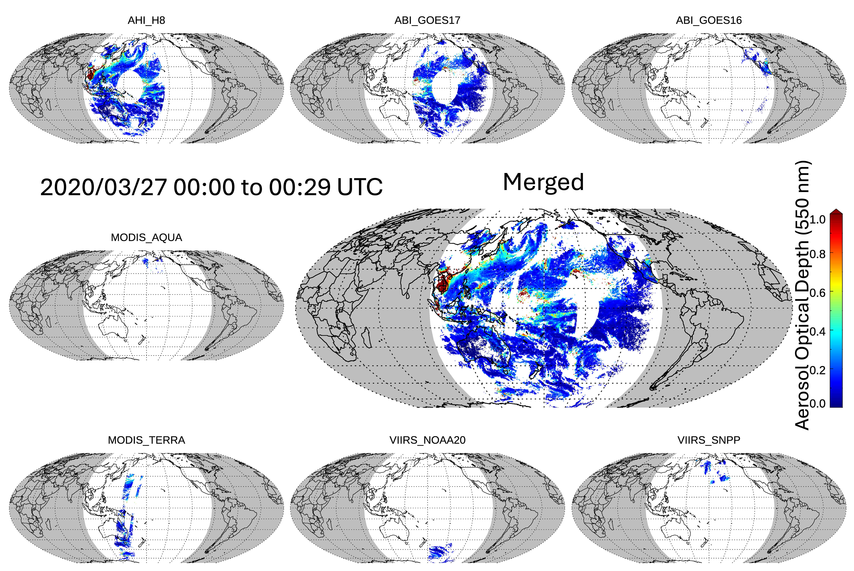

Dark Target (DT) Aerosol Retrieval Project
One algorithm + many sensors = All daylight globe
LAADS GEOLEO
Dark Target

