Slide 1

The PEGASOS project: Evaluation of Geo-Ring data with LEO and ground based measurements
Ronny Lutz¹, Diego Loyola¹, Timon Hummel², and the PEGASOS team
¹German Aerospace Center, ²European Space Agency
TEMPO DART Meeting

Slide 2





PEGASOS consortium
Product Evaluation of GEMS L2 via Assessment with S5P and Other Sensors
DLR
  German Aerospace Center
  Remote Sensing Technology Institute
AUTH
  Aristotle University of Thessaloniki
  Laboratory of Atmospheric Physics
BIRA-IASB
  Royal Belgian Institute for Space Aeronomy
IUP-UB
  University of Bremen
  Institute for Environmental Physics
ESA - ESRIN

Slide 3

Main objective
Evaluation of and L2 data products using
  a) LEO sensors (TROPOMI and other space-borne instruments)
  b) ground-based instruments/networks
a) | b)
TROPOMI / S5P | Brewer
OMI / Aura | Dobson
GOME-2 / MetOp | Ozonesondes
IASI / MetOp | FTIR
VIIRS / S-NPP | MAX-DOAS
CALIOP / CALIPSO | PGN
AMI / GK-2A | NDACC

Slide 4
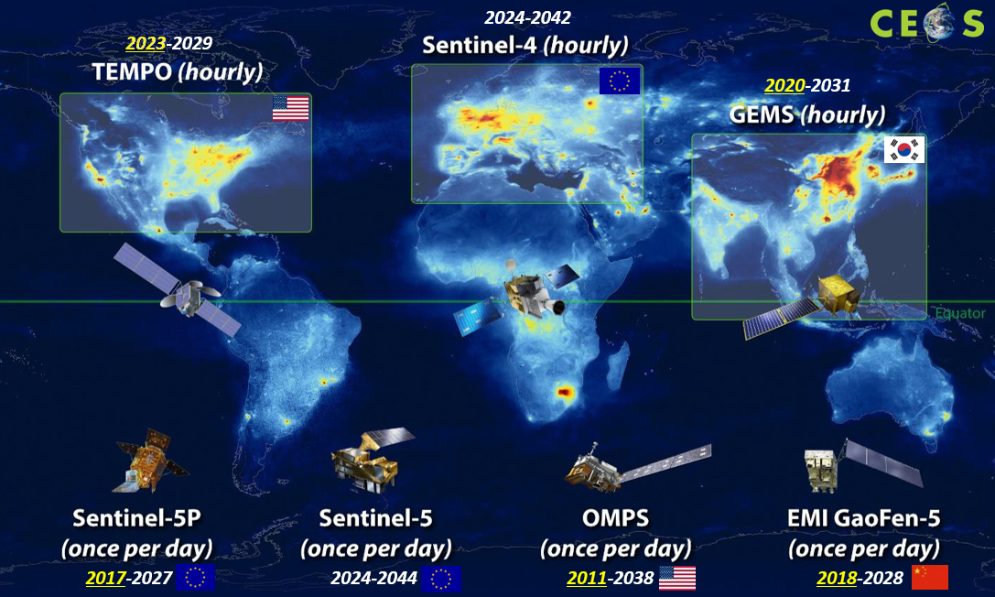
Geo-Ring for Air Quality
PEGASOS Phase 1
(2023-2024)
GEMS
PEGASOS Phase 2
(2025-2026)
GEMS
TEMPO
Future
EarthCARE!
Sentinel-4?
image courtesy: CEOS

Slide 5


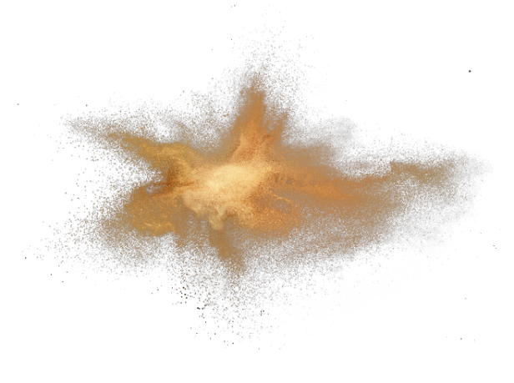

GEMS and TEMPO L2 products evaluated by PEGASOS
Ozone
total
Clouds
fraction
height
Nitrogendioxide
total
trop.
strat.
Aerosols
index
opt.depth
layer height
used for the comparisons:
Phase 1: also SO₂, HCHO, O₃ profile, tropospheric ozone and surface properties
Phase 2: limited to total Ozone, NO₂, Clouds, Aerosols

Slide 6

Examples (i):

Slide 7
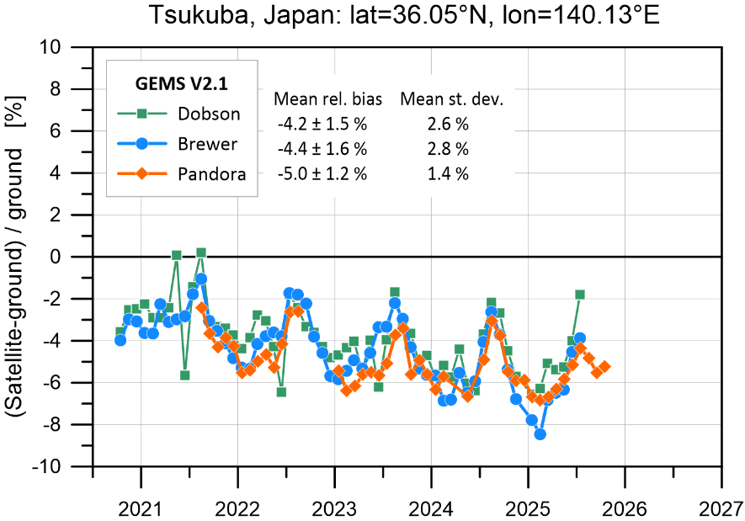
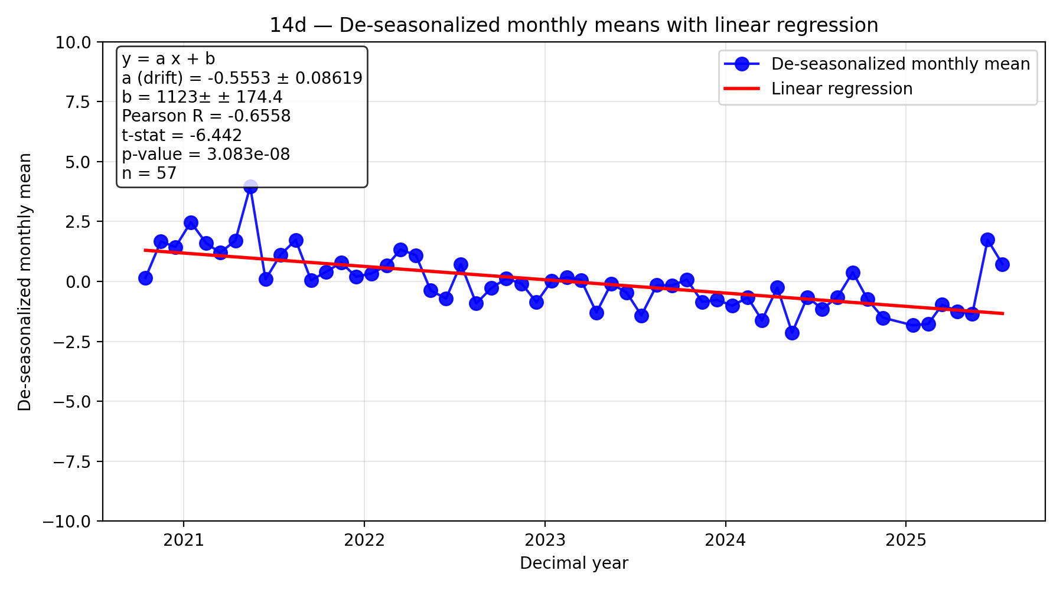
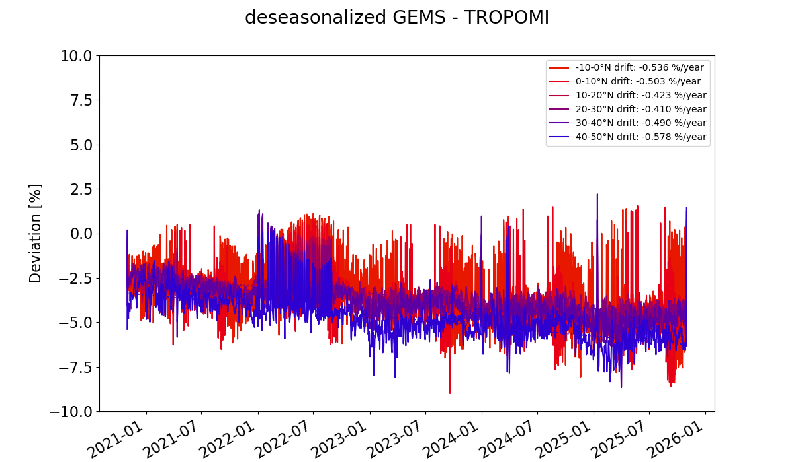
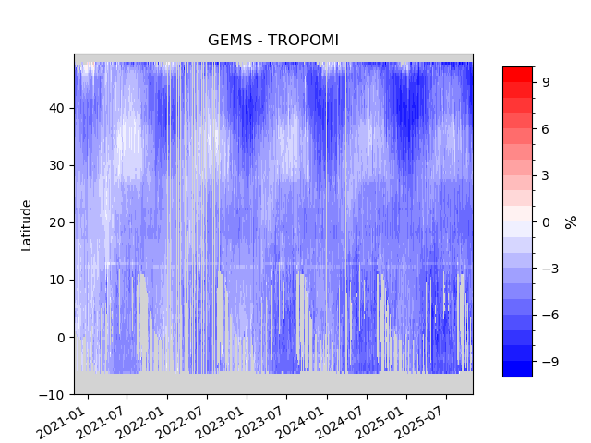
Total Ozone
Team: K. Garane, S. Compernolle, K.-P. Heue, T. Verhoelst
Results:
5 years of GEMS O3T v2.1 data showed:
Mean relative bias w.r.t. gr-based stations and other satellite missions: -4 %
Pearson correlation coefficient ≥ 0.9, showing a very good agreement between GEMS and the reference measurements
Clear non-unity slope (< 0.9-1): higher underestimation for high TOCs (North, winter)
A drift of -0.5%/year w.r.t. reference measurements
North – South gradient with an annual cycle that differs per latitude:
Very good agreement during summer months at high latitudes and winter months at tropics (± 1%).
During winter months and for higher latitudes GEMS underestimates total ozone by up to -7%
Tsukuba, Japan (Dobson)
Drift: -0.6%/year (st. sign.)
Left: Time-series of the mean relative bias (%) of GEMS O3T observations w.r.t. ground-based reference measurements from Brewer, Dobson and Pandora at Tsukuba, Japan.
Right: For the same station, the de-seasonalzed monthly mean time series of the GEMS vs Dobson comparisons.
Left: The mean percentage difference between the O3T observations from GEMS and TROPOMI over the GEMS FOV.
Right: De-seasonalized sat-to-sat differences per latitude belt.

Slide 8
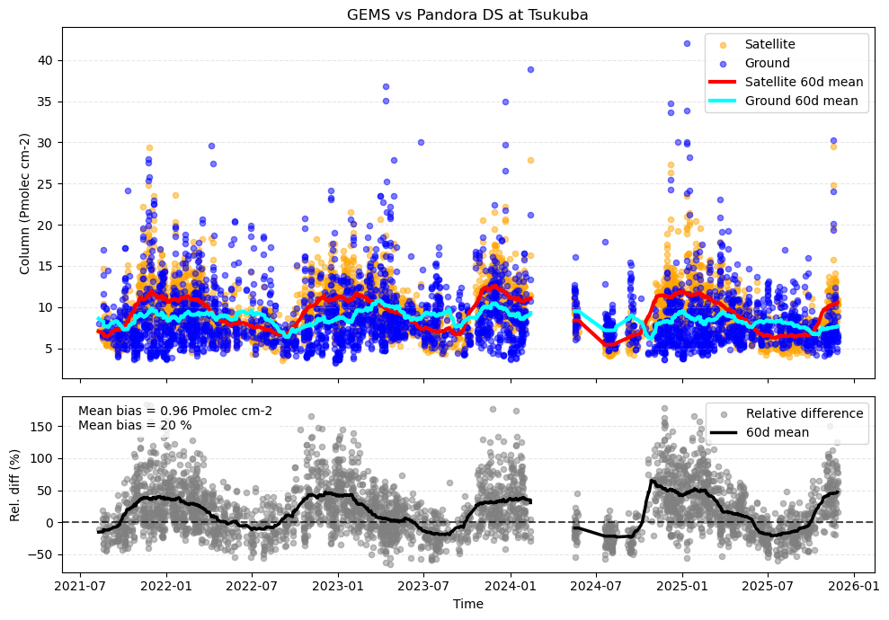
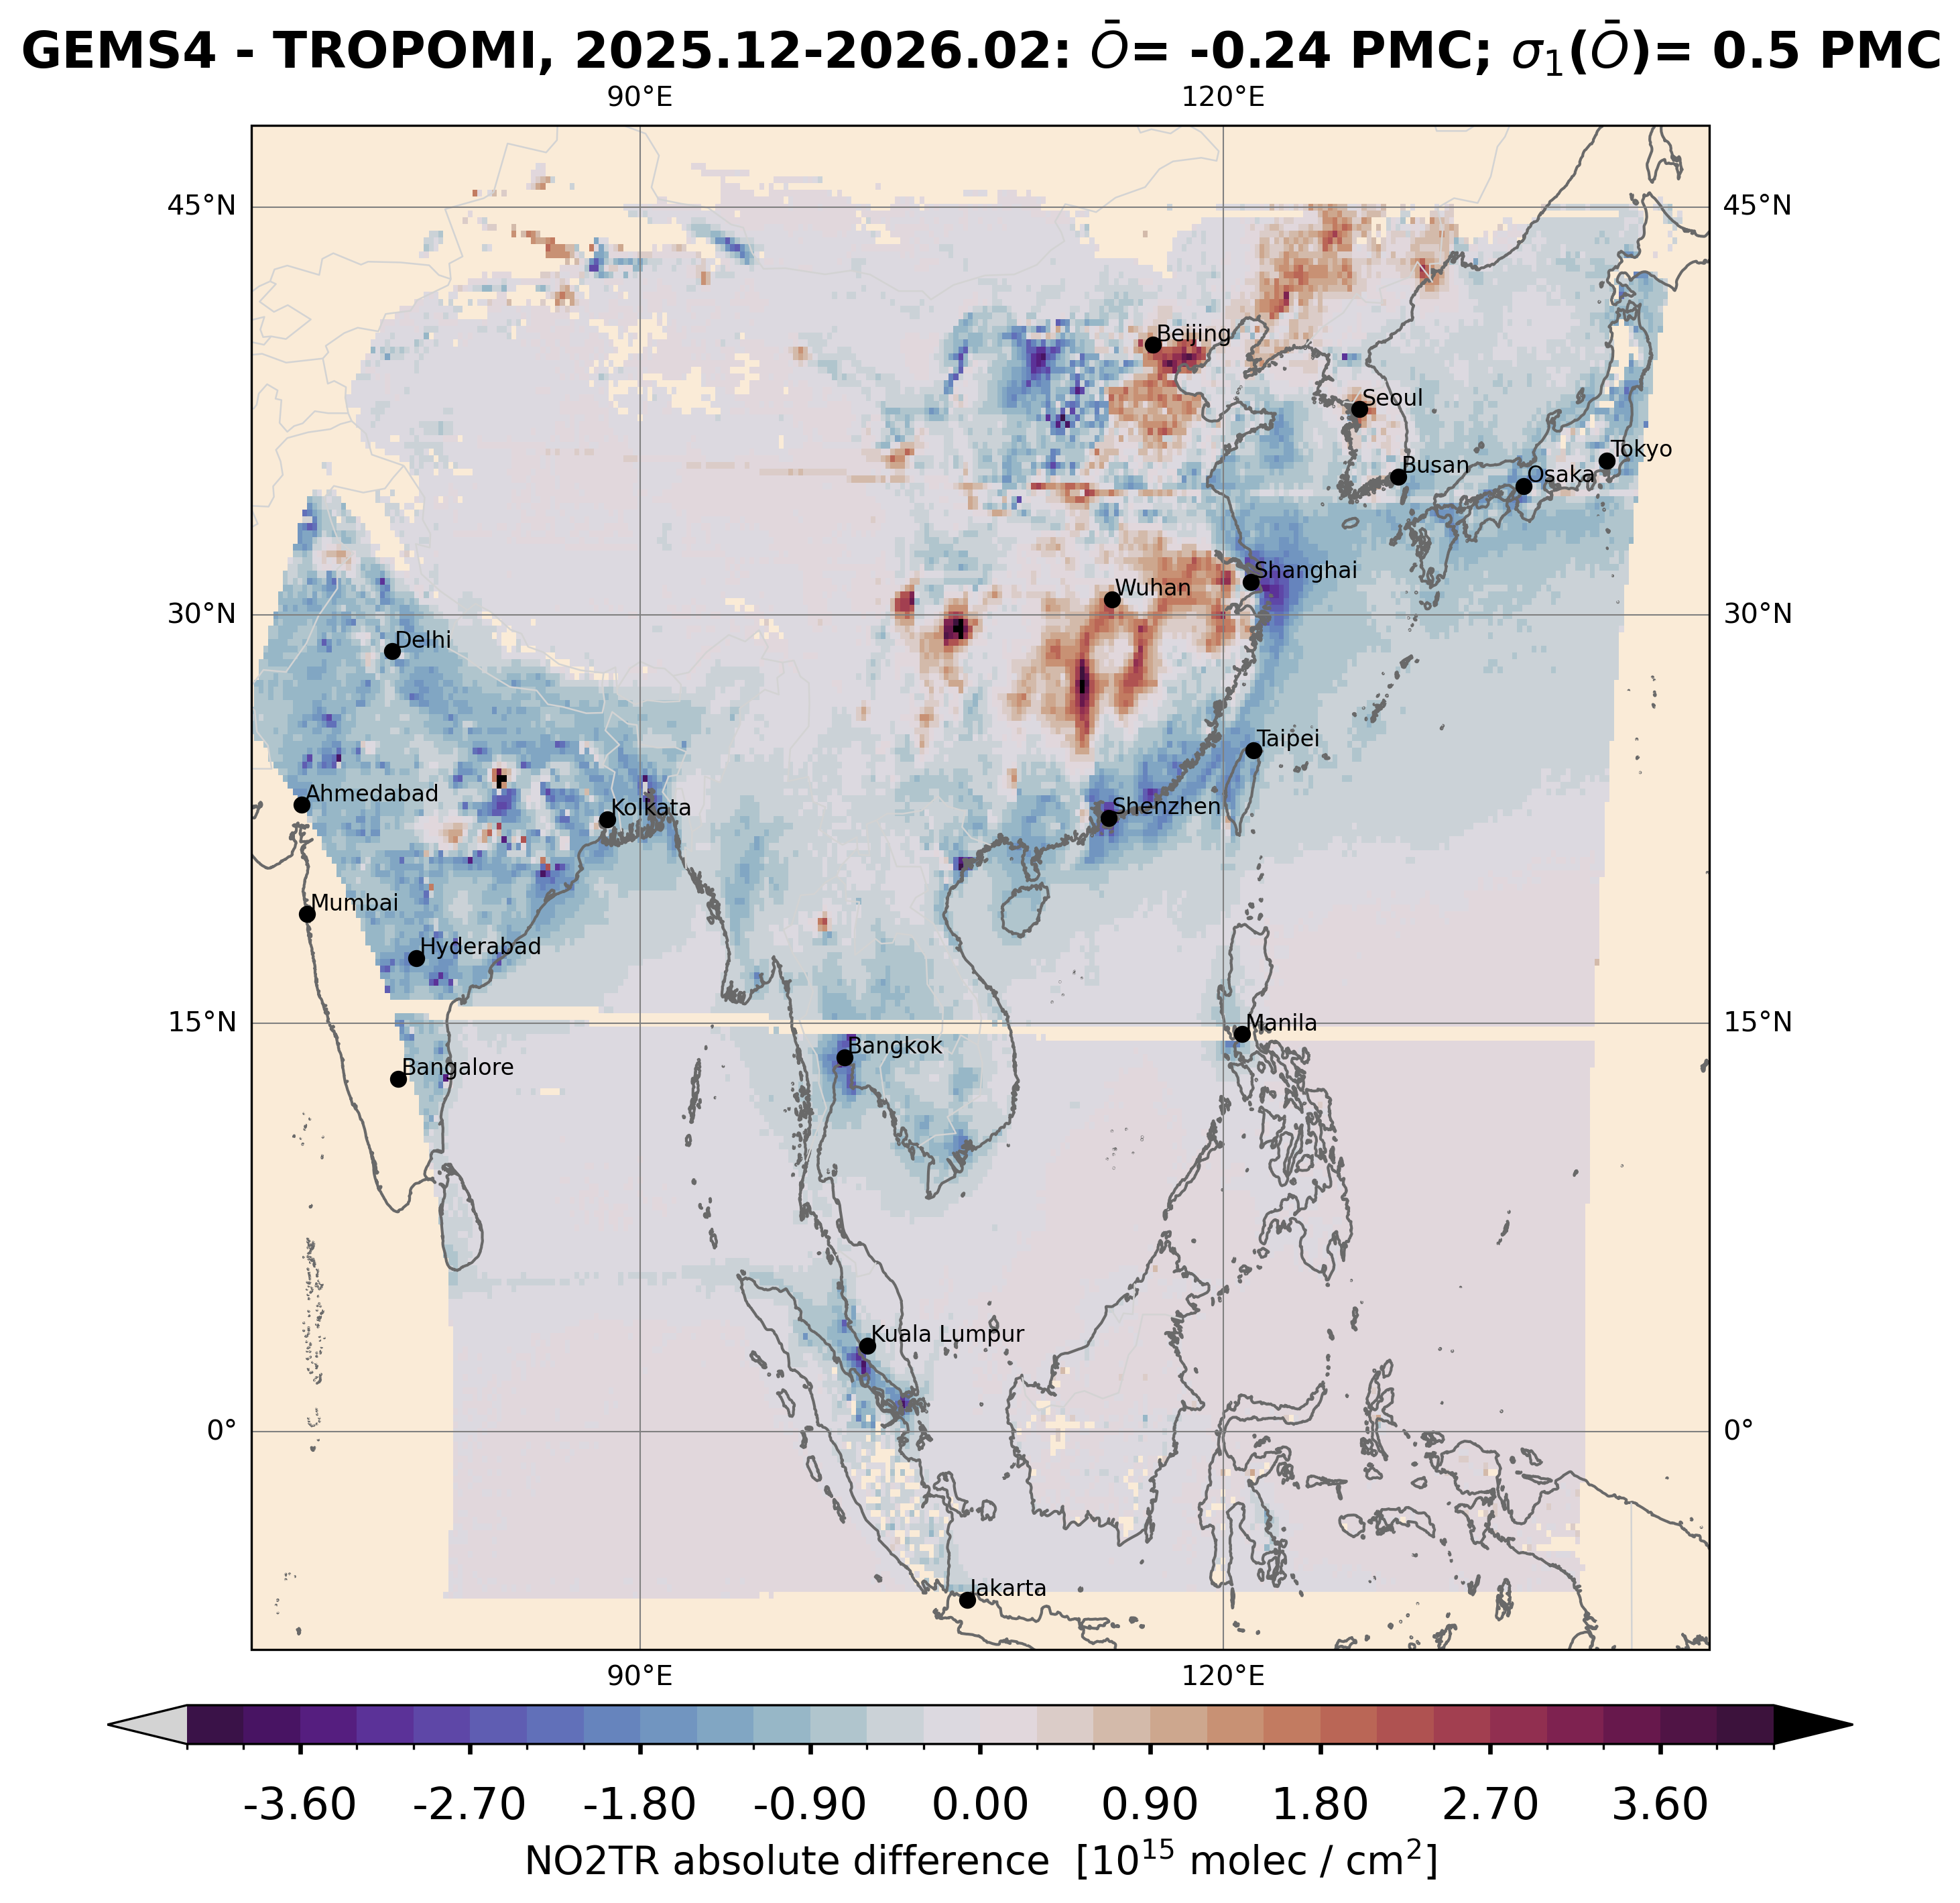
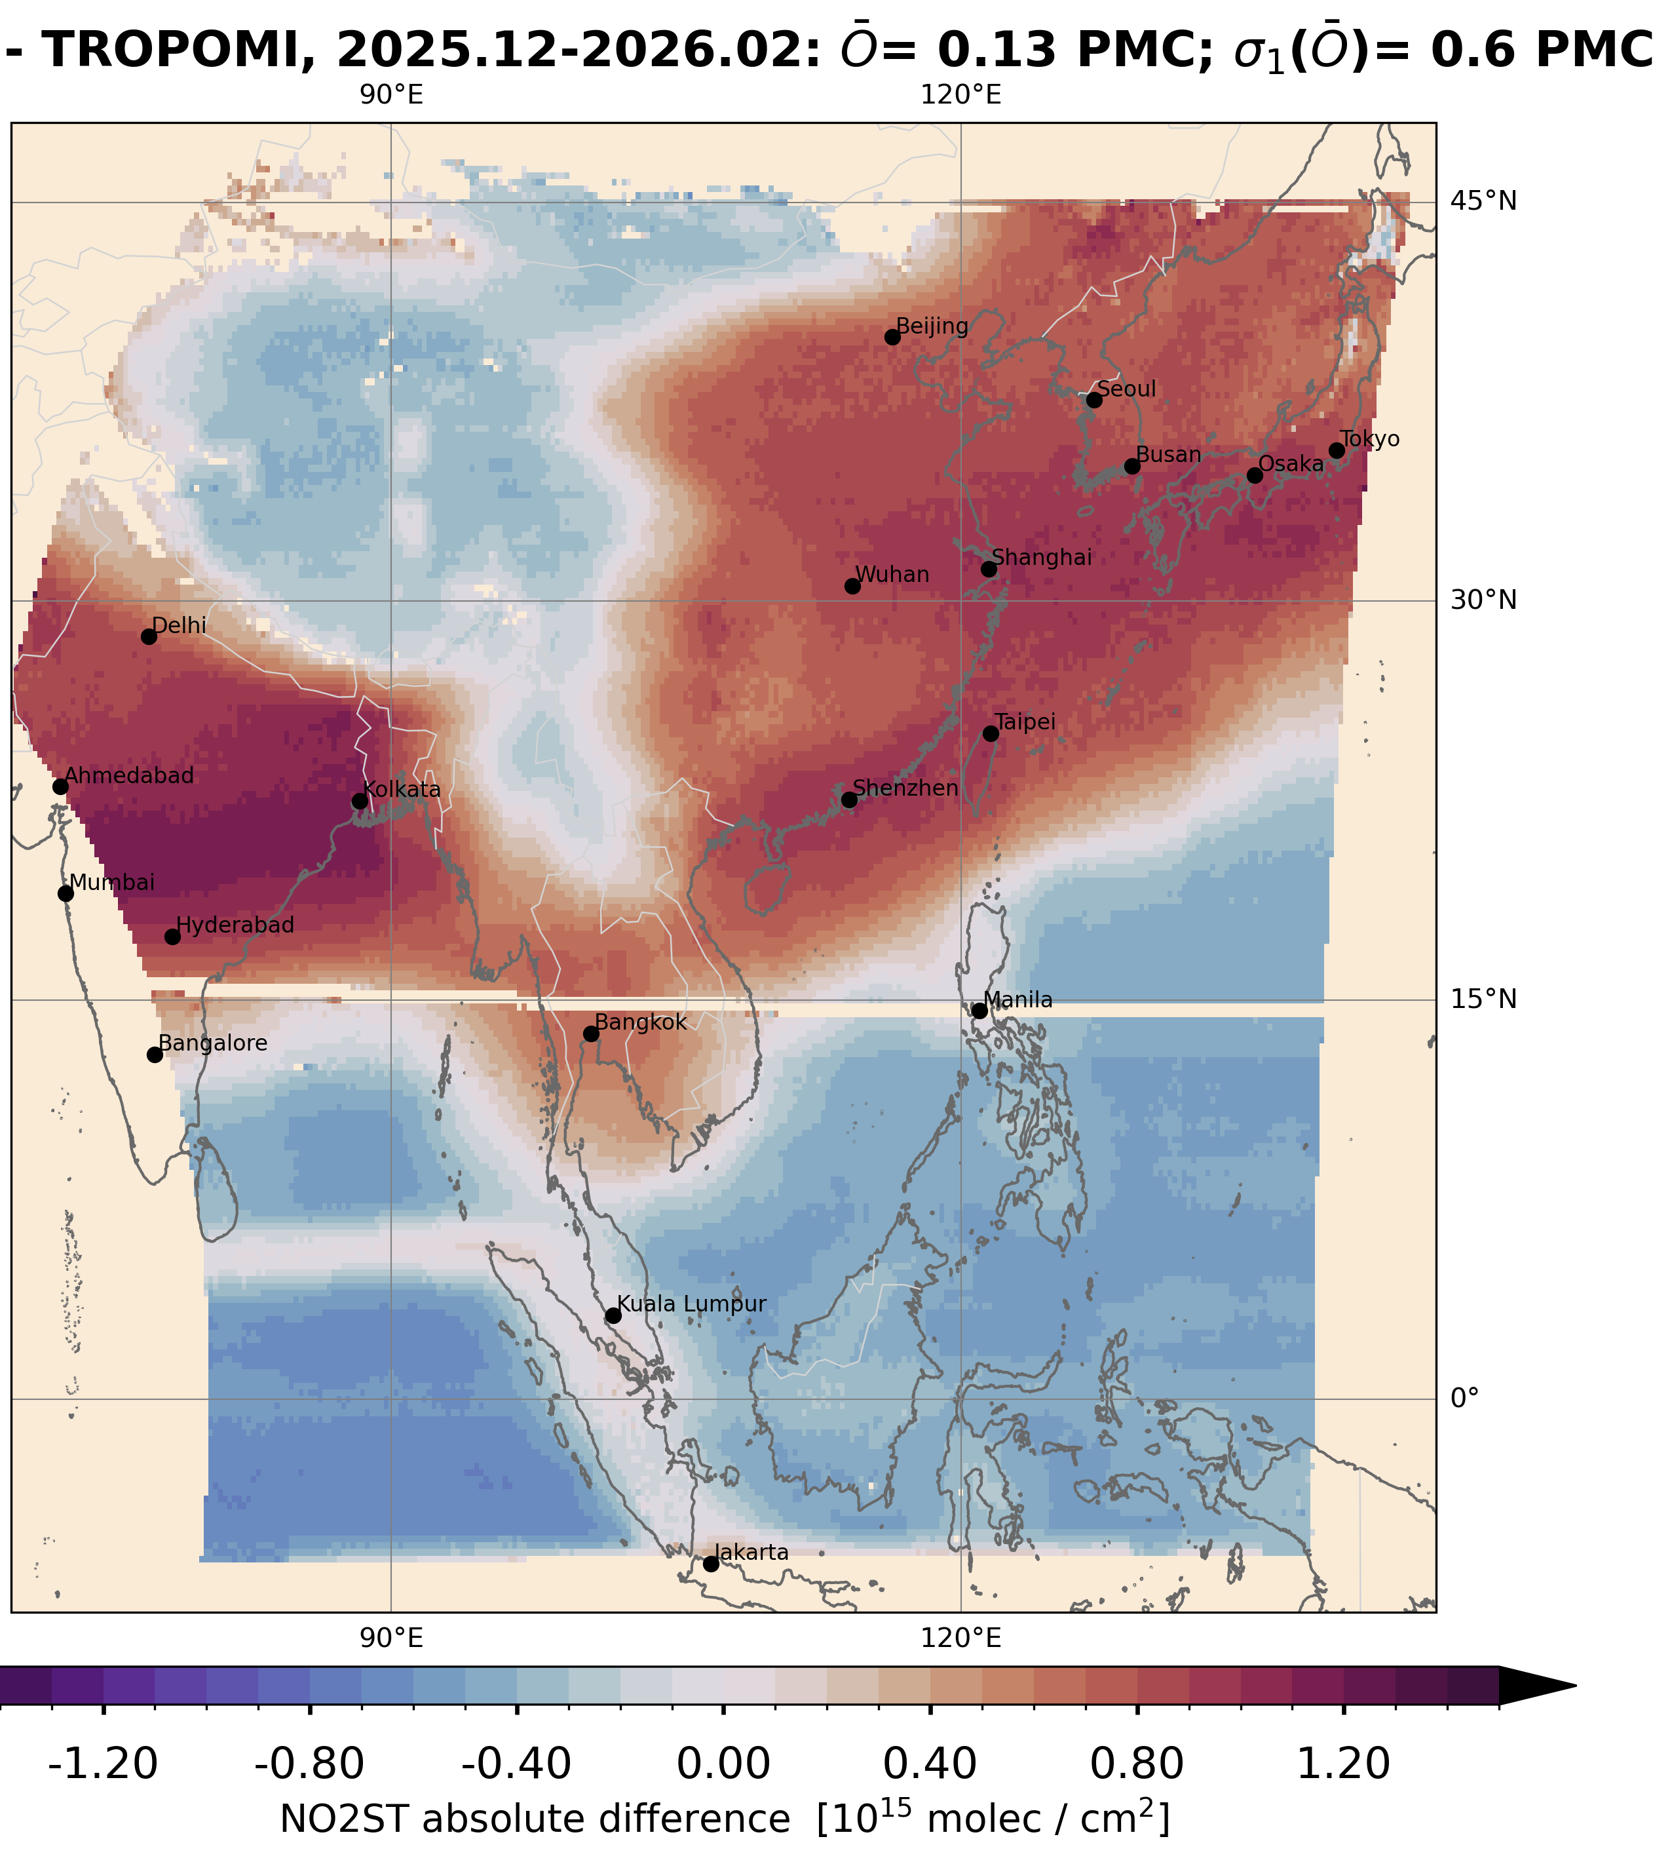
NO₂
Team: K.-U. Eichmann, I. de Smedt, C. Vigouroux, G. Pinardi, S. Compernolle, T. Verhoelst, S. Seo
Results:
We compared GEMS NO2 V3 and TROPOMI V2.8 for a three month period (2025/12 – 2026/02).
Total column difference AD = -0.3 ± 0.6 Pmolec/cm2, tropospheric AD = -0.2 ± 0.5 Pmolec/cm2 (higher bias over polluted areas, low bias over India), stratospheric AD = 0.13 ± 0.6 Pmolec/cm2.
The positive bias in the North changes to negative biases over the ocean in the South. That compensates with tropospheric columns in the total columns.
Tsukuba (NIES, Japan) Pandora PGN: Reasonable correlation (0.63) and RMSE (37%), but peculiar positive bias in local winter.
Troposphere
Stratosphere

Slide 9

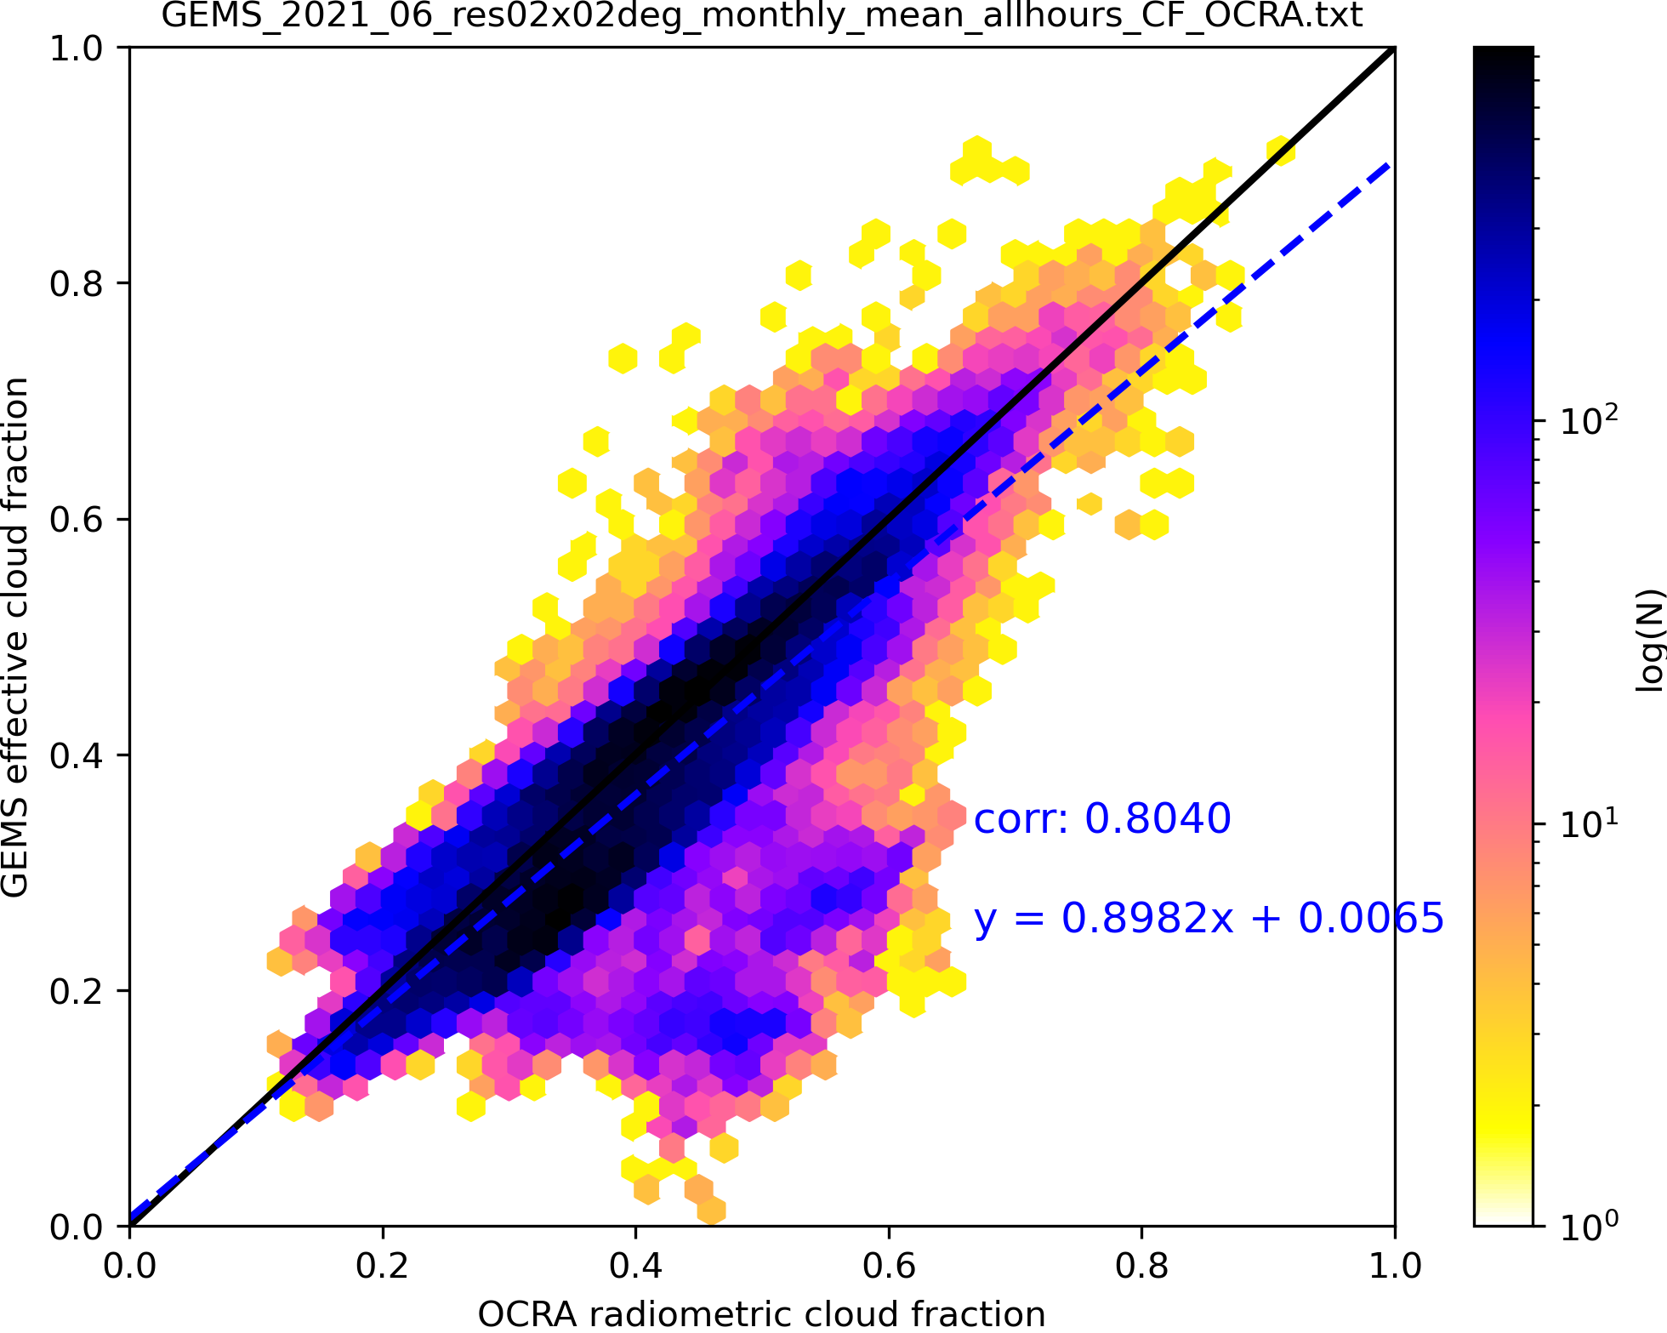
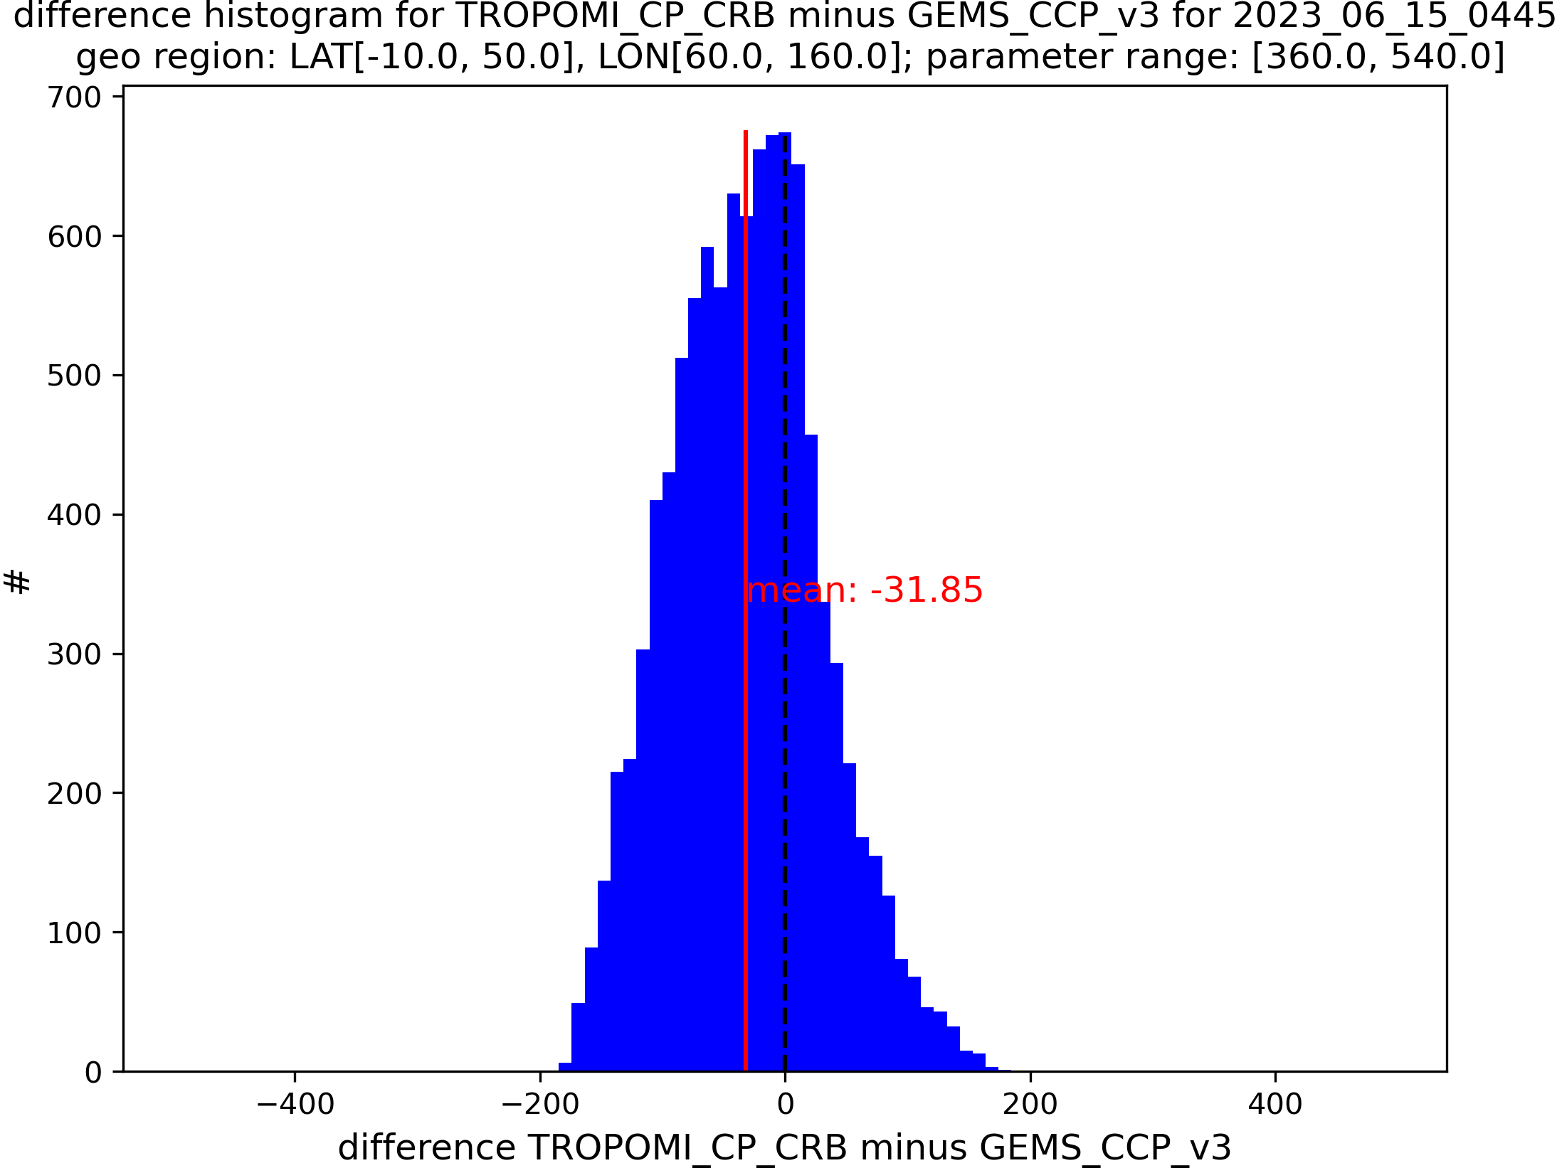
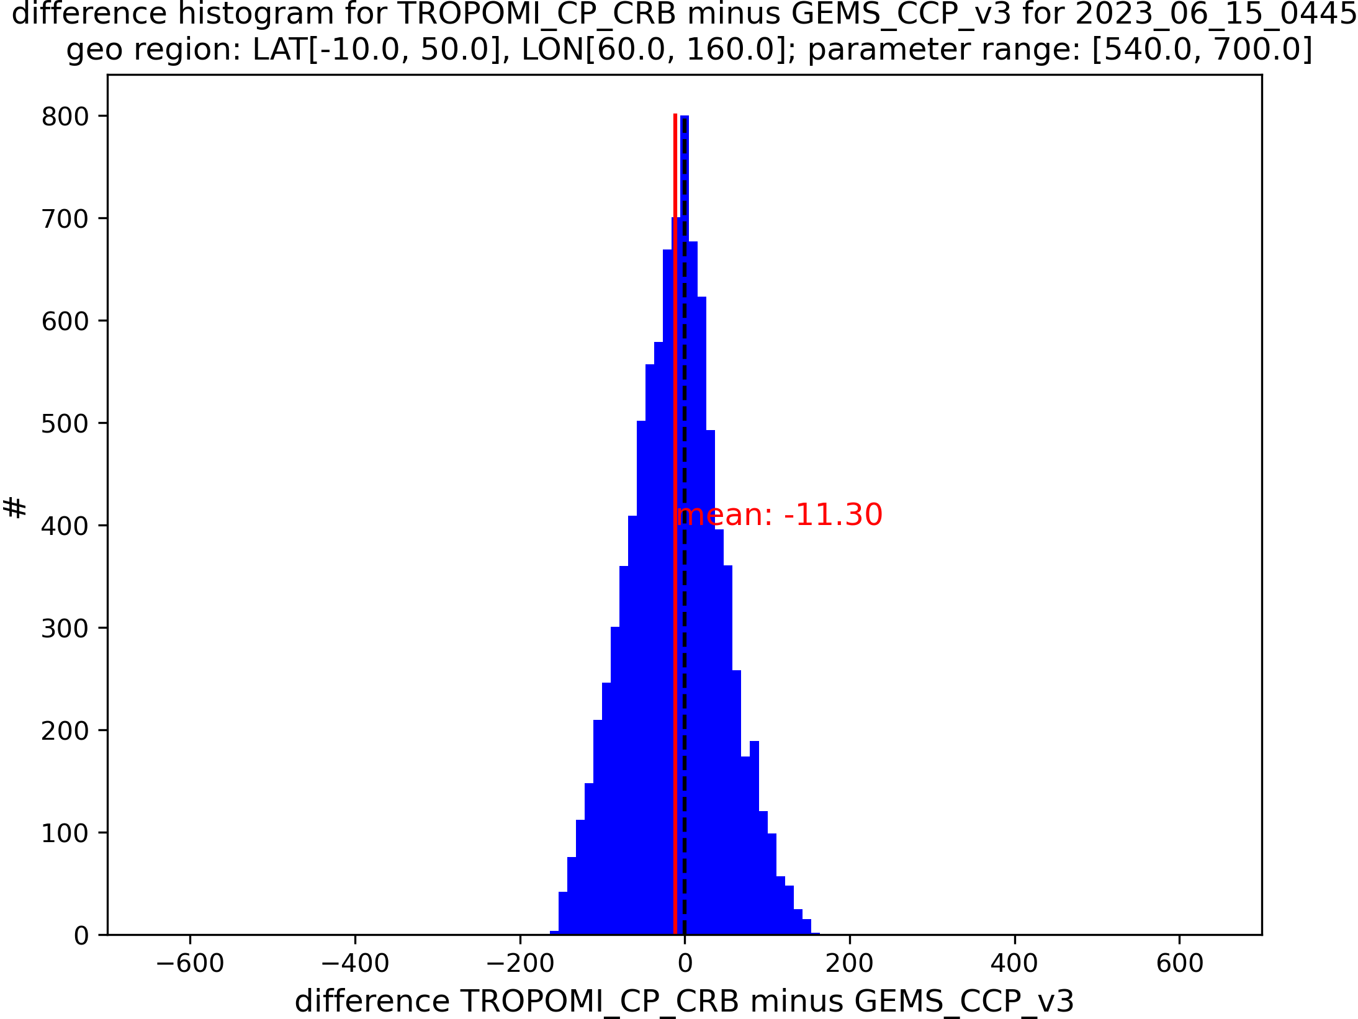
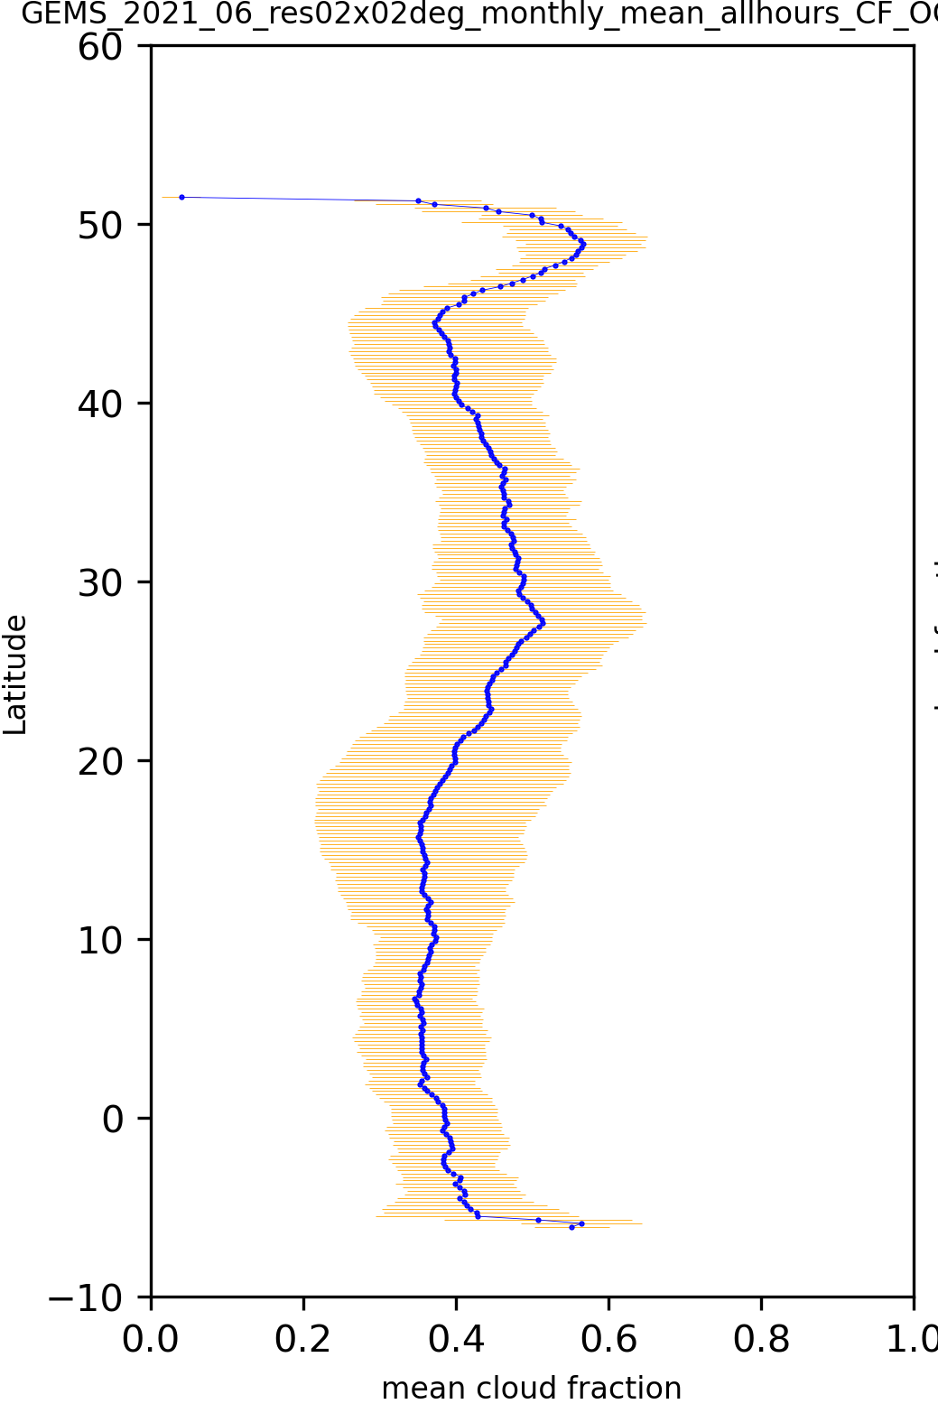
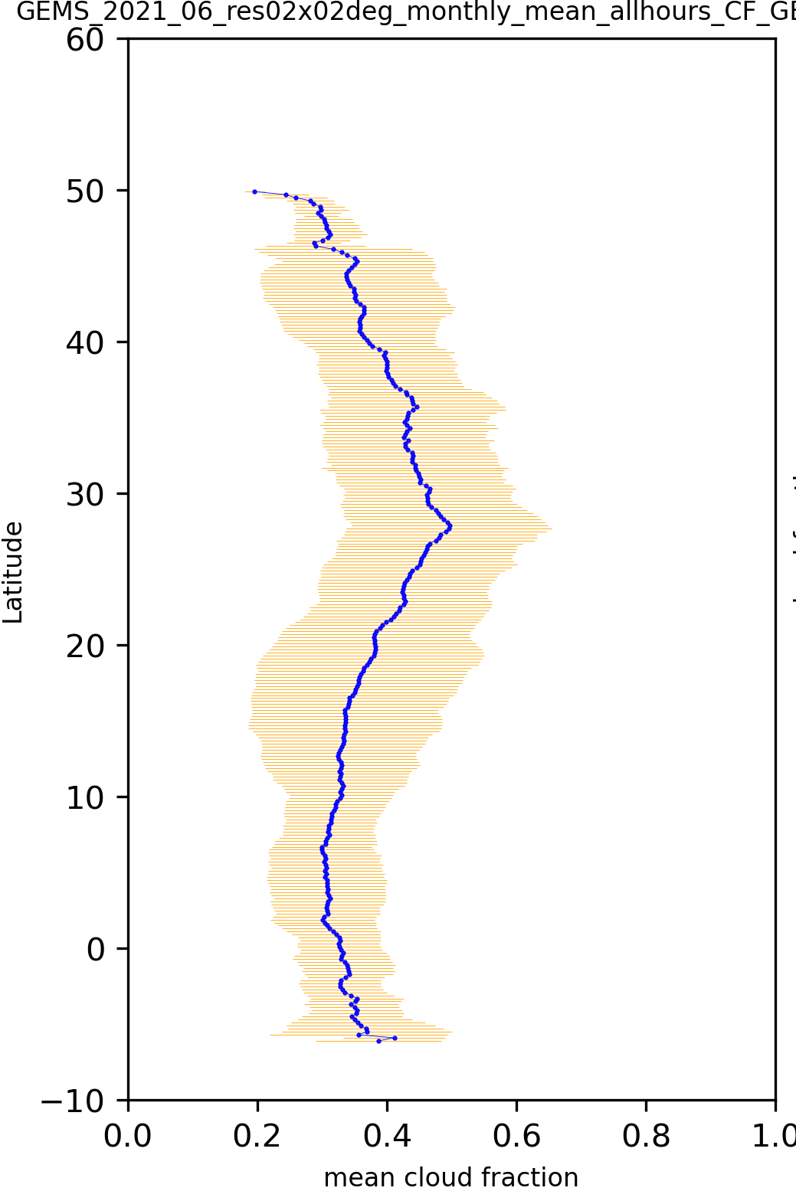
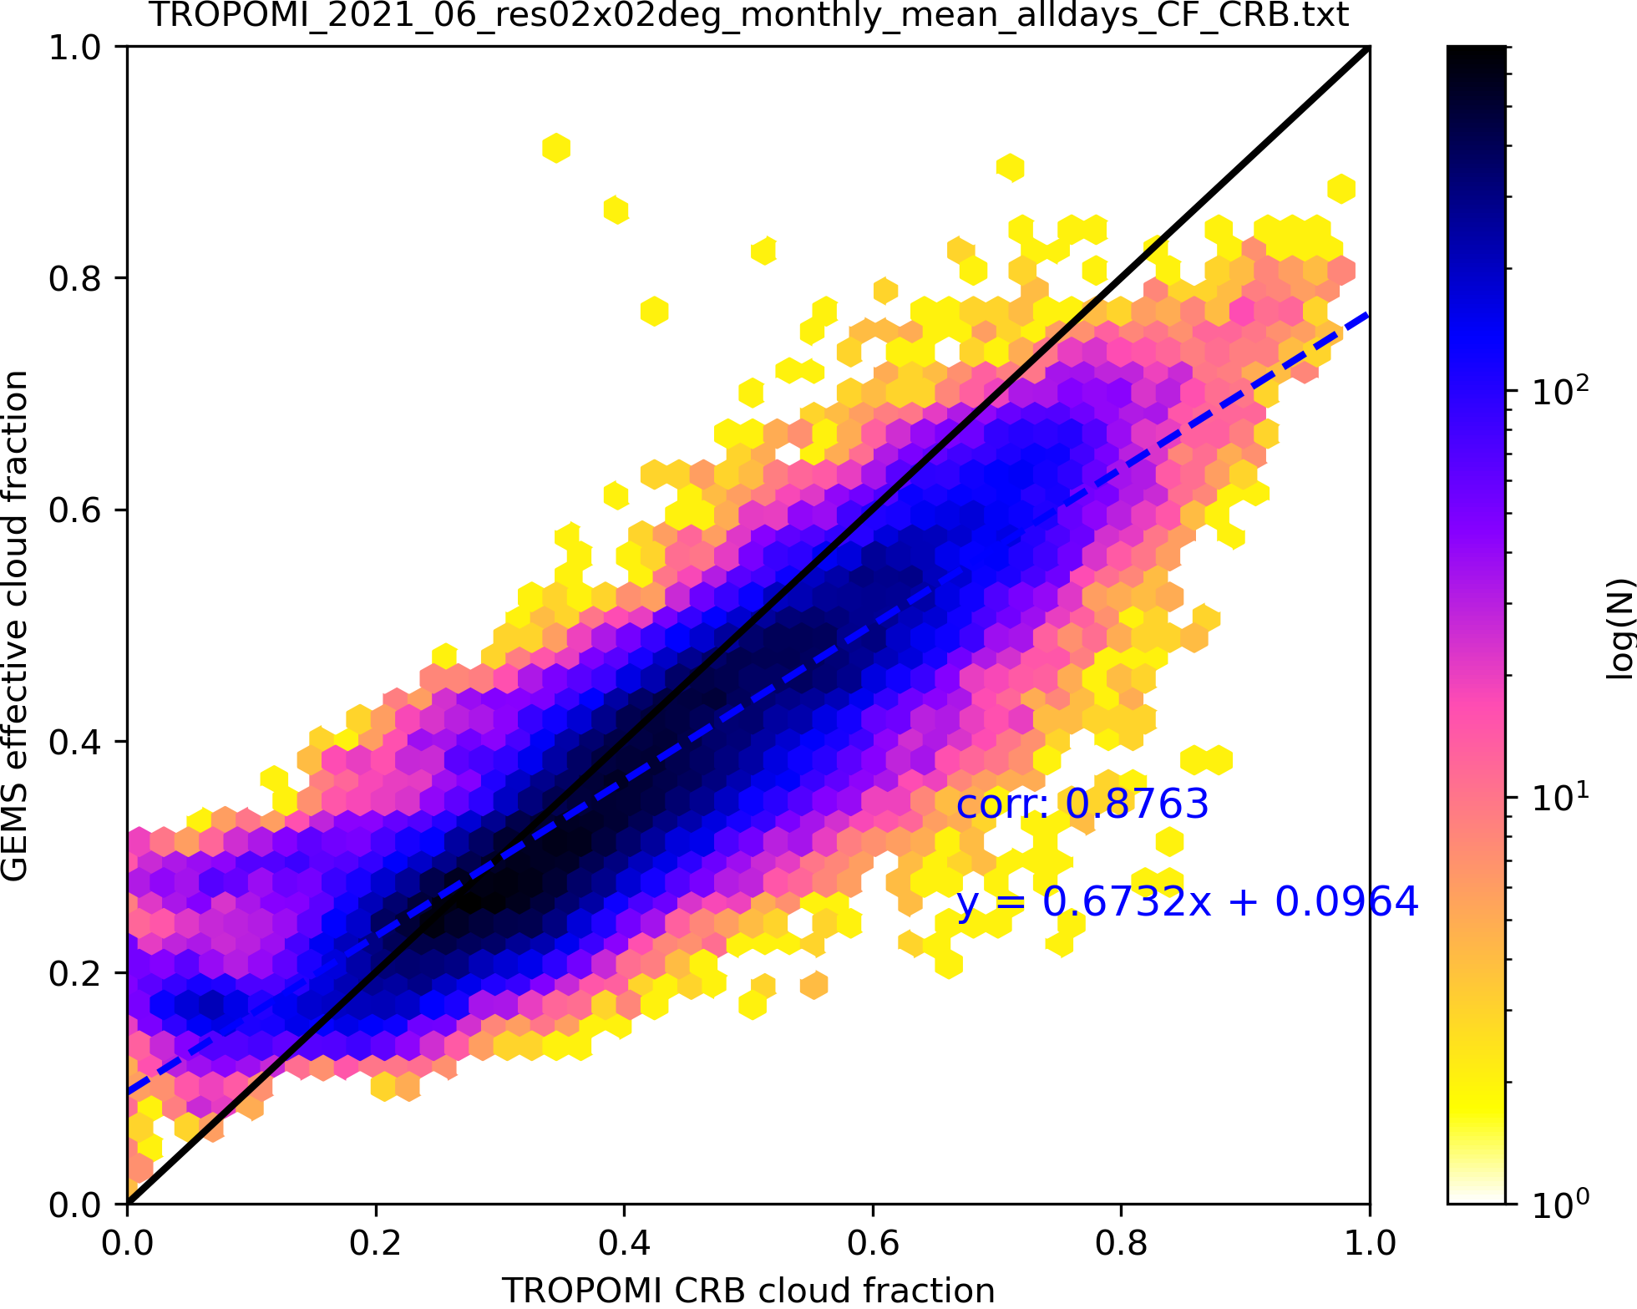
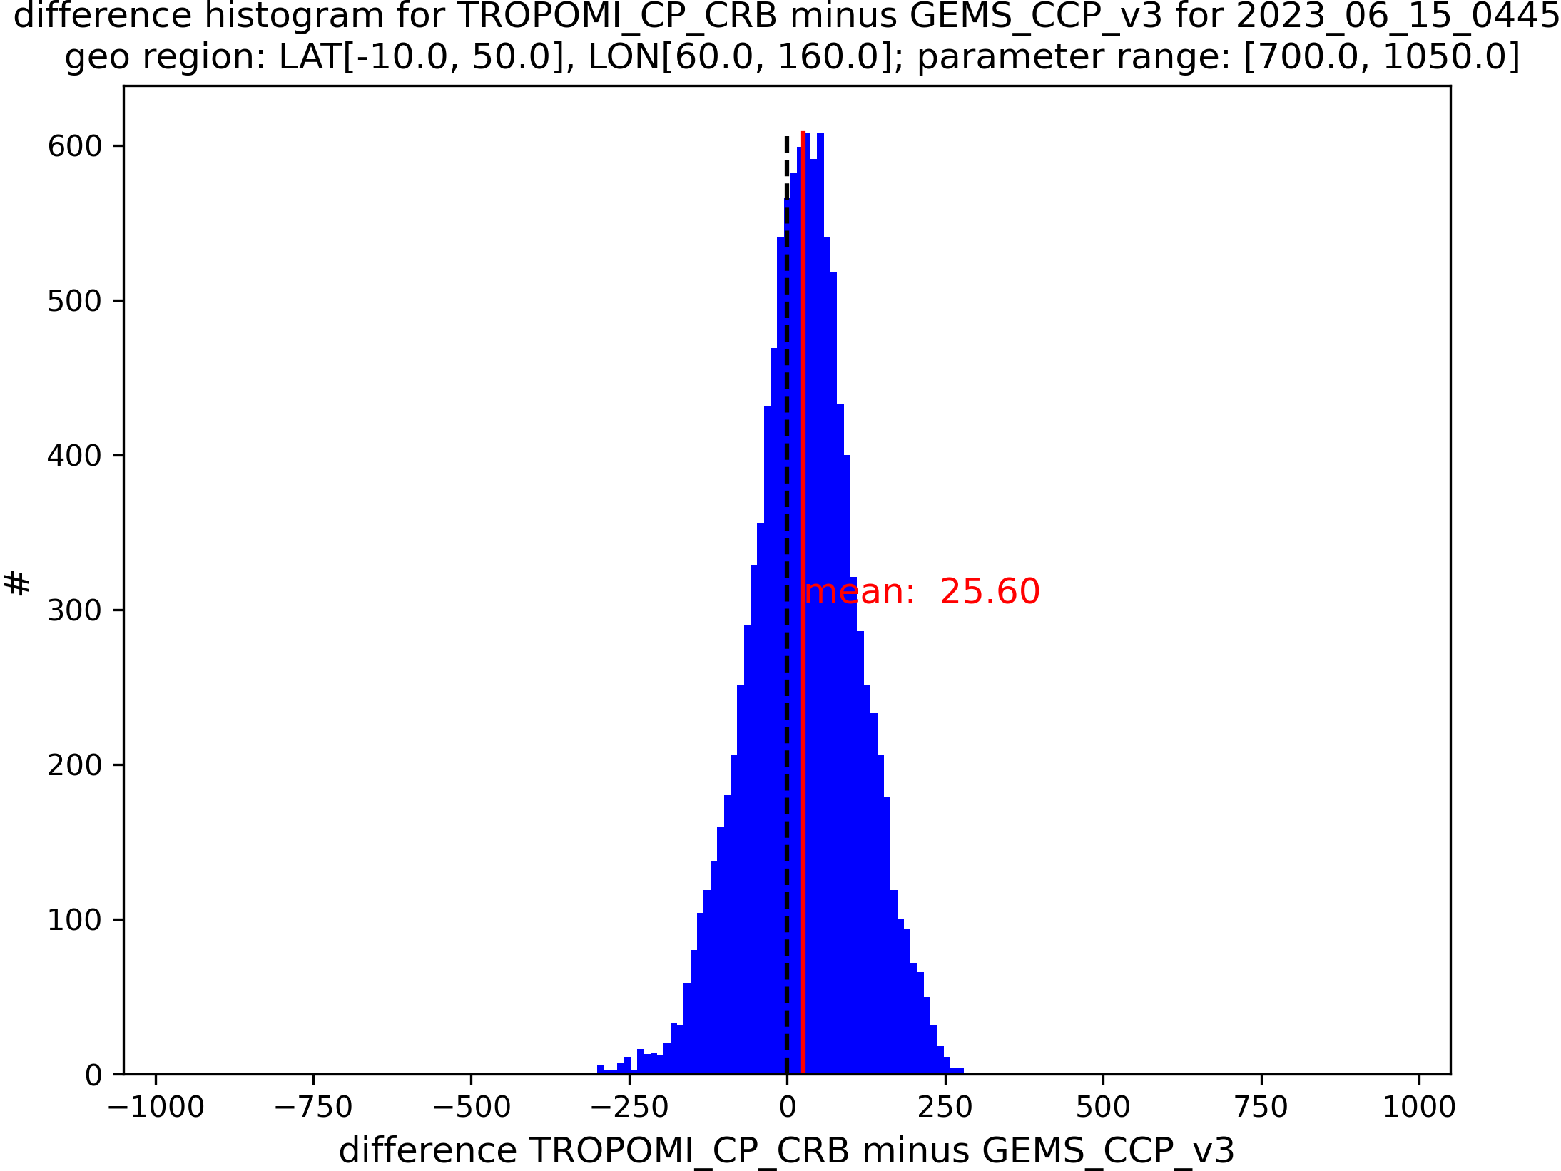
Clouds
Team: R. Lutz, V. Molina García, D. Loyola
Results:
We applied OCRA CF retrieval to GEMS L1 and compared with GEMS CLD V3.
high correlation (0.80) and slope close to unity
shape of zonal mean CF agrees very well
We compared GEMS CLD V3 and TROPOMI CRB
CF has very high correlation (0.88)
CP difference depends on cloud altitude
  low clouds: small positive difference
  high clouds: small negative difference
5 - 8 km
Δ = -32 hPa
3 - 5 km
OCRA CF vs GEMS CLD V3
Δ = -11 hPa
0 - 3 km
Δ = +26 hPa
Zonal mean CF from OCRA (left) and GEMS V3 (right)
cloud fraction comparisons TROPOMI vs. GEMS
cloud pressure differences TROPOMI – GEMS in hPa

Slide 10

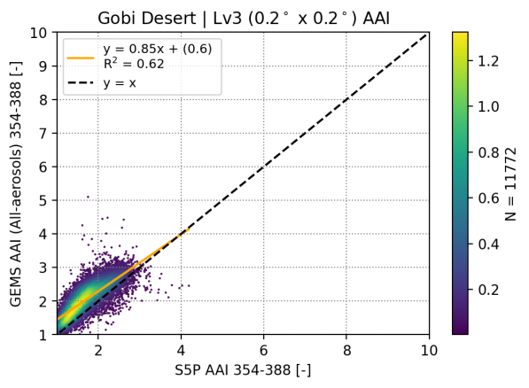
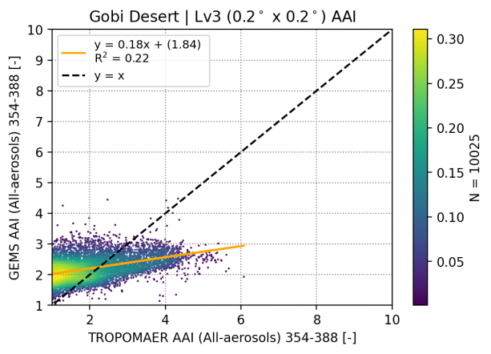
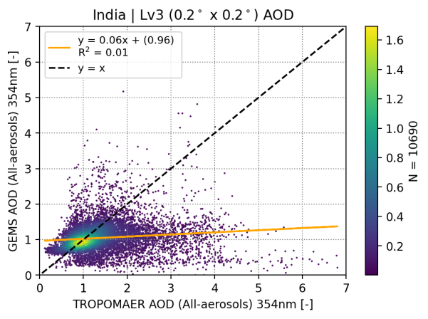
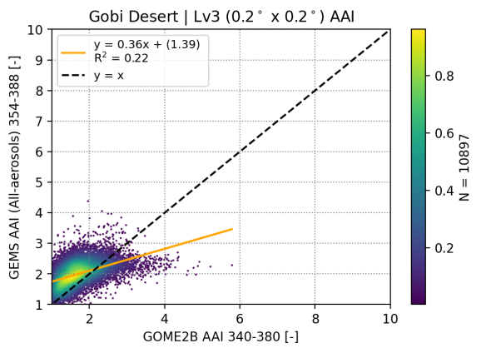
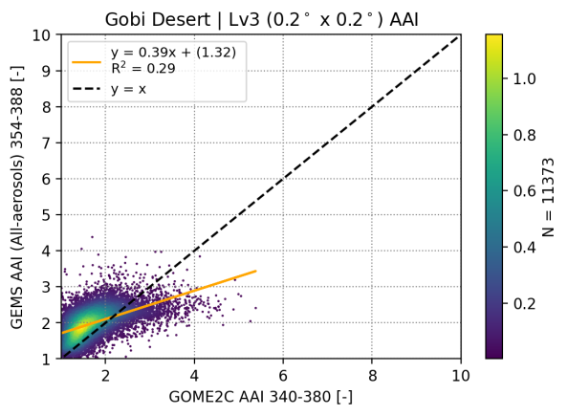
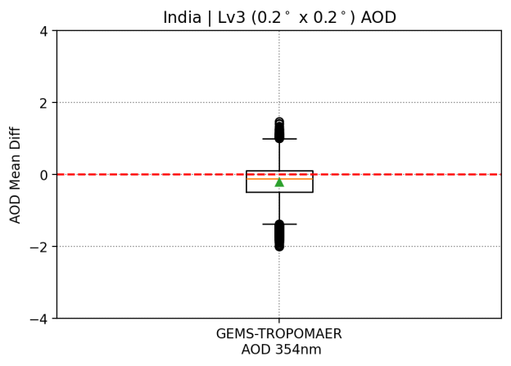
Aerosols
Team: K. Michailidis, P. Fountoukidis, P. Hedelt, D. Balis
GEMS Aerosol Index (v2.1) Validation over Gobi Desert
GEMS AOD (v2.1) Validation over Gobi Desert
MB: 0.17 ± 0.15
MB: 0.61 ± 11.65
MB: 0.0025 ± 0.53
MB: 0.14 ± 0.25
MB: 0.14 ± 0.23
Figure 1. Density scatterplots of AAI over the Gobi Desert (0.2° × 0.2°), for GEMS against (top left) TROPOMI, (top right) TROPOMAER, (bottom left) GOME-2B, GOME-2C (bottom right).
Figure 2. Evaluation of aerosol optical depth (AOD) across all case studies over India, comparing TROPOMAER and GEMS.

Slide 11
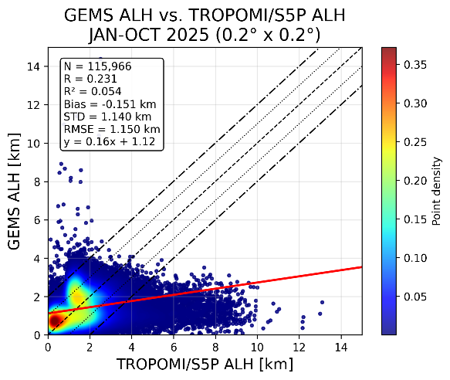
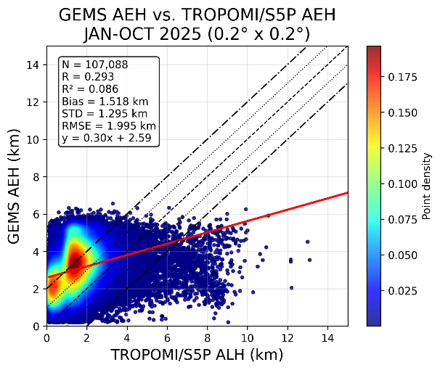
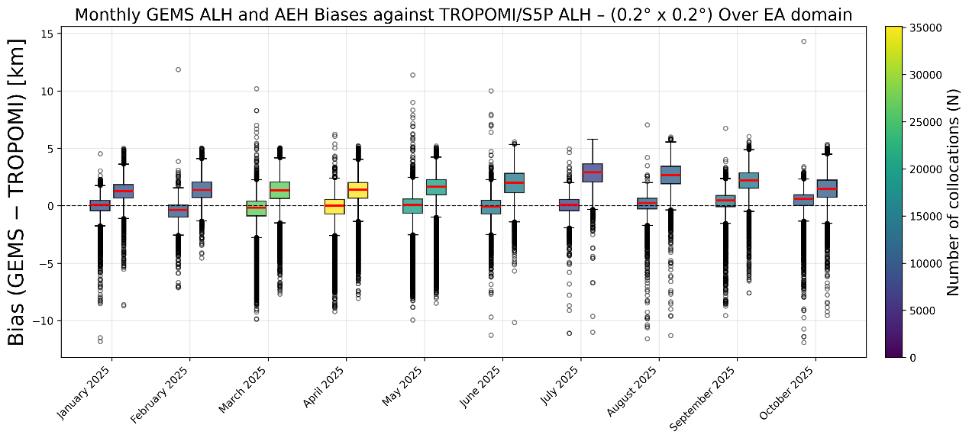
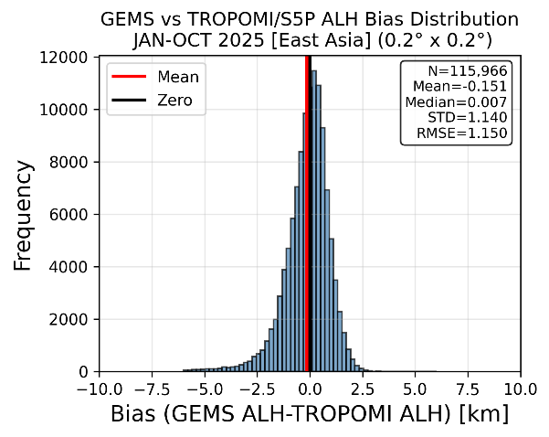
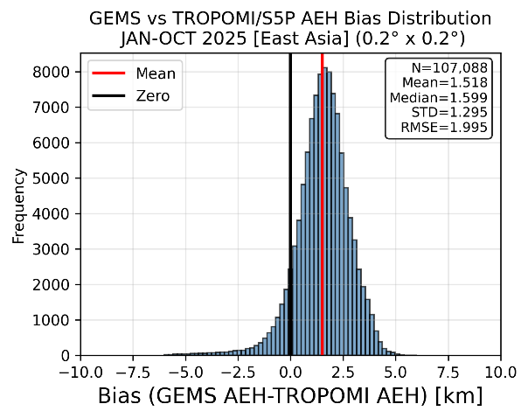
Aerosols
Team: K. Michailidis, P. Fountoukidis, P. Hedelt, D. Balis
GEMS Aerosol Height (v2.1) Validation [January to October 2025] – Eastern Asia
Figure 4. Box plots of ALH bias between GEMS (v2.1) and TROPOMI/S5P.
TROPOMI vs GEMS ALH (R = 0.23 / MB: -0.15±1.14 km)
TROPOMI vs GEMS AEH (R = 0.29 / MB: 1.52±1.29 km)
The GEMS retrieves both the ALH and AEH products by independent algorithm processes:
AEH: O₄ SCD (DOAS, L1C, pre. corrected) → Layer Midpoint
ALH: Opt. Estim. (AOD, SSA, a priori) → Densest Layer altitude
Figure 3. (Top) Density scatter plots of GEMS ALH (left) and AEH (right) with TROPOMI. (Bottom) Histograms showing the distribution of differences between GEMS ALH and TROPOMI ALH.
Consistent offset between ALH - AEH due to different definitions!

Slide 12
Examples (ii):

Slide 13
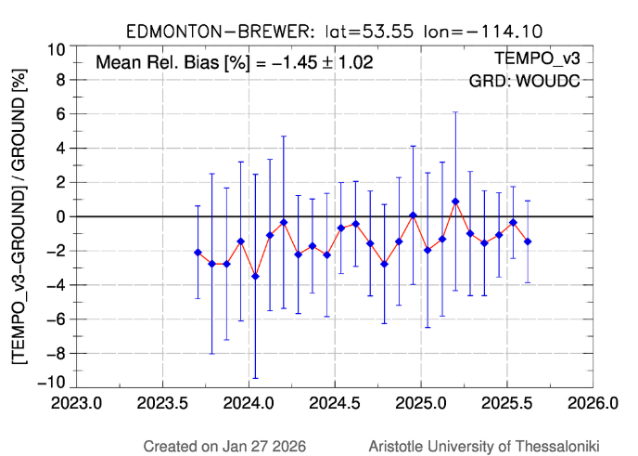
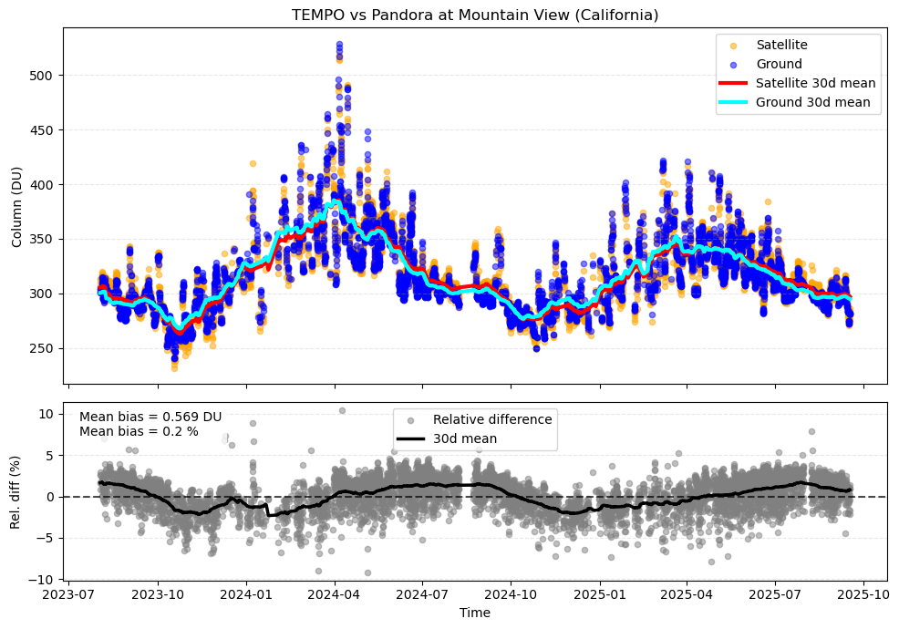
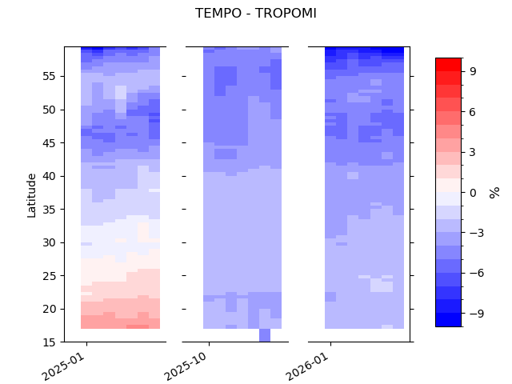
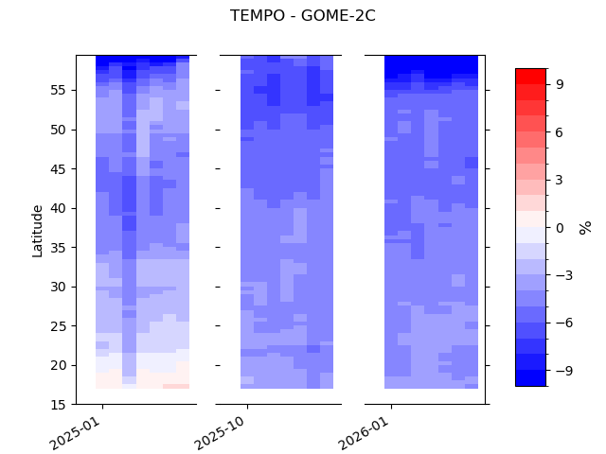
Total Ozone
Team: K. Garane, S. Compernolle, K.-P. Heue, T. Verhoelst
Mountain View (California) Pandora
v03 Mean Rel. Bias: -1.5 ± 1.0 %
Results:
TEMPO O3T v03 (2 years of data) :
Mean relative bias: -1.5 to -2 %
Pearson R > 0.95
Important North – South gradient:
  Tropics: Very good agreement (~ +1%)
  North: negative biases w.r.t. ground-based observations and other satellite sensors
  (~ -4%)
TEMPO O3T v04 data (3.5m of data):
Mean relative bias: -2 to -3.5 %
Pearson R > 0.97
Improved North – South gradient: almost stable bias across all latitudes
v03 Mean Rel. Bias: +0.2 %
Time-series of the mean relative bias (%) of GEMS O3T v03 w.r.t. ground-based reference measurements from the Edmonton Brewer station (left) and the Mountain View Pandora station (right)
v03
v04
v04
v03
v04
v04
TEMPO vs TROPOMI
TEMPO vs GOME-2C
The mean percentage differences between the O3T observations from TEMPO (v03 and v04) and TROPOMI (left), GOME-2C (right) over the GEMS FOV.

Slide 14
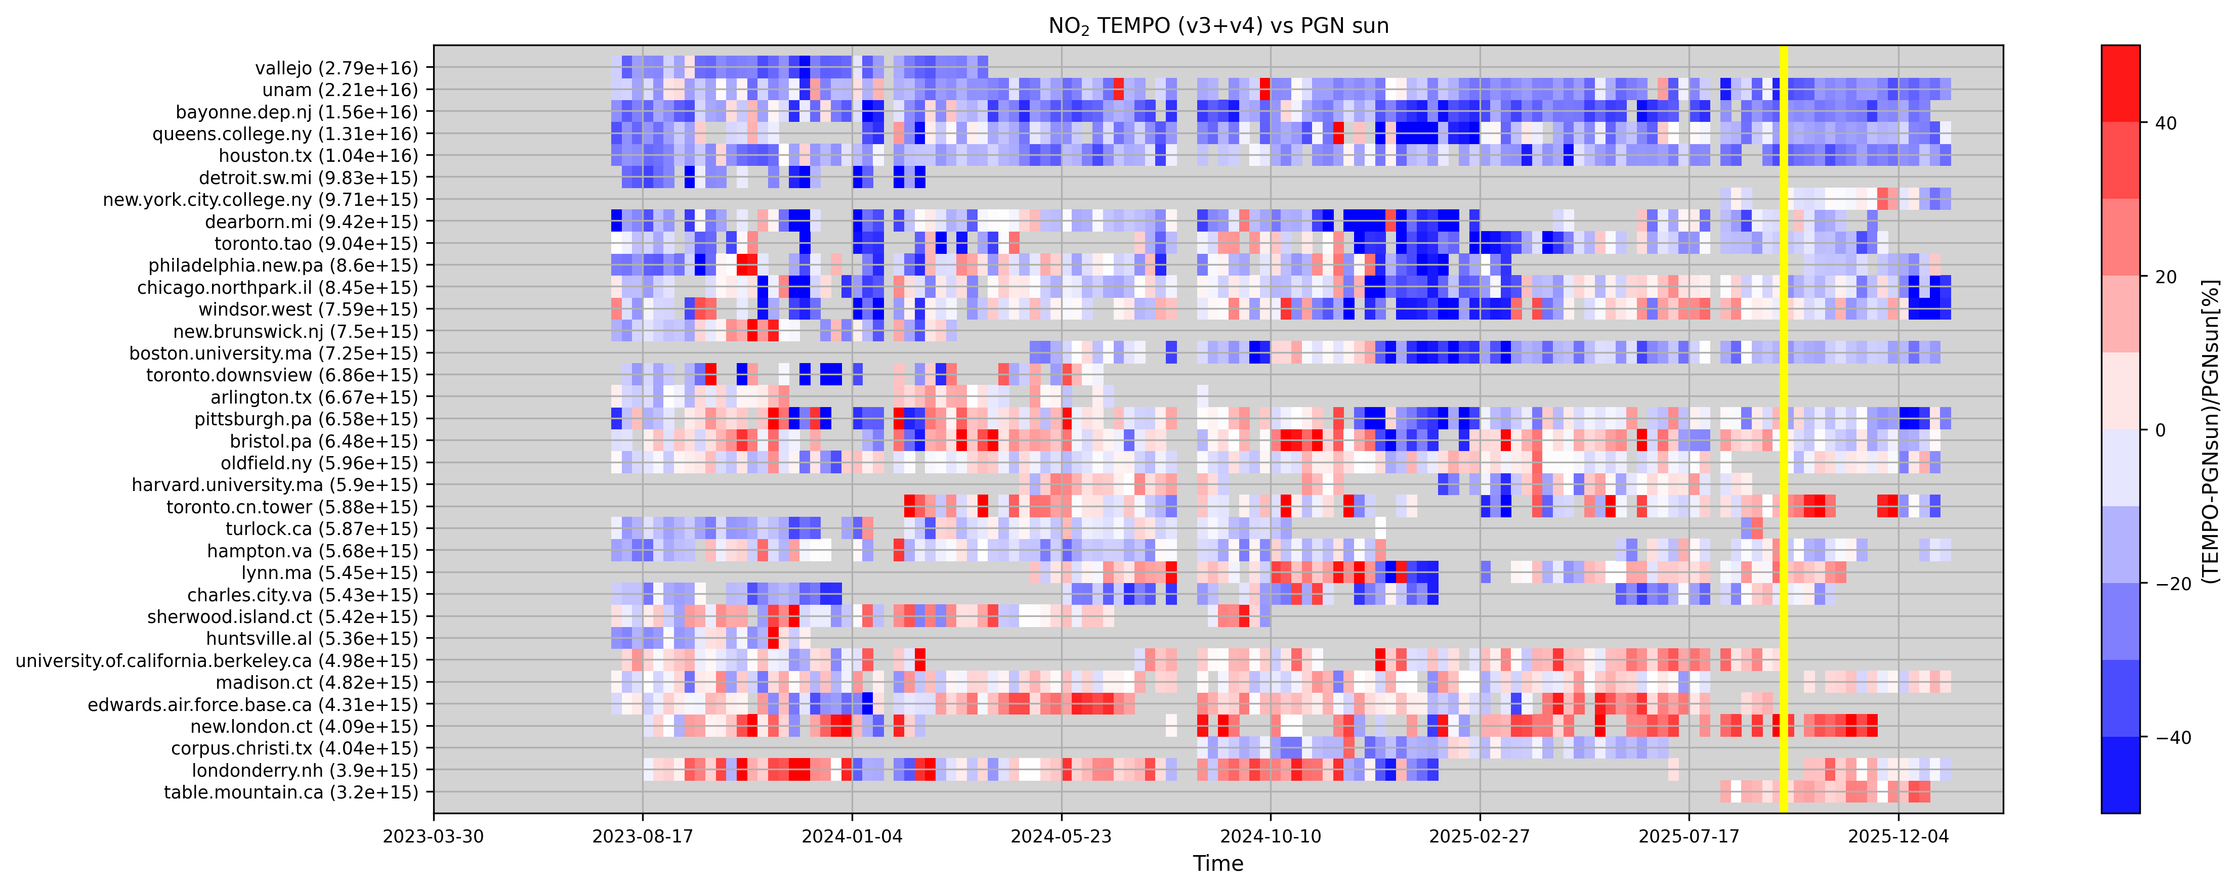
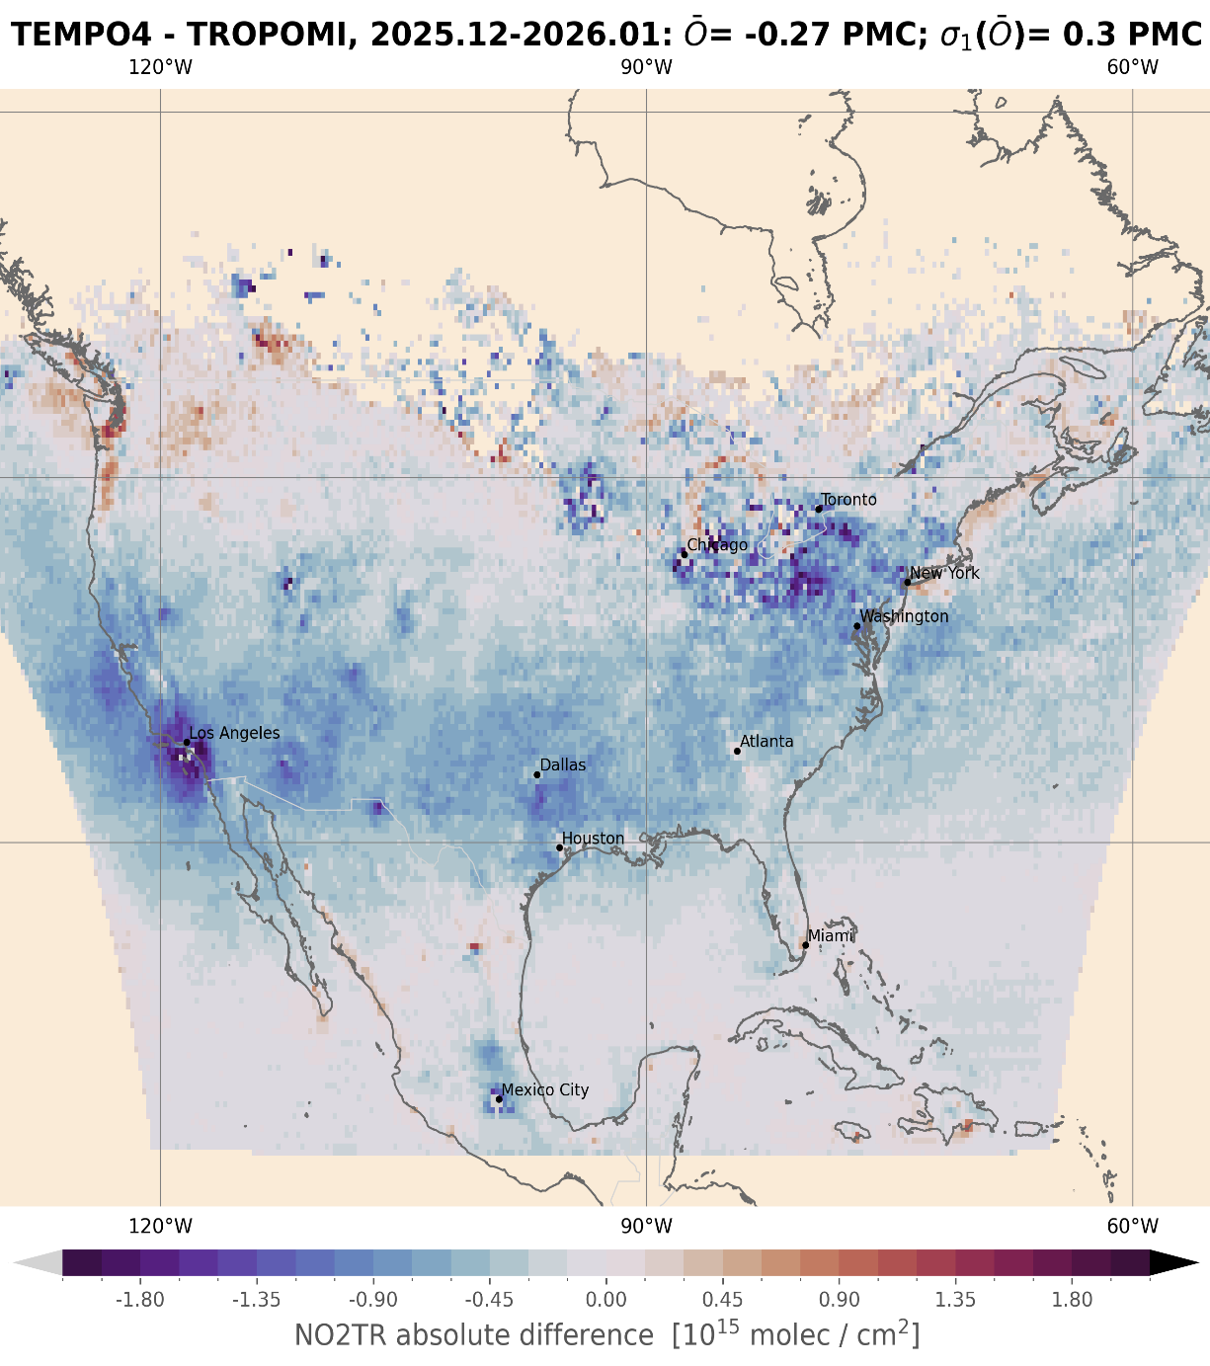
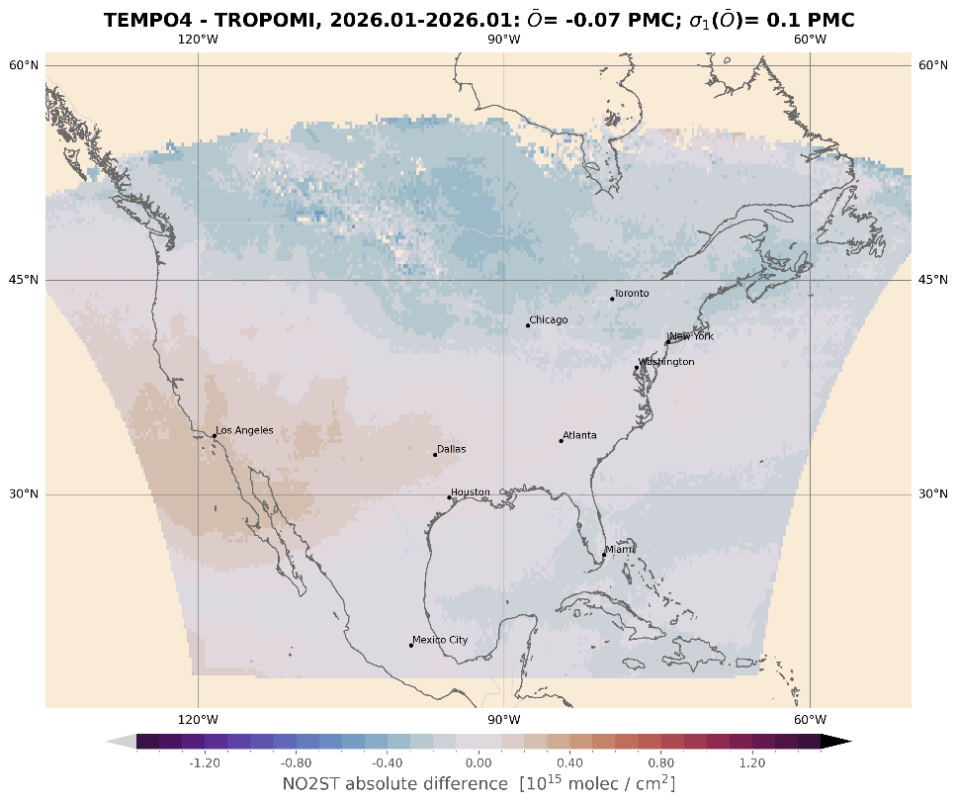
NO₂
Team: K.-U. Eichmann, I. de Smedt, C. Vigouroux, G. Pinardi, S. Compernolle, T. Verhoelst, S. Seo
Results:
We compared TEMPO NO2 V4 and TROPOMI V2.9 for a two month period (2025/12 – 2026/01).
Total column difference is -0.19 ± 0.5 Pmolec/cm2, tropospheric AD= -0.27 ± 0.3 Pmolec/cm2, stratospheric AD= -0.07 ± 0.1 Pmolec/cm2.
There is still a very low bias near LA in the tropospheric column. This is partly compensated by a high bias in the stratosphere.
Time series of the relative differences between TEMPO v3 and v4 and PGN (@EVDC) total NO2 measurements at the 34 PGN sites with meaningful temporal coverage.
Troposphere
Stratosphere

Slide 15
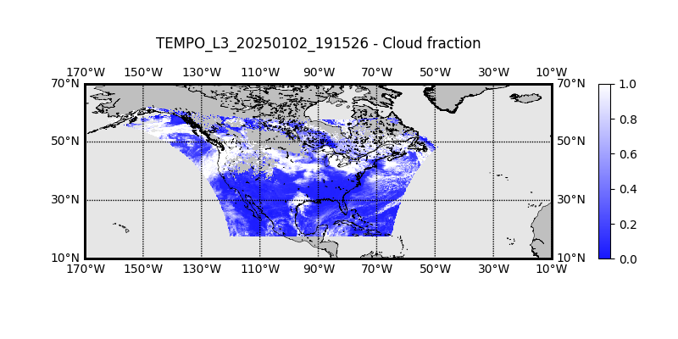
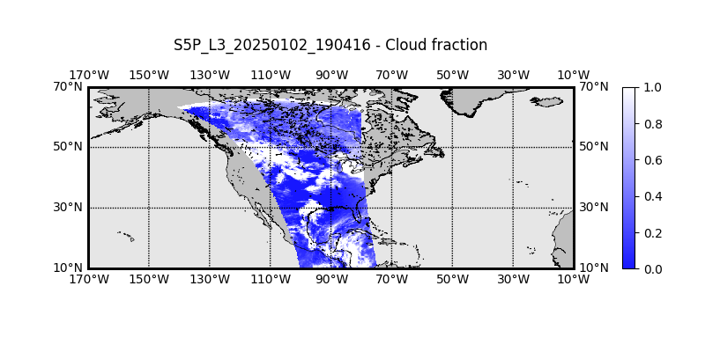
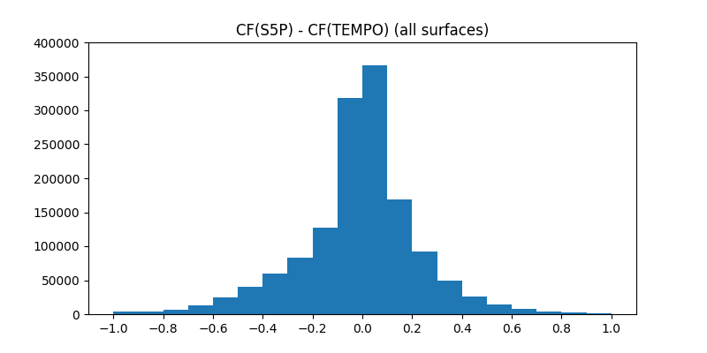
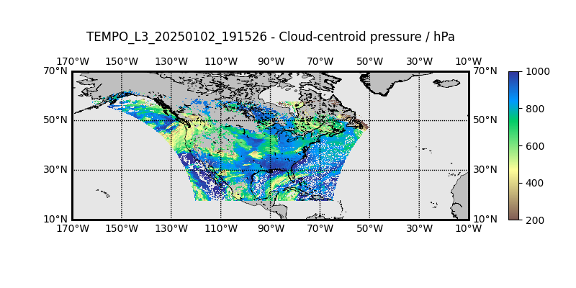
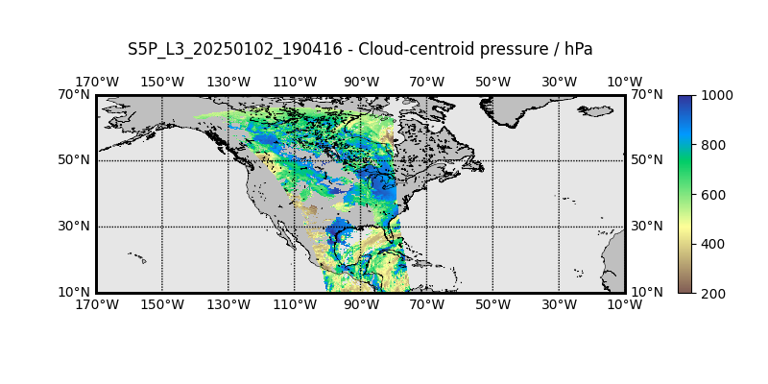
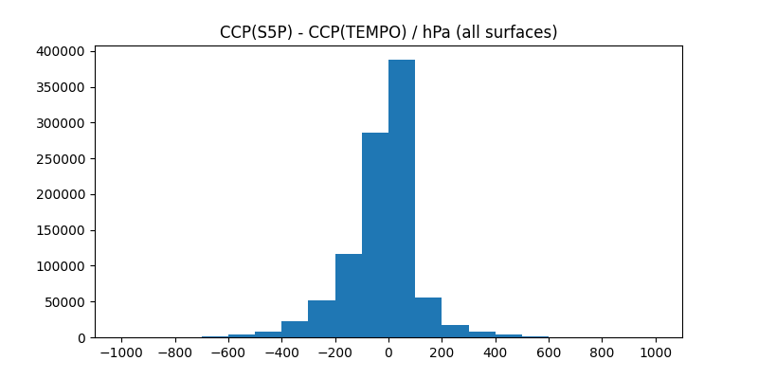
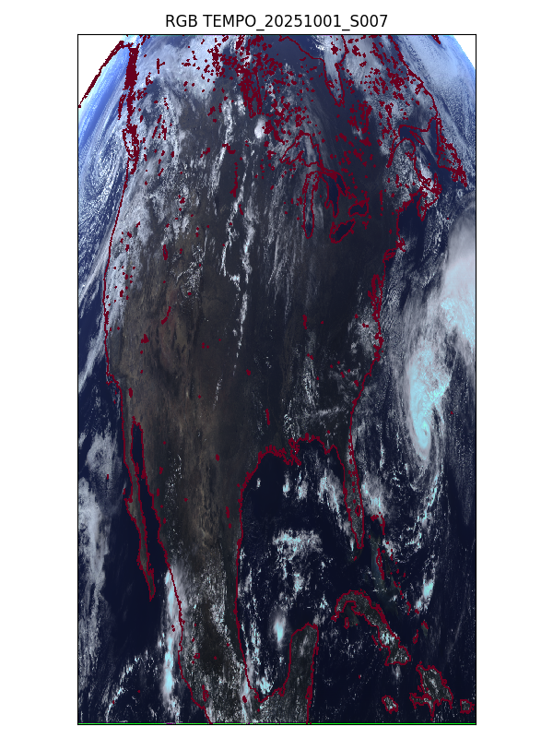
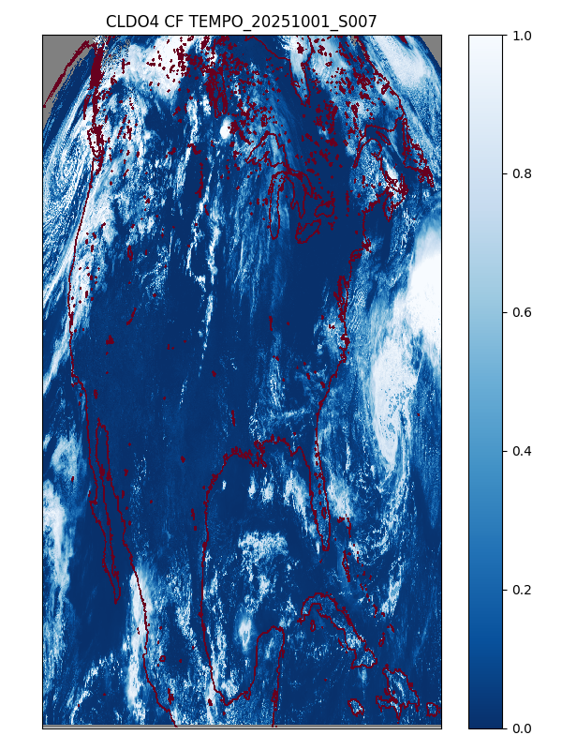
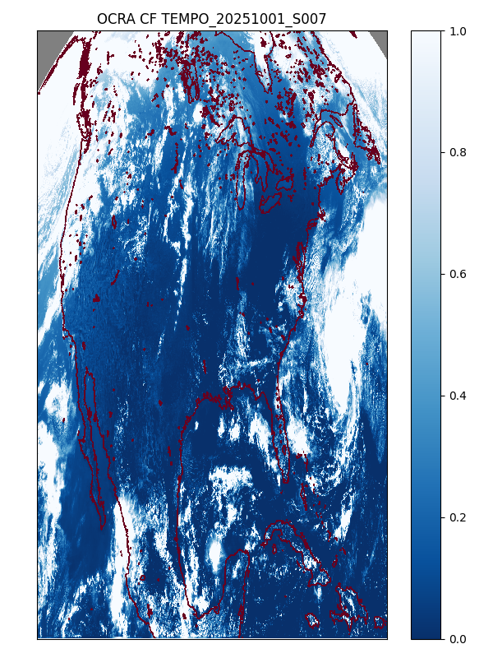
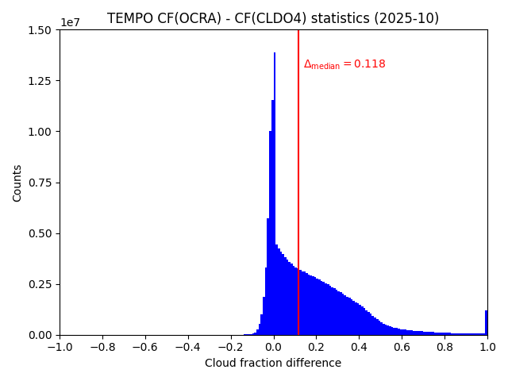
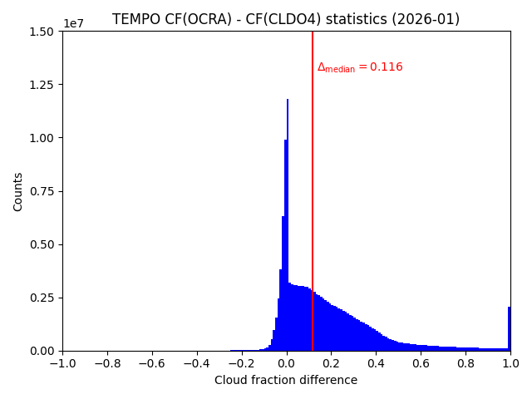
Clouds
Team: V. Molina García, R. Lutz, D. Loyola
Results:
TEMPO CLDO4 v03 (2025-01-01 to 2025-01-07) :
Regional averaged comparisons TEMPO vs S5P for cloud fraction and cloud-centroid pressure
Cloud Fraction (CF):
  Mean difference of -0.014
  Differences between S5P cloud fraction and TEMPO cloud fraction behave symmetric around 0.0
Cloud-Centroid Pressure (CCP):
  Mean difference of -23.776 hPa
  S5P cloud-centroid altitudes are slightly higher than
  TEMPO cloud-centroid altitudes
TEMPO CLDO4 v04 (2025-10-01 to 2025-10-07
and 2026-01-01 to 2026-01-07):
Direct pixel-by-pixel comparisons with custom TEMPO OCRA algorithm for cloud fraction
Cloud Fraction (CF):
  Mean difference of +0.172
  TEMPO CLDO4 CF does not reach 1 so often as TEMPO OCRA CF, even for big cloud structures
  TEMPO CLDO4 CF behaves better at high zenith angles, where TEMPO OCRA CF tends to saturate
TEMPO 2025-01-02 19:15:26
S5P 2025-01-02 19:04:16
CF difference
CCP difference
TEMPO 2025-10-01 S007
CLDO4 CF
OCRA CF
CF difference
2025-10-01 to
2025-10-07
CF difference
2026-01-01 to
2026-01-07

Slide 16

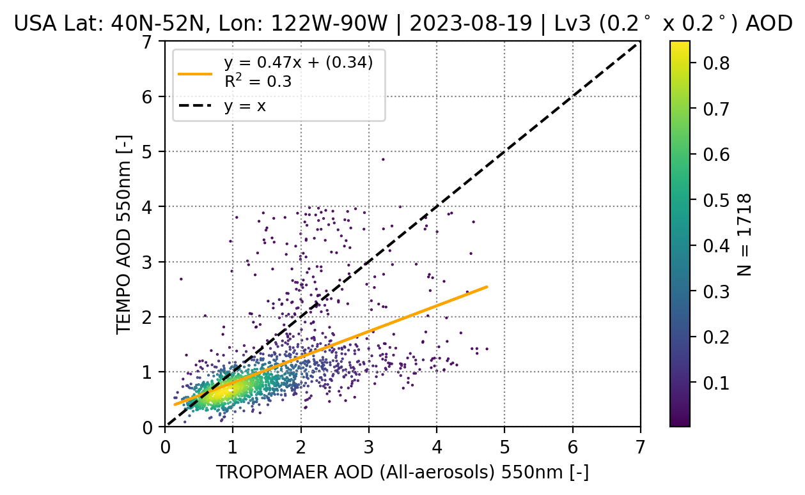
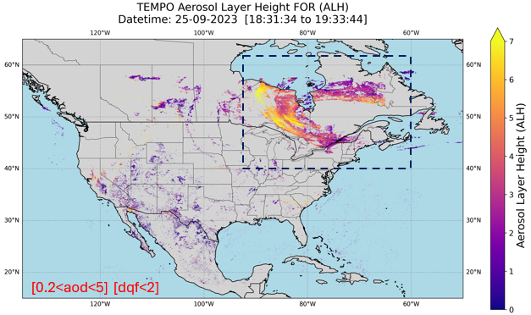
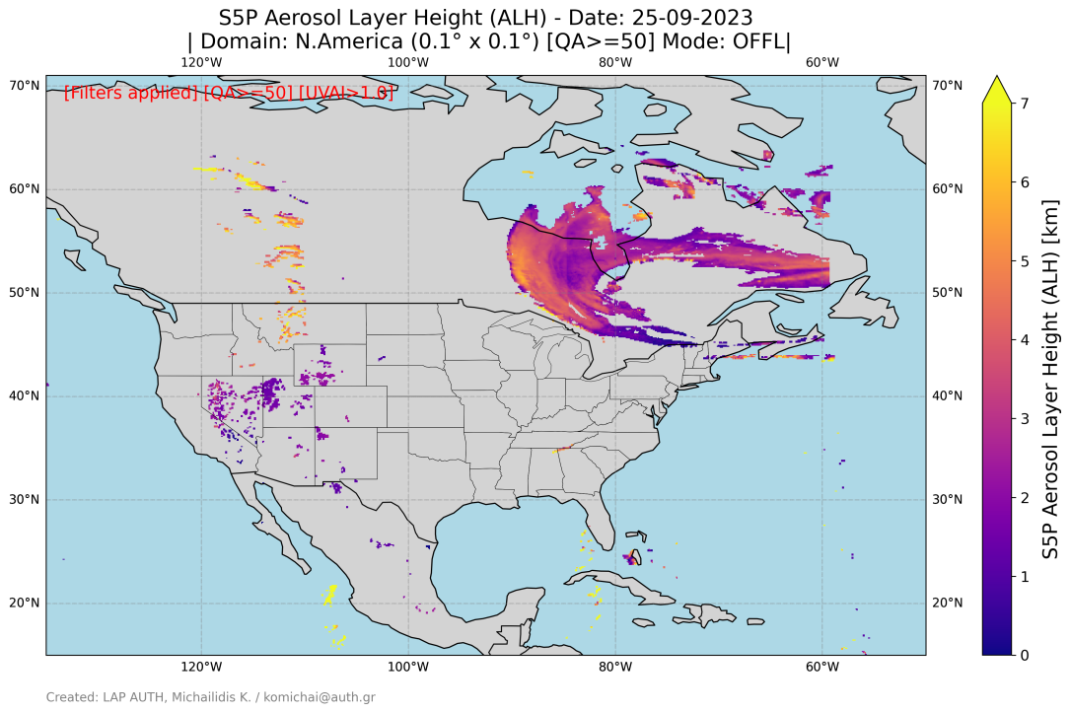
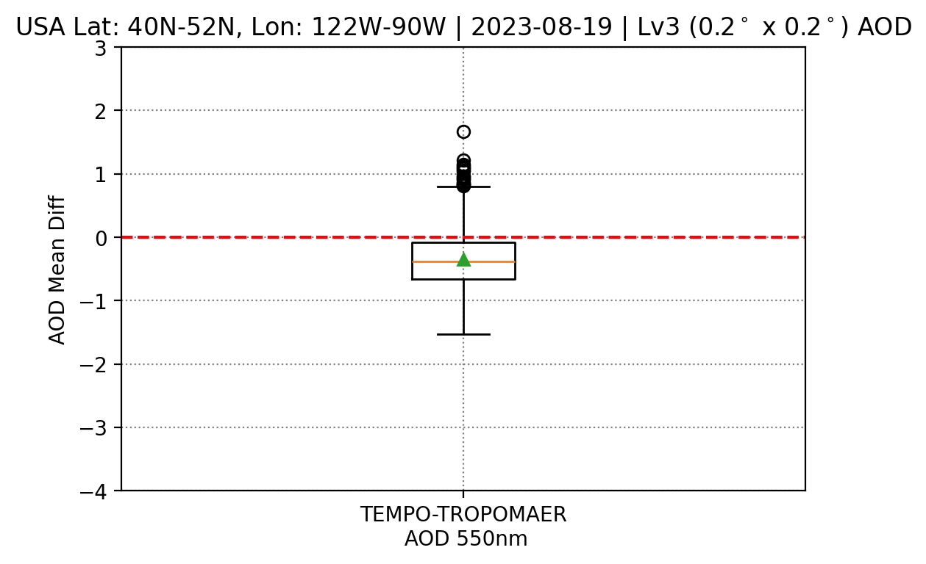
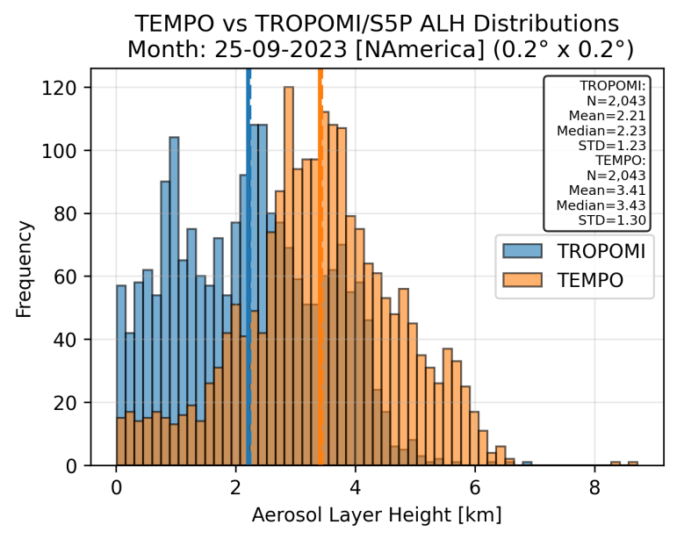



Aerosols
Team: K. Michailidis, P. Fountoukidis, P. Hedelt, D. Balis
AOD - Canadian Wildfire: 19-08-2023
Aerosol Layer Height [ALH] - Canadian Wildfire: 19-08-2023
Figure. Spatial distribution of aerosol height products over N.America during an extreme smoke event on 25 September 2023, (left) TEMPOALH (scan10) and TROPOMI/S5P ALH.
Figure 5. (Upper) Density scatter plots of TROPOMAER (left) against TEMPO AOD. (Bottom) Box-plot of the mean differences.
* TEMPO L2 OFFL Aerosol data provided by NOAA team within PEGASOS project.
Figure 6. (Left) Frequency distributions of collocated TEMPO & TROPOMI ALH. (Middle) Scatter density plot showing their correlation. (Right) Histogram of absolute differences (TEMPO−TROPOMI), indicating agreement and variability under smoke conditions.

Slide 17
Credits to the PEGASOS team
Timon Hummel, Claus Zehner
Pascal Hedelt, Klaus-Peter Heue, Diego Loyola, Ronny Lutz, Victor Molina Garcia, Sora Seo
Katerina Garane, Konstantinos Michaelidis, Panagiotis Fountoukidis, Dimitris Balis, MariLiza Koukouli
Steven Compernolle, Martine de Maziere, Isabelle de Smedt, Daan Hubert, Arno Keppens, Jean-Christopher Lambert, Gaia Pinardi, Nicolas Theys, Michel van Roozendael, Tijl Verhoelst, Corinne Vigouroux
Kai-Uwe Eichmann, Mark Weber

Slide 18
Credits to the GEMS and TEMPO teams
We appreciate the good collaboration with the GEMS and TEMPO L2 product developers and their contributions to the PEGASOS project!

Slide 19
Thank you for your attention!
comments or questions? Contact me at ronny.lutz@dlr.de

