Slide 1
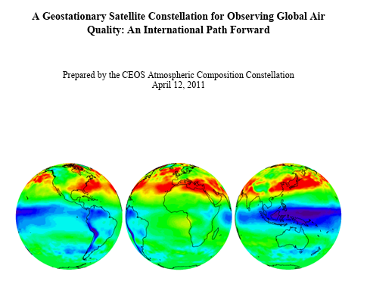
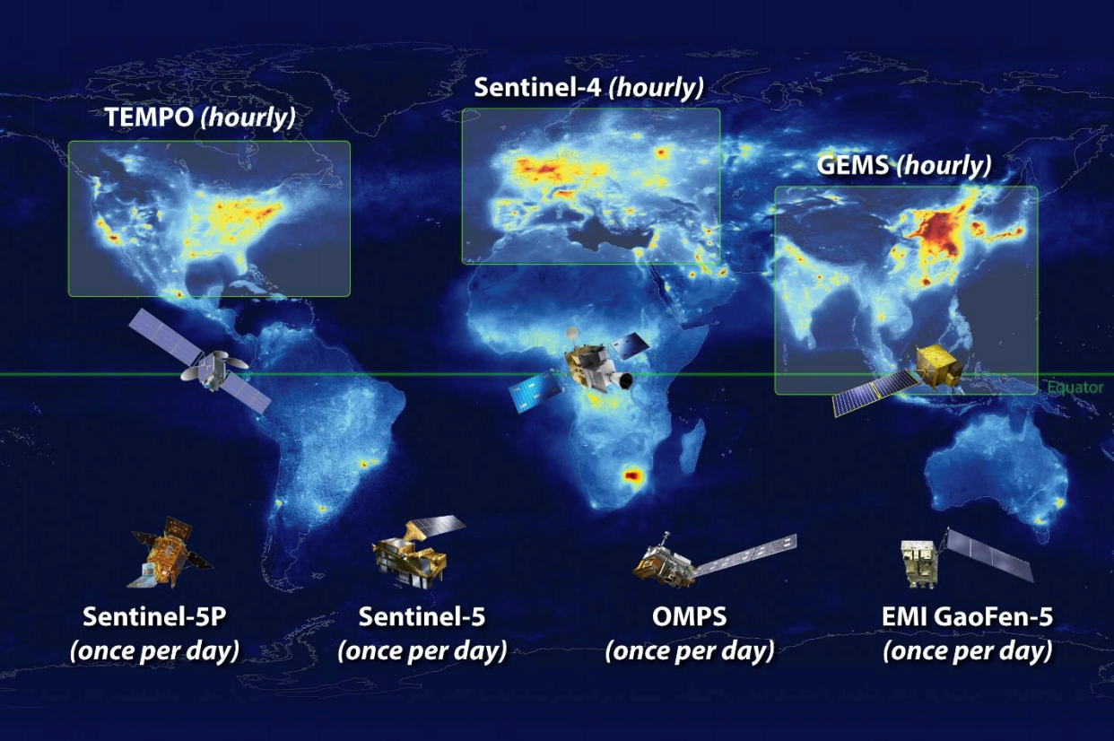
Geo Ring Synergy
While a single geostationary satellite can view only a portion of the globe, it is possible for a minimum of three geostationary satellites, positioned to view Europe/Middle East/Africa, Asia/Australasia, and the Americas, to collectively provide near-global coverage. Harmonizing the planned geostationary missions to be contemporaneous and have common observing capabilities and data distribution protocols would synergistically enable critically needed understanding of the interactions between regional and global atmospheric composition and of the implications for air quality and climate.
Having these missions in orbit during a common period of at least one year would allow a prototype demonstration of an integrated global observing system by capturing at least one complete annual cycle of hemispheric emissions and resultant initiation of intercontinental pollutant transport. Best efforts to cooperate on defining common requirements, capabilities, data products and validation activities will allow improved designs and data utilization of all sensors and allow cost savings by minimizing duplication of effort.

Slide 2
Harmonization of Data from GEO Sensors
Cross-calibrate the sensors at the Level 1B phase using one or two LEOs, combination of GEO/LEO
  Involves understanding each sensor performance
  Involves book-keeping of what is being done to the Level 1B radiances
Cross-calibrate the Level 2 products
  Need a reference (similar sensor in LEO) that is common to all three GEOs
  Highest level of confidence in one sensor and adjust other sensors accordingly
  Thorough validation of each sensor with ground-based reference network and bias correct each sensor accordingly
Vicarious calibration methods
  Targeted instruments on ground
  Deep Convective Clouds
  Bright desert surfaces
Let modelers handle bias correction approaches when assimilating the data

Slide 3
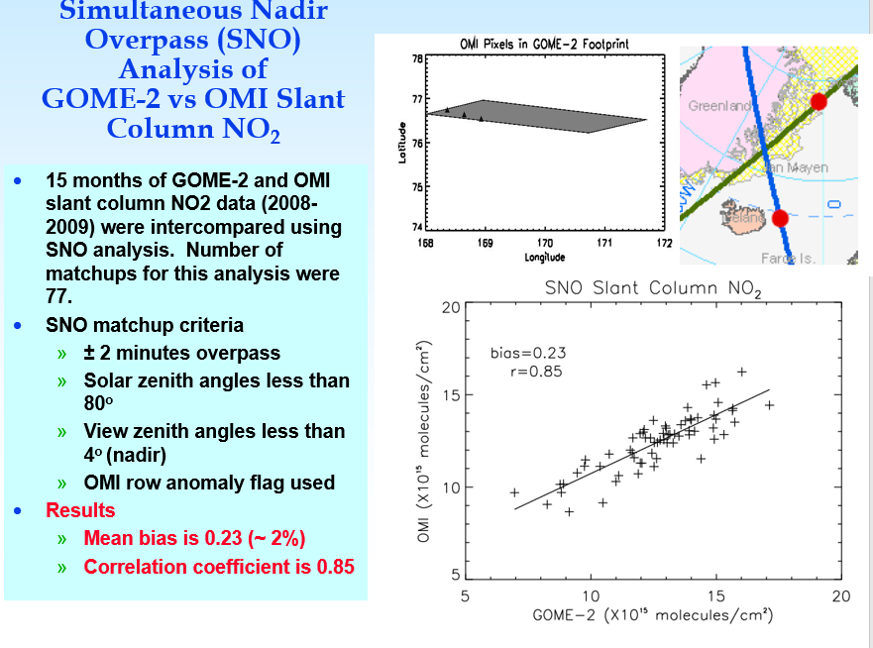
Before doing science applications with the data, we ran the same algorithm on both OMI and GOME-2 and compared the two NO₂ products

