Slide 1



Pandora MAX-DOAS profiling in support of TEMPO: updates from WRAVENS
Apoorva Pandey , Bryan Place, Jong-Uk Park, Glenn Wolfe, Thomas Hanisco
TEMPO DART Meeting 2026
Iowa City

Slide 2
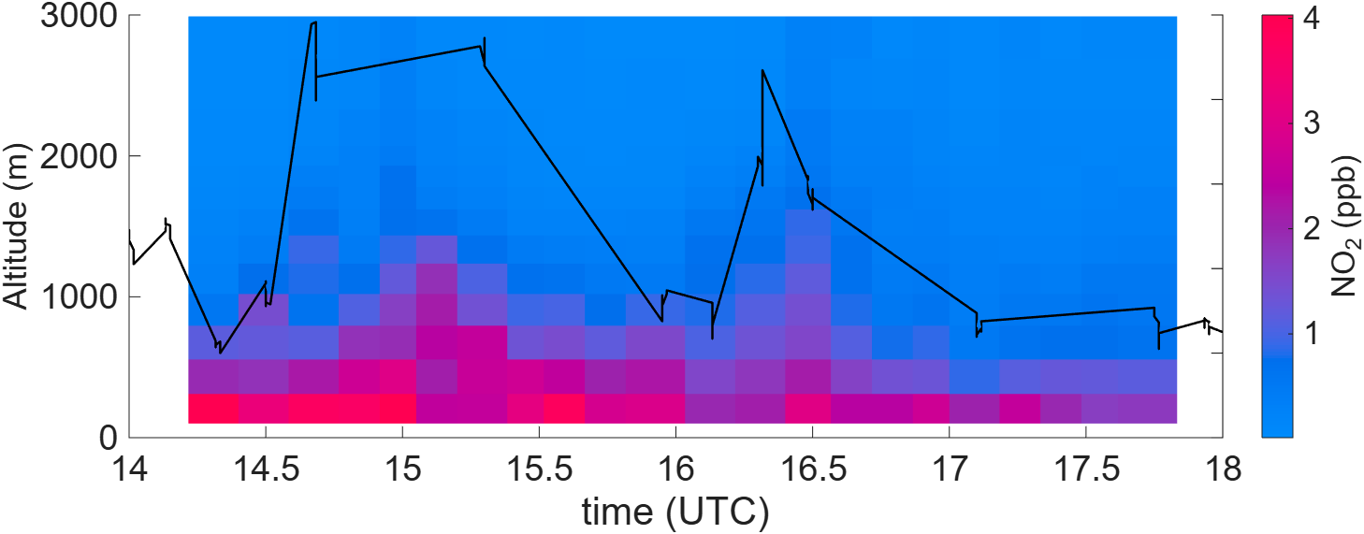
Pandora MAX-DOAS resolves vertical structure hidden in the column
Essex, MD Pandora# 75
2026/02/28
10
DS total column (right axis)
8
10¹⁵ molec./cm²
6
4
2
Profile shape determines AMF and affects retrieval accuracy
Vertical structure provides information on source attribution, transport, BL dynamics
Notes:
correct

Slide 3

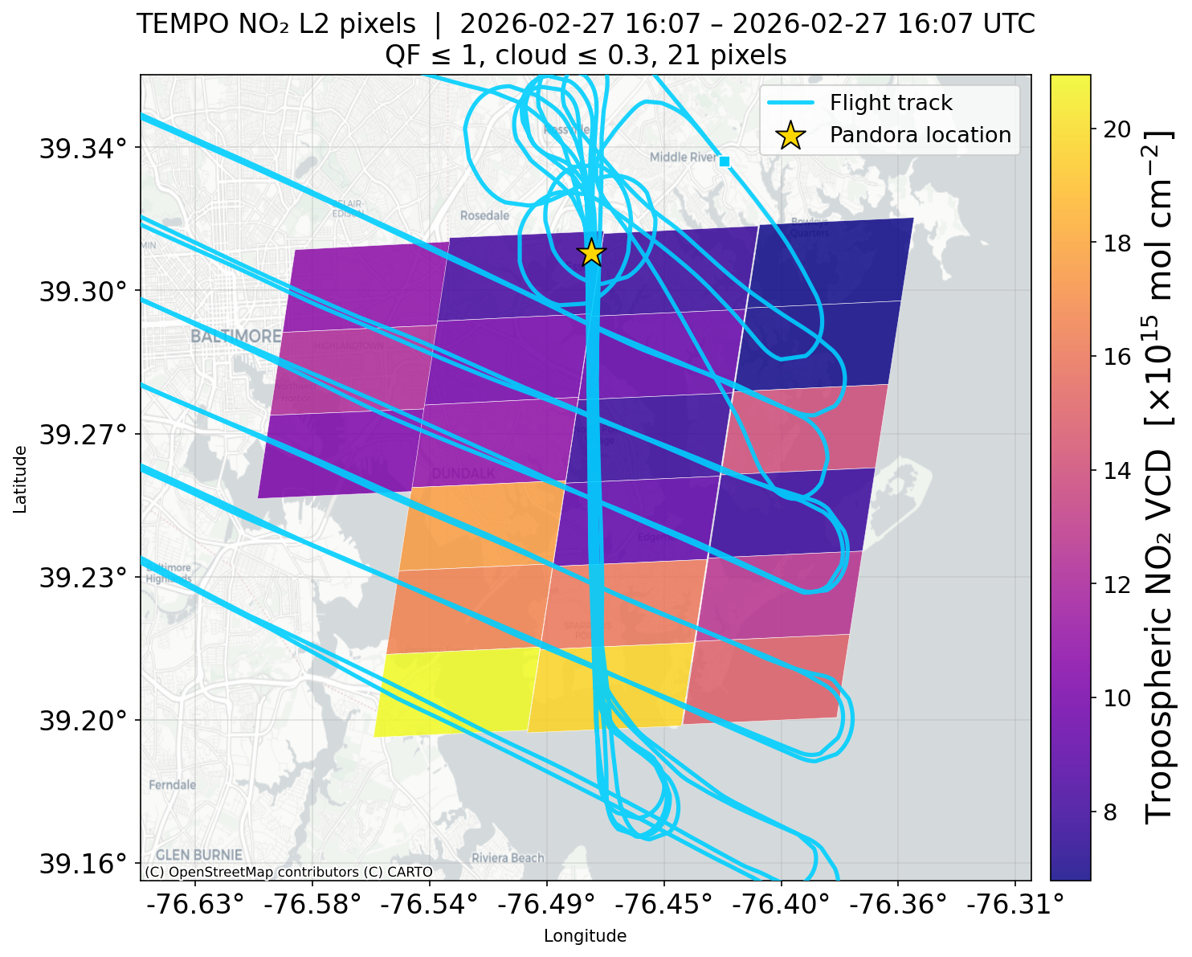
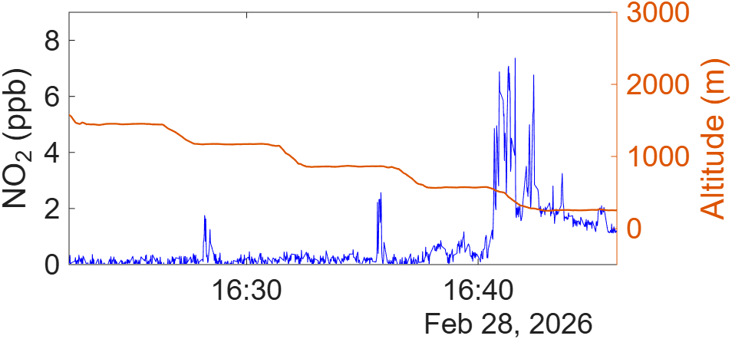
WRAVENS 2026: Essex MD, Feb 2026
Pandora + TEMPO+ aircraft
- What drives TEMPO-Pandora column differences?
- How do Pandora MAX-DOAS NO₂ profiles compare with airborne observations?
10 km
TEMPO filters: QF<=1 and cloud fraction < 0.2

Slide 4
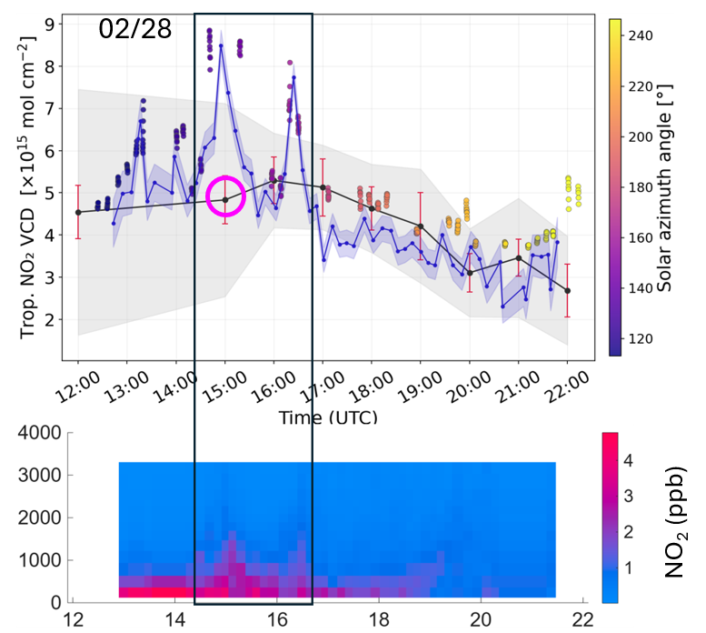
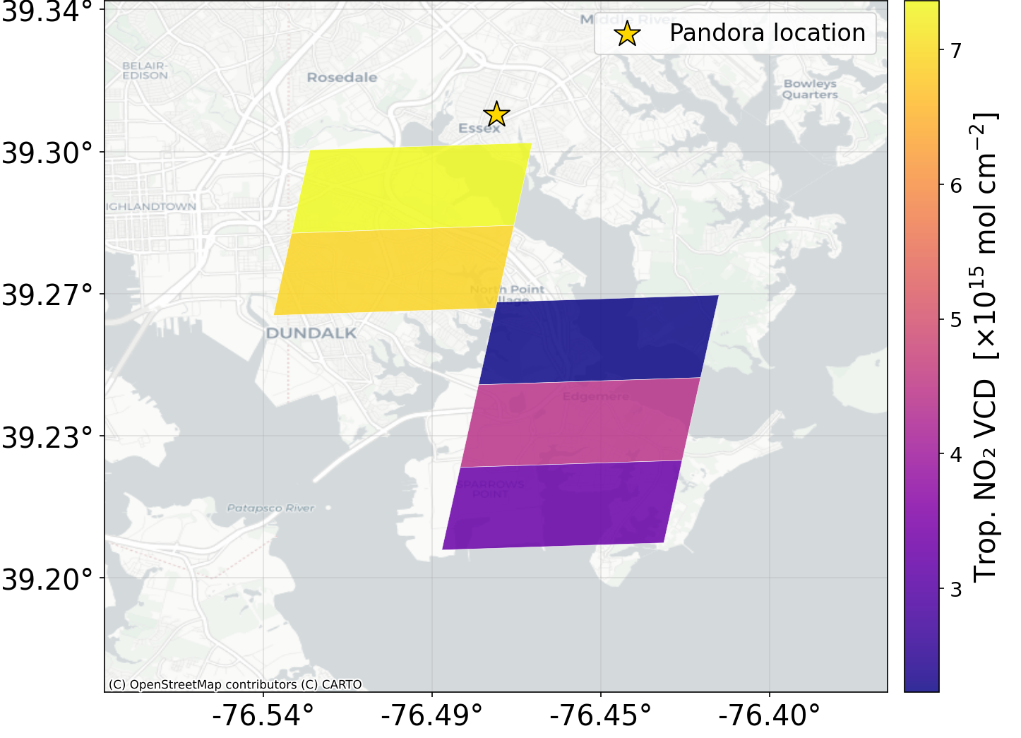
02/28: TEMPO sees lofted NO₂
Shading = inter-pixel variability
Pandora DS (circles)
TEMPO
Pandora MAX-DOAS
Pandora profiles
Winds confirm horizontally narrow elevated NO₂ layers, same time as TEMPO swath

Slide 5
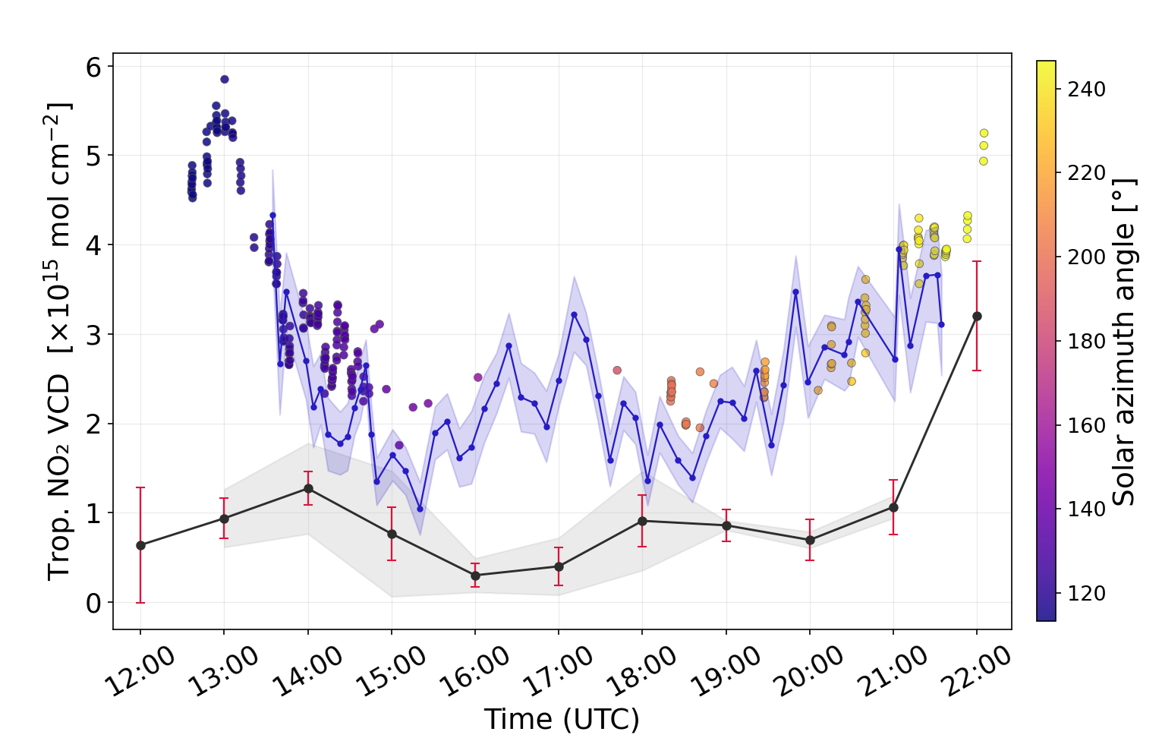

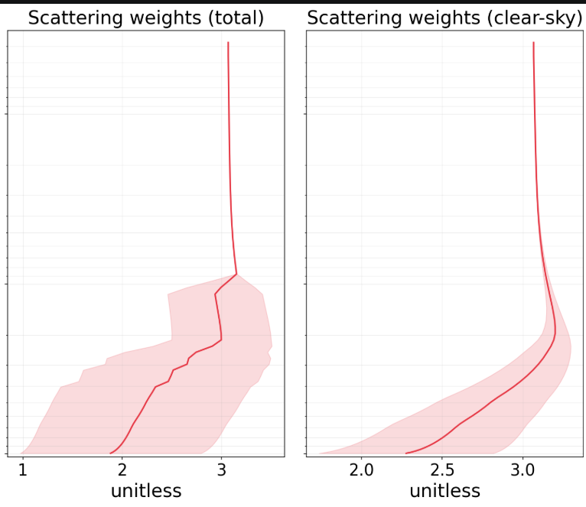

02/21: Undetected thin clouds bias TEMPO AMF
Even excluding high SZA, TEMPO is 2-6x lower than Pandora
Mean column difference = 1.5 x 10¹⁵
Scatter in Pandora DS diagnostics throughout the day points to thin clouds
But TEMPO cloud fractions ≤ 0.05
Scattering weights are too high: AMF is too high
Pandora DS (circles)
Pandora MAX-DOAS
Scattering weights
Clear sky
Cloudy sky
TEMPO: 02/21
TEMPO

Slide 6
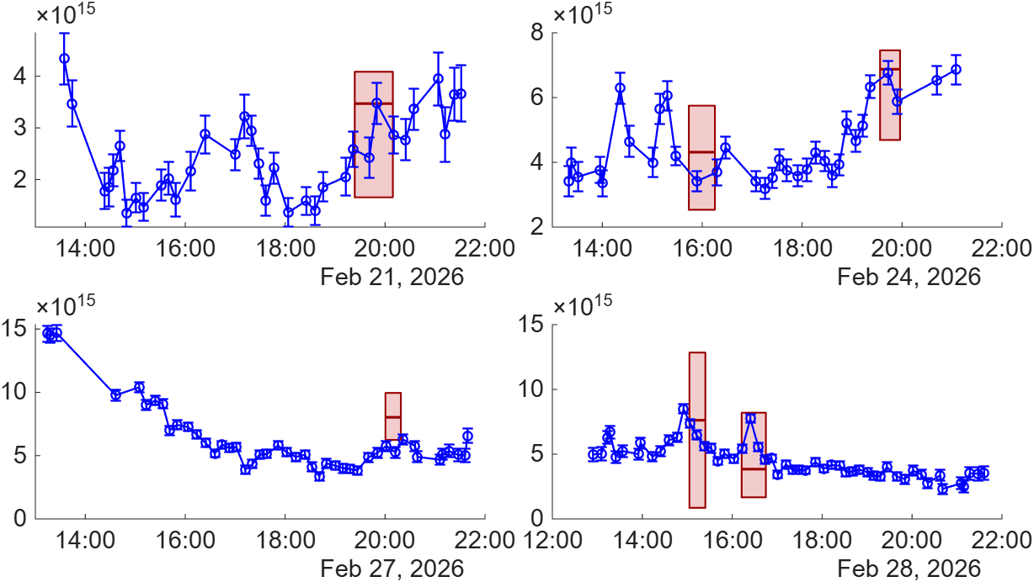
Aircraft vs. Pandora MAX-DOAS column: overview
Aircraft
Pandora
MAX-DOAS
NO₂ column (#/cm²)
Range = spatial variability + surface extrapolation uncertainty

Slide 7
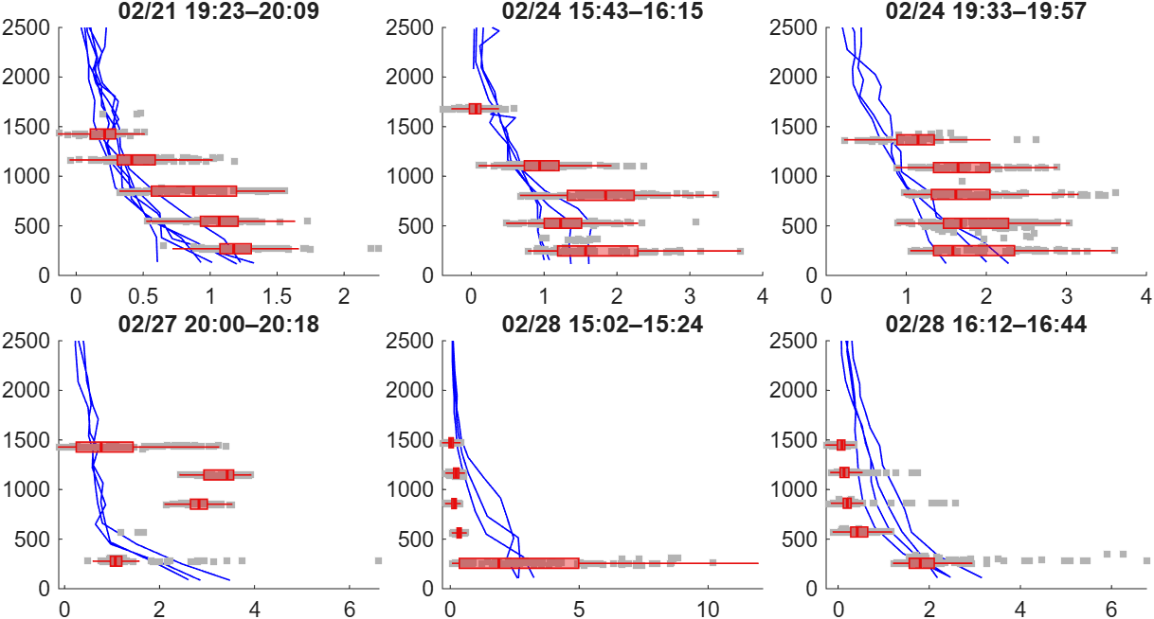
Aircraft vs. Pandora profiles: mostly consistent, one informative exception
Pandora
Aircraft
Altitude (m)
NO₂ mixing ratio (ppb)

Slide 8
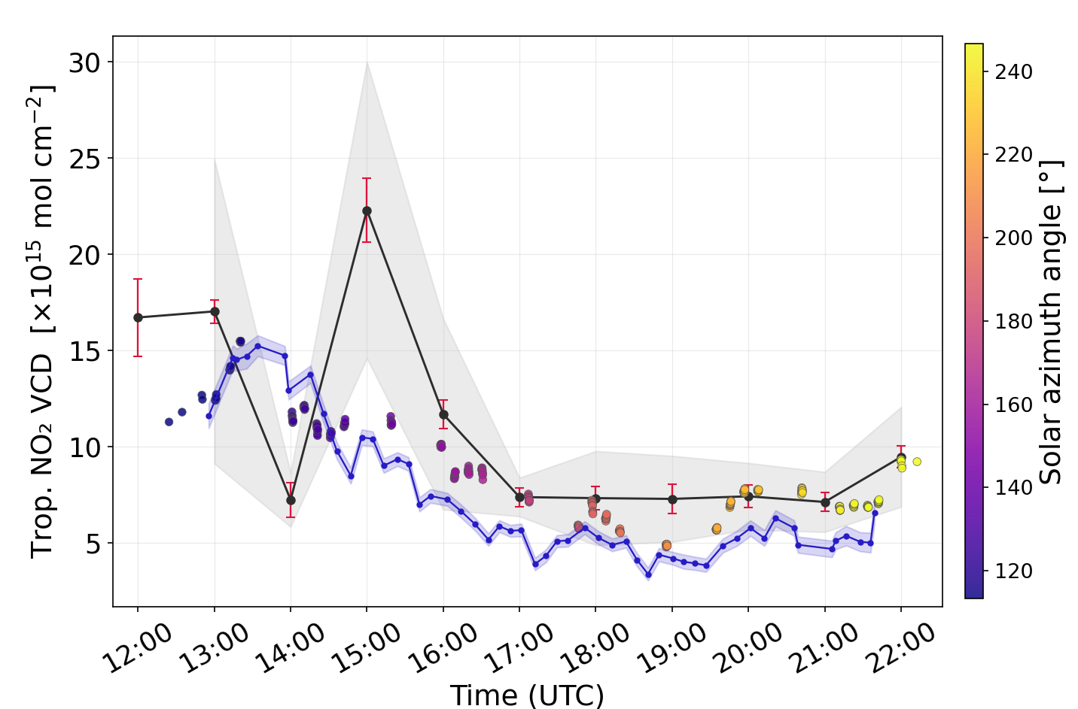
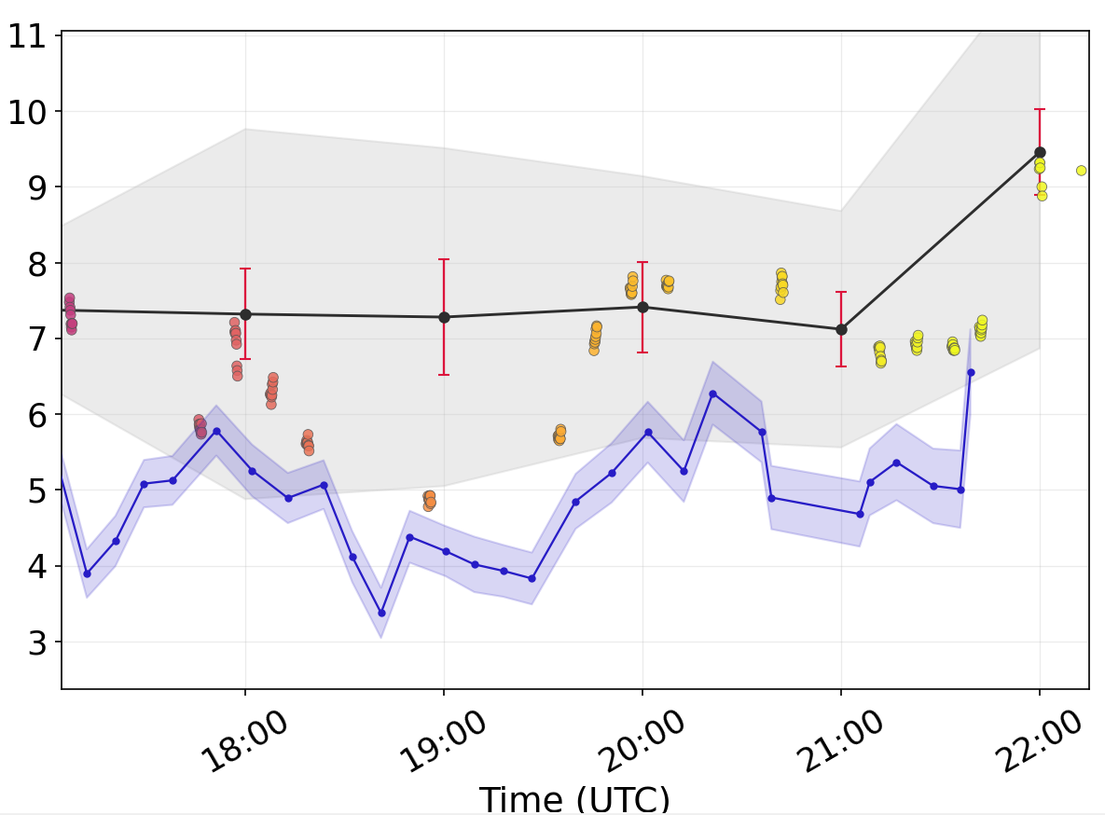
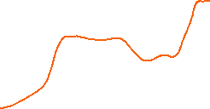

02/27: aircraft > TEMPO ≈DS> MAX DOAS
TEMPO morning variability highly sensitive to clouds
DS looking towards downtown Baltimore
TEMPO
Pandora DS
(circles)
Pandora
MAX-DOAS
TEMPO morning behavior improves with stricter cloud filtering (cloud fraction < 0.1)
Around the aircraft sampling: Pandora MAX-DOAS column is almost flat
  DS column increases more but it’s looking towards Baltimore core
  TEMPO inter-pixel spread spans Pandora and aircraft column range, but doesn’t register a plume

Slide 9
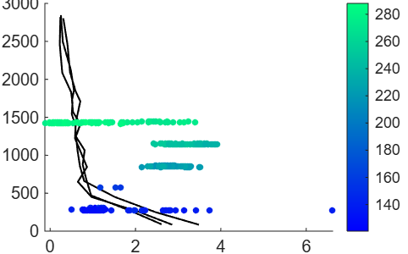
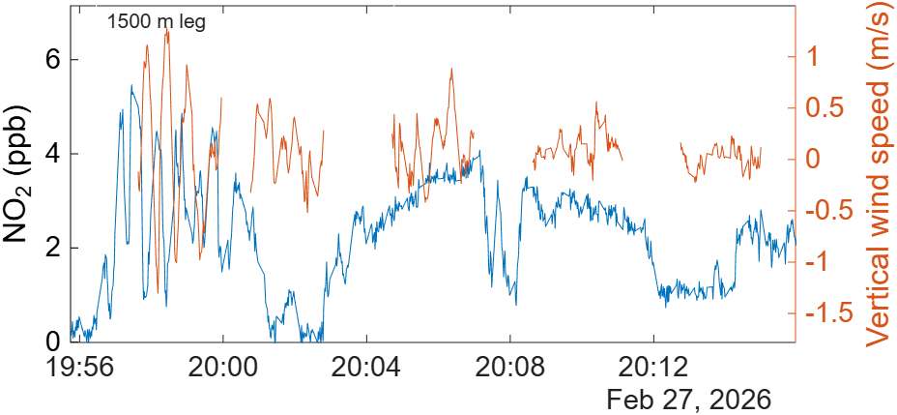

02/27 aircraft-MAX DOAS mismatch
Strong directional shear
distinct air mass origins
Pandora
active transport dynamics
Altitude (m)
Wind direction (deg.)
Winds from Baltimore
NO₂ mixing ratio (ppb)
Aircraft likely encountered a dynamic (and small-scale?) situation – does not correspond to the average atmospheric state seen by a remote sensing instrument
Need more targeted validation experiments!

