Slide 1
TOLNet Overview
Network highlights and roadmap
Fernando Chouza¹, Thierry Leblanc¹, Maurice Roots^{2,12}, Michael J. Newchurch³, John Burden³, Daniel Phoenix^{4,5}, Guillaume Gronoff^{4,5}, Raul J. Alvarez II⁶, Sunil Baidar^{6,7}, Fred Moshary⁸, Yonghua Wu⁸, Matthew S., Johnson⁹, Claudia Bernier⁹, Ruben Delgado¹⁰, Jia Su¹⁰, Laurence Twigg^{2,11}, Michael Shook⁴, Crystal Gummo^{4,13}, Gao Chen⁴, John Sullivan¹⁴, Emma Knowland¹⁴
¹Jet Propulsion Laboratory, California Institute of Technology, Wrightwood, CA, USA, ²Atmospheric Chemistry and Dynamics Laboratory, NASA Goddard Space Flight Center (GSFC), Greenbelt, MD 20771, USA, ³Atmospheric and Earth Science Department University of Alabama in Huntsville, Huntsville, Alabama, USA, ⁴NASA Langley Research Center, Hampton, Virginia, USA ⁵Science Systems and Applications Inc., Lanham, Maryland, USA, ⁶NOAA Chemical Sciences Laboratory, Boulder, Colorado, USA ⁷Cooperative Institute for Research in Environmental Sciences, University of Colorado, Boulder, Colorado, USA ⁸NOAA Cooperative Center for Earth System Sciences and Remote Sensing Technologies, City College of New York, New York, NY, USA ⁹Earth Science Division, NASA Ames Research Center, Moffett Field, CA, USA, ¹⁰Hampton University, Hampton, VA, USA, ¹¹Goddard Earth Sciences Technology and Research (GESTAR-II), University of Maryland, Baltimore, ¹²NASA Postdoctoral Program (NPP), Columbia, MD, USA, ¹³ADNet Systems, Bethesda, MD, USA, ¹⁴NASA HQ, MD, USA
© 2026 California Institute of Technology. Government sponsorship acknowledged.

Slide 2
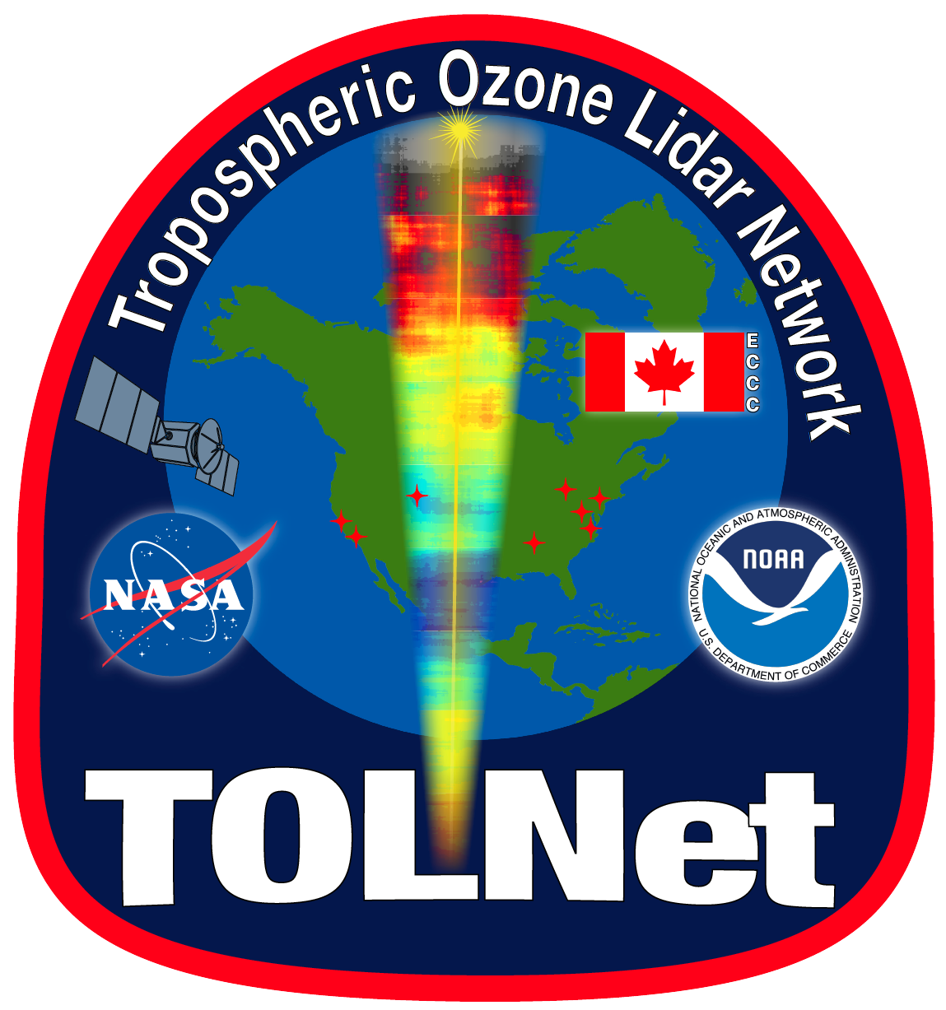
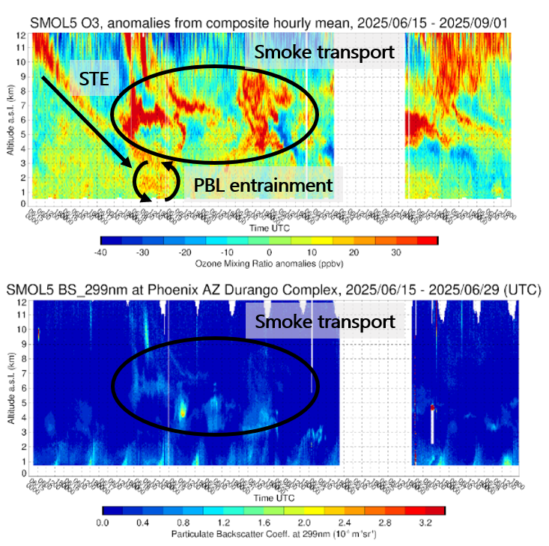
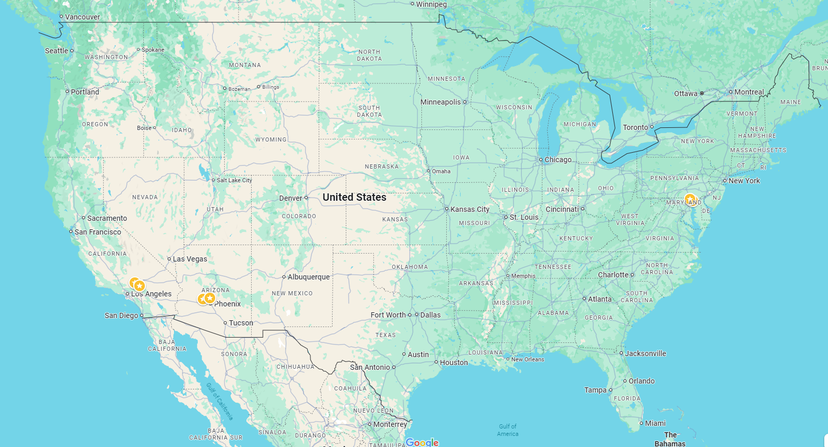



The Tropospheric Ozone Lidar Network (TOLNet)
Observe high resolution PBL O3
Evaluate air-quality forecast and chemical transport models
Study the atmospheric structure for evaluation of current and future satellites
Network map
CCNY
NOAA
UMBC
NASA GSFC
NASA ARC
NASA LaRC
Hampton U.
TMF
CSUSB
Buckeye
Durango
UAH
UH

Slide 3

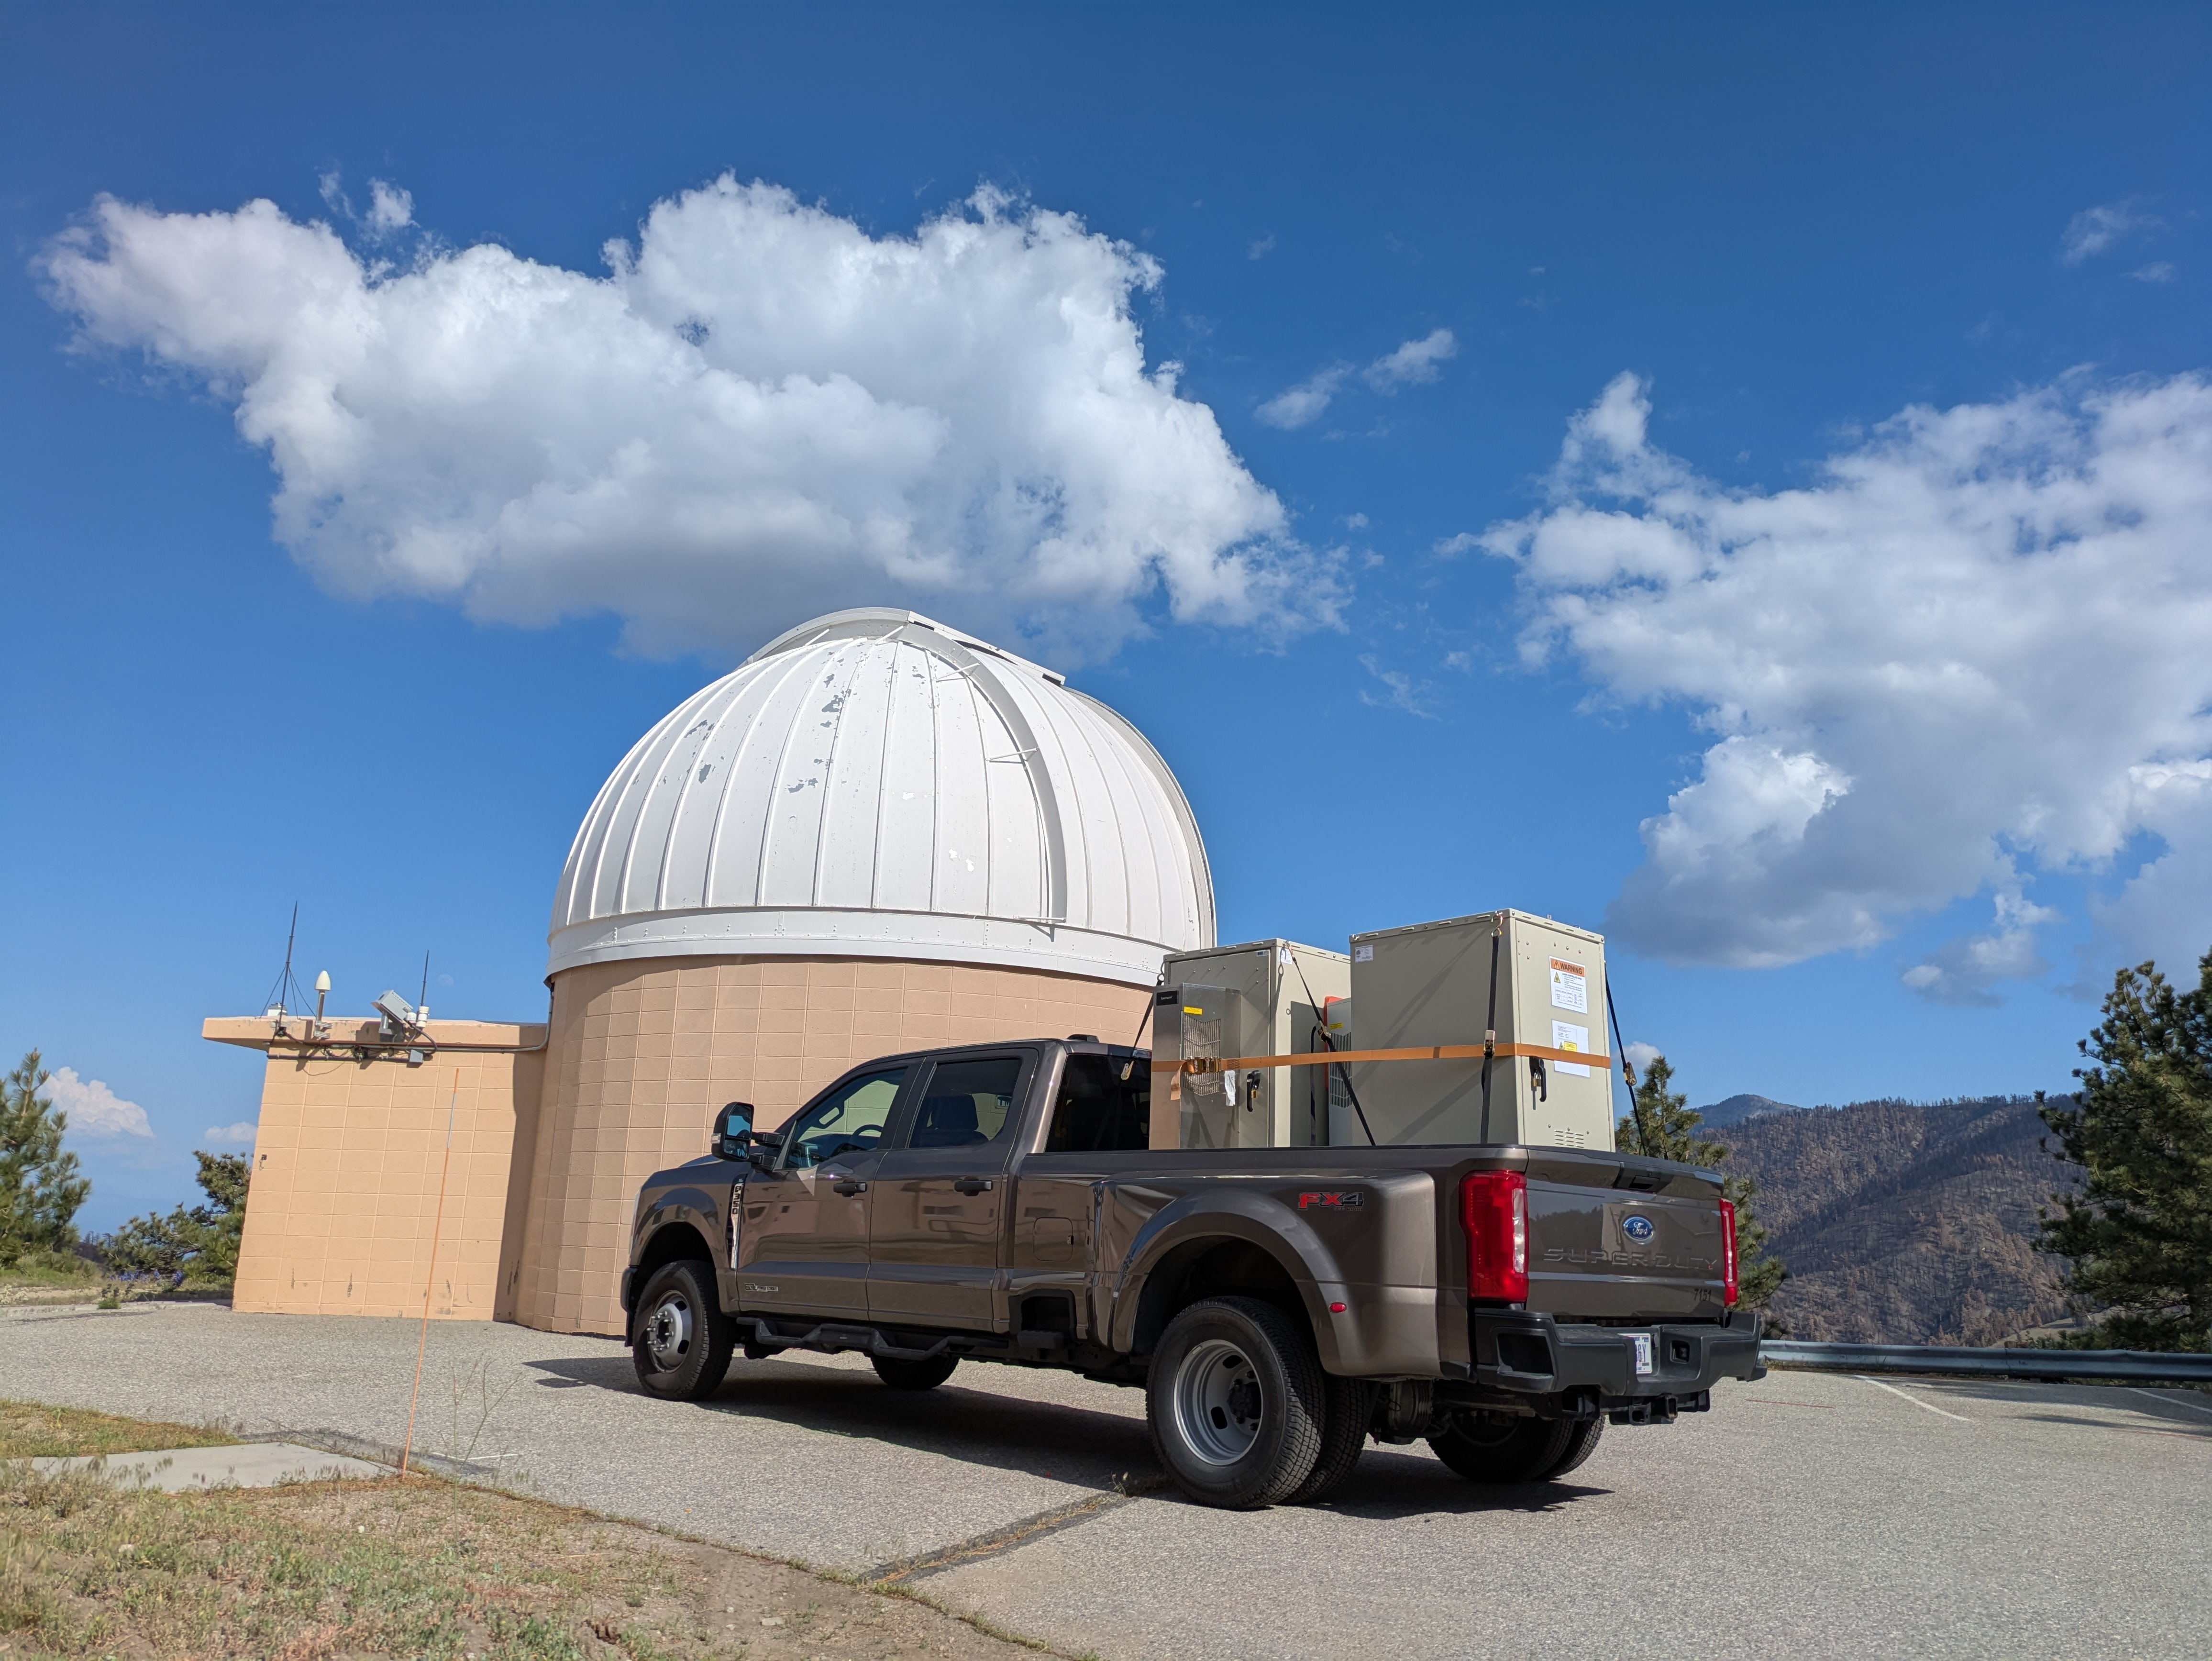
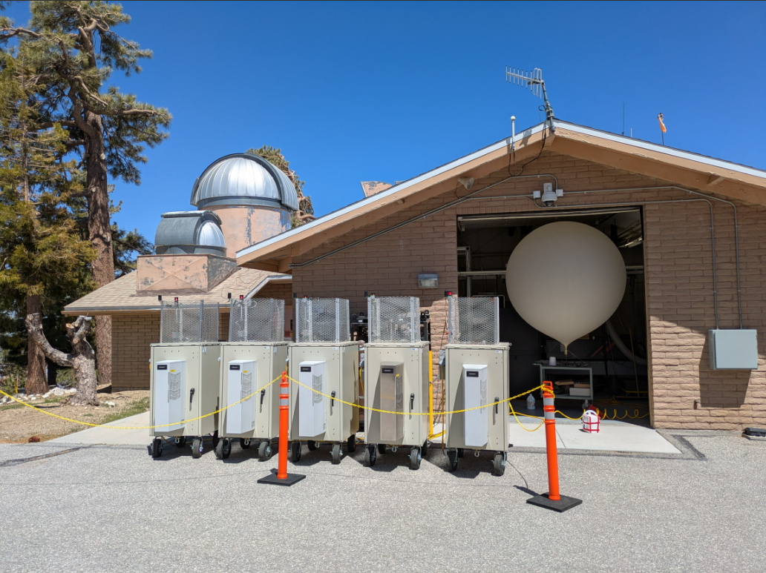
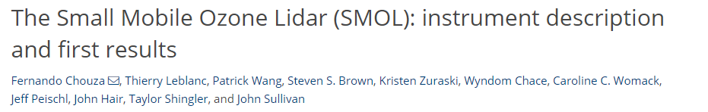
The SMOL: Standardized hardware
Robust and Field-Tested: reliability has been proven through continuous operation during intensive remote deployment campaigns (national and international deployments).
Low-Cost Architecture: Standardizing around commercially available hardware drastically reduces network-wide component and maintenance expenses.
Fully Autonomous: Automated control systems allow for continuous, unattended operation.

Slide 4



GLASS: Standardized processing
Centralized
Near-real-time
Aerosol retrieval
Raw network data is now automatically uploaded directly to a centralized server at NASA LaRC.
The GLASS processor is fully installed locally, enabling automated data ingestion.
Leveraging this centralized infrastructure, GLASS now executes automated NRT processing.
Raw data is transformed into atmospheric profiles with a latency of just 30 minutes.
An experimental aerosol backscatter product is currently undergoing validation.
This algorithm will soon be integrated directly into the standard TOLNet dataset.

Slide 5
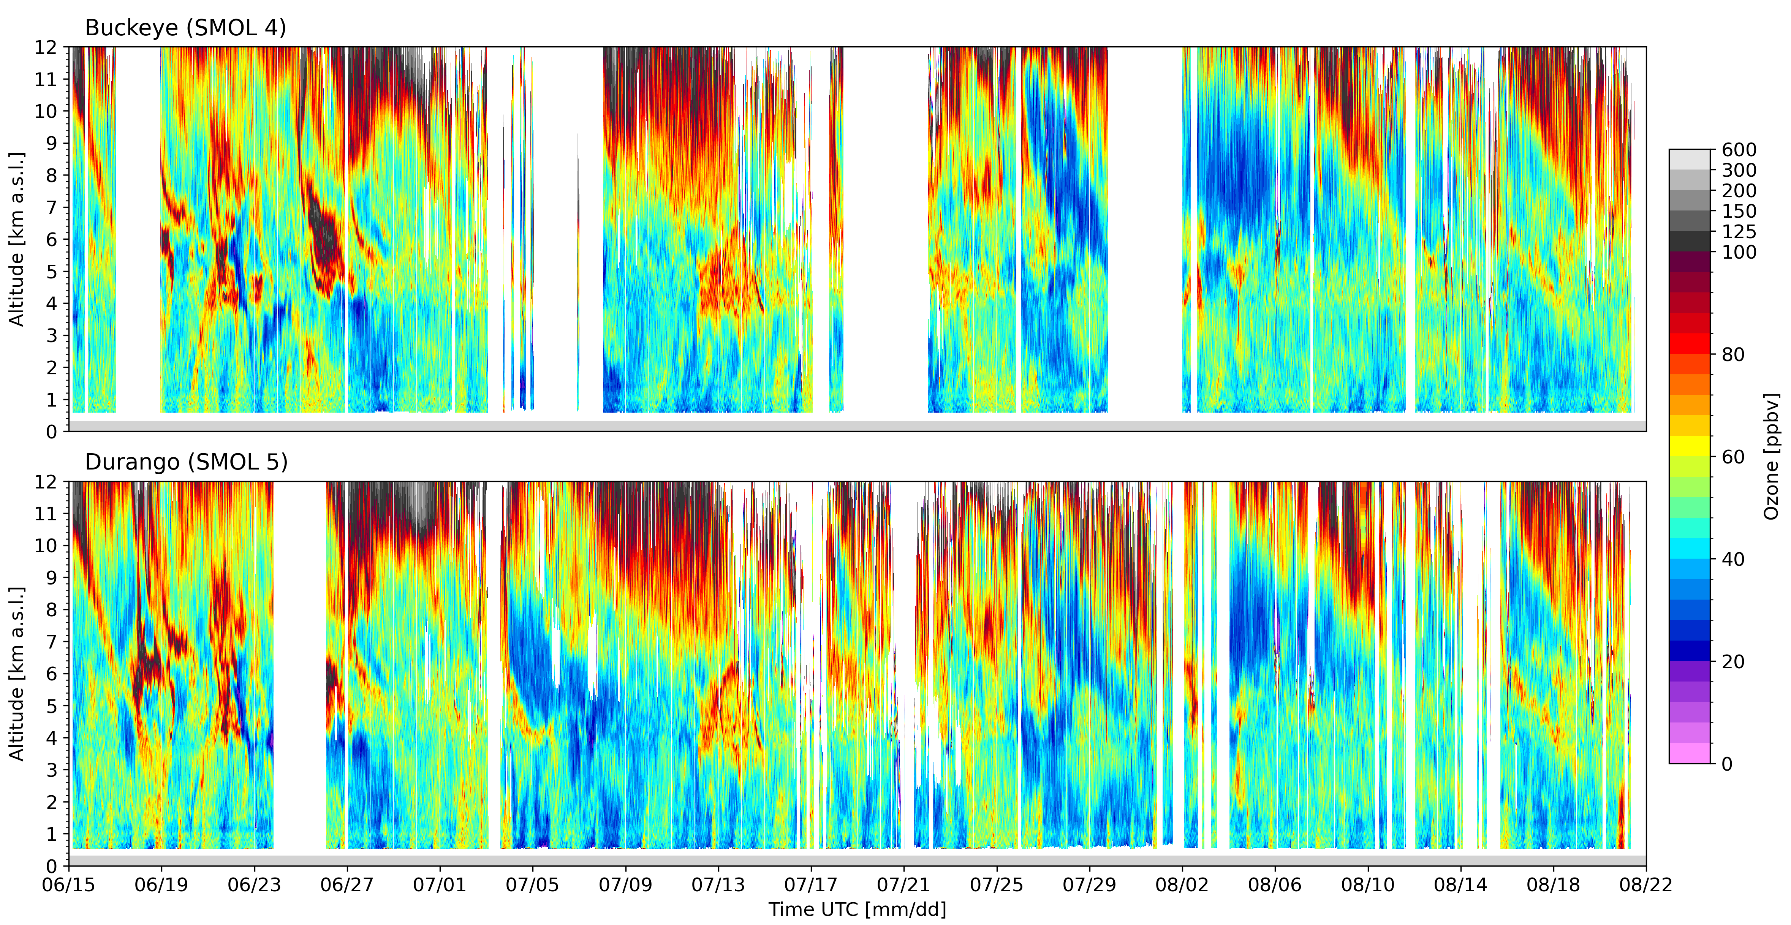
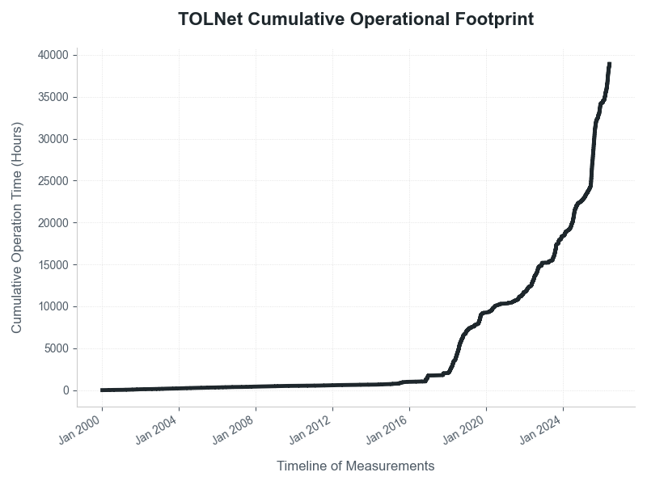
The benefits of standardization
Maximized Uptime: Adopting the SMOL system substantially increased operational time.
Cost Efficiency: Homogenizing hardware significantly reduced operational costs.
Data Reliability: Standardizing processing protocols ensured consistent and reliable data output.

Slide 6
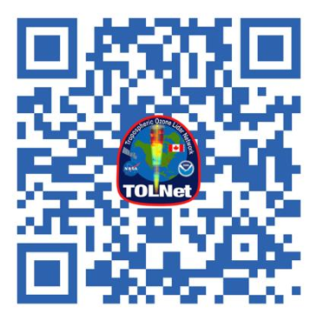
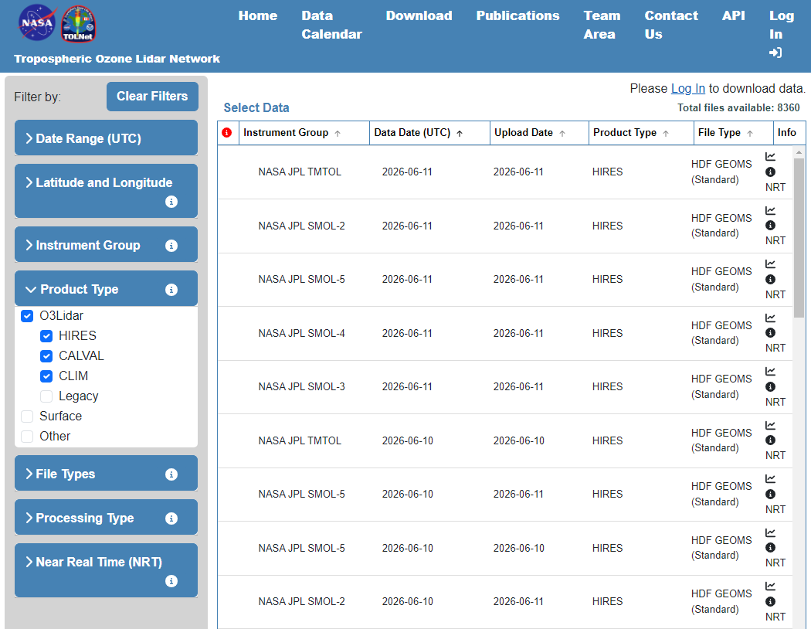
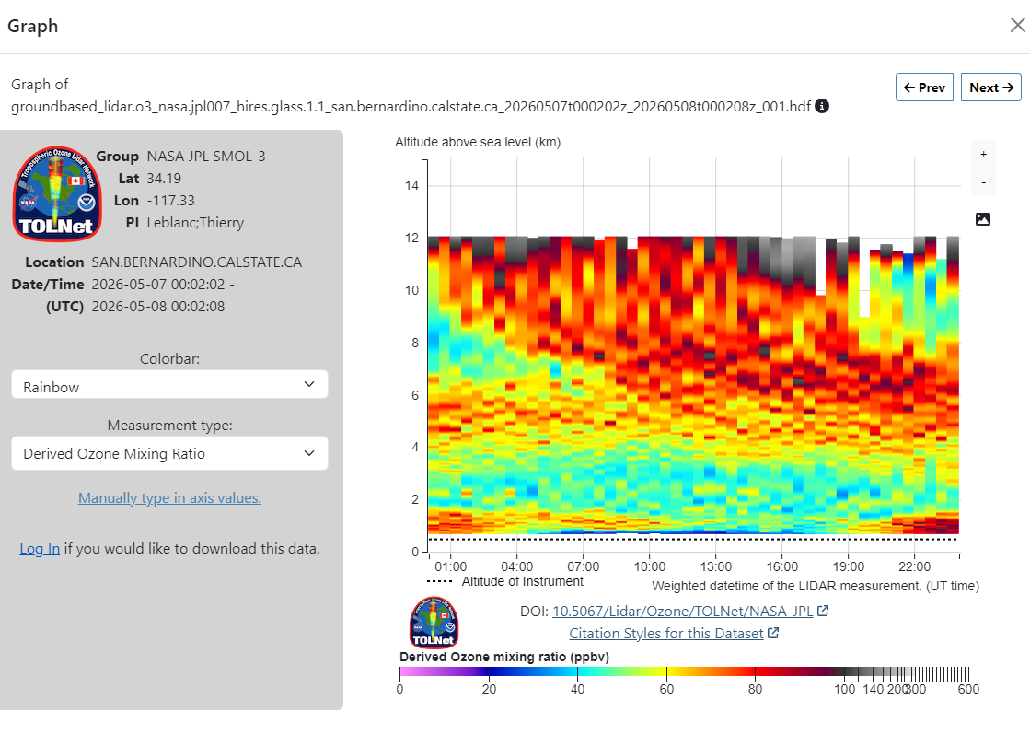
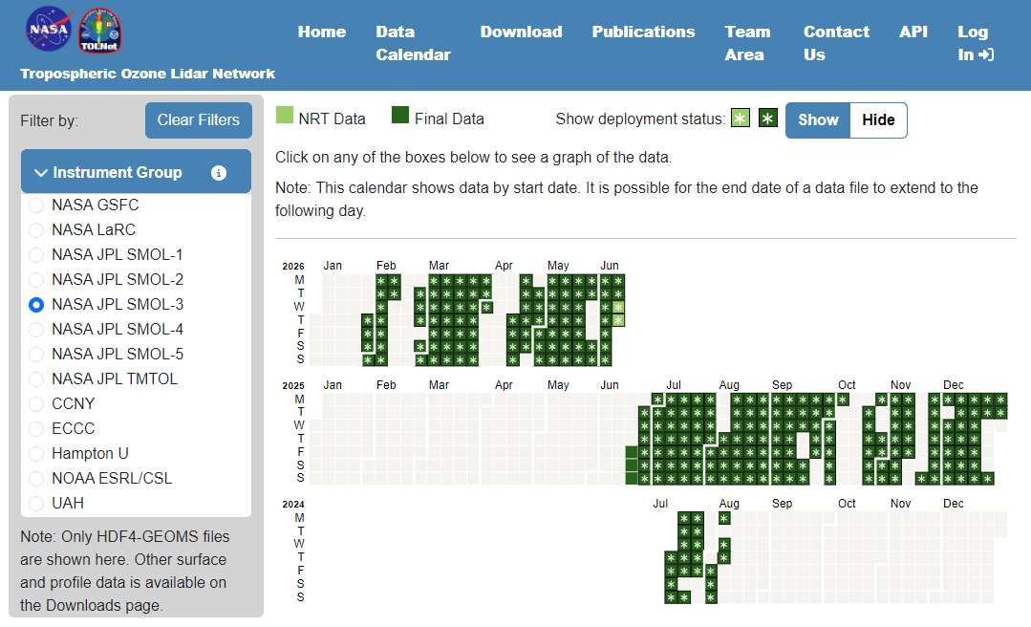
Data access and storage
Centralized raw data archive
Searchable results based on temporal and geolocation criteria
Rapid NRT and QC’ed data visualization
tolnet.larc.nasa.gov
Searchable
Calendar view
NRT display

Slide 7
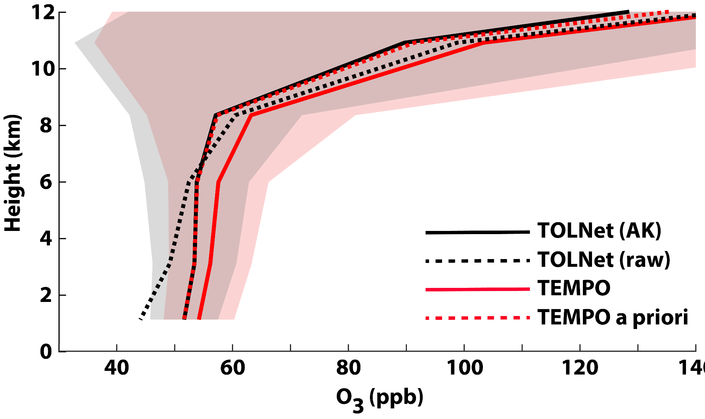
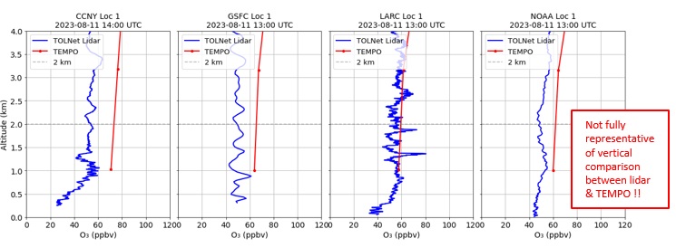
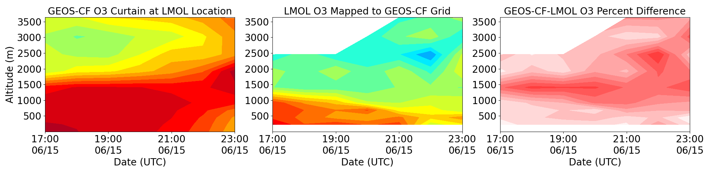
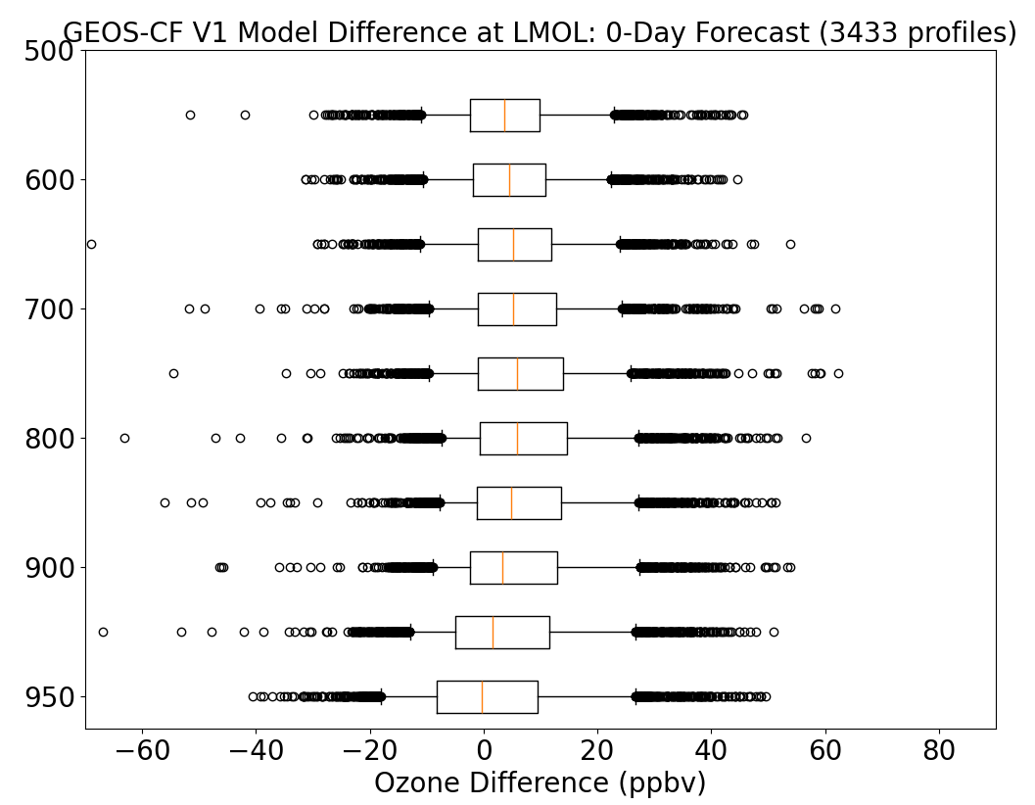
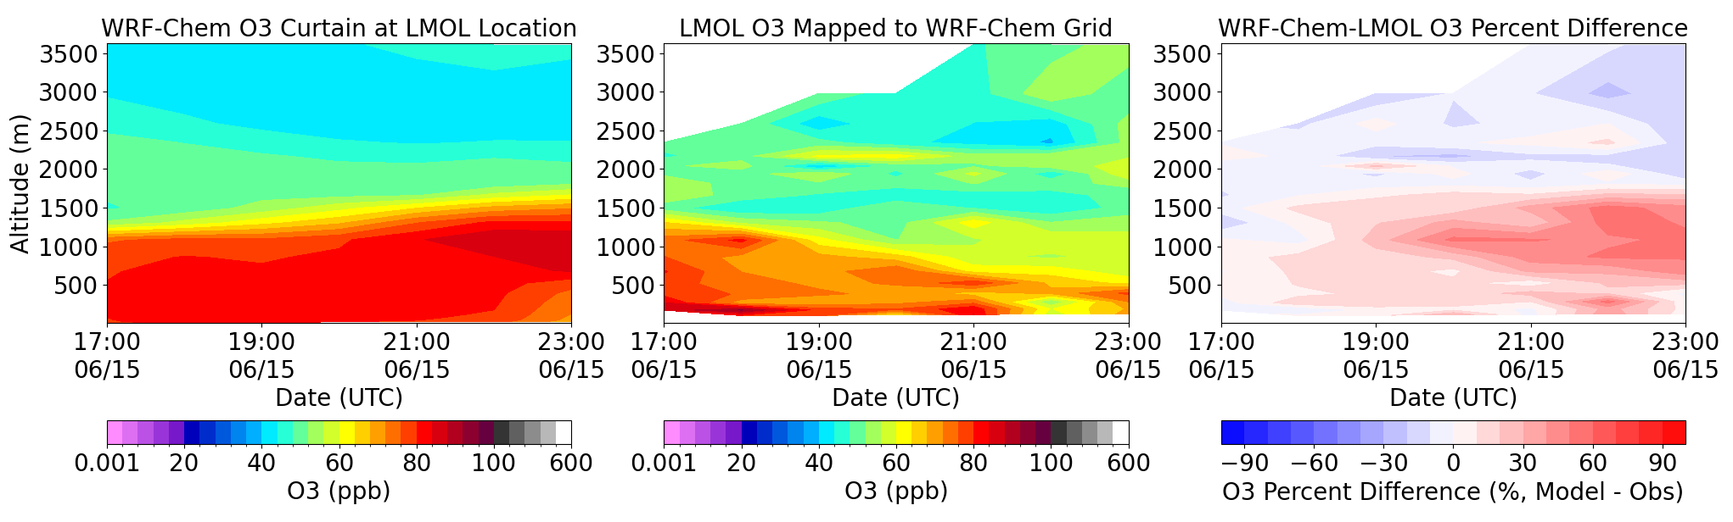
Some highlights (I)
TEMPO validation
Johnson et al.: in preparation
Bernier et al.: in preparation
Model evaluation
Phoenix et al.: in preparation

Slide 8
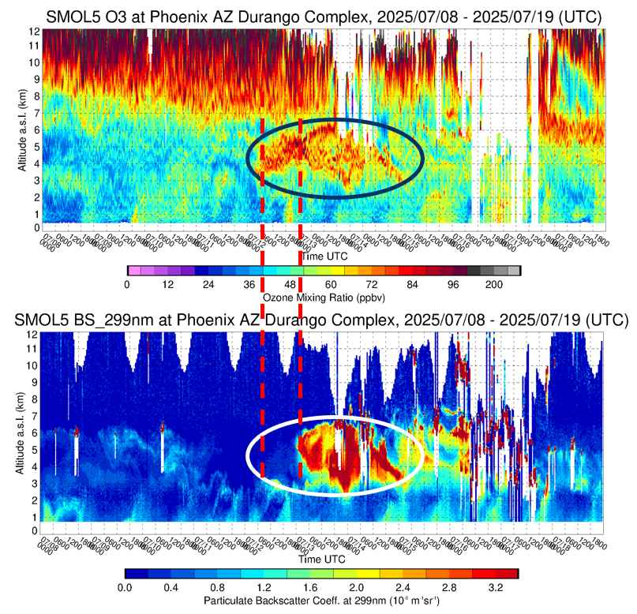
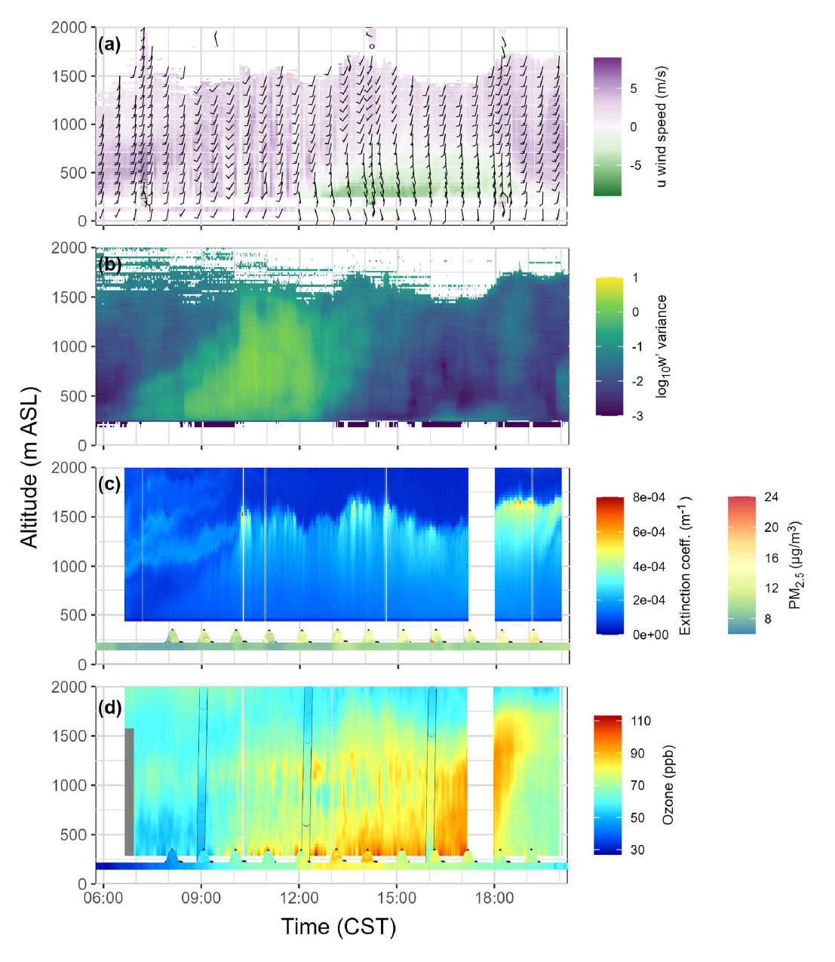
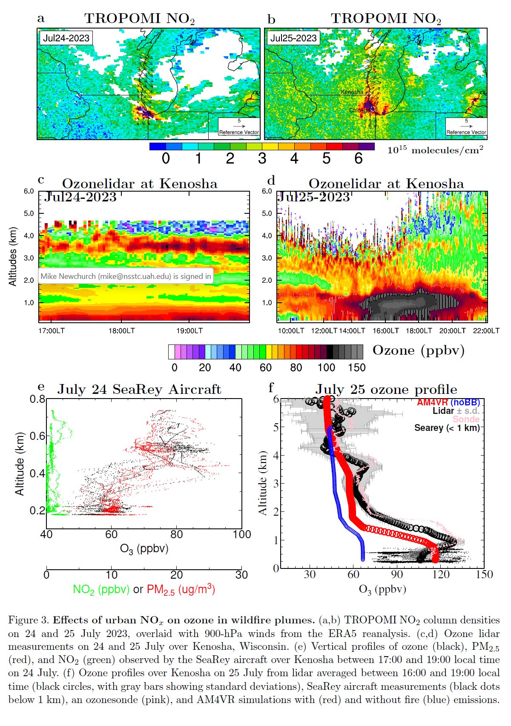
Some highlights (II)
Process studies
Leblanc et al.: in preparation, 2026
Dickens et al, submitted to JGR Atmospheres, 2026
Lin et al., submitted to Science Advances, 2026

Slide 9
TOLNet presentations
Johnson et al.: TEMPO Ozone Profile Validation in the Troposphere using TOLNet → Right after this talk!
Newchurch et al.: Validation of TEMPO O3 profile and NO2 column with TOLNet/RO3QET and SeaRey measurements → Tuesday, 11:20 LT
Leblanc et al.: Combining SMOL lidar and GEOS-CF Model Results to Investigate Elevated Ozone Events in the Southwest United States → Wednesday, 2:40 PM LT
TOLNet posters
Bernier et al.: Surface Characterization of 0-2 km Ozone Subcolumns across Urban Environments during STAQS → Poster #2
Phoenix et al.: GEOS-CF Forecast Evaluation Using TOLNet Ozone Profiles → Poster #16
Roots et al.: Multi-Source Observations for Understanding Pollution Distribution → Poster #22
Wu et al.: Comparisons of the TEMPO Ozone Profile Product with Ground-Based Ozone Lidar and Applications to Air Quality Studies over New York → Poster #24

Slide 10

SMOL deployment request form
CCNY
UMBC
NASA GSFC
NASA ARC
NOAA
NASA LaRC
Hampton U.
TMF
CSUSB
Buckeye
Durango
UAH
UH

