Slide 1




Cross-Satellite Comparison of TEMPO v04 NO₂ and HCHO Products
Madankui Tao (Tao-ma)¹
Qindan Zhu¹
Caroline Nowland¹
Gonzalo Gonzalez Abad¹
¹The Center for Astrophysics | Harvard & Smithsonian, Cambridge, MA, USA.
Image generated using AI
Notes:
10-min talk from 4:50-5:00 PM LT

Slide 2
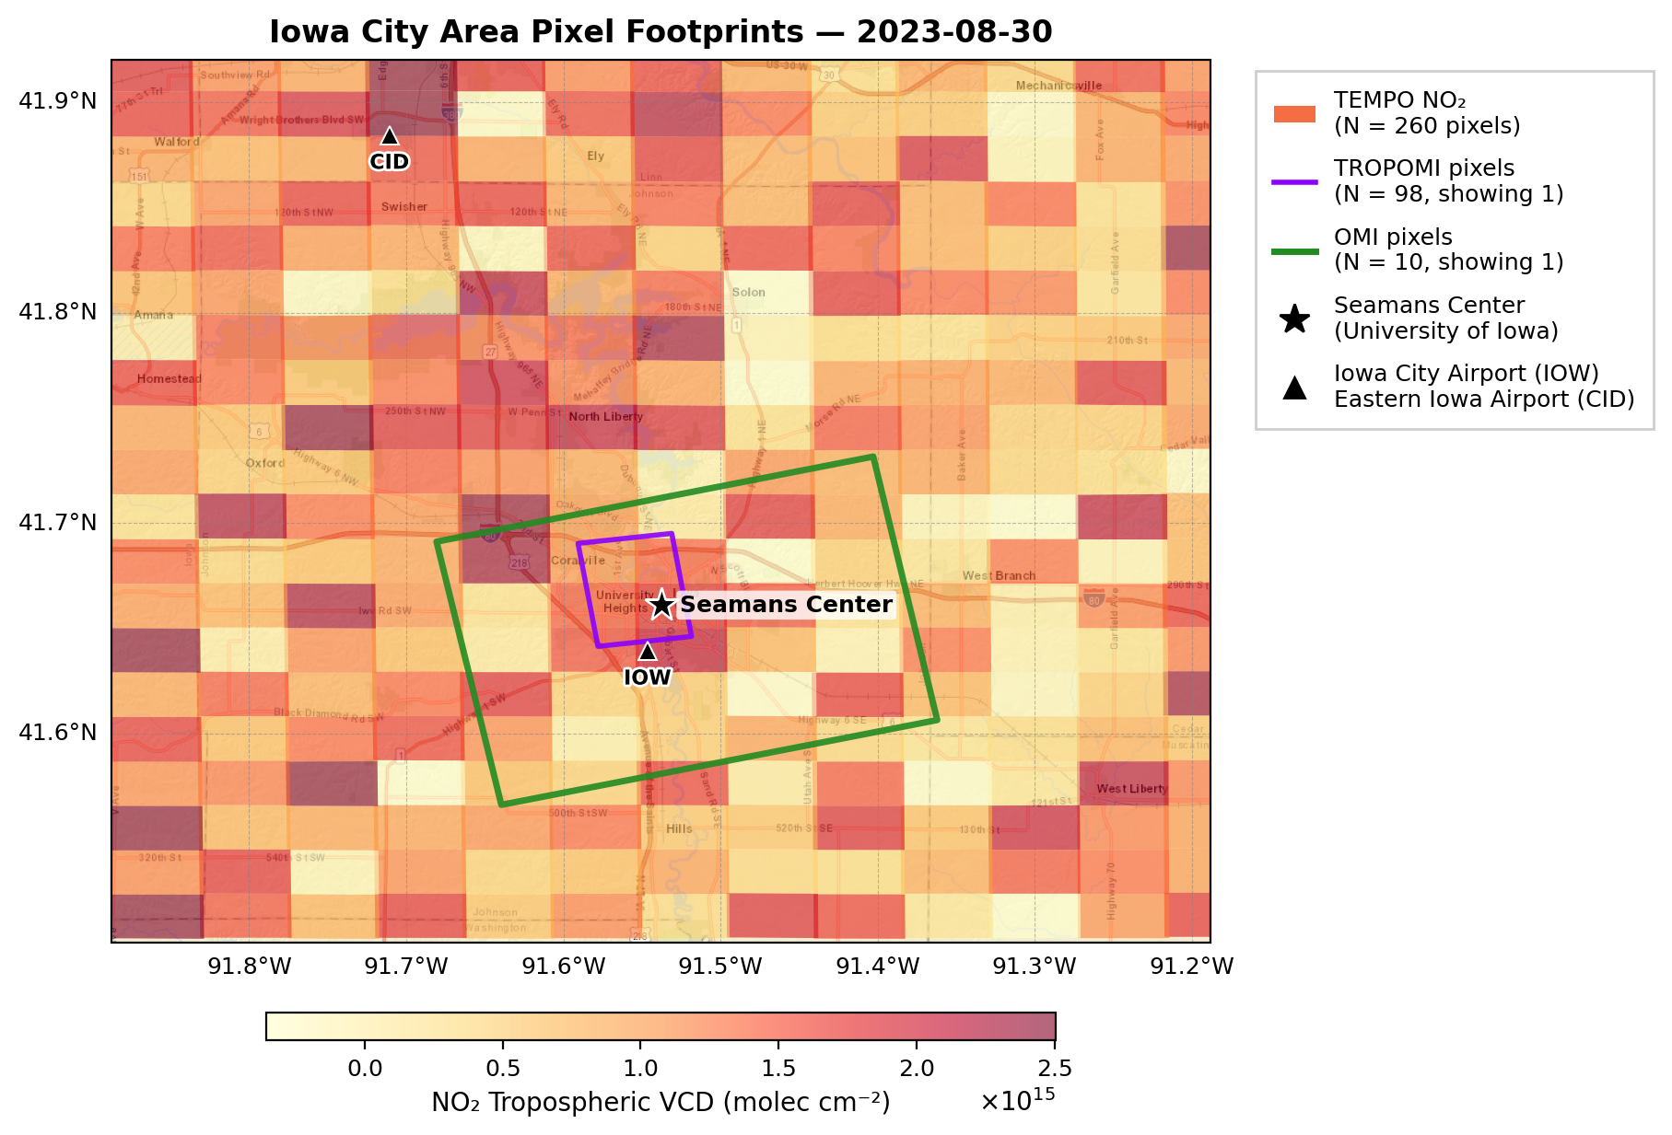
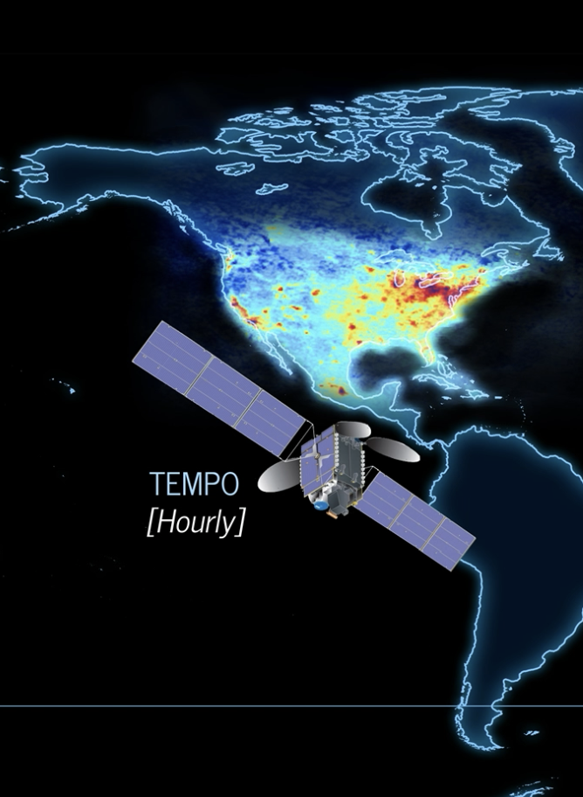







What new information does TEMPO provide? Insights from cross-satellite comparison
GEO
2 × 4.75 km²
(center of FOR)
1. How consistent are TEMPO NO₂ and HCHO columns with TROPOMI and OMI?
2. How well do these instruments capture localized pollution gradients?
NASA/SAO-CfA
?
LEO
ESA/KNMI
NASA/KNMI-FMI
HCHO
3.5 × 5.5 km² 13 × 24 km²
(nadir) (nadir)
Mission reference
TEMPO: Chance et al., 2019
TROPOMI: Veefkind et al., 2012
OMI: Levelt et al., 2018

Slide 3
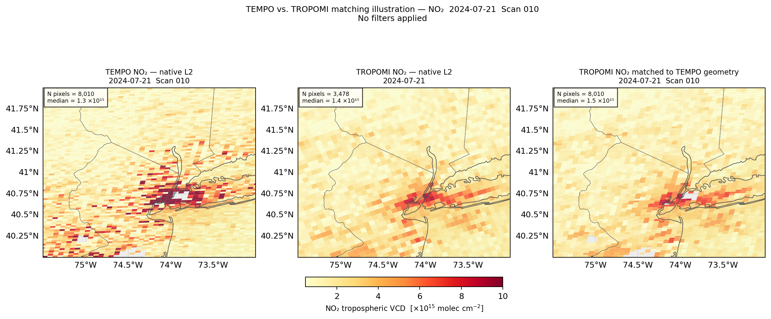
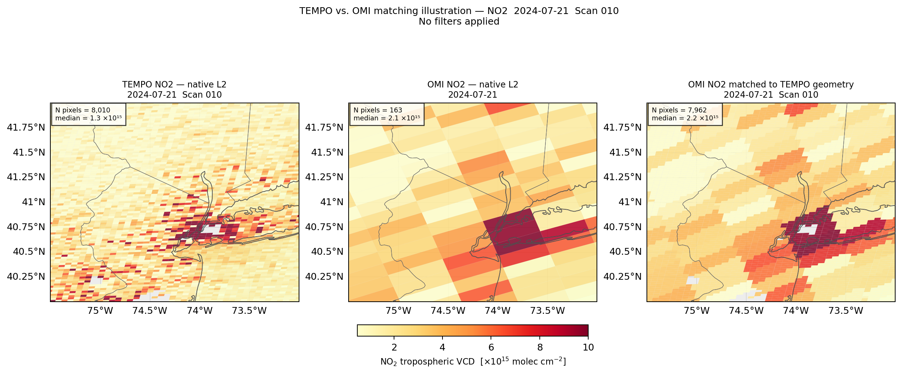
How do we match TROPOMI and OMI to TEMPO?
1. Level-2 Pixel Matching
|Δt| <30 min
Pixel center distance <5 km for TROPOMI or <30 km for OMI.
2. Data Filtering
TEMPO
  Main quality flag = 0;
  Cloud fraction <0.1;
  Solar zenith angle (SZA) <70°.
TROPOMI
  Quality assurance > 0.75;
  SZA <70°.
OMI
  Main quality flag = 0;
  Cloud fraction <0.3 (NO₂)/ 0.4 (HCHO);
  SZA <70°.
TROPOMI OFFL v2
TROPOMI NO₂
TROPOMI NO₂ matched to TEMPO
TEMPO v04 Level-2 NO₂
2024-07-21 Scan 010
OMI v004
OMI NO₂
OMI NO₂ matched to TEMPO

Slide 4
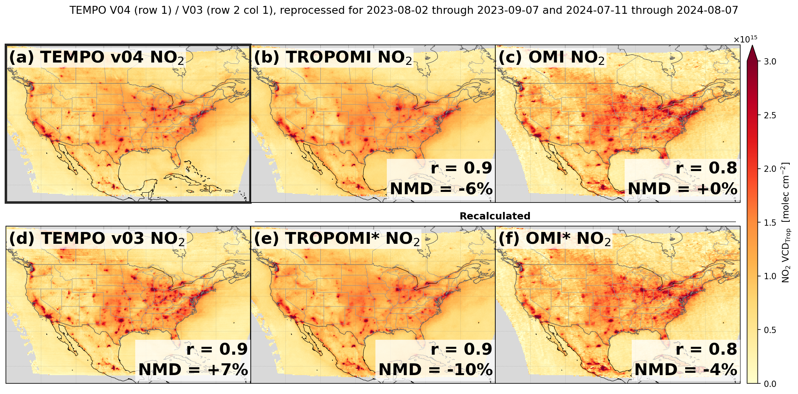

1. How consistent are TEMPO NO₂ and HCHO columns with TROPOMI and OMI?
TEMPO vs. TROPOMI r = 0.9; TEMPO vs. OMI r = 0.8
Recalculation: increases TROPOMI/OMI NO₂, making NMD more negative.
2023-08-02 to 2023-09-07 & 2024-07-11 to 2024-08-07
*Each panel shows the Pearson correlation (r) between TEMPO v04 and the displayed product across the domain, and the normalized mean difference (NMD) as (⟨TEMPO v04⟩ − ⟨product⟩) / ⟨product⟩ × 100%.
0.2$°$

Slide 5
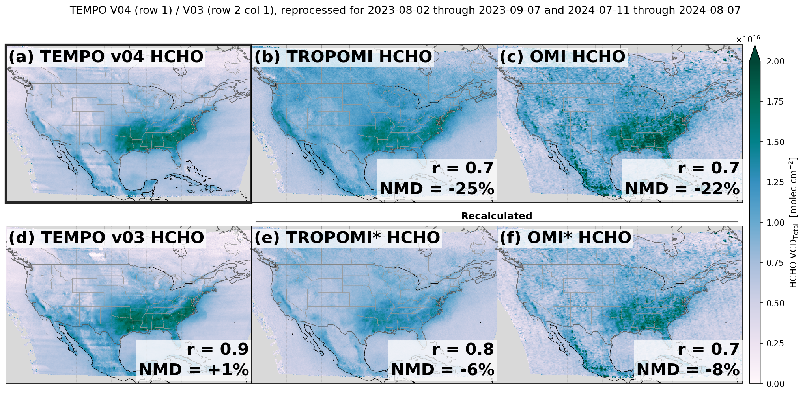
1. How consistent are TEMPO NO₂ and HCHO columns with TROPOMI and OMI?
TEMPO vs. TROPOMI r = 0.7; TEMPO vs. OMI r = 0.7
Recalculation: lowers TROPOMI/OMI HCHO overall, improving domain-mean agreement with TEMPO
2023-08-02 to 2023-09-07 & 2024-07-11 to 2024-08-07
*Each panel shows the Pearson correlation (r) between TEMPO v04 and the displayed product across the domain, and the normalized mean difference (NMD) as (⟨TEMPO v04⟩ − ⟨product⟩) / ⟨product⟩ × 100%.
0.2$°$

Slide 6
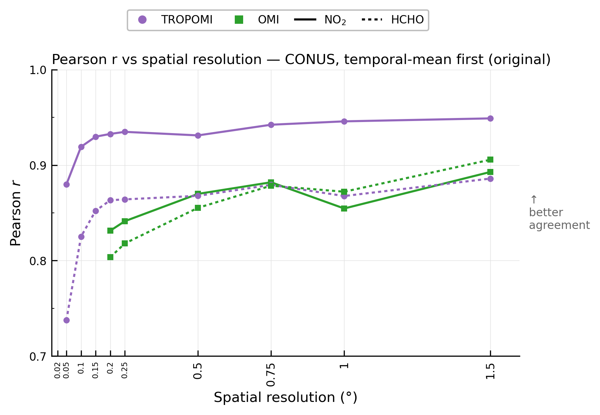
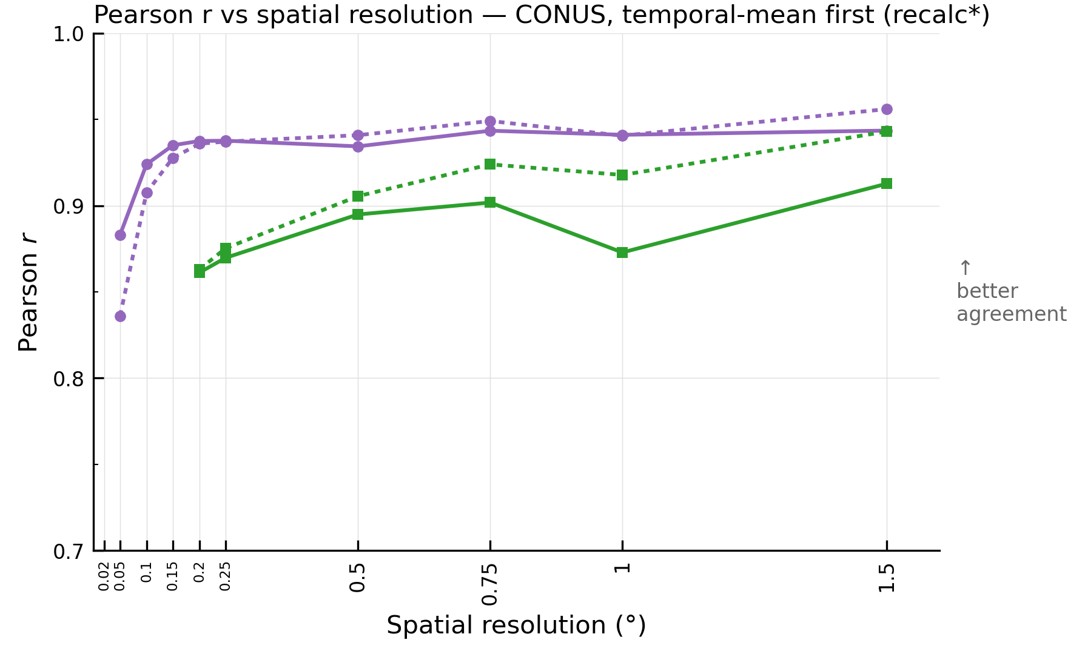
1. How consistent are TEMPO NO₂ and HCHO columns with TROPOMI and OMI?
Spatial averaging improves cross-satellite agreement, with most gains occurring by ~0.5°.
Recalculation: improves agreement especially for HCHO
2023-08-02 to 2023-09-07 & 2024-07-11 to 2024-08-07
Original
Recalculated
TEMPO v04 vs. TROPOMI
TEMPO v04 vs. TROPOMI*
TEMPO v04 vs. OMI
TEMPO v04 vs. OMI*

Slide 7
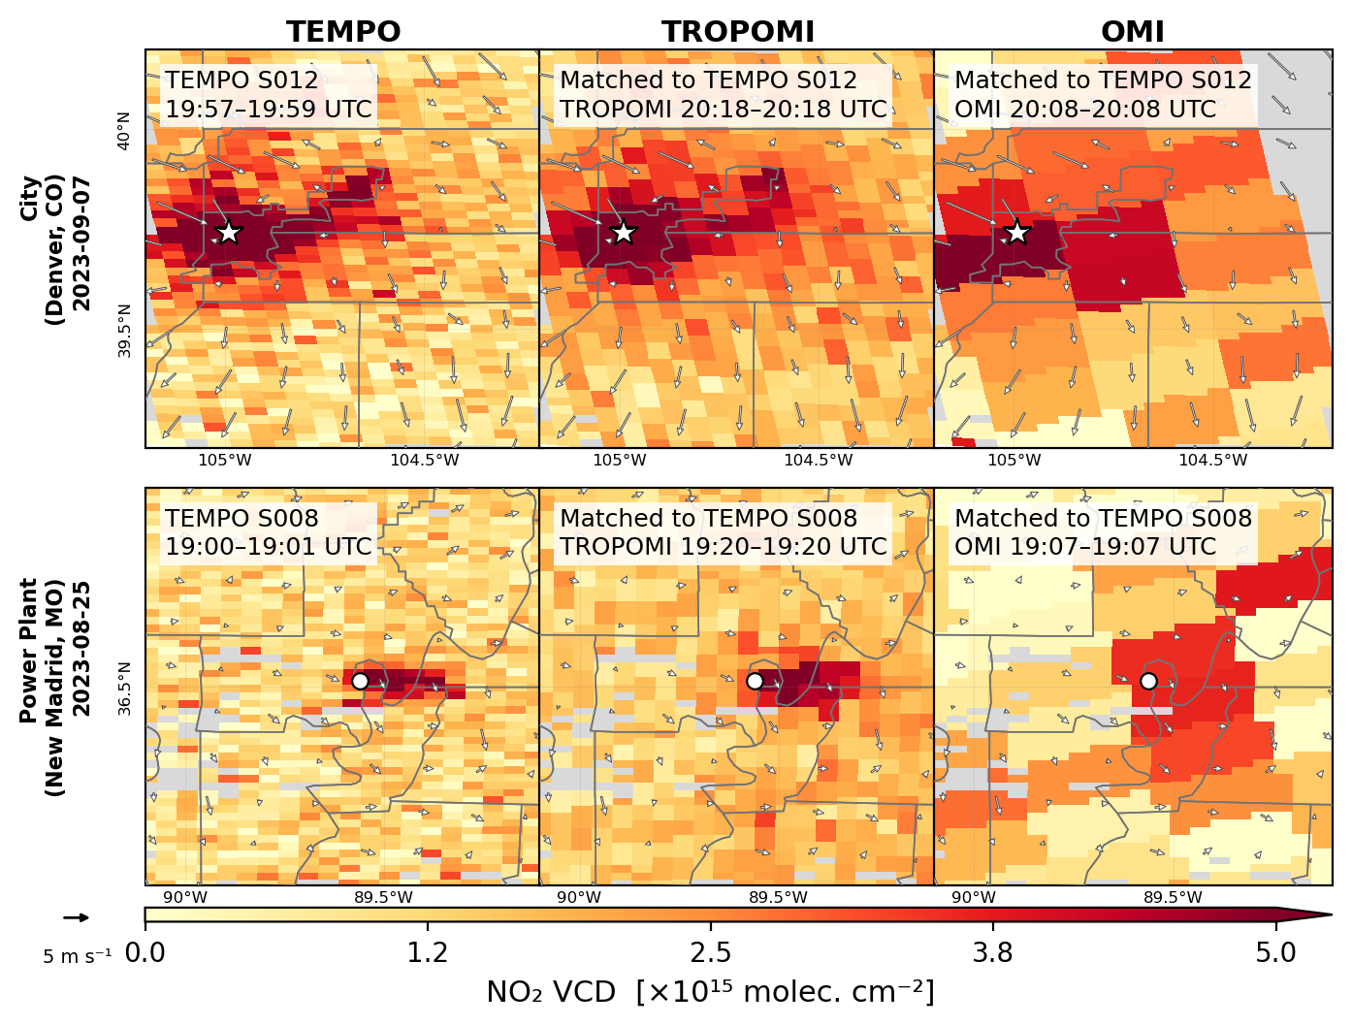
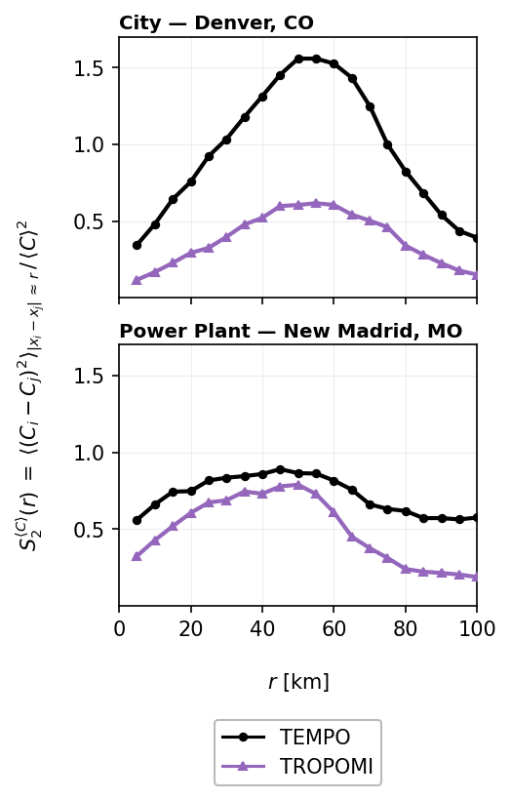
2. How well do the instruments capture localized NO₂ gradients?
TEMPO and TROPOMI capture localized NO₂ enhancements, while OMI captures broader, smoother patterns.
TEMPO captures stronger spatial variability than TROPOMI.
*⟨C⟩ = mean VCD over pixels within 100 km of the feature center
Follette-Cook et al., 2015; Tang et al., 2021
6
Notes:
Add a reference for the second order strcture function

Slide 8
Key Takeaways
1. How consistent are TEMPO NO₂ and HCHO columns with TROPOMI and OMI?
TEMPO shows good agreement with both TROPOMI (r~0.7-0.9) and OMI (r∼0.7-0.8).
With common-a-priori recalculation, the domain-mean TEMPO NO₂ remains lower relative to TROPOMI/OMI, whereas the negative TEMPO-minus-comparison NMD is reduced for HCHO.
Spatial averaging improves cross-satellite agreement. Most gains occur by ~0.5°, beyond which additional averaging yields minimal improvements.
2. How well do these instruments capture localized pollution gradients?
At the Level-2 scan scale, TEMPO and TROPOMI capture localized NO₂ gradients over cities and power plants, while OMI captures broader, smoother patterns.
TEMPO captures stronger spatial variability than TROPOMI.
madankui.tao@cfa.harvard.edu
Tao et al., in prep.

