Slide 1
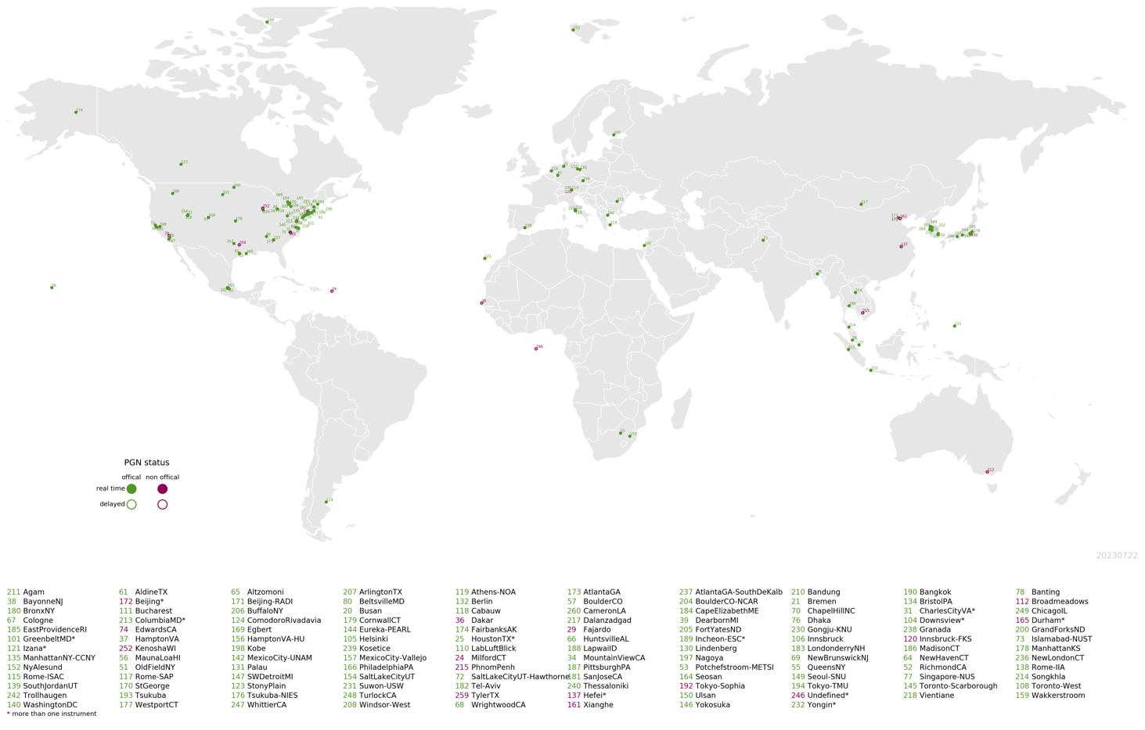

Updates and activities with Pandora and GCAS
Thomas Hanisco, NASA GSFC
TEMPO DART
University of Iowa
15-June, 2026

Slide 2

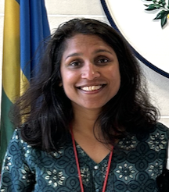
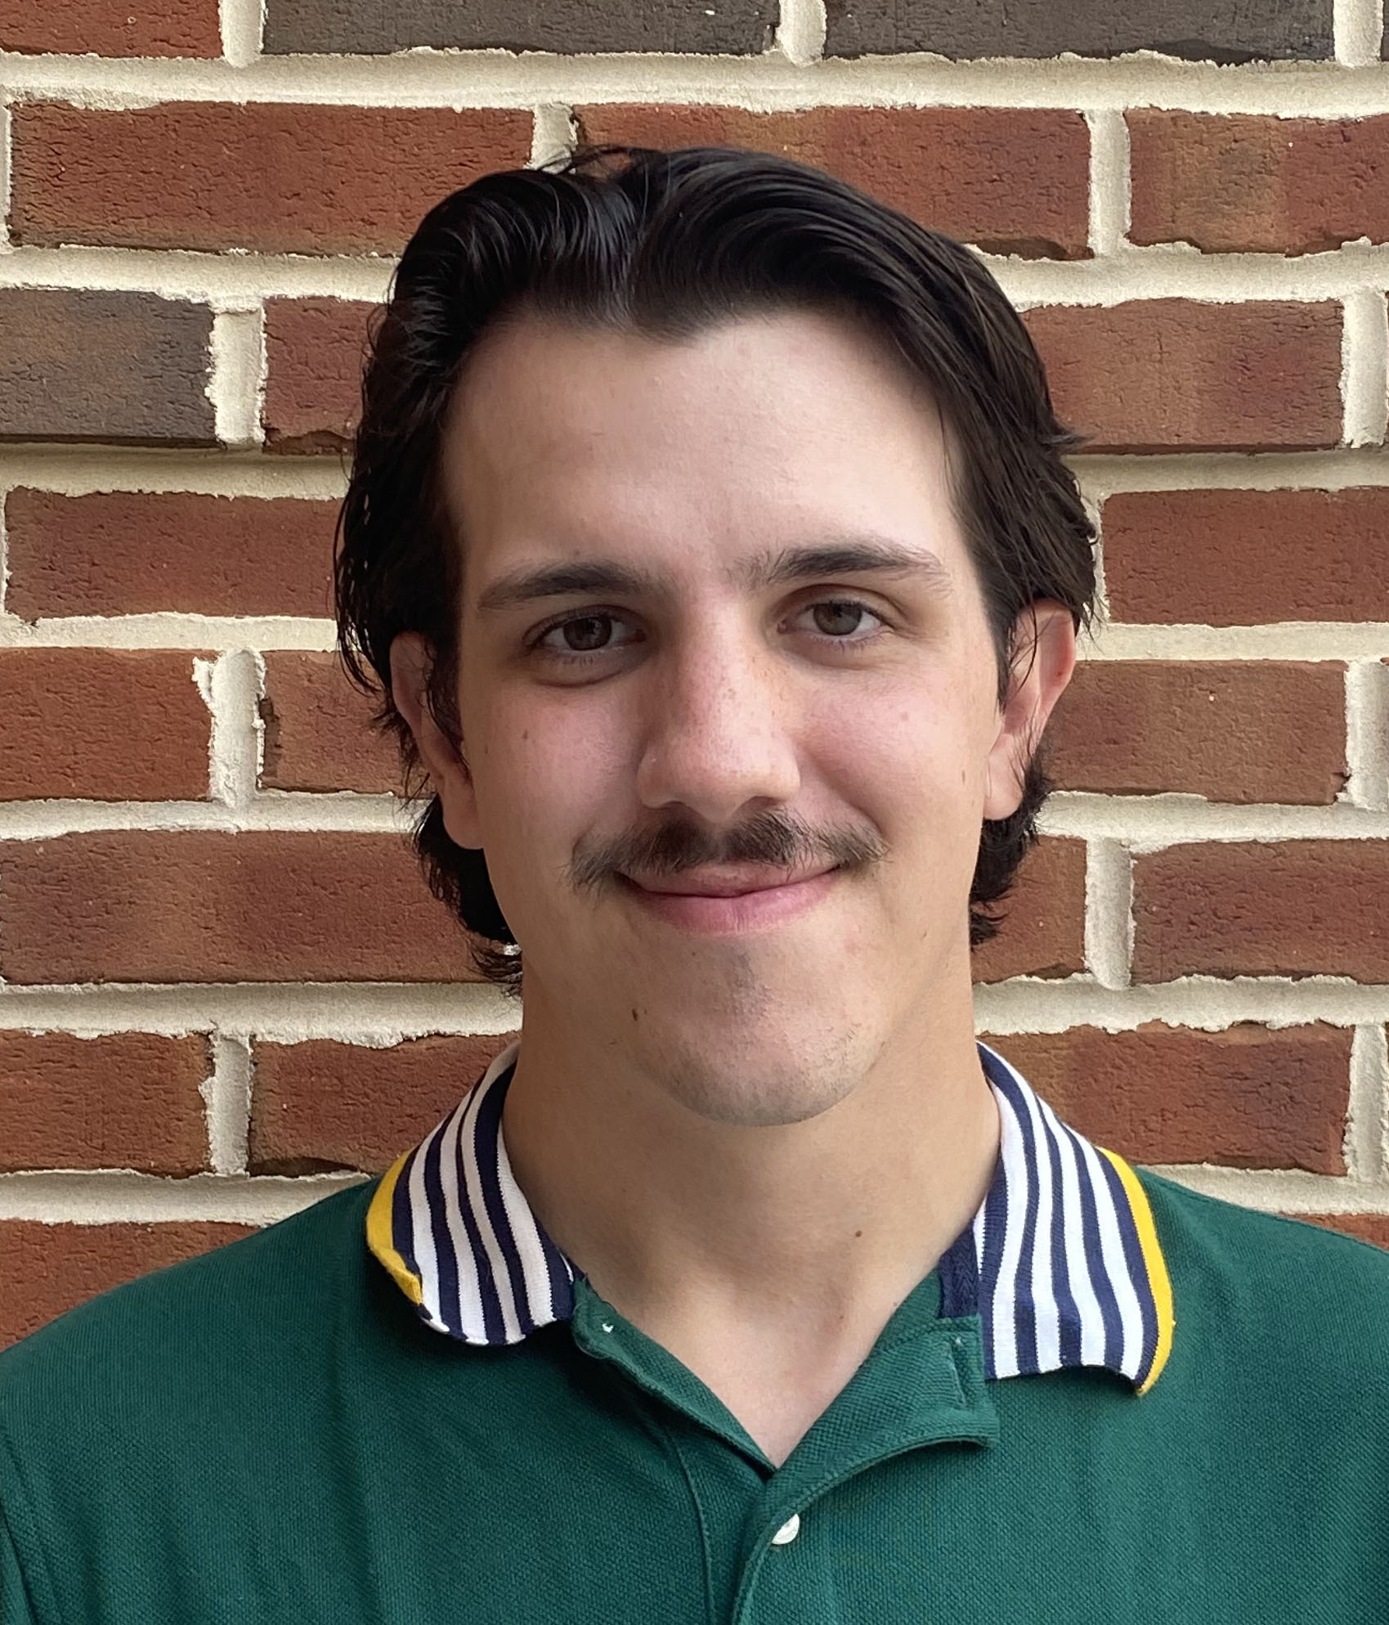
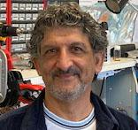

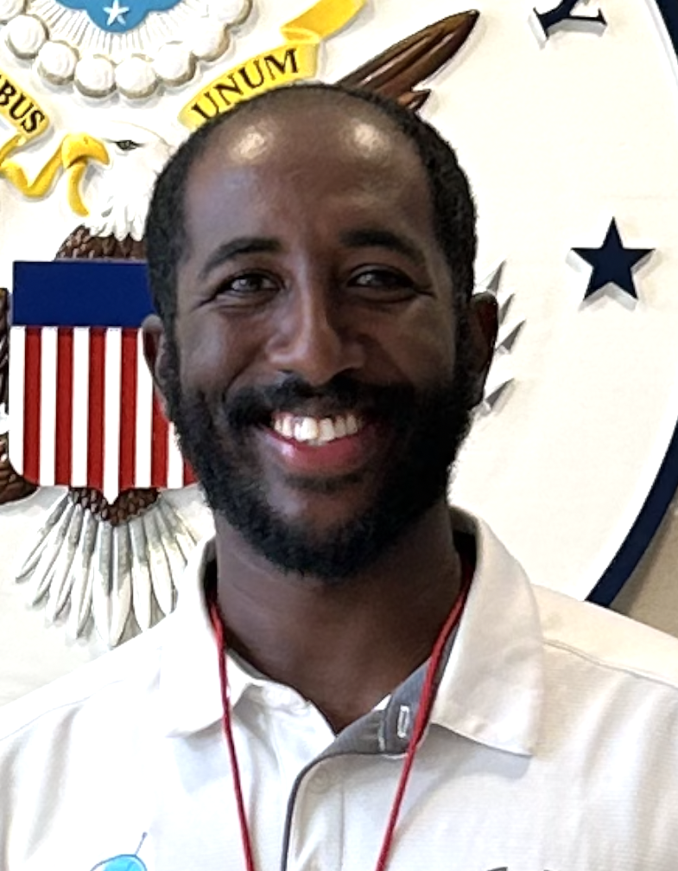
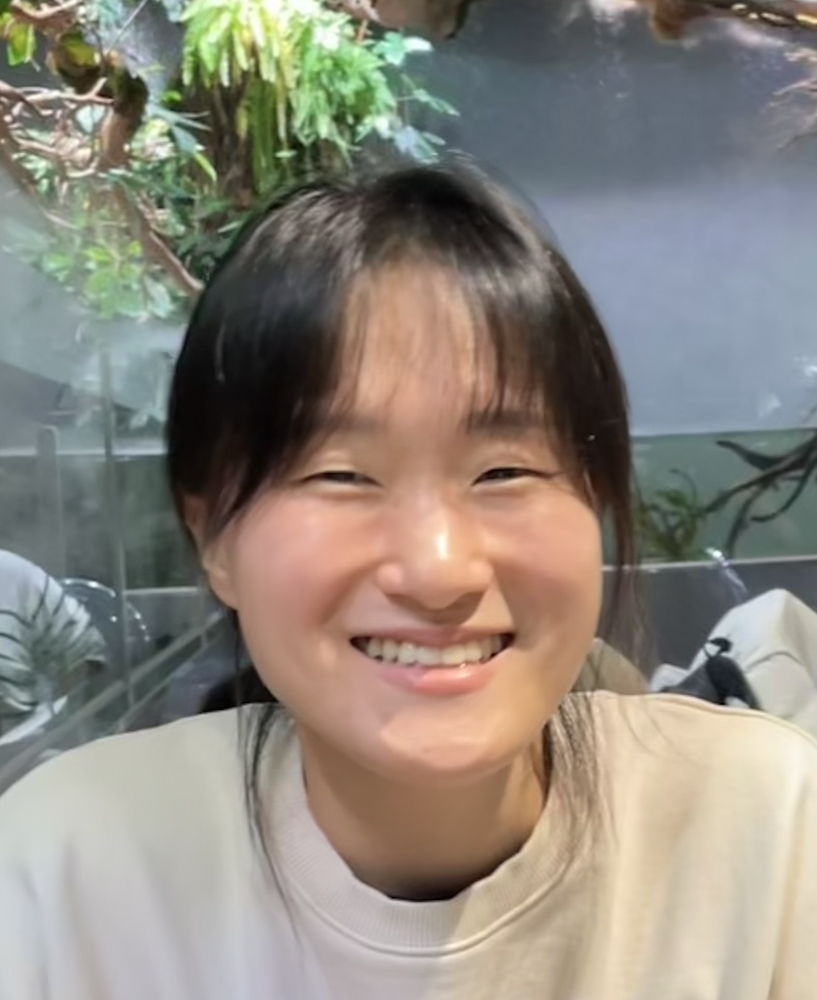

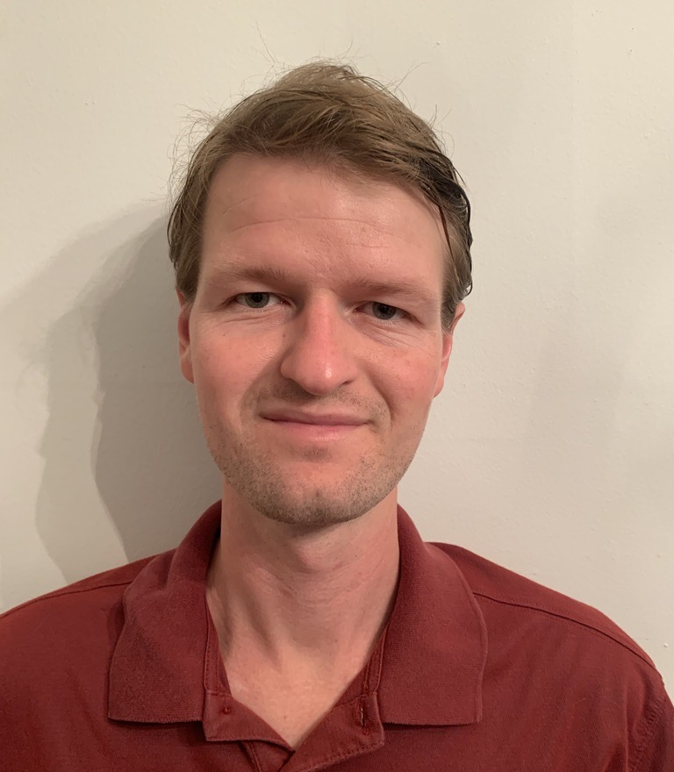
NASA GSFC Pandora Operations and Calibrations Team
Tom Hanisco, PI
Apoorva Pandey
Calibrations & Analysis
Nicholas Lombel
Operations & Calibrations
Jonguk Park
Calibrations & Analysis
Ksanet Zecharias
Operations & Calibrations
Nader Abuhassan,
Operations Lead
Chris Rader
Operations & Maintenance
Bryan Place
Calibrations &
Analysis
Soojin Park
Calibrations & Analysis

Slide 3
Research programs
NASA IPMSI – 13 instruments at colleges and universities with minimal prior NASA funding
  Completed 12/13 installations.
  Ongoing research programs developed by the IPMSI institutions
    Focus on student training with instruments and classroom instruction on remote sensing
TEMPO DART (PI: Pandey)
  Use Pandora measurements to improve TEMPO Formaldehyde retrievals
NASA Satellite needs Working Group (SNWG)
  10 US department of Agriculture rural sites – 9/10 installed
  20 US State Department embassy locations – 5/20 installed
  16 Fire locations “Smoky Pandoras” beginning in 2027
Notes:
Shobha Kondragunta at NOAA Bojan Bokov at Eumetsat

Slide 4
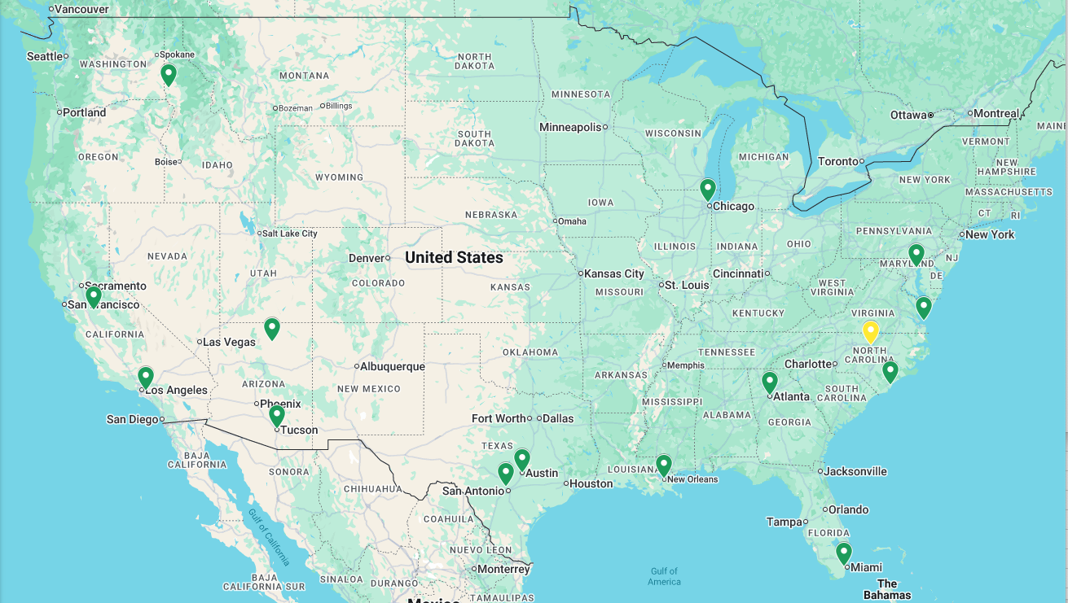
IPMSI
Planned
Complete

Slide 5
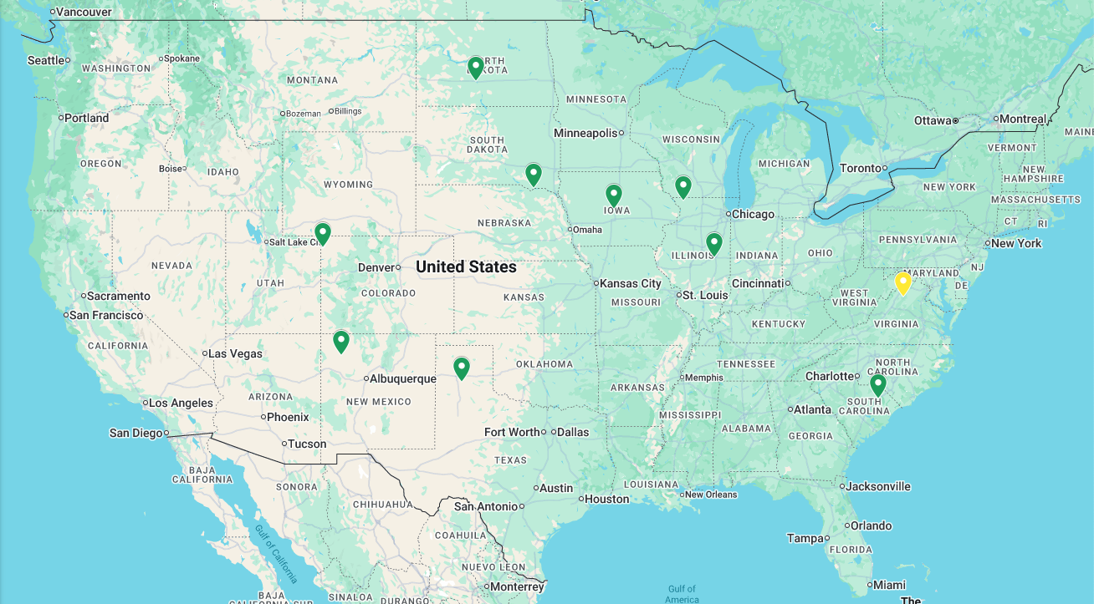
SNWG Agriculture
Planned
Complete

Slide 6
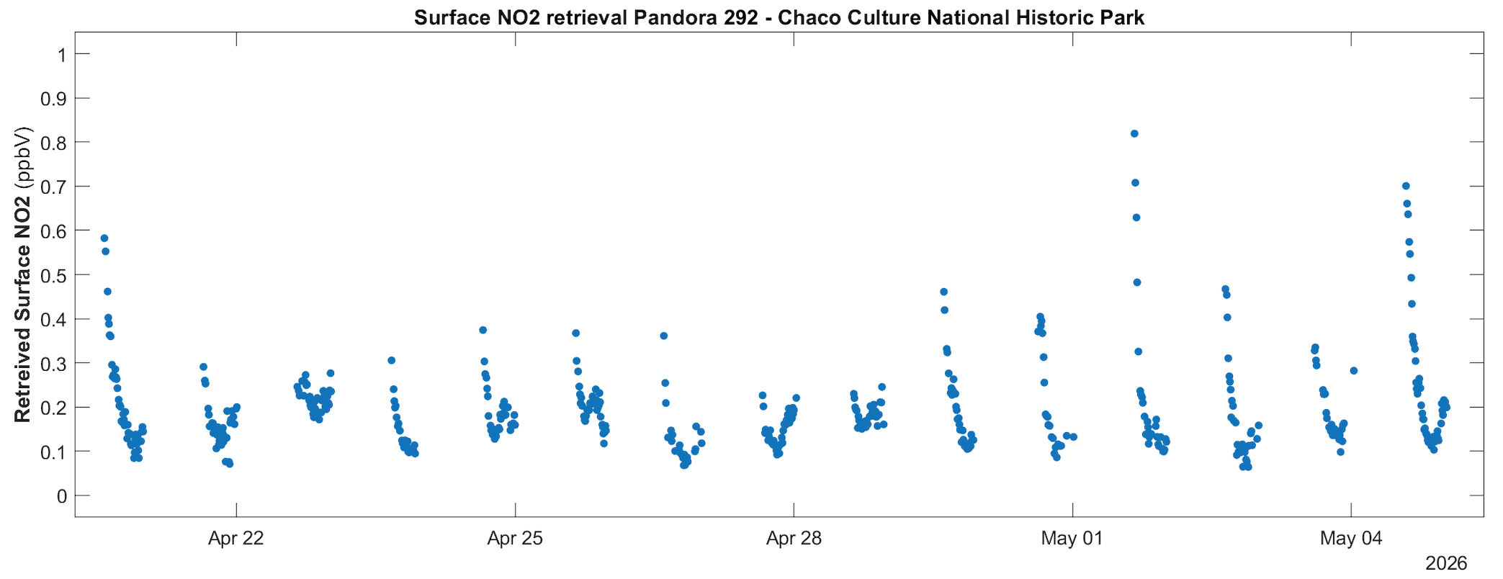
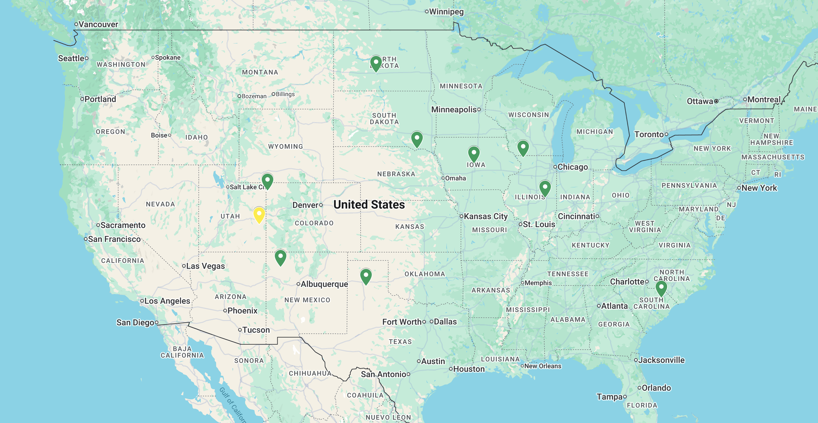
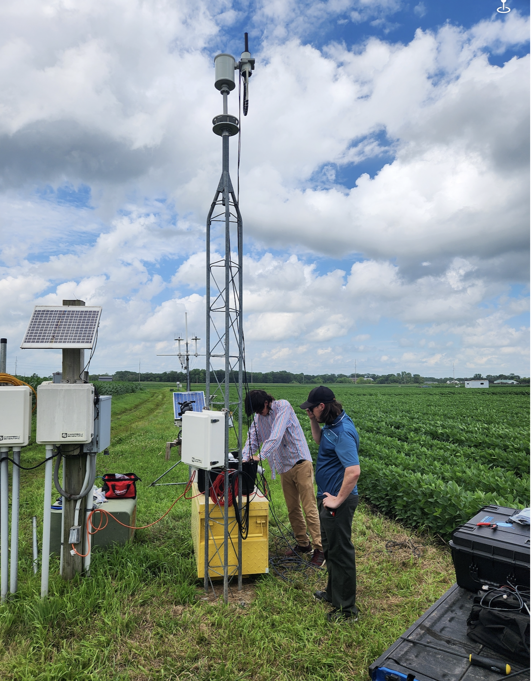
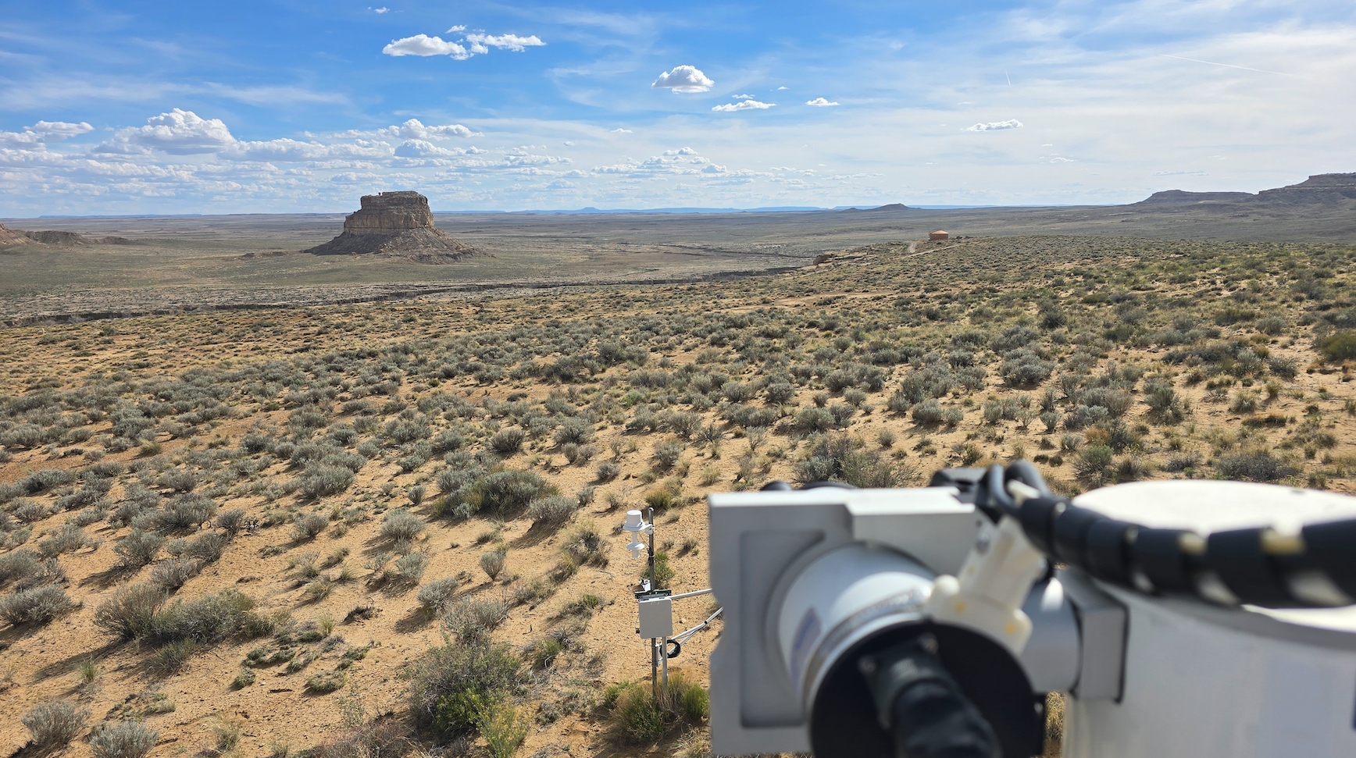
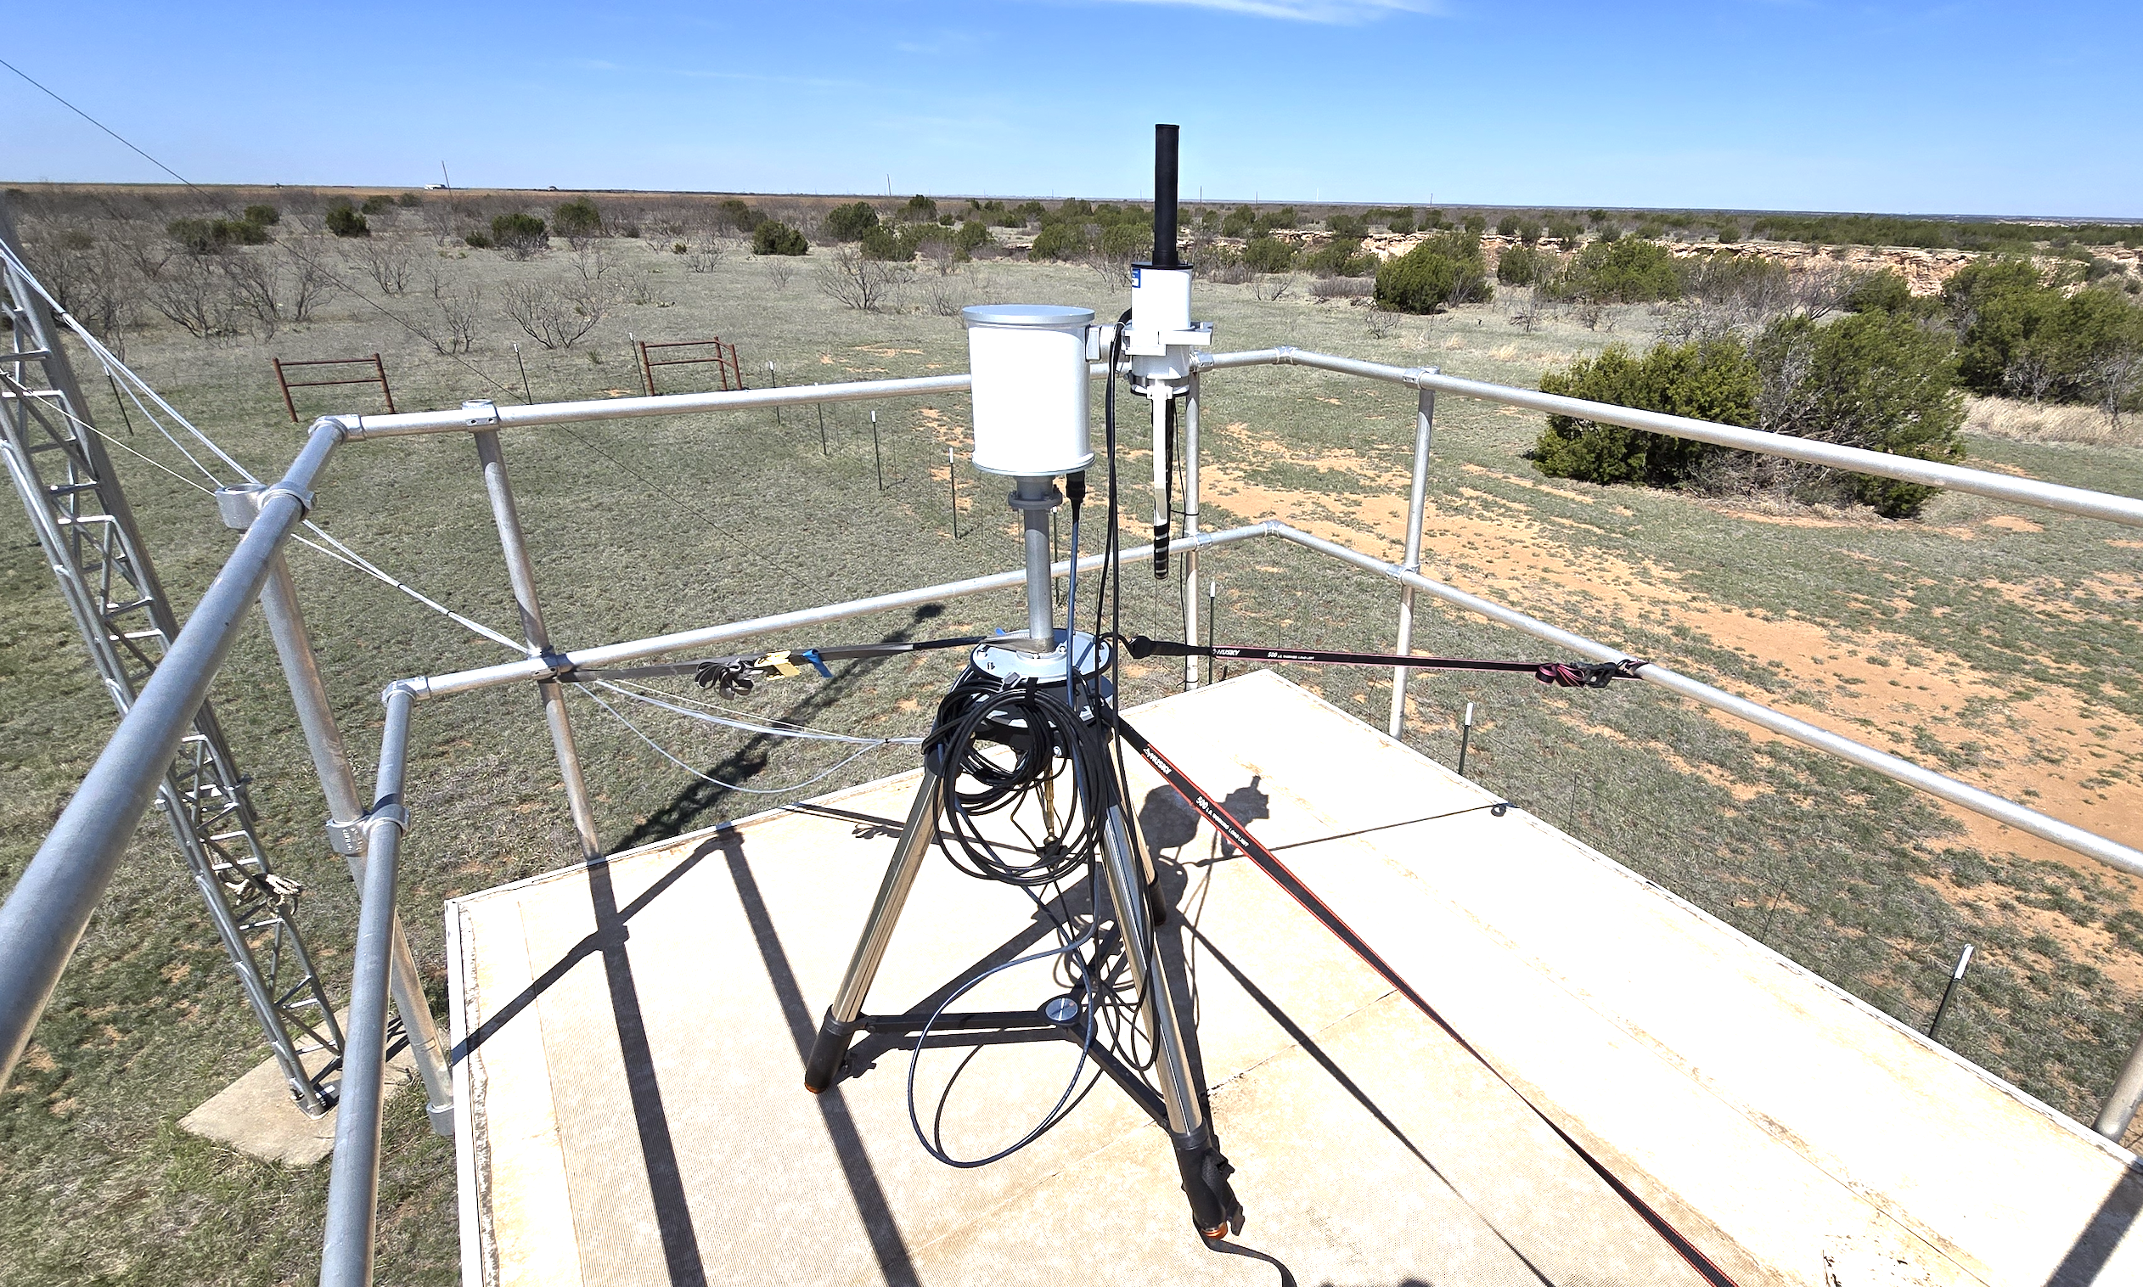
SNWG Agriculture
Luke Valin, EPA
Planned
Complete
Ames, IA
Chaco, NM
Palo Duro, TX

Slide 7
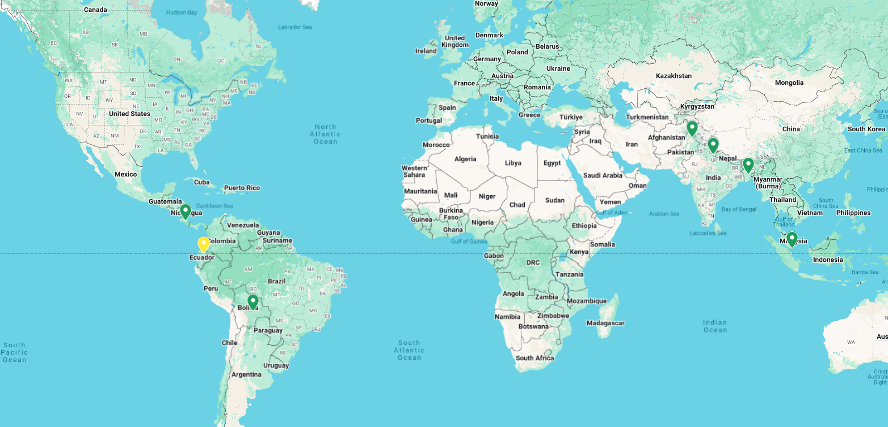
NASA Research & Analysis Program
Planned
Complete

Slide 8
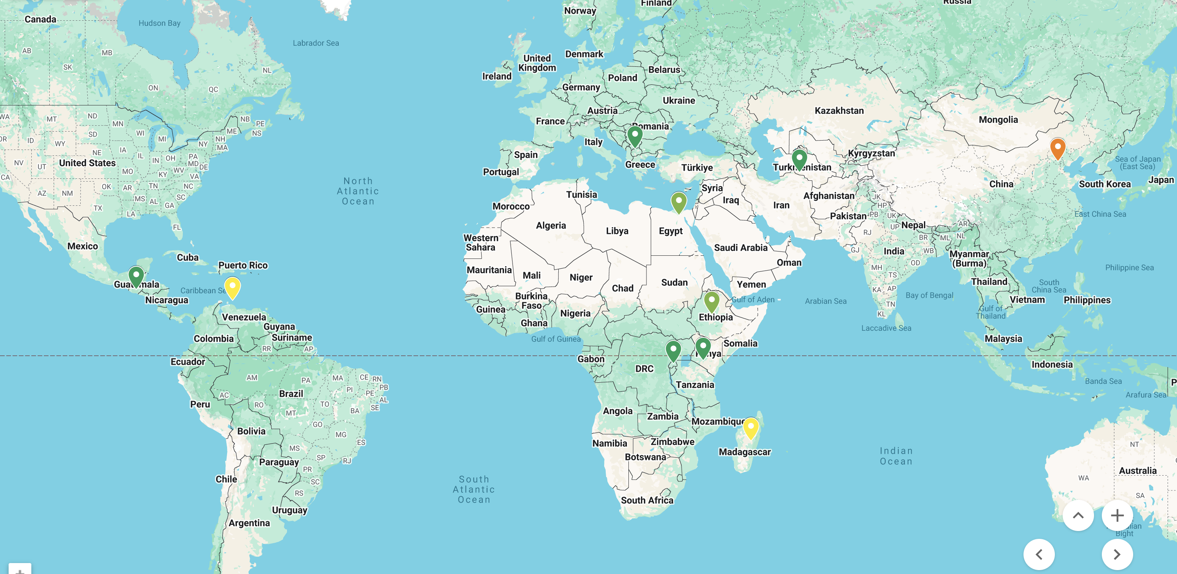
SNWG Embassies 2025-2026
Planned
Complete

Slide 9
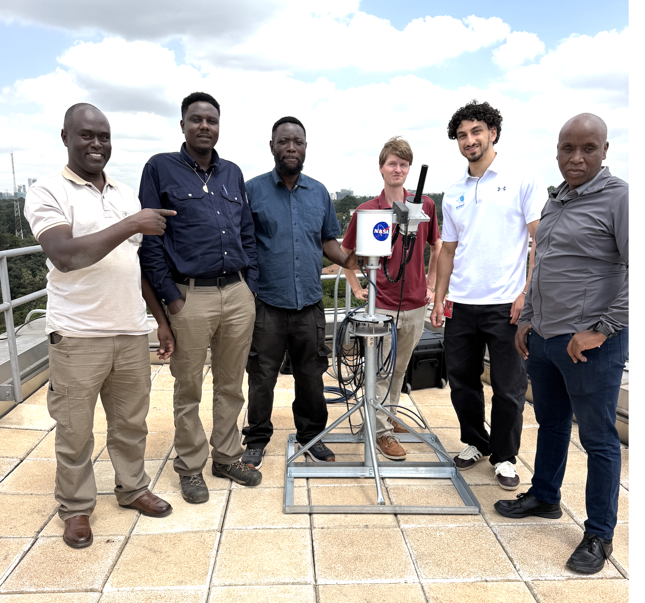
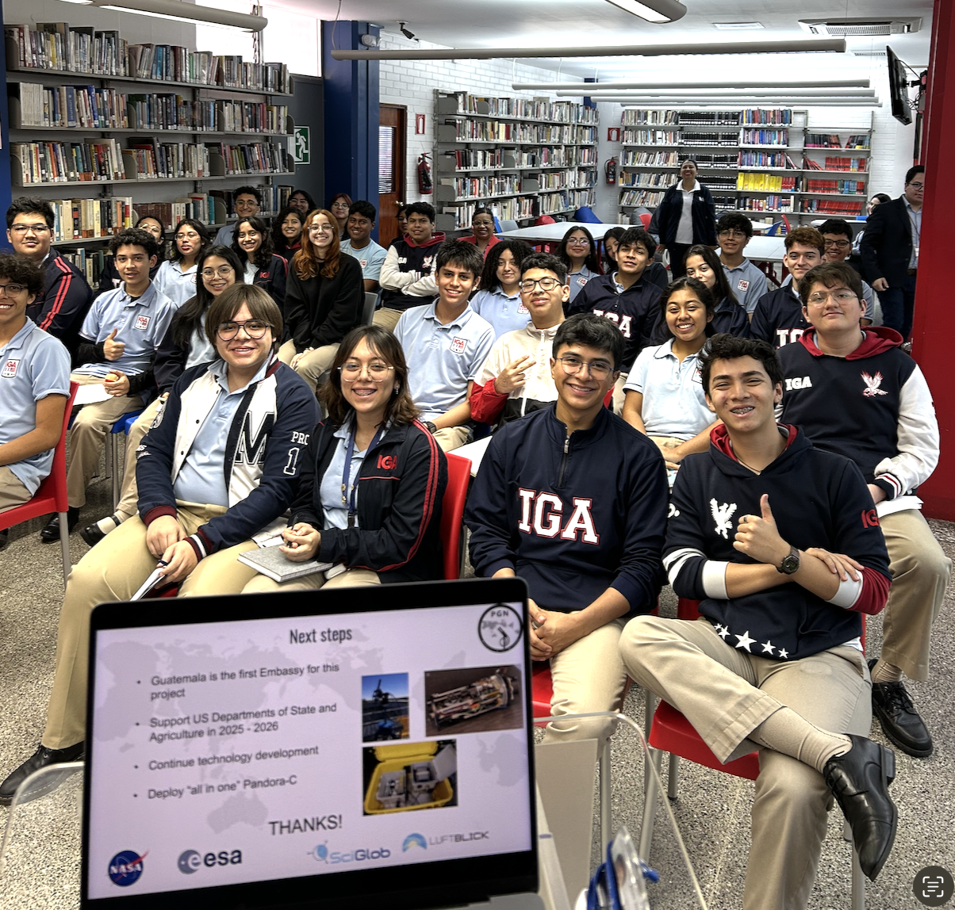
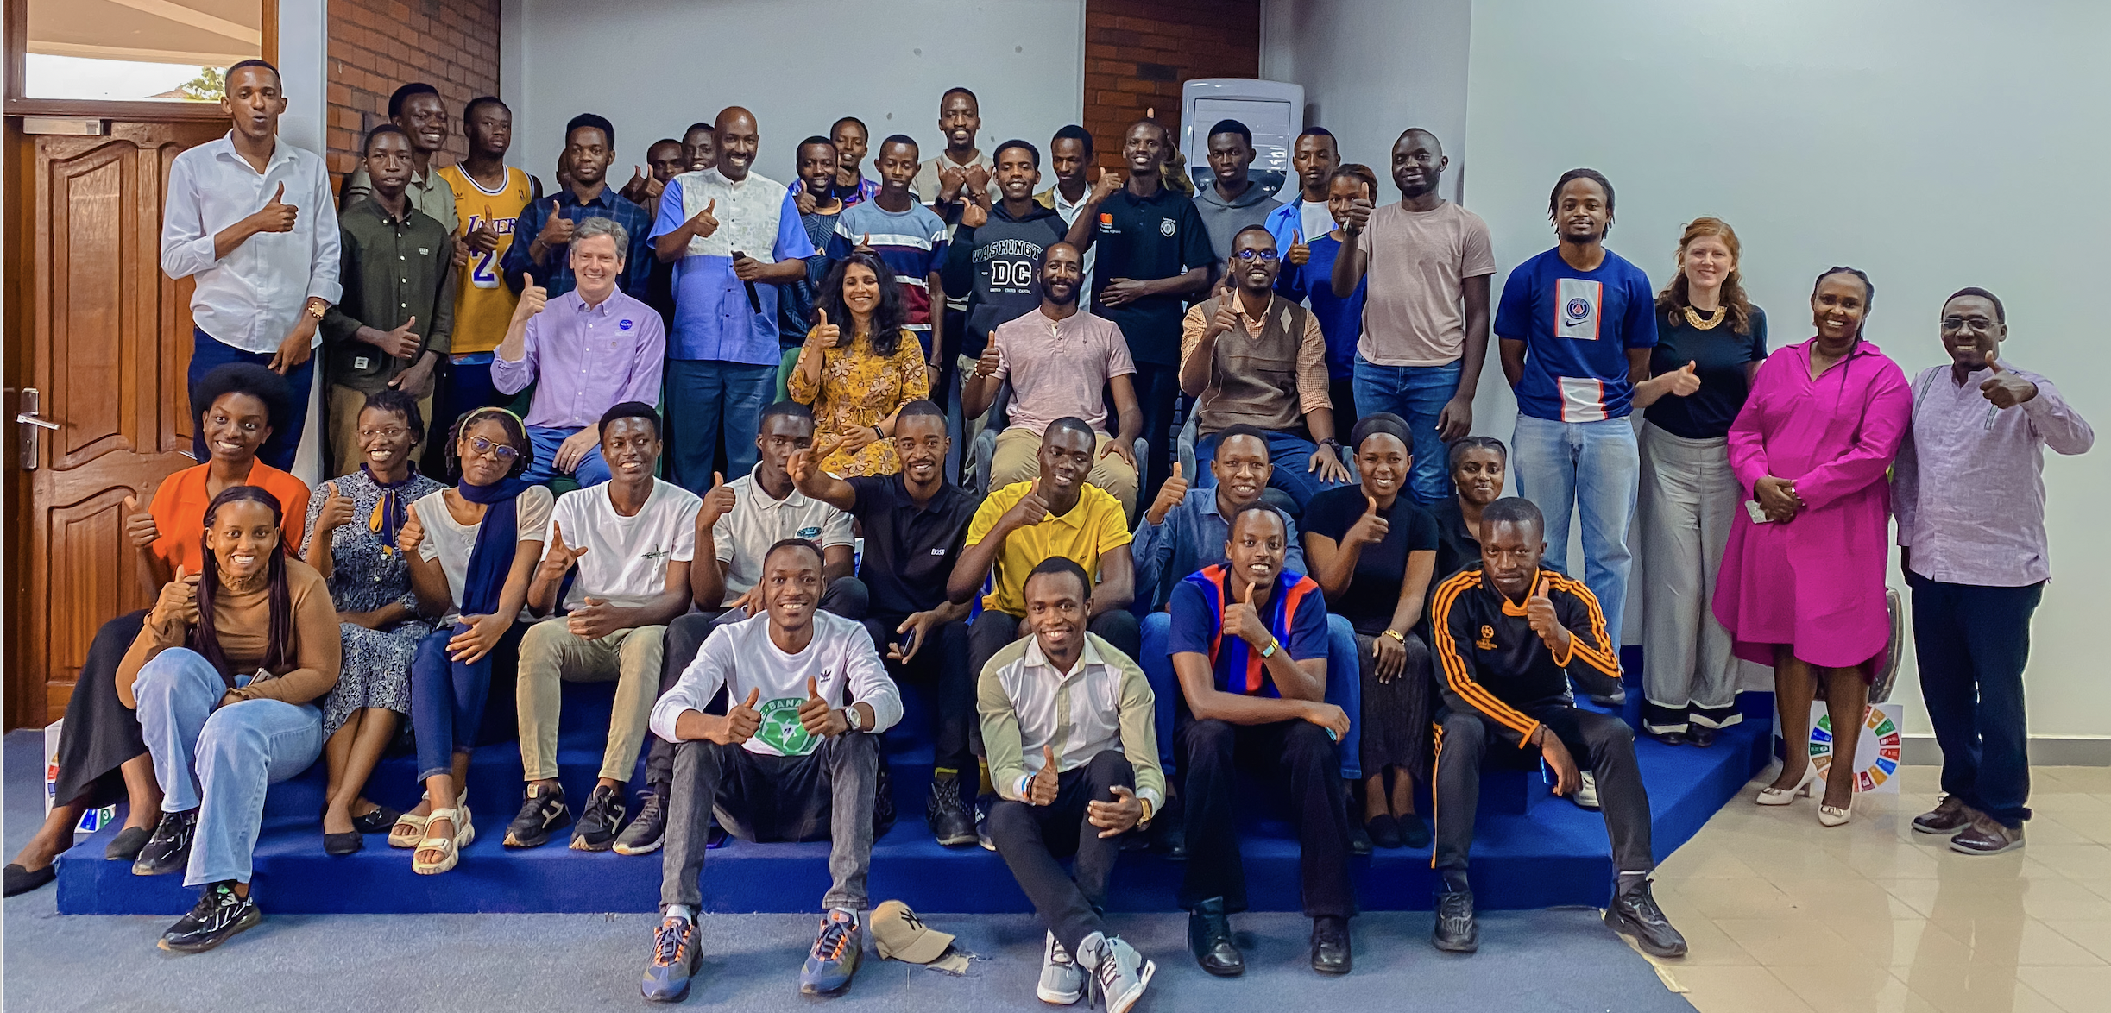
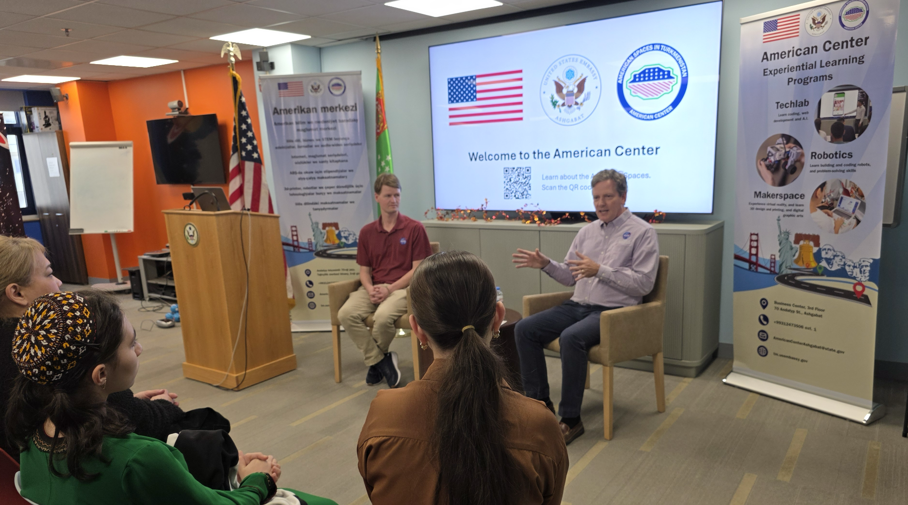
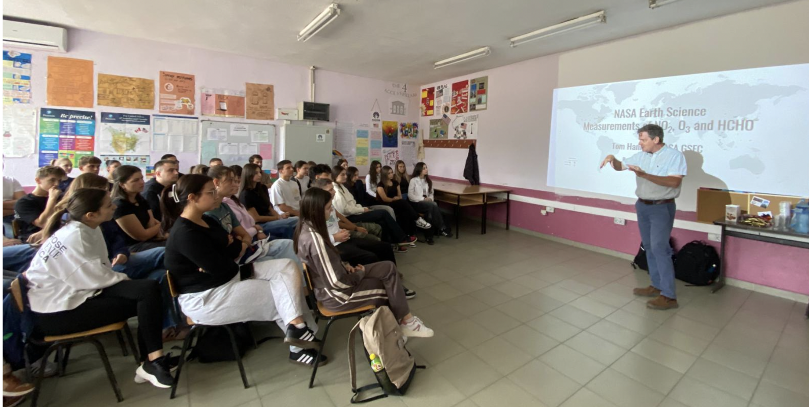
SNWG Embassies 2025-2026
Nairobi, Kenya
Planned
Guatemala City
Kigali, Rwanda
Complete
Ashgabat, Turkmenistan
Skopje, Macedonia

Slide 10
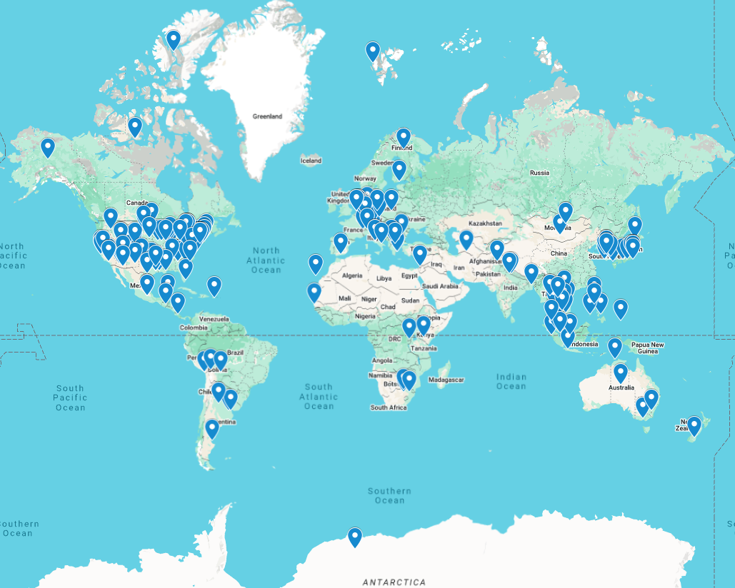
PGN 2026
211+ active sites
70+ in TEMPO FOR

Slide 11
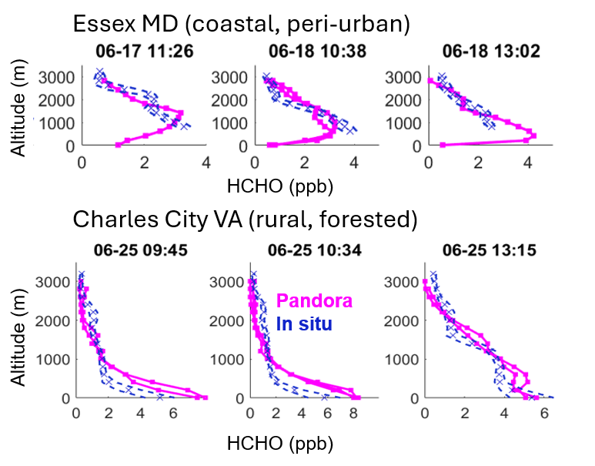
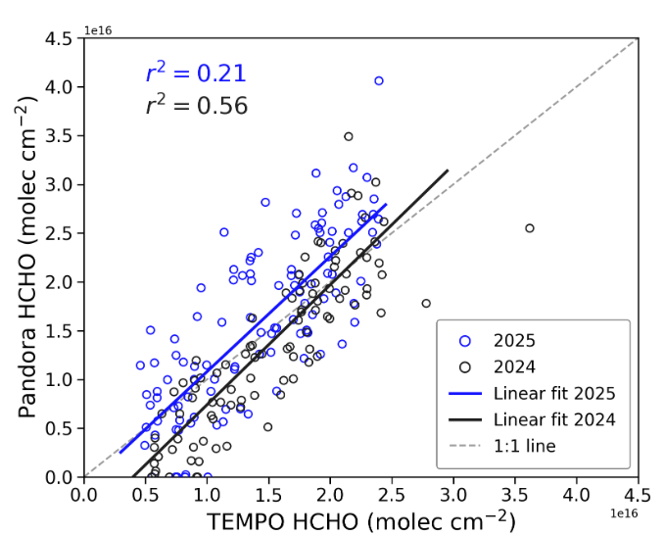
Formaldehyde Profiles – TEMPO DART (PI: Apoorva Pandey)
June 2025
June 2024
Ongoing work: the effect of profile shape factor on the scatter and slope between HCHO columns from TEMPO and Pandora MAX DOAS (Jin Liao)
Pandora HCHO profiles* and MAX-DOAS columns reproduce aircraft measurements across regimes and altitudes
*new version

Slide 12
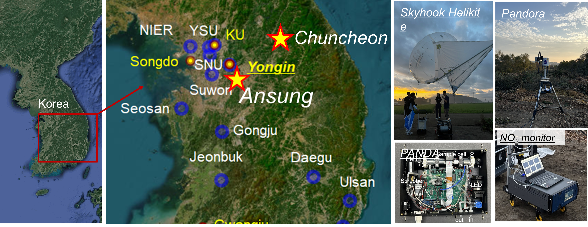
Professor Yonjoo Choi, Gyeol Lee

Slide 13
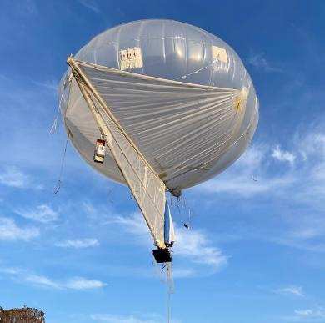
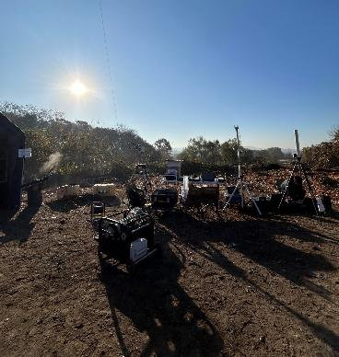
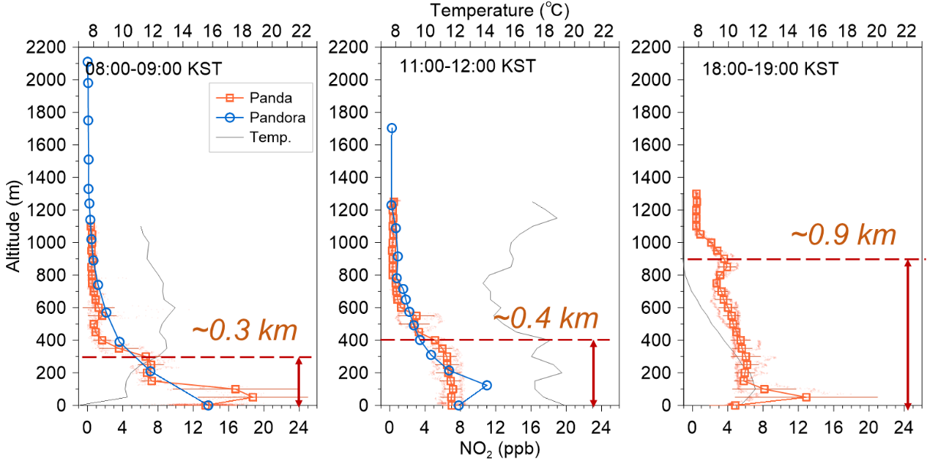
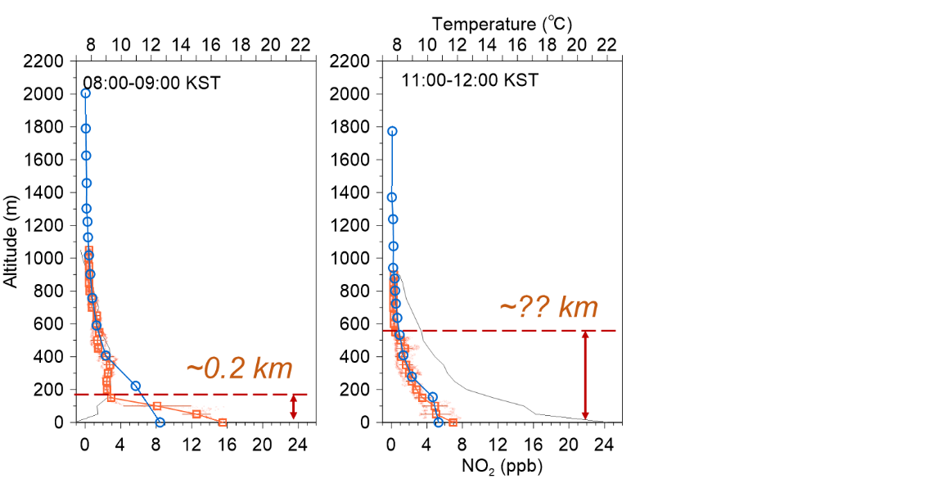
Ansung (winter)
Ansung (37.00 °N, 127.24 °E)
  2025-11-15 ~ 16 (three times in a day; AM. noon, PM)
  Variation in NO₂ layer depending on PBL height
2026-11-15
2026-11-16

Slide 14
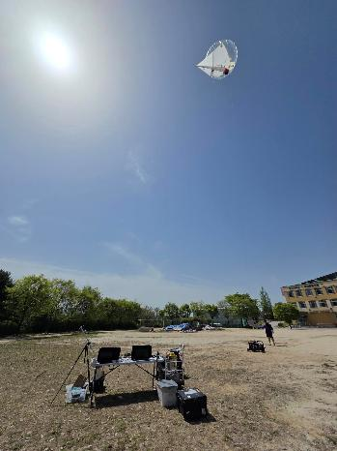
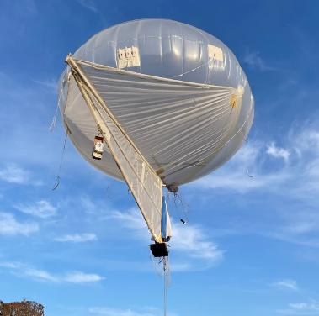
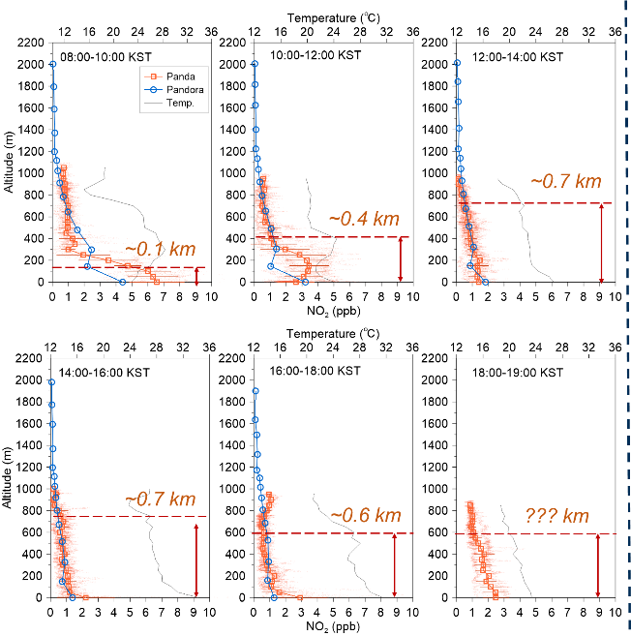
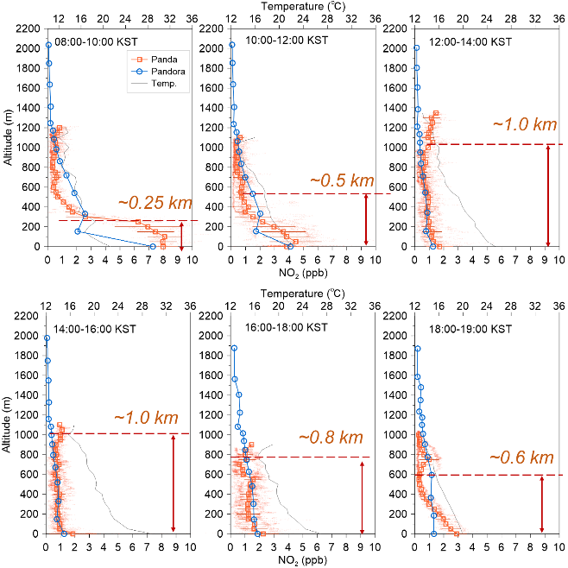
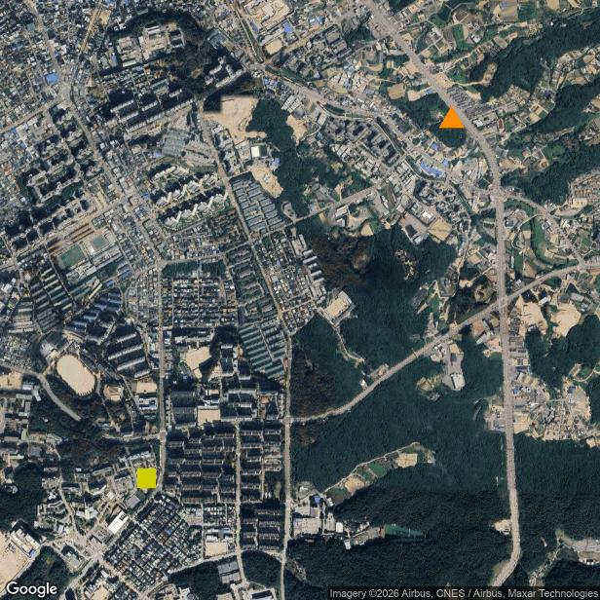
Chuncheon (spring)
Chuncheon (37.87 °N, 127.75 °E)
  2026-04-18,19,25,26 (sunrise to sunset; 8 to 19 LST)
  Diurnal variation in NO₂ and PBL height in urban scale
@춘천
2026-04-18/19
2026-04-25/26
강원권
대기환경연구소
~ 1.9 km
강원대학교 춘천캠퍼스

Slide 15
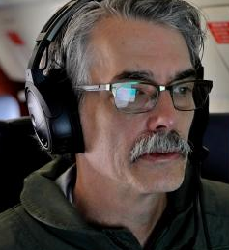
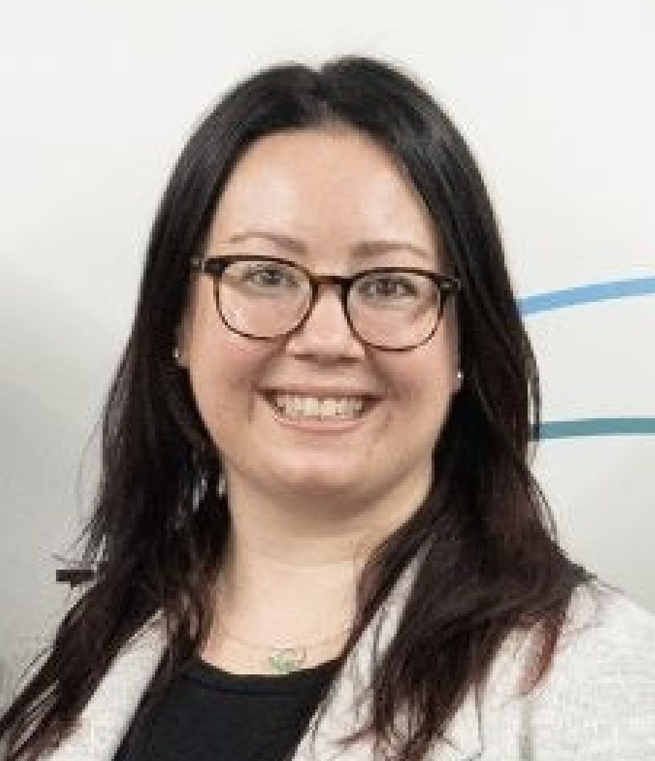
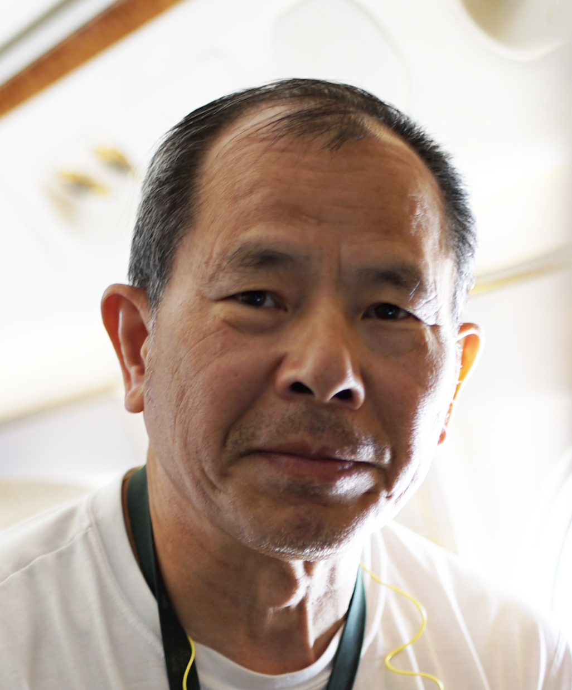
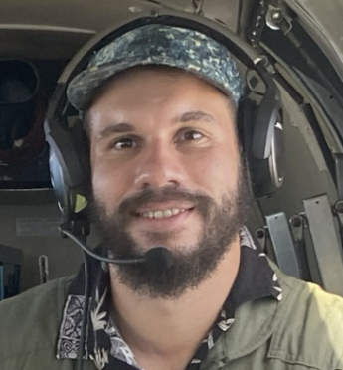
NASA GCAS Team
Scott Janz (Ret)
Calibrations & Analysis &
Engineering
Apoorva Pandey
Calibrations & Analysis
Tom Hanisco, PI
Laura Judd
Retrievals and Flight Planning
Jonguk Park
Calibrations & Analysis
Sam Xiong
Calibrations &
Operations
Zane McBride
Operations and Engineering

Slide 16
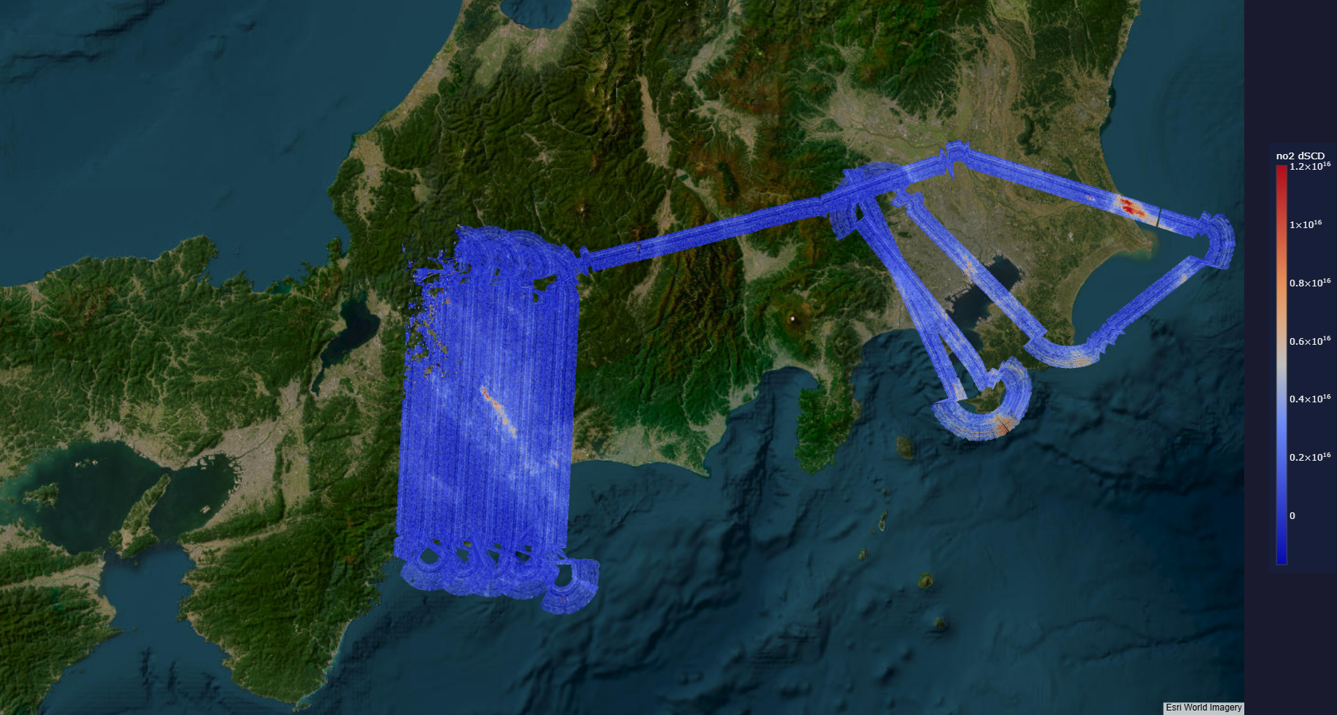
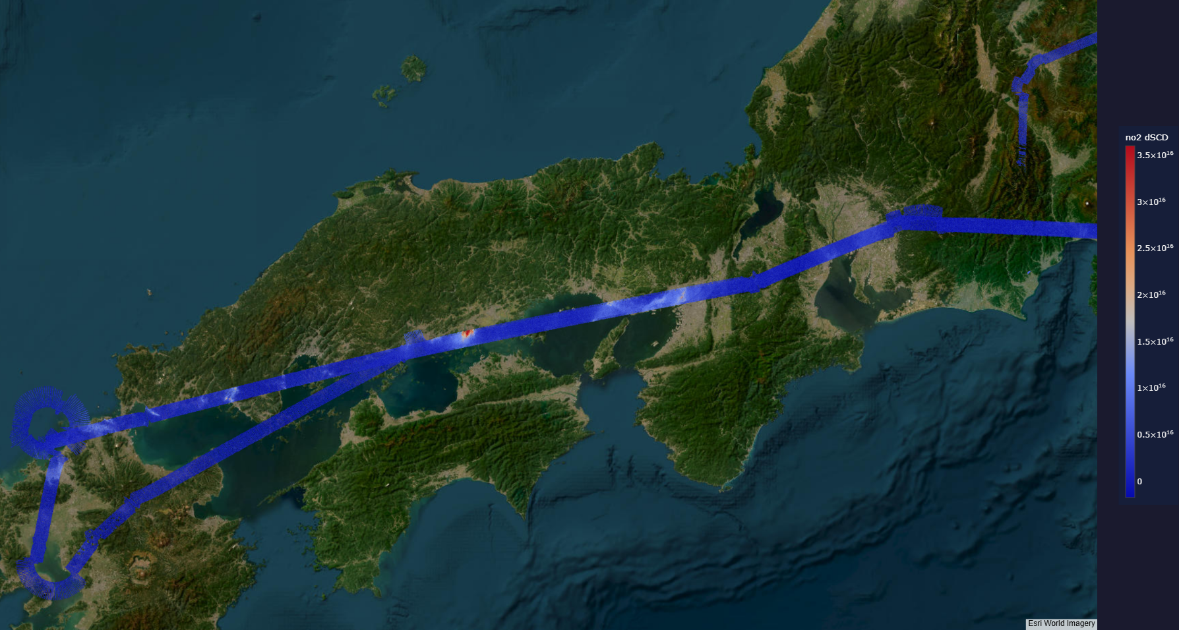

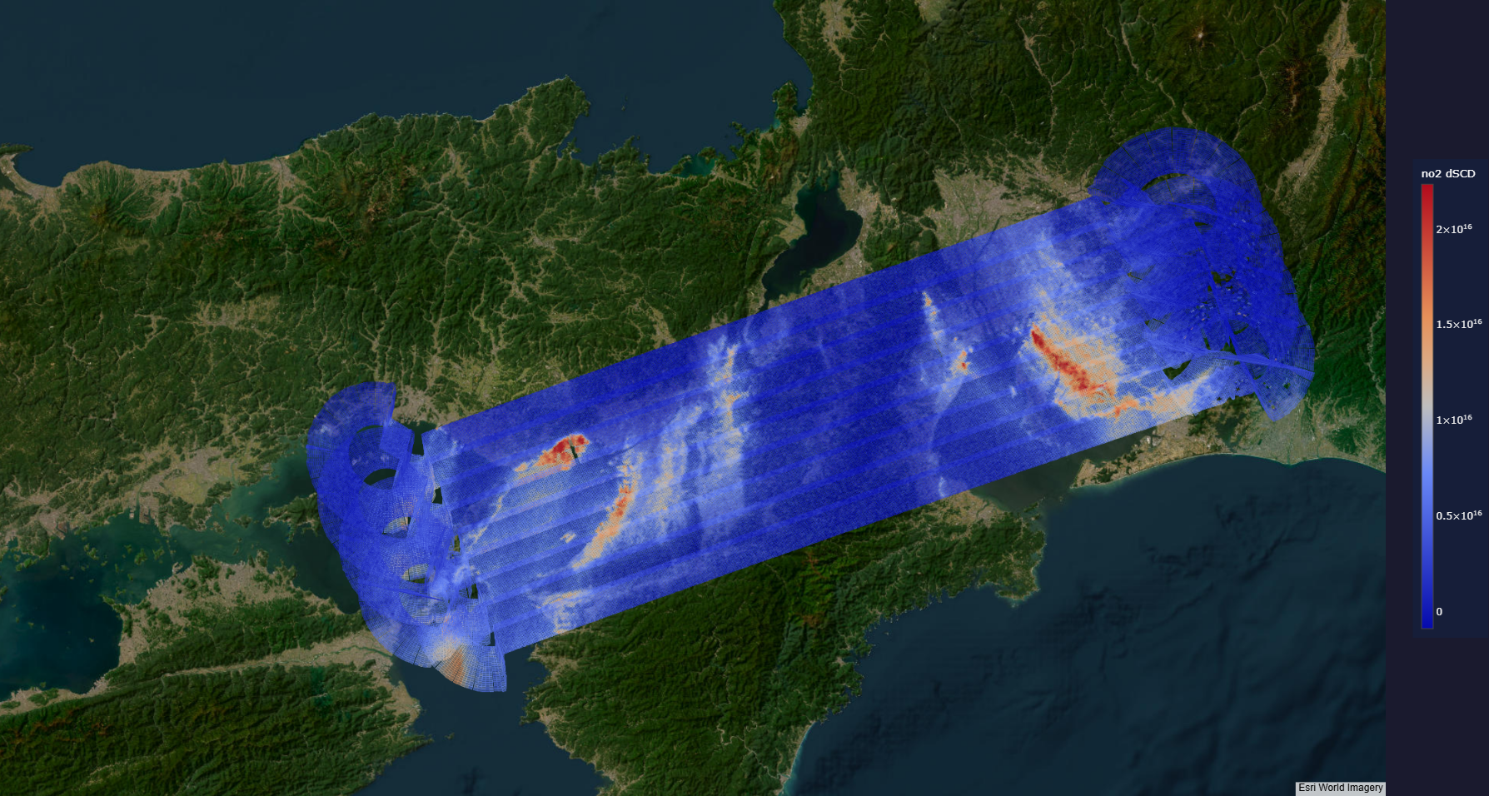
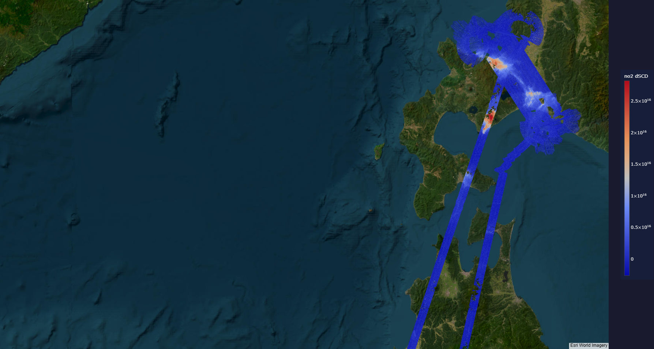
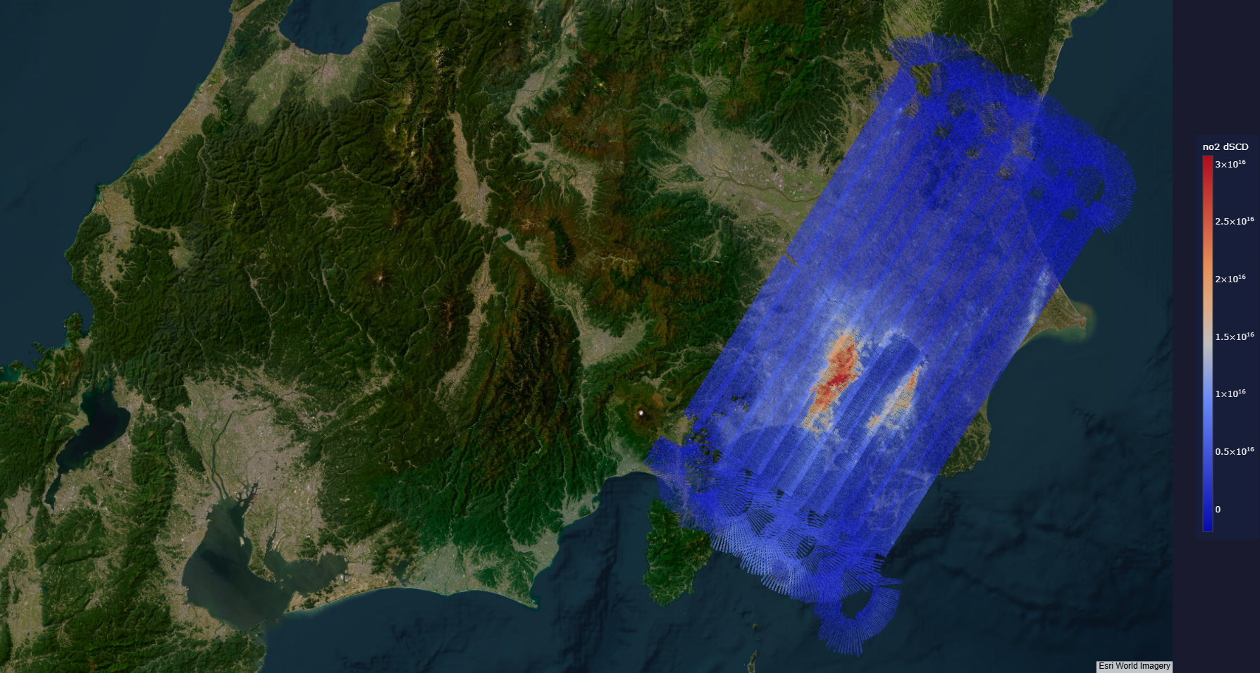
GCAS flights during the Tokyo-FC campaign
People working on GCAS
^{(GSFC)} Tom Hanisco, Jonguk Park, Apoorva Pandey, Scott Janz, Zane McBride, Sanxiong Xiong
^{(LaRC)} Laura Judd
Nagoya raster
Kyushu survey
Campaign period
Mar 8 – Mar 29, 2026 (flights)
Pandora
Mission objectives
Validation of recently launched GOSAT-GW data (GHG, NO₂)
Nagoya-Osaka raster
NASA LaRC G-Ⅲ
GCAS (NO₂; GSFC), AVIRIS-5 (CH₄, CO₂; JPL)
Japan King Air
JAMSTEC NO₂ Imager (NO₂)
Total 11 Science Flights (40 hrs)
Tokyo: Mar 11, 14, 24, 29
Nagoya: Mar 8
Nagoya-Osaka: Mar 12, 17, 27
Hokkaido: Mar 20, 25
Survey (Kyushu): Mar 21
Spectral resolution | 0.6 nm
Spectral sampling | 0.2 nm
Nominal spatial resolution * at nadir, alt=41,000 ft ** Flight speed=420 NM/hr | x-track: | 320 m*
 | a-track: | 500 m**
NO₂ fitting window | 430 – 460 nm
2-σ detection limit | 1.6e15 molecules cm⁻²
Hokkaido
Tokyo raster

Slide 17

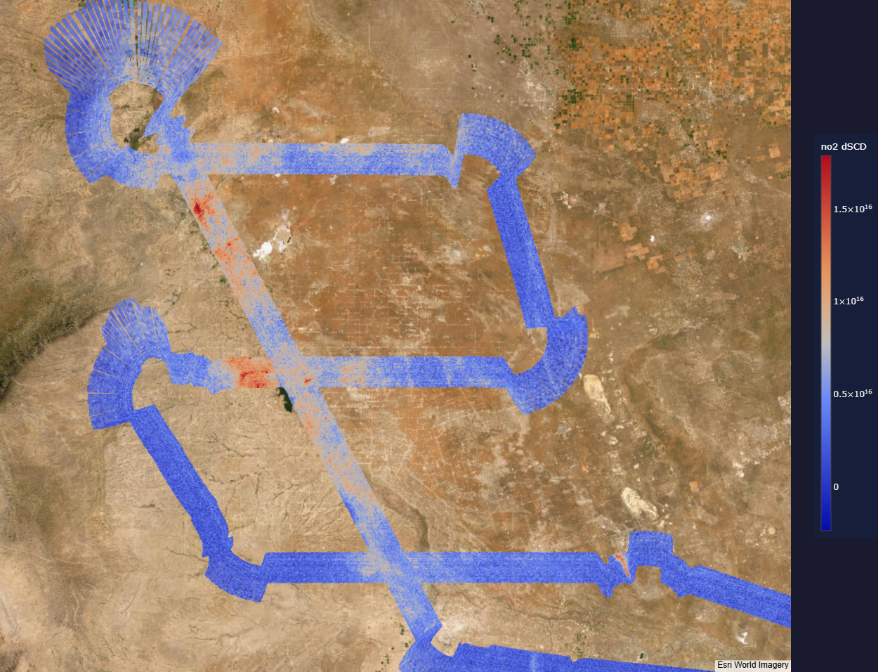
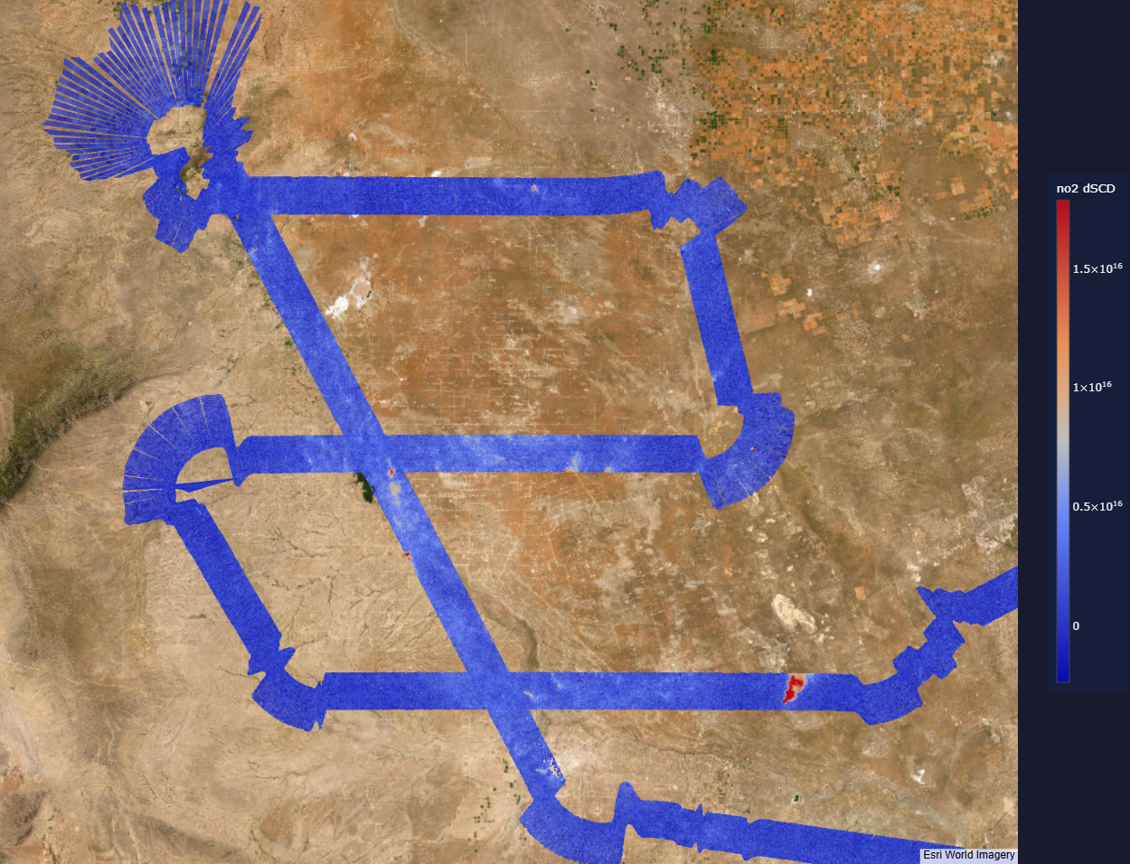
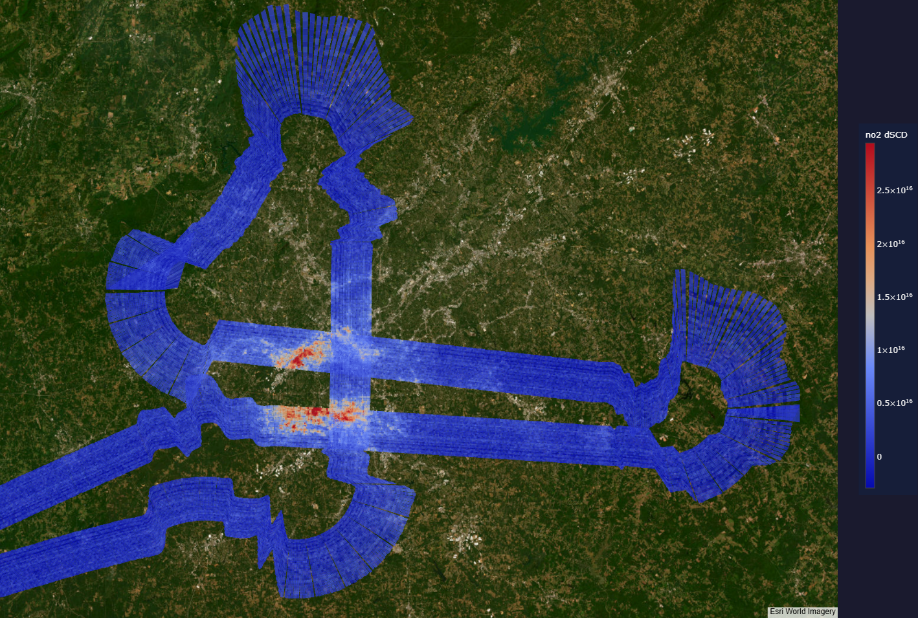
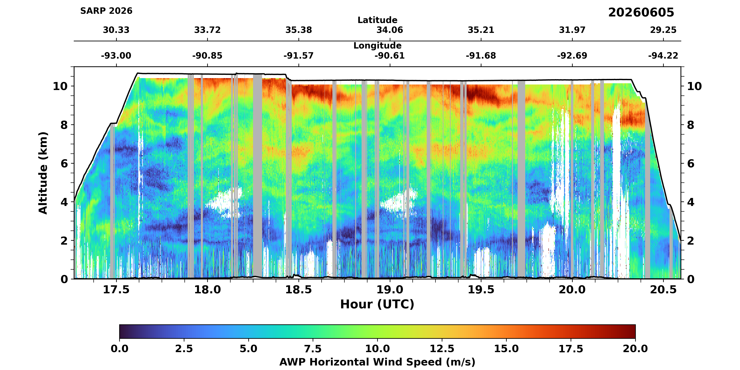
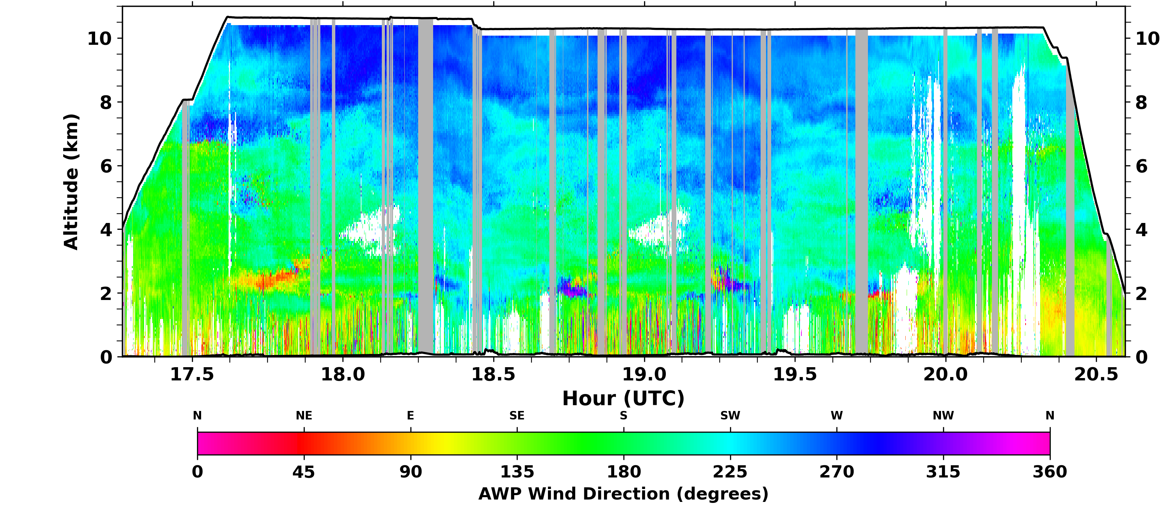
GCAS flights during the SARP2026 campaign
Campaign specifics
June 3 – June 14, 2026 / Houston, TX
Permian basin
NASA LaRC G-Ⅲ
GCAS (NO₂; GSFC), AWP (3-D wind profile; LaRC)
GCAS Instrument
Spectral resolution | 0.6 nm
Spectral sampling | 0.2 nm
Nominal spatial resolution * at nadir, alt=33,000 ft | x-track: | 250 m*
 | a-track: | 250 m
NO₂ fitting window | 430 – 460 nm
2-σ detection limit | 1.6e15 molecules cm⁻²
June 7, am flight
June 7, pm flight
Wind profile curtain plot from AWP
Atlanta
Other aircrafts
JSC G-V (HSRL2), Dynamic B200 (AVIRIS-3), NOAA P-3 (in-situ; TexAQS)
Science Flight hours: 42 hrs _{(planned)}
Dallas/Fort Worth: June 3
Atlanta: June 4
Permian basin: June 4, 7
Survey (Mississippi/Memphis): June 5
Survey (Houston): June 10
Pandora

Slide 18
Future Projects
2026-2027 Apply SNWG/GMAO air quality forecasts to US embassy and US rural/agricultural sites
2026-2027 Support the NASA FarmFlux Earth Venture suborbital campaign to measure agricultural nitrogen fluxes
2028 HAMAQ Pandora and GCAS
2028-2029 SNWG install Pandoras at US Forestry service locations to sample forest fire plumes.

Slide 19
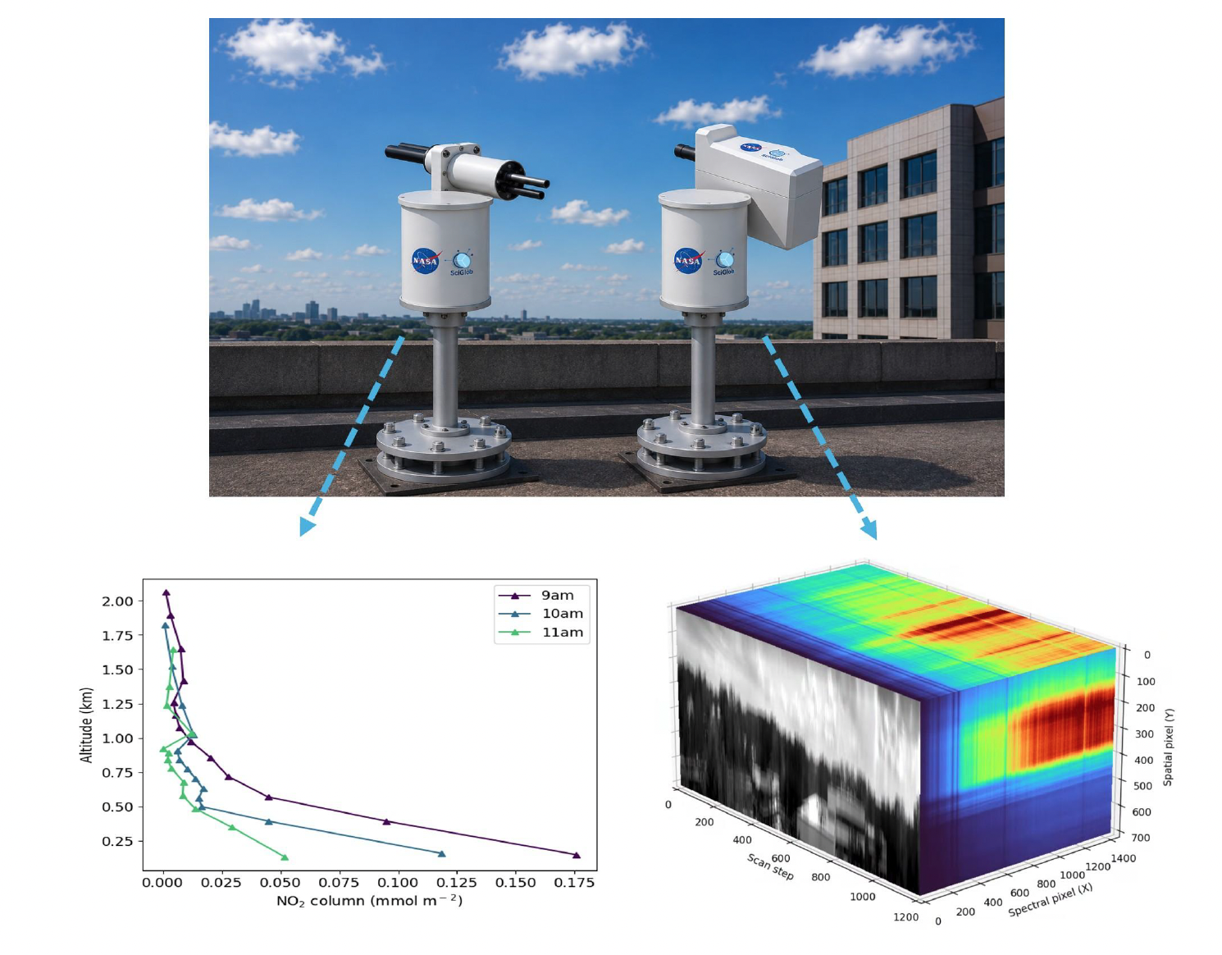
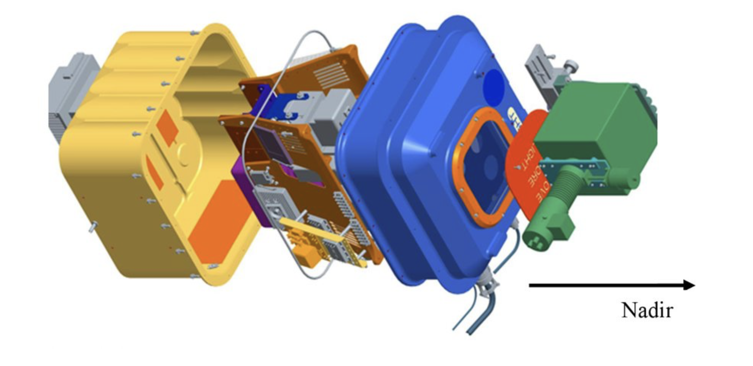
Future Projects
New PanCam concept will provide MAX-DOAS profiles of the horizon
New GCAS with CMOS camera and improved HCHO

