Slide 1



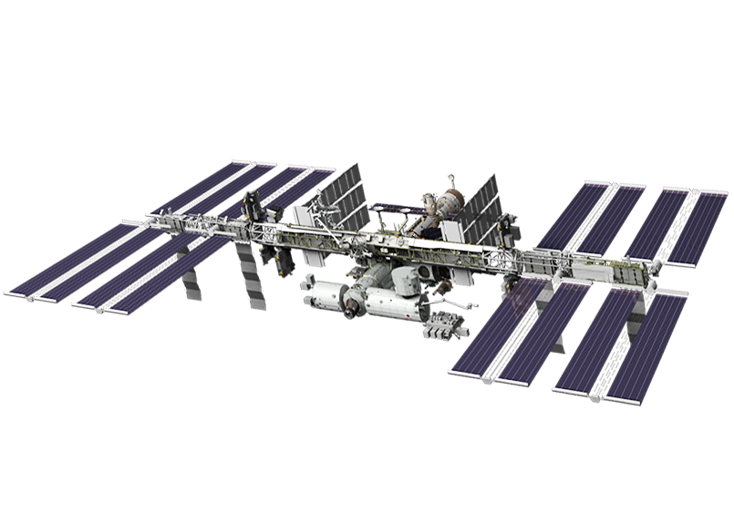
Solar-Induced Chlorophyll Fluorescence (from TEMPO)
thomas p kurosu
Nicholas C Parazoo
Jet Propulsion Laboratory,
California Institute of Technology
2026 TEMPO/DART Meeting Iowa City, IA
©2026 California Institute of Technology
Government sponsorship acknowledged

Slide 2
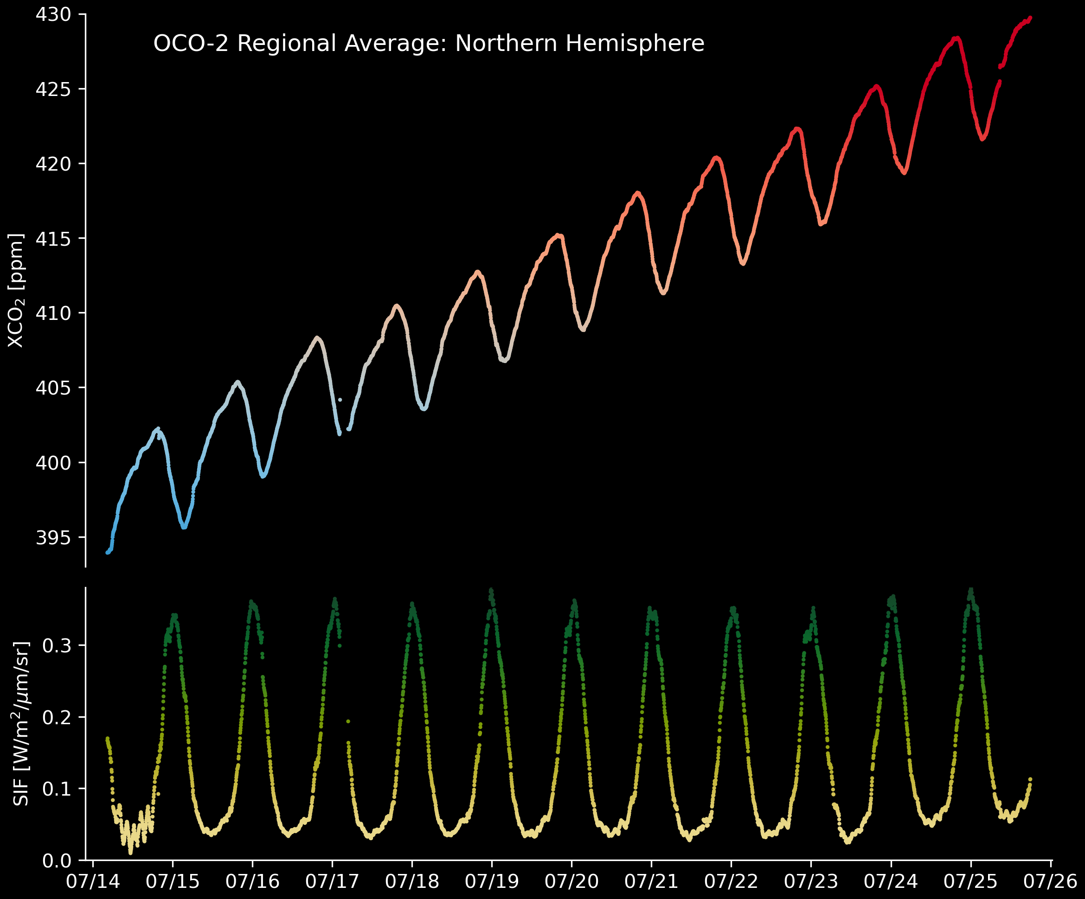

Carbon Cycle – Vegetation and Atmospheric CO₂
why bother with
Solar-Induced Chlorophyll Fluorescence?
Notes:
Key Points:
Continuous tracking of vegetation dynamics and water use efficiency is critical for food security, ecosystem resilience, and economic stability, as it helps decision-makers anticipate and limit the impacts of wildfires, drought, and other extremes.
Timely information on the efficiency of agricultural practices from satellite remote sensing is critical in helping society prepare for short-term disruptions to food supply and in informing strategies and adaptive management frameworks to enhance socioecological resilience

Slide 3
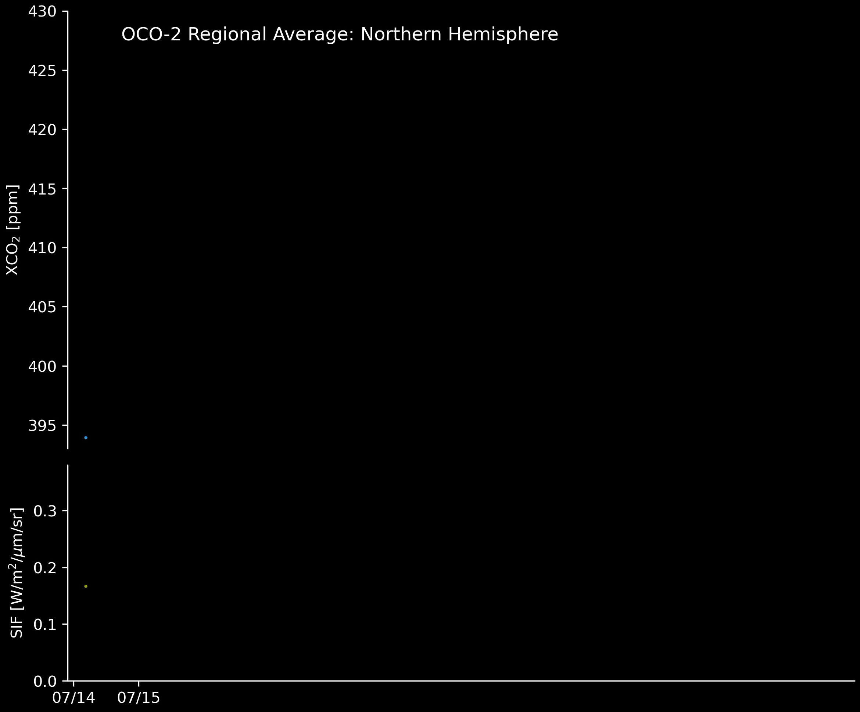
Carbon Cycle – Vegetation and Atmospheric CO₂
Plant Respiration (Photosynthesis)
Origin of the CO₂ “pulse” due to CO₂ draw-down
Determination of anthropogenic CO₂ fluxes requires accurate knowledge of biogenic fluxes
Solar-Induced Chlorophyll Fluorescence (SIF) is a direct indicator of plant photosynthetic activity, observable from space on regional and global scales
Increasing global temperatures will affect vegetation photosynthetic activity, i.e., vegetation health; different vegetation types will be affected differently
Notes:
Key Points:
Continuous tracking of vegetation dynamics and water use efficiency is critical for food security, ecosystem resilience, and economic stability, as it helps decision-makers anticipate and limit the impacts of wildfires, drought, and other extremes.
Timely information on the efficiency of agricultural practices from satellite remote sensing is critical in helping society prepare for short-term disruptions to food supply and in informing strategies and adaptive management frameworks to enhance socioecological resilience

Slide 4

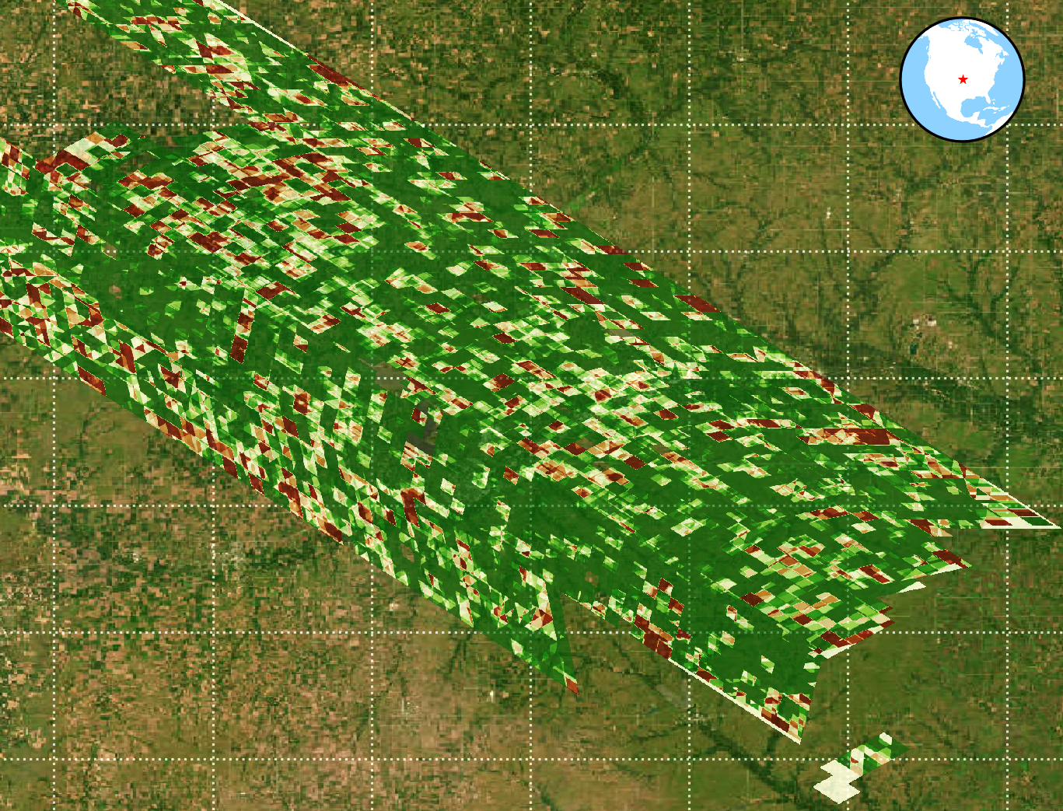
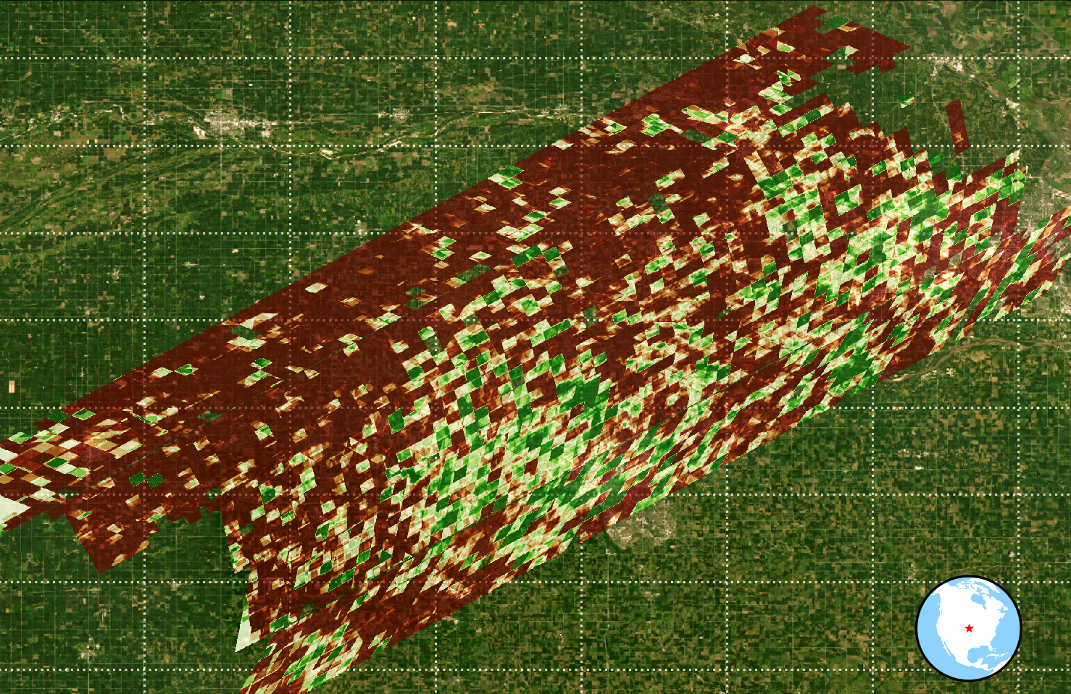
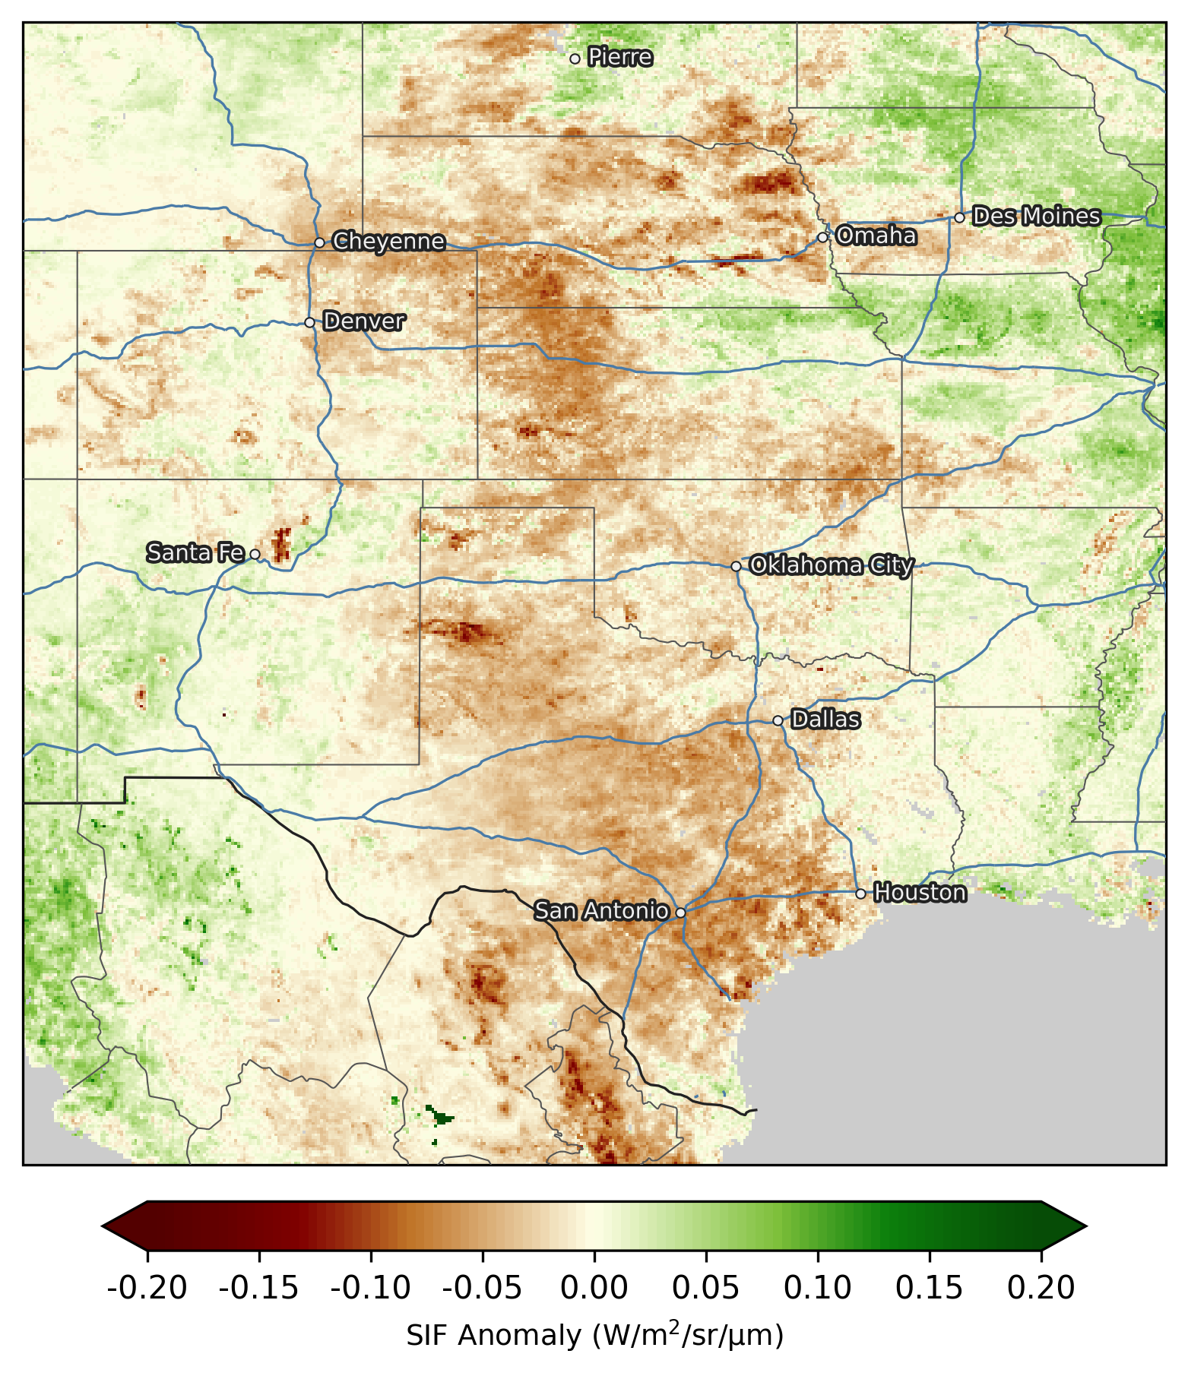
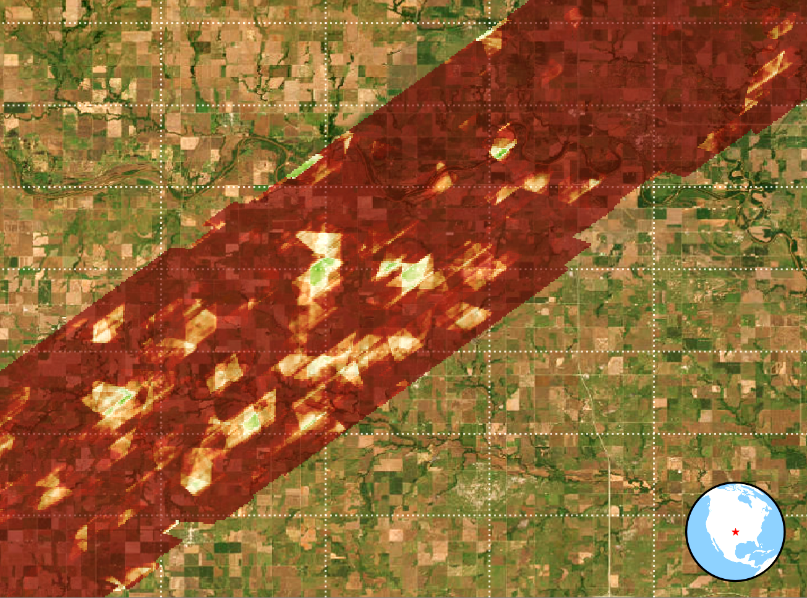
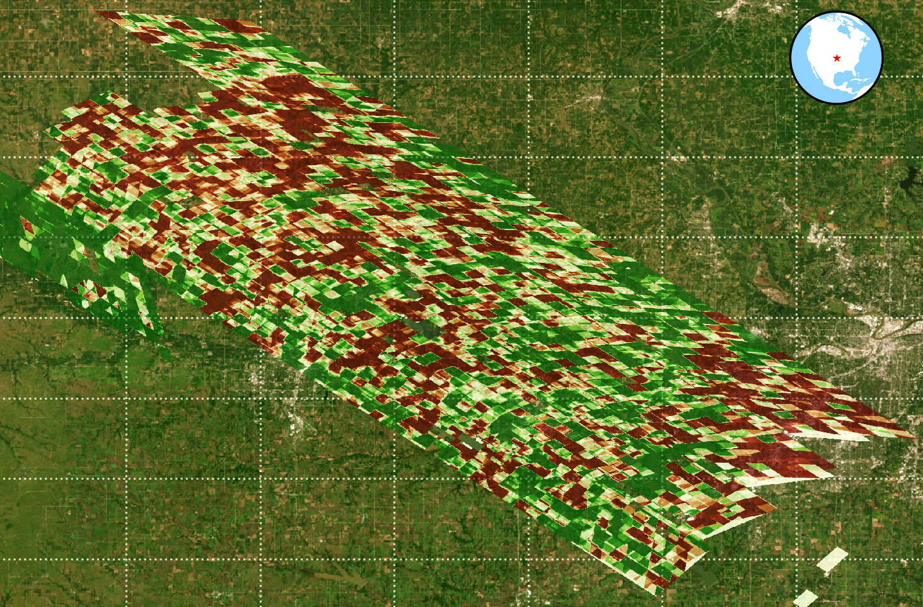
OCO-3 SIF Detail: Crop Stress and Productivity at Farm Scale (<100 acres)
2022 Midwest Drought
Summer Plant Growth Deficit
OCO-3 SAM
0.5 x 0.5 km (<100 acres)
June 9, 2022
Corn, Soy
OCO-2 based Level 3 SIF (GOSIF)
5 km x 5 km
Jun-Aug, 2022
OCO-3 SAM
0.5 x 0.5 km (<100 acres)
June 29, 2022
Grassland Prairie
★
Crop SIF loss ~
USDA NASS yield loss (10%–35%)
Prairie SIF loss minimal, better drought tolerance
Iowa City
Crop Yield data from U.S. Dept. of Ag. National Agricultural Statistics Service (USDA NASS)
OCO-3 SAM
0.5 x 0.5 km (<100 acres)
July 22, 2022
Winter Wheat, Soy
Agricultural areas show significant stress
Prairies show more resiliency to drought
OCO-3 SAM
0.5 x 0.5 km (<100 acres)
Aug 29, 2022
Grassland Prairie
Crop SIF loss ~
USDA NASS yield loss (25%– 50%)
SIF Anomaly, relative to multi-year baseline
(W/m²/sr/µm)
Notes:
Key Points:
Continuous tracking of vegetation dynamics and water use efficiency is critical for food security, ecosystem resilience, and economic stability, as it helps decision-makers anticipate and limit the impacts of wildfires, drought, and other extremes.
Timely information on the efficiency of agricultural practices from satellite remote sensing is critical in helping society prepare for short-term disruptions to food supply and in informing strategies and adaptive management frameworks to enhance socioecological resilience

Slide 5
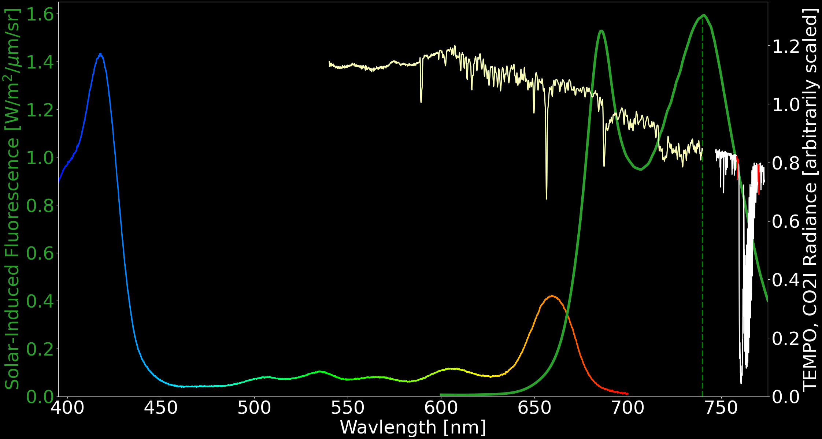
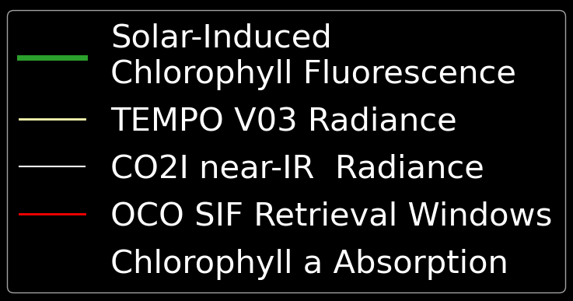
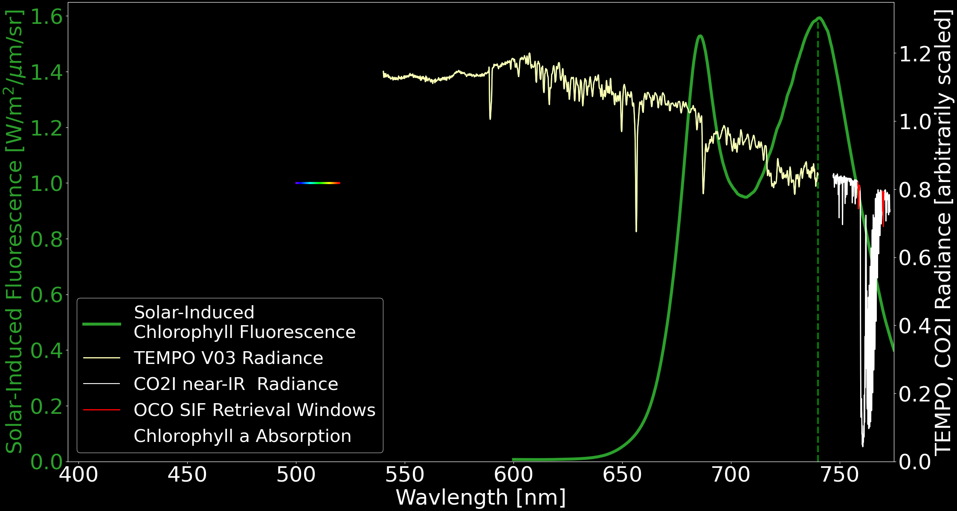
”Wiggly Line Science”: Radiance Spectra, SIF, Chlorophyll A
//
PS II
PS I +
PS II
SIF Retrieval:
Chlorophyll A absorption + SIF: net effect is akin to inelastic scattering (redistribution of energy)
SIF reduces FHL line depth, ~1-2% of absolute radiances
Ideal retrieval window: ~740 nm (avoid molecular absorption bands, e.g., O₂)
PS II region is less ideal (residual Chlorophyll A absorption)
O₂ 𝛿
FHL
FHL
FHL
O₂ 𝛾
FHL
O₂ B
FHL
FHL
PS: Photosystem
(protein complexes in membranes)
FHL: Solar Fraunhofer Line
//
O₂ A
Notes:
Key Points:
Continuous tracking of vegetation dynamics and water use efficiency is critical for food security, ecosystem resilience, and economic stability, as it helps decision-makers anticipate and limit the impacts of wildfires, drought, and other extremes.
Timely information on the efficiency of agricultural practices from satellite remote sensing is critical in helping society prepare for short-term disruptions to food supply and in informing strategies and adaptive management frameworks to enhance socioecological resilience

Slide 6
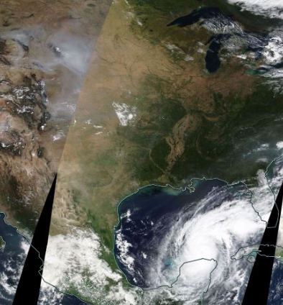
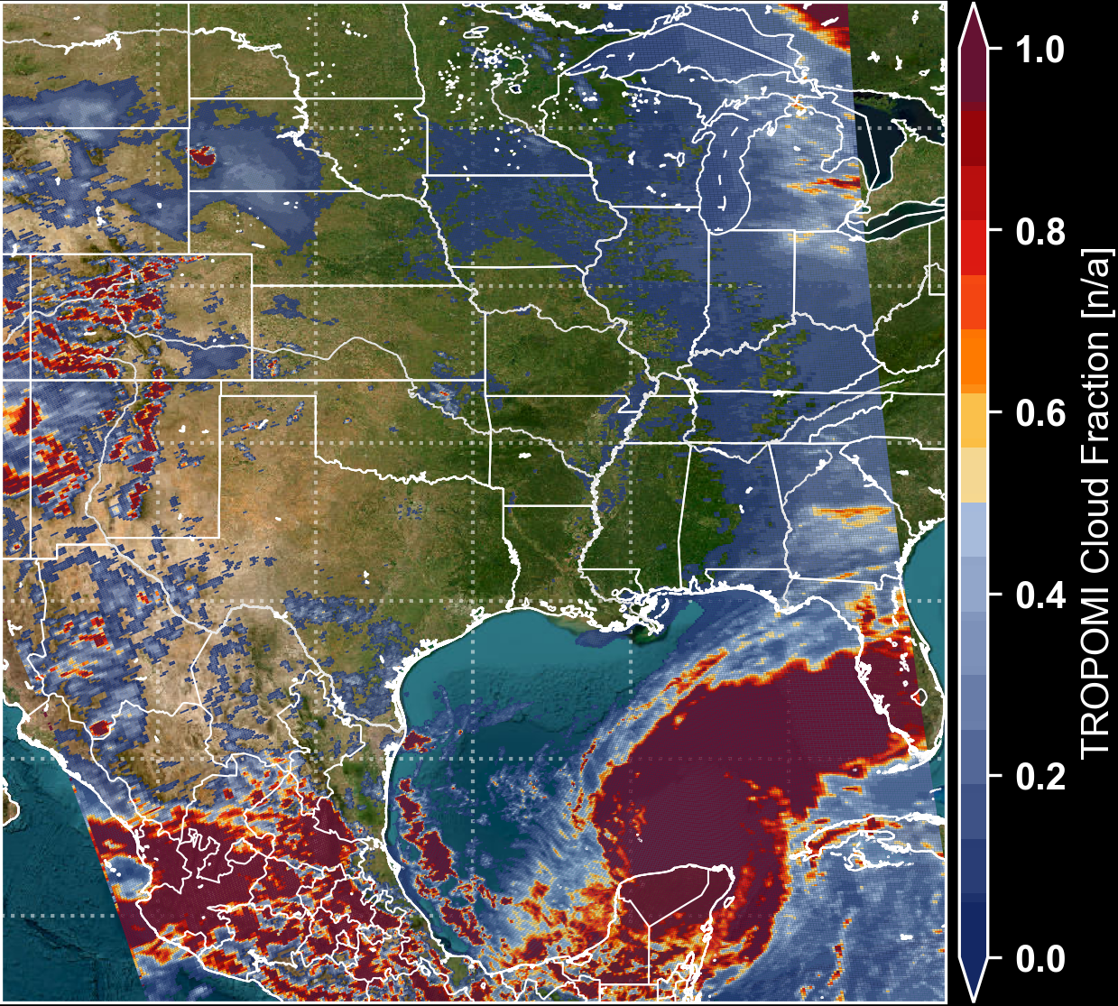
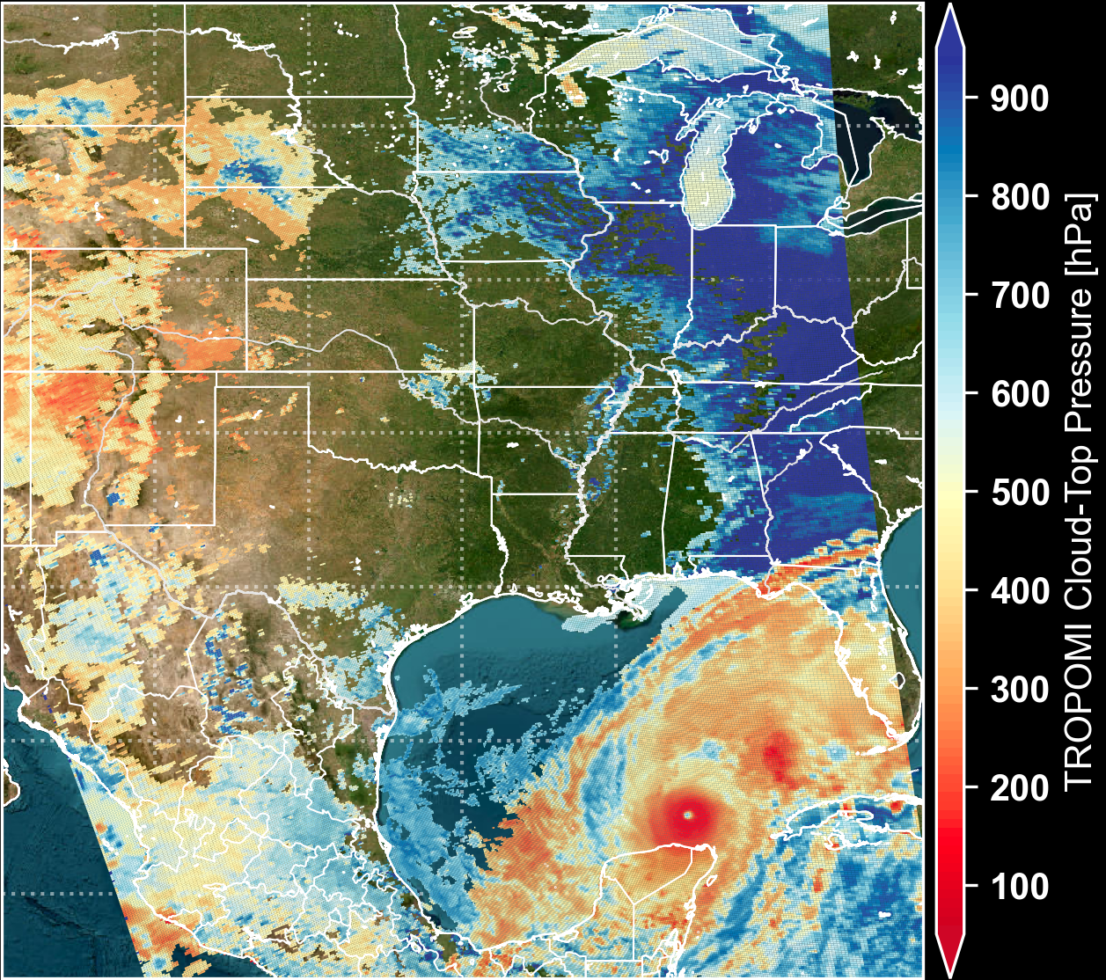
Test Case: Hurricane Milton, 2024-10-08
NASA Worldview
TROPOMI Cloud Fraction
TROPOMI Cloud Pressure
Notes:
Key Points:
Continuous tracking of vegetation dynamics and water use efficiency is critical for food security, ecosystem resilience, and economic stability, as it helps decision-makers anticipate and limit the impacts of wildfires, drought, and other extremes.
Timely information on the efficiency of agricultural practices from satellite remote sensing is critical in helping society prepare for short-term disruptions to food supply and in informing strategies and adaptive management frameworks to enhance socioecological resilience

Slide 7
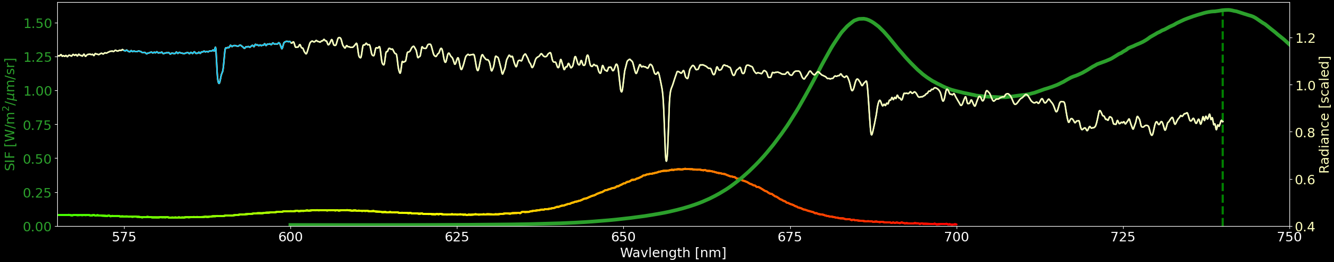
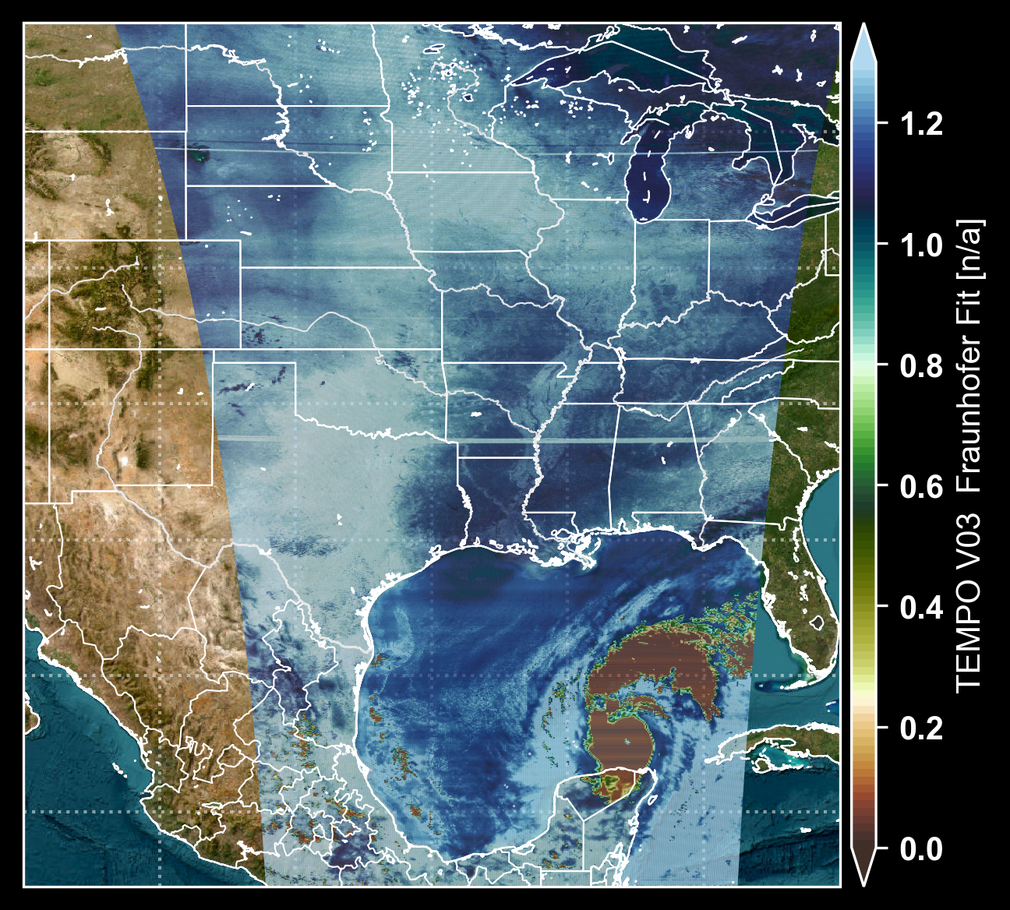
Test Case: Hurricane Milton, Solar FHL Fits
575 – 600 nm
Notes:
Key Points:
Continuous tracking of vegetation dynamics and water use efficiency is critical for food security, ecosystem resilience, and economic stability, as it helps decision-makers anticipate and limit the impacts of wildfires, drought, and other extremes.
Timely information on the efficiency of agricultural practices from satellite remote sensing is critical in helping society prepare for short-term disruptions to food supply and in informing strategies and adaptive management frameworks to enhance socioecological resilience

Slide 8

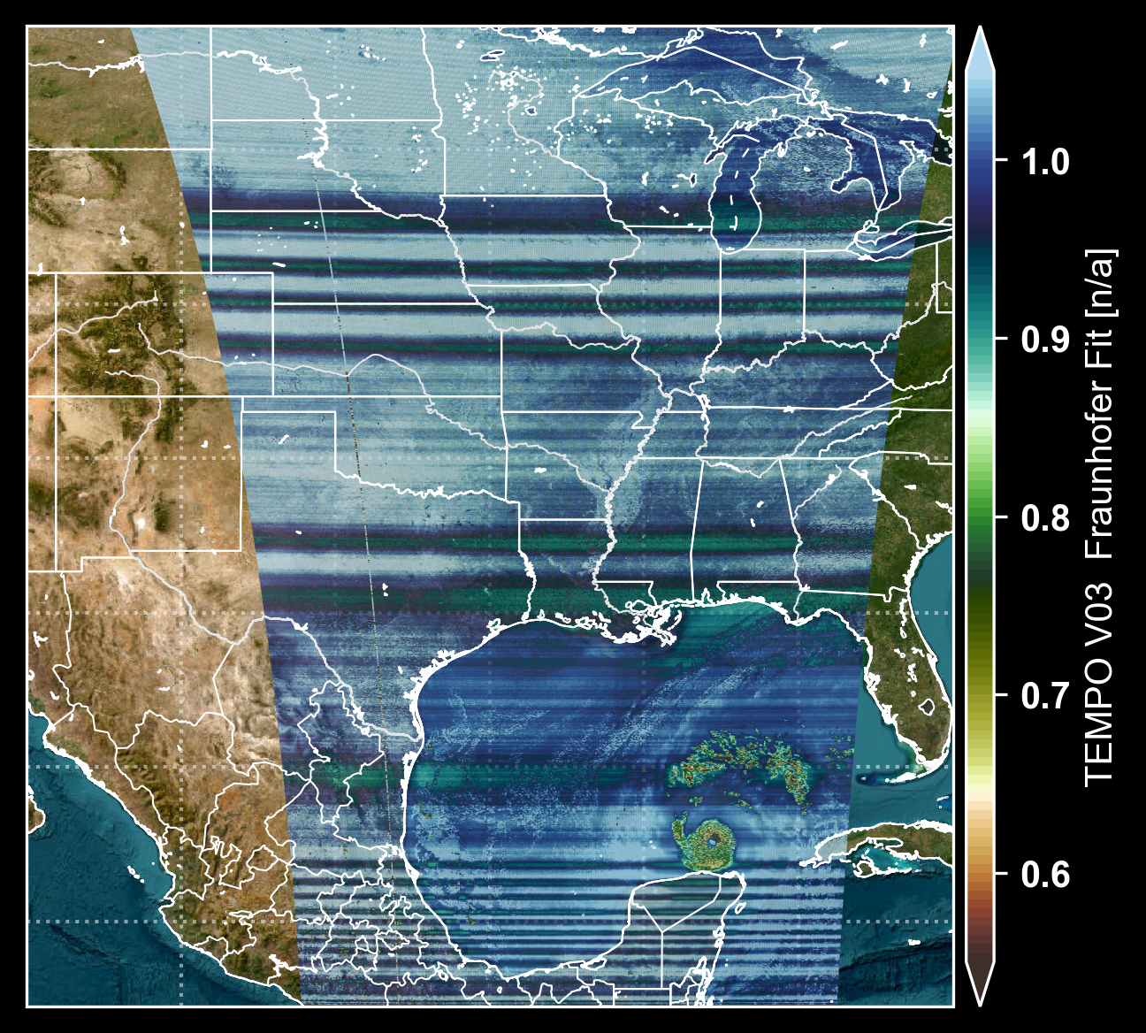
Test Case: Hurricane Milton, Solar FHL Fits
575 – 600 nm
645 – 665 nm
Notes:
Key Points:
Continuous tracking of vegetation dynamics and water use efficiency is critical for food security, ecosystem resilience, and economic stability, as it helps decision-makers anticipate and limit the impacts of wildfires, drought, and other extremes.
Timely information on the efficiency of agricultural practices from satellite remote sensing is critical in helping society prepare for short-term disruptions to food supply and in informing strategies and adaptive management frameworks to enhance socioecological resilience

Slide 9
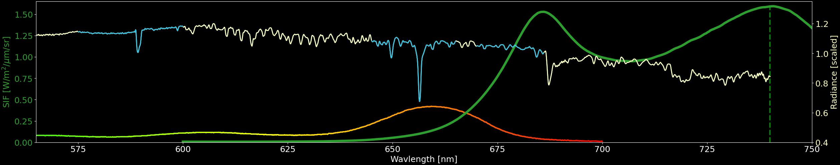
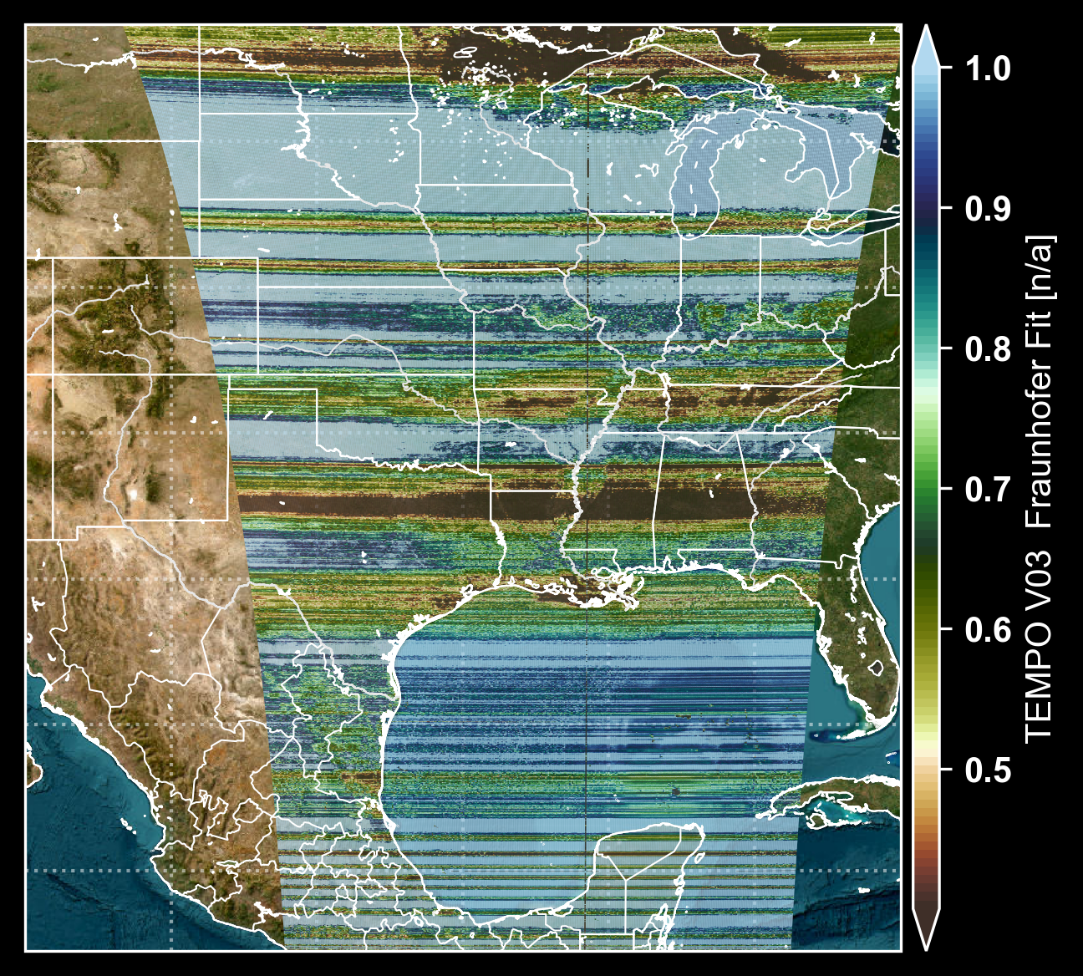
Test Case: Hurricane Milton, Solar FHL Fits
575 – 600 nm
645 – 665 nm
670 – 686 nm
Notes:
Key Points:
Continuous tracking of vegetation dynamics and water use efficiency is critical for food security, ecosystem resilience, and economic stability, as it helps decision-makers anticipate and limit the impacts of wildfires, drought, and other extremes.
Timely information on the efficiency of agricultural practices from satellite remote sensing is critical in helping society prepare for short-term disruptions to food supply and in informing strategies and adaptive management frameworks to enhance socioecological resilience

Slide 10
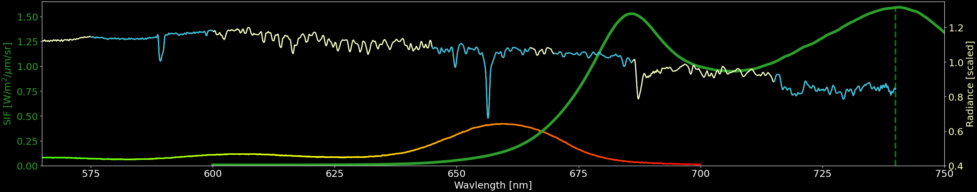
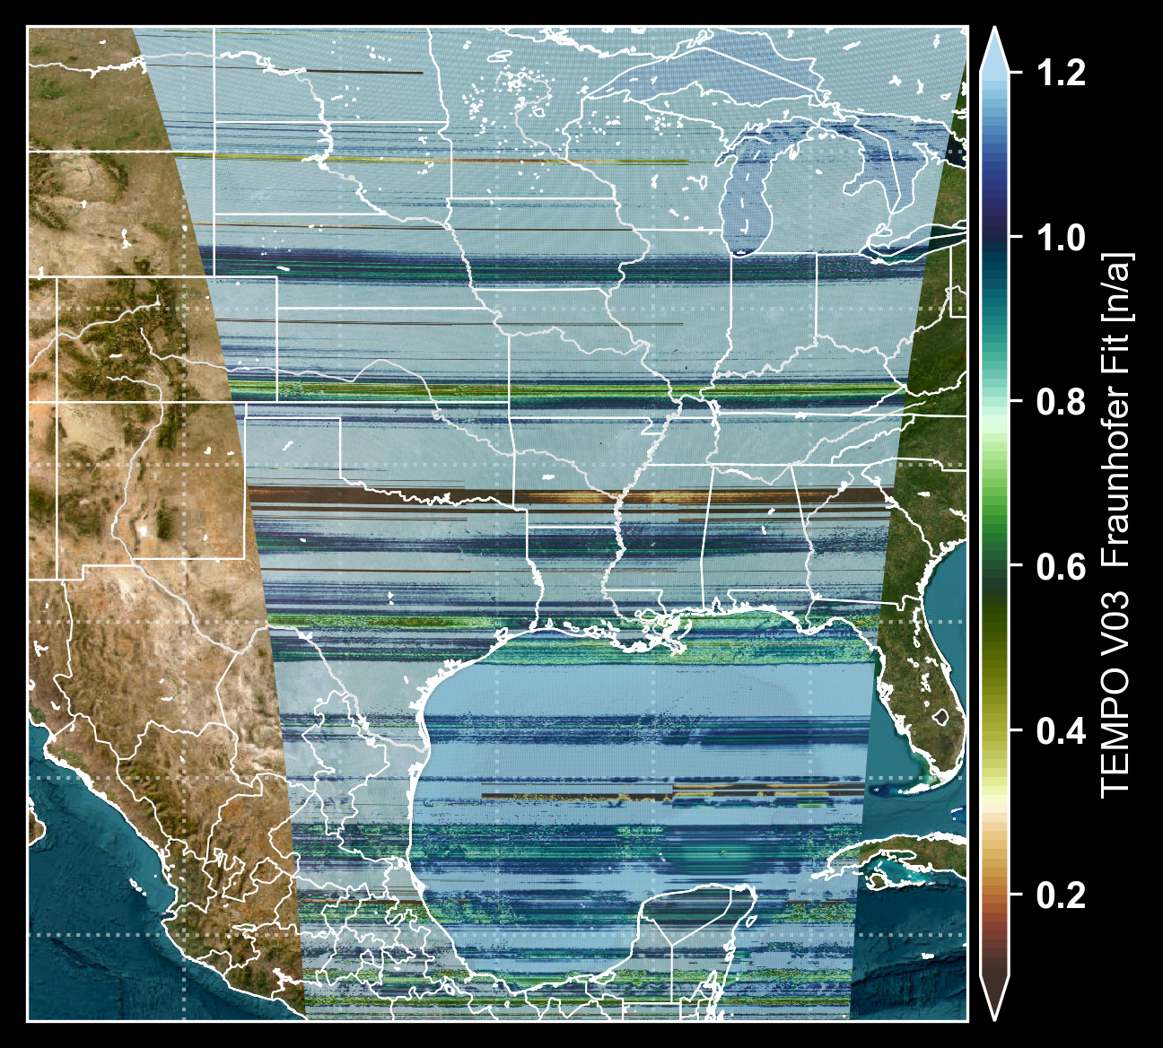
Test Case: Hurricane Milton, Solar FHL Fits
575 – 600 nm
645 – 665 nm
670 – 686 nm
715 – 740 nm
Notes:
Key Points:
Continuous tracking of vegetation dynamics and water use efficiency is critical for food security, ecosystem resilience, and economic stability, as it helps decision-makers anticipate and limit the impacts of wildfires, drought, and other extremes.
Timely information on the efficiency of agricultural practices from satellite remote sensing is critical in helping society prepare for short-term disruptions to food supply and in informing strategies and adaptive management frameworks to enhance socioecological resilience

Slide 11
Solar-Induced Chlorophyll Fluorescence from TEMPO
What Will It Take?
Improved Spectral Calibration of Band 2
Creative Retrieval Approaches
Tenacity
Notes:
Key Points:
Continuous tracking of vegetation dynamics and water use efficiency is critical for food security, ecosystem resilience, and economic stability, as it helps decision-makers anticipate and limit the impacts of wildfires, drought, and other extremes.
Timely information on the efficiency of agricultural practices from satellite remote sensing is critical in helping society prepare for short-term disruptions to food supply and in informing strategies and adaptive management frameworks to enhance socioecological resilience

