Slide 1
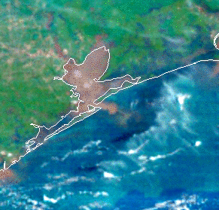


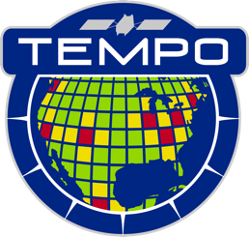

Extending TEMPO to Ocean Color: An AI/ML Approach for Monitoring the Oceans from TEMPO
TEMPO DART Meeting
University of Iowa
June 15, 2026
Zachary Fasnacht^{1,2} (Zachary.t.Fasnacht@nasa.gov)
James Allen^{2,3}, Amir Ibrahim² , Joanna Joiner⁴, Matthew Bandel^{1,2}, Nickolay Krotkov², Alexander Vasilkov^{2,5}, Michael Himes^{2,3}, Xiong Liu⁶, Heesung Chong⁶, Jim Carr^{2,7}
¹Science and Technology Corp, ²NASA GSFC, ³GESTAR II Morgan State University, ⁴Asticou Earth Systems LLC, ⁵ADNET Systems Inc,, ⁶Harvard SAO, ⁷Carr Astronautics Corp
We’d like to acknowledge support from the NASA Data, Applications, Research and Technology (DART) Team (Grant 80NSSC26K0193) as well as NASA's Advanced Information System Technology (AIST) program (Grant 80NSSC22K1156)
GIF from: https://www.nesdis.noaa.gov/events/noaas-satellite-applications-symposium-series-water

Slide 2
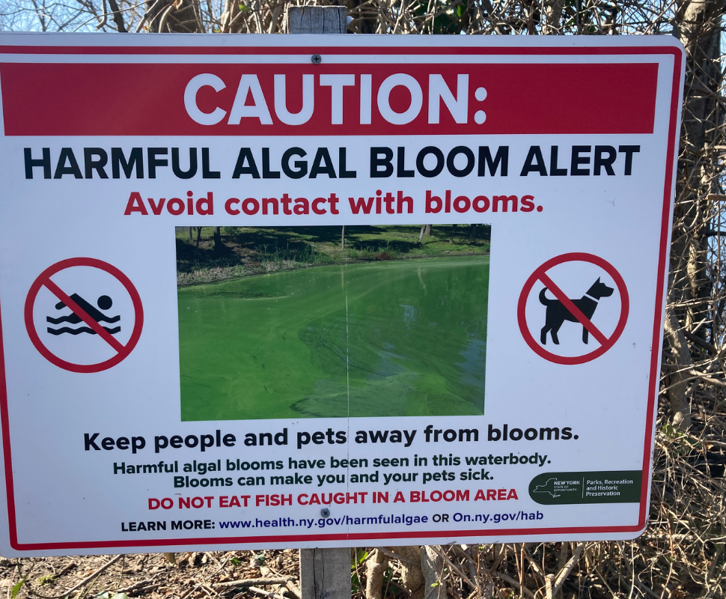
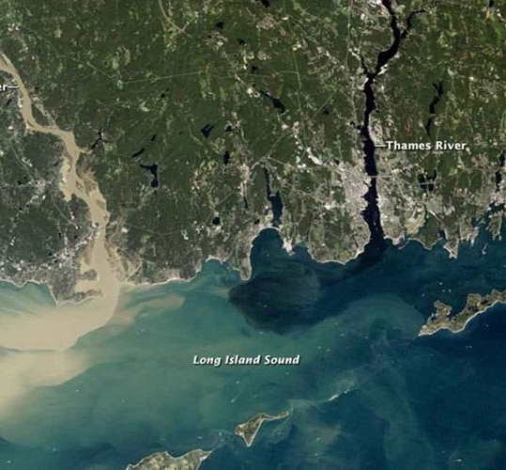
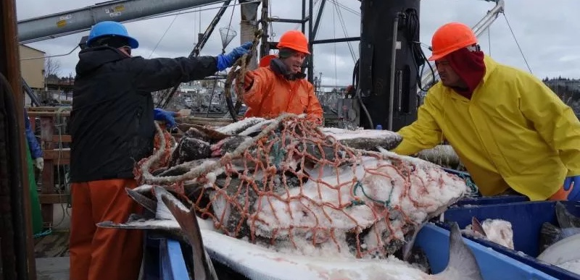
Why Geostationary Ocean Color?
U.S. fisheries contributed $321 billion to economy in 2023 (NOAA fisheries)
Harmful algae blooms (HABs) cause an estimated $1 billion per year in economic and health impacts
Polar-orbiting ocean color satellites have numerous gaps due to clouds & aerosols, limiting monitoring of HABs and short-term modeling of fisheries
GOCI-I and GOCI-II, launched in NE Asia by KIOST, have been shown to improve short-term monitoring of events such as HABs
NASA plans to launch Geostationary Littoral Imaging and Monitoring Radiometer (GLIMR) in 2028 to monitor North American coastal waters
https://science.nasa.gov/earth/earth-observatory/sediment-spews-from-connecticut-river-52059/
https://savethegreatsouthbay.org/algal-blooms-2/harmful-algal-blooms-habs-spot-it-avoid-it-report-it/
https://www.fisheries.noaa.gov/feature-story/alaska-fisheries-under-close-watch-ensure-compliance

Slide 3
Where Does
TEMPO Fit?
TEMPO
GLIMR
MODIS
PACE OCI
Spectral Resolution
0.6nm | 10-50nm | 5nm | 2nm in UV to 20nm in NIR
0.2nm | Multi-band | 2.5nm | 1-5nm in UV, 20nm at longer wavelengths
290-490nm 540-740nm | 400nm-14.385um | 340- 890nm* | 340-1040nm
2x4.75km² at center | 0.25-1km IFOV | 1km IFOV | 300m-500m
Hourly | 1 per day | 1 per day | Every 2-3 Hours
Although spatially coarser than typical OC instruments, TEMPO’s spectral coverage (including green/red) and resolution make it a useful proxy to explore Geo OC applications
The temporal resolution provides complimentary information alongside traditional OC sensors such as MODIS and PACE OCI
Spectral Sampling
Spectral Range
Spatial Resolution
Revisit Time
*PACE OCI also has 7 band measurements further into NIR/SWIR

Slide 4
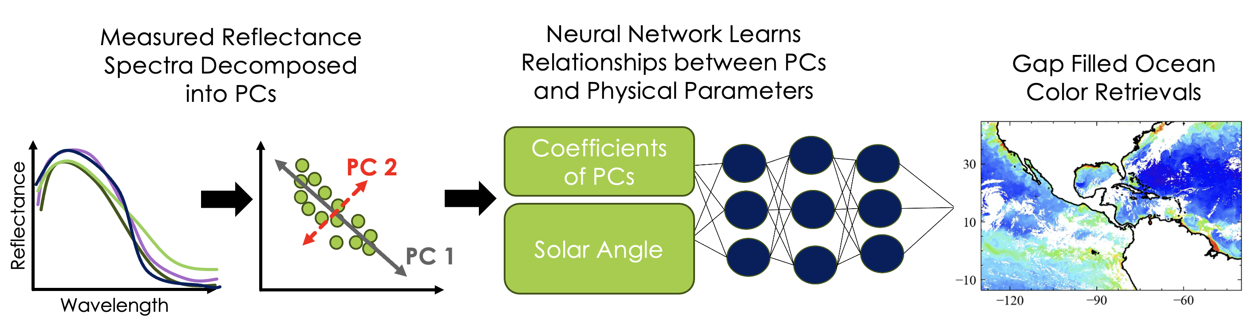
Pre-Processing
TEMPO L1b V4 reflectances from UV (345-485nm) and Vis (545-735nm) decomposed into principal components to train ML model (smoothed to 1nm FWHM)
Covariance matrix stored so that it can be applied to unseen spectra when making chlorophyll estimates
NN Training
Feed forward three-layer neural network used to learn relationships
PC’s + solar angle provided as input to NN
Optically thick clouds excluded using TEMPO O4 cloud radiance fraction
Predicted Output
Training data co-located from traditional OC instruments (MODIS, VIIRS, OLCI, or OCI)
Level 2 chlorophyll and remote sensing reflectance is gridded hourly at 2km spatial resolution before being co-located in time & space to the TEMPO field of regard using nearest neighbor approach

Slide 5
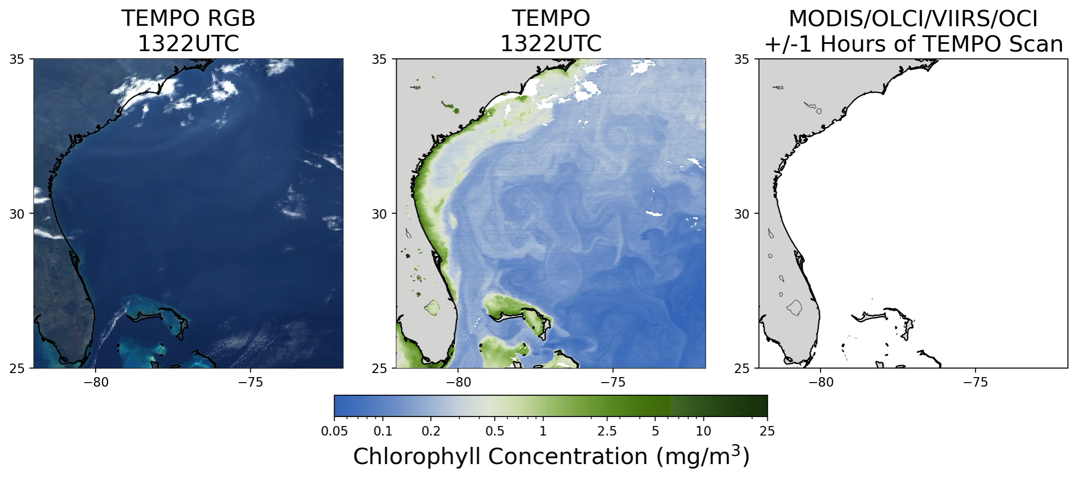
Gulf Stream Current
March 22, 2026
The Gulf Stream is a fast current that transports warm tropical waters into the North Atlantic
Example below shows sub-daily northward movement off the southeastern US coast, along with coastal upwelling
TEMPO’s hourly observations provide additional insight into the evolution and transport of ocean features throughout the day

Slide 6
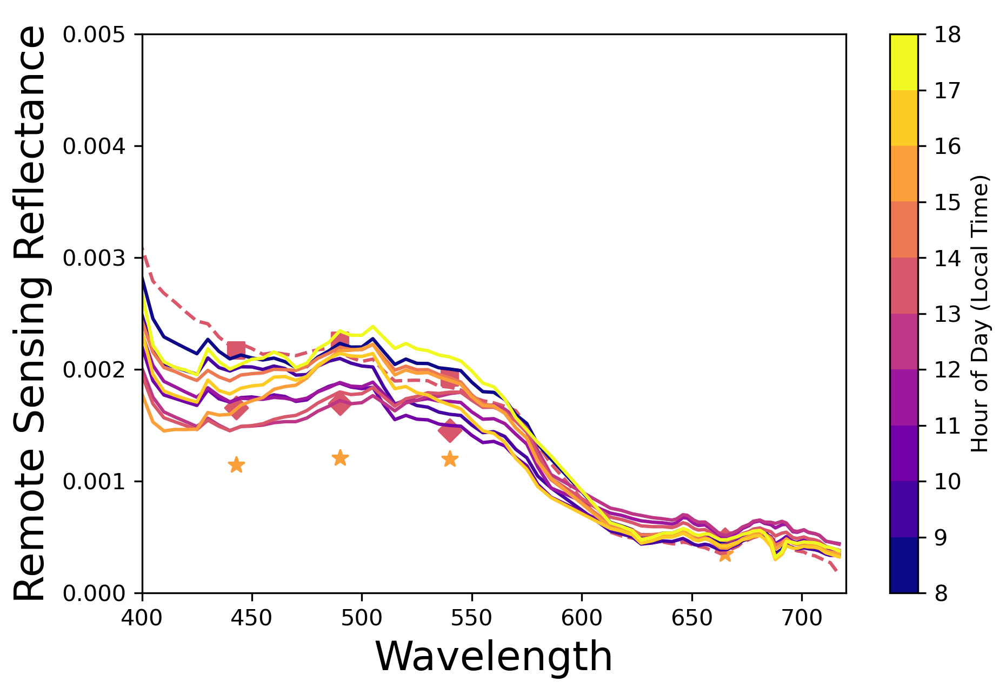
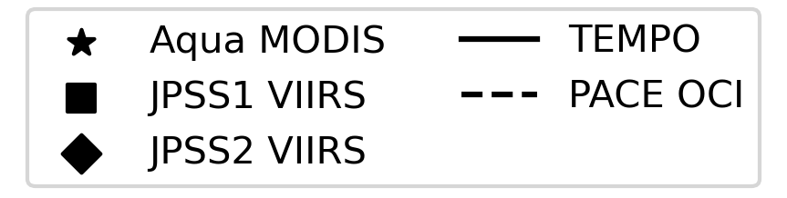
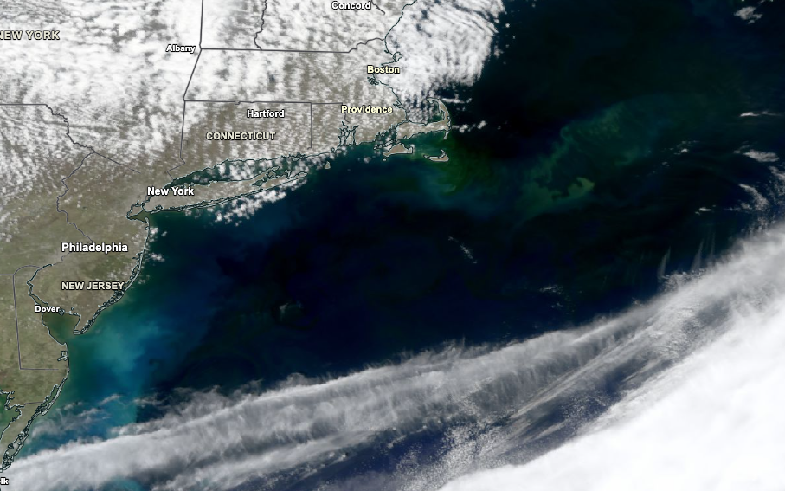
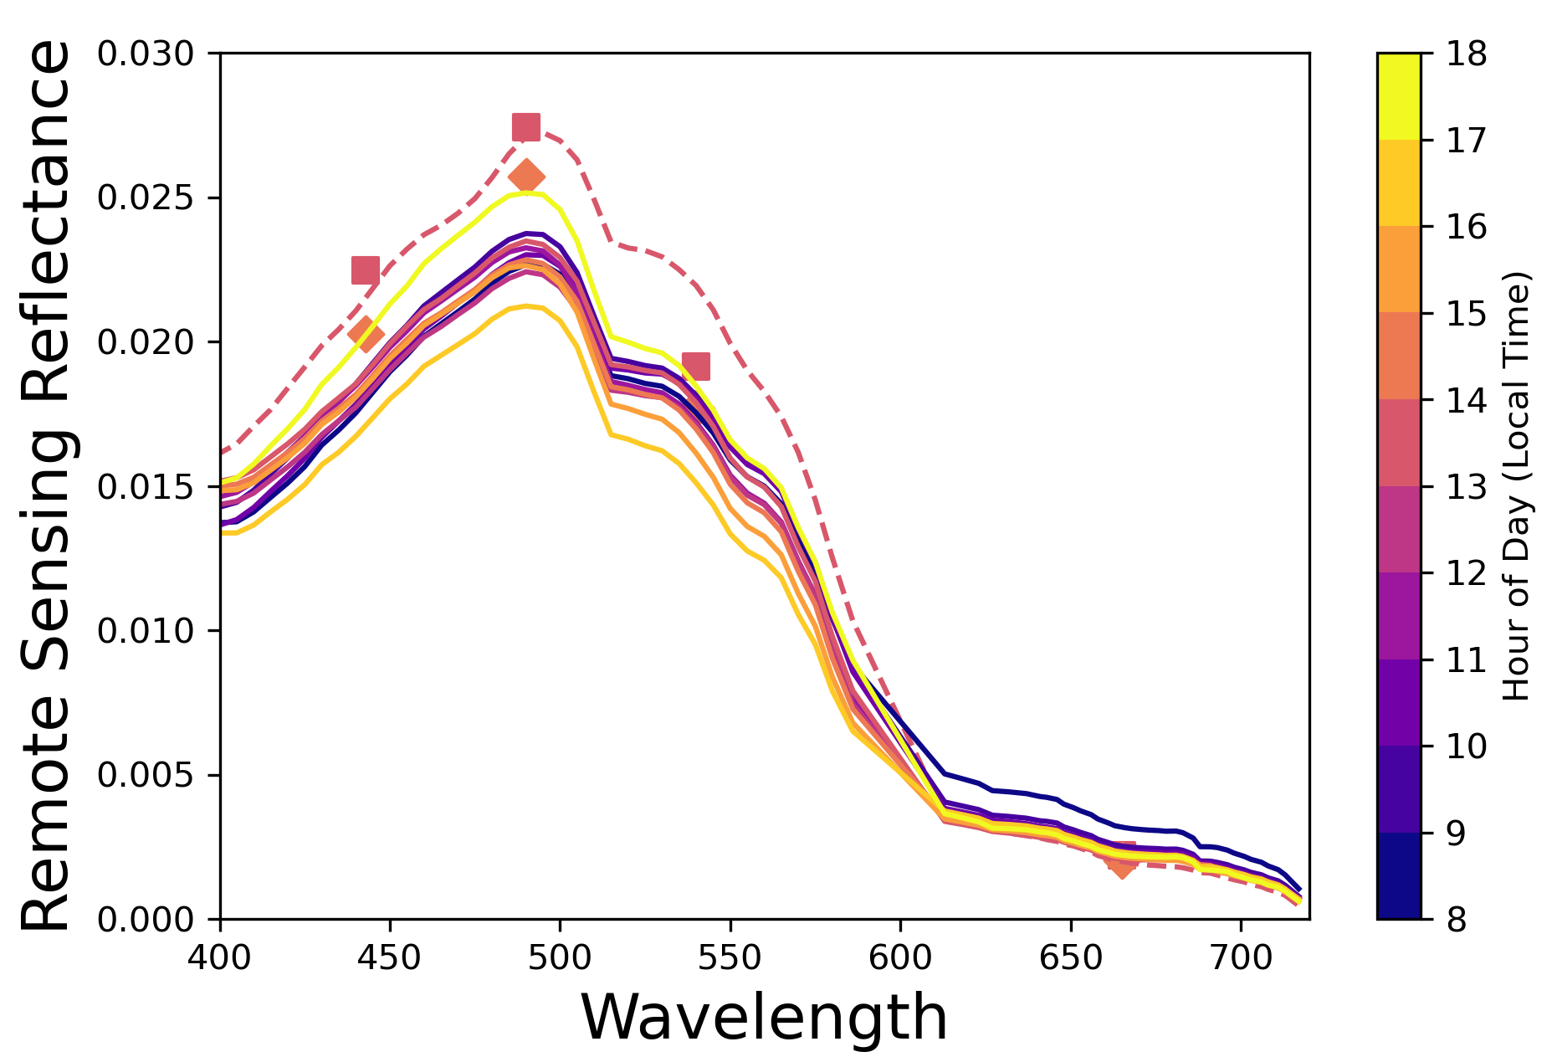
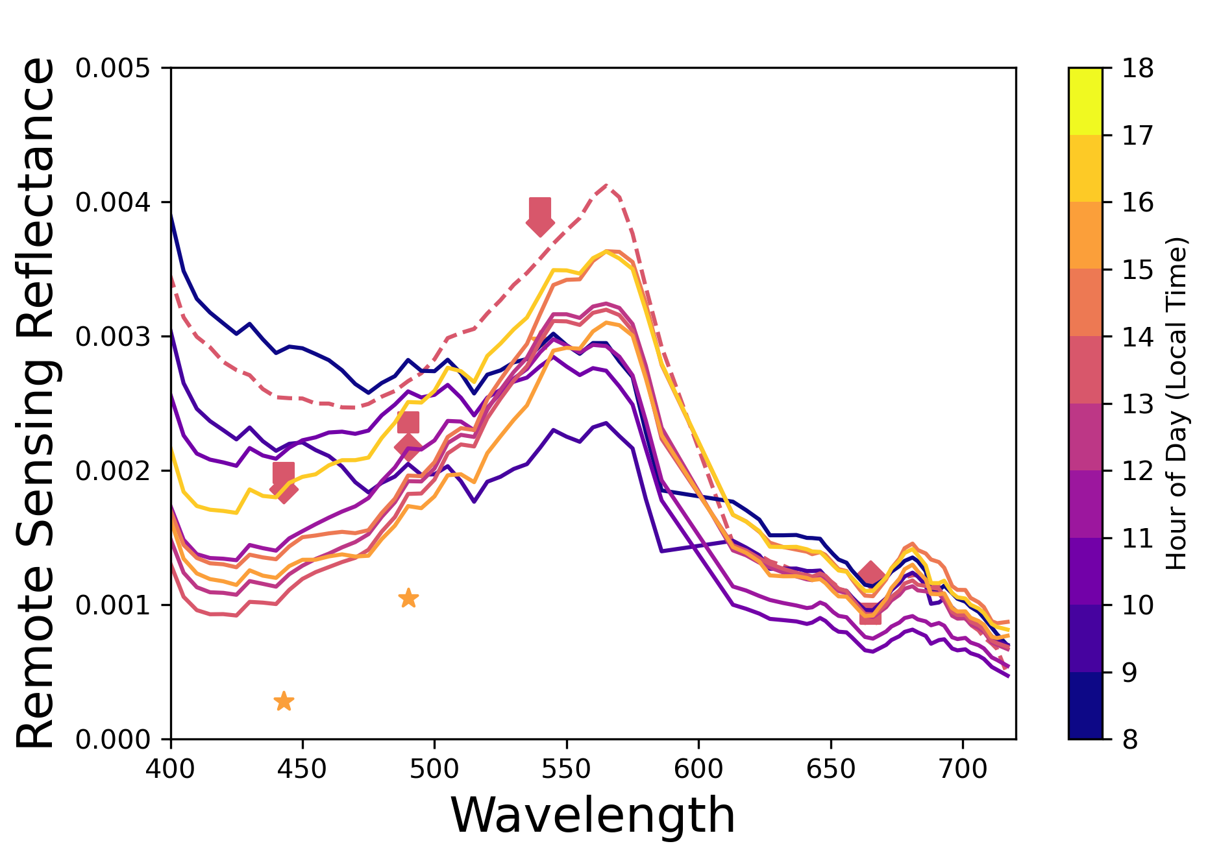
April 6, 2026
Mid-Atlantic Phytoplankton Bloom
March-April 2026
Large phytoplankton bloom developed off the New Jersey coast in late March 2026 and continued evolving through April.
Spring phytoplankton blooms are fueled by increasing sunlight, nutrient availability, and coastal/riverine inputs.
Early bloom stages often dominated by diatoms, which produce greener waters, while later stages may include coccolithophores that give the water a brighter blue or milky appearance.
Spectra shown on right highlight differences between bloom and open-ocean waters and demonstrate the added value of hyperspectral observations
PACE OCI RGB from NASA Worldview

Slide 7
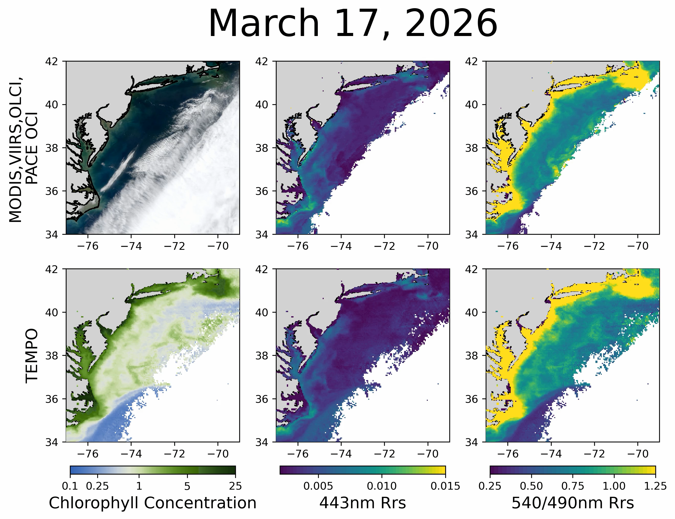
Mid-Atlantic Phytoplankton
Bloom
Example on right compares daily TEMPO remote sensing reflectance (Rrs) composites with a multi-instrument average derived from MODIS, VIIRS, OLCI, and PACE OCI
TEMPO’s improved spatial coverage enables more continuous monitoring of the bloom’s evolution
The green-to-blue reflectance ratio (right panel) increases during bloom development and decreases as the bloom matures, potentially indicating changes in the phytoplankton composition
OCI RGB
MODIS, VIIRS, OLCI,
PACE OCI
TEMPO

Slide 8
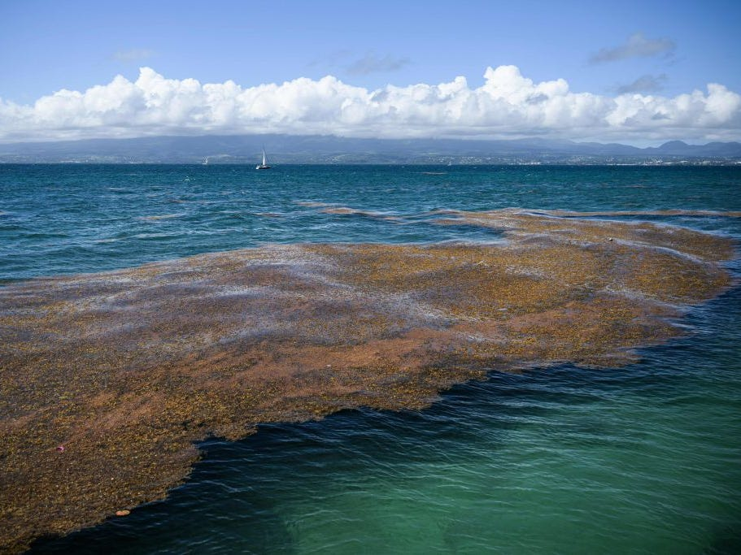
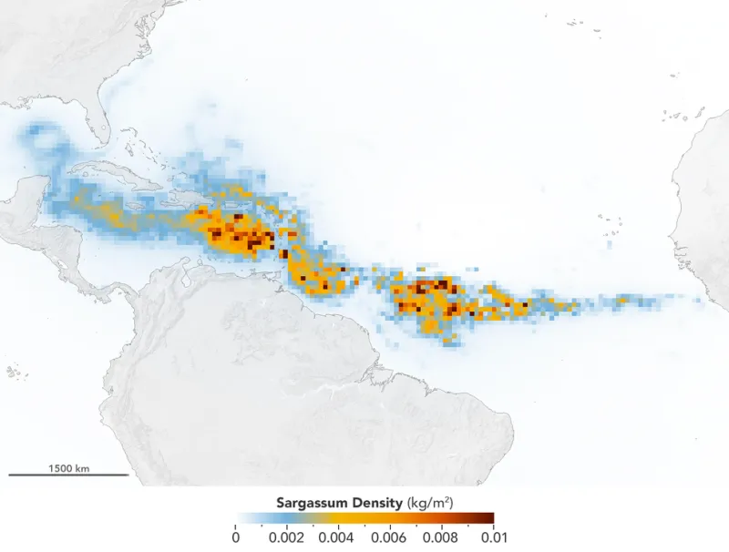
Great Sargassum Belt
https://www.popularmechanics.com/science/environment/a43439656/great-atlantic-sargassum-belt-explained/
The Great Atlantic Sargassum Belt is a massive accumulation of floating brown macroalgae that stretches across the tropical Atlantic Ocean
During major bloom years, the belt can extend more than 8,000 km (5,000 miles) from the coast of West Africa to the Caribbean Sea and Gulf of Mexico
Unlike most seaweeds, pelagic sargassum spends its entire life floating at the ocean surface and does not require attachment to the seafloor
Excessive sargassum accumulations can harm coastal ecosystems, disrupt tourism and fisheries, and degrade water quality as the algae decomposes
https://ocean.si.edu/ocean-life/plants-algae/sargassum-belt

Slide 9
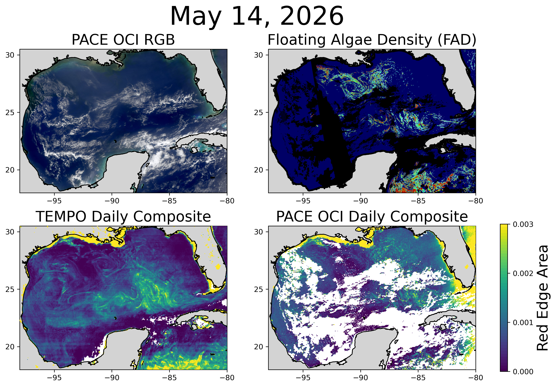

Sargassum in Gulf
of America
USF College of Marine Science FAD product (https://optics.marine.usf.edu; top right) estimates Sargassum coverage using a U-Net trained on MODIS, VIIRS, and PACE OCI.
Because TEMPO does not have SWIR bands, red edge area (REA) metric is used as proxy for floating algae index (FAI), computed by integrating Rrs from 680-720nm
Elevated REA values in TEMPO and PACE OCI corresponds to regions of elevated FAD, demonstrating sensitivity to floating Sargassum

Slide 10
Take Home Messages
TEMPO provides a great opportunity to explore the benefits of a dedicated Geostationary ocean color instrument
Machine learning can be utilized to quickly develop efficient retrievals and provide gap-filling/near real time approach (does not replace physically based approaches needed to develop training data!)
TEMPO ocean color products should be available to the public within the next 1-2 years

Slide 11
References
Figueredo, N., Bentley, S. J., Chaytor, J. D., Xu, K., Jafari, N., Georgiou, I. Y., Damour, M., Duxbury, J., Obelcz, J., and Maloney, J. (2024). Sedimentary Processes and Instability on the Mississippi River Delta Front near the Shipwreck of the SS Virginia. Water, 16(3), 421.
Office of Sustainable Fisheries: NOAA Fisheries, Status of Stocks 2023, NOAA, May 6, 2024, https://www.fisheries.noaa.gov/national/sustainable-fisheries/status-stocks-2023.
Olson, K. R., & Suski, C. D. (2021). Mississippi River Delta: Land subsidence and coastal erosion. Open Journal of Soil Science, 11(3), 139-163.
GeoXO Ocean Color Instrument (OCX) Fact Sheet, National Environment Satellite, Data, and Information Service, July 2024, https://www.nesdis.noaa.gov/s3/2024-07/2024_OCX-Fact-Sheet.pdf.
Xu, Yi, Travis Miles, and Oscar Schofield. "Physical processes controlling chlorophyll-a variability on the Mid-Atlantic Bight along northeast United States." Journal of Marine Systems, 212, 2020.

