Slide 1
Application of PCA to Reduce TEMPO L1 Data Noise and Speed Up Forward Modeling
Xu Liu
NASA Langley Research Center
Xiong Liu, Halen Wang, Junsung Park, Caroline R. Nowlan, Gonzalo G. Abad, Hee Sung Choing, and Weizhen Hou
Center for Astrophyiscs, Harvard & Smithsonian
Qiguang Yang, Xiaozhen Xiong, Ming Zhao, Wan Wu, and David Flitner
NASA Langley Research Center
NOAA OMPS team

Slide 2
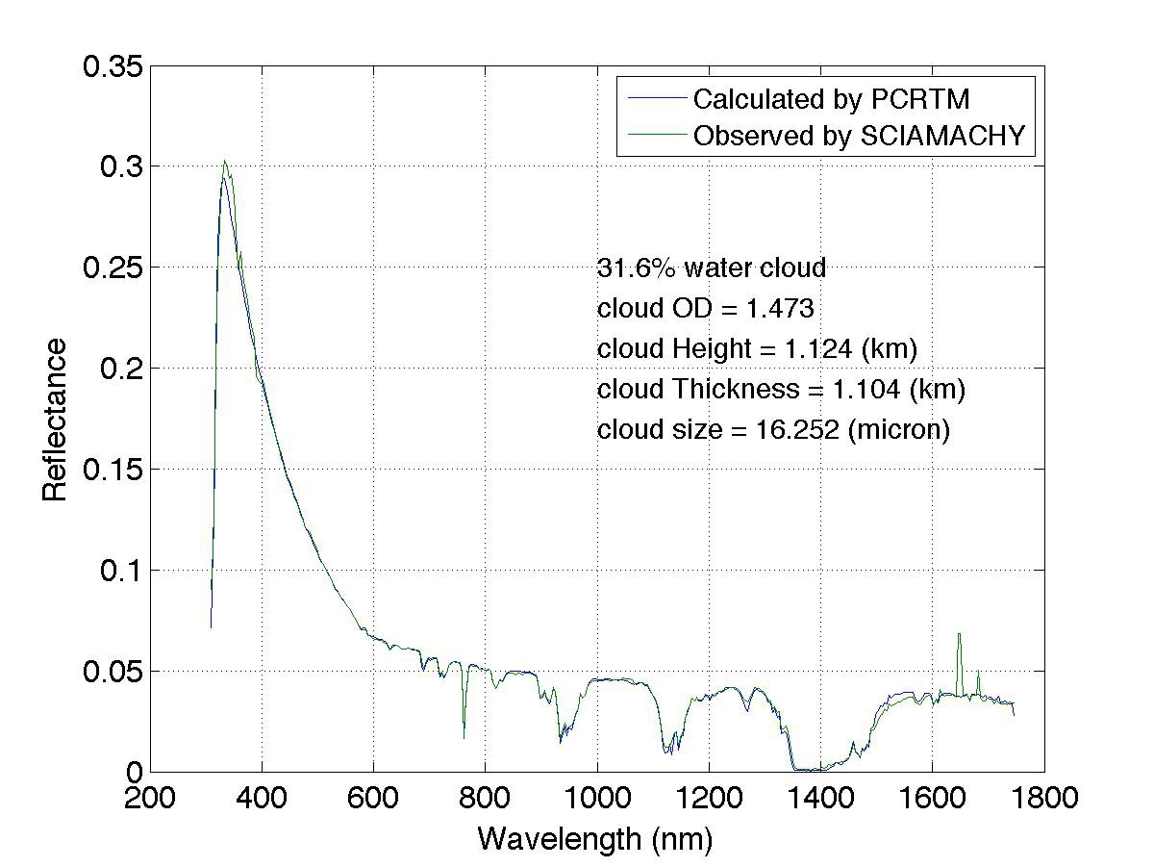
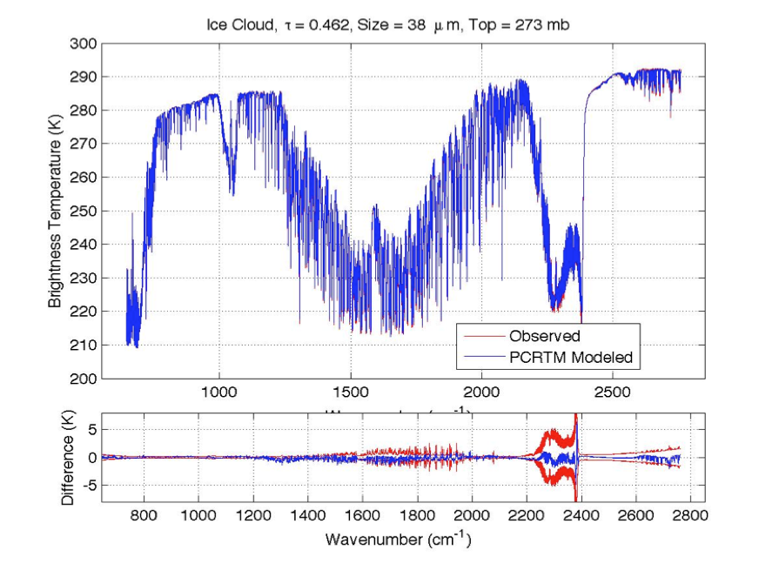
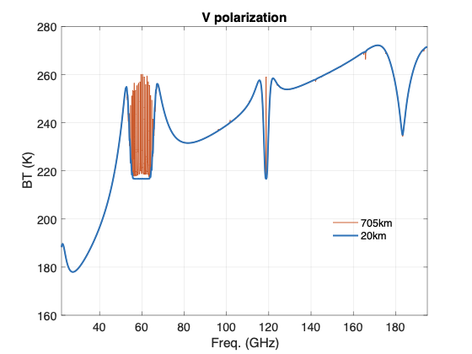
PCRTM Covers MW, Far-IR, IR, Near IR, Visible, and UV
SCHIAMACHY
IASI
PCRTM-IR | Channel Number | PC score (seconds)
CLARREO, 0.1 cm⁻¹ | 19901 | 0.014 s
CLARREO, 0.5 cm⁻¹ | 5421 | 0.011 s
CLARREO, 1.0 cm⁻¹ | 2711 | 0.0096 s
IASI, 0.25 cm⁻¹ | 8461 | 0.011 s
AIRS, 0.5-2.5 cm⁻¹ | 2378 | 0.0060 s
CrIS,0.625-2.5 cm⁻¹ | 1317 | 0.0050 s
NAST-I, 0.25 cm⁻¹ | 8632 | 0.010 s
S-HIS, 0.5 cm⁻¹ | 4316 | 0.008 s
CrIS, 0.625 cm⁻¹ | 2211 | 0.009 s
PCRTM-Solar | Speed-up relative to MODTRAN or LBL
CPF (3 nm, 350-2400 nm) | 5000
EMIT (7.5 nm, 380-2500 nm) | 7000

Slide 3
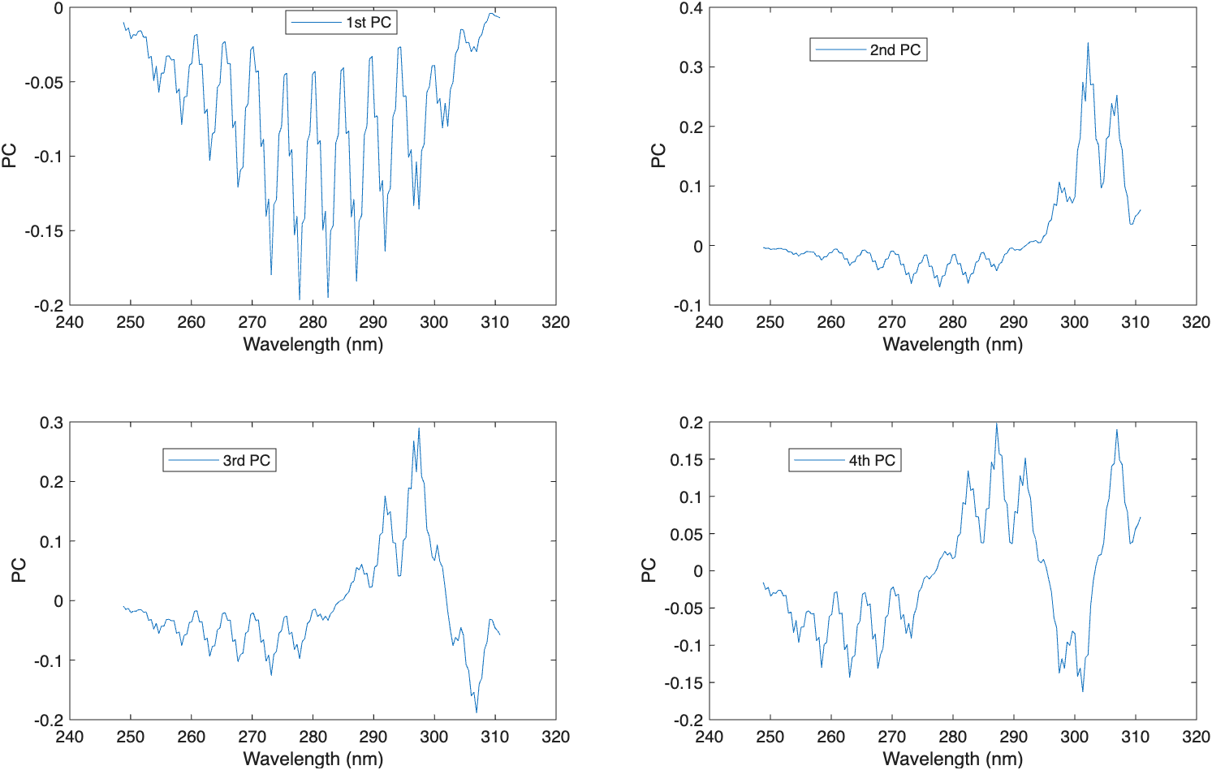
Recent Progress on PCRTM Model
SNPP_OMPS_NP_NADIR_SRF.h5
Number of Mono Simulations Needed | 16
Speed Up relative to LBL | 1838
Spectral Mean Bias | 0.002%
Spectral Mean RMSE | 0.03%
SNPP_OMPS_TC_NADIR_SRF.h5
Number of Mono Simulations Needed | 54
Speed Up relative to LBL | 695
Spectral Mean Bias | -0.0003%
Spectral Mean RMSE | 0.09%

Slide 4
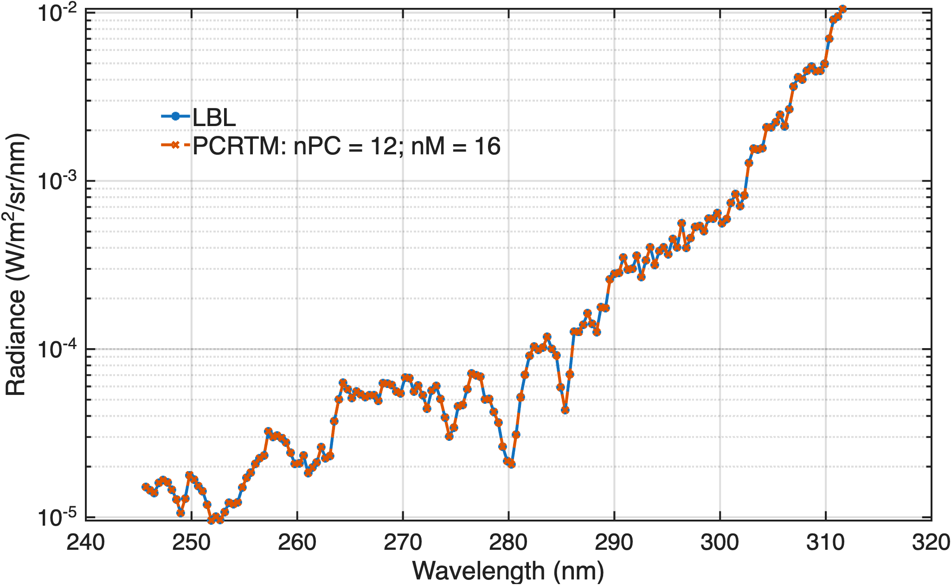
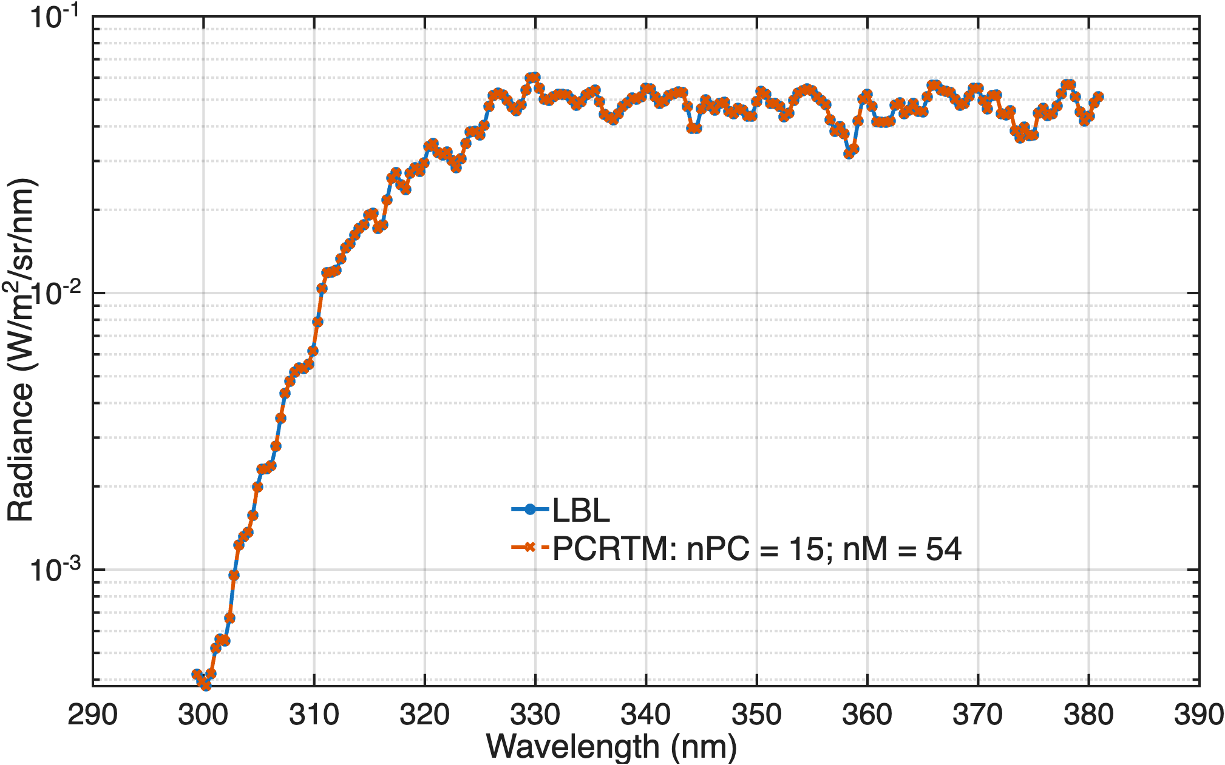
Examples from Validation Results
Recent Progress on PCRTM Model

Slide 5
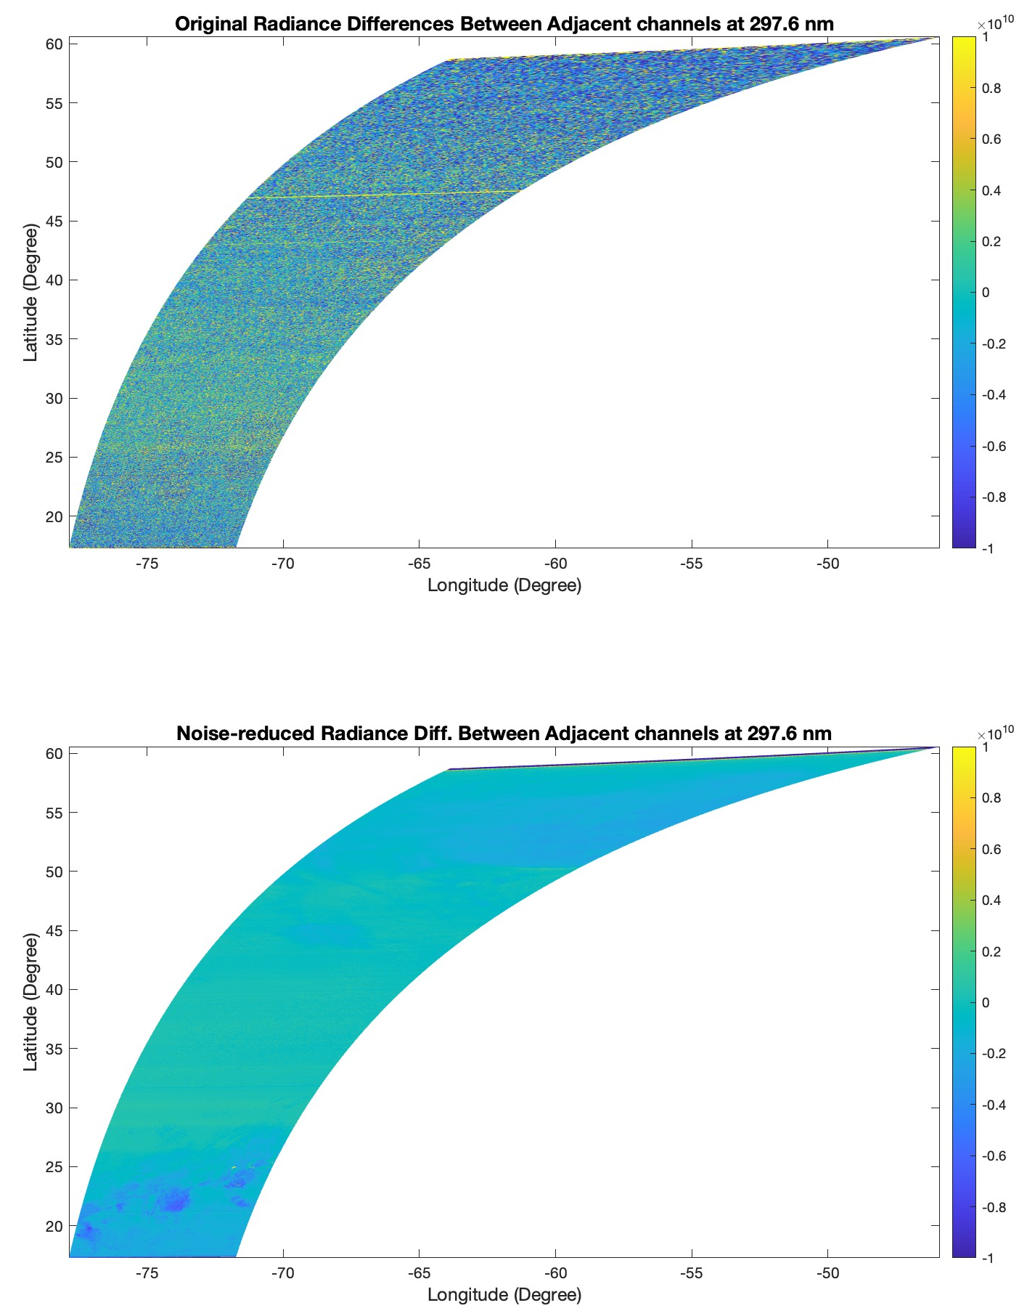
Example of spatial coherency after noise reduction
(TEMPO_RAD_L1_V04_20260324T151507Z_S006G01.nc)
Original TEMPO data
(Radiance differences between TEMPO spectral channel 29 and 30 near 297.6 nm show noise pattern due to random noise)
After noise reduction (coherent spatial features emerge from noise reduced spectra

Slide 6
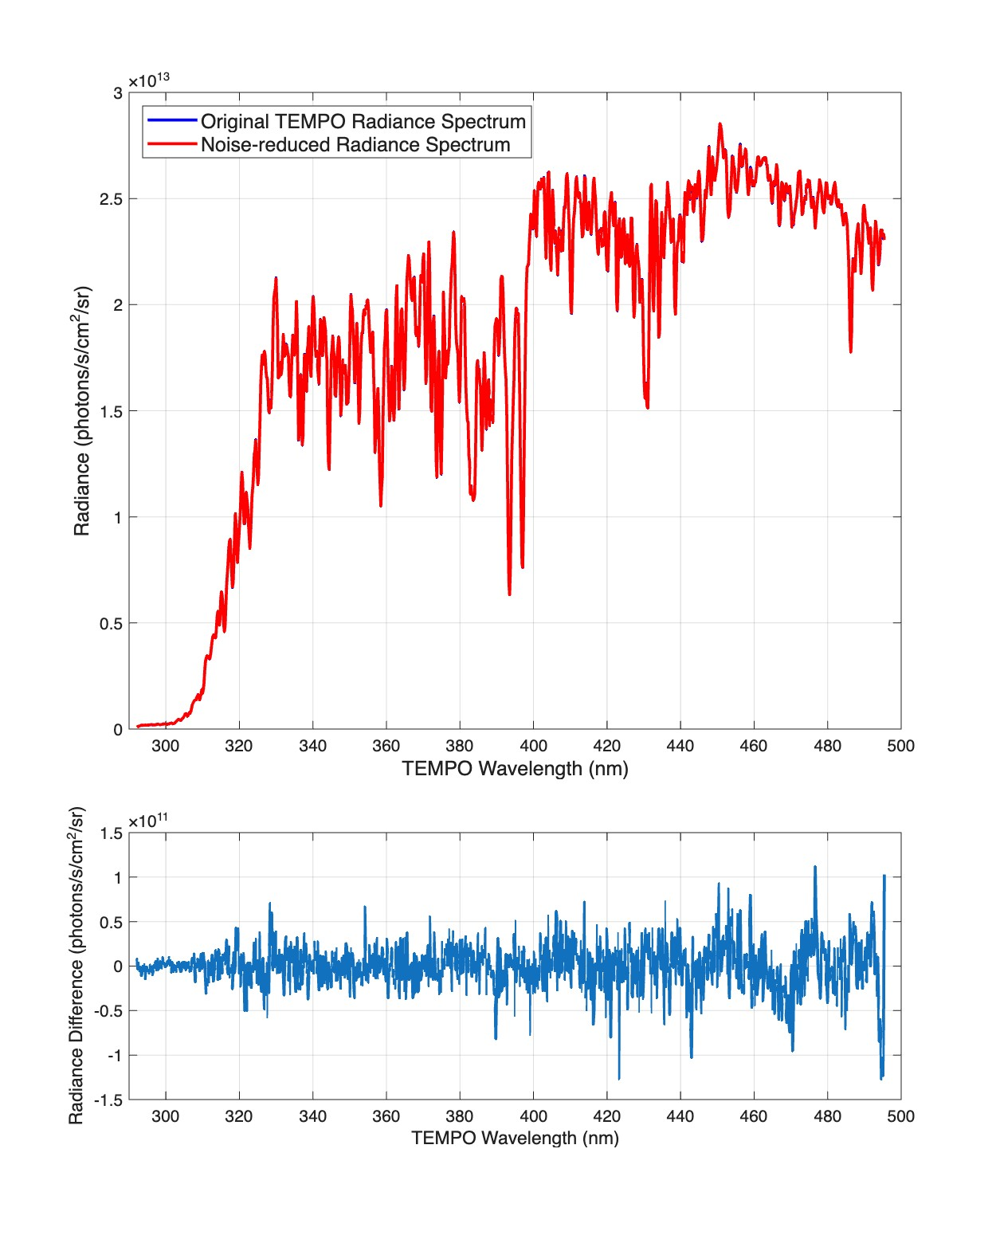
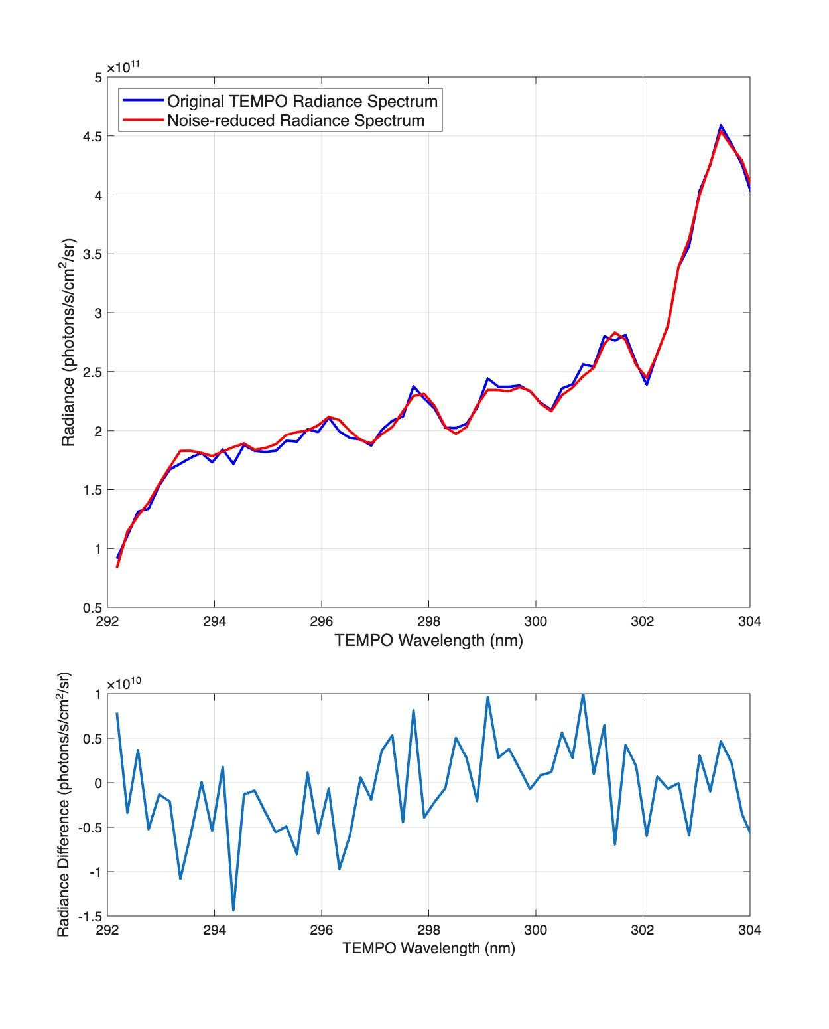
Example of original and noise reduced TEMPO spectra

Slide 7
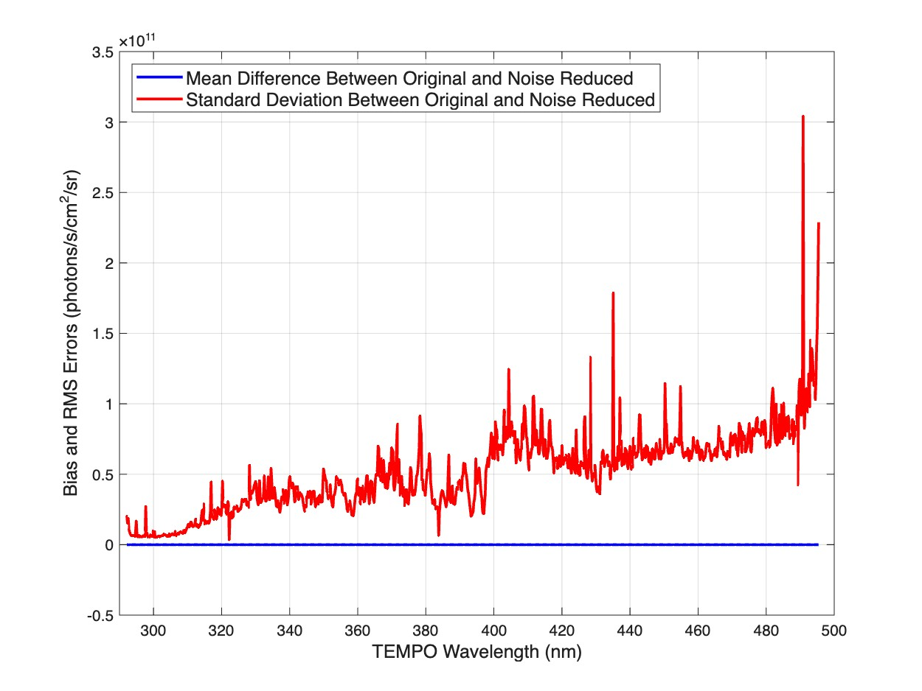
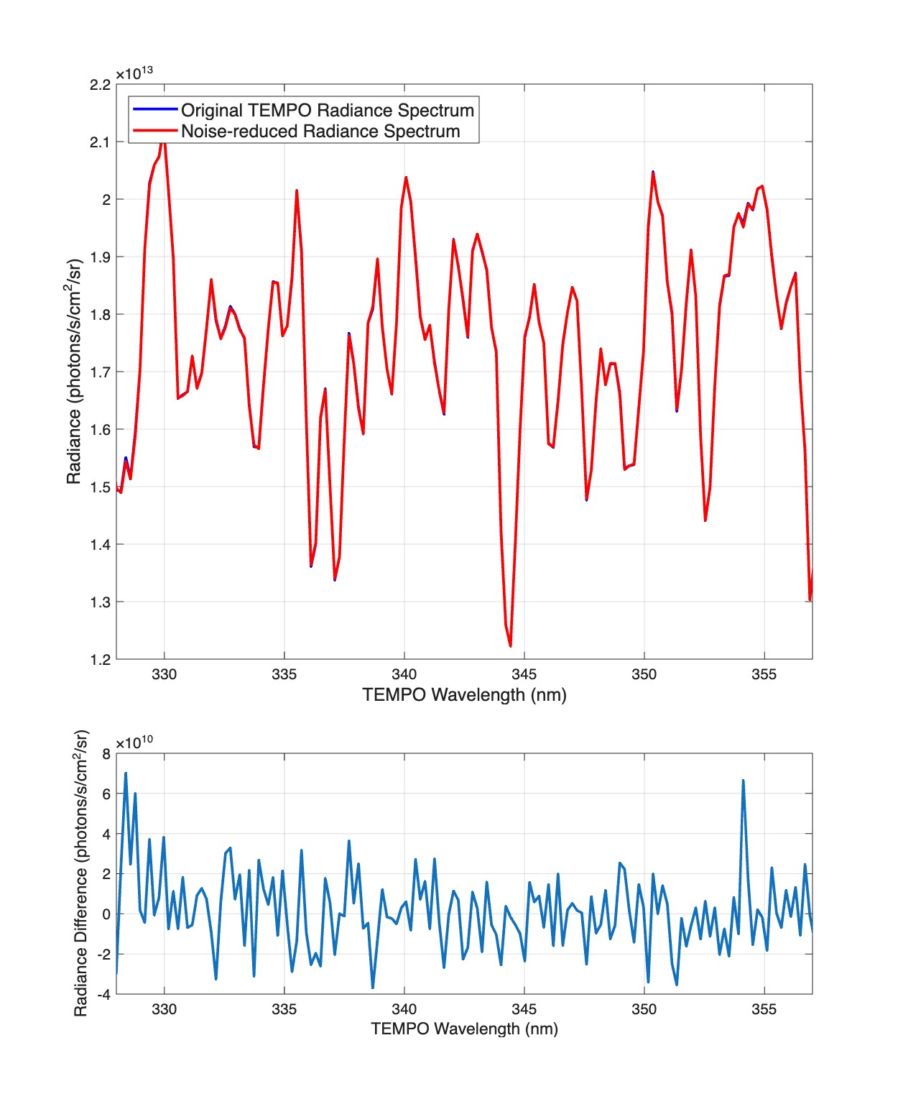
Mean Differences between the noise reduce spectra and the original TEMPO spectra (246K spectral samples)
Spectral differences in HCHO spectral region
If you divide the standard deviation by the mean spectrum, you will get the Signal to Noise Ratio of the TEMPO instrument

Slide 8
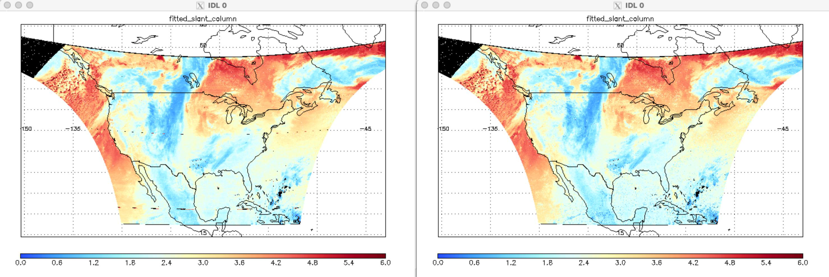
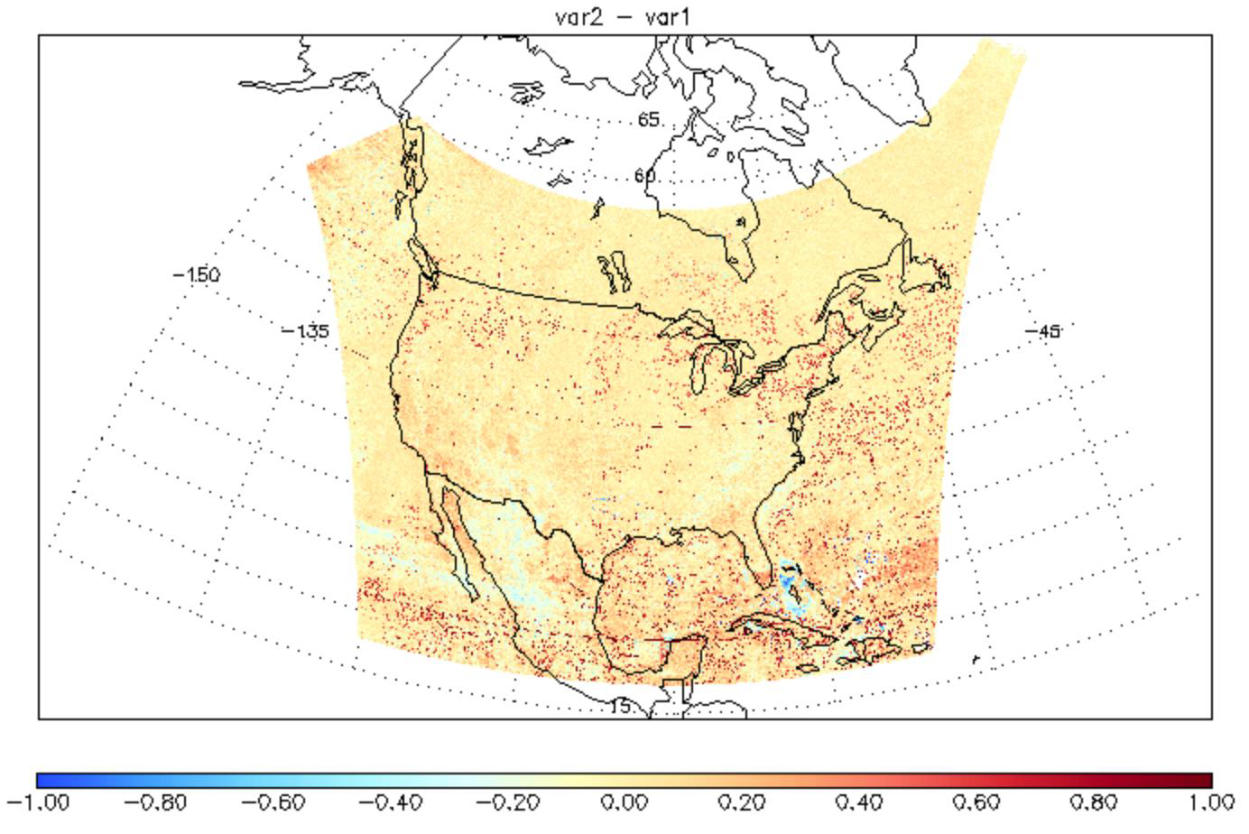
Smoother Fitted Slant Column
20251101 S006
SCD: XuLiu – ASDCv4

Slide 9
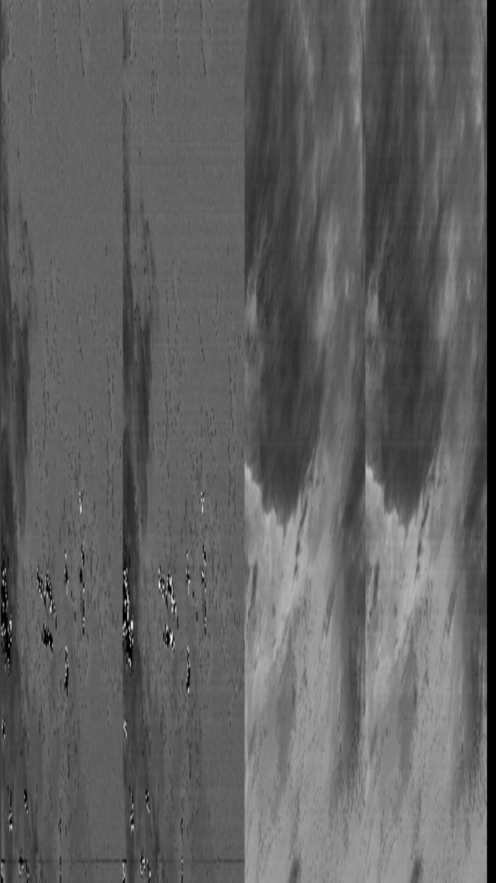
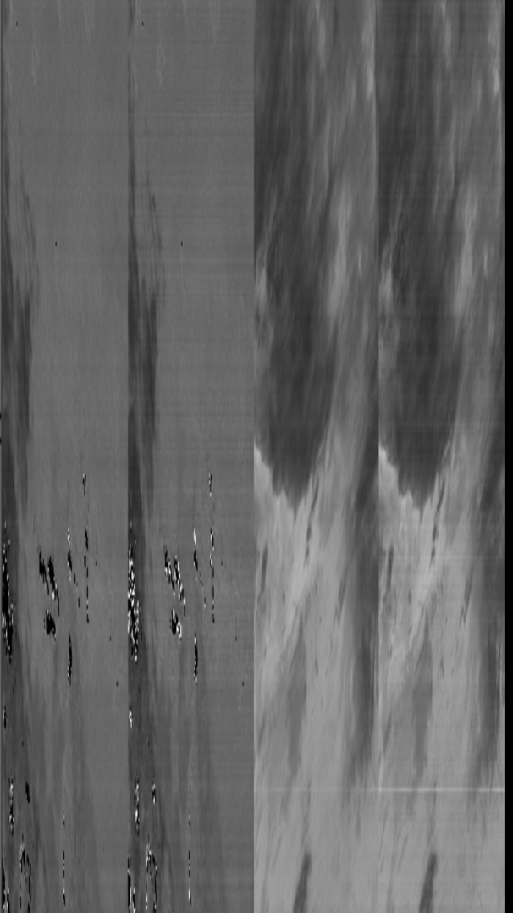
PCA provides more convergences and smoother image
ASDC_V4
PCA Filtering
ASDC_V4
PCA Filtering

Slide 10
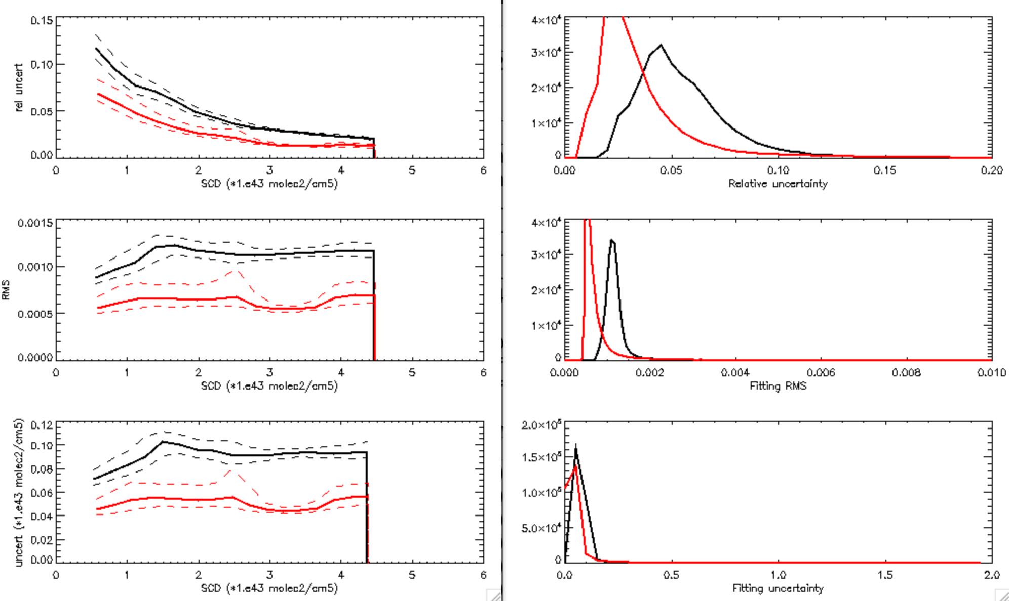
PCA provides better spectral fits
20251101 S006G07
PCA
ASDCV4

Slide 11
Summary O₂-O₂ Test
 | ASDCV4 | PCA Test
Fitting RMS |  | better
Fitting Uncertainty |  | better
Convergence |  | better
Stripes | better
Anomaly line | better
Other |  | smoother

Slide 12
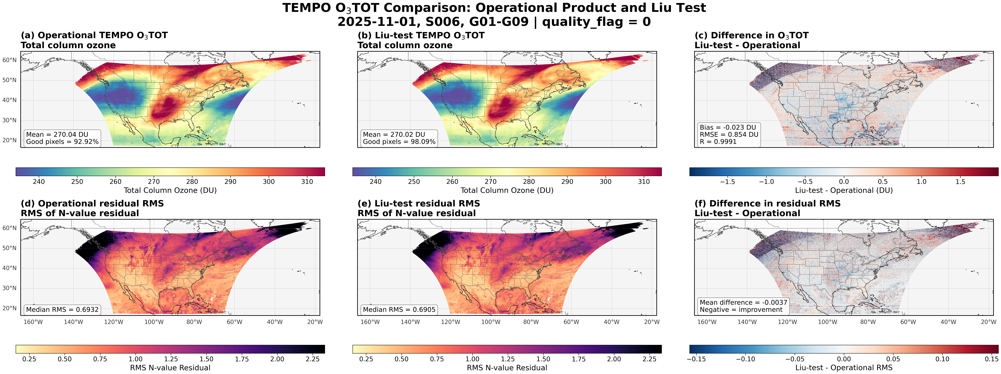
Noise-reduced TEST 2 (New)
TEMPO O3TOT 20251101 (S006)
The new version shows a slight improvement in RMS

Slide 13
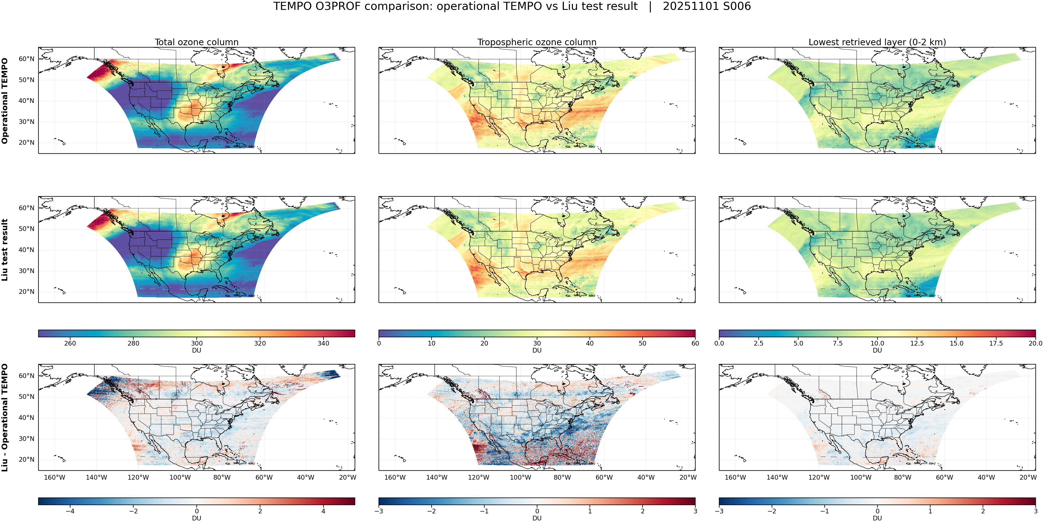
Noise-reduced TEST 2 (New)
TEMPO O3PROF 20251101 (S006)
PCA Test for O3 profile retrievals

Slide 14
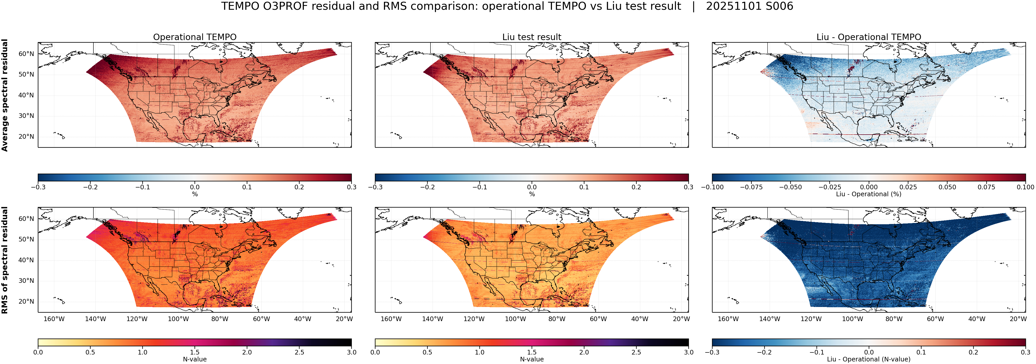
Noise-reduced TEST 2 (New)
TEMPO O3PROF 20251101 (S006)
PCA reduces both residual and RMS

