Slide 1
Update on TEMPO and Geo-Ring SO₂ Algorithm Work
Can Li¹, Jeonghyeon Park², Hanlim Lee², Nick Krotkov¹, Junsung Park³, Heesung Chong³, Xiong Liu³
¹NASA Goddard Space Flight Center, ²Pukyong National University, ³Smithsonian Astrophysical Observatory
TEMPO DART Meeting
June 15, 2026
Email: can.li@nasa.gov
Funding: SNWG & TEMPO project

Slide 2
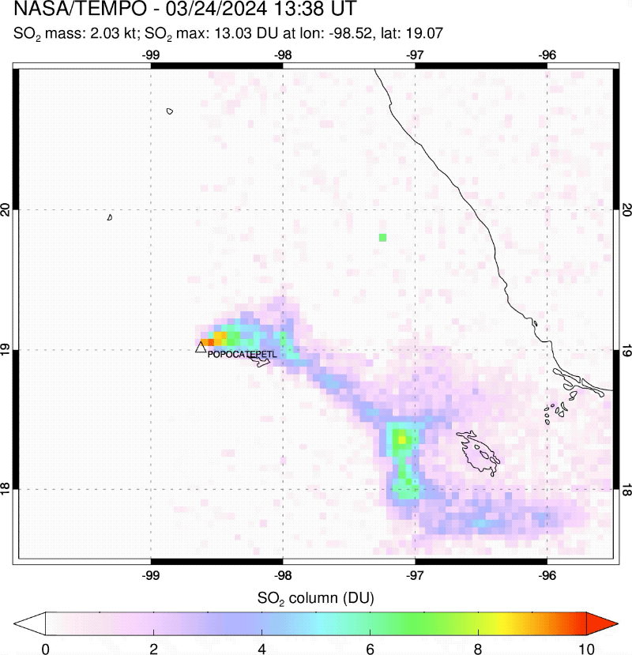
TEMPO SO₂ Algorithm: Overview
Principal component analysis (PCA) SO₂ algorithm:
Heritage: adapted from NASA’s standard SO₂ algorithm for Aura/OMI, SNPP/OMPS and NOAA-20/OMPS [Li et al., 2013, 2017, 2020, 2024]
An efficient data-driven algorithm:
  Derive principal components (PCs) from radiances over SO₂-free areas – use the PCs in spectral fitting to reduce interferences (e.g., ozone absorption, rotational Raman scattering) and instrumental factors.
  Offers good sensitivity and is easily adapted for other sensors (e.g., TROPOMI, GEMS, GOME).
Specific algorithmic updates for TEMPO:
  Speed up AMF/Jacobian calculations to handle TEMPO data volume (~10x of OMI).
  Use hourly a priori profiles based on GEOS-CF for anthropogenic SO₂ at different hours of the day.
  Updates to algorithmic flow to meet latency requirements for near-real-time (NRT) implementation.
Hourly TEMPO SO₂ over Popocatépetl volcano (Courtesy: Simon Carn, Michigan Tech.)

Slide 3
TEMPO SO₂ Algorithm: Status and Ongoing Work
For OMI and OMPS, anthropogenic and volcanic SO₂ retrievals are conducted in separate algorithms, each with its own step 1 processing (for data screening, PCA and initial spectral fit). The results are then merged.
For TEMPO, anthropogenic and volcanic SO₂ retrievals now share a common step 1 to reduce computation.
Step 2A:
Spectral fit and iterations for volcanic SO₂ VCDs
Step 1:
Data screening, PCA, spectral fit for SO₂ SCDs
Step 3:
Merge steps 2A and 2B results into a single output file
Step 2B:
AMF calculation, SCDs converted to anthropogenic VCDs
Updated algorithm flow for TEMPO SO₂
Ongoing work:
  Refine data screening and spectral fit to reduce biases in SCDs.
  Current step 1 processing uses data from an entire scan. Will test step 1 using fewer granules for NRT processing.
  Work on metadata and output file format, prepare software for integration into TEMPO production pipeline.

Slide 4
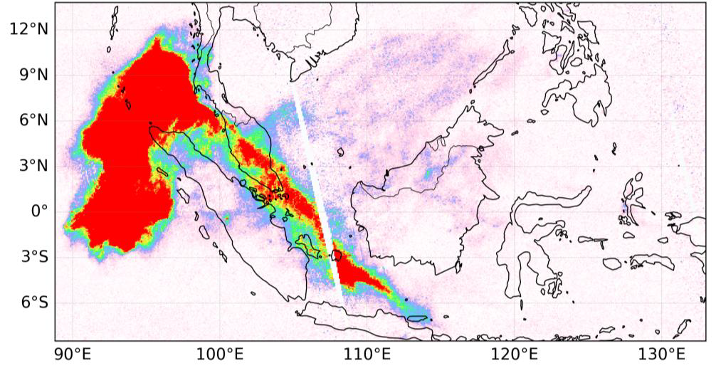
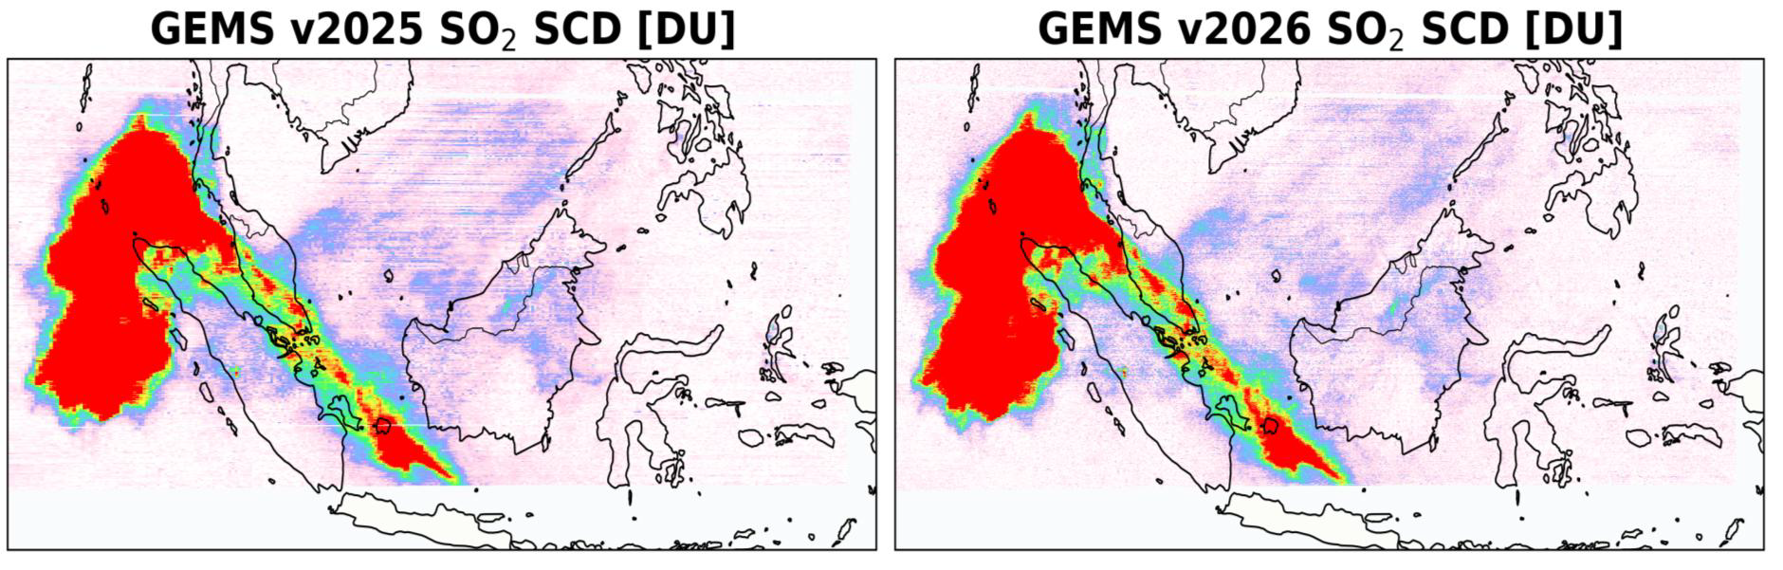
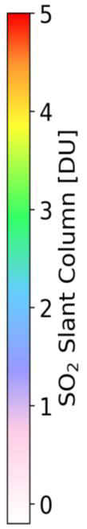
GEMS SO₂ Effort under Geo-Ring
As a collaborator in a Geo-Ring project led by SAO, we work with the GEMS team to help to evaluate and improve the GEMS SO₂ algorithm.
  To facilitate algorithm evaluation, produced test GEMS SO₂ retrievals with a (GSFC) research algorithm.
This has led to improved consistency in SO₂ retrievals between GEMS and other satellites.
TROPOMI SO₂ SCDs
GEMS SO₂ SCDs (OLD)
GEMS SO₂ SCDs (NEW)
For the Ruang volcano eruption (05/02/2025), updated GEMS SO₂ algorithm through Geo-Ring effort has led to reduced striping in retrievals and better agreement with TROPOMI retrievals.

Slide 5
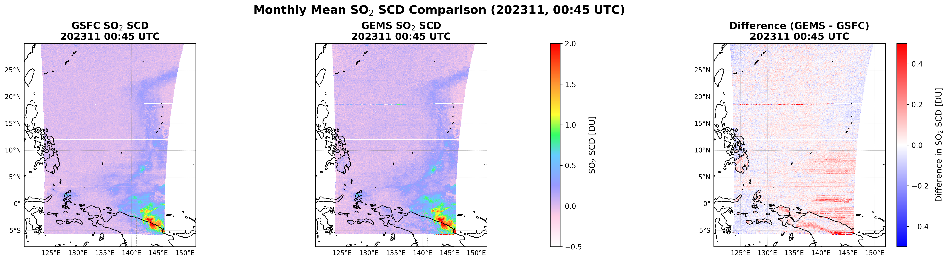
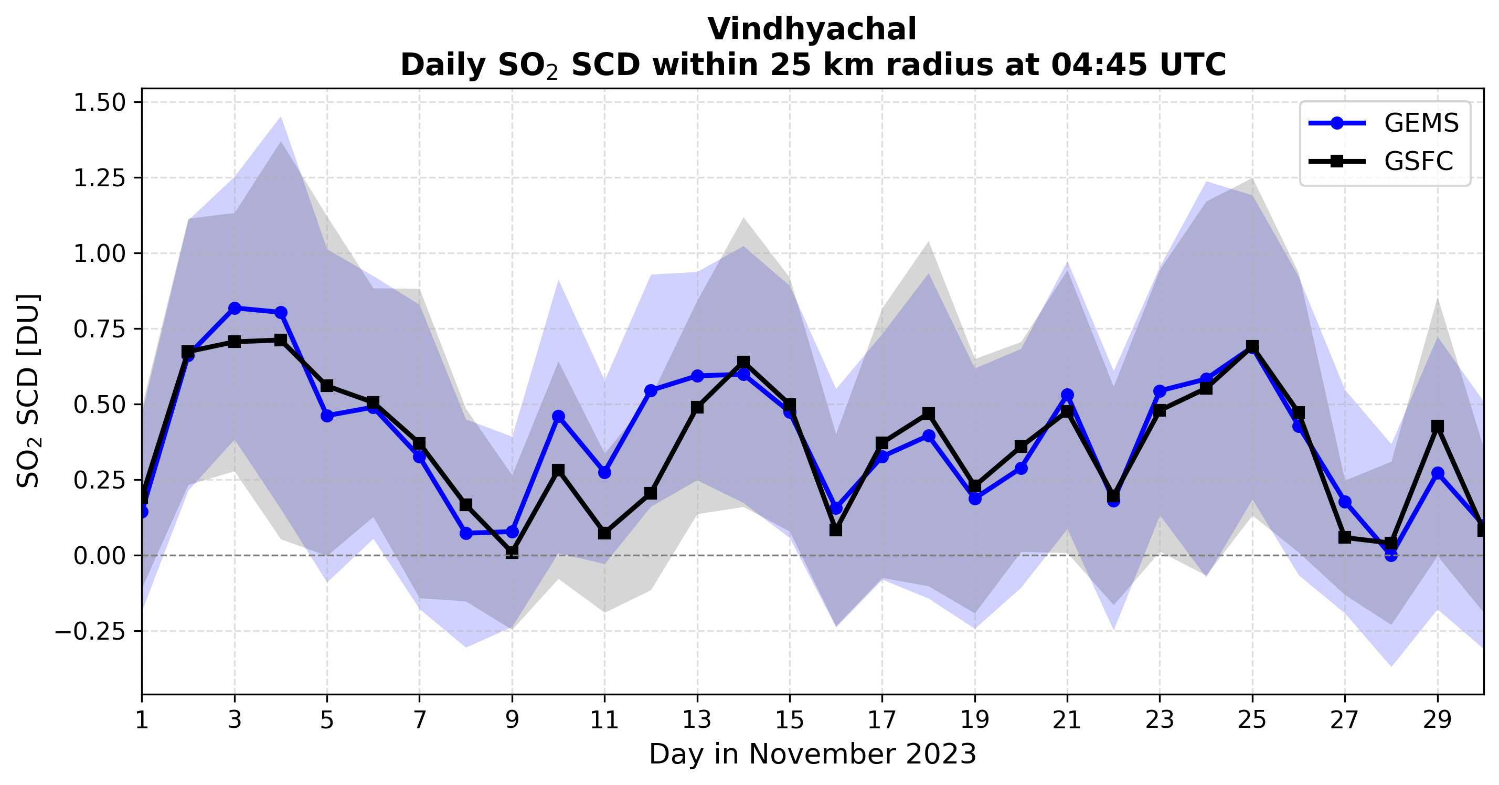
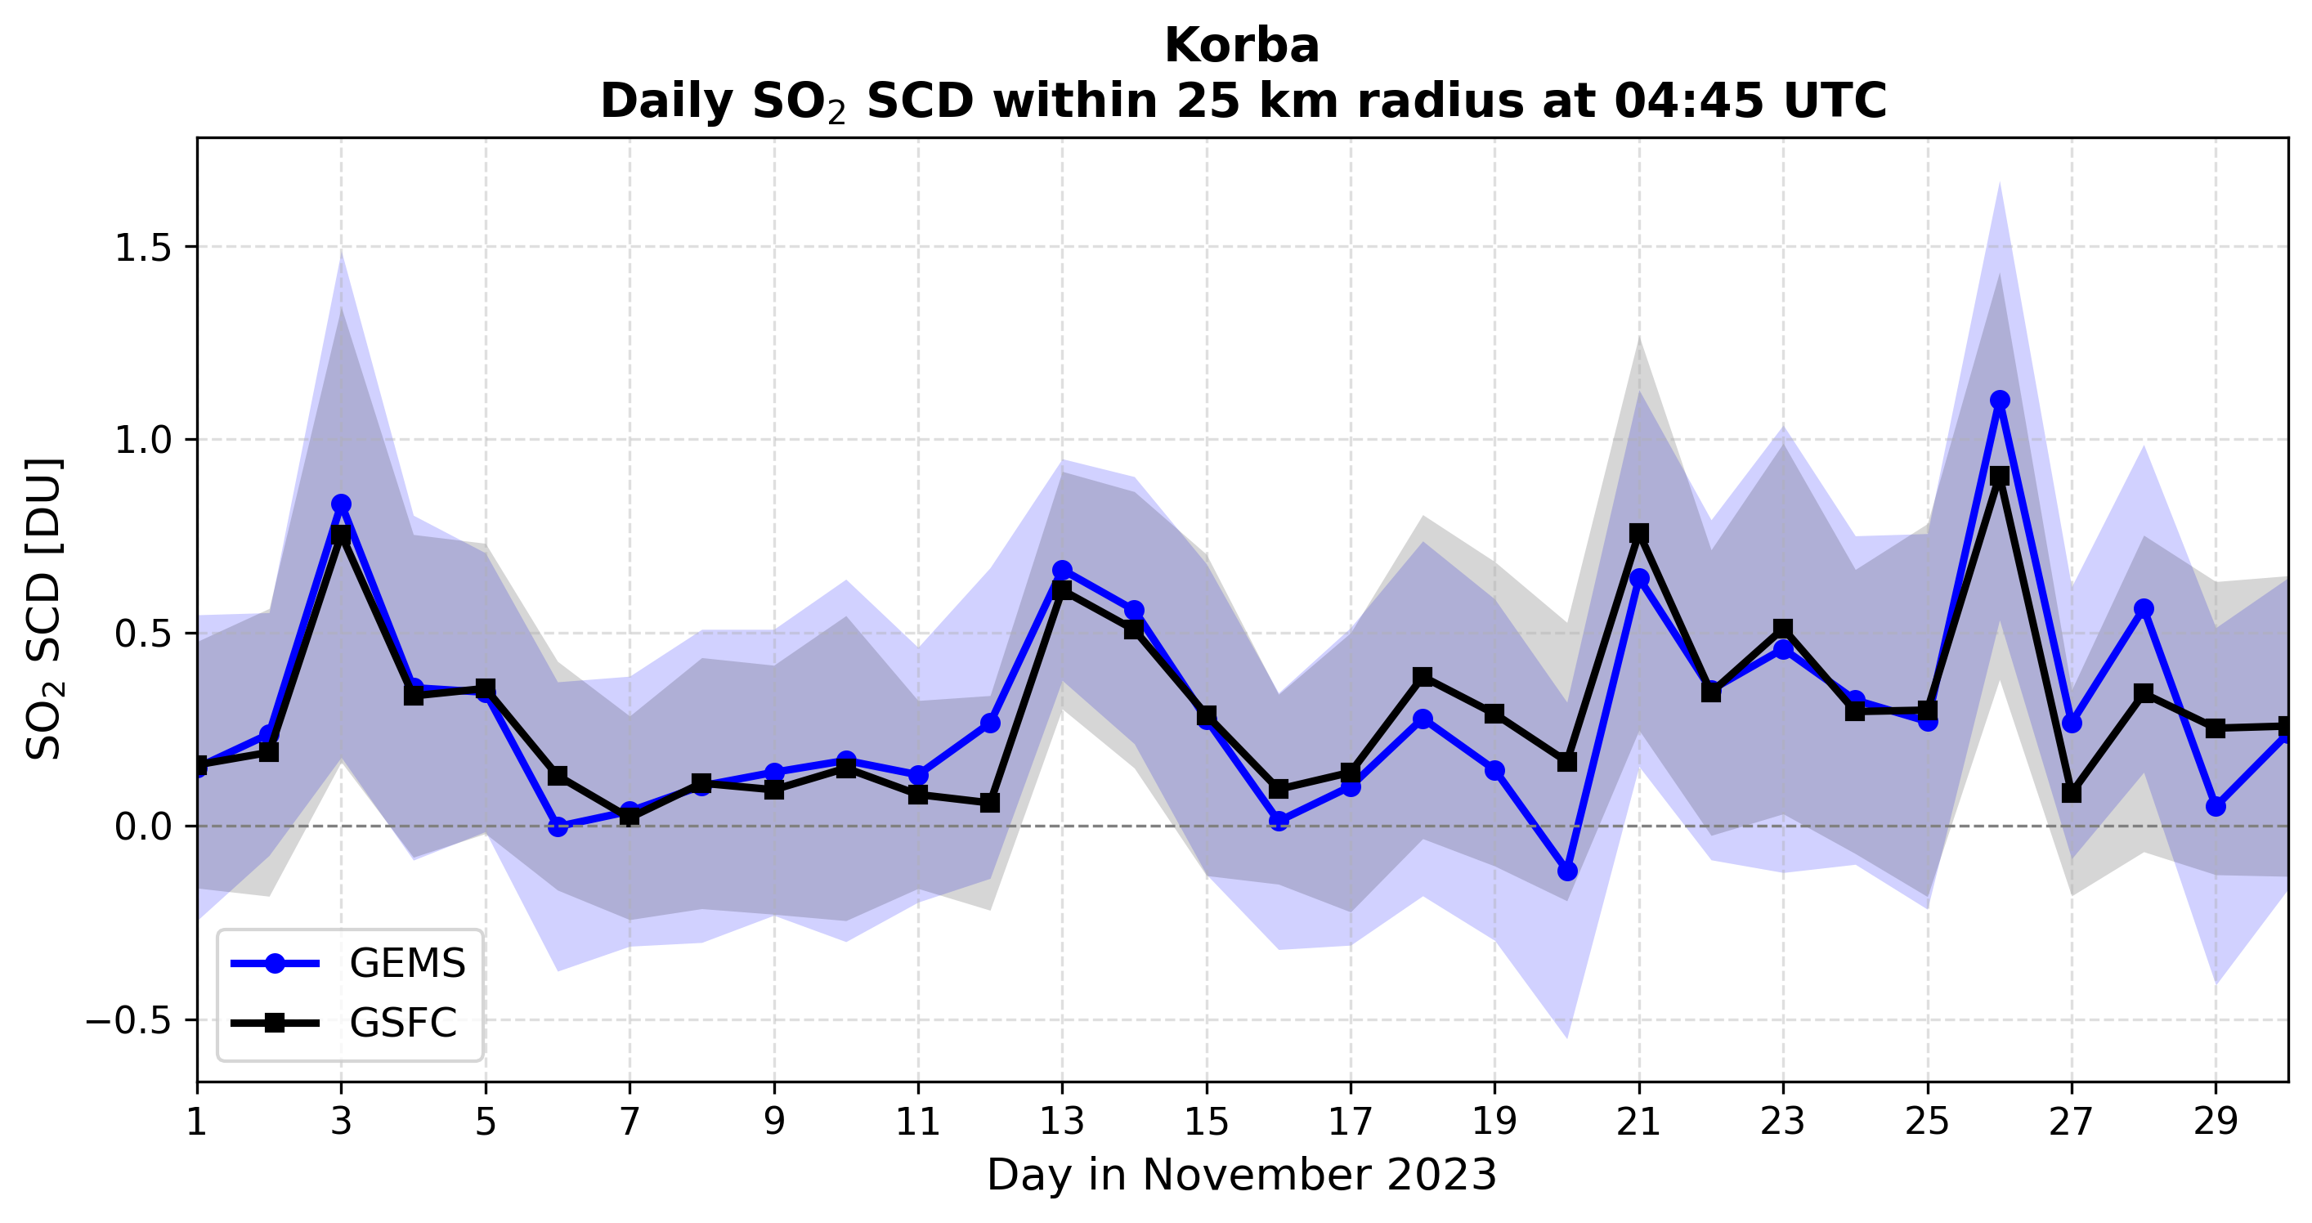
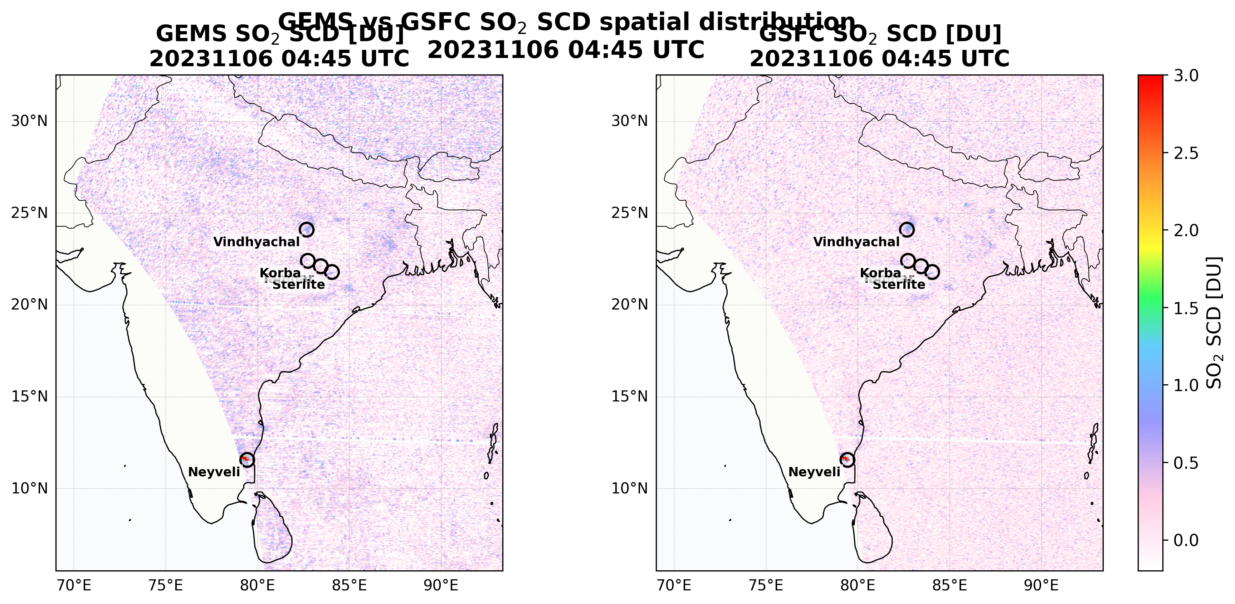
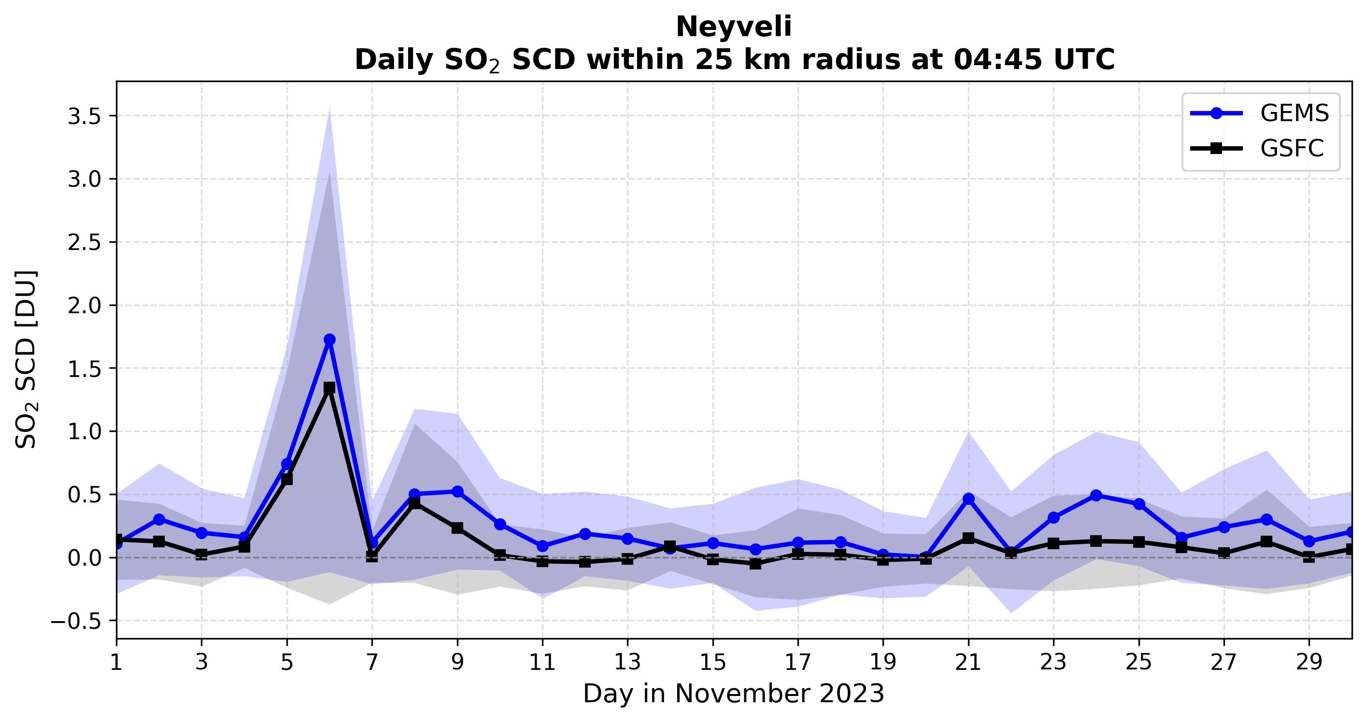
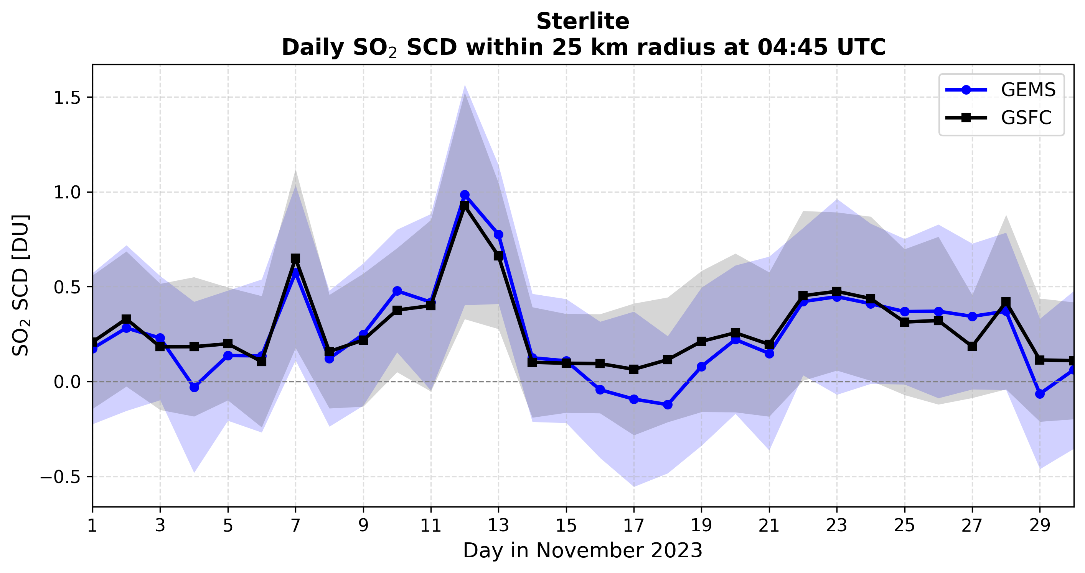
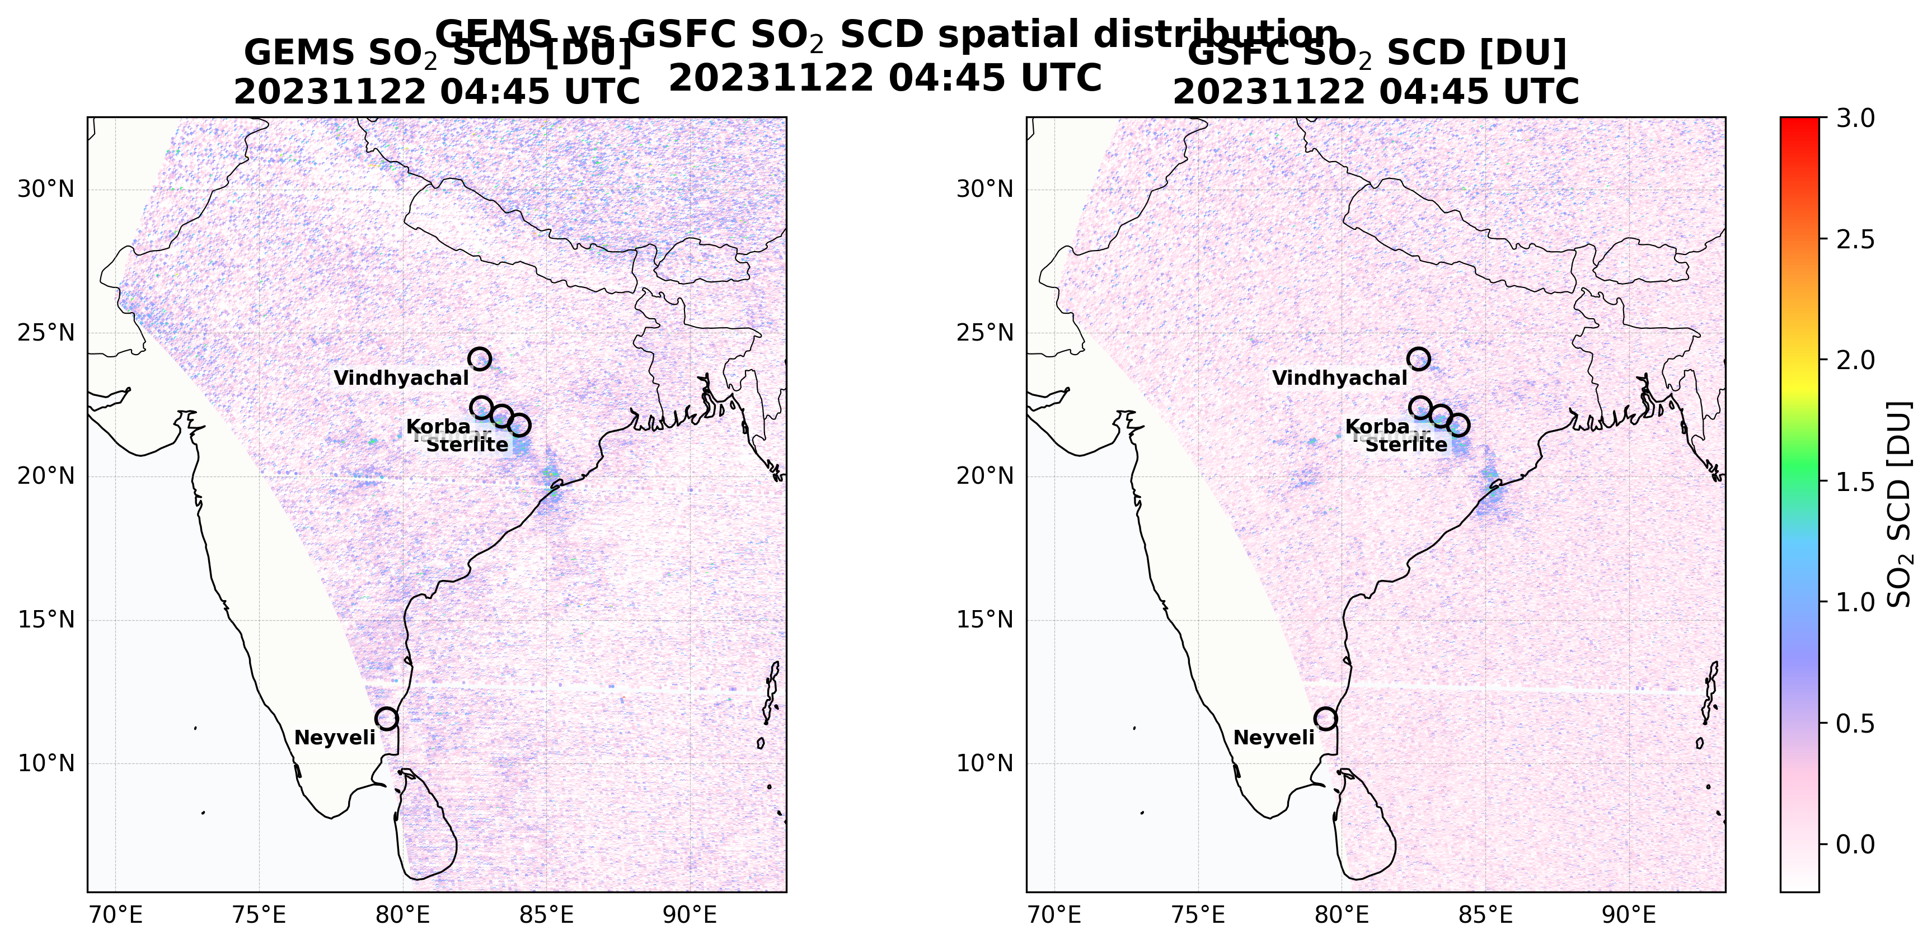
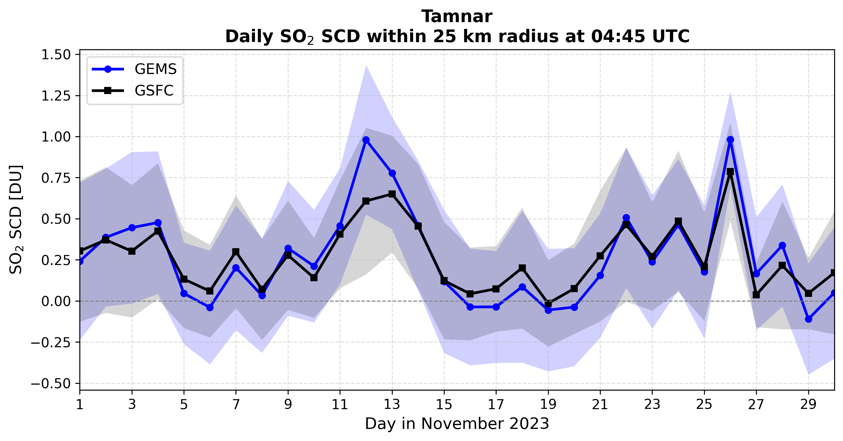
GEMS SO₂ Retrievals Capture Day-to-Day Changes in Pollution over India
11/06 2023 04:45 UTC
Days in November 2023
Substantial day-to-day variations in SO₂ loading over Indian power plants.
Updated GEMS SO₂ retrievals show good correlation with the GSFC research retrievals, although differences remain over cleaner areas.
11/22 2023 04:45 UTC
Days in November 2023

Slide 6
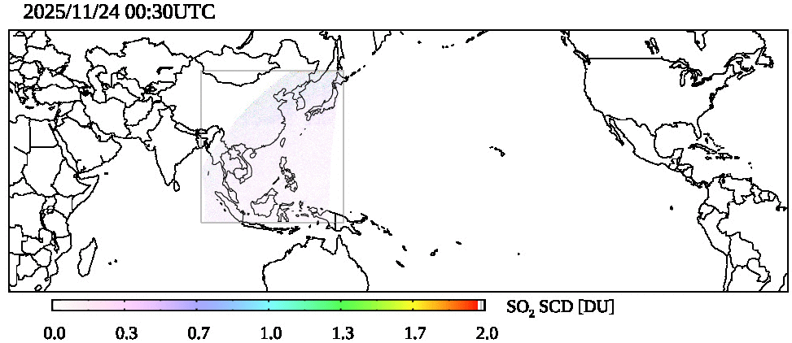
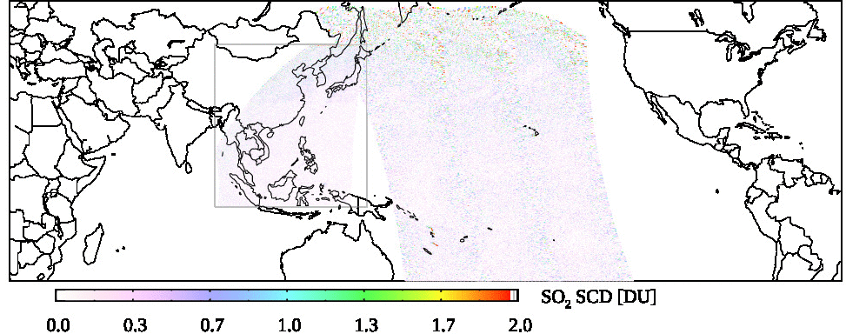
Application of Geo-Ring: Hayli Gubbi Eruption November 2025
GEMS + TEMPO
GEMS captured volcanic SO₂ plumes during November 25-29, 2025, from sources outside of its FoR.
TEMPO captured volcanic SO₂ plumes on November 29-30 – likely connected to GEMS-observed plumes, but LEO data are needed for a more complete picture.
NOAA-20/OMPS data within ±3 hours from each time step attribute the SO₂ plumes to the Hayli Gubbi eruption, providing context connecting GEMS/TEMPO observations.
First time the same algorithm applied to three GEO/LEO instruments to observe the same eruption.
Potential GEO-LEO synergy: ongoing study to extract SO₂ plume height information from multi-angle data.
Potential applications for aviation safety with NRT implementation.
OMPS + GEMS + TEMPO

Slide 7
Summary of Algorithm Status
TEMPO SO₂ algorithm status and timeline:
  Algorithm workflow updated, preliminary tests conducted.
  Currently implementing and testing relatively minor algorithm updates (e.g., data format, metadata, and updated a priori profiles).
  Initial delivery of the algorithm software package for implementation in the TEMPO science data pipeline in ~1 year.
  Public release of the product anticipated in ~2 years.
GEMS SO₂ algorithm status:
  Substantial algorithm improvements (reduced retrieval noise and artifacts) by GEMS team through collaboration under Geo-Ring.
  Additional tests needed before the new version product is finalized and publicly released.
  Ongoing effort on GEO-LEO synergy for volcanic SO₂ retrievals and for tracking long-range transport.

