Slide 1
TEMPO aerosol products: ADP, AOD-ALH and PM_{2.5}
Hai Zhang¹, Pubu Ciren¹, Shobha Kondragunta²
¹ STC at NOAA; ² NOAA
June 15, 2026
TEMPO DART Team Meeting
Disclaimer: The scientific results and conclusions, as well as any views or opinions expressed herein, are those of the author(s) and do not necessarily reflect those of NOAA or the Department of Commerce.

Slide 2
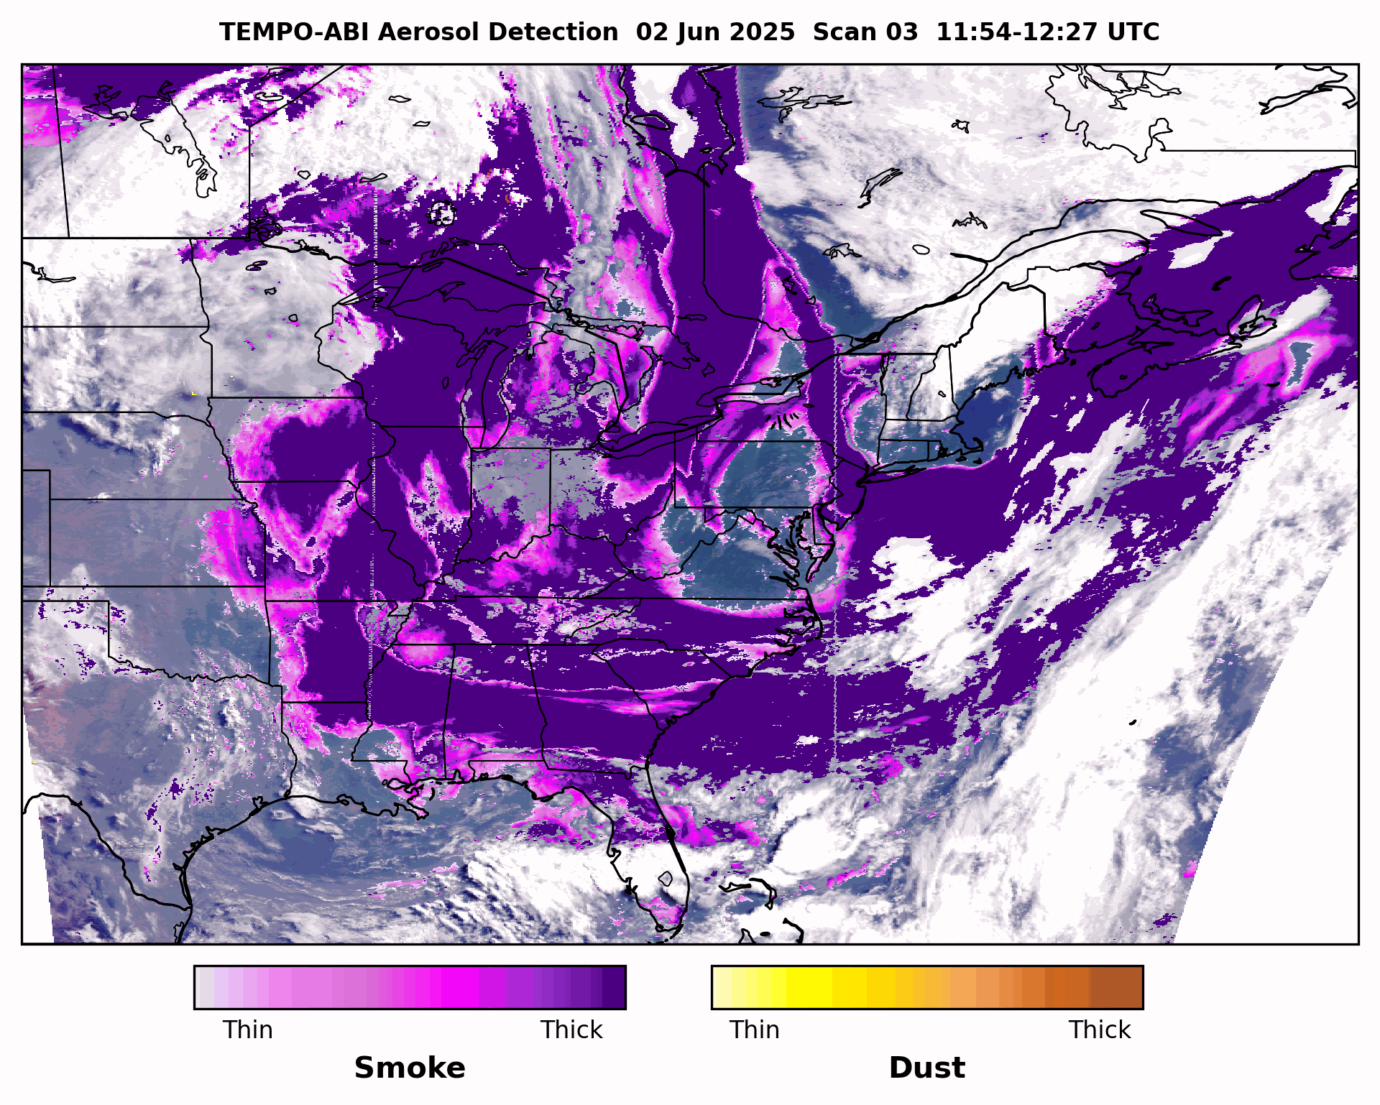
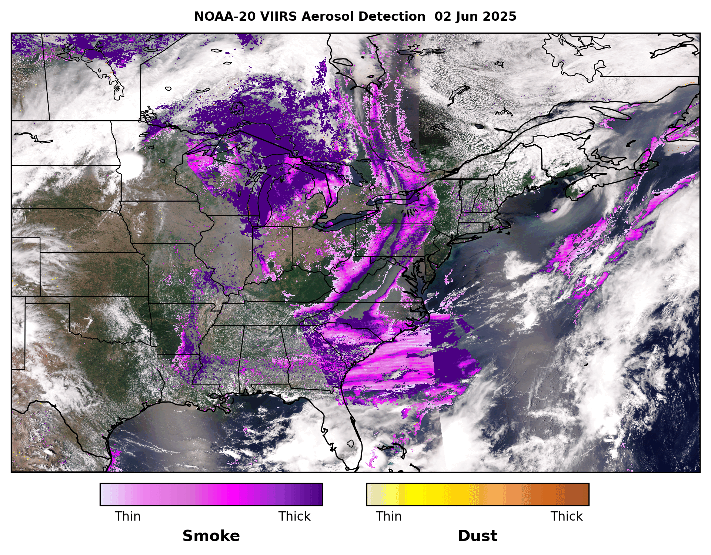
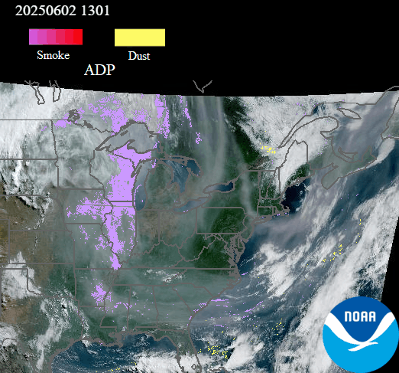
Smoke detection and quantification enhanced by UV observations…
UV-Deep Blue-IR Hybrid
Deep Blue-IR
GOES-R ABI+TEMPO Smoke
Visible-IR
JPSS VIIRS Smoke
GOES-R ABI Smoke

Slide 3
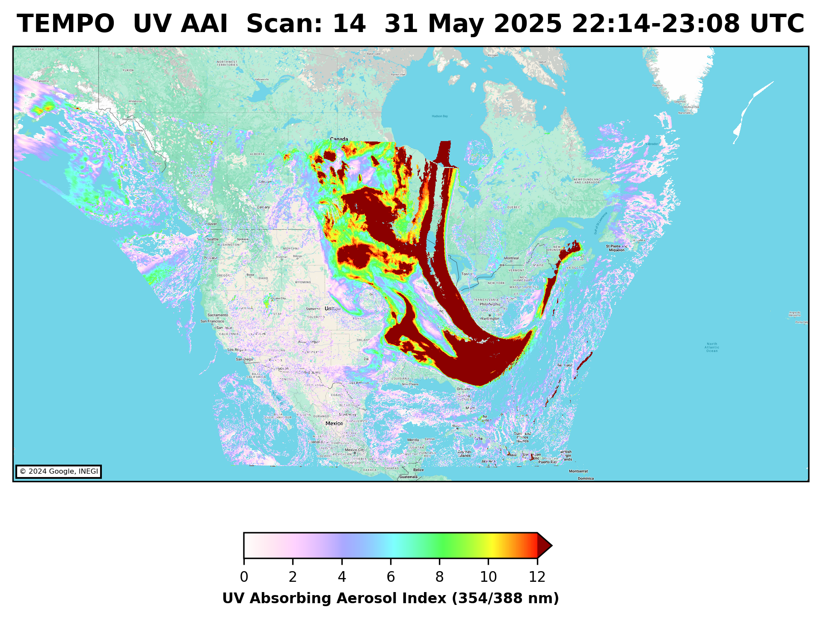
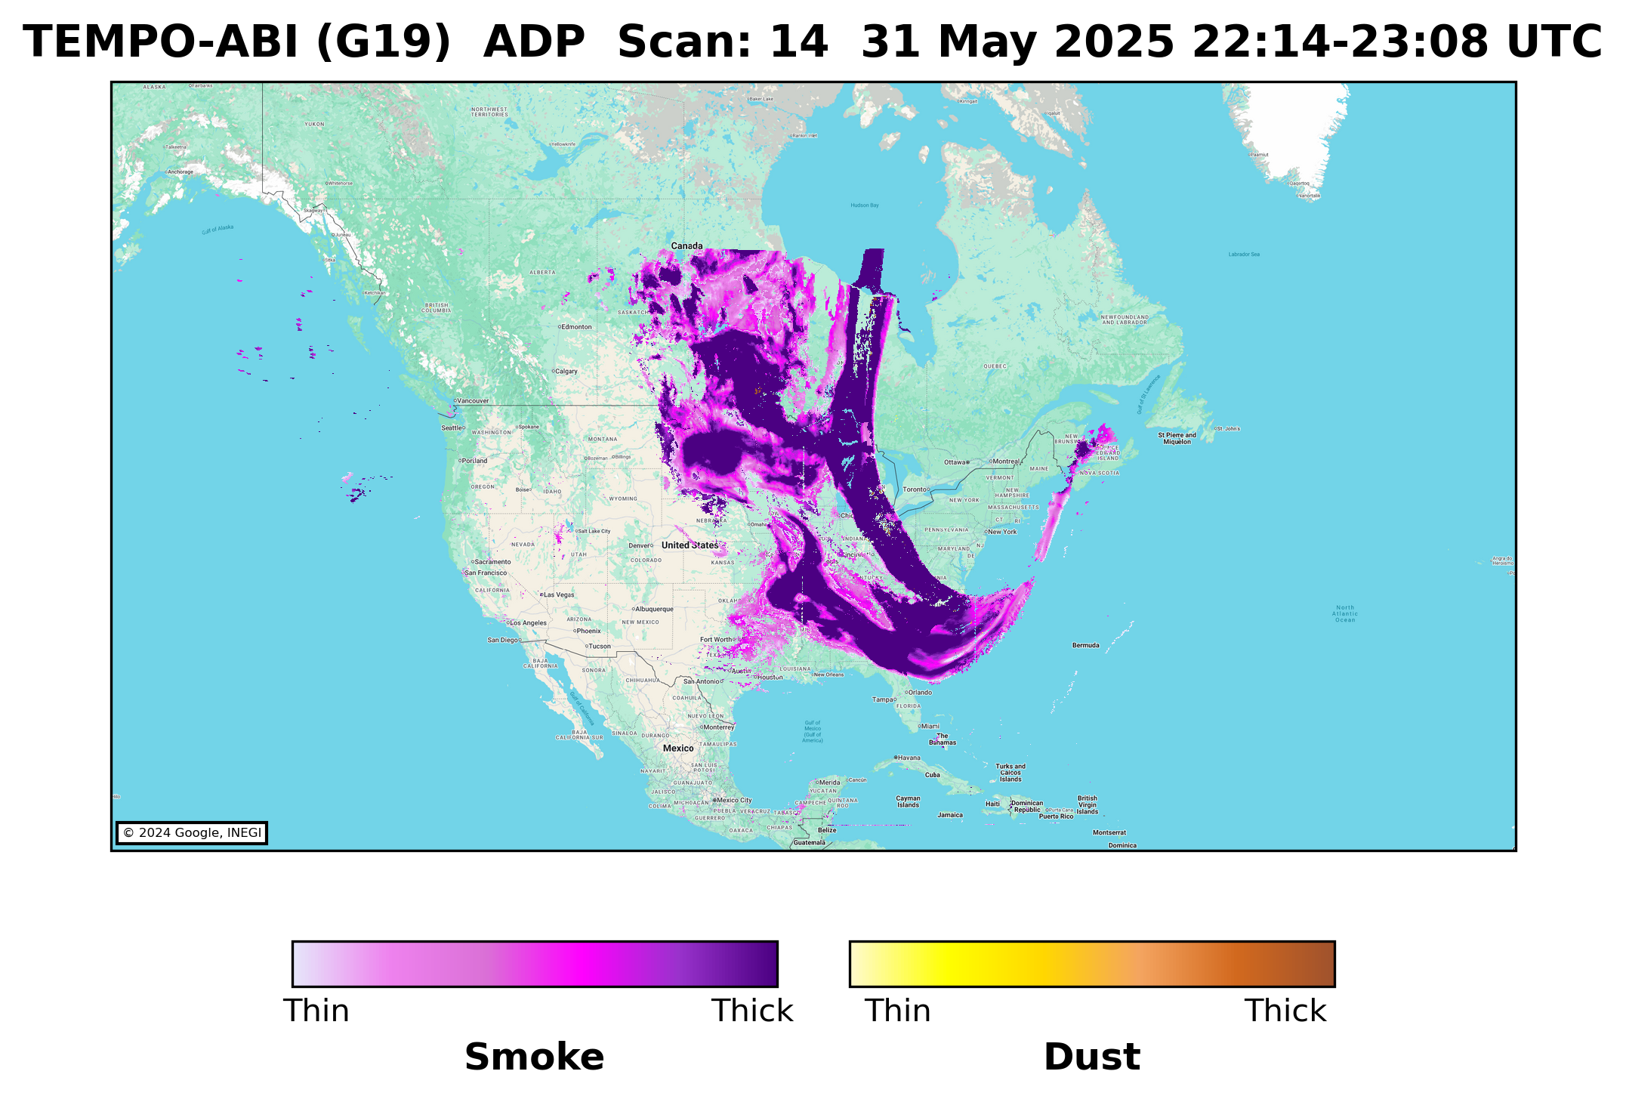
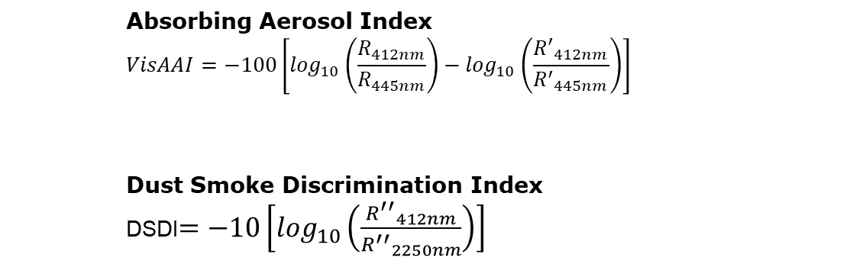
NOAA TEMPO-ABI Hybrid Aerosol Detection Algorithm
Hybrid approach for smoke and dust detection.
TEMPO+ABI synergy (East and West, dual view).
Cloud screening: Remapped cloud mask from ABI
Cloud/Snow-ice Callback: Identifies high UV AAI values over clouds and snow-ice
Outputs
  Smoke/Dust mask
  UV AAI (354/388 nm)
  Visible AAI (412/440 nm)
Absorbing Aerosol Index
$$VisAAI=−100\left[\log_{10}\left(\frac{R_{412nm}}{R_{445nm}}\right)−\log_{10}\left(\frac{{R^{′}}_{412nm}}{{R^{′}}_{445nm}}\right)\right]$$
Dust Smoke Discrimination Index
DSDI$=−10\left[\log_{10}\left(\frac{{R^{′′}}_{412nm}}{{R^{′′}}_{2250nm}}\right)\right]$
$$UVAAI=−100\left[\log_{10}\left(\frac{R_{354nm}}{R_{388nm}}\right)−\log_{10}\left(\frac{{R^{′}}_{354nm}}{{R^{′}}_{388nm}}\right)\right]$$

Slide 4
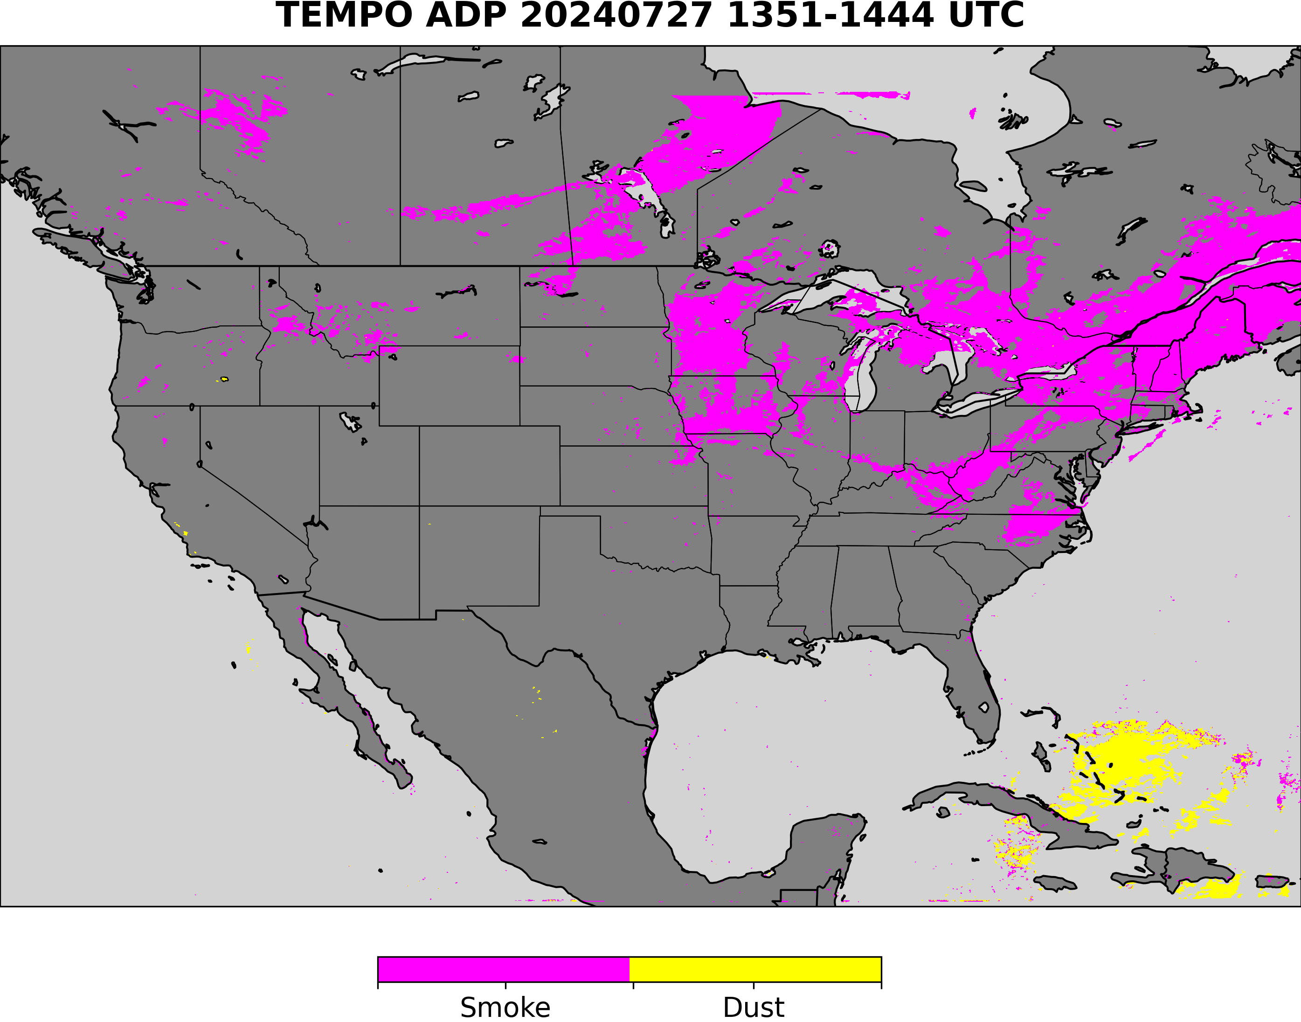
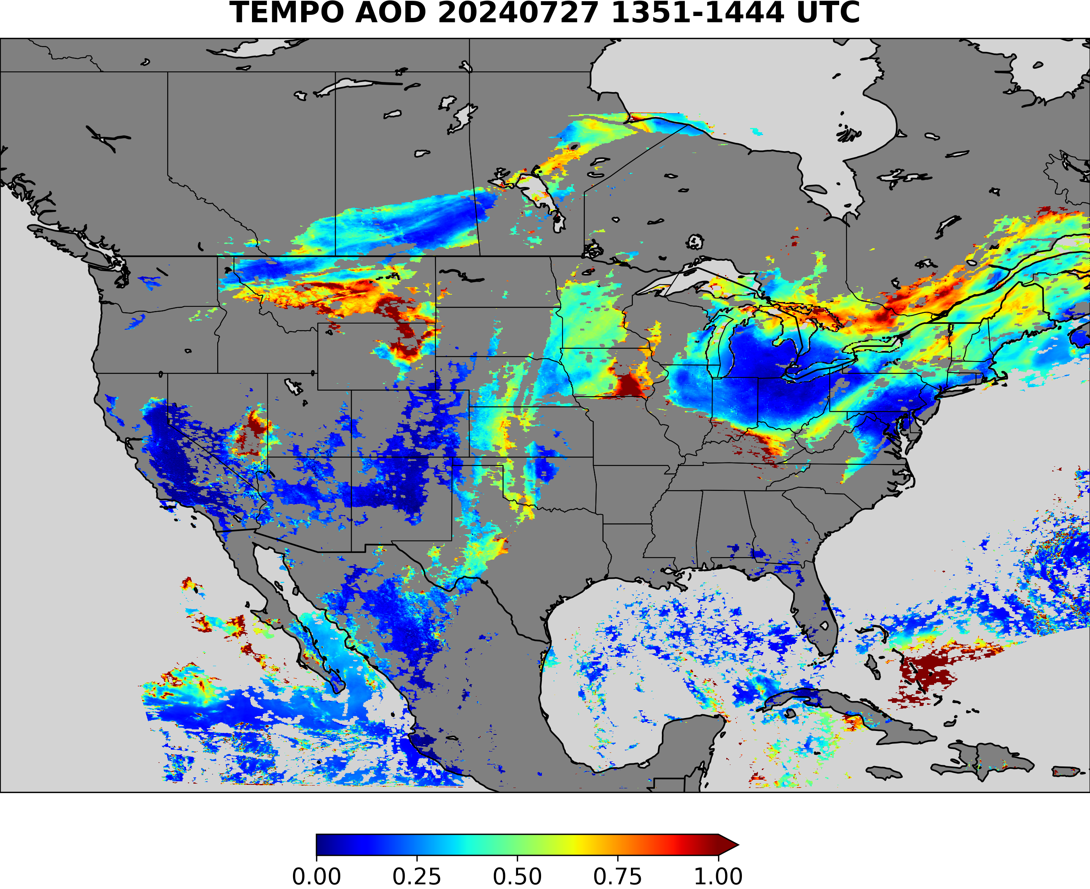
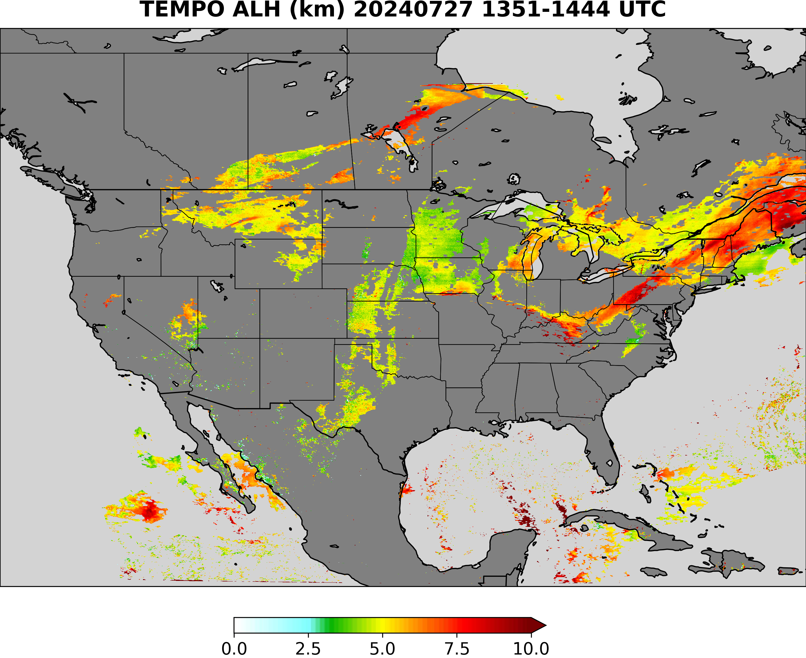
TEMPO AOD-ALH retrieval uses ADP to differentiate aerosol type
Smoke
TEMPO ADP Smoke Dust Mask Input
smoke
Smoke or dust ?
dust
No detection
Use smoke model
Use generic model
Use dust model
With UV bands available from TEMPO, the combined TEMPO and ABI detection can better detect the dust and smoke and can help AOD retrieval, because dust plumes usually missing in ABI AOD retrievals

Slide 5
TEMPO AOD-ALH retrieval uses ADP to differentiate aerosol type
Dust
TEMPO ADP Smoke Dust Mask Input
smoke
Smoke or dust ?
dust
No detection
Use smoke model
Use generic model
Use dust model
With UV bands available from TEMPO, the combined TEMPO and ABI detection can better detect the dust and smoke and can help AOD retrieval, because dust plumes usually missing in ABI AOD retrievals

Slide 6
TEMPO AOD-ALH retrieval uses ADP to differentiate aerosol type
Generic
TEMPO ADP Smoke Dust Mask Input
smoke
Smoke or dust ?
dust
No detection
Use smoke model
Use generic model
Use dust model
With UV bands available from TEMPO, the combined TEMPO and ABI detection can better detect the dust and smoke and can help AOD retrieval, because dust plumes usually missing in ABI AOD retrievals

Slide 7
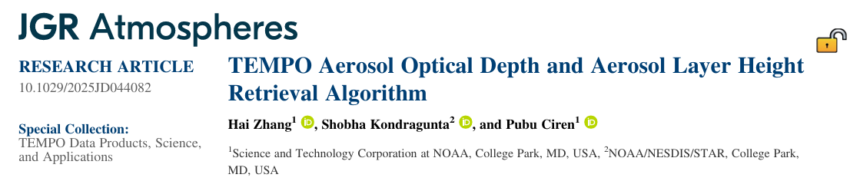
TEMPO AOD-ALH Algorithm updates
Soft calibration of L1b updates
  Use AERONET matchup data over water; updated soft calibration for V03 and V04
TEMPO-AERONET matchup dataset for algorithm development
Directional Lambertian Equivalent Reflectivity (DLER) database
  Updated using 2-year dataset; evaluated against AERONET matchups
  Developed bias correction method using lightGBM machine learning
Machine learning QA filter for poor-performing AOD retrievals
Validation
  AOD retrievals validated using AERONET; ALH retrievals validated using EarthCARE

Slide 8
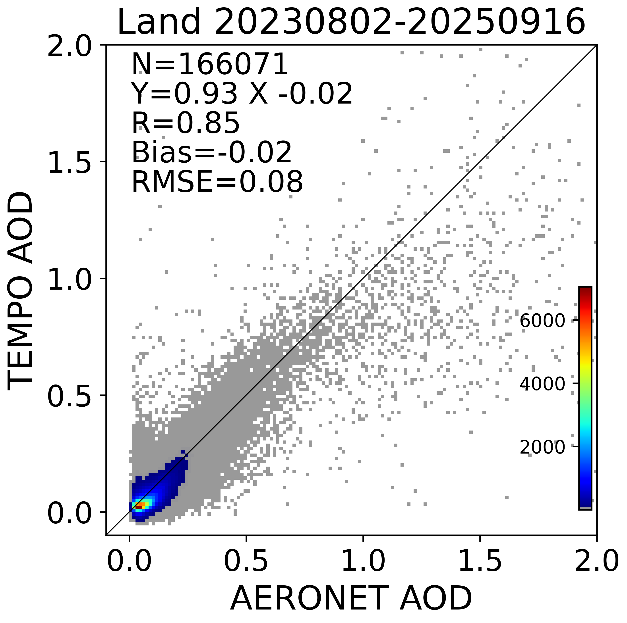
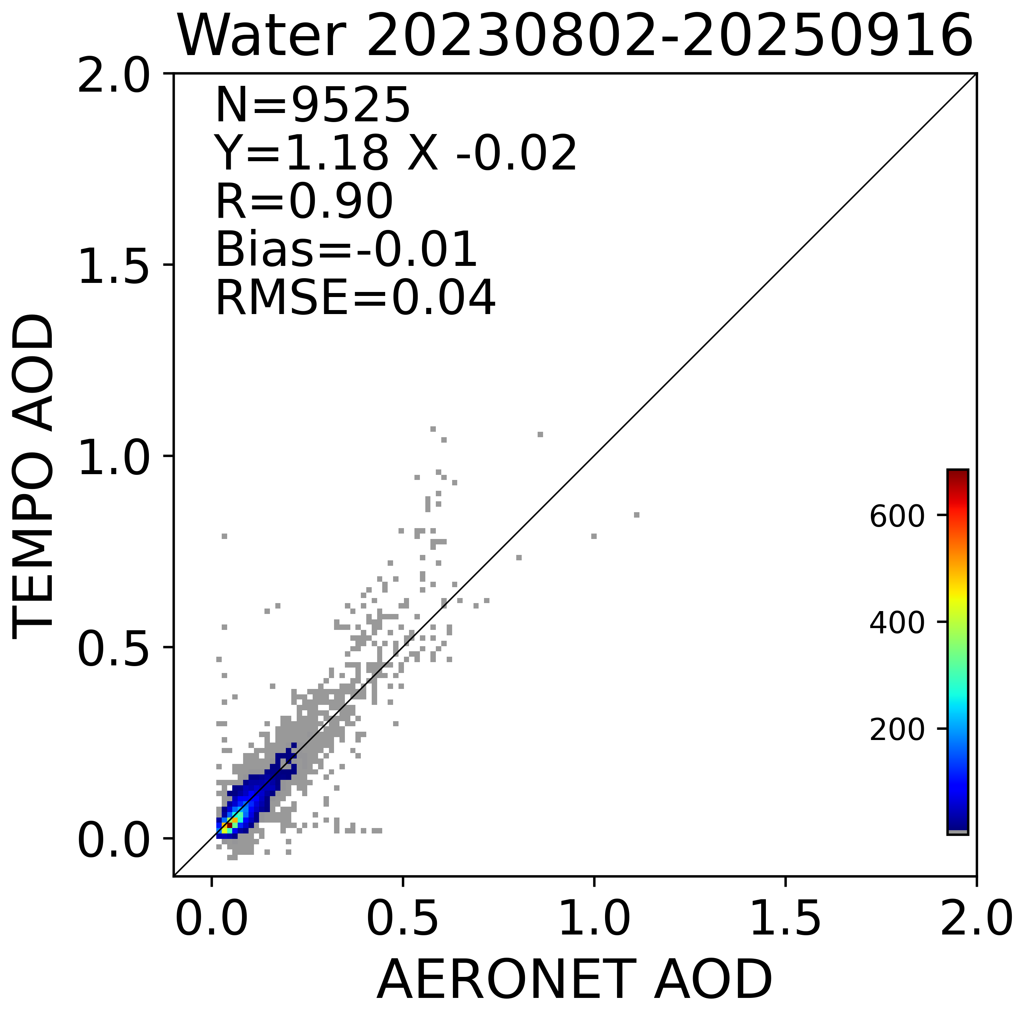
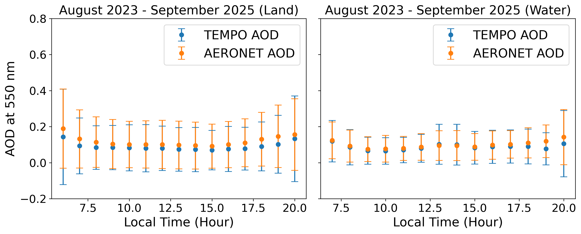
TEMPO AOD validation (August 2023-September 2025)
Performance statistics by AOD regime
(Requirements from VIIRS AOD ATBD are in parenthesis)
 | Over land |  | Over water
 | Accuracy | Precision | Accuracy | precision
Low AOD (AERONET AOD <0.1 over land, AERONET AOD <0.3 over water) | -0.01 (0.06) | 0.04 (0.15) | -0.01 (0.08) | 0.03 (0.15)
Medium AOD (AERONET AOD [0.1, 0.8] over land) | -0.04 (0.05) | 0.07 (0.25)
High AOD (>0.8 over land, > 0.3 over water) | -0.31 (0.20) | 0.52 (0.45) | 0.03 (0.15) | 0.14 (0.35)

Slide 9
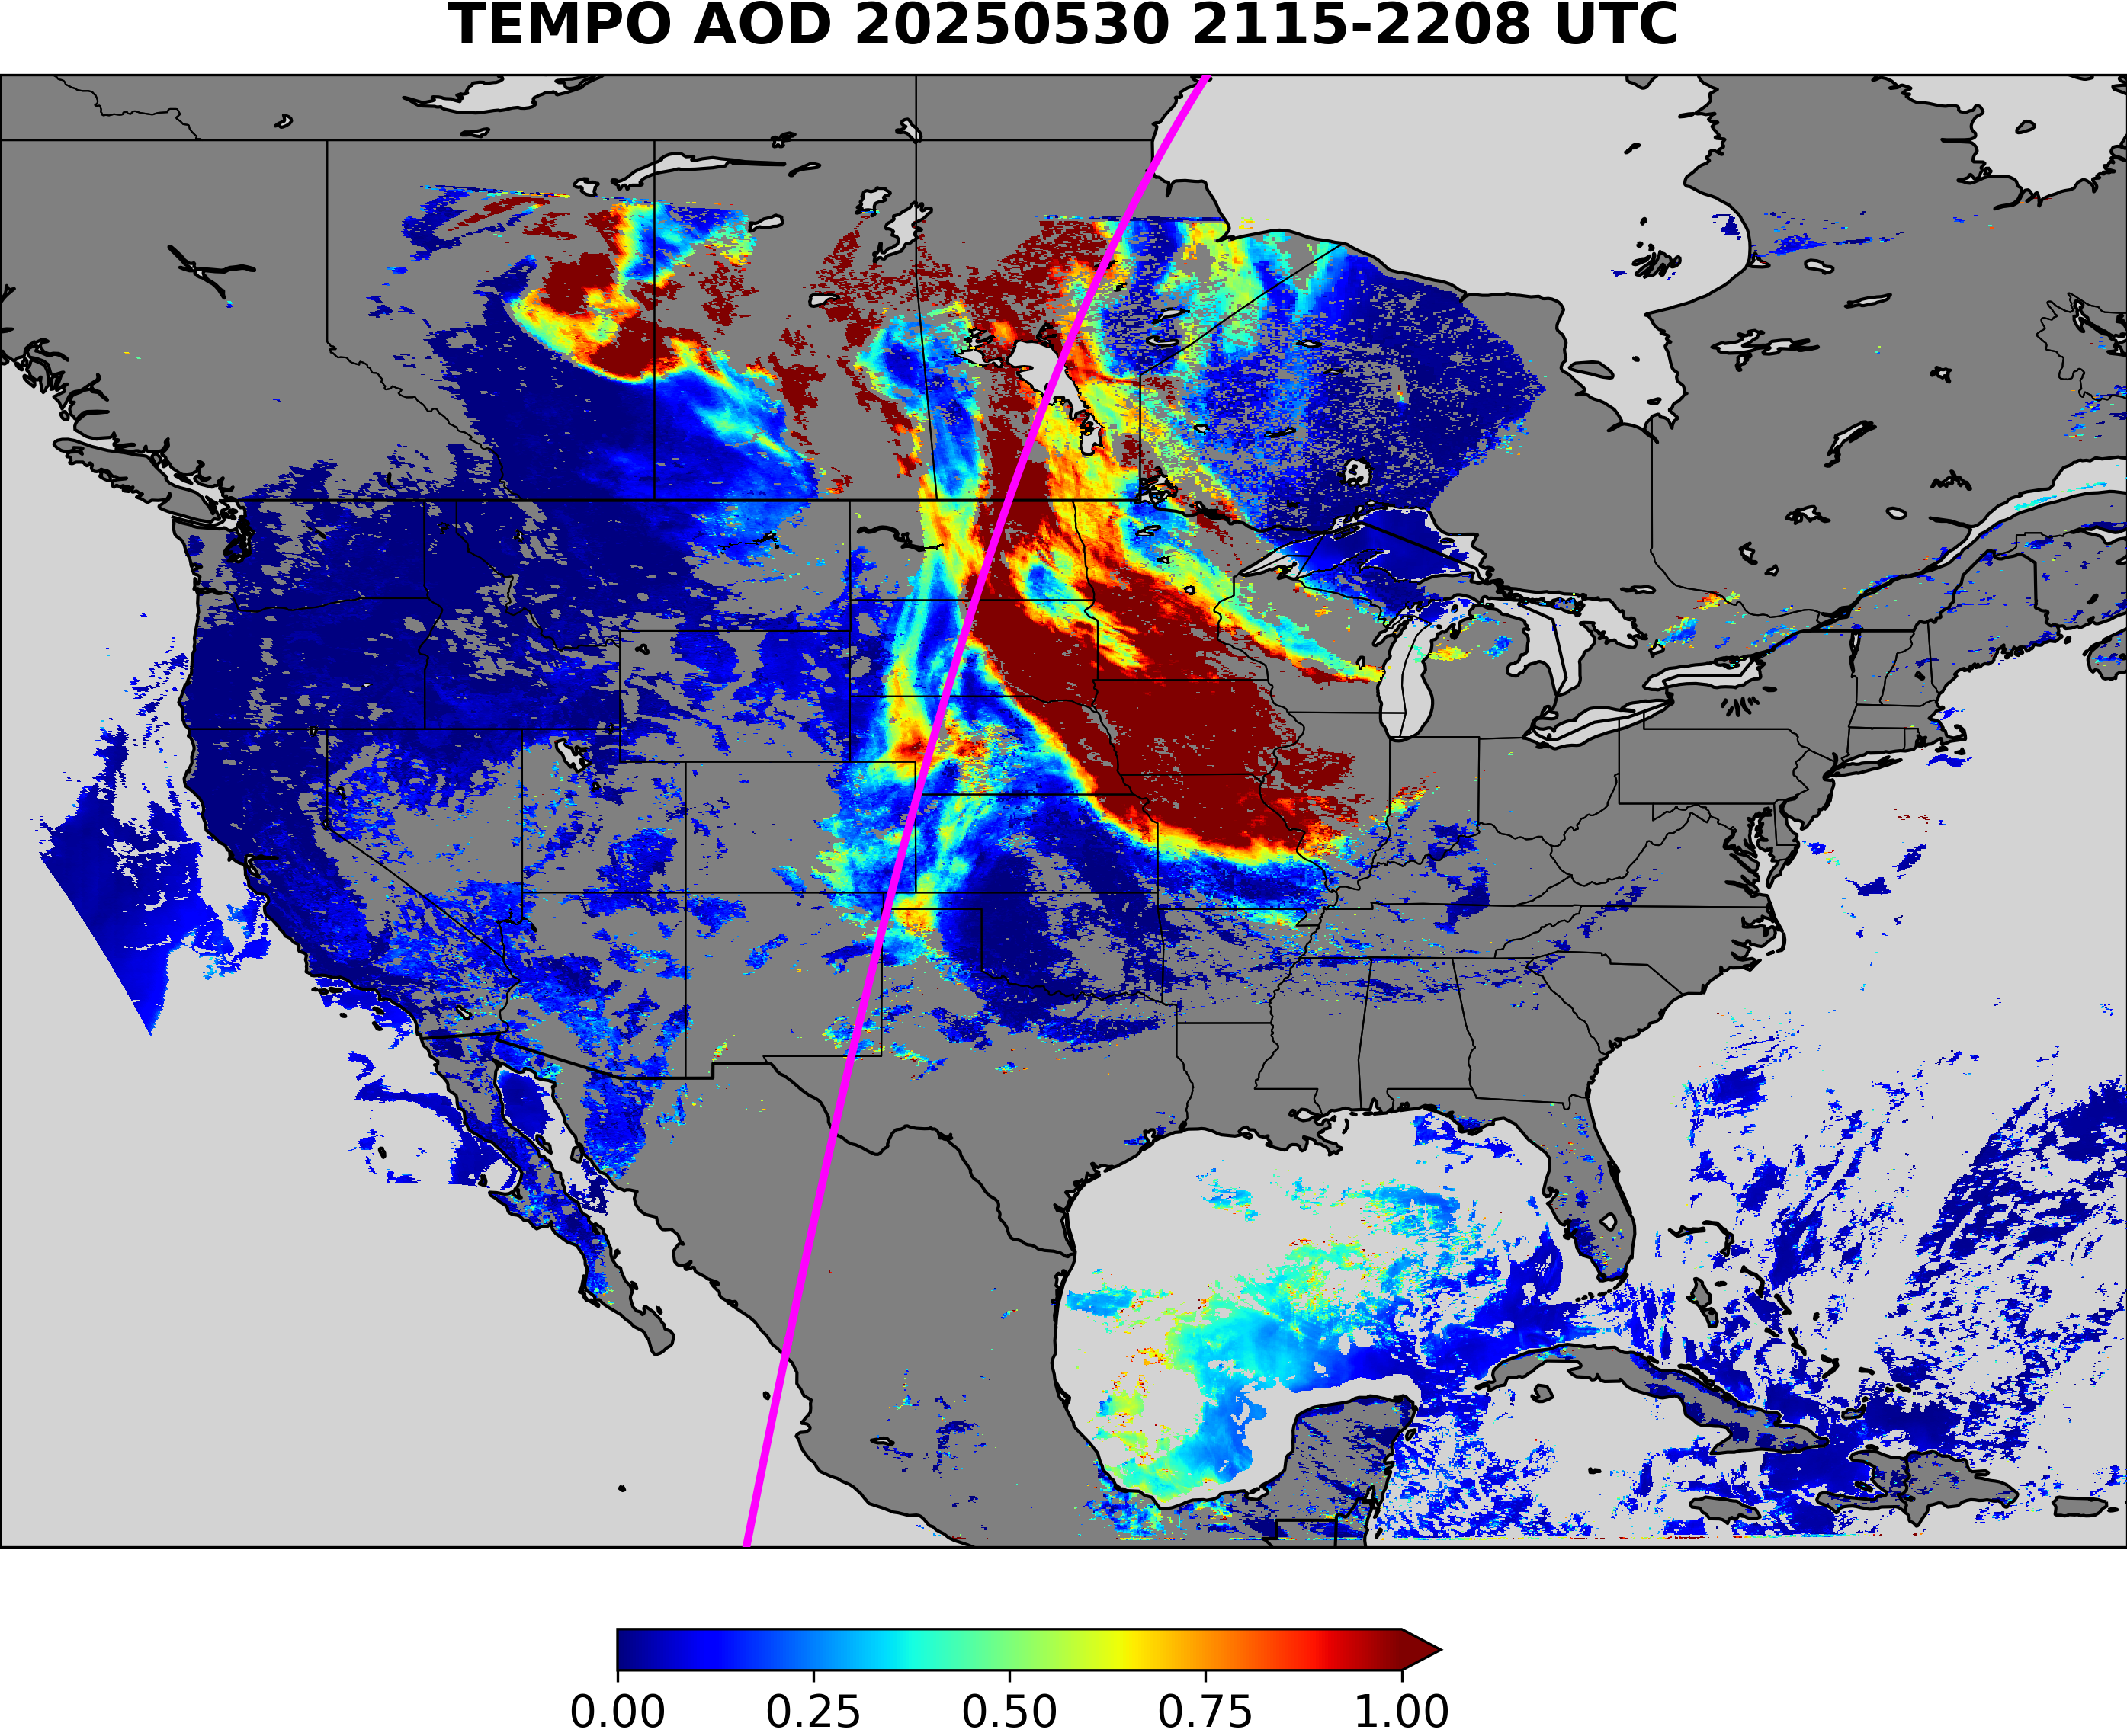
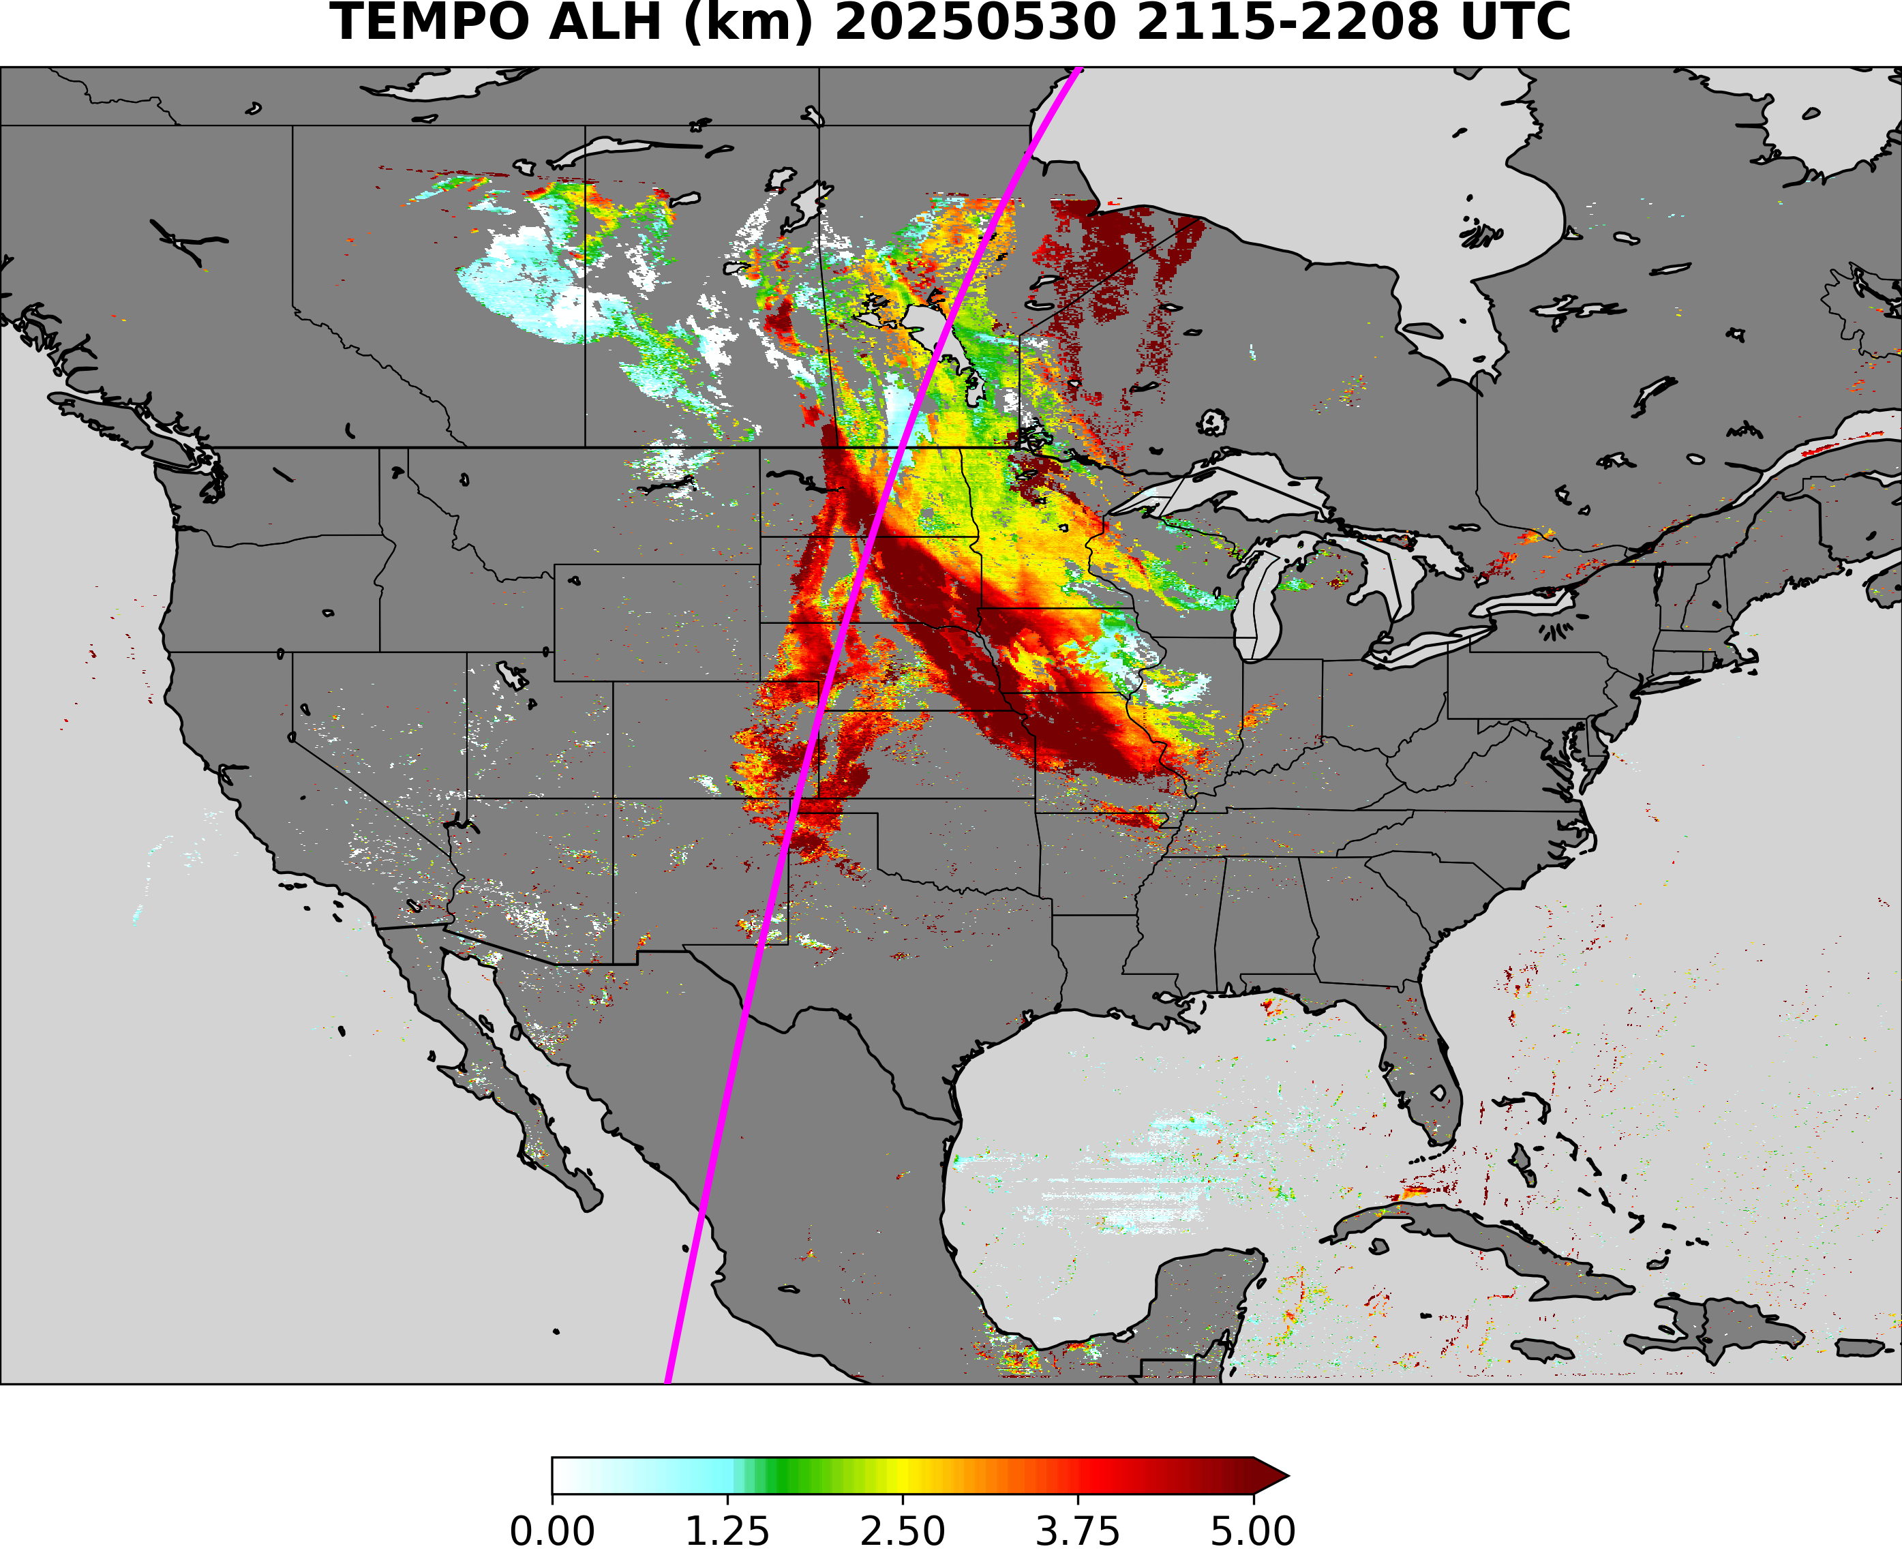
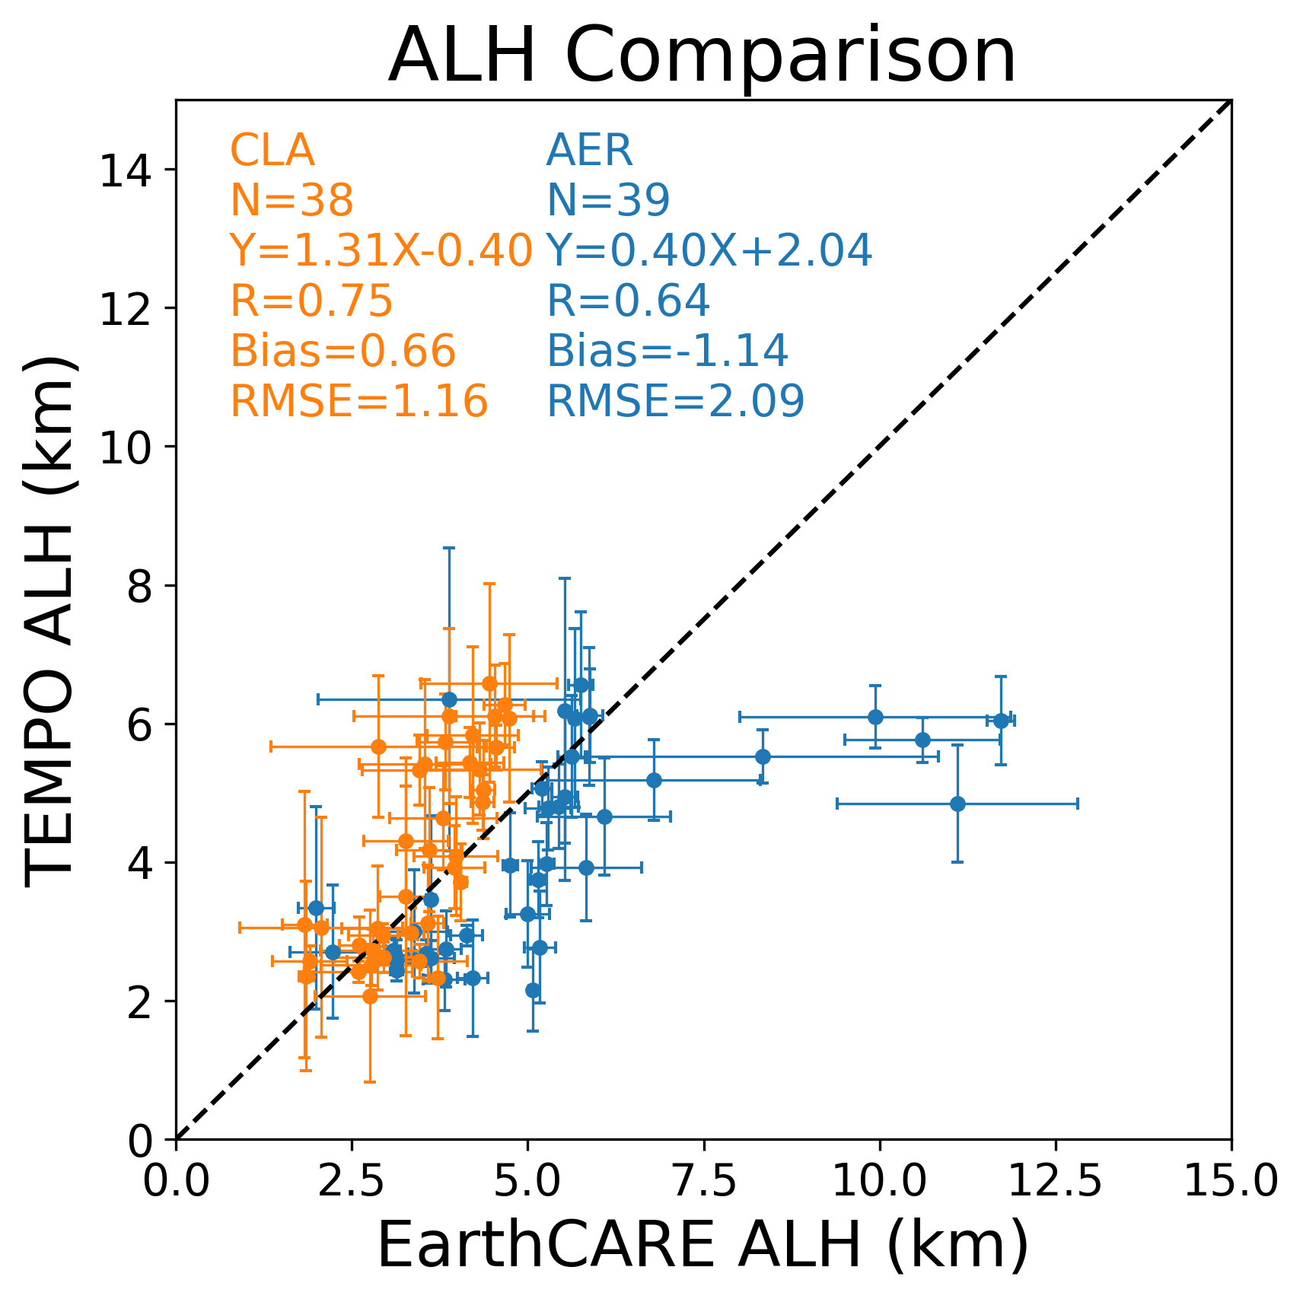
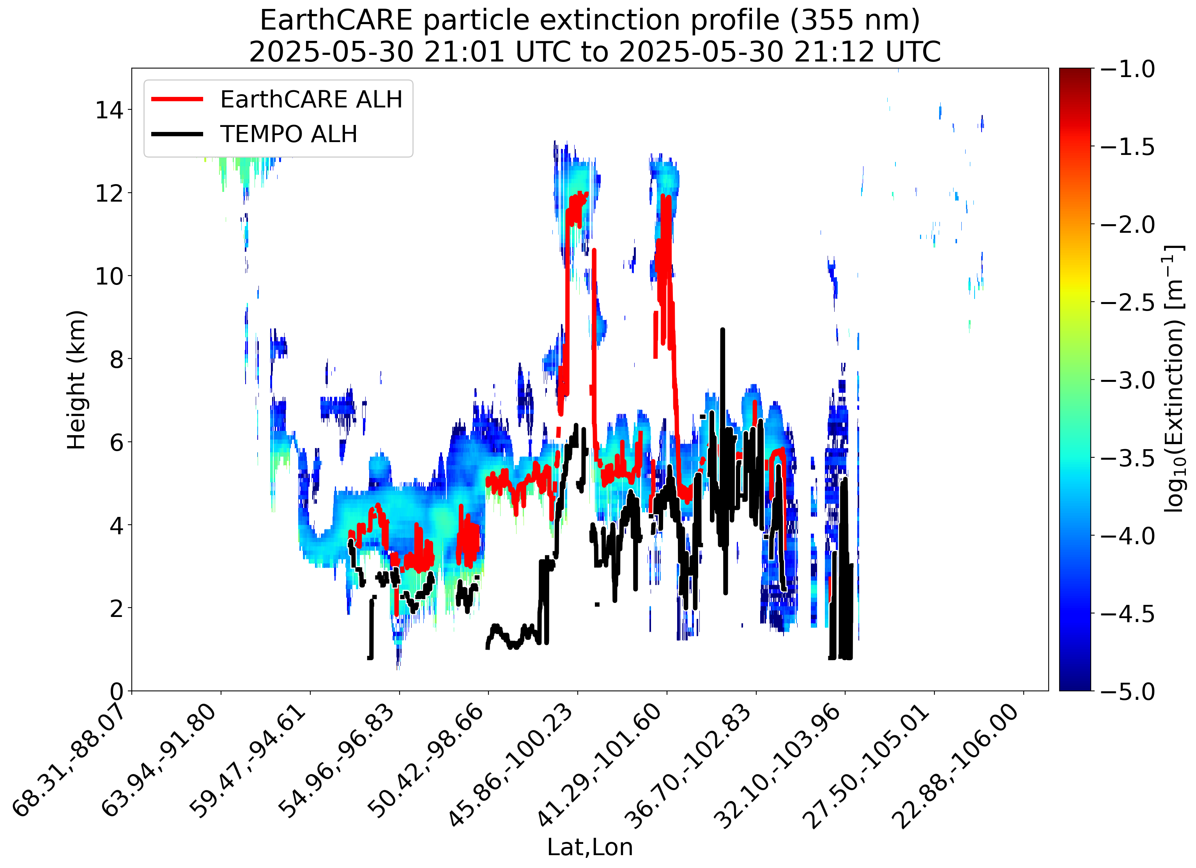
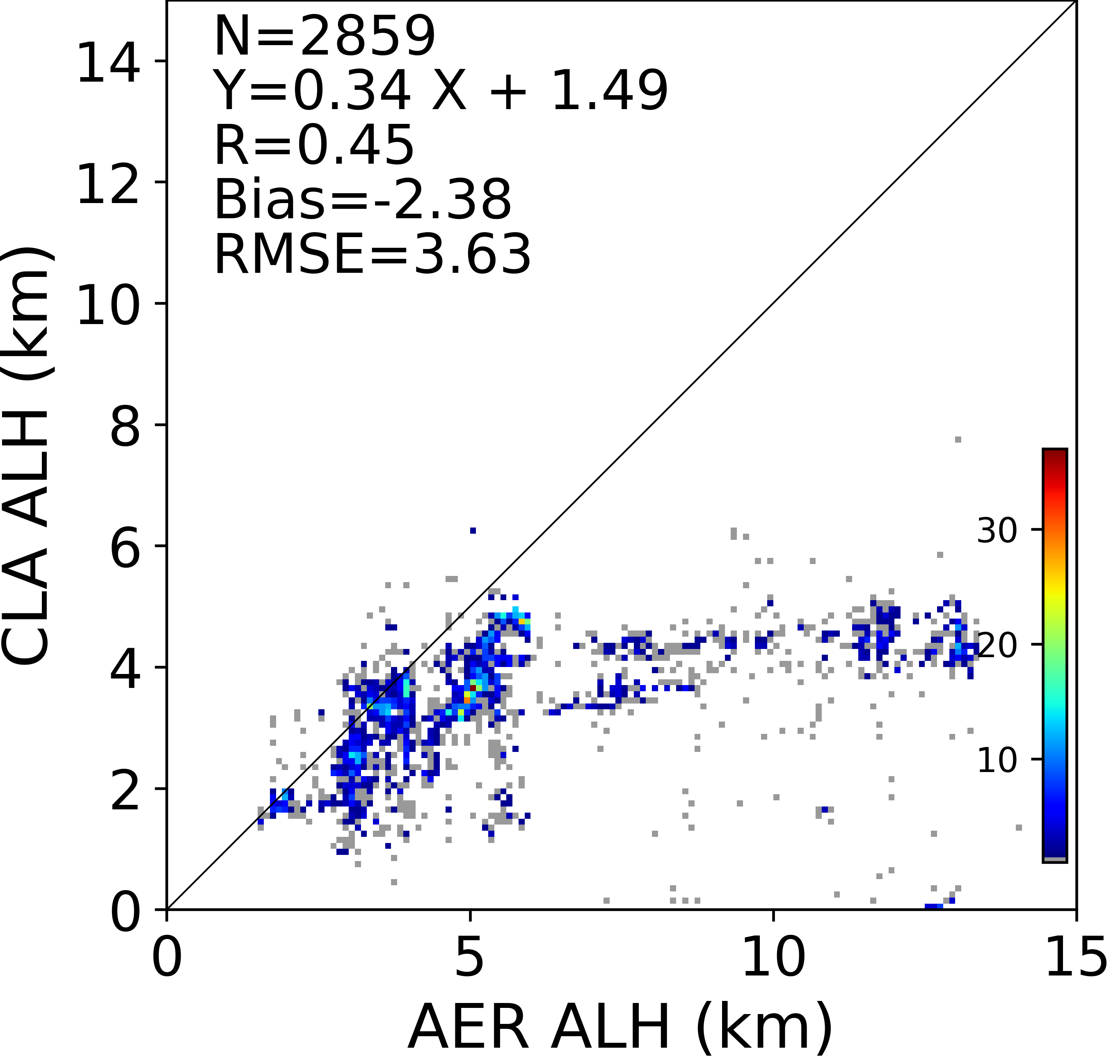
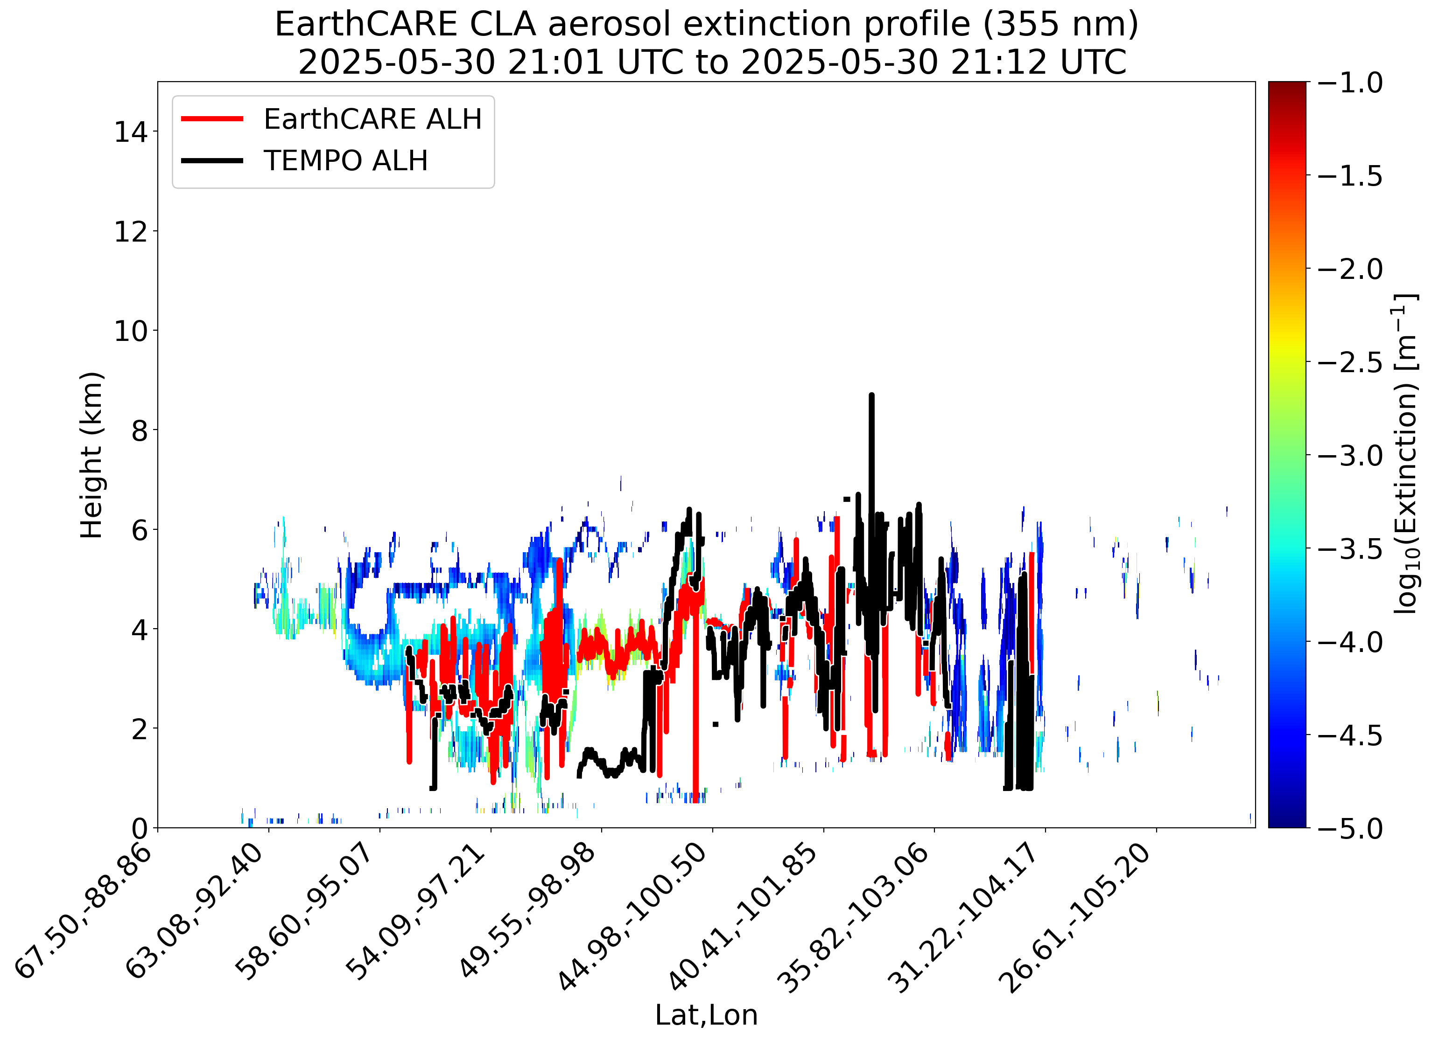
ALH Comparison to EarthCARE (Case study)
AER(ESA)
CLA(JAXA)

Slide 10
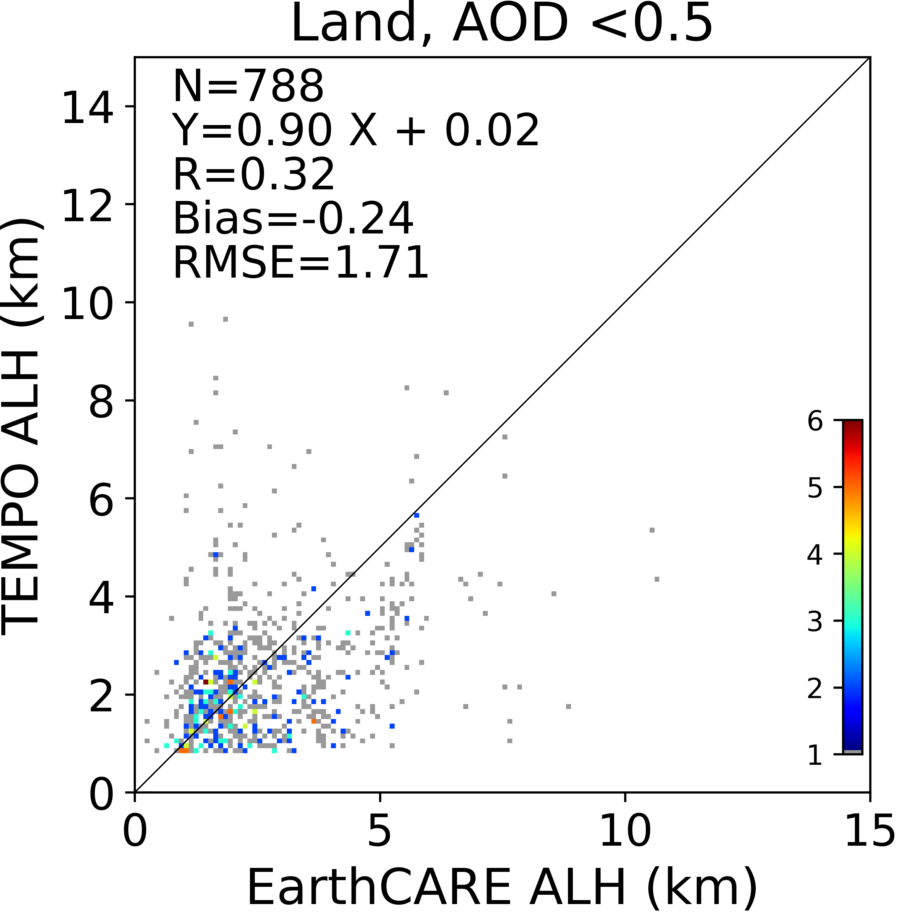
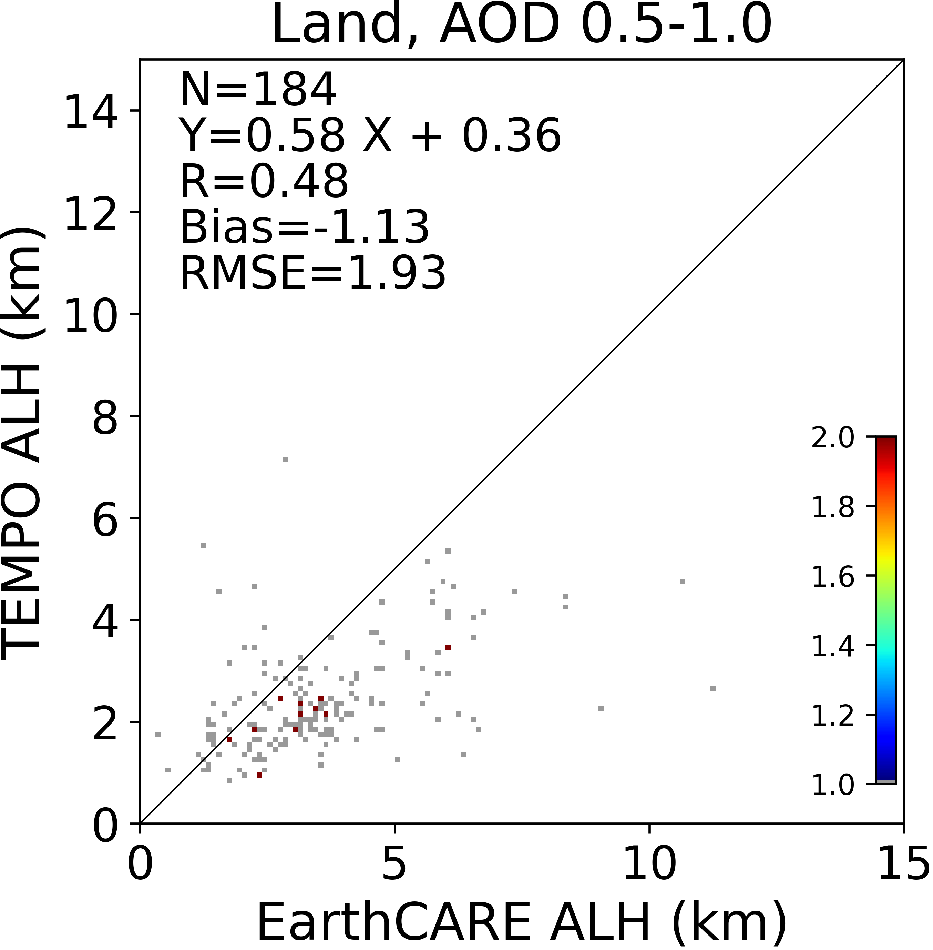
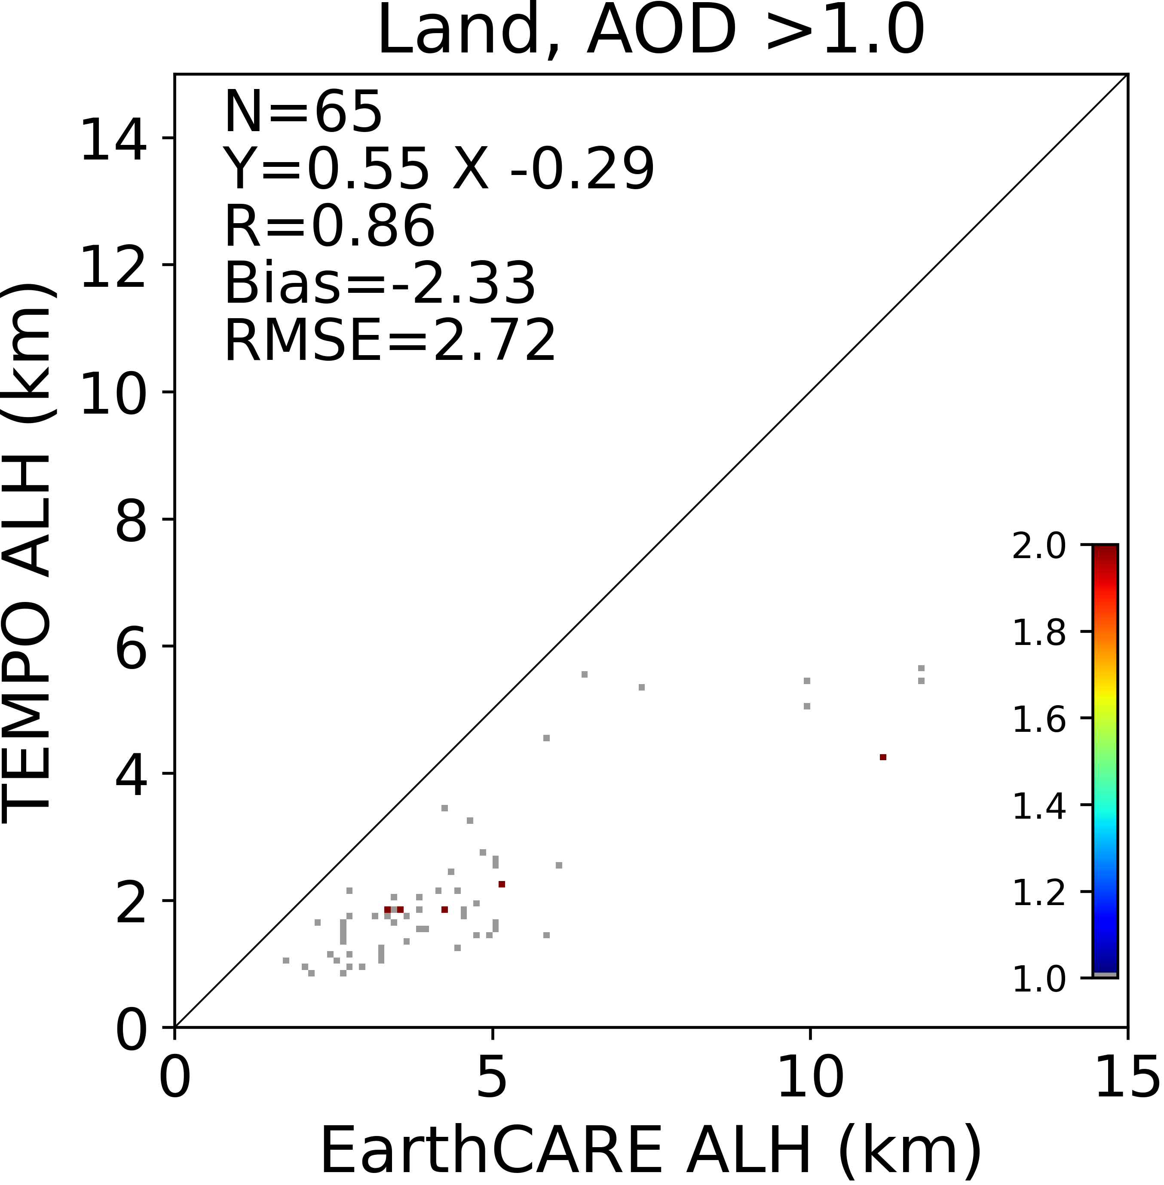
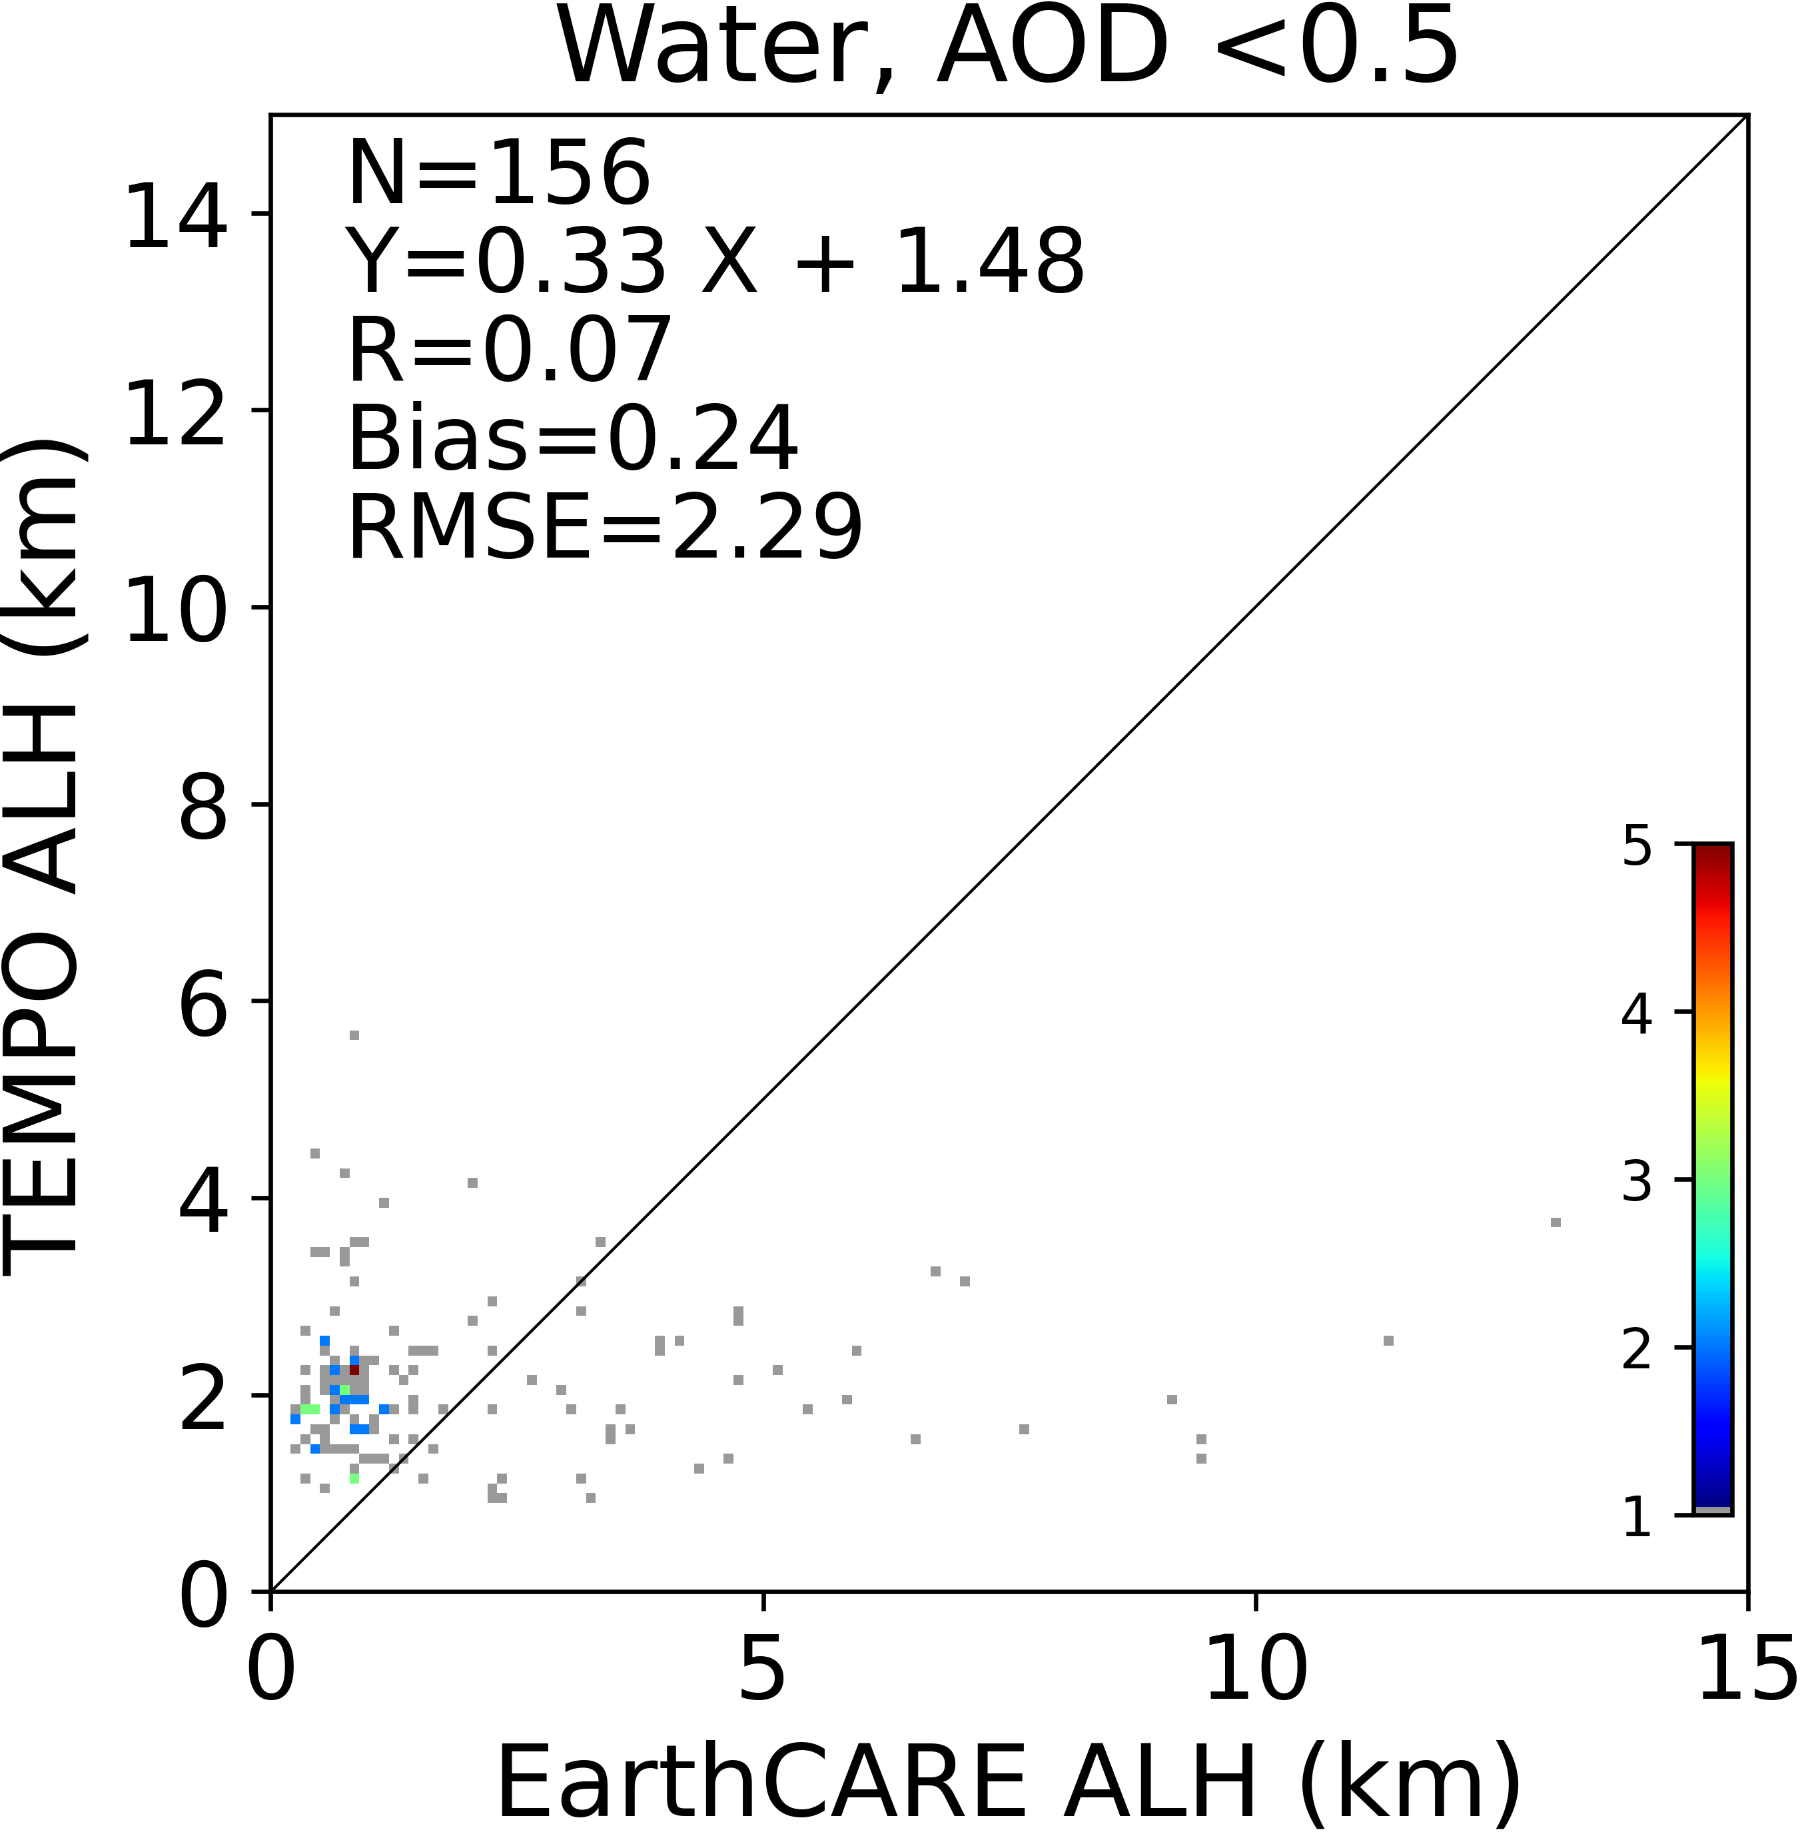
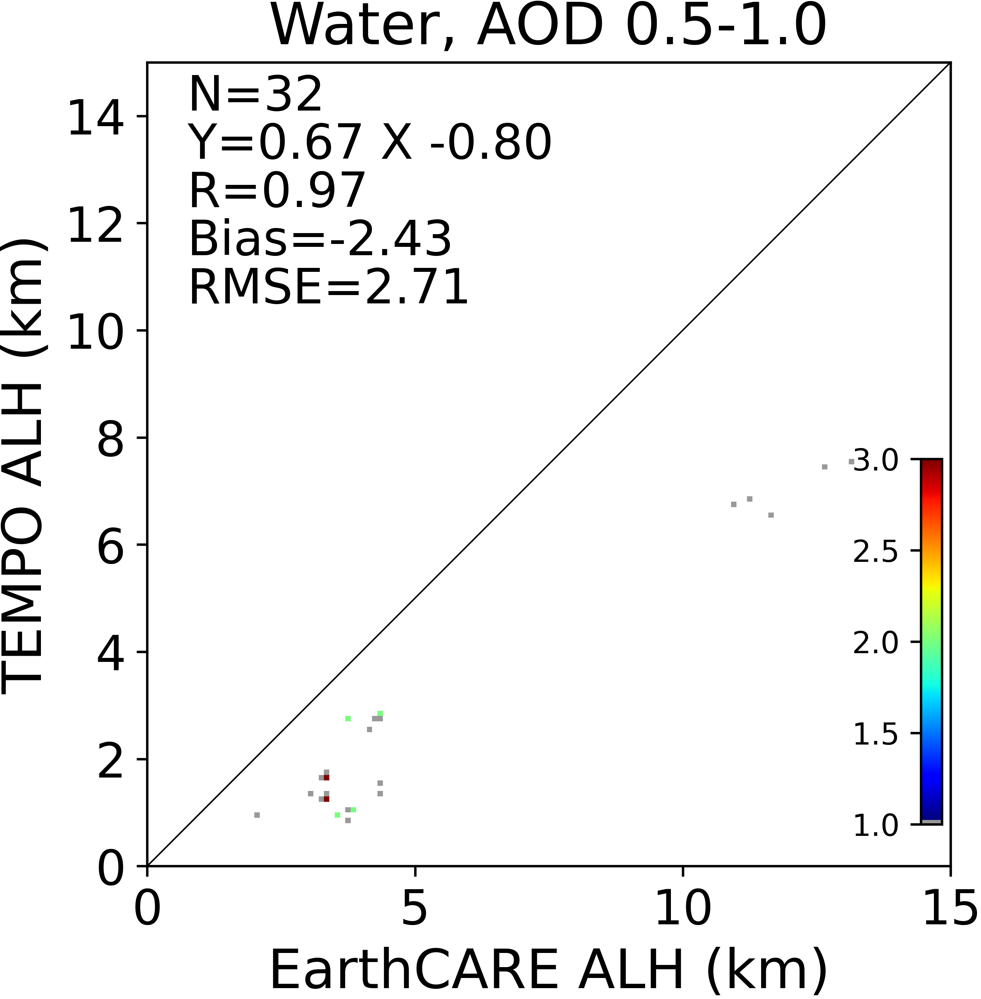
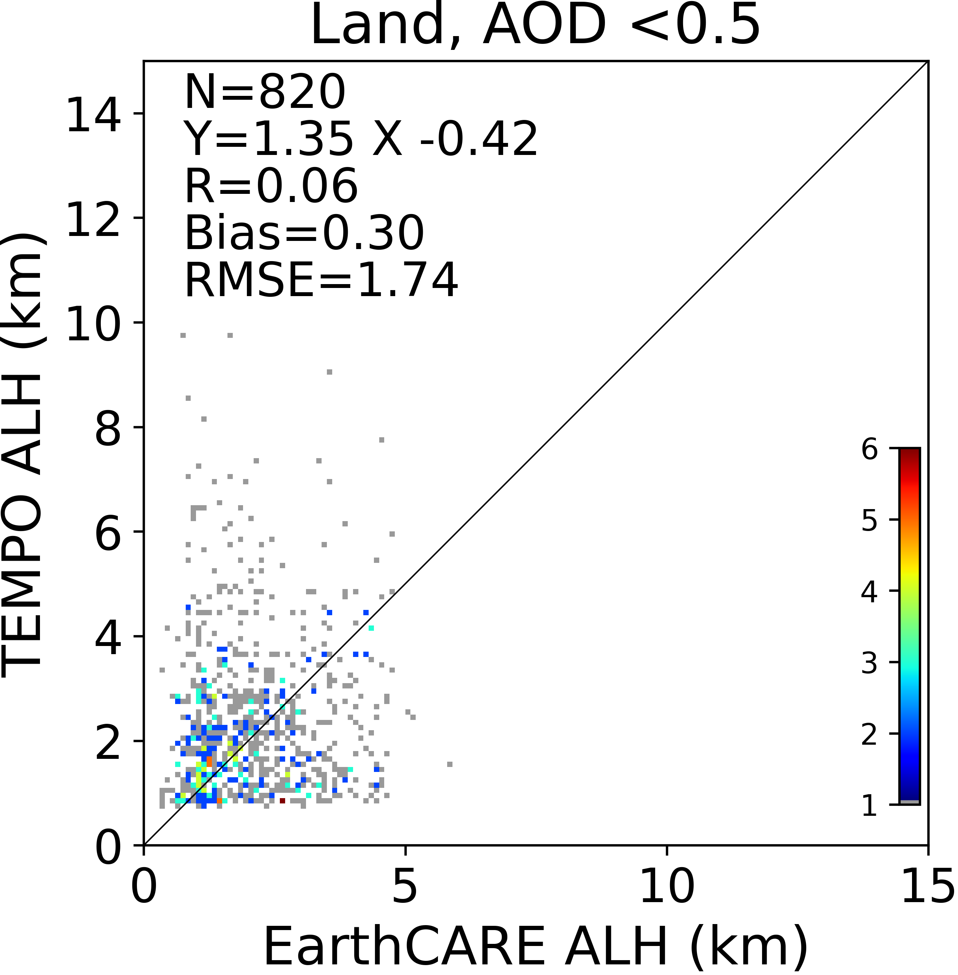
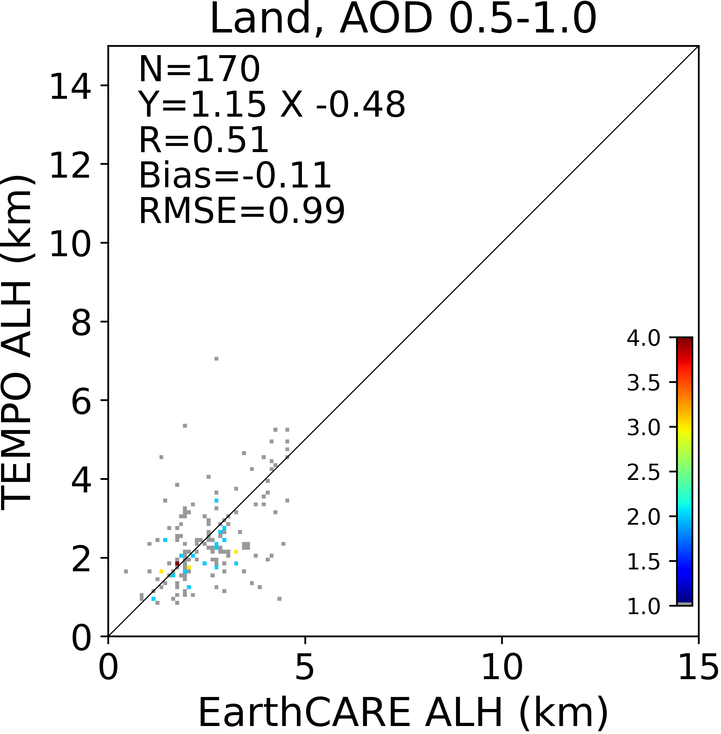
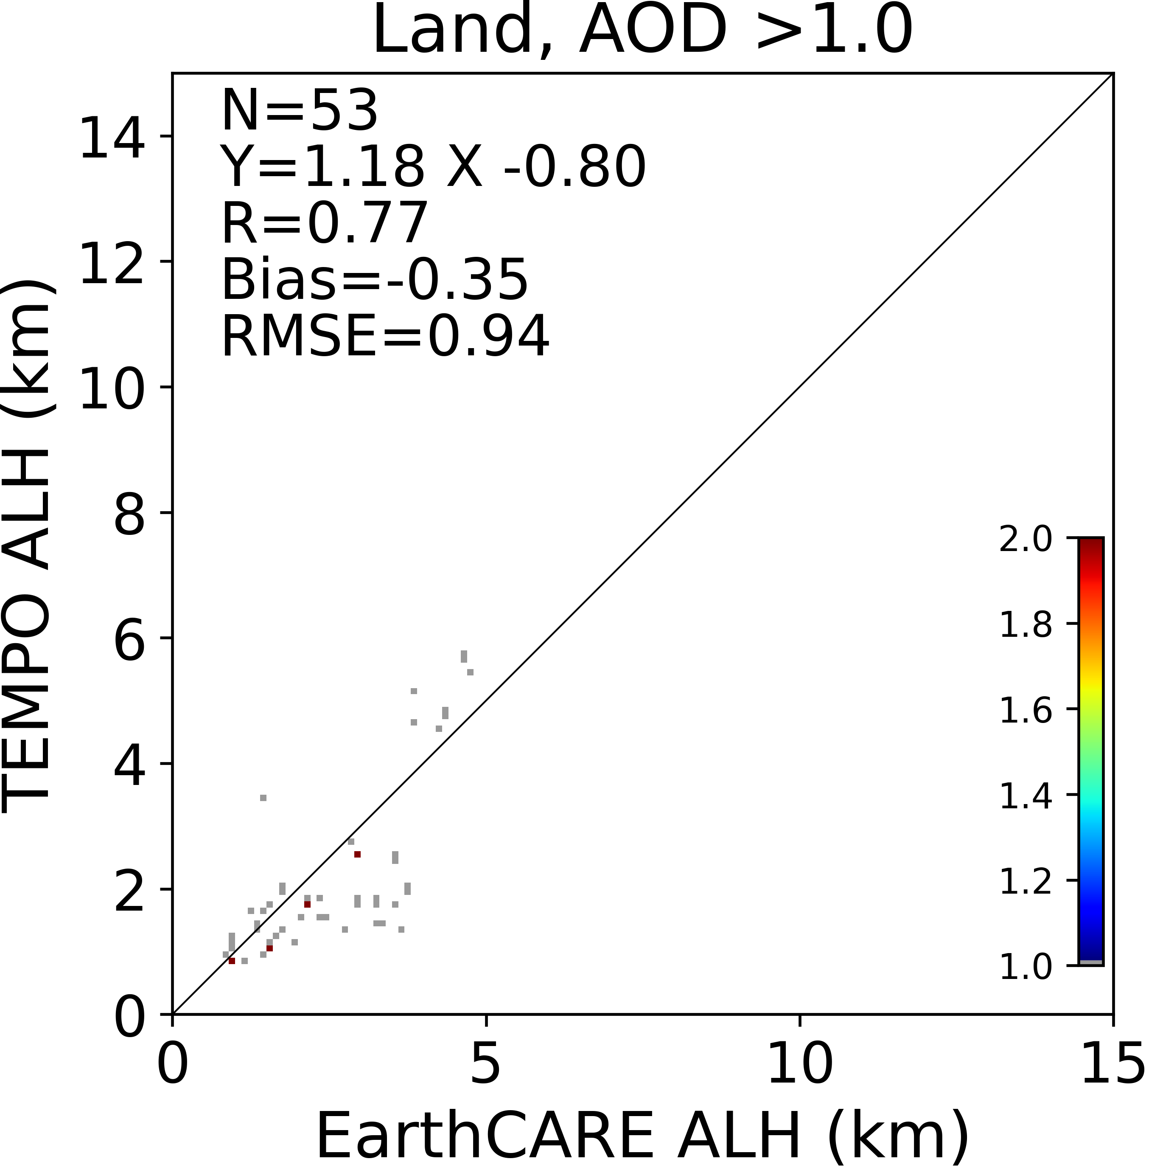
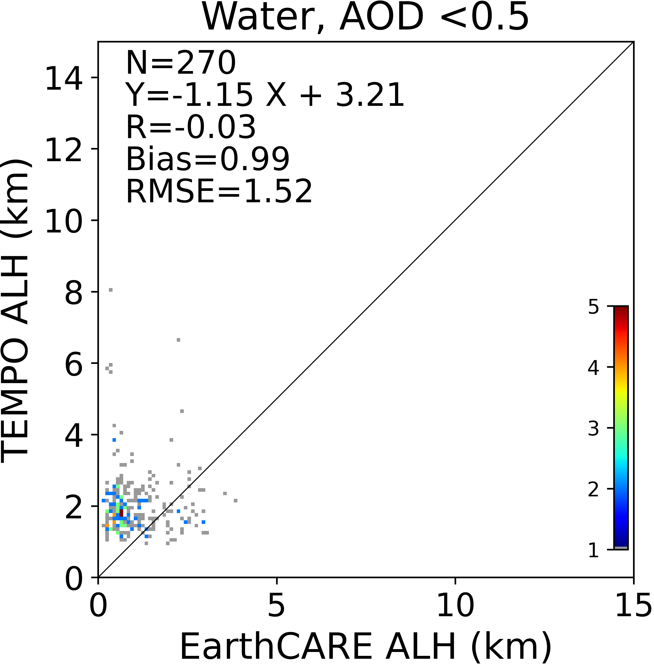
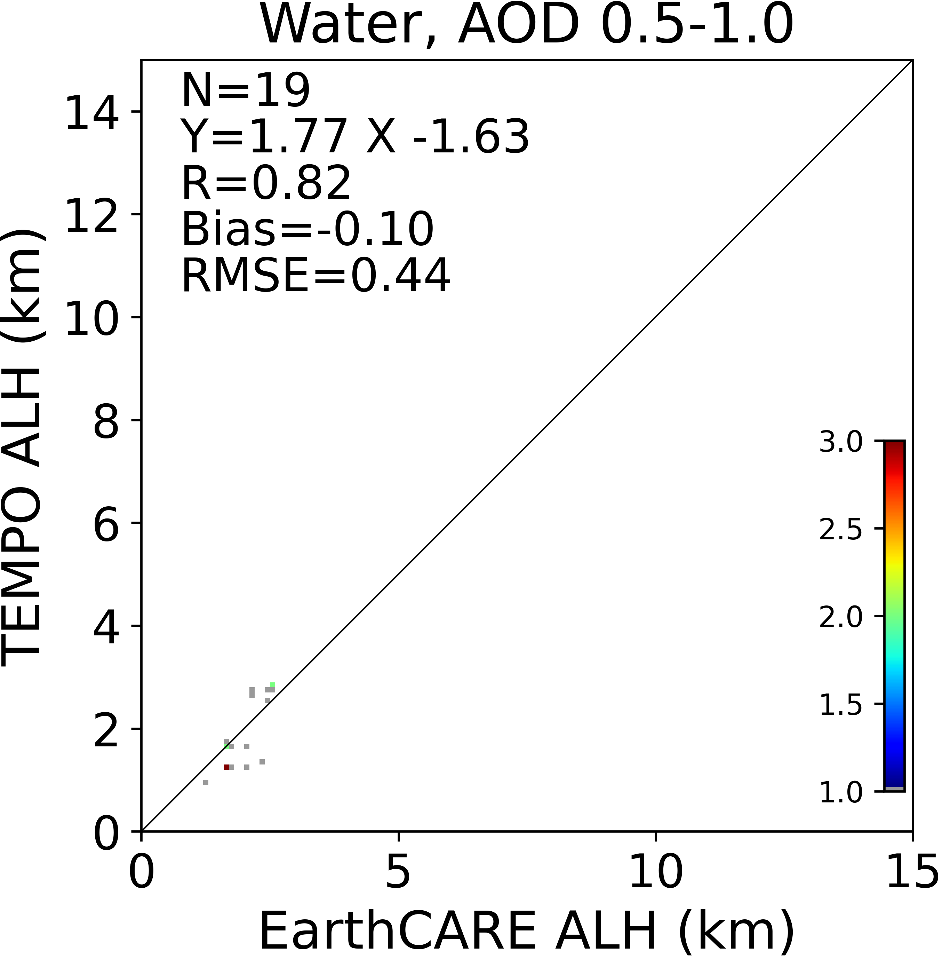
ALH Comparison to EarthCARE (March 2025-December 2025)
Land
Water
AER
CLA
Better agreement with CLA product
Better performance for higher AOD

Slide 11
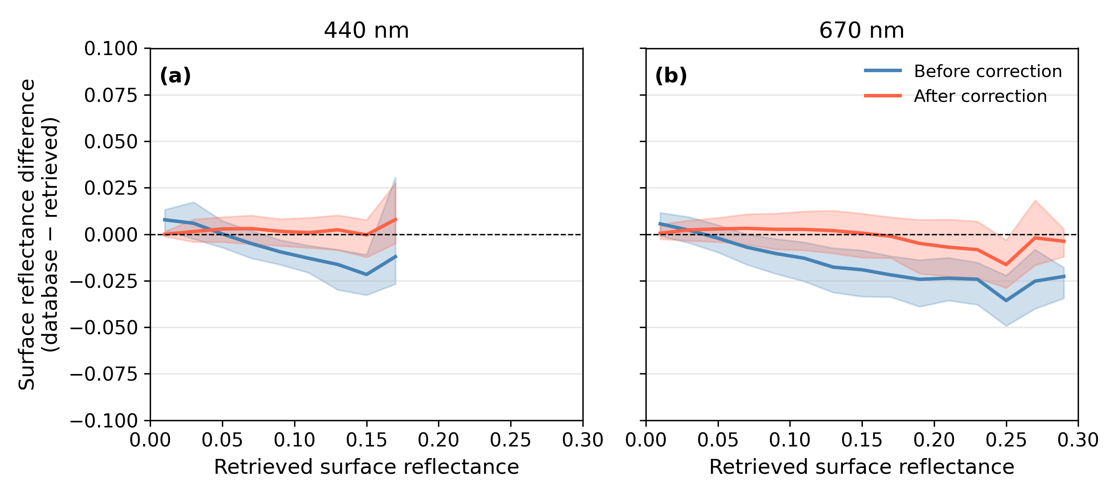
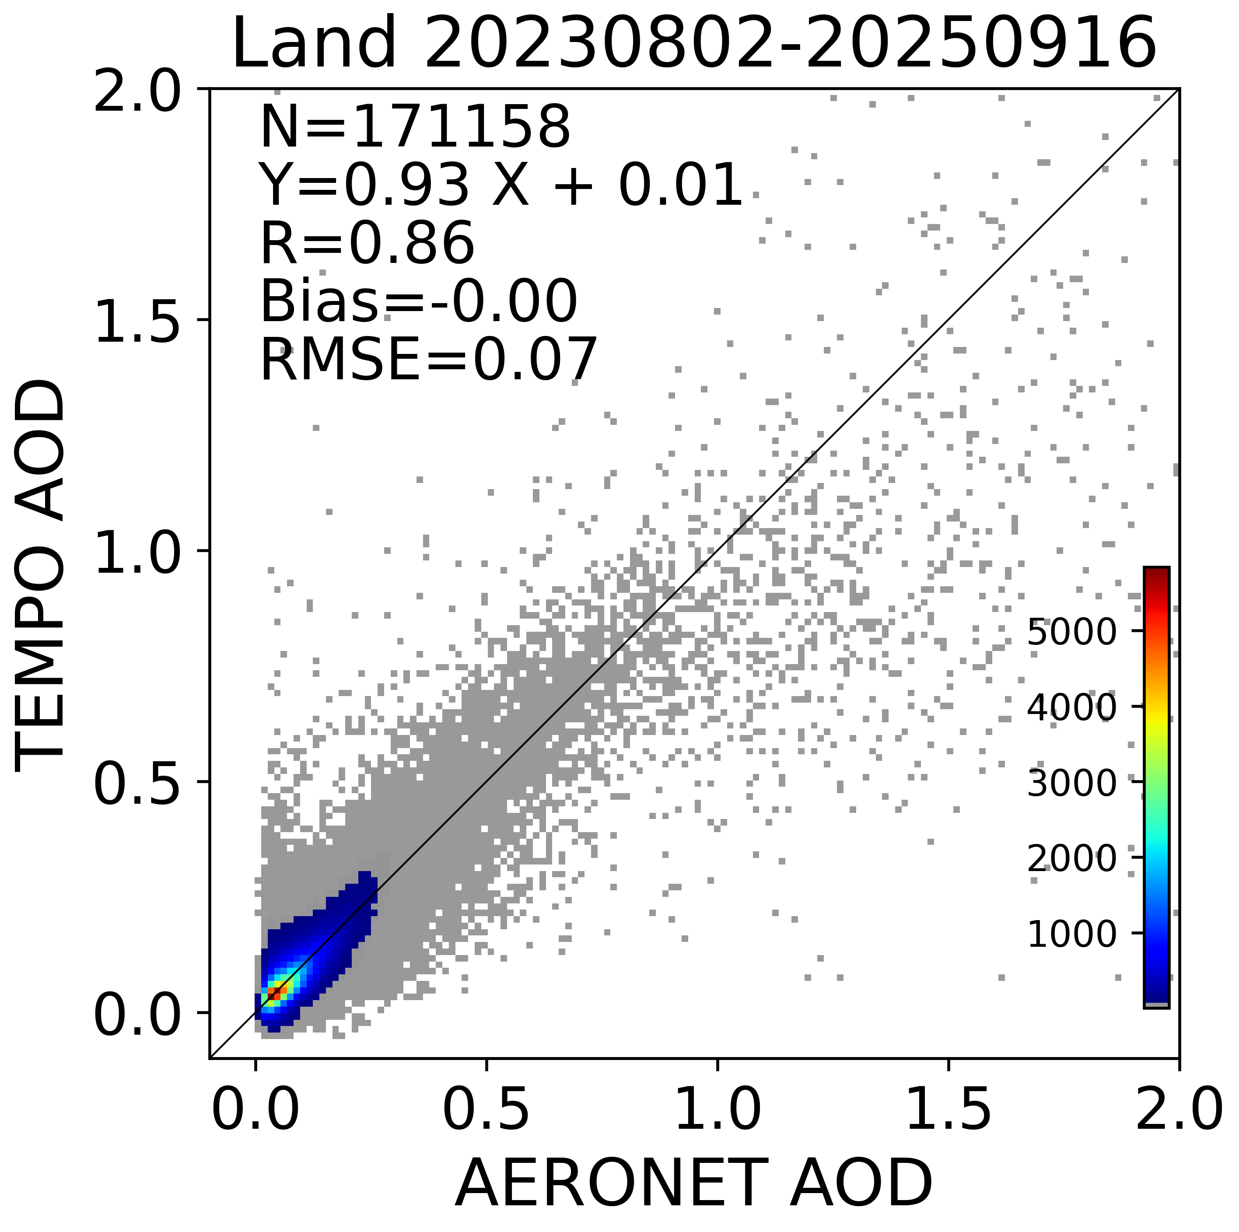
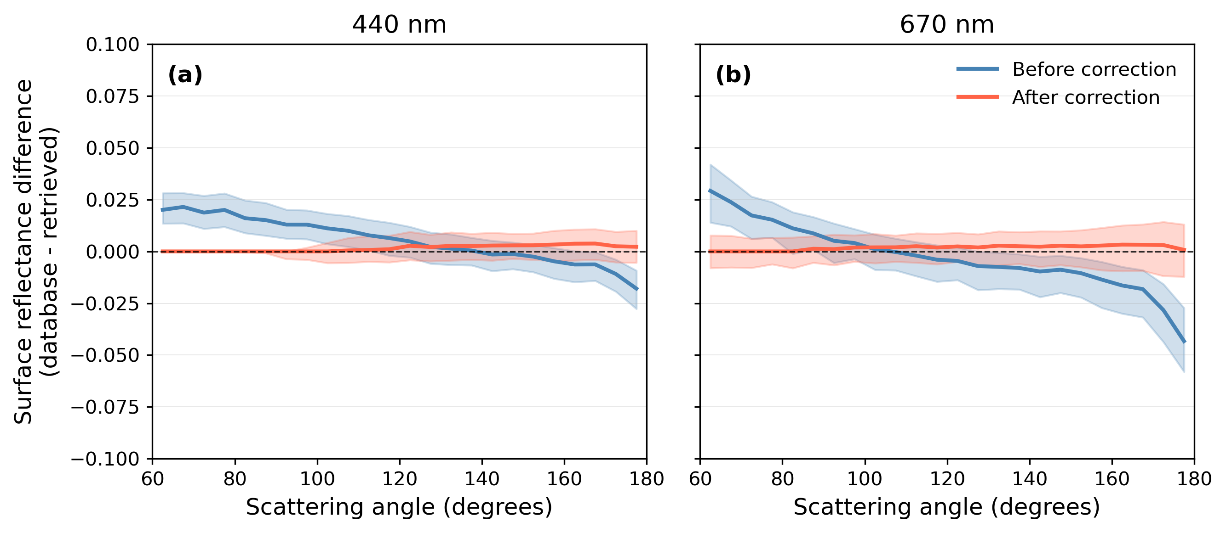
Bias correction of DLER
Use TEMPO-AERONET matchup dataset
Atmospheric correction to obtain surface reflectance for low AOD matchups
Compare DLER with the retrieved
Use machine learning (lightGBM) to correct bias
Still not deployed in the full product yet
Before correction
After correction

Slide 12
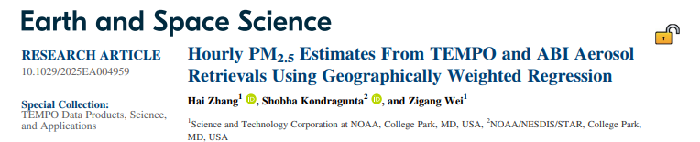
TEMPO–ABI PM_{2.5} Estimates using GWR
Geographically Weighted Regression (GWR)
Estimate PM₂.₅ separately from TEMPO AOD–ALH and ABI AOD, then merge
Including TEMPO aerosol information improves PM_{2.5} estimates, especially for high ALH and heavy dust cases
TEMPO-only estimates will be operational; TEMPO-ABI merged product coming next

Slide 13
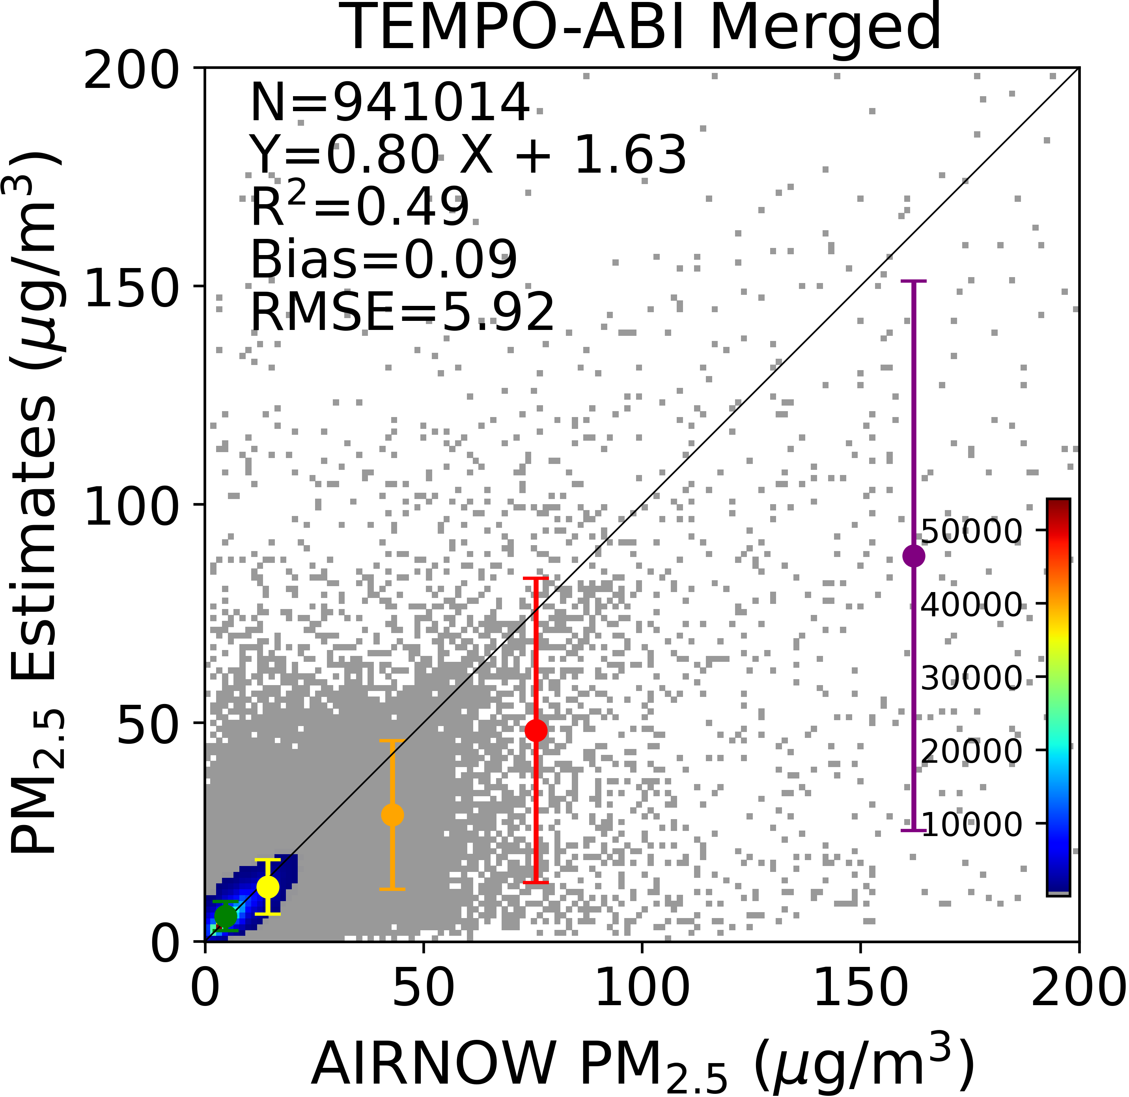
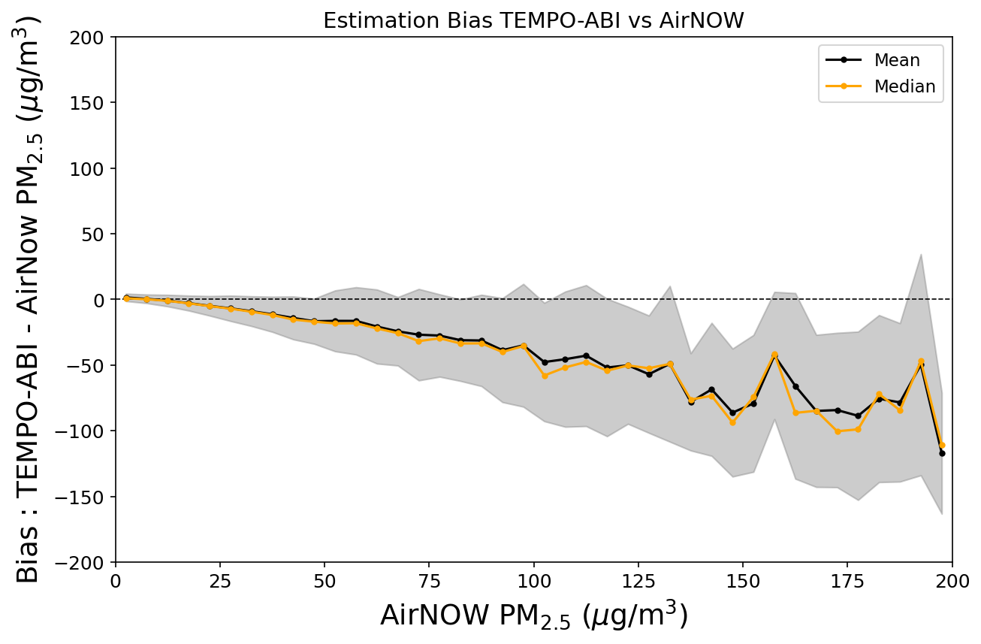
10-fold cross validation (August 2023-July 2024)

Slide 14
Summary
TEMPO ADP generated improved smoke/dust detection due to the availability of UV bands
TEMPO AOD-ALH retrieval algorithms developed and validated
  Multiple updates: soft calibration, DLER bias correction, ML-based QA filter
Merged TEMPO-ABI PM_{2.5} estimates outperform ABI-only in challenging conditions
  Improved accuracy for high aerosol layer height (ALH) and dusty environments
Published papers
  Zhang et al. (2025). TEMPO aerosol optical depth and aerosol layer height retrieval algorithm. JGR: Atmospheres, 130, e2025JD044082.
  Zhang et al. (2026). Hourly PM2.5 estimates from TEMPO and ABI aerosol retrievals using GWR. Earth and Space Science, 13, e2025EA004959.

