Slide 1
The NASA GEOS Composition Forecasting system (GEOS-CF)
Fei Liu, Viral Shah, Pam Wales, Carl Malings, Maryam Abdi-Oskouei, Joe Ardizzone, Nikolay Balashov, Jerome Barré, Sourish Basu, Michael Long, Rob Lucchesi, Retha Mecikalski, Sandra Roberts, Tommy Tobin, Kris Wargan, Brad Weir,
Emma Knowland, Christoph Keller, Lesley Ott, Steven Pawson

Slide 2
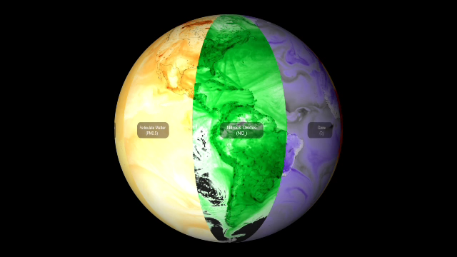
GEOS-CF is widely used for research and mission support
NASA’s Composition Forecasting system
Global Coverage | 25km resolution worldwide
Real-Time Information | Daily NRT estimates + 5-day forecasts
Open Science | Collaborative development + public data & software
NASA Mission Support | TEMPO • TolNet • Field Campaigns
Research Applications | Atmospheric chemistry + air quality and health
Air Quality Monitoring | Supporting communities in the US and globally
Version 2 released last year and used in TEMPO V04
Keller et al., 2021, JAMES; Knowland et al., 2022, JAMES, Malings et al., 2026, BAMS

Slide 3
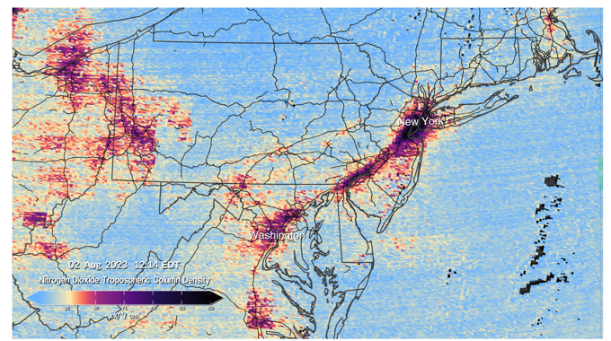
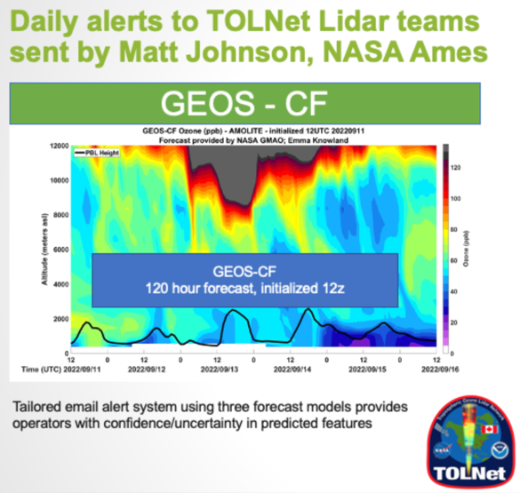

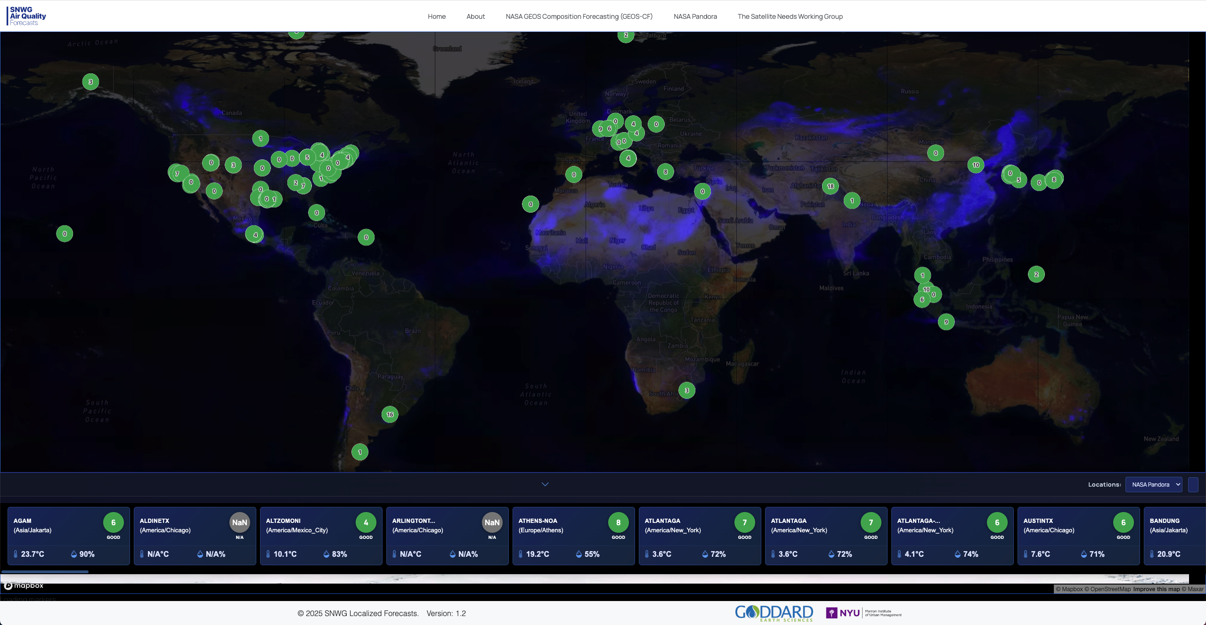
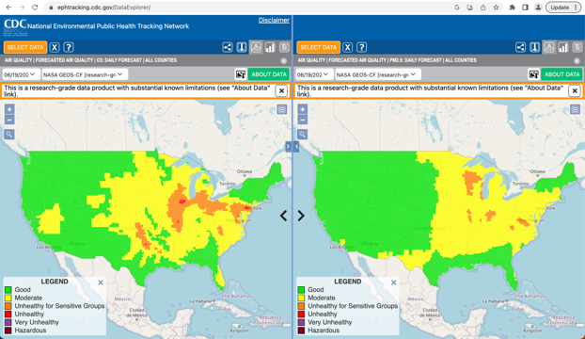

Engaged with a broad user community
User survey feedback
Strengths:
Global coverage, low latency, multi-pollutant forecasts
Multiple access options (direct file access, API, OPeNDAP, GEE)
Features most desired:
Finer spatial resolution, especially over US
Malings et al., 2026, BAMS

Slide 4
GEOS-CF version 2 marks a major advance for the system
Data assimilation
Model components
Emissions
GEOS 10.23 & GEOS-Chem 14.0
Assimilation of ozone column and profile data from OMPS/OMI and MLS/OMPS-LP
HTAP → CEDS
Replay to GEOS-IT
Updated fire emission factors & lightning NO_{x} emissions
CO₂ and CH₄ forecasts

Slide 5
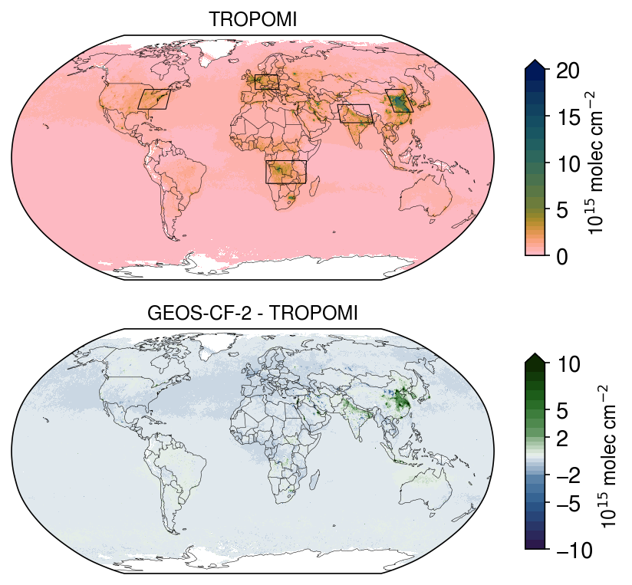
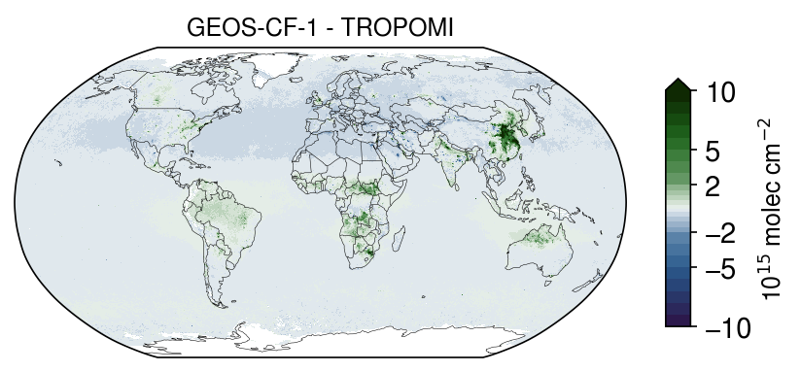
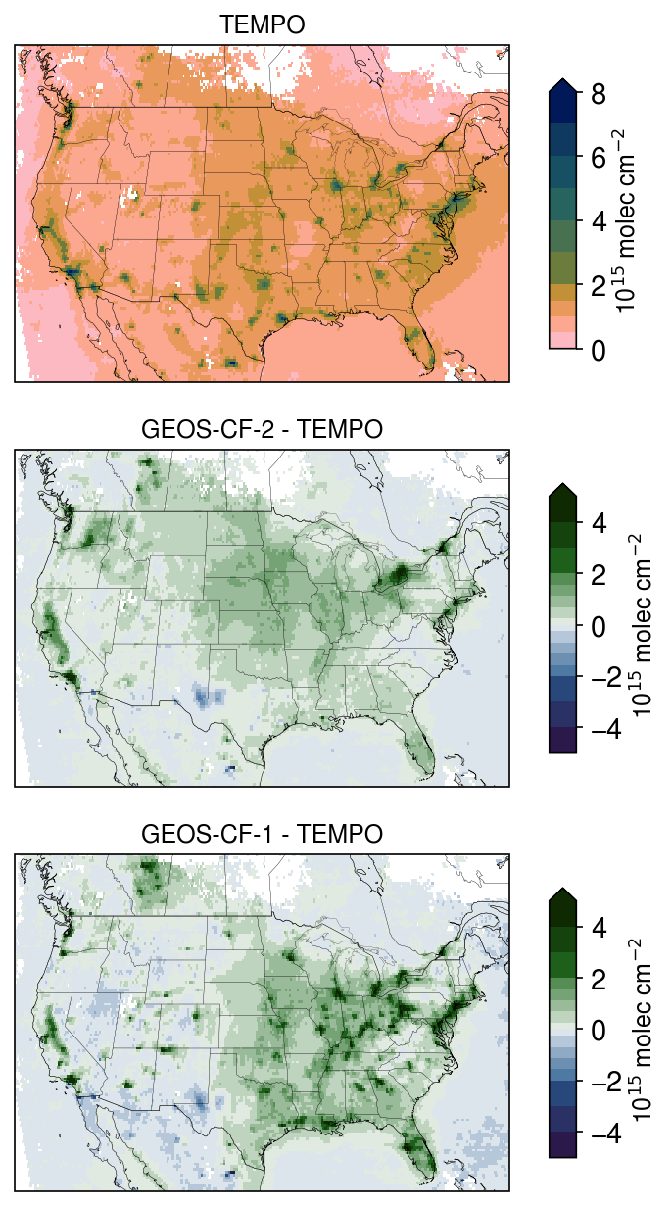
Updated emissions improve NO₂ in GEOS-CF version 2
TROPOMI NO₂
(trop columns, annual mean)
GEOS-CF-2 – TROPOMI
GEOS-CF-1 – TROPOMI
Within NO₂ retrieval
uncertainties
Winter NOx lifetime in model too long,
and high retrieval uncertainties
Updated BB emissions
TEMPO NO₂ (V04)
(trop columns, Aug-Sept)
GEOS-CF-2 – TEMPO
GEOS-CF-1 – TEMPO
Soil NOx emissions overestimated in the model
Improved anthro. emissions
Results for 2023

Slide 6
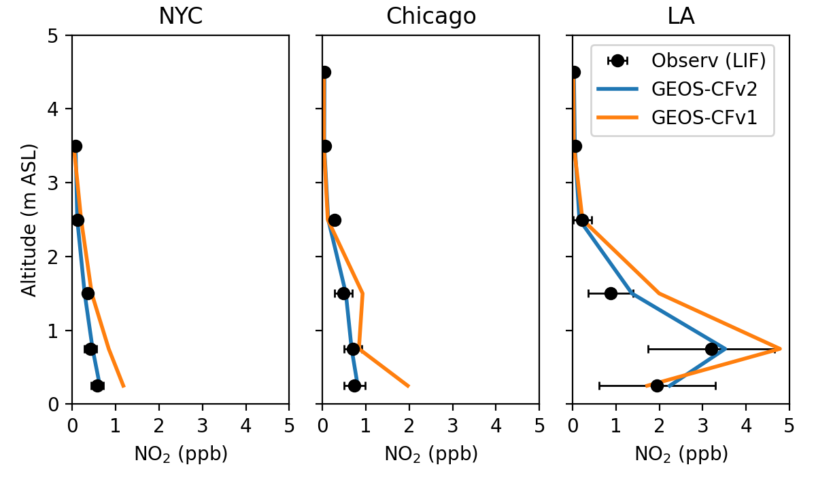
GEOS-CF-2 NO_{2,} NO_{y} profiles more consistent with aircraft observations over the US
NOy profiles during MAGEQ: July ‘25
NO2 profiles during AEROMMA: July-Aug ‘23
CF-2
CF-1
Obs
CF-1
CF-2
NO₂ & NO_{y} measurements from NOAA (CSL)
Figure courtesy of Nikolay Balashov

Slide 7
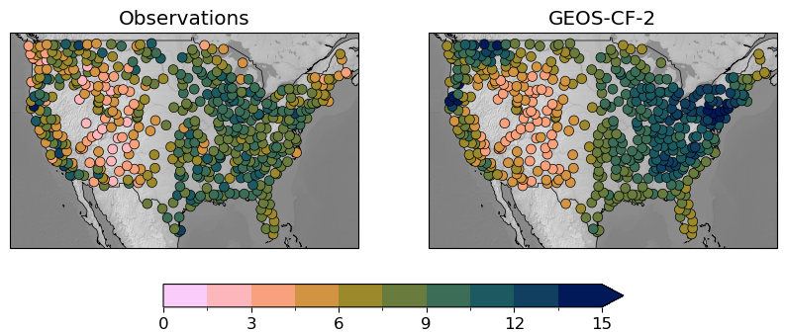
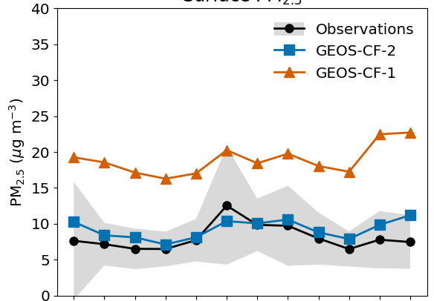
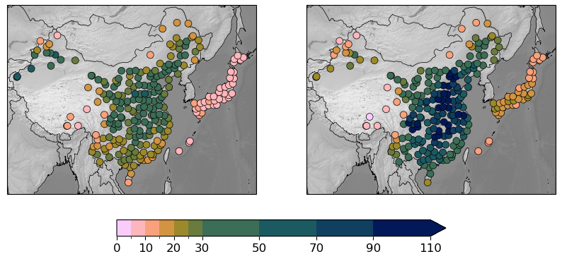
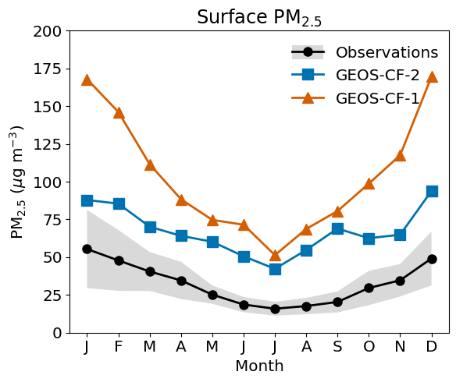
Surface PM_{2.5} is much improved in GEOS-CF-2
Observations
GEOS-CF-2
Monthly cycle
US
CF-1
CF-2
Observations
Annual mean PM_{2.5}
µg m⁻³
China
CF-2
CF-1
Observations
Results for 2023
µg m⁻³

Slide 8
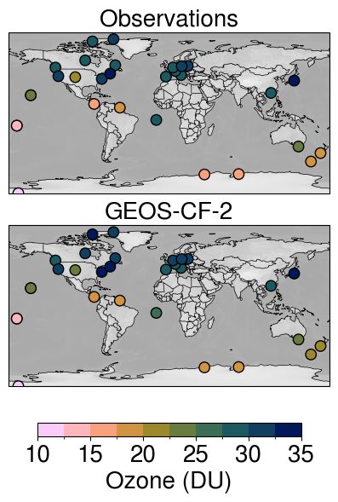
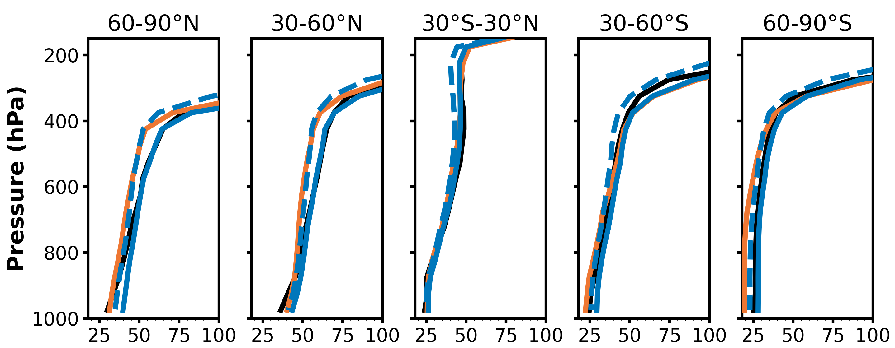
Ozone data assimilation improves tropospheric ozone in GEOS-CF-2
Columns (sfc-300 hPa)
Tropospheric profiles
No DA
CF-1
CF-2
Obs
Ozone (ppbv)
Improvement in free tropospheric ozone;
but mixing in the boundary layer may be too fast
Mean bias: 0.9 DU
r: 0.98
Ozonesonde observations are from the
SHADOZ, WOUDC, and NOAA networks
Results for 2023

Slide 9
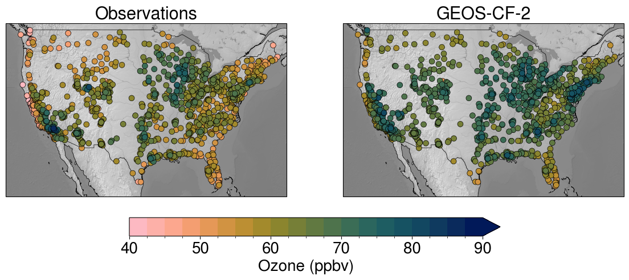
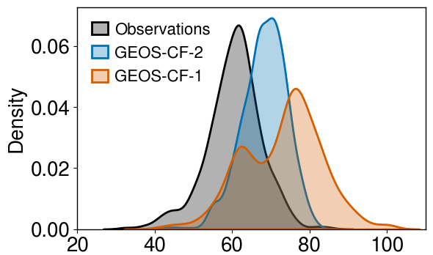
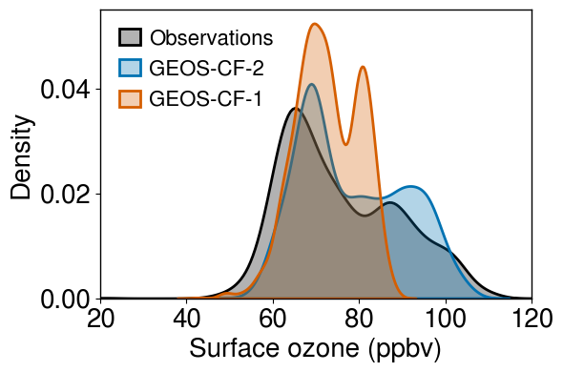
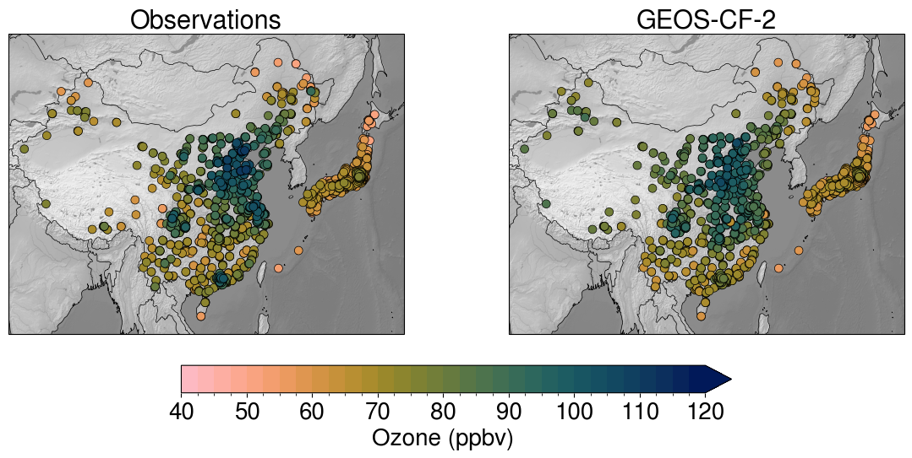
Surface ozone improves with updated NO_{x} and VOC emissions, but some bias remains over US
Annual 95th percentile MDA8 ozone
Observations
GEOS-CF-2
CF-2
Obs
CF-1
Results for 2023

Slide 10
Conclusions & outlook
GEOS-CF is a state-of-the-science, versatile tool for atmospheric chemistry research and applications
v2 of the system includes major updates and improvements; targeted research on ozone profiles in the PBL
v3 would include new model physics & chemistry, better vertical resolution, advanced data assimilation & modernized workflow
Launching soon: GEOS Composition Reanalysis (2009–18 in phase I)

