Slide 1




Tropospheric Emissions:
Monitoring of Pollution
TEMPO Total-Ozone and Ozone-Profile Algorithm: Current Status, Updates, and Evaluation
Junsung Park¹, Xiong Liu¹, Juseon Bak², Heesung Chong¹, Kelly Chance¹,
Weizhen Hou¹, John Houck¹, Gonzalo González Abad¹, Caroline R. Nowlan¹,
Huiqun Wang¹, Kai Yang³, Lawrence E. Flynn⁴, Dave P. Haffner⁵, David E. Flittner⁶,
Matthew Johnson⁷, John Sullivan⁵, Laura Judd⁶, Mary Angelique G. Demetillo⁶,
K. Emma Knowland⁸, Viral Shah⁵, Pamela Wales⁵, Arthur Mizzi⁷, Stacey M. Frith⁵,
Jay Herman⁵, Jerry R. Ziemke⁵, Natalya Kramarova⁵, Michael J. Newchurch⁹,
Robert Spurr¹⁰, Xiaoyi Zhao¹¹, Can Li⁵, Kanghyun Baek⁵,
and the TEMPO Team
¹Center for Astrophysics | Harvard & Smithsonian (SAO),
²Busan National University, ³University of Maryland, ⁴NOAA/NESDIS,
⁵NASA Goddard Space Flight Center, ⁶NASA Langley Research Center,
⁷NASA Ames Research Center, ⁸NASA Headquarters,
⁹University of Alabama in Huntsville, ¹⁰RT Solutions Inc.,
and ¹¹Environment and Climate Change Canada
TEMPO DART Team Meeting
June 15–18, 2026, in Iowa City, Iowa

Slide 2
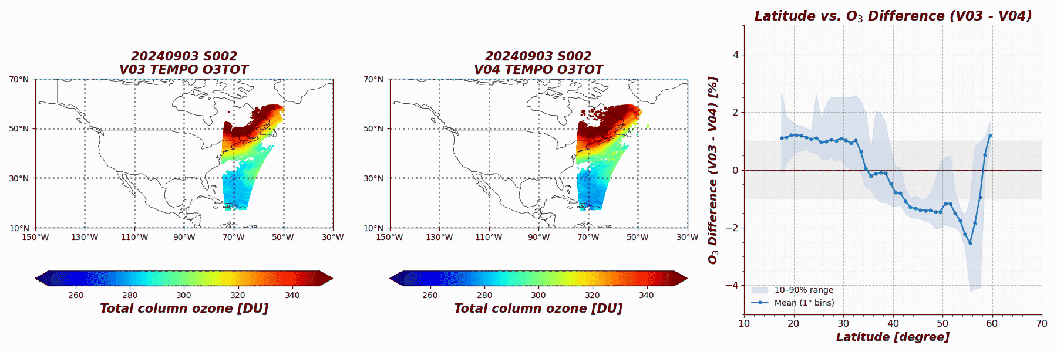
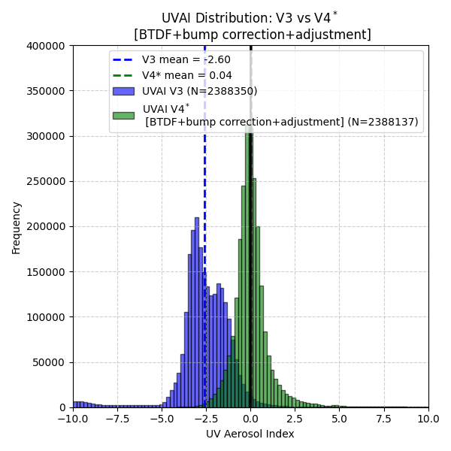



Summary of the V04 TEMPO O3TOT algorithm updates
In prep. Park et al. (TEMPO O3TOT)
TEMPO O3TOT (total column ozone) algorithm
  OMTO3 V8.5 (TOMS V8.5) based algorithm
  Uses two wavelength pairs: (317.62 and 331.34 nm) and (331.34 and 360.15 nm)
  Total O₃, UVAI, and cloud fraction with spatial resolution of 2.0 km $×$ 4.75 km
TEMPO O3TOT V03
Update Quality_Flag
Improve latitudinal-dependent bias in total column ozone.
Update LUTs using the on-orbit slit function and the BDM ozone cross-section
TEMPO O3TOT V04
Publicly released
on May 20, 2025
Publicly released
on Sep 17, 2025
Applied filtering:
quality_flag < 4096, SZA < 80$°$, VZA < 80$°$, and CF < 0.5
Applied filtering:
quality_flag = 0 and 1, SZA < 80$°$, VZA < 80$°$, and CF < 0.5

Slide 3
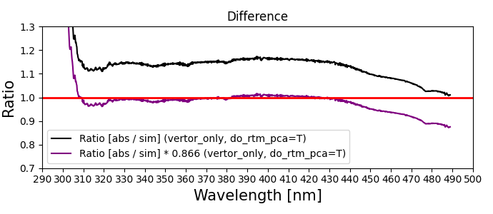
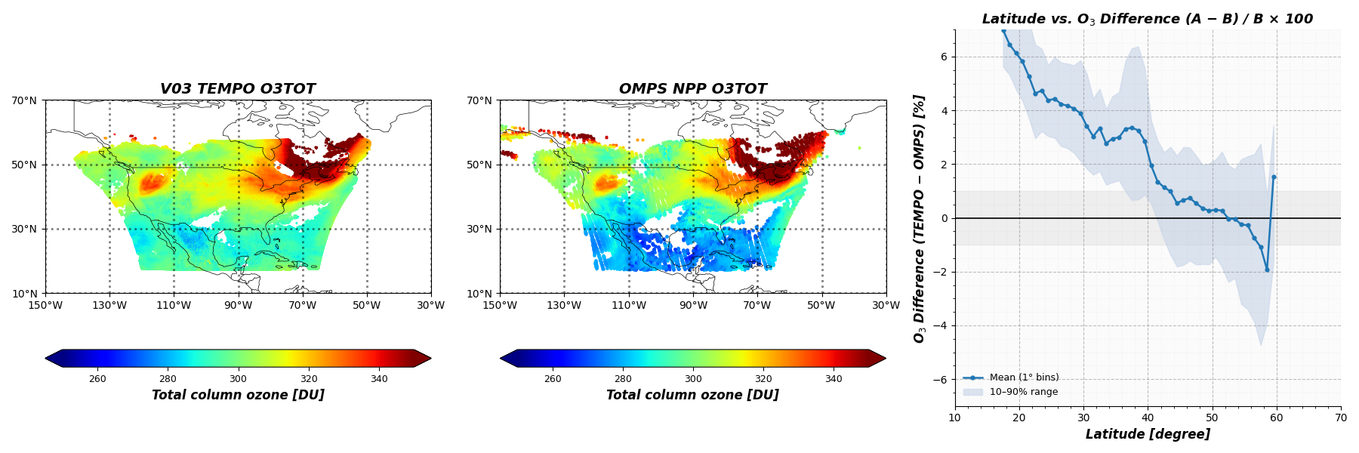
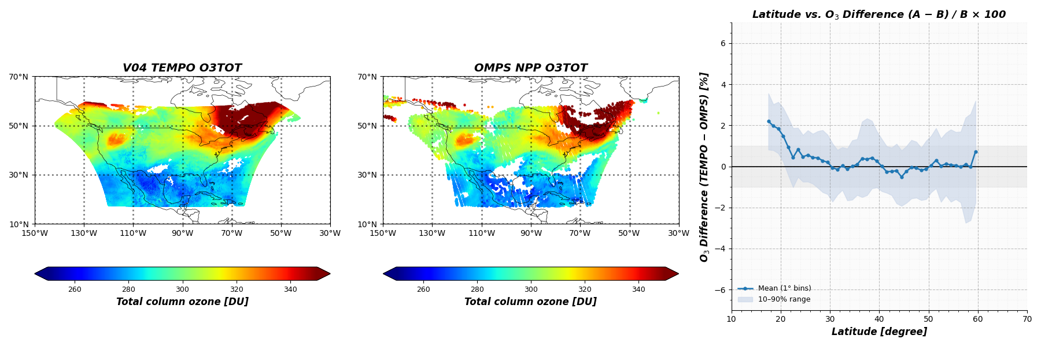
Summary of the V04 TEMPO O3TOT algorithm updates
Implemented BTDF update in TEMPO L1B + bump correction + 360nm adjustment
In prep. Park et al. (TEMPO O3TOT)
Applied filtering: quality_flag < 4096, SZA < 80$°$, VZA < 80$°$, and CF < 0.5
V03
Updated
BTDF correction update
V03 exhibits significant latitudinal-dependent bias against OMPS NPP
(+6% in low-latitude regions and - 2% in high-latitude regions).
Bump correction
bump correction
Applied filtering: quality_flag = 0 and 1, SZA < 80$°$, VZA < 80$°$, and CF < 0.5
-1%
360nm adjustment
V04 shows improved stability with a small bias (mostly within ±1%).
A slight positive bias (+2%) remains only in very low-latitude regions.
3

Slide 4
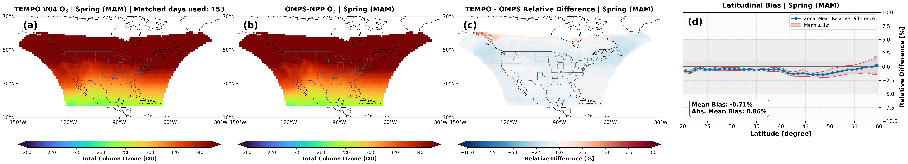
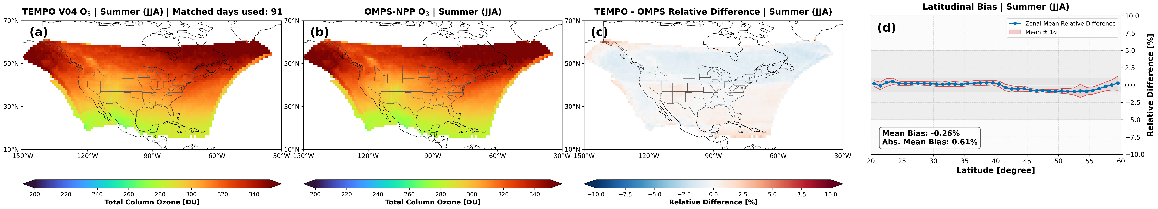
Evaluation of V04 TEMPO O3TOT:
V04 TEMPO vs. OMPS NPP
V04 TEMPO O3TOT vs. OMPS NPP
Available data between 2023 and 2026
In prep. Park et al. (TEMPO O3TOT)
Co-location: Temporal: 13:30 pm ± 30 minutes
TEMPO Data Filtering: Cloud Fraction < 0.5, SZA & VZA < 80°, Quality_Flag = 0
OMPS Data Filtering: Cloud Fraction < 0.5, SZA & VZA < 80°, AlgorithmFlags = 1
The spring season data came from 2024, 2025, and 2026.
The summer season data only came from 2023, 2024, and 2025.
4

Slide 5
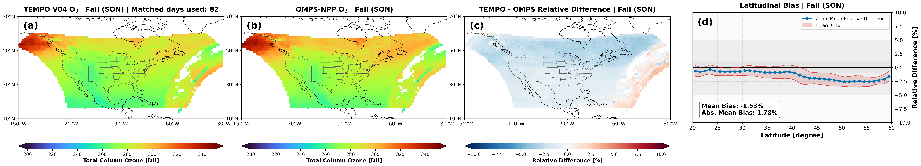
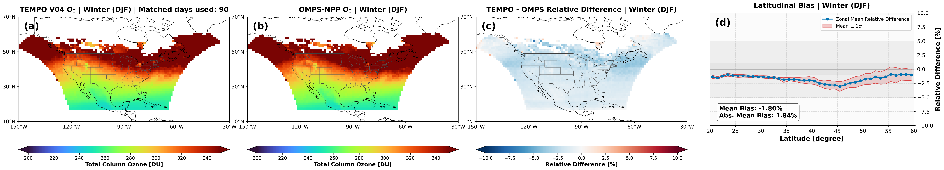
Evaluation of V04 TEMPO O3TOT:
V04 TEMPO vs. OMPS NPP
V04 TEMPO O3TOT vs. OMPS NPP
Available data between 2023 and 2025
In prep. Park et al. (TEMPO O3TOT)
Co-location: Temporal: 13:30 pm ± 30 minutes
TEMPO Data Filtering: Cloud Fraction < 0.5, SZA & VZA < 80°, Quality_Flag = 0
OMPS Data Filtering: Cloud Fraction < 0.5, SZA & VZA < 80°, AlgorithmFlags = 1
The autumn season data came from 2023, 2024, 2025, and 2026.
The winter season data only came from 2025 and 2026.
5

Slide 6
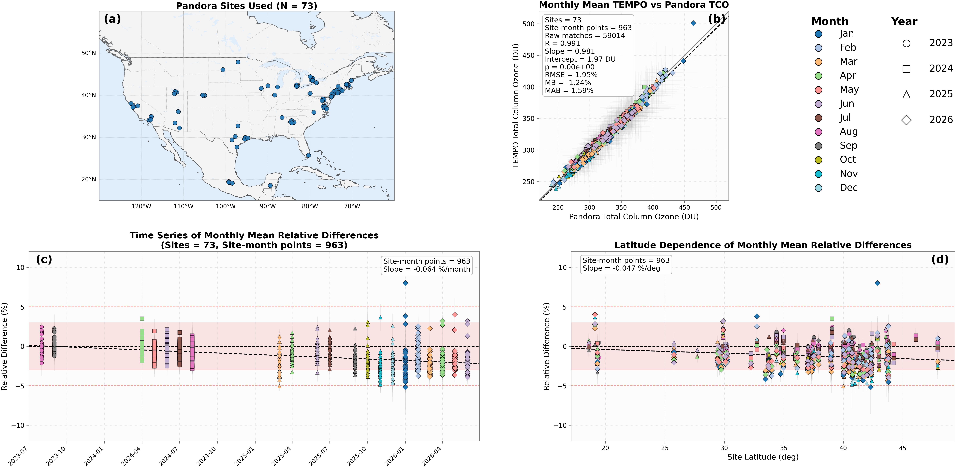
Evaluation of V04 TEMPO O3TOT:
V04 TEMPO O3TOT vs. Pandora
V04 TEMPO O3TOT vs. Pandora
Available data between 2023 and 2026
In prep. Park et al. (TEMPO O3TOT)
Co-location: Temporal: ±15 minutes, Spatial: Radius ≤ 5 km
TEMPO Data Filtering: Cloud Fraction: ≤ 0.5, SZA & VZA: ≤ 80°, Quality_Flag: 0
Pandora Data Filtering: Quality Flag: 0 & 10
6

Slide 7
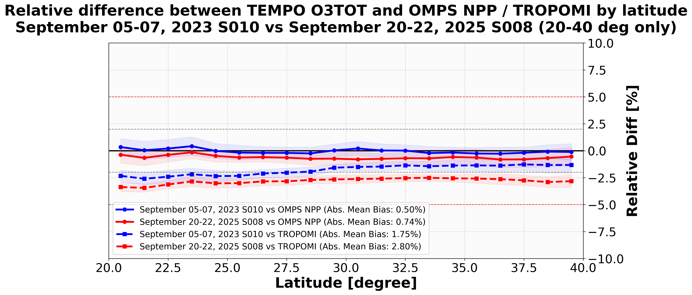
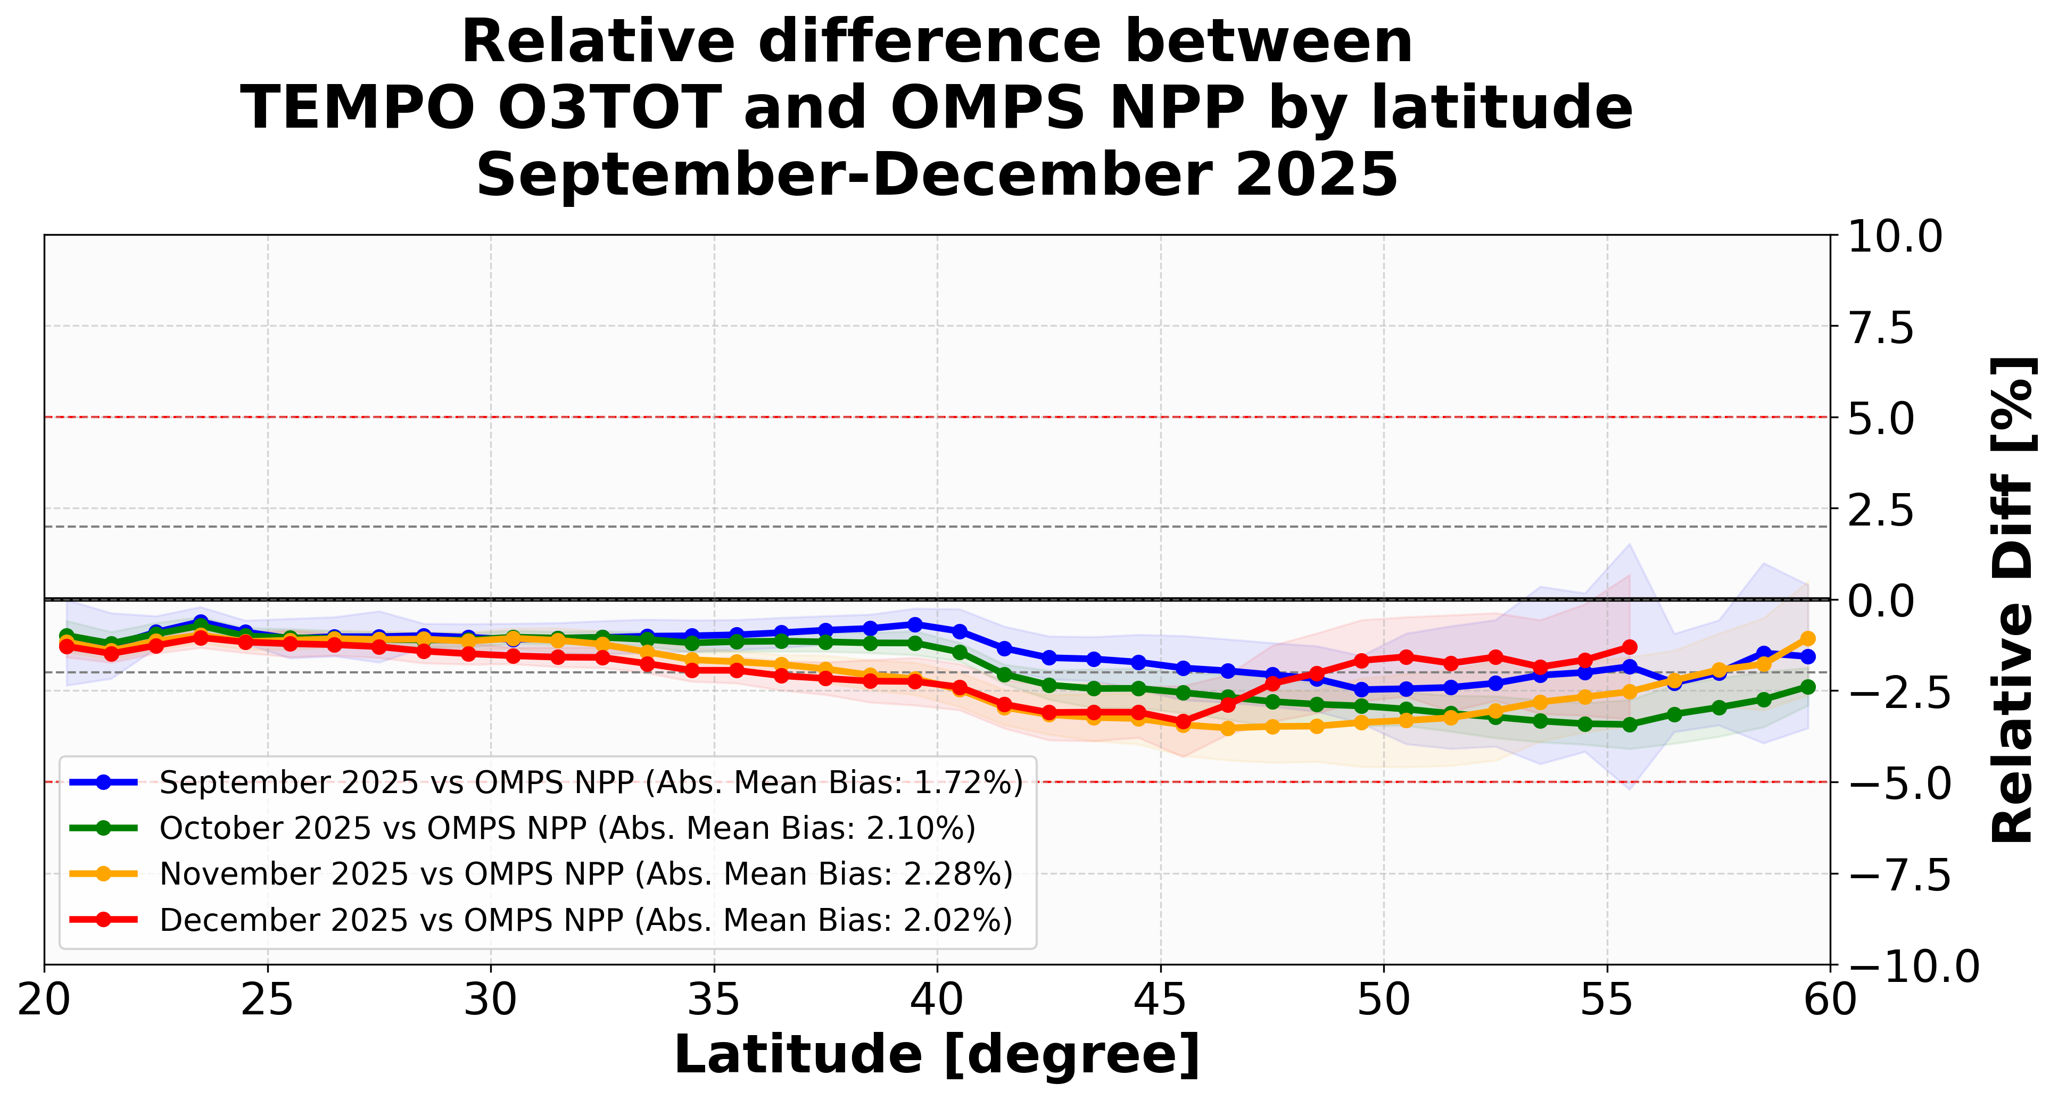
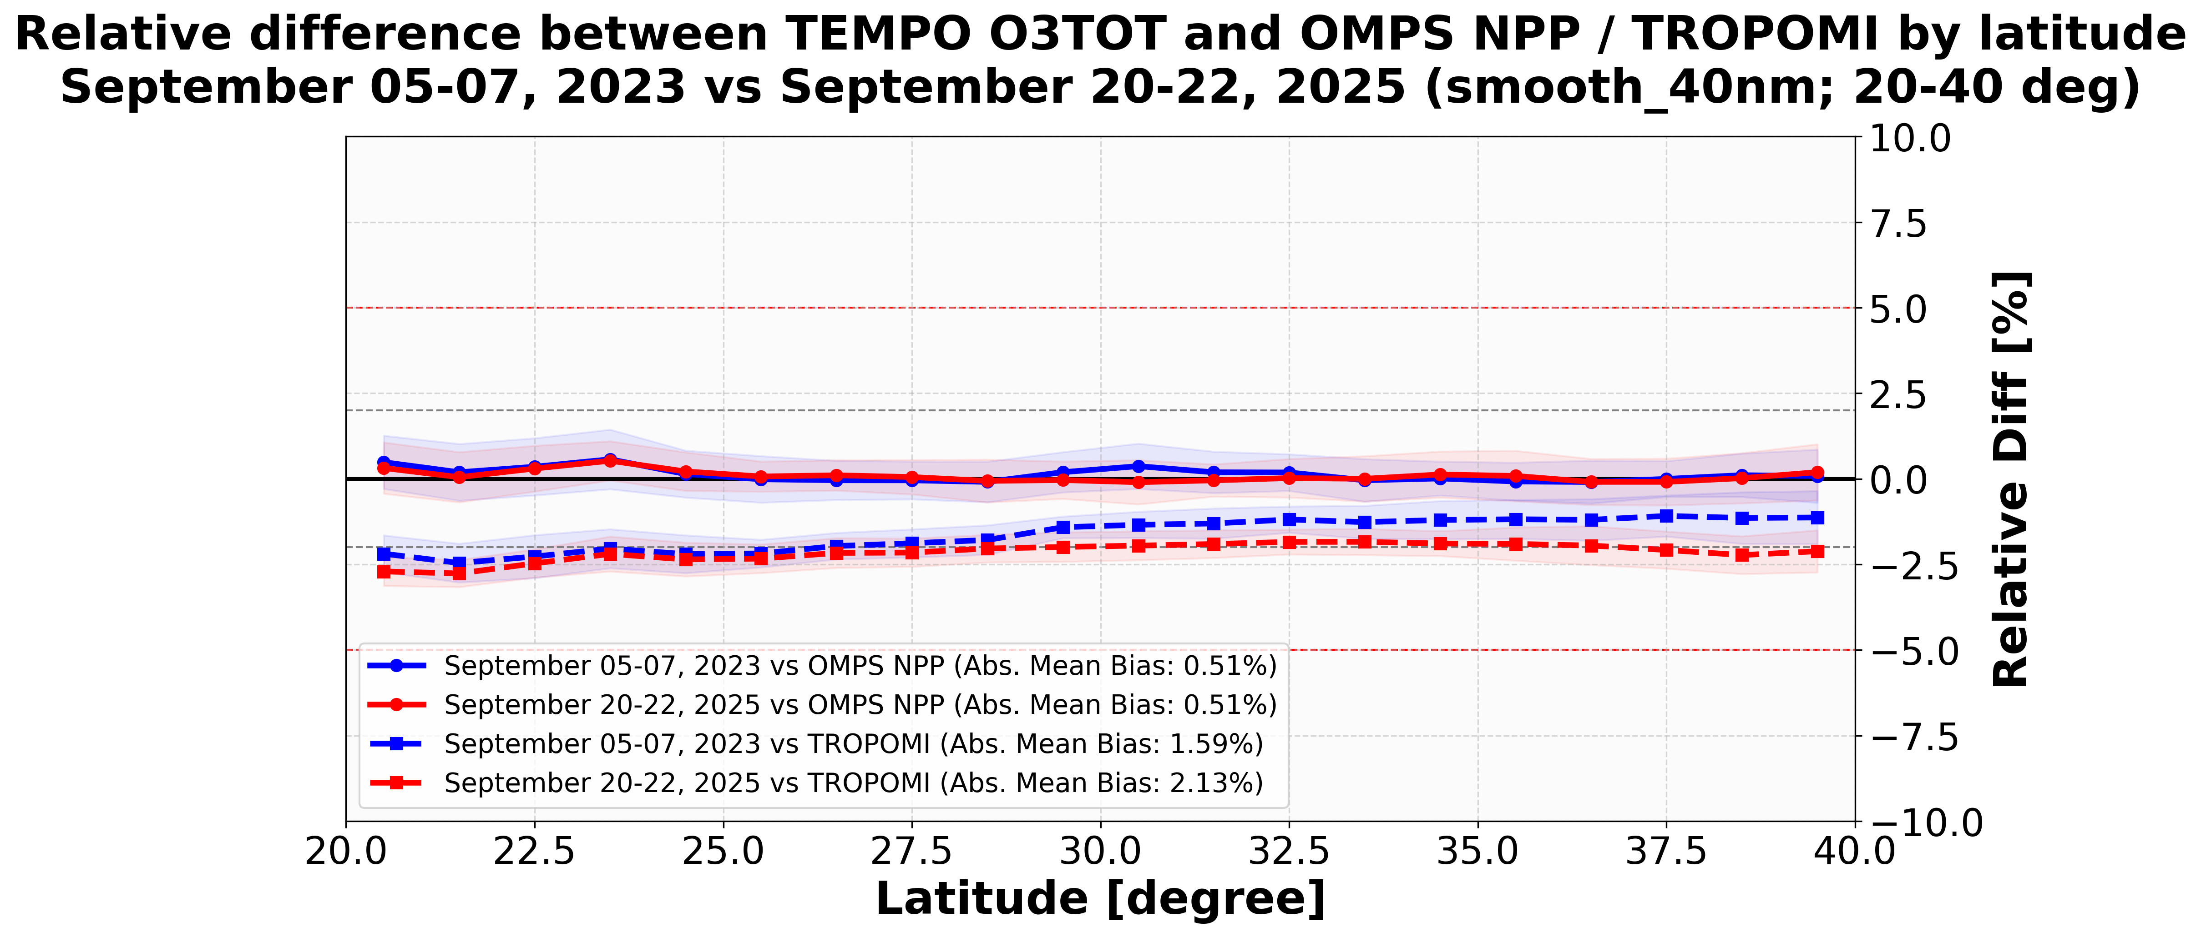
V05 Update Plan:
Low-bias due to the Instrument degradation and high geometry angles
Instrument degradation correction
V04 operational product
Geometry angle dependence correction
V04 operational product
Improved version

Slide 8
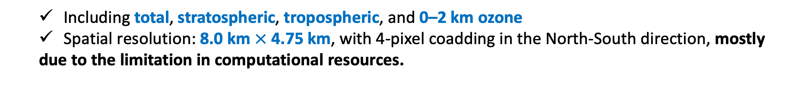
Summary of the V04 TEMPO O3PROF algorithm updates
TEMPO O3PROP (ozone profile) algorithm
  Adopted from the Optimal Estimation (OE) method-based SAO OMI ozone profile algorithm (UV only)
    Proposed using UV (293-340 nm) and VIS (540-650 nm)
    The publicly released V04 TEMPO O3PROF algorithm is
    UV only (308-340 nm) algorithm
    The VIS channel, which can improve low-tropospheric ozone sensitivity, will be implemented in a future version.
  Retrieve Ozone profile at 24 layers
  A prior
    Combination of V2 GEOS-CF (ozone profile) and
    TB (tropopause-based) Climatology, TB climatology (error)
UV & VIS, @0.6 nm, 0.2nm/pixel Optimal estimation approach based
  Including total, stratospheric, tropospheric, and 0–2 km ozone
  Spatial resolution: 8.0 km $×$ 4.75 km, with 4-pixel coadding in the North-South direction, mostly due to the limitation in computational resources.

Slide 9
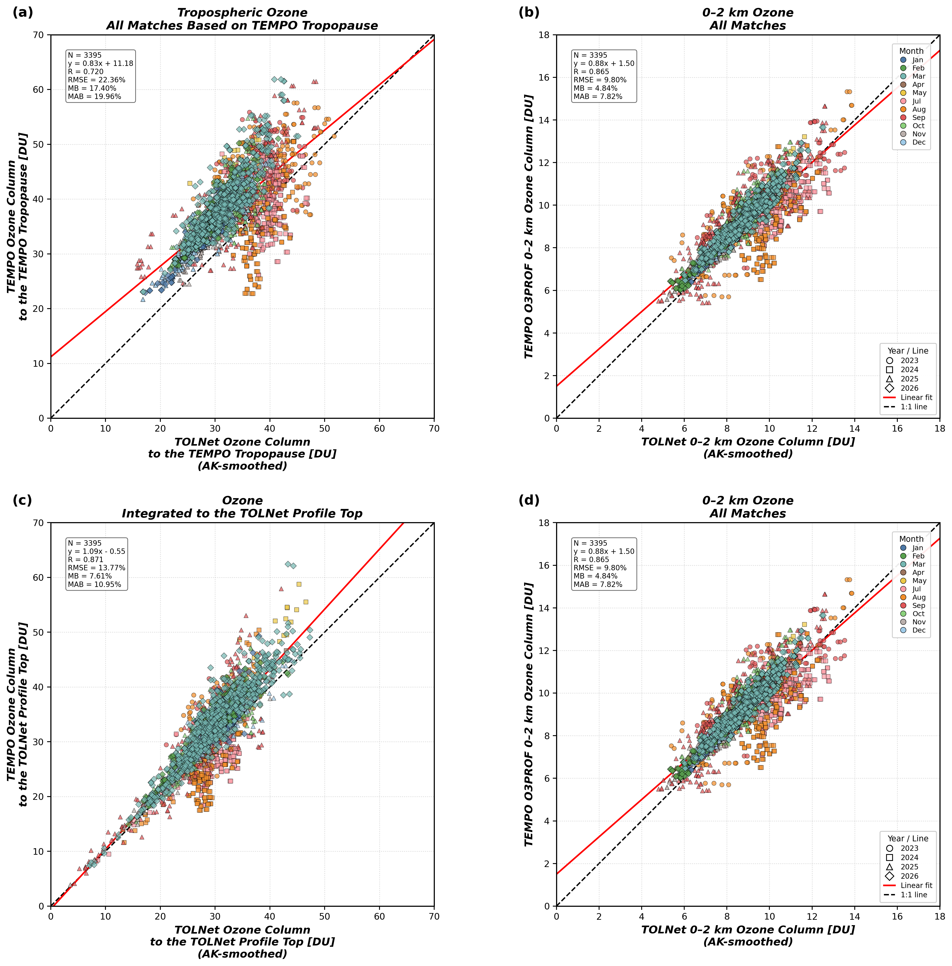
Evaluation of V04 TEMPO O3PROF:
V04 TEMPO vs. TOLNet
In prep. Park et al. (TEMPO O3PROF)
Using all available TEMPO and TOLNet observations from 2023 to 2026
TEMPO Data Filtering
  Cloud Fraction: ≤ 0.5
  SZA & VZA: ≤ 80°
  Quality_Flag: 0
  1 ≤ exit_status ≤ 99
  avg_residual ≤ 0.3
  fit_RMS ≤ 3.0
Co-location
  Temporal: ±30 minutes
  Spatial: Radius ≤ 5 km
Matthew’s Oral presentation “TEMPO Ozone Profile Validation in the Troposphere using TOLNet”: Today, 5:30 PM

Slide 10
Evaluation of V04 TEMPO O3PROF:
V04 TEMPO vs. TOLNet
In prep. Park et al. (TEMPO O3PROF)
Using all available TEMPO and TOLNet observations from 2023 to 2025
TEMPO Data Filtering
  Cloud Fraction: ≤ 0.5
  SZA & VZA: ≤ 80°
  Quality_Flag: 0
  1 ≤ exit_status ≤ 99
  avg_residual ≤ 0.3
  fit_RMS ≤ 3.0
Co-location
  Temporal: ±30 minutes
  Spatial: Radius ≤ 5 km
Matthew’s Oral presentation “TEMPO Ozone Profile Validation in the Troposphere using TOLNet”: Today, 5:30 PM

Slide 11
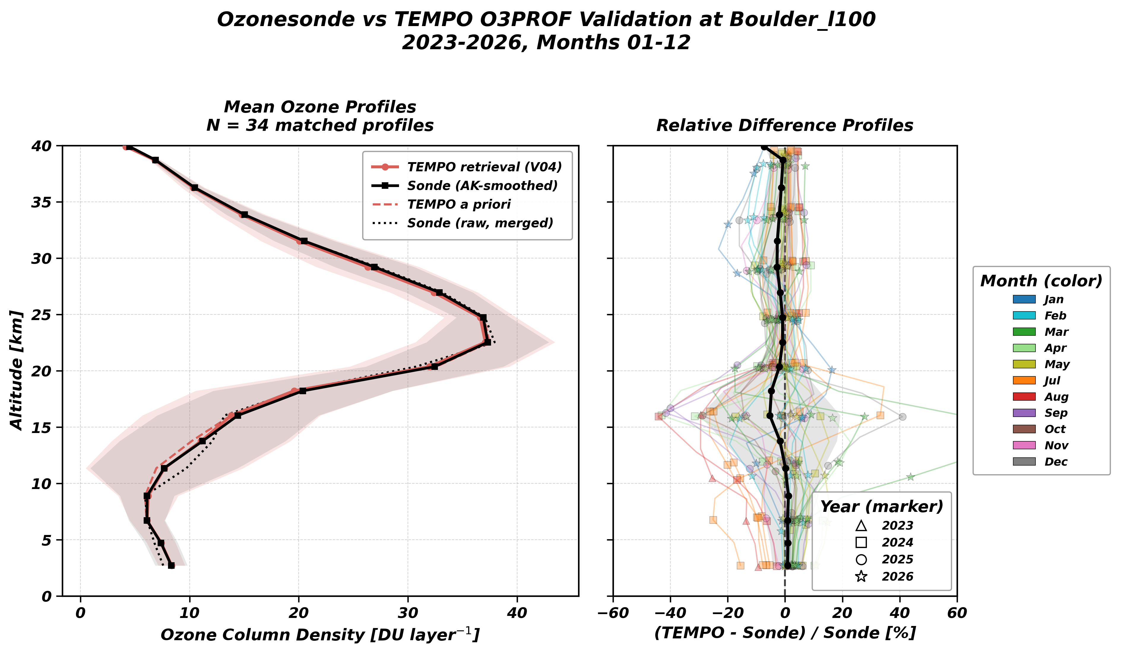
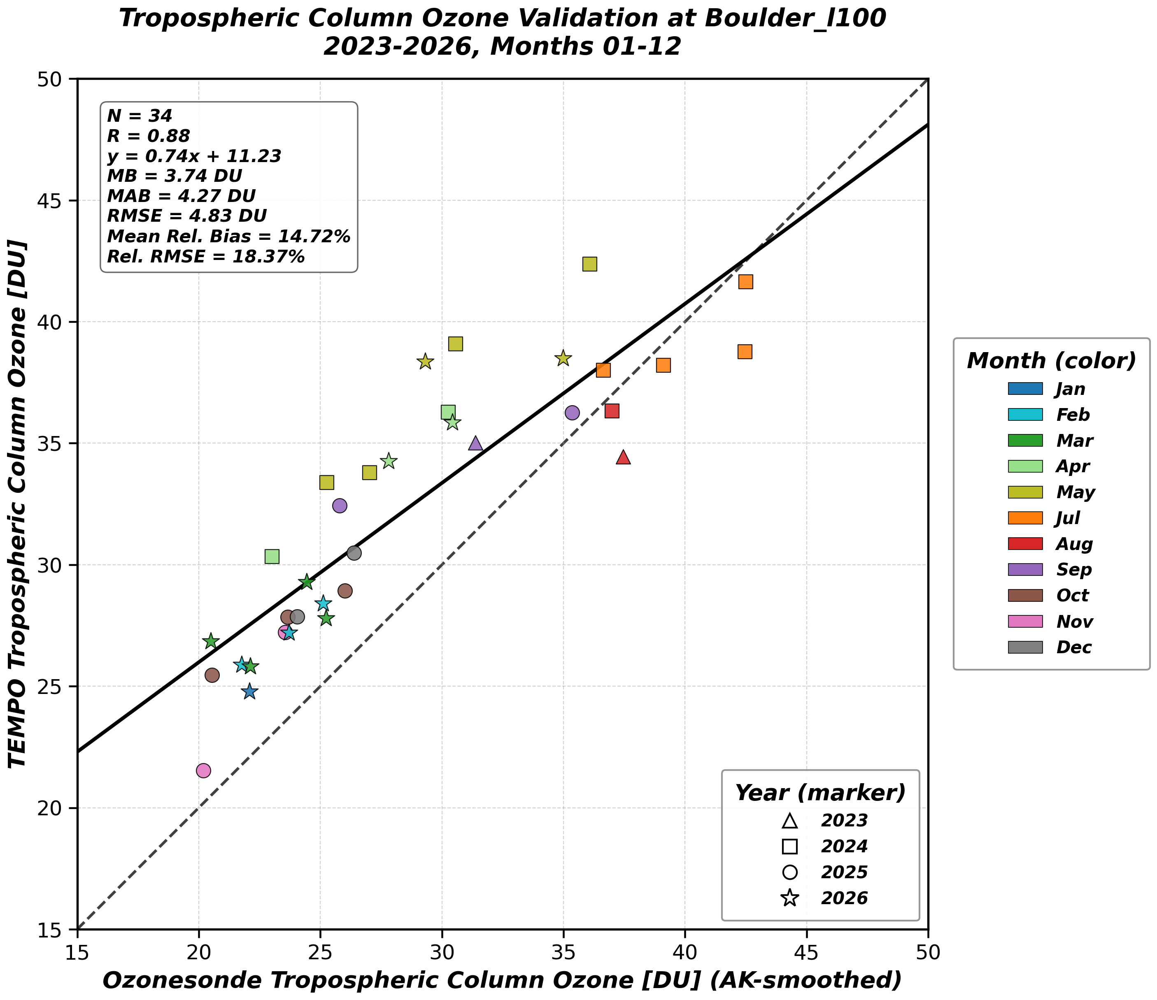
Evaluation of V04 TEMPO O3PROF:
V04 TEMPO vs. Ozonesonde
In prep. Park et al. (TEMPO O3PROF)
Using all available TEMPO and Ozonesonde observations from 2023 to 2026 at Boulder

Slide 12
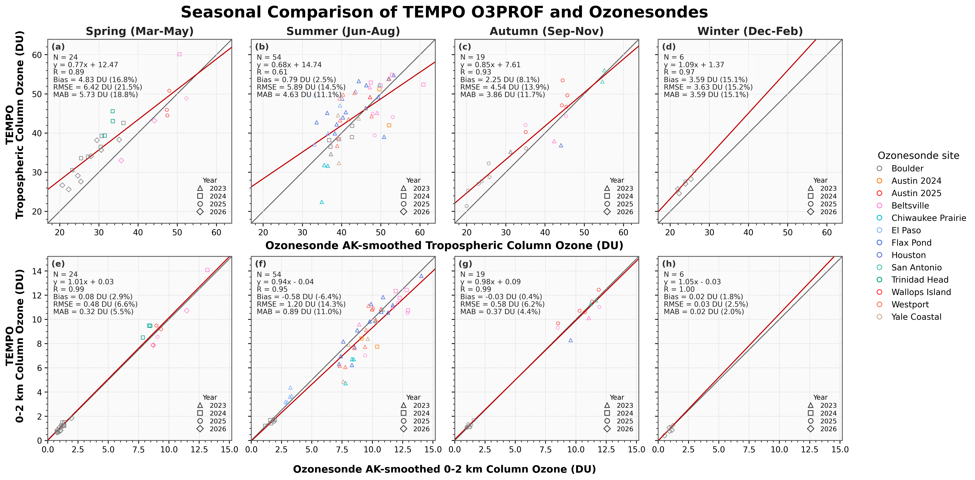
V04 TEMPO O3PROF:
Evaluation profile using Ozonesonde
In prep. Park et al. (TEMPO O3PROF)

Slide 13
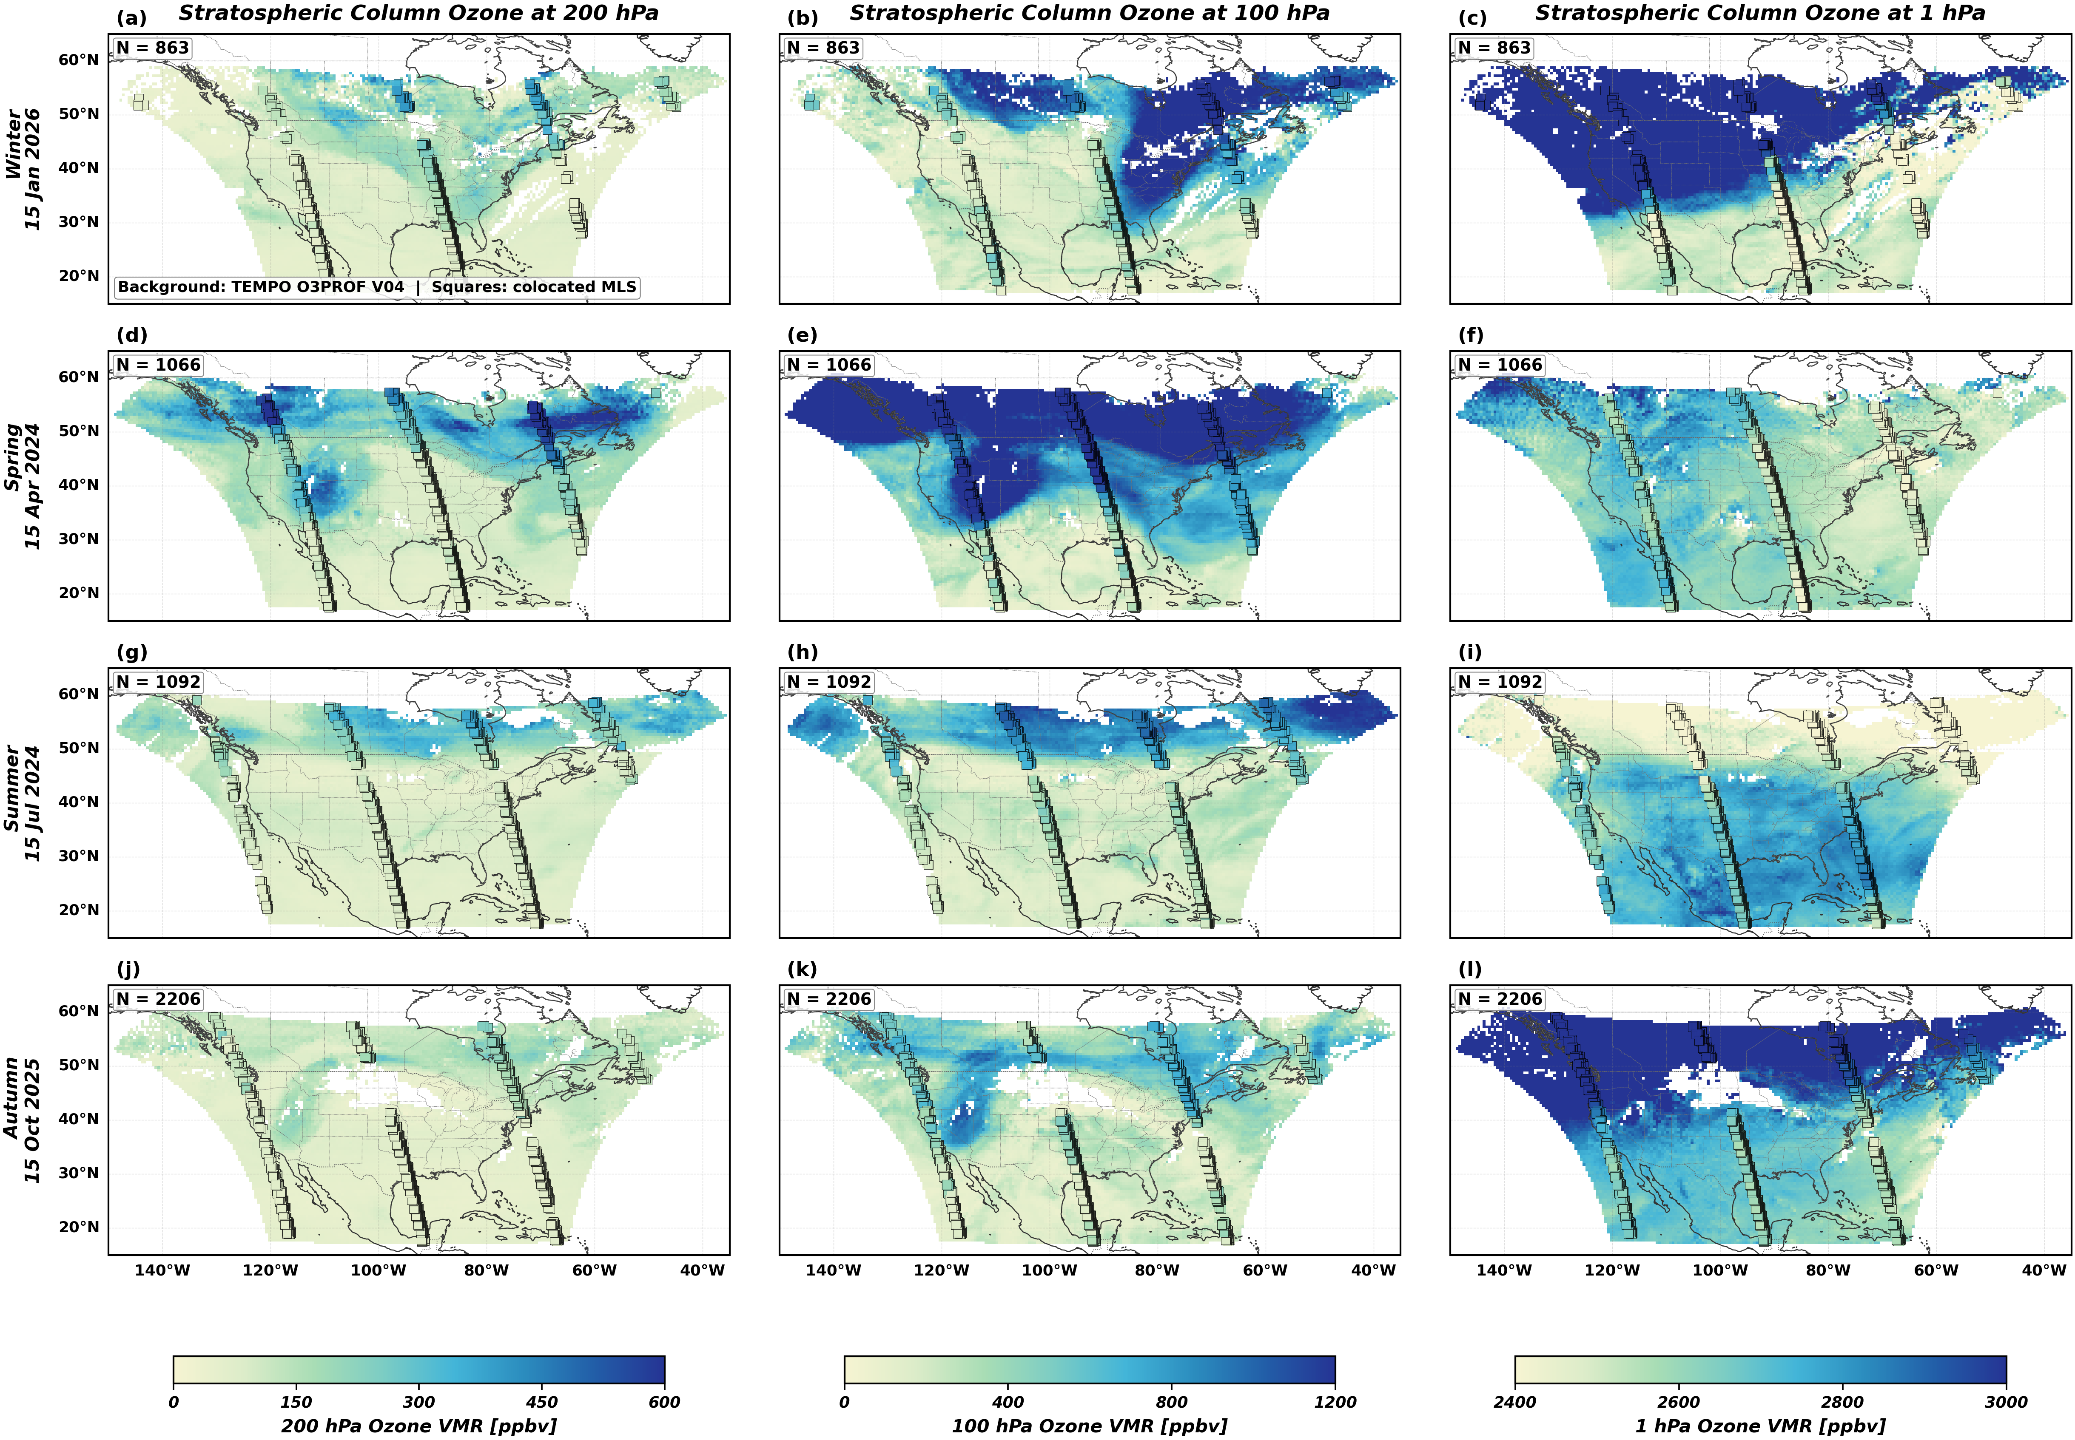
V04 TEMPO O3PROF:
Evaluation STO using MLS
In prep. Park et al. (TEMPO O3PROF)
Co-location:
SZA, VZA ≤ 80
CF ≤ 0.5
1 ≤ Exit_status ≤ 99
Avg_residual ≤ 0.3
Fit_rms ≤ 3.0
Temporal ±30 minutes
Spatial ≤ 50 km
TEMPO and MLS show strong agreement at three pressure levels (1, 100, and 200 hPa) for a specific date in each season.
Successfully captured latitudinal variations in ozone distribution from each season.

Slide 14
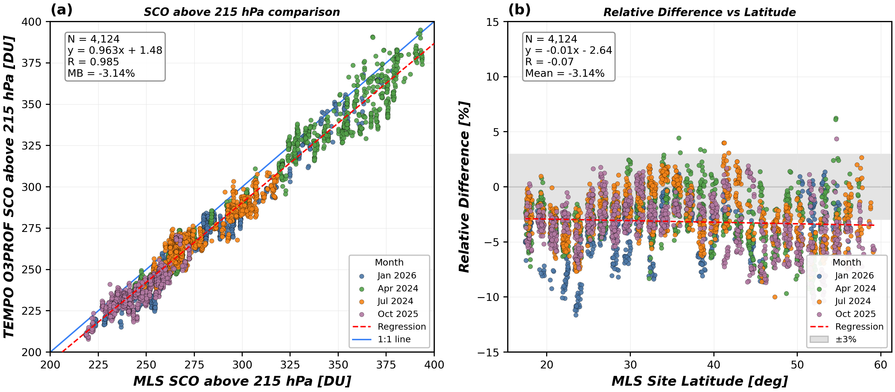
V04 TEMPO O3PROF:
Evaluation STO using MLS
In prep. Park et al. (TEMPO O3PROF)
Co-location:
SZA, VZA ≤ 80
CF ≤ 0.5
1 ≤ Exit_status ≤ 99
Avg_residual ≤ 0.3
Fit_rms ≤ 3.0
Temporal ±30 minutes
Spatial ≤ 50 km
Demonstrated high agreement between TEMPO and MLS profiles at the Stratosphere (10-260 hPa).
However, the TEMPO stratospheric has a systematic low bias (V04 known issue).
It could be caused by differences between the a priori profiles used in the soft calibration calculation and in the retrieval.
We plan to improve these in the next version (V05).

Slide 15
Summary
TEMPO O3TOT product
  Total column ozone from V04 TEMPO O3TOT products shows a strong correlation with both ground-based and other satellite observations.
  The known issue of latitudinal-dependent bias has been mitigated in V04.
  Known issues: Instrument degradation and viewing/solar zenith angle-dependent bias
TEMPO O3PROF product
  Tropospheric and 0−2 km ozone from V04 TEMPO O3PROF show great agreement with ground-based TOLNet observations.
  Ozone profiles demonstrate good agreement with the ozonesonde observations.
  Known issues: Stratospheric column ozone shows a systematic low bias compared to MLS observations.

Slide 16
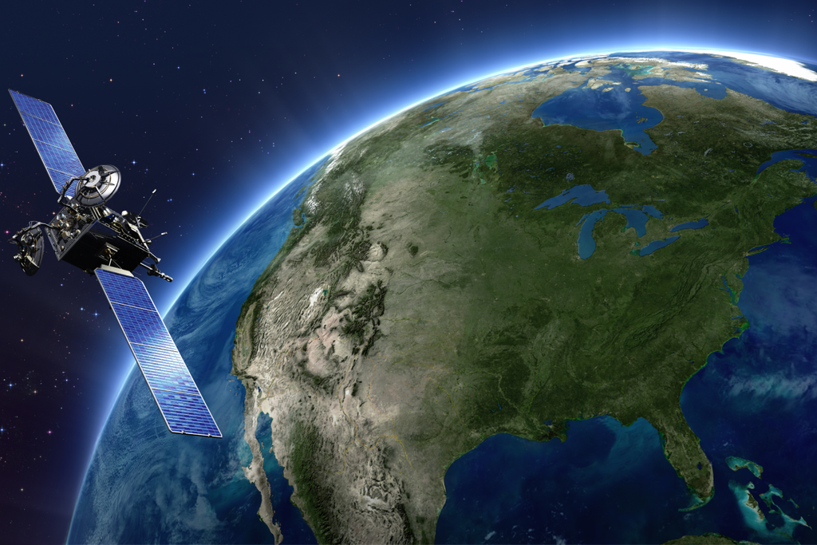
TEMPO DART team meeting
Thank you for your attention!

