Slide 1



Tropospheric Emissions:
Monitoring of Pollution
TEMPO HCHO Product Updates
Gonzalo González Abad, Caroline Nowlan, Ivan Ortega and the TEMPO Team
TEMPO DART Team Meeting
June 15, 2026
University of Iowa

Slide 2
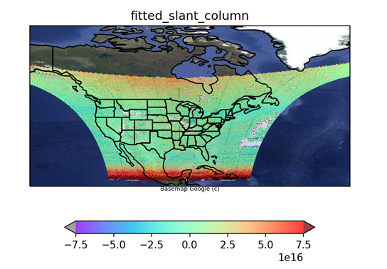
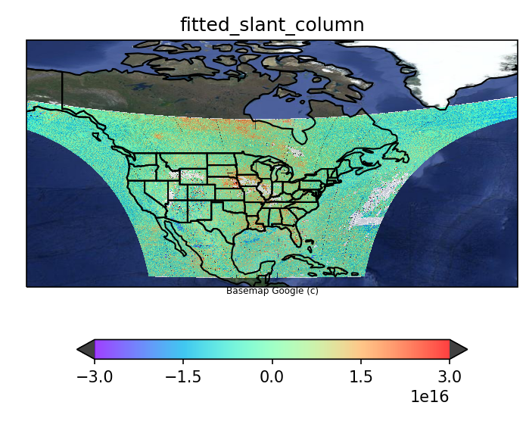
Radiance Reference and Background Correction
First light August 2, 2023 - SCAN #3 (17:15:51Z – 18:20:01Z) V1 tests
Slant column
Differential slant column
molecules cm⁻²
molecules cm⁻²
Using solar irradiance as spectral fit source
Using radiance reference
To avoid stripes and have a very stable fit we use a radiance reference as source term. However, that implies retrieving a differential slant columns and the need for background correction with its own uncertainties.

Slide 3
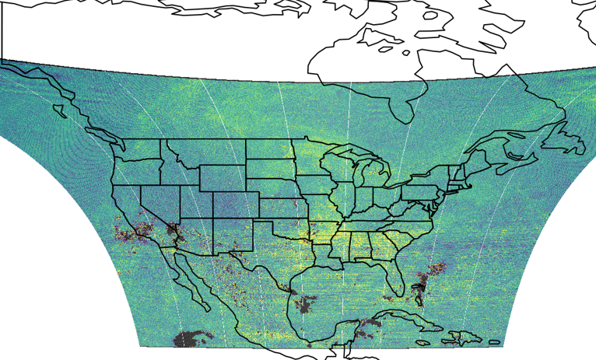
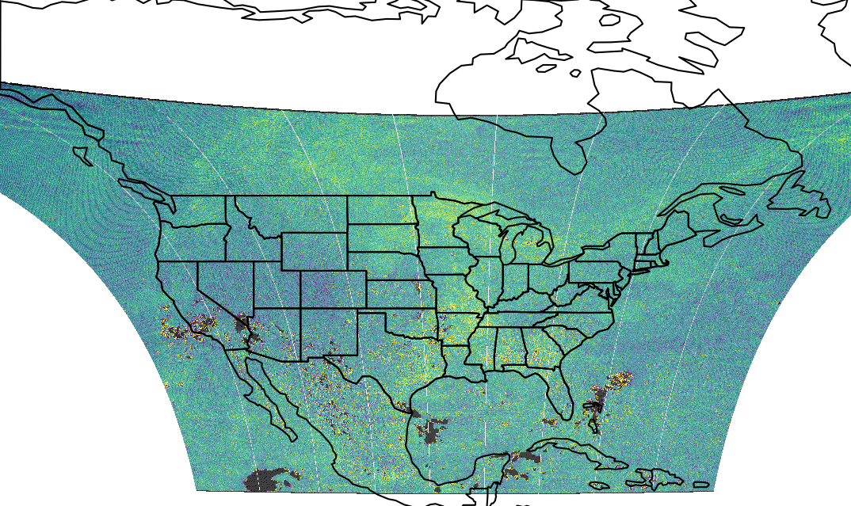
Radiance Reference and Background Correction
Differential slant columns retrieved using either 0.5 or 0.3 cloud fraction limit in radiance reference calculation
2025-09-18 S010
Cloud fraction 0.5
Cloud fraction 0.3
Because of changes in the cloud fraction histogram, we had to adjust the cloud fraction selection criteria during the calculation of the radiance reference. This change, had minor effects on the differential slant columns retrieved.

Slide 4
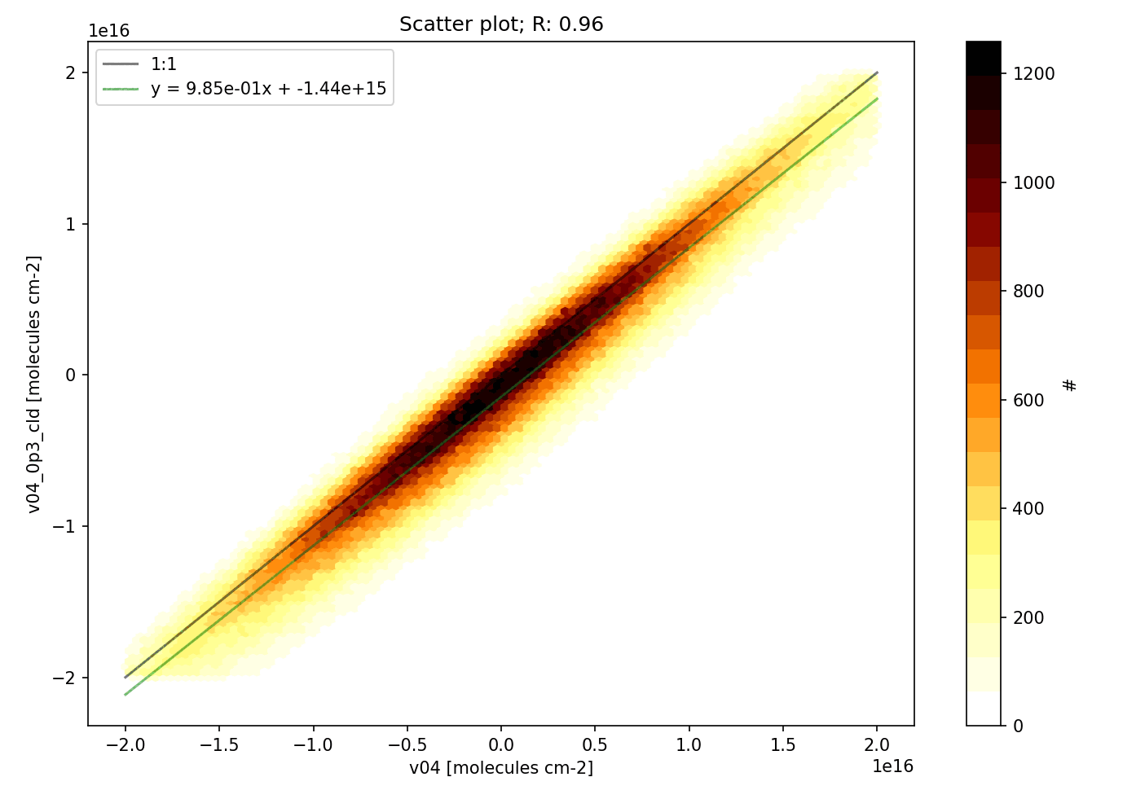
Radiance Reference and Background Correction
Differential slant columns retrieved using either 0.5 or 0.3 cloud fraction limit in radiance reference calculation
2025-09-18 S010
Cloud fraction 0.5
Cloud fraction 0.3
molecules cm⁻² [cloud fraction 0.3]
molecules cm⁻² [cloud fraction 0.5]
Because of changes in the cloud fraction histogram, we had to adjust the cloud fraction selection criteria during the calculation of the radiance reference. This change, had minor effects on the differential slant columns retrieved.

Slide 5
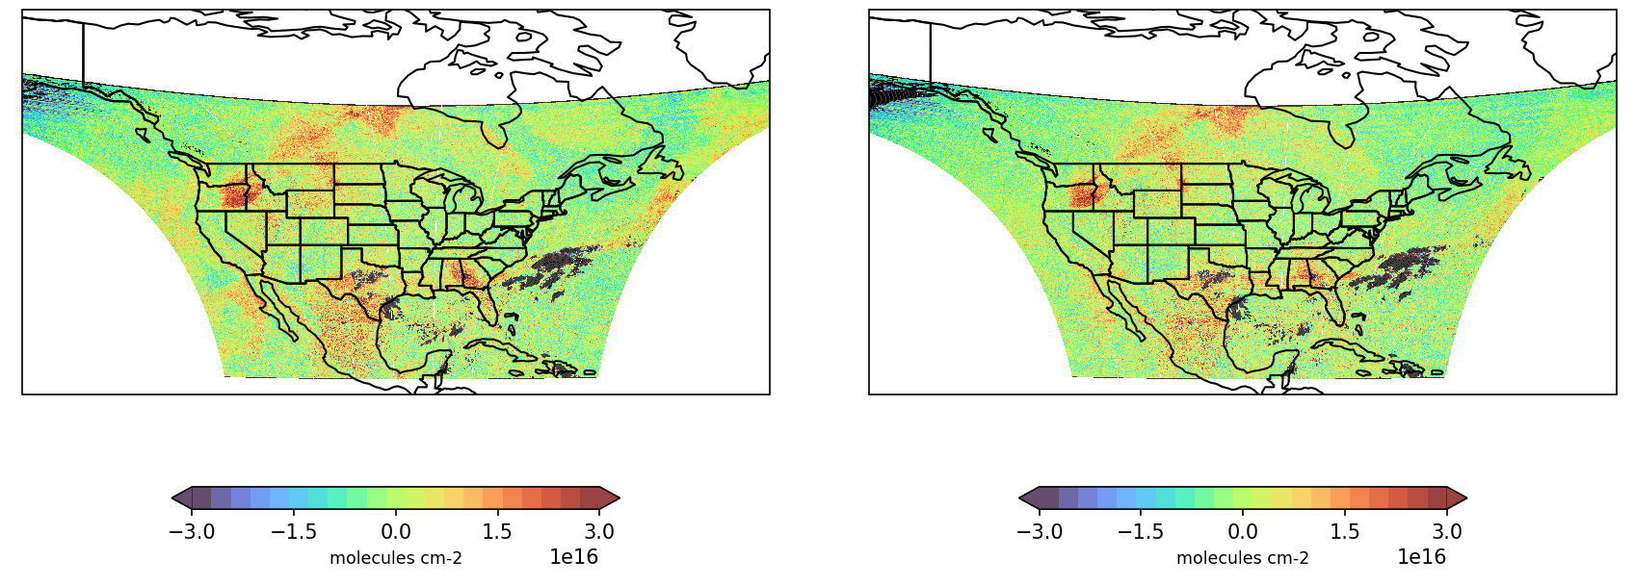
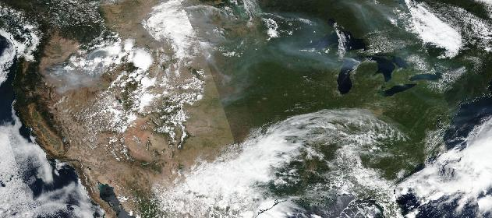
Straylight and slant columns over clouds and bright scenes
Slant column reduction over clouds
September 3, 2024; S007
Version 3 slant column
Version 4 slant column
Smoke plume
HCHO retrievals are very sensitive to straylight contamination resulting in artificial enhancements over bright scenes clouds and some types of smoke plumes???
Suomi NPP VIIRS image from Worldview

Slide 6
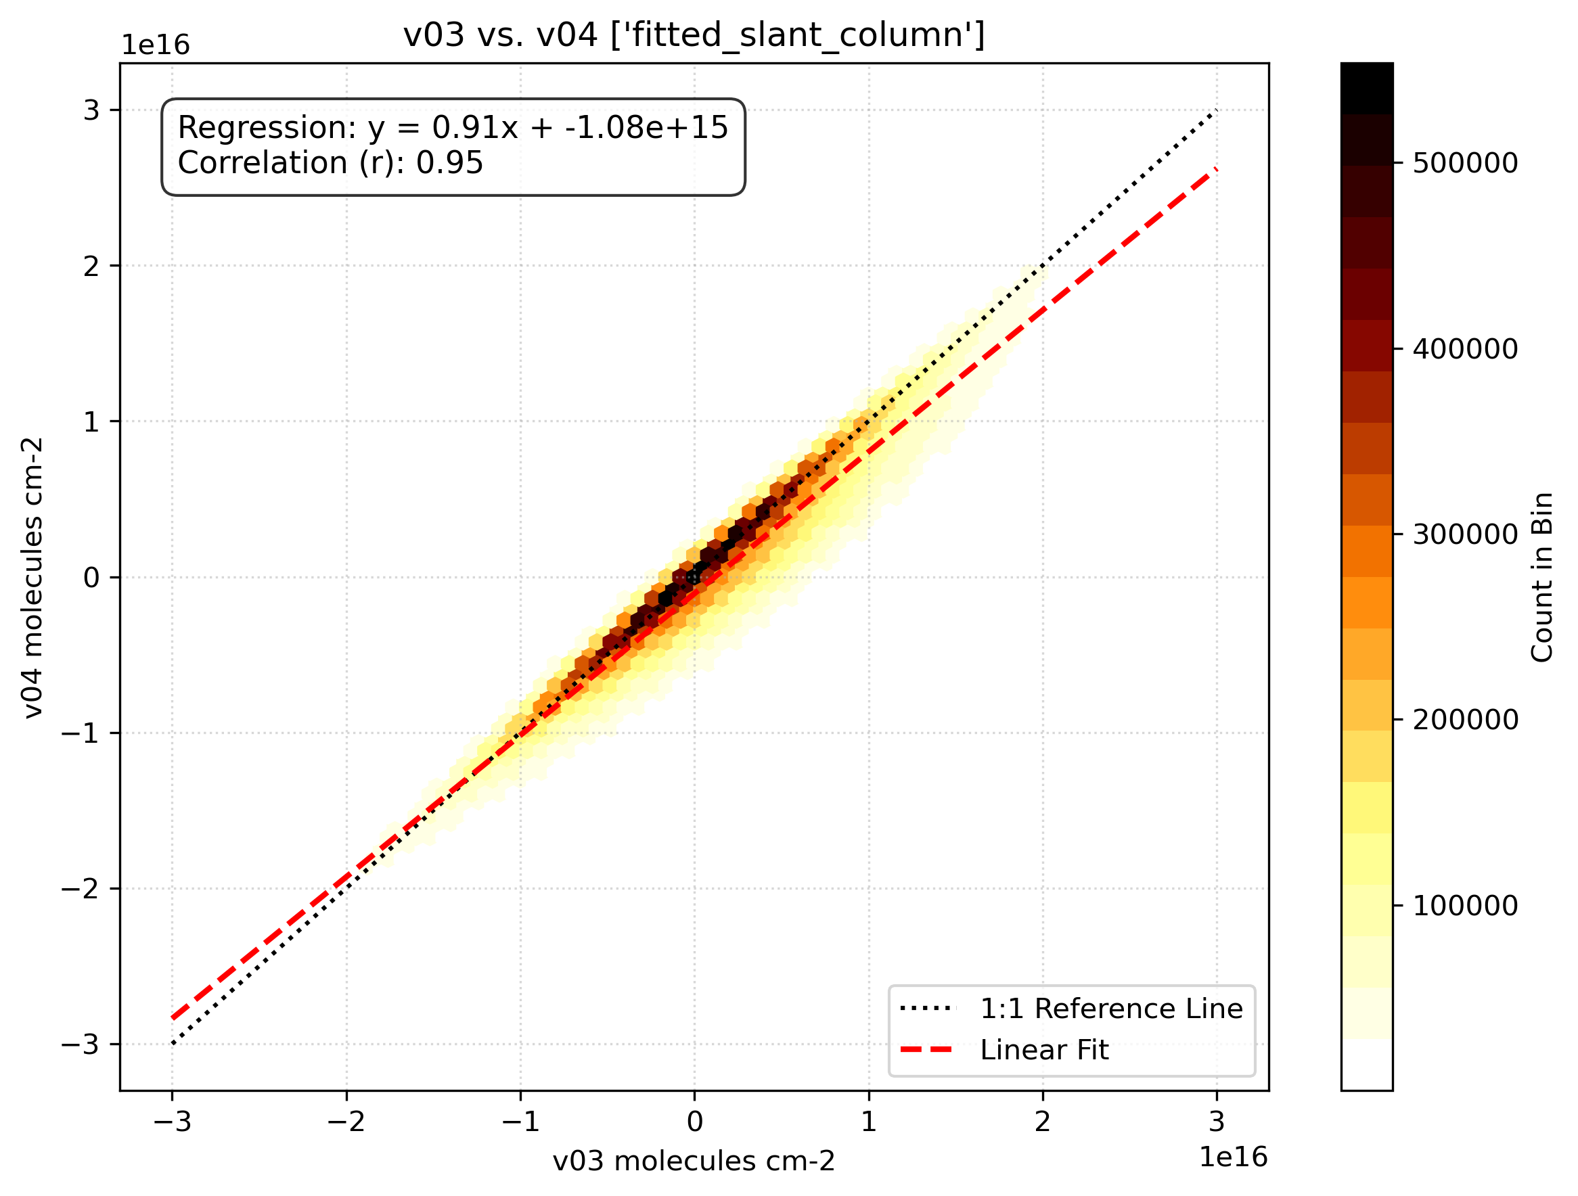
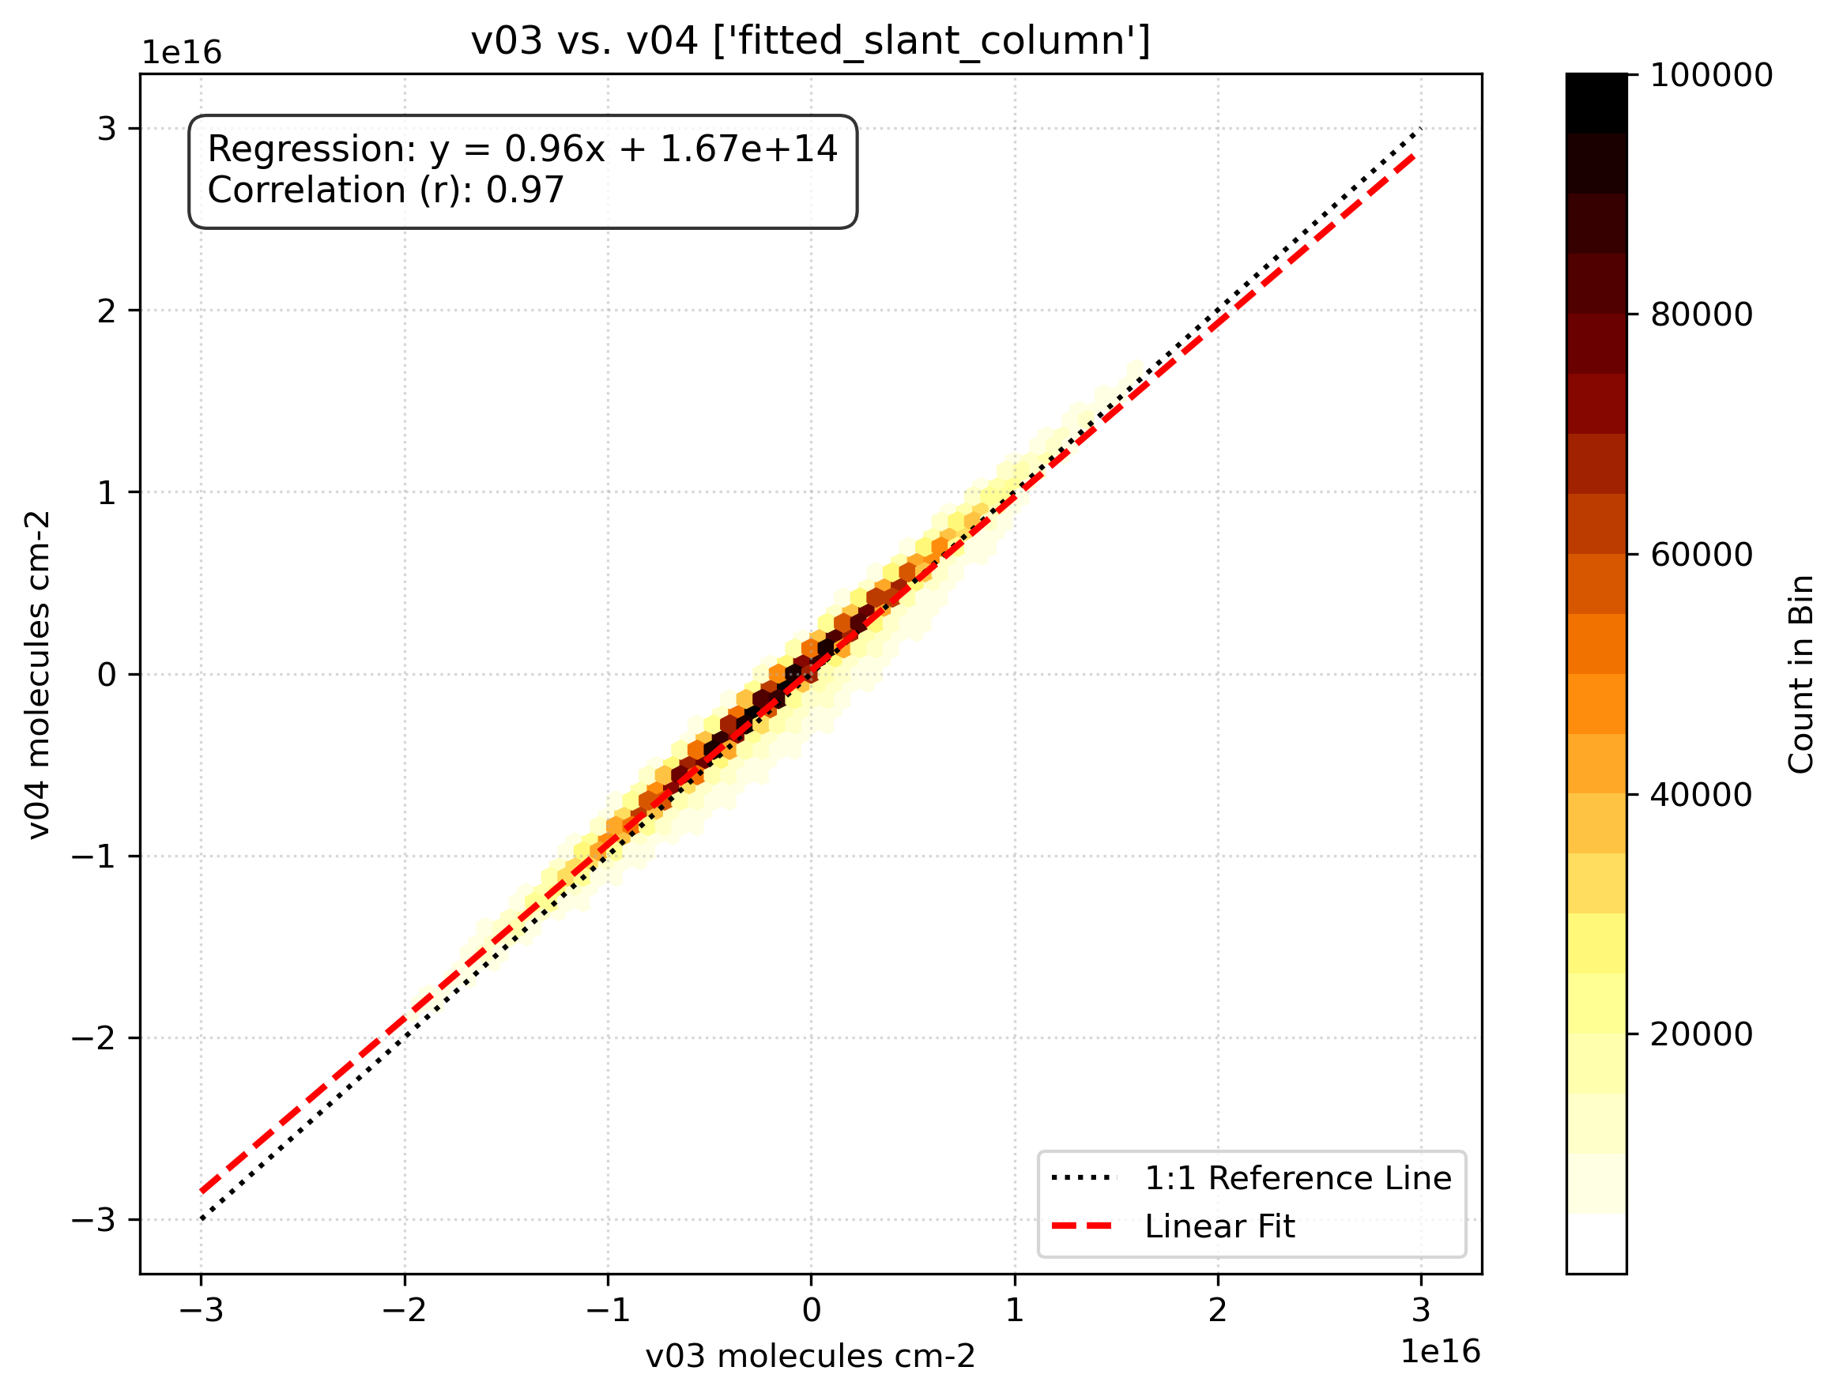
v4 vs. v3 differential slant columns and background correction
Differential slant column (all cloud fractions)
Differential slant column (cloud fractions < 0.1)
High consistency between differential slant columns (particularly for cloud fraction smaller than 0.1)

Slide 7
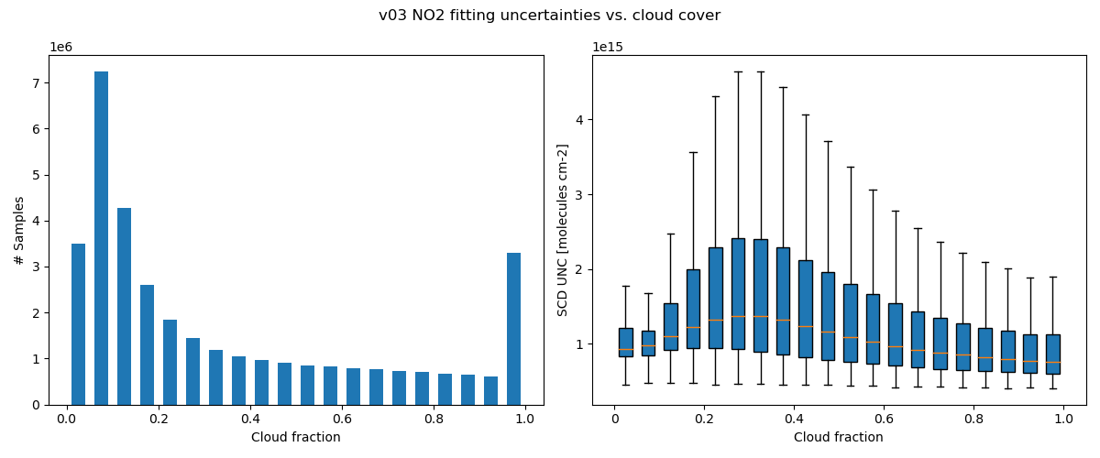
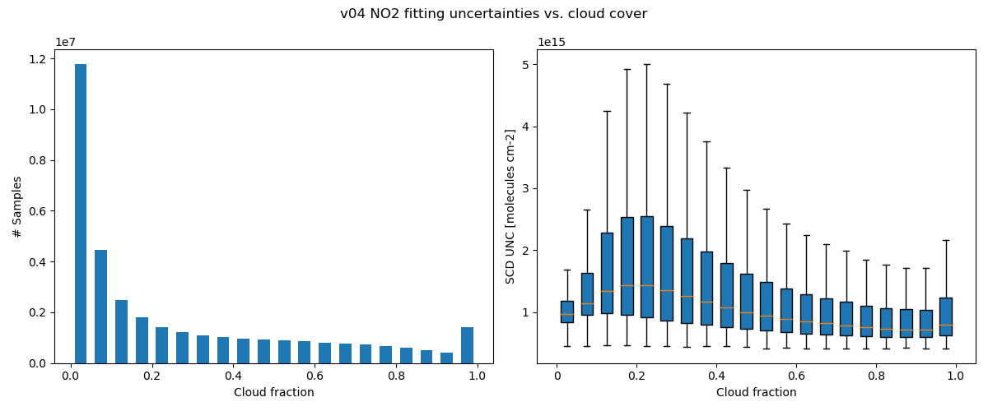
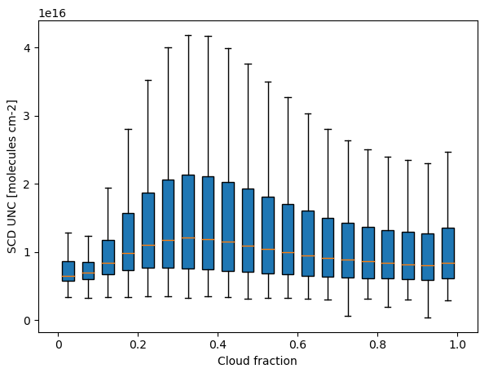
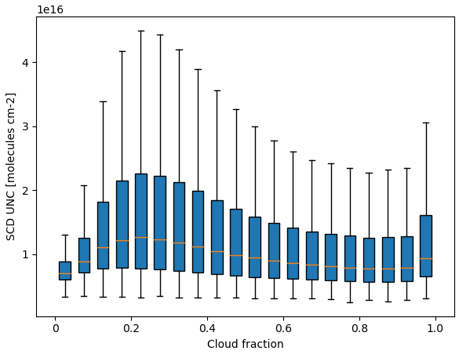
Version 4: Updated Cloud Filter Threshold
v3
NO₂
v4
v3
HCHO
v4
v3
v4
Version 4 recommended cloud fraction threshold for NO₂ and HCHO is 0.1!!!
Notes:
Data from July 10 to July 12 2025

Slide 8
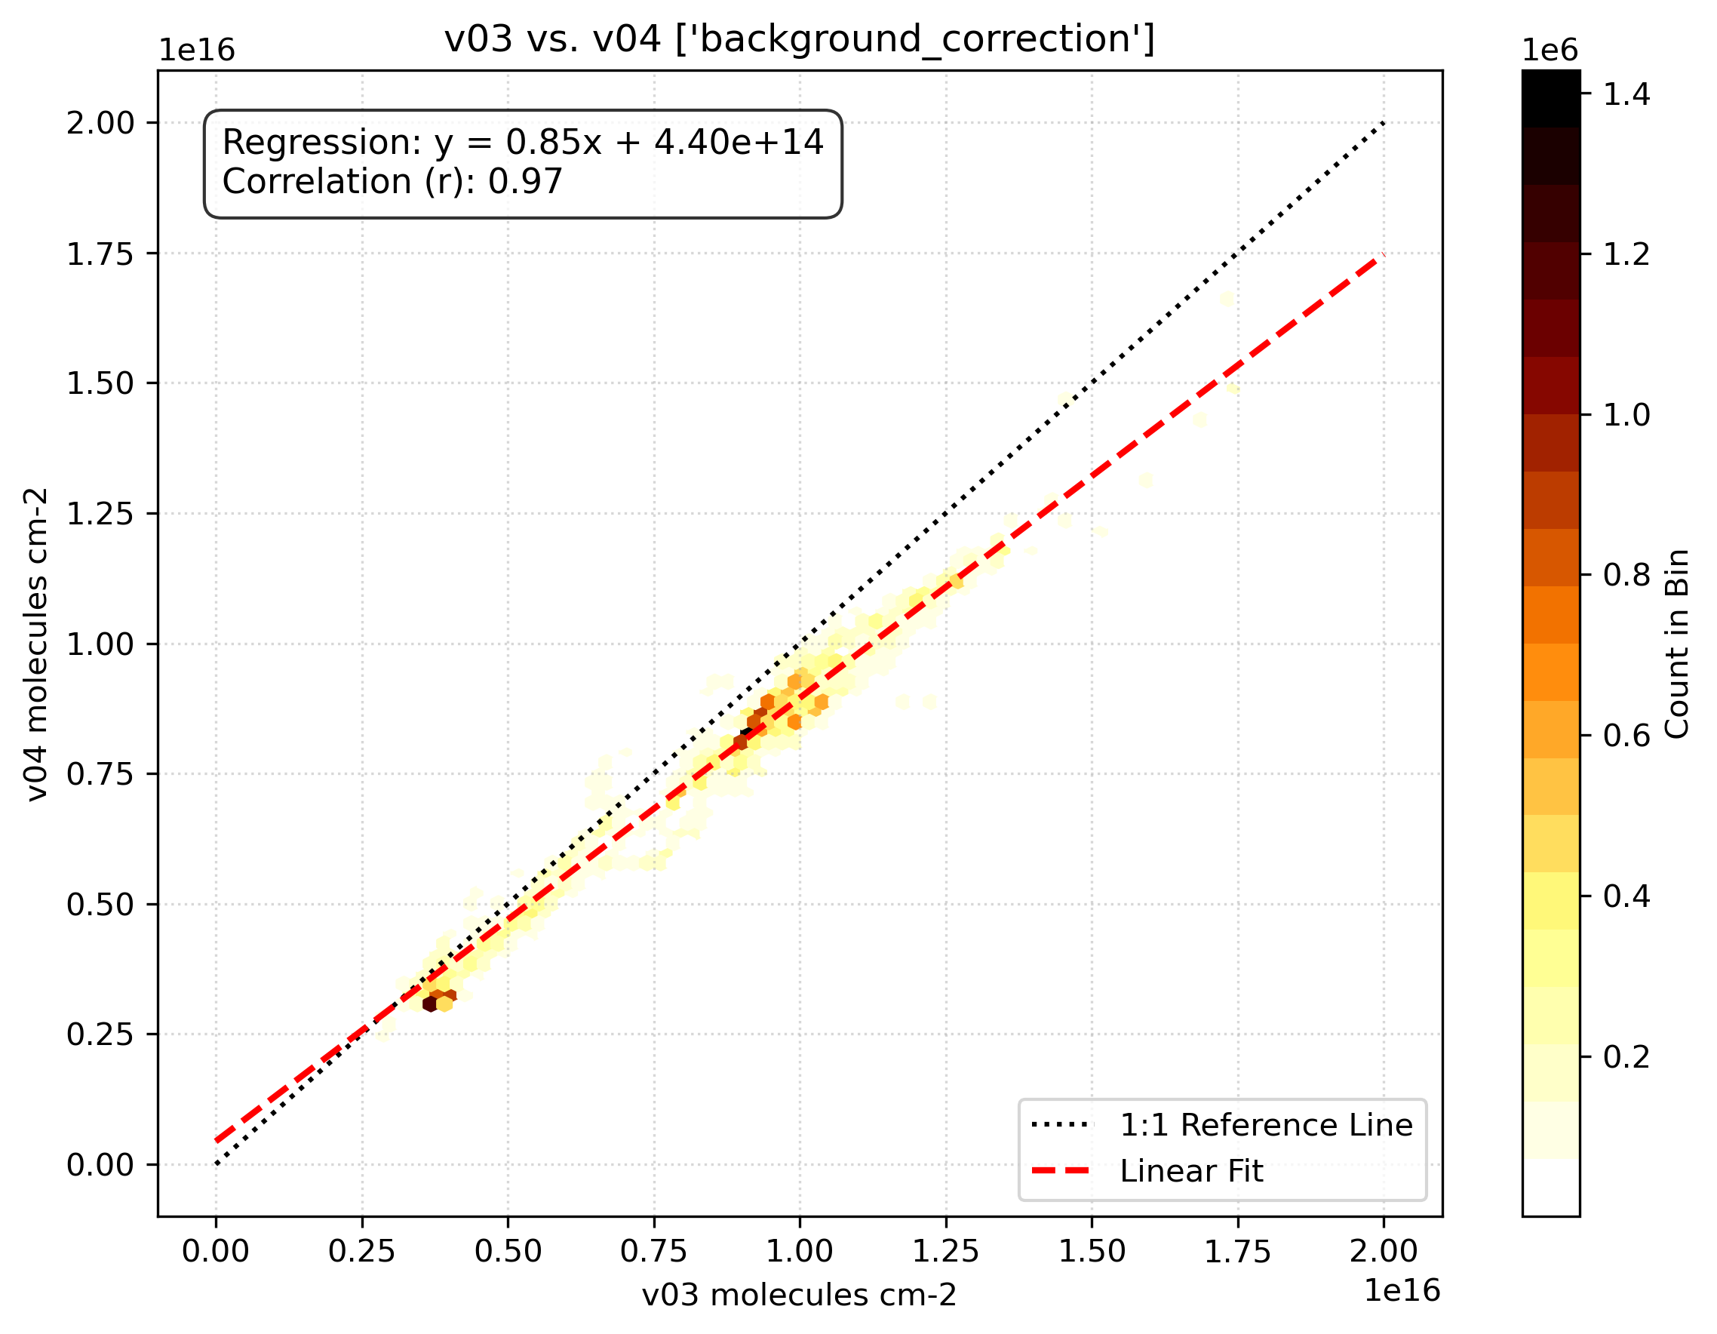
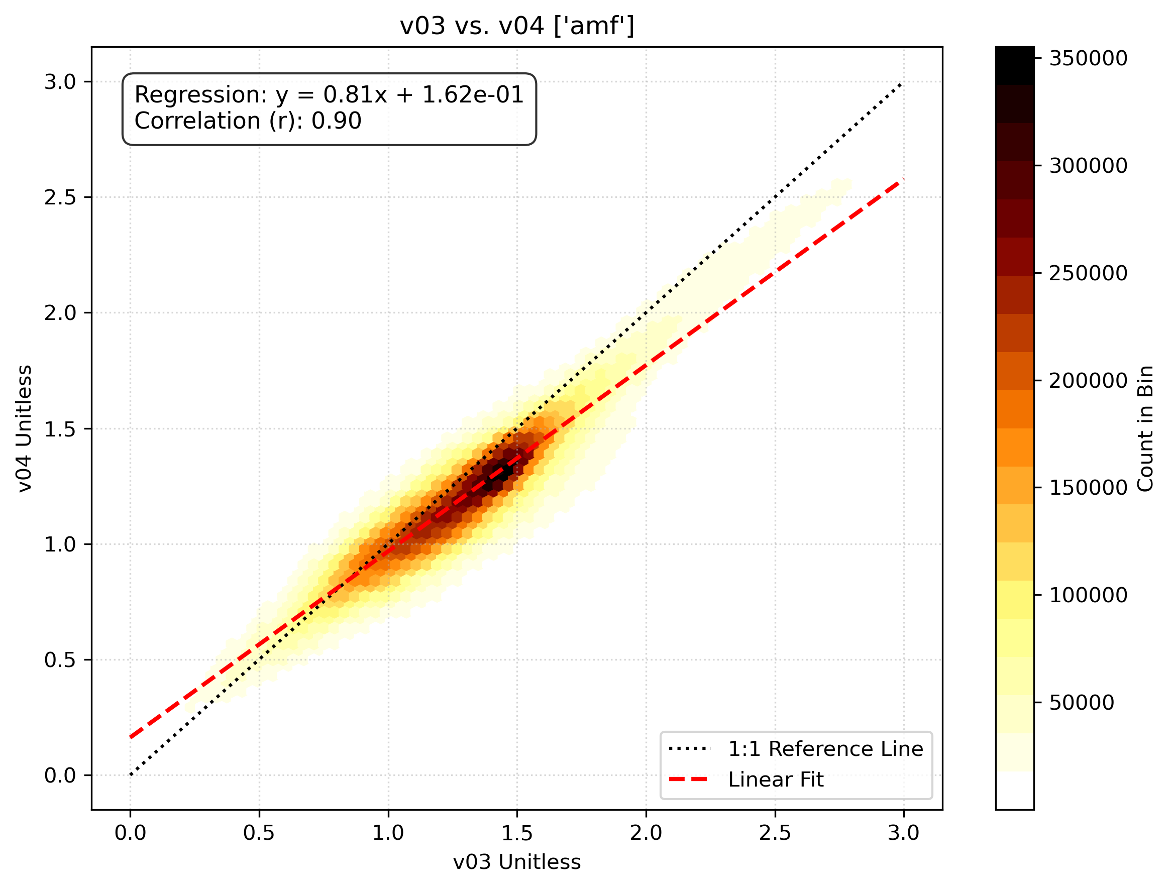
v4 vs. v3 background correction and AMF
Background correction
Air Mass Factor
Background correction and air mass factor are linked together; smaller the one smaller the other but as can be seen in next slide, its effect mostly cancels out in final vertical columns.

Slide 9
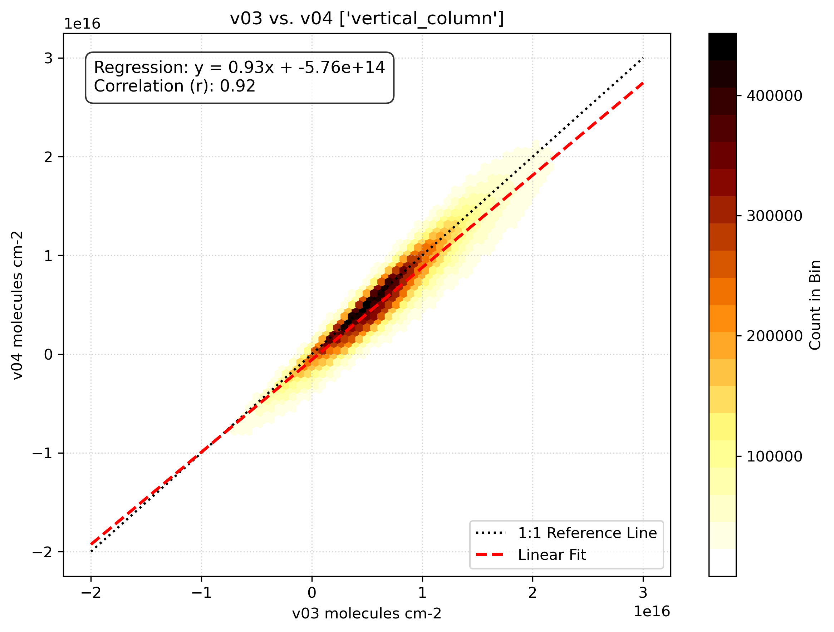
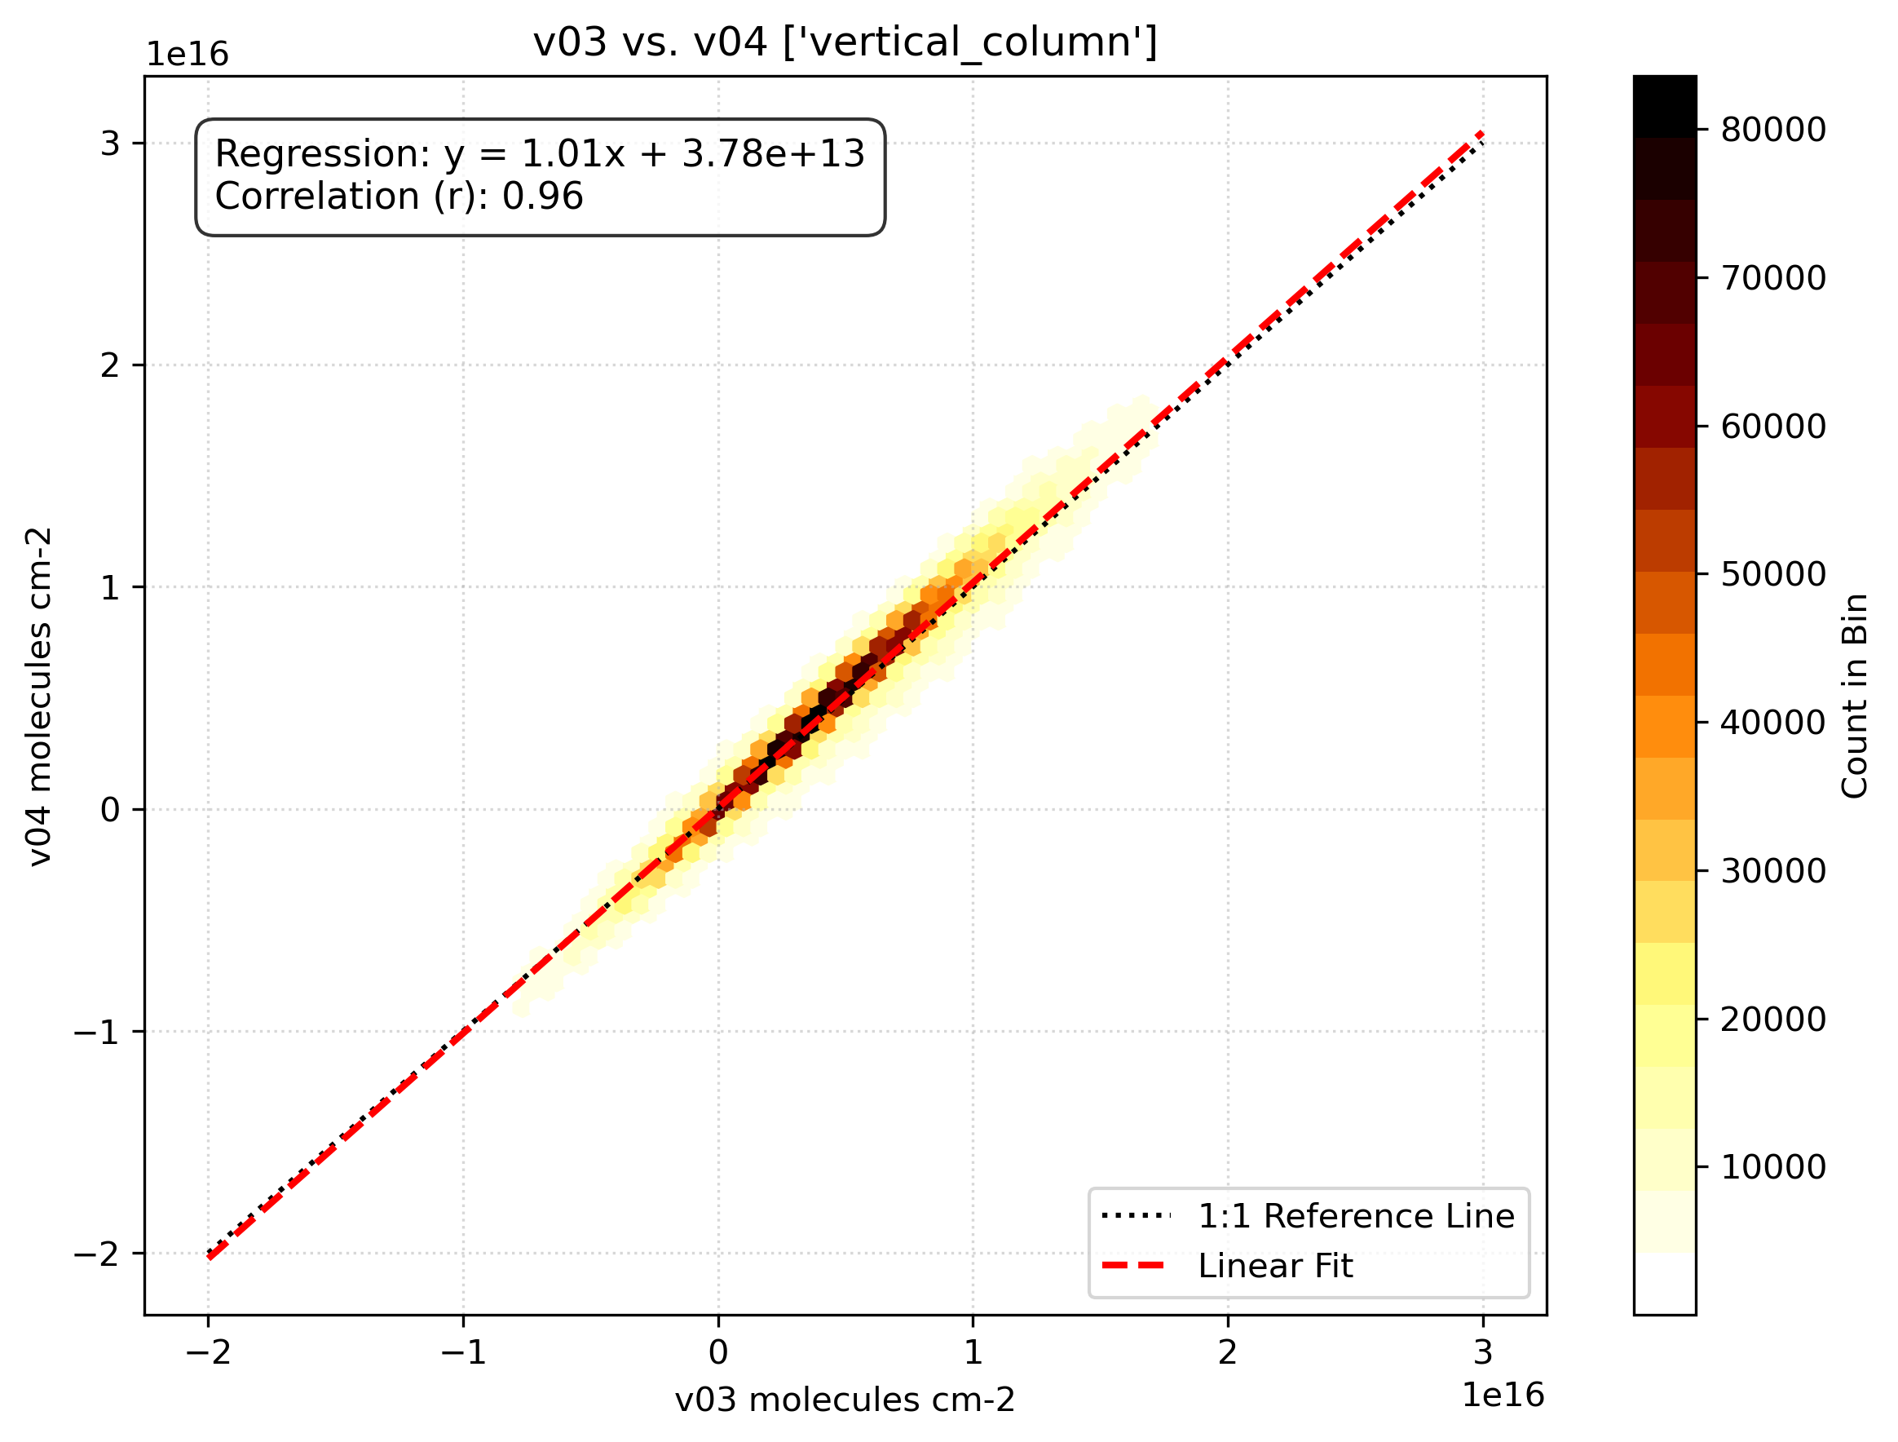
v4 vs. v3 vertical columns
Vertical column (all cloud fractions)
Vertical column (cloud fractions < 0.1)
Particularly for cloud fraction smaller than 0.1 v3 and v4 vertical columns are highly consistent, with v4 showing small validation statistics improvements

Slide 10
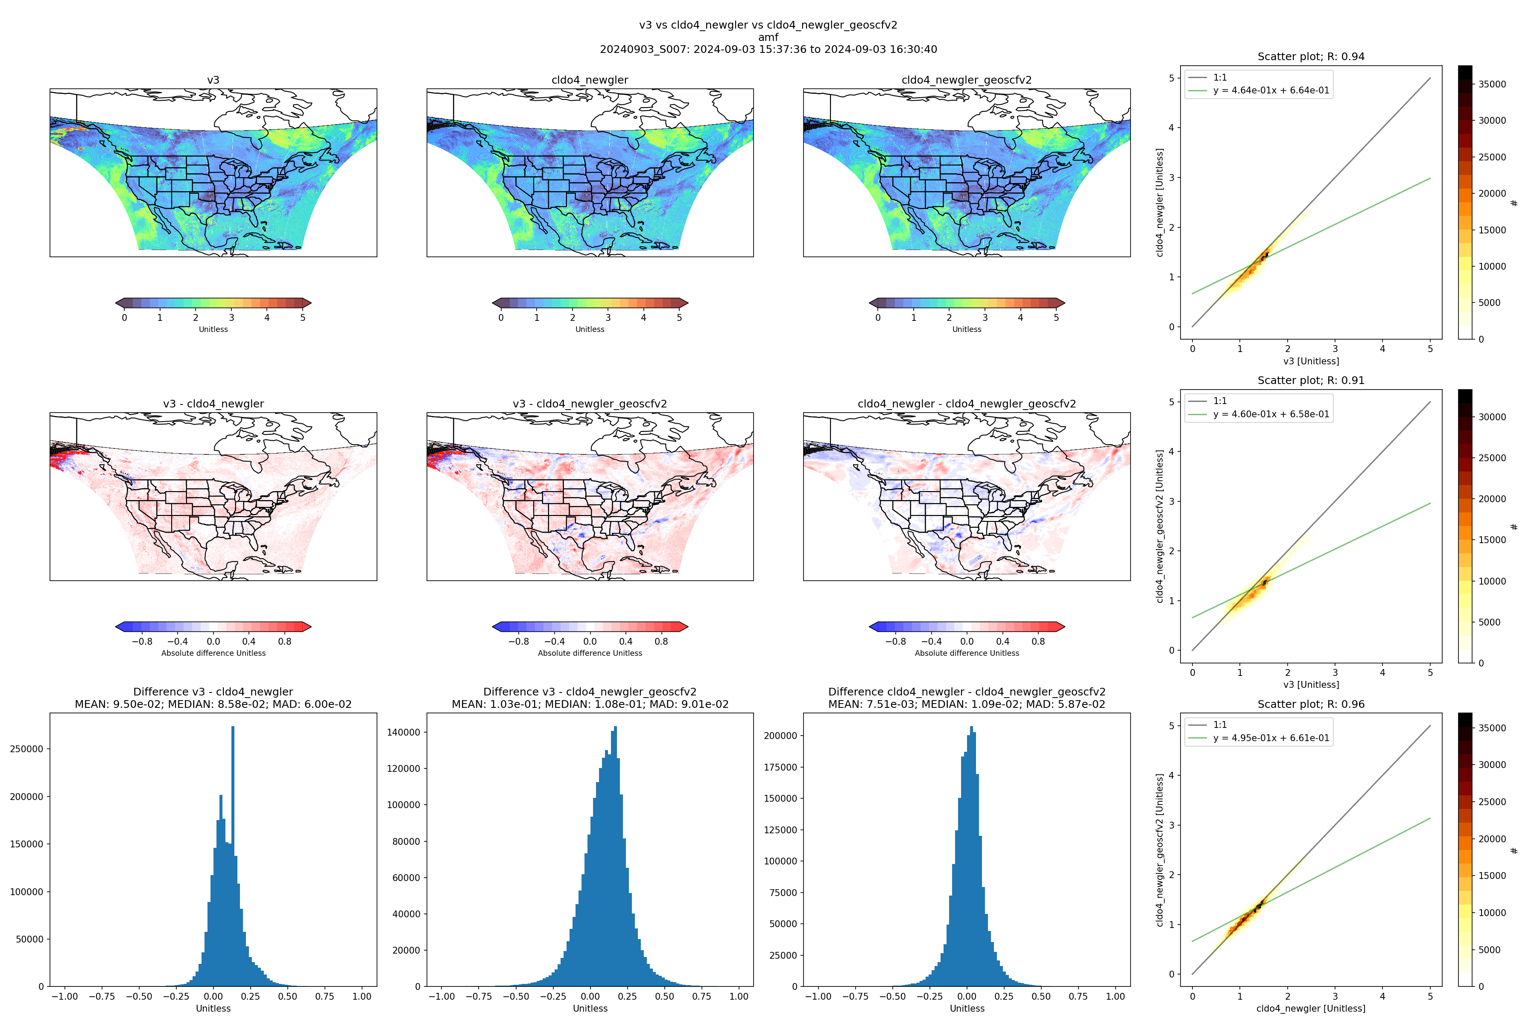
Cloud, GLER and GEOS-CF v2 AMF effects
Version 3 AMF
Version 4 (cloud and GLER change) AMF
Version 4 (cloud, GLER + GEOS-CF V2 change) AMF
AMF change due to clouds + GLER
Version 3 – Version 4 AMF change
AMF change due to GEOS-CF V2

Slide 11
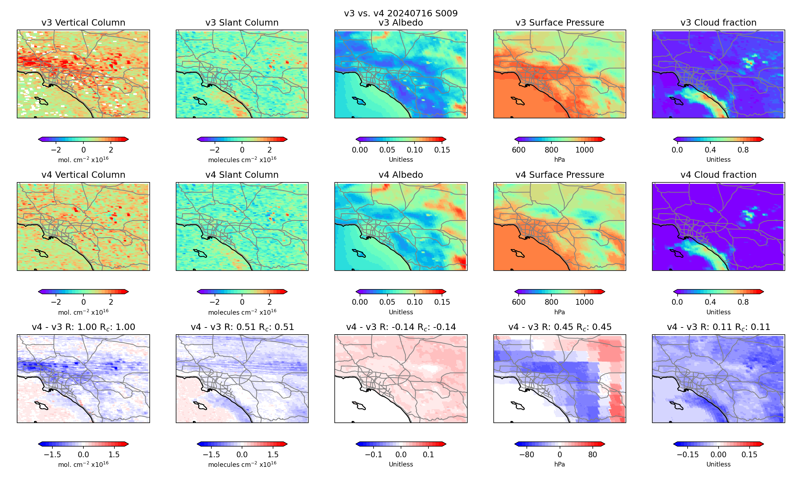
But it is important to realize that changes vary substantially with time and location
In this example over LA basin for July 16 2024, the combined effect of changes in the slant column and surface pressure explain most of the changes in the vertical columns.

Slide 12
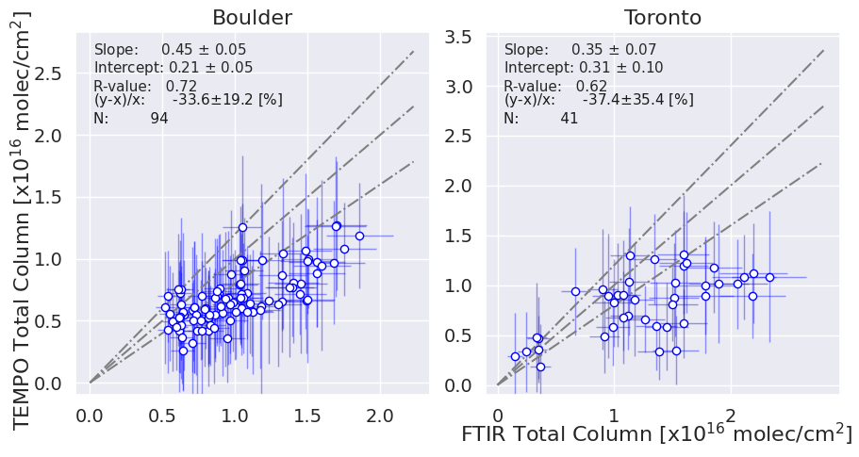
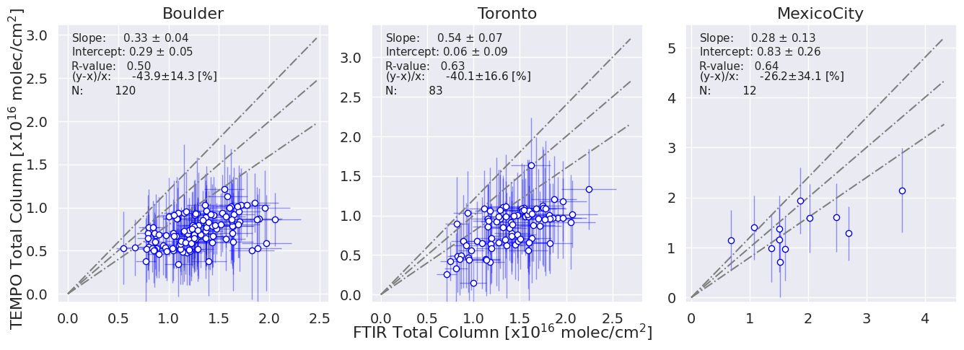
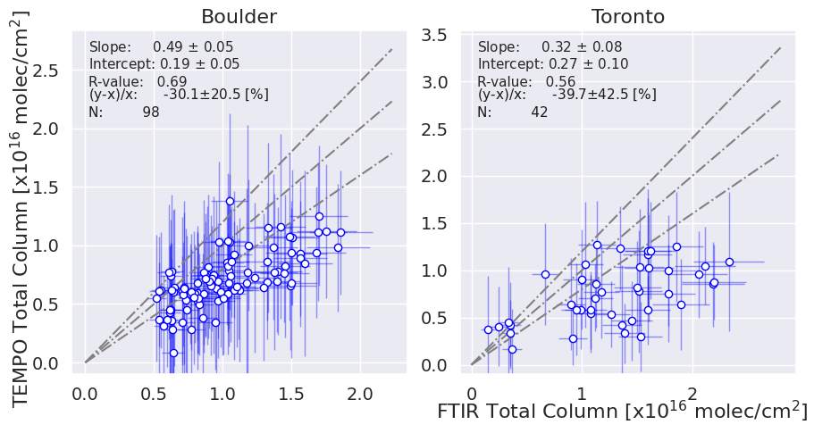
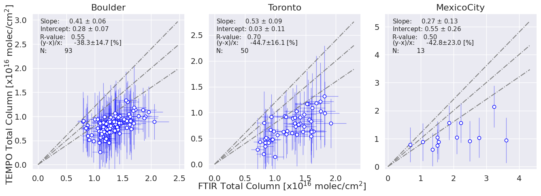
FTIR vs TEMPO HCHO versions 3 and 4
Similar performance (Ivan Ortega, NCAR)
August 2 – September 7 2023
July 11 – Aug 08 2024
v3
v4

Slide 13
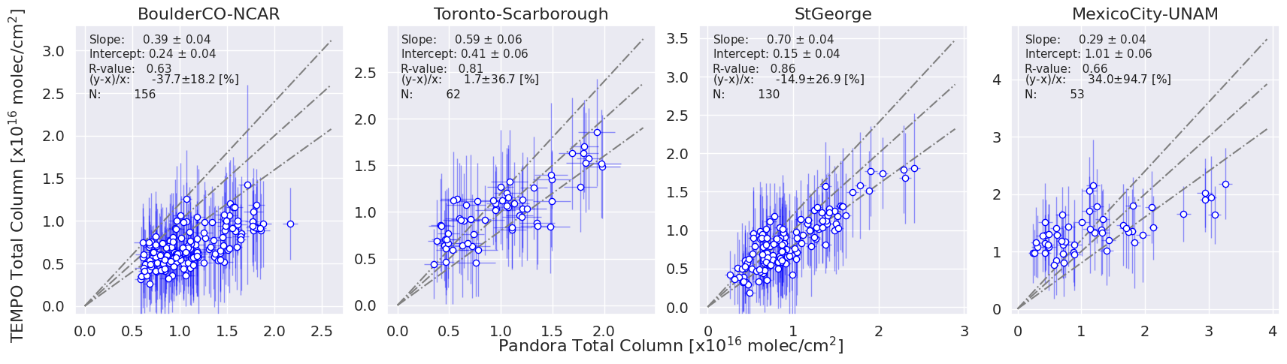
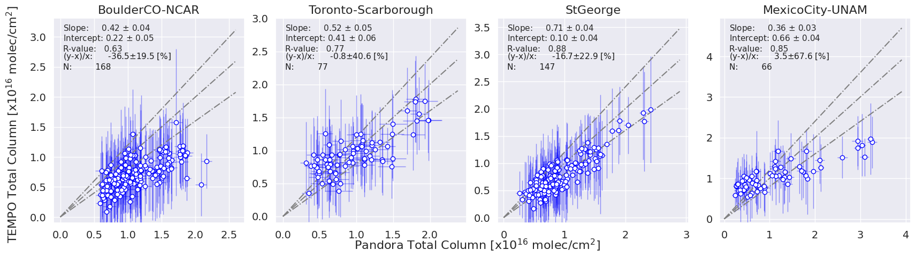
Pandora vs TEMPO HCHO versions 3 and 4
Similar performance (Ivan Ortega, NCAR)
August 2 – September 7 2023
- Version 4 includes more data points.
- There is a slight improvement in Boulder with v4 apparent in both FTIR and Pandora.
- There is an improvement at Mexico City using v4; however, FTIR data are unfortunately not available during this period to double check.
- The good agreement with Toronto-Scarborough appears to result from the low bias in Pandora rather than TEMPO being fully accurate.
Overall, the results are similar with some improvements visible in version 4.
v3
v4

Slide 14
Thanks for your attention and support
Questions?

Slide 15
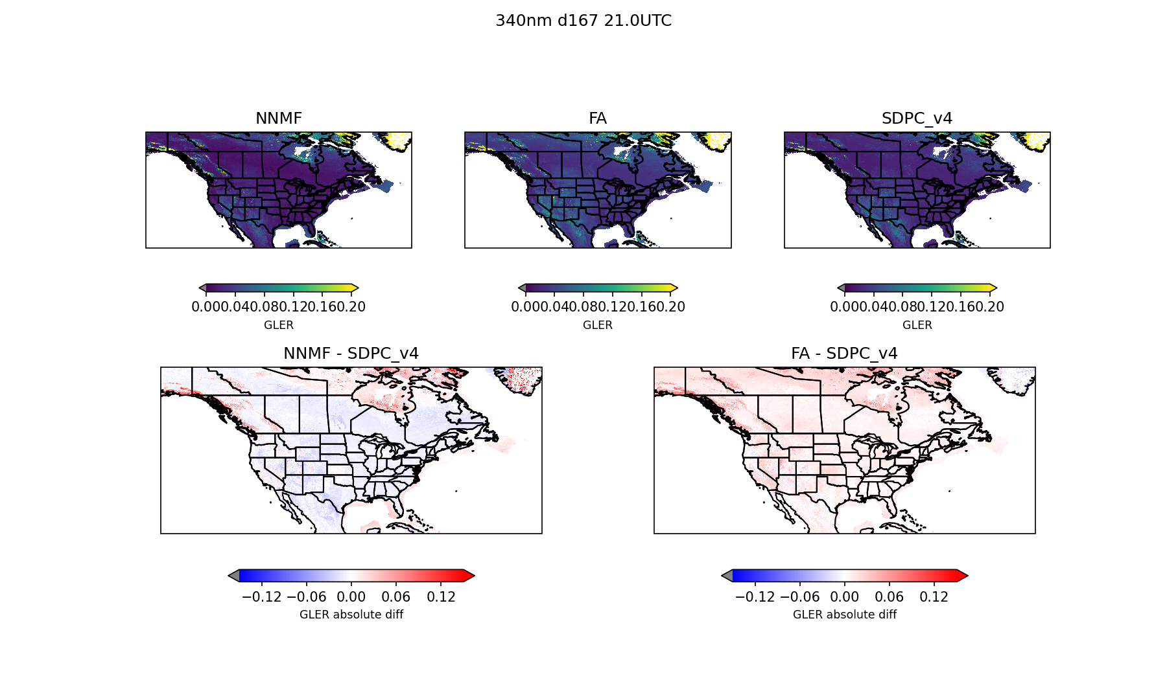
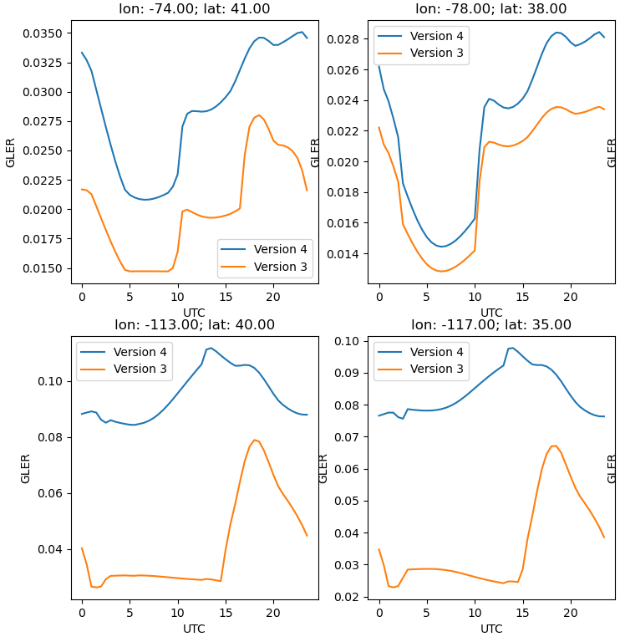
Improved GLER
340 nm; June; 21 UTC
Version 4 GLER
Version 3 GLER
Version 3 – Version 4

Slide 16
Cloud, GLER and GEOS-CF v2
Version 3 AMF
Version 4 (cloud and GLER change) AMF
Version 4 (cloud, GLER + GEOS-CF V2 change) AMF
AMF change due to clouds + GLER
Version 3 – Version 4 AMF change
AMF change due to GEOS-CF V2

Slide 17
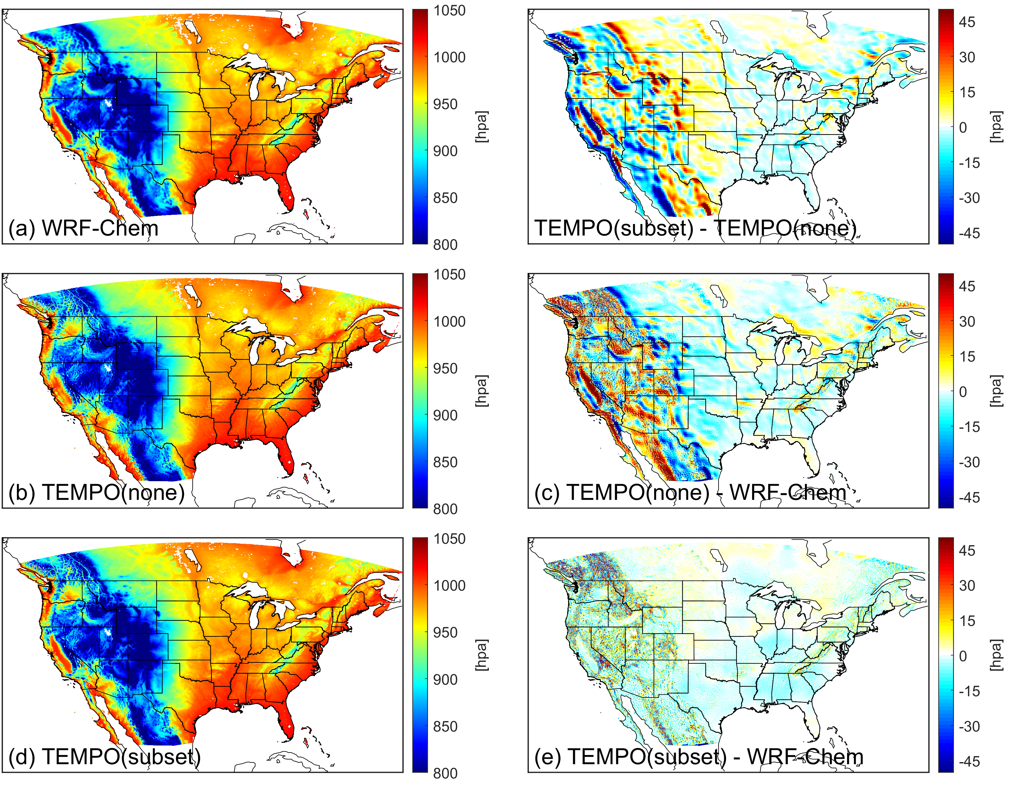
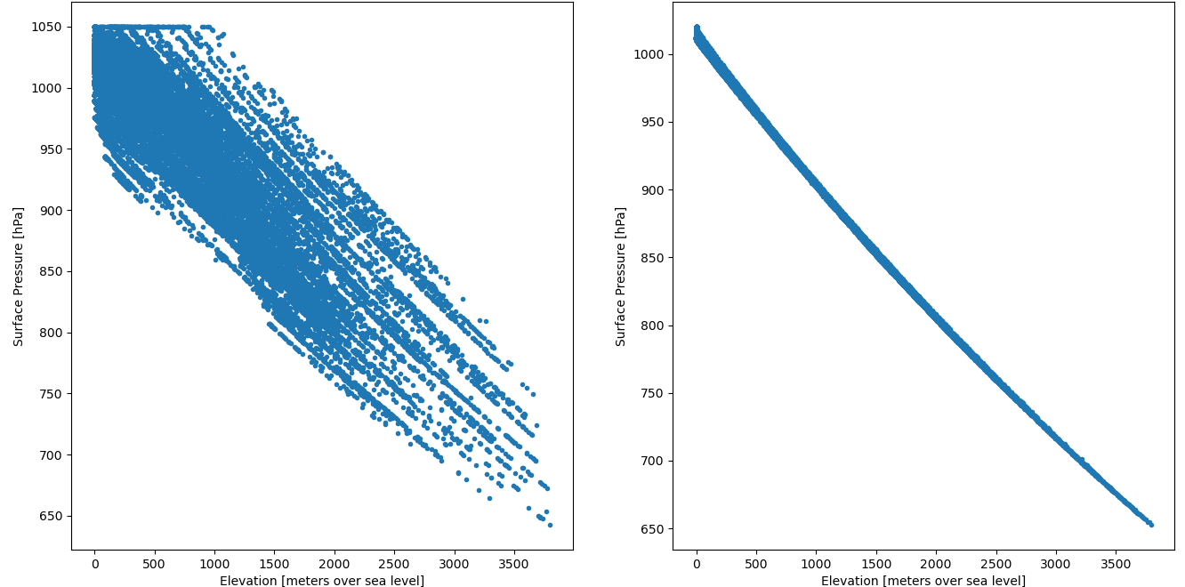
Fix surface pressure interpolation thanks to Chia-Hua’s feed back
Surface pressure vs. altitude
Version 3
Version 4
Image credit: Chia-Hua Hsu

Slide 18
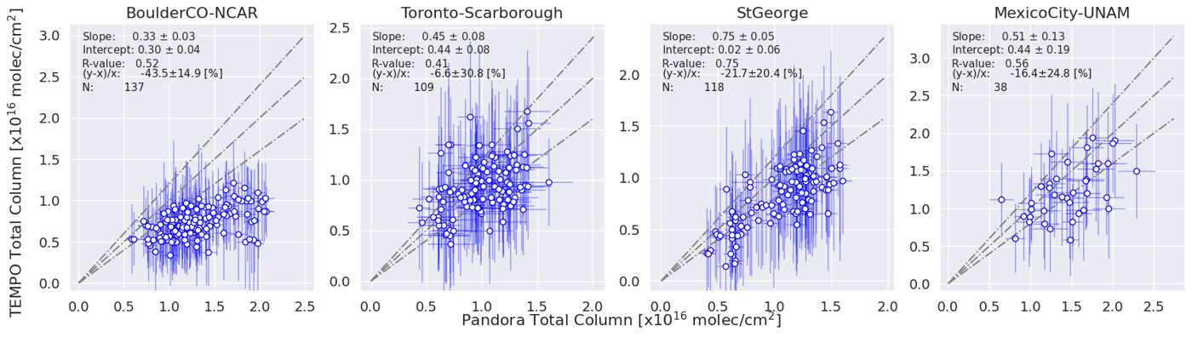
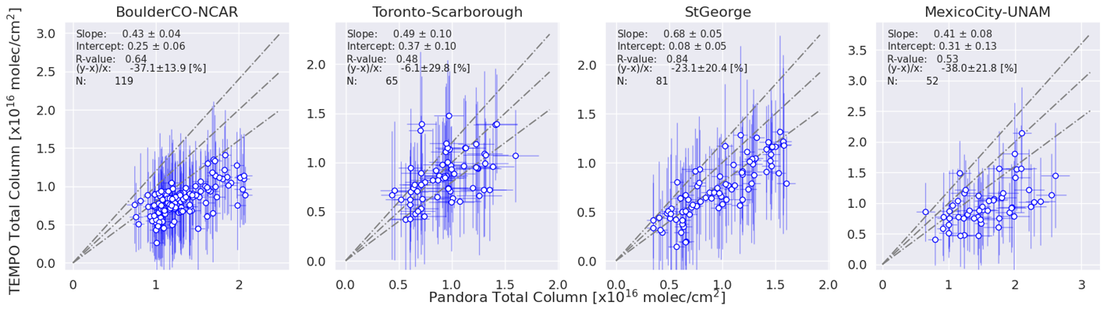
Pandora vs TEMPO HCHO versions 3 and 4
Similar performance (Ivan Ortega, NCAR)
July 11 – Aug 08 2024
- Version 4 includes more data points.
- There is a slight improvement in Boulder with v4 apparent in both FTIR and Pandora.
- It seems like v4 decrease HCHO at Mexico City apparent in both FTIR and Pandora.
- The good agreement with Toronto-Scarborough appears to result from the low bias in Pandora rather than TEMPO being fully accurate.
Overall, the results are similar.
v3
v4

Slide 19
Air mass factor calculation inputs
Input | Source
Cloud fraction and pressure | TEMPO cloud product. Defaults to a cloud pressure climatology (OMI-derived) if cloud retrieval is unavailable.
Trace gas profiles | GEOS-CF hourly forecast from prior day (25-km resolution). Defaults to monthly 1-hour climatology derived from GEOS-CF if forecast is unavailable.
Vertical layers | 72 layers on GEOS-CF vertical grid
Surface albedo | GLER climatology (0.05° resolution) using OMI GSFC team methodology over land (Fasnacht et al., 2019) and water (Qin et al., 2019). Derived from MODIS BRDF v6.1, extended to shorter wavelengths 340 nm (HCHO) using visible surface reflectance EOFs updated from Zoogman et al. (2016) and SCIAMACHY reflectance climatologies.
Snow/ice fraction | IMS snow and ice (1-km resolution)
Meteorological variables: Temperature profile (for hypsometric equation and NO₂ T-dependency), surface pressure, tropopause pressure (for NO₂ stratospheric correction), wind speed (for ocean GLER) | GEOS-CF hourly forecast from prior day (25-km resolution). Defaults to monthly 1-hour climatology derived from GEOS-CF if forecast is unavailable.
Terrain height correction | Corrected following Boersma et al. (2011) using GMTED2010 (30 arcsec) DEM
Aerosols | Not applied (considered implicitly in cloud retrieval)

Slide 20
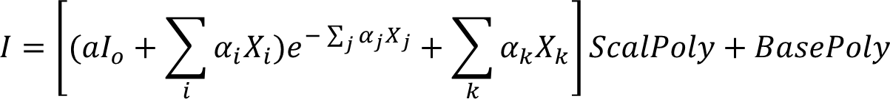
Differential slant column spectral fit set up
Fitting window | 328.5 - 356.5 nm
I₀ | CCD position dependent radiance reference calculated using same scan
Baseline polynomial | 3rd order
Scaling polynomial | 3rd order
Solar reference spectrum | Coddington et al., (2023) TSIS-1 Hybrid Solar Reference Spectrum
Raman Scattering | Derived using Chance and Spurr (1997)
Undersampling correction | Derived using Chance et al. (2005)
O₃ | Serdyuchenko et al. (2014) at 223K and 243K
NO₂ | Vandaele et al. (1998) 220K
O₂-O₂ | Finkenzeller and Volkamer (2022) 293K
BrO | Wilmouth et al. (1999) 228K
HCHO | Chance and Orphal (2011) 300K

