Slide 1

TEMPO CLDO4 Update
Helen Wang (hwang@cfa.Harvard.edu) & SAO TEMPO team
Adapted from the NASA Goddard OMI
[Vasilkov et al., 2018]
Theory
Prior Knowledge
CLDO4 product

Slide 2
TEMPO CLDO4 Conceptual Structure
Rad. Transfer LUTs for
RAD/IRR
O₂-O₂ AMF
Acloud = 0.8
2 constraints
GLER
Meteorology (Psfc, T-P, Q)
Geometry
(SZA, VZA, RAA)
TEMPO L1b
(1) RAD/IRR @466nm
(2) O₂-O₂ SCD (439-488nm)
2 unknowns
ECF (Effective Cloud Fraction)
OCP(Optical Centroid Pressure)

Slide 3
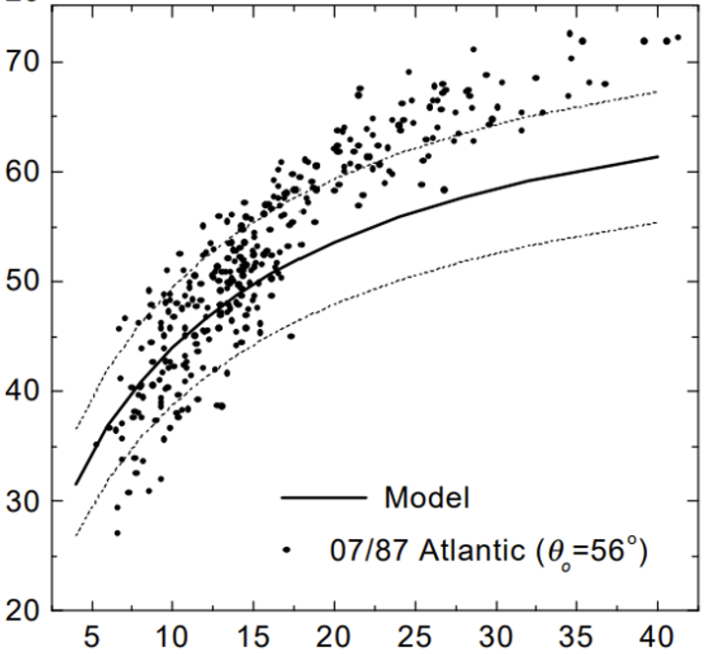
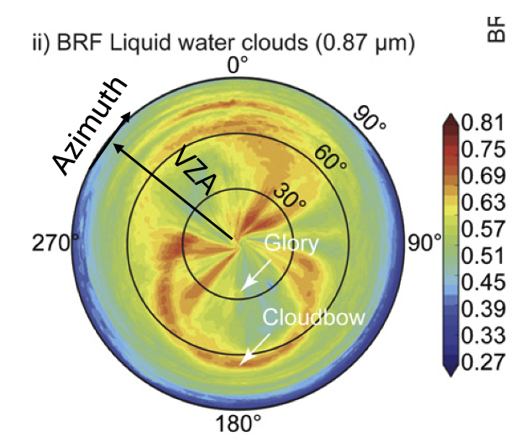
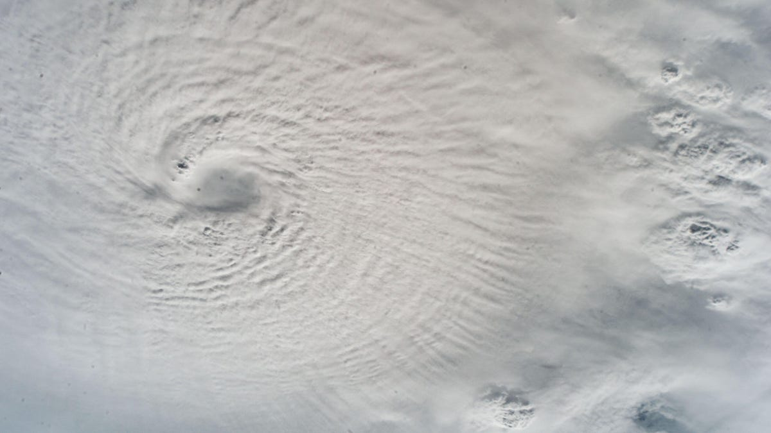
[Chang et al., 1998]
[Gatebe et al., 2016]
Hurricane Milton
cloud albedo (%)
cloud optical depth
Large Variations in Cloud Reflectance

Slide 4
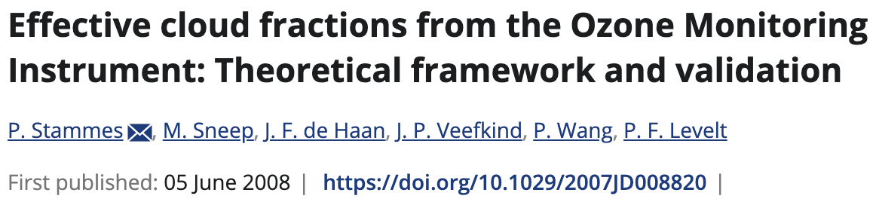
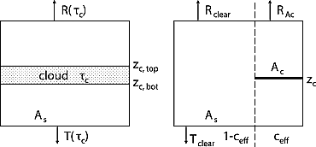

C=1
Geometric C $≠$ Effective C_{eff} $≠ Radiance$C_{rad}
C_{rad} = C_{eff} * R_{cloud}(λ)/R_{observed}(λ)

Slide 5
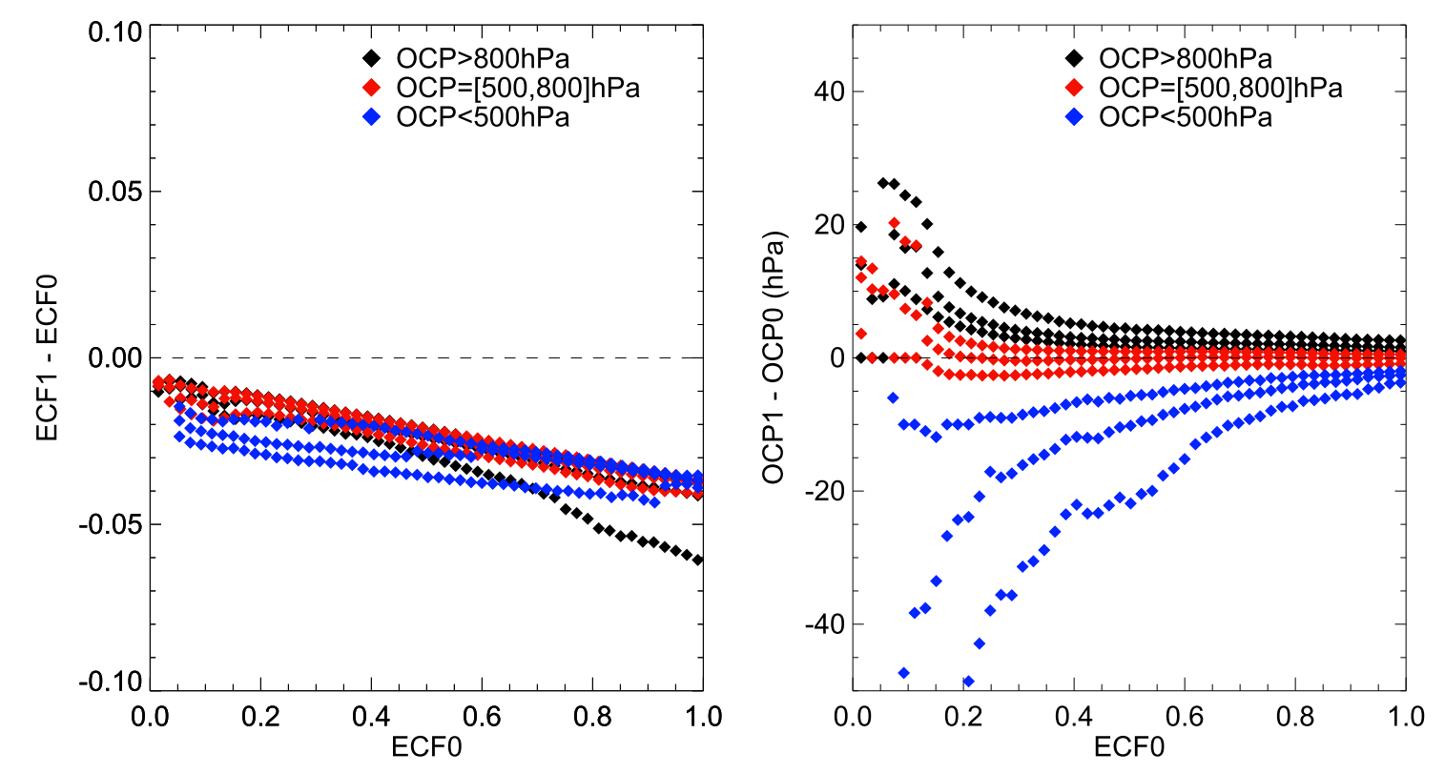
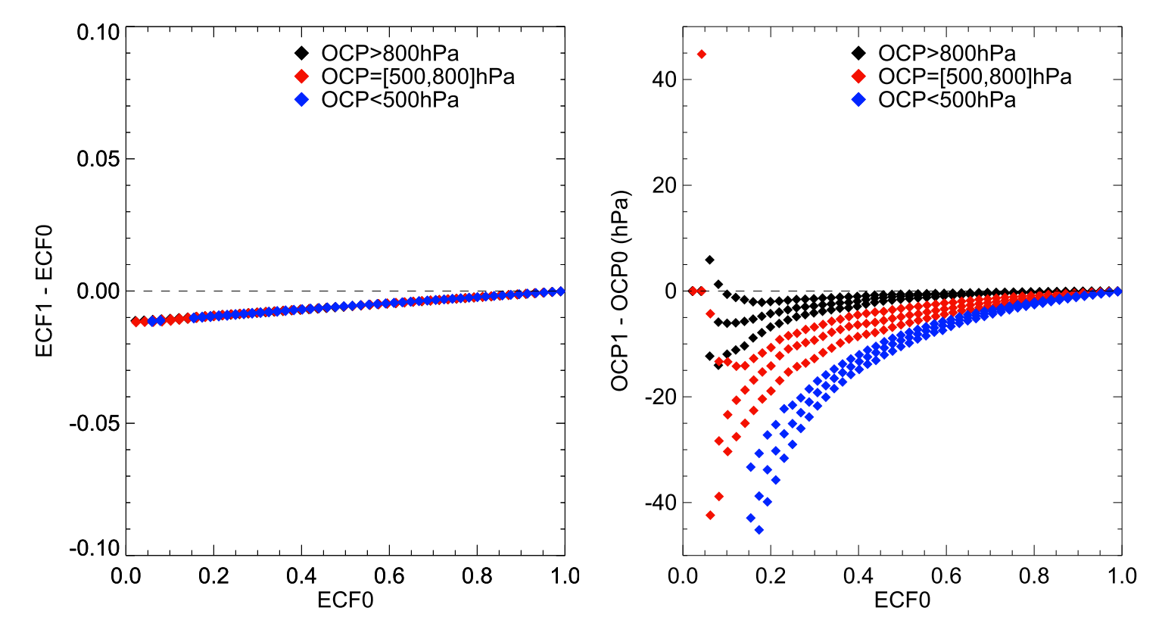
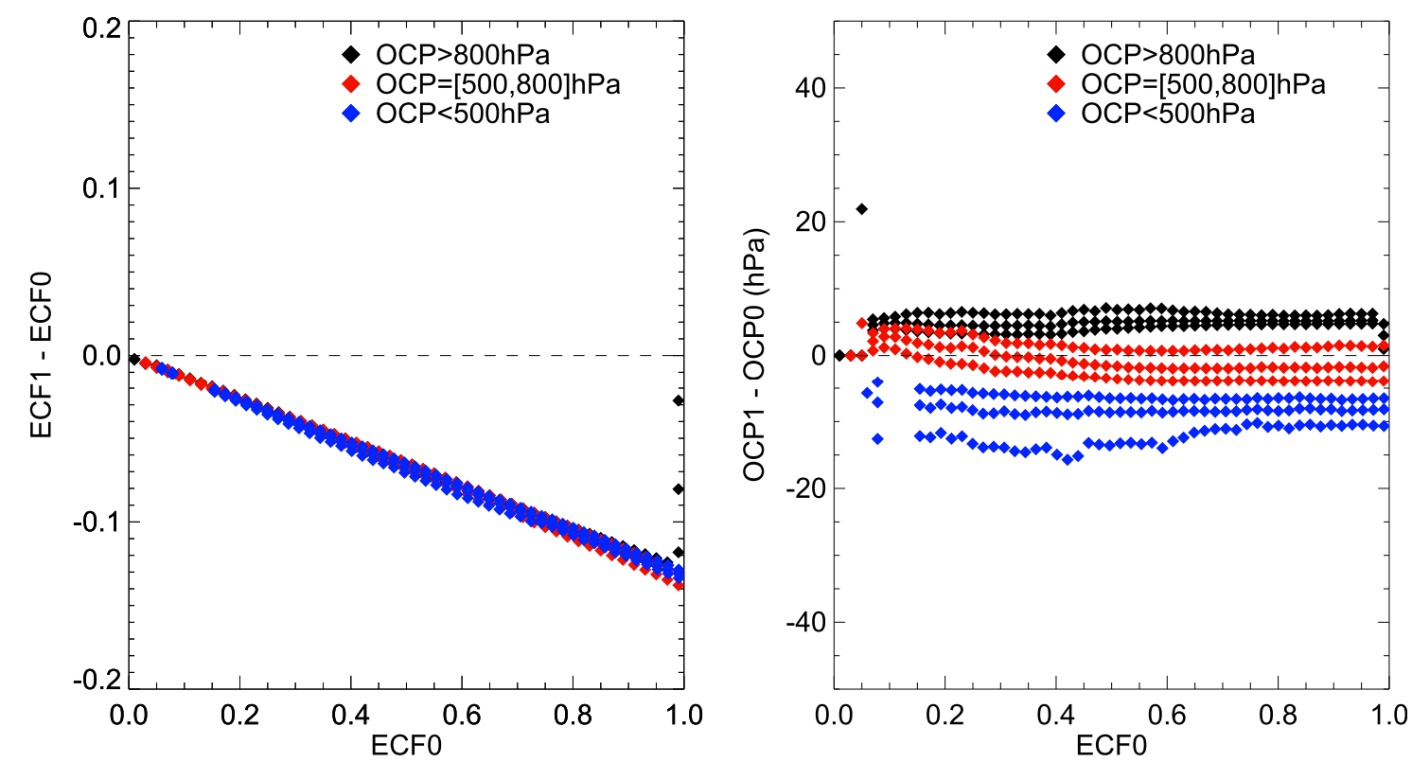
Sensitivity of ECF & OCP to different variables
Sensitivity to 466nm RAD decrease of 3%
Sensitivity to GLER increase of 0.01
Sensitivity to Ac increase from 0.8 to 0.9
dECF
dOCP
dECF
dOCP
dECF
dOCP
CLDO4 ATBD

Slide 6
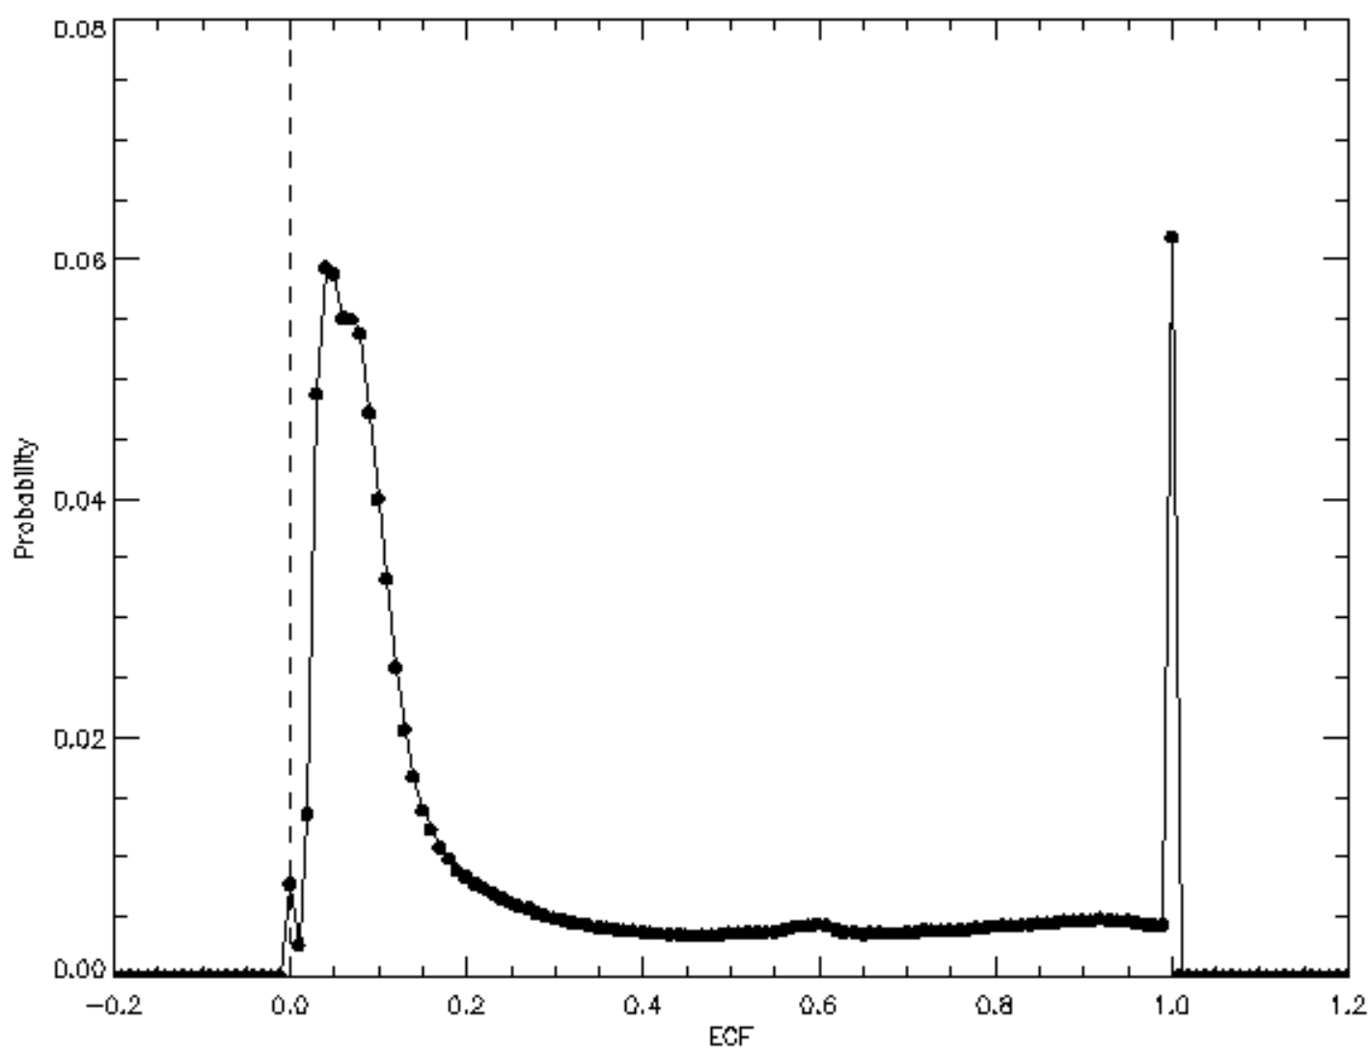
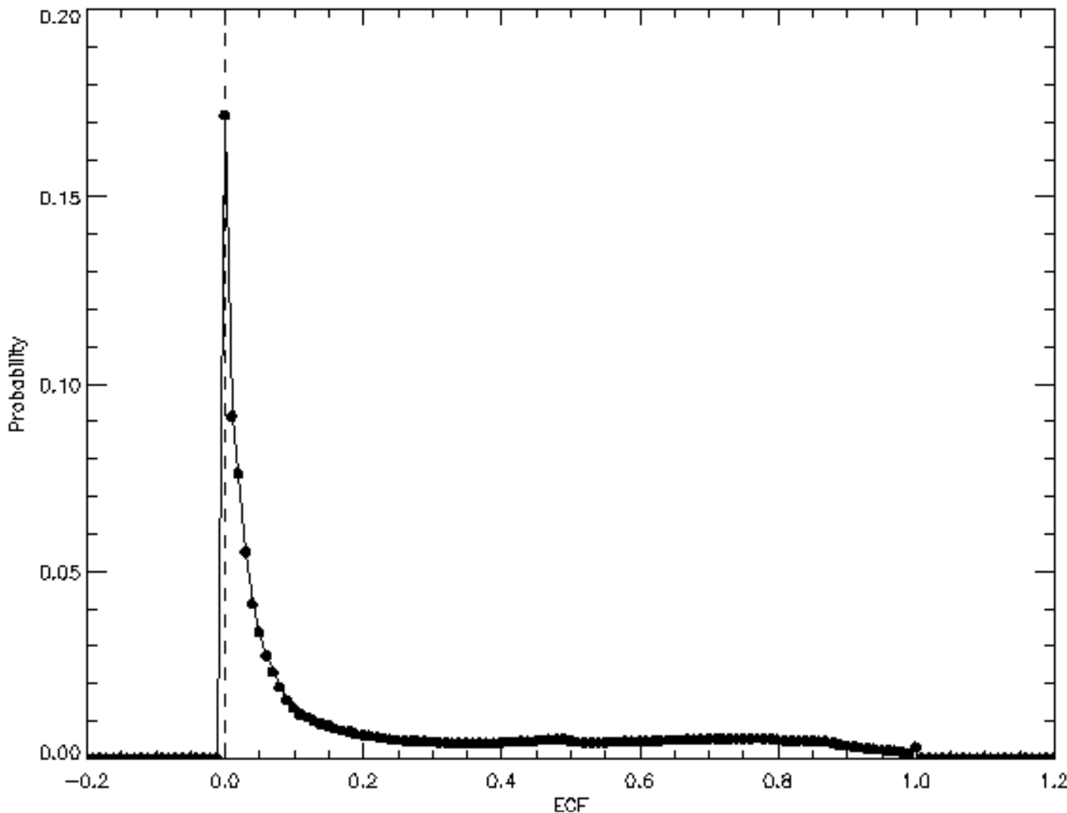
ECF histogram
V3 CLDO4
V4 CLDO4
20240601 S007
20240601 S007
L1B
GLER

Slide 7
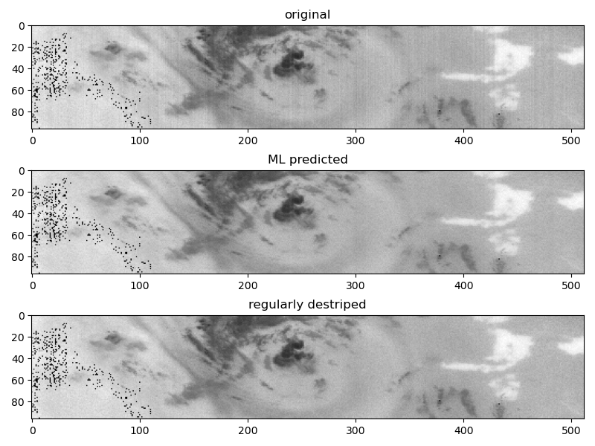
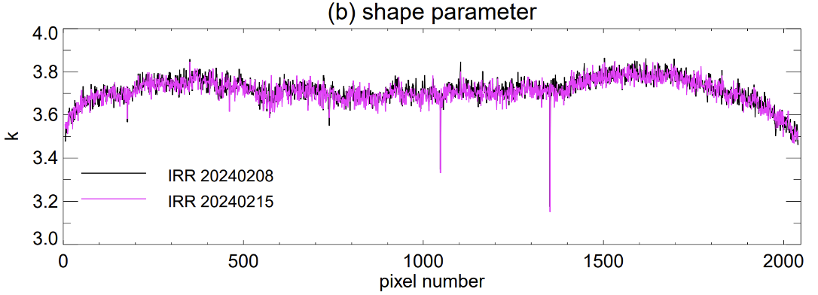
V4: O₂-O₂ SCD
Destriping
Original
with stripes
ML
destriped
Statistically
destriped
Stripes (IRR)
Stripes (Slit function)
No O₂O₂ destriping the day after IRR in V4
operational

Slide 8
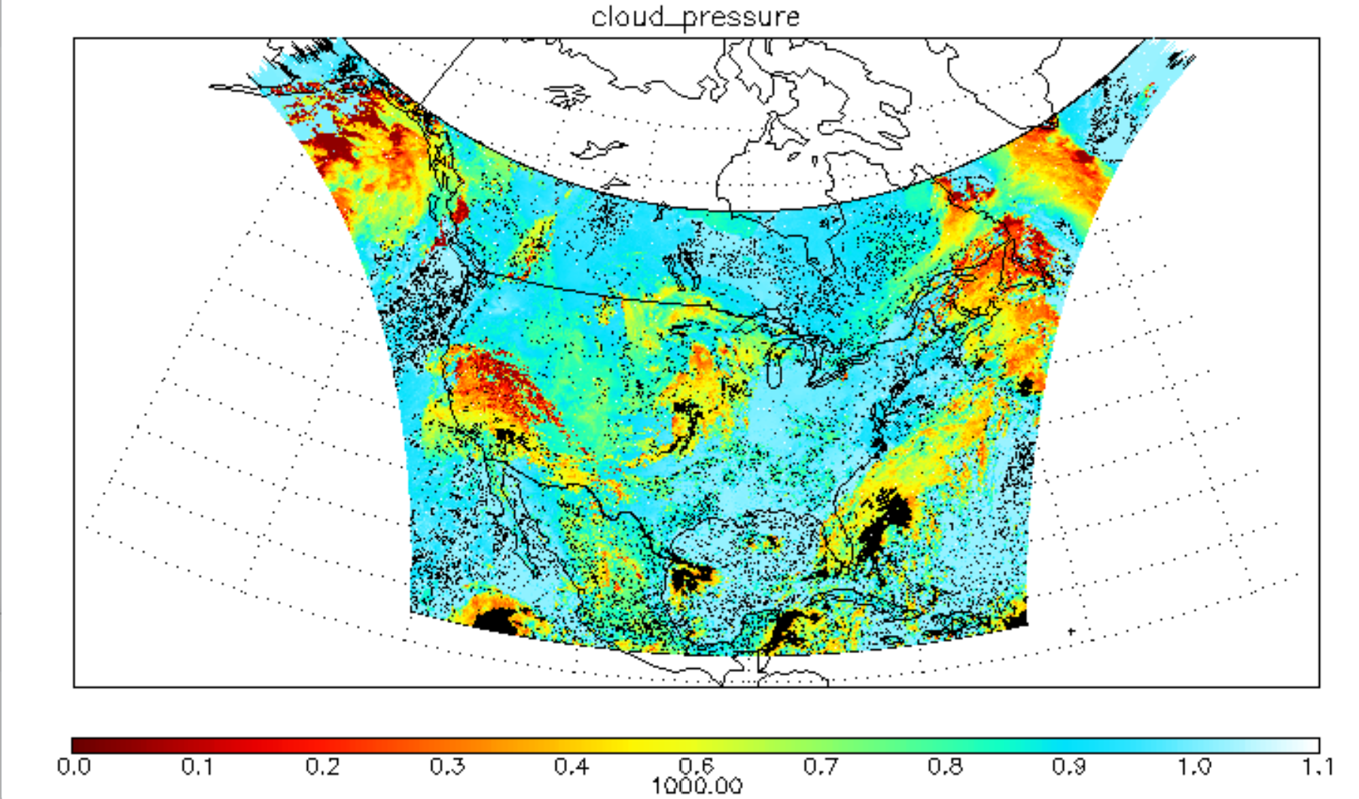
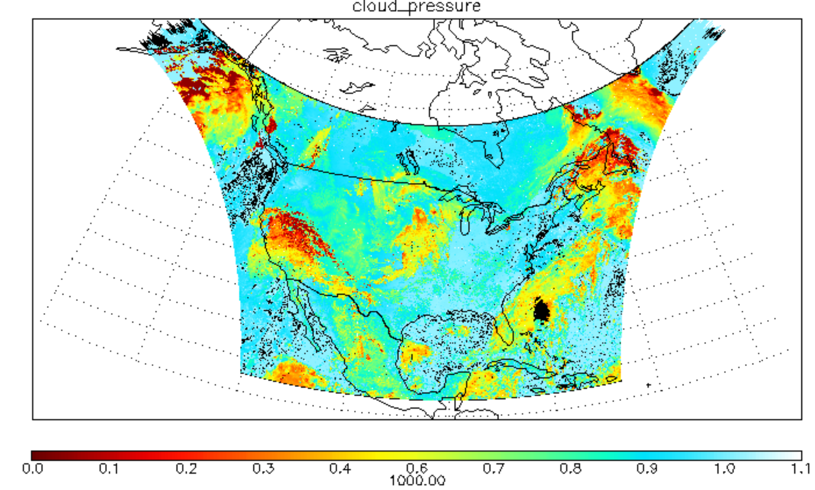
20250918S008
Recent Development (a) OCP
Clear sky
Failed OCP retrieval
    Off planet
    ECF failed
    SCD fitting failed
spectral saturation
low signal-to-noise
slow convergence
    SCD filtered out
unphysical values
large fitting RMS
large fitting abs // relative uncertainty
    Unreasonable inputs
GLER
meteorology
    Small theoretical dynamical range
    snow/ice
    extreme angles
    Improper Underlying assumption
for highly reflective scene
V4 OCP
Current OCP
hPa
ECF=0 pixels: OCP =Pscene in these plots to focus on clouds

Slide 9
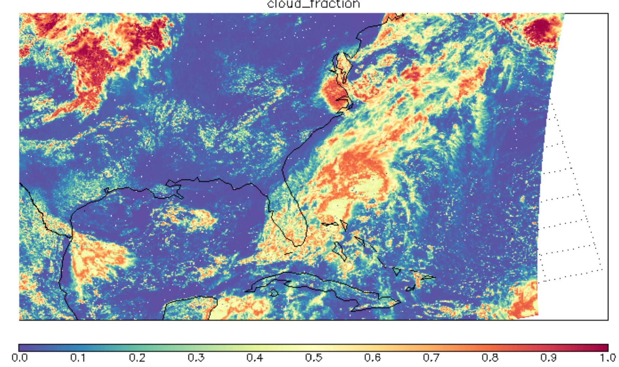
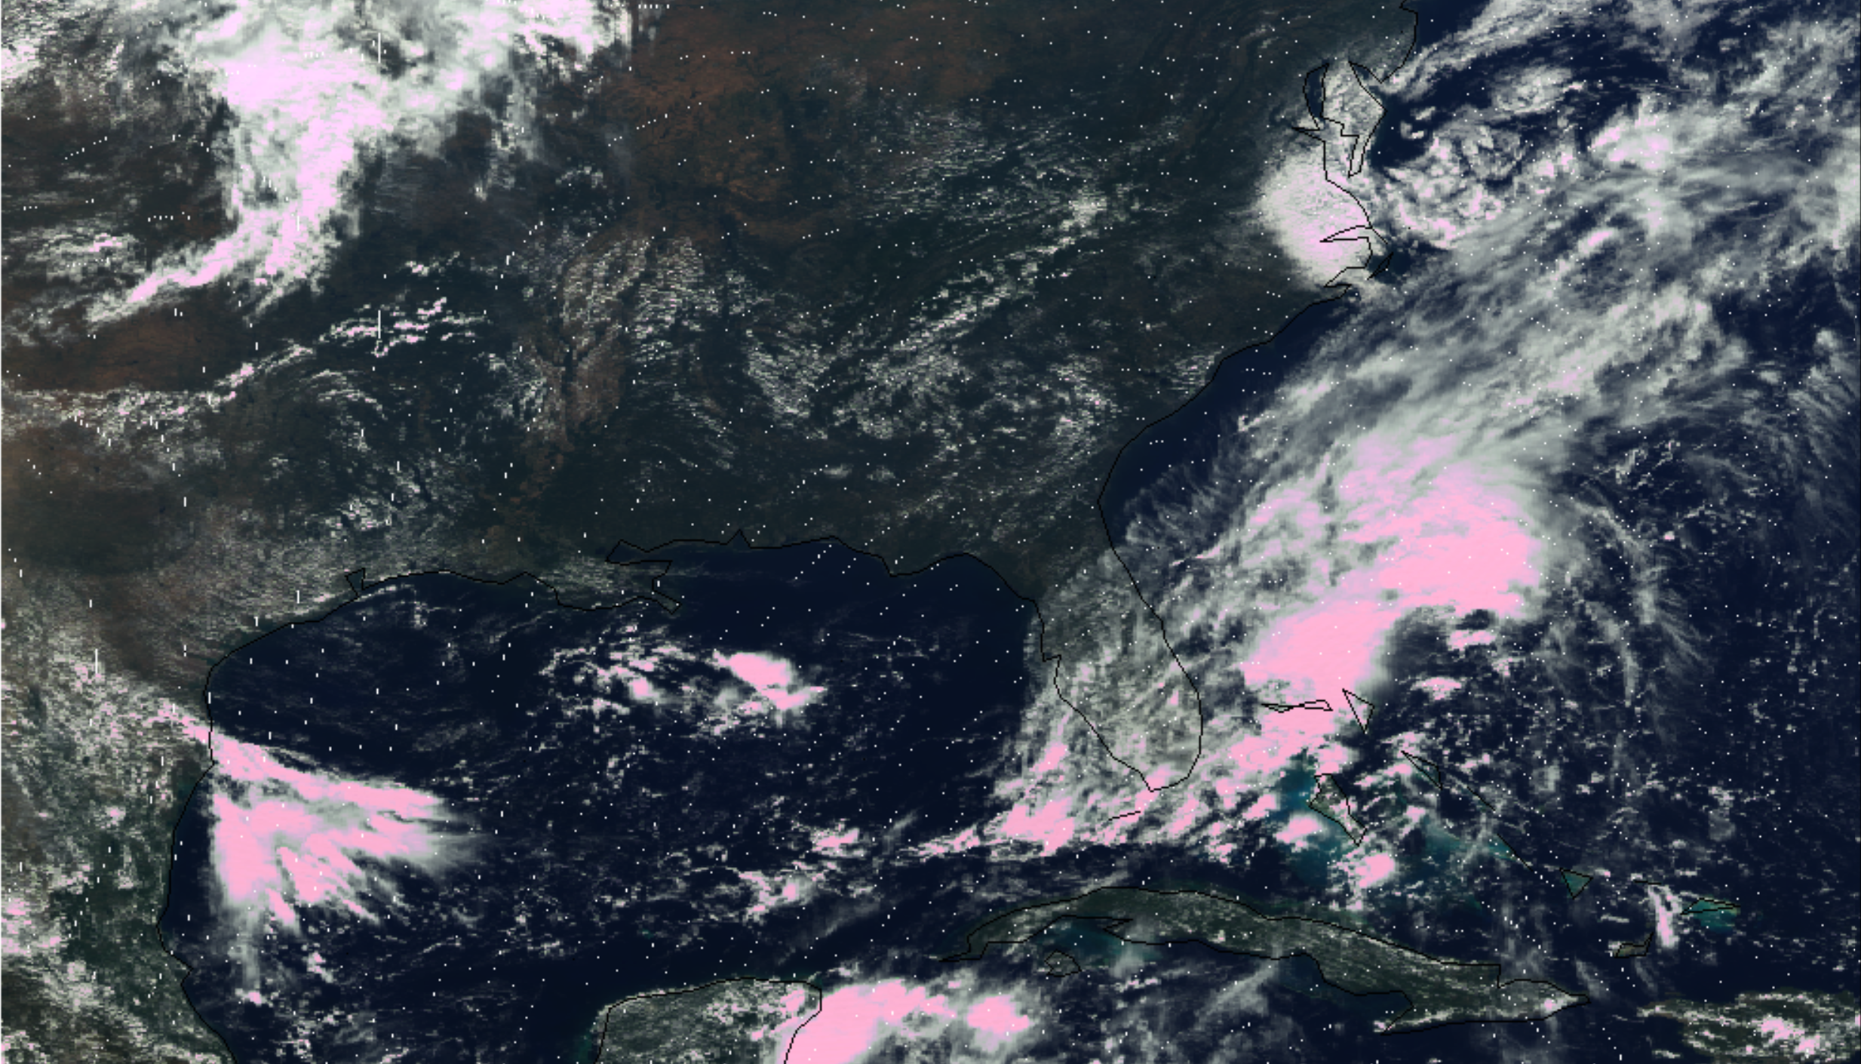
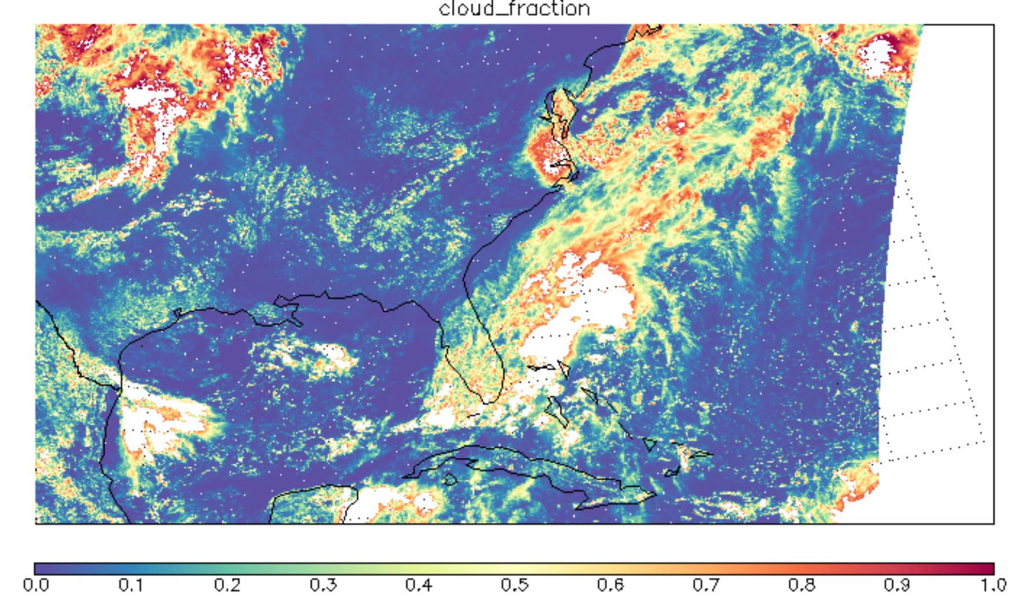
Recent Development (b) ECF
V4 ECF
Additional 16-bit Processing Flags

Slide 10

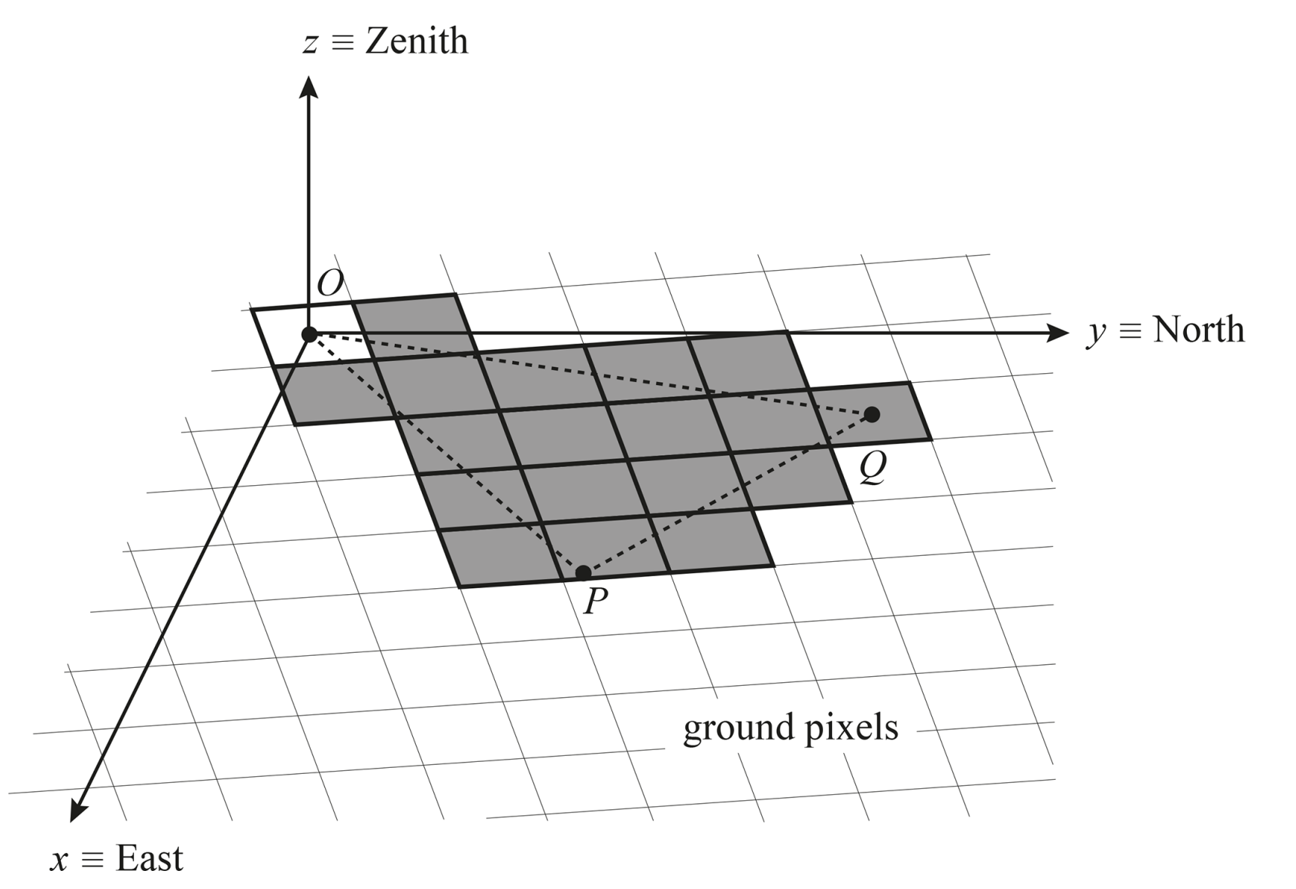
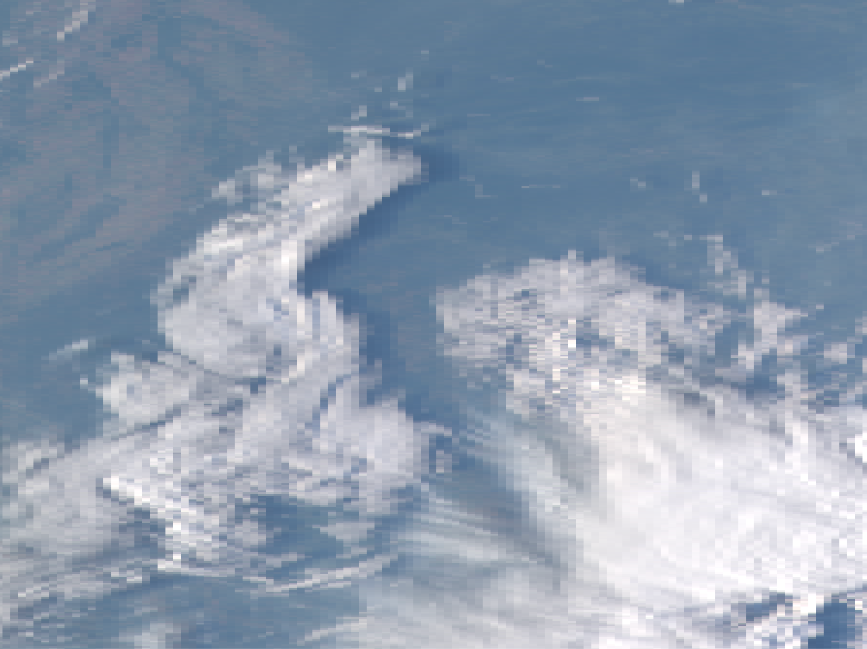
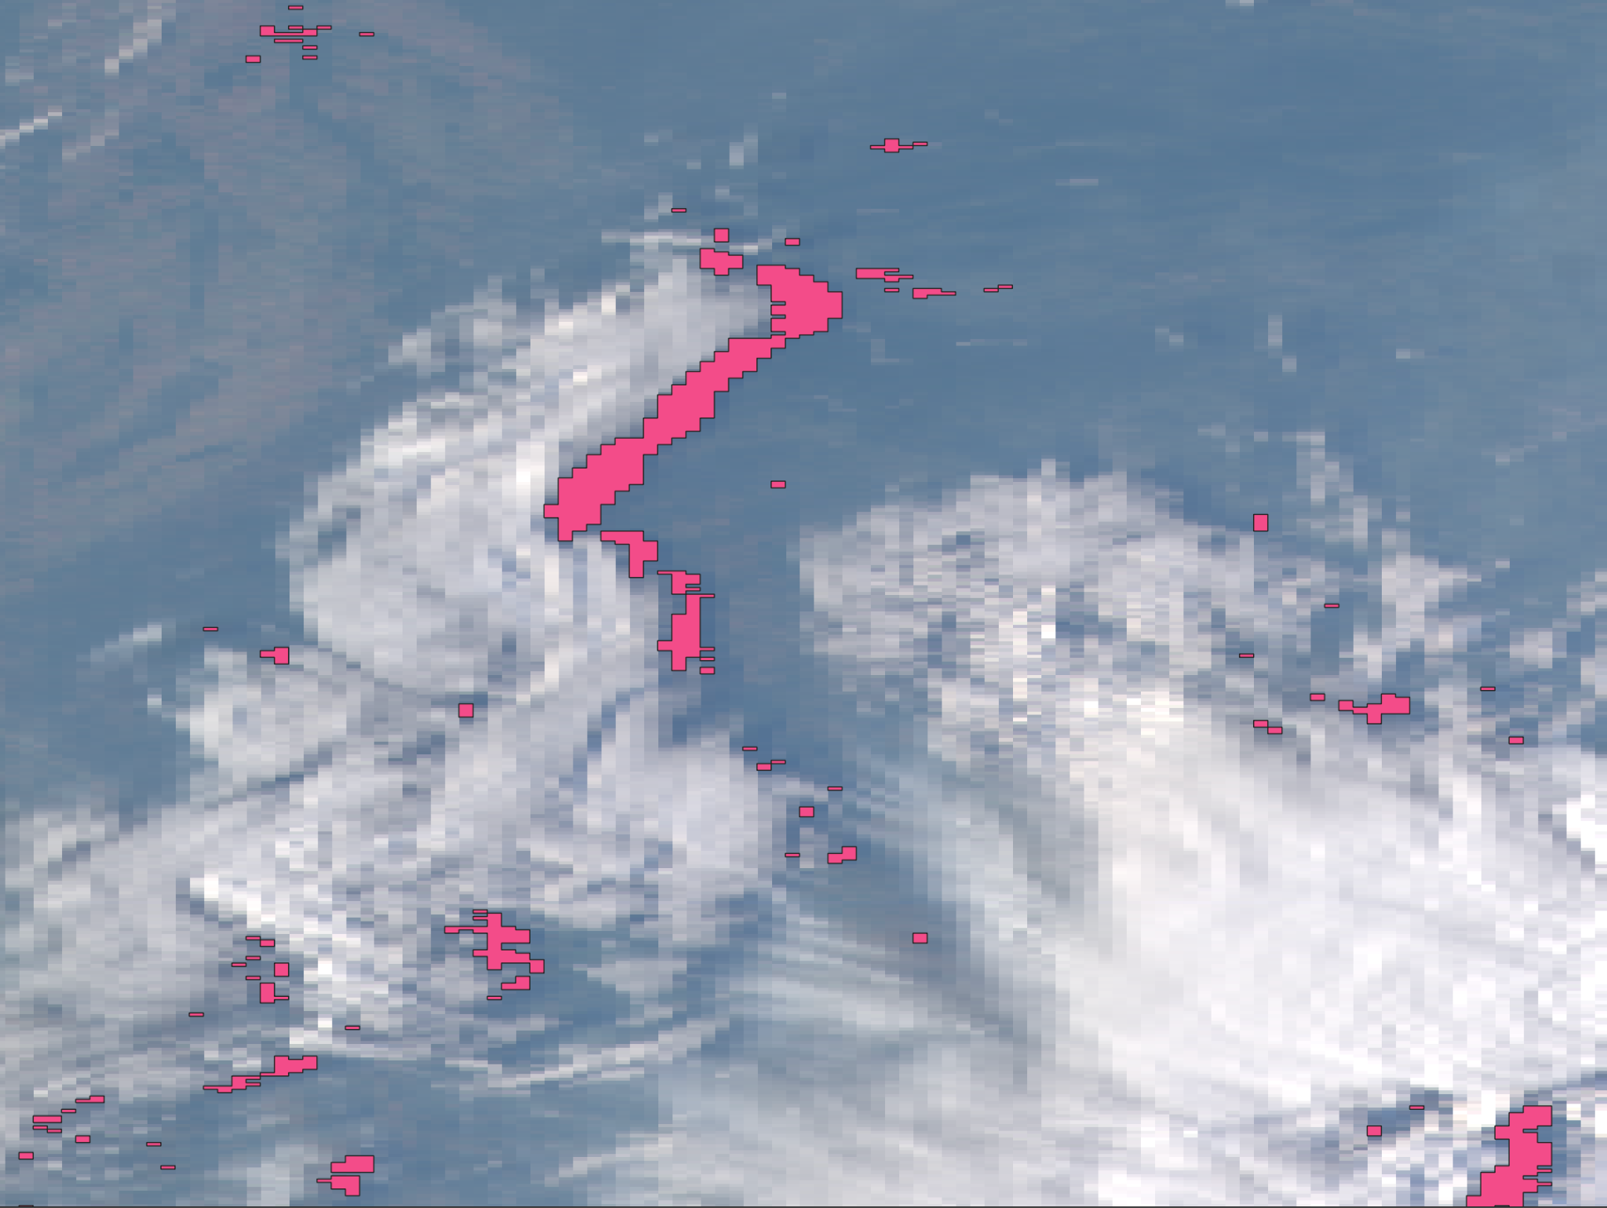

TEMPO Cloud Shadows Masking
Manuel Perez-Carrasco
postbaccalaureate student
Potential Cloud Shadows Flag
Actual Cloud Shadows Flag
[Trees V. J. H. et a. 2022]

Slide 11
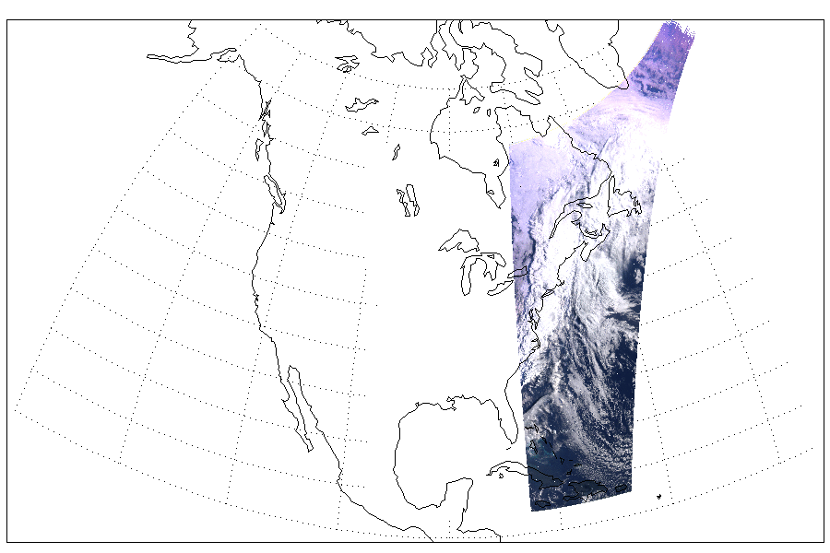
Complications from clouds
cloud shadow
Brightness contrast inhomogeneity
L = 10m/s * 3600s = 36 km >> TEMPO pixel

Slide 12
TEMPO CLDO4 Future Development
Rad. Transfer LUTs for
RAD/IRR
O₂-O₂ AMF
GLER
Meteorology (Psfc, T-P, Q)
Geometry
(SZA, VZA, RAA)
TEMPO L1b
(1) RAD/IRR @466nm
(2) O₂-O₂ SCD (439-488nm)
Miscellaneous
CLDO4 product

