Slide 1
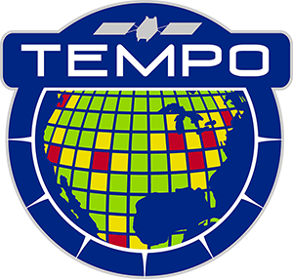



Tropospheric Emissions:
Monitoring of Pollution
TEMPO Solar Calibration Status
Heesung Chong¹, X. Liu¹, J. Houck¹, D.E. Flittner², J. Carr³,
W. Hou¹, J. E. Davis¹, R. M. Suleiman¹, K. Chance¹,
J. Park¹, G. González Abad¹, C.R. Nowlan¹, H. Wang¹,
J. Fitzmaurice¹, B. Baker⁴, J. Lasnik⁴, D. Nicks⁴, L. Flynn⁵,
S. Marchenko⁶⁷, J. Joiner⁶, Colin Seftor⁶⁷, Glen Jaross⁶
¹SAO, CfA ²NASA LaRC ³Carr Astro.
⁴BAE ⁵NOAA/NESDIS ⁶NASA GSFC ⁷STC
June 15, 2026

Slide 2
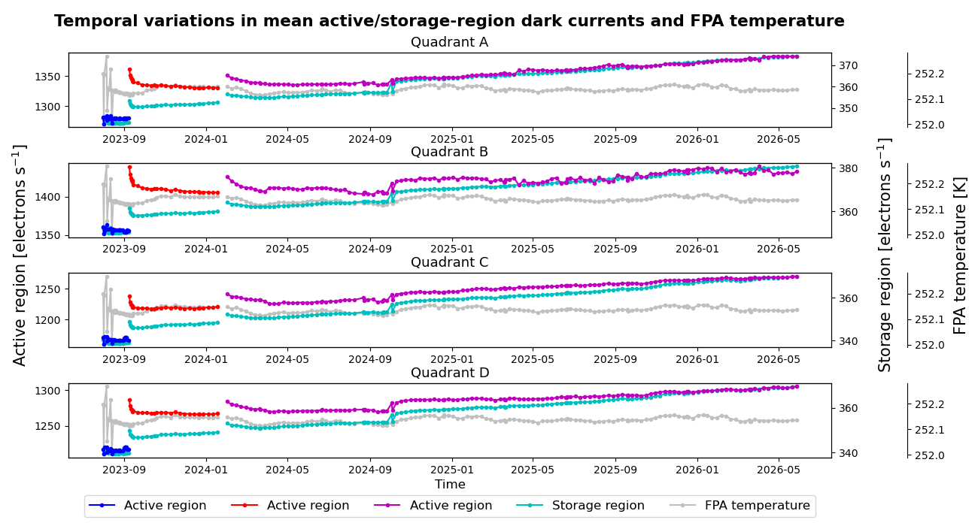
Solar dark time series (quadrant median)
median
(1)
(2)
(3)
1st safe mode 2023-09-08)
2nd safe mode (2024-01-24)
Change integration time
(2024-10-10)
Linear trend since
2024/10/10
Quadrant A: 1.60%/yr
Quadrant B: 0.73%/yr
Quadrant C: 1.72%/yr
Quadrant D: 1.35%/yr

Slide 3
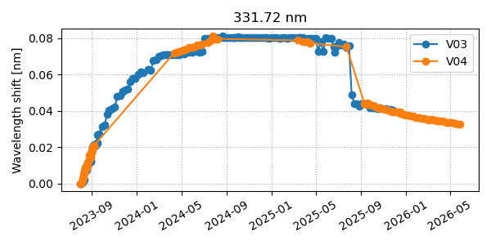
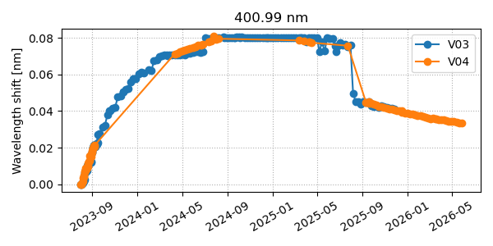

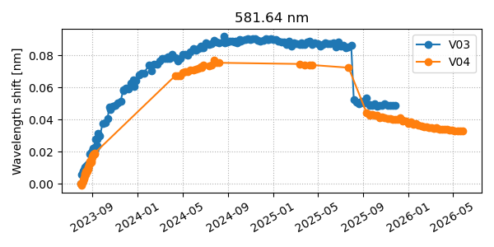
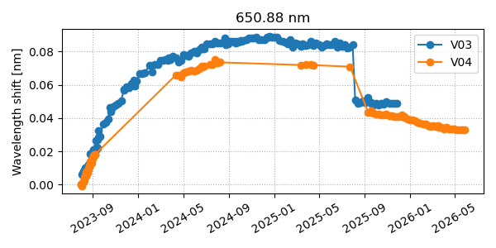
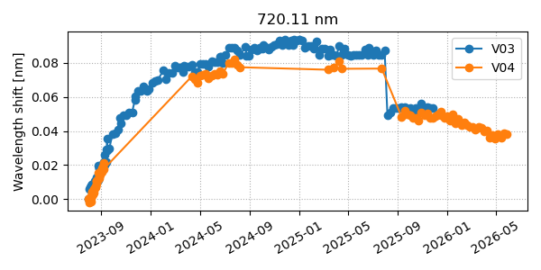
Spectral Calibration
Wavelength Shifts V3 vs. V4
Spatial index = 1025
A wavelength shift occurred between 07/31/2025 and 08/07/2025 (0.03–0.04 nm).
Two events during this period:
Idle: No radiance data collected between 07/31 and 08/06
Thermal control for FPA radiators was adjusted: 08/02

Slide 4
Irradiance Variations
TEMPO solar irradiance variability = Diffuser degradation
+ Optics/detector degradation
+ Seasonal variability (goniometry errors)
+ Solar activity
The seasonal variability differs by wavelength.
Plan to determine each term:
- Neglect the solar activity
- Perform diffuser degradation correction first
- Fit ‘optics/detector degradation’ and ‘seasonal variability’ simultaneously
Plan for V05 online solar irradiance processing:
- Using pre-determined look-up tables, extrapolate (predict) the three terms and provide degradation- and seasonal-variability-corrected solar irradiance

Slide 5
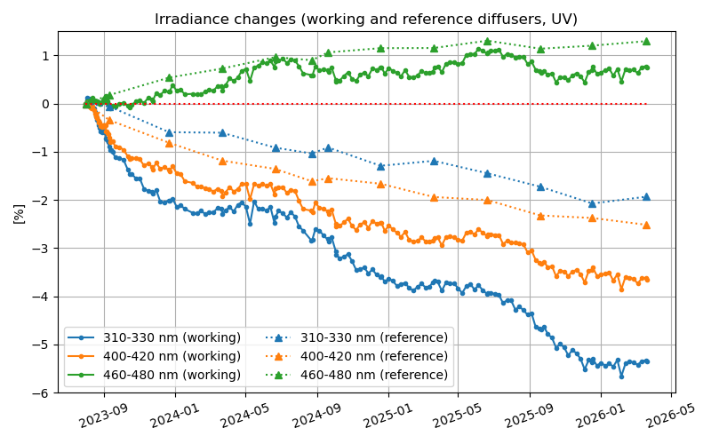
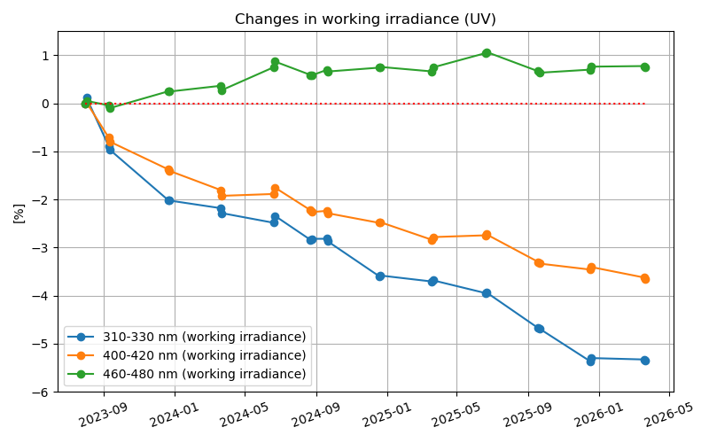
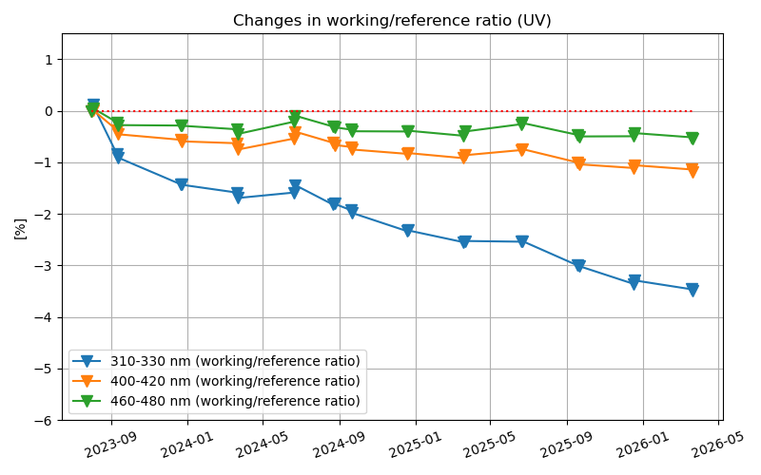
TEMPO solar irradiance changes
Working and reference irradiance changes
UV (290–490 nm)
Working/reference irradiance ratio change
Working irradiance change
(1-day before and after each reference measurement)
Both working and reference irradiance changes exhibit seasonal variations,
and they do not fully cancel out in the ratio.
→ To improve the fit, we eventually excluded the solstice measurements,
which have the most extreme range of angles.

Slide 6
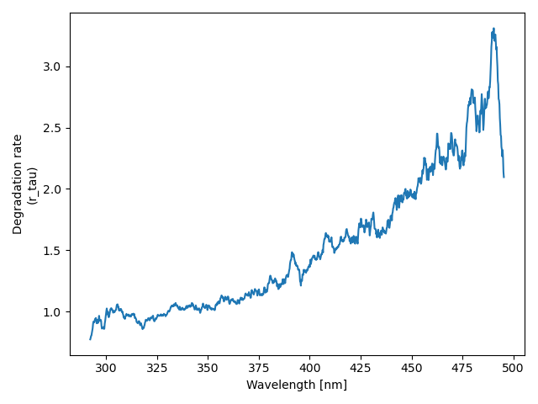
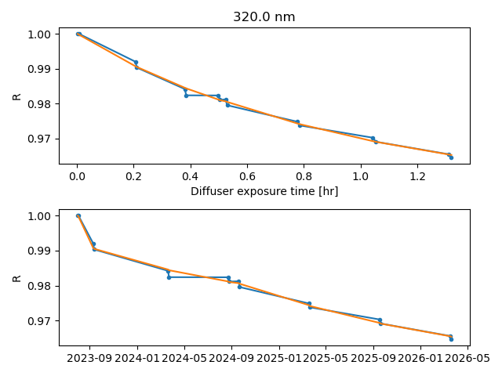
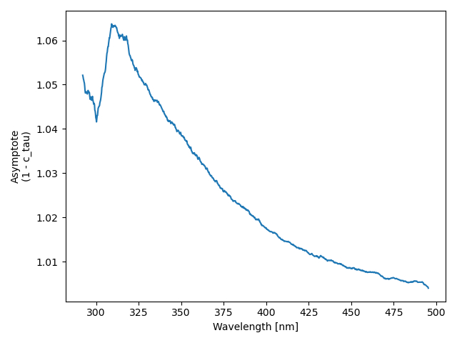

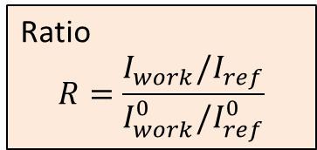

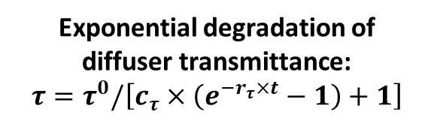
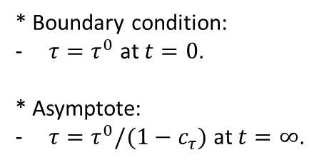
The model, suggested by GEMS Team
Ratio
$$R=\frac{I_{work}/I_{ref}}{I_{work}^{0}/I_{ref}^{0}}$$
Exponential degradation of diffuser transmittance:
$$τ=τ^{0}/\left[c_{τ}×\left(e^{−r_{τ}×t}−1\right)+1\right]$$
Degradation factor
$r_{τ}$ (unit: 1/hr)
* Boundary condition:
$τ=τ^{0}$ at $t=0$.
* Asymptote:
$τ=τ^{0}/(1−c_{τ})$ at $t=∞$.
21 spectral points averaged (~4 nm)
Asymptote
${1−c}_{τ}$ (dimensionless)
21 spectral points averaged (~4 nm)

Slide 7
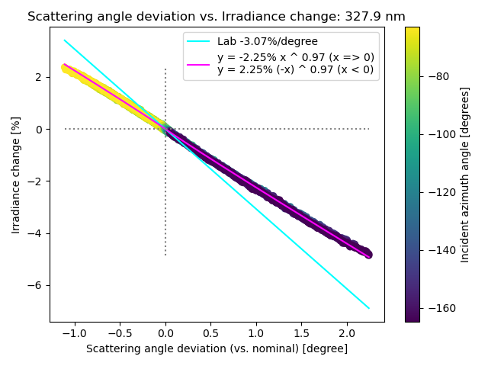
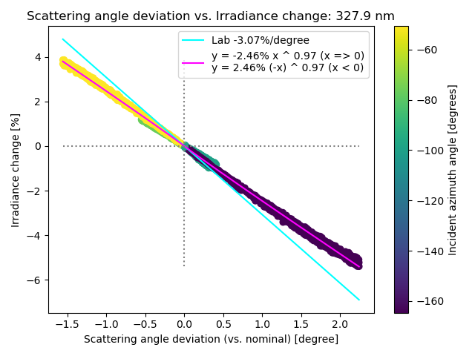
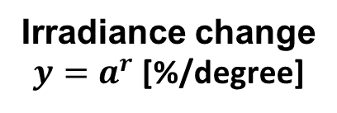
Characterizing reference diffuser
Azimuth-angle dependence
Irradiance change
$y=a^{r}$ [%/degree]
Working diffuser
Reference diffuser
Irradiance change [%]
So far, we have derived the working diffuser’s in-flight sensitivity only and applied it to the reference diffuser.
Now, the reference diffuser has its own look-up table.

Slide 8
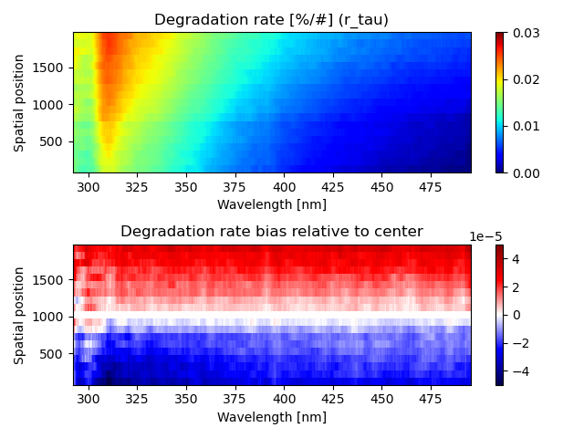
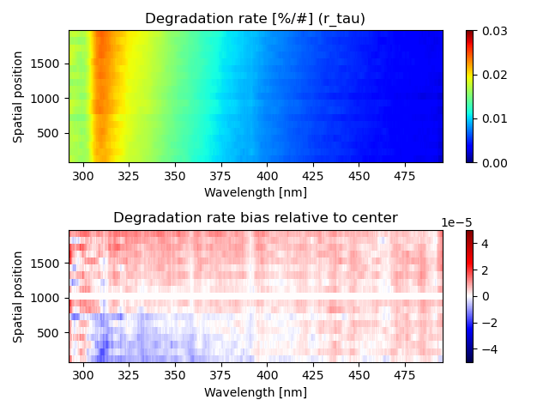
Updating reference diffuser table
Before
After
Elevation-angle dependence has not been updated because we have very few samples at different elevation angles.

Slide 9
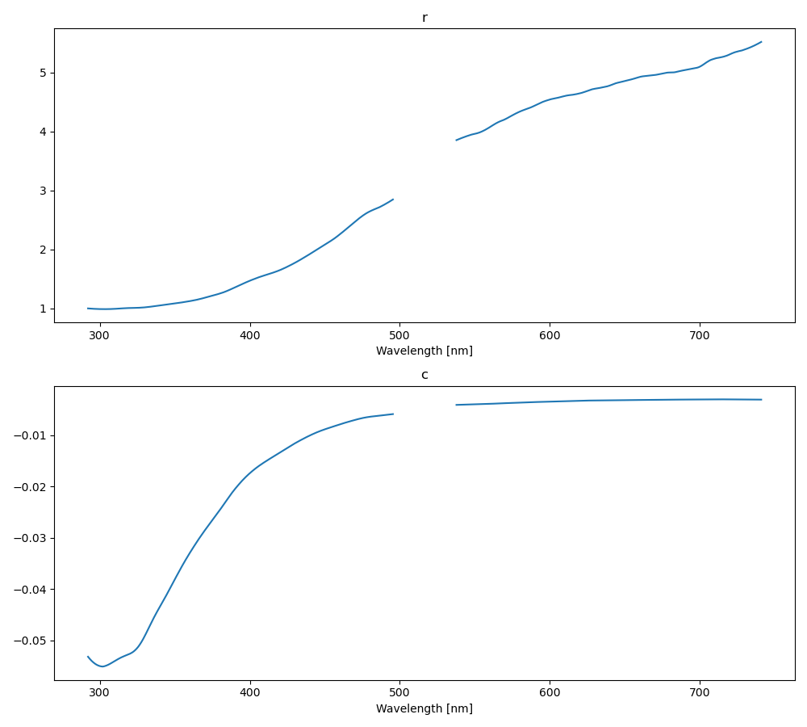
Checking spectral continuity
r
Reasonably good continuity from UV to VIS CCDs
40 nm spectral smoothing + some spatial averaging was used here
c

Slide 10
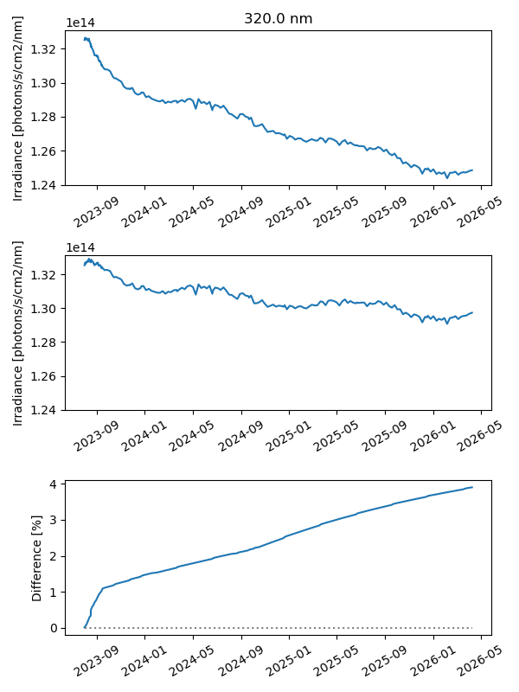
Diffuser degradation correction results
320.0 nm
21 spectral points averaged (~4 nm)
(Note that a 40-nm binning window was used to derive the degradation parameters.)
Before correction
After correction
(optics/detector degradation) + (seasonal variability)
Difference

Slide 11
Summary
Dark current of CCDs has been better than projected pre-launch
  Presently is increasing at the modest rate of slightly less than 2%/yr
Wavelength scale has been stable since June 2024, except for…
  After returning to operating mode, a shift back towards First light by ~0.03 nm occurred.
Diffuser transmittance correction (BTDF)
  Artifacts in solar irradiance seasonal variability reduced between V3 and V4, but can do better
  Degradation of diffuser and optics/detector are evident, along with uncorrected goniometry
  Working on approach for V5 to correct for temporal changes involving:
    Diffuser degradation
    Optics/detector changes
    Uncorrected goniometry
  Will examine polarization correction for irradiance (IRR)
Impact of etalon structure in calibration + ground to orbit image shift reduced in V4, but the team will work to better represent the in-flight case

Slide 12
Thank you for your attention!

