Slide 1


Sentinel-5P Mission Status
TEMPO Dart Meeting
11 June 2026 | Online
Timon Hummel
ESA Sentinel-5P Mission Manager

Slide 2



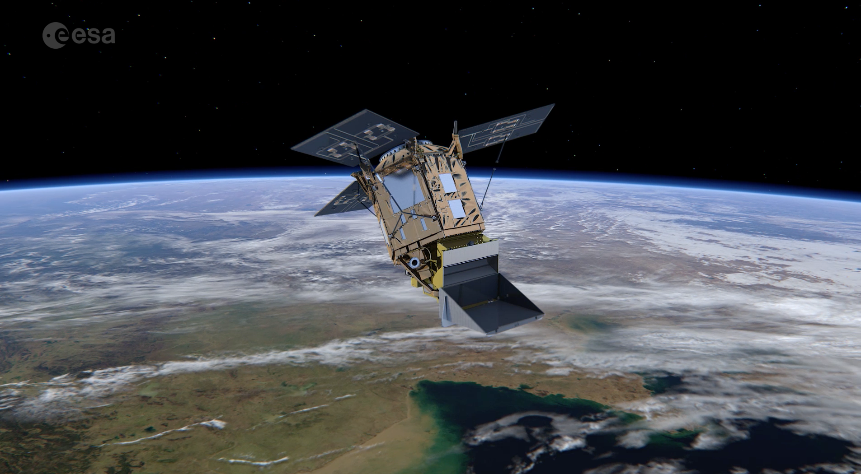
Sentinel-5P - First Atmospheric Sentinel
Launched: 13 October 2017, Plesetks
Launcher: Rockot
Main Payload: TROPOMI (co-funded by The Netherlands and ESA) - Hyper-spectral push-broom imaging spectrometer, 4 spectrometers with 2D detectors with 4000 spectral channels
Orbit: Altitude of 820 km, 227 orbit repeat cycle
Daily Global Coverage: 13:30 ascending node crossing time
Spatial Sampling: 5.5 x 3.5/7.0 km (mission requirement: 7 x 7 km)
Mission Control: ESOC
TROPOMI Mission Planning: KNMI
Ground Stations: Svalbard (NOR) and Inuvik (Canada)
Operational Data Processing: DLR (on behalf of ESA)
Mission Design Life Time: ~7 years
National co-funding during Routine Operations (e.g. on Algorithm Development/QA Monitoring): Belgium, Germany, and The Netherlands
Operations Funding: end 2027
Key User: Copernicus Atmosphere Monitoring Service (ECMWF)

Slide 3

Sentinel-5P Products
Operational Products
Level-1B | Radiance Irradiance
Level-2 Operational Core Products | Ozone total and tropospheric column and profile, Nitrogen Dioxide total and tropospheric columns, Sulphur Dioxide total column, Carbon Monoxide total column, Methane total column, Formaldehyde total column, Cloud information, UV Aerosol Index, Aerosol Layer Height - https://dataspace.copernicus.eu/
Pre-operational Products
Level-2 Pre-operational Products | Aerosol Optical Thickness, Bromine Monoxide, Chlorine Dioxide, Glyoxal, Isotopic Water Vapour, Sun-Induced Fluorescence, Ocean Colour, Sulphur Dioxide product using the Covariance-Based Retrieval Algorithm (COBRA), Surface Reflectance, Water Vapour, Nitrous Acid - https://data-portal.s5p-pal.com
Level-3 Gridded data | Gridded data produced at varying time averaging scales, ranging from daily to yearly products. Maps of the gridded data are provided on the PAL Mapping portal at https://maps.s5p-pal.com

Slide 4
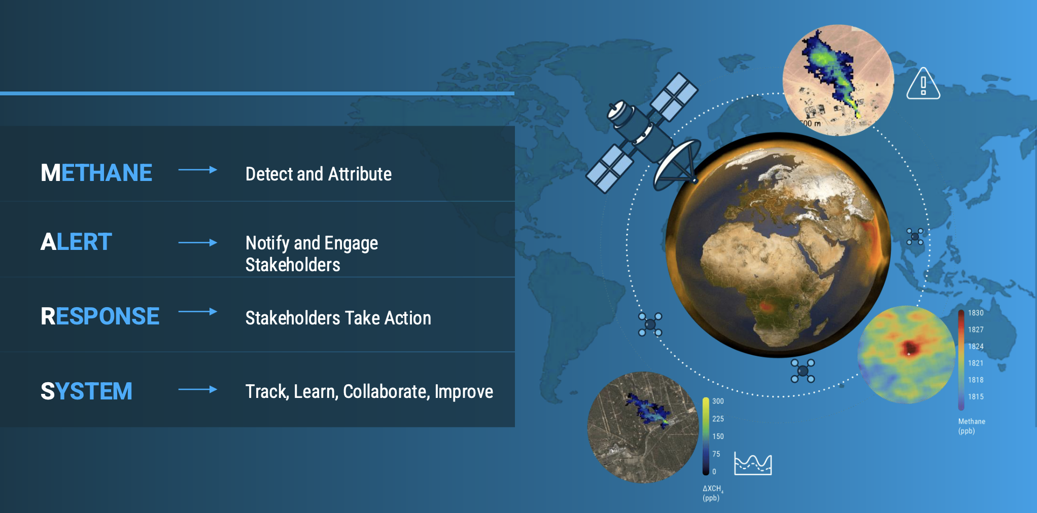
Sentinel-5P Status
Satellite and Instrument:
  The satellite and the TROPOMI instrument continue to perform excellent in orbit, with a theoretical mission extension until at least ~2033.
Mission Operations:
  Sentinel-5P operations secured until end of 2027; Discussions on possible extension on-going
  The loose formation with S-NPP will end by Q4 2026, with no expected impact on data quality.
Complementarity with Sentinel-5:
  Afternoon (S5P, ~13:30 LTAN) and morning (S5, ~09:30 LTDN) orbits provide two daily atmospheric observations.
Scientific benefit:
  Dual overpasses enable diurnal variability studies (e.g. NO₂ traffic peaks, ozone production, biomass burning) and improve model assimilation, forecasts, and emission estimated.
Processor and Product evolution Q4 2025:
  A major processor upgrade was implemented in November 2025, with key improvements to calibration and product quality.
  A highlight is the introduction of the CH₄ Near Real Time service, expanding the usability of the methane product for applications such as CAMS and UN IMEO.
Conclusions from the S5P Yearly Mission Review 2025
UNEP’s IMEO : Methane Alert Response System (MARS)

Slide 5
Major Processor Update (Nov. 2025)
Major Update of the ground-segment and processors (non-exhaustive):
New Near Real Time (NRT) Processing for Methane (CH4): A new NRT processing service was introduced for the Methane product, coupled with a machine learning–based quality assurance assessment. Further improvements planned for Q4 2026.
→ 97.7% within 3 hours
Fallback Cloud Mask for Aerosol Layer Height (AER_LH): A new fallback cloud mask, based on machine learning, has been added to the AER_LH product to ensure nominal quality even when the Suomi-NPP VIIRS data is unavailable.
Level-1B Processor Improvements: The L1B processor includes dynamic straylight correction for Bands 1–2, residual background correction for Bands 1–6, and a correction for a sharp detector feature in Band 3.
Updated SO2 and HCHO Products: The Sulphur Dioxide (SO2) and Formaldehyde (HCHO) products will implement new look-up tables for Air Mass Factor (AMF) variables, introduce a new surface albedo climatology (GE-LER), and feature improved QA-value calculation for snow and ice conditions. The SO2 product will also gain a 3 km VCD product.

Slide 6
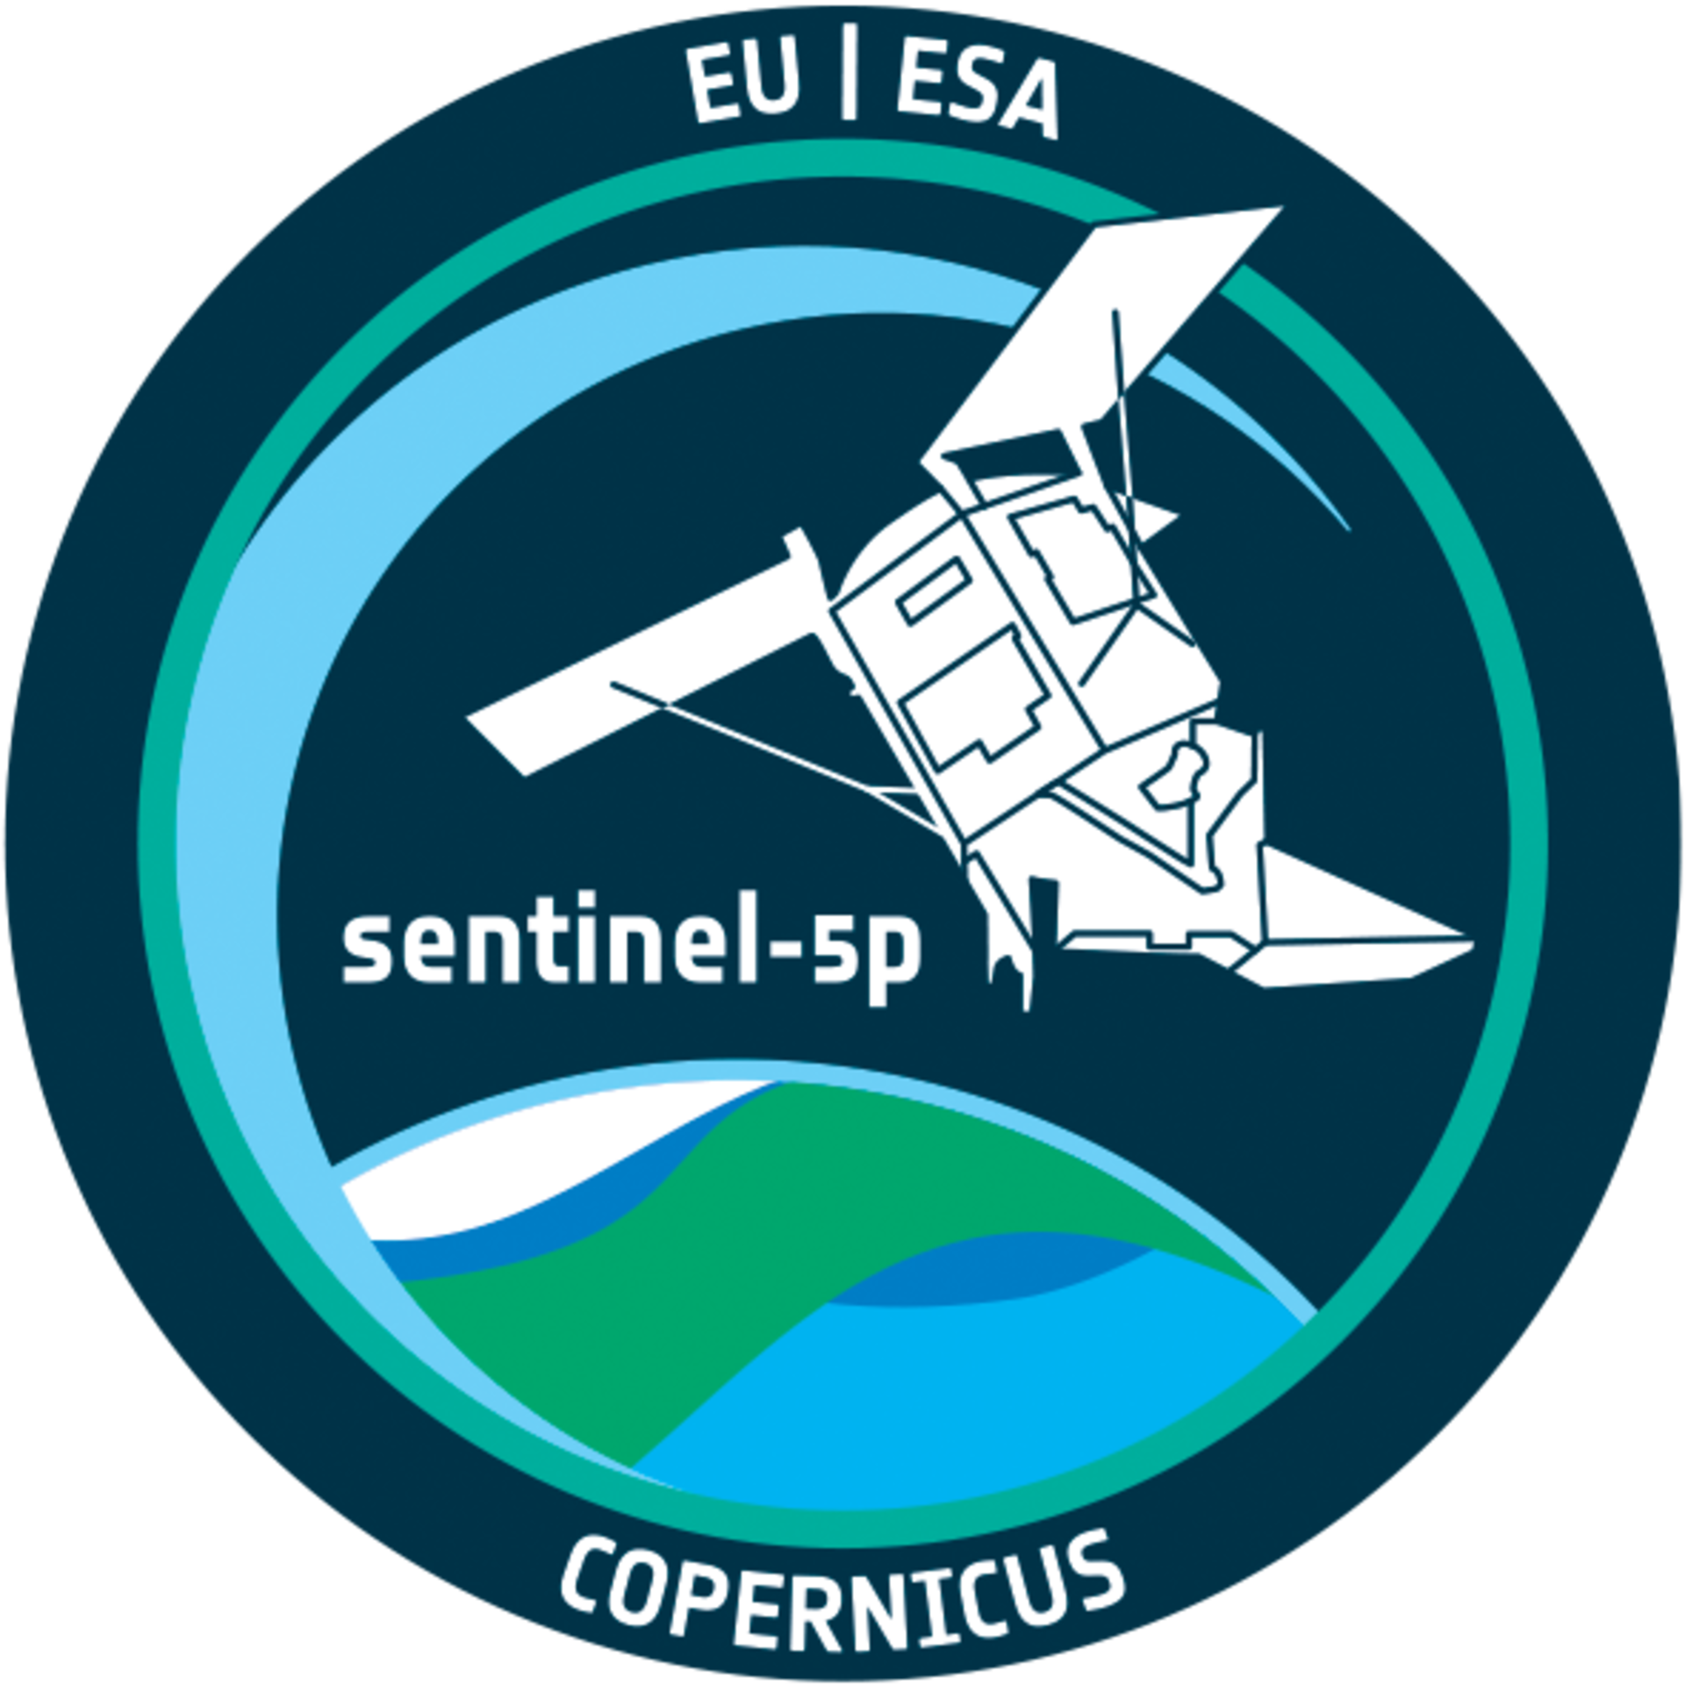
Sentinel-5P Satellite Status
Satellite In-Orbit Performance Review 2026 Conclusions:
Since launch in October 2017 the Sentinel-5P satellite has gone beyond nominal lifetime of 7 years and continues to deliver nominal performance across all subsystems.
Continuous monitoring of key parameters and trends show minimal ageing effects and both the platform and payload are deemed to be in very good health.
The main items marked as Life-Limited Items are :
    As of Feb 2026 remaining hydrazine propellant 66.8kg (disposal allocation of 35.4kg) sufficient to support operations until at least Q3 2038.
    Tropomi Folding Mirror Mechanism (FMM) reaches the design limit cycle allocation in Q2 2026. Detailed analysis of the FMM show no degradation in the operational performance of this mechanism and it is expected that the FMM continues functioning well beyond the design limit.
Sentinel-5P complies with the applicable ESA Space Debris Mitigation Requirements.
    Extensive investigations into Disposal strategies have been carried out by ADS-SAS. Various disposal scenarios have been investigated with the simplest descend-and-forget uncontrolled re-entry scenario ensuring re-entry within 5 years (revised propellant allocation of ~55kg).
    Probability of Successful Disposal remains >0.95 at 15.3 years lifetime i.e. Q1 2033 with battery performance driving this limit.

Slide 7
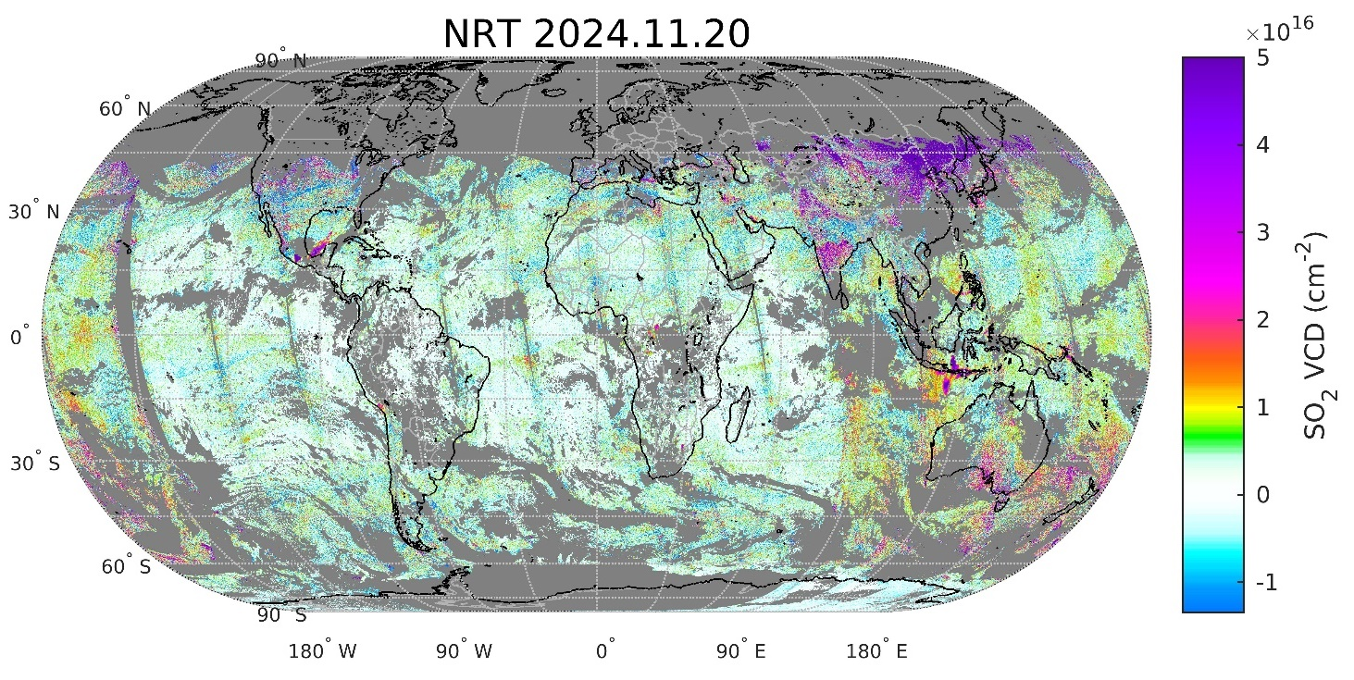
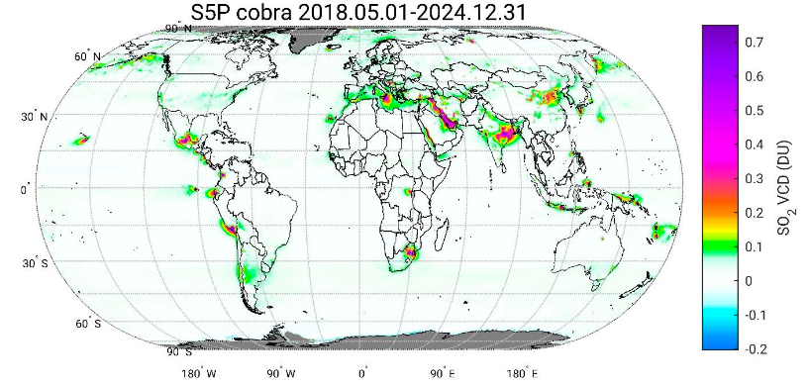
Reprocessing: Enhanced global SO2 retrievals
COBRA algorithm update for Sentinel-5P/TROPOMI SO₂ data:
  (1) Significantly reduced noise & bias
  (2) Enables detection of anthropogenic SO₂ plumes co-located with NO₂ (previously not possible)
Switch Orbit
(1)
Credits: N. Theys – BIRA/DLR Teams
✅ Full-mission (2018–2024) reprocessed and validated SO₂ products now available on CDSE.
  This includes SO2 Layer Height data sets for the first time in the official SO2 product.
(2)
Credits: N. Theys – BIRA/DLR Teams

Slide 8
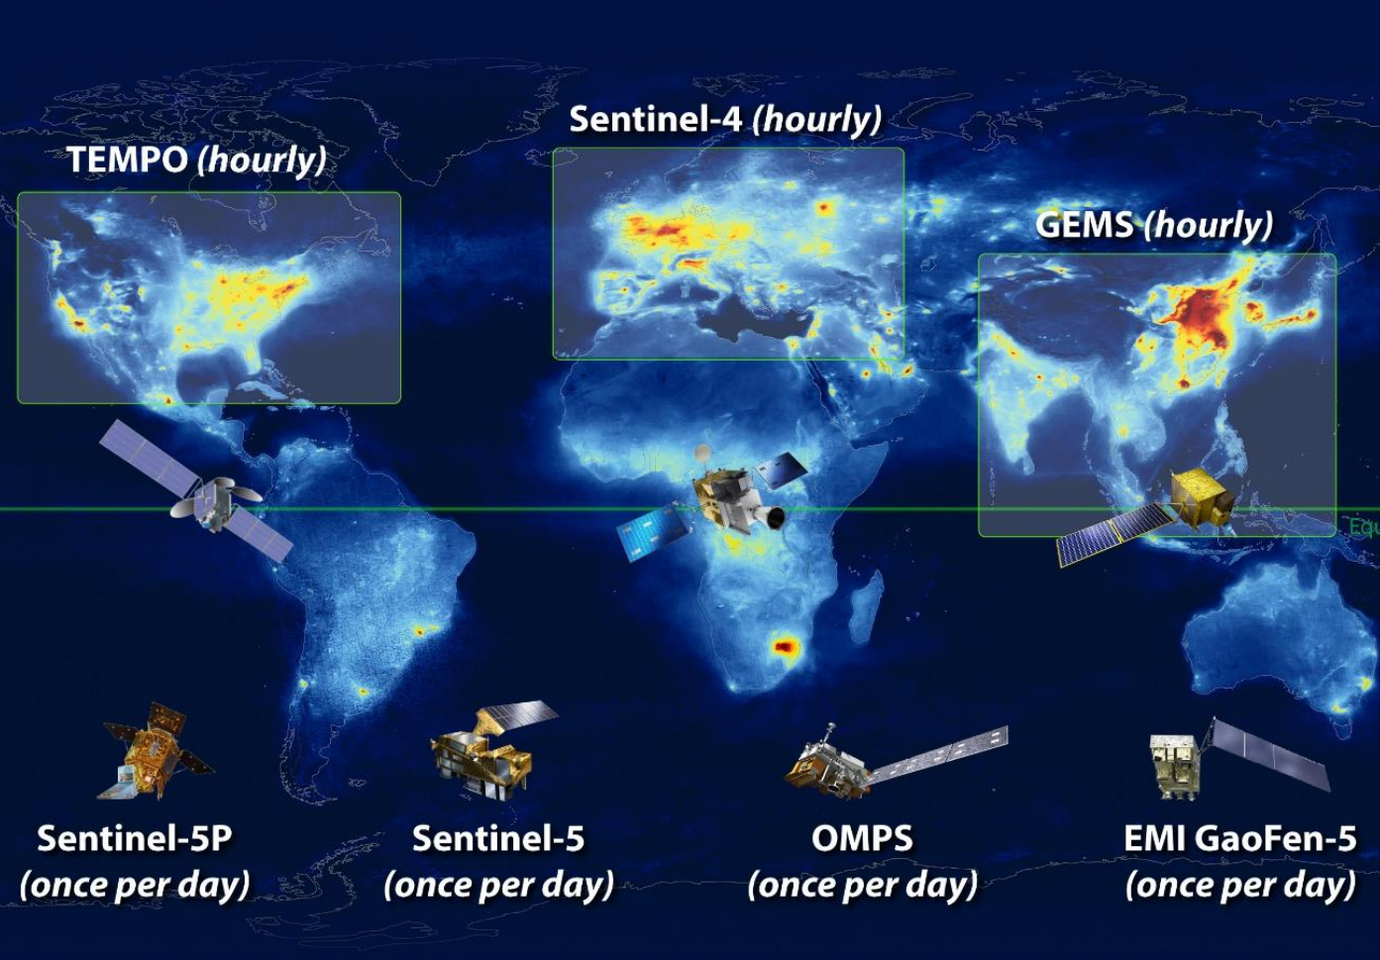
Sentinel-5P – Global Reference Mission
The ever-increasing role of TROPOMI to serve as an anchor point:
  Geostationary missions;
  Sentinel Suite (S4 & S5 added)
  Ground-based sites – FRM;
  Field campaigns & mobile measurements;
  CCMs higher spatial resolution, small footprints
  Copernicus services, particularly ECMWF-CAMS, for global assimilation & forecasting
Credit: D. Stein Zweers (KNMI)

Slide 9

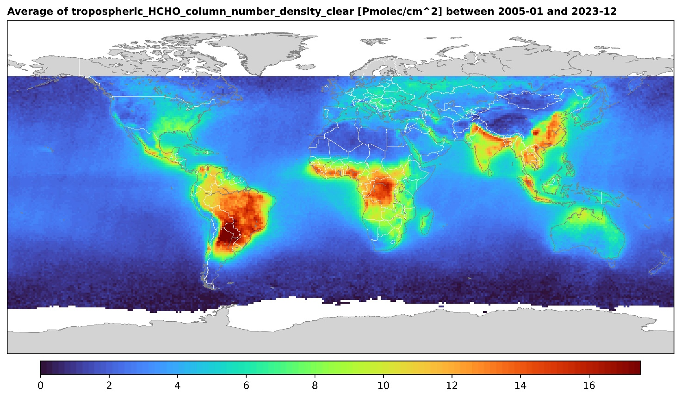
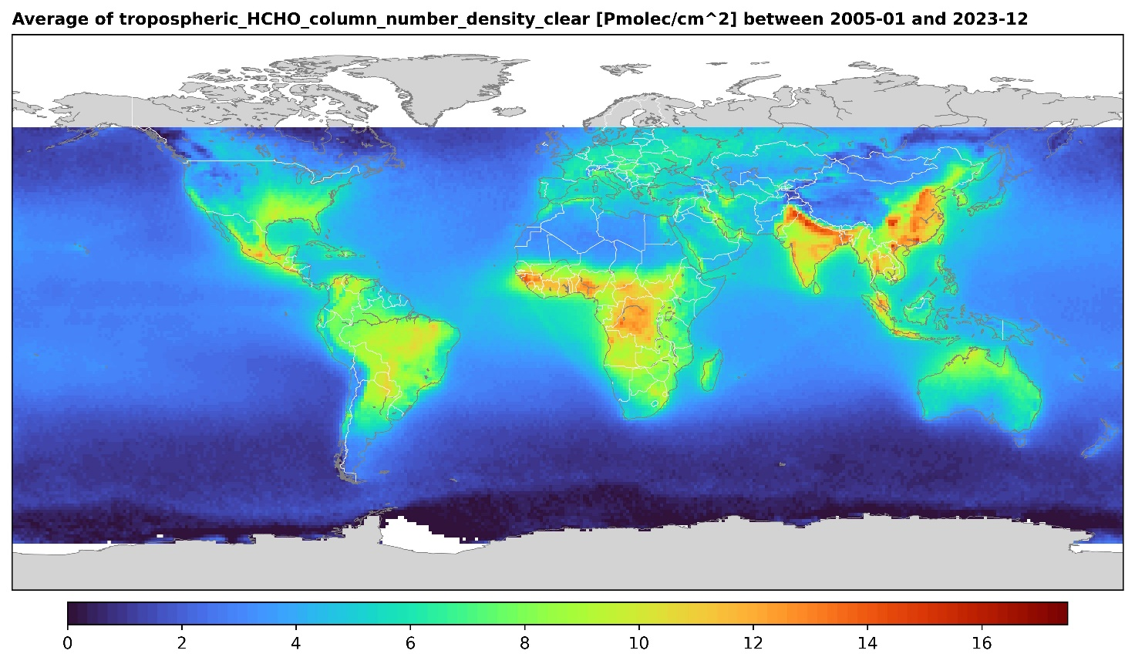
Complementarity with Sentinel-5
Morning CDR
Afternoon CDR
GOME, SCIAMACHY, GOME-2 A,B,C, (Sentinel-5)
OMI, Sentinel-5P
Credit: v. Roozendael (BIRA-IASB)
Larger morning columns in South America & Africa
Good agreement in Asia
Larger afternoon columns in US/Europe
➔ simultaneous observations by S5P and S5 will provide a new insight in the diurnal variations of HCHO (and others).
Same period: 2005-2023
Same resolution= 1°

Slide 10
Conclusions
Sentinel-5P/TROPOMI is a Game Changer for atmospheric monitoring from Space:
  Daily Global Coverage
  Spatial Resolution of 5.5 x 3.5 km (UV-VIS,NIR), 5.5 x 7.0 km (SWIR)
  Excellent instrument sensitivity – accuracy of products
  High number of products (23 – Nitrous Acid (HONO) recently added to the S5P PAL portfolio)
  Key Cal/Val contributions to Sentinel-4/5
  Synergistic data exploitation with Sentinel-5 (morning/afternoon orbits)
  Synergistic data exploitation with Sentinel-4 (proven already with the GEMS mission)
  Excellent in orbit performance (limited number of anomalies, expected lifetime – including controlled de-orbiting - is 2033)
  Continued evolution of algorithms and processors – next update planned for Q4 2026.

