Slide 1





Copernicus Sentinel-5/UVNS
Rasmus Lindstrot
EUMETSAT Atmospheric Chemistry CAM
Thanks to
S5 Teams at ESA, EUMETSAT, S&T + science consortium, Consortium led by Airbus, EC, CAMS
TEMPO DART team meeting, June 15-18, 2026

Slide 2
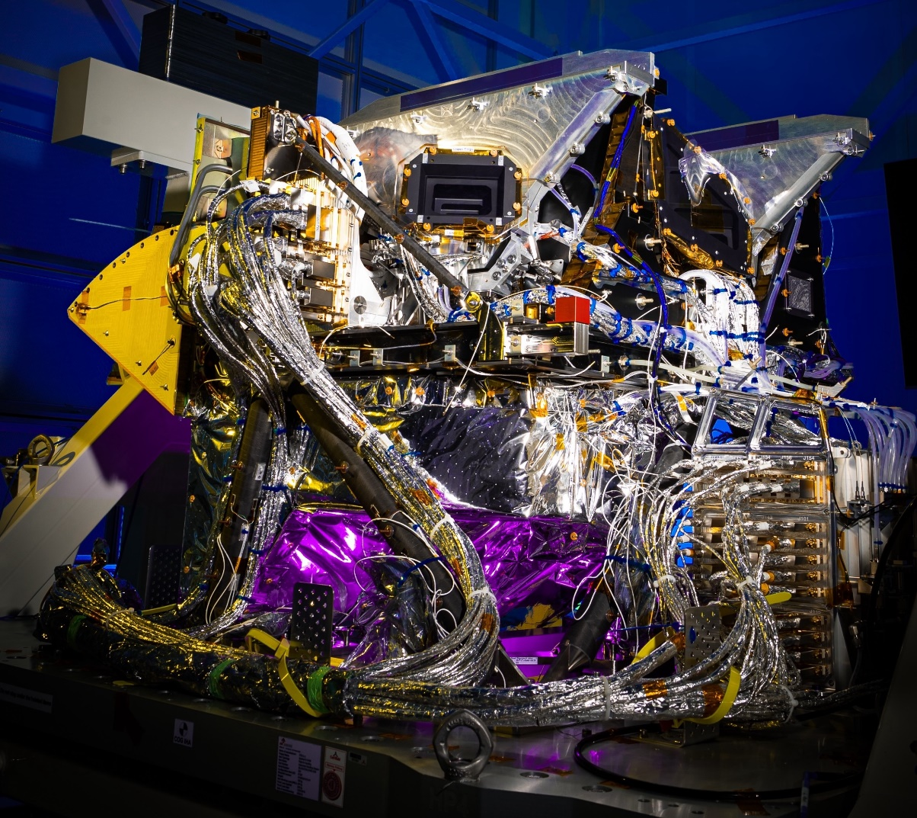
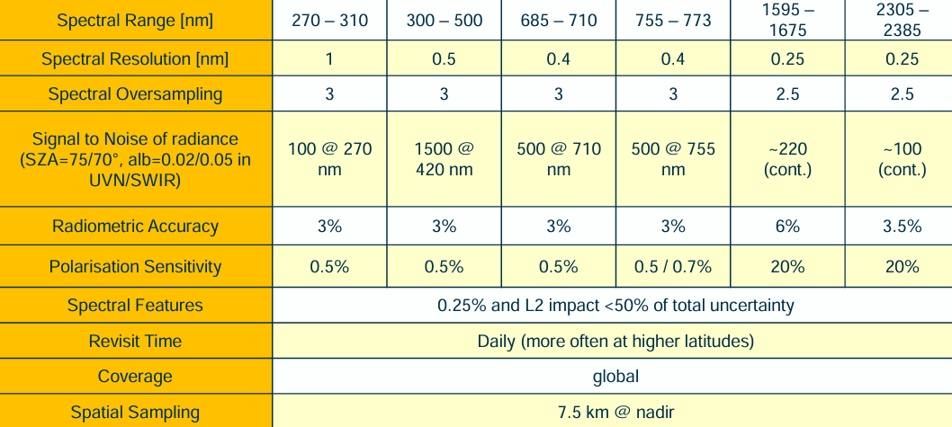
Copernicus Sentinel-5
Grating imaging UVNS (UV-VIS-NIR-SWIR) spectrometer in push broom configuration with a nominal swath of 2670 km width, and spatial sampling of 7.5 x 7.5 km² and daily global coverage.
Sentinel-5/UVNS on EPS-SG A1
(LEO orbit)
Developed by industrial consortium under ESA contract, operated by EUMETSAT – on behalf of the EC.
Launched on 13 August 2025
Sentinel-5 Proto Flight Model

Slide 3
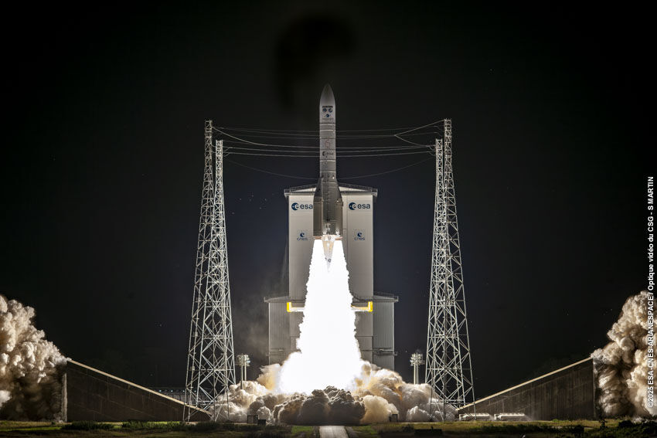
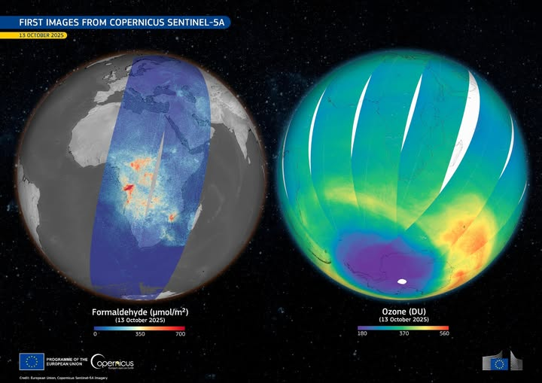
Copernicus Sentinel-5 – timeline of events
Sentinel-5/UVNS on EPS-SG A1 (LEO orbit)
13/08/2025 | MetOP-SG A1 launch
15/08/2025 | LEOP hand-over
09/09/2025 | Decontamination completed
October 2025 | First Earth radiance acquisitions
26/11/2025 | First images released
04/12/2025 | Satellite In-Orbit-Verification Review
12/02/2026 | Instrument configuration updated Correction of spectral band settings and removal of inhomogeneous swath coaddition
Q3 2026 | Start of Cal/Val (EUM in-house + S4S5VT + EUM/COPER services) Staggered per product group, depending on progress regarding L1 data quality and ESA’S L2 product commissioning activities
September 2026 | ESA-EUMETSAT handover EUM takes over mission responsibility

Slide 4
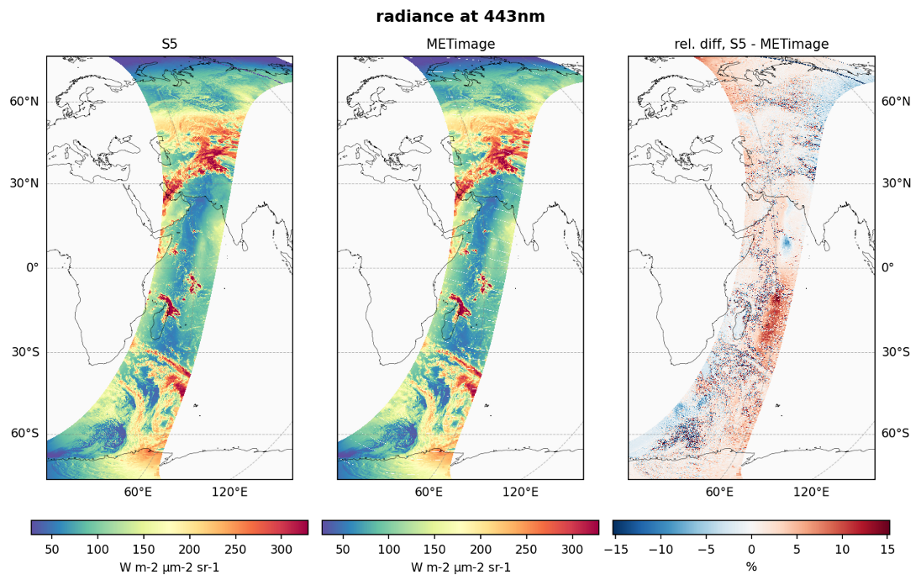
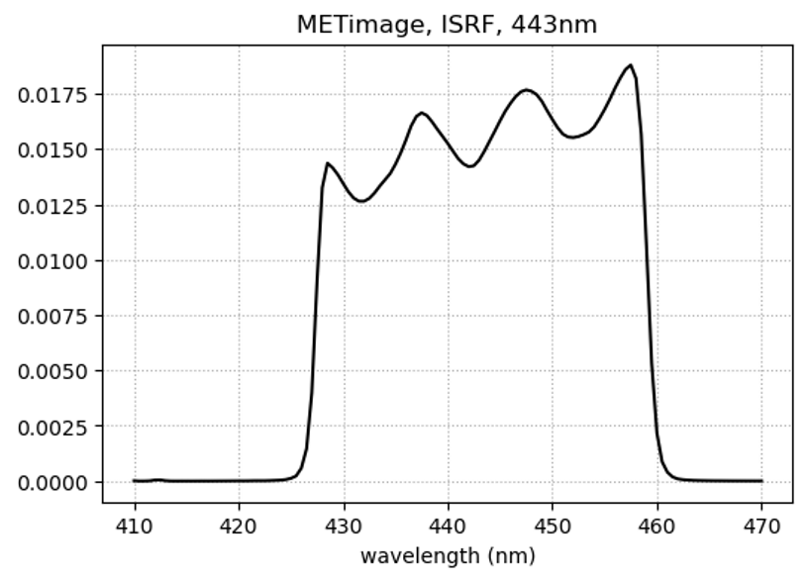
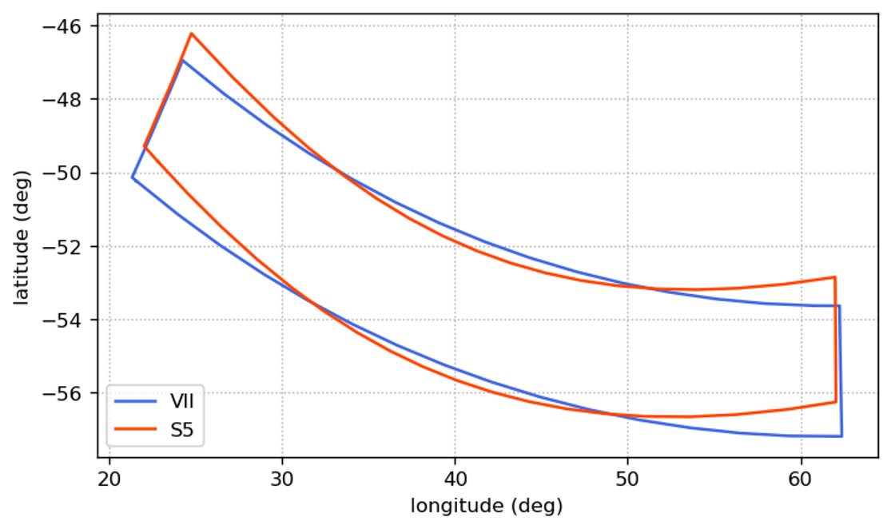
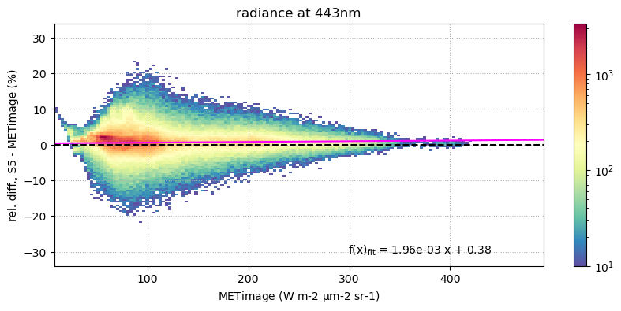
Commissioning example: S5 - METimage Radiance Comparison
Compare S5 and METimage L1B Radiances
→ Exploit simultaneous observations with identical observation geometry.
Method:
Calculate S5-PSF-weighted mean METimage radiance per S5 ground sample
Convolve S5 radiance with METimage ISRF
METimage ISRF, 443nm
Example for 443nm channel
Both missions in commissioning, → results are preliminary.
METimage and S5 scanline comparison
Result:
Radiances in good agreement over homogeneous surfaces.
Larger deviations observed over cloudy scenes and in regions affected by sun glint.
Some viewing angle dependent deviations found, with opposite signs in the two hemispheres (hypothesis: residual polarization sensitivity).

Slide 5
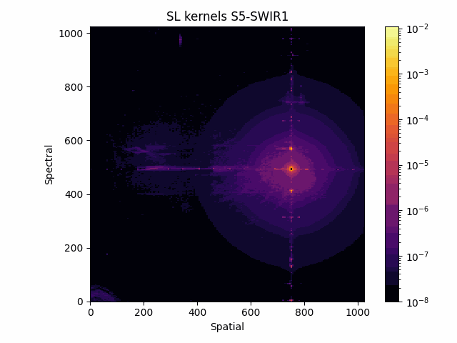
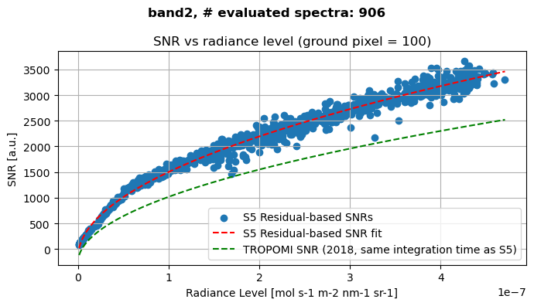
Sentinel-5 - L1 commissioning status
Sentinel-5 UVN data provides excellent SNR, thanks to, e.g., avoiding pseudo-noise from inhomogeneous slit illumination (→ slit homogenizer). Some improvements in radiometric calibration ongoing. In-orbit dynamic calibration to be fully tested and put into operation.
Sentinel-5 SWIR data so far affected by RTS noise and residual stray light, with ongoing improvements.
Instrument operational timeline under optimization.

Slide 6
Sentinel-5 L2 product suite
S5 L2 Product | Algorithm Development | Software Implementation | Software Implementation | Prototype Processor | Operational Processor
SO2 | BIRA | S[&]T | S[&]T | ESA | EUMETSAT secretariat
FDY (Formaldehyde) | BIRA | S[&]T | S[&]T
GLY (Glyoxal) | BIRA | S[&]T | S[&]T
NO2 | KNMI | S[&]T | S[&]T
O3 (Total ozone) | BIRA | S[&]T | S[&]T
O3P (Ozone profile) | RAL
CLD (Cloud) | KNMI | TriOpSys
AUI (Absorbing aerosol index) | KNMI | TriOpSys
ALH (Aerosol layer height) | KNMI | TriOpSys
AOD (Aerosol optical depth) | KNMI | TriOpSys
RFL (Surface reflectance) | KNMI | TriOpSys
UV (UV index) | FMI | TriOpSys
CH4 | SRON | S[&]T
CO | SRON | S[&]T
H2O | AC SAF / DLR |  |  | EUMETSAT AC SAF
BrO | AC SAF / DLR
OClO | AC SAF / DLR
ESA S5L2PP Product led by S[&]T to implement prototype processors as basis for algorithm-identical Eumetsat operational processors
Algorithm development team use scientific “breadboard” processors, used for analysis / testing / development etc.
Consolidated algorithms implemented as L2PP prototype processor
Implemented as L2OP operational processor in EPS-SG ground segment.
Maintenance and evolution throughout mission lifetime by EUMETSAT.
Additional L2 products, developed, implemented and operated by EUMETSAT AC SAF

Slide 7
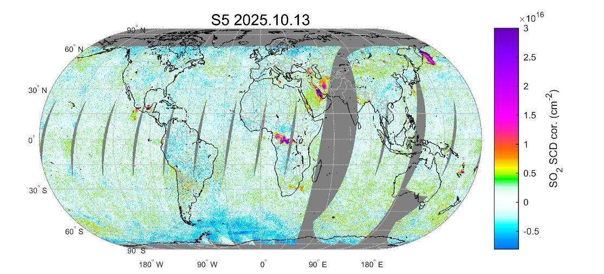
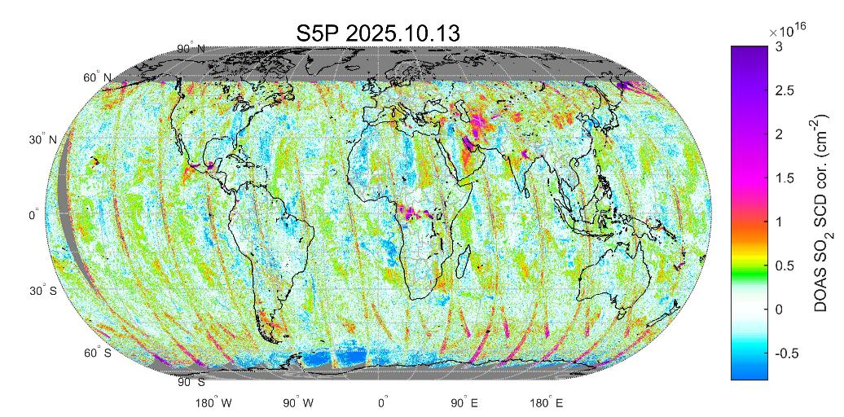

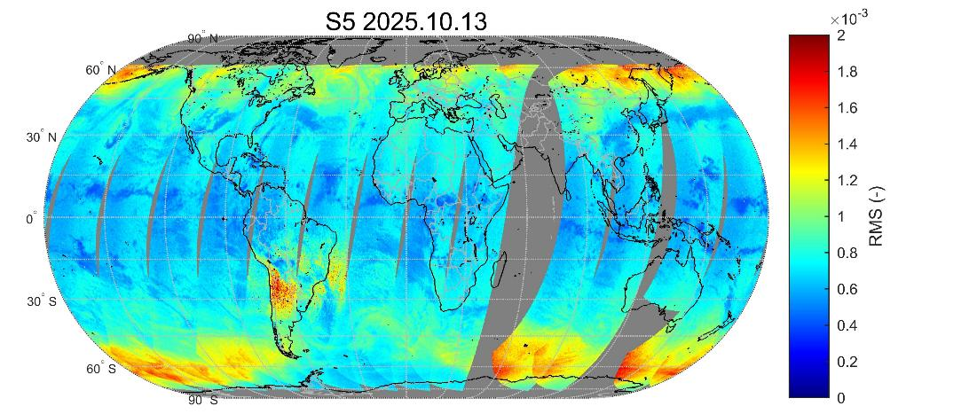
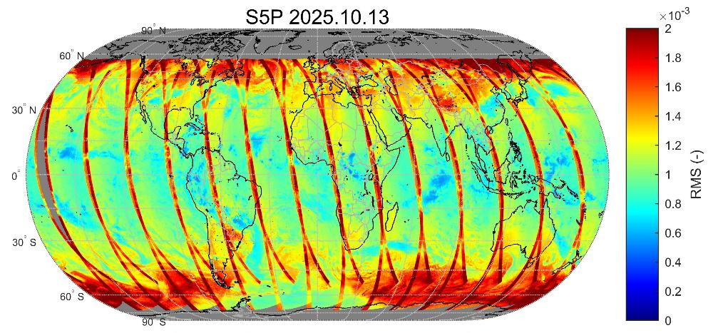
Commissioning example: S5 SO2 Slant column density (background corrected) compared to S5P
N. Theys (BIRA)

Slide 8
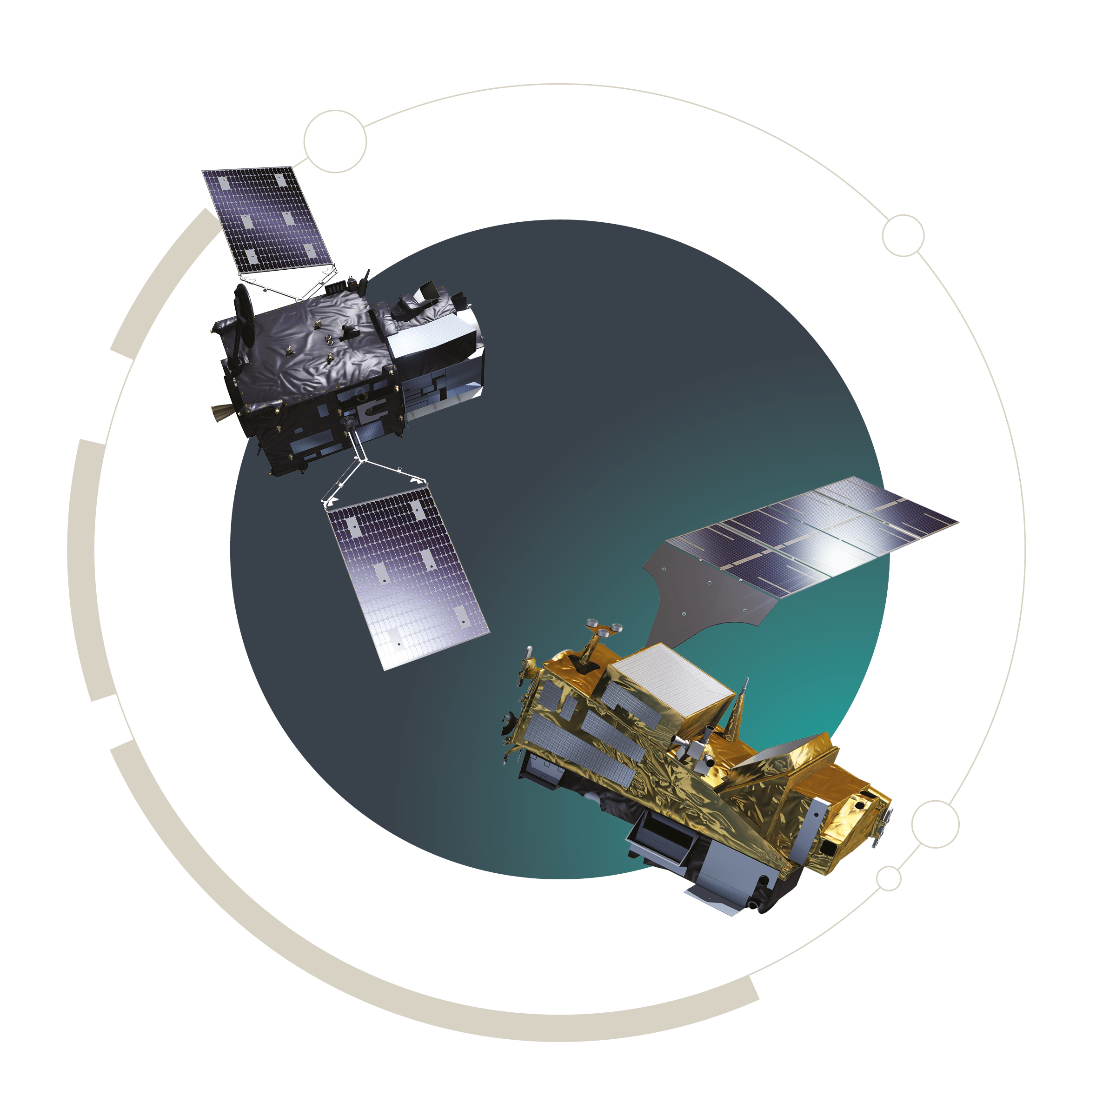
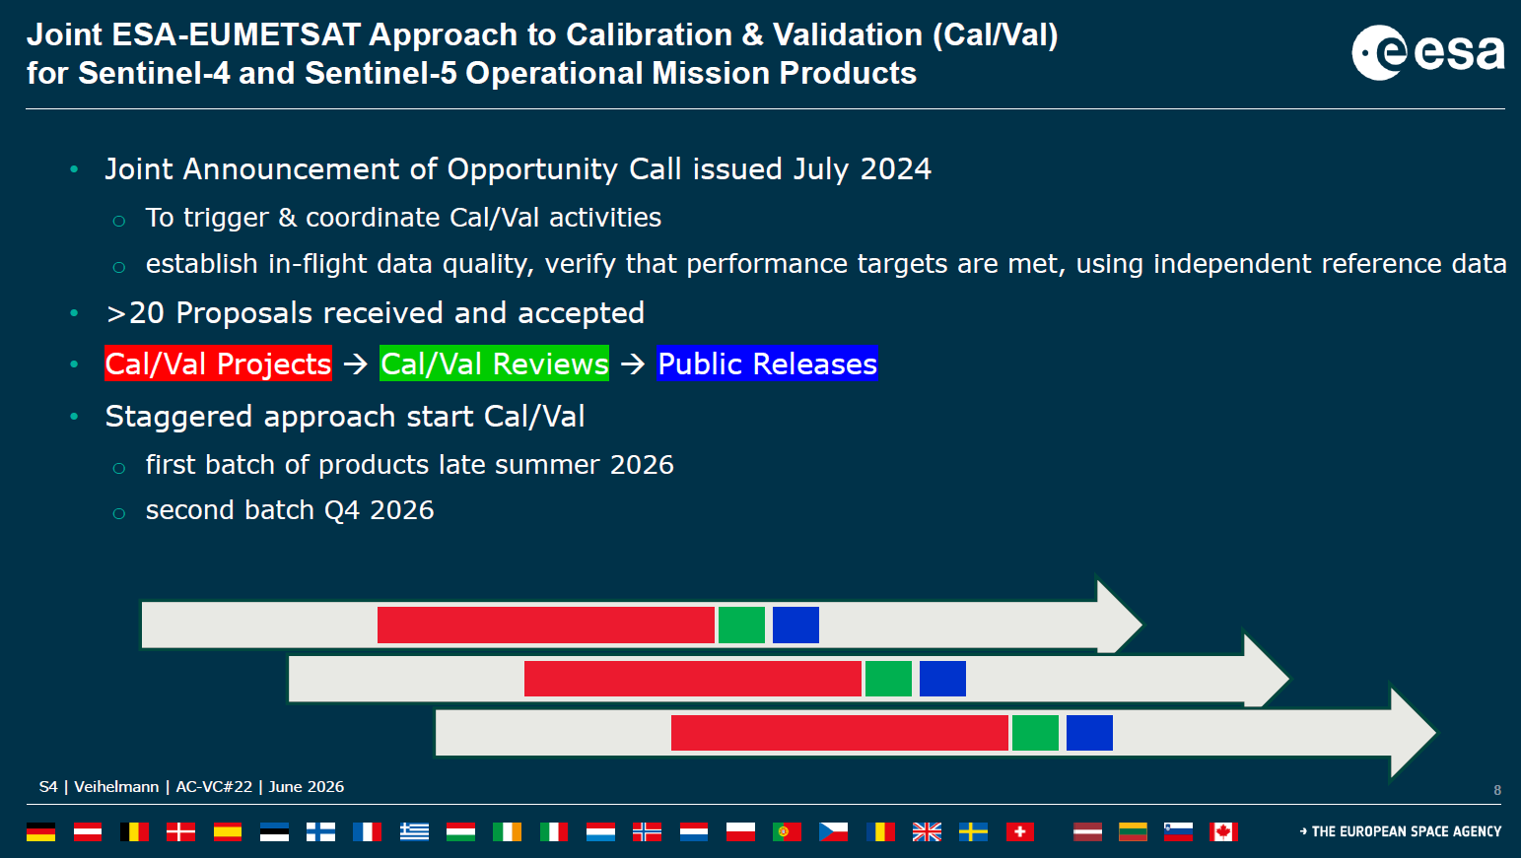
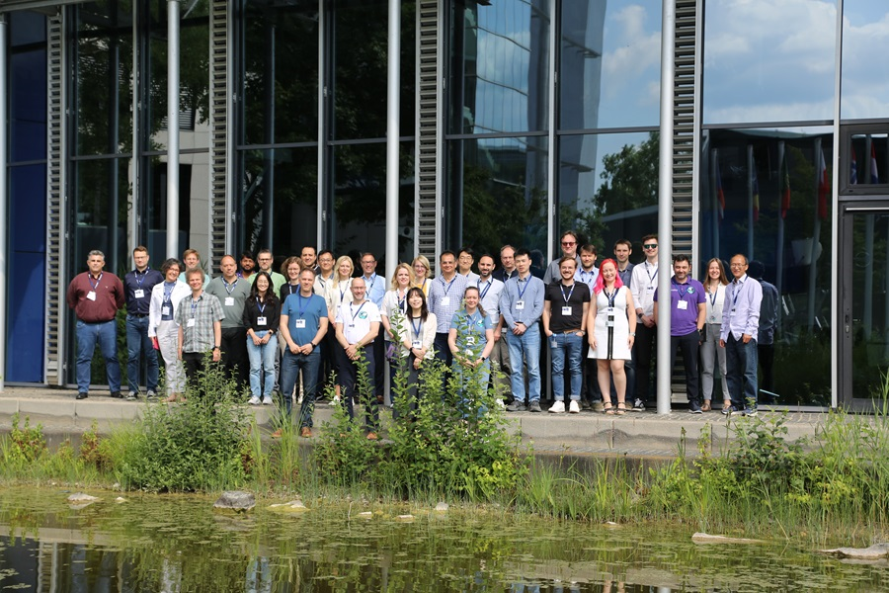
Cal/Val schedule
Similar to S4 case, S5 Cal/Val activities will start after
  ESA L2 commissioning activities are finished and final L2 algorithms delivered
  EUMETSAT ground segment updated and successful Product Validation Review Board
Staggered approach to Cal/Val
  L1 + first batch of L2 products in late Summer
  Remaining L2 products in Q4 2026. SWIR products (CO, CH4) might take longer
S4 & S5 Validation Team

Slide 9
Thank you!
Questions are welcome.

