Slide 1





Copernicus Sentinel-4
Ben Veihelmann, ESA Mission Scientist for Sentinel-4 and Sentinel-5
Thanks to
  S4 Teams at ESA, EUMETSAT, DLR,
  Consortium led by Airbus, EC, CAMS
  TEMPO-DART, 15 June 2026, SRON, Leiden, Netherlands

Slide 2
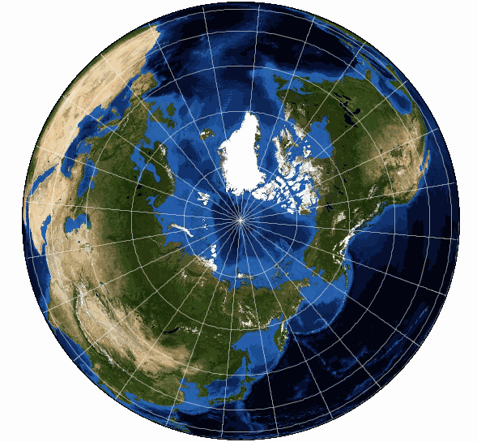
Consistency Targets
O₃ | Total column | 1%
 | Stratospheric | 5%
 | Tropospheric | 20%
NO₂ | Total column | 1×10¹⁵ molec/cm²
 | Tropospheric | 1×10¹⁵ molec/cm²
SO₂ |  | 1×10¹⁶ molec/cm²
HCHO |  | 1×10¹⁶ molec/cm²
CHOCHO |  | 4×10¹⁴ molec/cm²
AOD |  | 0.05 @ 440 nm
Earth radiance |  | 2-5%
Solar irradiance |  | 1-2%
Reflectance |  | 2-5%
Sentinel-4
TEMPO
Sentinel-5
AC-VC whitepaper on
GeoAQ Validation Needs
Sentinel-5P
GEMS
2000 + | 17 |  | 18 | 19 | 20 | 21 | 22 | 23 | 24 | 25 |  | 26 | 27 | 28 | …
S5P |  |  |  |  |  |  |  |  |  |  |  |  |  | …
GEMS |  |  |  |  |  |  |  |  |  |  |  |  |  |  |  | …
TEMPO |  |  |  |  |  |  |  |  |  |  |  |  |  |  | …
S4 |  |  |  |  |  |  |  |  |  |  |  |  |  |  | … | FM2
S5 |  |  |  |  |  |  |  |  |  |  |  |  |  |  | … | FM2 | FM3

Slide 3
Copernicus Sentinel-4
For observing air quality over Europe with hourly revisit time
on a long-term operational basis
UV-Vis-NIR (UVN) Imaging Spectrometers on MTG-S series
Built under the responsibility of ESA
  Instruments and L1 Prototype Processor by a consortium led by Airbus
  L1 Reference Processor by Huld
  L2 Operational Processor by a consortium led by DLR
Operated by EUMETSAT
Hourly coverage of Europe enabled by geostationary orbit
Mission lifetime of >16.5 years: two S4 in sequence
Copernicus Atmosphere Monitoring Service (CAMS) is committed to exploit S4 data for operational information services

Slide 4
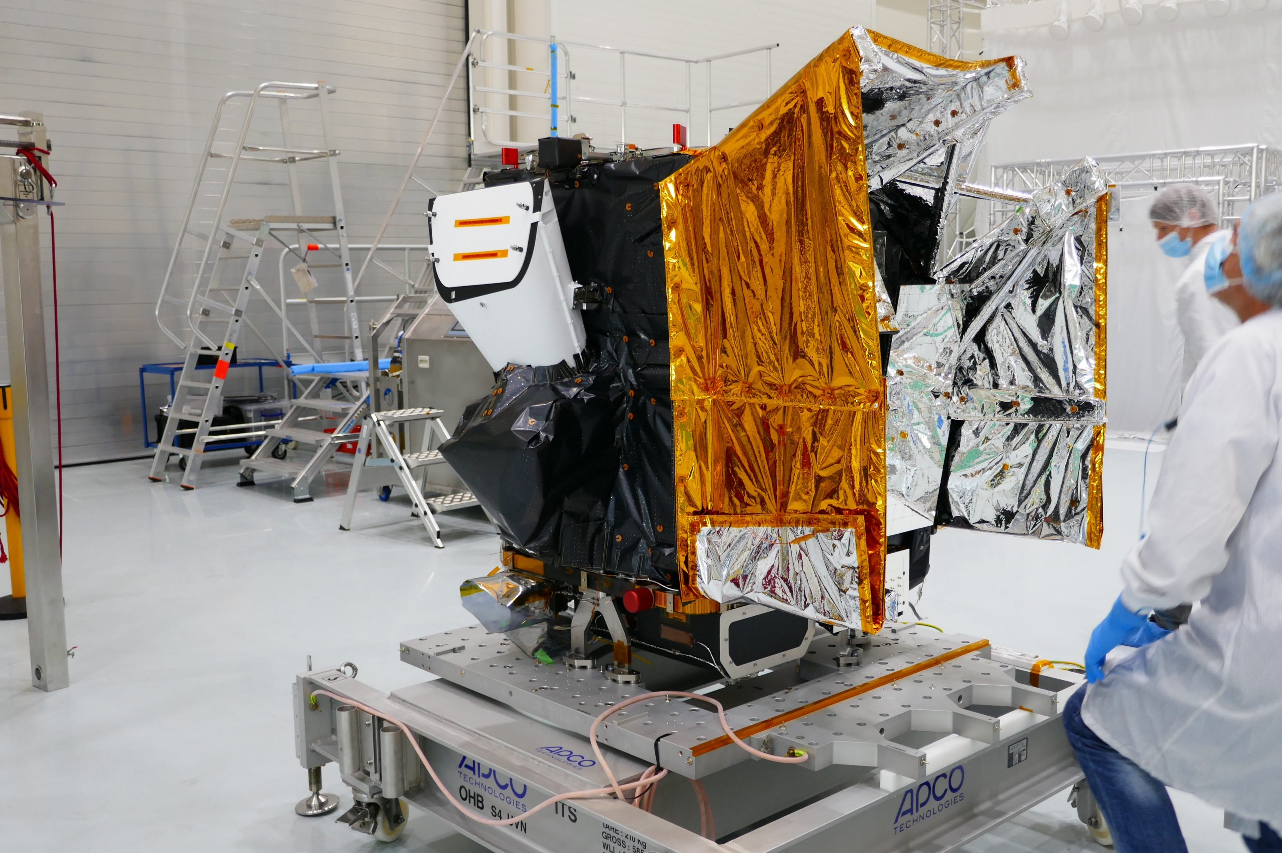
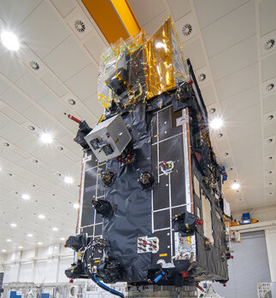
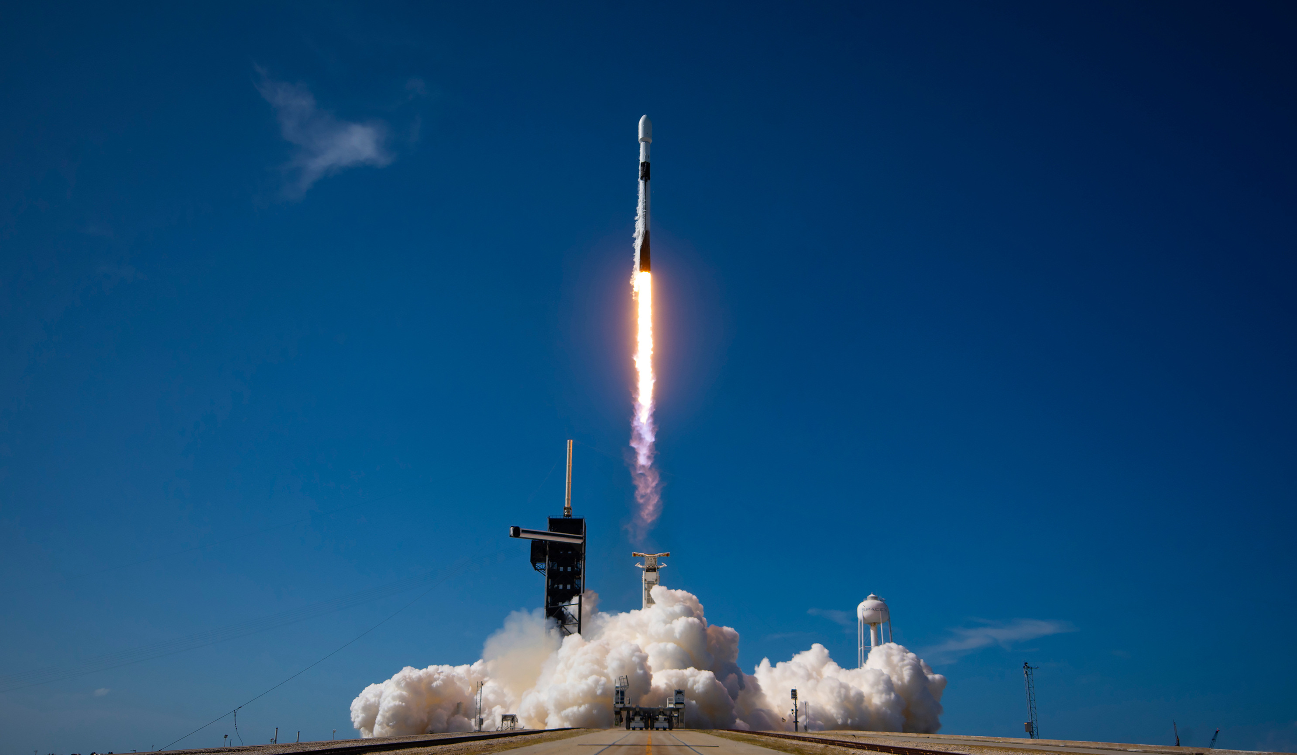
Copernicus Sentinel-4
Sentinel-4
Proto Flight Model
Sentinel-4 on MTG-S1 satellite
Launch of MTG-S1 with a Falcon 9
1 Juli 2025

Slide 5
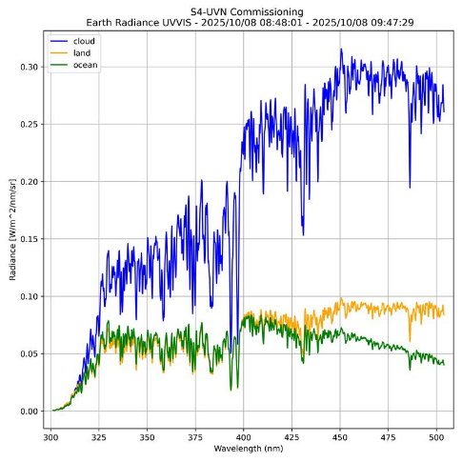
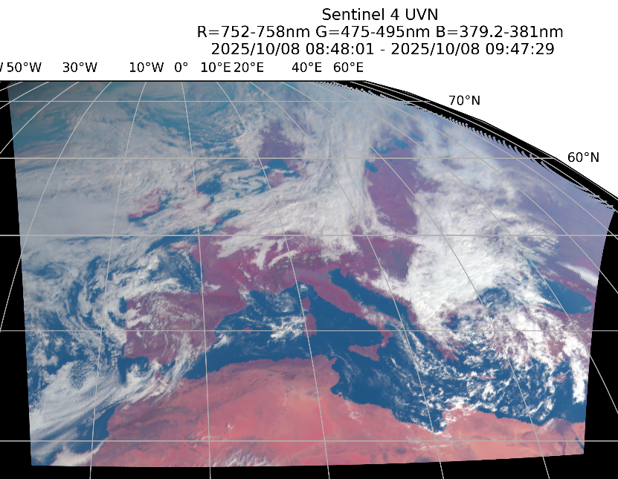
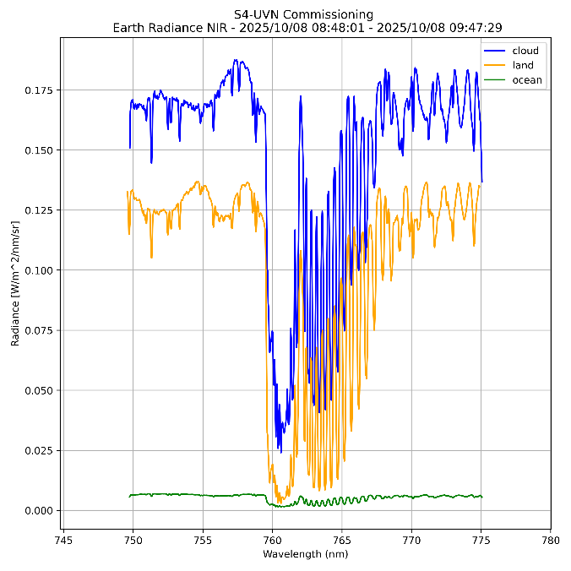
Copernicus Sentinel-4
UV-Vis
NIR
Proto Flight Model on MTG-S1
Launched with a Falcon 9 on 1 July 2025
Switched on 15 September
Nominal acquisitions since mid November
S4/UVN Commissioning Results Review January 2026
In-flight commissioning of L1 and L2
Ongoing tests: full disc, fast scans, PICS, planets
Re-location 3.6⁰W to final position 0⁰E
Next steps
Hand-over to EUMETSAT
Cal/Val start first batch September
Public release of data products in staggered approach
Flight Model 2
On-ground characterization & calibration completed April 2026
Outlook: tests at satellite level, long-term storage, re-calibration
Earth Radiance RGB
8 Oct 2025
Earth Radiance 8 Oct 2025

Slide 6
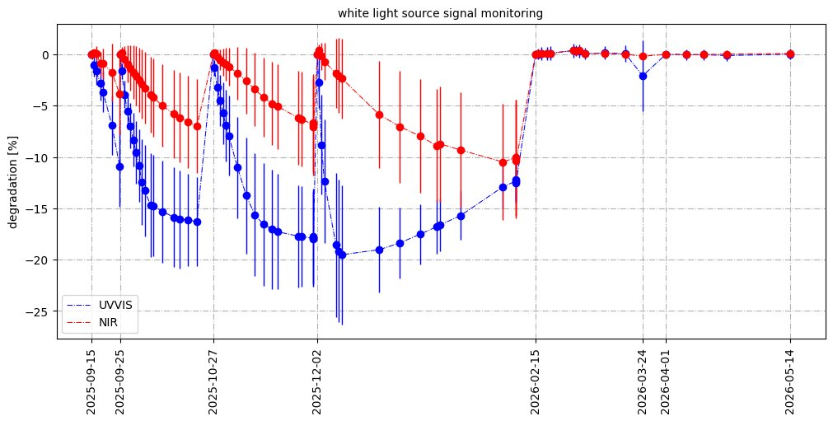
S4/UVN Instrument and Level-1 Products
S4 Proto Flight Model is behaving well in flight
L1 radiometric, spectral, geometric performances are overall very good
Ongoing work on remaining smaller features
... after solving an issue
radiometric degradation and evolving pseudo-noise
due to molecular contamination of detectors
fixed by operating the instrument with a higher detector temperature, February 2026
cold
warm

Slide 7
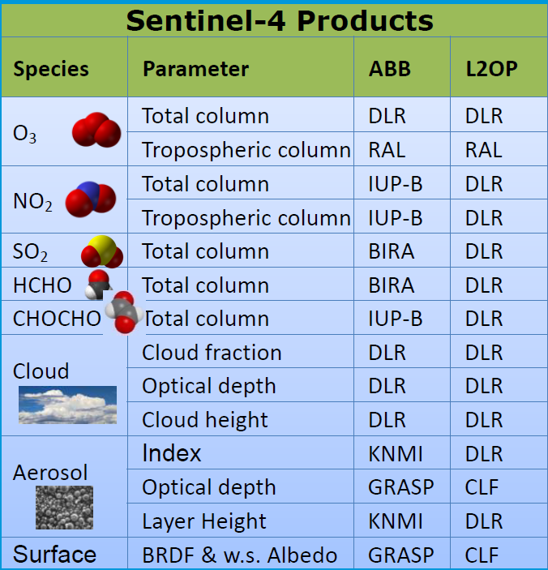
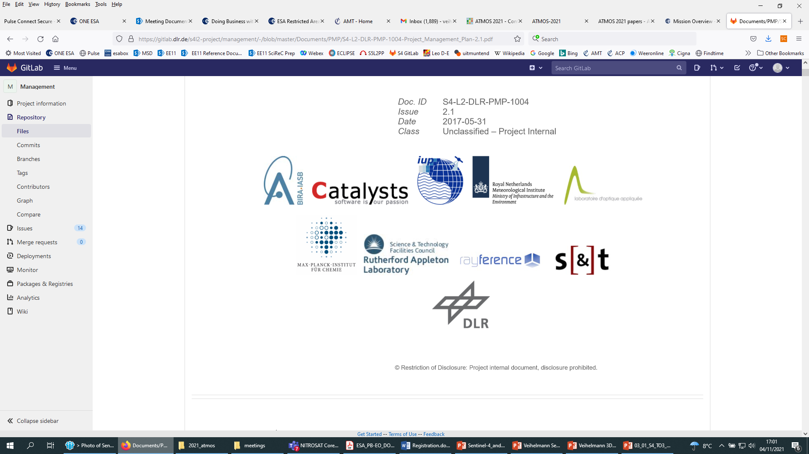
S4 Level-2 Products
L2 processor developed by a consortium lead by DLR

Slide 8
S4 Level-2 Products
Cloud Fraction
Cloud Height
Surface Reflectance

Slide 9
S4 Level-2 Products
Total Ozone
Tropospheric Ozone
SO2
NO2

Slide 10
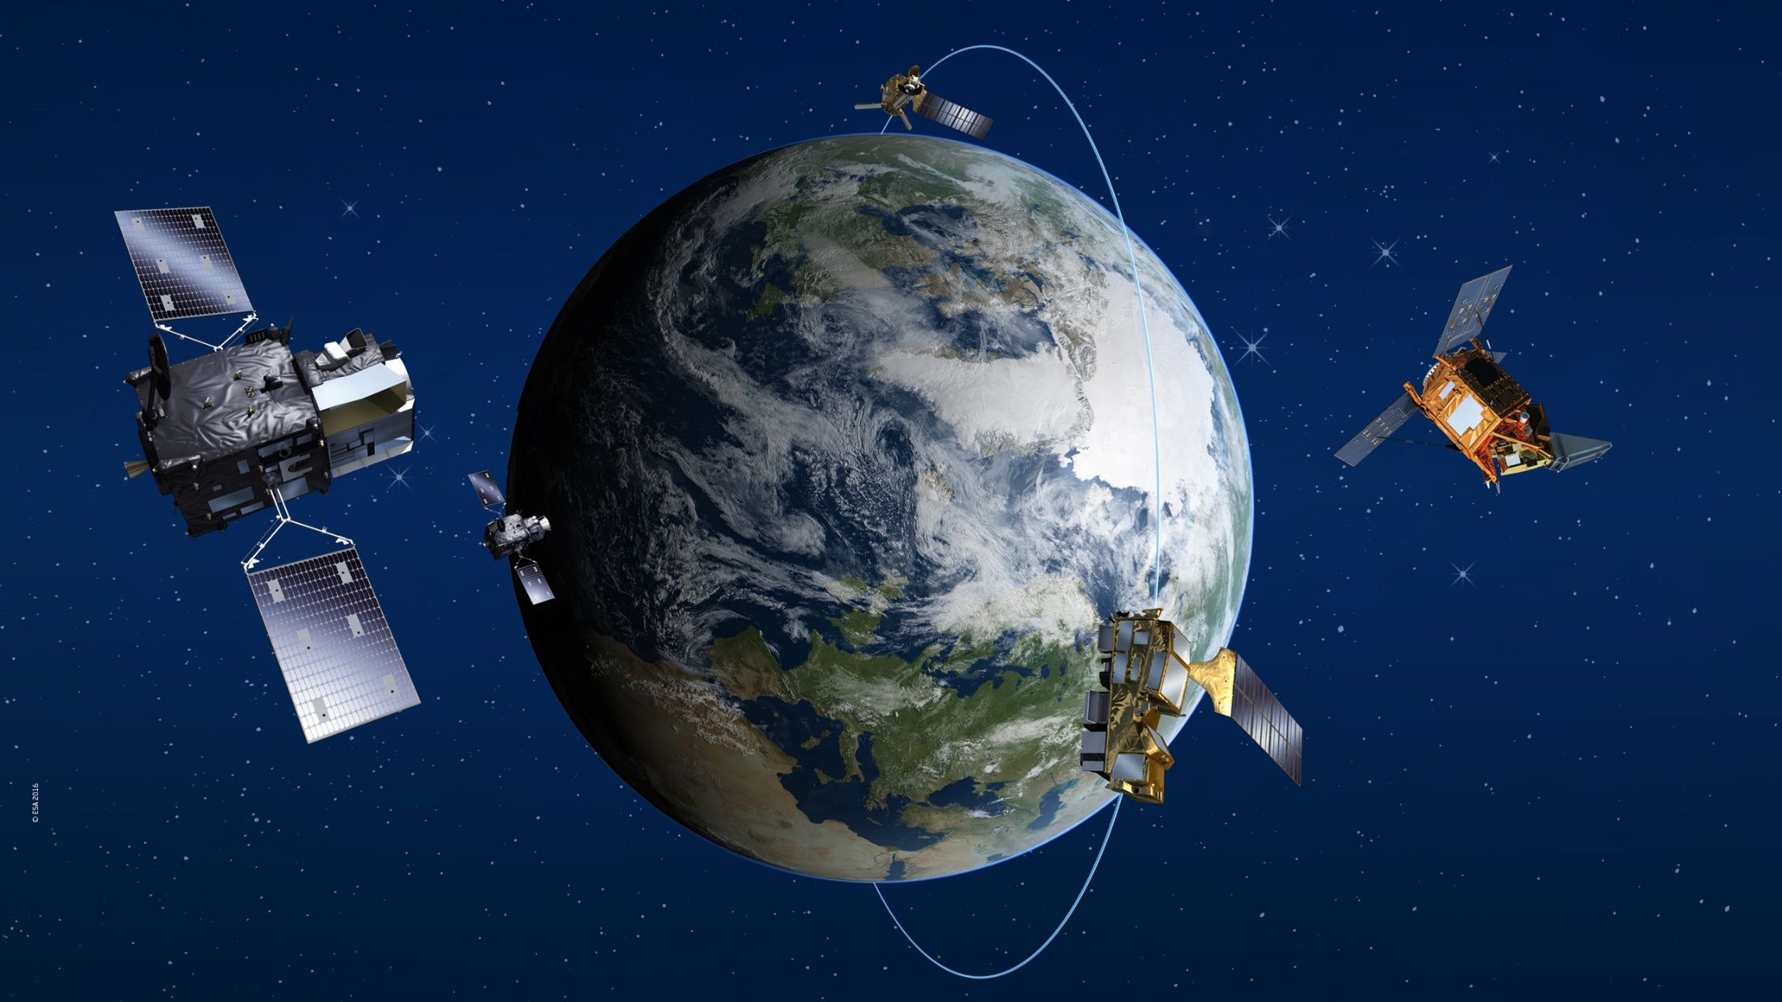
Sentinel-4 on MTG-S1 and -S2
UV-Vis-NIR Imaging Spectrometer
Geostationary orbit → hourly Europe
Air quality
End of presentation
Thank you
Questions?
Image: ESA
O₃
NO₂
SO₂
Aerosol
HCHO
CHOCHO
CH₄
CO
Sentinel-5 Precursor
TROPOMI
Early afternoon
Sentinel-5 on MetOp-SG-A1, -A2, -A3
Morning
UV-Vis-NIR-SWIR Imaging Spectrometer
Polar orbit → daily global
Air quality, climate, ozone & UV

