Slide 1

Shobha Kondragunta for
Andy Heidinger
GEO Senior Scientist
June 15, 2026
GeoXO Mission Update

Slide 2
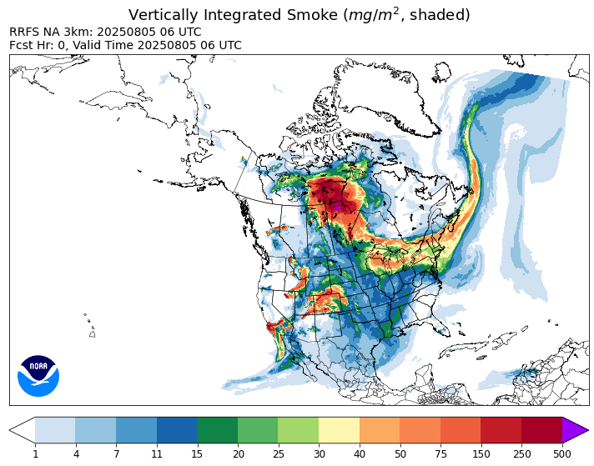
GOES-R Update
GOES-19 entered operational service as GOES East on April 7, 2025
GOES-18 continues to serve as GOES West
GOES-16 is the primary on-orbit backup
GOES-17 is an additional spare
Ravan Ahmdov, OAR GSL
TEMPO DRAT Workshop |15-18 June 2026 | Iowa City IA

Slide 3

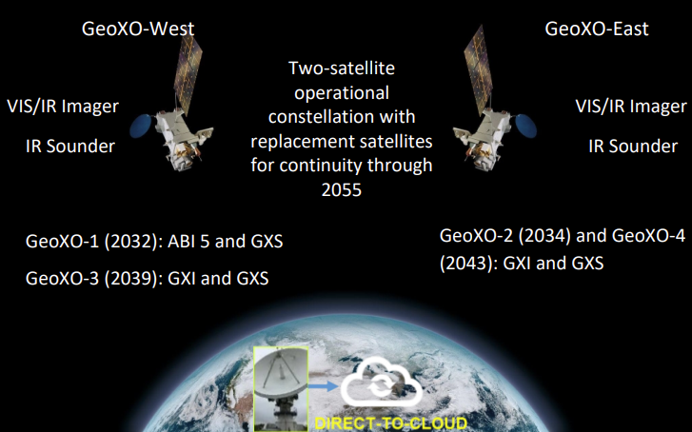
GeoXO Basline
PENDING APPROVALS:
Restructured program in August 2025 to prioritize weather observations
Two satellite constellation (East and West) provides full disk imagery and sounding through 2055
First launch planned for 2032
Continuity of imaging driving 2032 launch prioritization
TEMPO DRAT Workshop |15-18 June 2026 | Iowa City IA

Slide 4
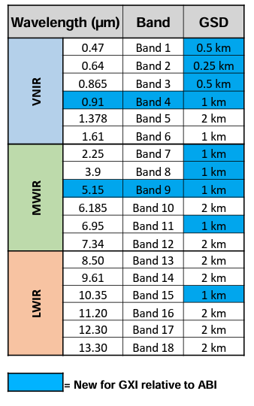
GXI Introduction
GXI is an improved version of the GOES-R ABI.
  multiple channels have a finer spatial resolution (even IR bands) including a 250 m visible band.
  two new channels focused on low-level water vapor.
Temporal scanning options remain (10 min FD, 5 min CONUS, 1 min MESO).
First GeoXO imager is an ABI.
Vendor is L3Harris, same as ABI
TEMPO DRAT Workshop |15-18 June 2026 | Iowa City IA

Slide 5
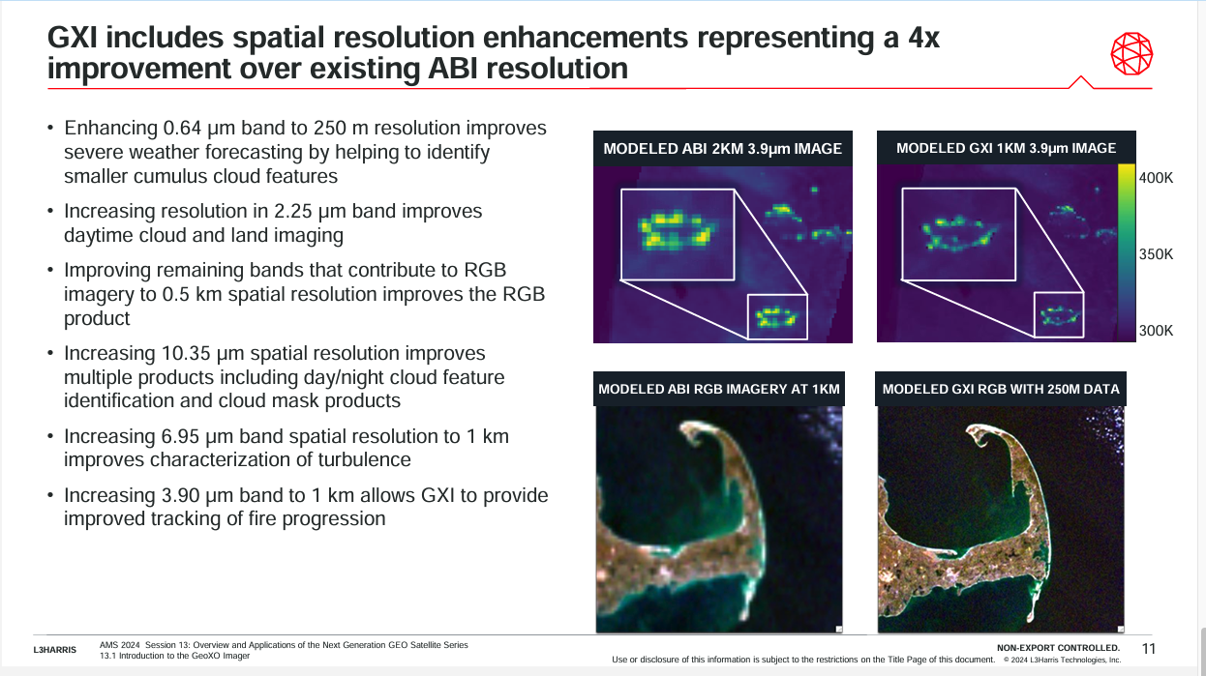

Slide 6
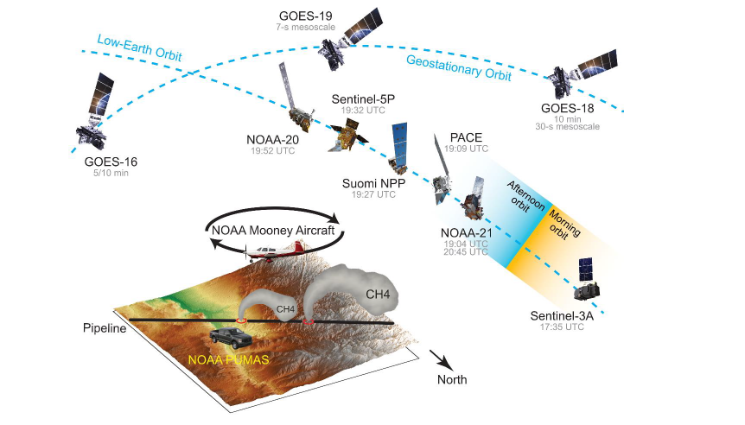
NOAA’s Very Large Methane Release Experiment
Estimates of total release mass are consistent across satellite platforms but ~25% lower than the operator’s reported value based on pipeline pressure and 280 volume.
In situ mass balance analysis underestimates early source rates by ~50%, reflecting the difficulty of sampling rapidly evolving, heterogeneous plumes from transient point sources.
He, T., D. Varon, S. Kondragunta et al., PNAS, under review, https://eartharxiv.org/repository/view/11628/
TEMPO DRAT Workshop |15-18 June 2026 | Iowa City IA

Slide 7
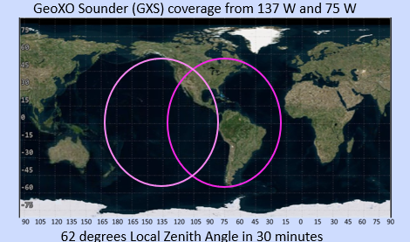
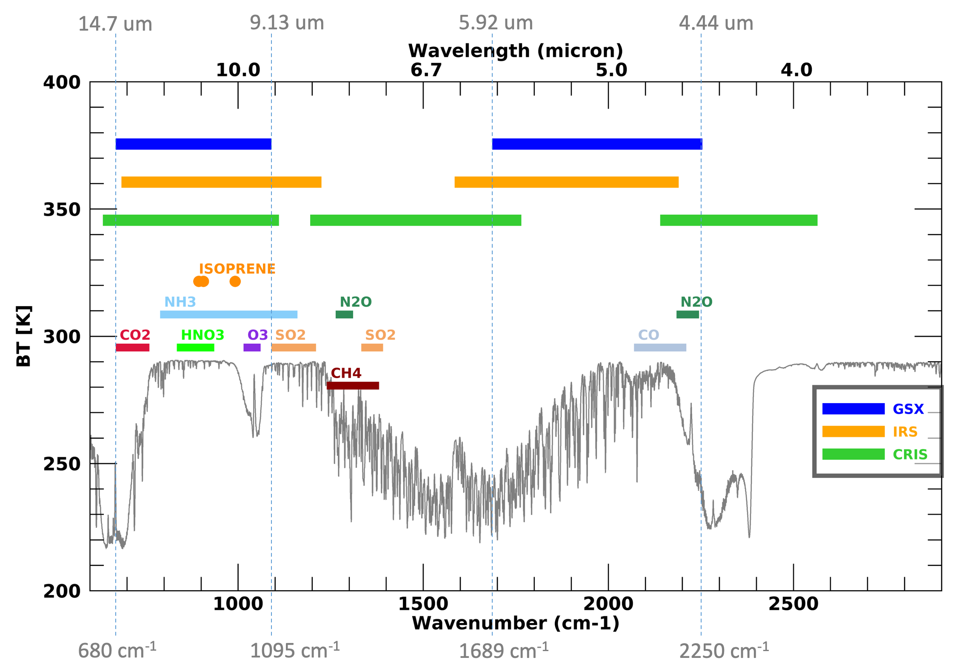
Baseline Requirements:
IR Sounder(GXS)
Baseline Requirements
GSD | 4 km (Same as GOES-13 Imager IR)
Coverage Area | Sounding Disk (SD) defined by a 62º zenith angle centered at 75W & 135W
Revisit Time | 60 minutes
Spectral Coverage | 4.44-5.92μm, 9.13-14.7μm
Spectral Resolution | 0.625 cm⁻¹
Signal:Noise | NEdN requirements are comparable to those of other IR hyperspectral sounders
GXS

Slide 8
Conclusions
GeoXO has a new baseline consisting of imagers and sounders in the East and West positions from 2032 to 2055.
GXI is an improved version of ABI with 2 new channels and multiple channels at finer spatial resolution.
GXS (IR sounder) is similar to other geostationary hyperspectral sounders being flown by EUMETSAT and JMA and includes observations of key atmospheric gases.
Atmospheric composition in the GeoXO era was always planned as a multi-instrument strategy. Despite the descoping of ACX and most likely the GLX, the combination of GXI and GXS on both East and West satellites will provide us with an opportunity for atmospheric composition monitoring to improve weather and air quality.
TEMPO DRAT Workshop |15-18 June 2026 | Iowa City IA

Slide 9



Thank You!
TEMPO DRAT Workshop |15-18 June 2026 | Iowa City IA

