Slide 1
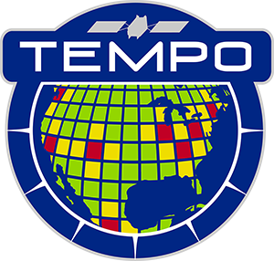
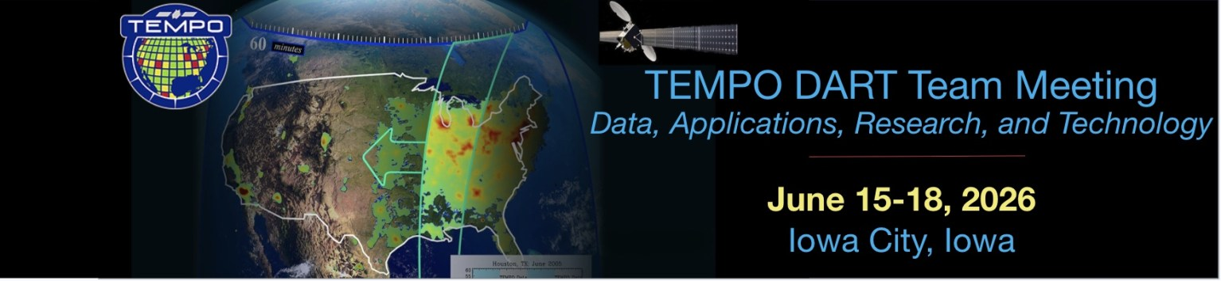


Tropospheric Emissions:
Monitoring of Pollution
TEMPO Mission Status
Xiong Liu¹, K. Chance¹, C.R. Nowlan¹, G. Gonzalez Abad¹, R. Suleiman¹,
J. Houck¹, J. Davis¹, H. Wang¹, H. Chong¹, W. Hou¹, J. Park¹,
M. Ghahremanloo¹, J. Bak¹, C. Chan Miller¹, J. Fitzmaurice¹,
L. Yatsuhashi¹, A. Oppenheimer¹, K. Daugherty², D.E. Flittner²,
C. Fenn², L. Judd², J. Carr³, J. Szykman⁴, B. Henderson⁴, J. Joiner⁵,
Z. Fasnacht⁵, E. Knowland⁵, N. Krotkov⁵, C. Li⁵, A. Vasilkov⁵,
E.-S. Yang⁵, J. Ziemke⁵, M. Newchurch⁶, A. Naeger⁶,
R. Cohen⁷, J. Geddes⁸, J. Herman⁹, B. Pierce¹⁰, R. Spurr¹¹,
J. Wang¹², O. Torres⁵, and the TEMPO Team
¹Smithsonian Astrophysical Observatory (SAO), CfA
²NASA LaRc ³Carr Astro. ⁴EPA ⁵NASA GSFC ⁶UAH ⁷UCB
⁸BU ⁹UMBC ¹⁰UWM ¹¹RT Sol. Inc ¹²UI
TEMPO DART Team Meeting 2026
University of Iowa
June 15, 2026

Slide 2
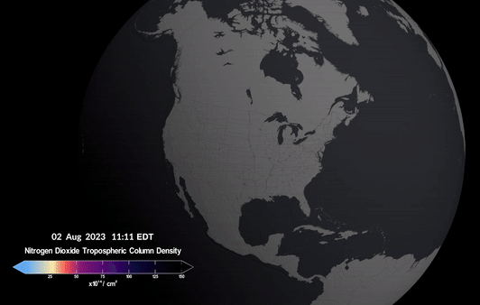
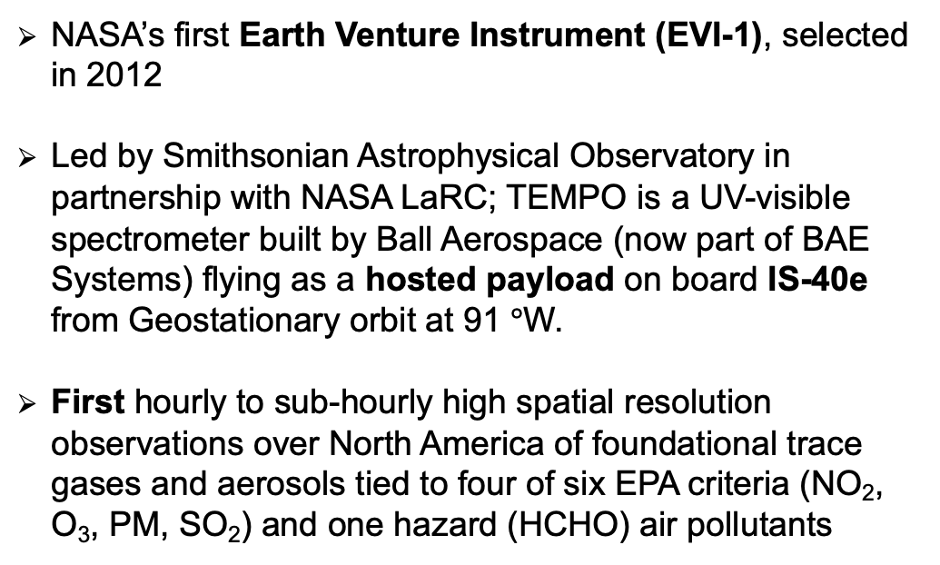
TEMPO (Tropospheric Emissions:
Monitoring of Pollution)
NASA’s first Earth Venture Instrument (EVI-1), selected in 2012
Led by Smithsonian Astrophysical Observatory in partnership with NASA LaRC; TEMPO is a UV-visible spectrometer built by Ball Aerospace (now part of BAE Systems) flying as a hosted payload on board IS-40e from Geostationary orbit at 91 $°$W.
First hourly to sub-hourly high spatial resolution observations over North America of foundational trace gases and aerosols tied to four of six EPA criteria (NO₂, O₃, PM, SO₂) and one hazard (HCHO) air pollutants
2 x 4.75 km²
(N/S x E/W) at center of Field of Regard
First light scans from TEMPO. [Credit: NASA’s Scientific Visualization Studio]
Launch
4/7/2023
First Light
8/2/2023
PLAR
10/19/2023
Public Release (V3)
5/20/2024
Public Release (V4 & NRT V2) 9/17/2025
TEMPO Senior Review 4/14/2026
Senior Review Extension
Commissioning
Nominal Operations (Phase E)
10/19/23 – 6/18/25
Extended Operations (Phase E)
6/19/25 – 9/30/26
Both TEMPO Instrument and IS-40e spacecraft are very healthy!!!

Slide 3
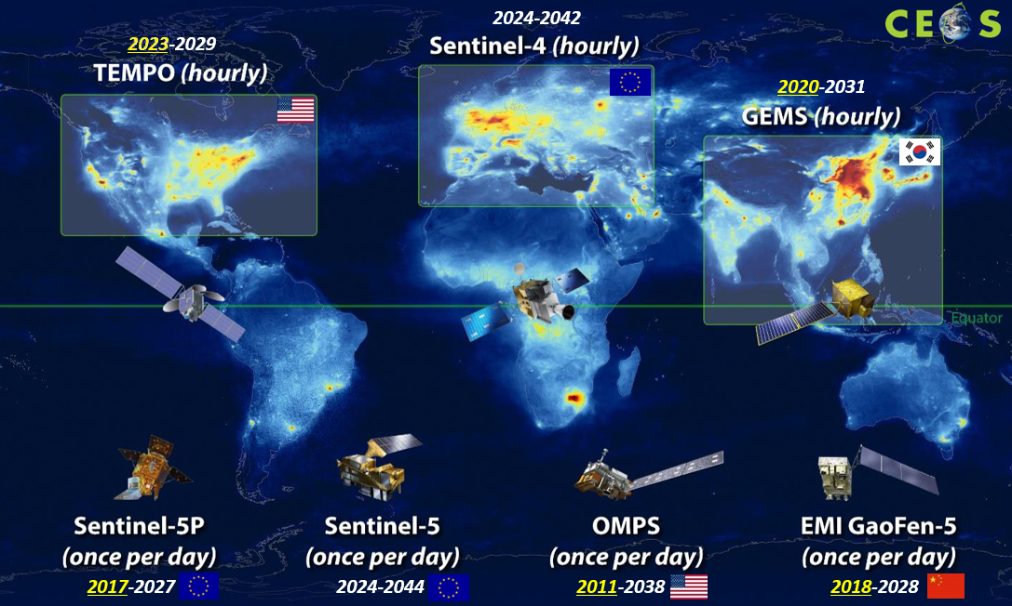
Geostationary Air Quality Constellation
TEMPO is the North American “eye” in the global constellation for air quality, contributing to a unified, global “Gold Standard” dataset for atmospheric science and applications.
Sentinel-4a: Launch 2025
Sentinel-4b: Launch ~2035
TEMPO: Launch 2023
TEMPO-2 ?
GEMS: Launch 2020
GEMS-2: Launch ~2032
With the cancellation of GeoXO ACX, there is no TEMPO successor.
Low Earth Orbit and Geostationary (LEO+GEO) satellite constellation for air quality monitoring [Credit: CEOS]

Slide 4
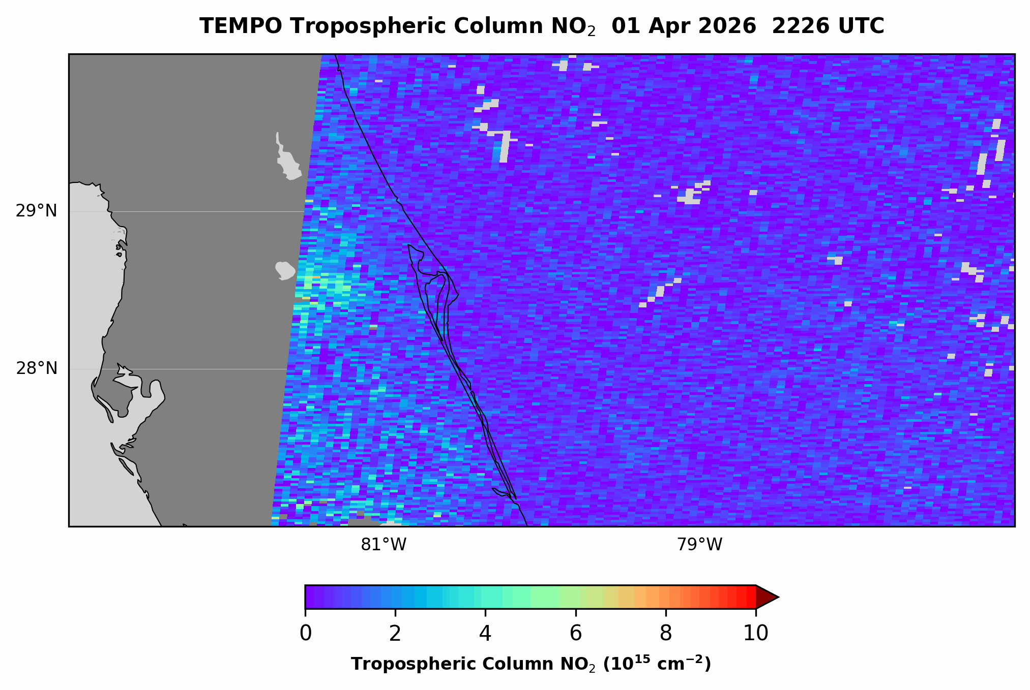
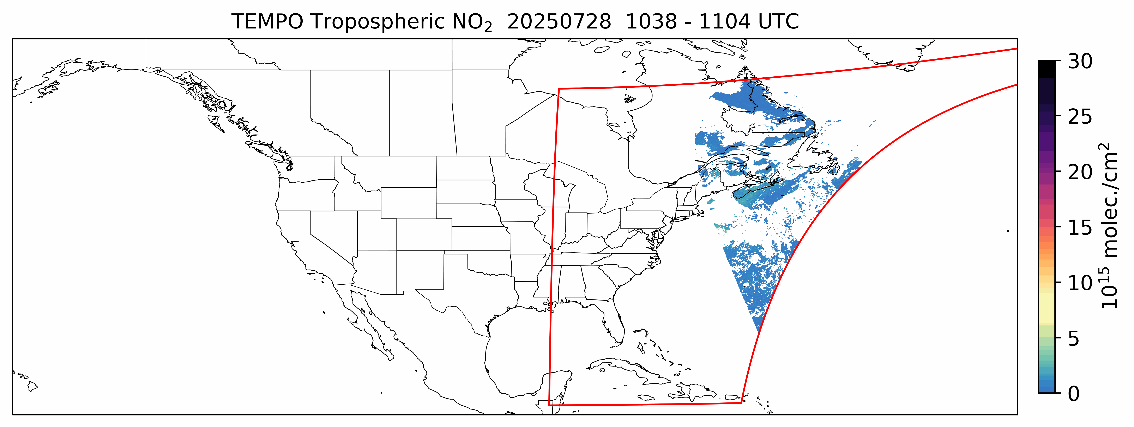
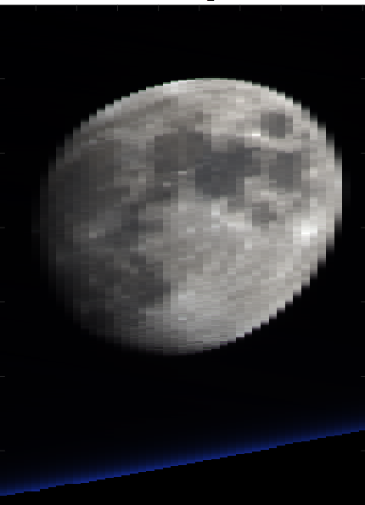
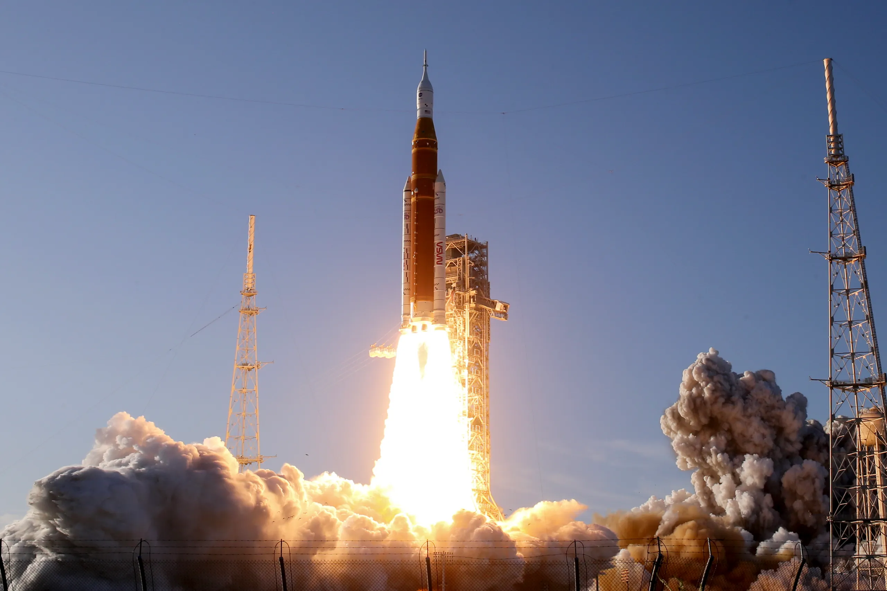

TEMPO Scanning
Nominal scans: hourly, 2.4M pixels
  2035 N/S pixels x 1181 E/W steps per hour
  2 x 4.75 km² at center of field of regard
Optimized scans
  Higher temporal resolution scans in early AM and late PM over coasts (40 mins)
Special observations to support TEMPO Green Paper & Cal/Val: wildfires, prescribed burning, lightning NOx, field campaigns, Artemis-II Launch, CAL/VAL
  High-frequency scans (~5-10 mins) over
  selected regions (alternate with hourly scan )
  Side slither scans
    Lunar collects (4/9/2025, 9/9/2025, 11/3/2025, 12/10/2025, 2/3/2026, 4/26/2026)
    Railroad Valley (6/2024, 6/2025, 10/2025, 6/2026)
Credit: Aaron Naeger
Credit: Jean Fitzmaurice
Credit: Jim Carr
Credit: Jim Carr
Request Special Observations at TEMPO Early Adopter Website
See poster by J. Fitzmaurice: TEMPO Special observations
Detection of enhanced NO₂ associated with Artemis-II Launch
Credit: Joe Raedle

Slide 5
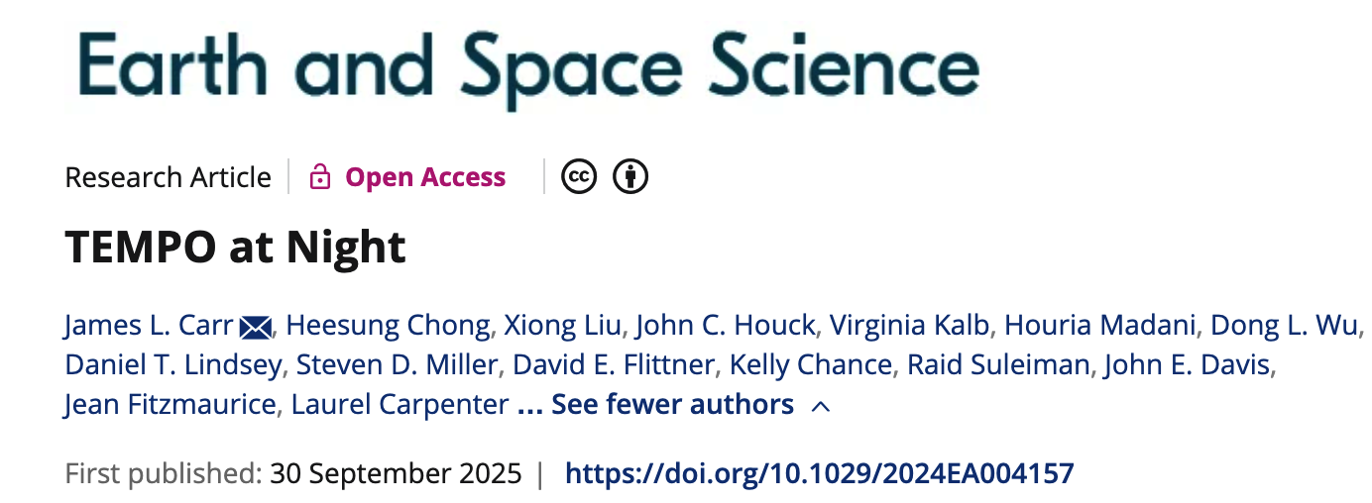
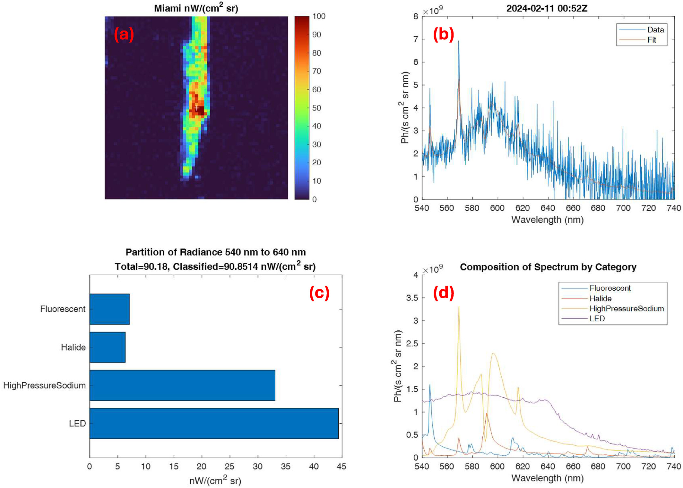
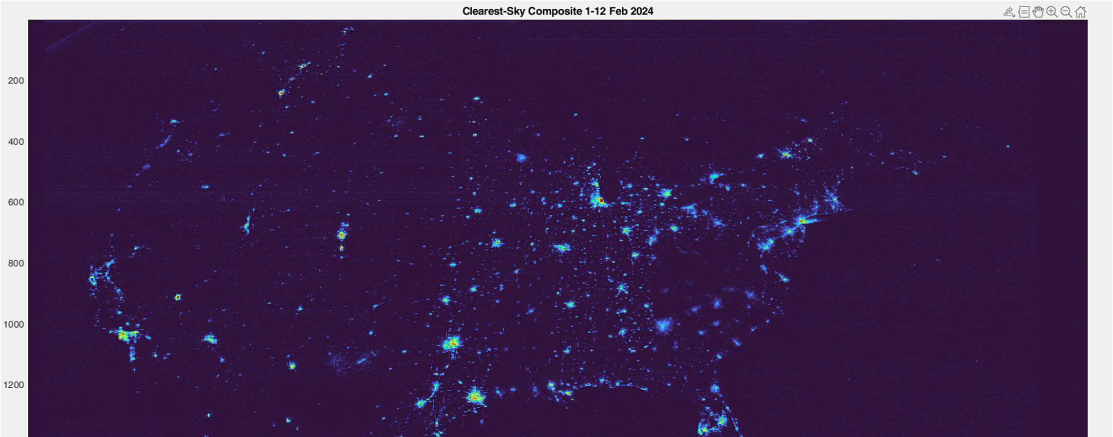
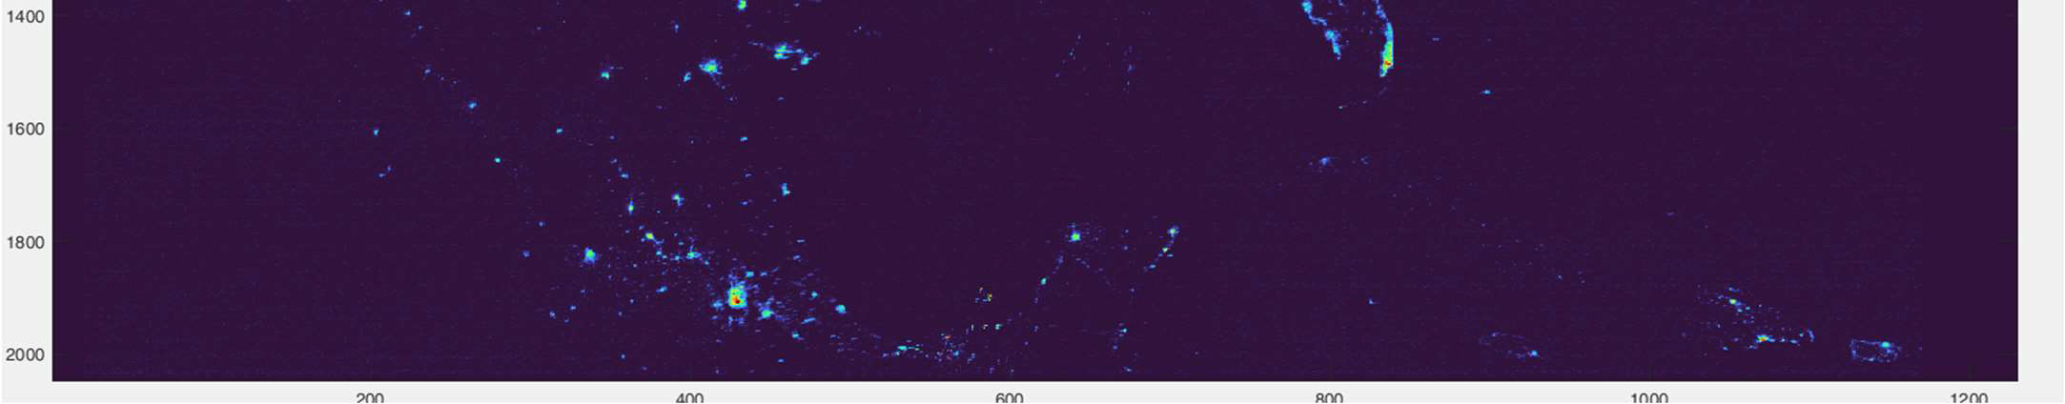
TEMPO at Night
Bonus Science and Discovery
Twilight (Nighttime) scans
  Performed during darkness (~Aug. 15-Apr. 15)
  City lights, moonlights, Aurora, airglow, gas flaring, fires, lightning
  Hyperspectral measurements of nighttime lights
  Light pollution, energy use, sleep health, and ecology, etc.
City lights composite 1–12 February 2024
Hyperspectral nighttime measurements allow lighting types to be identified, including over Miami in this example.
Credit: Jim Carr
New RADT V4 product; See J. Carr et al., TEMPO at Night Session, 3:30 pm Wed.

Slide 6
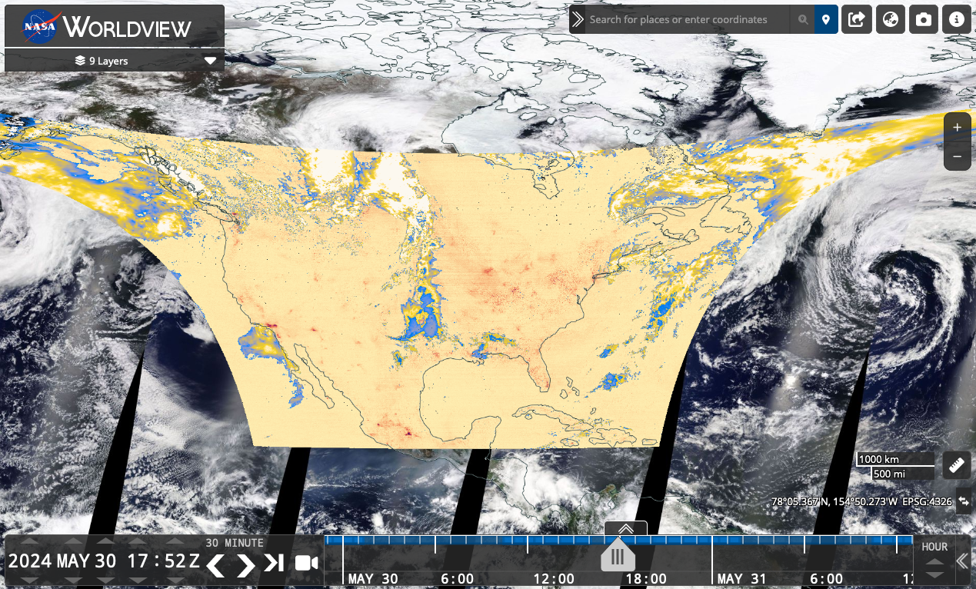

TEMPO Data Products Public Release
NASA’s ASDC & EarthData
Public Release | Date | Details
V03 | 5/20/2024 | L1, L2/3 cloud, NO₂, H₂CO, total O₃ (provisional) V3 O₃ profile (ASDC 6/9/2025, not for the public)
V04 | 9/17/2025 | Ozone Profile (beta), L1 + other L2/L3 (provisional) RADT (1/6/2026), Reprocessing started on (1/29/2026)
NRT V02 | 9/17/2025 | L1, L2/3 cloud, NO₂, H₂CO (funded by SNWG)
TEMPO data now publicly available at NASA’s ASDC/Earthdata (~6 hours latency, NRT with 2-3 hours latency).
Multiple tools ([enabled] by Earthdata):
  Earthdata Search, OPeNDAP
  NASA Worldview: all data products (L2+L3)
  ArcGIS services (Earthdata & Living Atlas):
  L3 NO₂ + HCHO + total ozone
  RSIG (EPA)
  TEMPO-Lite (CfA CosmicDS): L3 NO₂
  NASA SPoRT Viewer
  Google Earth Engine (L3 NO2 & HCHO)
For more information check out:
  User Guides (known issues)
  Daily operation & commissioning logs
  Validation reports
  ATBD (drafts available upon request for L0-1 & O₃ profile, released for total O₃, cloud, NO₂, & HCHO)
V4 reprocessing of all data products excl. O₃ profile by early Sep.;
Reprocessing of O₃ profile by late Dec.
ASDC TEMPO
TEMPO V3/V4 & NRT V2 download metrics (May 2024-December 2025)
5 PB, 170M files, >1300 unique user IPs
Worldview: >5300 unique user IPs, 6.2M records
ArcGIS Trop. NO₂ (Living Atlas): >7800 unique user IPs

Slide 7
Baseline TEMPO Data Products (V4)
Level | V4 Product | Validation Status
L1 | Irradiance | Provisional
 | Radiance | Provisional
 | Radiance (twilight – city lights) | Provisional
L2 | Clouds | Provisional
 | NO₂ | Provisional
 | HCHO | Provisional
 | O₃ (total) | Provisional
 | O₃ (profile) | Beta->Provisional in 6/2026
L3 | L2 gridded to 0.02° × 0.02° | Provisional
Develop in-house validation capability &
work with the Validation Team to validate V4 and advance it to Full level (mid. 2027)
*Beta: “minimally validated”, publication “not recommended and highly discouraged”
*Provisional: “performance demonstrated”, "suitable for scientific publication”
See J. Park @11:50 am next session; and M. Johnson at 5:30 pm today

Slide 8
Expand Beyond TEMPO Baseline Products
SNWG NRT + SNWG Enhanced + Research
Level | Product | Developer
L1 | Irradiance | SAO
 | Radiance ^{NRT} | SAO (Chong, ESS, 2026)
 | Radiance (twilight – city lights) | SAO (Carr, ESS, 2025)
L2 | Cloud ^{NRT} | SAO/GSFC (Wang, ESS, 2025)
 | NO₂ ^{NRT} | SAO (Nowlan, ATBD, 2024)
 | H₂CO ^{NRT} | SAO (Gonzalez Abad, ATBD,2024)
 | O₃ (total) | SAO/GSFC
 | O₃ (profile) | SAO
 | TEMPO/GOES-R aerosol products ^{NRT} | NOAA(released, ASDC, Zhang, JGR,25,26)
 | C₂H₂O₂ | SAO
 | H₂O | SAO
 | BrO | SAO
 | SO₂ ^{NRT} | NASA GSFC (Li, 2025, GRL)
 | UVAOD | NASA GSFC (under develop.)
 | Aerosol Optical Centroid Height | U. Iowa (under develop.)
 | UVB | NASA GSFC (under develop.)
Baseline Products: V5 in ~9/2028
Satellite Needs Working Group (SNWG)
Cycle 3 NRT Products (~2-3 hours)
Public release (Sep. 17, 2025)
SNWG Cycle 4
TEMPO SO₂ NRT & Enhanced Products
Public release in ~9/2028
Research Products
Ocean color (Fasnacht, 2025, ESS, NASA ROSES)
Vegetation (GPP) (Bandel @SSAI/NASA GSFC)
HNO₂ (Theys @BIRA-IASB)
Free tropospheric NO₂ (Dang, 2025, PNAS)
Surface Products (Ghahremanloo, JGR & many studies)
Emissions (Sun, JGR, Hsu, submitted @many studies)
JEDI Data Assimilation (Abdi-Oskouei, 2026)
TEMPO/GOES-R Synergy Radiance (Wang+Carr, ROSES)
Surface albedo/DLER (Zhang, JGR, NOAA)
IO, NO₃, Solar induced fluorescence

Slide 9
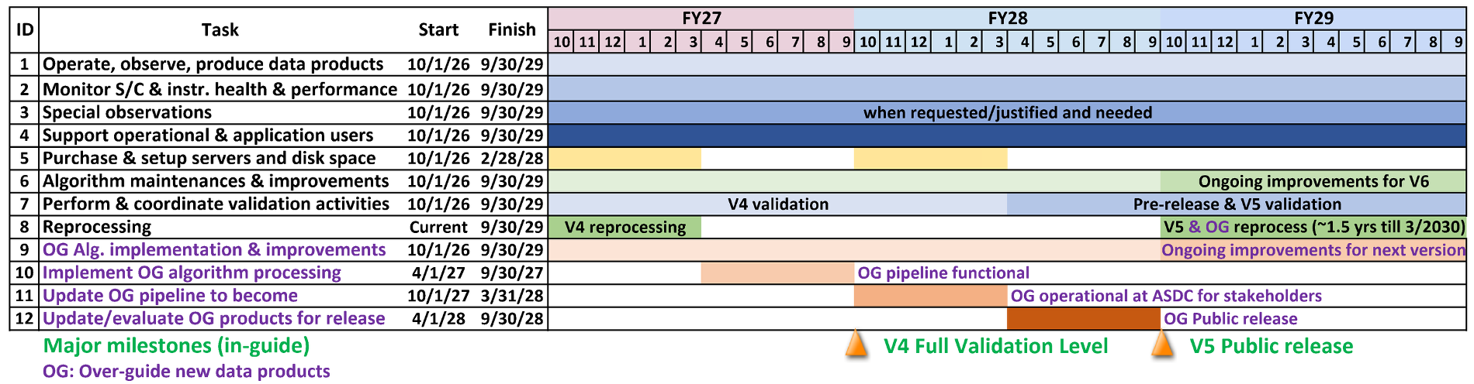
Mission Extension Plans:
Schedule and Over-Guide Activities
We also propose to implement existing algorithms (i.e., surface NO₂, ocean color, TEMPO/GOES synergy) operationally through over-guide (OG) requests:
  Work with the original algorithm developers to implement algorithms at TEMPO's Science Data Processing Center (SDPC), meeting NASA's data product requirements
  Integrate OG algorithms into a processing pipeline, and produce data products with early access provided to algorithm developers and stakeholders for evaluation
  Public release of OG data products and reprocessing of entire data record

Slide 10
Algorithm Improvements for V5
 | Planned Update | Benefit
Instrument calibration and L1b | Perform dynamic degradation correction | Level 2 improvements, especially products derived with absolute radiances (O₃ and clouds)
 | Improve radiometric calibration
 | Perform polarization correction | Lower fitting residuals in Level 2 retrievals
 | Improve straylight correction (spatial) | Spectral fitting improvements, remove artifacts from spatial reflection
 | Improve pixel quality flagging | Perform Level 2 retrievals with only reliable pixels
 | Refine spectral calibration | Total O₃ retrieval improvement
Common | Improve GLER & RTM Outgoing Sphericity Correction | Improve key surface inputs, correct for retrievals at larger VZAs
 | Update LUTs: RTM outgoing sphericity corr. , on-orbit ISRFs | Improve retrieval accuracy
Clouds | Improve pixel classification (shadow, cloud, snow/ice) | Improve retrievals and under retrieval artifacts
 | Improve scene albedo and pressure retrieval | Reduce trace gas biases over snow
Use clouds in L2 retrievals | Use scene albedo and pressure over snow/ice | Reduce trace gas biases over snow
 | Improve the use of cloud retrievals | Improve retrievals under low quality cloud retrievals
NO₂ and HCHO | Improve fitting over partial clouds with scene inhomogeneity | Reduce measurement uncertainty over partial clouds
 | Refine HCHO radiance reference | Reduce background bias in HCHO
 | Implement aerosol correction | Improve products over fires and urban regions
O₃ total & profile | [Both] Minimize inconsistency in ancillary data | Reduce inter-product discrepancy in total O₃
 | [Both] Update soft calibration | Reduce striping; reduce regional and systematic biases
 | [O₃ profile] Optimize & Speed-up UV-only & UV-visible retrieval | Improve retrieval accuracy and sensitivity & reduce computational needs

Slide 11

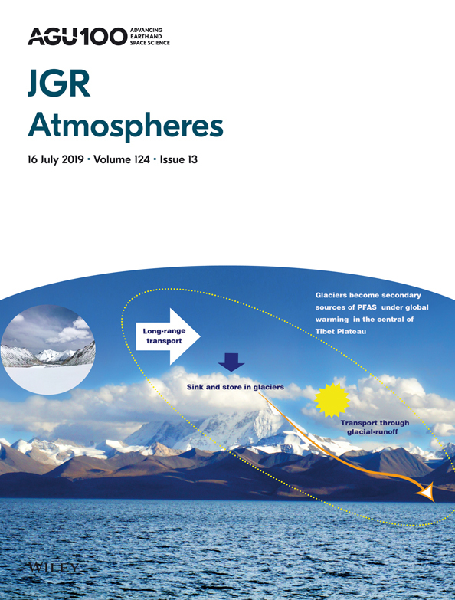
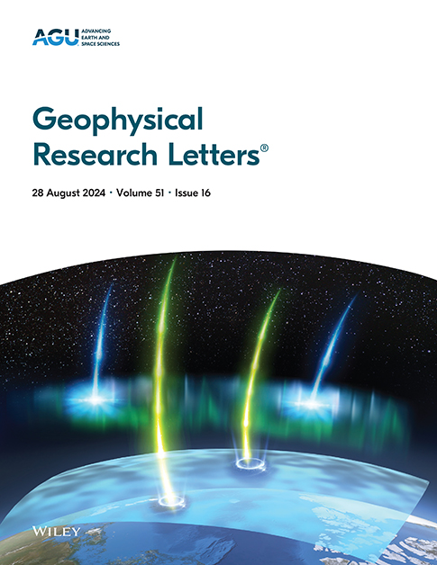
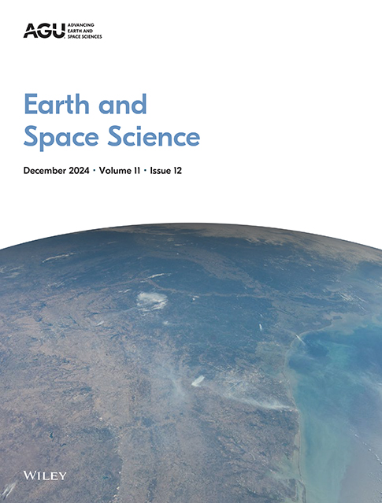

Publications & AGU Special Collection
Enthusiastic community uptake has translated into a high number of publications.
TEMPO AGU Special Collection
TEMPO Data Products, Science, and Applications
Nearly 40 refereed publications since mid-2025
Publications span diverse areas:
  Air quality: Urban air quality, diurnal patterns, wildfires
  New cross-disciplinary products: Ocean color and nighttime lights
  Technical & foundational: Algorithms and validation
31 papers submitted, 27 papers published/accepted
Open until 31 December 2026
TEMPO Library https://scixplorer.org/public-libraries/7Fzv13x4TSe-mmt3SQqiYQ
https://tempo.si.edu

Slide 12
Summary and Outlook
Revolutionizing air quality monitoring from space with widespread data adoption
Successful commissioning and nominal operations
Instrument and spacecraft performing very well
Successfully completed baseline mission. 1st extension to Sep. 2026 + NASA Senior Reviews
Special observations capability to support TEMPO Green Paper & CAL/VAL
TEMPO at night capability provides bonus science and discovery
Released significantly improved V4 data products including ozone profile (reprocessing ongoing) and V2 NRT products on September 17, 2025.
Continue to improve data products (next version in ~9/2028)
Develop new data products (funded under SNWG, public release in ~9/2028)
Expand the wide usage of TEMPO data for science and applications
Acknowledgements: Funding from NASA (TEMPO, NNL13AA09C; SNWG TEMPO NRT, 80MSFC24CA004)
Thank you!

Slide 13










