Slide 1
ESSRP
NASA Earth System Science Research Program: What these changes mean for TEMPO DART
Emma Knowland, PhD
k.e.knowland@nasa.gov
Program Manager, NASA Earth Science Division,
ESSRP, AtmoSphere
NASA Headquarters
Washington, DC

Slide 2
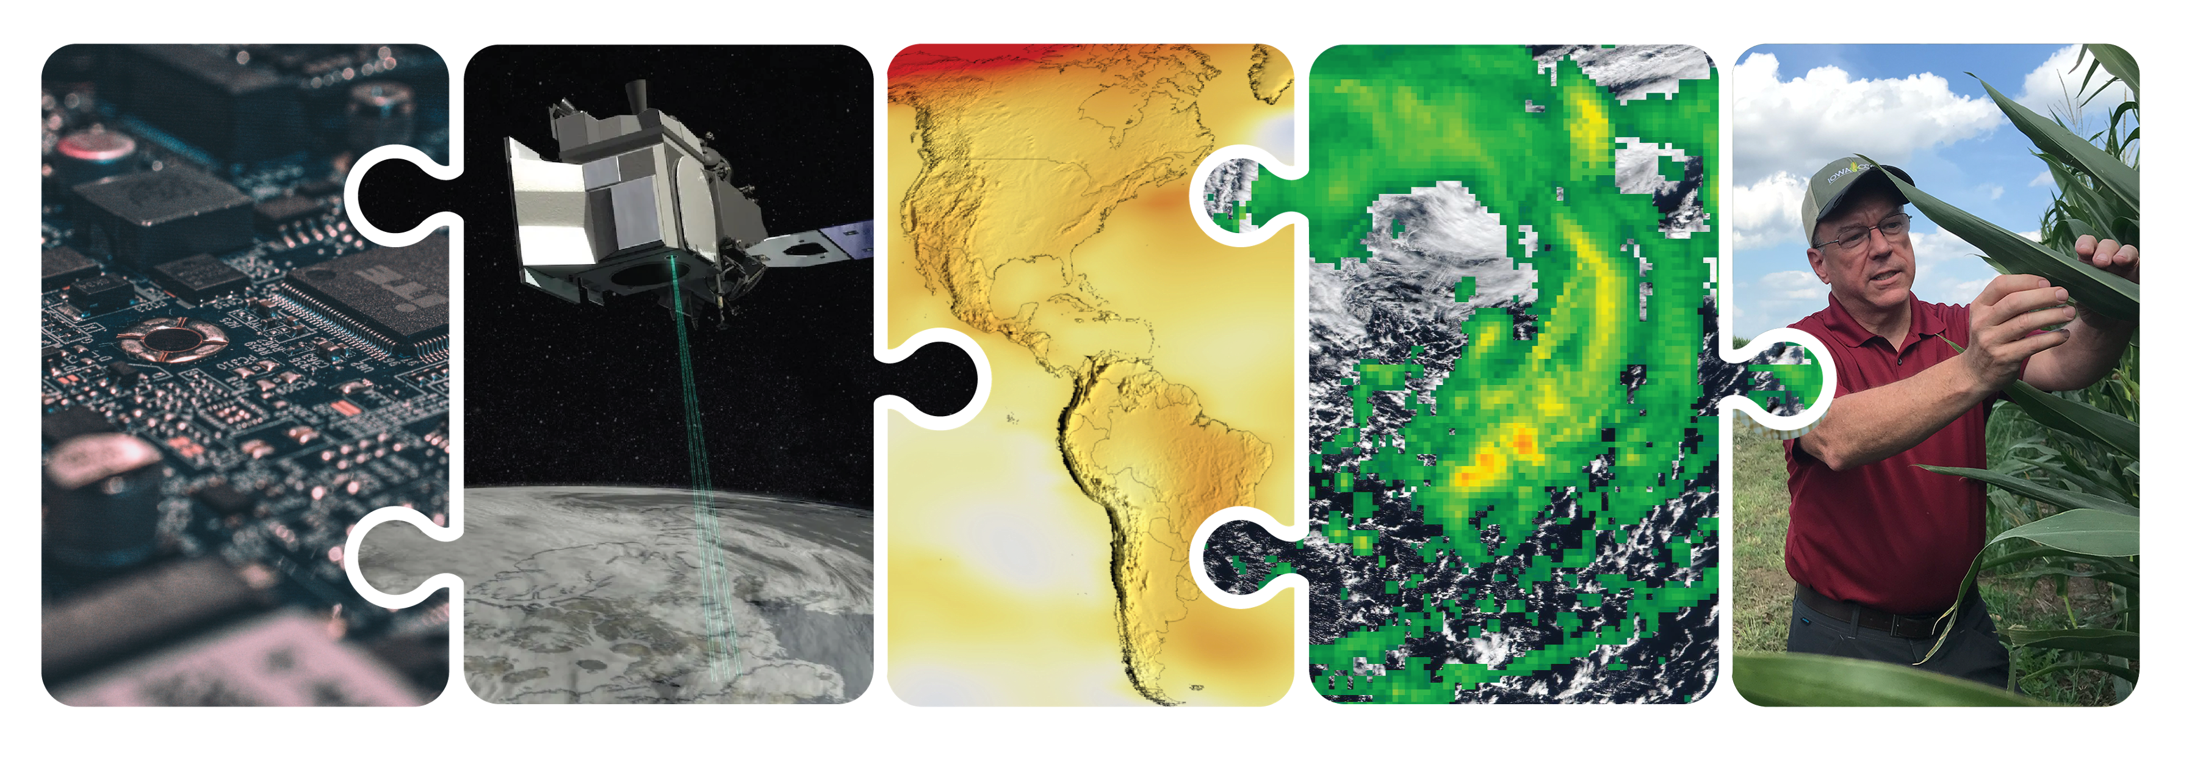
NASA’s End-to-End Earth System Science Capability
Technology
Flight
Research
Data Systems
Earth Action
10 Tech Infusions/year
24 Missions on Orbit
1,330 Active Research Projects
49 States
Collect 160 TB/Day
Serving 600 TB/Day
>10M Users
World-Class Models
Agriculture
Energy
Disasters
Wildfires
& more
12.11.2025
Notes:
Source: March 2026 CESAS Presentation

Slide 3
Increasing the Speed of Earth Science
NASA’s Earth Science Division is accelerating functions and simplifying processes with the goal of increasing speed of science and scale of impact.
This includes:
Speed to orbit
Speed to science and scientific discovery
Speed and scale of impact of science
Driving interdisciplinary science to go after the most complex questions
Notes:
Source: March 2026 CESAS Presentation

Slide 4
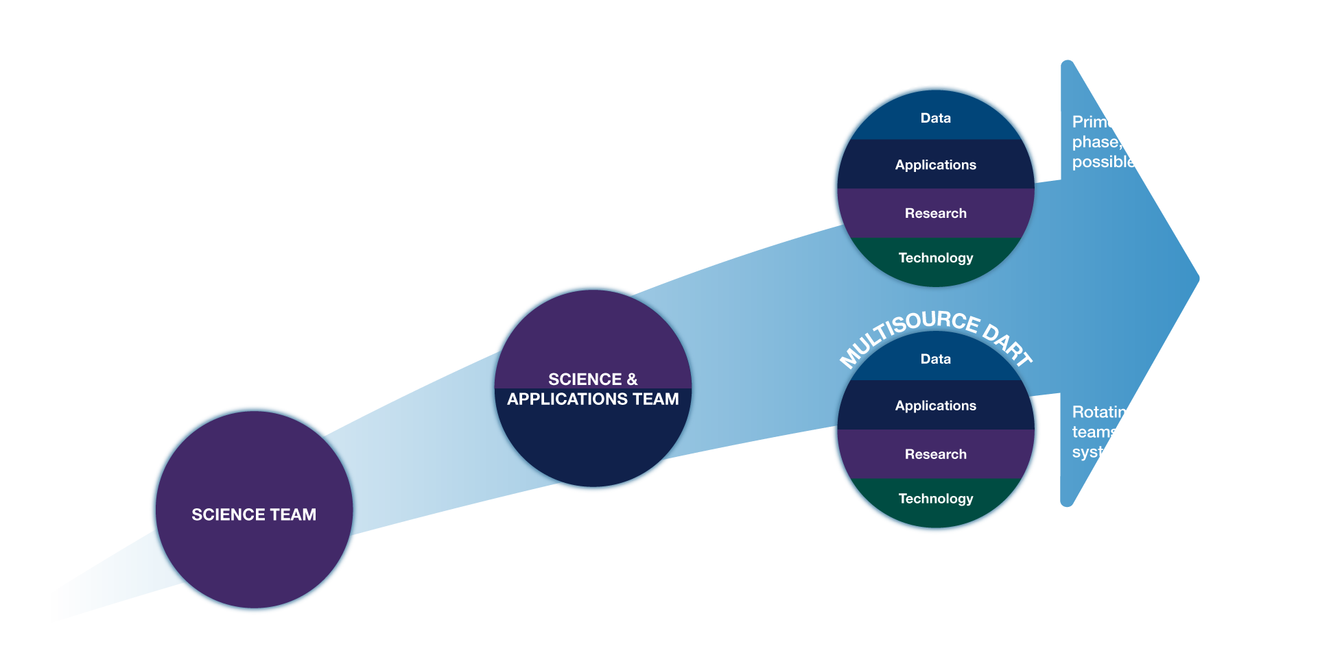
Evolution of NASA Mission Science Teams
Notes:
Updated version: 4.17.2026

Slide 5
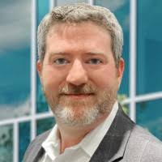
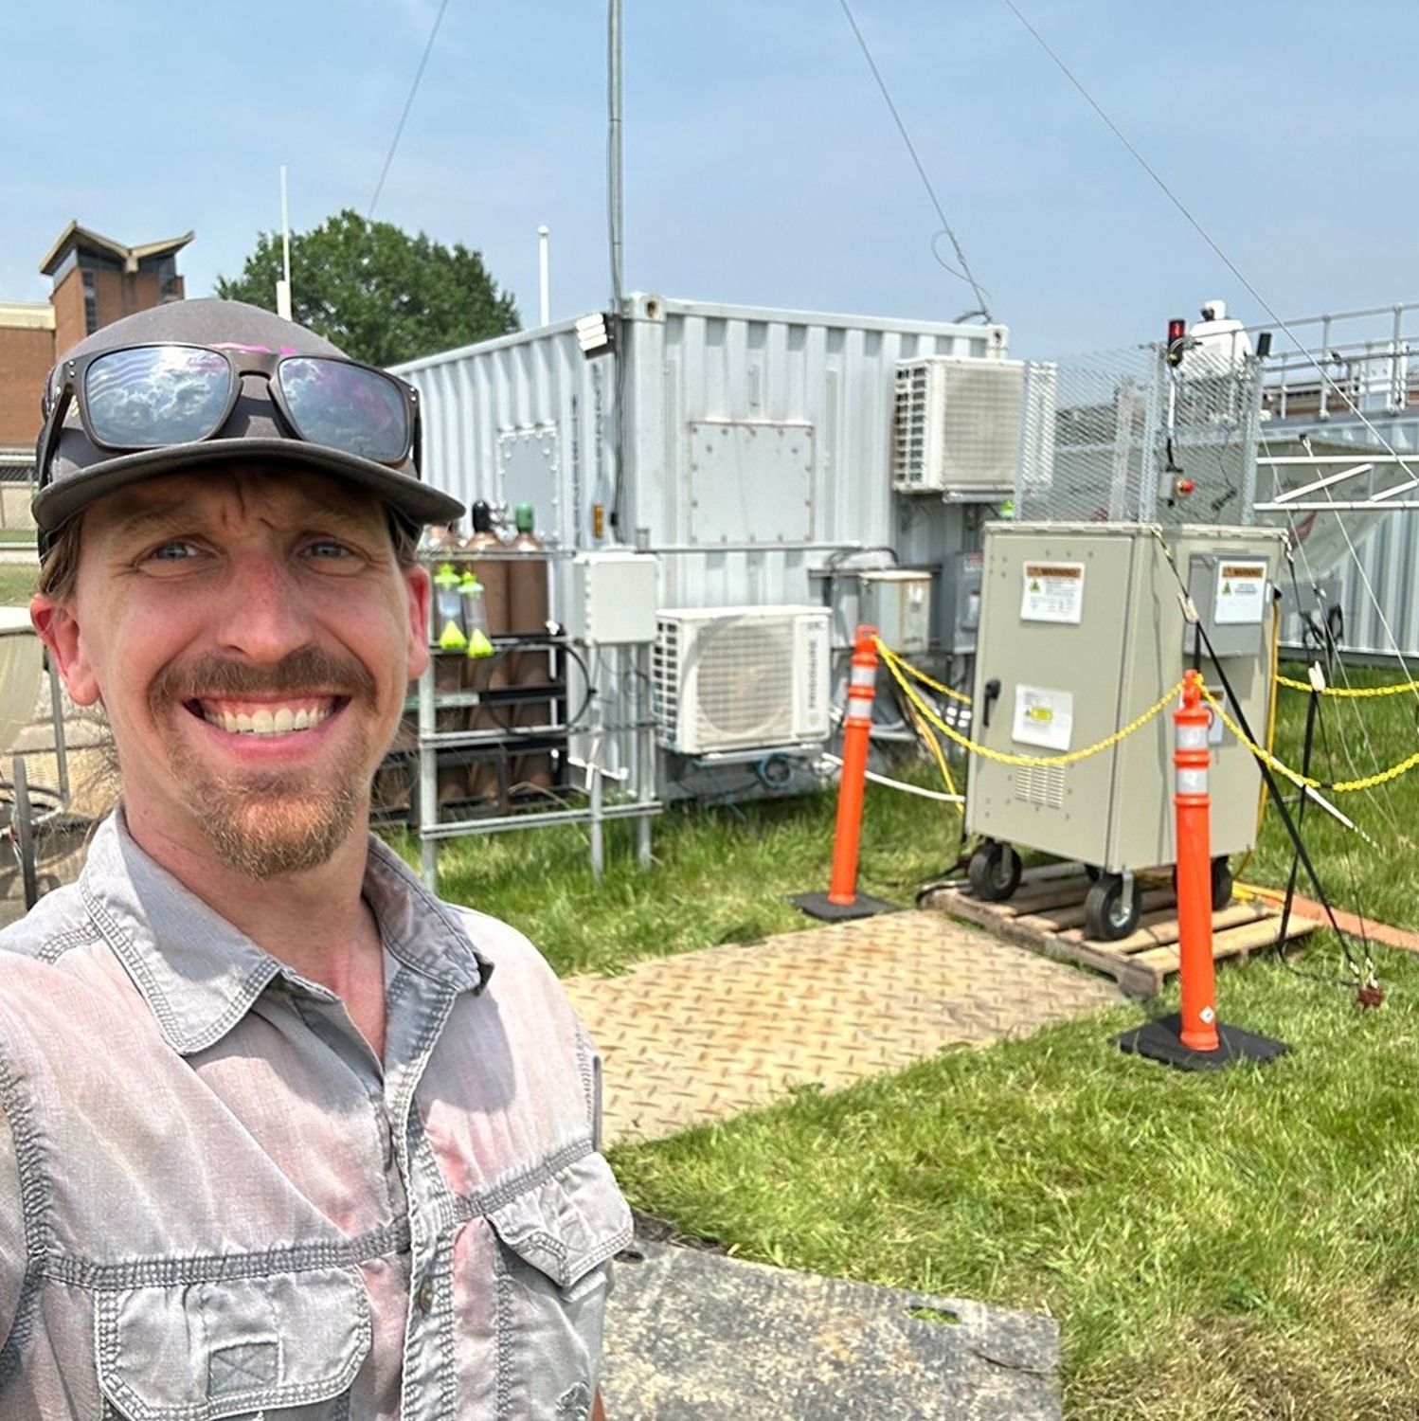
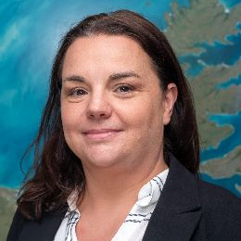
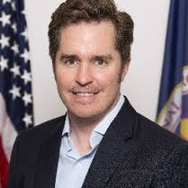
John Haynes
John Sullivan
Program Manager
Deputy Program Manager
Project Leadership
HEADQUARTERS
Leadership and oversight of all MIO activities, including DARTs and Project Office. Programmatic alignment across ESD.
Multisource Integrated Observatory
Cecile Rousseaux
Joel McCorkel
Project Scientist
Project Manager
PROJECT OFFICE (GSFC)
Facilitation of Multisource DARTs, integration support for Mission DARTs, and delivery of enabling infrastructure and capabilities.
Notes:
Created for March 2026 CESAS MIO Presentation

Slide 6
Multisource Integrated Observatory Goal and Objectives
ESD sees growing opportunities in integrated Earth-observing to answer complex Earth system science questions
Goal: Maximize science and applications from individual missions and observations combined across NASA, partner, and commercial fleets
Objectives
  Integrate the broad spectrum of activities required to accelerate the pace of scientific discovery and innovation
  Deliver high-impact, actionable applications based on multisource data, technology, and science
  Advance science-to-application pipelines across public and private sectors
Multisource Integrated Observatory
Notes:
Created for March 2026 CESAS MIO Presentation
Maximize science and applications from individual missions and observations combined across NASA and partner fleets
Just giving a short MIO highlight here, John Sullivan will provide more information later this afternoon.
We believe integration in Earth observation can really help us maximize the value of our missions, and maintain our position as a leading innovator in Earth science discovery
Science only we can do – multi-mission, cutting edge
Goal of MIO
Making sure the mission focused science teams make the most of each mission and then work across missions to get the max science across the portfolio

Slide 7

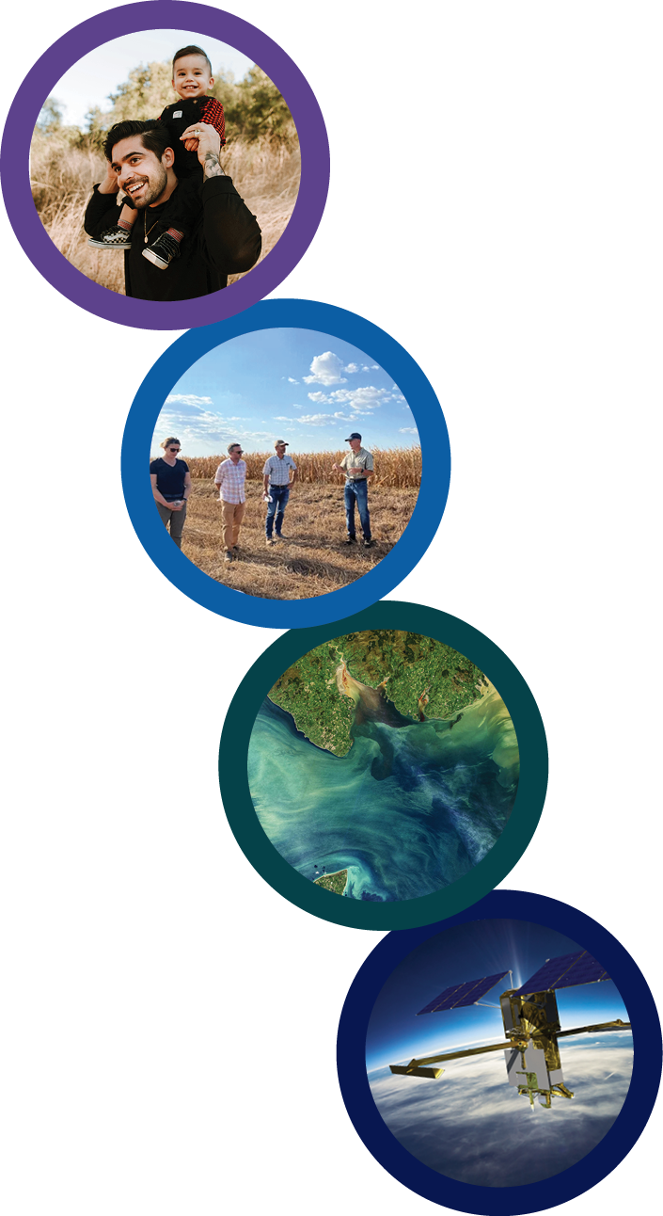
Earth Science to
Action Strategy
Virtuous Cycle
User needs inform next iteration of programs, missions and initiatives
Earth Science to Action
Public Understanding & Exchange
Put more scientific understanding into public sphere
Deliver applied science to users
Participate in multi-way info exchange
Use input to inform subsequent work
EARTH SCIENCE DIVISION
Solutions with Value to the Nation
Offer models, scientific findings and info through
Open-Source Science principles
Support private sector development of applications of
Earth observations
Provide science applications and tools to inform decisions
Earth System Science & Applied Research
Grow scientific understanding of Earth’s systems
Develop predictive models of dynamic Earth systems and tools to understand and adapt to changes
Foundational Knowledge,
Technology, Missions & Data
Technology innovation
Earth observations missions
Data collected from space, air and ground
04.29.2025

Slide 8
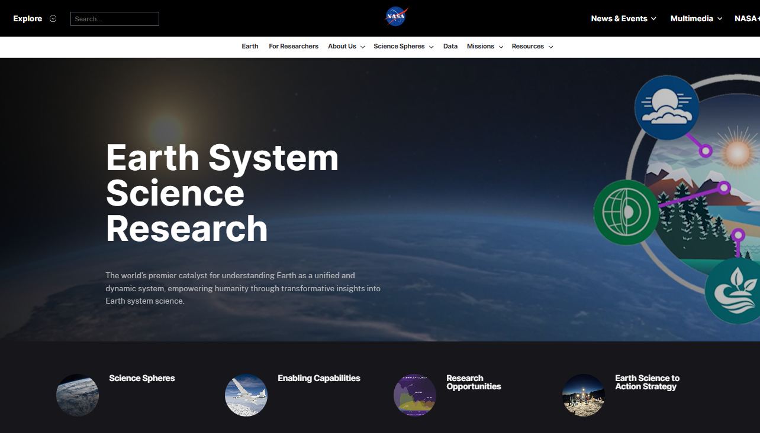

Scan the QR code or go to science.nasa.gov/earth-science/research/

Slide 9
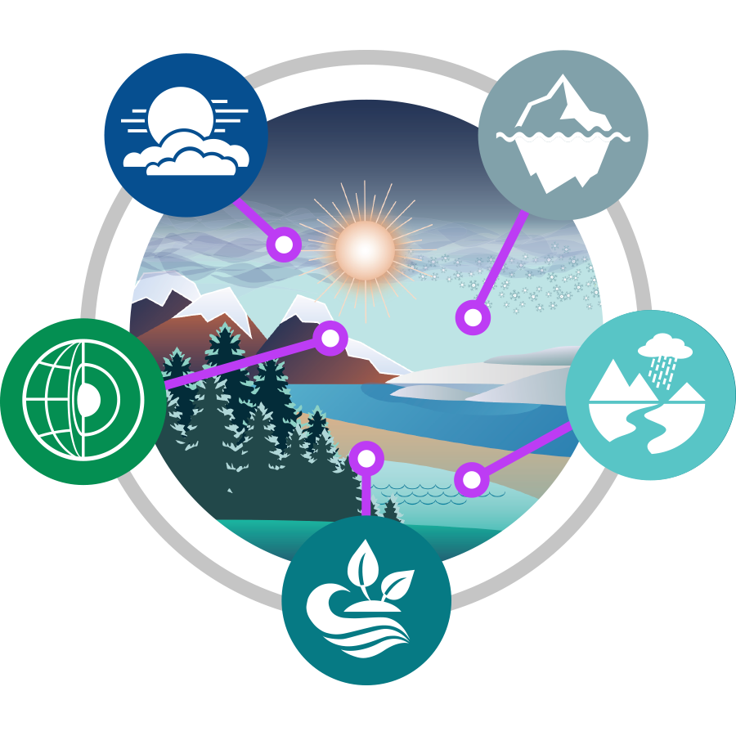
ESD Research advances Earth system science by enabling the use of satellite, airborne, and ground-based observations, along with modeling approaches, to improve understanding of Earth processes.
Atmosphere
Studies the dynamics and thermodynamics of the atmosphere, its physical and chemical composition, and the interdependent impacts that these have on the Earth’s radiative balance, air quality, and weather.
Cryosphere
Studies polar ice, including the Antarctic and Greenland ice sheets, polar glaciers, sea ice in the Arctic and Southern Oceans, and the cryosphere’s link to Earth system
Geosphere
Studies processes and changes in the Earth’s core, mantle, and crust along with surface topography and geology, and the hazards they generate, along with studying geodesy and geodynamics.
Hydrosphere
Improves the observation, understanding, and prediction of water and energy in the Earth System across land, ocean, and the atmosphere through the integration of measurements from satellites, surface networks, and airborne campaigns.
Biosphere
Studies the interactions between/within terrestrial and aquatic ecosystems, along with changes in their biogeochemistry and biodiversity, to further understand the Earth system in which both human-induced and natural changes influence productivity and the availability of natural resources.
Notes:
Source: March 2026 CESAS Presentation

Slide 10
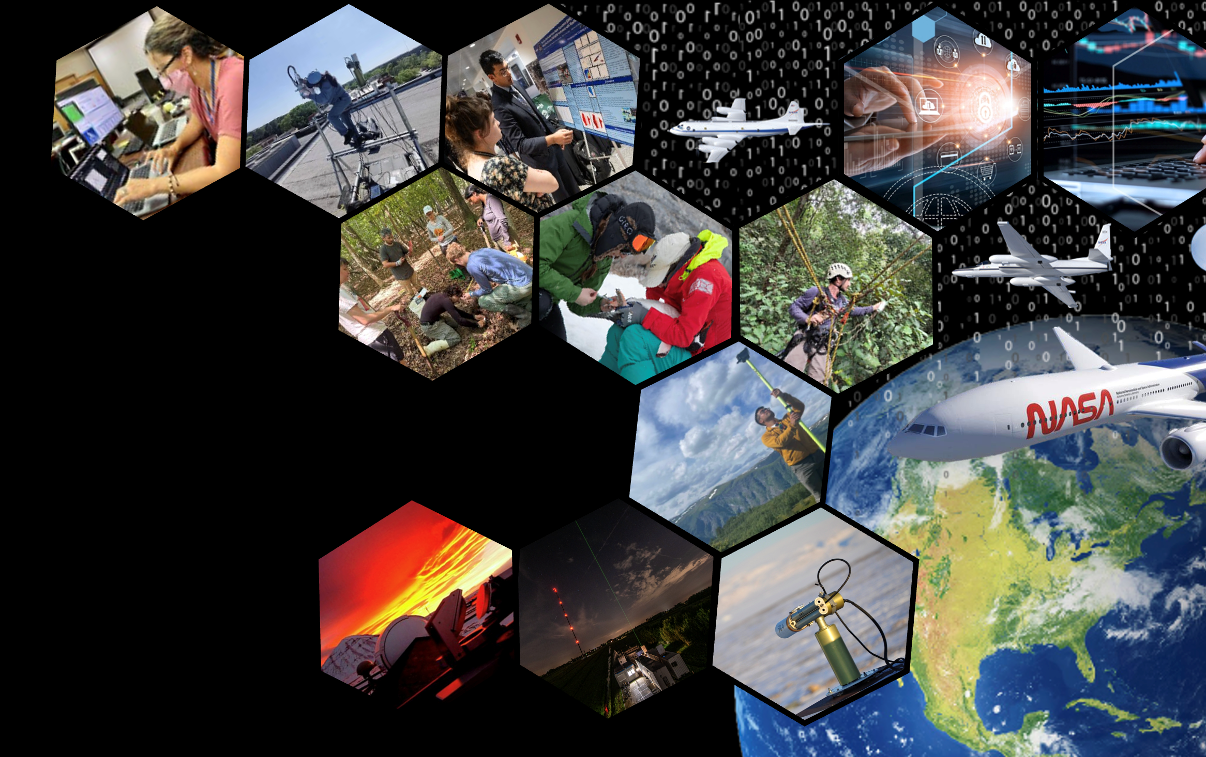
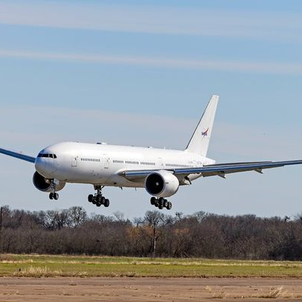
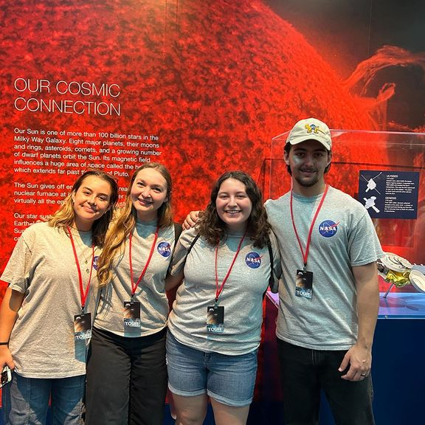
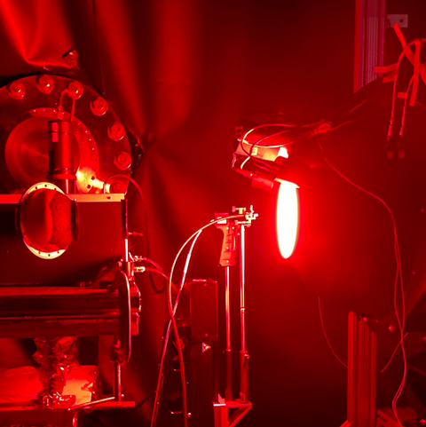
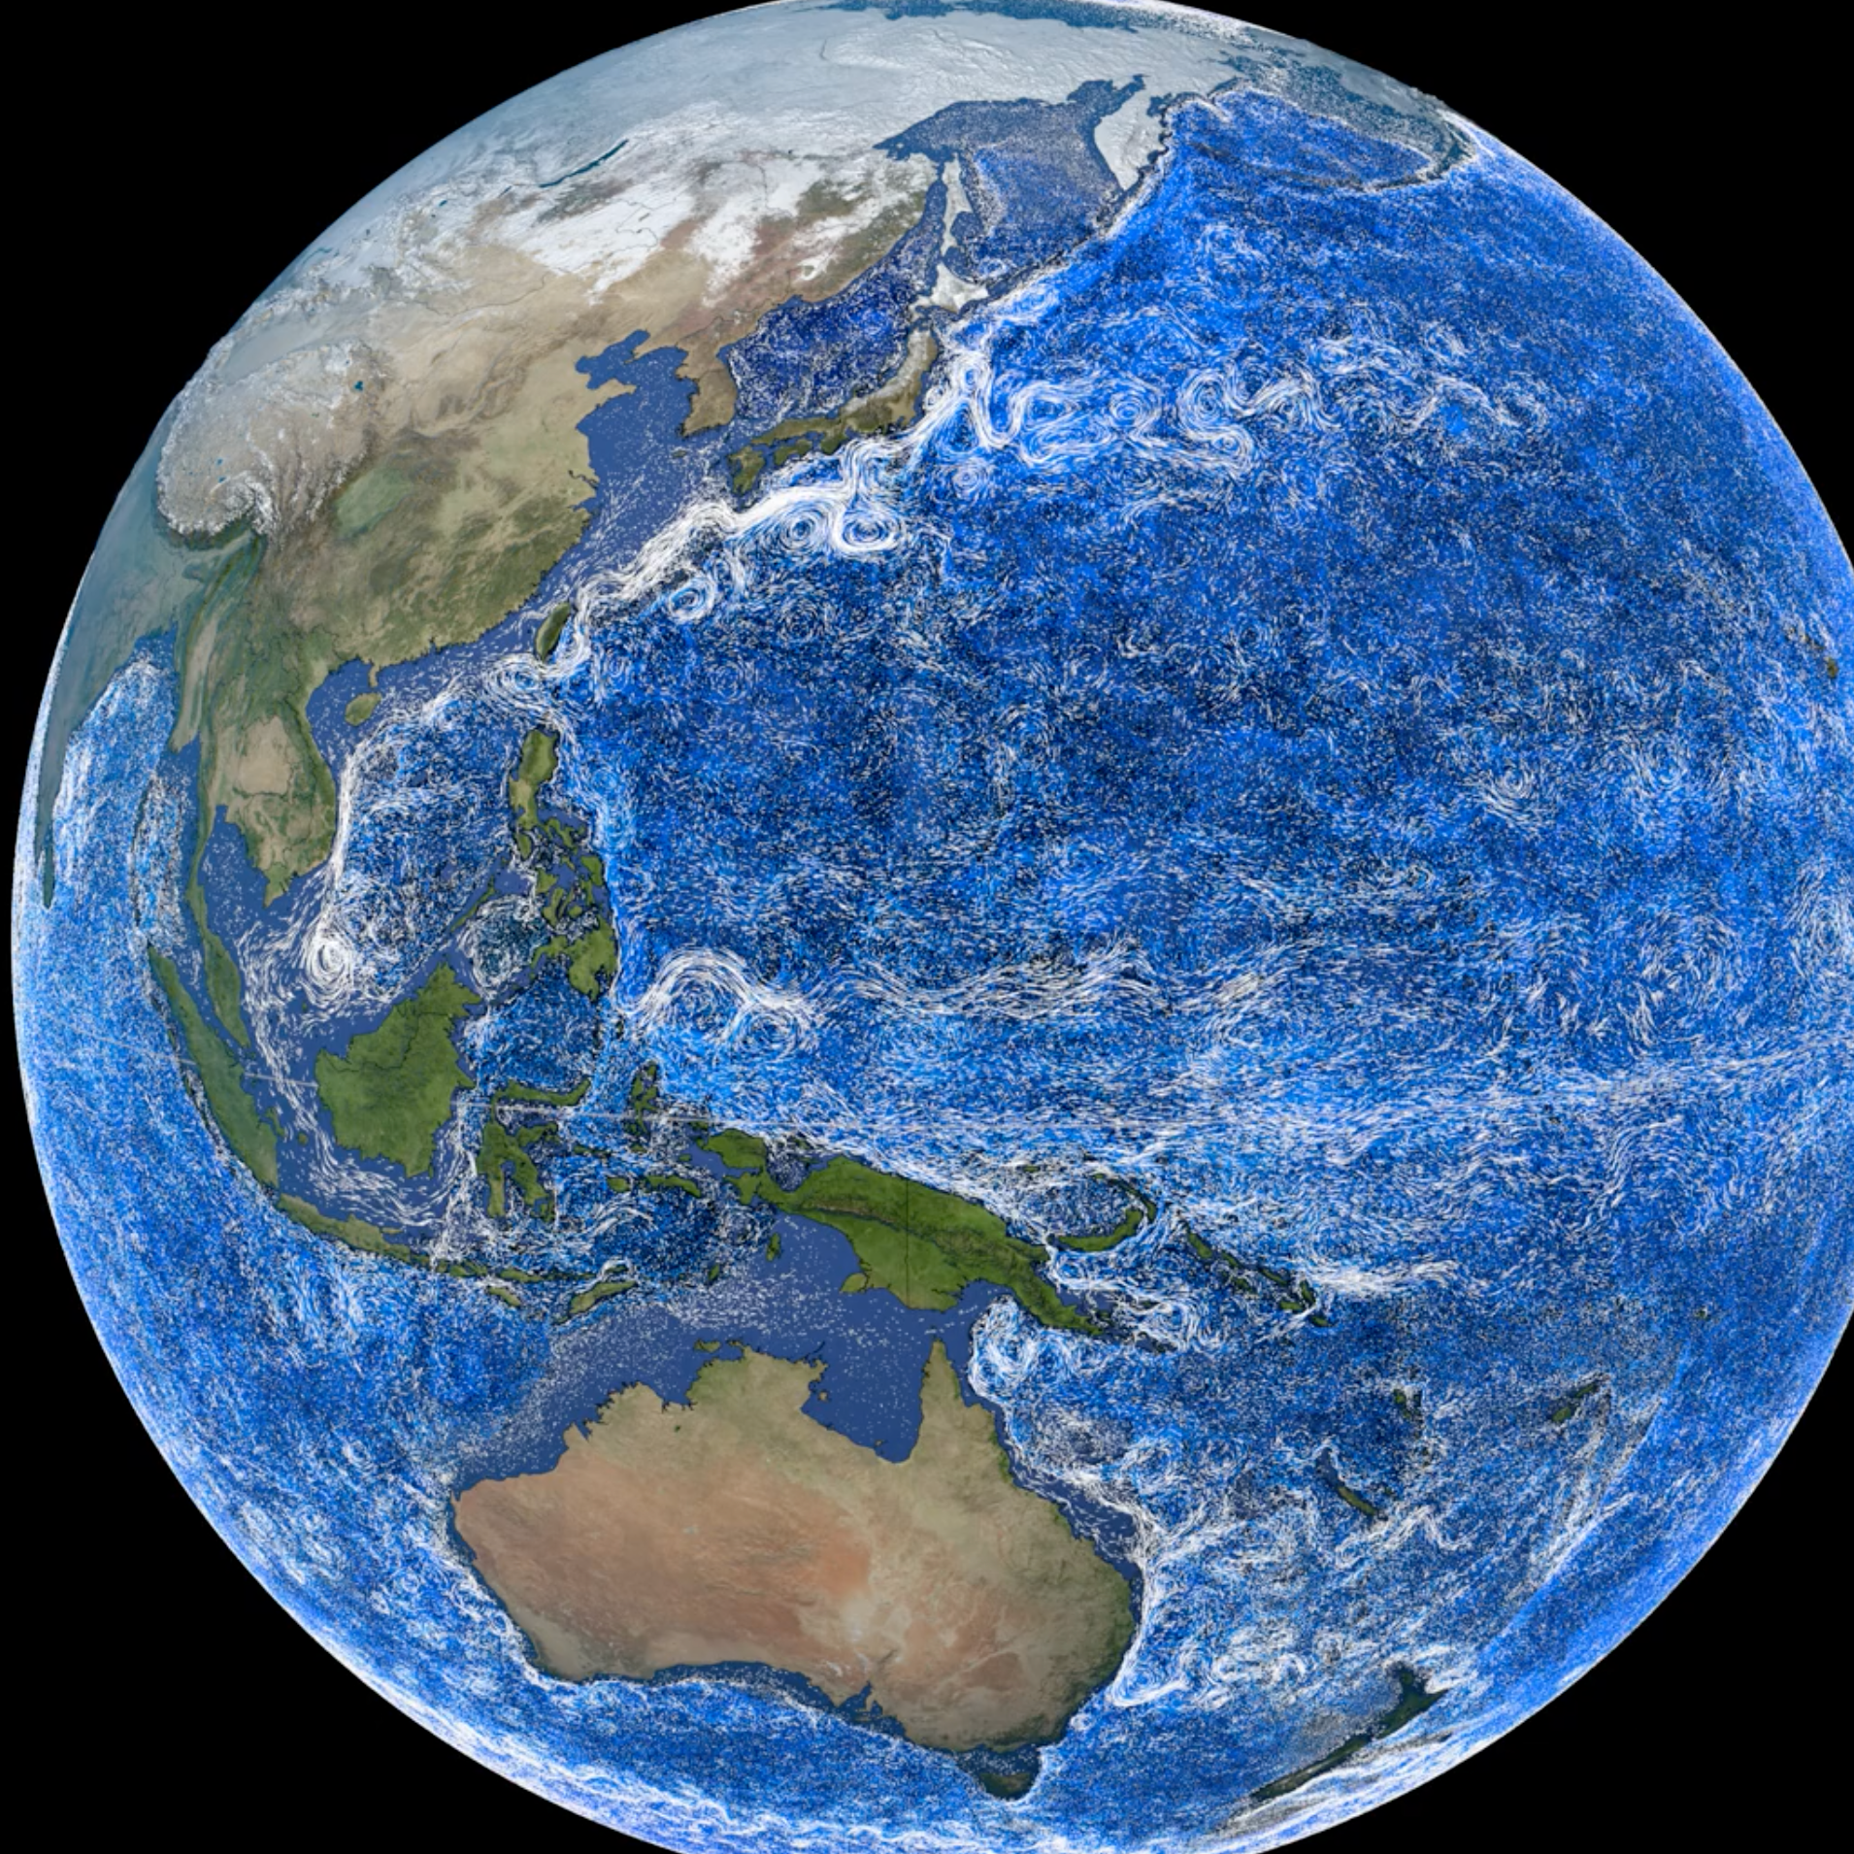
Enabling Capabilities
Foundational cross-cutting activities, opportunities, technologies, systems, or processes that benefit all Earth Science Division elements and Science Spheres.
Airborne Science Program
Early Career Research
Ground Networks, Calibration Labs, and Crowdsourcing
Integrated Earth System Modeling
Notes:
Source: January 2026 CESAS Presentation
Airborne Science Program
Integrated Earth System Modeling
Ground Networks, Calibration Labs, and Crowdsourcing
Early Career Research

Slide 11
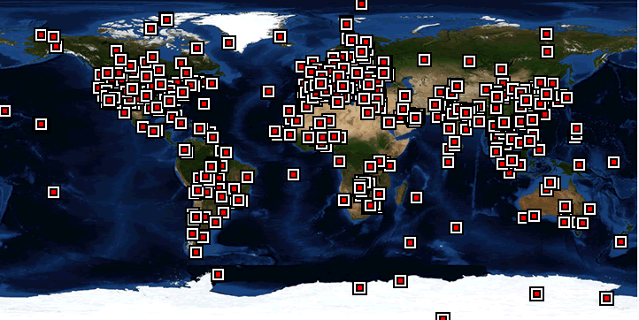
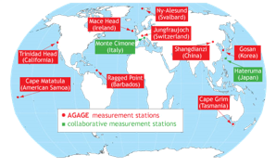
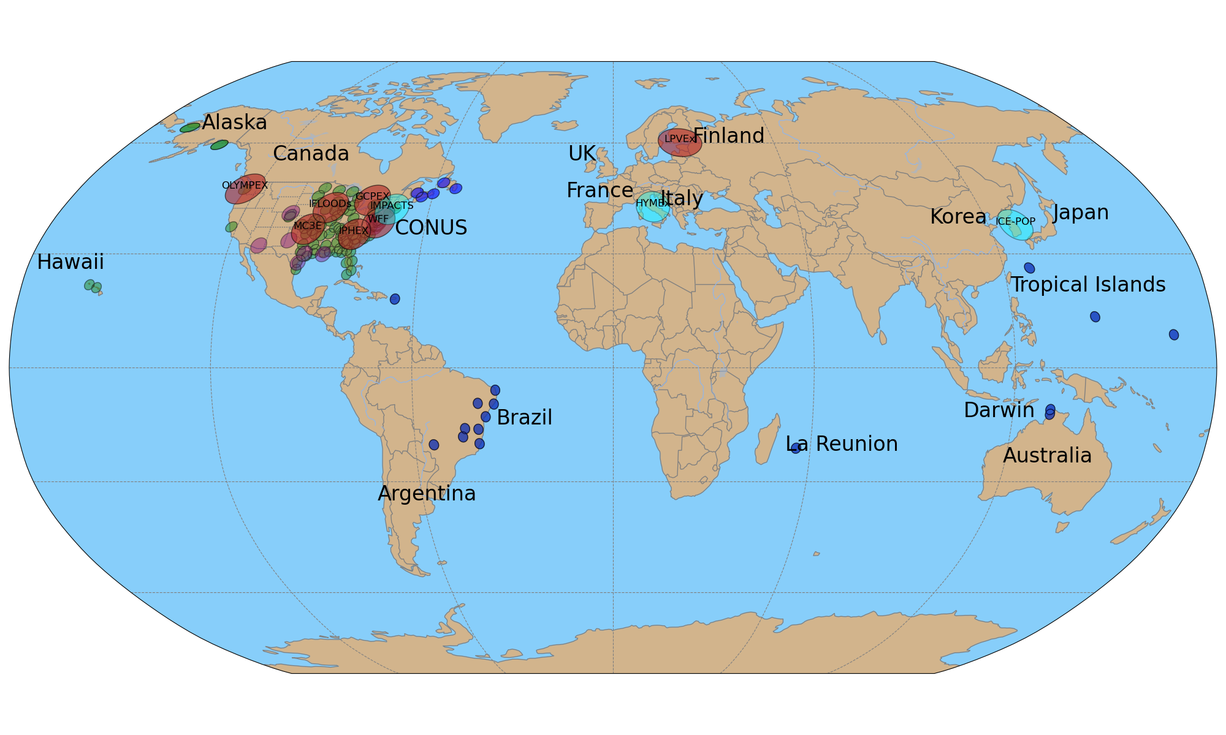
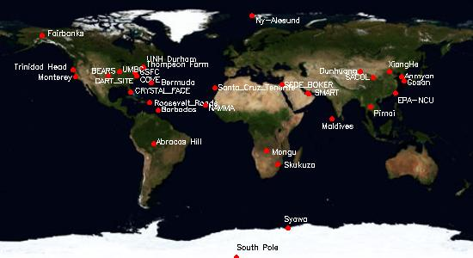
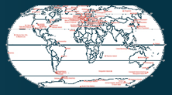
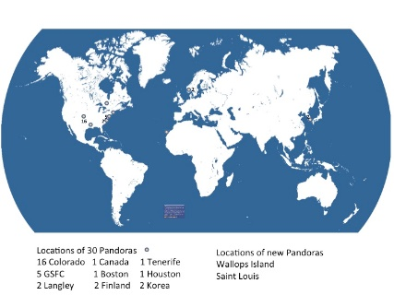
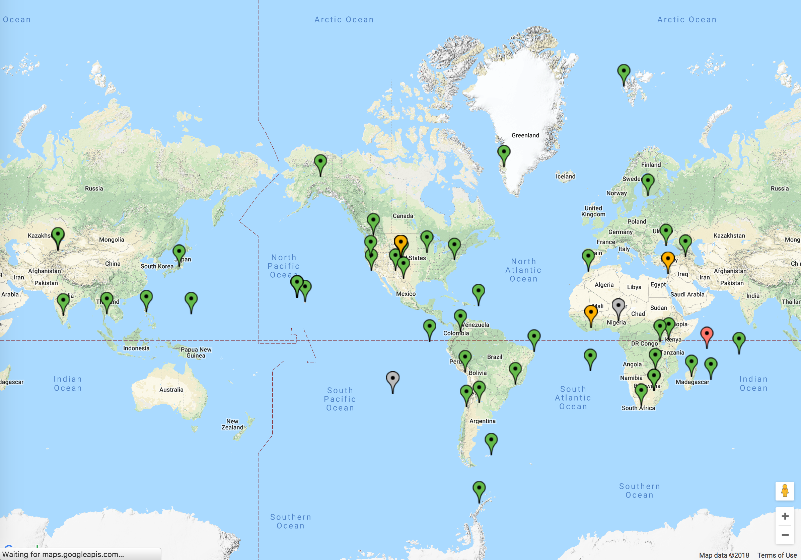
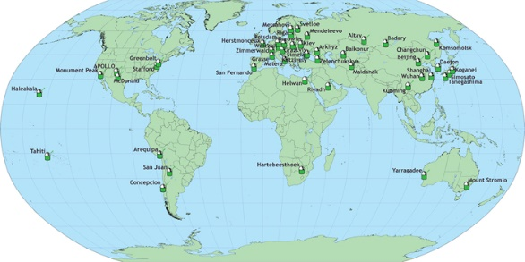
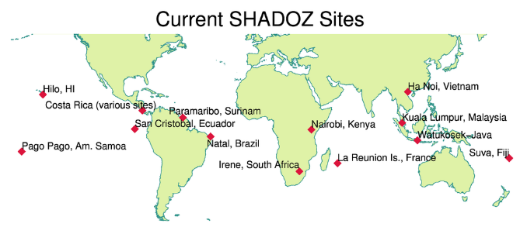
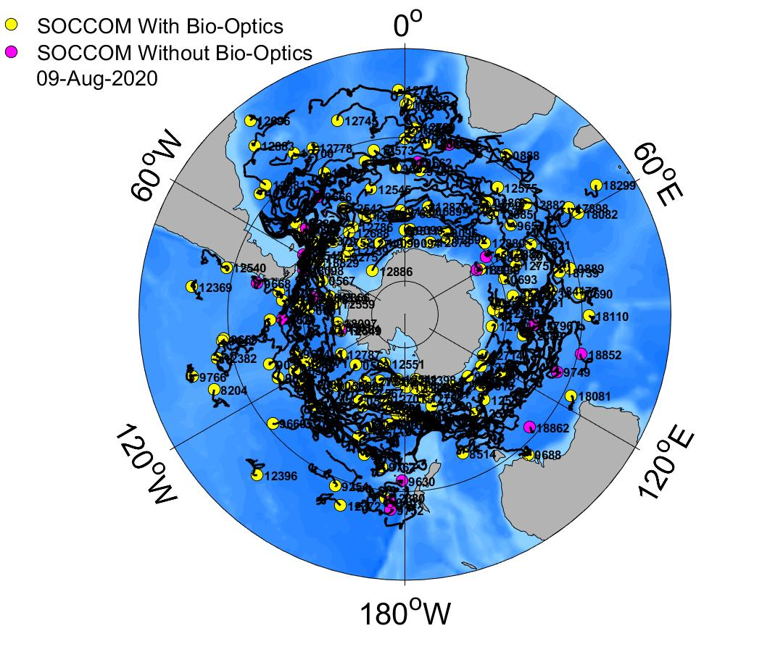
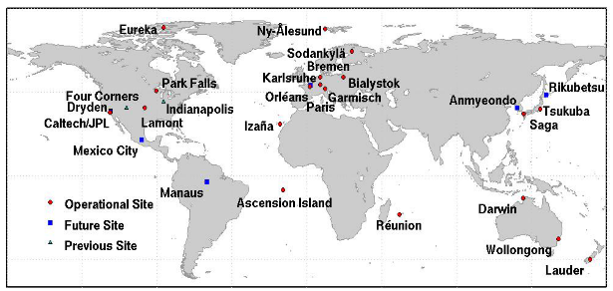
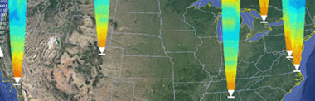
NASA Surface-Based Measurement Networks
AERONET
AGAGE
GPM Ground Validation
MPLNet
NDACC
PANDORA
Space Geodesy
GGN
NSGN
SHADOZ
SOCCOM
TCCON
TOLNet
11
Notes:
All networks updated April 2024
GPM Ground Validation added August 2024

Slide 12
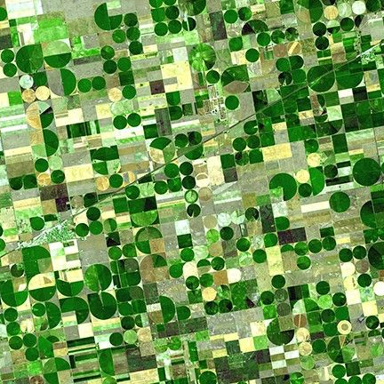
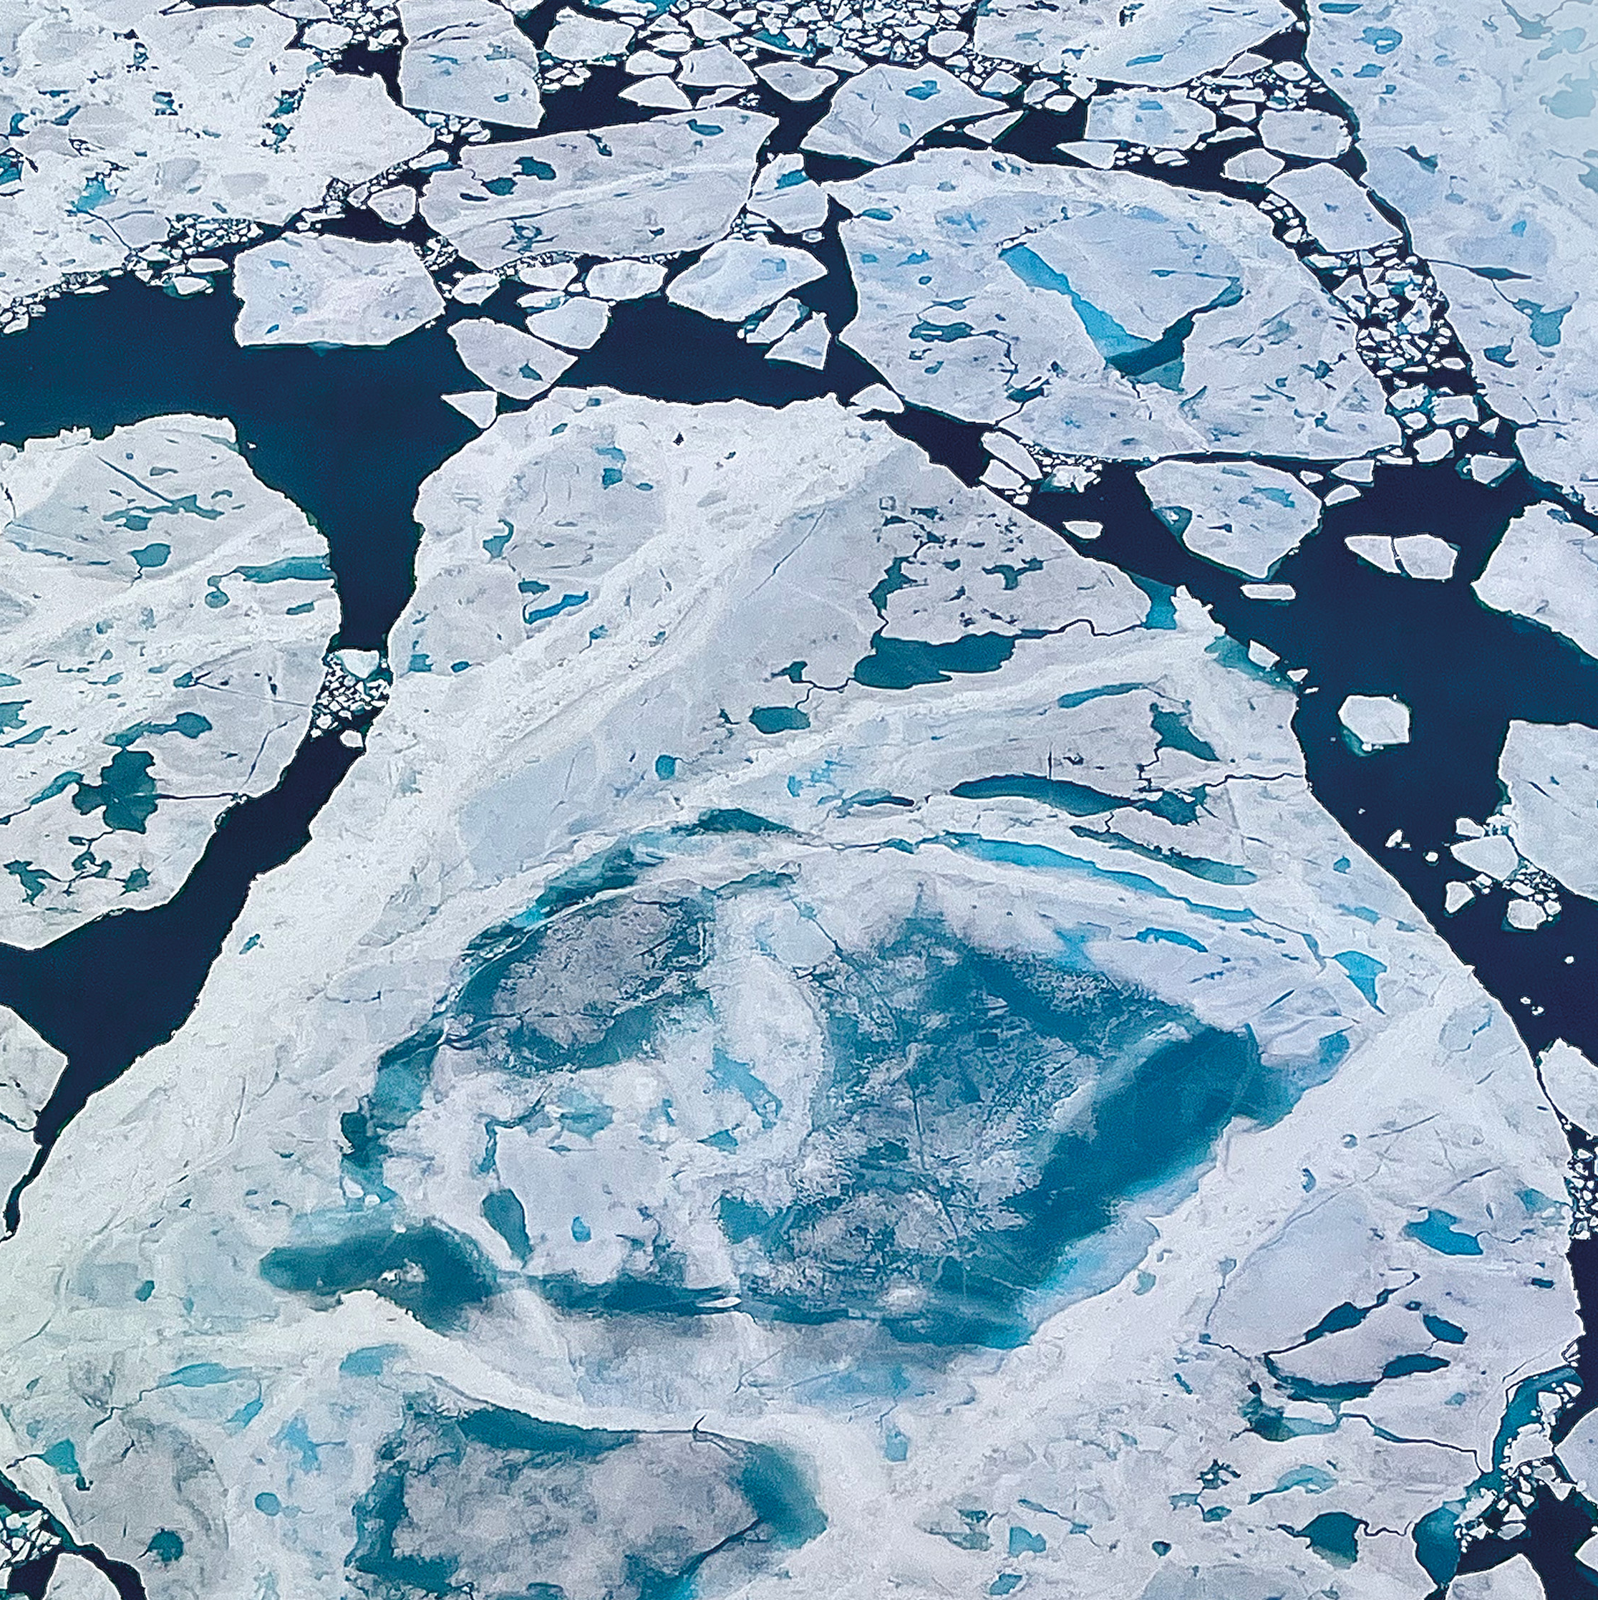
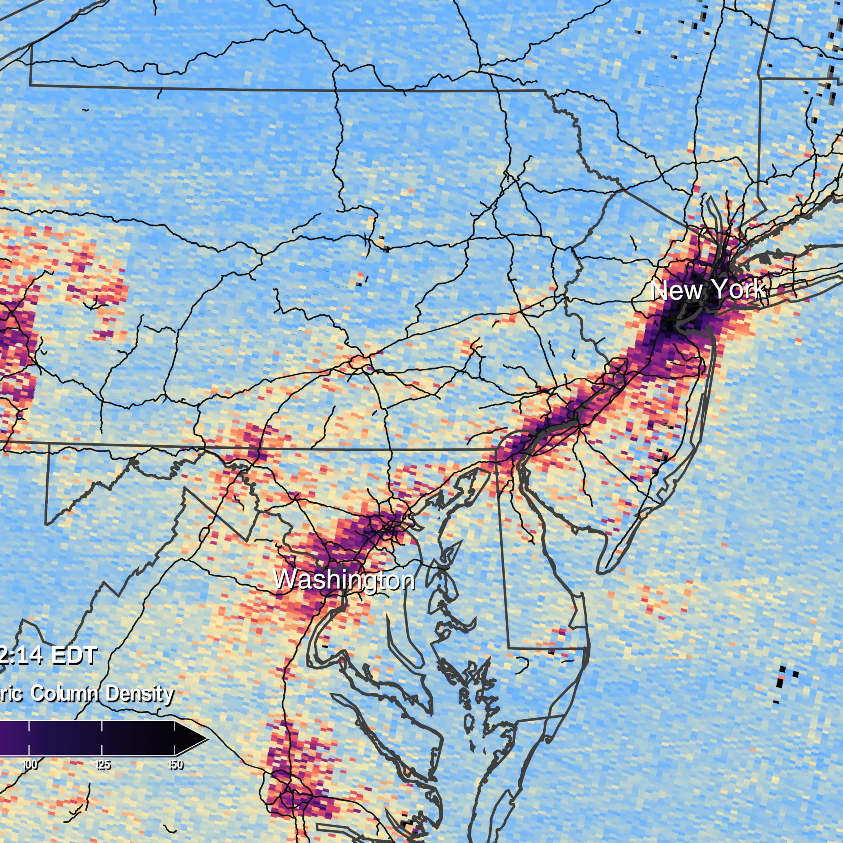
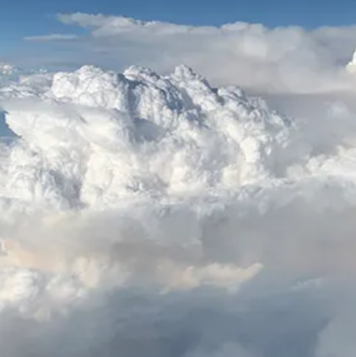
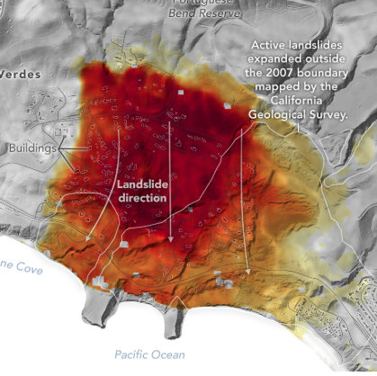
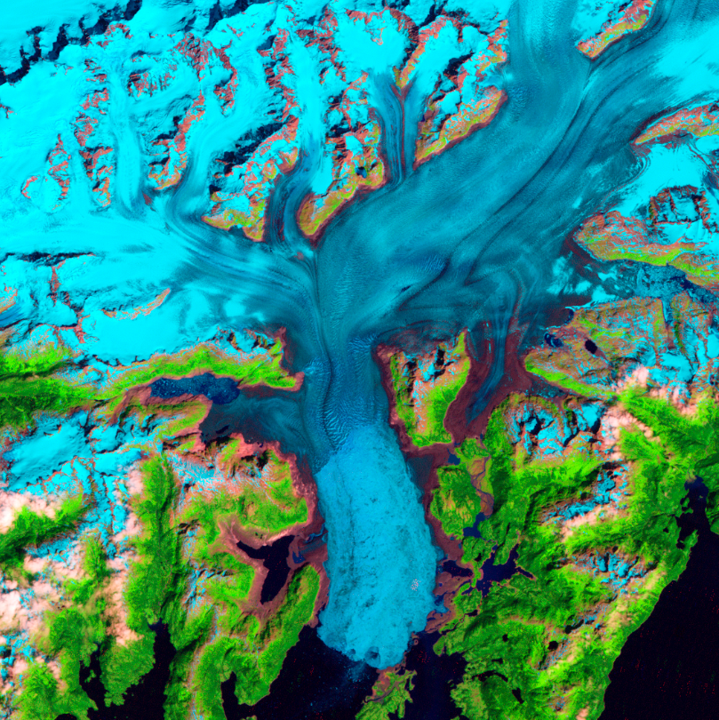
Earth Venture Suborbital Missions
FarmFlux
FORTE
ESD selected six new airborne missions that include domestic and international studies of fire-induced clouds, Arctic coastal change, air quality, landslide hazards, shrinking glaciers, and emissions from agricultural lands.
HAMAQ
INSPYRE
LACCE
Snow4Flow
Notes:
Created March 2026

Slide 13

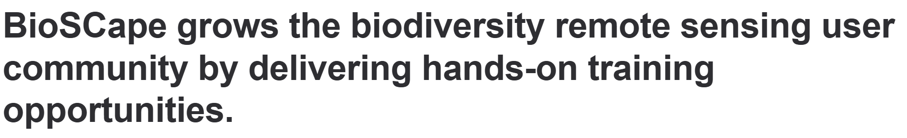
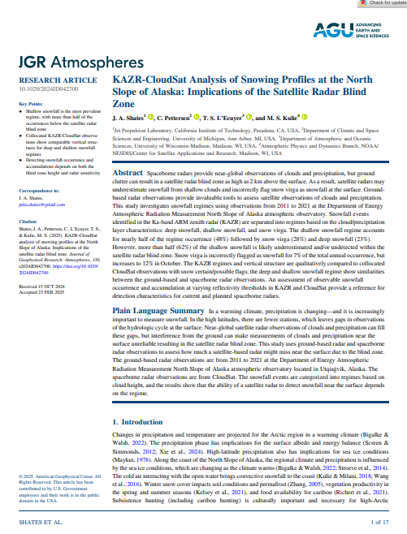
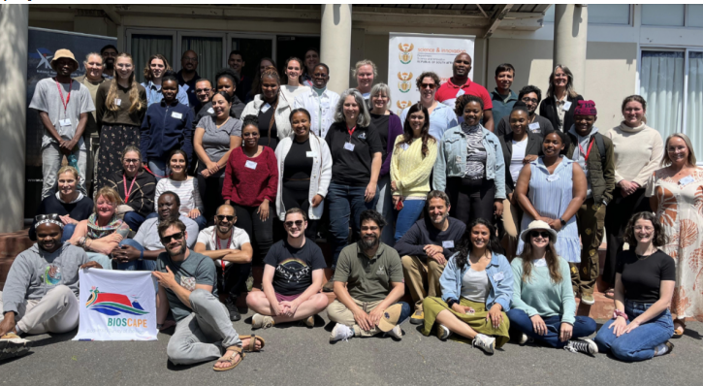
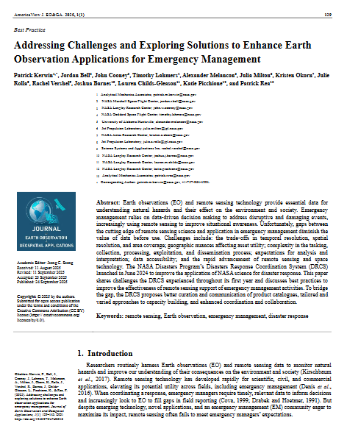
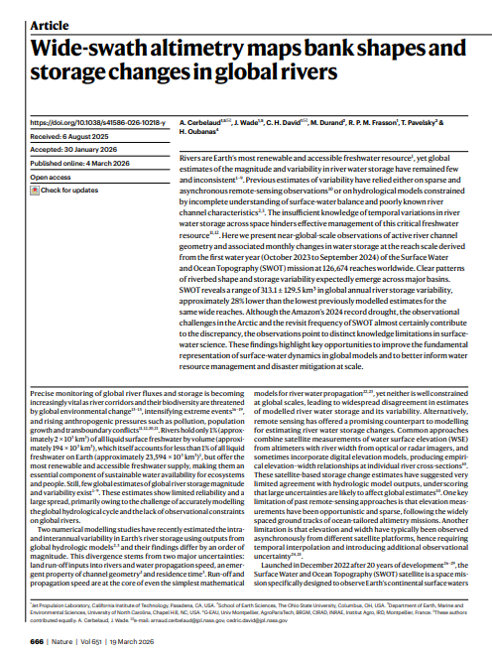
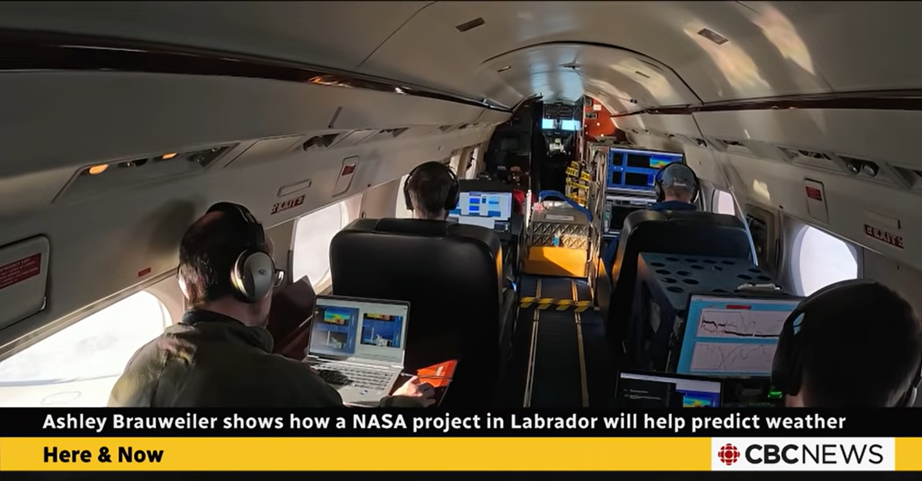
NASA Earth Science Research Results Portal
esdresearch.nasa.gov
Meetings and Events
Research Results and Scientific Developments
Campaign Highlights
Notes:
Source: March 2026 CESAS Presentation
Link: https://esdresearch.nasa.gov/

