Slide 1


Synthetic TEMPO Data Products at NASA SPoRT for Air Quality and Public Health Communities
Aaron Naeger, Michael Newchurch, Susan Alexander, Emily Berndt, and Erika Duran
June 5-6, 2019
TEMPO Science Team Meeting
Madison, WI

Slide 2

Short-term Prediction Research and Transition (SPoRT)
Mission: Transition unique NASA and NOAA observations and research capabilities to the operational weather community to improve short-term weather forecasts on a regional and local scale
SPoRT prepares the community of end users and mission scientists for next generation satellite missions and capabilities through an interactive R2O/O2R paradigm
Current/Future Activities:
Successful partnerships to prepare NWS forecasters for GOES-R and JPSS through use of experimental proxy products
Expanding partnerships to other government agencies and new NASA missions
https://weather.msfc.nasa.gov/sport/

Slide 3
R2O/O2R Paradigm
Bridge the “Valley of Death” through interactive partnership with end users and product or algorithm developers
  Integrate data into user decision support tools
  Create product training
  Conduct product assessments
Concept has been used to successfully transition more than 40 satellite datasets to operational users for nearly 15 years
Other groups in the community have adopted this paradigm
https://weather.msfc.nasa.gov/sport/

Slide 4



Data Approach
SPoRT provides experimental data to end users by LDM, FTP, and WMS depending on the application
While NASA is not an “operational” data provider, team members strive to provide 24/7 data feeds, knowing that product reliability is key to use by operational forecasters and decision makers
Monitor our product ingest and status for all experimental products going to a customer
Data downlinked from satellite
Data obtained by SPoRT; value-added products generated
Product disseminated to end-user formatted for their decision support system
End-user makes operational decisions using SPoRT products
https://weather.msfc.nasa.gov/sport/

Slide 5
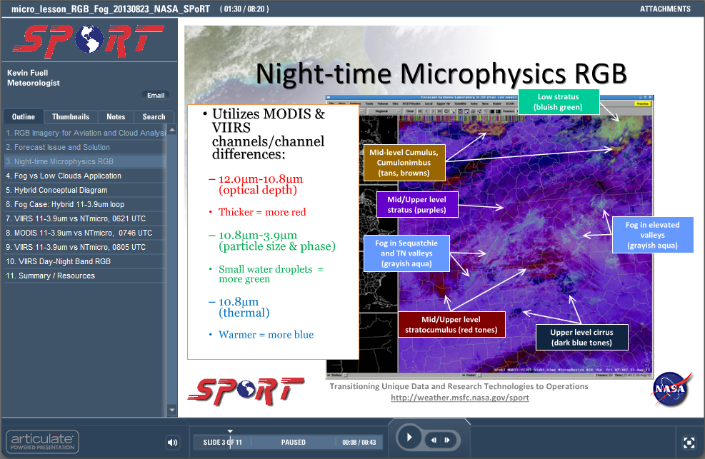
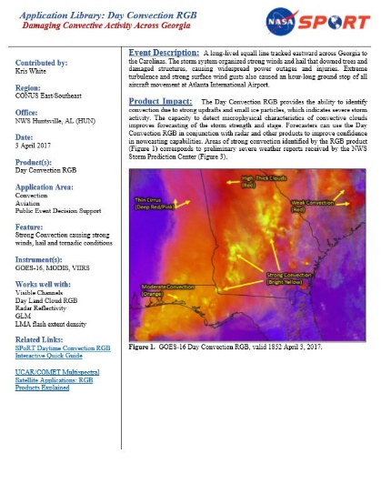
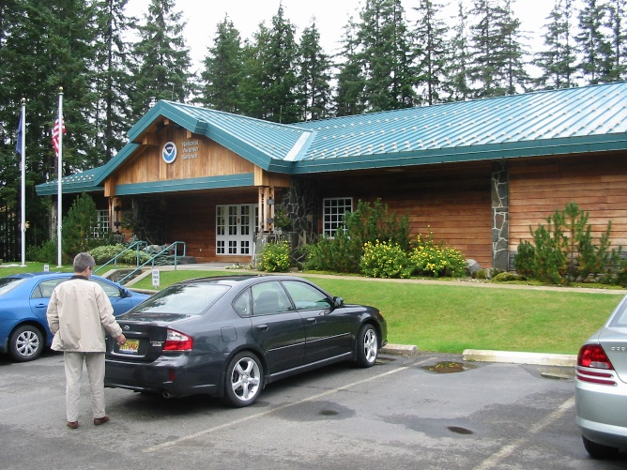
Training Approach
Targeted, applications based training
Multiple flavors of training are needed to reach all learning styles
  Site visits
  Microlessons
  User-based, interactive modules
SPoRT Applications Library
  1-minute examples
  Short videos
  21 total cases (and counting)
Collaborate with end users for operational/decision maker perspective
https://weather.msfc.nasa.gov/sport/

Slide 6
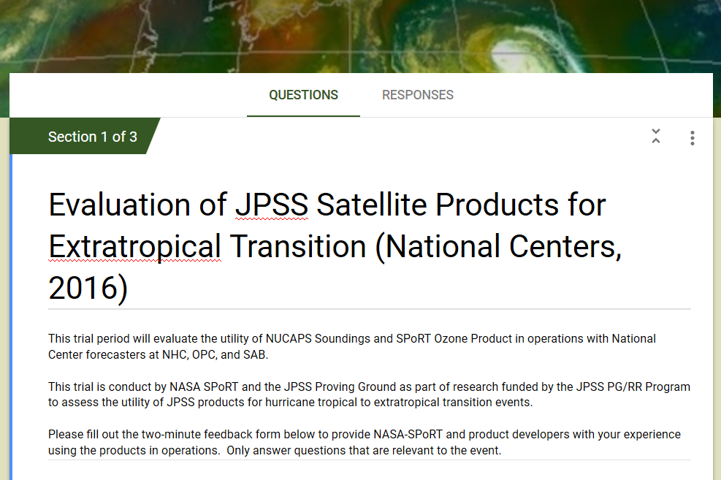
Assessment Approach
Targeted product assessments with the end user to evaluate utility of product and give feedback to developers
Methods for feedback
  Online form
  Email/phone calls
  Blog
Assessment follow-up
  Wrap-up telecon with participants
  Summarize results in a report for the developers
https://weather.msfc.nasa.gov/sport/

Slide 7
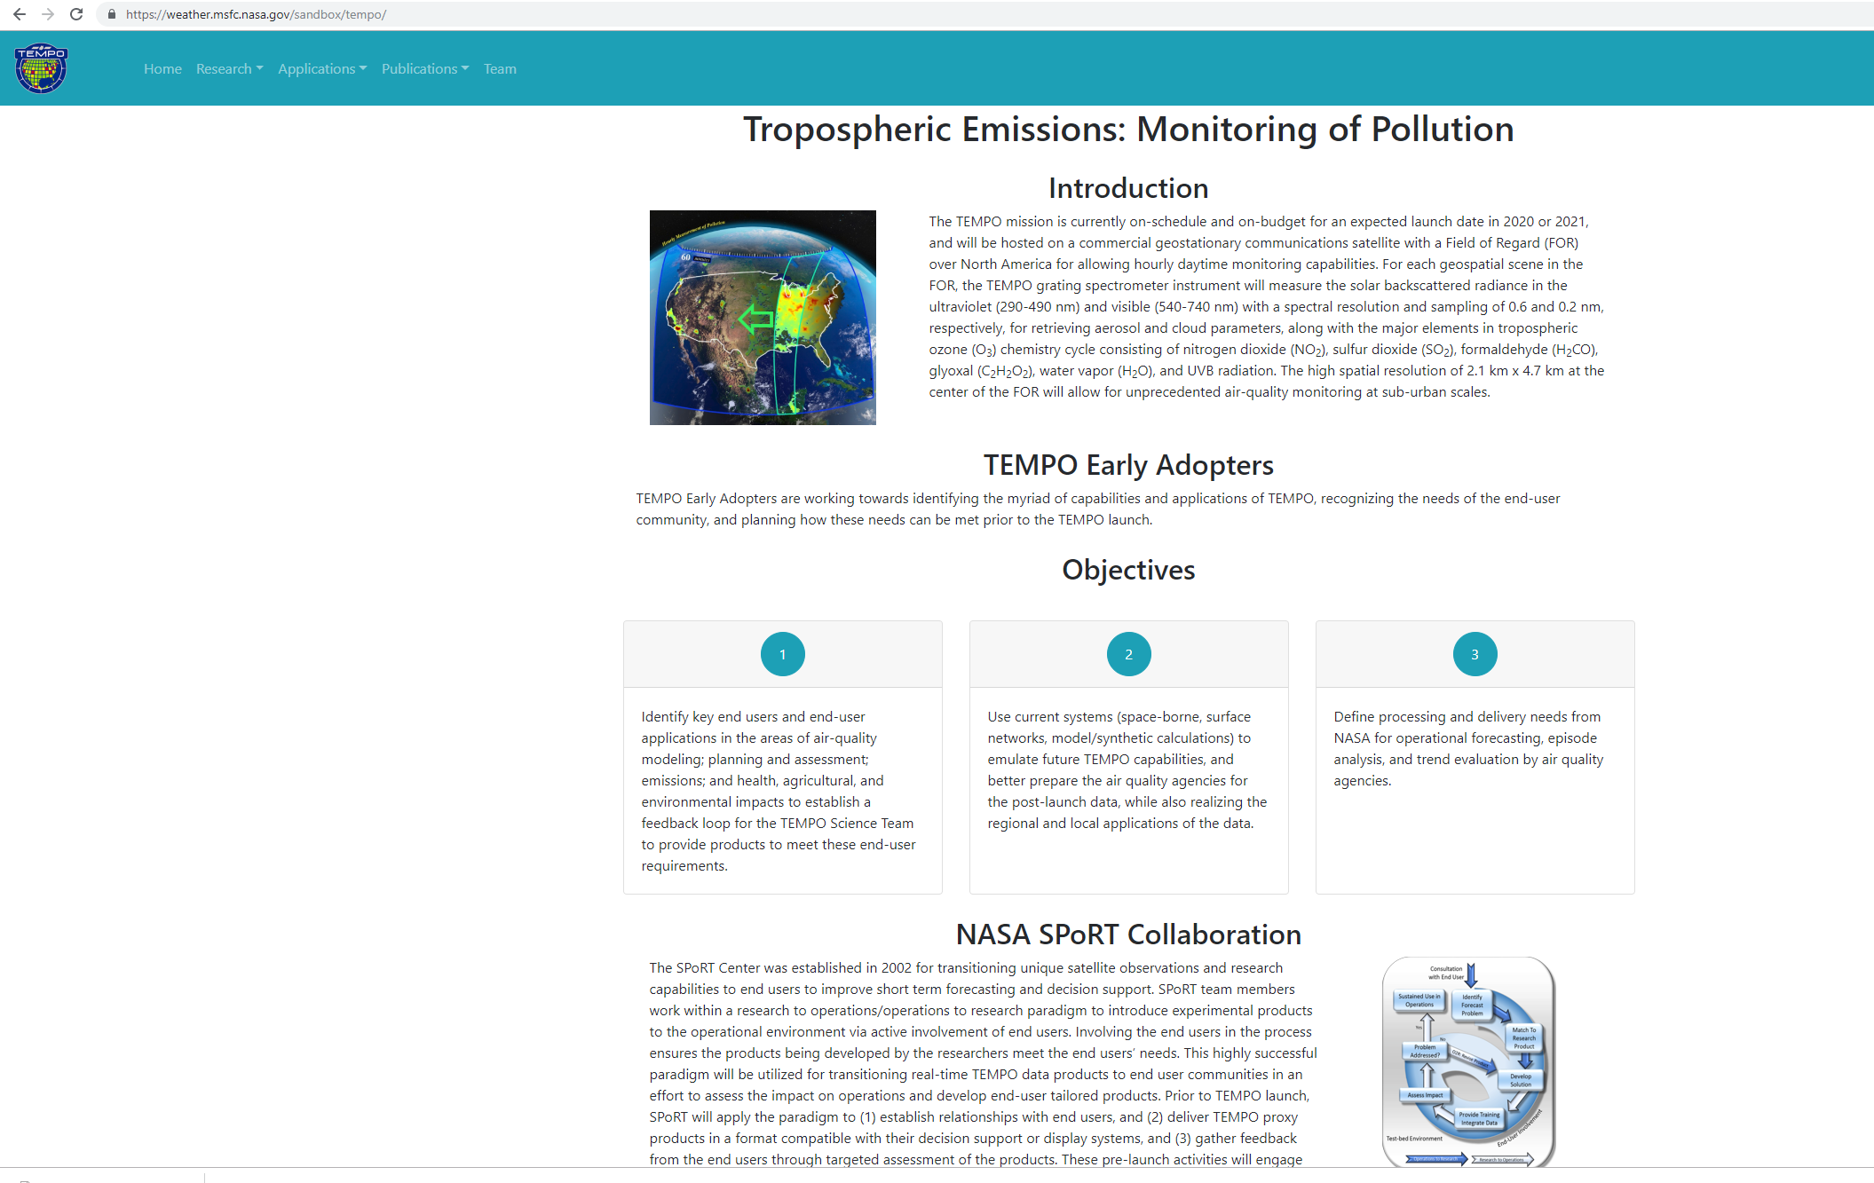
Pre-launch R2O/O2R Activities
Keys to successful day 1 readiness
  Data in the end users’ display system
  Targeted training
  Assessments to gather feedback from users for the mission scientists
  Pre-launch R2O/O2R activities can provide valuable input to data processers, mission scientists, algorithm developers, and guide baselining of products/capabilities
https://weather.msfc.nasa.gov/sport/

Slide 8
Synthetic TEMPO data
GEOS-Chem
Synthetic TEMPO observations generated using simulated gaseous and aerosol composition from GEOS-NR
GEOS-NR spatial resolution of ~12 x 12 km² spatiotemporally interpolated to finer TEMPO grid
Profiles and vertical column amounts of species obtained from interpolation
H₂CO
Aircraft (CAMS)
H₂CO
Zhu et al. (ACP, 2016)

Slide 9
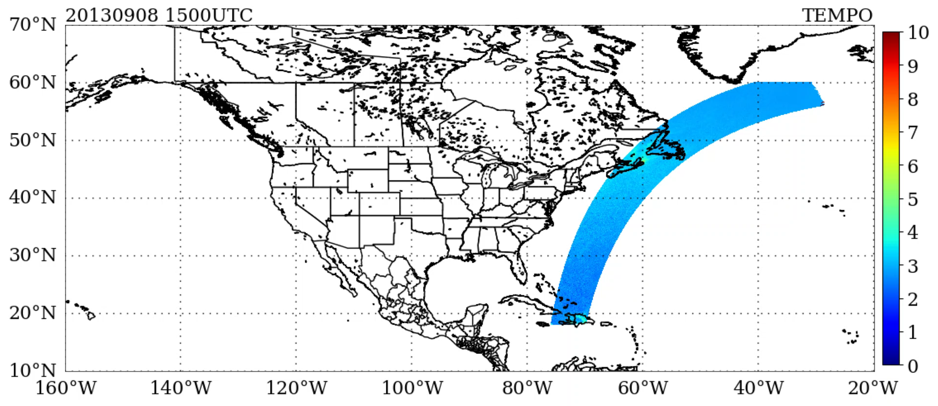
Synthetic TEMPO data
TEMPO NO₂
NO₂ tropospheric column density (10¹⁵ molec./cm²)
Generating long-term archive of TEMPO proxy products
Goal: Utilize TEMPO proxy data for applications to accelerate operational use of real TEMPO products after launch
https://weather.msfc.nasa.gov/sport/

Slide 10
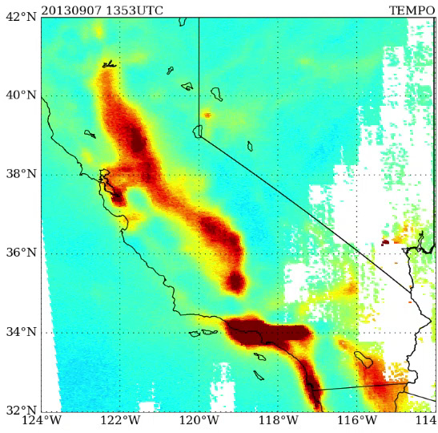
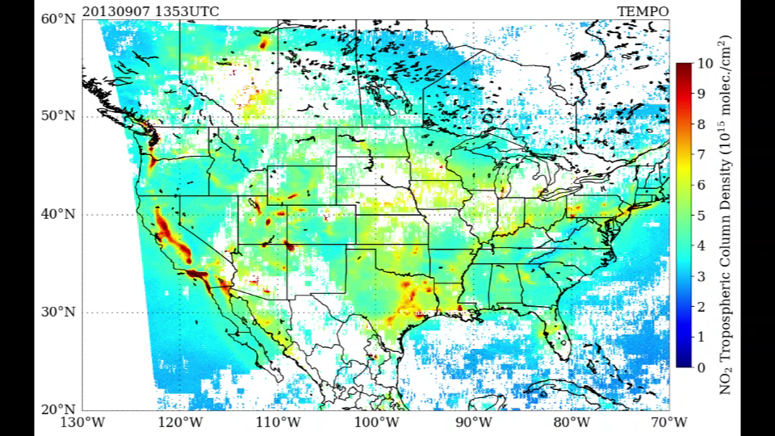
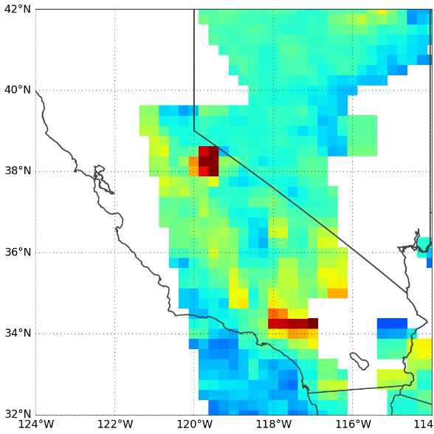
Synthetic TEMPO data
TEMPO NO₂
TEMPO NO₂
OMI NO₂ at 2130 UTC
Diurnally varying mobile source emissions and smoke plumes shown in TEMPO proxy data
https://weather.msfc.nasa.gov/sport/

Slide 11
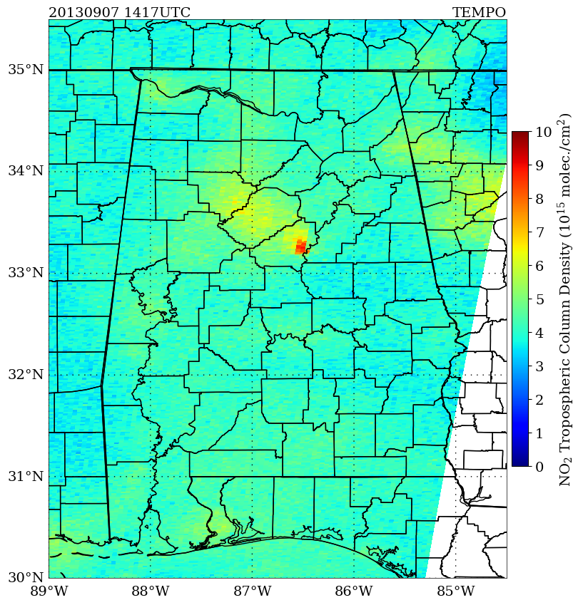
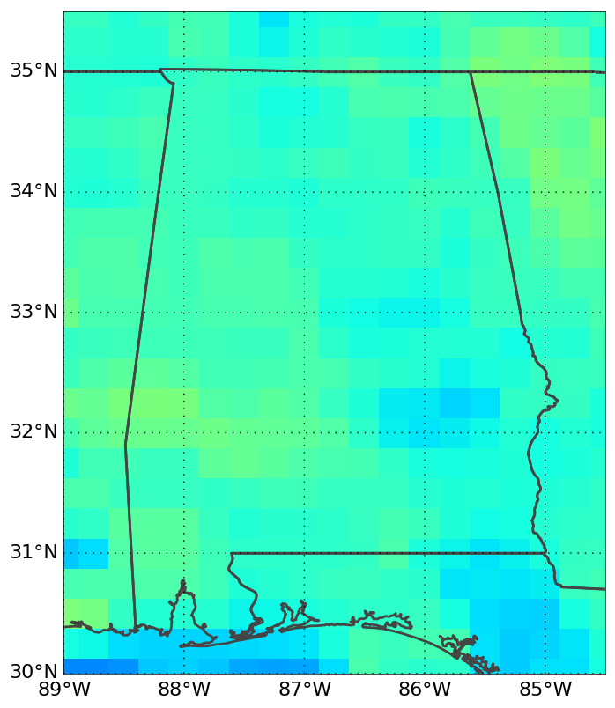
Synthetic TEMPO data
TEMPO NO₂
OMI NO₂ at 1900 UTC
https://weather.msfc.nasa.gov/sport/

Slide 12
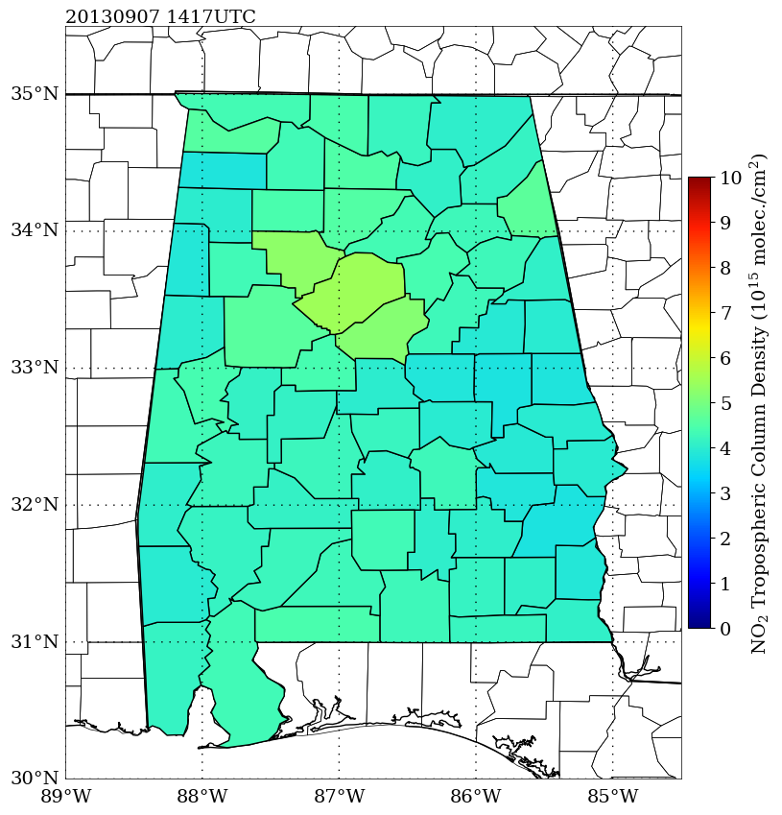
Synthetic TEMPO data
TEMPO NO₂
OMI NO₂ at 1900 UTC
TEMPO at county level, broader scale NO₂ field shows at county level, but NO₂ emission from Alabama Power Gaston Plant is no longer apparent
https://weather.msfc.nasa.gov/sport/

Slide 13
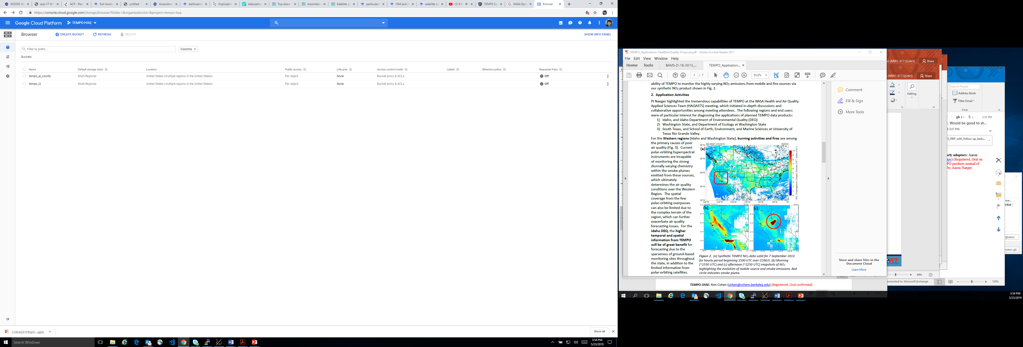
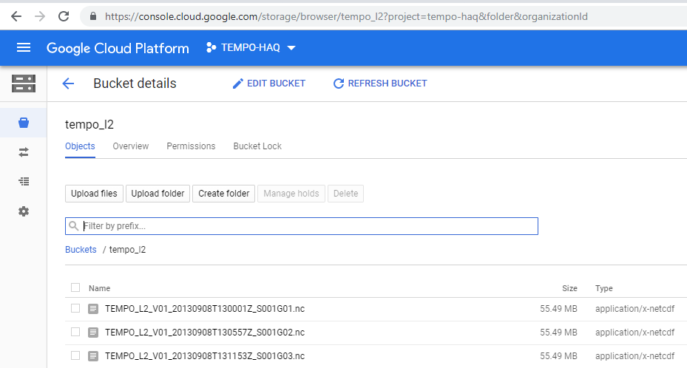

Google Cloud Platform
Preparing and storing L2 products and formatted text files of gas concentrations and meteorology at county level for public health stakeholders (e.g., Alabama Hospital Association, Alabama Quality Assurance Foundation)
https://weather.msfc.nasa.gov/sport/

Slide 14
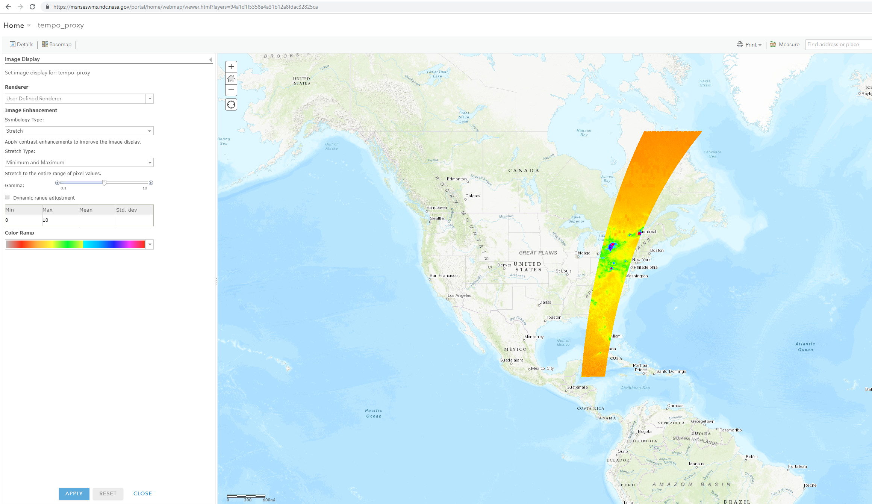
ESRI Visualization for TEMPO
Advantages of ESRI platform
1) Point and click feature for retrieving raw geophysical variables
2) Perform analysis via locally installed ArcGIS
3) Can ingest GRIB, NetCDF (CF compliant), GeoTIFF
https://weather.msfc.nasa.gov/sport/

Slide 15
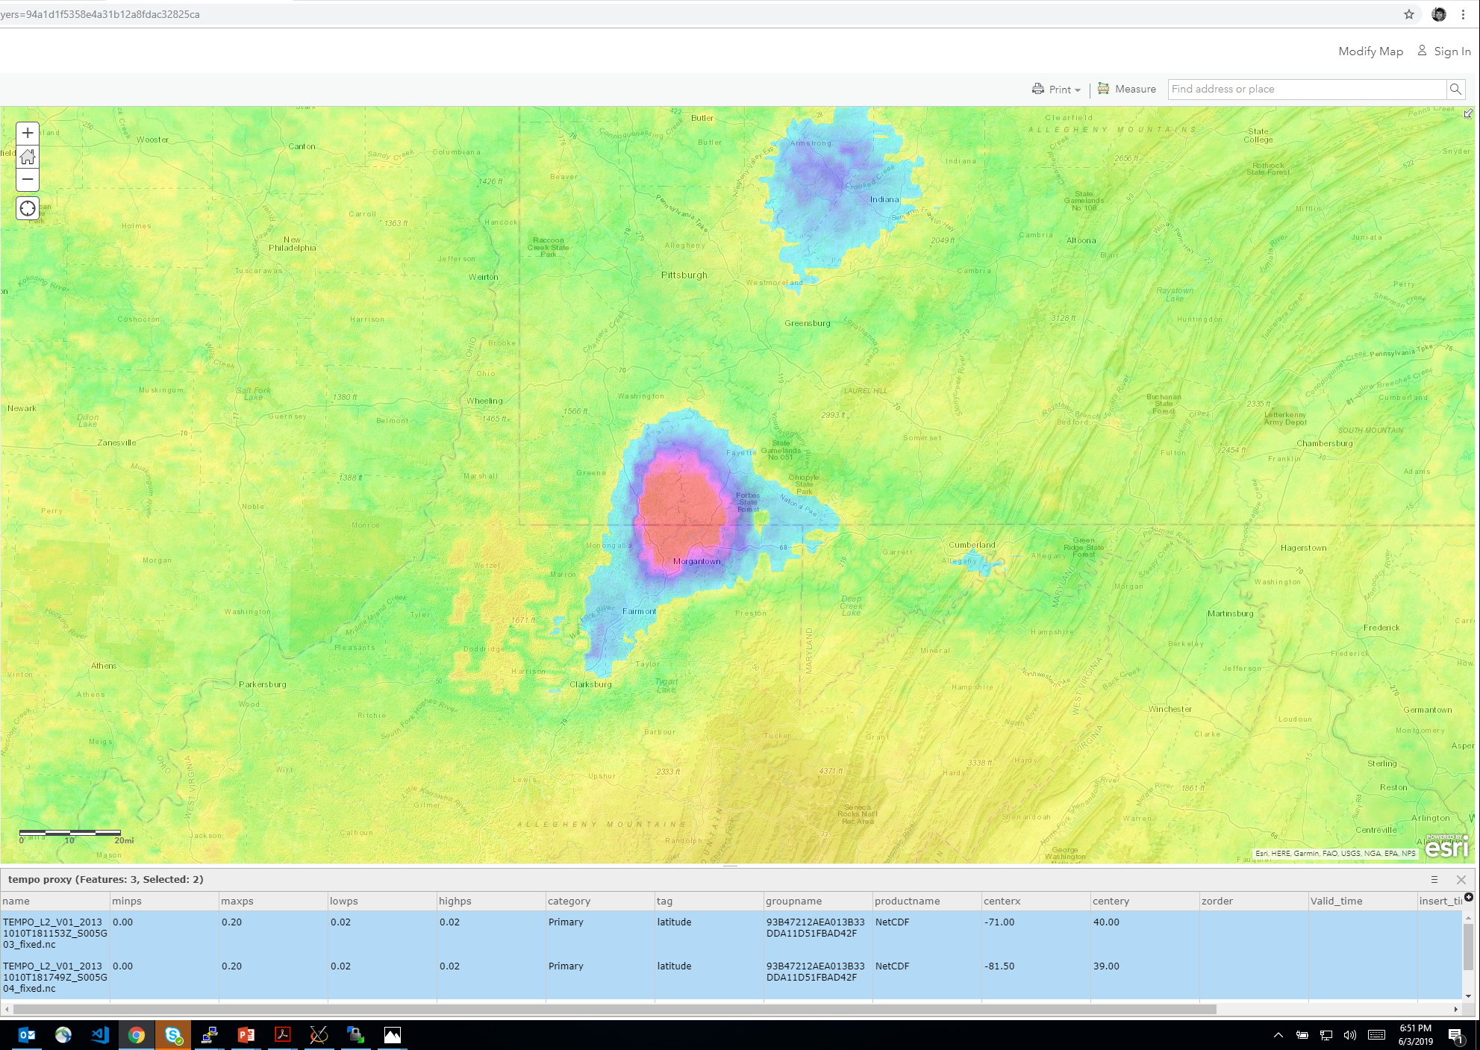
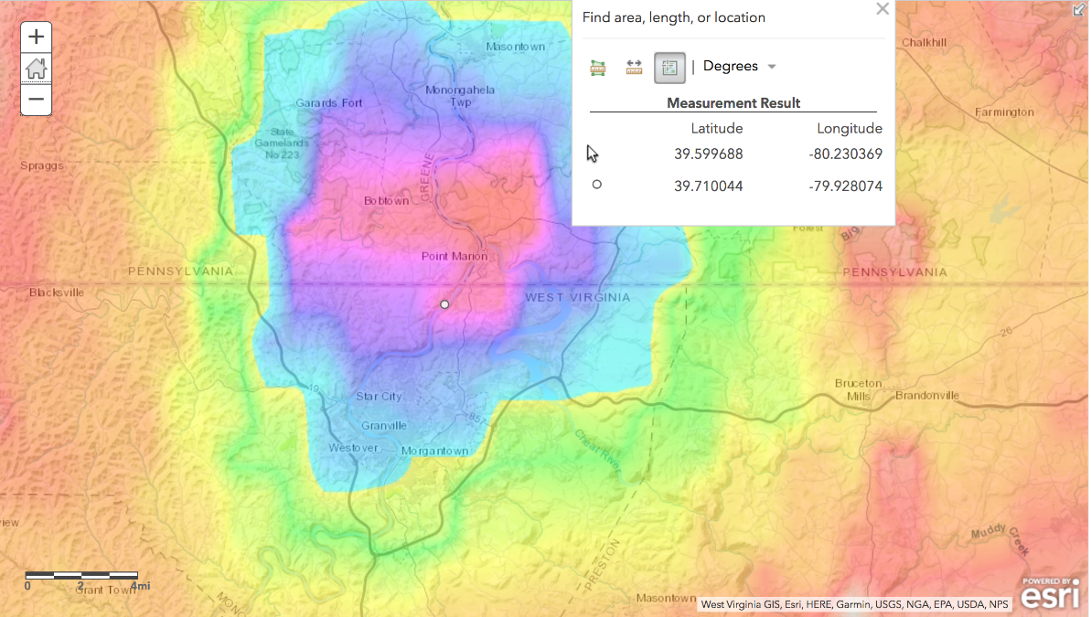
ESRI Visualization for TEMPO
set min/min range
dynamically scaled range
Accurate geolocation of TEMPO data, high NO₂ associated with strong emissions from two active coal plants in area
https://weather.msfc.nasa.gov/sport/

Slide 16
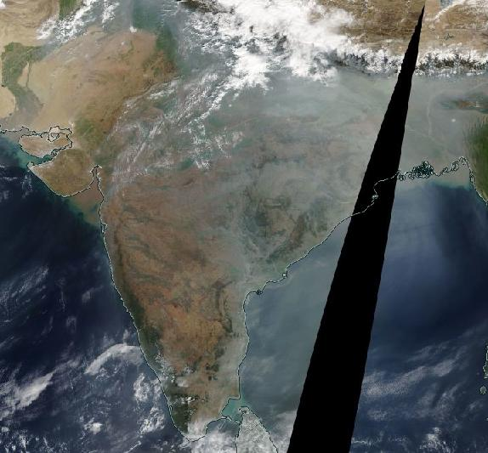
Constellation of satellites
Proposed activity to start ingesting upcoming GEMS data into WRF-Chem modeling system over South Asia, which will help recognize future capabilities of TEMPO
https://weather.msfc.nasa.gov/sport/

Slide 17
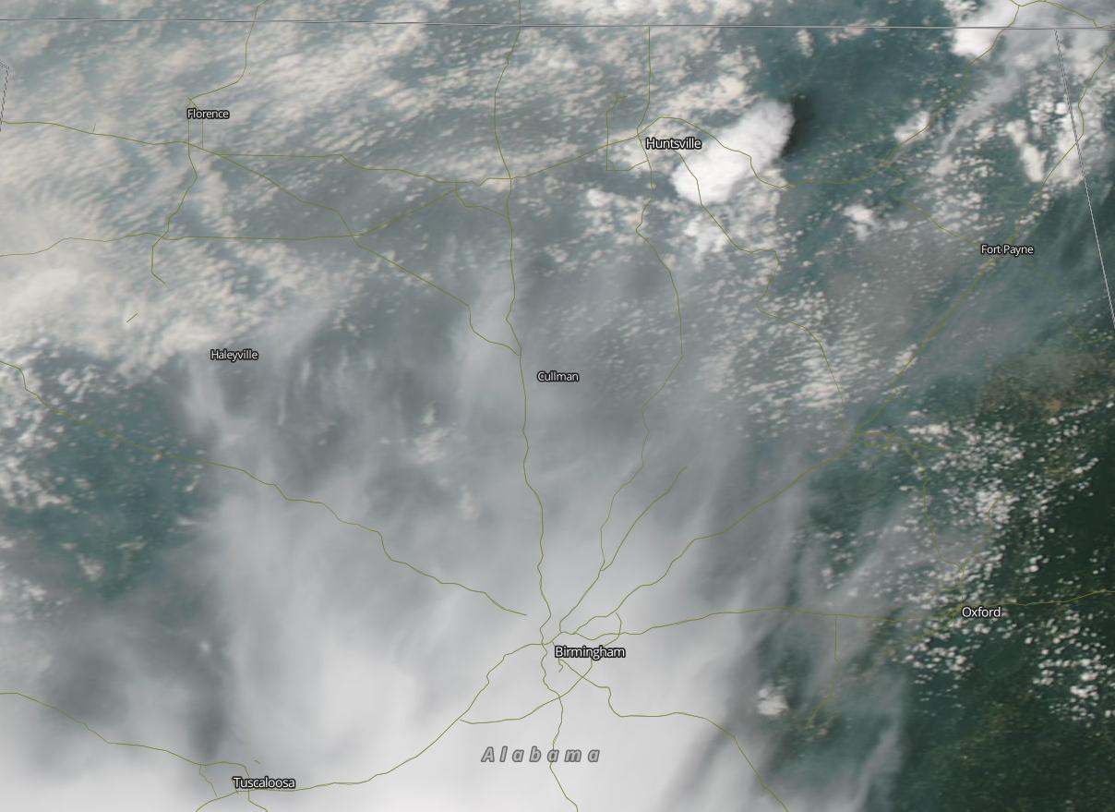
Pilot Health Study over AL
Deployment of 20 low-cost AQ sensors measuring O₃, CO, NO, NO₂ and PM_{2.5}, along with surface meteorology in Madison County, AL by summer 2019
Additional 20 sensors to be deployed in Birmingham
Hospital claims data for state of Alabama at county and zip code level
Combine health and AQ (TEMPO) data over AL to build a readmission rate model for reducing hospital costs related to readmissions
https://weather.msfc.nasa.gov/sport/

Slide 18
TEMPO Activities at SPoRT
Our pre-launch activities can provide input to the Science Team on valuable fields/products to be accessible via Lance/Worldview
Fully ingest TEMPO proxy dataset from July 2013-June 2014 into ESRI platform for allowing effective analysis of L2 products
Compare to current WMS at SPoRT and interact with end users/stakeholders on preferred solution for real data
Setup FTP server for distributing proxy data to community, LDM solution for future real-time data
Plan to utilize TEMPO data along with hospital claims data over AL for public health study, begin building prediction system with proxy data
Proposed activity to start ingesting upcoming GEMS data into modeling system over South Asia, which will help identify future capabilities of TEMPO
TEMPO public health conference at University of Alabama in Huntsville with conference date of 10/11/19, ARSET training sessions preceding the conference date
https://weather.msfc.nasa.gov/sport/

Slide 19
Thanks!
aaron.naeger@nasa.gov
https://weather.msfc.nasa.gov/sport/

