Slide 1
Instrument Characterization: Status
Nischal Mishra
David Flittner
June 06, 2018
(757).864.7797
Nischal.Mishra@nasa.gov
david.e.flittner@nasa.gov

Slide 2
Outline
Introduction
Results to-date
  Detector and Electronics
  Spectrometer properties:
    Spectral Range, Spectral Bandpass, Spectral Sampling, Bandpass Shape, Spectral Smile and Key Stone
  Image Quality
Road ahead
Summary

Slide 3
Introduction
TEMPO is a modest cost mission
Characterization is no exception
Testing at a variety of levels, i.e. sub-system and integrated system
  All characterization data will be transferred to NASA/SAO servers.
Measure important characteristics and verify important assumptions, where possible

Slide 4
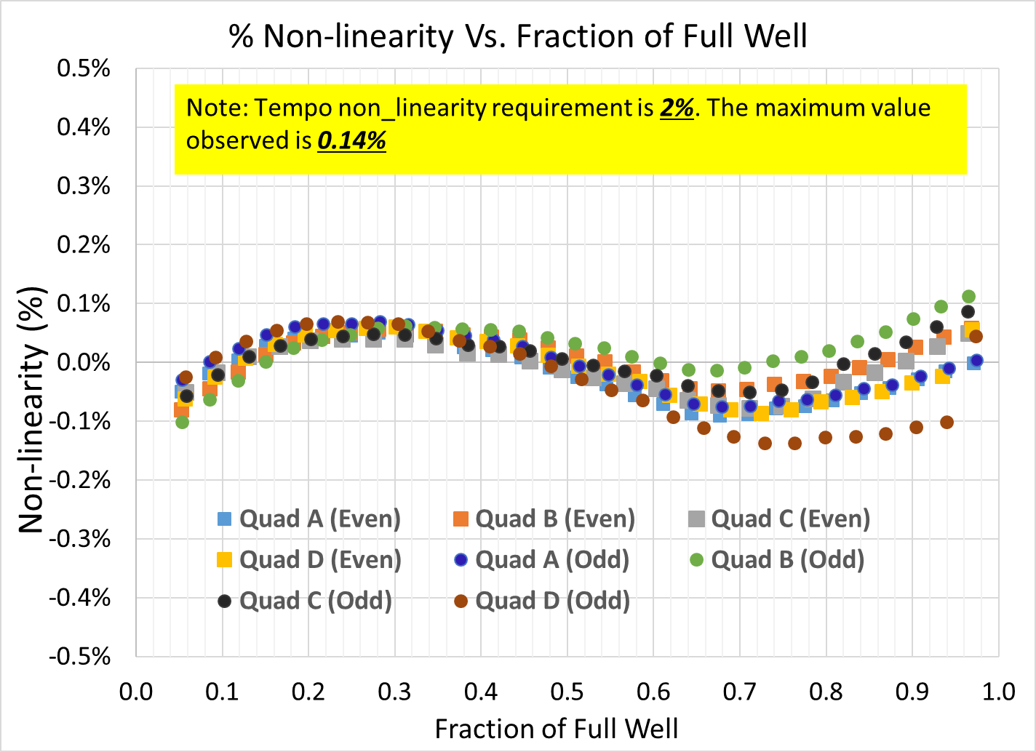
Detector and Electronics
Focal Plane (two 1K x 2K CCDs) has circa 99.6% science grade pixels
Non-linearity of TEMPO CCD and electronics is less than ±0.15% from 5% to 98% of the Full well.
Ground processing will use linearity sequence data from sub-system and TVac testing to correct non-linearity.
Outliers

Slide 5
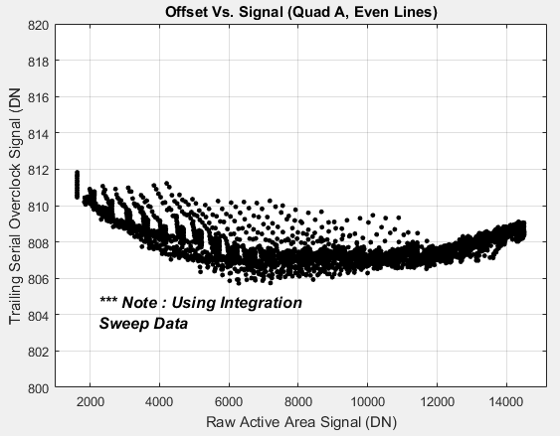
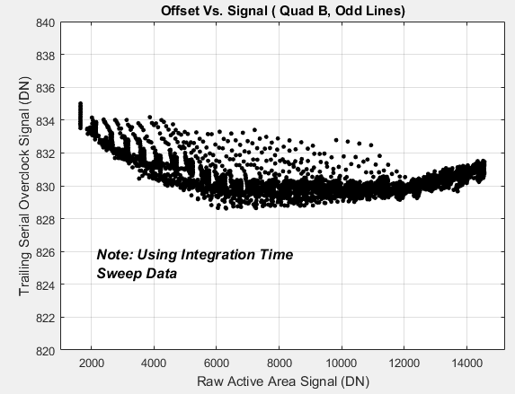
Challenges : Signal Dependent offset (SDO)
SDO is at most 4-5 Digital Numbers (DN) for all the signal levels in the active region.
The parabolic nature of the curve is very repeatable.
Preliminary estimated residual error after correction is 0.2 DN.
Anticipate refining estimated error with TVAC data in order to incorporate in the radiometric uncertainty budget.
Signal Dependent Offset
Signal Dependent Offset

Slide 6
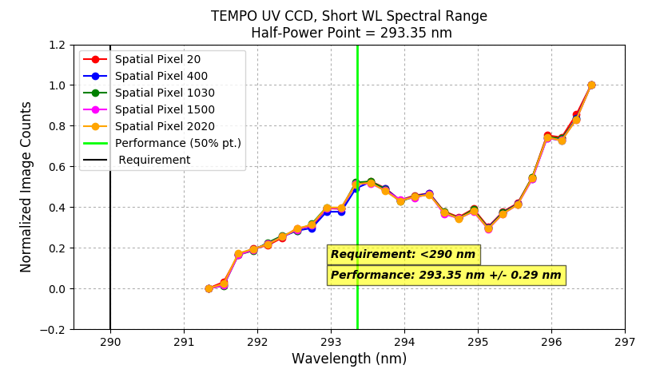
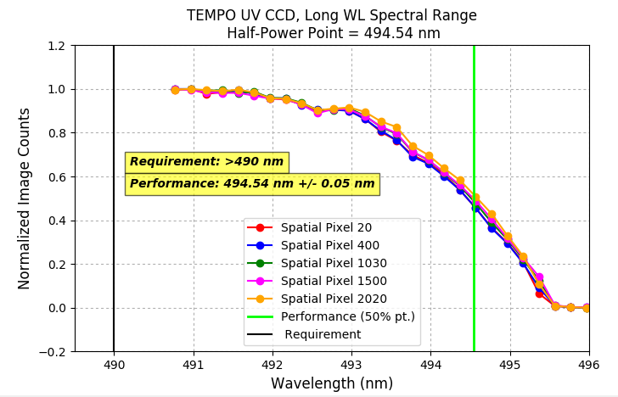
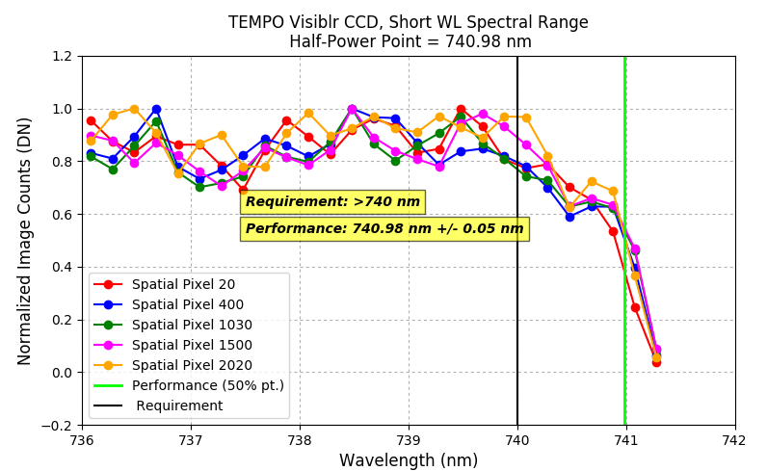
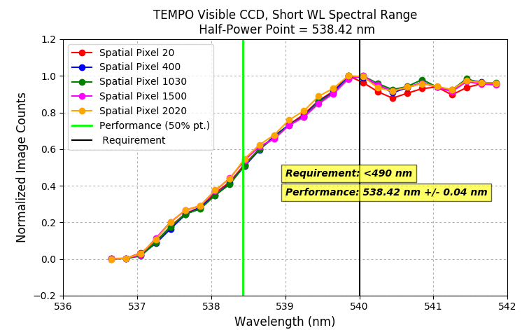
Spectrometer:
Spectral Range
< 540 nm
Spectral Range 294 nm – 494 nm and 539 nm – 740 nm

Slide 7
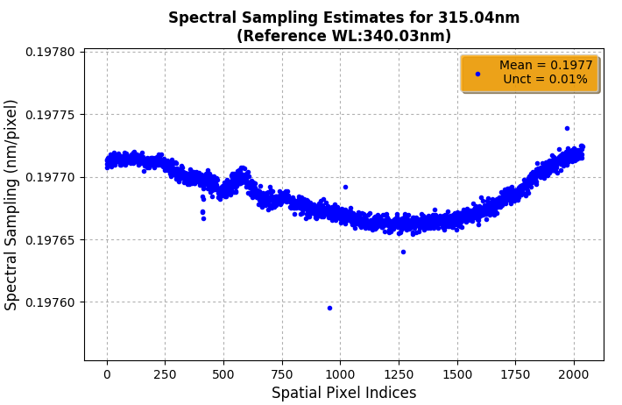
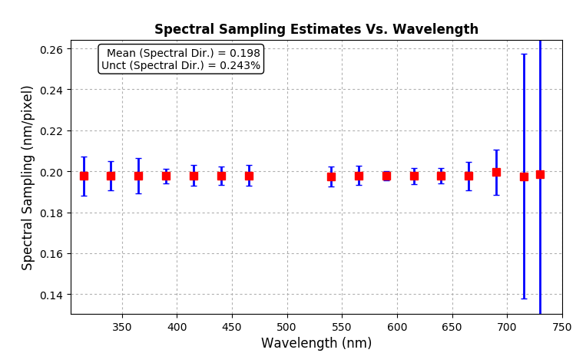
Spectral Sampling (Dispersion)
Dispersion was estimated to be around 0.198 nm/pixel and is compliant with TEMPO allocation of 0.2 nm/pixel.
The estimates vary slightly (±0.24% of mean) for each wavelengths analyzed but this variation is not systematic to apply empirical model.
Estimates at longer wavelengths (>700 nm) are affected by CCD Fringes (more on that later).

Slide 8
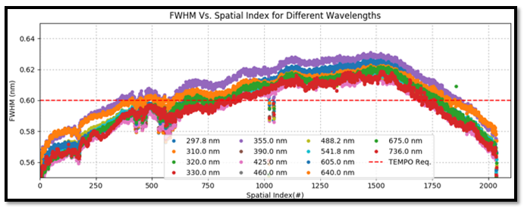
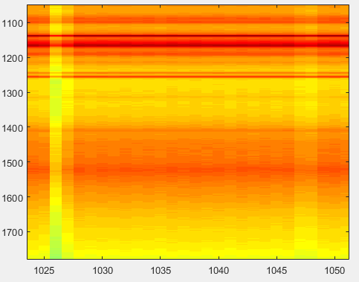
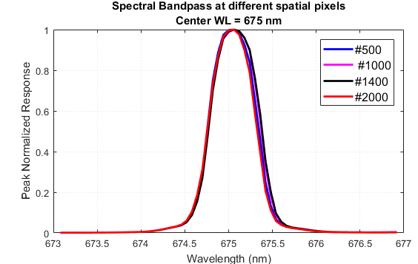
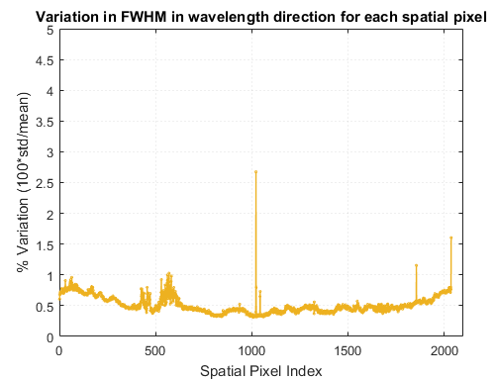
Bandpass Full Width Half Max (FWHM)
Slit feature manifested as outliers from neighbors
FWHM at different wavelengths exhibit similar dependence on spatial index
  For any given wavelength, the peak to peak variation in spatial direction is 10%; the worse case FWHM is 0.63 nm.
  On the other hand, for any given spatial pixel, COV (std/mean) variation in FWHM in wavelength direction is generally <1%.

Slide 9
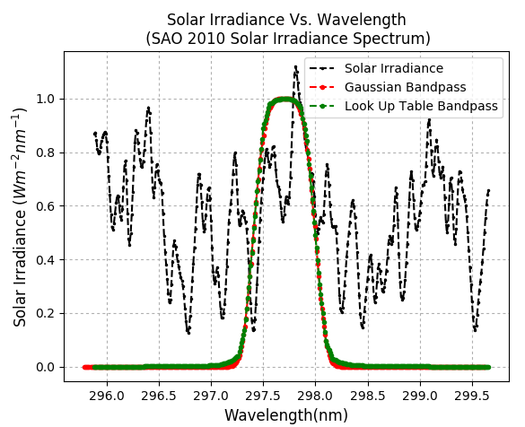
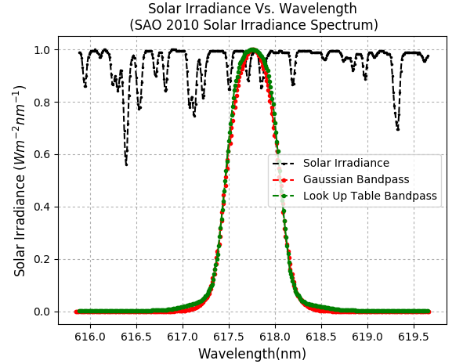
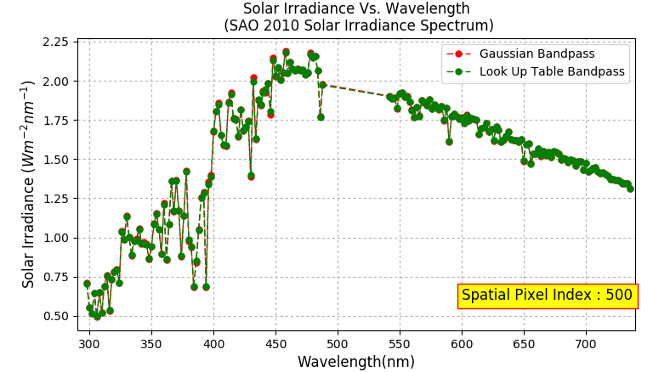
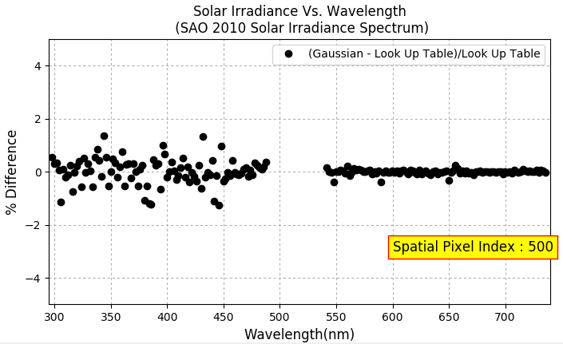
Comparing Look Up Table &“Flat Top”
Gaussian Bandpass
High res. Solar Irradiance convolved using Look Up Table Gaussian bandpass is generally within ±1.3% for UV and ±0.4% for visible.
Exploring other analytic representations
  *** f(λ) = a₁*exp(-(λ - λ₀)^{n1}/(2*sigma₁²)) + a₂*exp(-(λ – λ₁)^{n2}/(2*sigma₂⁴))
  For UV channels, n₁=4, for visible channels n₁=2, For all channels, n₂=4

Slide 10
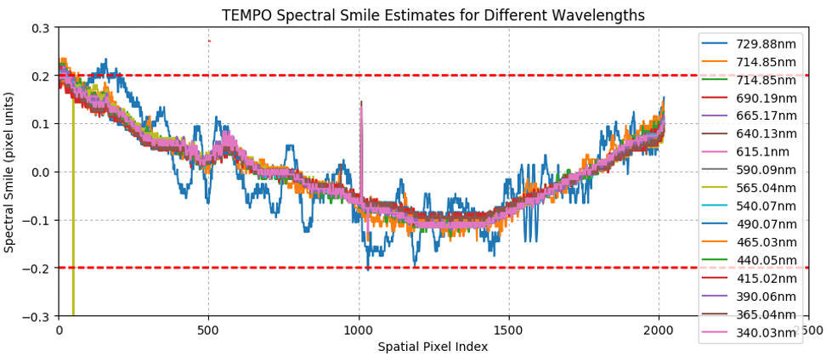

Spectral Smile
Spectral smile = alignment of spectrum to detector grid (less is better).
Worse case value is ~0.23 nm, the estimates at longer wavelengths are affected by CCD fringes.

Slide 11
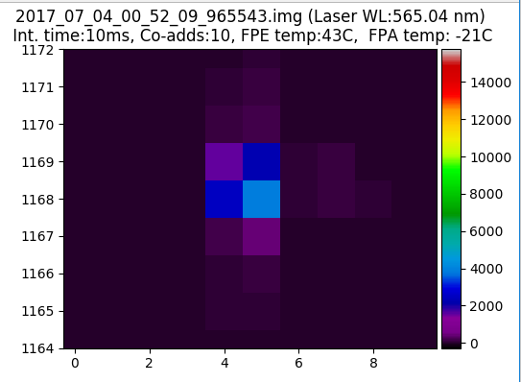
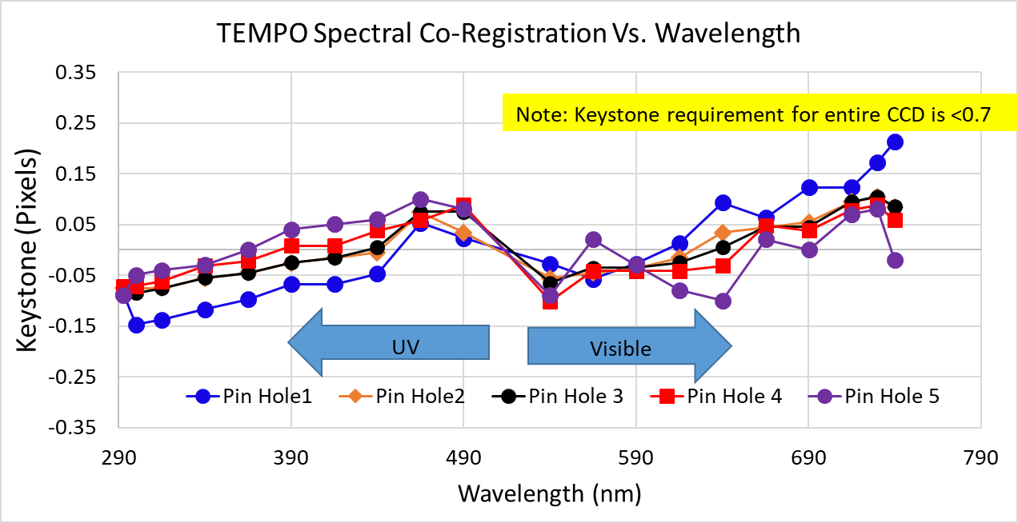
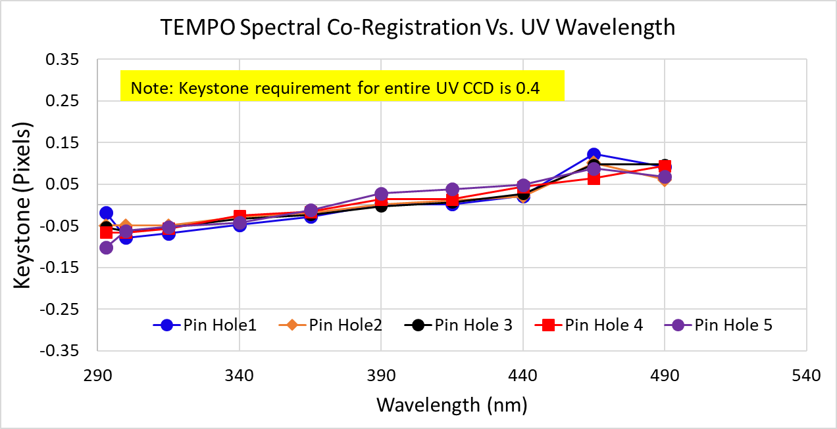
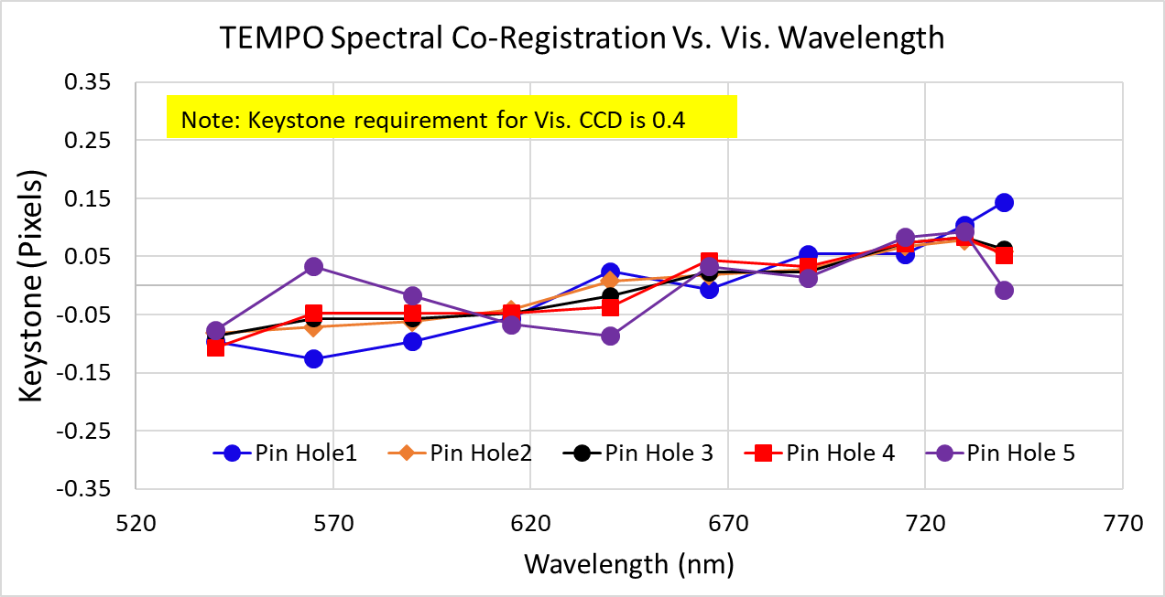
Spectral Co-Registration Estimates (Keystone)
***Note: Data acquired at 5 different pin hole locations in 20 Wavelengths.
Pin Hole # 1

Slide 12
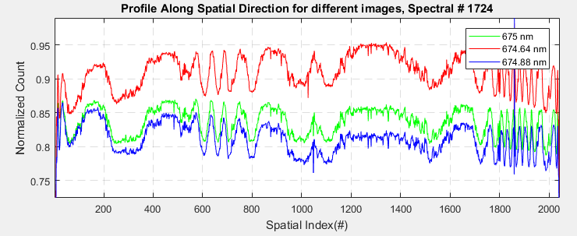
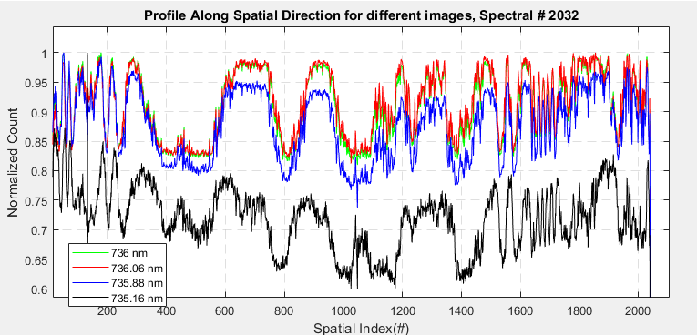
Challenges : CCD Etaloning
Longer wavelengths (>600nm) seem to affected by interference pattern as silicon is more transparent to light.
Patterns appear as fringes in image profile and affects some of the requirement verifications.
Possible to minimize the striping due to etalon by generating a spectrally resolved relative response.
  Using quantum efficiency map data is under investigation

Slide 13
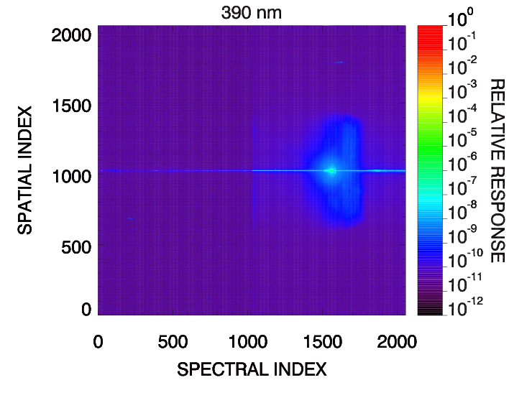
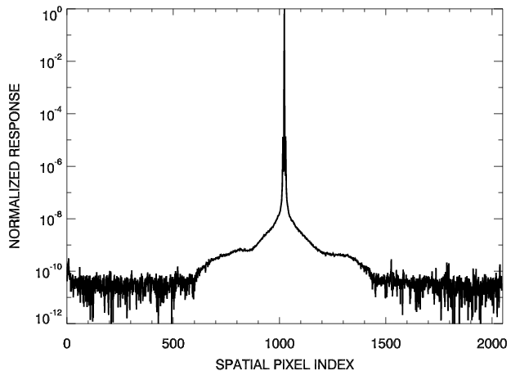
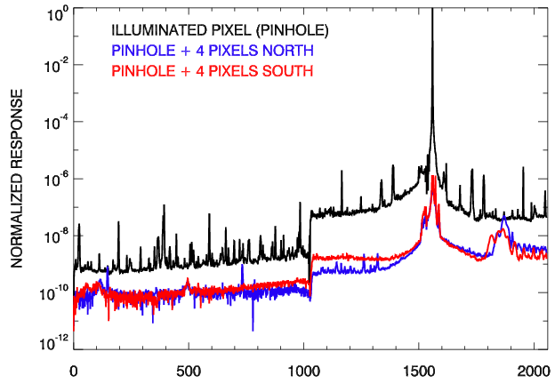
Stray Light (SL)
Background SL 10⁻⁹
Spectral SL is 10⁻⁷, within 3 spatial pixels
A few ghosts are >5e-4 in visible channels
SPATIAL INDEX
SPECTRAL INDEX

Slide 14
Image Quality
Scan mirror very stable with < 2 urad of jitter
Instrument Modulation Transfer Function (spatial response) exceeds requirements by > 30%
1
System level spatial resolution, with S/C jitter:
≤ 2.2km N-S,
≤ 5.2 km E-W
at location 36.5° N, 100° W
Nyquist = 27.8 cyc/mm
0.5
North/South MTF
Minimum Requirement
Courtesy Ball Aerospace
0
0
10
20
30
40
50
Spatial Frequency (cyc/mm)

Slide 15
Road Ahead
Ambient Radiance (done 6/3)
Thermal Vacuum (TVac)
  Radiometric
  Polarization
  Solar diffuser check
    Diffusers already characterized at GSFC
  Thermal Sensitivity of:
    Boresight
    Image quality
    Wavelength stability
    Bandpass
Ball 10 Chamber
Large Spherical Source (LSS, aka Death Star)
Courtesy Ball Aerospace

Slide 16
SUMMARY
TEMPO instrument characterization informs ground processing of Level 0 and Level 1.
Spectrometer spectral sampling/resolution sufficient to record spectra for Baseline species.
In general, imaging performance exceeds instrument requirements.
Radiometric calibration performed in TVac at on-orbit temperatures for detector and electronics.

Slide 18
Recommended Image Processing Steps
Raw Image
Mask Outliers
Note *** The orders of processing can be negotiated depending on what the team thinks. Subsequent slides will discuss each of this blocks in the order of the block diagram.
Offset Removal
Non-Linearity Correction
SMEAR Removal
Cross-Talk Correction
Dark Data
Dark Current Removal
PRNU Mask
Processed Image

Slide 19
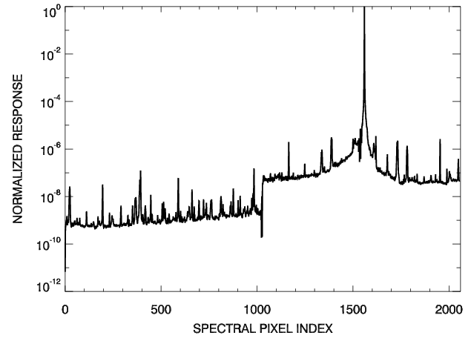
Stray Light (SL)
Background SL 10⁻⁹
Spectral SL is 10⁻⁷, within 3 spatial pixels
A few ghosts are >5e-4 in visible channels
SPATIAL INDEX
SPECTRAL INDEX

