Slide 1
Tropospheric Emissions: Monitoring of Pollution (TEMPO)
Kelly Chance & the TEMPO Team
July 23, 2013

Slide 2
TEMPO science team
Team Member | Institution | Role | Responsibility
K. Chance | SAO | PI | Overall science development; Level 1b, H₂CO, C₂H₂O₂
X. Liu | SAO | Deputy PI | Science development, data processing; O₃ profile, tropospheric O₃
J. Carr | Carr Astronautics | Co-I | INR Modeling and algorithm
M. Chin | GSFC | Co-I | UV aerosol product, AI
R. Cohen | U.C. Berkeley | Co-I | NO₂ validation, atmospheric chemistry modeling, process studies
D. Edwards | NCAR | Co-I | VOC science, synergy with carbon monoxide measurements
J. Fishman | St. Louis U. | Co-I | AQ impact on agriculture and the biosphere
D. Flittner | LaRC | Project Scientist | Overall project development; STM; instrument cal./char.
J. Herman | UMBC | Co-I | Validation (PANDORA measurements)
D. Jacob | Harvard | Co-I | Science requirements, atmospheric modeling, process studies
S. Janz | GSFC | Co-I | Instrument calibration and characterization
J. Joiner | GSFC | Co-I | Cloud, total O₃, TOA shortwave flux research product
N. Krotkov | GSFC | Co-I | NO₂, SO₂, UVB
M. Newchurch | U. Alabama Huntsville | Co-I | Validation (O₃ sondes, O₃ lidar)
R.B. Pierce | NOAA/NESDIS | Co-I | AQ modeling, data assimilation
R. Spurr | RT Solutions, Inc. | Co-I | Radiative transfer modeling for algorithm development
R. Suleiman | SAO | Co-I, Data Mgr. | Managing science data processing, BrO, H₂O, and L3 products
J. Szykman | EPA | Co-I | AIRNow AQI development, validation (PANDORA measurements)
O. Torres | GSFC | Co-I | UV aerosol product, AI
J. Wang | U. Nebraska | Co-I | Synergy w/GOES-R ABI, aerosol research products
J. Leitch | Ball Aerospace | Collaborator | Aircraft validation, instrument calibration and characterization
R. Martin | Dalhousie U. | Collaborator | Atmospheric modeling, air mass factors, AQI development
D. Neil | LaRC | Collaborator | GEO-CAPE mission design team member
J. Kim | Yonsei U. | Collaborators, Science Advisory Panel | Korean GEMS, CEOS constellation of GEO pollution monitoring
J. McConnell | York U. Canada |  | CSA PHEOS, CEOS constellation of GEO pollution monitoring
B. Veihelmann | ESA |  | ESA Sentinel-4, CEOS constellation of GEO pollution monitoring

Slide 3
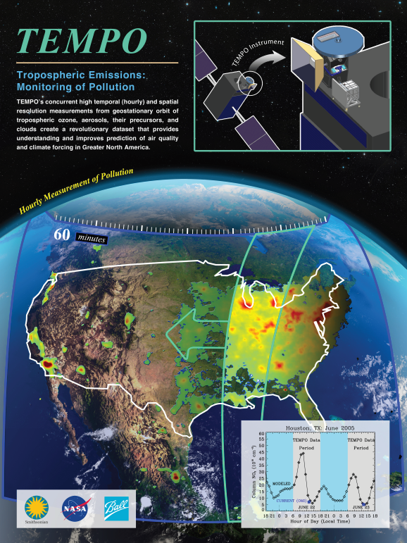
Hourly atmospheric pollution from geostationary Earth orbit
PI: Kelly Chance, Smithsonian Astrophysical Observatory
Deputy PI: Xiong Liu, Smithsonian Astrophysical Observatory
Instrument Development: Ball Aerospace
Project Manager: Wendy Pennington, NASA LaRC
Project Scientist: Dave Flittner, LaRC; Deputy PS: Jay Al-Saadi, LaRC
Other Institutions: NASA GSFC (led by Scott Janz), NOAA, EPA, NCAR, Harvard, UC Berkeley, St. Louis U, U Alabama Huntsville, U Nebraska
International collaboration: Korea, ESA, Canada, Mexico
Selected Nov. 2012 through NASA’s first Earth Venture Instrument solicitation
Currently in Phase A, System Requirements Review 9/30/2013±
Instrument delivery May 2017
NASA will arrange hosting on commercial geostationary communications satellite with expected 2018-2019 launch
Provides hourly daylight observations to capture rapidly varying emissions & chemistry important for air quality
  UV/visible grating spectrometer to measure key elements in tropospheric ozone and aerosol pollution
  Exploits extensive measurement heritage from LEO missions
  Distinguishes boundary layer from free tropospheric & stratospheric ozone (the Smithsonian “eXceL” algorithm)
Aligned with Earth Science Decadal Survey recommendations
  Makes most of the GEO-CAPE atmosphere measurements
  Responds to the phased implementation recommendation of GEO-CAPE mission design team
  The North American geostationary component of an international constellation for air quality monitoring
Notes:
TEMPO makes a minimally-redundant set of atmospheric pollution measurements: O3, NOx, SOx, VOCs

Slide 4
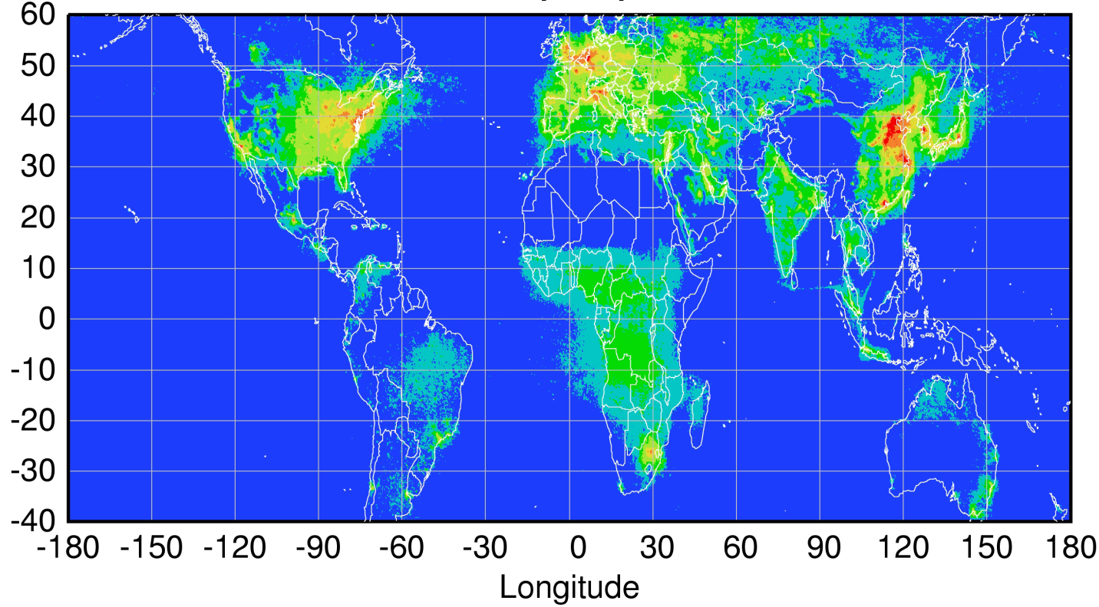
Geostationary constellation coverage
Sentinel-4
TEMPO
GEMS
Courtesy Jhoon Kim,
Andreas Richter
Policy-relevant science and environmental services enabled by common observations
Improved emissions, at common confidence levels, over industrialized Northern Hemisphere
Improved air quality forecasts and assimilation systems
Improved assessment, e.g., observations to support the United Nations Convention on Long Range Transboundary Air Pollution

Slide 5
TEMPO science questions
What are the temporal and spatial variations of emissions of gases and aerosols important for air quality and climate?
How do physical, chemical, and dynamical processes determine tropospheric composition and air quality over scales ranging from urban to continental, diurnally to seasonally?
How does air pollution drive climate forcing and how does climate change affect air quality on a continental scale?
How can observations from space improve air quality forecasts and assessments for societal benefit?
How does intercontinental transport affect air quality?
How do episodic events, such as wild fires, dust outbreaks, and volcanic eruptions, affect atmospheric composition and air quality?

Slide 6
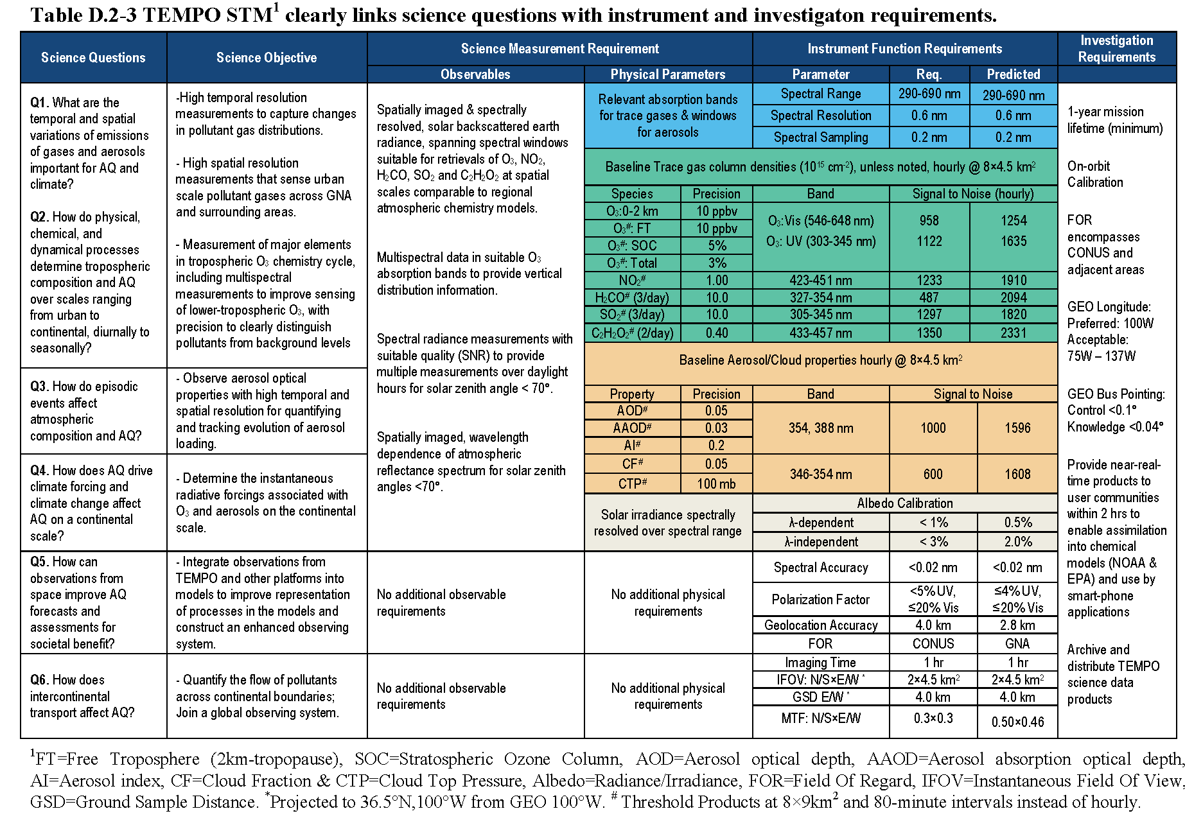
TEMPO Science Traceability Matrix

Slide 7
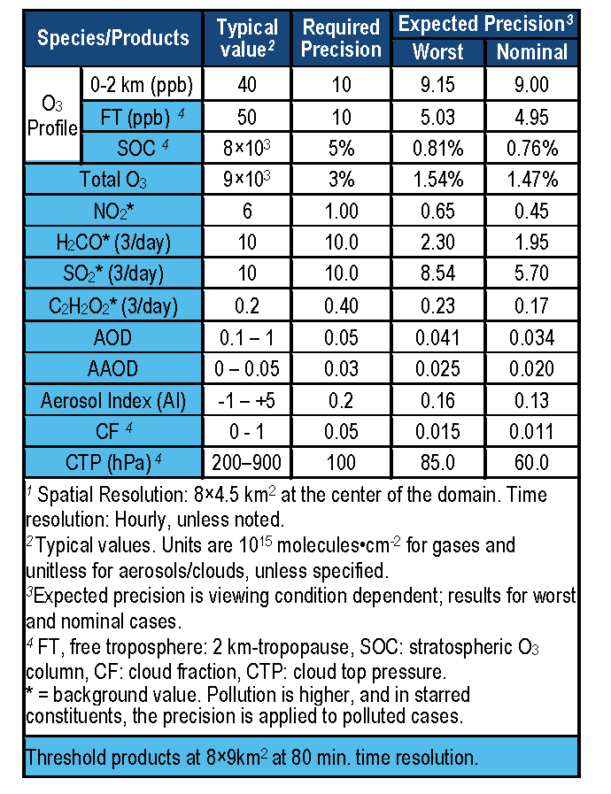
TEMPO baseline products
TEMPO has a minimally-redundant measurement set. No:
CO (alternate VOC)
CH₄ (near-term climate change, fracking)
CO₂ (climate, done by OCO-2, China)

Slide 8
TEMPO instrument concept
Measurement technique
  Imaging grating spectrometer measuring solar backscattered Earth radiance
  Spectral band & resolution: 290-750 nm @ 0.6 nm FWHM, 0.22 nm sampling
  2 2-D, 2k×1k, detectors image the full spectral range for each geospatial scene
Field of Regard (FOR) and duty cycle
  Mexico City/Yucatan Peninsula to the Canadian tar/oil sands, Atlantic to Pacific
  Instrument slit aligned N/S and swept across the FOR in the E/W direction, producing a radiance map of Greater North America in one hour
Spatial resolution
  2 km N/S × 4.5 km E/W native pixel resolution (9 km²)
  Co-add/cloud clear as needed for specific data products
Standard data products and sampling rates
  NO₂, O₃, aerosol, and cloud products sampled hourly, including eXceL O₃ (troposphere, PBL) for selected target areas
  H₂CO, C₂H₂O₂, SO₂ sampled 3 times/day (hourly samples averaged to get S/N)
  Nominal spatial resolution ≤ 8 km N/S × 4.5 km E/W at center of domain
  Measurement requirements met up to 70º SZA for NO₂, 50º for other standard products

Slide 9
TEMPO mission concept
Geostationary orbit, operating on a commercial telecom satellite
  NASA will arrange launch and hosting services (per Earth Venture Instrument scope)
    90-110º W preferred, 85-115º W acceptable
    Surveying COMSAT companies for specifications on satellite environment, accommodation, and launch manifests
  Hourly measurement and telemetry duty cycle for at least ≤70º SZA
    Hope to measure 20 hours/day
TEMPO is low risk with significant space heritage
  All proposed TEMPO measurements have been made from low Earth orbit satellite instruments to the required precisions
  All TEMPO launch algorithms are implementations of currently operational algorithms
    NASA TOMS-type O₃
    SO₂, NO₂, H₂CO, C₂H₂O₂ from AMF-normalized cross sections
    Absorbing Aerosol Index, UV aerosol, Rotational Raman scattering cloud, UV index
    eXceL profile/tropospheric/PBL O₃ for selected geographic targets
  Near-real-time products will be produced
Example higher-level products: pollution/AQ indices from std products, city lights
TEMPO research products will greatly extend science and applications
  Example research products: eXceL profile O₃ for broad regions; BrO from AMF-normalized cross sections; height-resolved SO₂; additional cloud/aerosol products; vegetation products

Slide 10
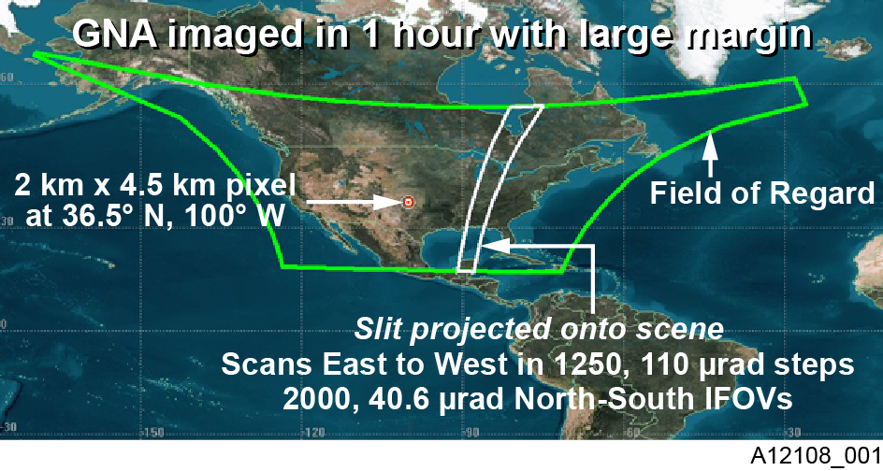
TEMPO footprint, ground sample distance and field of regard
Each 2 km × 4.5 km pixel is a 2K element spectrum from 290-690 nm
GEO platform selected by NASA for viewing Greater North America

Slide 11

TEMPO footprint, ground sample distance and field of regard
Each 2 km × 4.5 km pixel is a 2K element spectrum from 290-690 nm
GEO platform selected by NASA for viewing Greater North America

Slide 12
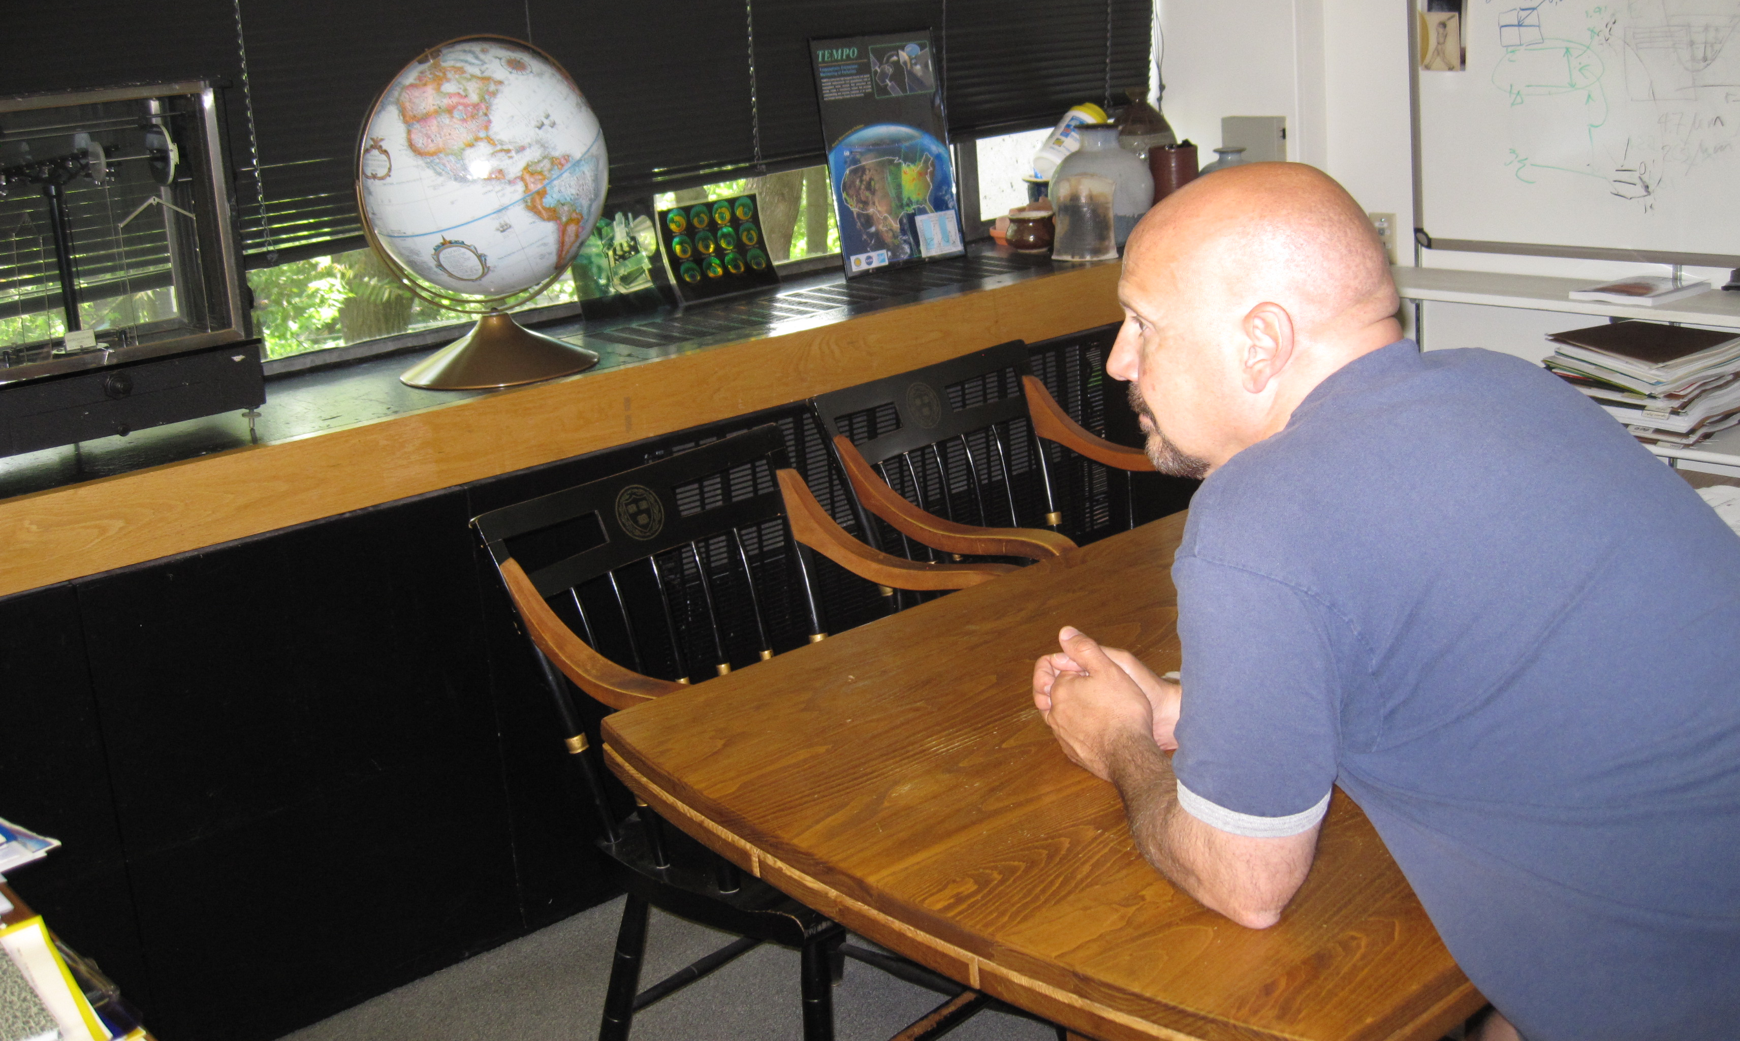
The view from GEO

Slide 13
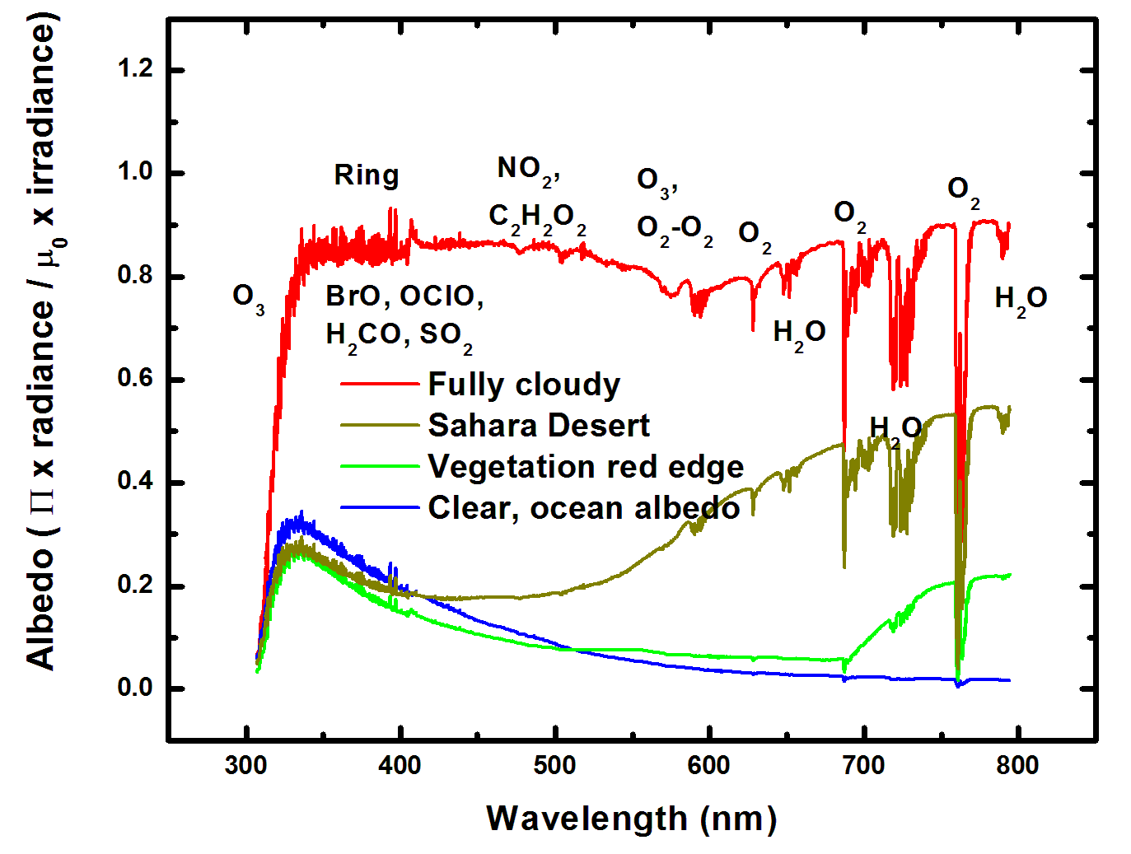
Typical TEMPO-range spectra (from ESA GOME-1)

Slide 14
Typical TEMPO-range spectra (from ESA GOME-1)

Slide 15
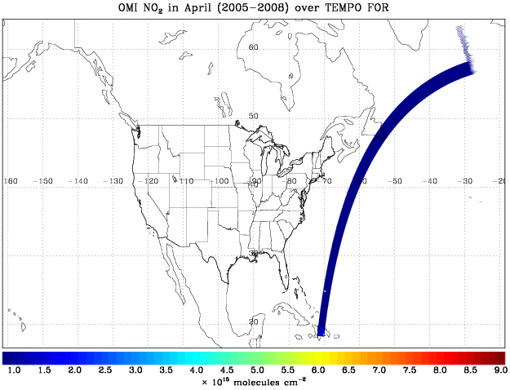
TEMPO hourly NO₂ sweep
16ºN versus 18ºN?

Slide 16
Sun-synchronous nadir heritage
Instrument | Detectors | Spectral Coverage [nm] | Spectral Res. [nm] | Ground Pixel Size [km²] | Global Coverage
GOME-1 (1995-2011) | Linear Arrays | 240-790 | 0.2-0.4 | 40×320 (40×80 zoom) | 3 days
SCIAMACHY (2002-2012) | Linear Arrays | 240-2380 | 0.2-1.5 | 30×30/60/90 30×120/240 | 6 days
OMI (2004) | 2-D CCD | 270-500 | 0.42-0.63 | 13×24 - 42×162 | daily
GOME-2a,b (2006, 2012) | Linear Arrays | 240-790 | 0.24-0.53 | 40×80 (40×10 zoom) | near-daily
OMPS-1 (2011) | 2-D CCDs | 250-380 | 0.42-1.0 | 50×50 | daily
Previous experience (since 1985 at SAO and MPI)
Scientific and operational measurements of pollutants O₃, NO₂, SO₂, H₂CO, C₂H₂O₂ (& CO, CH₄, BrO, OClO, ClO, IO, H₂O, O₂-O₂, Raman, aerosol, ….)

Slide 17
LEO measurement capability
A full, minimally-redundant, set of polluting gases, plus aerosols and clouds is now measured to very high precision from satellites. Ultraviolet and visible spectroscopy of backscattered radiation provides O₃ (including profiles and tropospheric O₃), NO₂ (for NO_{x}), H₂CO and C₂H₂O₂ (for VOCs), SO₂, H₂O, O₂-O₂, N₂ and O₂ Raman scattering, and halogen oxides (BrO, ClO, IO, OClO). Satellite spectrometers planned since 1985 began making these measurements in 1995.

Slide 18
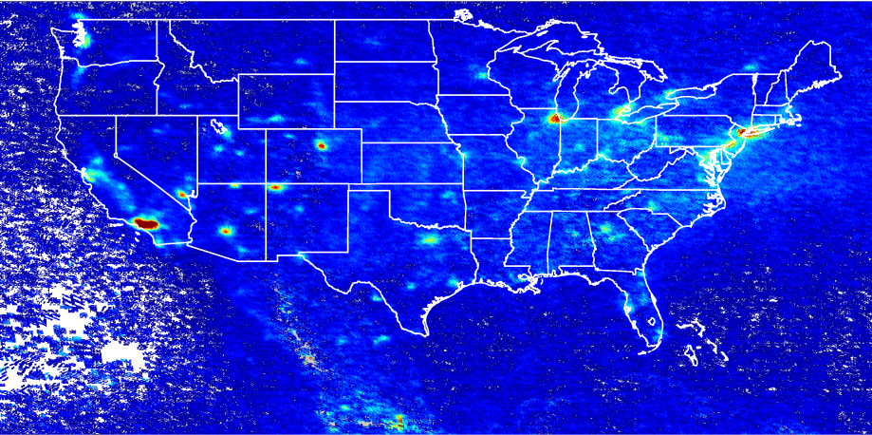
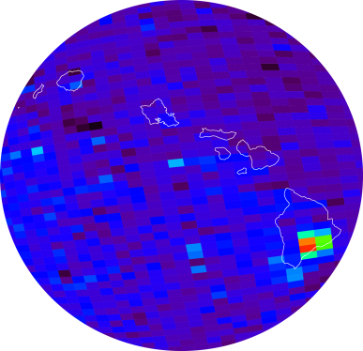
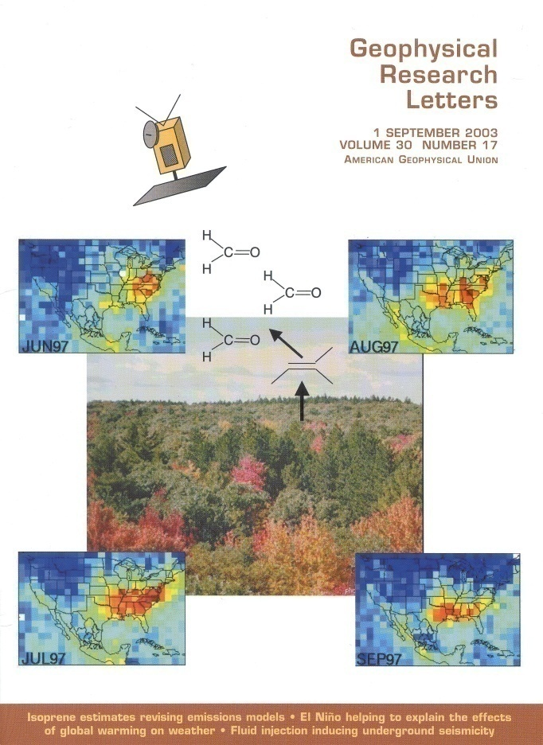
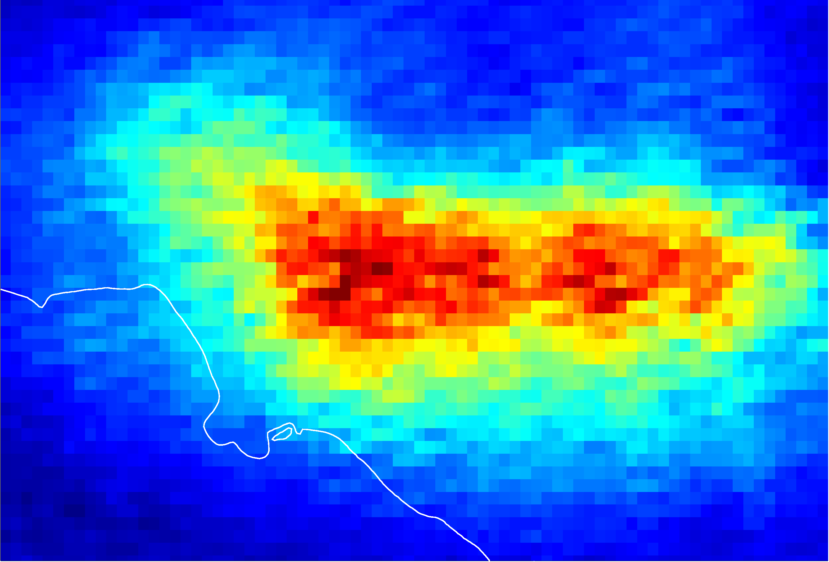
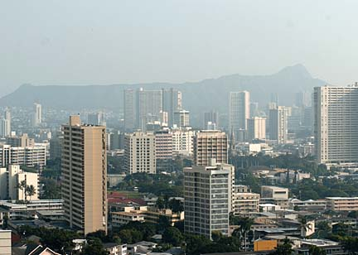
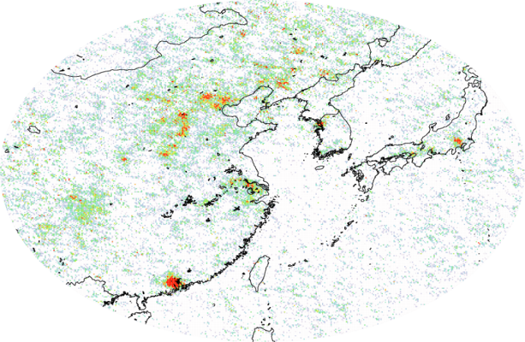
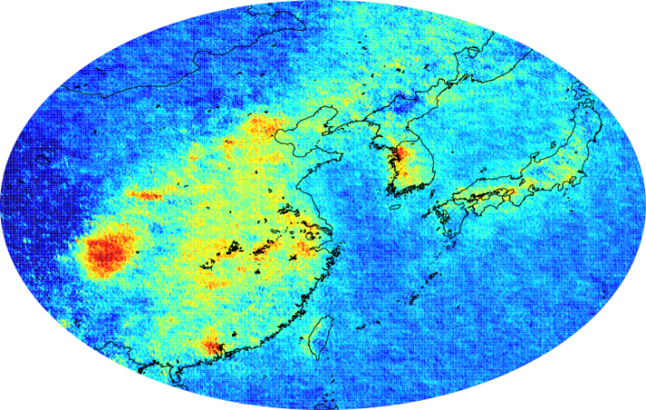
GOME, SCIA, OMI examples
NO₂
SO₂
Kilauea activity, source of the VOG event in Honolulu on 9 November 2004
O₃ strat
trop
H₂CO
C₂H₂O₂

Slide 19
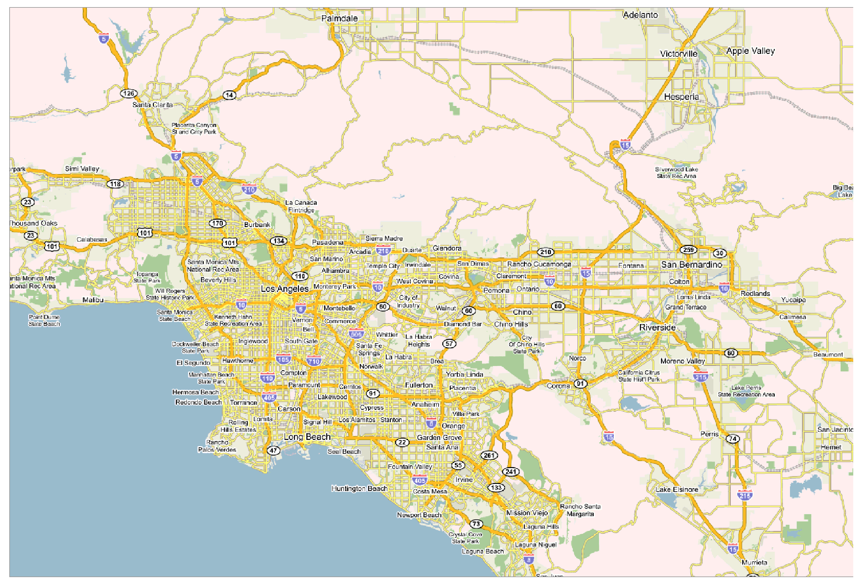
NO₂ over Los Angeles

Slide 20
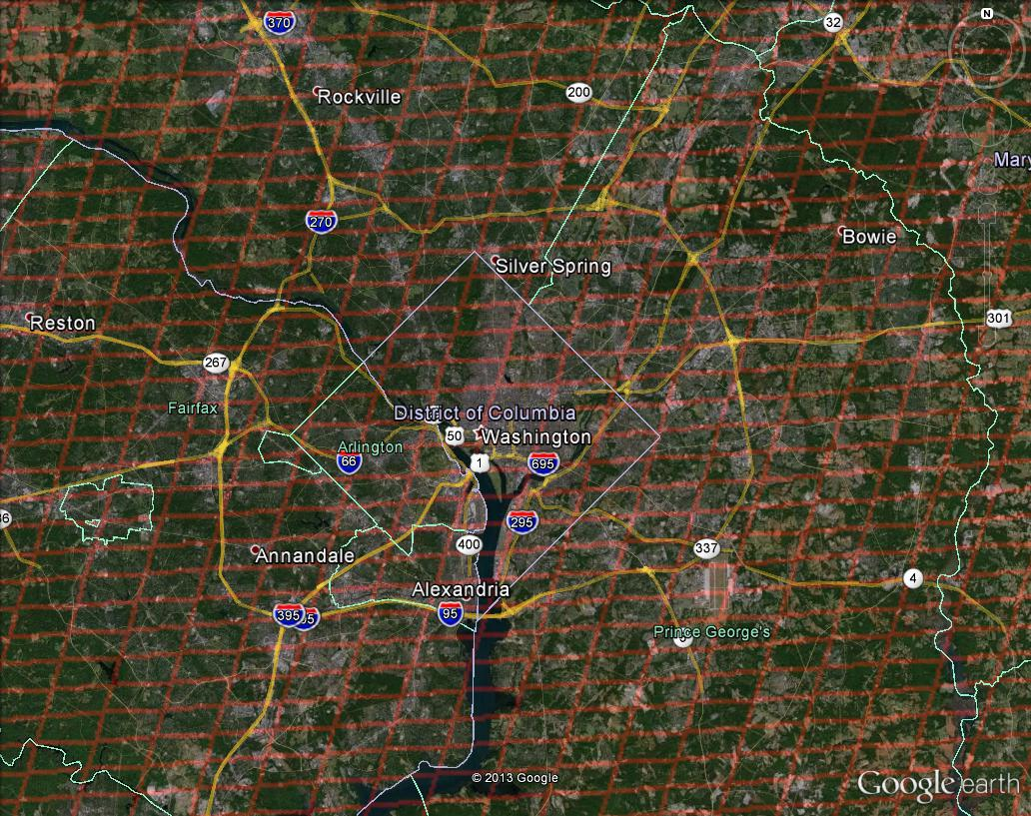
Washington, DC coverage
Hourly!

Slide 21

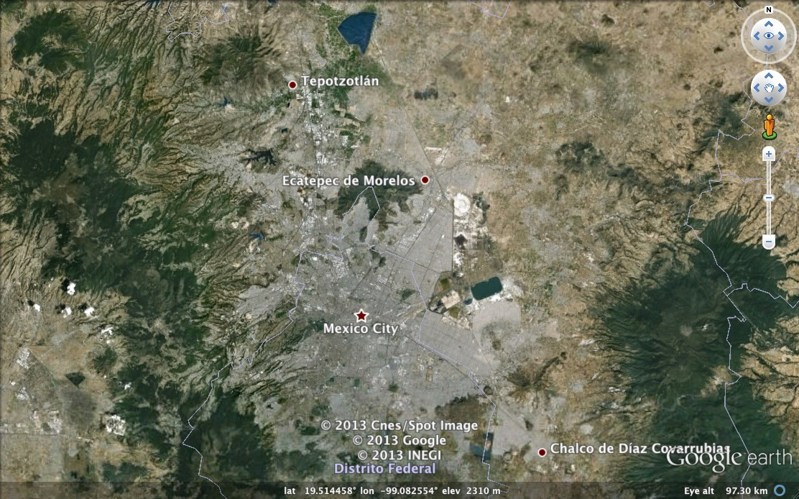
Mexico City coverage
¡Cada hora!

Slide 22
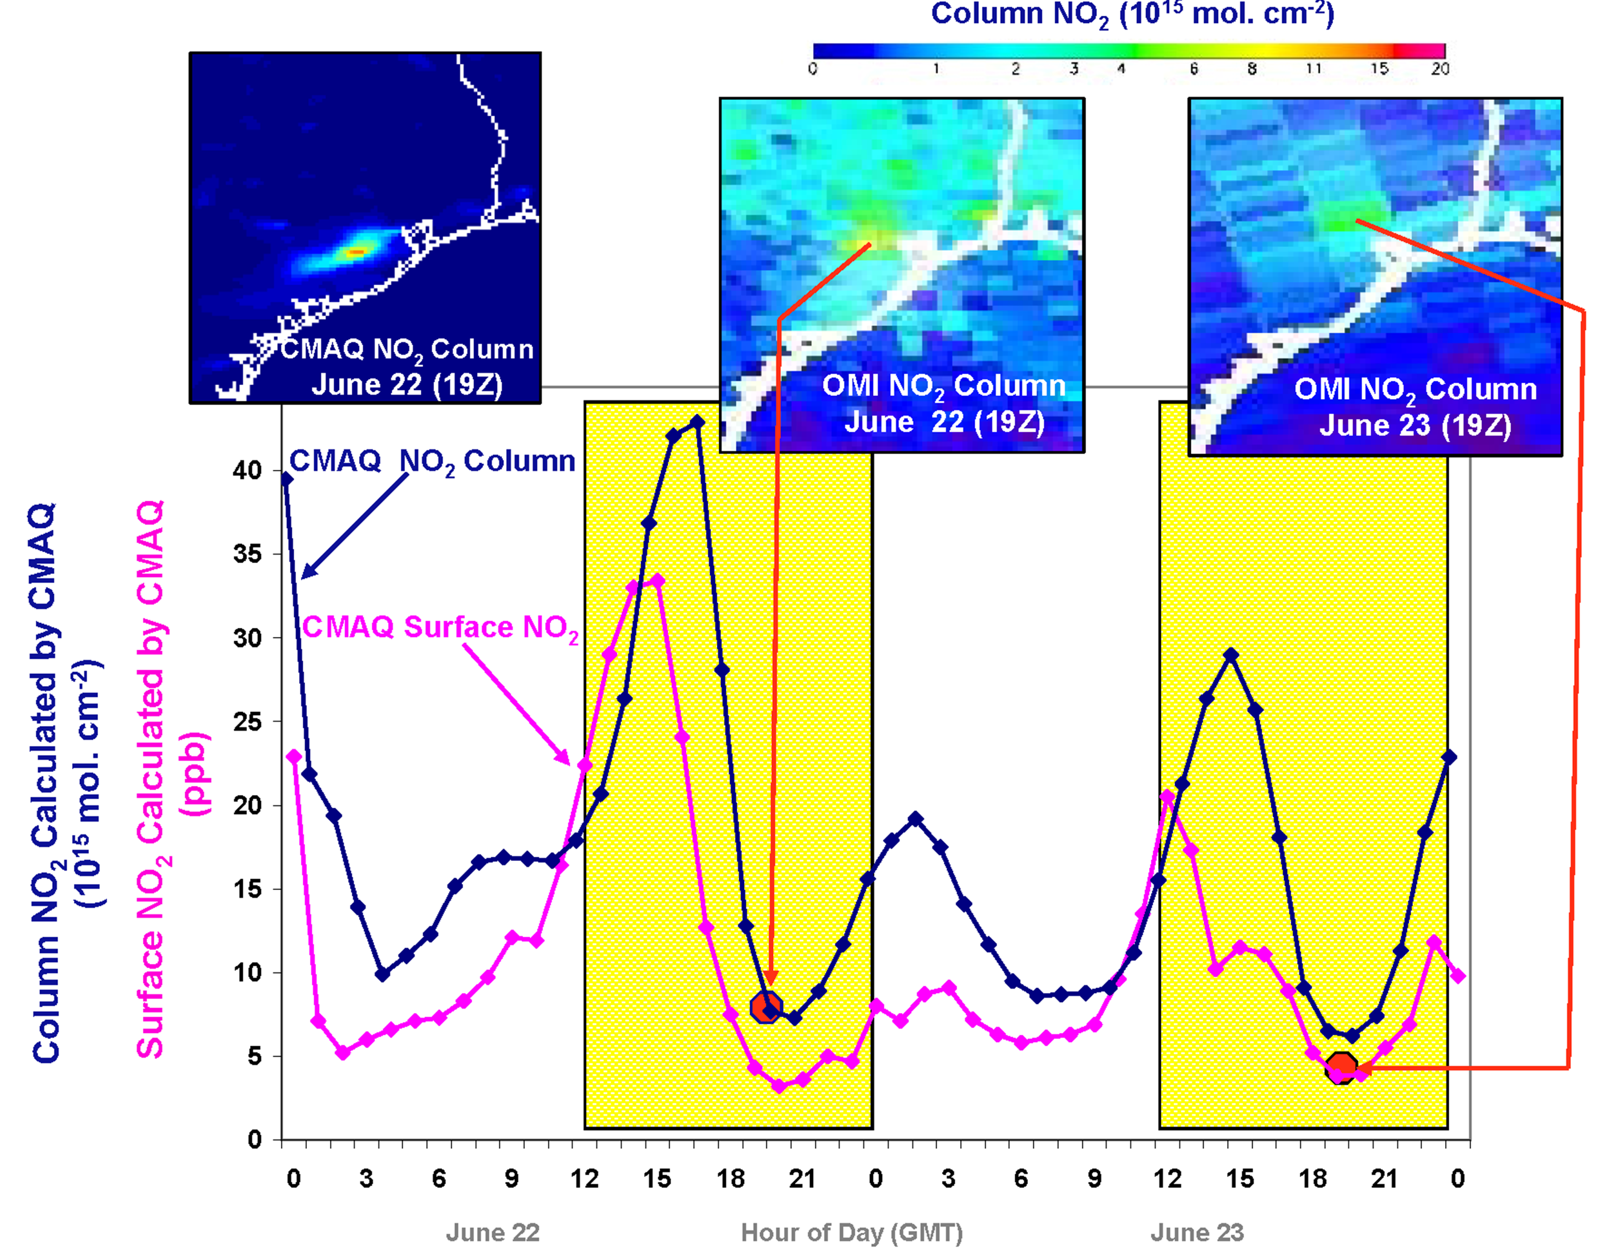
Why geostationary? High temporal and spatial resolution
Hourly NO₂ surface concentration and integrated column calculated by CMAQ air quality model: Houston, TX, June 22-23, 2005
June 22
Hour of Day (UTC)
June 23
LEO observations provide limited information on rapidly varying emissions, chemistry, & transport
GEO will provide observations at temporal and spatial scales highly relevant to air quality processes

Slide 23
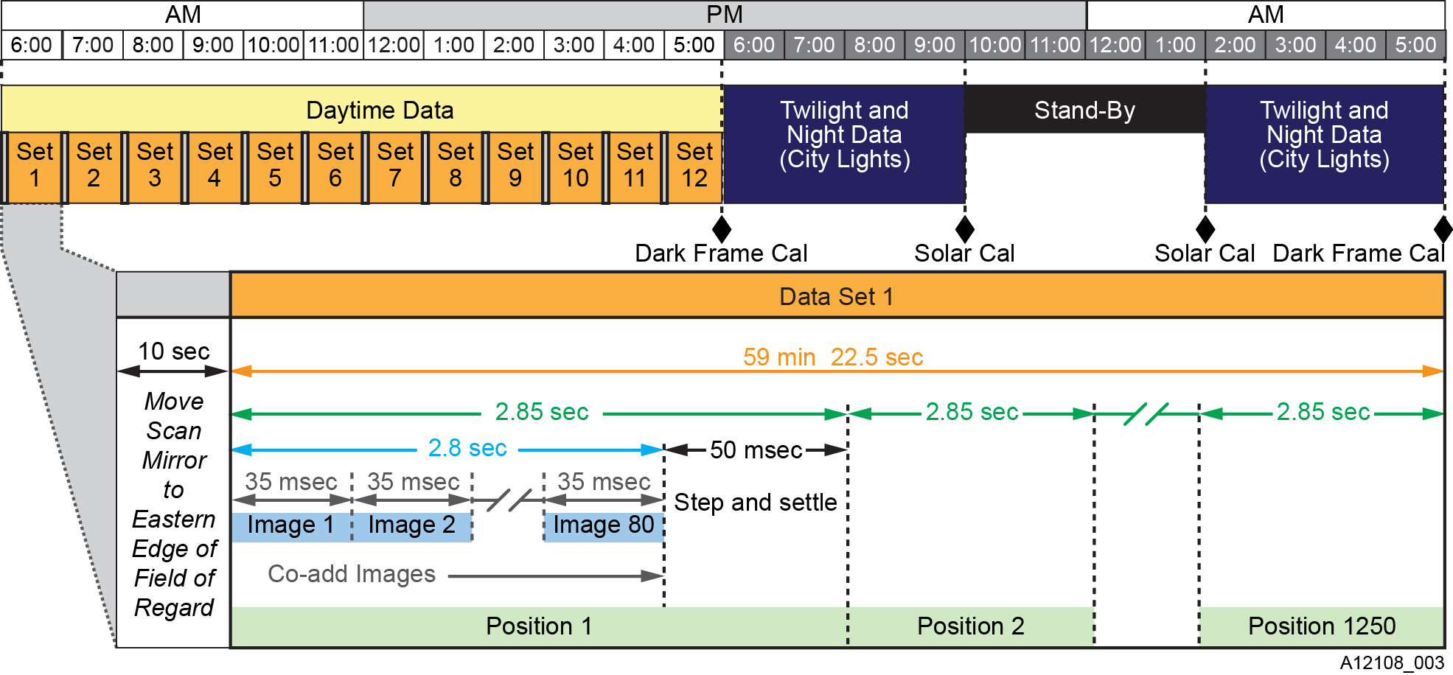
TEMPO Sensor Operations
Measurement modes for the TEMPO sensor operation change with the solar illumination of the Earth scene. Frame co-adding at a single position boosts sensitivity to atmospheric constituents. Special measurements are made by adjusting the dwell time and the scanning start and stop longitudes.

Slide 24




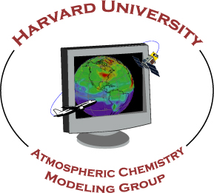


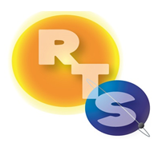


The End!

Slide 25
Team TEMPO!

Slide 26
Current TEMPO schedule

Slide 27
TEMPO Phase A & B Schedule

Slide 28
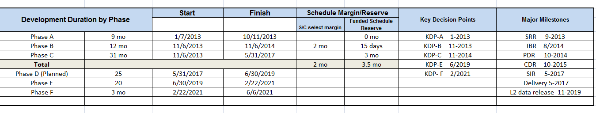
TEMPO major project milestones

Slide 29
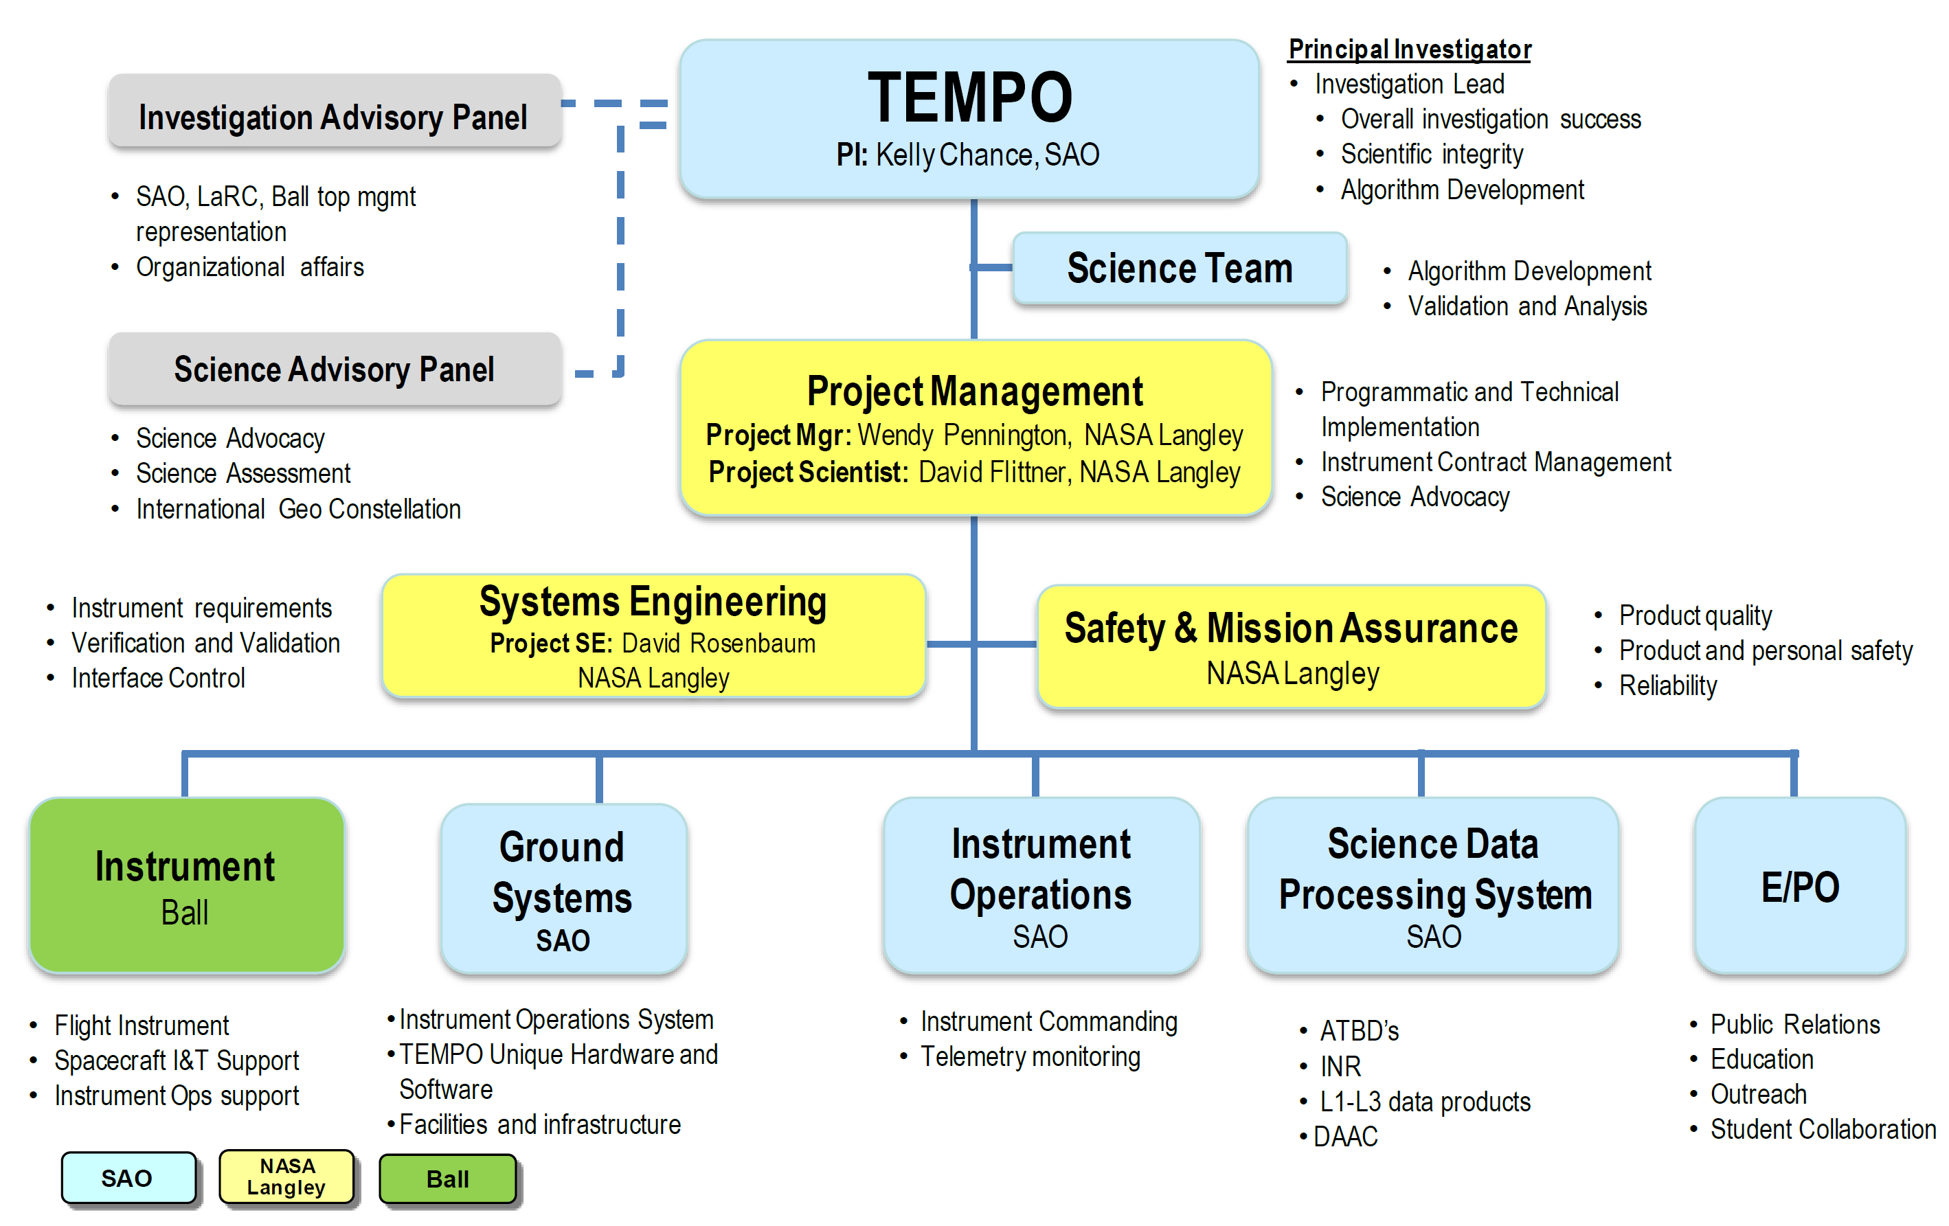
TEMPO Organization

Slide 30
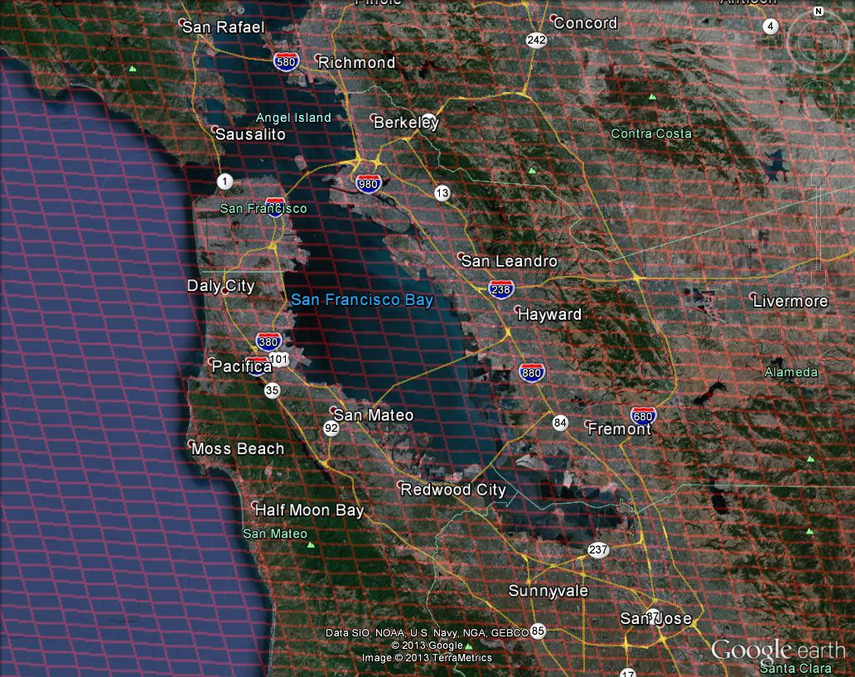
Bay area coverage

Slide 31
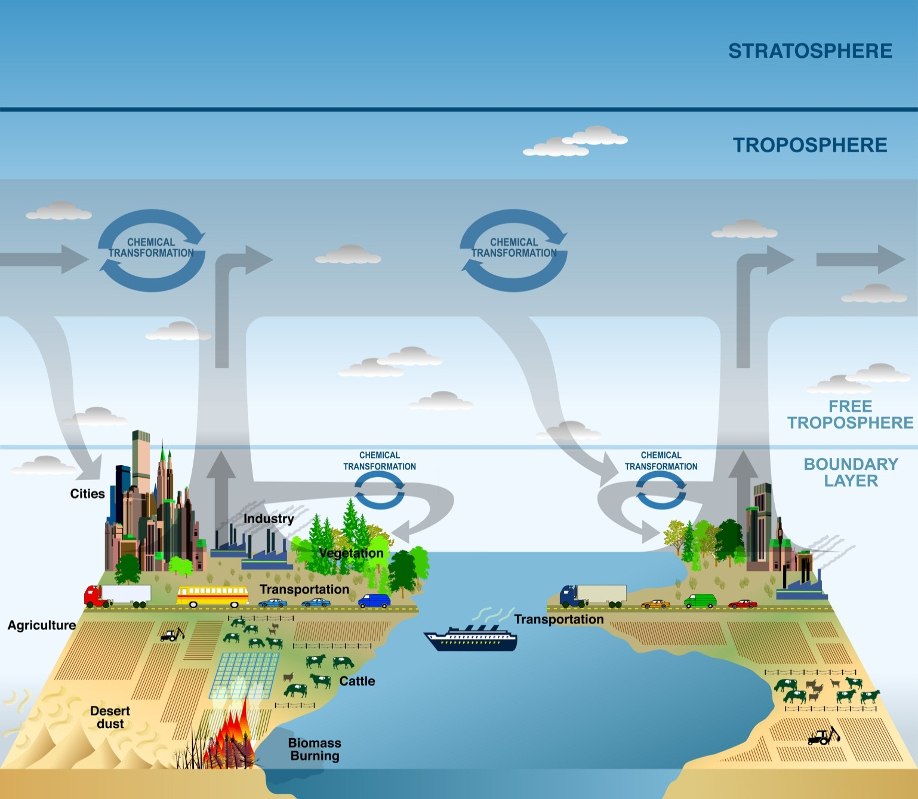
WHY: Science Rationale for GCIRI Measurements
GEO-CAPE addresses 6 science questions regarding the emission, chemical transformation, transport, and climate impacts of air pollutants
1. Emissions
CO distinguishes anthropogenic from natural emissions. CH₄ is key to air quality, climate, and energy policy.
2. Processes
CO vertical profile distinguishes between emissions, transport, and photochemistry
3. Air Pollution and Climate
CH₄ is a major driver of near term climate change
O₃, CO, CH₄, aerosol
4. Intercontinental Impact
CO identifies long-range transport plumes
O₃ , CO,
aerosol
NO₂, CO, CH₄, aerosol
O₃, NO₂, HCHO, CO, aerosol
5. Air Quality Prediction
Co-incident CO improves O₃ forecast and assessment
6. Episodic events
CO traces wildfires and stratospheric O₃ intrusions
Image adapted from CCSP Strategic Plan (illustrated by P. Rekacewicz)
The measurements required to answer GEO-CAPE science questions are provided when GCIRI (including CO and CH₄) and TEMPO observations are made at the same time
Notes:
The set of GEO-CAPE atmospheric composition measurements as recommended in the Decadal Survey includes the most important EPA Criteria Pollutants (O₃, aerosols), total constraints on O3 formation (NO₂, CH₂O), and information on source attribution and long range transport (CO, aerosols). These species have the largest impact on air quality and meet the minimum GEOCAPE success criterion.
Volatile Organic Compounds (VOC) are the many reactive hydrocarbons that produce ozone when they are photo-oxidized in the presence of nitrogen oxides. Formaldehyde (HCHO) measurements constrain total VOC.
CH4 is the 2nd most important Greenhouse Gas (after CO2) and is fundamental to emerging co-management of air quality, climate, energy.

Slide 32
Typical TEMPO-range spectra (from ESA GOME-1)

Slide 33
Typical TEMPO-range spectra (from ESA GOME-1)

