Slide 1
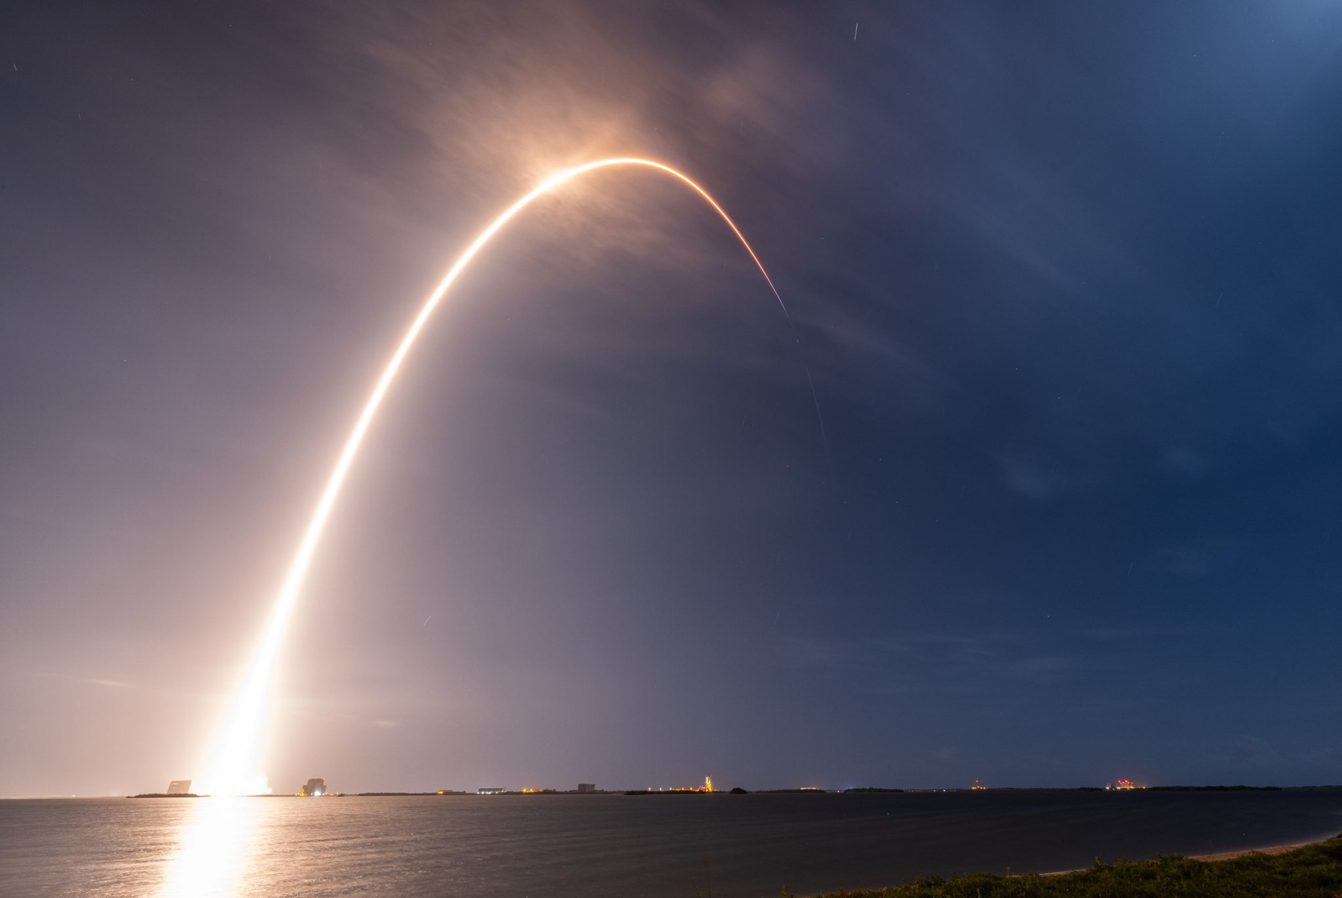
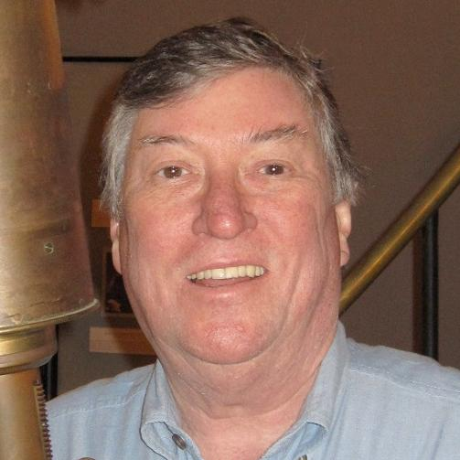
GEO-CAPE to TEMPO, it’s about time
Kelly Chance
Symposium
David Edwards (NCAR)
David Edwards, NSF-NCAR, USA
TEMPO launch April 7, 2023, from Kennedy Space Center, FL USA

Slide 2
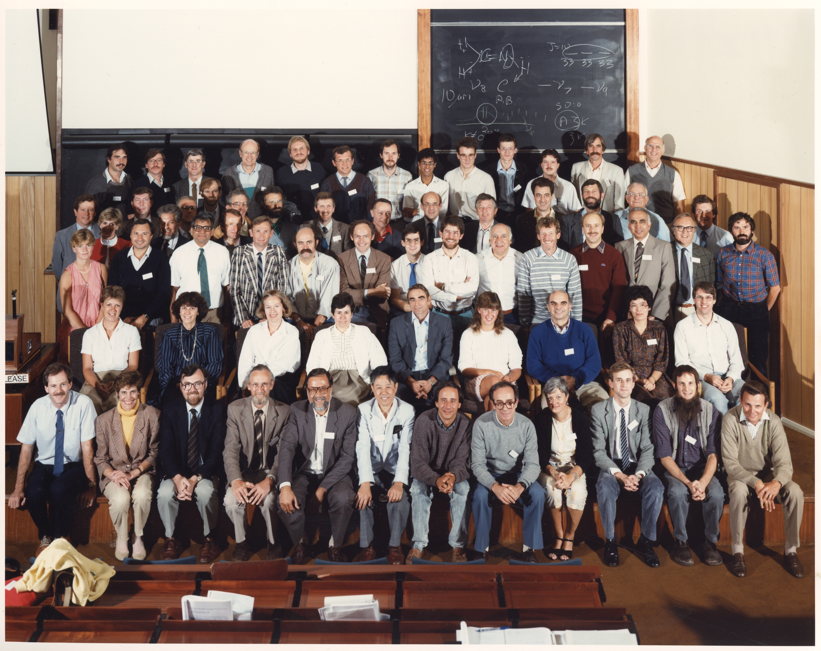
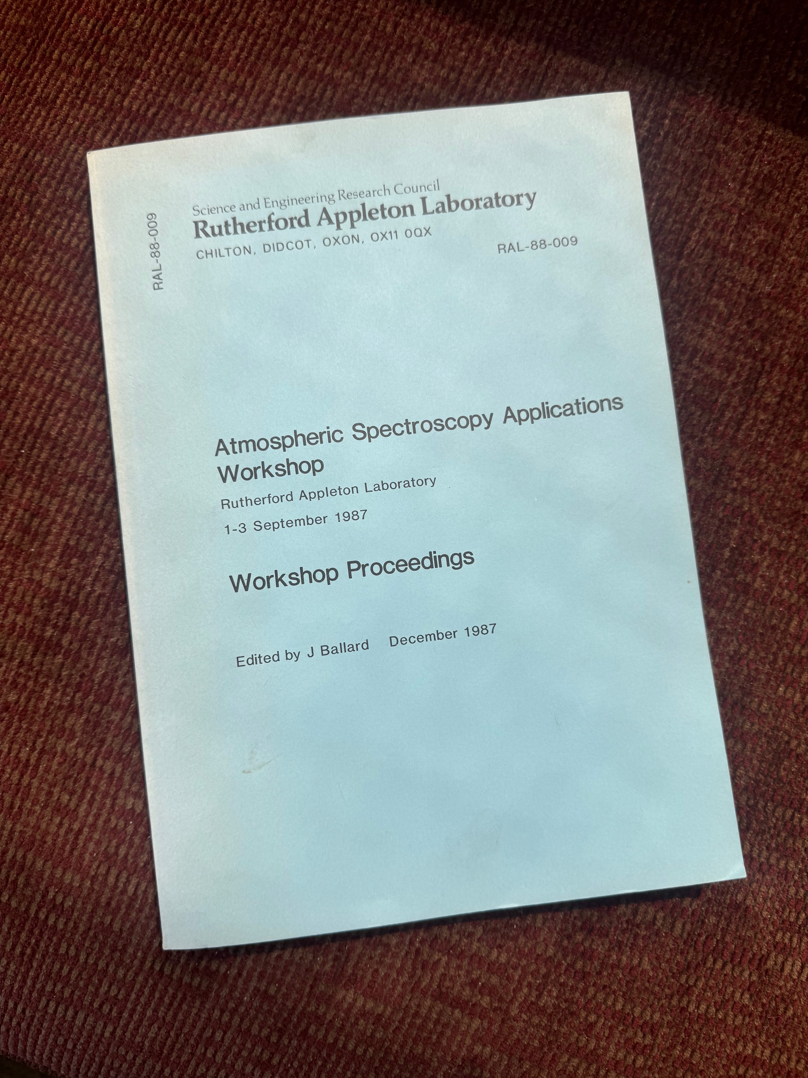
I first met Kelly…
Notes:
I met Kelly at the first atmospheric science meeting I attended
That’s him back row with John Burrows from Max Planck
Quite a number of other luminaries in attendance but Kelly, Larry and I are the only 3 present today
Don’t know for sure but they must have been planning for GOME before it’s launch in 1995
Meeting was all about understanding the spectroscopy and radiative transfer, mainly physicists
Important for launching my career: pub-crawl, conversations, post-docs
Methane imine is CH2=NH, an analog of ethylene. interstellar molecule. detect around 10 micron

Slide 3
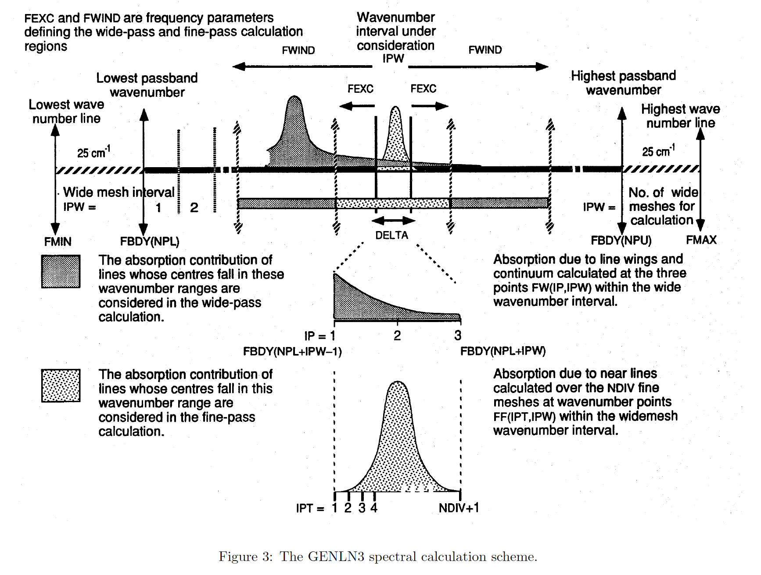
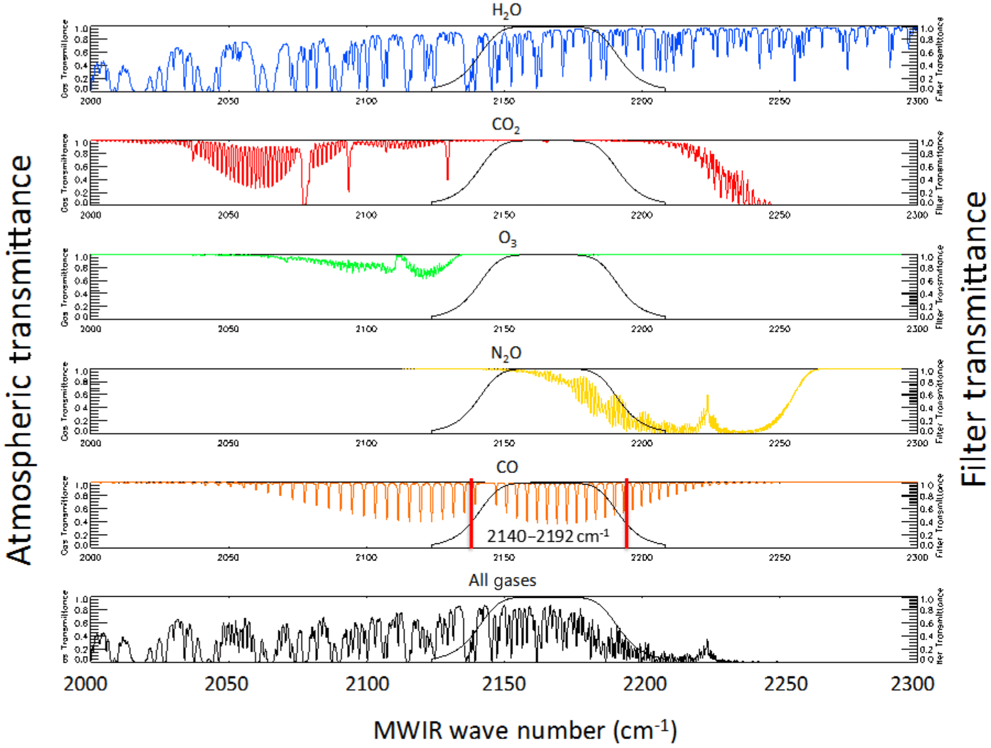
Importance of spectroscopy and radiative transfer
Is important to remember that everything we do in atmospheric composition remote sensing depends on accurate spectral parameters and good radiative transfer
Community line-lists like HITRAN are indispensable
As we probe the atmosphere for increasingly weak gas signatures, the details of fundamental molecular physics and the ability to make efficient radiative transfer calculations remain essential
Kelly did a lot of work on the development of GOME and SCIAMACHY radiative transfer and retrieval algorithms including:
studies for wavelength calibration
improved solar reference spectrum
Raman scattering and the Ring effect
cloud-top height and cloud coverage using the O2 A and B bands
improving line parameters and quantifying spectroscopic error impact
The GENLN spectral calculation scheme
Radiative transfer in the CO 4.3μm band

Slide 4
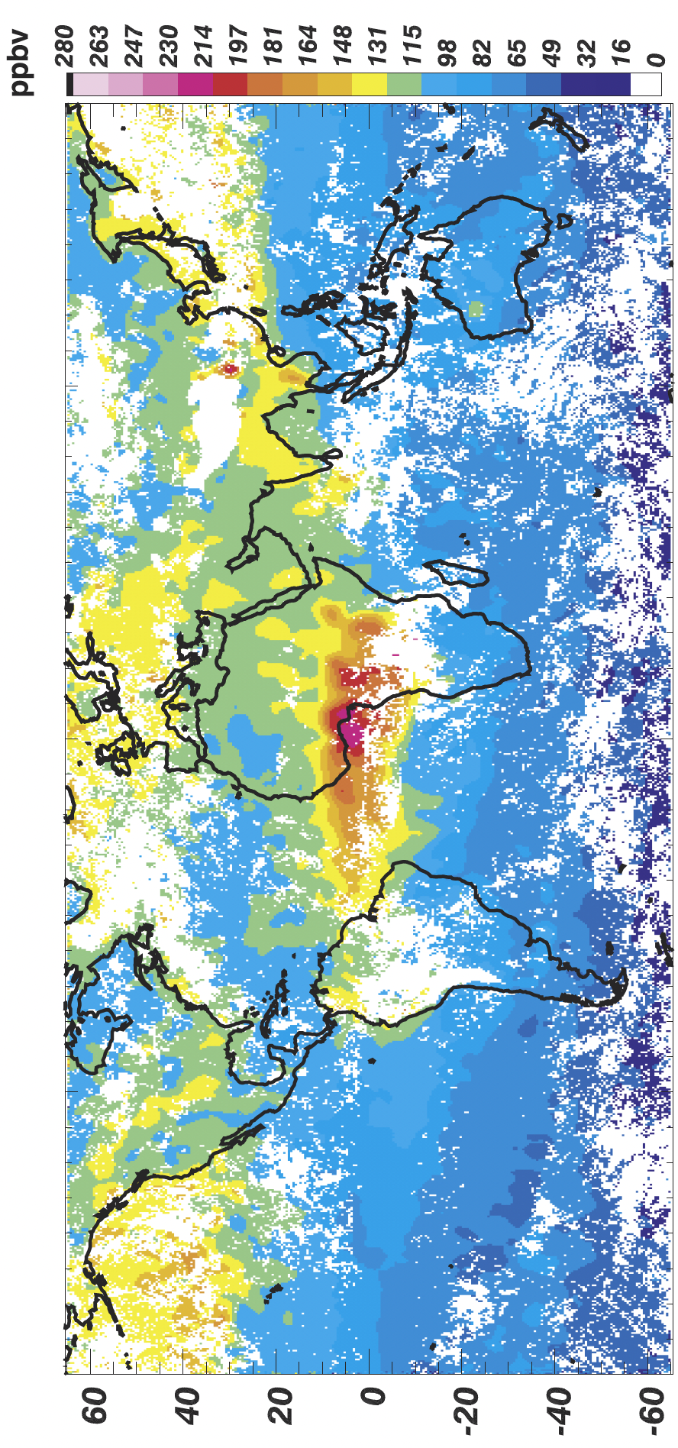
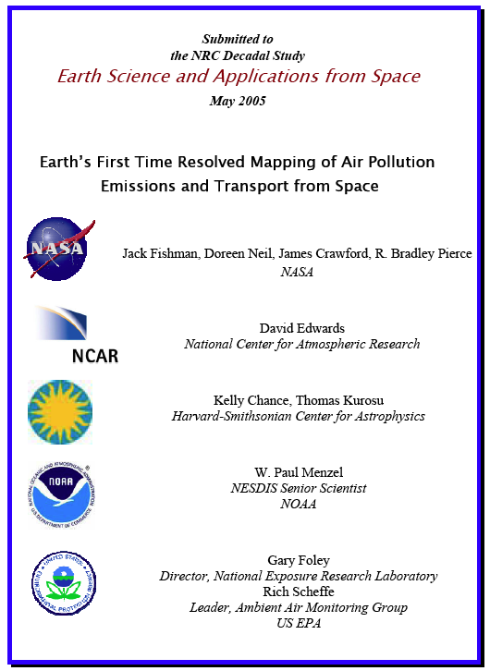
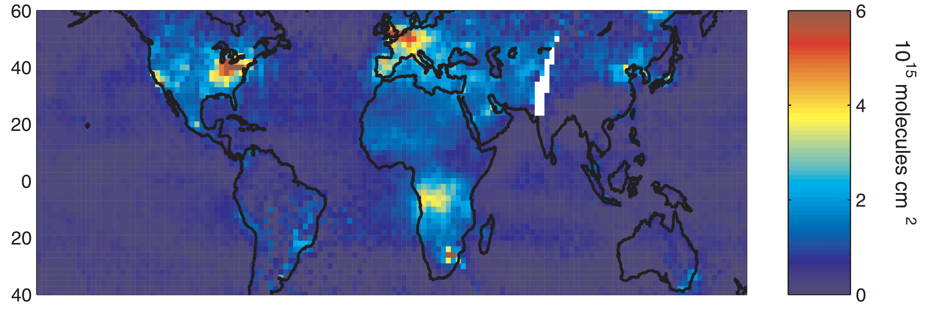
Early tropospheric trace gas retrievals
But people were already talking about going to GEO….
Jack Fishman is the authority on the early ideas and proposals starting in 1995
Based on MOPITT CO discussions, I was invited by Jack and Doreen Neil at LaRC and Kelly at SAO to be part of their submission to the 2007 Decadal Survey RFI based on the GeoTRACE mission concept
And Doreen persuaded me to hold a Workshop at NCAR …
GOME Trop NO₂ VC, July, 1996
MOPITT CO@700h Pa, Jan 20-27, 2001
Martin et al., JGR, 2002
Edwards et al., JGR, 2004
Value of measuring multiple species with different lifetimes
Investigations of emissions, chemistry and transport
Quantifying measurement sensitivity and errors and the ability to integrate with models
Limitations of spatial resolution and repeat time necessitating long averaging periods to get a complete picture

Slide 5
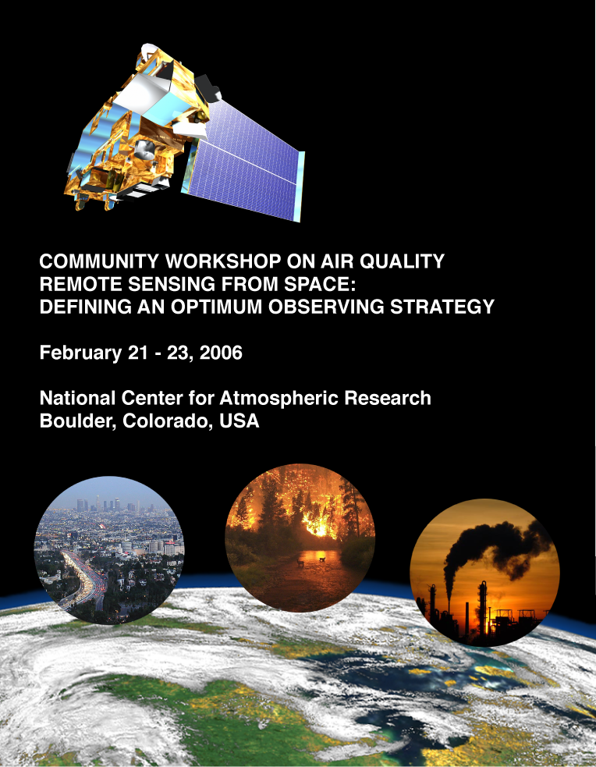
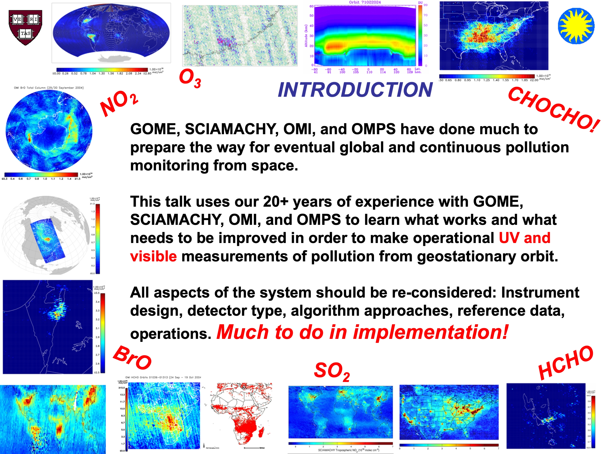
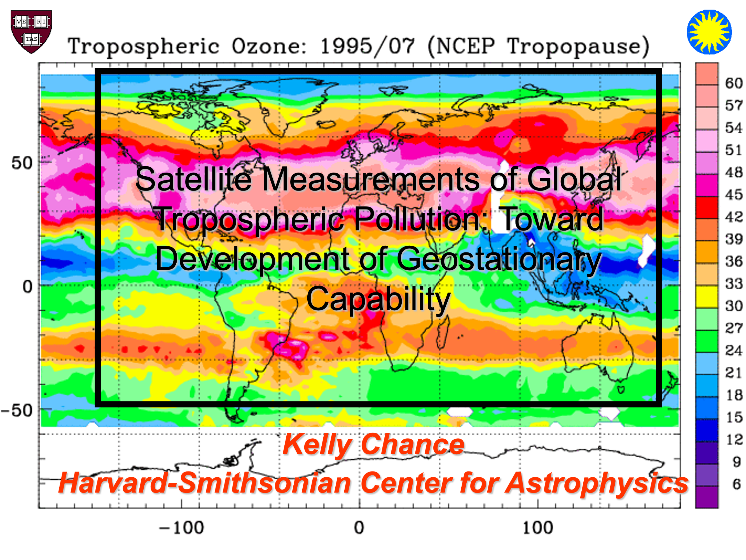
NCAR 2006 Community Workshop
Workshop Objectives
Discuss requirements for AQ satellite observations
Review current tropospheric trace gases and aerosol measurement capability and assess benefits and limitations for AQ applications
Look at techniques for combining space-based measurements with models, particularly at the regional scale, for estimating sources and sinks, and for separating local production and transported pollution
Examine the horizontal, vertical, and temporal measurement resolutions required to capture the variation of the important atmospheric constituents and processes determining AQ
Explore future mission concepts
Submit recommendations NASA Atmospheric Composition and the 2007 Decadal Survey
Community Input to the NRC Decadal Survey from the NCAR Workshop on Air Quality Remote Sensing From Space: Defining an Optimum Observing Strategy
“The AQ community envisions a scientific and observing framework for atmospheric composition that is analogous to that achieved for weather forecasting… (relying on a) combination of observations from GEO, LEO, suborbital and surface platforms to derive a 4-dimensional view (3 spatial plus temporal) of the physical state of the atmosphere….
… Workshop participants reached a consensus that multi-spectral sentinel missions that have high spatial and temporal resolution, and which are able to provide some species concentrations within the boundary layer, would be most beneficial to the AQ community. At the present time, GEO meets this measurement capability with the least amount of risk, and the greatest societal benefit from a U.S. perspective would be derived from placing such a satellite in an orbit capable of observing North America”
Blueprint for TEMPO!
Notes:
Successful in bringing together the community
This impressed Rick Anthes, the DS Chair
The Workshop produced a Report as Input to the DS strongly recommending GEO

Slide 6

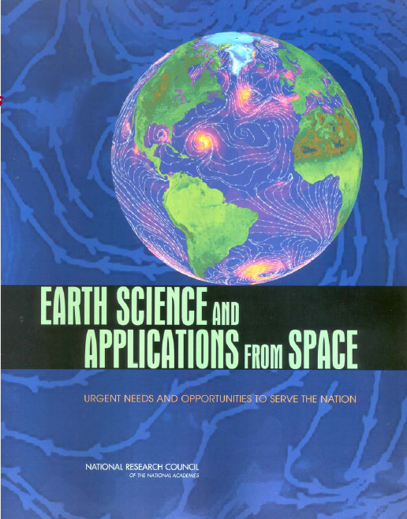
GEO-CAPE
NASA initiated the GEOCAPE project following the recommendation of the 2007 Decadal Survey to quantify the added value of GEO observations of both coastal ocean biophysics and atmospheric composition and chemistry
GEO-CAPE was identified as a near-too-medium term Tier 2 mission that could be implemented with mature instrumentation with significant LEO space heritage
Recommended GEO atmospheric measurements similar to those of GOME and MOPITT to provide high spatiotemporal resolution for regional studies relatable to global composition and for co-management of AQ and climate change
Motivational modeling studies highlighted the rapid diurnal variability in reactive pollutants that a GEO satellite might capture
CMAQ modeling of the NO₂ column and surface values over Houston are shown with the 1:30 local time OMI observation for June 22-23, 2005 from Fishman et al., BAMS, 2008
Notes:
The 2007 DS GEO-CAPE atmospheric composition objectives strongly reflect the community meeting report.

Slide 7
GEO-CAPE Science Questions
Emissions: What are the temporal and spatial variations of emissions of gases and aerosols important for air quality and climate?
Processes: How do physical, chemical and dynamical processes determine atmospheric composition and air quality over scales ranging from urban to continental, diurnally to seasonally?
Climate: How does pollution drive climate forcing and how does climate affect air quality on a continental scale?
Applications: How can observations from space improve air quality forecasts and assessments for societal benefit?
Global impact: How does intercontinental transport affect surface air quality?
Events: How do episodic events affects atmospheric composition and air quality?
Early GEOCAPE work
NASA funded GEO-CAPE Science Working Groups (SWGs) in 2009
Charged with defining UV-vis-IR measurement requirements and formulating Science Traceability Matrices (STMs) based on:
  Examination of horizontal, vertical and temporal gradients in atmospheric composition data at fine measurement scales
  Retrieval capability to provide independent information on near-surface composition especially with multispectral retrievals for ozone and CO
  Requirements for aerosol observations and impact on atmospheric composition and coastal ocean color science goals
Also verified that no significant technology development was required
Important decision point: A hosted payload approach would significantly reduce risks and cost for accomplishing GEO-CAPE science objectives
Promoted GEO-CAPE as part of the international constellation
Notes:
Lots of work going on before 2009: NASA 2006 GeoMAC study to look at GEO
GeoMAC)ISAL study in September 2006 focused on a two-instrument payload similar to the GEO-CAPE mission ultimately recommended by the DS: a UV/Vis spectrometer (the GeoMAC instrument itself) and an IR gas-correlation radiometer (the Compact Imaging Spectro-Radiometer, or CISR).

Slide 8
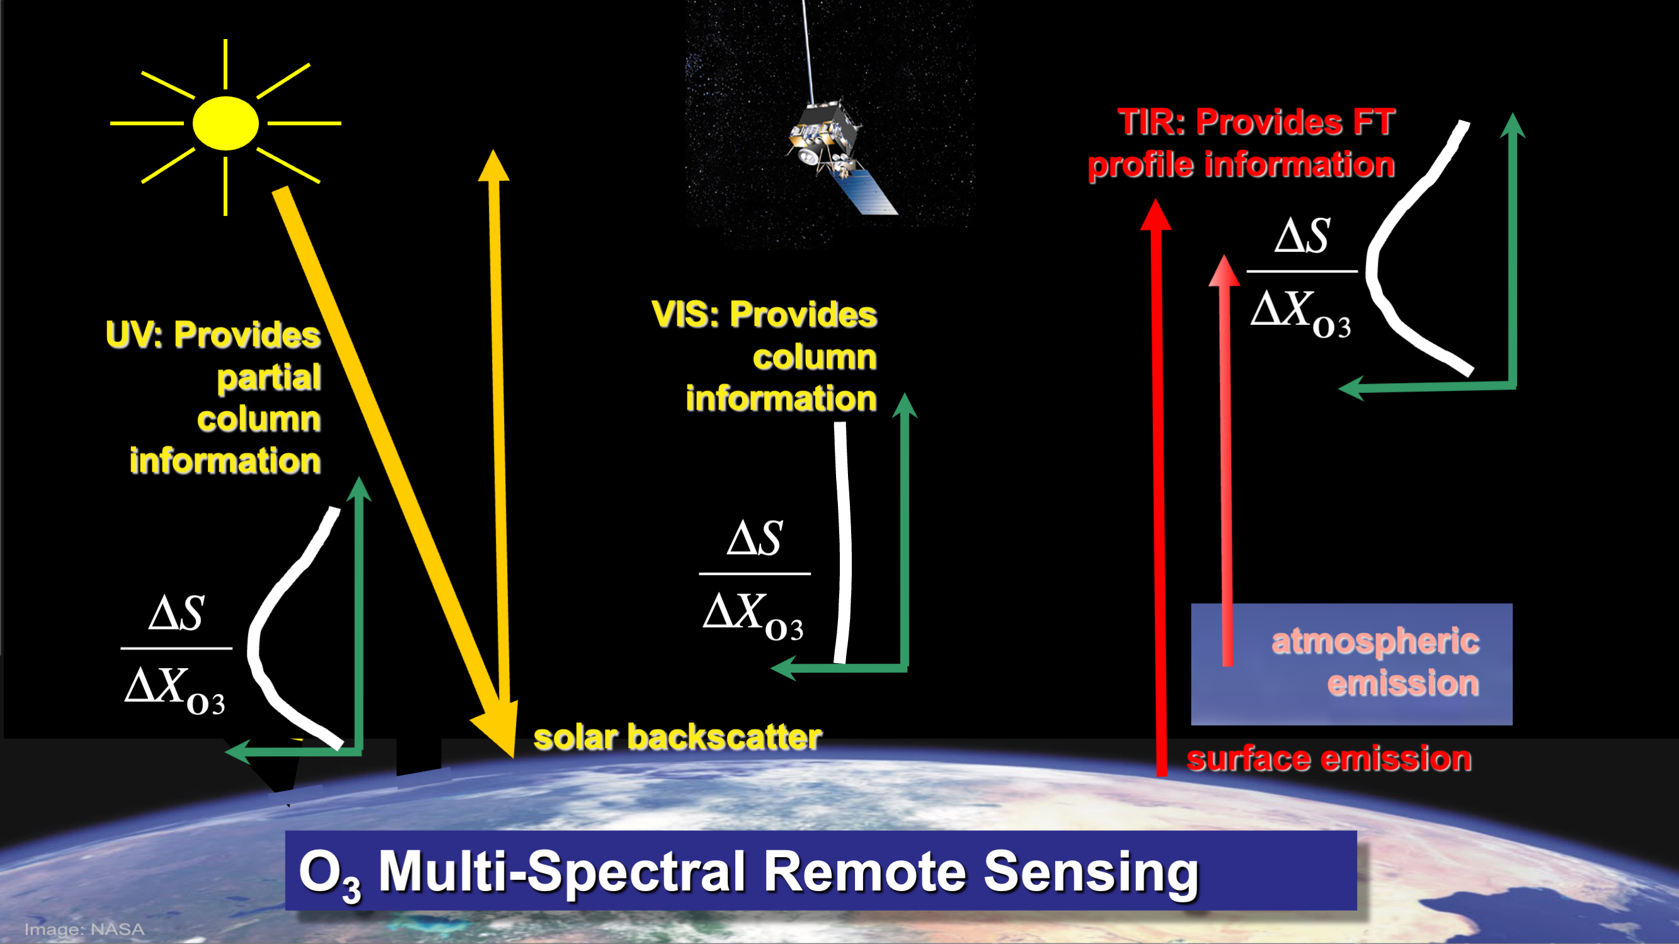
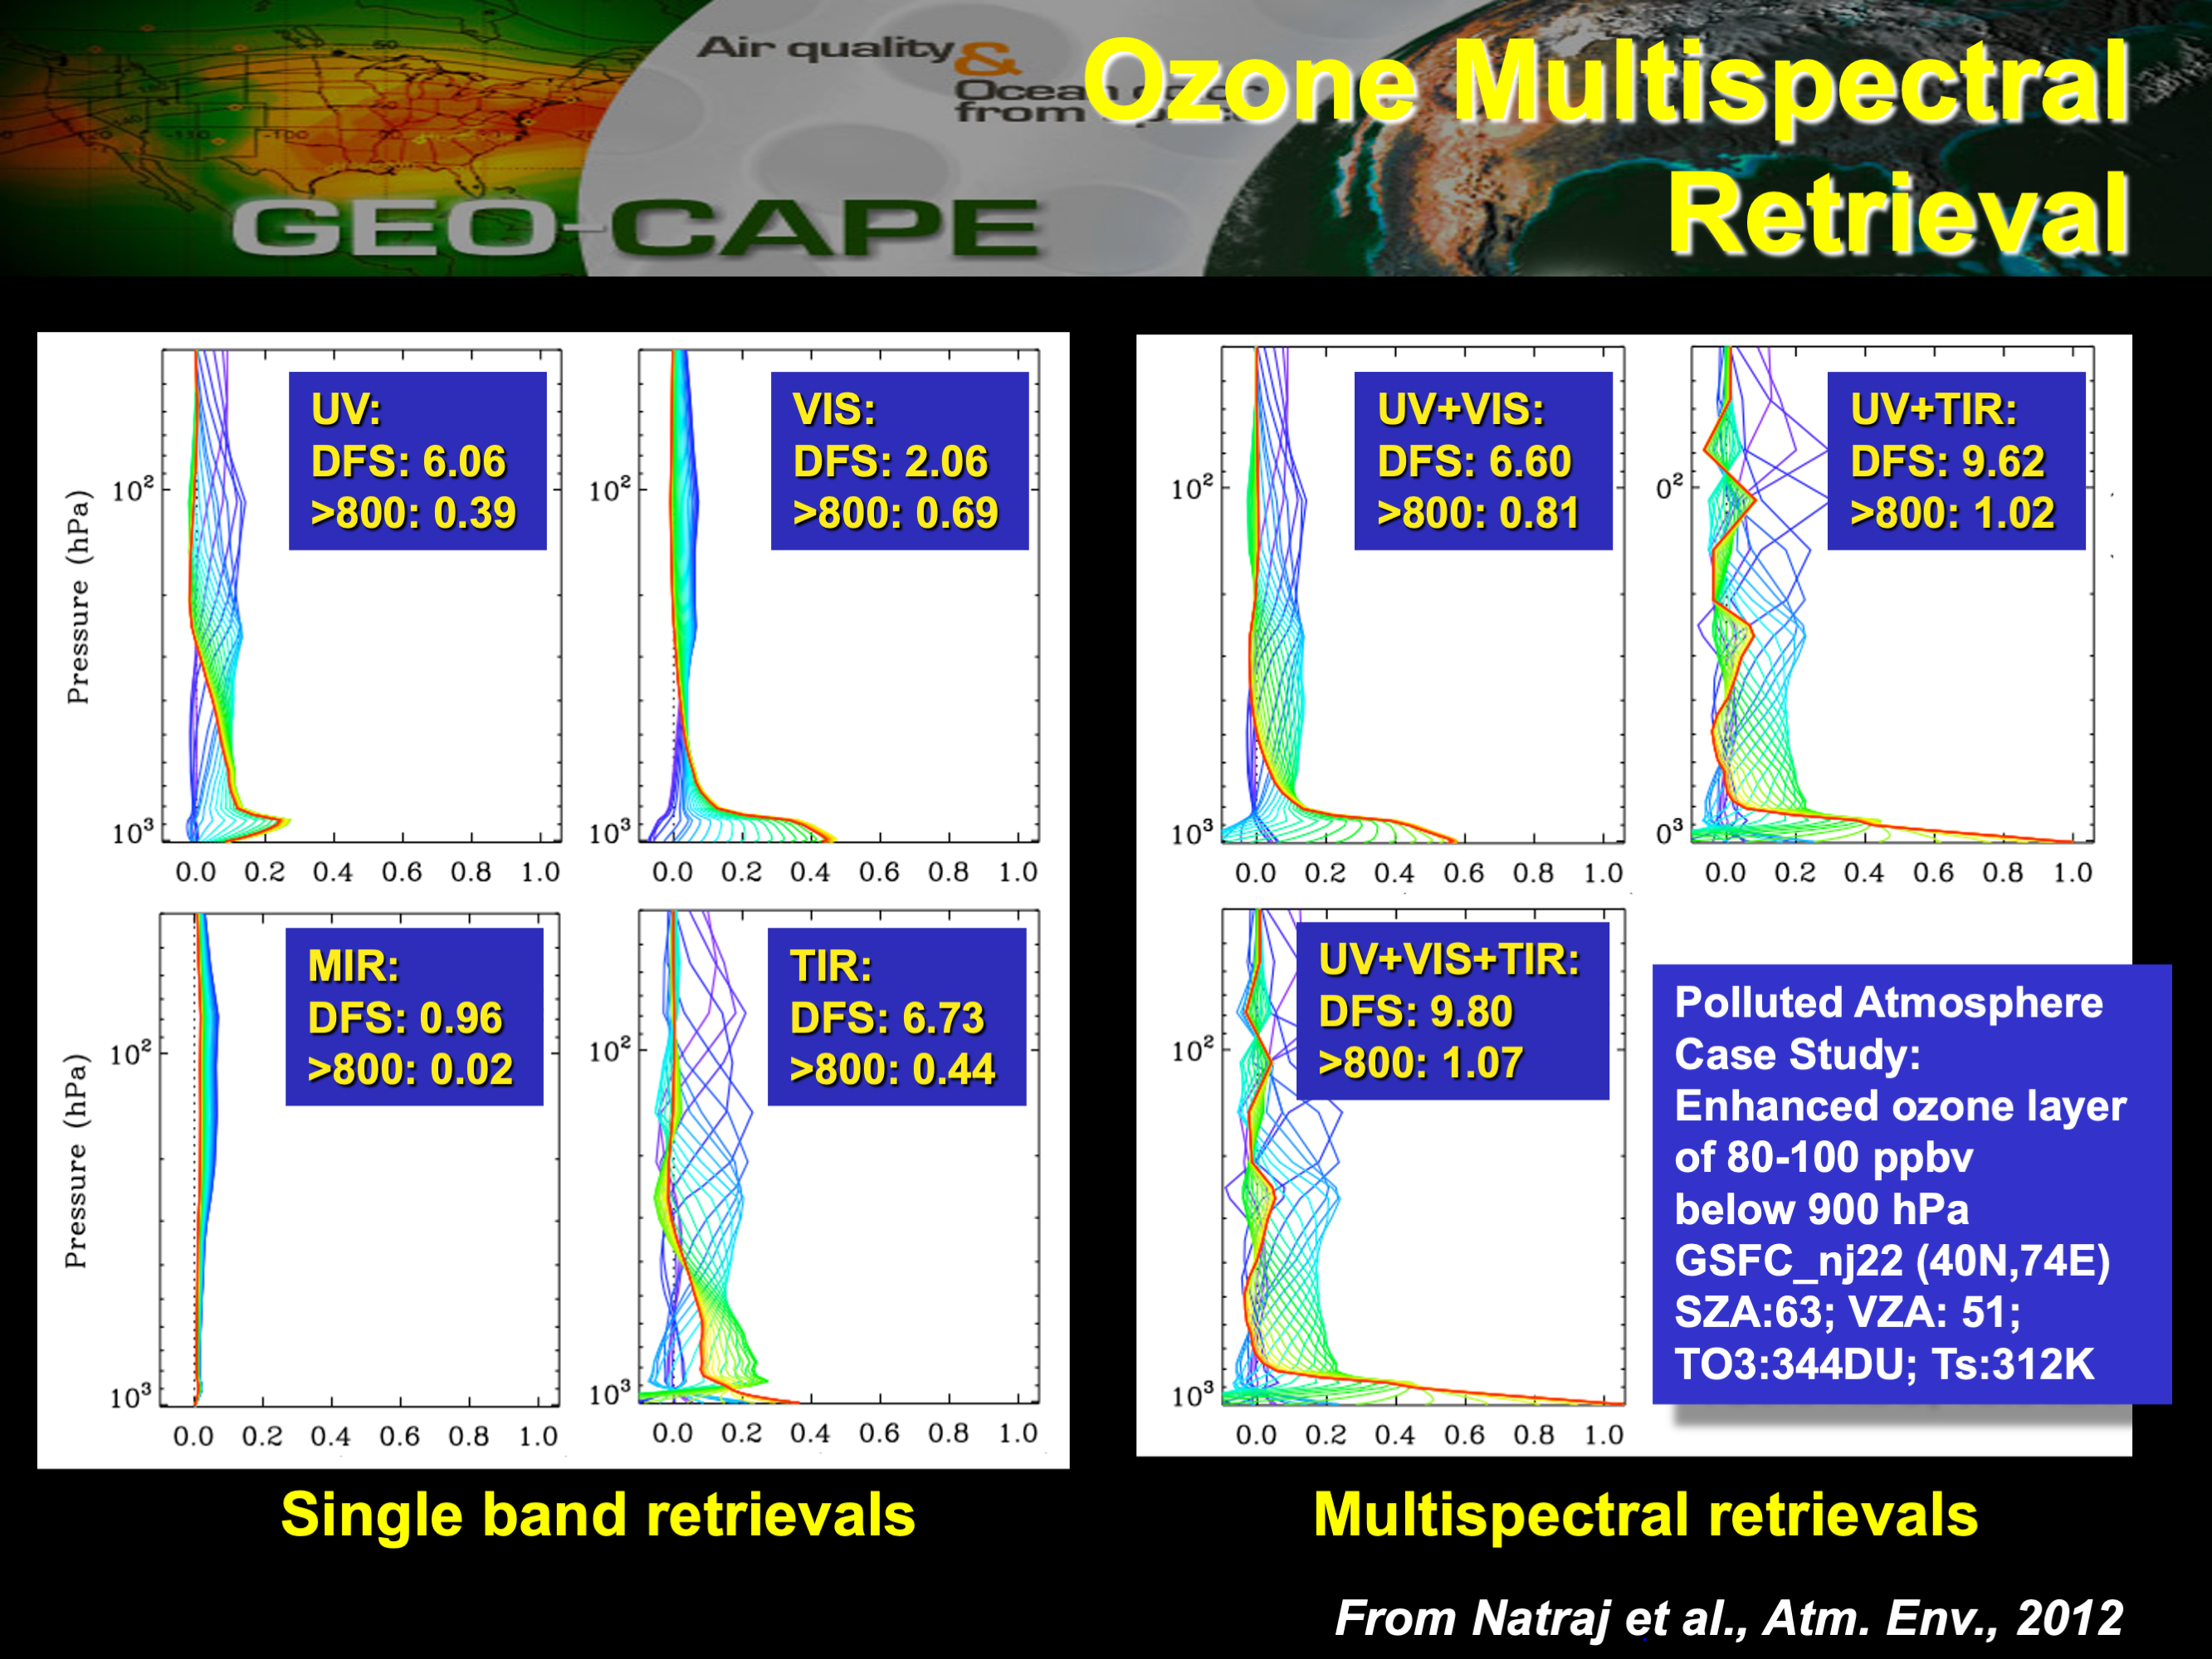
Multispectral measurements

Slide 9
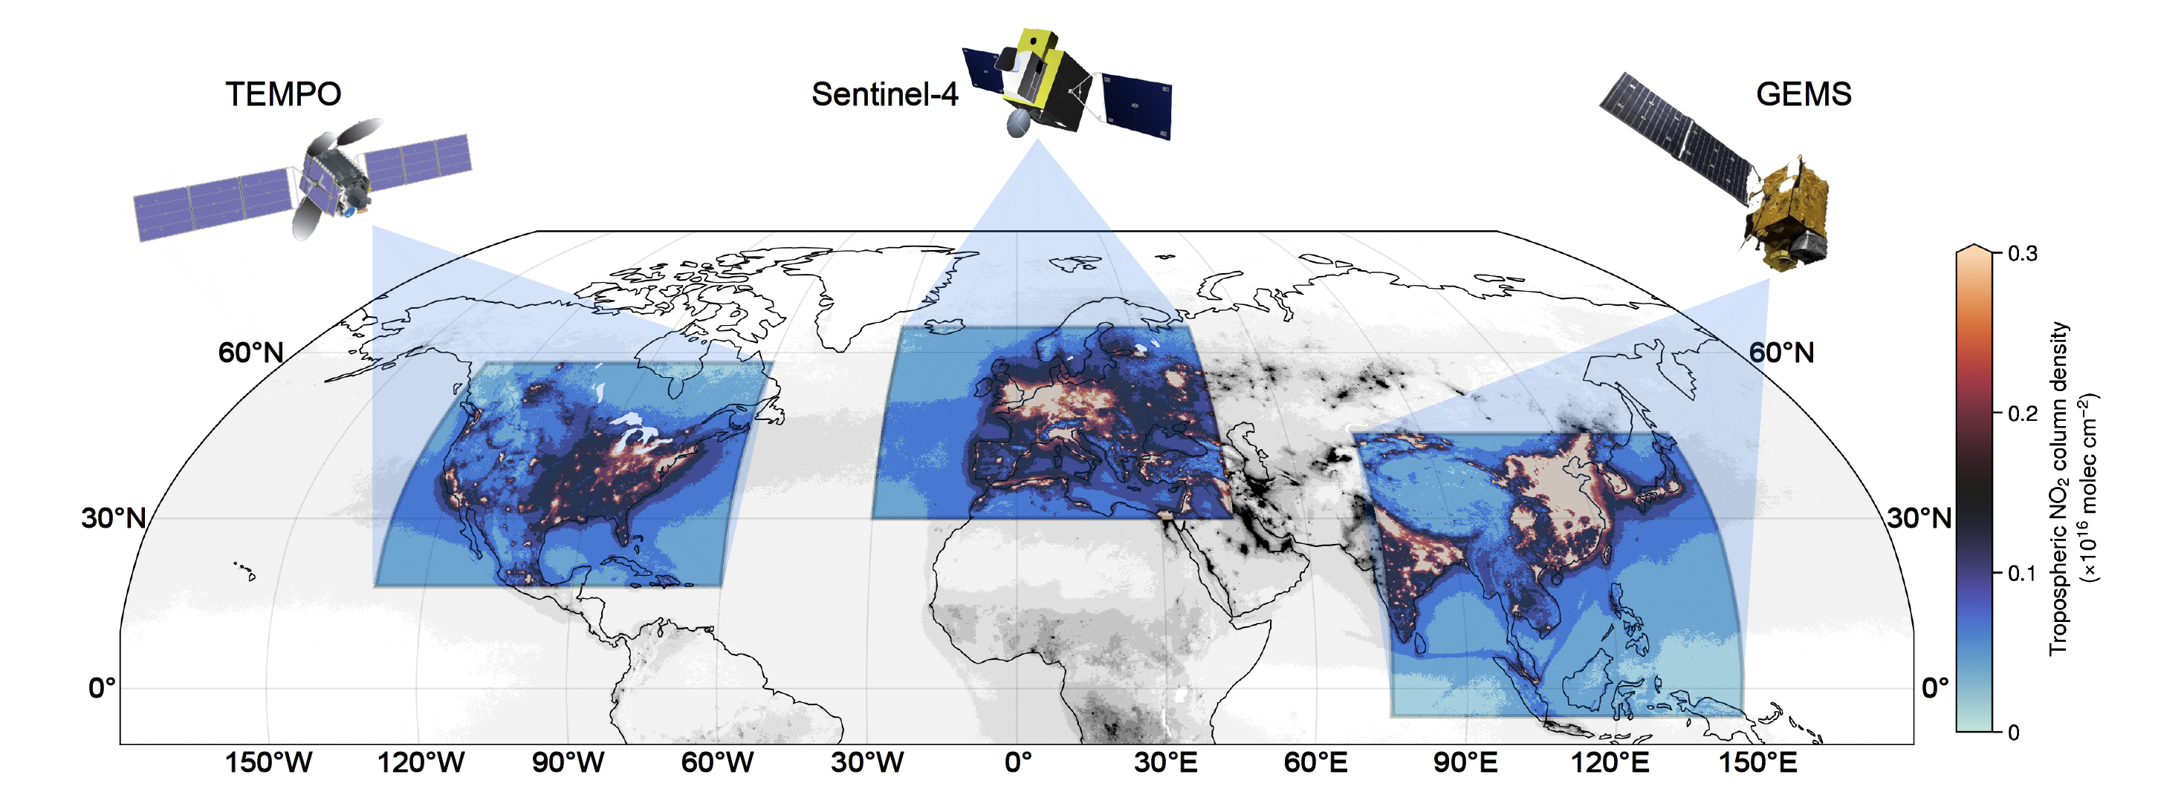

The GEO constellation
He et al., BAMS, 2025
Recognizing that several countries had plans to go to GEO, CEOS ACC took on a coordinating role in 2009 to promote common objectives, baseline products and a constellation vision adding GEOs to the current and planned LEO missions
This international interest helped promote individual regional efforts and proposals and resulted in an influential whitepaper in 2012
Identified collaborative activities for cal/val standards, and science activities related to improved NH emissions, AQ forecasts and data assimilation, AQ/climate co-benefits and assessment of downwind regional impacts of long-range transport
Notes:
GEO-CAPE Would Be Part of International AC Geo-Constellation as Envisioned in IGACO Observing Strategy described in 2004 Report
Also encouraged other international projects looking for AO such as MAGEAQ for EE-8, V-H Peuch PI, Chance, Liu and Edwards Co-Is
Toulouse meetings with Kelly

Slide 10
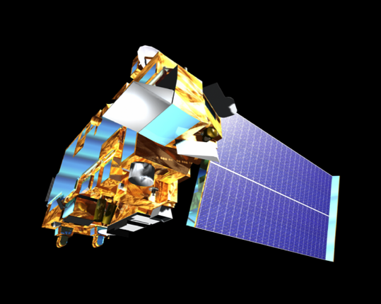
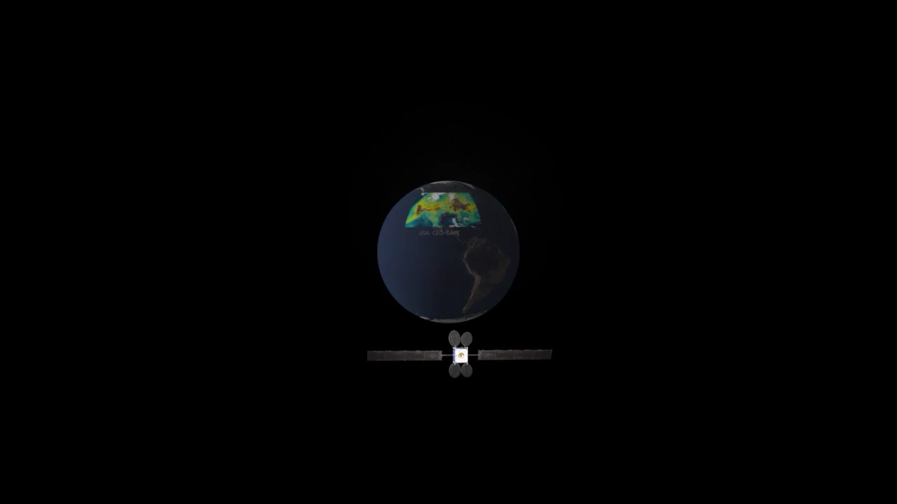
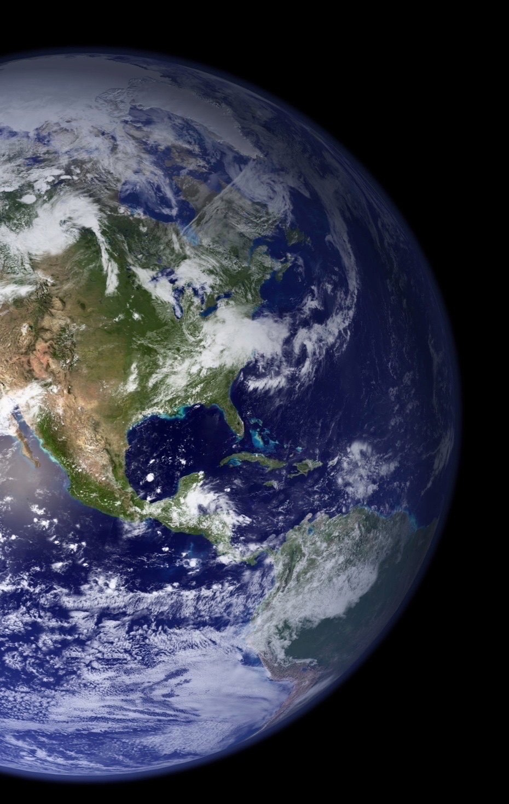
Thank you!

Slide 11
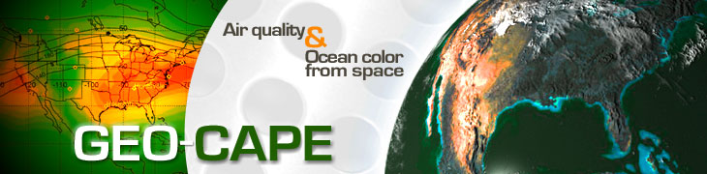
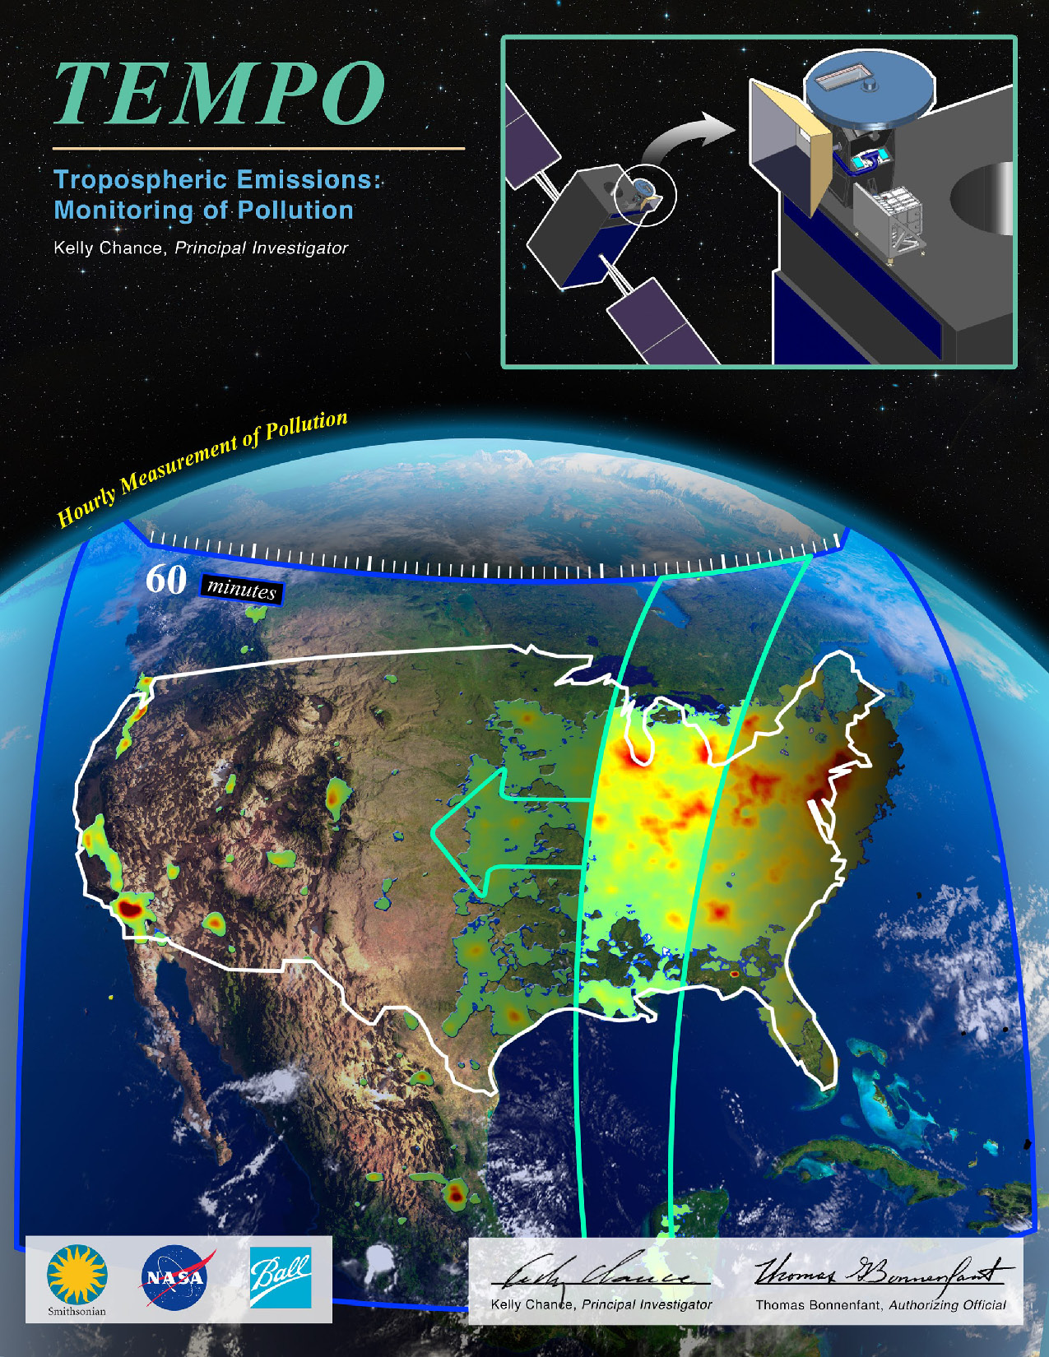
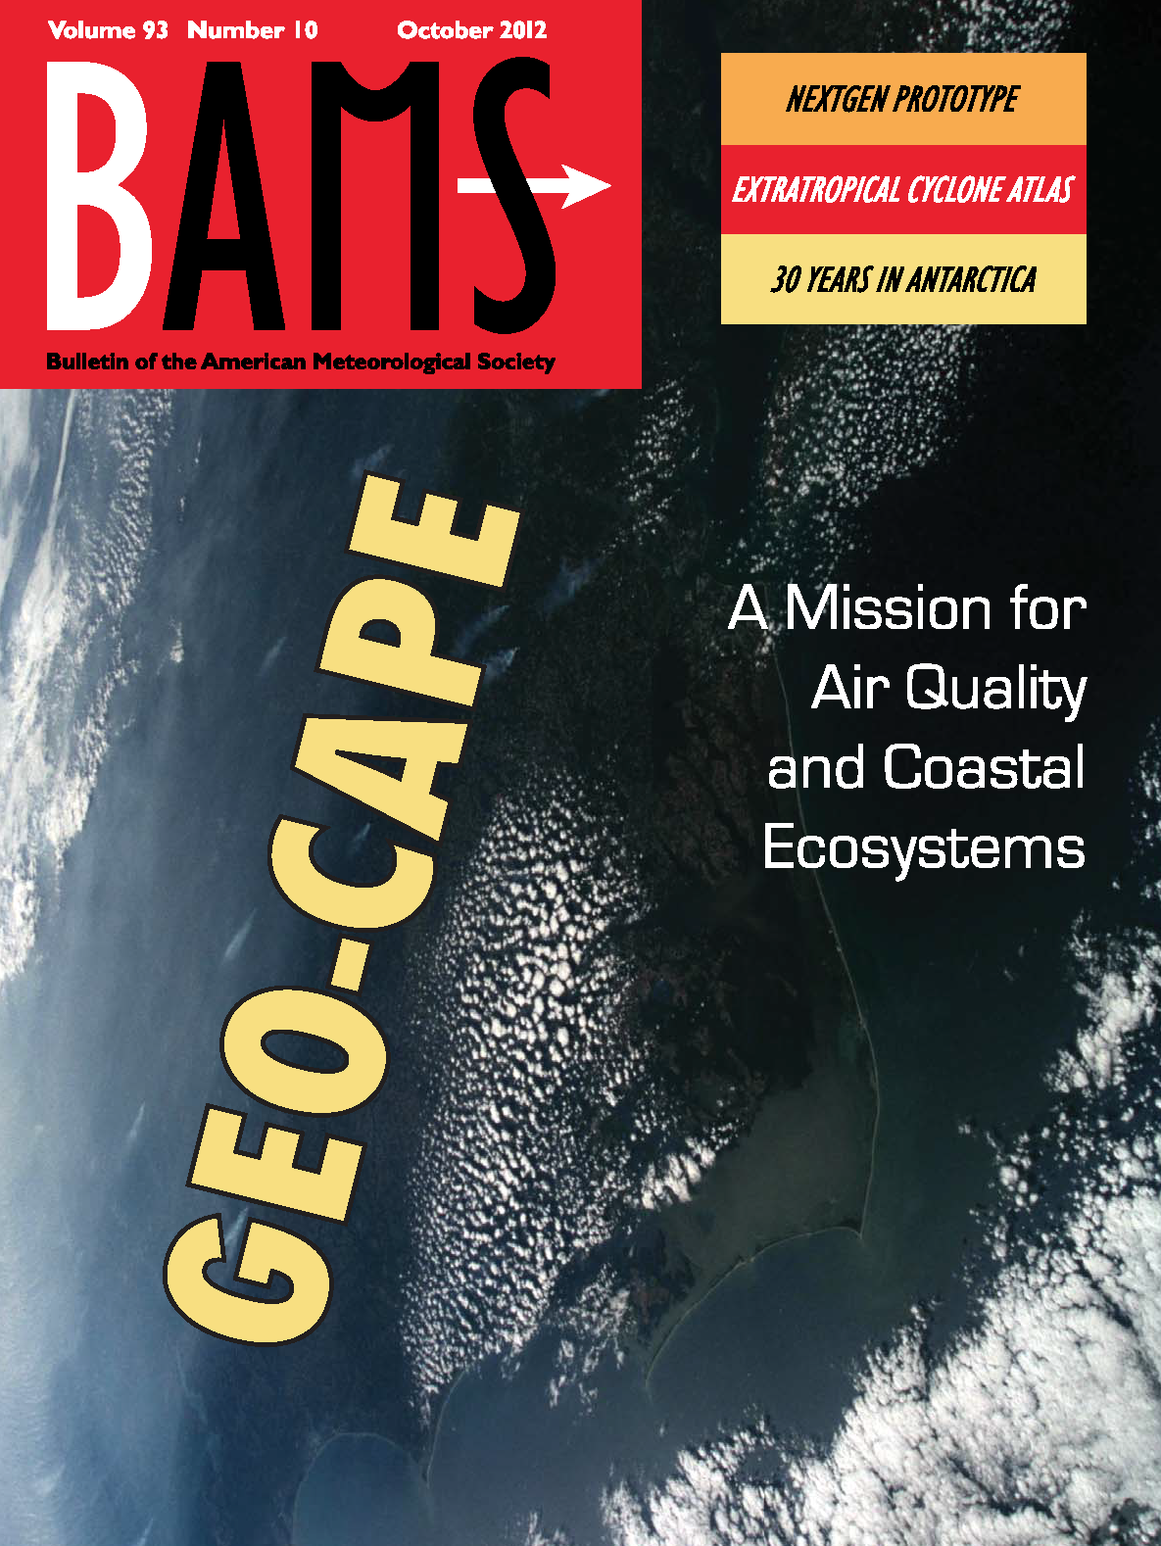
TEMPO selected as EVI-1 November 2012!
Notes:
The TEMPO proposal was able o leverage all the preceeding work to define requirements for GEO-CAPE
TEMPO used the GEO-CAPE STM

Slide 12
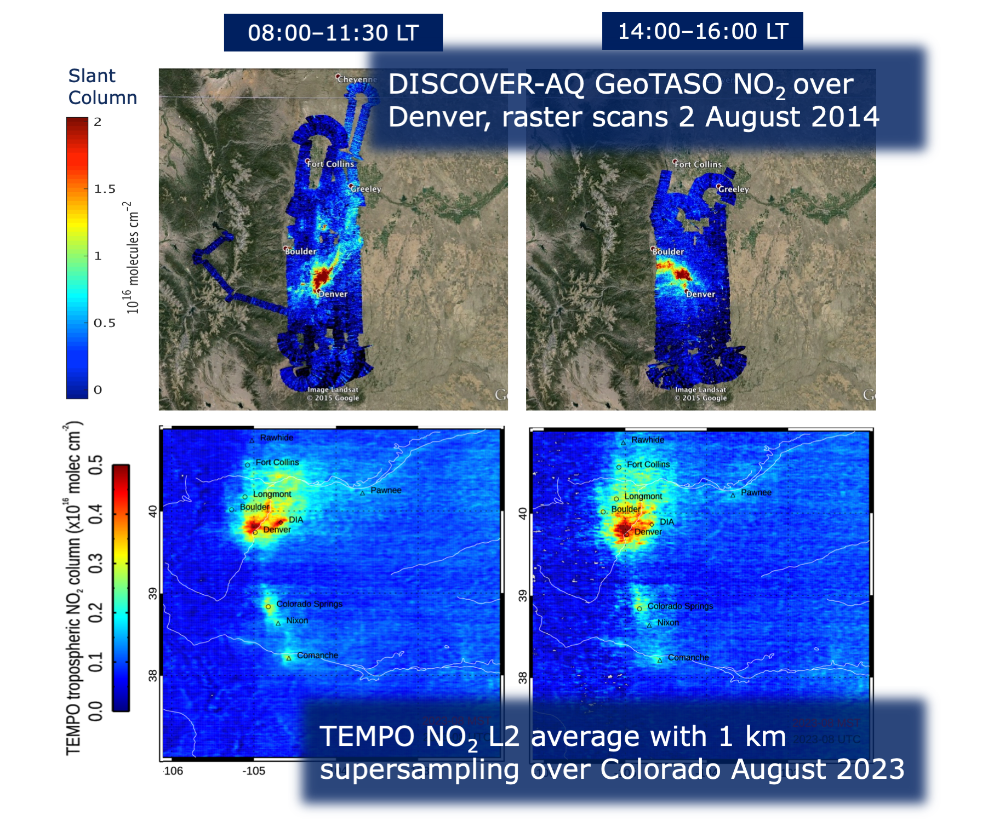
GEOCAPE work after TEMPO selection
GEO-CAPE continued to fund Science Working Group activities to support readiness for TEMPO launch
This was a cost-effective model for community engagement
Activities focused around:
  Emissions and Chemical Processes Working Group: Studies using satellite, aircraft and ground-based monitoring and inverse models
  Aerosol Working Group: Understanding daily variability of both AOD and PM2.5 and how these are related, algorithm development
  Global OSSE Working Group and Regional/Urban OSSE Working Group: Evaluate the contributions of the GEO missions, alone and together, to improve knowledge of near-surface air pollution due to LRT and to quantify emissions; develop accurate and fast observation simulators; workshops
  Methane Working Group: Quantifying measurement requirements and improvements in emissions knowledge from GEO
Field campaigns: Support of and deployment of aircraft TEMPO simulators GEO-TASO, GCAS to test algorithms and prepare validation
Support of ground-based CLARS-FTS of CH4, CO, CO2 in LA
GCIRI: Development of options for GEO measurements of CO and CH₄
Notes:
Kelly visits to NCAR:
while visiting Ball for TEMPO and GeoTASO; CO proposal to IIP
Harvard representative to UCAR
I always appreciated the discussion, good ideas and mentorship
GEO-TASO development supported by ESTO
Campaigns: KORUS-AQ , LMOS, SARP, LISTOS

Slide 13
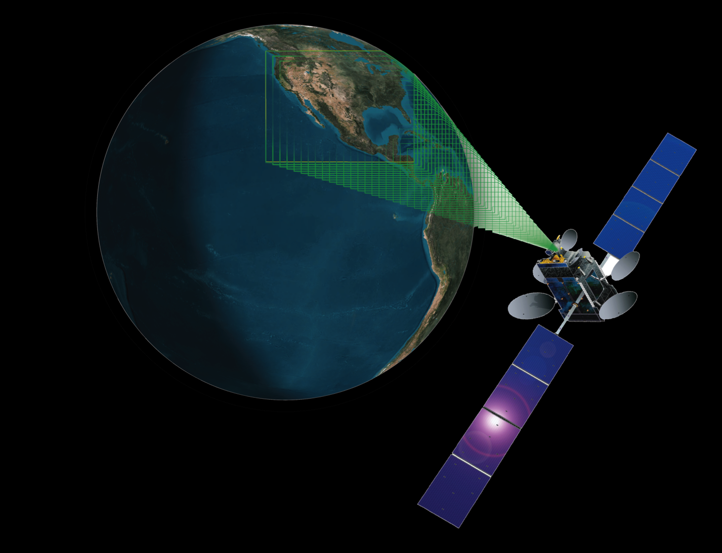


CHRONOS solution for GCIRI
Edwards et al., AMT, 2018
David Edwards, Principal Investigator
Helen Worden, Deputy P.I.
and the CHRONOS Science Team
Notes:
Based on MOPITT Heritage, CHRONOS is a gas correlation filter radiometer (GFCR) instrument concept, David Edwards, PI.
GLIMR for ocean color
GeoCARB for CISR

Slide 14
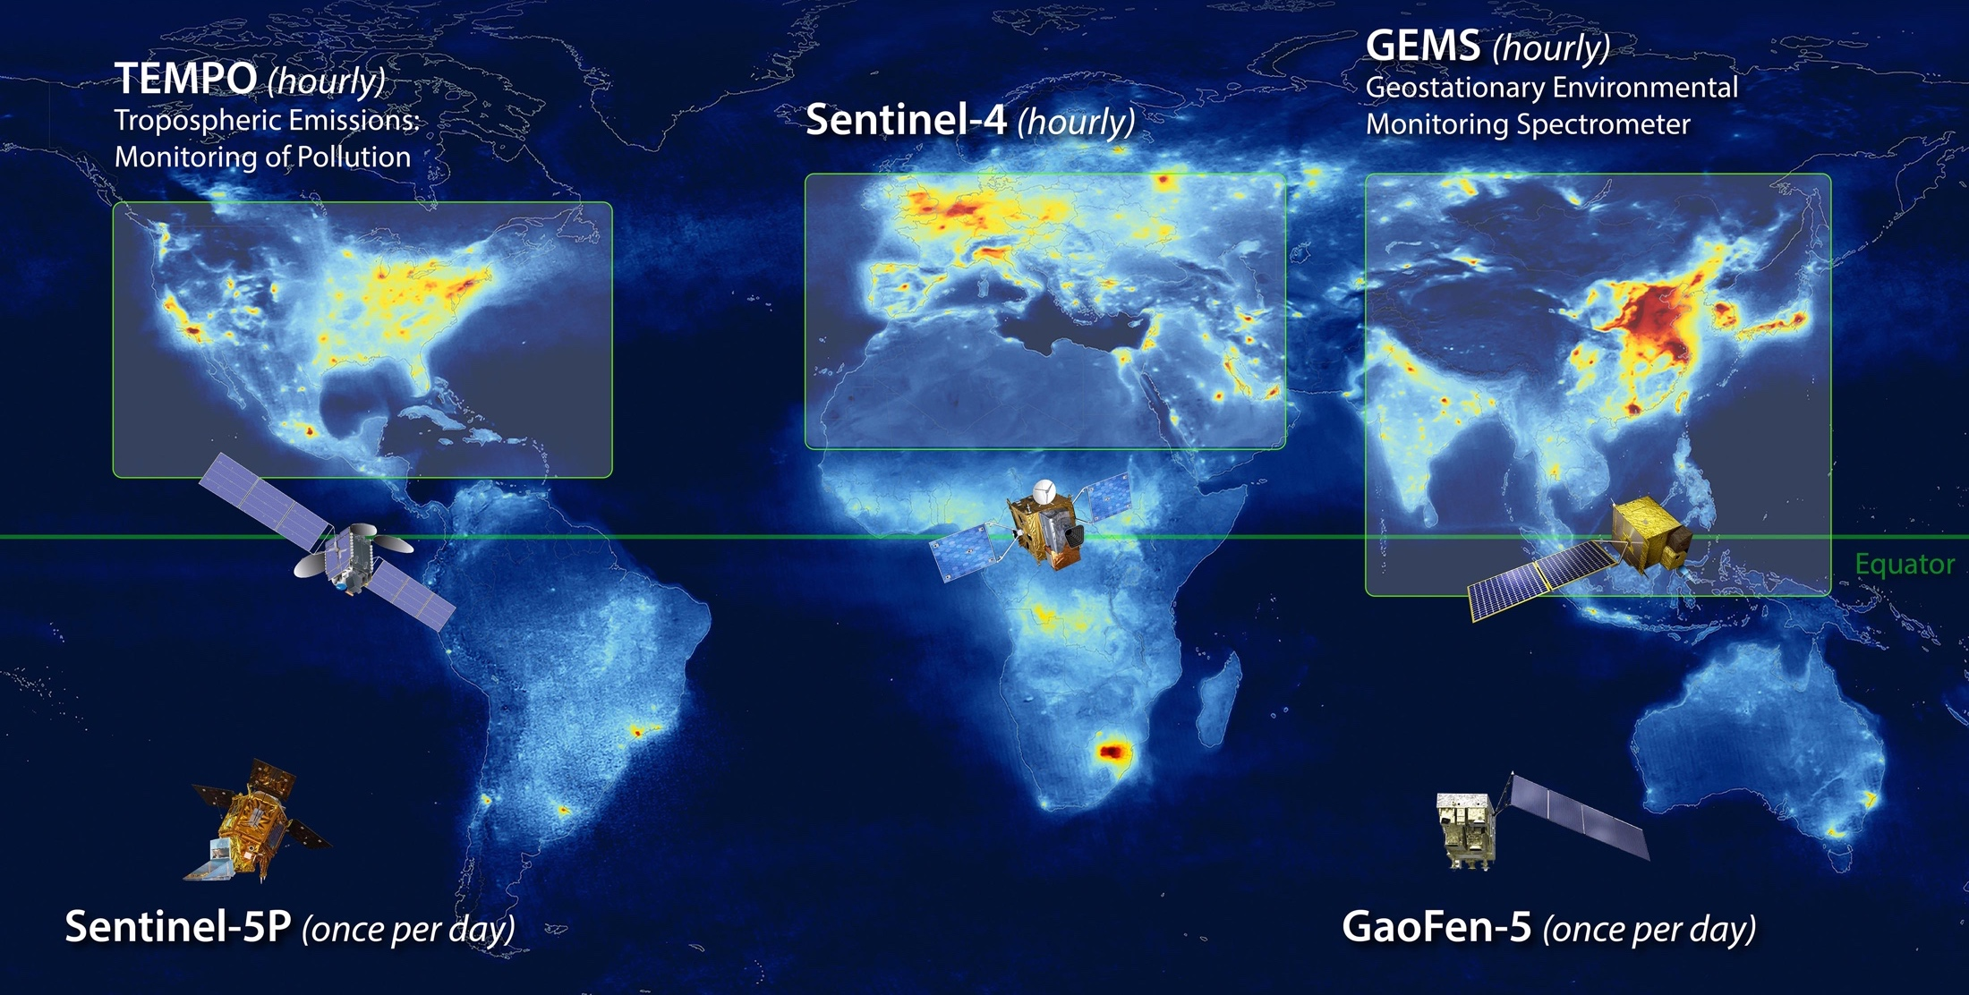
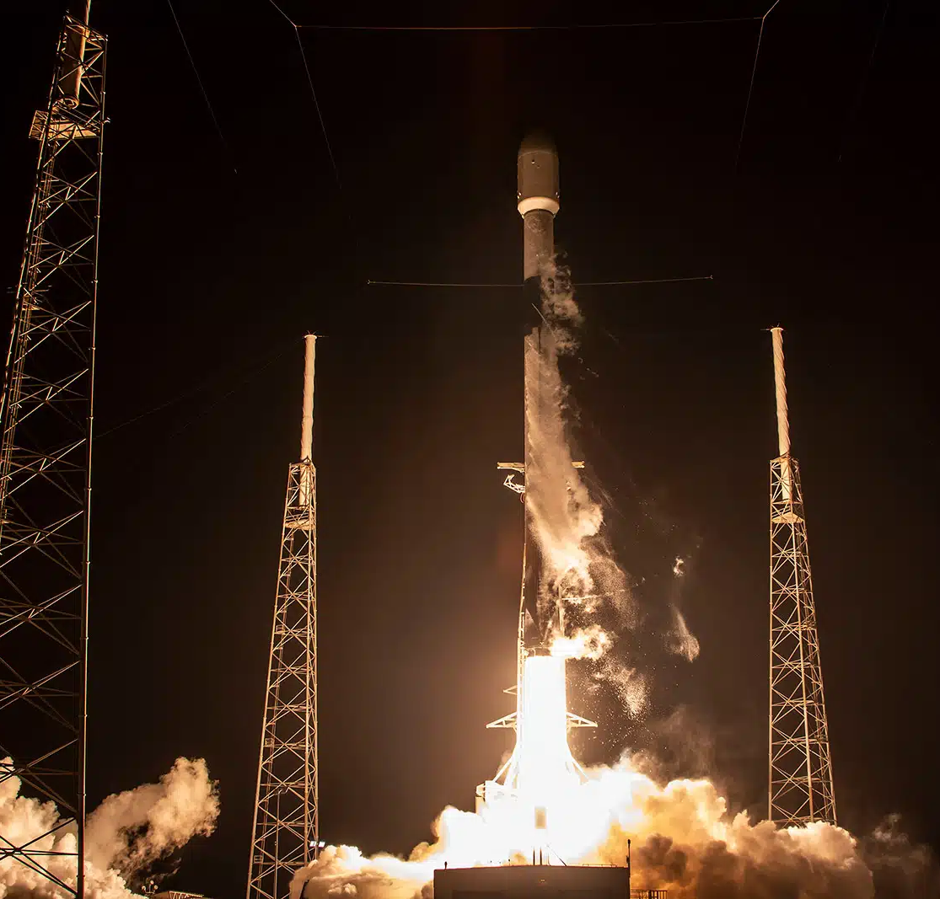
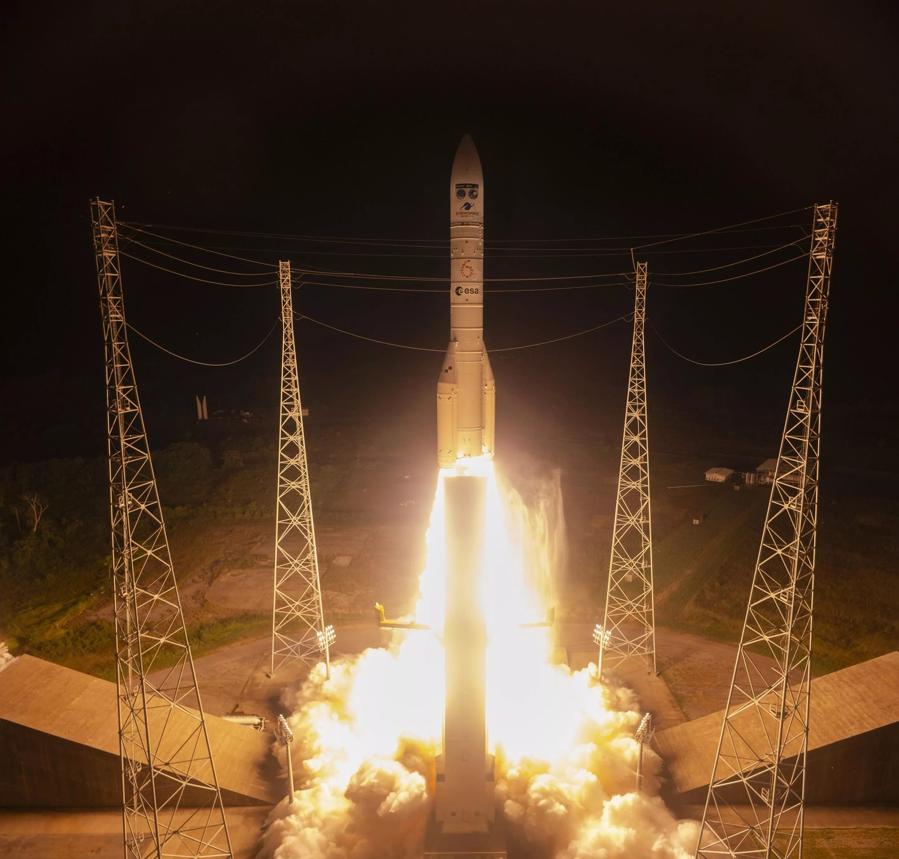
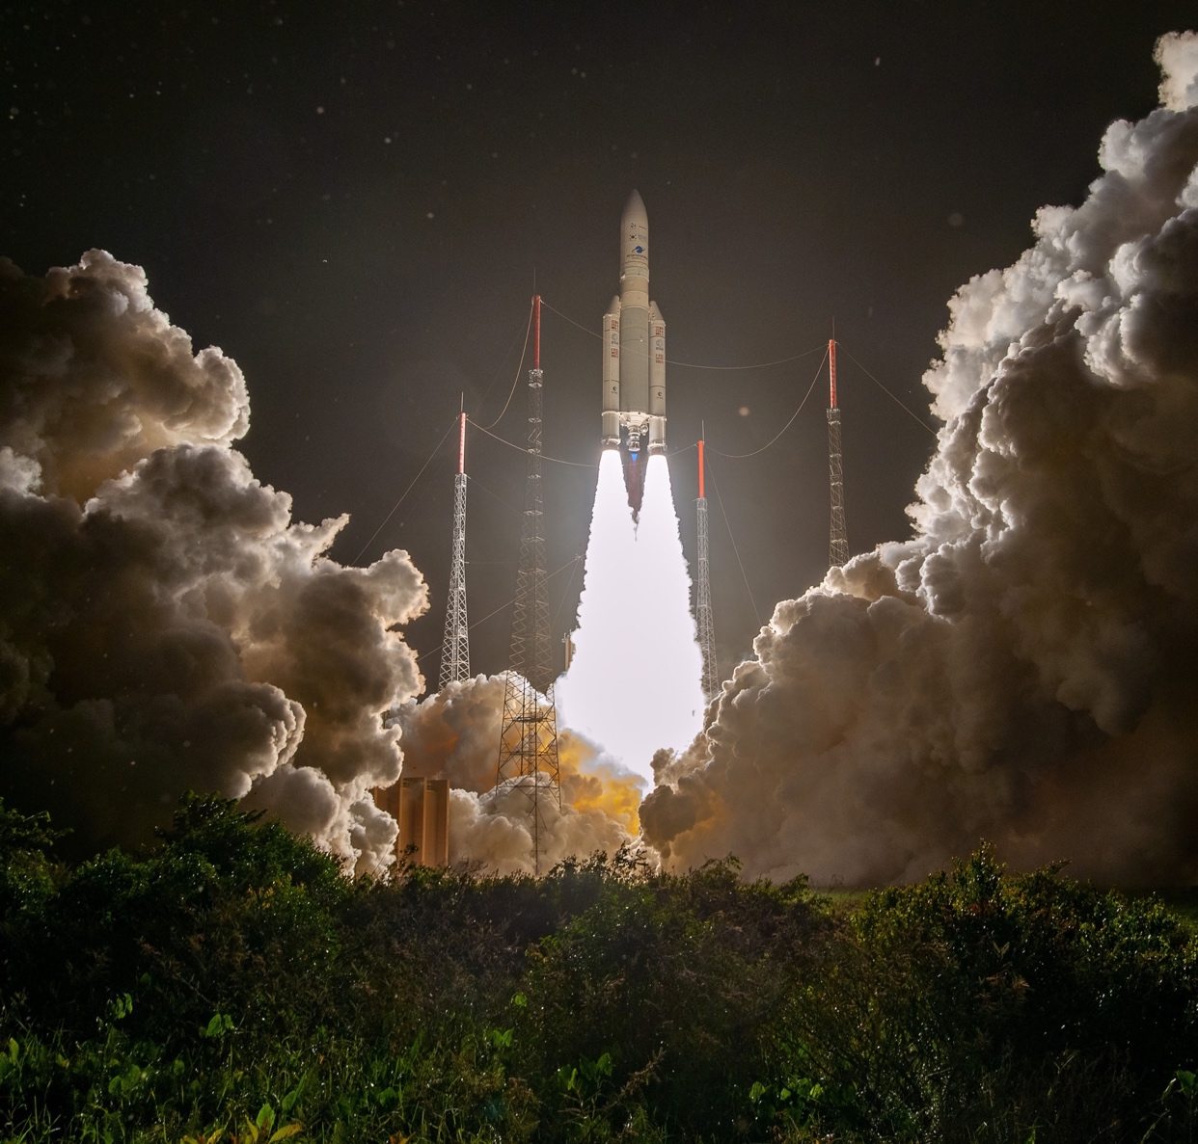
TEMPO launch Apr. 2023 from Kennedy Space Center
S5 launch Aug. 2025 from the French Guiana Spaceport
GEMS launch Feb. 2020 from the French Guiana Spaceport

Slide 15
Congratulations to Kelly on a long career of seminal achievements across molecular spectroscopy, atmospheric radiative transfer, instrument development and mission realization
… and for the support and mentoring!
David Edwards (NCAR)
TEMPO launch April 7, 2023, from Kennedy Space Center, FL USA

