Slide 1
Improving Remote Sensing of Volcanic Carbon Dioxide Emissions from OCO-2 through Machine Learning-Based Retrieval of Aerosol Parameters from L1B Spectra
Yuk L. Yung (Caltech) and Collaborators
Kevin Peng, Sihe Chen, Vijay Natraj, Robert R. Nelson
The Kelly Chance Symposium, Harvard, 18 August 2025

Slide 2
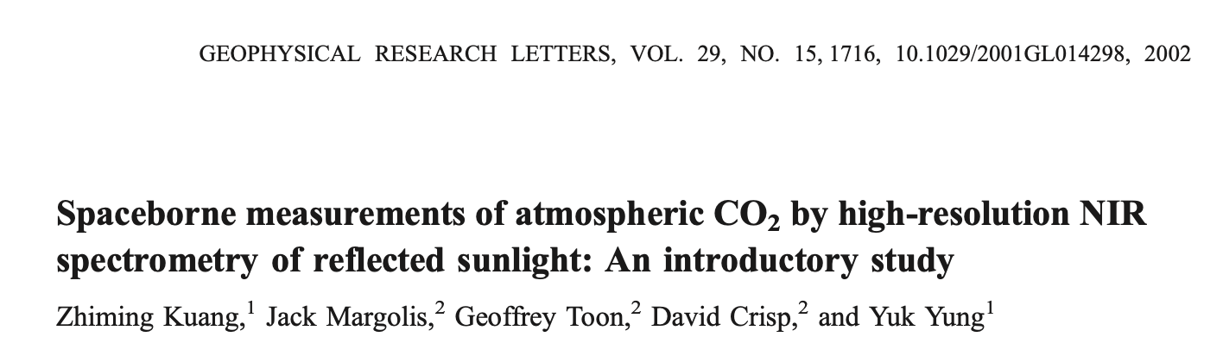
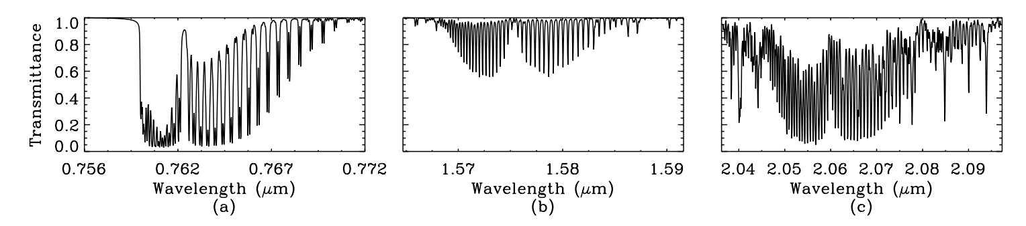

Slide 3
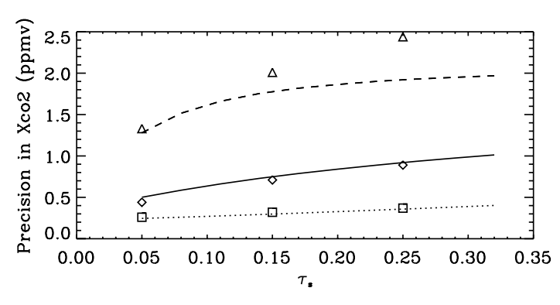

Slide 4
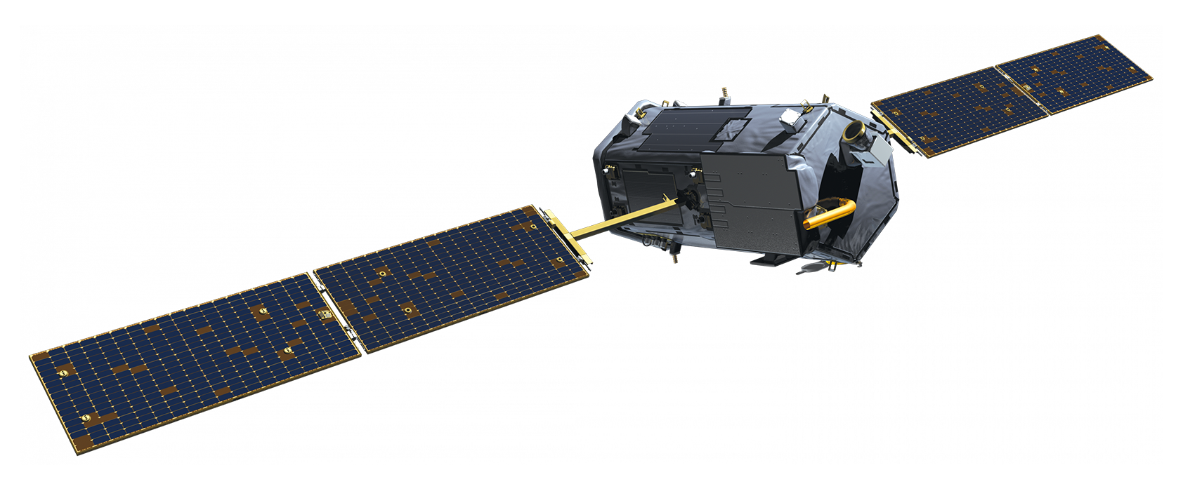
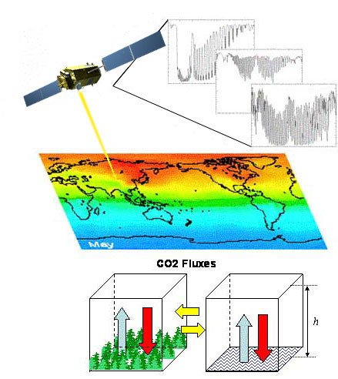
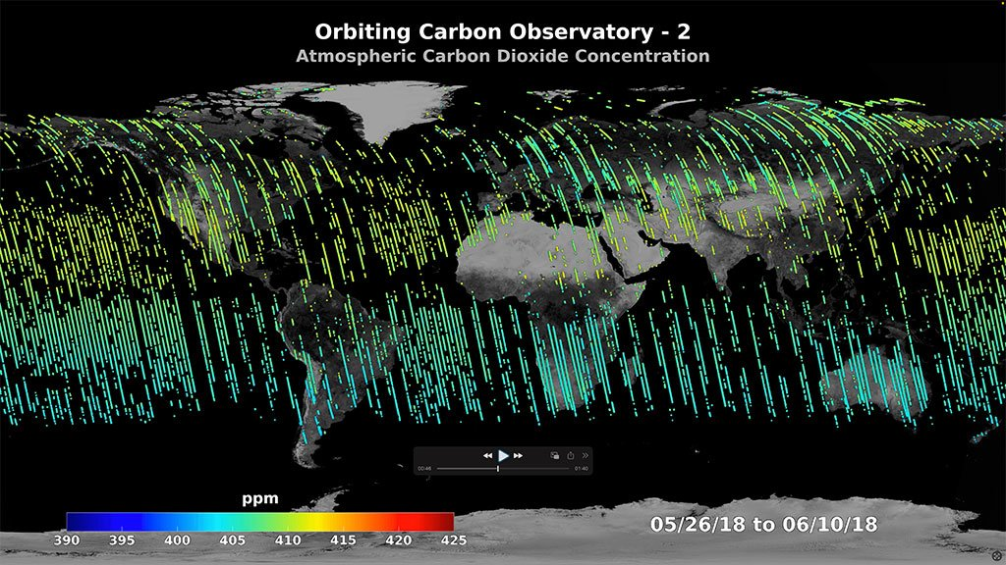
Background
The Orbiting Carbon Observatory-2 (OCO-2) was launched in 2014 to identify carbon sources and sinks through measuring the column averaged dry air mole fraction of carbon dioxide (XCO₂), followed by OCO-3 in 2019 (Crisp et al., 2015)
  Our understanding of the carbon cycle is still relatively limited, with volcanoes being a major carbon source
Retrieval Bias
Sulfate aerosols emitted by eruptions induce significant biases in XCO₂ retrievals over volcanic eruptions, making carbon dioxide emission characterization difficult
Previous Work
Previous research using OCO-2 to estimate volcanic carbon dioxide emissions used uncertain and generalized aerosol priors (Johnson et al., 2020)
Improved aerosol priors have been shown to improve XCO₂ retrievals (Nelson et al., 2019)
Machine learning can derive more accurate aerosol priors from OCO-2 radiances (Chen et al., 2022; Zeng et al., 2020)

Slide 5
Methodology
Training Data
  Match OCO-2 L1B data from historical eruptions with colocated Aqua MODIS Level 2 AOD and CALIPSO Level 2 ALH data
Spectral Sorting
  Sorting the radiances along specific intervals allow for feature extraction of aerosols (Chen et al., 2022; Zeng et al., 2020)
  Continuum radiance obtained from each band (3 in total)
  Three intermediate radiances obtained through averaging radiance along three channel intervals for each band (9 in total)
Machine learning - Deep Neural Network
  Train neural networks with outputting either AOD or ALH
Atmospheric CO2 Observations from Space (ACOS) Retrieval
  Run ACOS XCO2 retrieval algorithm with ML aerosol priors
OCO-2 L1B Data
Spectral sorting
Aerosol Layer Height
MODIS
L2 Data
Neural Network
ACOS Full-Physics Retrieval
Aerosol Optical Depth
CALIPSO L2 Data

Slide 6
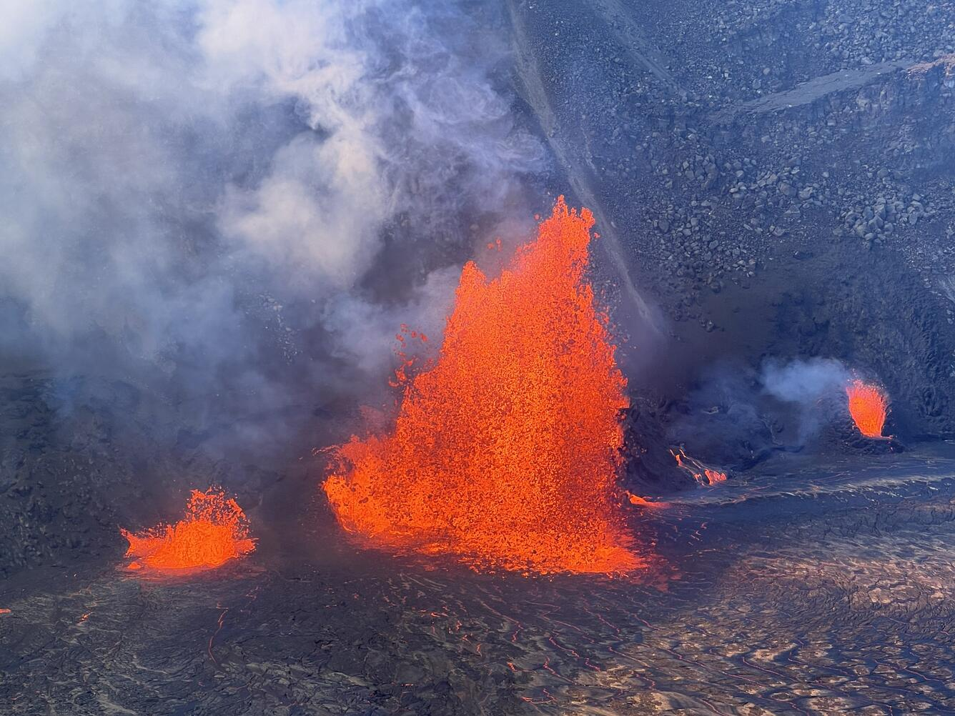
Kilauea 12/25/2025 Episode 1 Eruption Case Study
Photo taken 12/24/25 (Source: USGS)

Slide 7
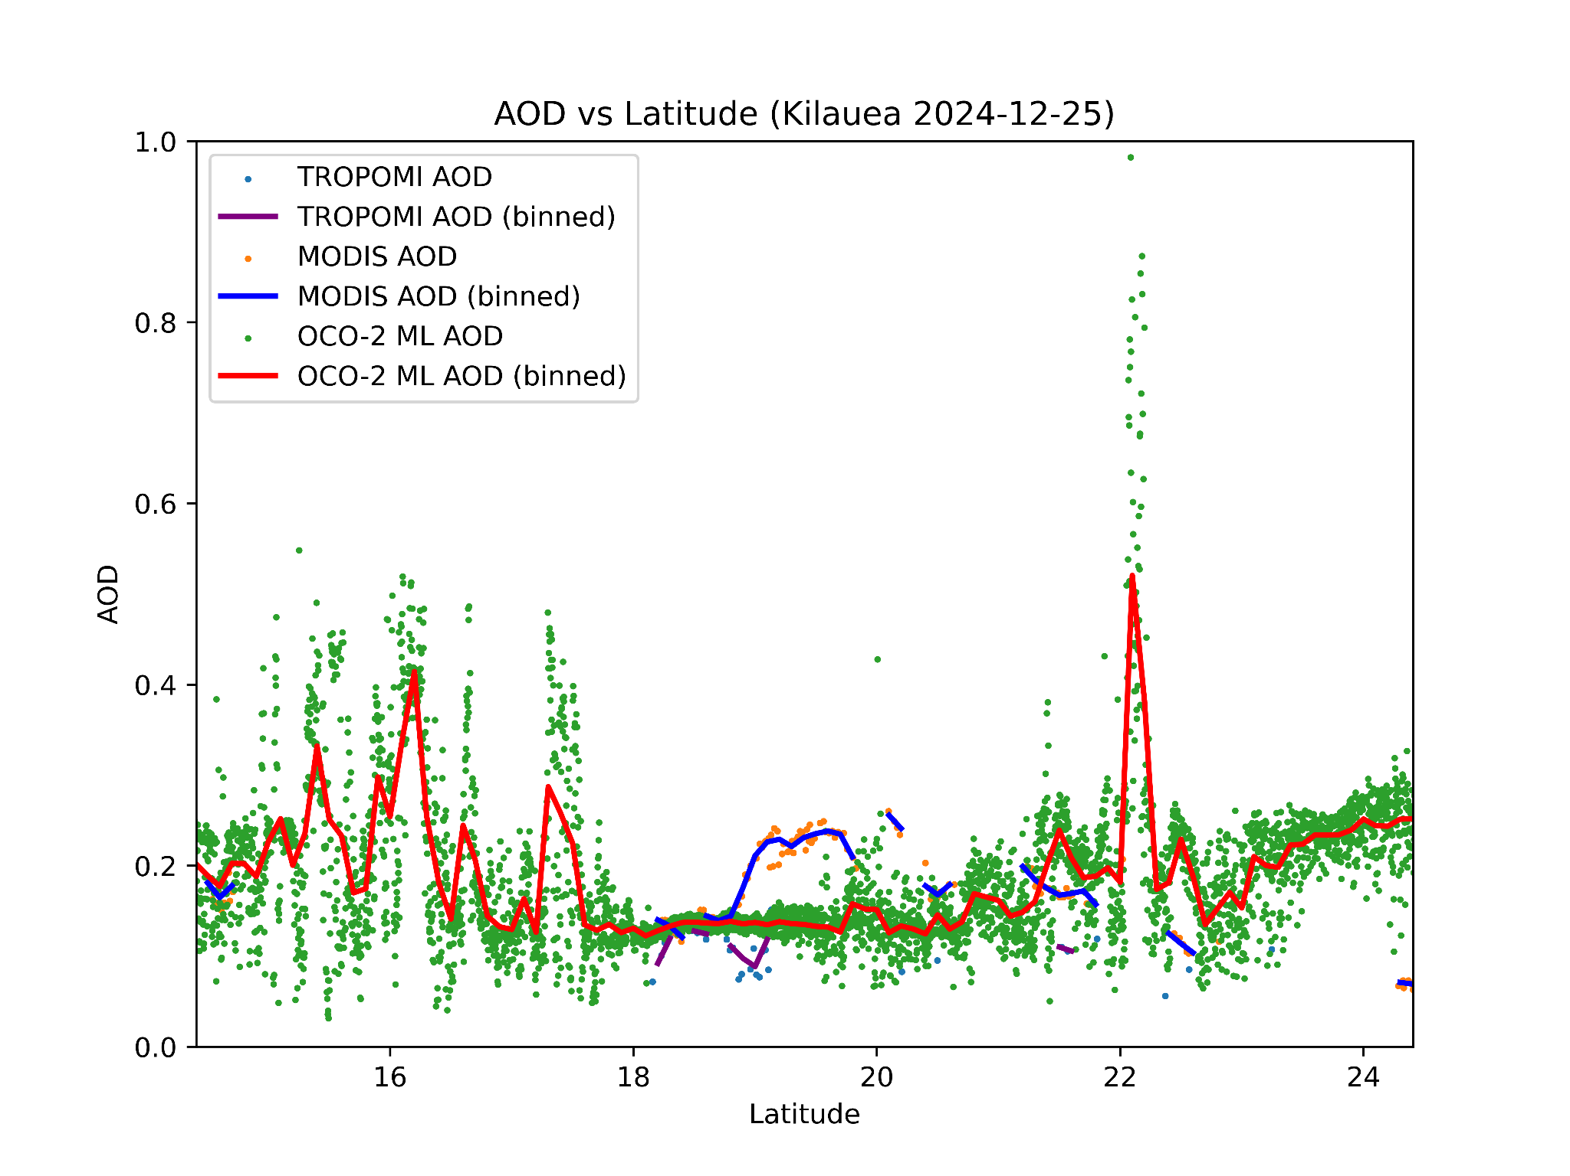
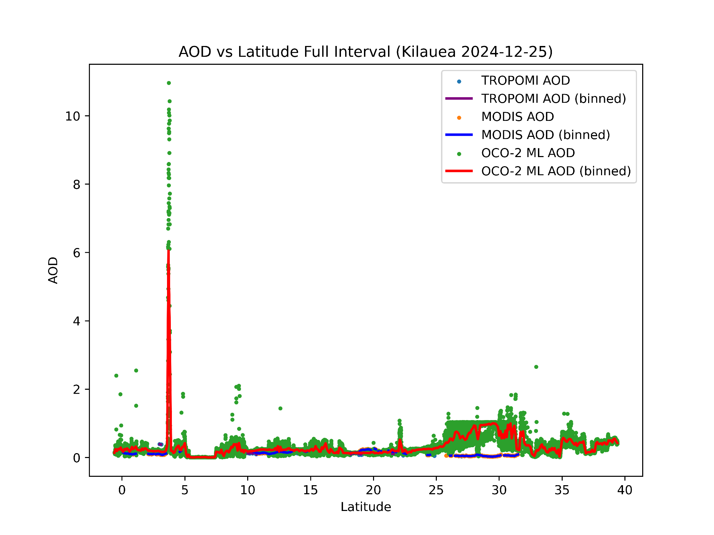
Aerosol Optical Depth (AOD) ML Results
Data colocated with MODIS (Aqua) and TROPOMI (Sentinel-5P)
  TROPOMI soundings obtained ~30 minutes after OCO-2 soundings
  MODIS soundings obtained ~2 hours after OCO-2 soundings
Difficult to validate this case due to sparse and unsuitable collocated data
  TROPOMI data very sparse, while Aqua drift has caused a large temporal mismatch between MODIS and OCO-2
  Good correlation with TROPOMI, some agreement with MODIS despite time difference
Some AOD values are notably very high due to cloud contamination

Slide 8
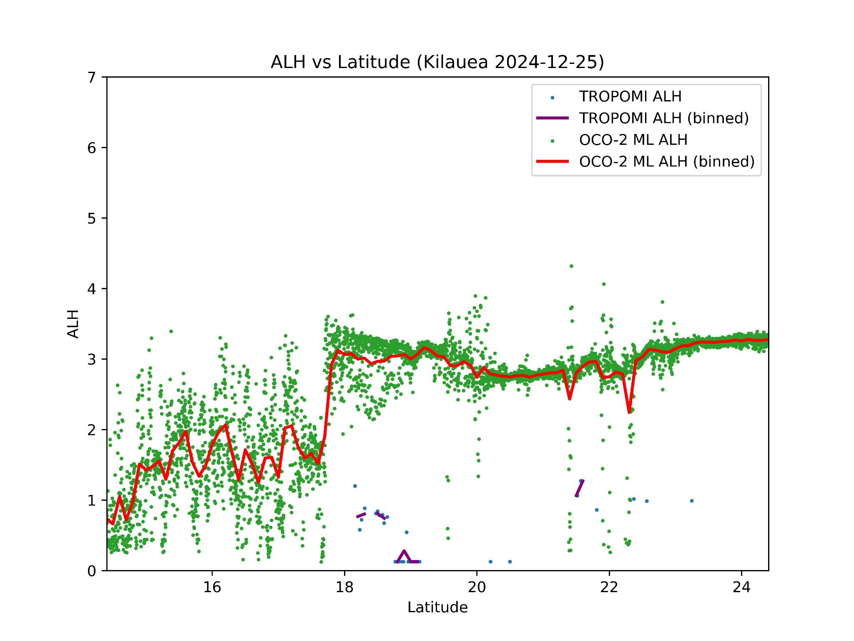
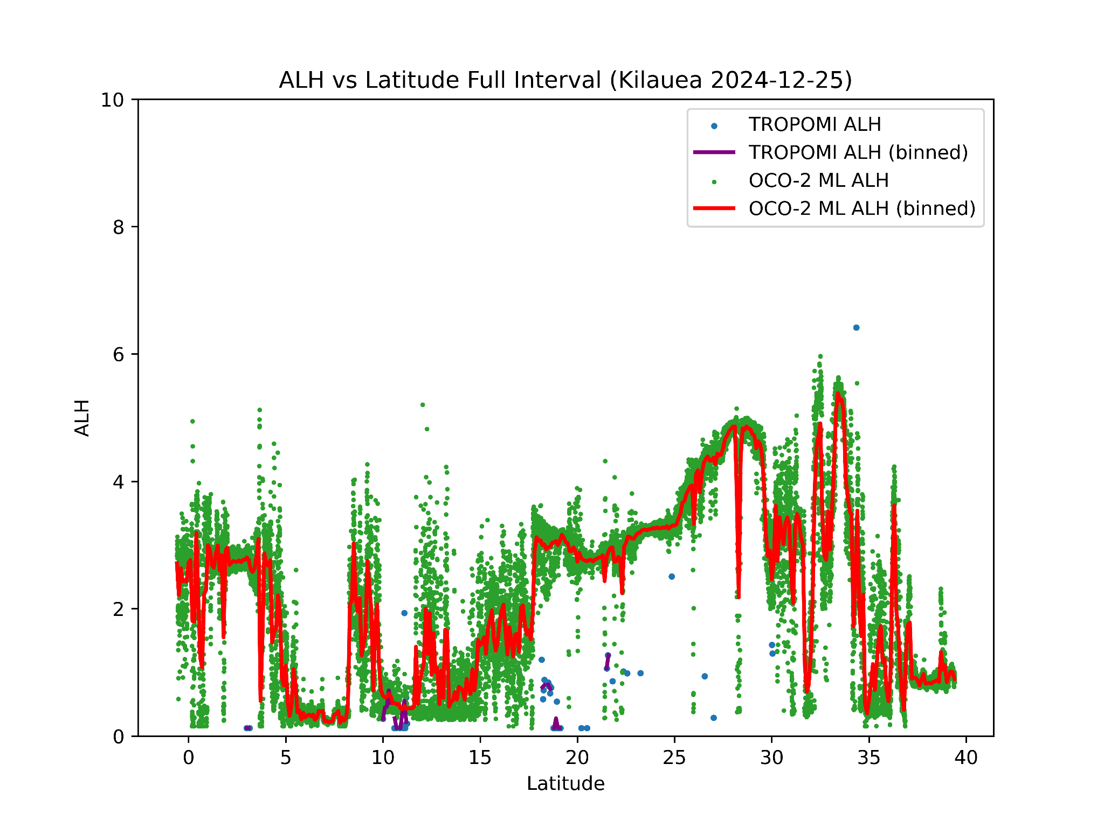
Aerosol Layer Height (ALH) ML Results
ALH validation data also difficult to find
  Cases before after 2020 cannot use CALIPSO after it was moved to the C-Train
  EarthCARE orbit differs from OCO-2 significantly
TROPOMI used for validation, same soundings as before with AOD
  TROPOMI ALH indicates that the plume is very low to the ground, which is likely inaccurate
  Downside of TROPOMI for ALH validation is that it is a retrieved parameter rather than directly measured using LiDAR like CALIPSO or EarthCARE

Slide 9
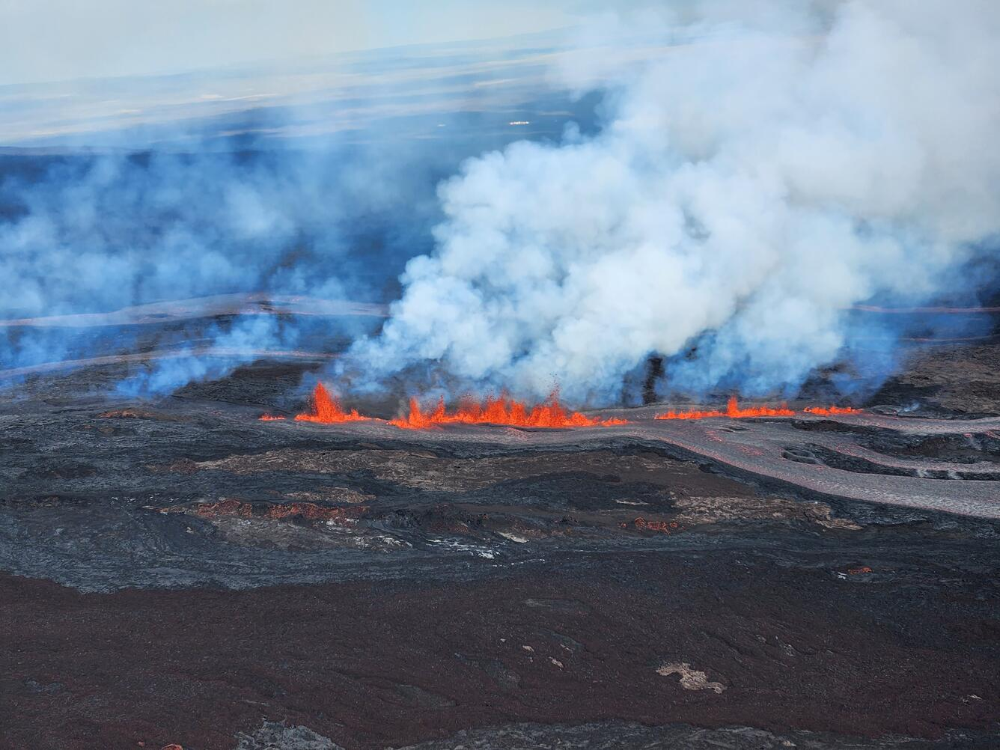
Mauna Loa 11/30/22 Eruption Case Study
Photo taken 11/30/24 (Source: USGS)

Slide 10
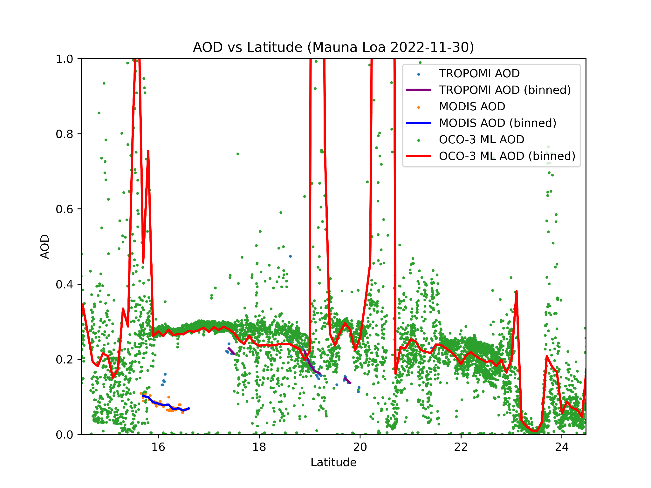
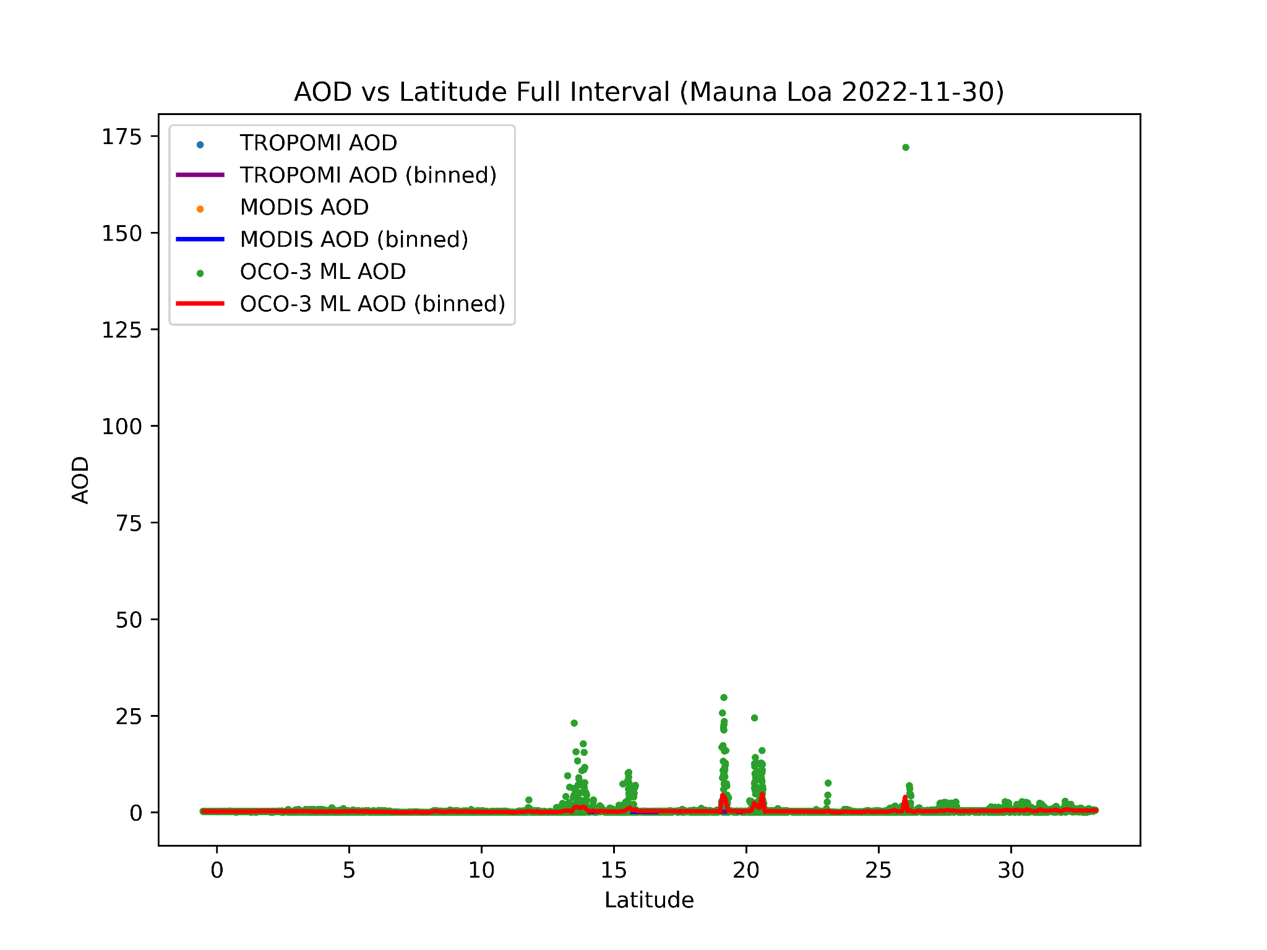
Aerosol Optical Depth (AOD) ML Results
Again colocated with MODIS and TROPOMI
  TROPOMI soundings obtained ~1.5 hours after OCO-3 soundings
  MODIS soundings obtained ~30 minutes before OCO-2 soundings
Cloud contamination causing high AOD values again
  This time, they are a lot higher and more frequent due to very high cloud cover

Slide 11
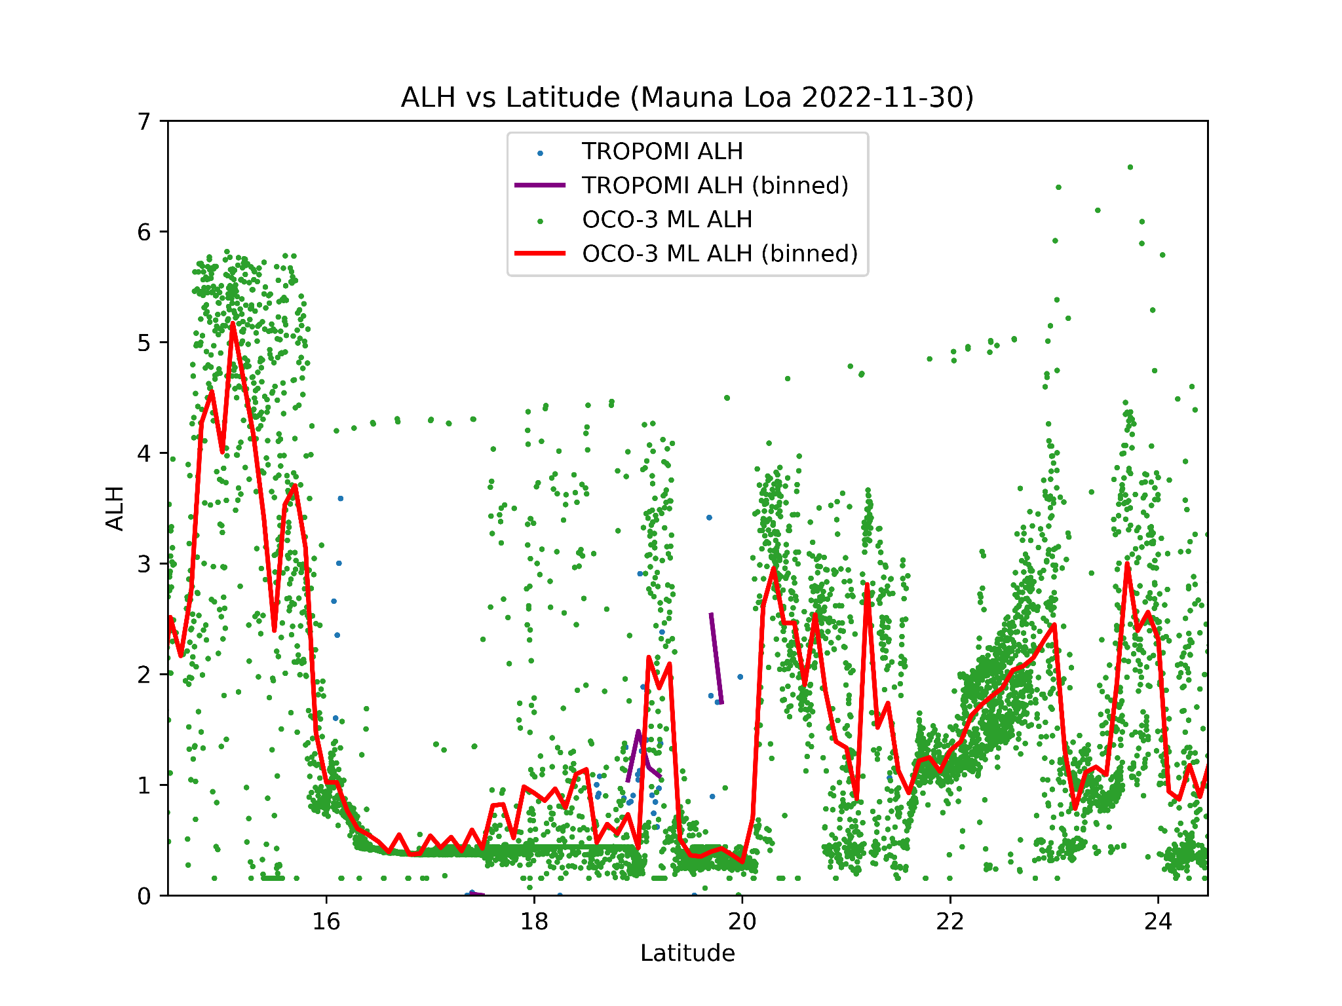
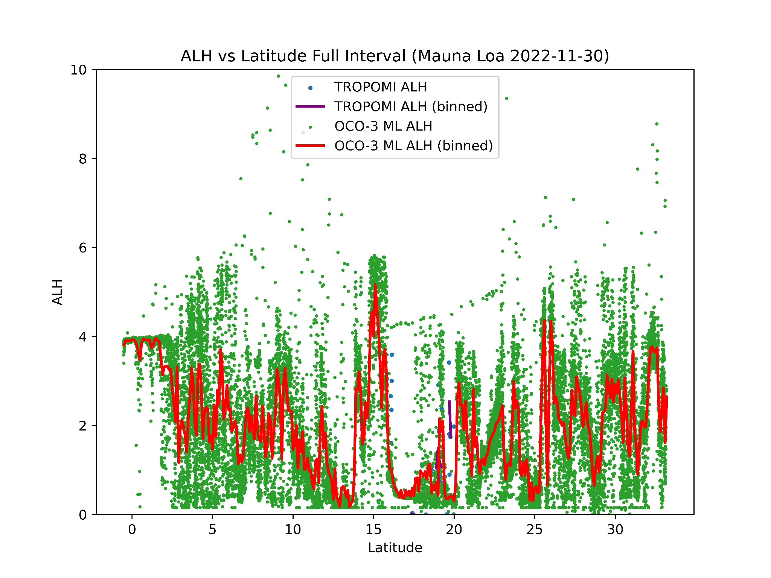
Aerosol Layer Height (ALH) ML Results
ALH validation data sparse again
  TROPOMI ALH data shows some agreement with the OCO-3 ML ALH, but too many invalid TROPOMI ALH retrievals for good comparison
Plume ALH much lower than Kilauea case

Slide 12
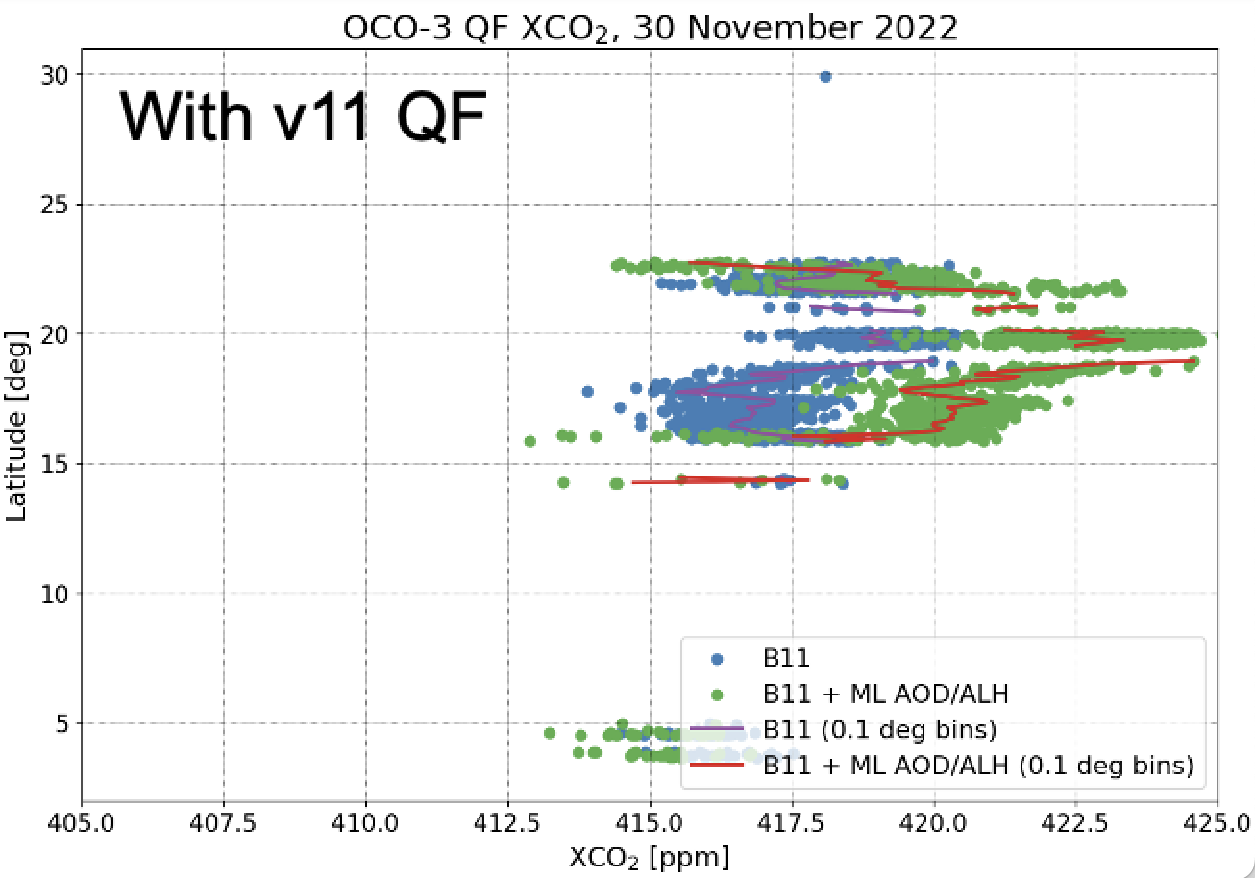

Slide 13
Future Work
Improving aerosol validation
  Current validation from CALIPSO/TROPOMI/MODIS is sparse and coincidences with OCO-2 soundings necessary for effective comparison are rare
  AERONET could be useful for providing more accurate validation
Improving quality filtering (QF)
  Default OCO QF results in many potentially useful retrievals being eliminated
  Development of a custom QF algorithm could further improve retrievals and subsequent flux estimates
  Retrieving cloud optical depth (COD) using the same methodology as AOD
    Possible applications outside of volcanic carbon dioxide emission retrieval, could show improvements over OCO QF algorithm

Slide 14
References
Chen, S., Natraj, V., Zeng, Z.-C., & Yung, Y. L. (2022). Machine learning-based aerosol characterization using OCO-2 O2 A-band observations. In Journal of Quantitative Spectroscopy and Radiative Transfer (Vol. 279, p. 108049). Elsevier BV. https://doi.org/10.1016/j.jqsrt.2021.108049
Crisp, D. (2015). Measuring atmospheric carbon dioxide from space with the Orbiting Carbon Observatory-2 (OCO-2). In J. J. Butler, X. (Jack) Xiong, & X. Gu (Eds.), SPIE Proceedings. SPIE Optical Engineering + Applications. SPIE. https://doi.org/10.1117/12.2187291
Johnson, M. S., Schwandner, F. M., Potter, C. S., Nguyen, H. M., Bell, E., Nelson, R. R., Philip, S., & O’Dell, C. W. (2020). Carbon Dioxide Emissions During the 2018 Kilauea Volcano Eruption Estimated Using OCO‐2 Satellite Retrievals. In Geophysical Research Letters (Vol. 47, Issue 24). American Geophysical Union (AGU). https://doi.org/10.1029/2020gl090507
Nelson, R. R., & O’Dell, C. W. (2019). The impact of improved aerosol priors on near-infrared measurements of carbon dioxide. In Atmospheric Measurement Techniques (Vol. 12, Issue 3, pp. 1495–1512). Copernicus GmbH. https://doi.org/10.5194/amt-12-1495-2019
Zeng, Z.-C., Chen, S., Natraj, V., Le, T., Xu, F., Merrelli, A., Crisp, D., Sander, S. P., & Yung, Y. L. (2020). Constraining the vertical distribution of coastal dust aerosol using OCO-2 O2 A-band measurements. In Remote Sensing of Environment (Vol. 236, p. 111494). Elsevier BV. https://doi.org/10.1016/j.rse.2019.111494

