Slide 1
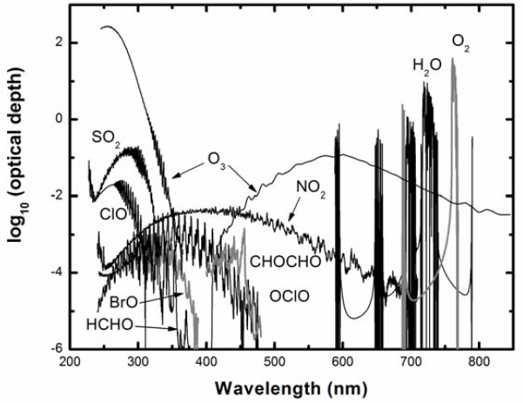



GOME-to-TEMPO: New views on tropospheric chemistry
through windows opened by Kelly
c/o Spring 2022
IEEE GRSS seminar announcement
Chance, 2006
Arlene M. Fiore
amfiore @ mit.edu | teampaccc.mit.edu
Kelly Chance Symposium
Harvard CfA/SAO, Cambridge, MA
August 18, 2025

Slide 2
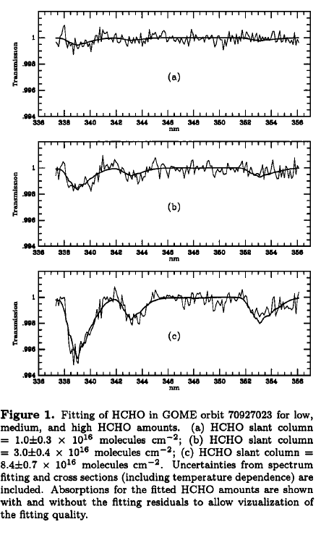
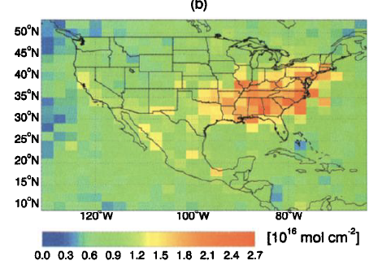
Mapping formaldehyde from space: Big views through a 20-nm spectral window
July 1996 HCHO columns
Chance et al., 2000

Slide 3
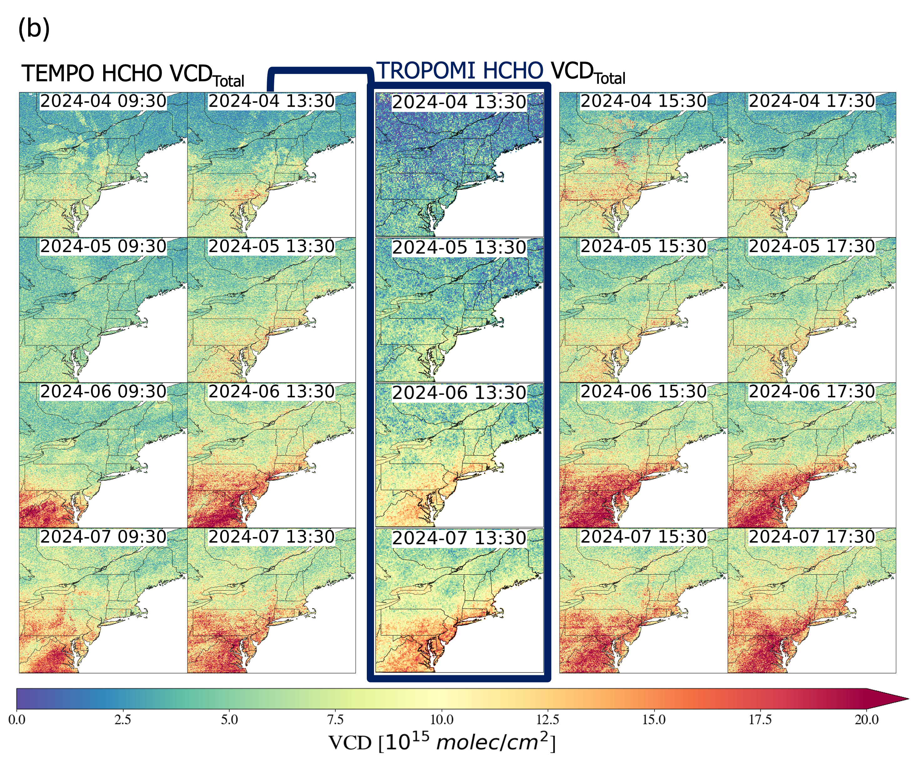

A quarter-century later, we now routinely have daytime hourly formaldehyde columns streaming in from TEMPO
Diurnal variation
Seasonal
variation
Madankui Tao (MIT)
Catch her poster on Wed: TEMPO & early season NE US high-ozone events

Slide 4







Satellite products offer many windows into the ozone source attribution puzzle
Upwind sources of ozone
TRANSPORT +
LOCAL PHOTOCHEMISTRY
(CO, NO₂, PAN)
(HCHO & NO₂)
NO_{x}, VOC, CO
EMISSIONS
NO_{x}, VOC, CO
(NO₂, HCHO, CO)
BVOC
Soil NO_{x}
NO_{x}

Slide 5
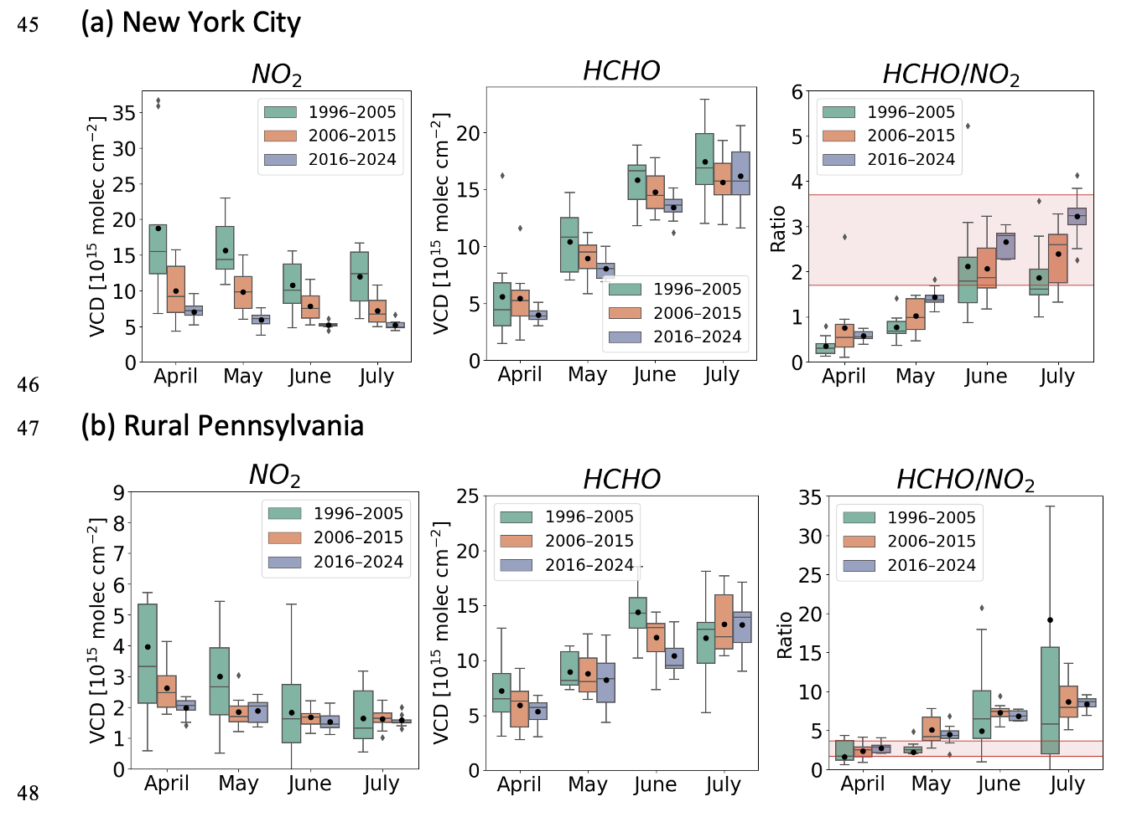
We now have three decades of satellite data for air quality to explore trends and variations and connect to local ozone photochemistry
Figure c/o M. Tao;
Harmonized GOME-SCIAMACHY-OMI-TROPOMI dataset c/o X. Jin
Data + HCHO/NO₂ thresholds from Tian, Wang & Jin, EGUSphere, 2025

Slide 6
Satellites offer views of different pieces of this ozone source attribution puzzle
WILDFIRE PLUMES: TRANSPORT + PHOTOCHEMISTRY
LOCAL PHOTOCHEMISTRY
VOC
CO
NO_{x}, VOC, CO
NO_{x}
Background
sources of ozone
BVOC
Soil NO_{x}
NO_{x}

Slide 7
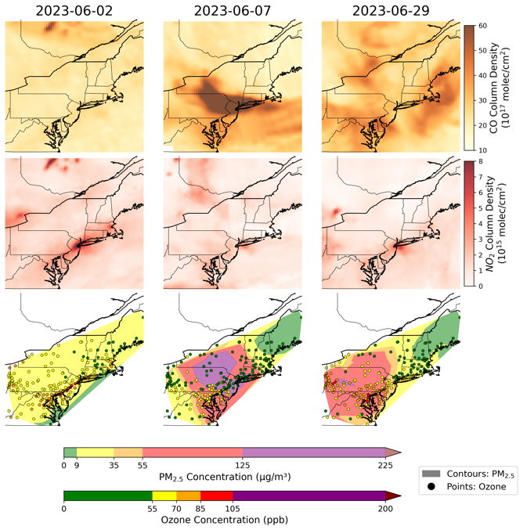
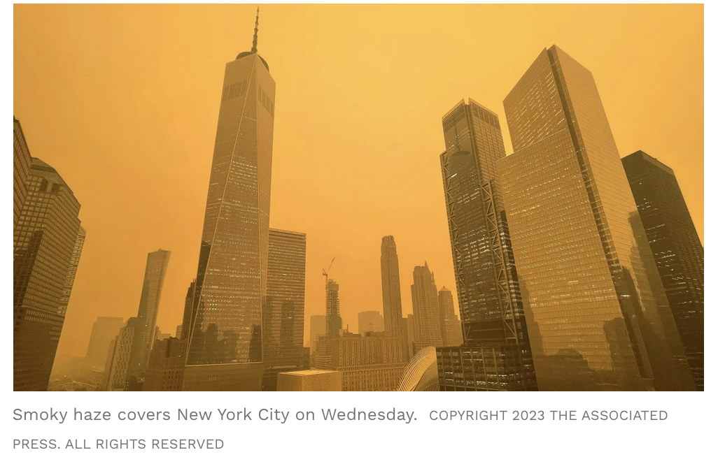
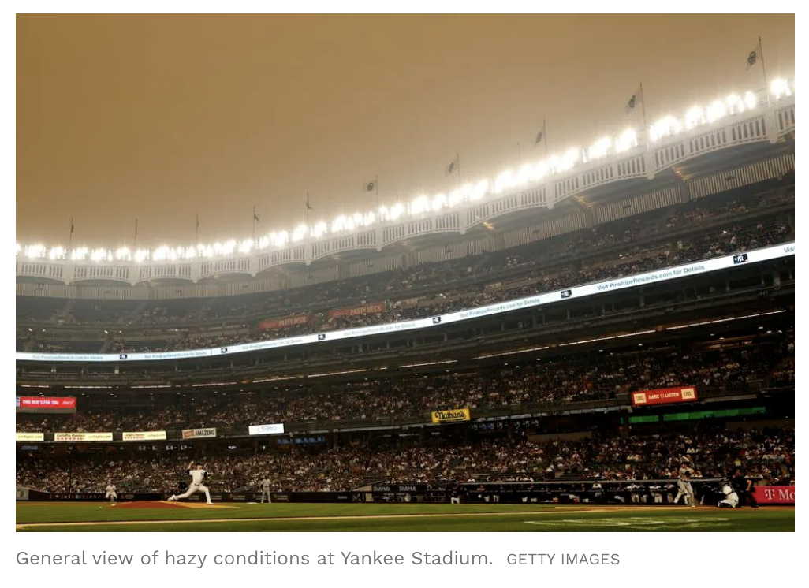

Key Challenge: How much ozone from wildfires? Is ozone produced in transit (background) or after the smoke mixes with urban NO_{x} (& thus controllable)?
June 7, 2023: Canadian
wildfire plumes hit NYC
high smoke
medium smoke
TROPOMI
CO
June 7
June 29
low ozone
high ozone
State & local
PM_{2.5} & ozone
monitors
J. Palmo
https://www.forbes.com/sites/tylerroush/2023/06/07/images-of-new-york-city-engulfed-by-canadian-wildfire-smoke/

Slide 8
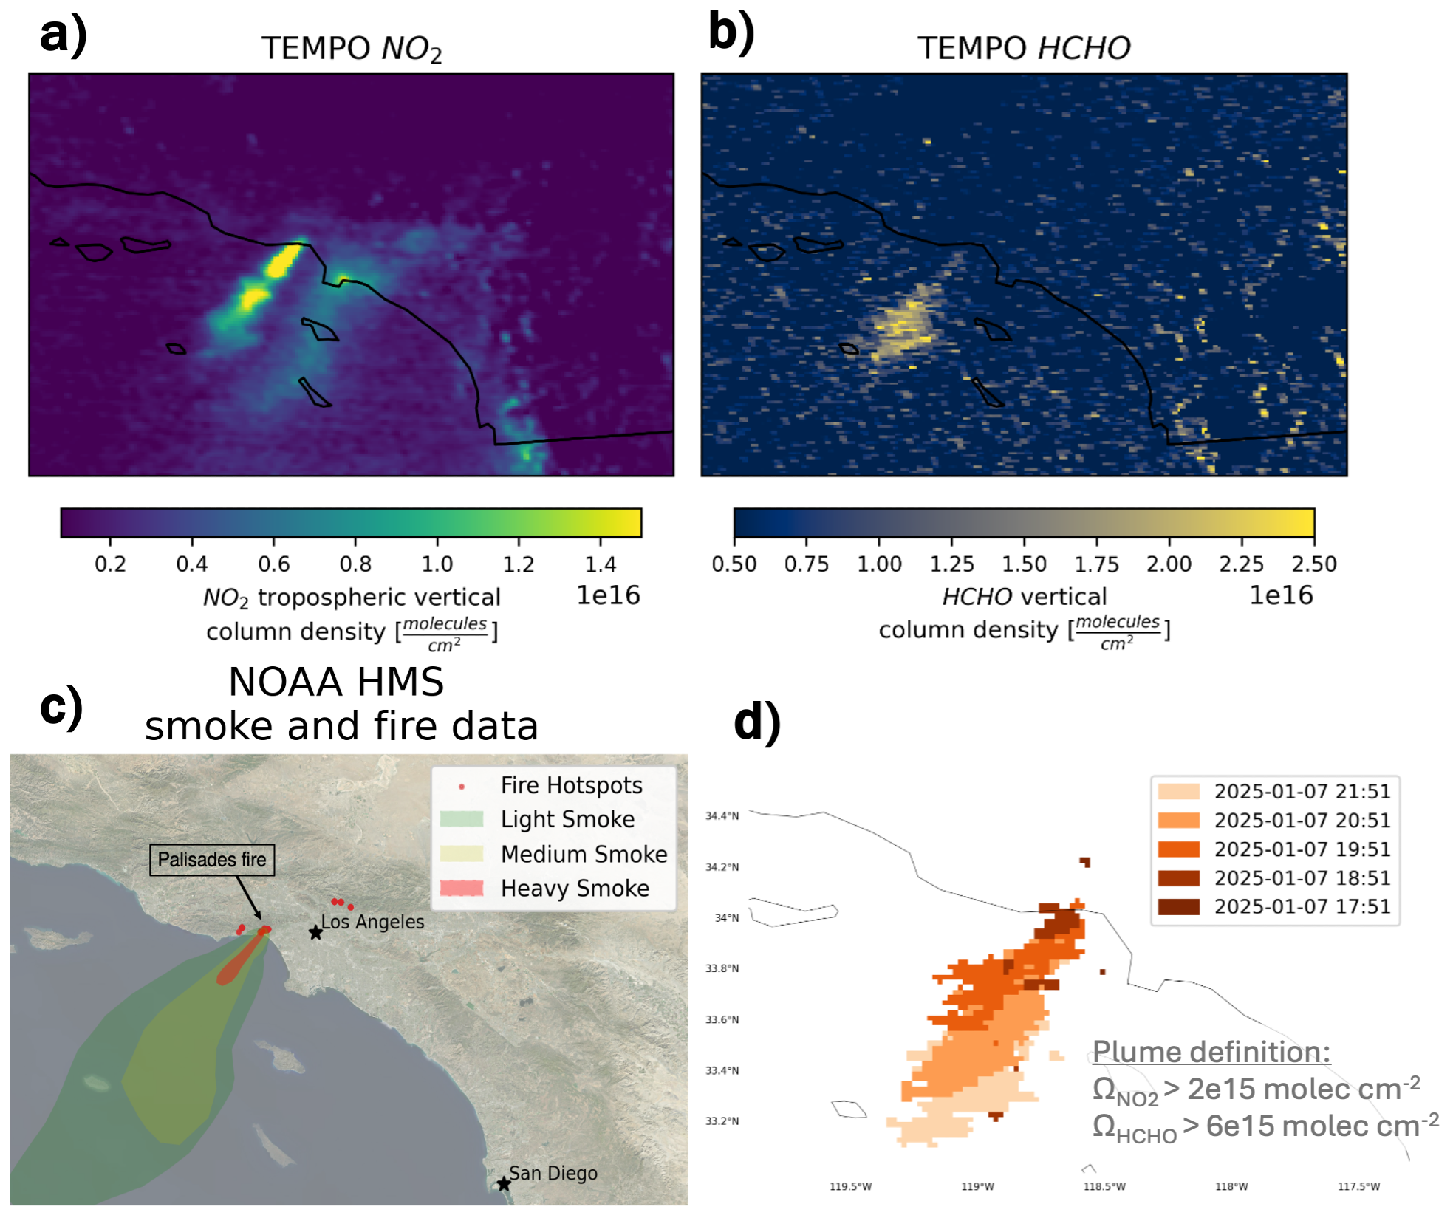
What will we learn from TEMPO?
(Palisades fire,
January 2025)
J. Palmo
Notes:
This is how TEMPO data looks – NO2 and HCHO
This plume passed through Fort Collins CO, which is just north of Denver
You can see minor NO2 signal from Denver and then signal in both retrievals for the observed smoke
As you all know the power of TEMPO is its high temporal resolution, and the picture is more interesting when we look at the evolution of the plume hour to hour

Slide 9
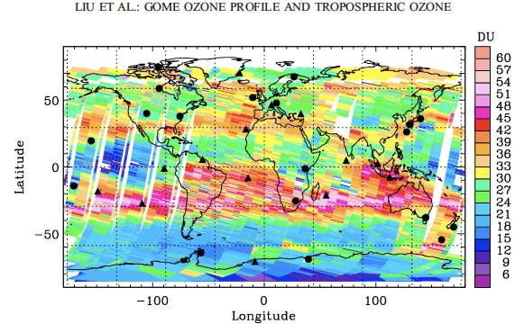
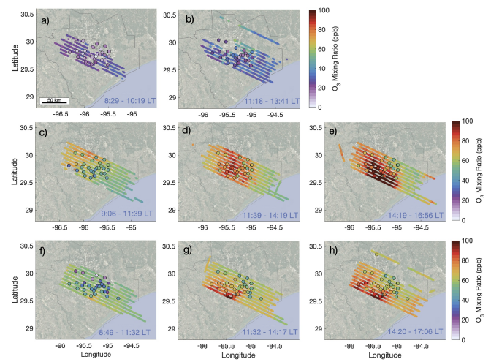
New windows on the horizon:
Will we soon be watching hour-by-hour lower tropospheric ozone transport?
~2 km tropospheric ozone partial column over Houston
early morning
mid-morning
9/3/21
afternoon
?
9/8/21
Liu et al., 2005: direct tropospheric
column retrievals from GOME
(3-day composite: 22-24 Oct 1997)
9/25/21
Demetillo et al., 2025 (TRACER-AQ
airborne HSRL + ground monitors)

Slide 10
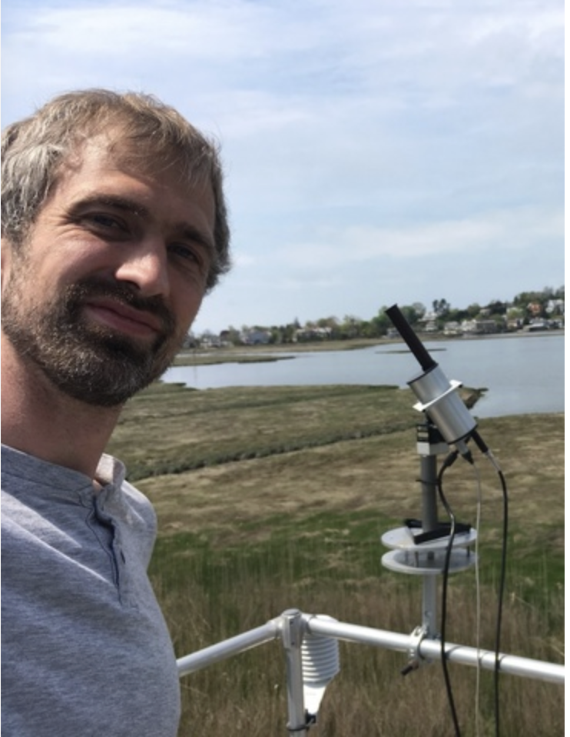


From our group, present and past:
Thank you for opening so many new windows, especially for collaborations!
Luke Valin (U.S. EPA)
Xiaomeng Jin (Rutgers)
c/o Spring 2022
IEEE GRSS seminar announcement
Madankui Tao
Postdoc
Qindan Zhu
Postdoc (next job: SAO)
Joe Palmo Grad Student

