Slide 1
Study of aerosol optical centroid height in O2 absorption bands and beyond: Tributes to Dr. Kelly Chance
Jun Wang
Lichtenberger Family Chair in Chemical Engineering
College of Engineering, The University of Iowa
The Kelly Chance symposium
18 August 2025

Slide 2
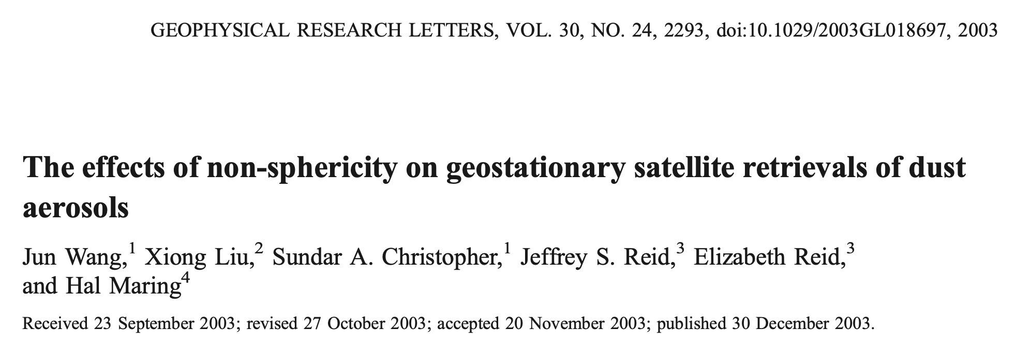
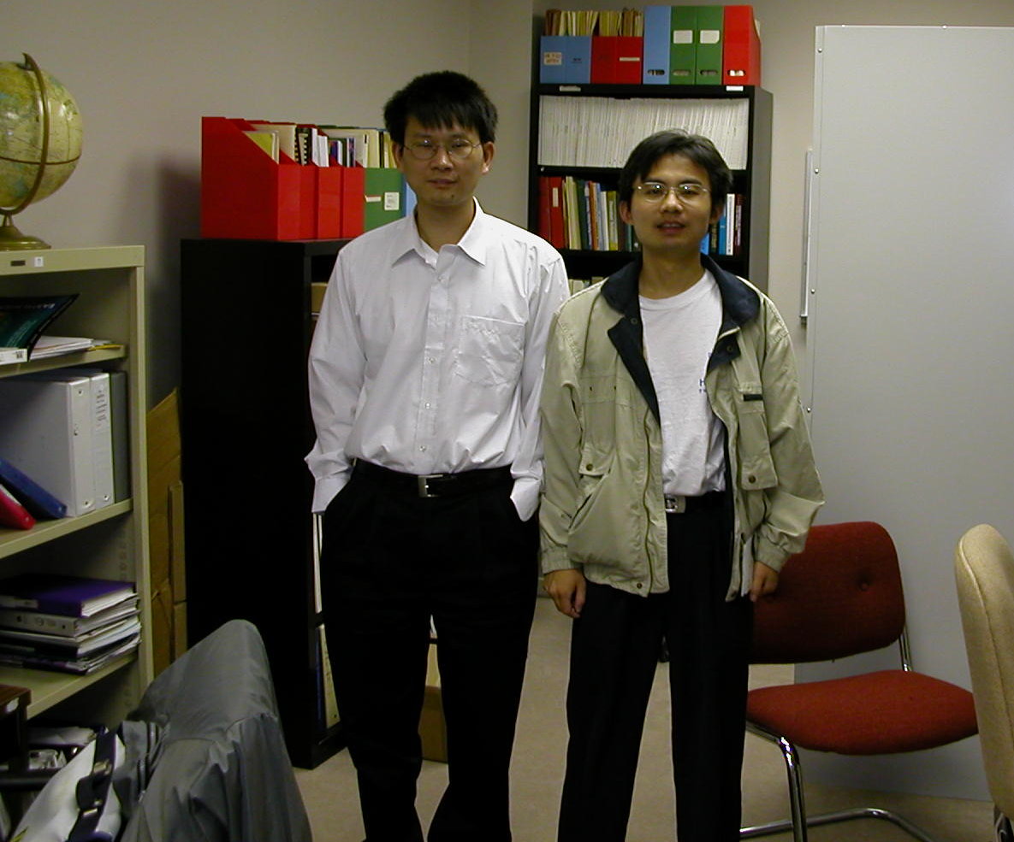
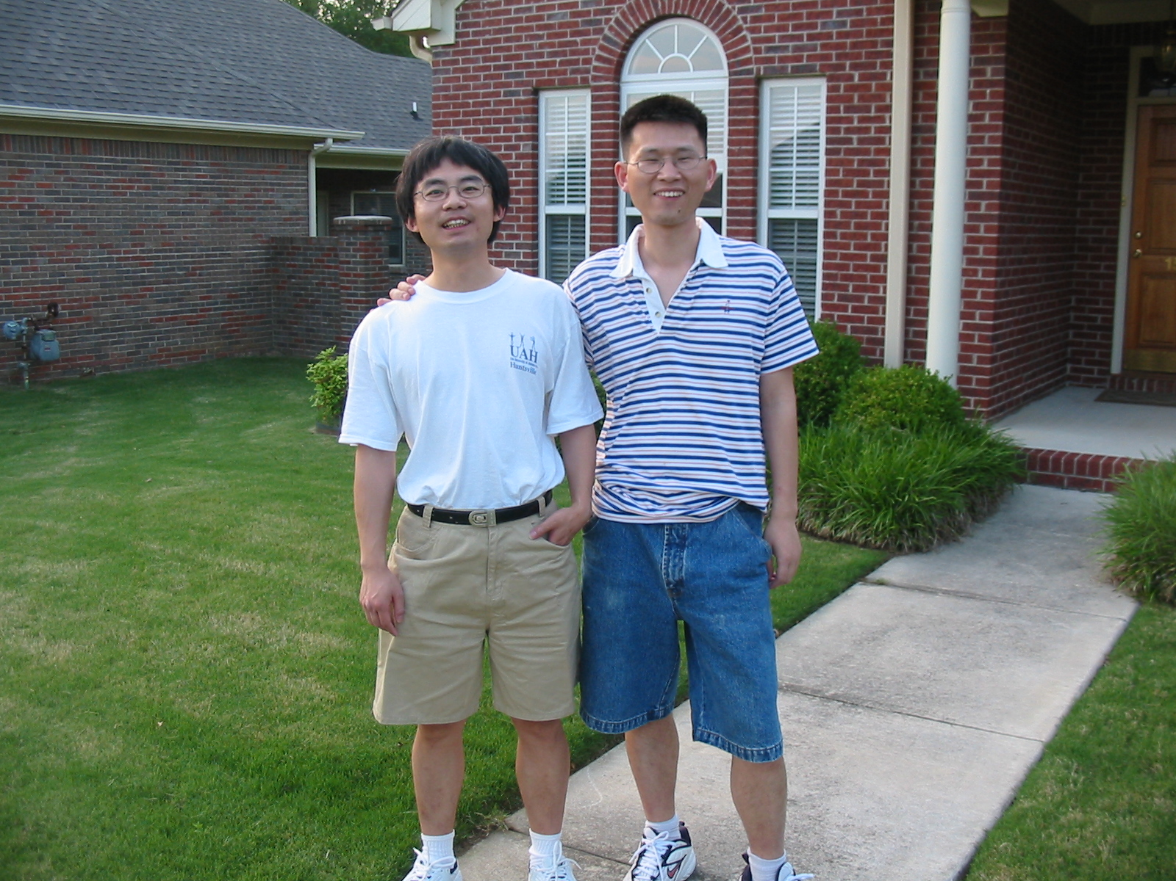
It started with Xiong Liu
Oct 18, 2002
May 26, 2003

Slide 3
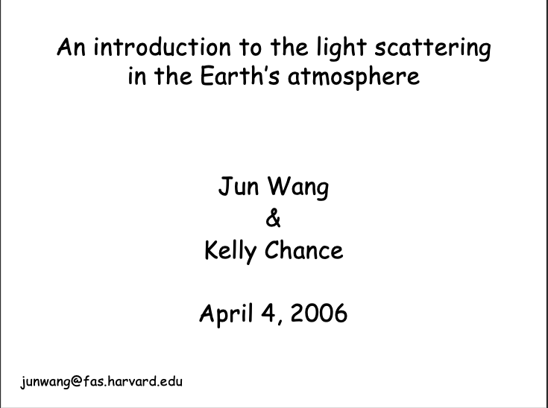
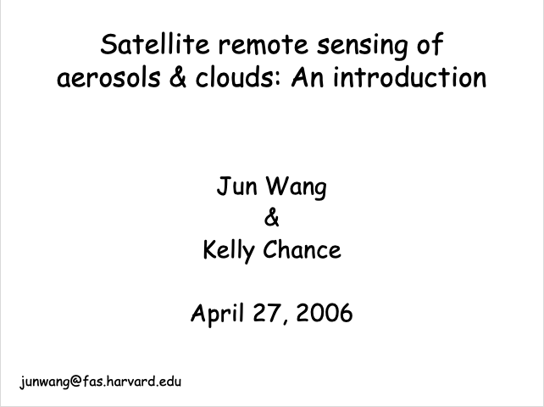
Kelly gave me the privilege to teach in Harvard for two lectures in his class

Slide 4
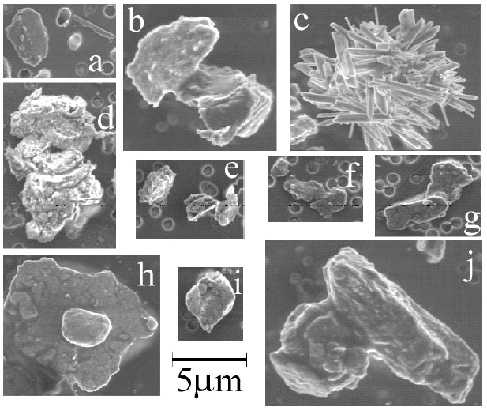
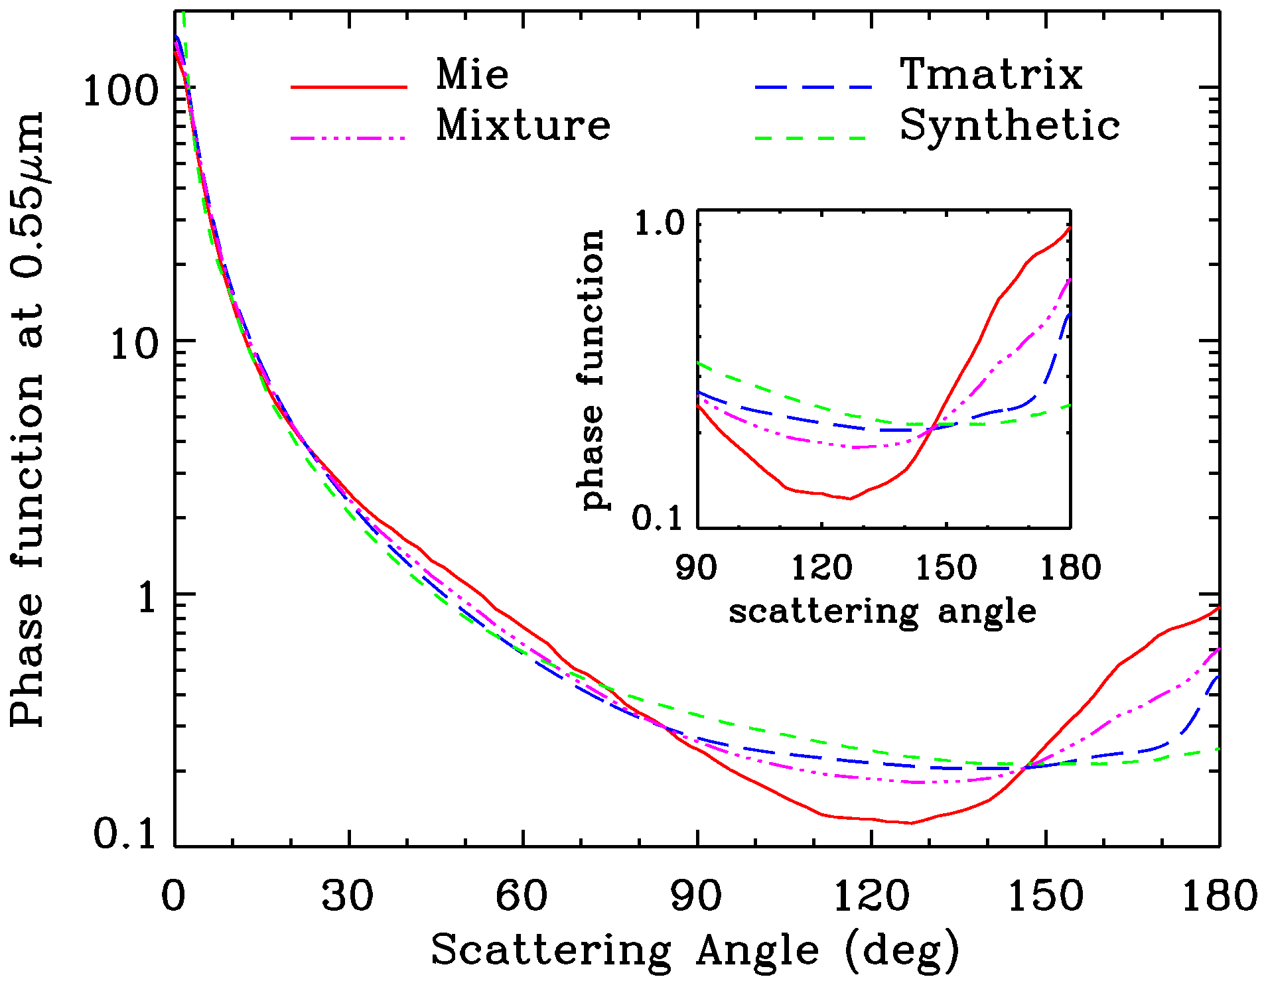
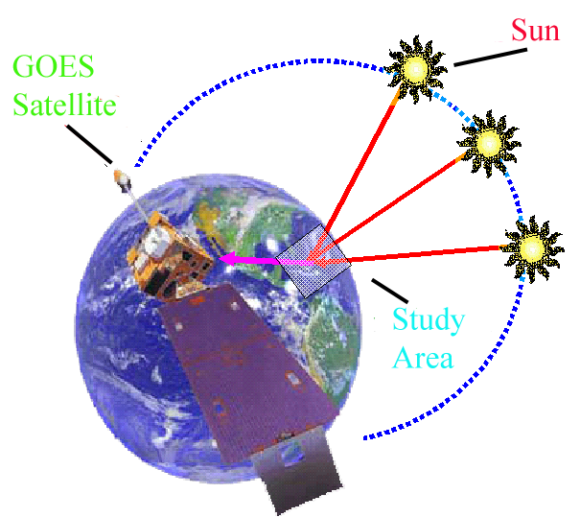
Challenges: Aerosol optical property

Slide 5
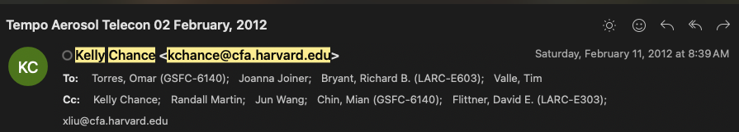

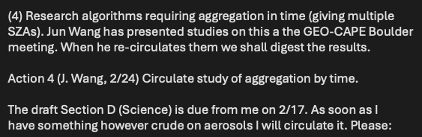

Slide 6
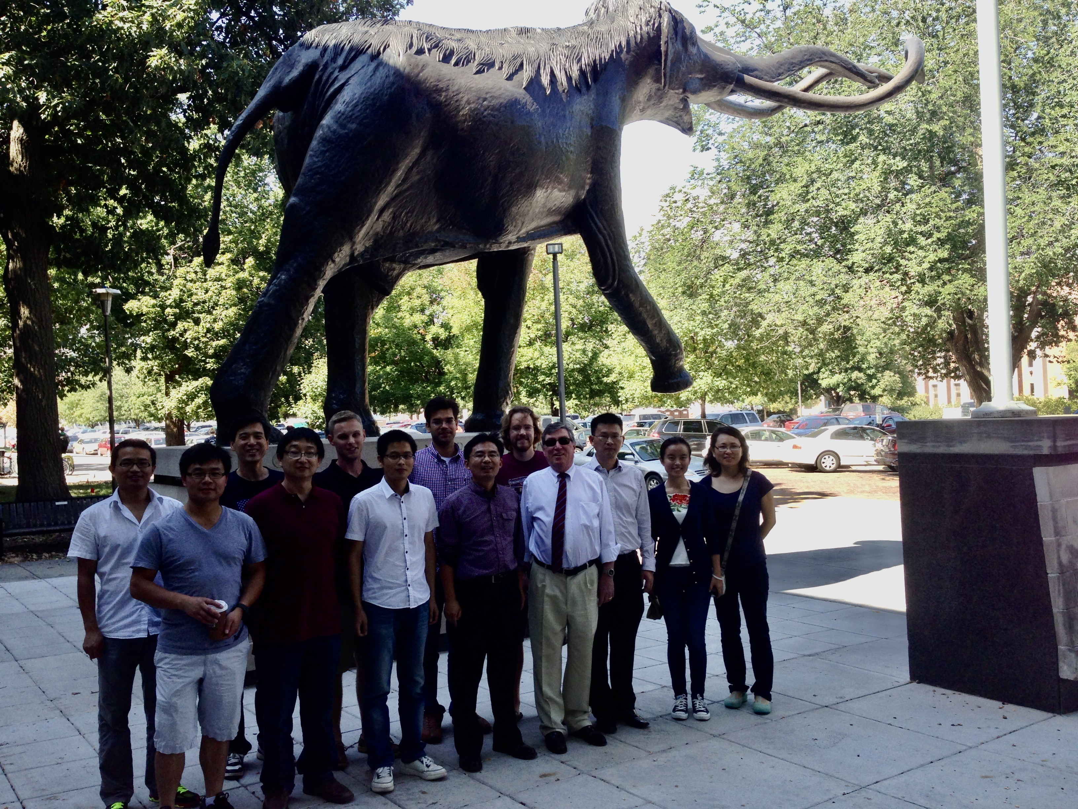
Kelly and Xiong’s visit in 2013
26 & 27 September 2013

Slide 7
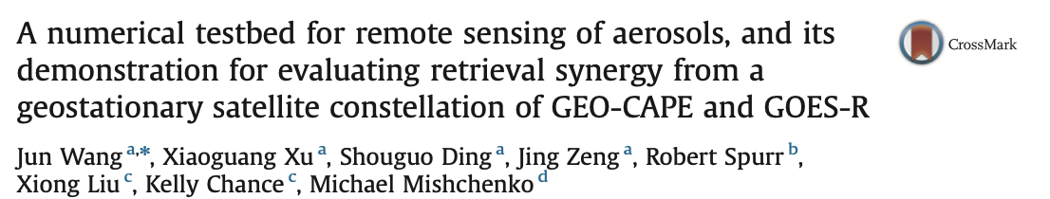
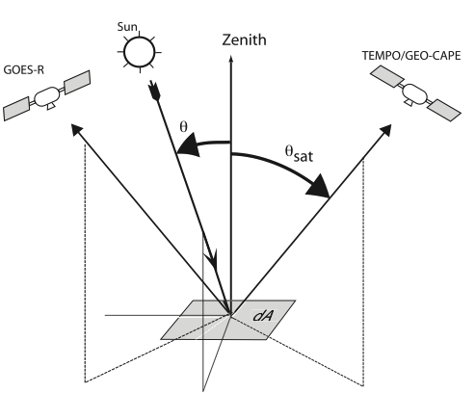
we demonstrate the use of the testbed to conduct a feasibility study of using polarization measurements in and around the O2 A band for the retrieval of aerosol height information from space, as well as an to assess potential improvement in the retrieval of aerosol fine and coarse mode aerosol optical depth (AOD) through the synergic use of two future geostationary satellites, GOES-R and TEMPO (Tropospheric Emissions: Monitoring of Pollution). Strong synergy between GEOS-R and TEMPO are found especially in their characterization of surface bi-directional reflectance, and thereby, can potentially improve the AOD retrieval to the accuracy required by GEO-CAPE.

Slide 8
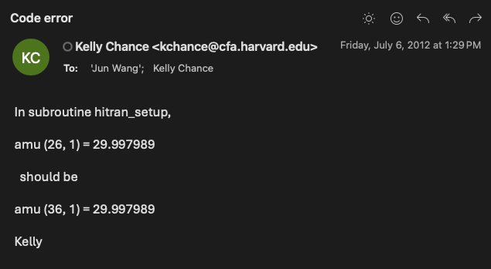
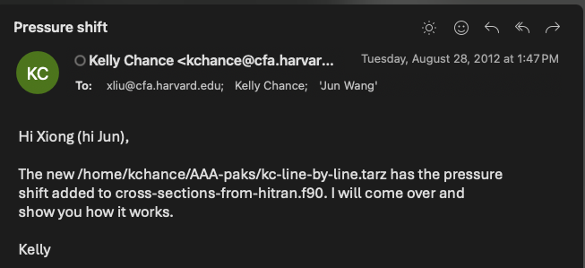

Slide 9
My 17-year journey of passive sensing of aerosol layer height
2025. Che et al., AOCH over bright surface; Lu et al., aerosol vertical profile
First Mapping of Monthly and Diurnal Climatology of Saharan Dust Layer Height Over the Atlantic Ocean From EPIC/DSCOVR in Deep Space, GRL., Lu Wang et al.
2023
2021
Hourly Mapping of the Layer Height of Thick Smoke Plumes Over the Western U.S. in 2020 Severe Fire Season, FRS Lu, Wang, et al.,
First retrieval of absorbing aerosol height over dark target using TROPOMI oxygen B band, RSE, Chen, Wang et al.
Can multi-angular polarimetric measurements in the oxygen-A and B bands improve the retrieval of aerosol vertical distribution? JQSRT, Chen, Wang, et al.
2019, Detecting layer height of smoke aerosols over vegetated land and water surfaces via oxygen absorption bands: Hourly results from EPIC/DSCOVR satellite in deep space
Encouraged and supported by K. Chance along the way!
Passive remote sensing of aerosol height, in Remote Sensing of Aerosols, Clouds, and Precipitation, Xu, Wang, et al. in Remote Sensing of Aerosols, Clouds, and Precipitation
2017, Passive remote sensing of altitude and optical depth of dust plumes using the oxygen A and B bands: First results from EPIC/DSCOVR at Lagrange-1 point, GRL, Xu, Wang, et al.,
2016, Polarimetric remote sensing in O2 A and B bands: Sensitivity study and information content analysis for vertical profile of aerosols, AMT, Ding, Wang et al.
2014, A numerical testbed for remote sensing of aerosols, and its use for evaluating retrieval synergy GEO-CAPE and GOES-R, JQSRT, Wang et al.
Thanks to NASA, NOAA, ONR …
2008, High-spectral resolution simulation of polarization of skylight: sensitivity to aerosol vertical profile, GRL, Zeng, Wang, & Han.
2005-07 foundational years with K. Chance.

Slide 10
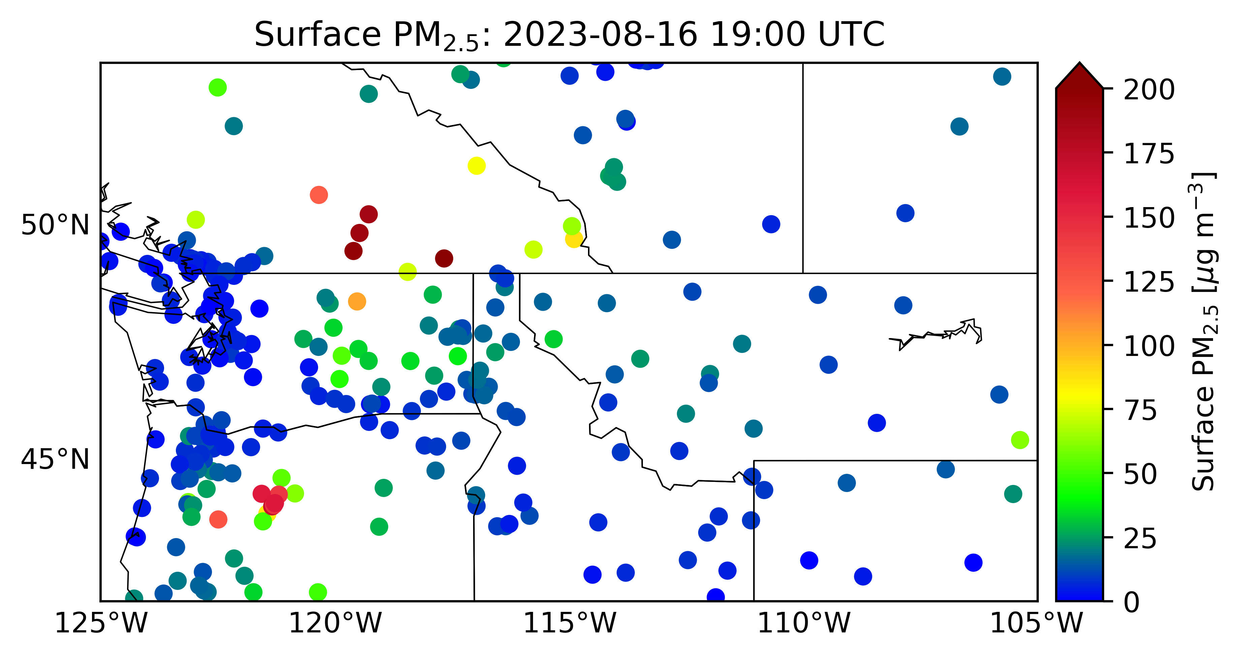

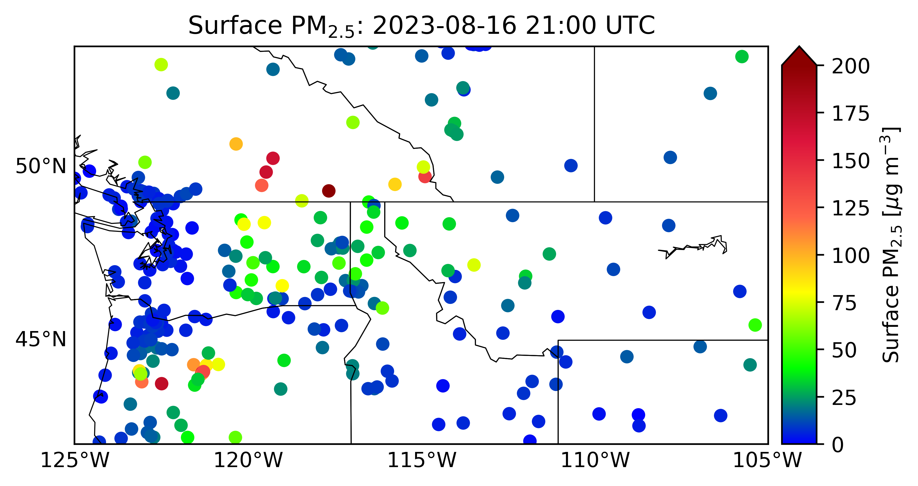
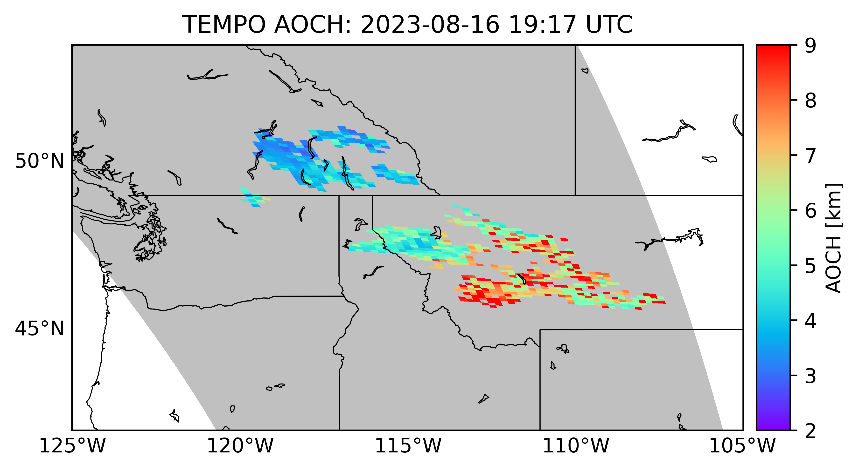
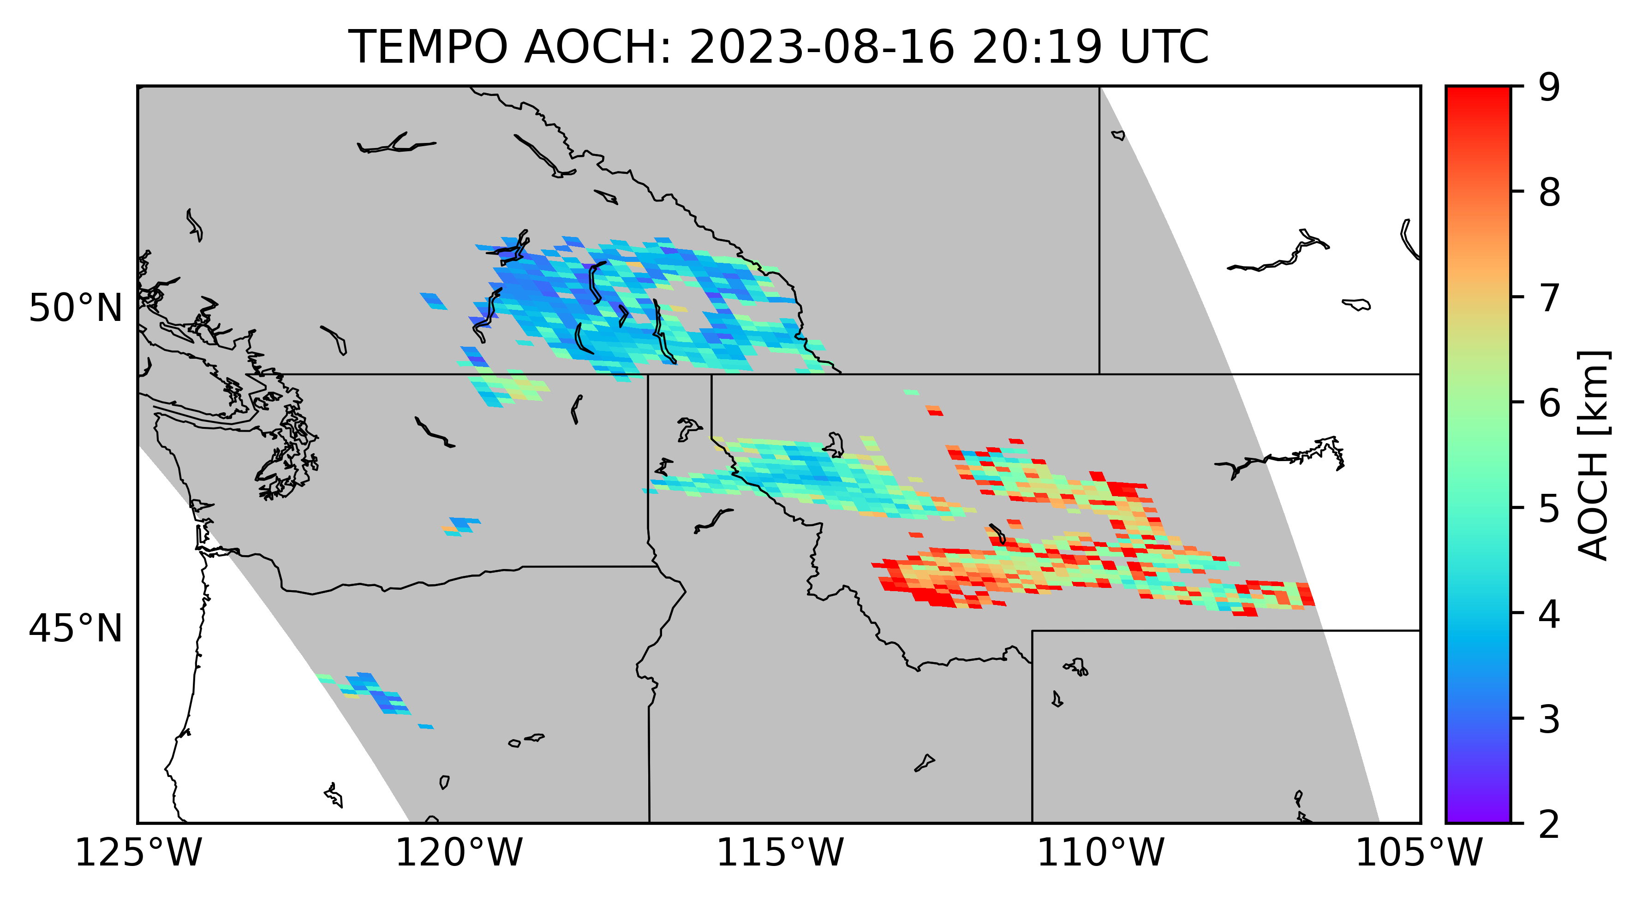
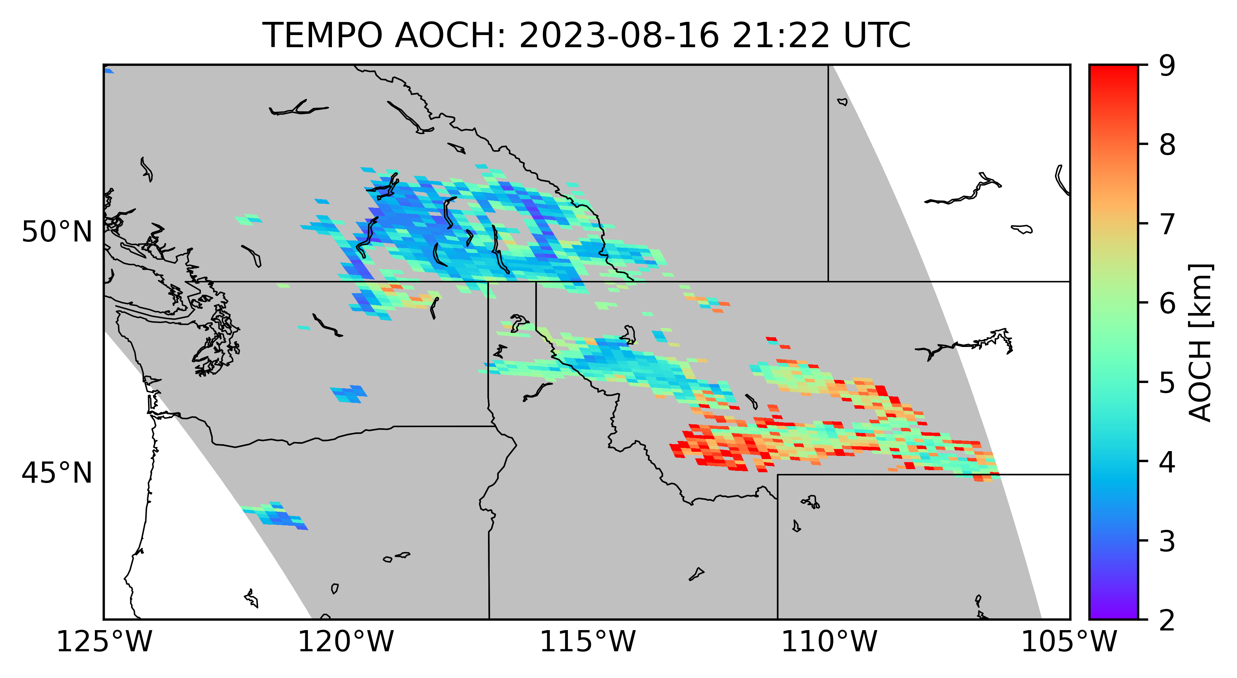
Diurnal variation of the TEMPO AOCH and surface PM2.5
08/16/2023 19:00 UTC 20:00 UTC 21:00 UTC

Slide 11
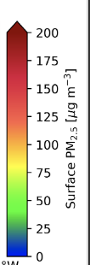

Zoom-in view at regional/community scale
08/16/2023 19:00 UTC 20:00 UTC 21:00 UTC

Slide 12
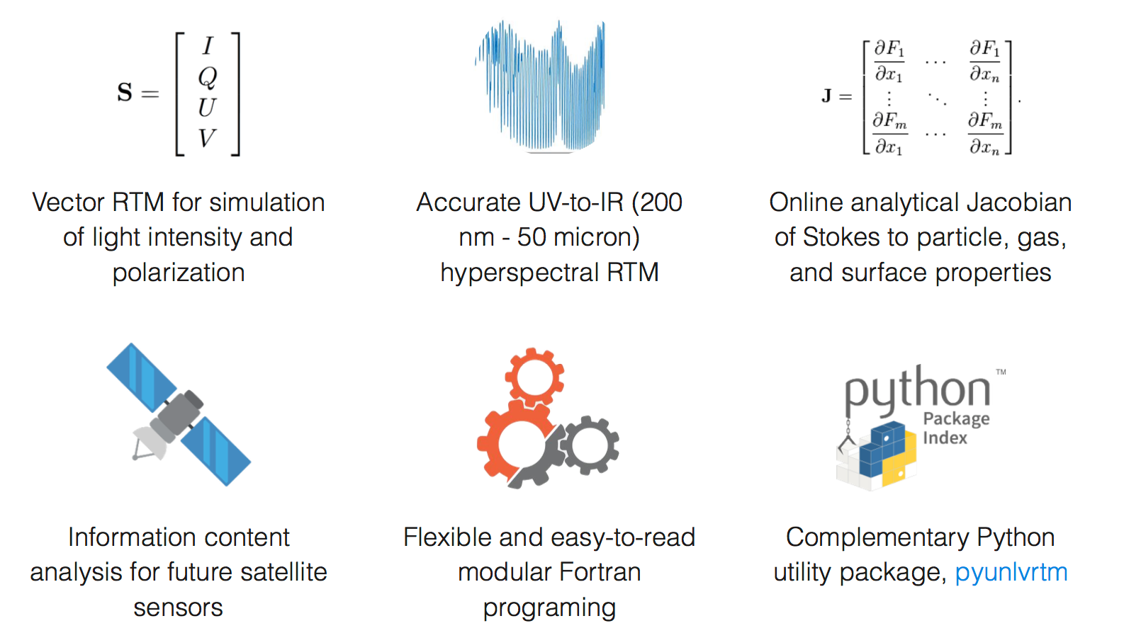

UNL-VRTM Features
www.unl-vrtm.org
Well-maintained user guide

Slide 13
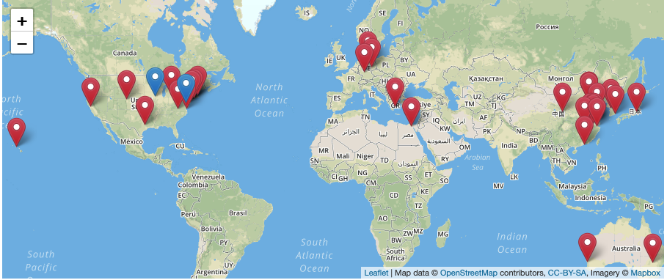
User Community
As part of UNL-VRTM, Kelly’s line-by-line code for gas absorption calculation has been used widely by the aerosol community and beyond
Being used for remote sensing of aerosol, gas, cloud, and surface
User feedbacks are important sources to improve the model
Routinely maintained by Dr. Xiaoguang Xu, UMBC and research team in U. Iowa.

Slide 14
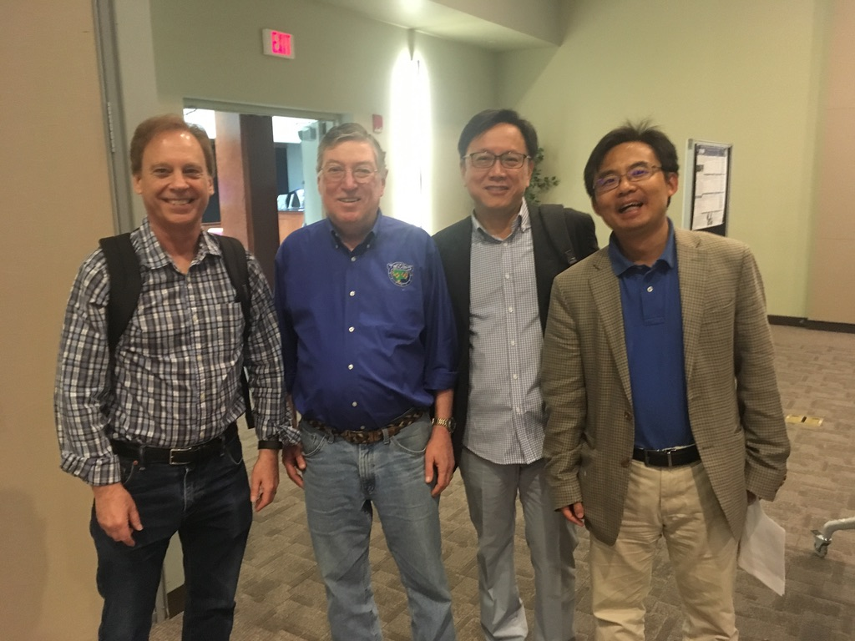
Mission Collaborations
06/06/2018; NCAR

Slide 15
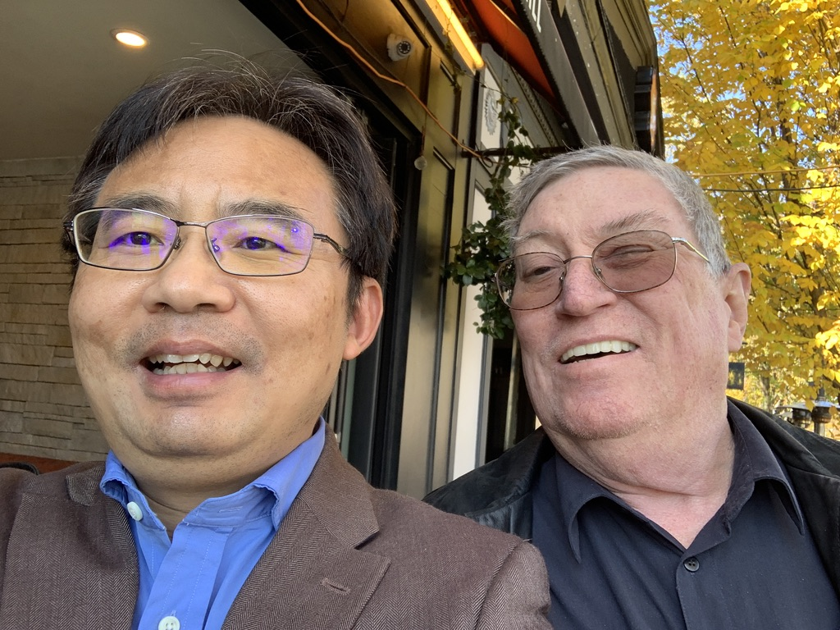
Mentorship and Regular Exchange
9 Nov. 2021; Cambridge, MA

Slide 16
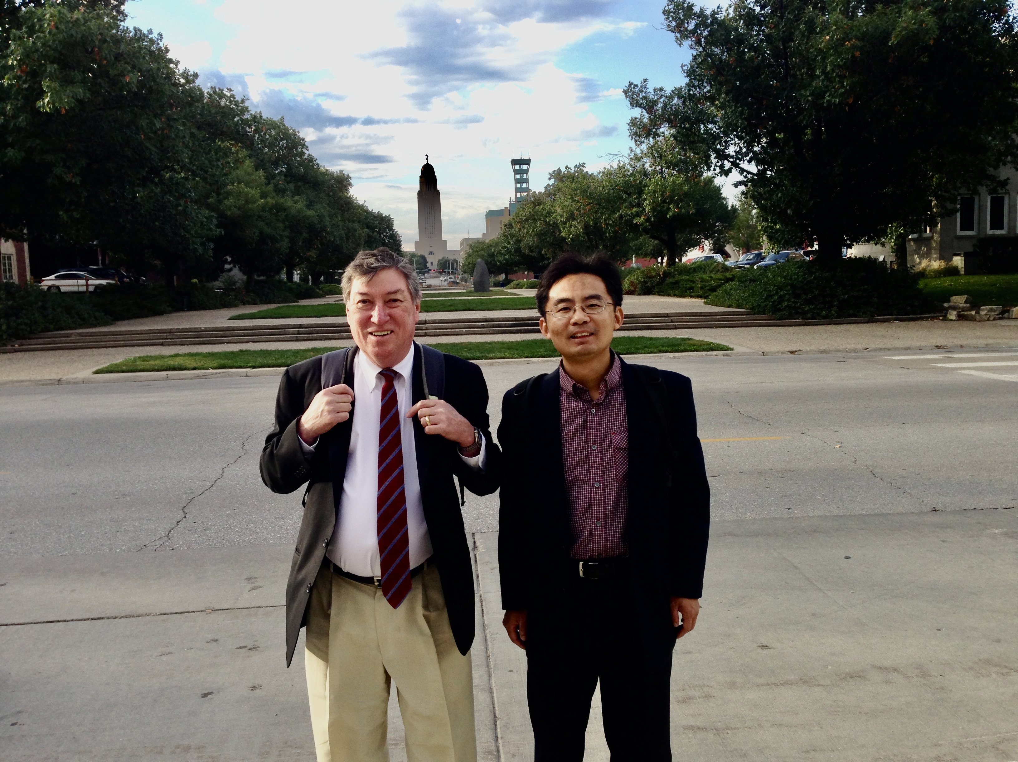
Many Thanks to mentorship and support!
Thanks to your vision for TEMPO aerosol work!
Thanks to your generosity – your LBL code is used widely in aerosol remote sensing!
27 September 2013 Lincoln, NE

Slide 17

Kudos to all your achievement & congrats to your retirement!
This quote, attributed to Hartley Burr Alexander, a philosophy professor at the University of Nebraska, is famously inscribed Memorial Stadium in Lincoln, Nebraska

Slide 18
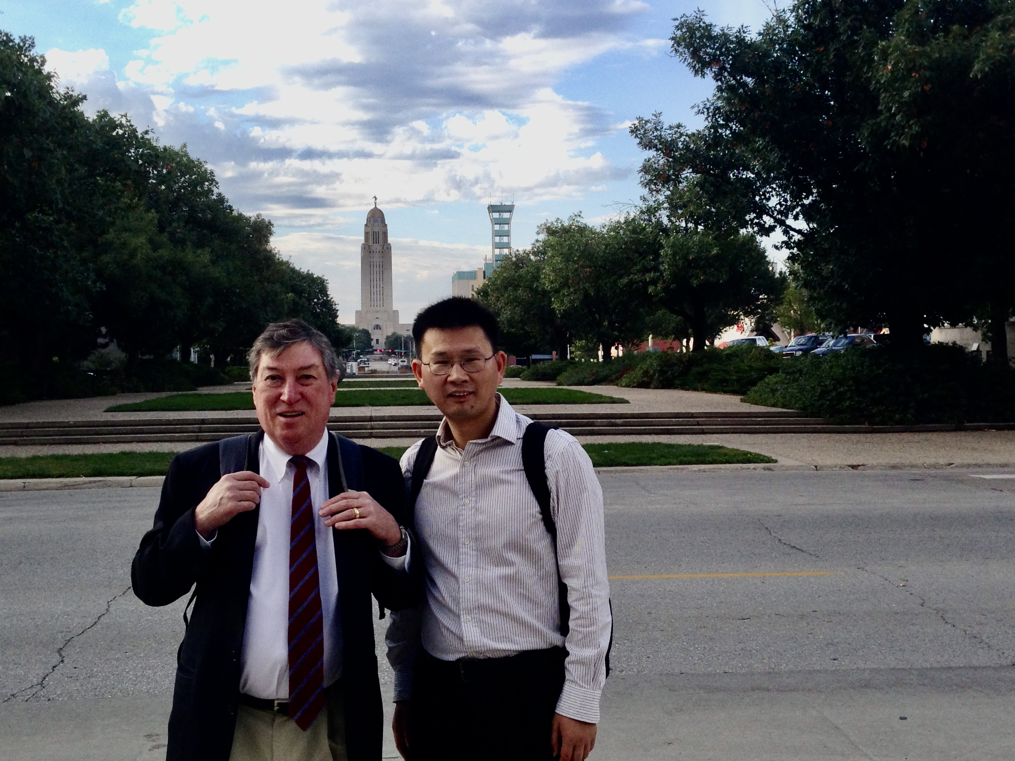
Way ahead...
"following in Kelly's footsteps…” Xiong Liu
27 September 2013 Lincoln, NE

