Slide 1
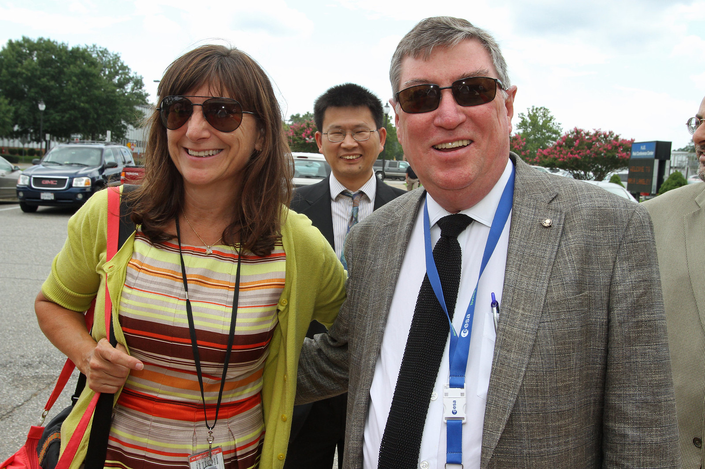
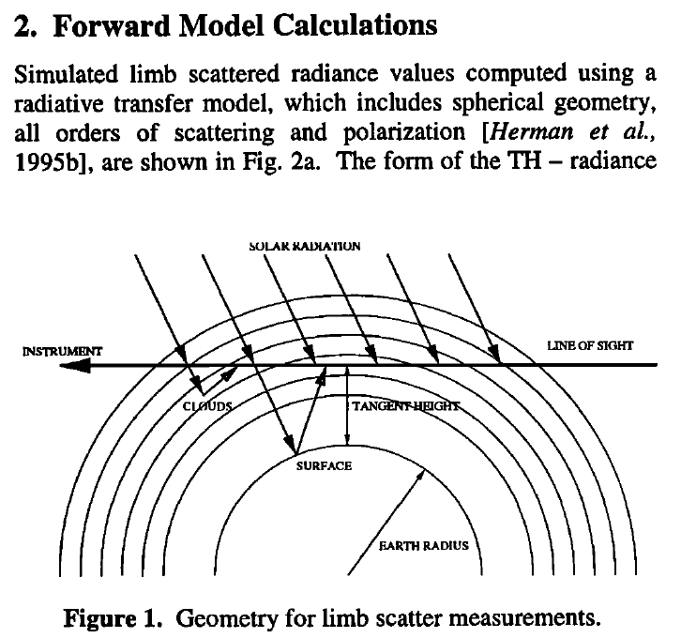
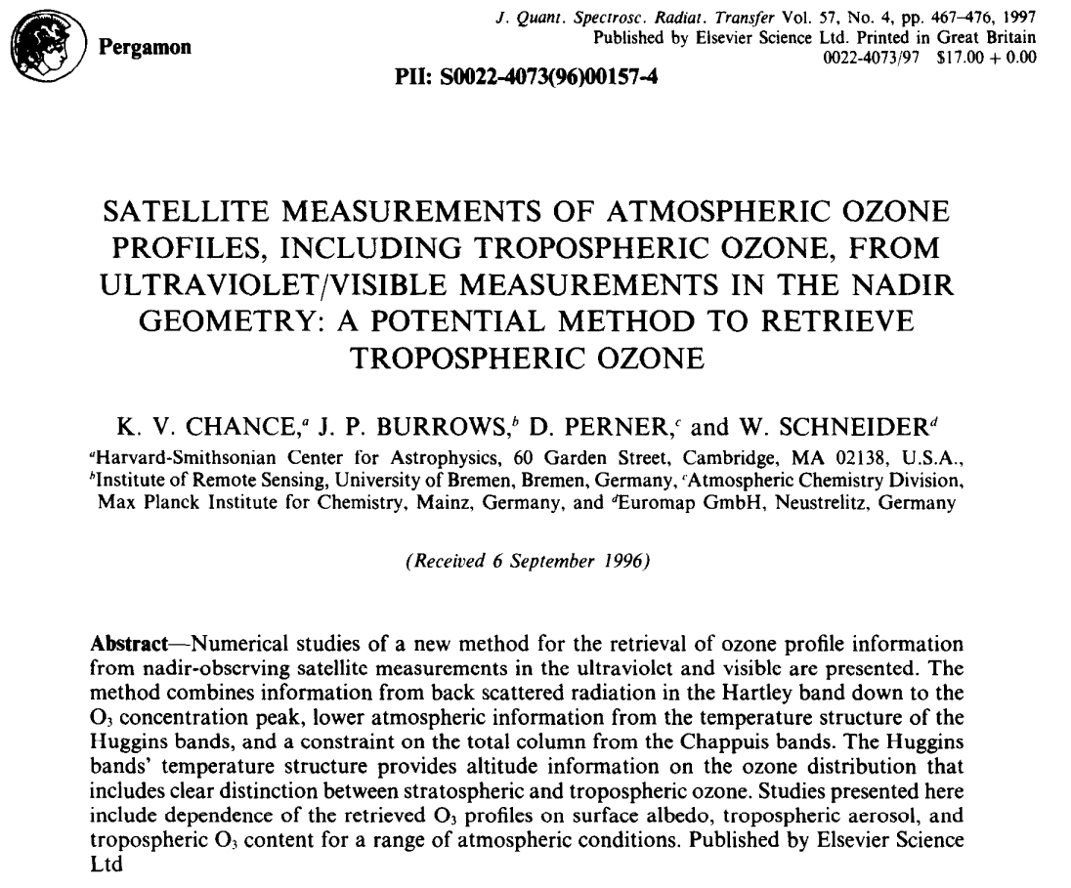
Kelly’s advice to me, direct and indirect
Remember the spectroscopy
  BTW, “Subscripts matter”
“It is easier to criticize than create.”
Persistence and keep your eye on the details
Have fun

