Slide 1
Remember the Cake
Remember this Day!

Slide 2
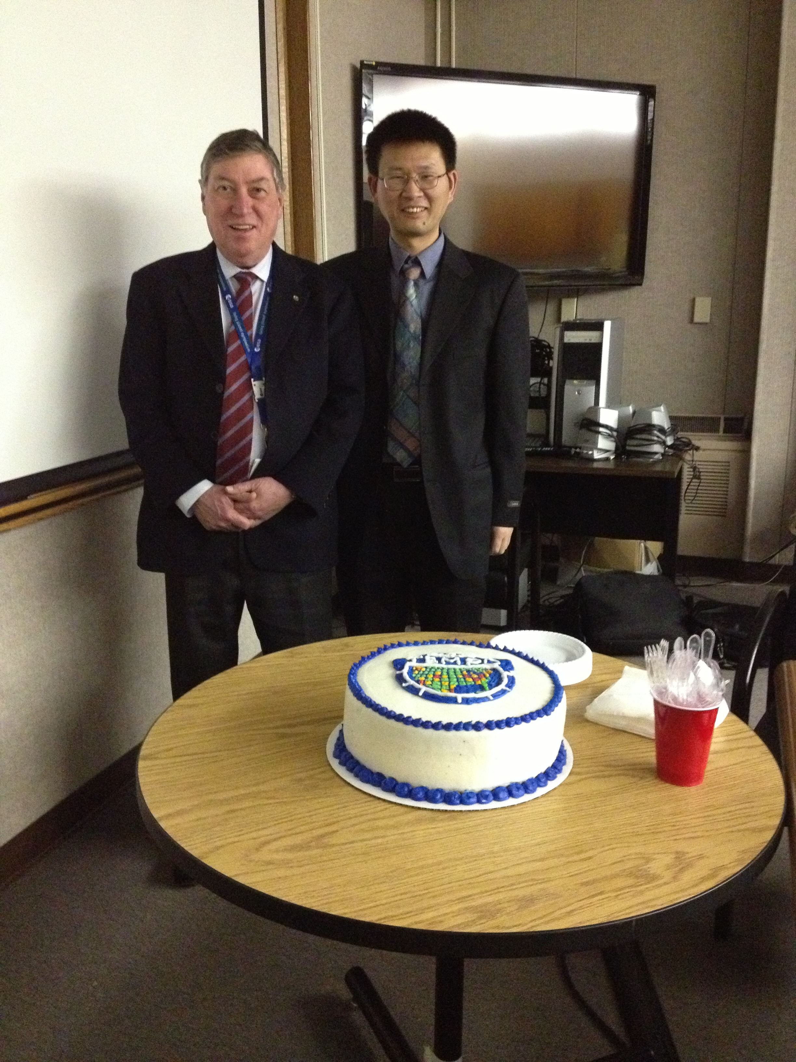
“Remember the cake, remember this day”
-Dennis Nicks
In other words….

Slide 3
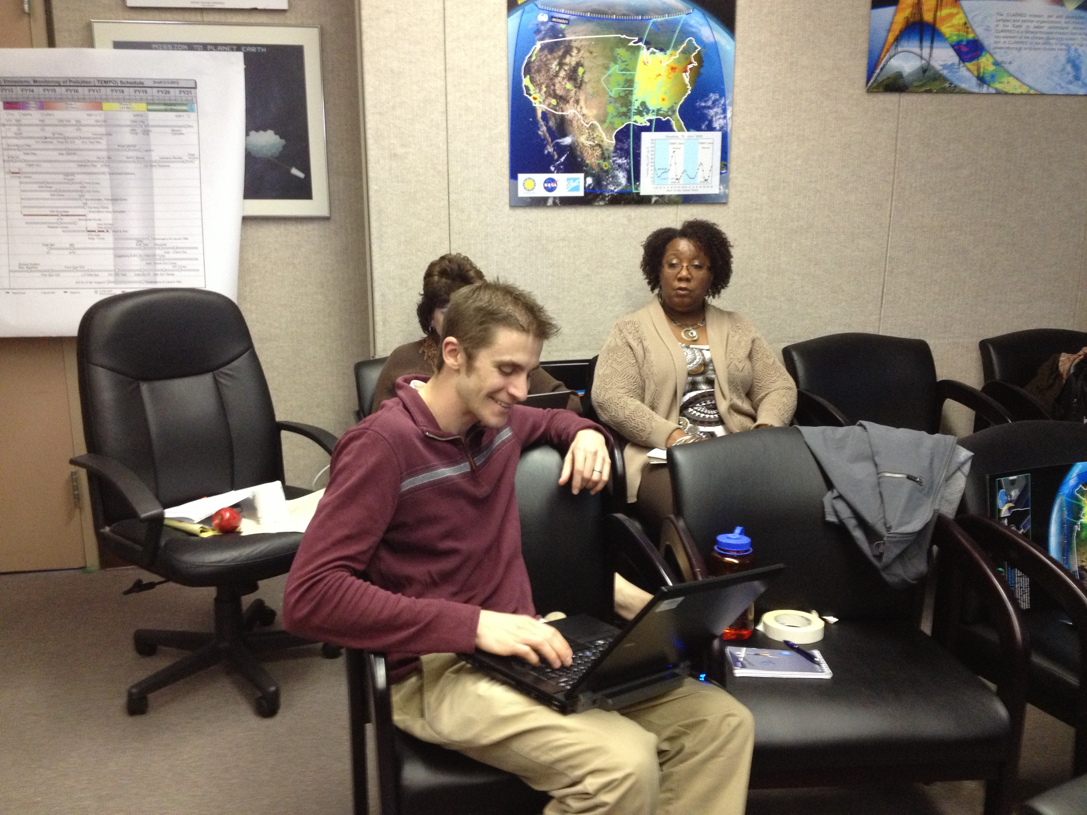
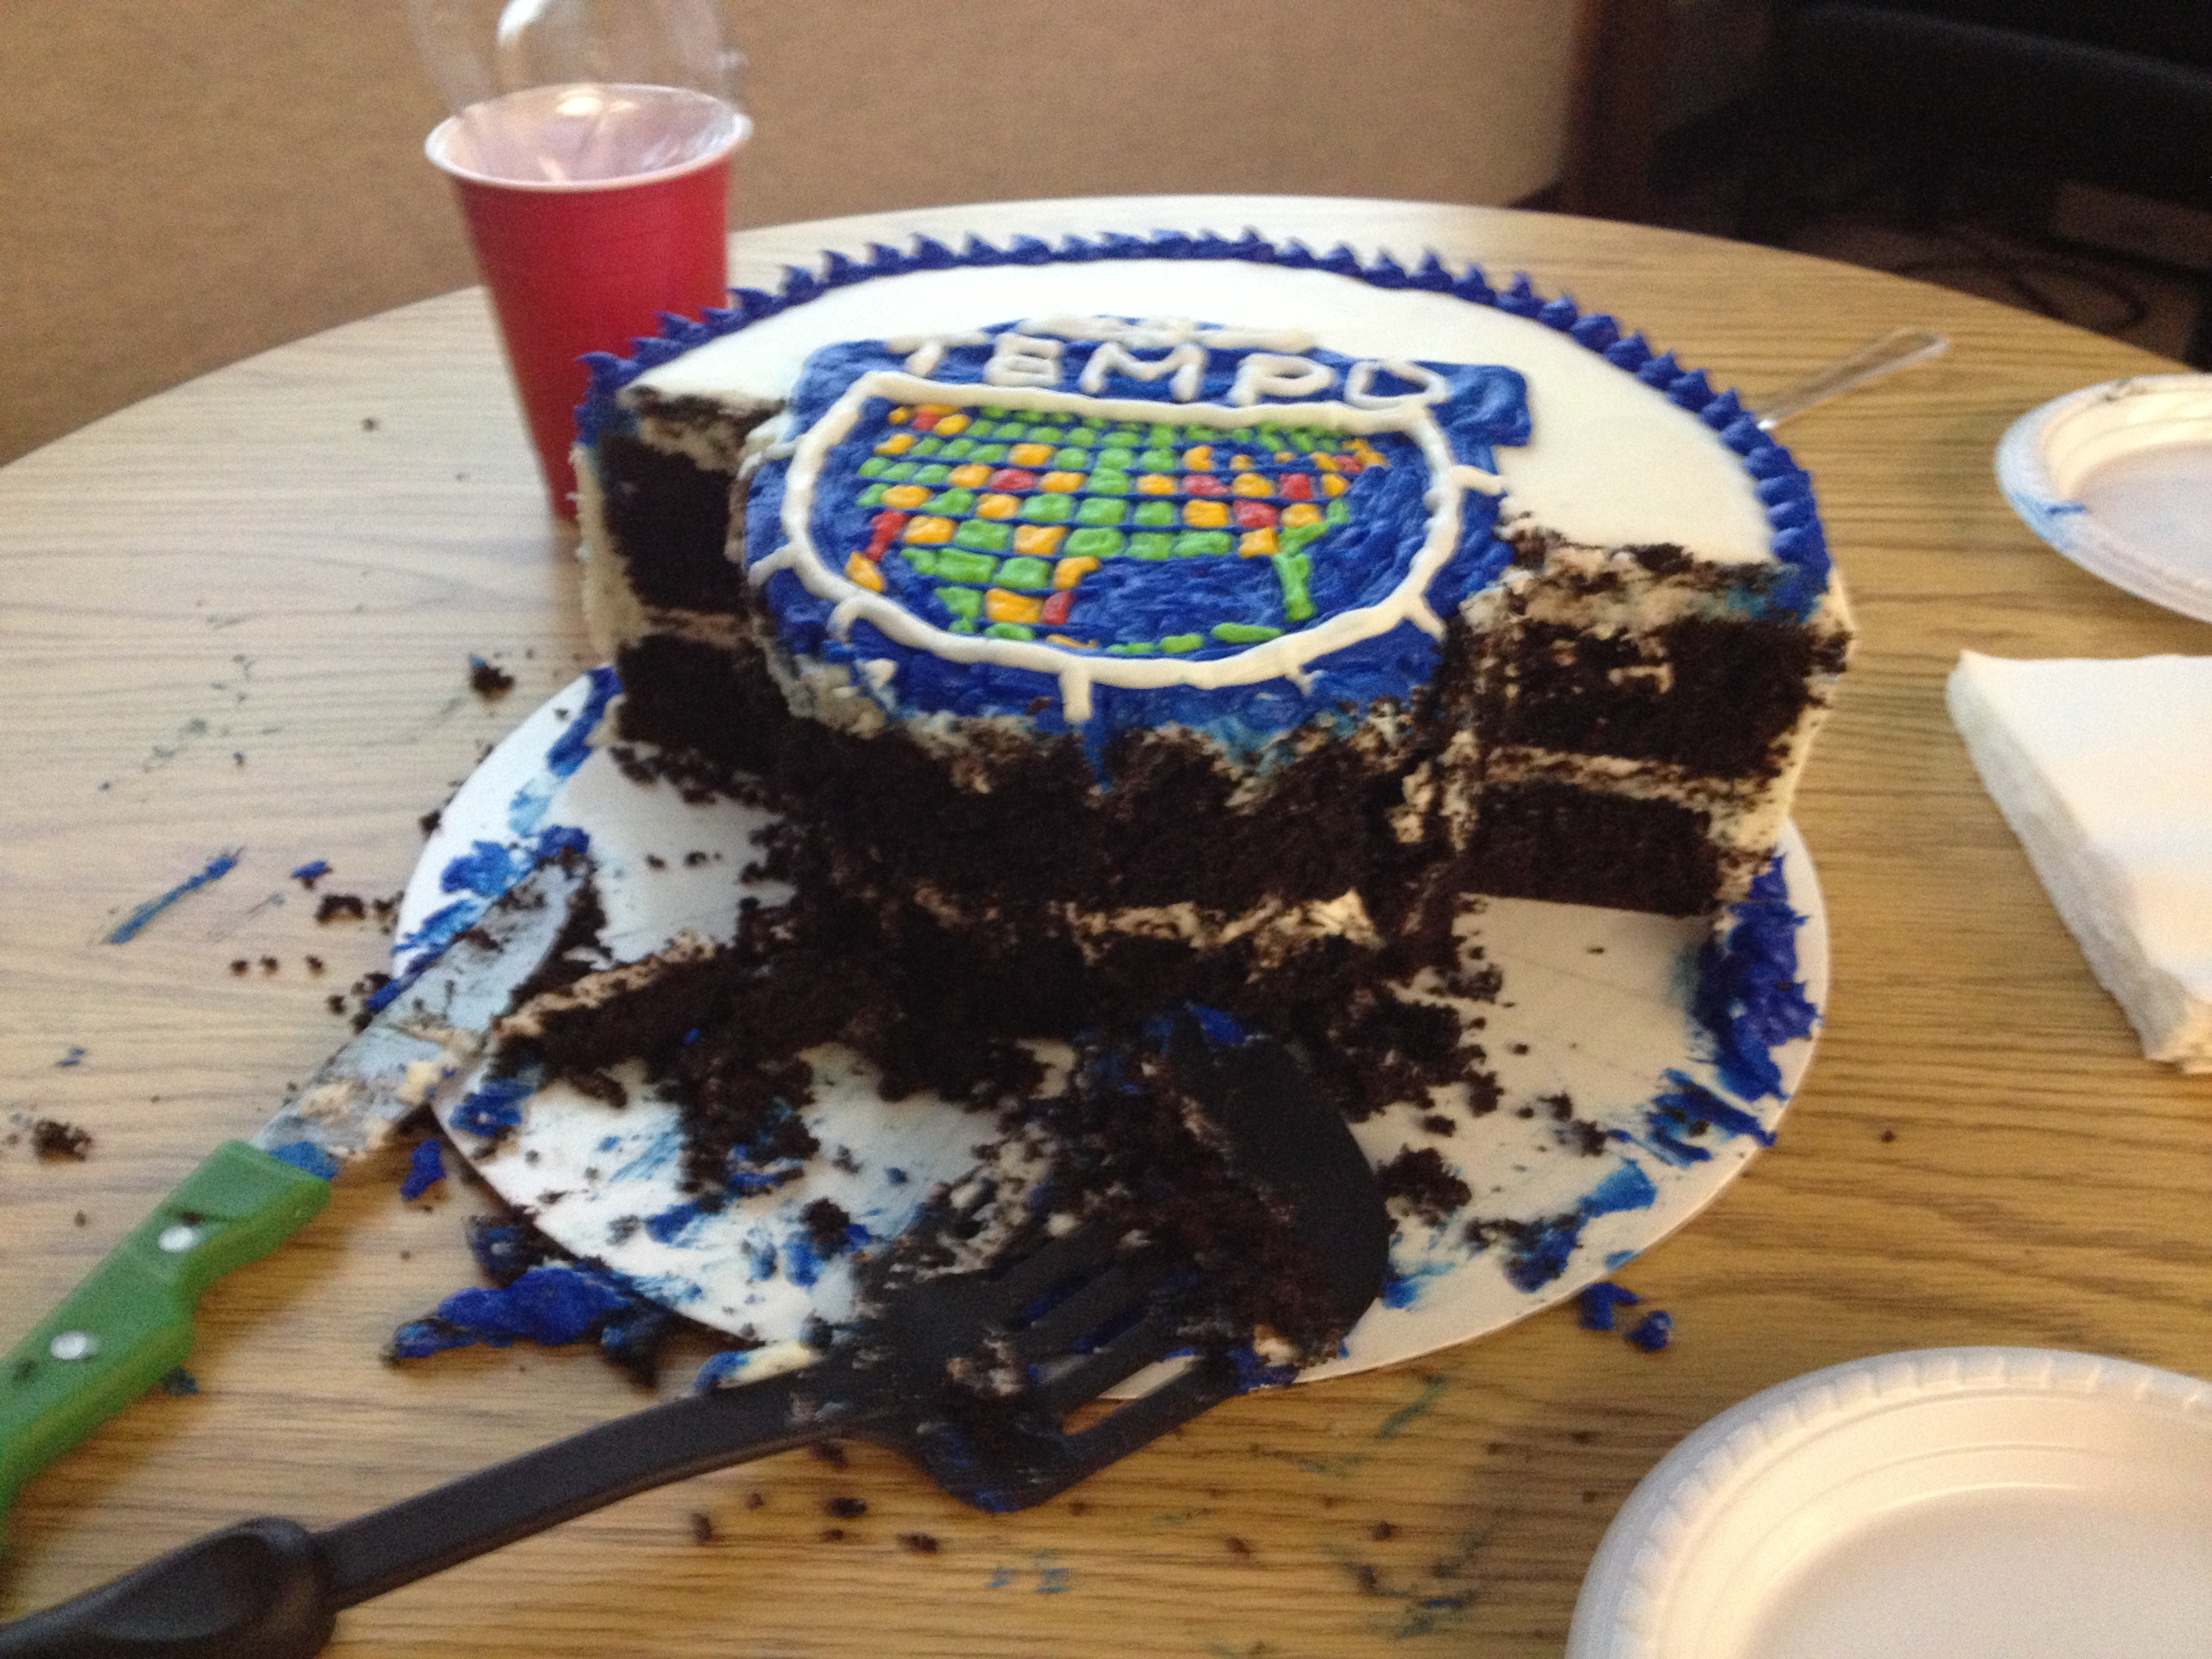
Remember the Cake!

Slide 4
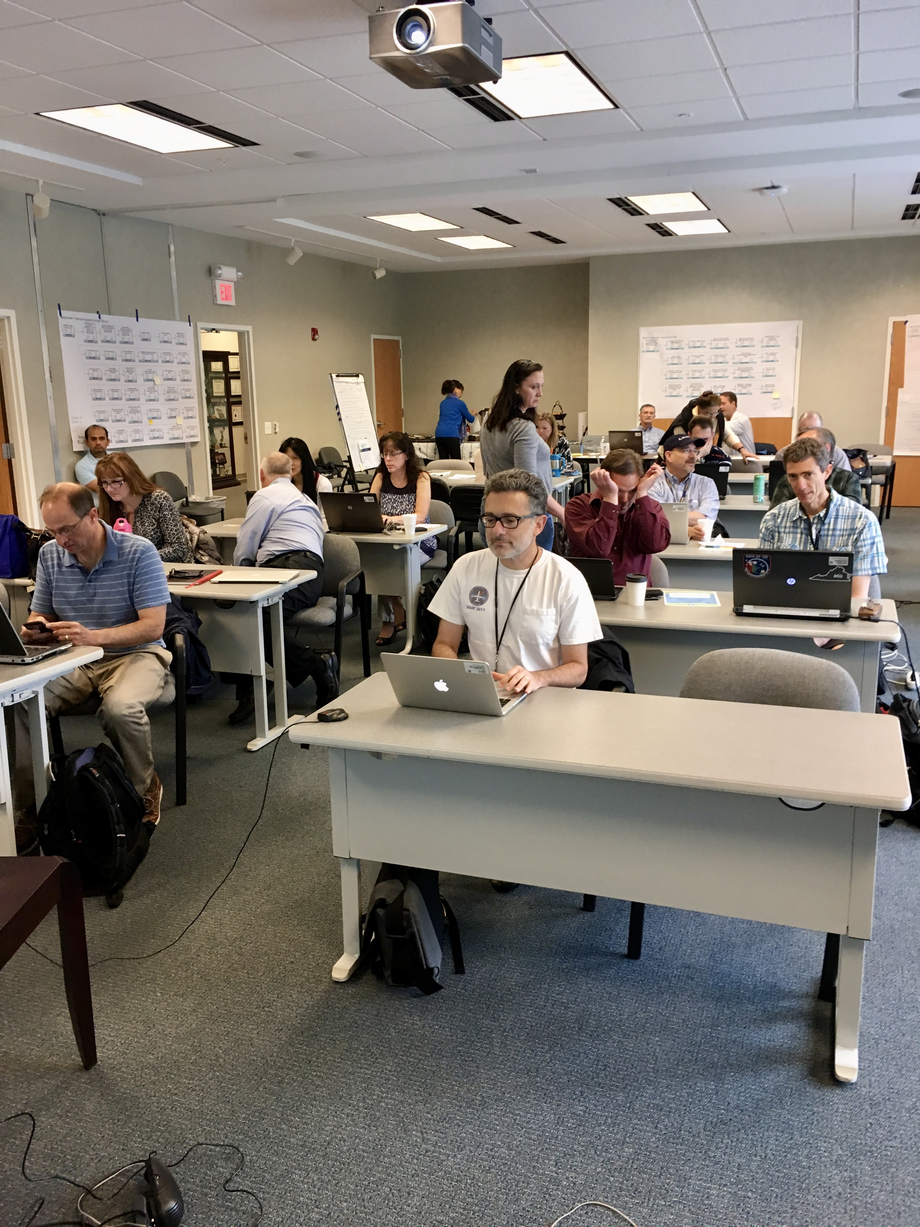
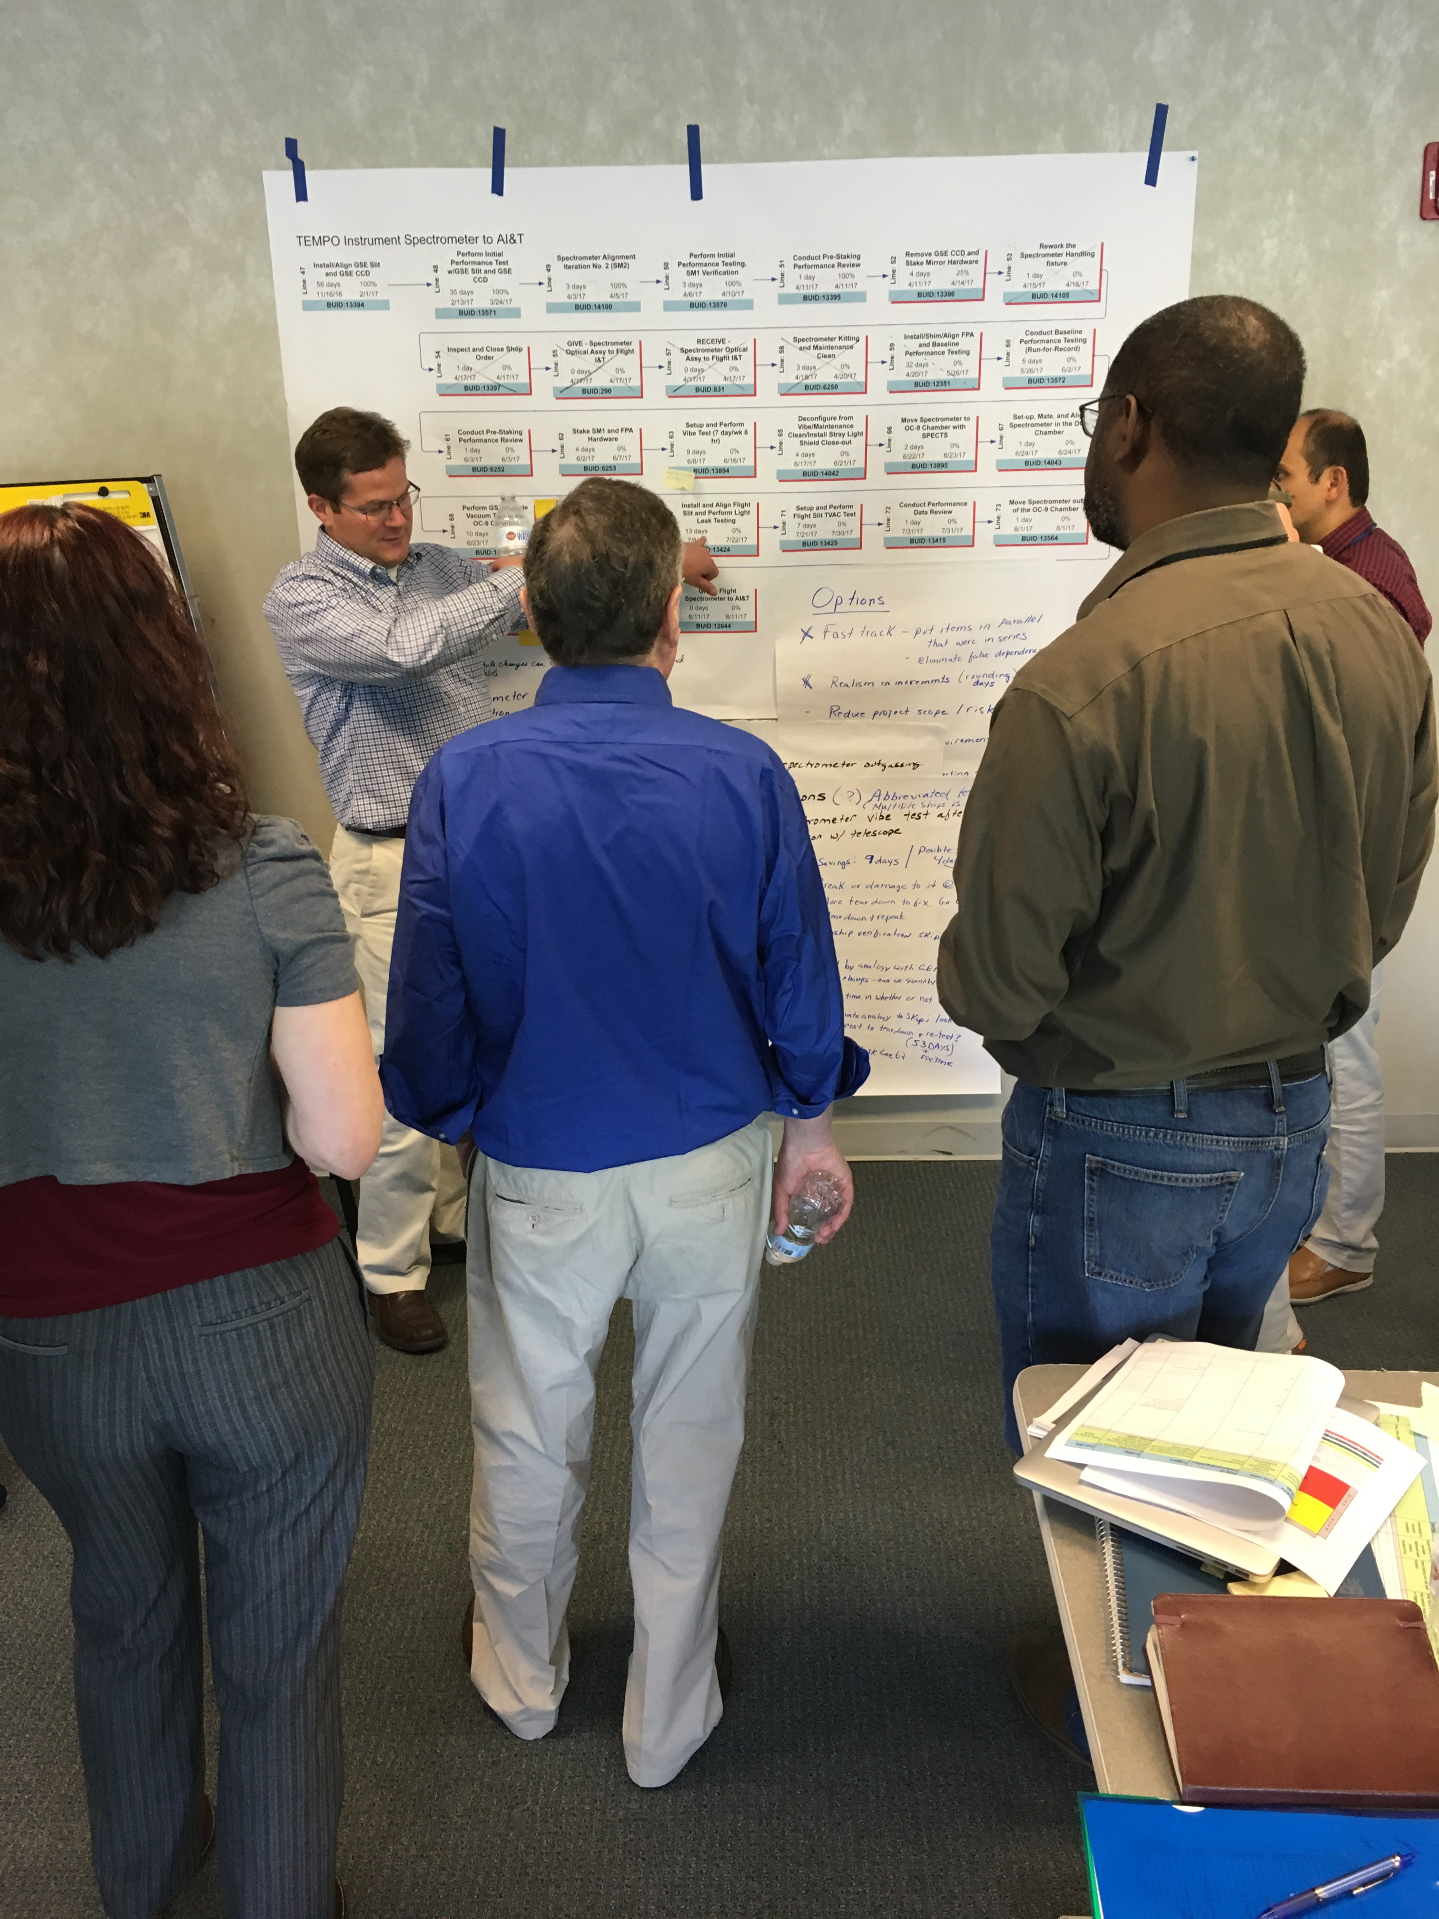
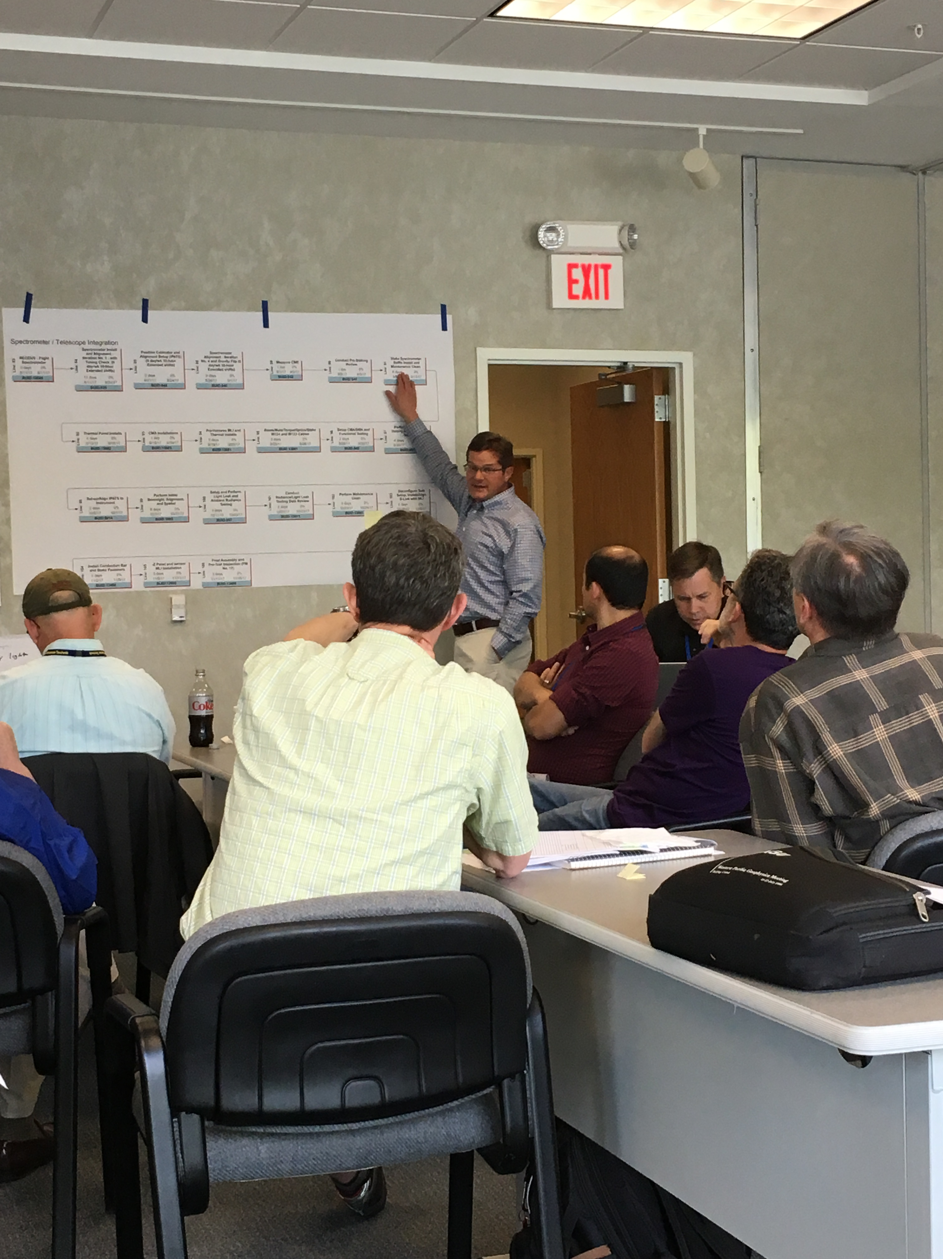

Remember the Cake!

Slide 5
