Slide 1



How I became part of the TEMPO Science Team
Brad Pierce
UW-Madison
Space Science and Engineering Center
Kelly Chance Symposium, August 18, 2025, Cambridge, MA

Slide 2
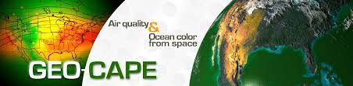

Doreen Neil
GEOstationary Coastal and Air Pollution Events (GEO-CAPE) NASA LaRC Mission Implementation Lead
The NASA EV-I TEMPO mission is the realization of one component (UV-VIS) of GEO-CAPE.

Slide 3
Sometime in 2011….
First NASA Air Quality Applied Science Team (AQAST at Harvard?)
Dinner with Kelly and Doreen
  TEMPO Science Team needs a modeler
  Did I realize that I was being vetted?
How does a world expert on molecular spectroscopy vet a modeler?
  I knew what a Nyquist Frequency was

Slide 4
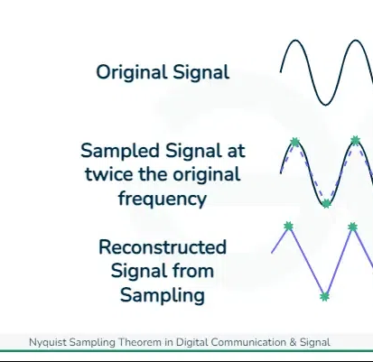
Nyquist Sampling Theorem
To reconstruct a continuous signal from its sampled version accurately, the sampling rate must be at least twice the highest frequency present in the signal.
The Formula for Nyquist Sampling Theorem can be given as
f_{s}>=2f_{m}
Where,
f_{s}​ refers to frequency signal
f_{m}​ refers to max frequency
This ensures that there are enough samples taken per unit of time to capture all the details of the original waveform without introducing aliasing, which can cause distortion or artifacts in the reconstructed signal.

Slide 5

Nyquist Frequency
In Spectroscopy: TEMPO Spectral range: 293–741 nm (UV, visible); spectral sampling: 0.2 nm; spectral resolution: 0.6 nm.
In Numerical Weather Prediction: For a given grid spacing (dx), the Nyquist frequency corresponds to a wavelength that is twice the grid spacing (2dx).
In atmospheric observing systems: Asynoptic sampling by polar orbiting satellites introduces biases, particularly diurnal cycles.

Slide 6
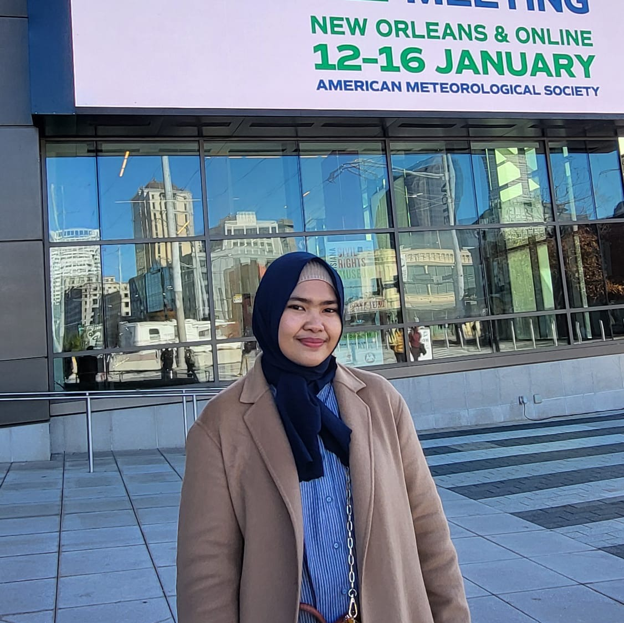
The Next Generation of Scientists: Adji Lubianashari
Forecaster and analyst at the Indonesian Agency for Meteorology, Climatology, and Geophysics (BMKG)
Professional Masters of Science in Atmospheric and Oceanic Sciences, University of Wisconsin-Madison, US
Summer Internship: Evaluating UFS-RAQMS NO₂ Predictions with TEMPO and GEMS Satellite Observations

Slide 7
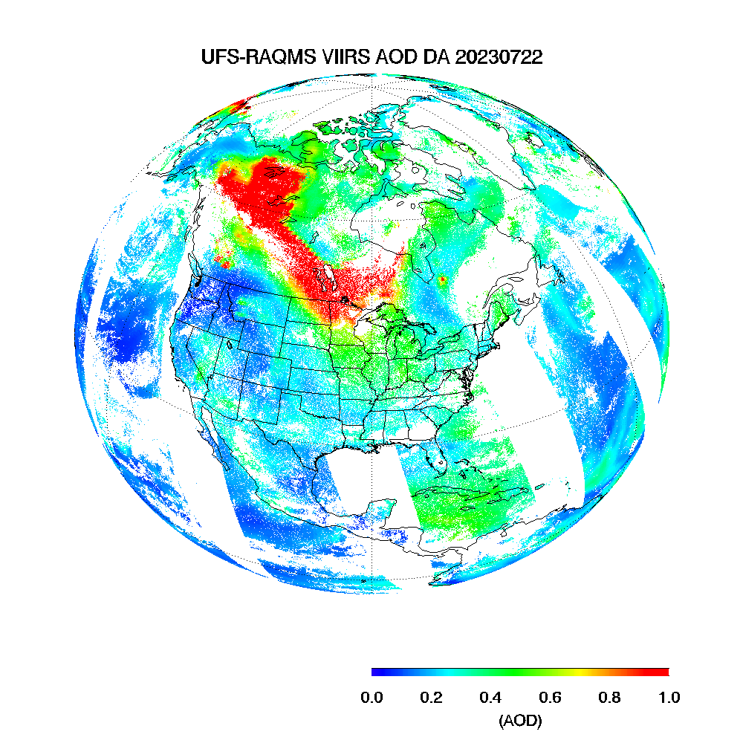
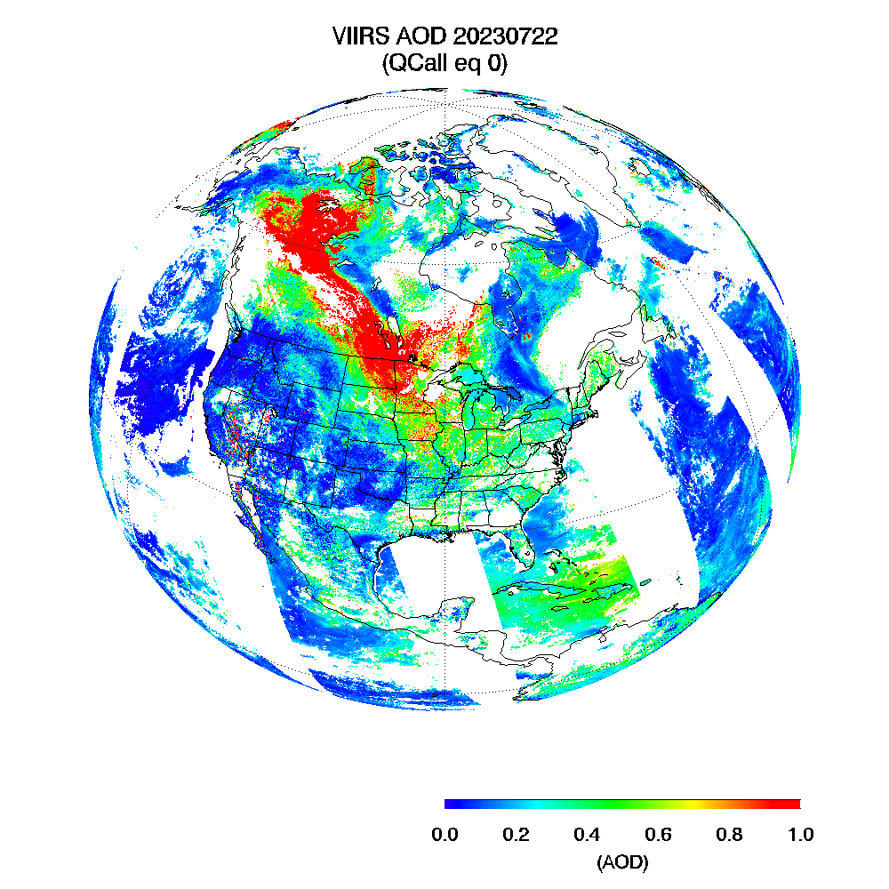
UFS-RAQMS Model
An experimental version of NOAA’s United Forecast System (UFS) with chemistry from the Real-time Air Quality Modeling System (RAQMS)
Combines stratospheric and tropospheric chemistry in one framework
Horizontal resolution: 0.5° (C192)
Includes:
  CEDS anthropogenic emissions (2021)
  GBBEPx real-time biomass burning emissions
  GSI 3D-Var assimilation of VIIRS AOD, OMPS LP/NM Ozone, TROPOMI CO
SSEC Summer Internship Presentation – July 2025

Slide 8
Satellite Data Preparation
Step | GEMS | TEMPO
Product Used | L3 Tropospheric NO₂ (daily average) | L3 Tropospheric NO₂ (individual scan files)
Cloud/QA Filtering | Cloudy pixels already set as NaN in file | Filtered using QC flag == 0 and cloud frac < 0.15
Daily Averaging | Already averaged | Averaged from filtered scans per day
Use in RAQMS Comparison | Used NaN mask from GEMS | Applied same mask to RAQMS
GEMS data came pre-masked using NaNs for cloudy pixels
TEMPO required manual filtering and averaging (QC = 0 for good data and cloud frac < 0 .15)
For both satellites, only valid pixels were used when comparing with RAQMS
SSEC Summer Internship Presentation – July 2025

Slide 9
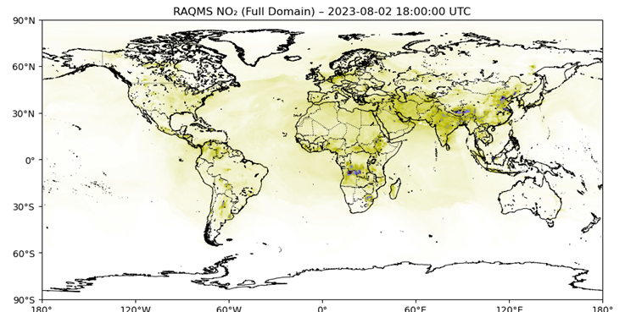
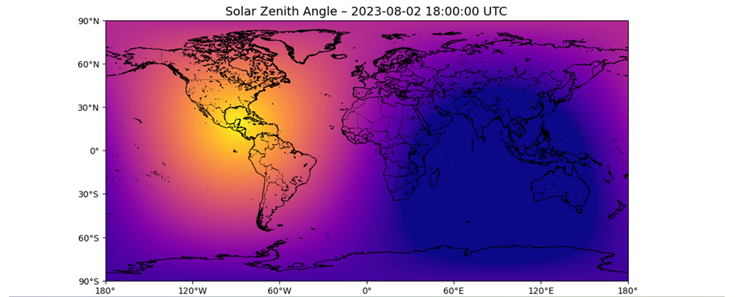
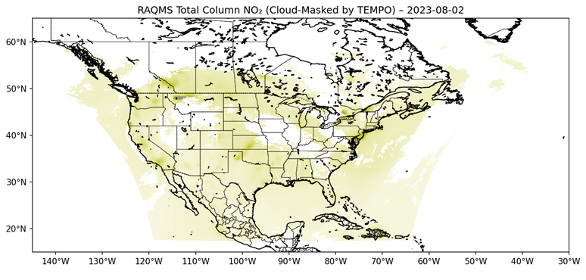
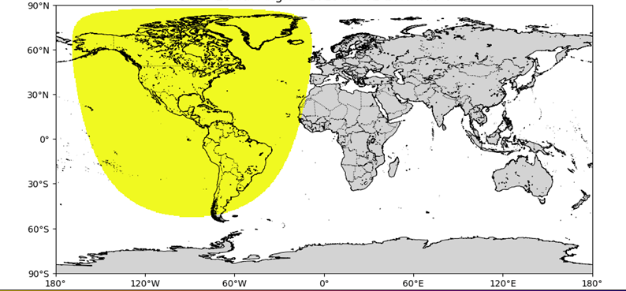
RAQMS Processing Workflow
RAQMS data is masked to match satellite observation conditions: daylight only, regridded to the satellite grid, and masked using satellite cloud and quality control flags.
Daylight Filter (keep only SZA < 70°)
Regrid to satellite resolution
Final RAQMS Output
Apply Satellite Mask (e.g., TEMPO cloud fraction < 0.15)
SSEC Summer Internship Presentation – July 2025

Slide 10
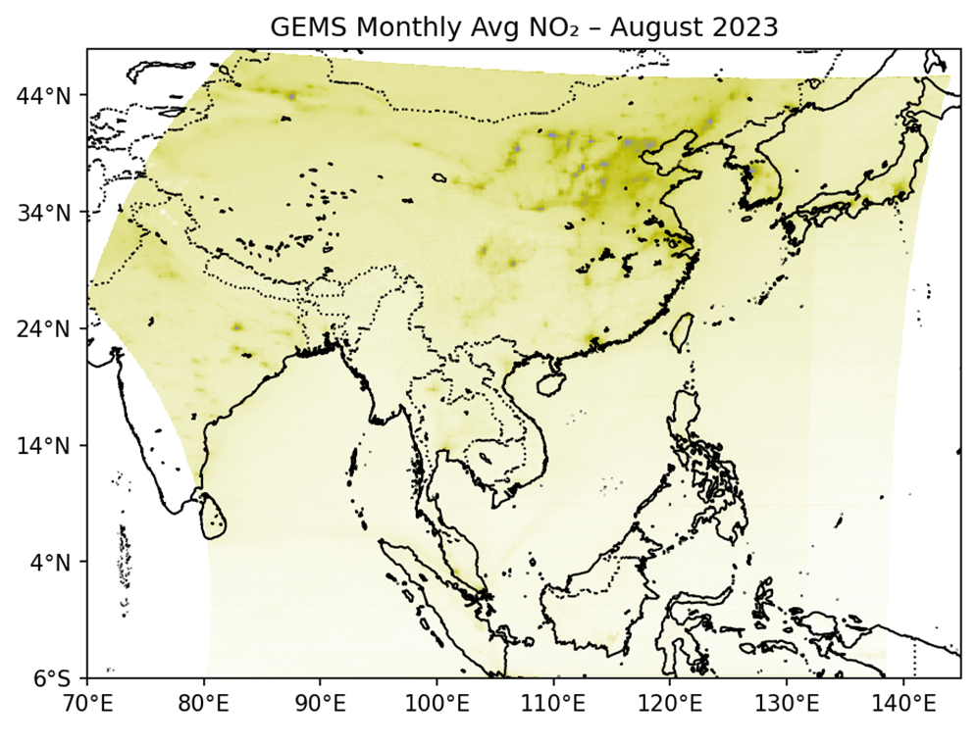
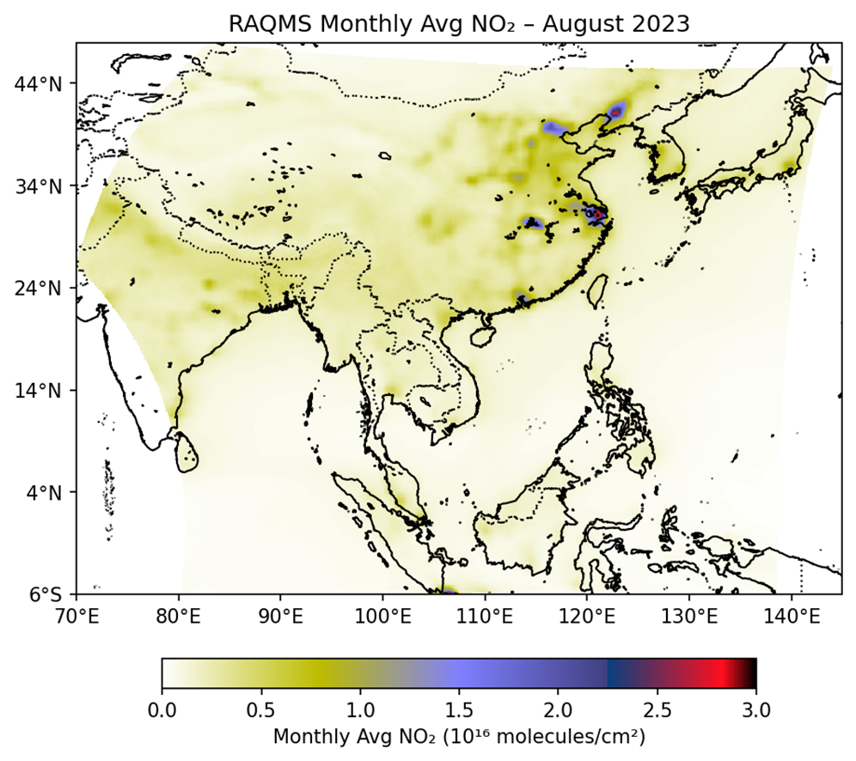
GEMS vs RAQMS Monthly Avg Tropospheric NO₂
RAQMS captures the same large-scale patterns as GEMS but tends to overestimate NO₂ in urban areas.
SSEC Summer Internship Presentation – July 2025
Notes:
Isolates the stratospheric column reduces the differences.
Reduction in high-lat differences shows that stratospheric NO2 have significant role in the discrepancies
Compared to the total column, the values appear closer between model and satellites 🡪 improves agreement between UFS-RAQMS

Slide 11
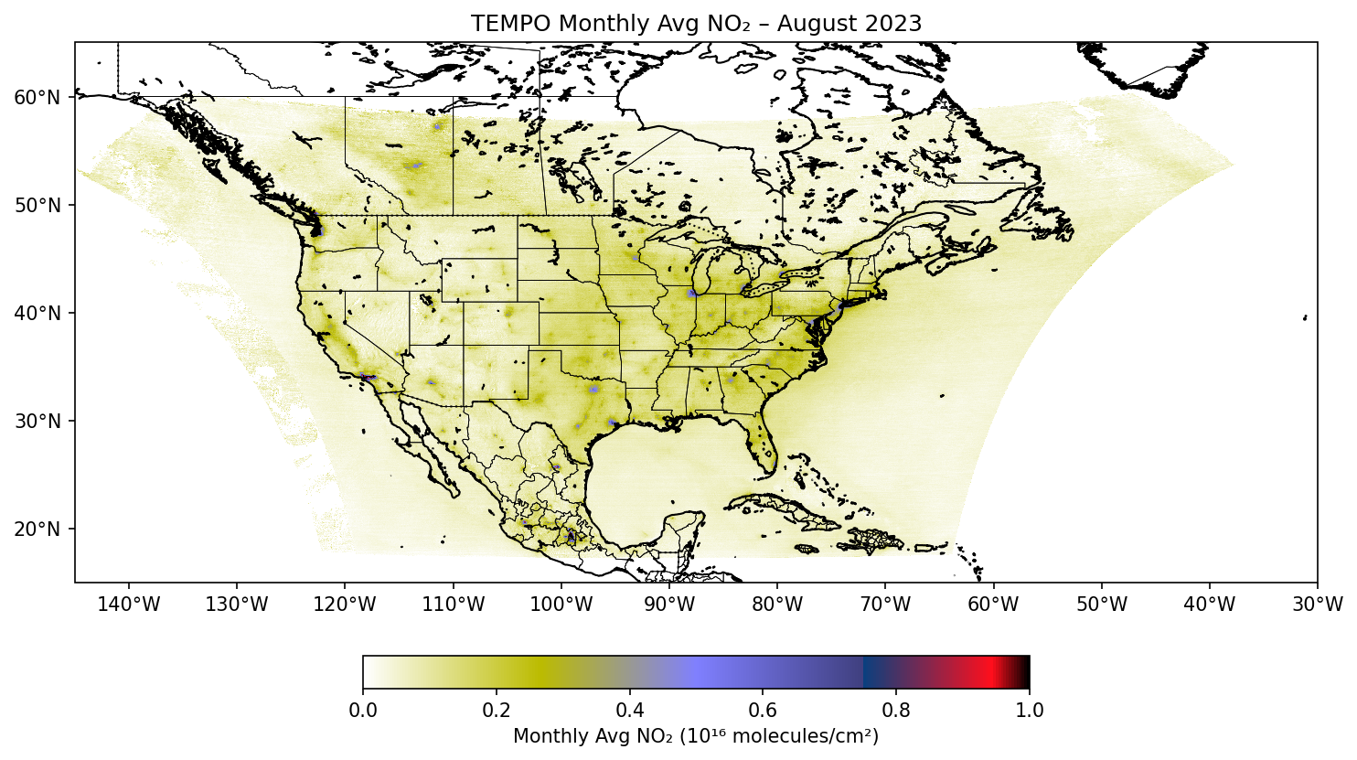
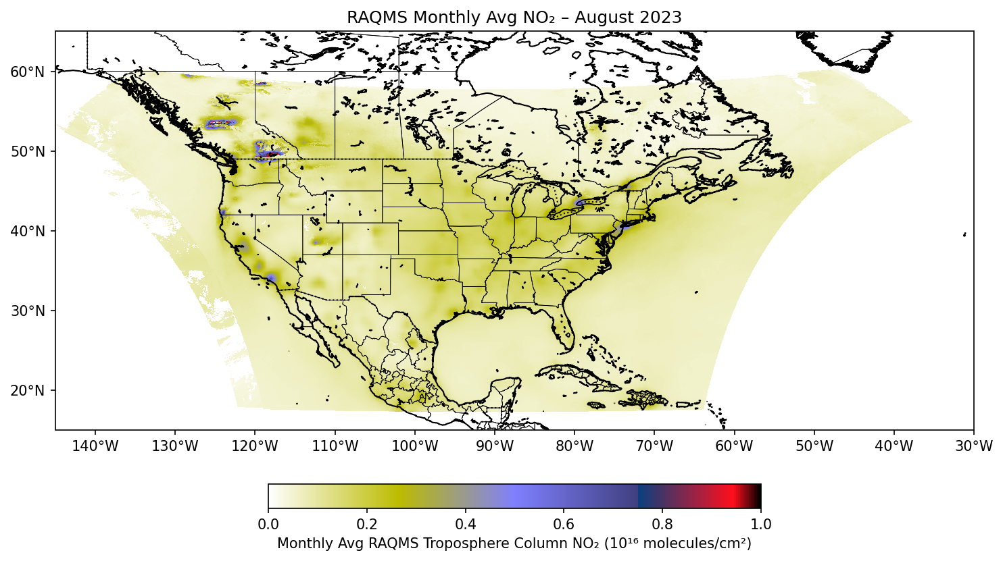
TEMPO vs RAQMS Monthly Avg NO₂
RAQMS shows slightly lower NO₂ than TEMPO in urban area.
RAQMS shows higher NO₂ in Wildfire regions, which not captured in satellite retrievals due to cloud/smoke masking (cloud fraction filter of 0.15).
SSEC Summer Internship Presentation – July 2025

Slide 12
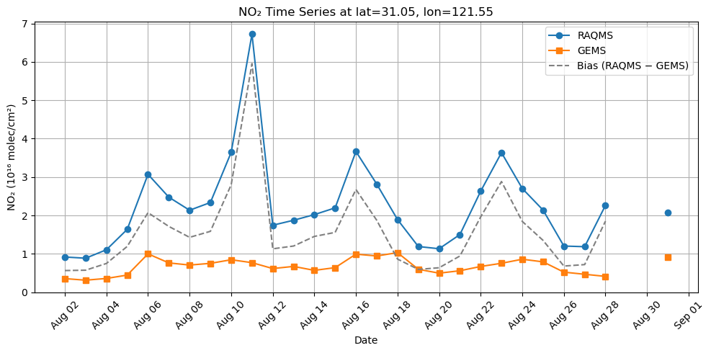
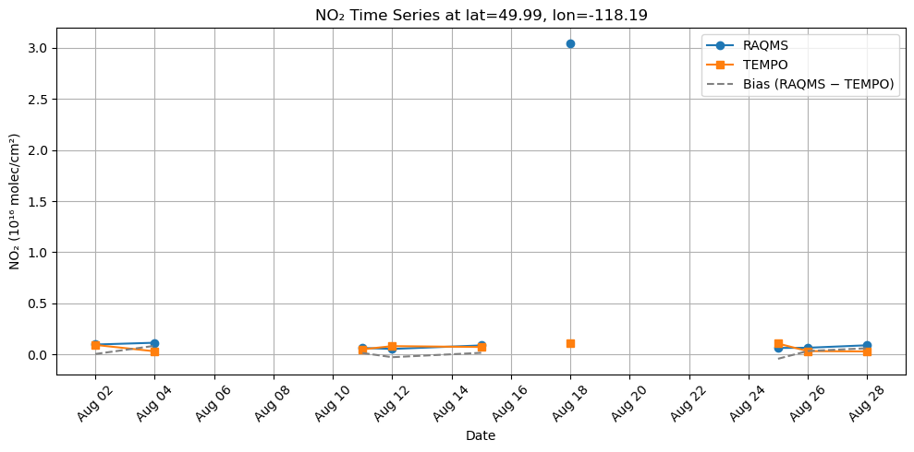
High – Bias Locations
RAQMS > GEMS in eastern China (top): consistent high bias
RAQMS > TEMPO in wildfire region (bottom): large spike on Aug 18 only seen by RAQMS
Shows how bias varies with pollution type (urban vs wildfire) and data availability
SSEC Summer Internship Presentation – July 2025

Slide 13

From Doreen
In 2010 when we were putting the TEMPO mission concept together, the idea of time resolved tropospheric chemistry from space was so new that working on it was a career risk.
Kelly already had an international reputation, and he took that risk on TEMPO.
His perseverance through the decade to complete and launch TEMPO after selection speaks to his generosity to the next generation of tropospheric chemistry scientists, to all of you who are using this profoundly new data to help navigate a changing world.
Thank you, Kelly!

Slide 14
From Doreen
In 2010 when we were putting the TEMPO mission concept together, the idea of time resolved tropospheric chemistry from space was so new that working on it was a career risk.
Kelly already had an international reputation, and he took that risk on TEMPO.
His perseverance through the decade to complete and launch TEMPO after selection speaks to his generosity to the next generation of tropospheric chemistry scientists, to all of you who are using this profoundly new data to help navigate a changing world.
Thank you, Kelly!
Thanks for letting me join you on this exciting adventure Kelly! Brad

