Slide 1
30+ years collaboration between DLR and SAO
Dr.-Ing. Diego Loyola, German Aerospace Center (DLR-IMF)
Kelly Chance Symposium, 18th August 2025

Slide 2
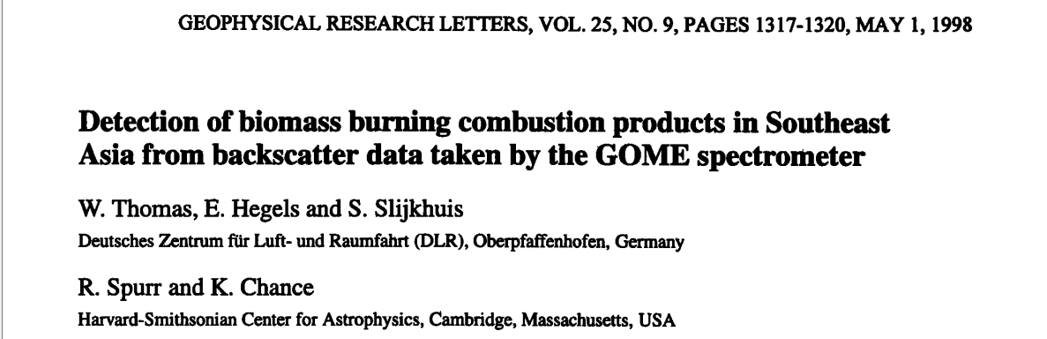
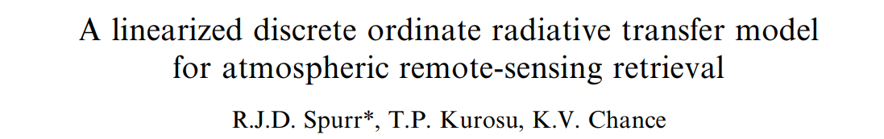
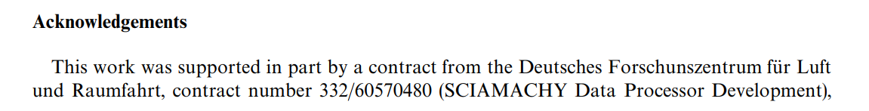
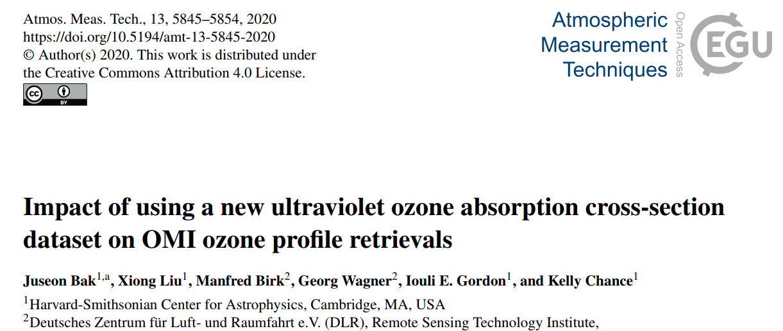
European Atmospheric Composition UVNS LEO Spectrometers
CO2M
CO2M
CO2M
Sentinel-5
Sentinel-5
Sentinel-5
TROPOMI
GOME-2c
GOME-2b
GOME-2a
OMI
SCIAMACHY
2
GOME
1995 2005 2015 2025 2035 2045
Year

Slide 3
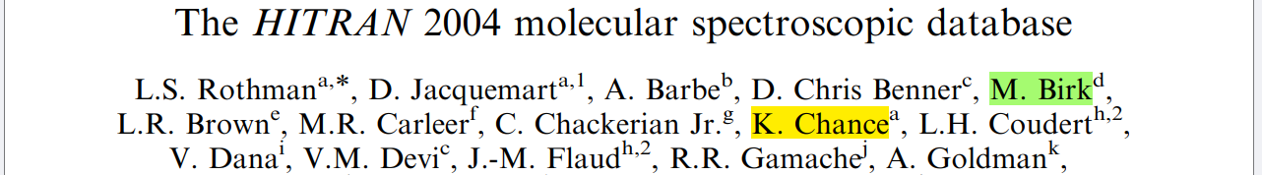
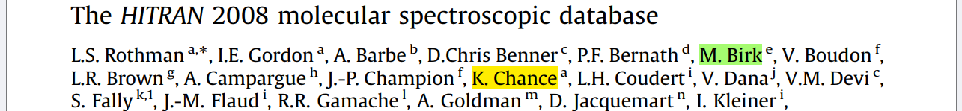
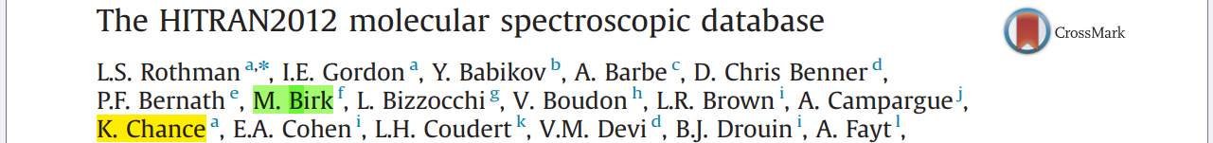
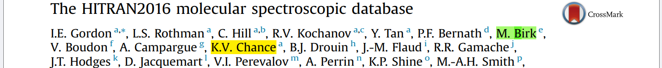
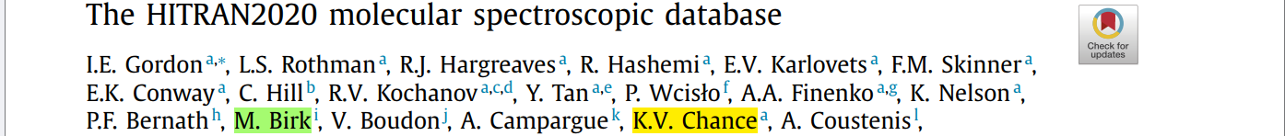
HITRAN
Journal of Quantitative Spectroscopy & Radiative Transfer

Slide 4
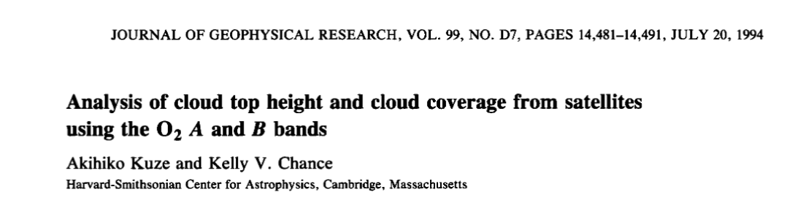
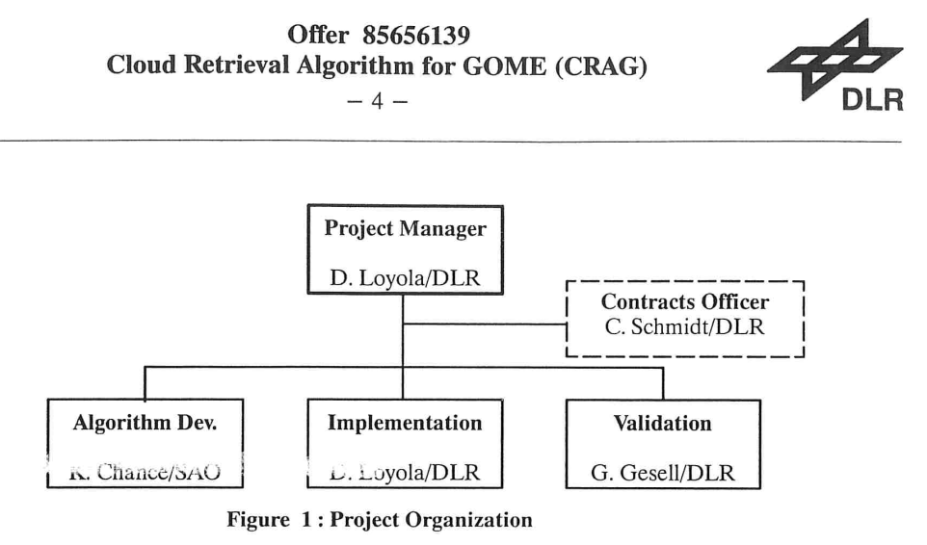
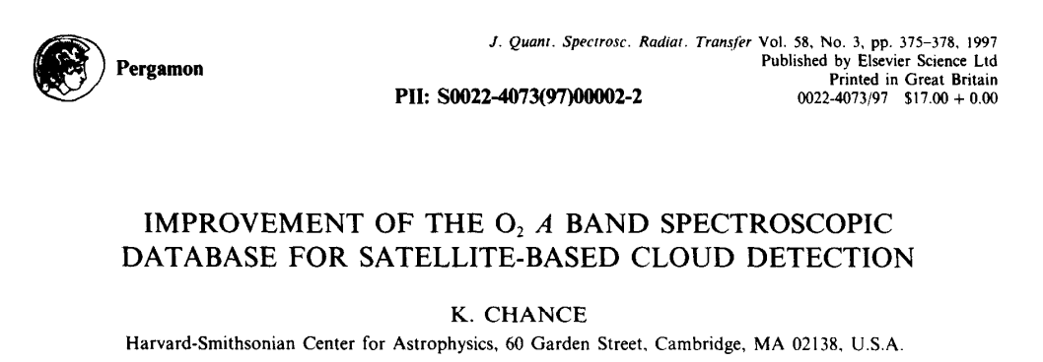
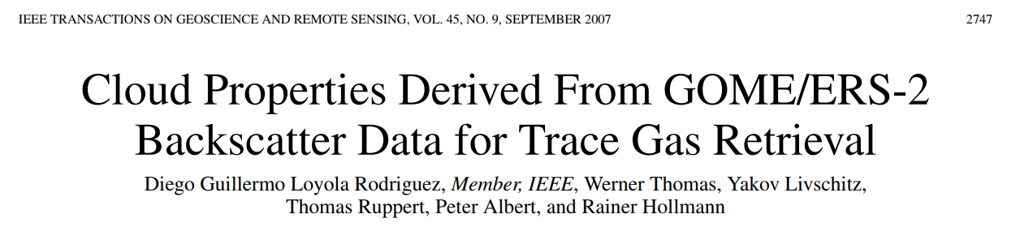
Cloud Retrieval from the O₂ A-band

Slide 5
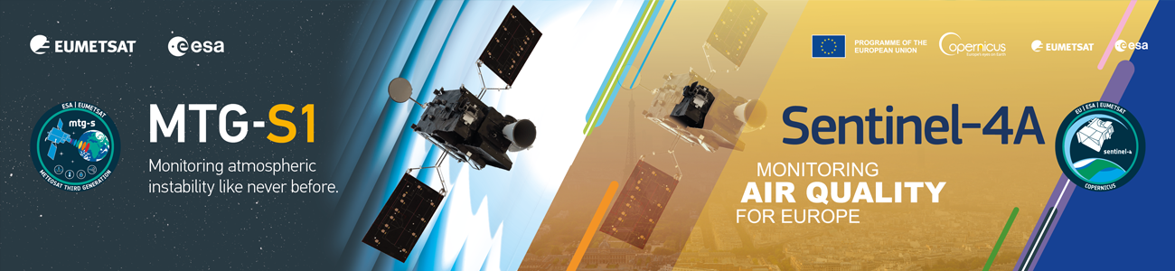
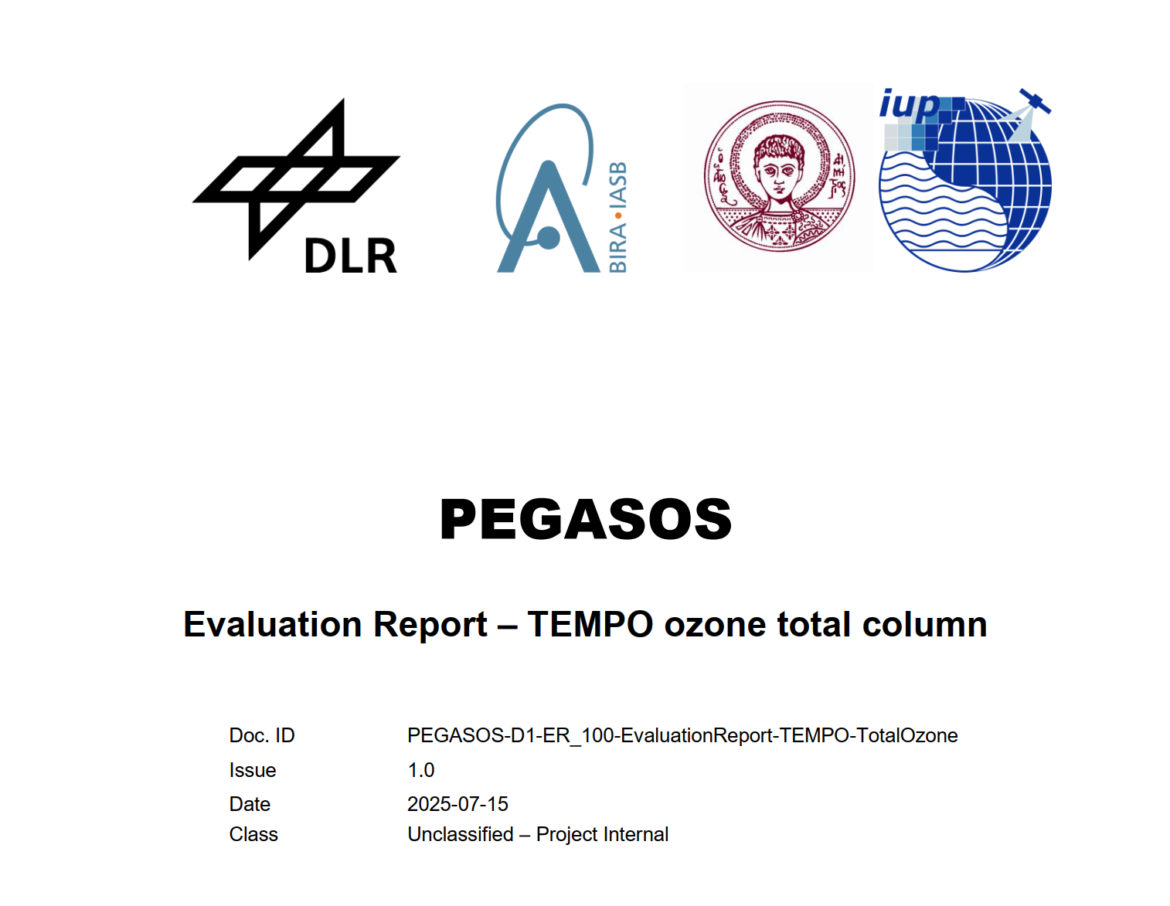
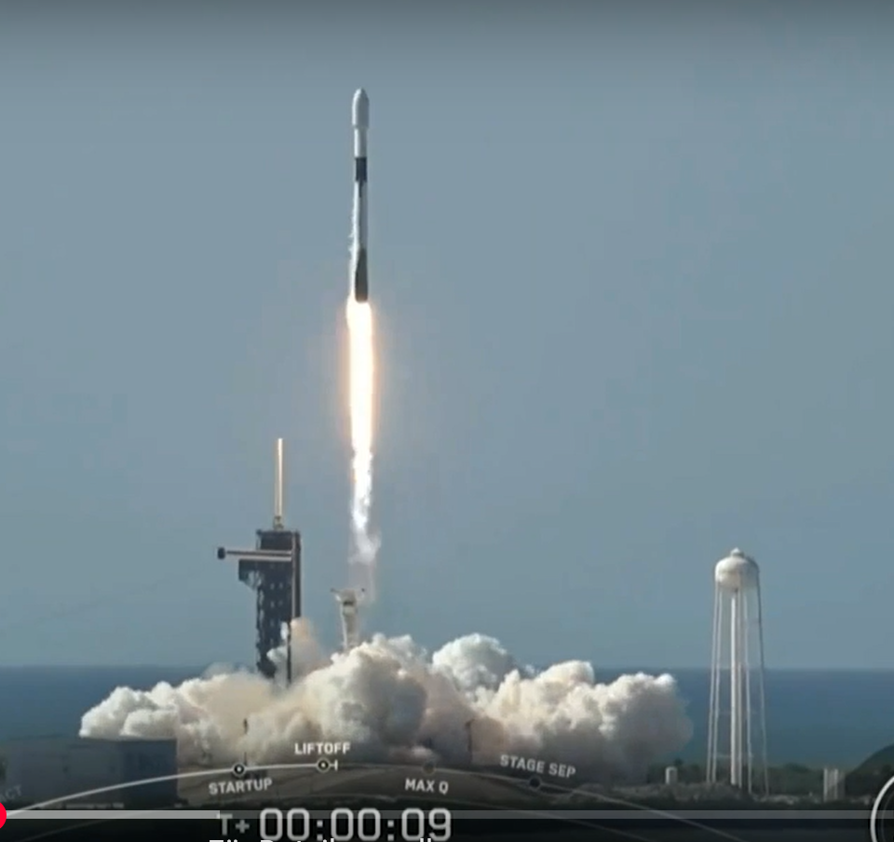
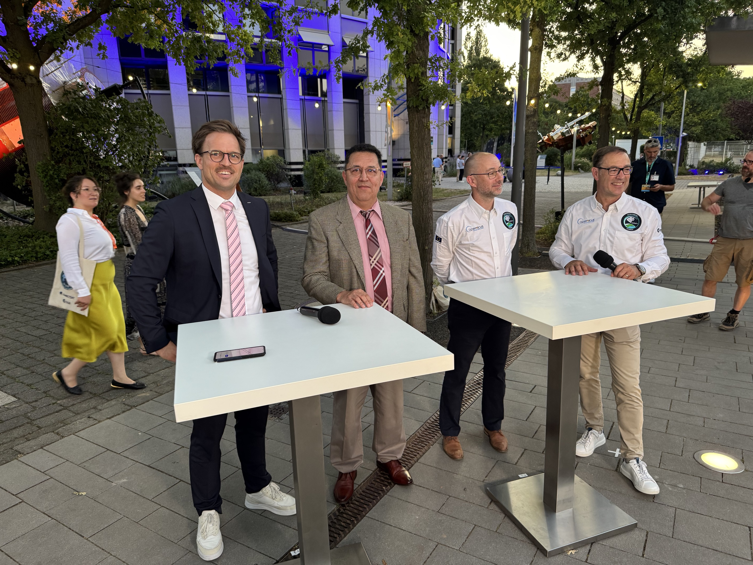
MTG-S1 / Sentinel-4A launch event, EUMETSAT July 1st
Herzlichen Dank Kelly!

