Slide 1

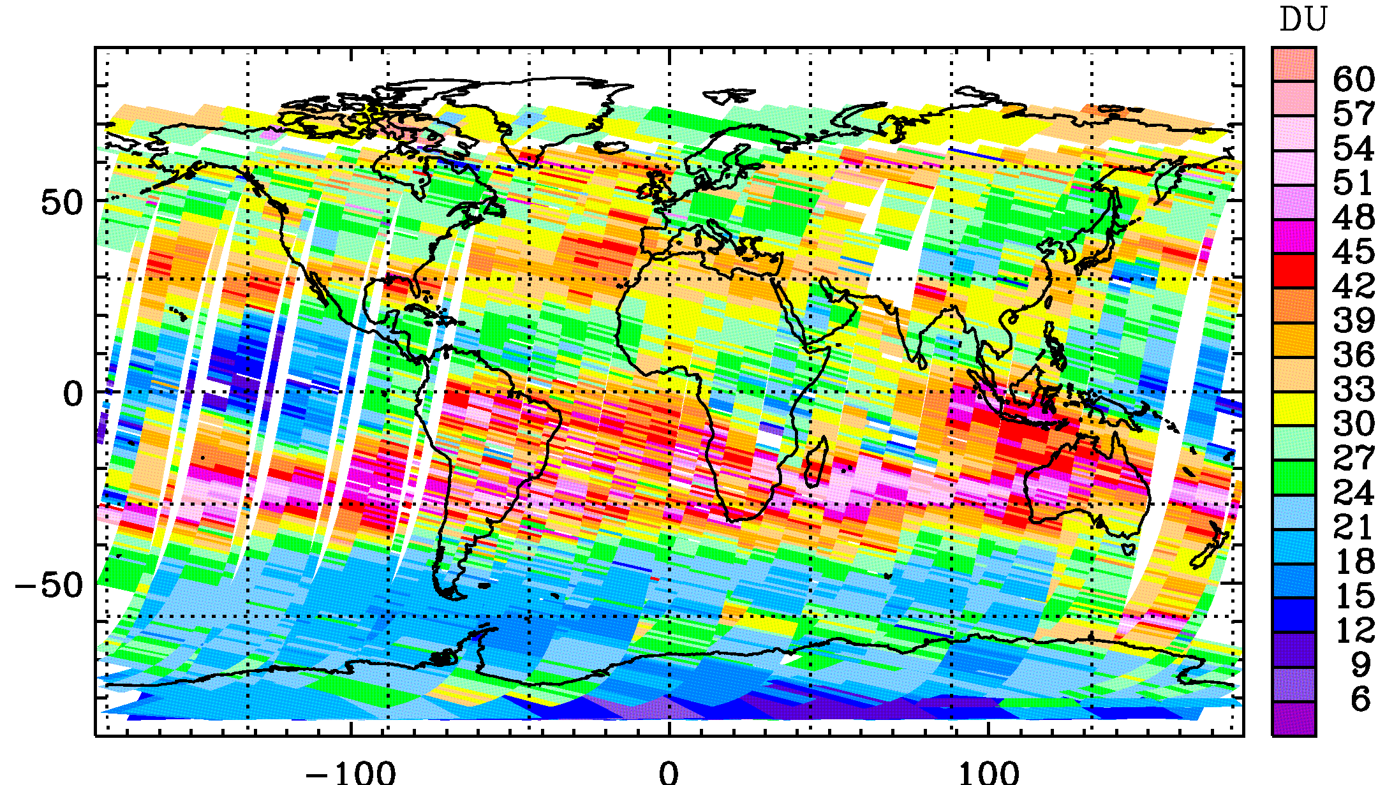
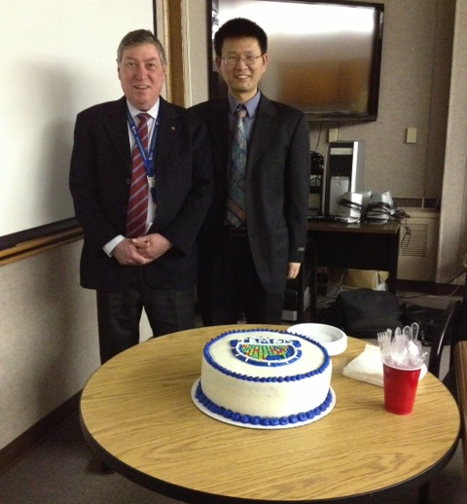
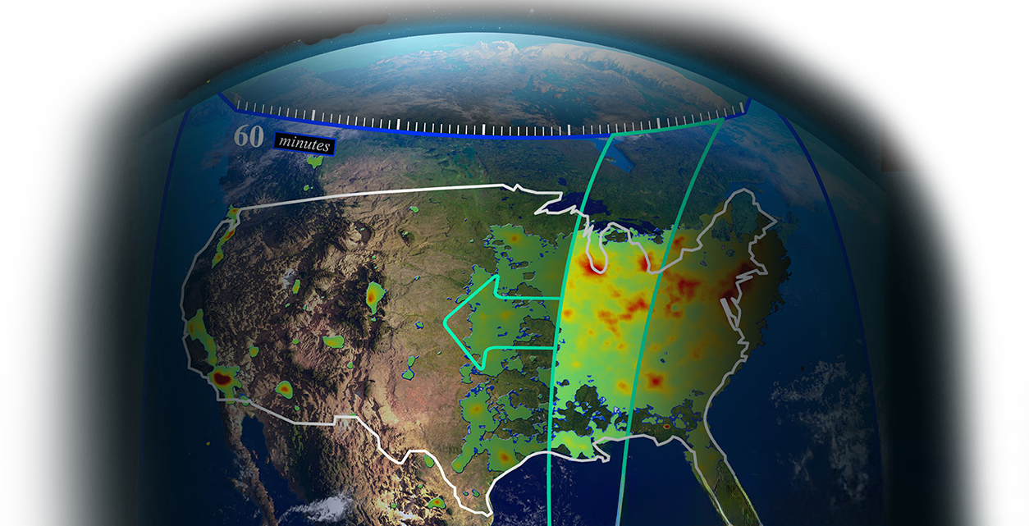

From Tropospheric Ozone Retrieval to TEMPO: Following in Kelly’s Footsteps
Tropospheric Emissions:
Monitoring of Pollution
GOME TrOC 10/22-24/1997
Xiong Liu
CfA | Harvard & Smithsonian
The Kelly Chance Symposium
CfA | Harvard & Smithsonian
August 18, 2025

Slide 2

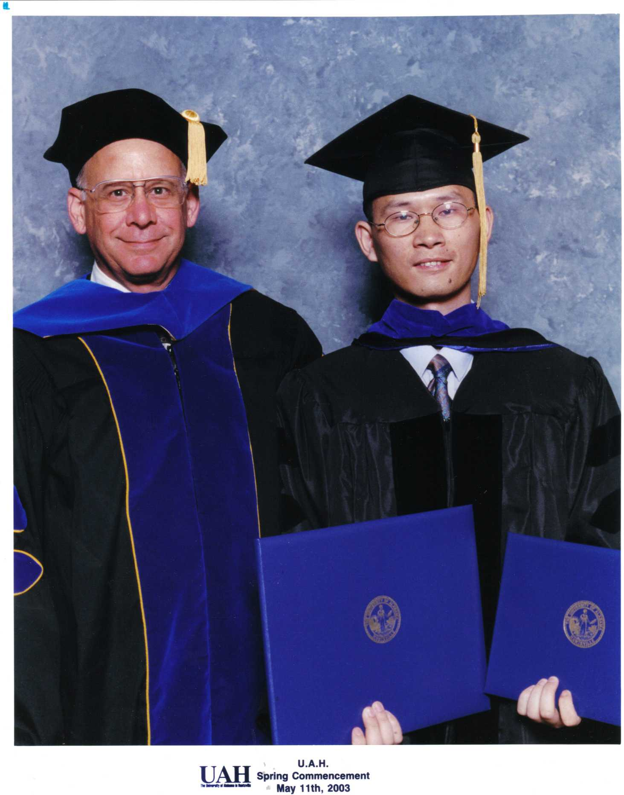
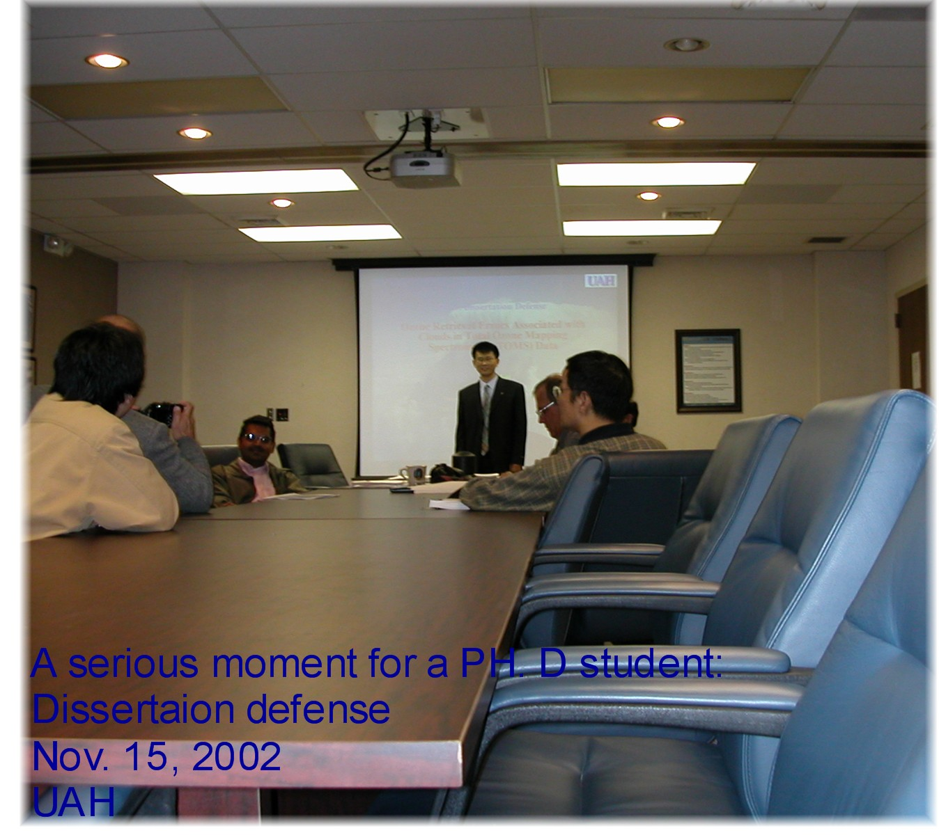
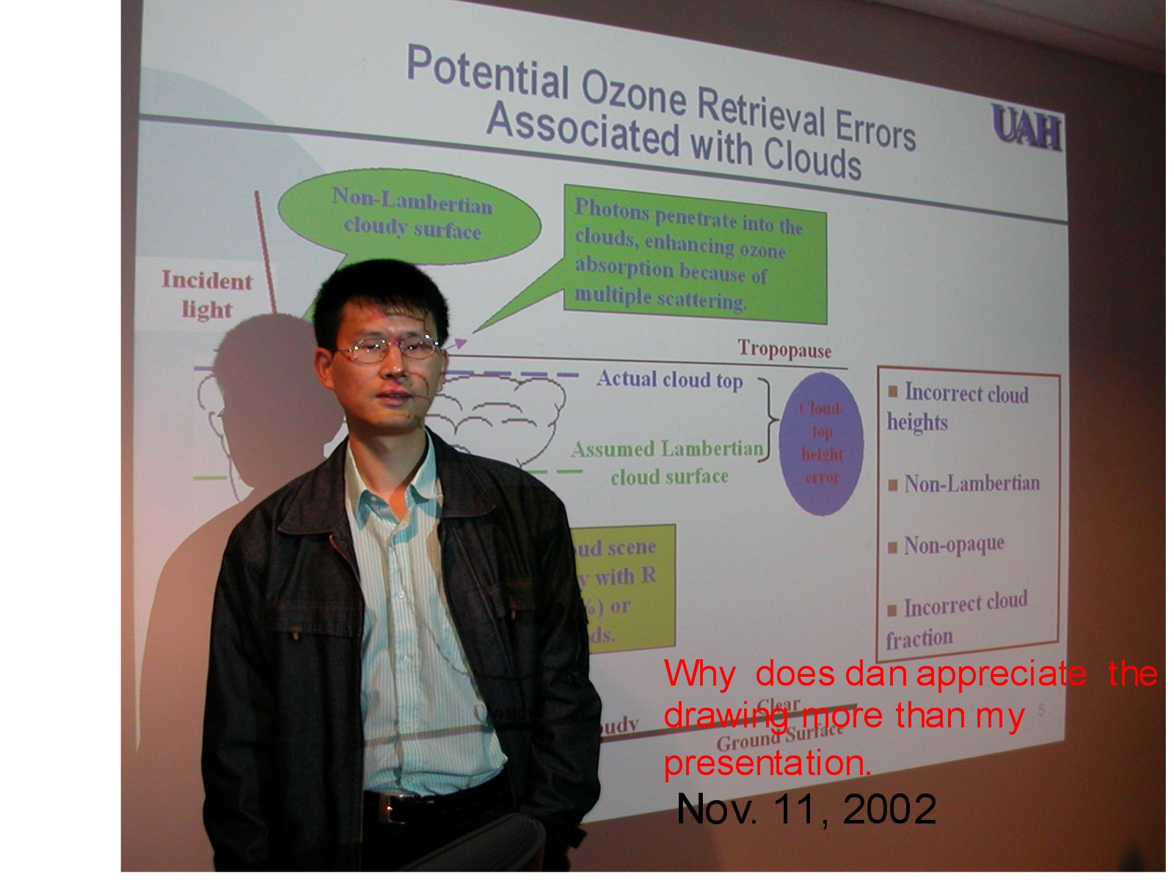
Introduction to My PhD
May 2023
Phd Dissertation: Newchurch et al., 2001a, Liu et al. (2003, 2004)
                Ozone retrieval errors associated with clouds in TOMS data
Topographic contrast to derive lower trop. O₃ (Newchurch et al., 2001b)
Contributed to Cloud-clear pair methods (Newchurch et al., 2003)
Aerosol radiative forcing and retrieval accounting for non-sphericity (Liu, Wang et al., 2003; Wang, Liu, et al., 2003)

Slide 3
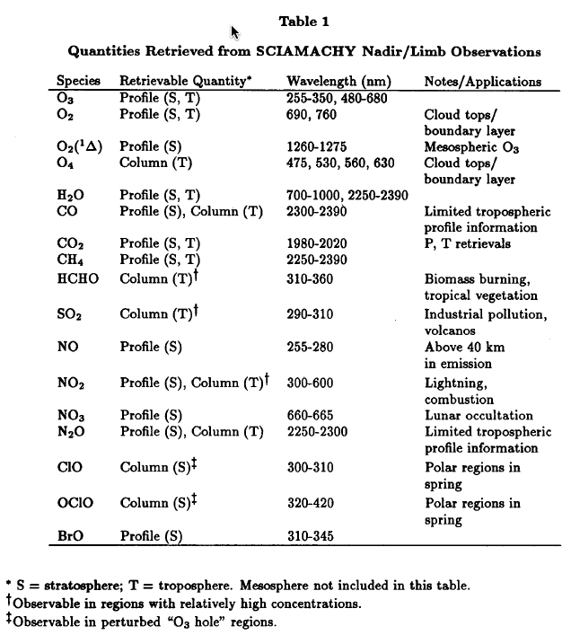
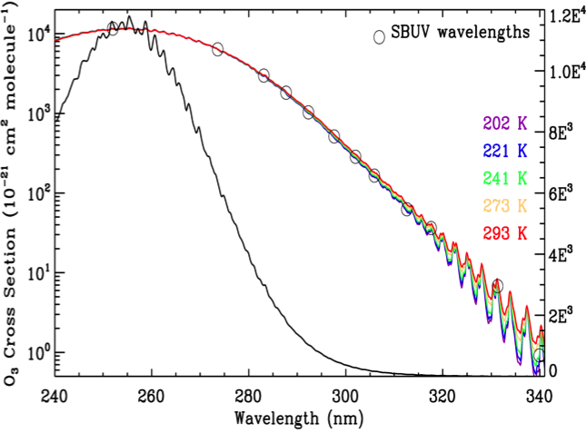
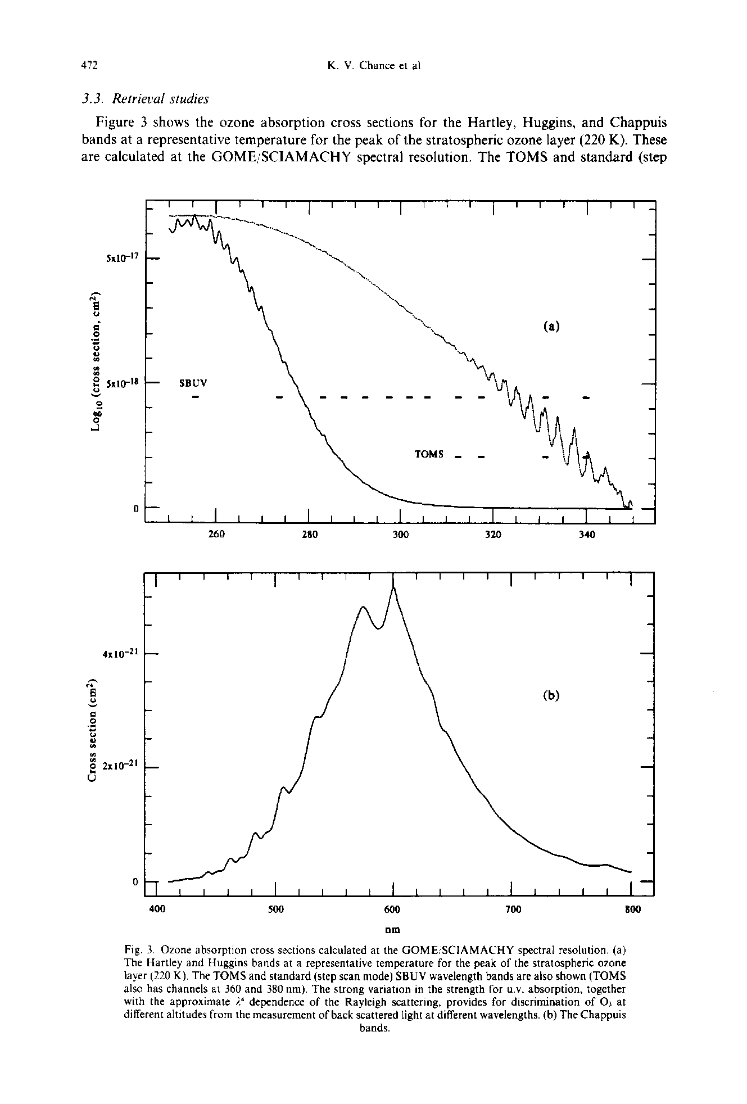
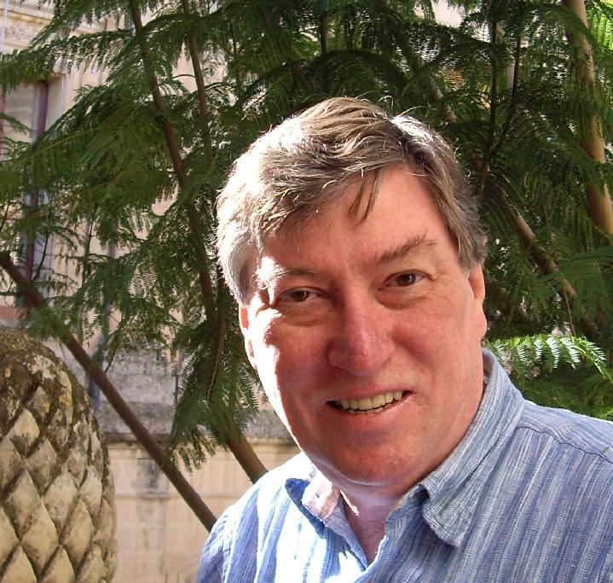
Retrievals of O₃ profile including trop. O₃ from BUV & VIS Measurements
Old Paradigm: BUV O₃ profile technique (Singer & Wentwrath, 1957; Mateer et al., 1971; Bhartia et al., 1996) cannot measure O₃ profile below the density peak, could not separate strat. O₃ from total O₃
Extend retrievals to the troposphere from backscattered UV and VIS spectra: Chance et al. (1991, 1997)
UV
VIS
T-depend. in Huggins bands
Photon penetration to the surface
Chance et al, Satellite measurements of atmospheric O₃ profiles, including tropospheric O₃, from UV/visible measurements in the nadir geometry: A potential method to retrieve tropospheric ozone, JQSRT, 1997
Chance et al, Retrieval and molecule sensitivity studies for the GOME & SCIAMACHY, SPIE, 1991.

Slide 4
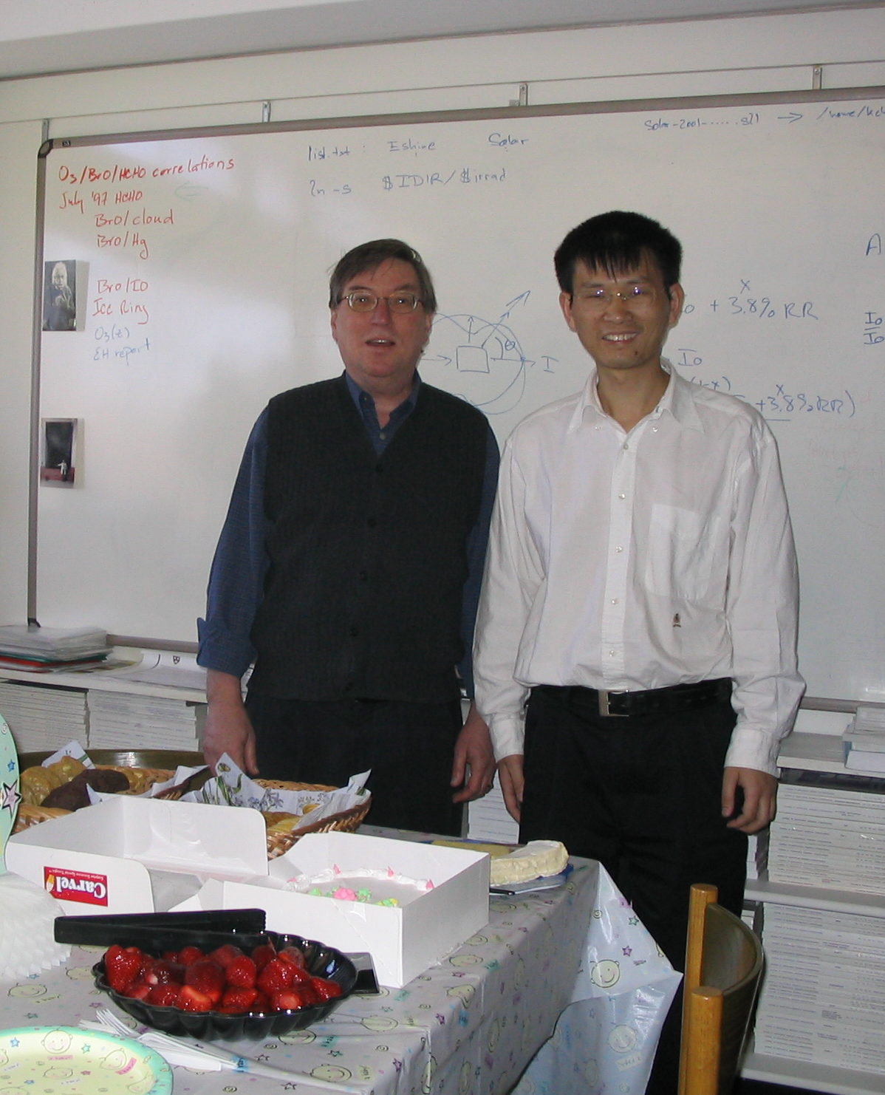
SAO Ozone Profile and Tropospheric Ozone Algorithm
Worked with Kelly since Feb. 2003
Several European groups developed O₃ profile algorithm from GOME: Munro et al., 1998; Hoogen et al., 1999, Hasekamp & Landgraph, 2001, Van Oss et al., 2002.
Adapt it from the OMI trace gas algorithm (Kurosu & Chance)
Spectral fitting with full radiative transfer model simulation (VLIDORT) (Spurr et al., 2001; 2002, 2004, 2006, 2008).
Fitting windows: 290-307, 325-340 nm (GOME), 270-330 nm (OMI)
Retrieve O₃ partial columns at 24 layers from surface to above 60 km
Ill-posed problem: non-linear optimal estimation (Rodgers, 2000) with ozone profile climatology (McPeters et al., 2007) to constrain retrievals
Y: Measurement vector (e.g., radiances)
  X, X_{i}, X_{i+1}: State vector (e.g. ozone profile)
  X_{a}: a priori state vector
  K : Weighting function matrix, sensitivity of radiances to ozone
  Sa: A priori covariance matrix
  Sy: Measurement error covariance matrix
Kelly: always available to help and provide hands on teaching: solar ref, wave. calibration, undersampling, Ring effect, cross sections, spectroscopy, numerical recipes, …
Also thanks a lot for help & discussions from Chris Sioris, Thomas Kurosu, Rob Spur et al.
Liu et al., 2005, JGR, Liu et al., 2010

Slide 5
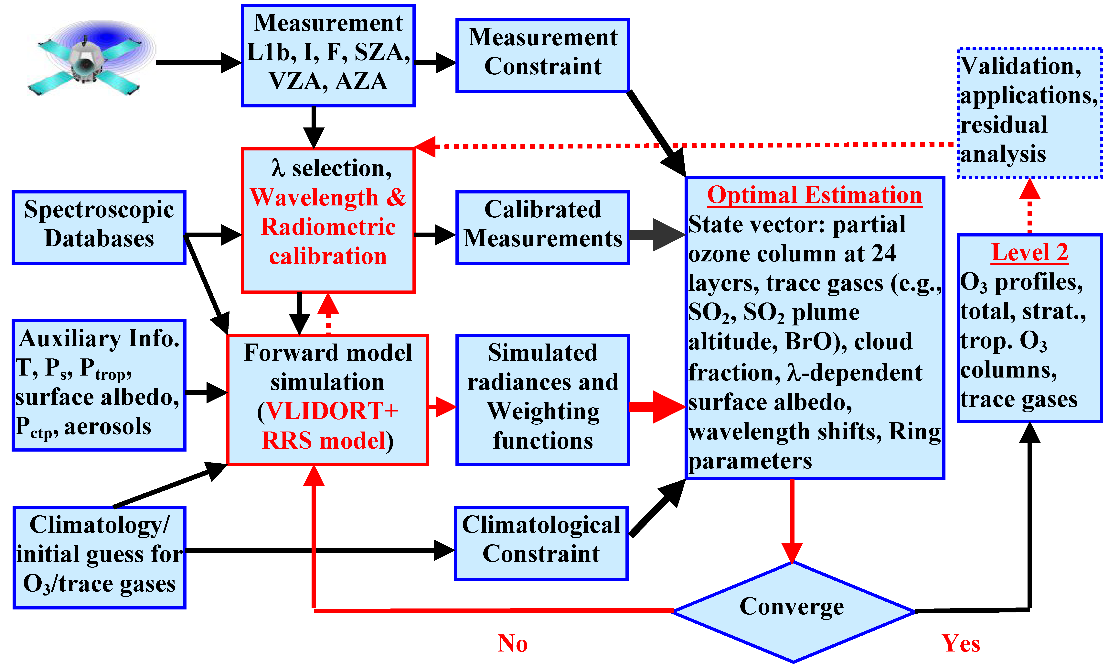
SAO Ozone Profile and Tropospheric Ozone Algorithm
Keys to successful retrievals: accurate calibration and forward model simulations, fit the measurements to better than 0.1-0.2% in the Huggins bands

Slide 6
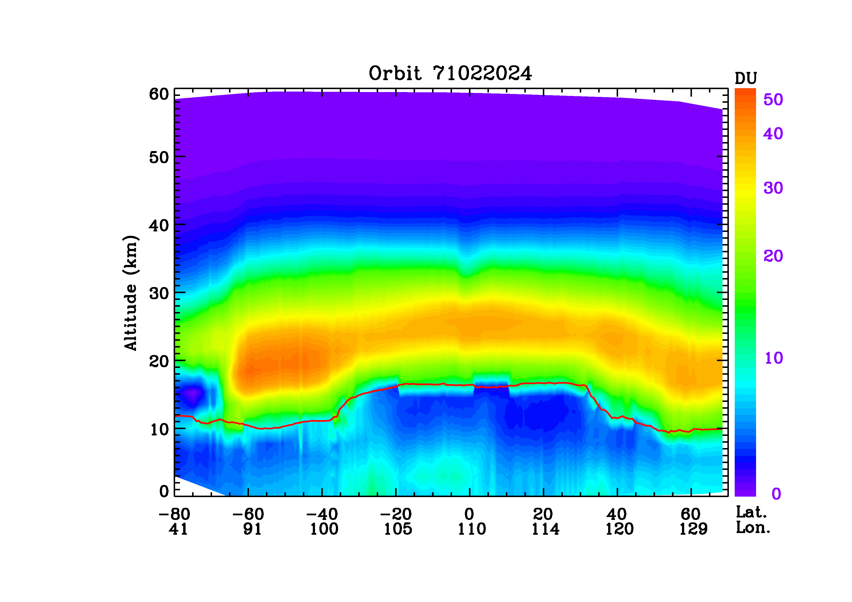
Examples of Ozone Profile Retrievals and Tropospheric Ozone Column (GOME,1997m1022-24)
24 ~2.5-km layers
4-6 tropospheric layers
Biomass burning over Indonesia
Ozone hole
Liu et al., 2005, Ozone Profile and Tropospheric Ozone Retrieval from Global Ozone Monitoring Experiment (GOME): Algorithm Description and Validation, JGR
Zonal contrast in the tropics
Biomass burning over Indonesia

Slide 7
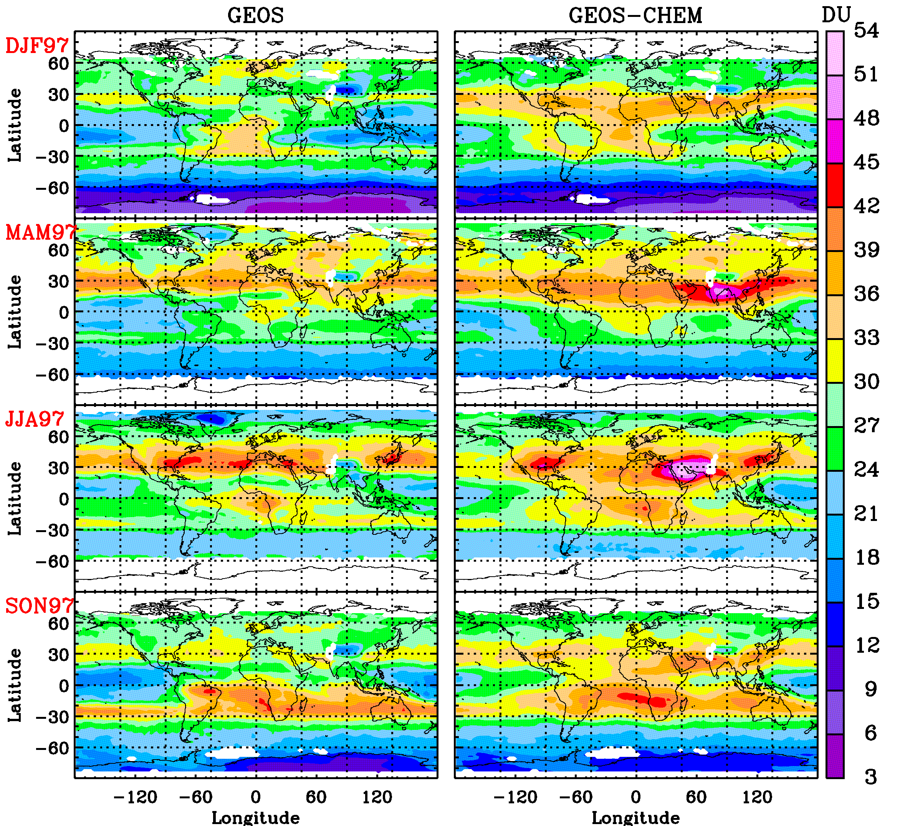
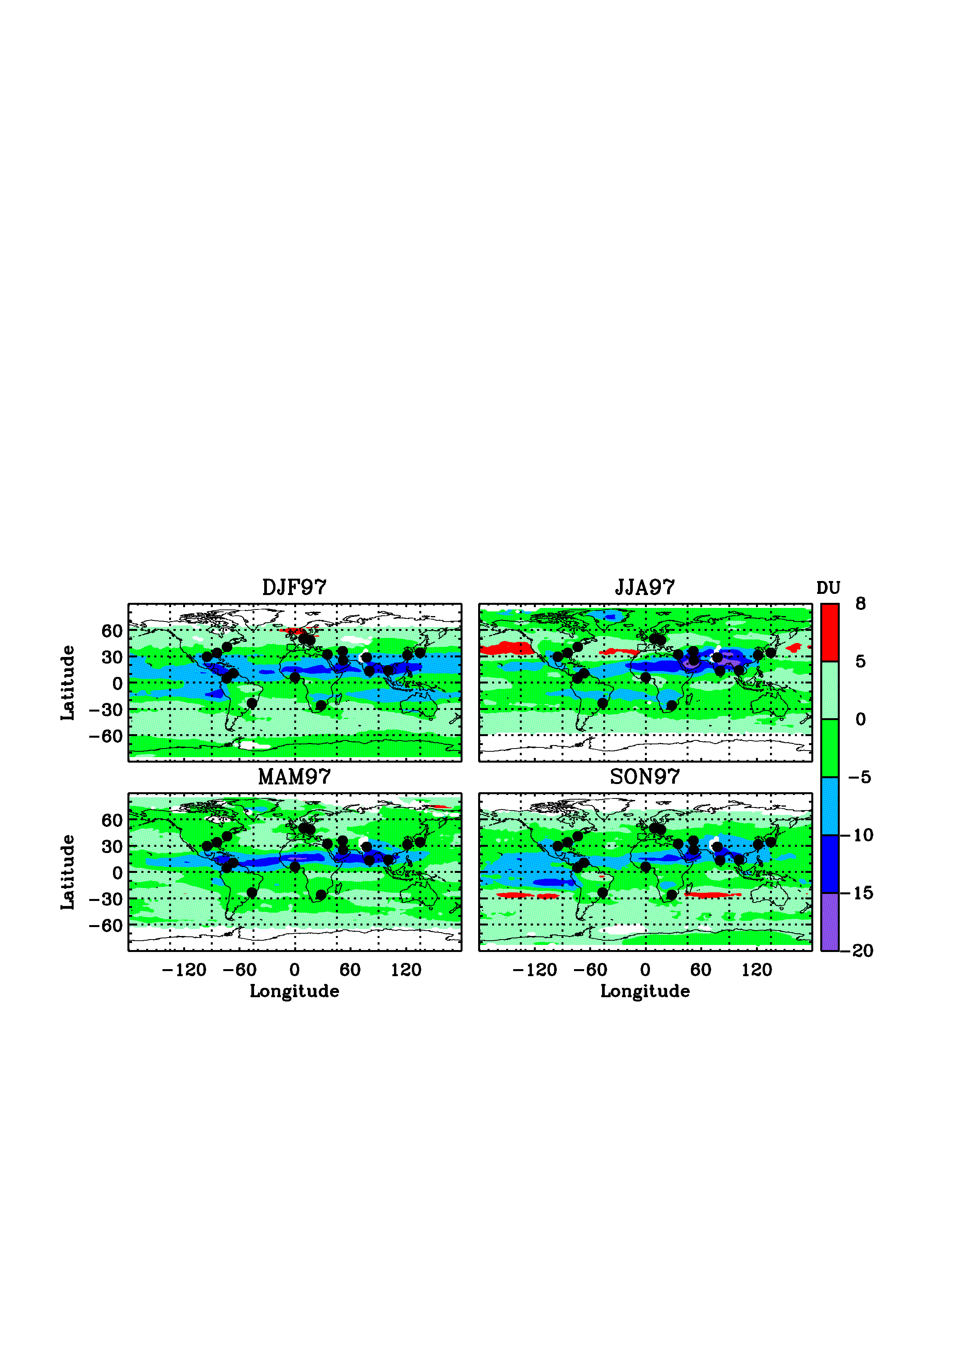
GOME vs. GEOS-Chem (Dec. 96-Nov. 97)
GOME
GEOS-Chem
GOME minus GEOS-CHEM
GEOS-Chem shows biases of +(5-15) DU over some northern tropical and subtropical regions.
GOME are consistent with MOZAIC except for inadequate capture of enhanced lower trop. O₃ (DJF North Africa, MAM Southeast Asia) due to reduced sensitivity and the improper a priori O₃ profile.
Similar overall structures, global mean biases: <2±4 DU, r=0.82-0.9
SH: <1±2 DU, r=0.94-0.98
NH: <4.3±4.6 DU, r=0.6-0.8
Liu et al., 2006, First directly-retrieved global distribution of tropospheric column ozone: comparison with the GOES-CHEM model, JGR

Slide 8
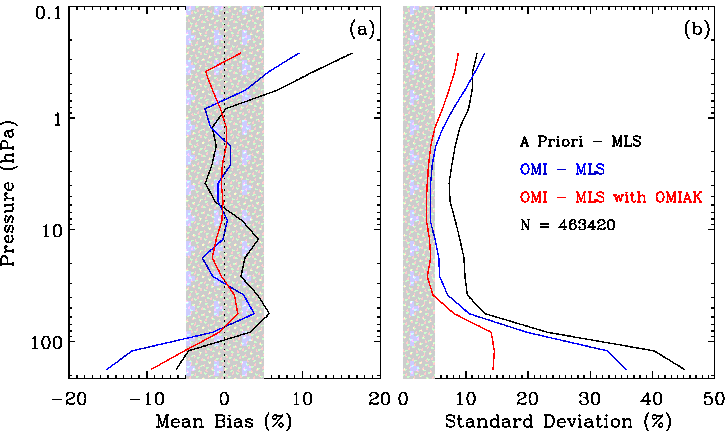
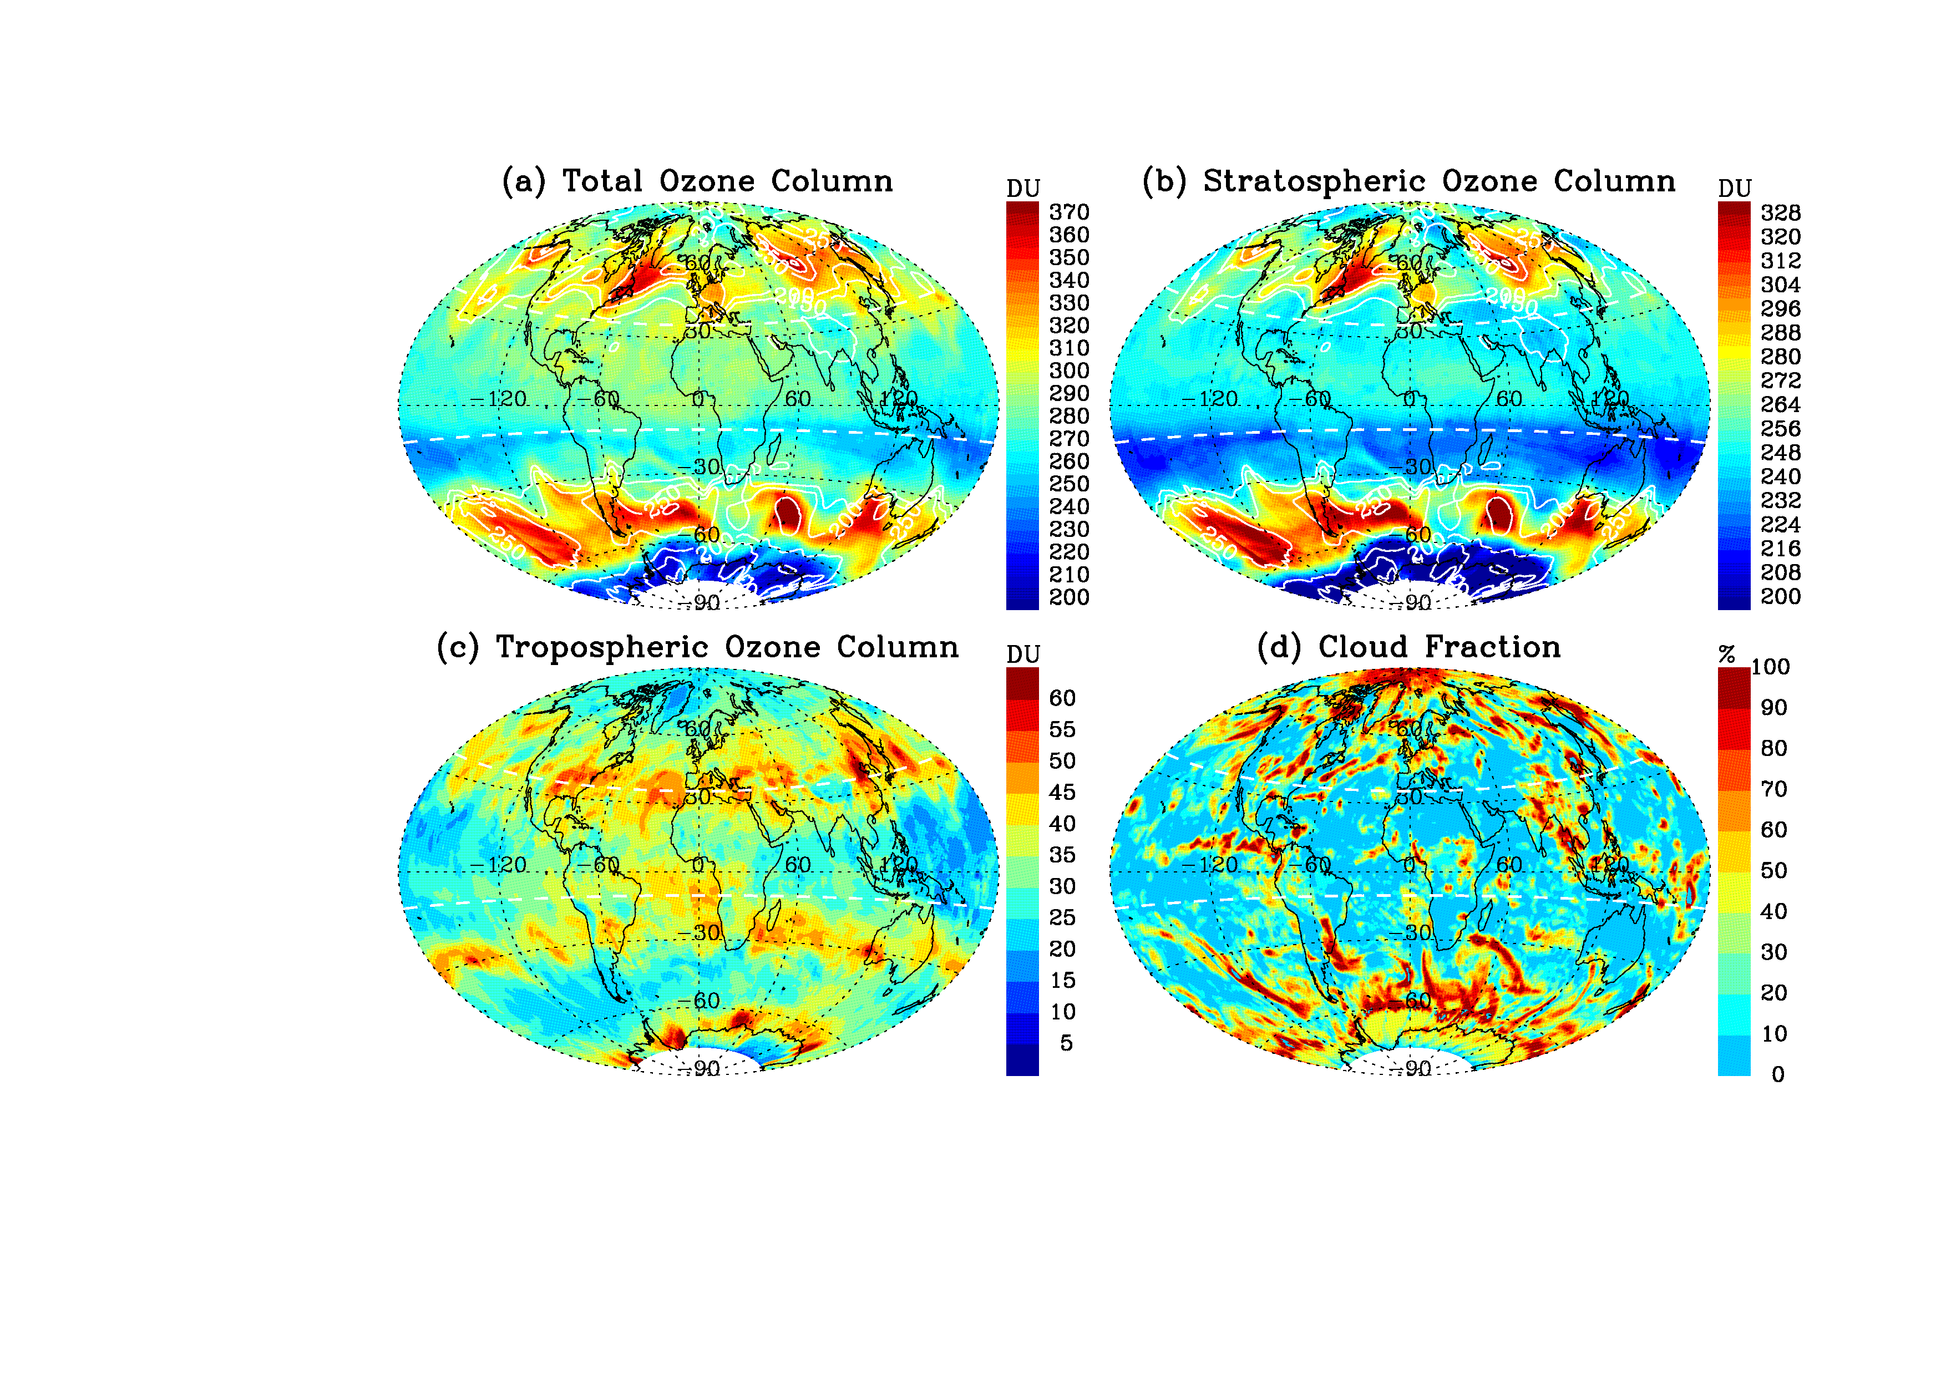
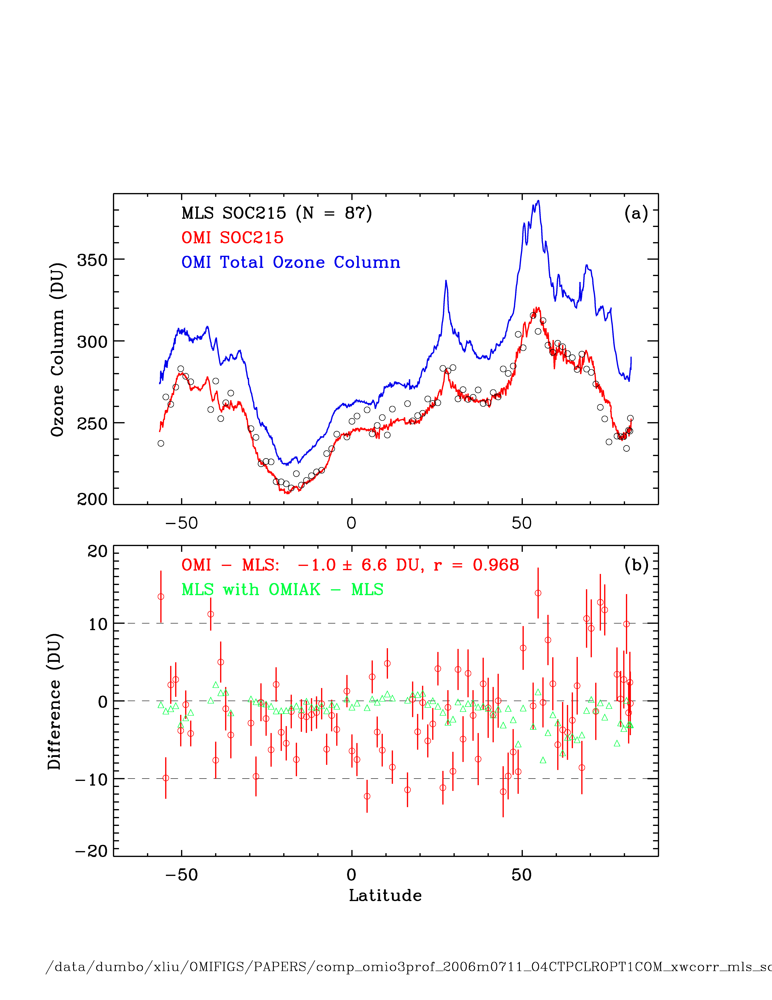
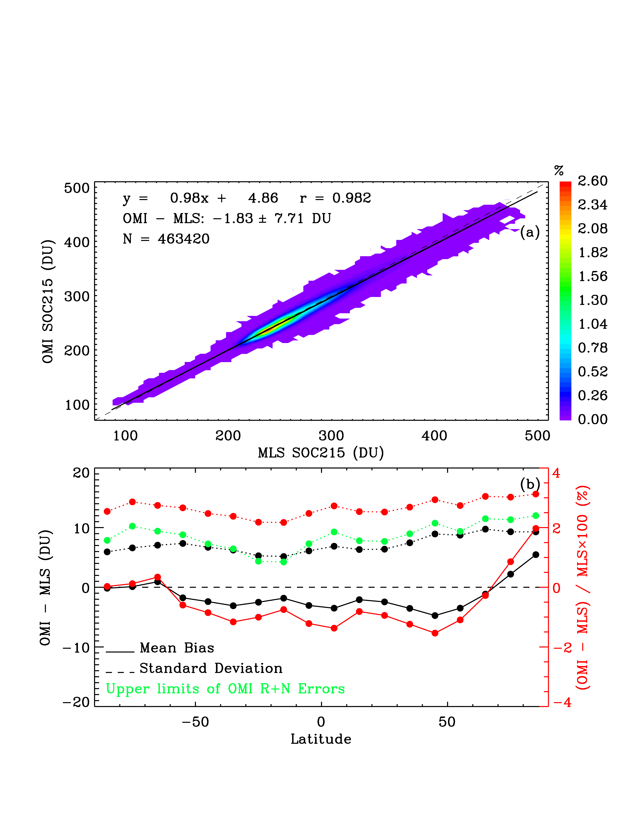
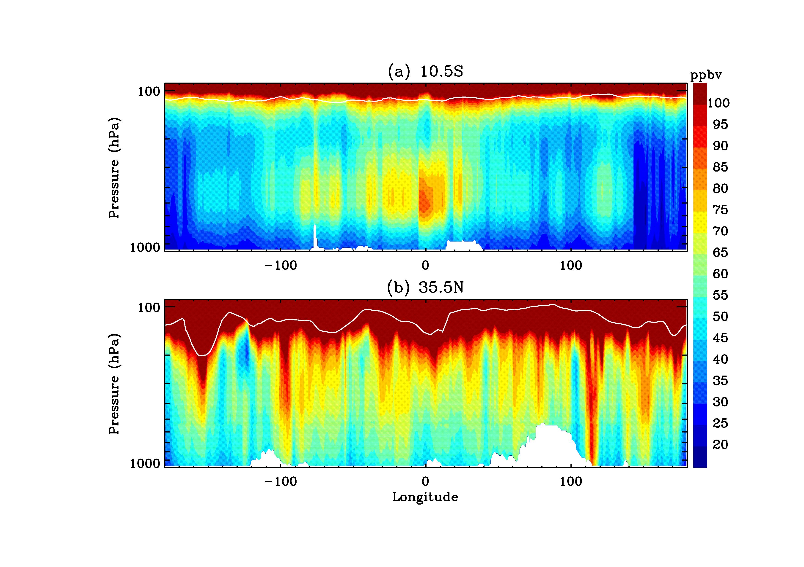
Examples of Retrievals (OMI, 2006m0826) and Validation Against MLS
Stratospheric ozone column can be accurately derived from OMI data alone!!!
Liu et al., 2010a, b

Slide 9
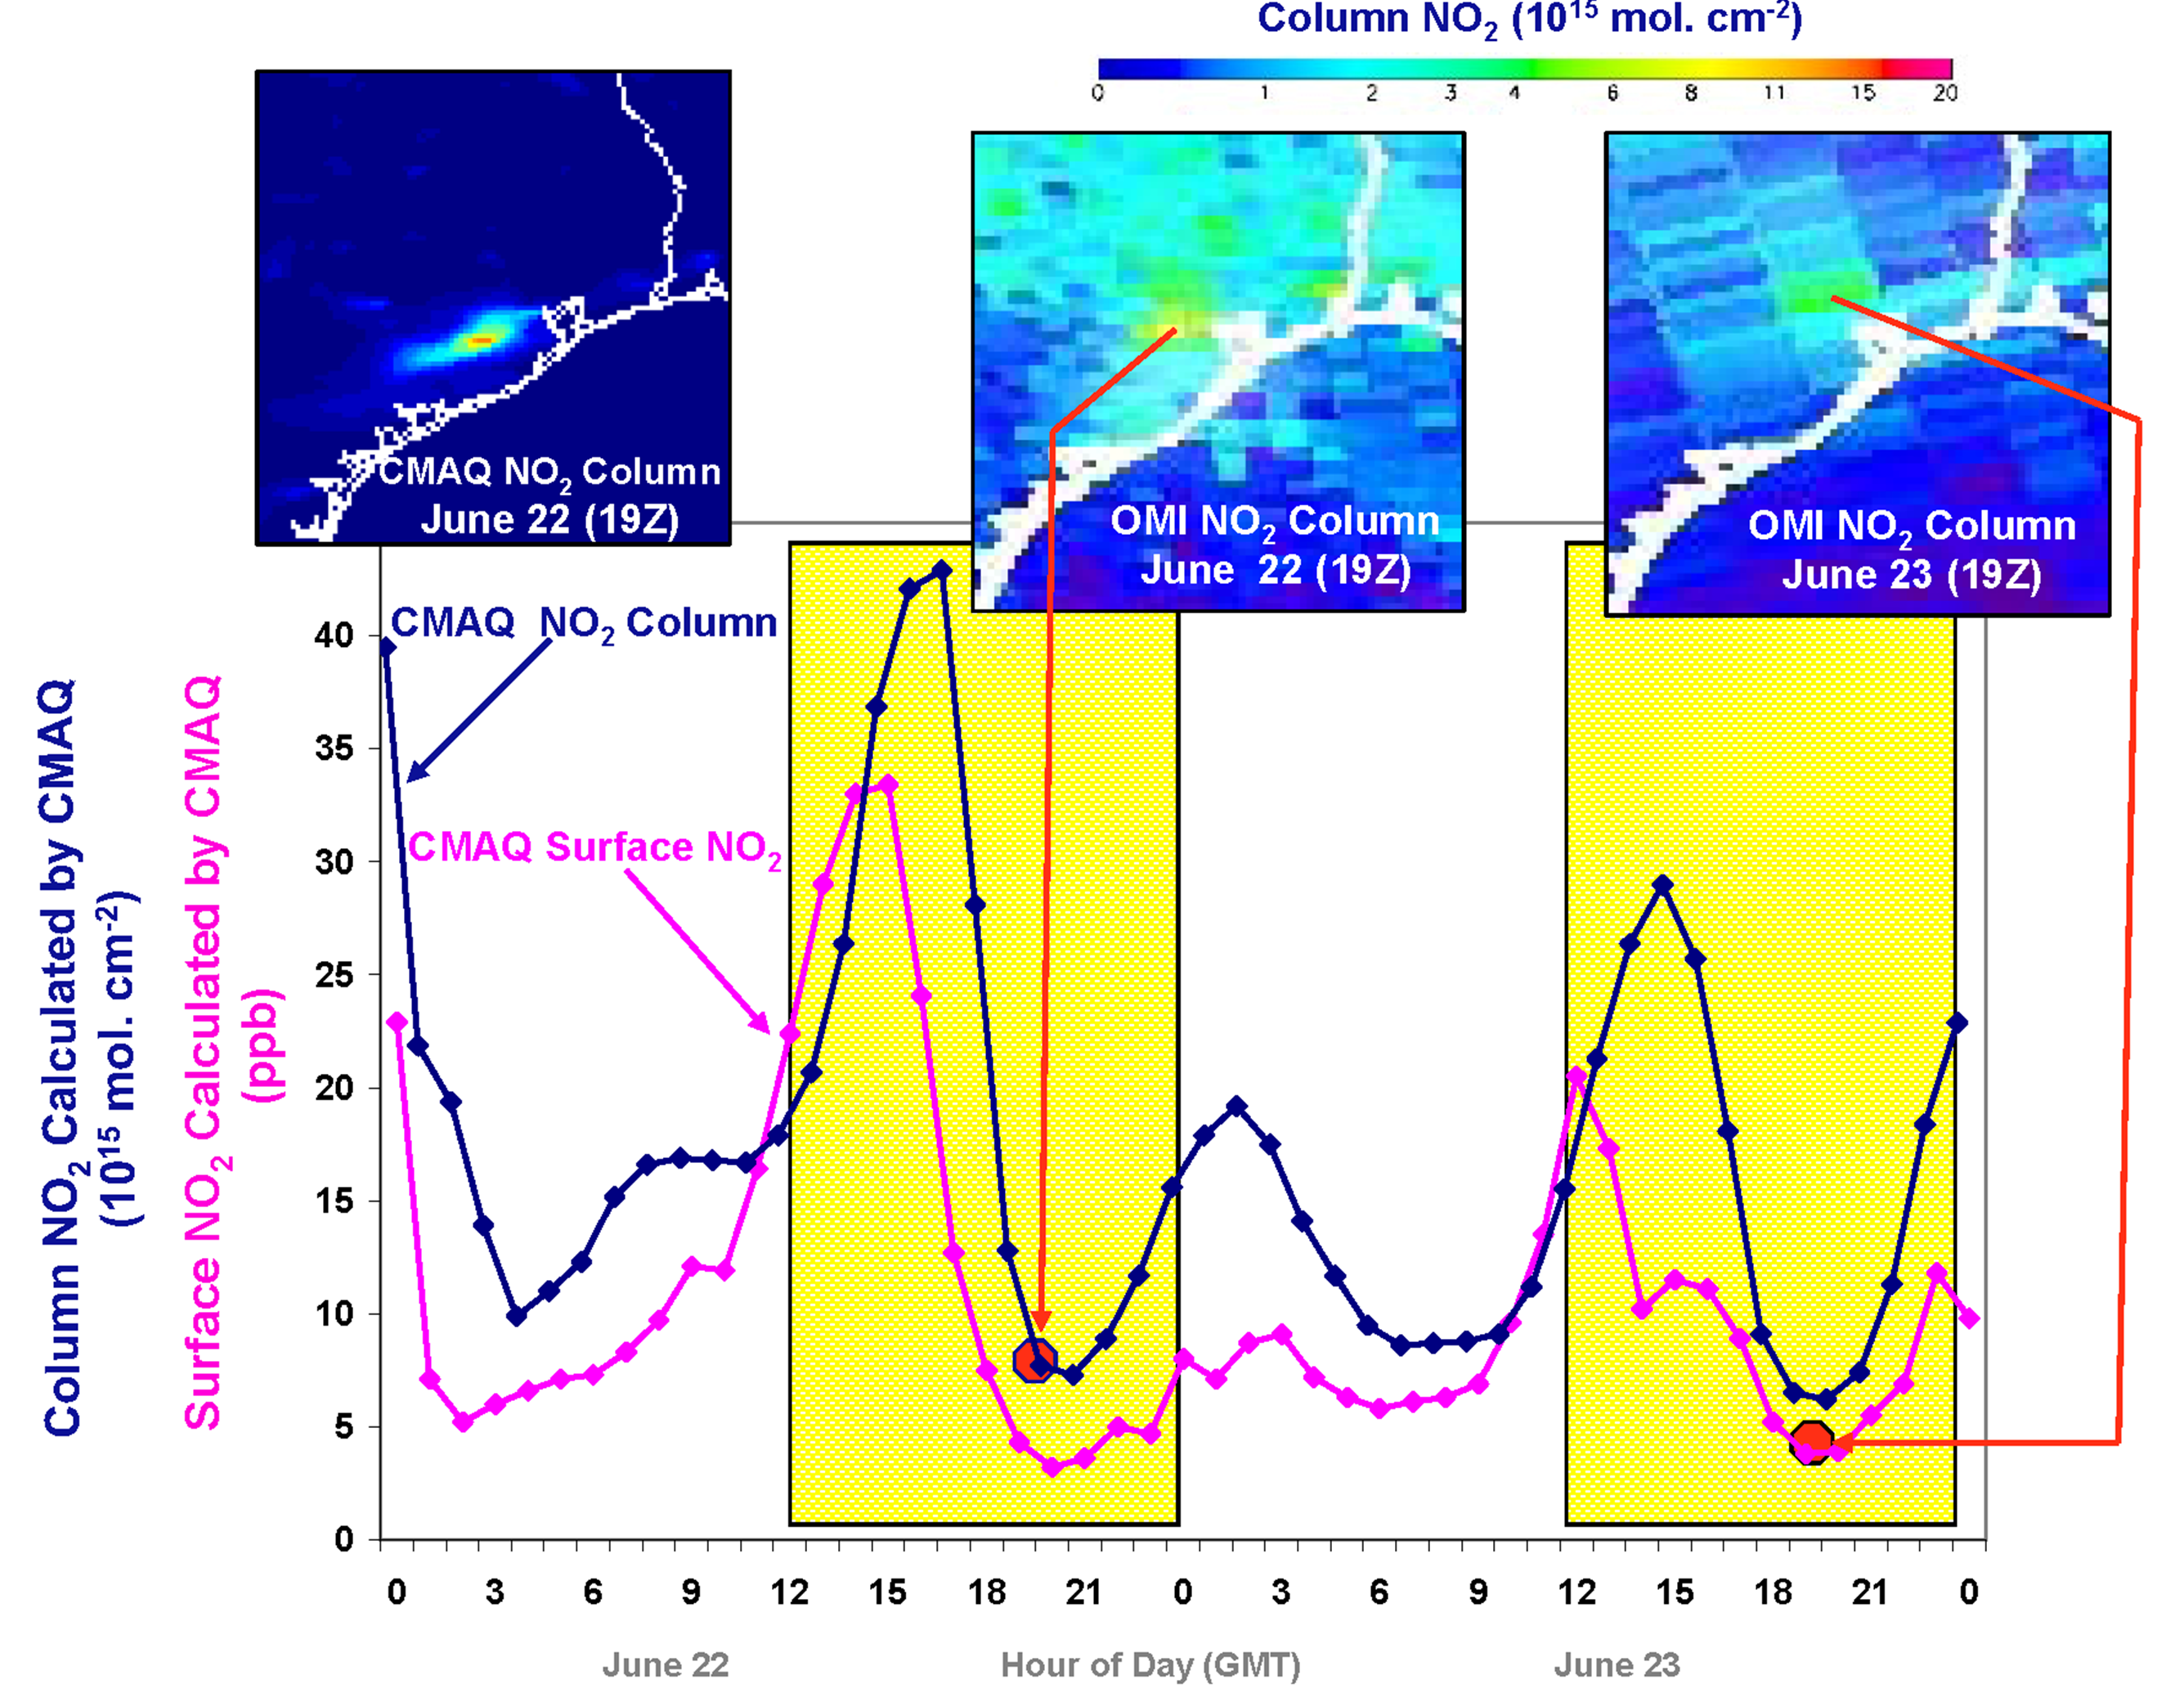
Why geostationary?
High temporal and spatial resolution
Hourly NO₂ surface concentration and integrated column calculated by CMAQ air quality model: Houston, TX, June 22-23, 2005
[Fishman et al., 2008]
June 22
Hour of Day (UTC)
June 23
NRC’s 2007 Earth Science Decadal Survey recommended Geostationary Coastal & Air Pollution Events (GEO-CAPE) mission: GEO-CAPE mission studies (2009-2018)
GEO will provide observations at temporal and spatial scales highly relevant to air quality processes
South Korea started to plan for GEO AQ (GEMS) mission in 2009.

Slide 10


Required Concentration Precisions for
GEO-CAPE Air Quality Measurements*
Molecule | Vertical Column [mol cm⁻²] | Sensitivity Driver
O₃ | 2.4×10¹⁶ | Hourly for SZA ≤ 70º ~10 ppbv in PBL; reality (profiling) is more complicated
NO₂ | 3.0×10¹⁵ | Hourly for SZA ≤ 70º Distinguish background from enhanced/polluted scenes
SO₂ | 1.0×10¹⁶ | 3/day for SZA ≤ 50º Identify major pollution and volcanic emissions
HCHO | 1.0×10¹⁶ | 3/day for SZA ≤ 50º Observe biogenic VOC emissions, expected to peak at midday
CHO-CHO | 4.0×10¹⁴ | 2/day for SZA ≤ 50º Track urban and fire emissions
Chance et al., 2010,
1st GEMS Workshop
*In PBL @ 8×8 km² resolution
BrO, OClO, and IO will also be measured well!
10

Slide 11

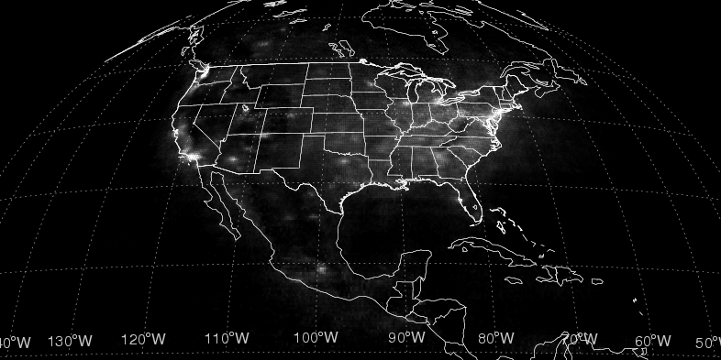

Scalable Strawman
North American Version
Quantitatively developed from
the measurement requirements,
using the current capabilities
we have developed
Geostationary Minimal Case
11

Slide 12
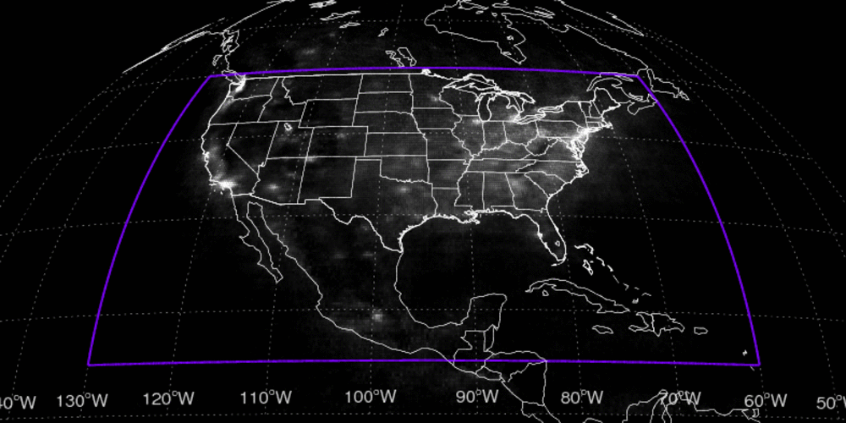
Scalable Strawman
North American Version
15º - 50ºN, 60º - 130ºW (parked at 0˚N, 95˚W)‏
SZAs ~ 0˚– 70˚
VZAs ≤ 57˚
Spatial resolution 8×8 km² footprints
Sampling every 60 minutes
12

Slide 13
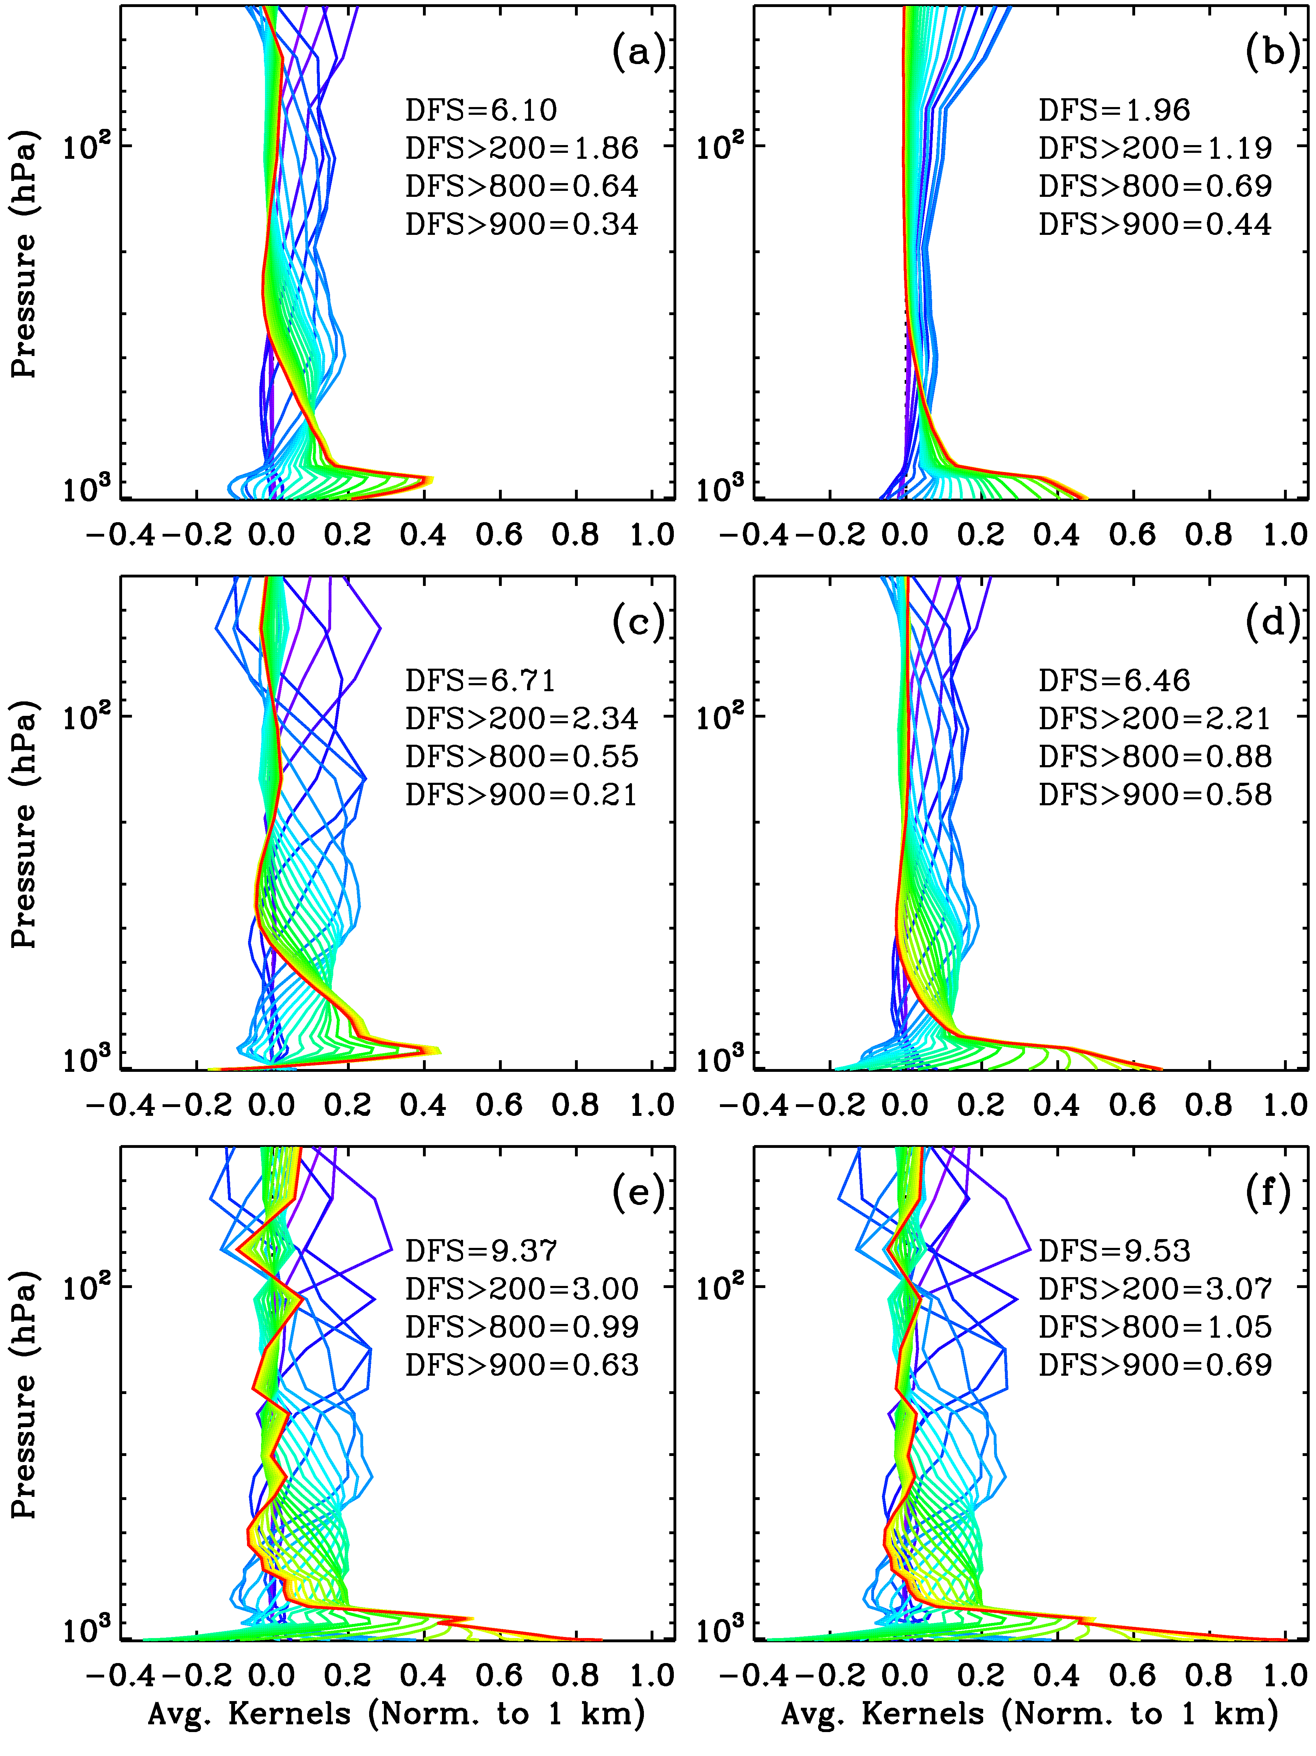
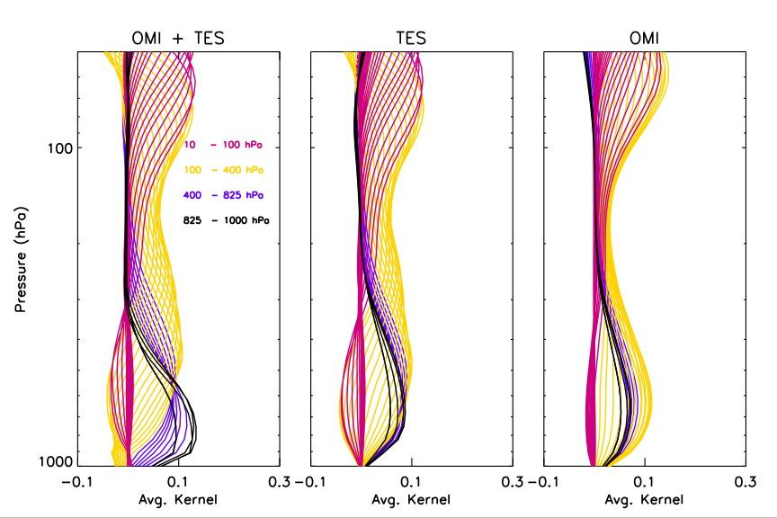
GEOSCAPE Multispectral Studies to Improve Tropospheric O₃ Retrievals
UV + VIS + +MIR + TIR + UV/Vis. Polarization?
Multispectral retrievals: Combine UV with VIS/TIR radiances can significantly improve sensitivity to O3 in the lower troposphere (Natraj, Liu et al., 2011)
OMI + TES (Worden, Liu et al., 2007)
OMI/TES, Fu et al., 2013
OMI/AIRS, Fu et al., 2018
GOME-2/IASI, Cuesta et al., 2013

Slide 14
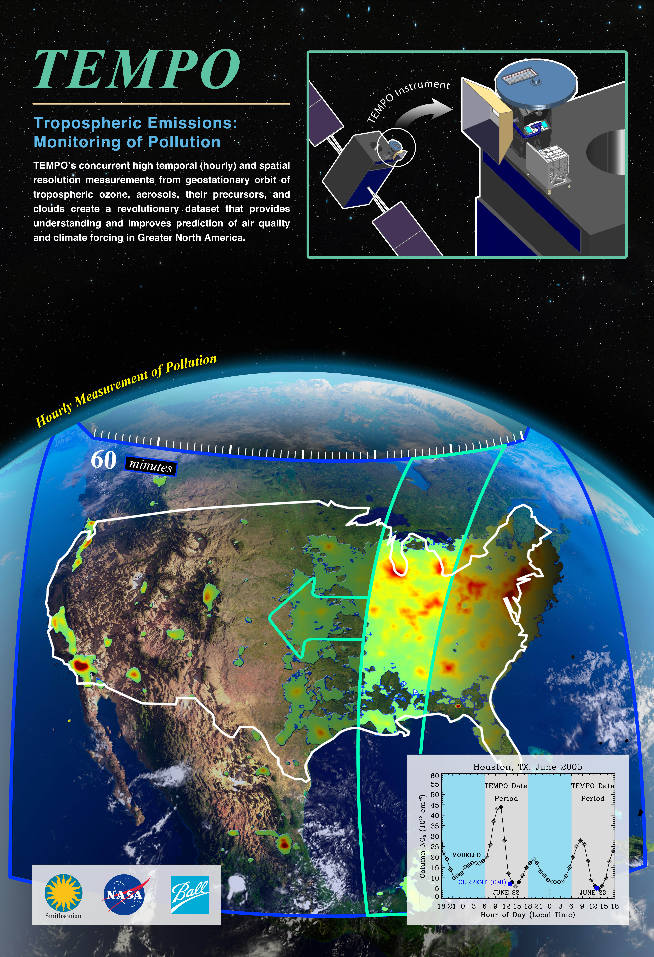
Visible for TEMPO &
Retrieval Sensitivity Studies
The inclusion of visible is driven by the need to improve retrieval sensitivity to lower tropospheric ozone, although also very useful for:
  Aerosol layer height and visible AOD
  Improved cloud retrieval
  SIF, GPP, vegetation, ocean color
  …
Perform retrieval sensitivity studies for O3 and other trace gases to define instrument requirements and assess instrument performance
  ~90,000 GEOS-Chem scenarios (12 days, 1 day/month)
  Optimal estimation approach

Slide 15
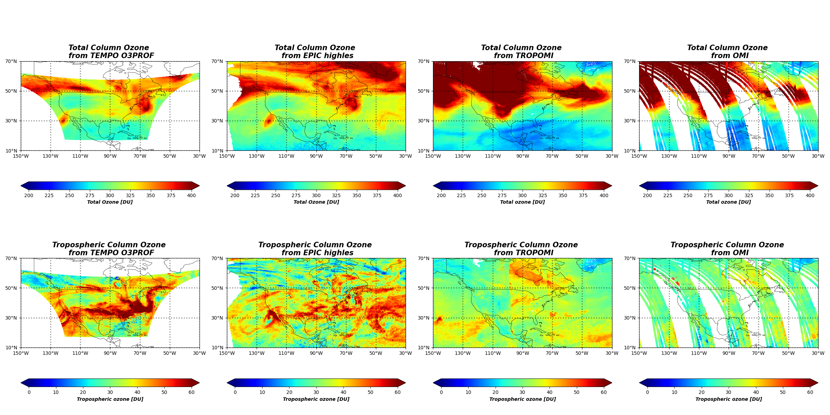
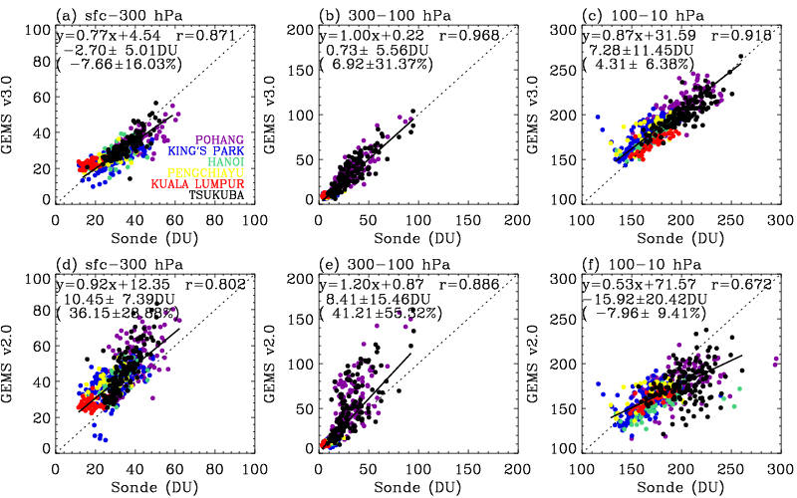
Ozone Profile Retrievals
from OMI to TEMPO/GEMS
Worked with Juseon (Sunny) Bak on improving OMI ozone profile retrievals (Bak et al., 2012; 2013a,b; 2015, 2016, 2017, 2019a, 2019b, 2020, 2021, 2022, 2024, 2025a, b, c, d)
A significantly improved V2 OMI PROFOZ (Bak et al., 2024) is being produced at OMI SIPS.
V2 OMI PROFOZ have been adapted to TEMPO and GEMS.
Junsung Park: TEMPO V4* UV Only retrievals (to be released to the public in September)
Future UV/Vis. retrievals: surface albedo characterization, UV/Vis. radiometric calibration accuracy and UV/Visible consistency, cross sections
Bak et al., GEMS ozone profile retrieval: impact and validation of version 3.0 improvements, AMT, under view

Slide 16
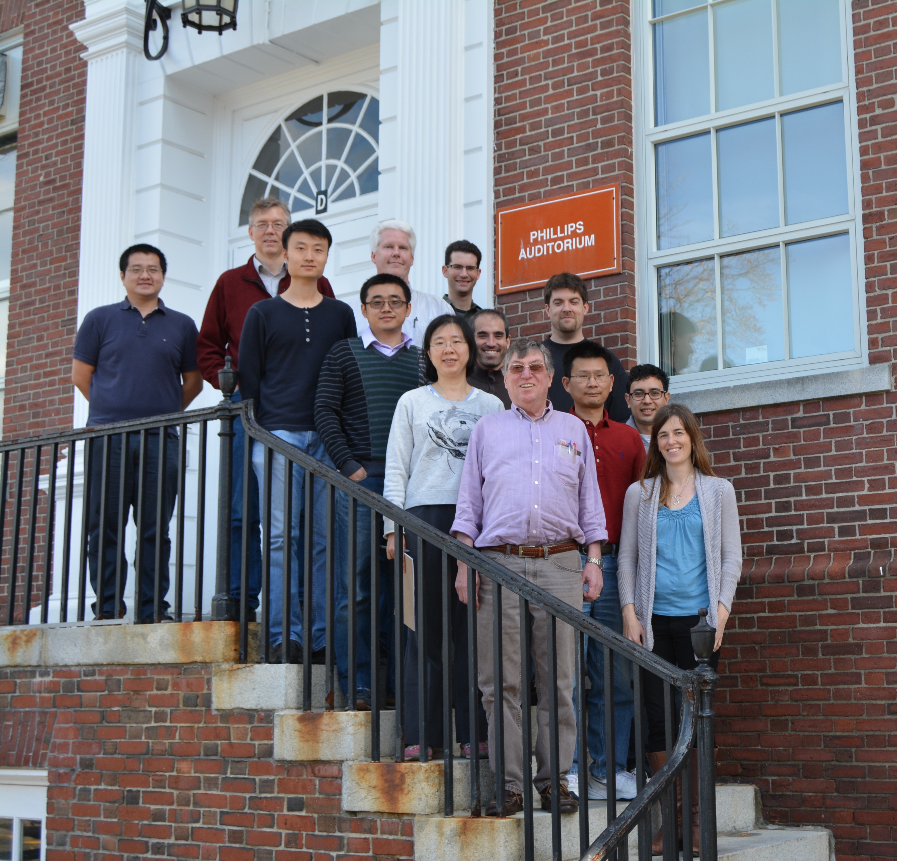
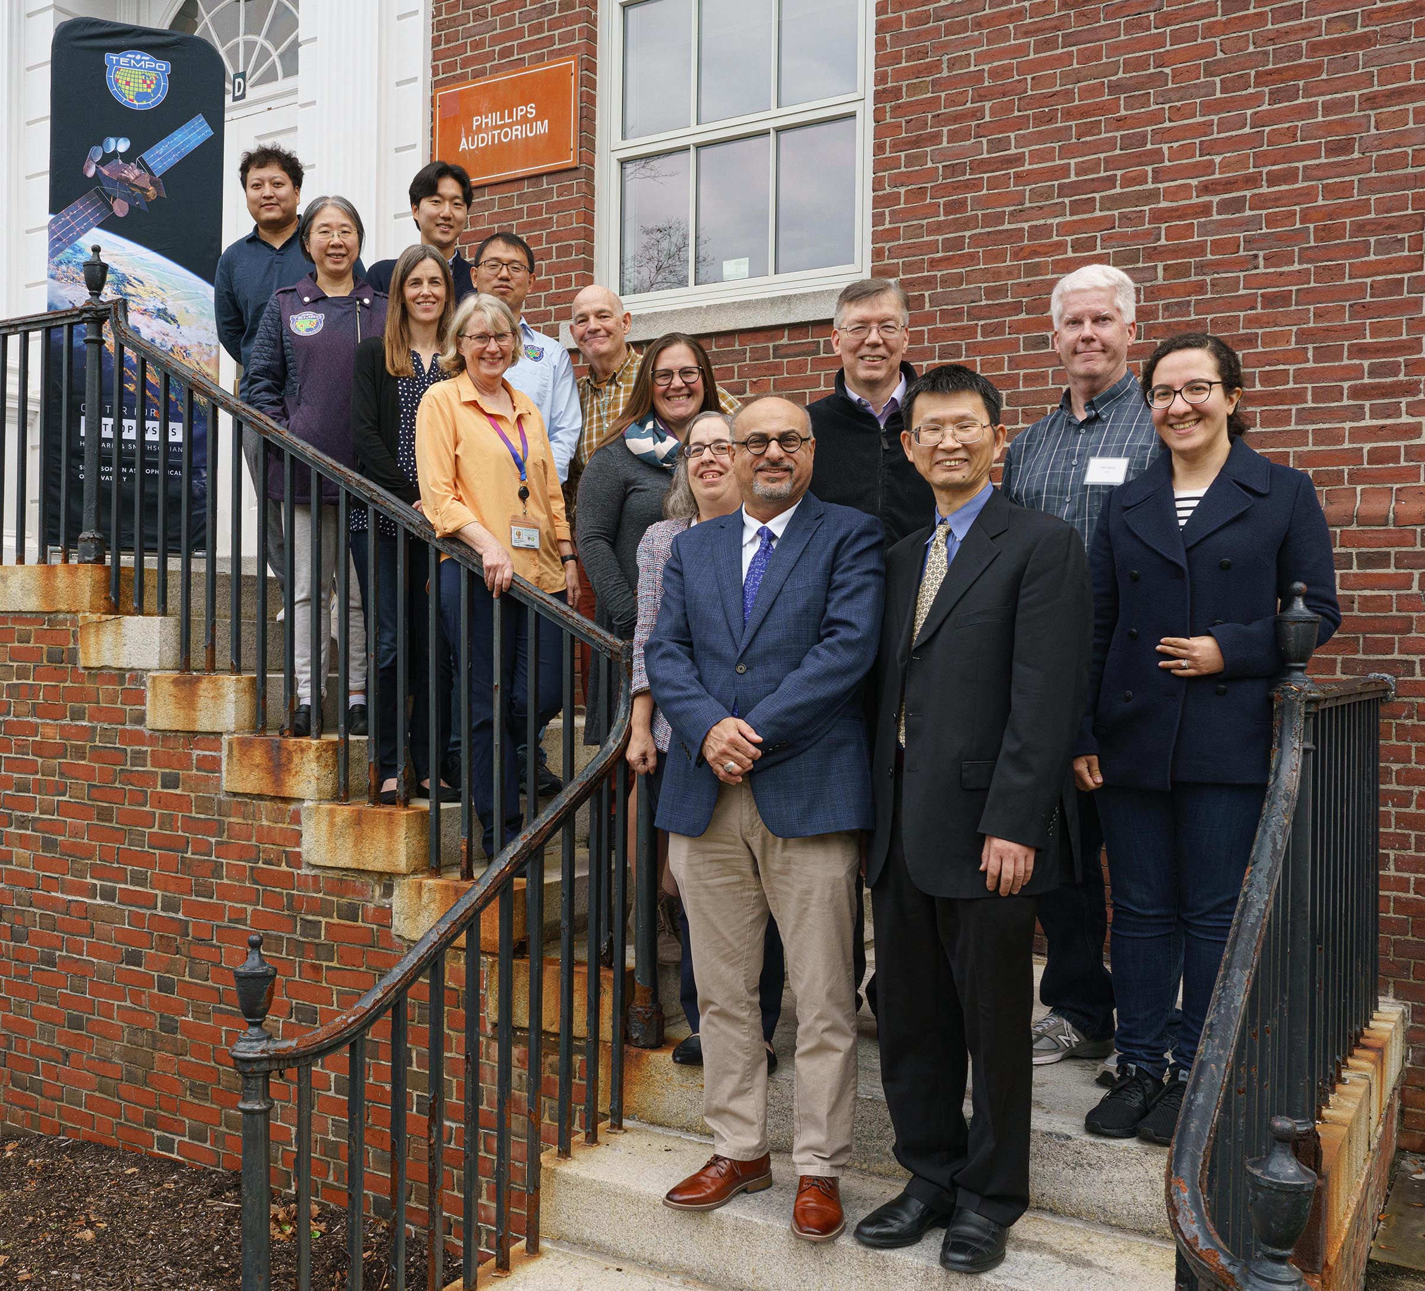
Thank you so much, Kelly!

