Slide 1


GOME formaldehyde: my gateway into tropospheric chemistry
Or: how Kelly influenced my career
Paul Palmer

Slide 2
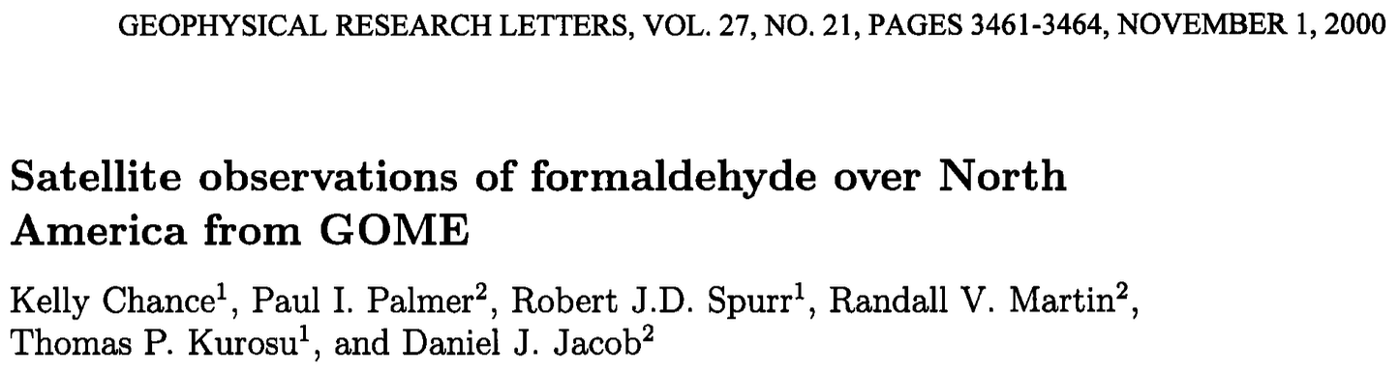
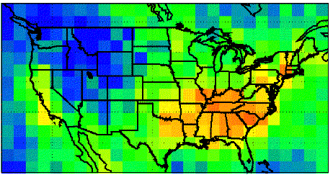
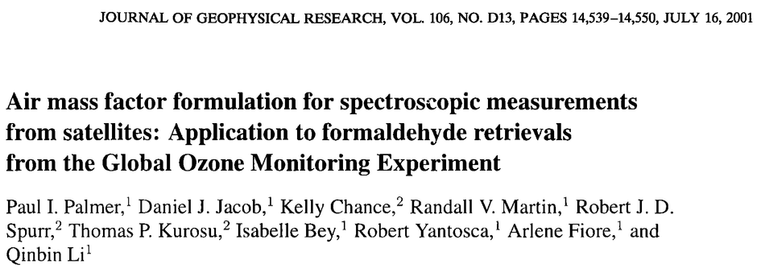
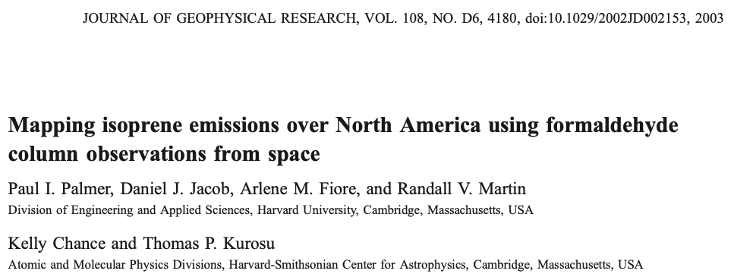

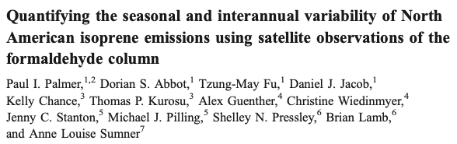

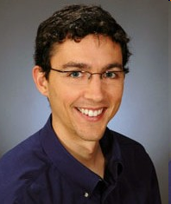
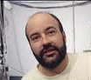


Atmospheric formaldehyde…wait, what?!
July 1996
[10¹⁶molec cm⁻²]
HCHO fitted in UV (~340 nm)
Spatial resolution: 320 x 40 km²
July 1996

Slide 3
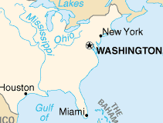
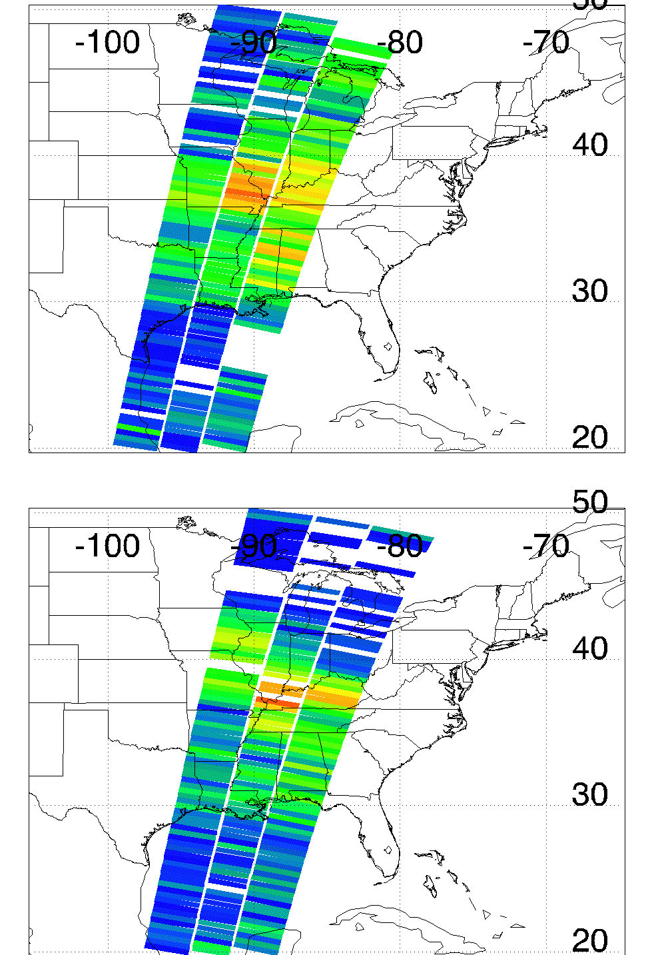
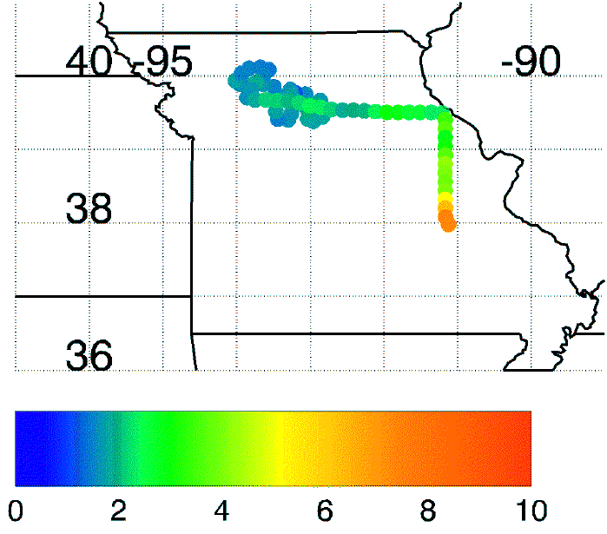

The Ozarks isoprene “volcano”
Dissected plateau - 129,500 sq km
Oak trees – good isoprene emitters
Aircraft data @ 350 m during July 1999
GOME
July 7 1996
Illinois
Missouri
c/o Y-N. Lee, Brookhaven National Lab.
Kansas
OZARKS
[ppb]
July 20 1996
“Trees cause more pollution than automobiles do.”
Notes:
Greece 132 000 Km2
Nicaragua 130 000 Km2

Slide 4
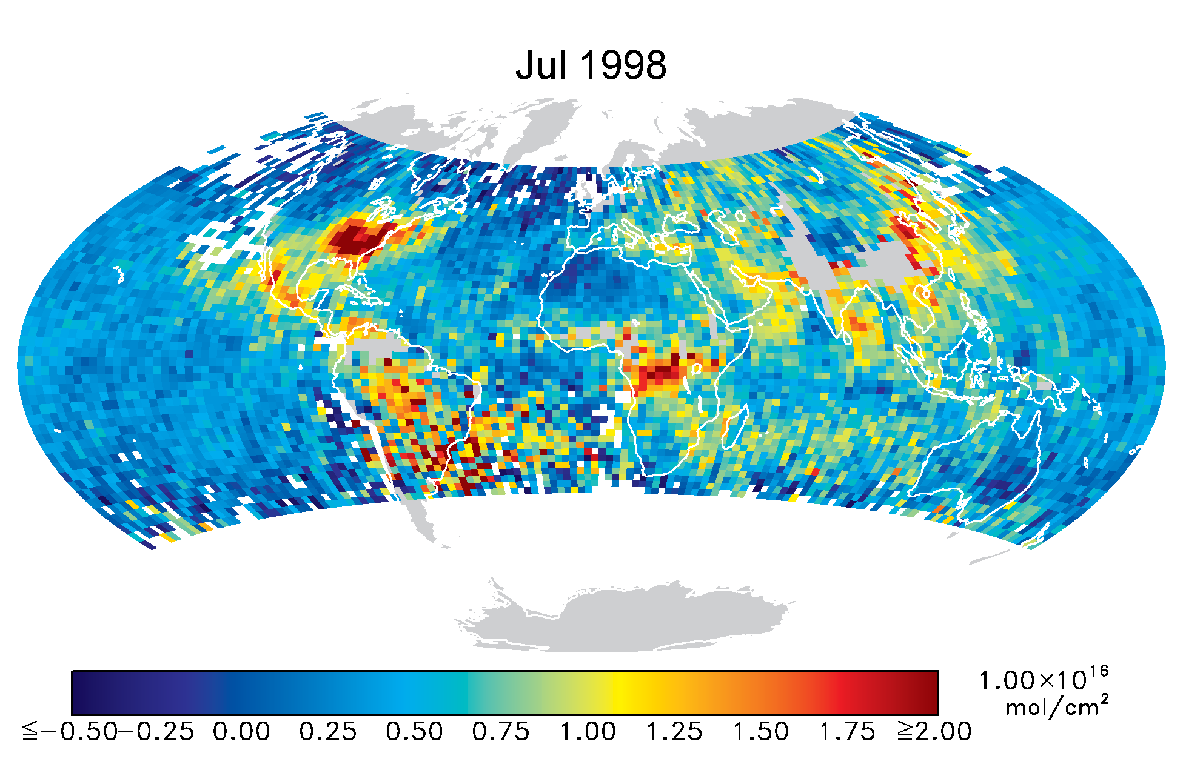
GOME HCHO data revealed lots about the global troposphere
Biogenic emissions
Palmer et al, Abbot et al, Millet et al
Curci et al
Fu et al, Shim et al
July 1998 data: c/o Chance et al
South Atlantic Anomaly
Palmer et al, Barkley et al
Biomass burning
Gonzi et al
* Columns fitted: 337-356 nm * Pixel: 320km x 40km * Fit uncertainty < continental signals * Only use cloud fraction<40%
[10¹⁶ molec cm⁻²]

Slide 5
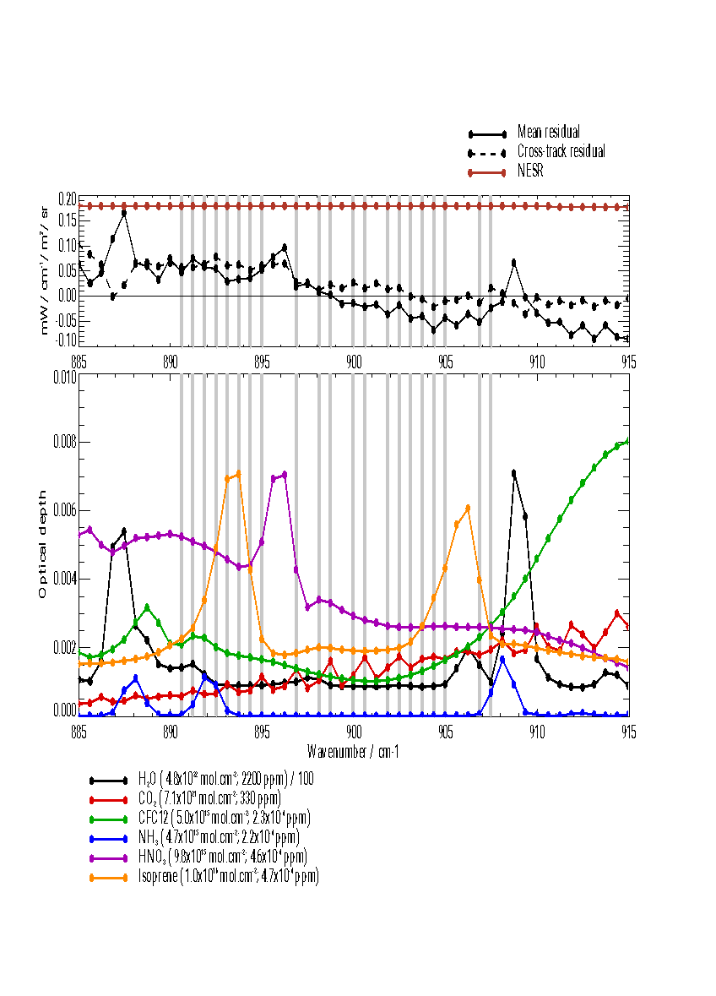
We now have satellite IR observations of isoprene…
Isoprene is a weak IR signal with spectral features overlapping with a range of other gases
First (daytime) isoprene product reported by JPL/Minnesota in 2019 using data from the Cross-track Infrared Instrument (CrIS).
Local satellite overpasses 1300 and 0100
The advantage of IR measurements is that CrIS can observe during night.
  Instrument sensitivity to changes in isoprene is such that CrIS is more sensitive to isoprene at night.
Rutherford Appleton Laboratory retrieval of isoprene using IMS scheme
Palmer, Marvin et al, 2022

Slide 6
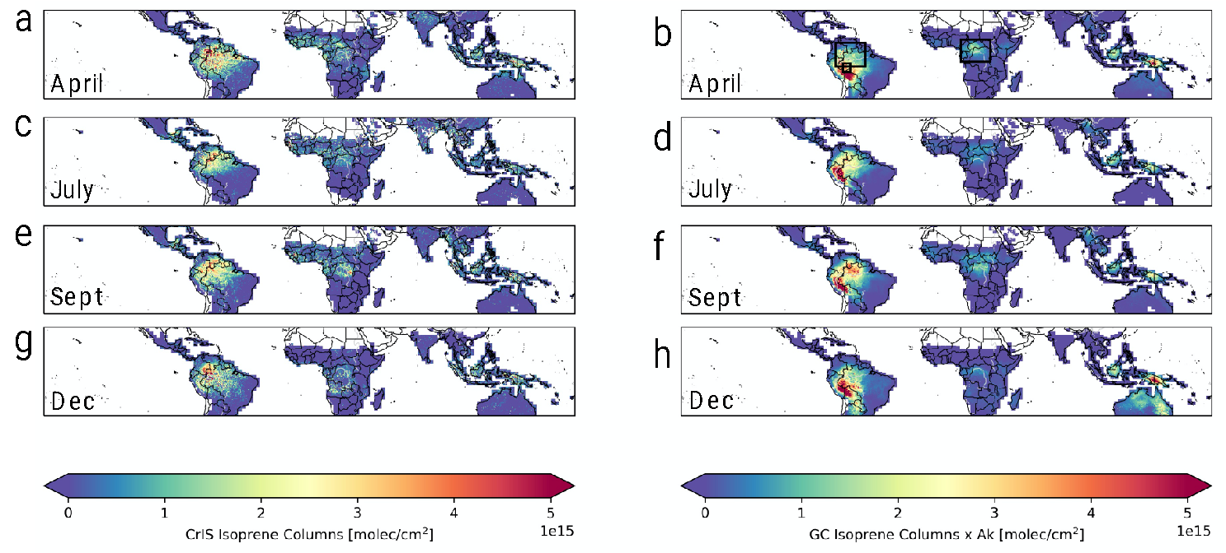
Night observations of isoprene – distributions determined by transport
2018
GEOS-Chem (2ºx2.5º) sampled at CrIS time/location, accounting for averaging kernels
CrIS
Palmer, Marvin et al, 2022

Slide 7
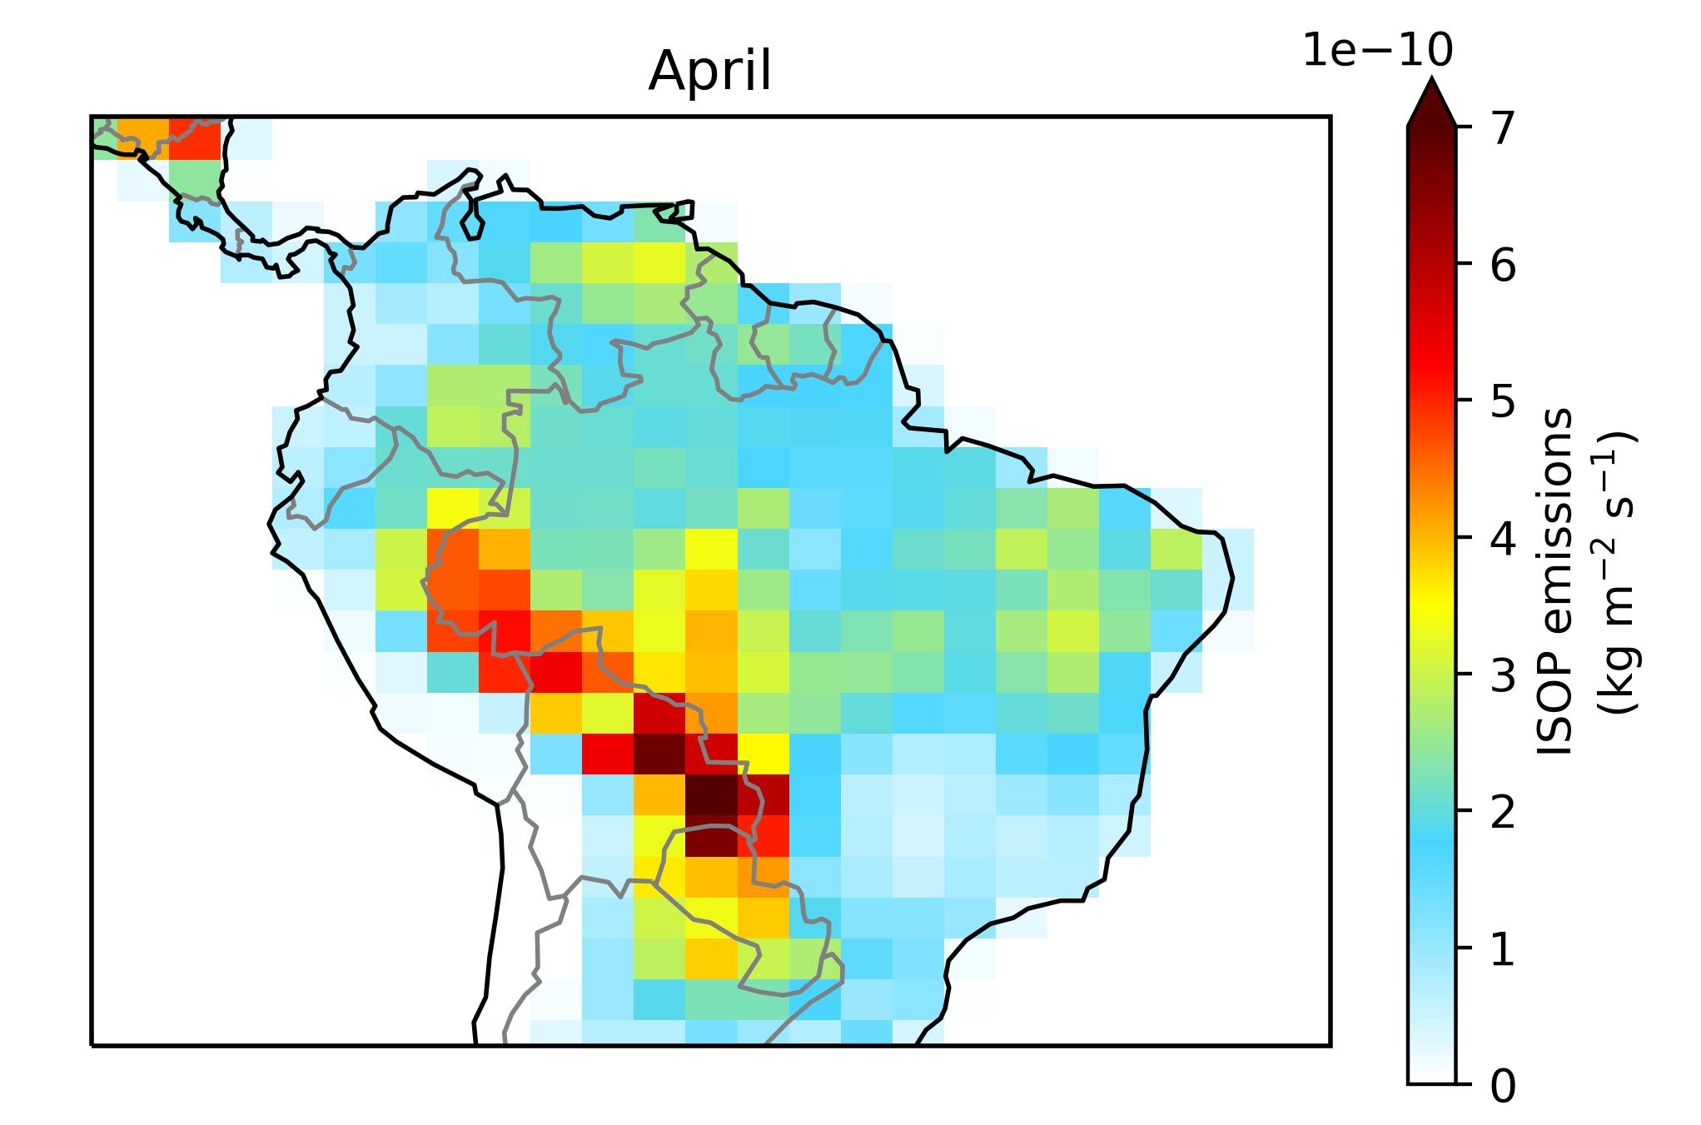
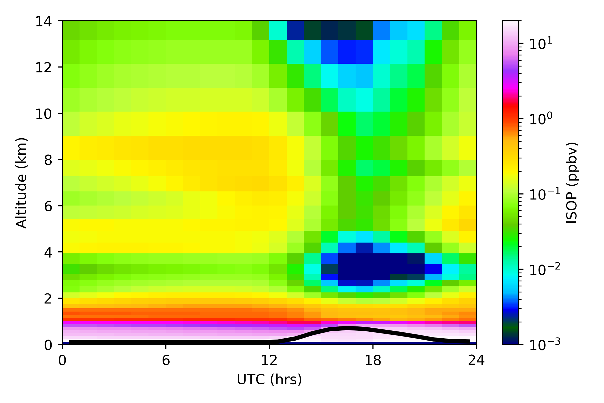
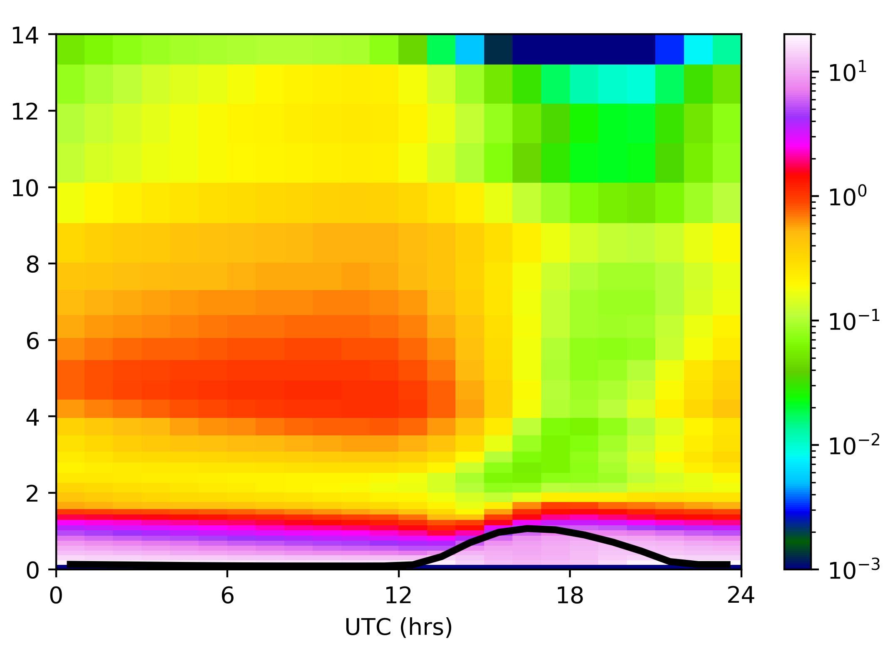
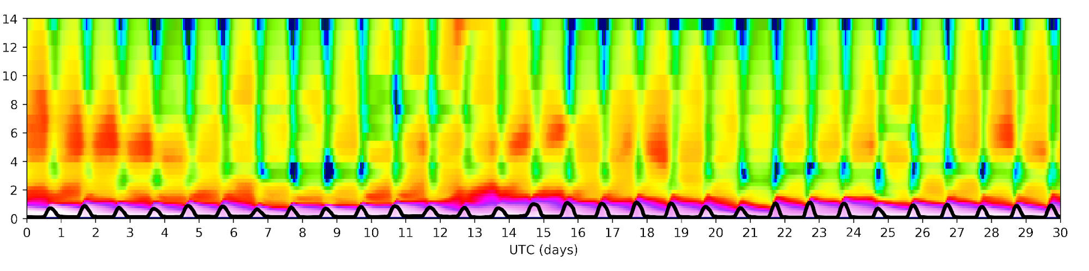
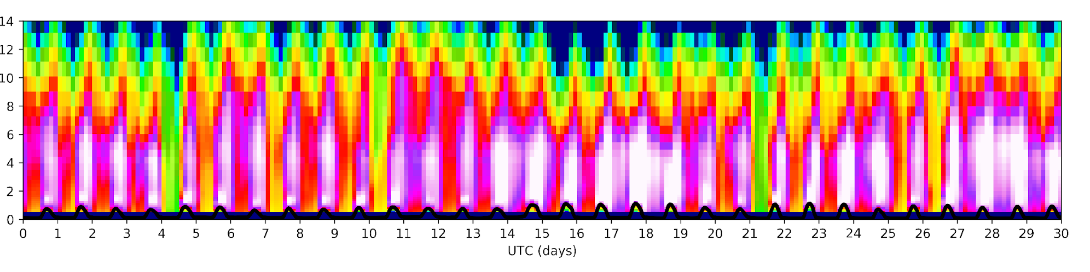
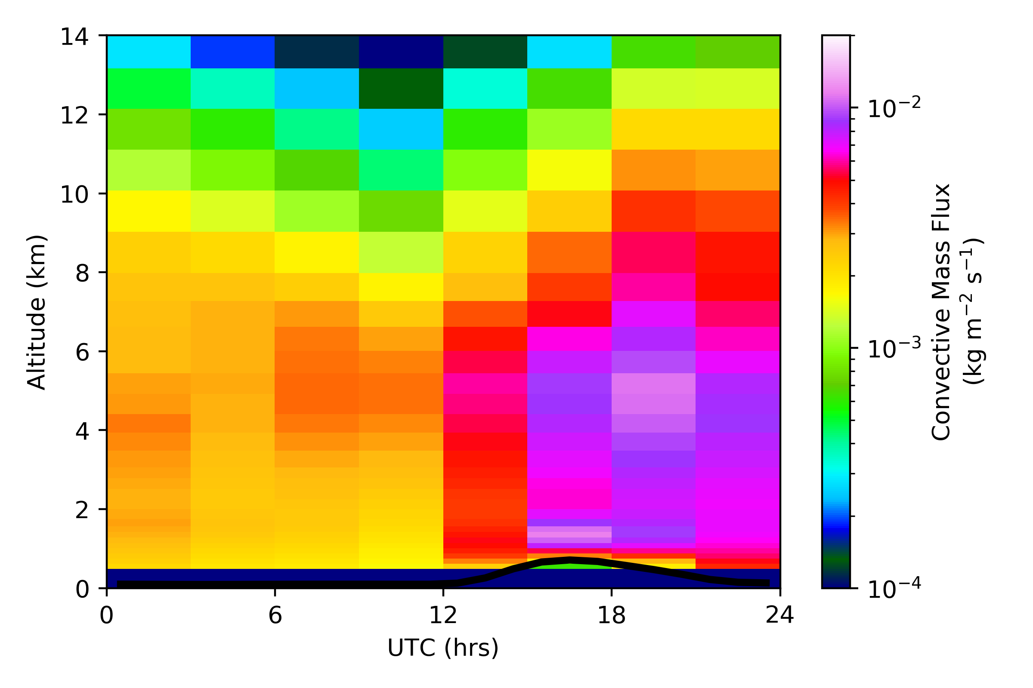
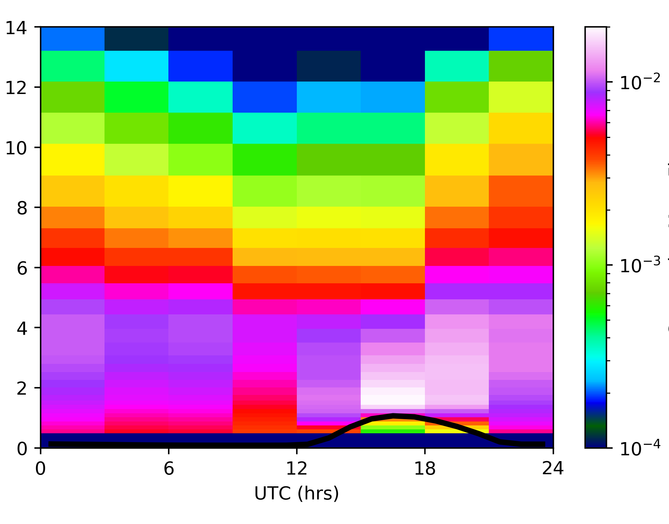
Instances of observed nighttime isoprene in free troposphere generally follows periods of elevated cloud mass flux during late afternoon
2018
April 9th
April 19th
April 2018
Isoprene (ppb)
Isoprene (ppb)
Altitude [km]
Conv. Mass flux (kg/m²/s)
Conv. Mass flux (kg/m²/s)
Lightning source of NOx also reduces the influence of isoprene in the free troposphere.
Black lines denote boundary layer height
Palmer, Marvin et al, 2022

Slide 8

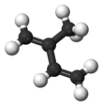


Nighttime isoprene SOA hypothesis: initiation
Atmospheric chemistry
+ oxidation products
During night, τ is very long
Periods of early evening rapid vertical mixing
During day, τ ~1 hr against OH oxidation
Free troposphere
Boundary layer
At sunset, isoprene emissions and chemistry cease
Tropical S. America
South Atlantic
Sunset
Sunrise
Palmer, Marvin et al, 2022

Slide 9

Nighttime isoprene SOA hypothesis: summary
High NOx HCHO
Low NOx
OH
OH
+ oxidation products
ROOH IEPOX IEPOX SOA
τ ~3-5 hrs
τ ~20-30 hrs
Free troposphere
Boundary layer
CCN
At sunset, isoprene emissions and chemistry cease
Williamson et al, 2019
Kupc et al, 2020
Tropical S. America
South Atlantic
Palmer, Marvin et al, 2022
Sunset
Sunrise

Slide 10
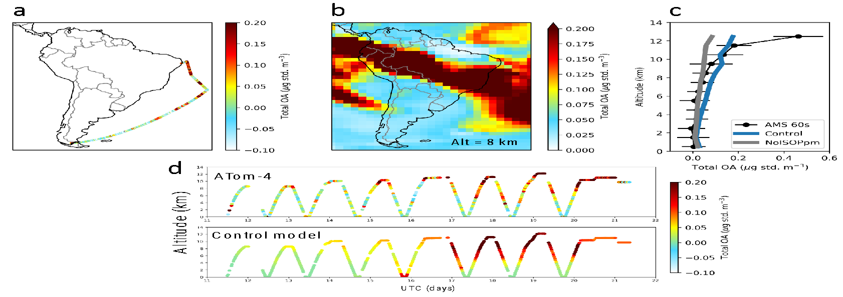
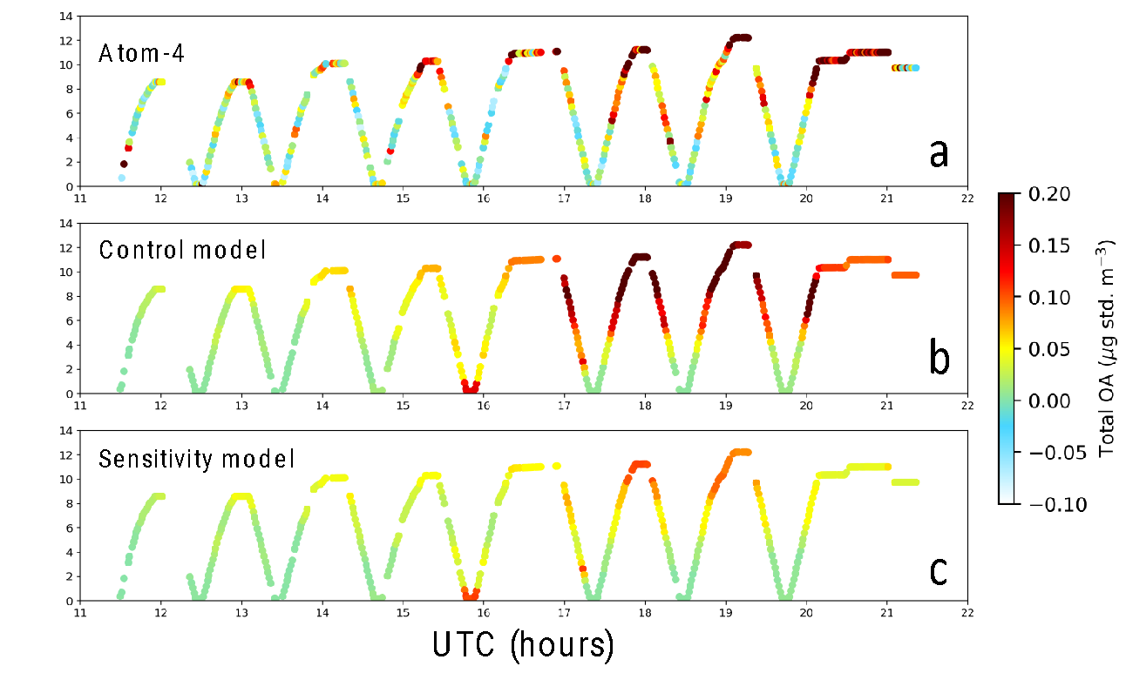
Example of sparse data available to test our hypothesis
To test the importance of the nighttime isoprene, we also report a sensitivity calculation for which isoprene in the atmosphere is removed after sunset (NoISOPpm).
We find that almost all the OA during this flight could be attributed to IEPOX-SOA from the nighttime isoprene.
We have a handful of additional comparisons.
NoISOPpm
Palmer, Marvin et al, 2022

Slide 11
Nighttime isoprene SOA hypothesis: revised summary
Low NOx
OH
OH
ROOH IEPOX IEPOX SOA
τ ~3-5 hrs
τ ~20-30 hrs
+ oxidation products
High NOx organonitrates
new particle formation
Free troposphere
Boundary layer
CCN
At sunset, isoprene emissions and chemistry cease
Williamson et al, 2019
Kupc et al, 2020
Tropical S. America
South Atlantic
Sunset
Sunrise
Curtius et al, 2024

Slide 12
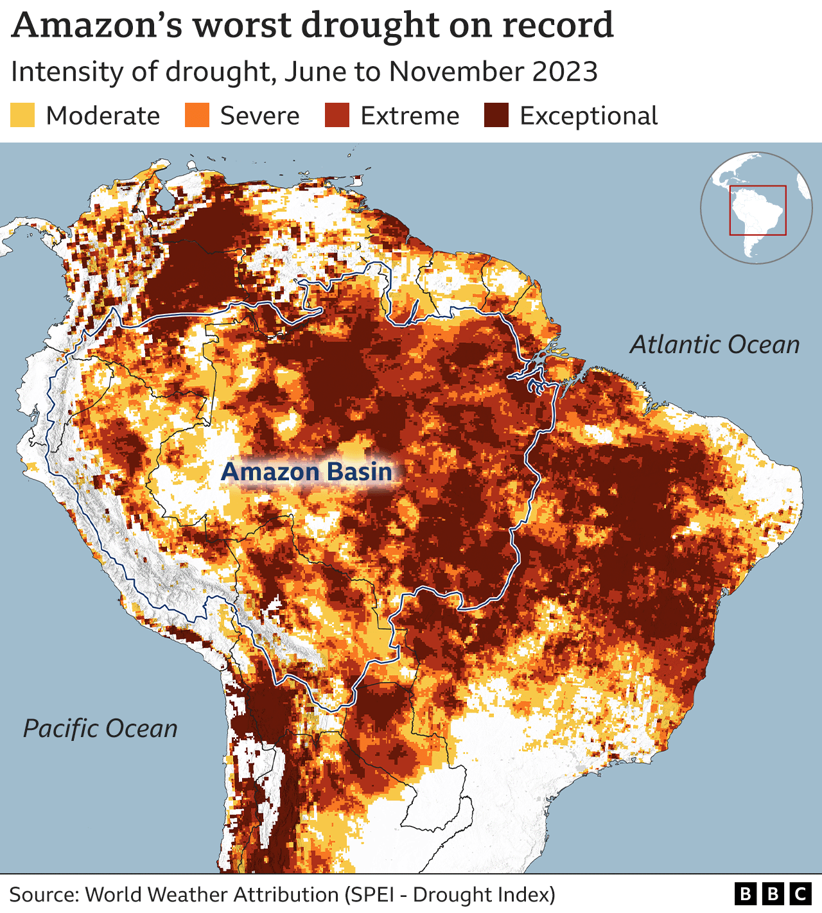
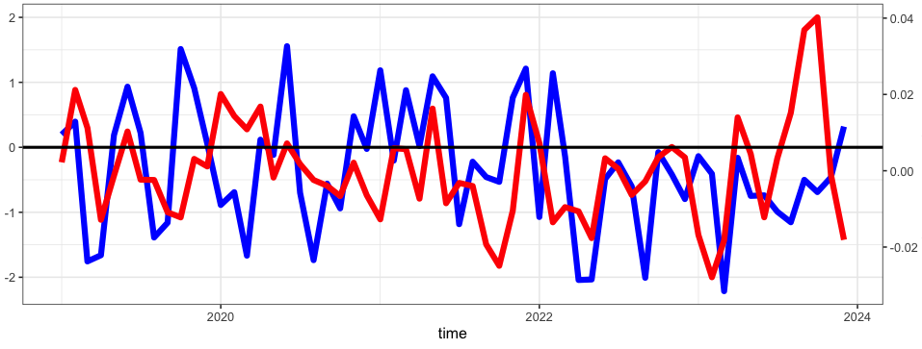
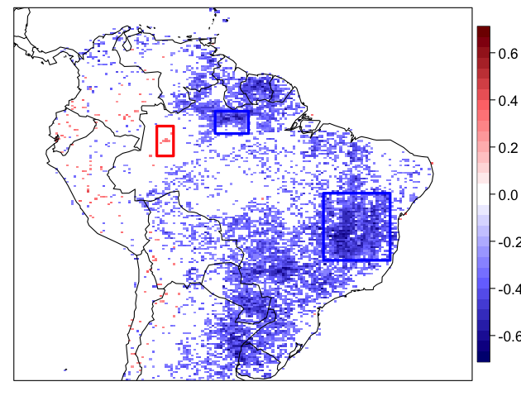
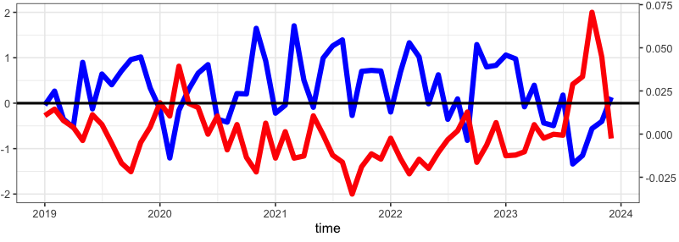
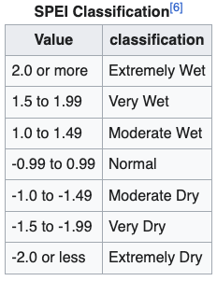
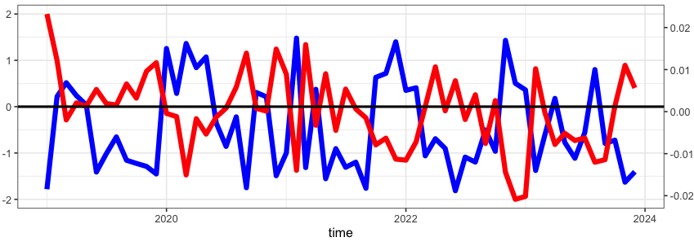
Work in progress: Understanding response of isoprene emissions to Amazon drought
Correlation between de-seasonalised CriS isoprene columns and SPIE (standardized precipitation evapotranspiration index)
De-seasonalised CriS isoprene (molec/cm²)
SPIE
2019-2024
C/o Susie Sun

Slide 13
Closing remarks
Chance et al 2000 kickstarted tropospheric chemistry from space
  Particularly, it reinvigorated the biogenic VOC community.
This scientific legacy continues as we move to next-gen sensors capable of observing isoprene directly and of finer resolved HCHO
  Extends our ability to see how the natural world is responding to human-driven changes in climate
Kelly’s legacy from a personal perspective
  played a key role in my career but also the careers of others I have supervised/advised.

