Slide 1


Leveraging UV-Vis Satellite Retrievals for Insight into Atmospheric Chemistry and Composition
Randall Martin
Chance Symposium
August 18, 2025

Slide 2
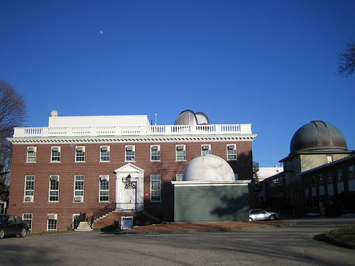
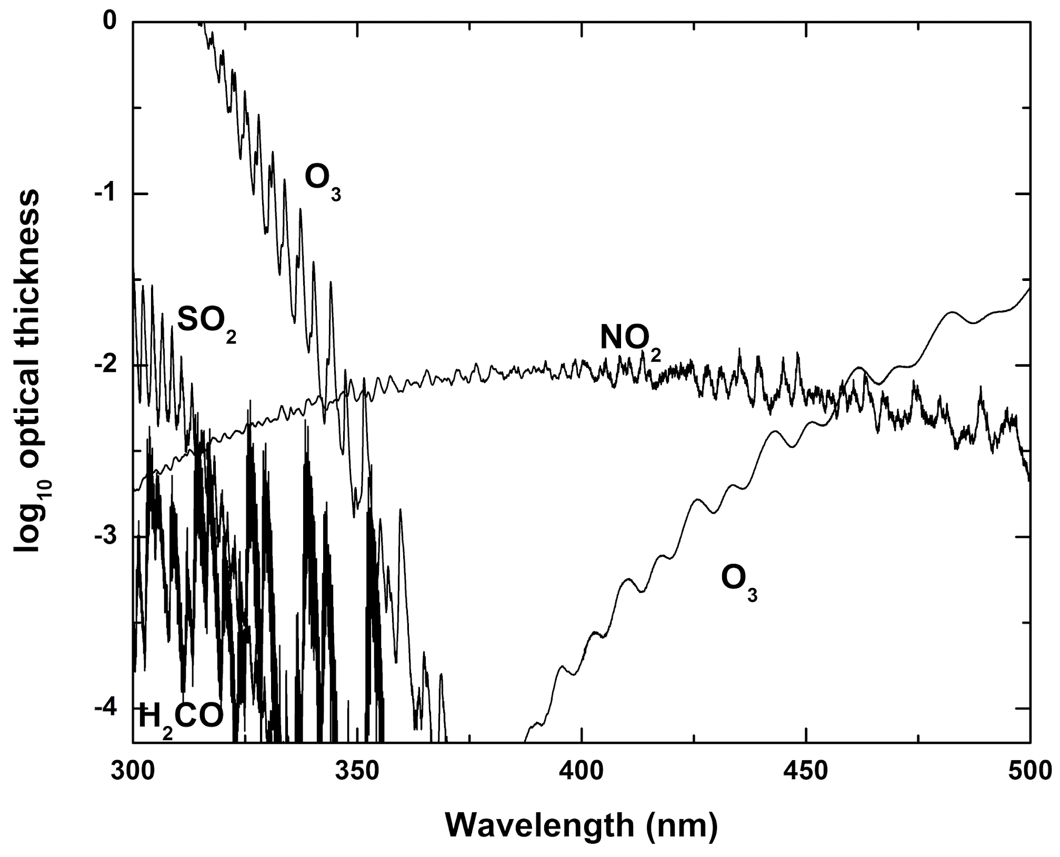
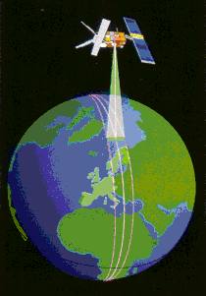
Training for a Lifetime
Personalized weekly 3-hr tutorials during PhD
  Introduction to spectroscopy
  Remote sensing
  Questions
  Application to NO₂ from GOME
GOME Footprint 320 km x 40 km
Chance and Martin, 2016

Slide 3
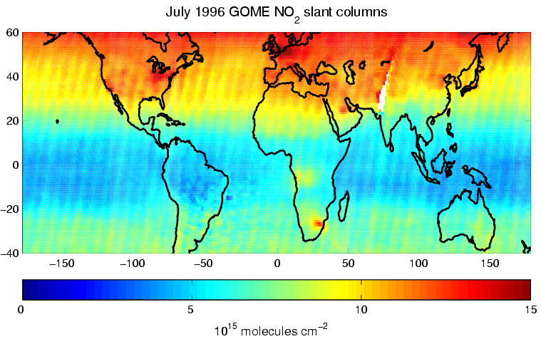
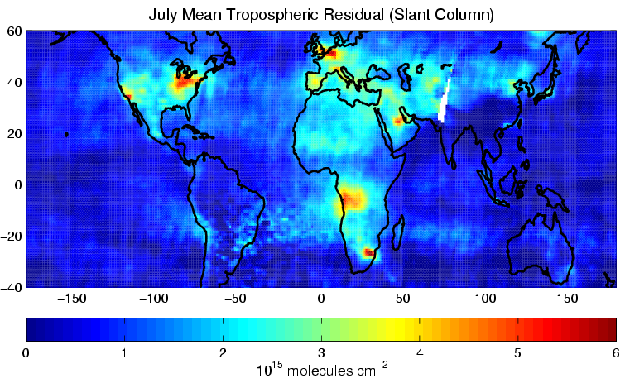
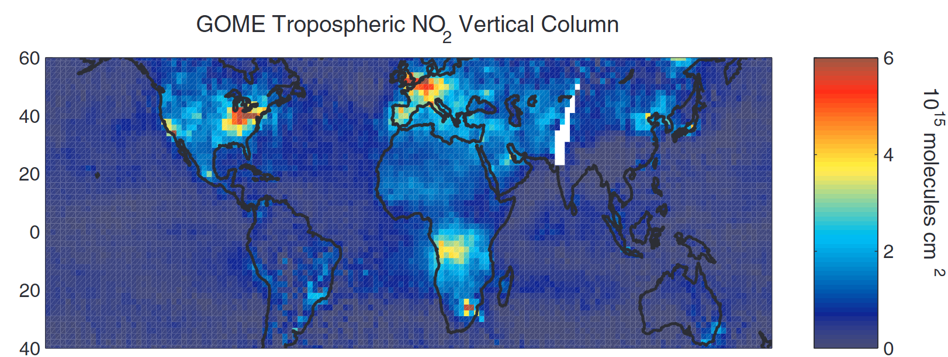
Retrieval of Tropospheric NO₂ From GOME
(errors ε in 10¹⁵ molecules cm⁻²)
GOME Spectrum (423-451 nm)
Fit spectrum
ε₁ = 0.6−0.8
O₃, O₂-O₂, H₂O, Ring, Undersampling,
Total Slant NO₂ Column
Common Mode
Remove stratospheric contribution, diffuser plate artifact
Use Central Pacific GOME data with:
HALOE to test strat zonal invariance
GEOS-Chem constrained by PEM-Tropics to treat tropospheric residual
ε₂ = 0.4
Tropospheric Slant NO₂ Column
Use radiative transfer model with:
local surface albedos from GOME
local vertical shape factors from GEOS-Chem
local cloud info from GOMECAT
Apply Air Mass Factor (AMF) to convert slant column to vertical column
Quantitative retrieval in partly cloudy scene
ε₃ = 0.5−3.2
Tropospheric NO₂ Column
Martin, Chance, Jacob, et al. 2002

Slide 4
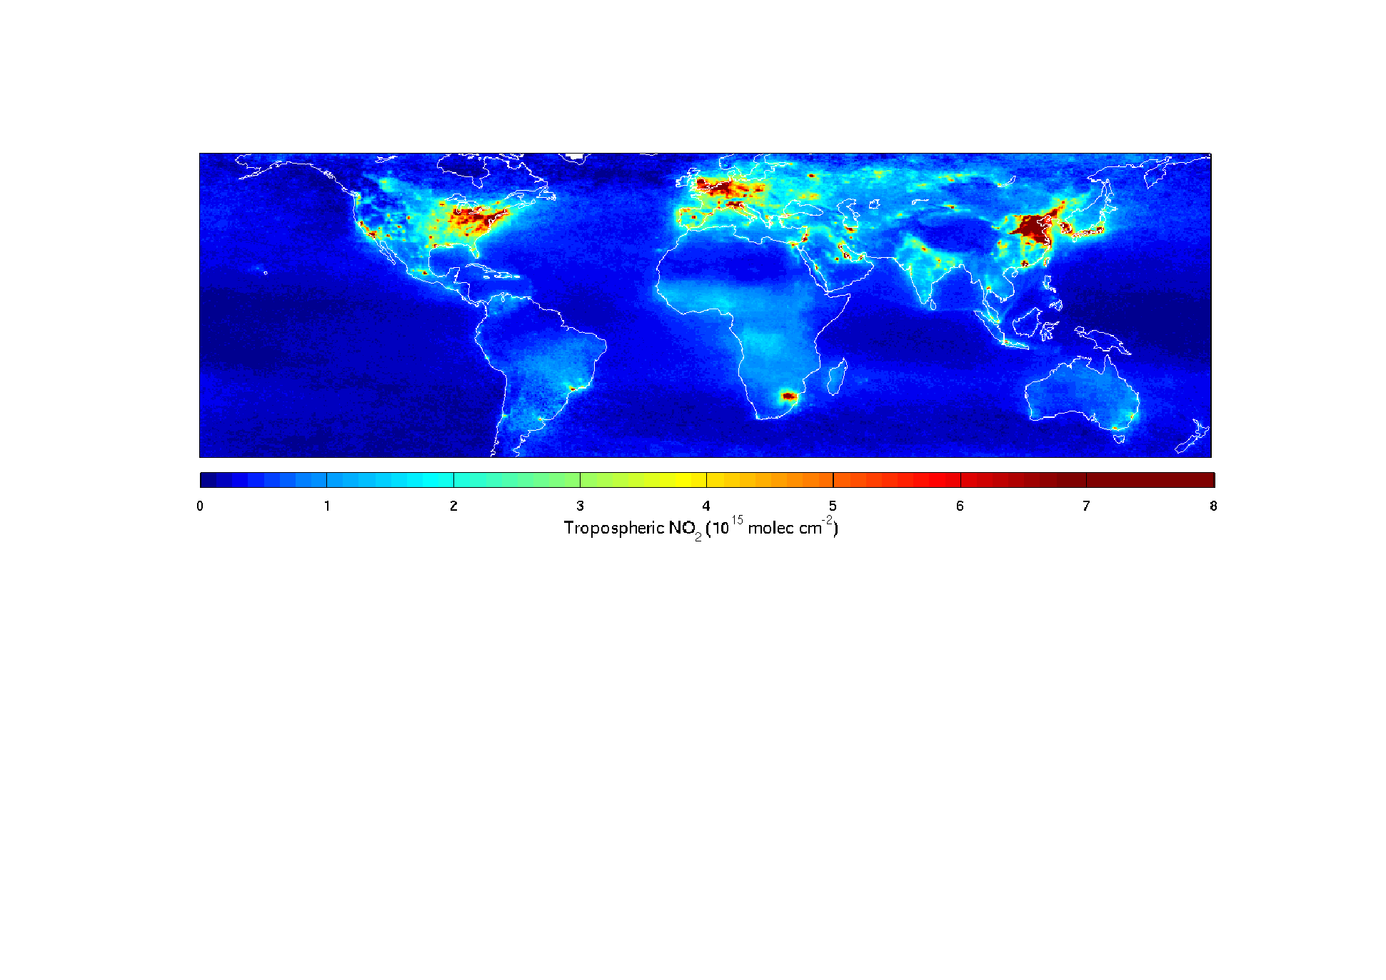
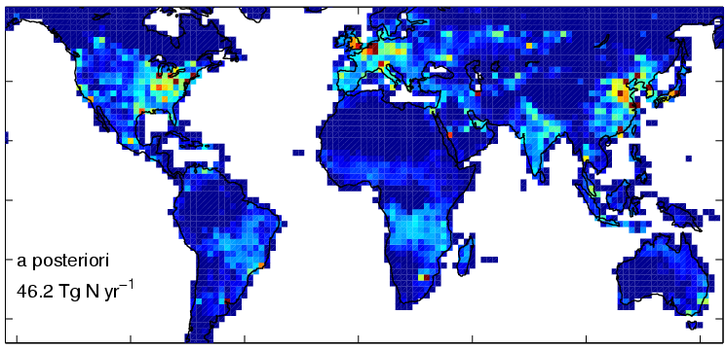
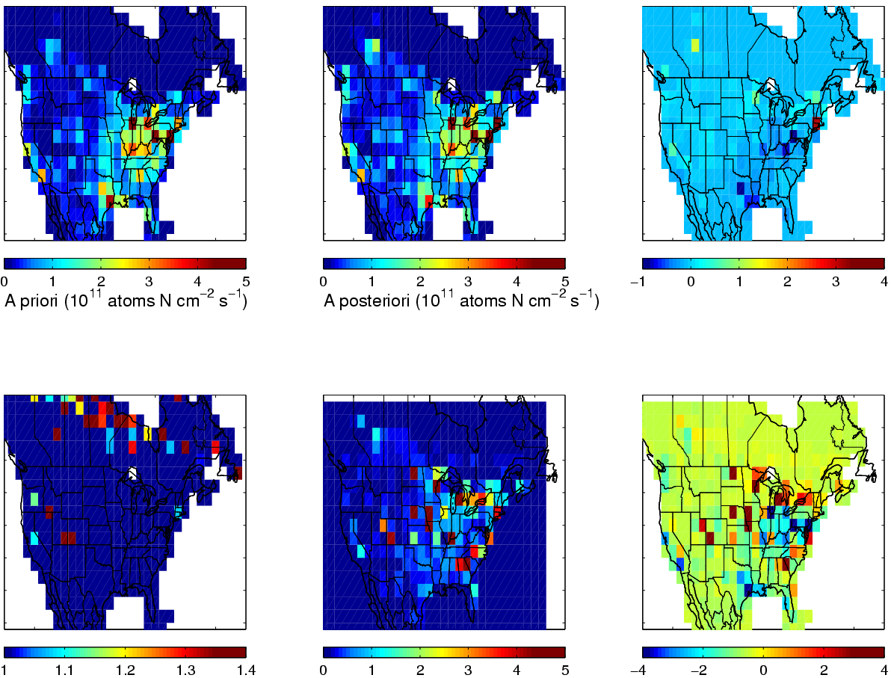
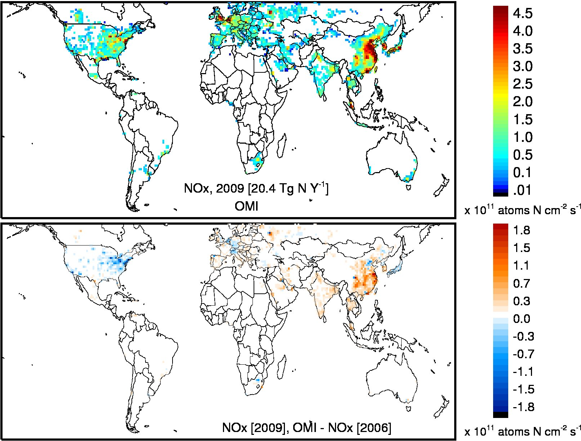
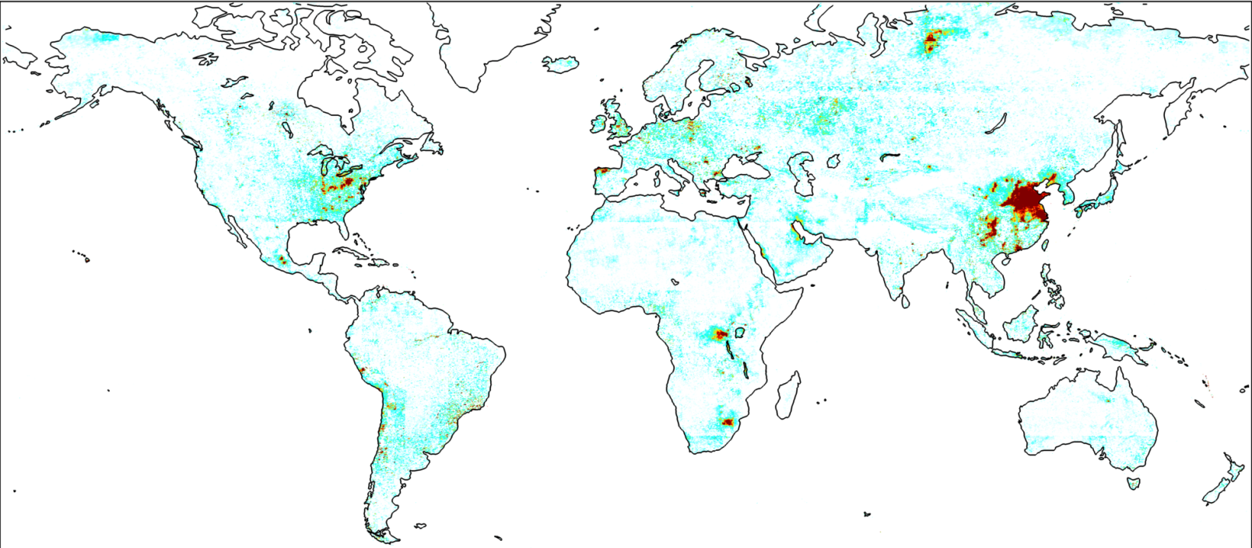
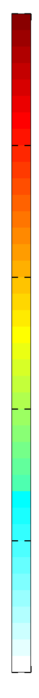
Research at Intersection of Remote Sensing and Modeling
Inverse Modeling Using GEOS-Chem
Tropospheric NO₂ from SCIAMACHY
NO_{x} Emissions
^{NO}/_{NO2} ↑ ↑
with altitude
2003-2005
Martin et al., 2006
SCIAMACHY Tropospheric NO₂ (10¹⁵ molec cm⁻²)
NO_{x} emissions (10¹¹ atoms N cm⁻² s⁻¹)
Changes in NO_{x} Emissions (OMI & GEOS-Chem)
Constraints on NO₂ and SO₂ Dry Deposition (OMI & GEOS-Chem)
10
8
6
4
2
0
SO₂ Dry Deposition Flux
(kg S ha⁻¹ yr⁻¹⁾
Lamsal et al., 2011
Nowlan et al., 2014
Notes:
Often involves relating retrieved quantity to another quantity of interest

Slide 5
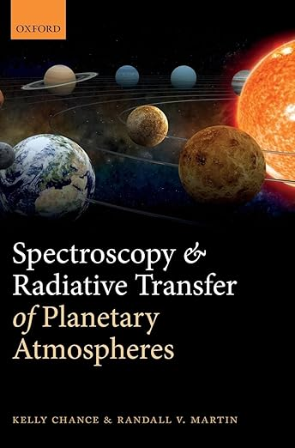
An Outcome of Our Partnership
1. Basic solar and planetary properties
2. Elements of Math and Physics
3. Blackbody radiation, Boltzmann statistics, temperature, and thermodynamic equilibrium
4. Radiative transfer
5. Spectroscopy fundamentals
6. Line shapes
7. Atmospheric scattering
8. Radiation and climate
9. Radiative transfer modeling
10. Principles of atmospheric remote sensing measurements
11. Data fitting

Slide 6
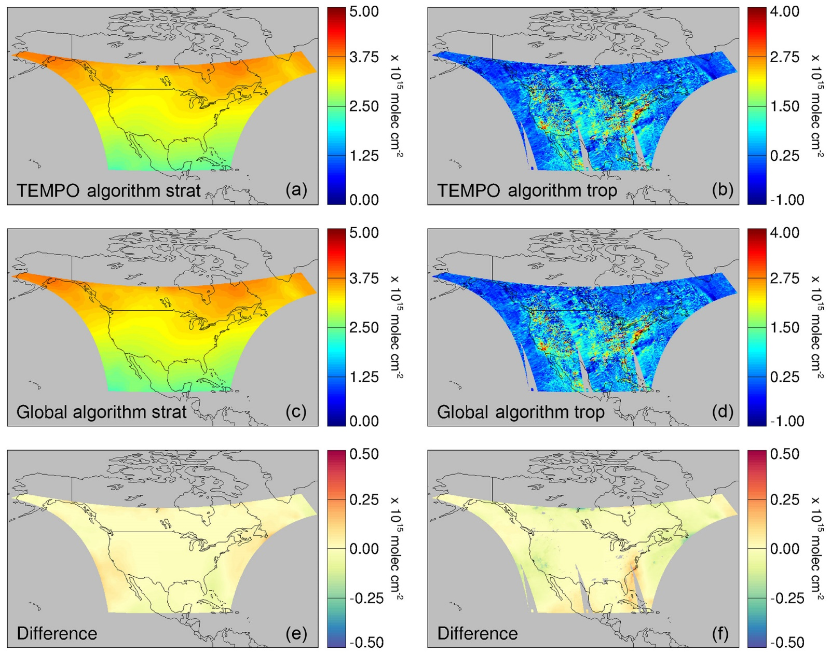
Contributions to TEMPO: Negligible Information Penalty from Inferring Stratospheric NO₂ Column from TEMPO Field of Regard
Tests Developed Using OMI Observations vs Full LEO Data
Geddes et al., AMT, 2018

Slide 7
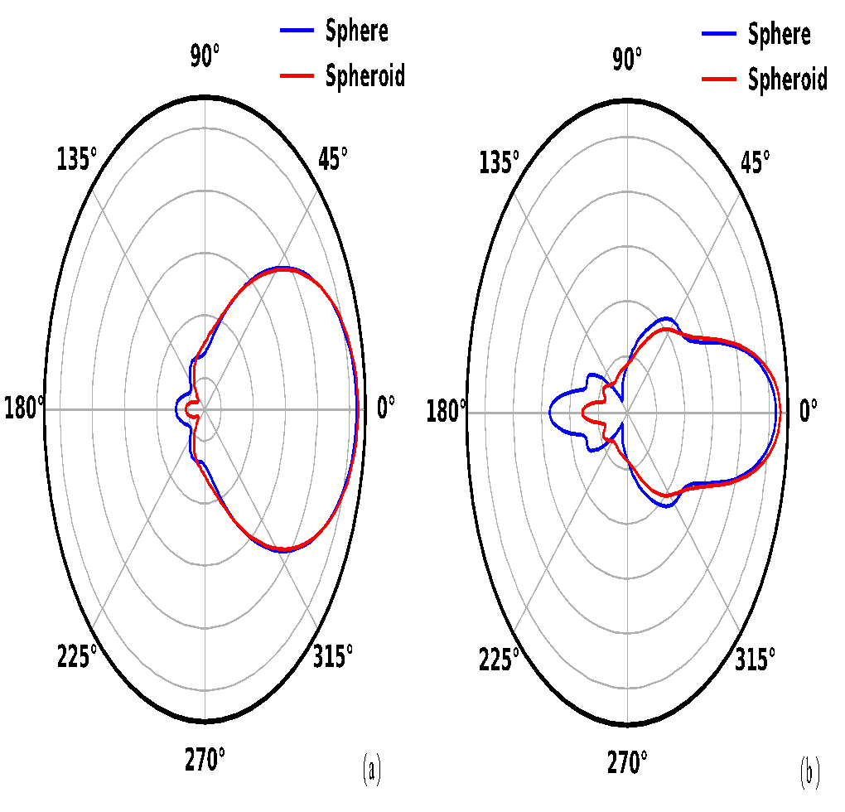
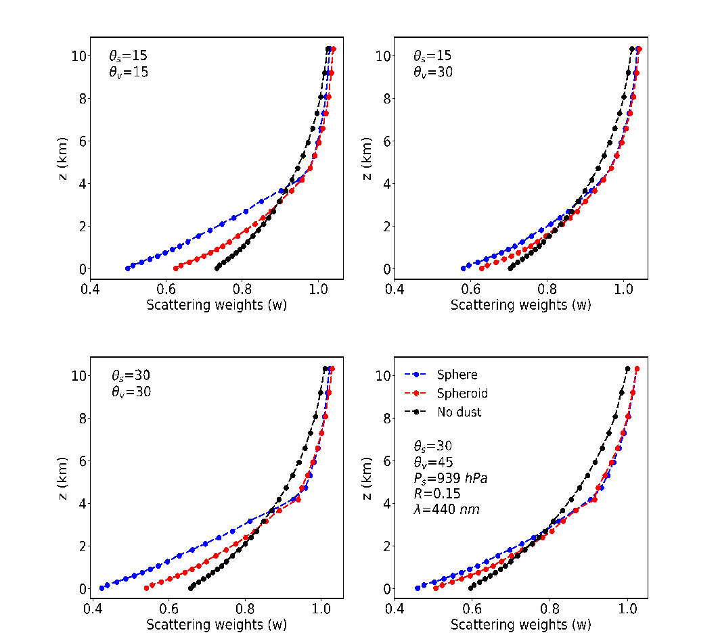
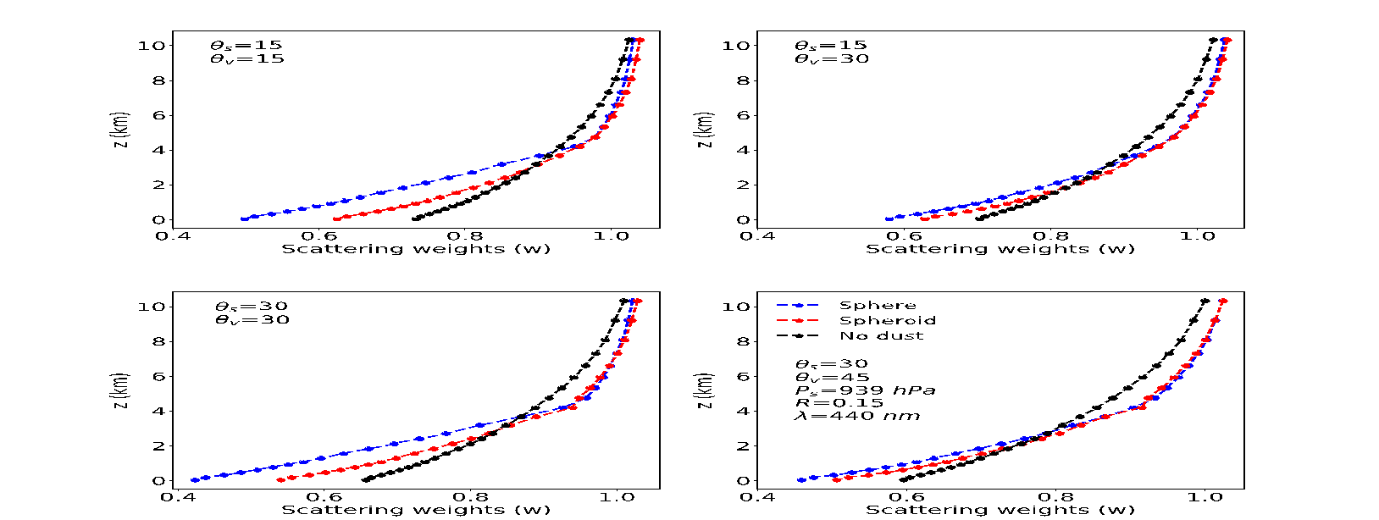
Recent Work at Intersection of UV-Vis Remote Sensing and Modeling:
Effects of Mineral Dust on UV-Vis NO₂ Retrievals Weaker than Previously Expected
Nonspherical Particles Behave More Like Direct Beam
Aerosol Effect on NO₂ Within Dust Layer is Halved
Decreased Backward Scattering for Nonspherical
Dust layer (0-4 km)
τ₄₄₀ = 0.3
Phase Function of Spheroids Calculated with T-Matrix Method
VLIDORT Calculation at 440 nm
Singh et al., JAMES, 2024

Slide 8
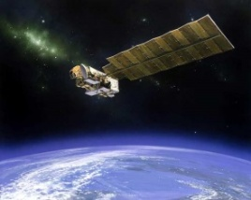
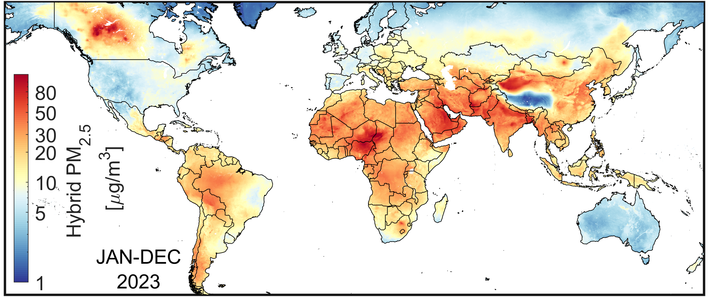
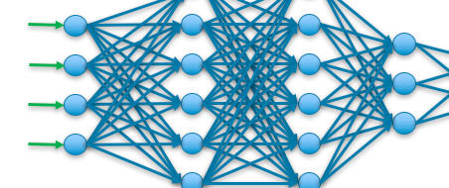
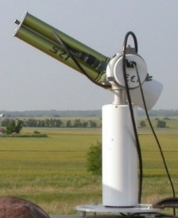

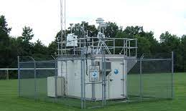
Recent Work at Intersection of Remote Sensing and Modeling:
Satellite-Derived Fine Particulate Matter (PM_{2.5})
Geophysical
Satellite-Derived PM_{2.5}
Hybrid PM_{2.5} (1998-2023)
Aerosol Optical Depth (AOD) from multiple satellite instruments and algorithms constrained with AERONET
Calculate coincident local solution to
PM_{2.5} = f(x,y,t,AOD)
Deep Learning
Monitoring networks
Shen et al., ES&T Air, 2024

Slide 9
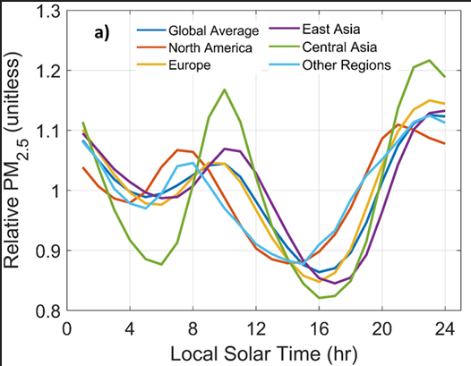
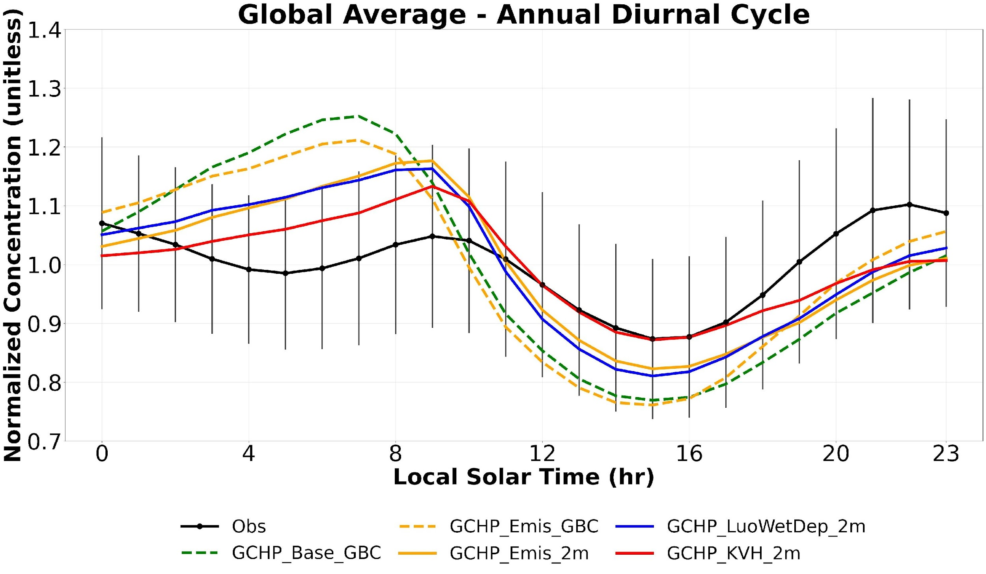
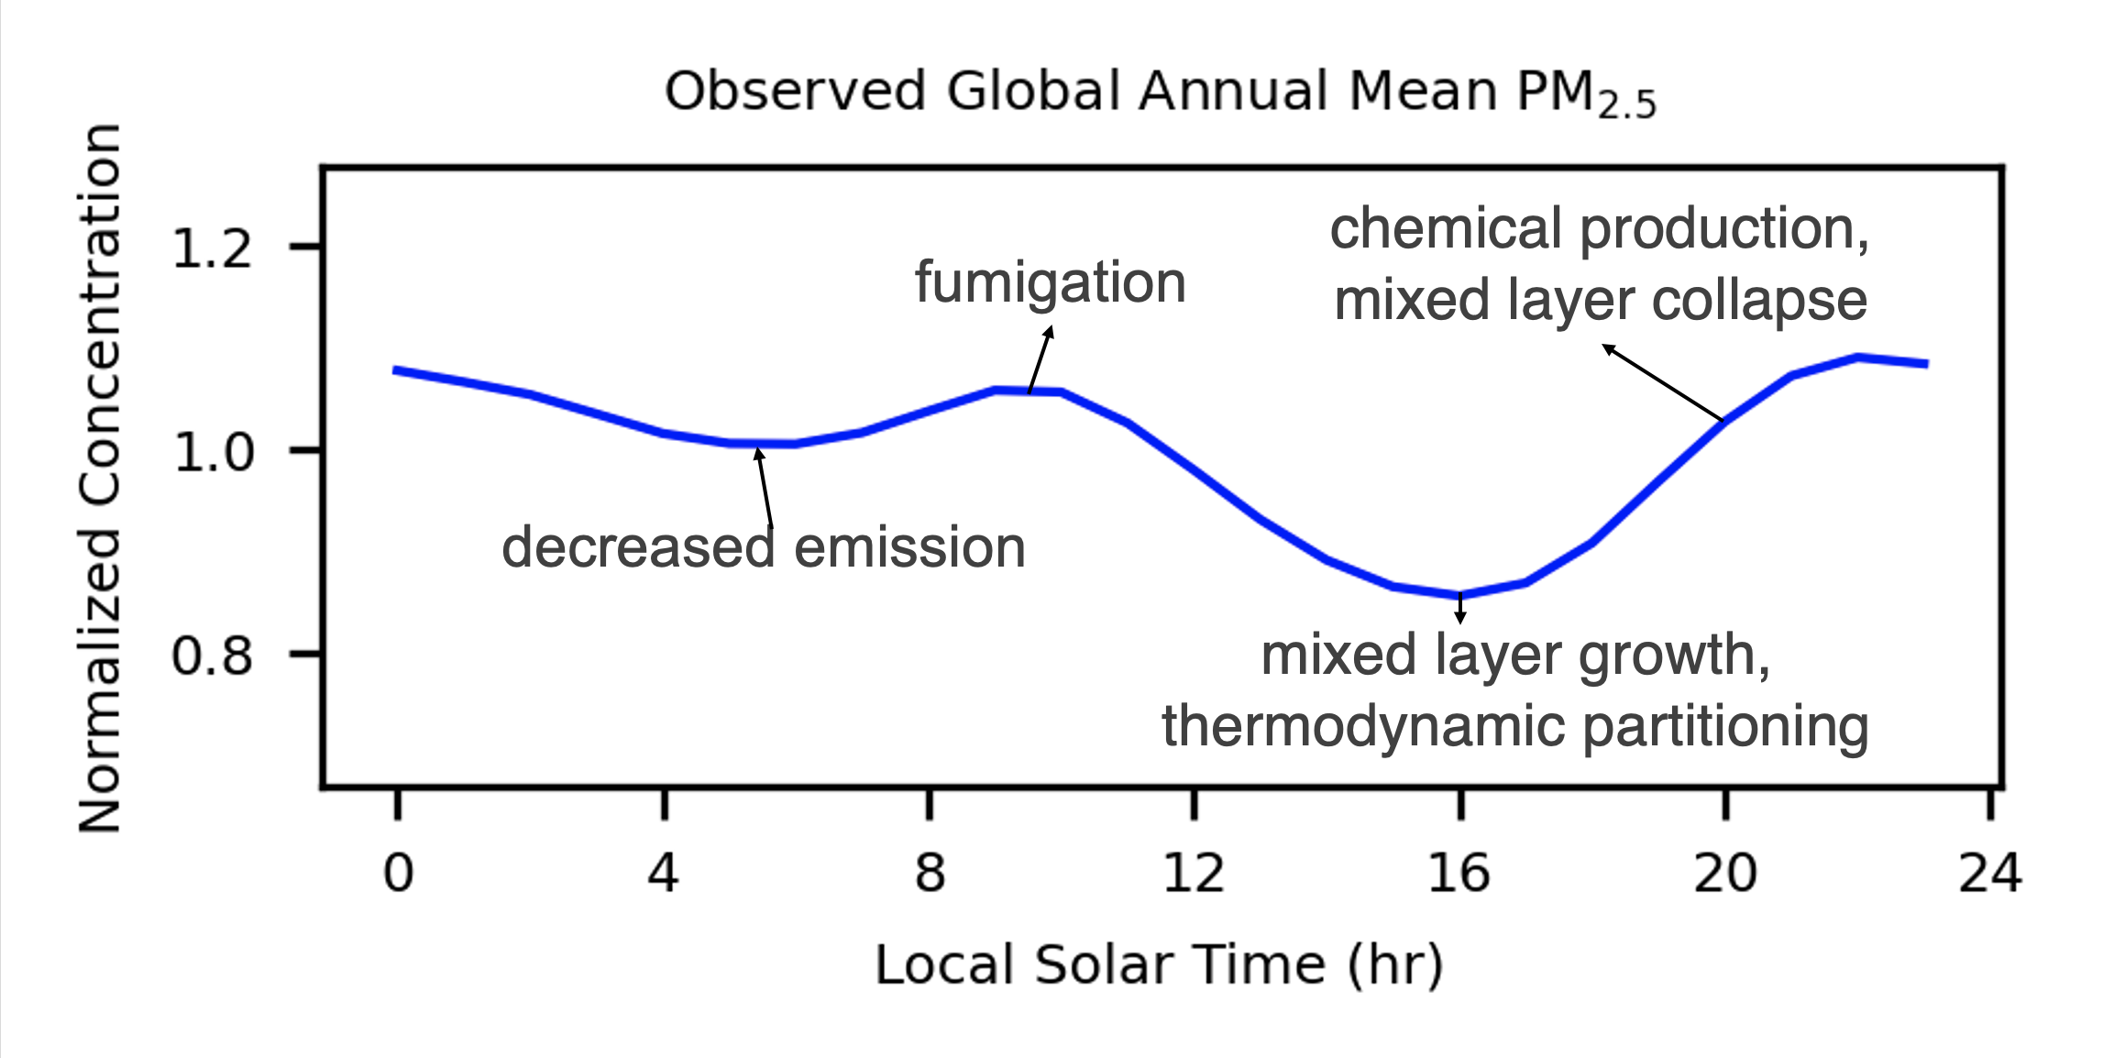
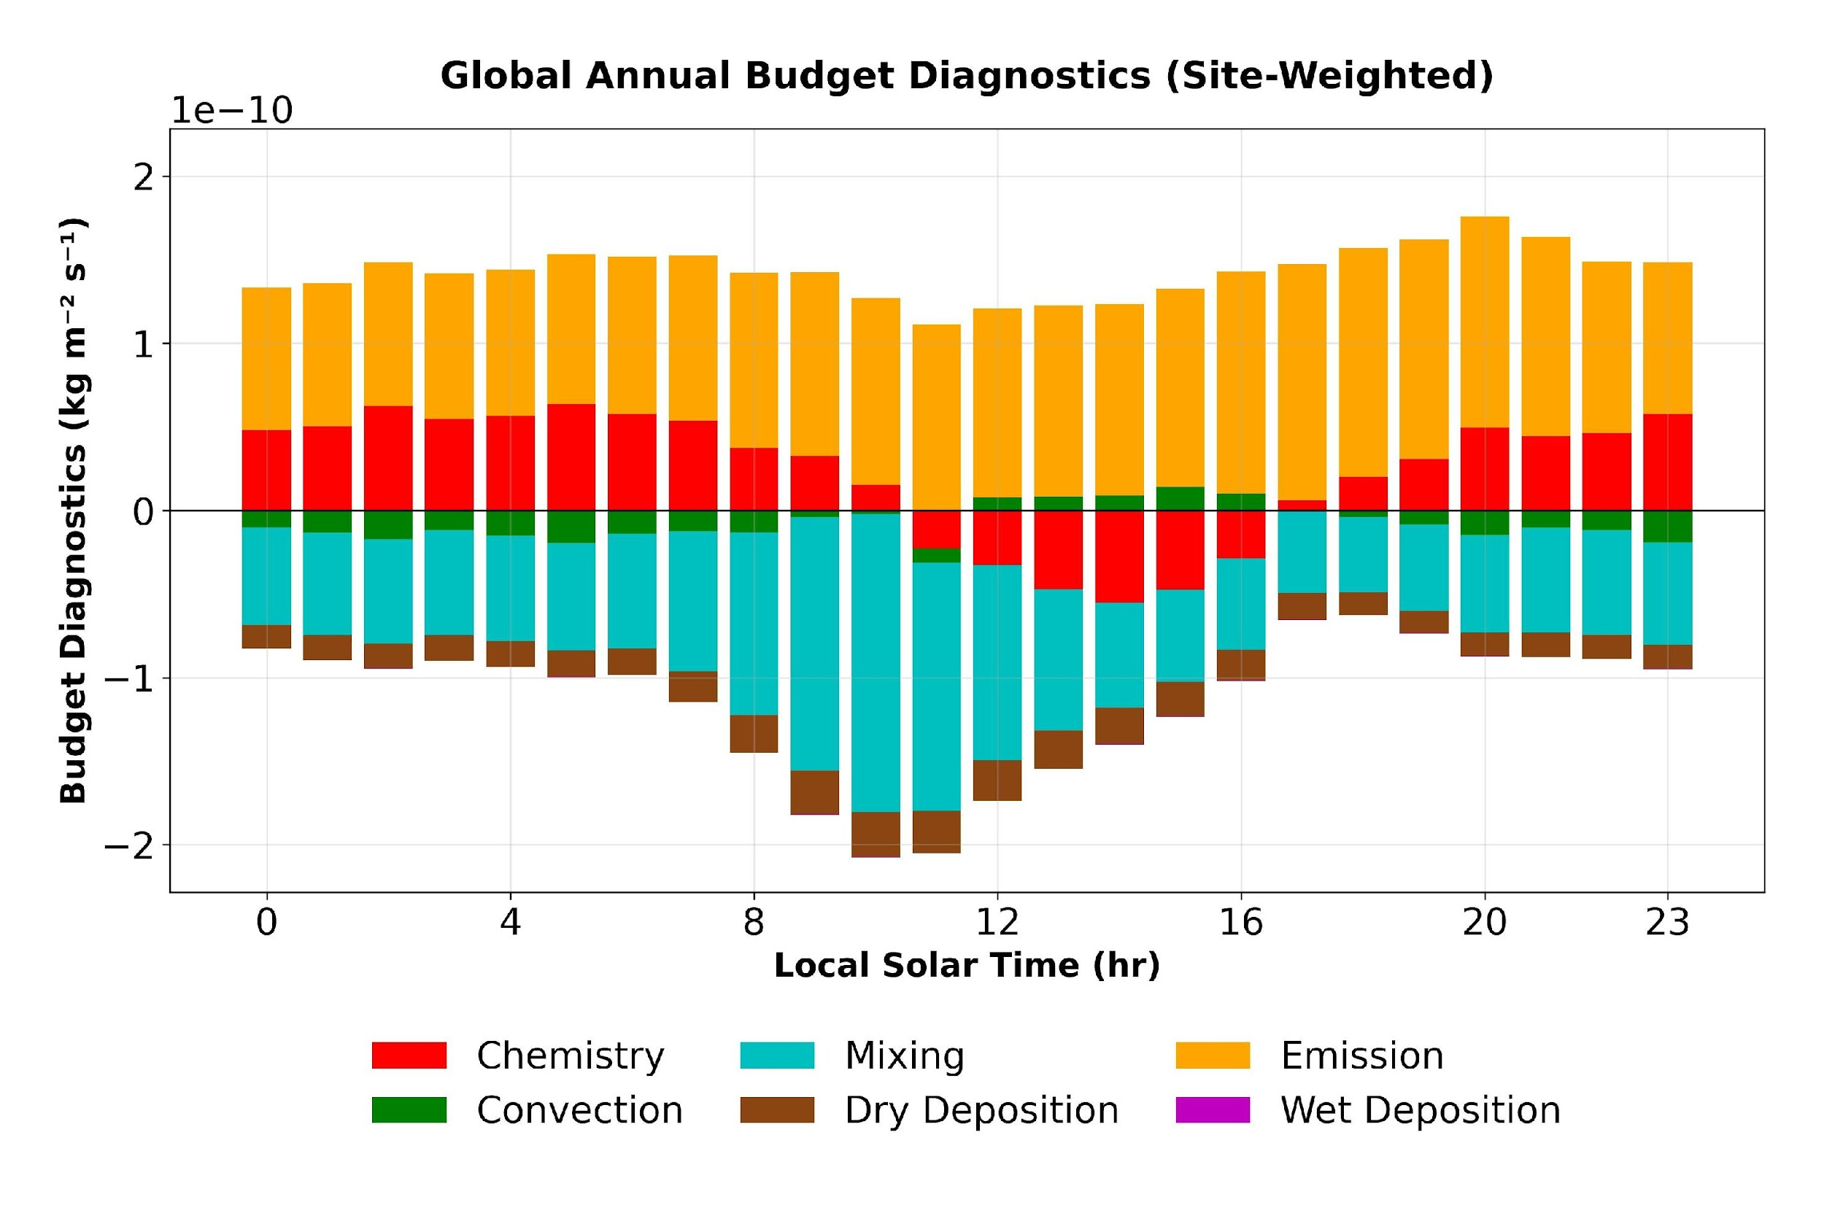
Recent Work at Intersection of Remote Sensing and Modeling:
Diurnal Variation in PM_{2.5}
Similar Measured Diurnal Variation Across Regions
Manning et al. 2017
Calculated with High Performance Configuration of GEOS-Chem (GCHP)
Y. Li et al., ES&T Air, 2025

Slide 10
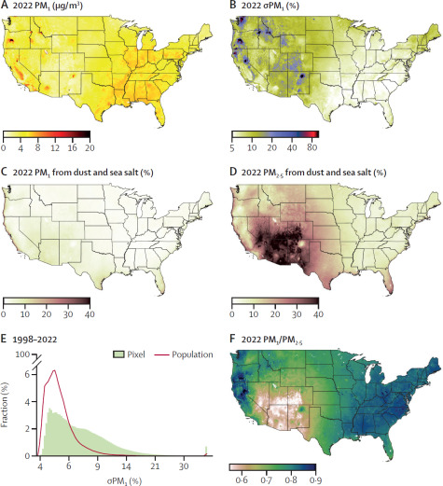
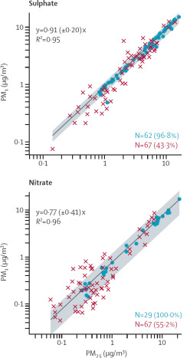
National Estimates of PM₁ for 1998-2023 using PM₁ Measurements, Satellite-Derived PM_{2.5}, and PM_{2.5} Component Info from GEOS-Chem and Measurements
Co-located PM₁ and PM_{2.5} Measurements Reveal PM₁ Fraction by Component
Satellite-Derived PM_{2.5} Mass Concentrations
Partition PM_{2.5} Component / Total PM_{2.5} Using GEOS-Chem and Measurements (IMPROVE and CSN)
Moudi (PM₁ and PM_{2.5})
AMS (PM₁), ACSM (PM₁), IMPROVE (PM_{2.5}), CSN (PM_{2.5})
Apply Component-specific Co-located PM₁/PM_{2.5}
C. Li et al., Lancet Planetary Health, 2025

Slide 11
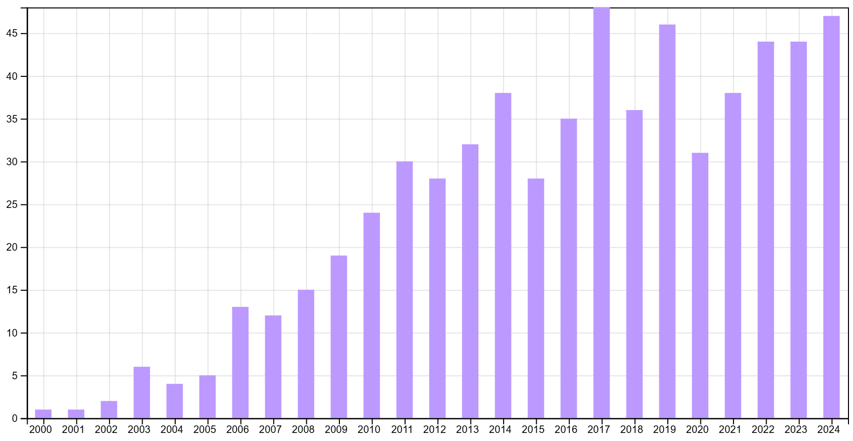
ISI Web of Science Search for “GEOS-Chem and Satellite”
Publications
OMI
CALIOP
TEMPO
GOME
ATSR
GOSAT
GEMS
OCO-2
TROPOMI
VIIRS
MISR
SCIAMACHY
GHGSat
MODIS
MLS
Himawari
TOMS
MOPITT
IMG
ACE-FTS
TES
POLDER
AIRS
IASI
GOME-2
OMPS
OSIRIS
GOCI
EPIC

Slide 12
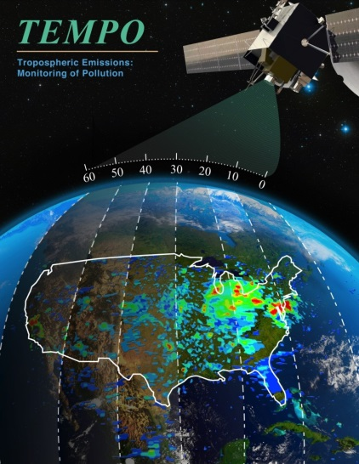

Thanks Kelly!

