Slide 1
The Stratosphere, Far Infrared, and high-altitude balloons
Ken Jucks
NASA HQ Program Scientist, and former SAO employee…

Slide 2
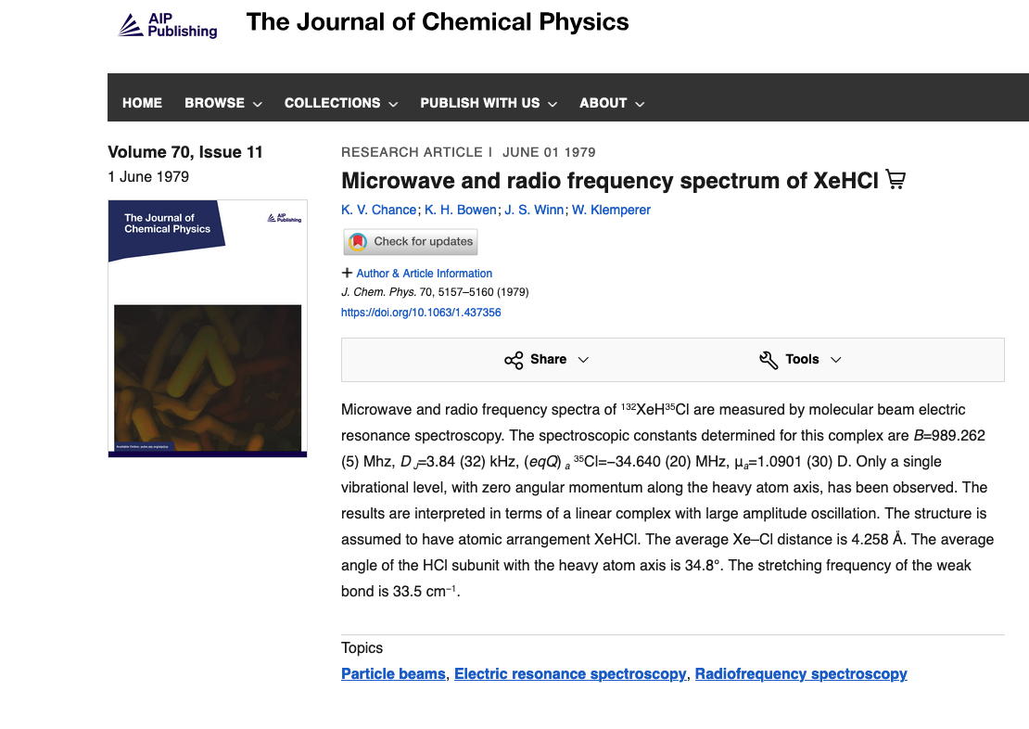

Slide 3
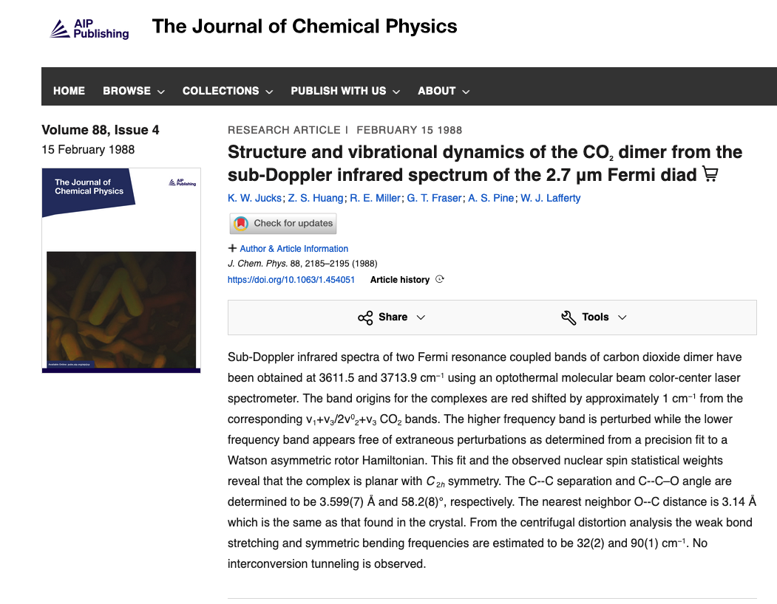

Slide 4
History of Far-IR spectroscopy at CfA
The original FIRS was built to go onto the back end of an astronomy telescope in the early 80s.
It worked OK for astronomy, but was excellent at seeing our own atmosphere.
Wes Traub and Kelly Chance turned it into a balloon instrument for the stratosphere.
It had a few successful flights, until it met its demise on a termination mishap that resulted in a free fall from 35 km.
Funds were obtained to rebuild the instrument. It had high spectral resolution, 2 output channels (using detectors developed for the Spitzer Space Telescope), and a mylar beamsplitter.
After several successful flights (and a DC-8 campaign during AASE-II), the beamsplitter was changed over phases to allow for more complete spectral coverage and better s/n.

Slide 5
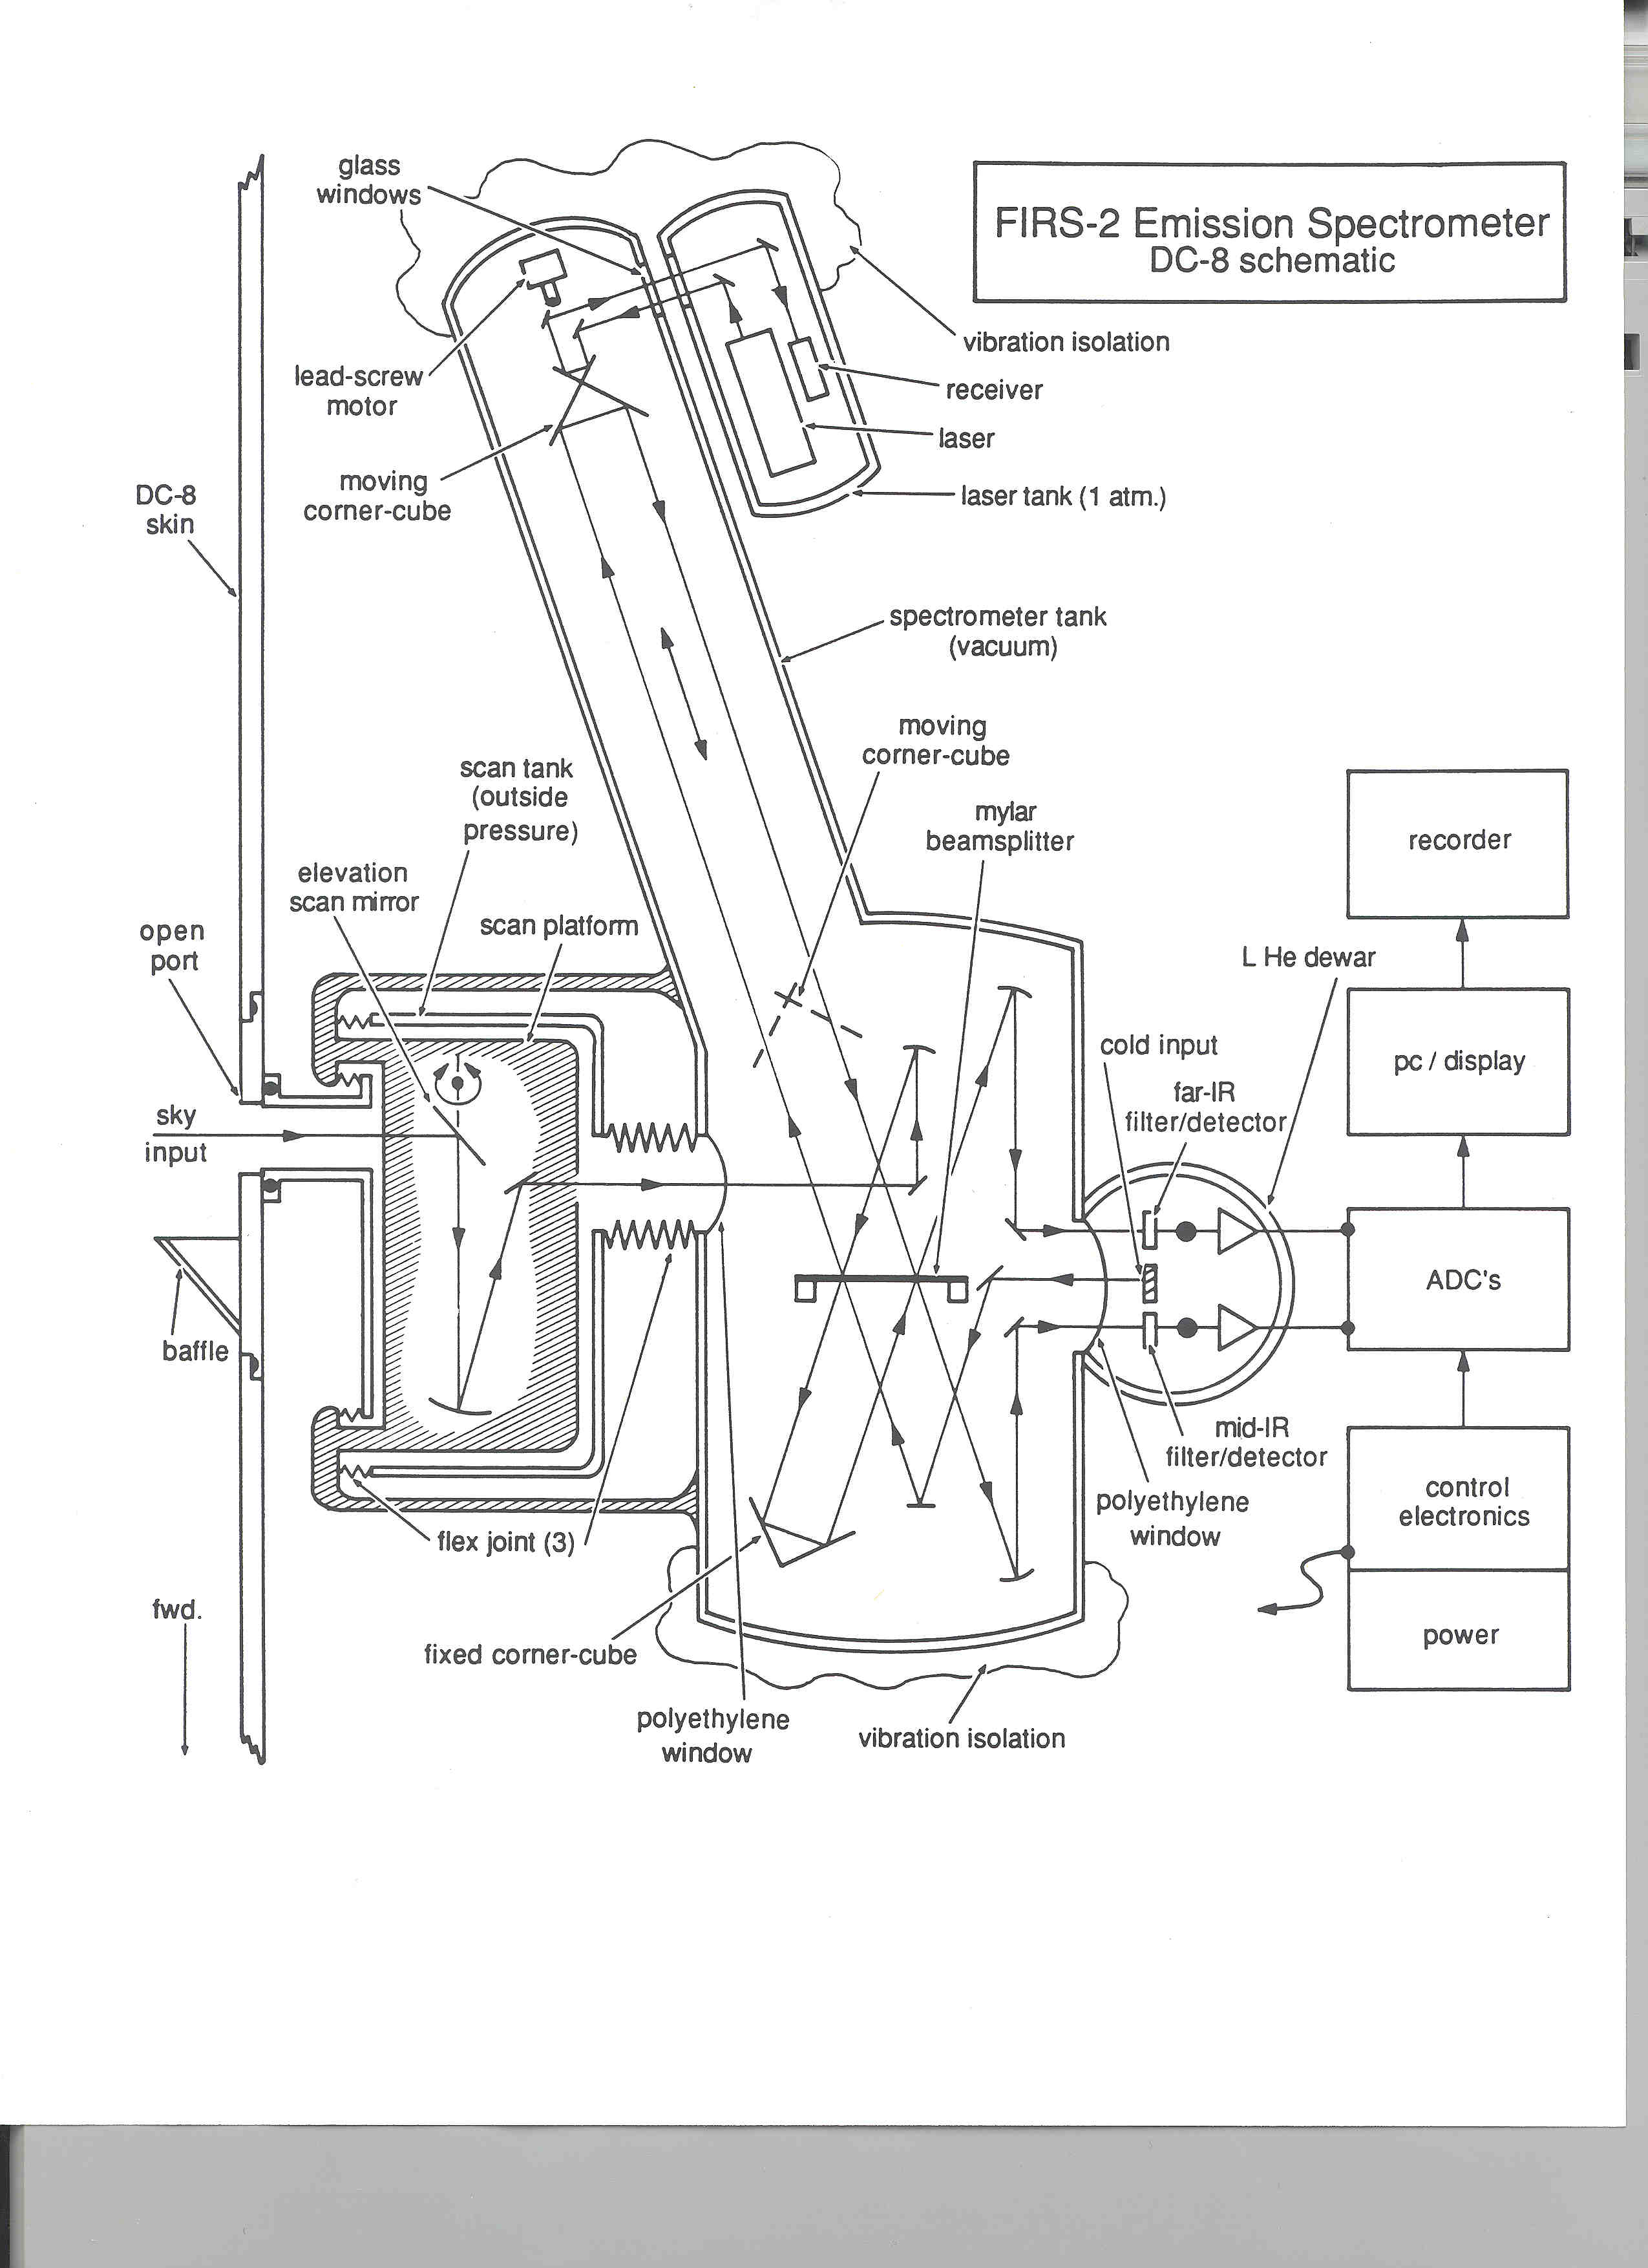

Slide 6
Sample of ONE FIRS-2 spectrum

Slide 8
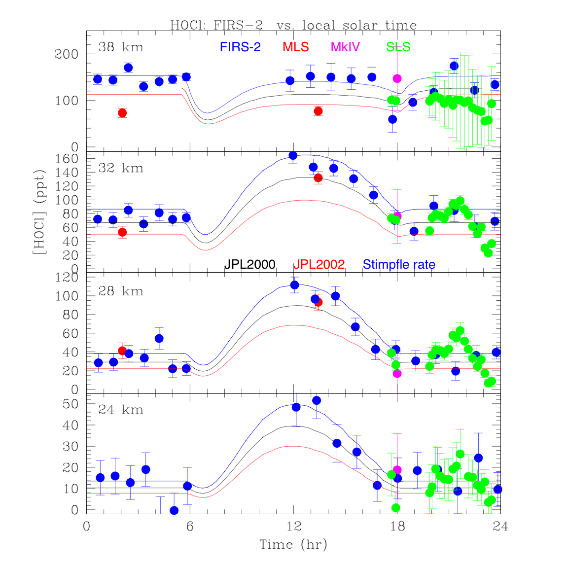
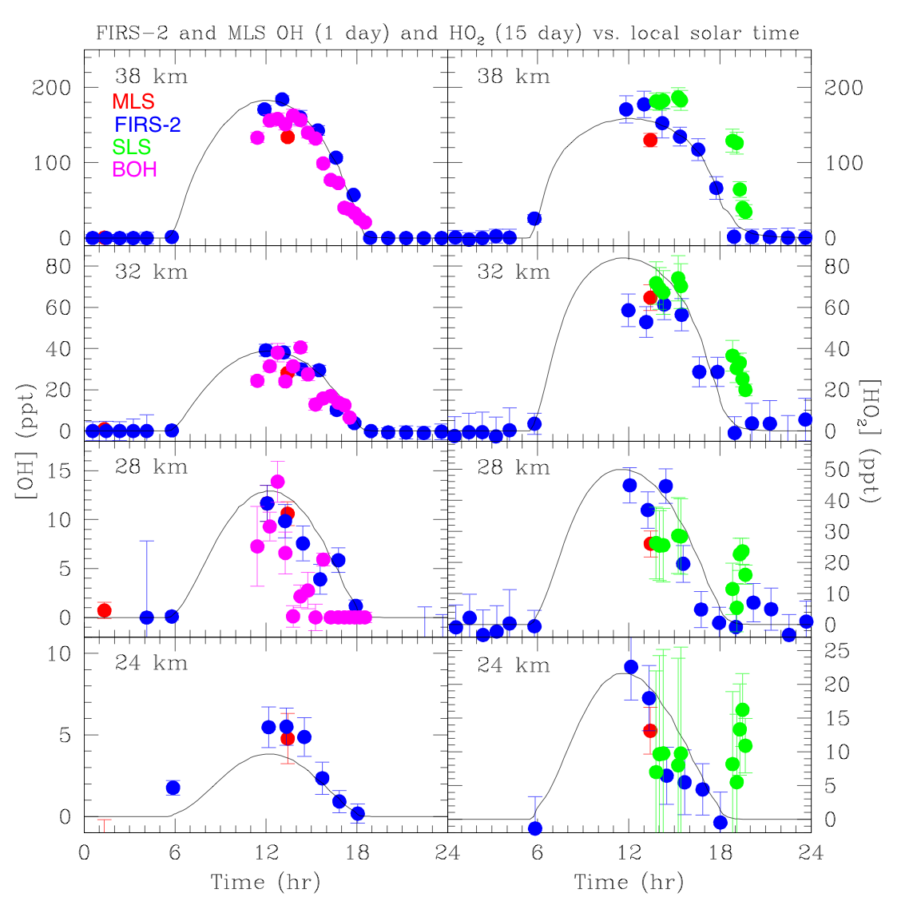
Sample of what FIRS-2 was used for…

Slide 9
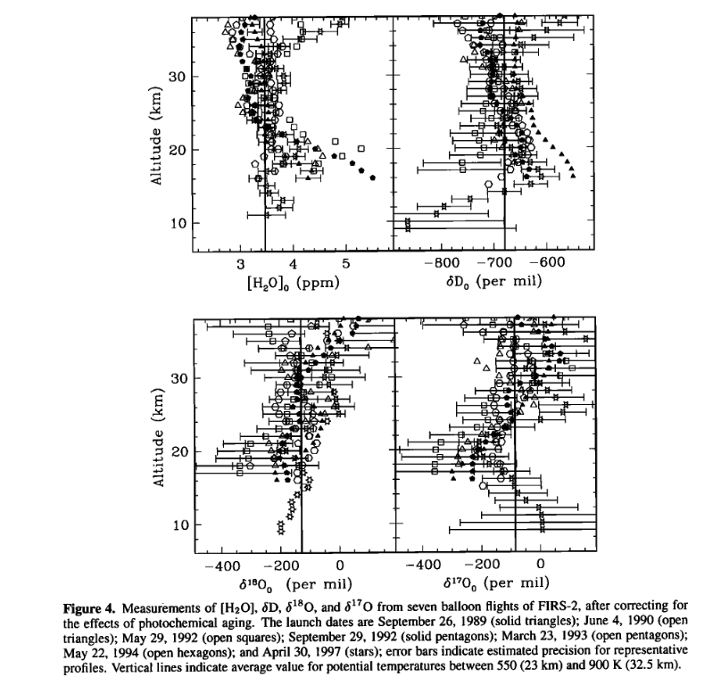

Slide 10
List of science results from FIRS-2 data
HO_{x} photochemistry
HOCl photochemistry
HCl to ClO to ClONO₂ partitioning
HNO₃ to NO_{x} partitioning
Bromine stratospheric chemistry
Water vapor trending
Water vapor isotope studies
Basic molecular spectroscopy
  Including line mixing of the CO₂ band
And many more…
57 publications on just MY CV…

Slide 11
Molecules retrieved include:
CO₂, H₂O, HDO, H₂¹⁸O, H₂¹⁷O, O₃ (and many isotopomers), O₂,
OH, HO₂, H₂O₂, O³P,
HCl, HOCl, ClONO₂, HBr, HOBr, HF,
NO₂, HNO₃, N₂O₅, (inferred NO),
N₂O, CH₄, numerous CFCs, HCFCs, SF₆, OCS, acetone, volcanic aerosol OD, water vapor continuum

Slide 12
How did that get me to NASA HQ?
Besides Mike Kurylo feeling sorry for me for spending too much time in Fort Sumner?
This experience helped to to understand much of the critical science topics of NASA’s Upper Atmospheric Research Program.
I had a fundamental grasp on remote sensing.
I knew enough about science instrumentation to be dangerous.
I knew how to learn from smart people I’ve worked with, like Kelly!

Slide 13
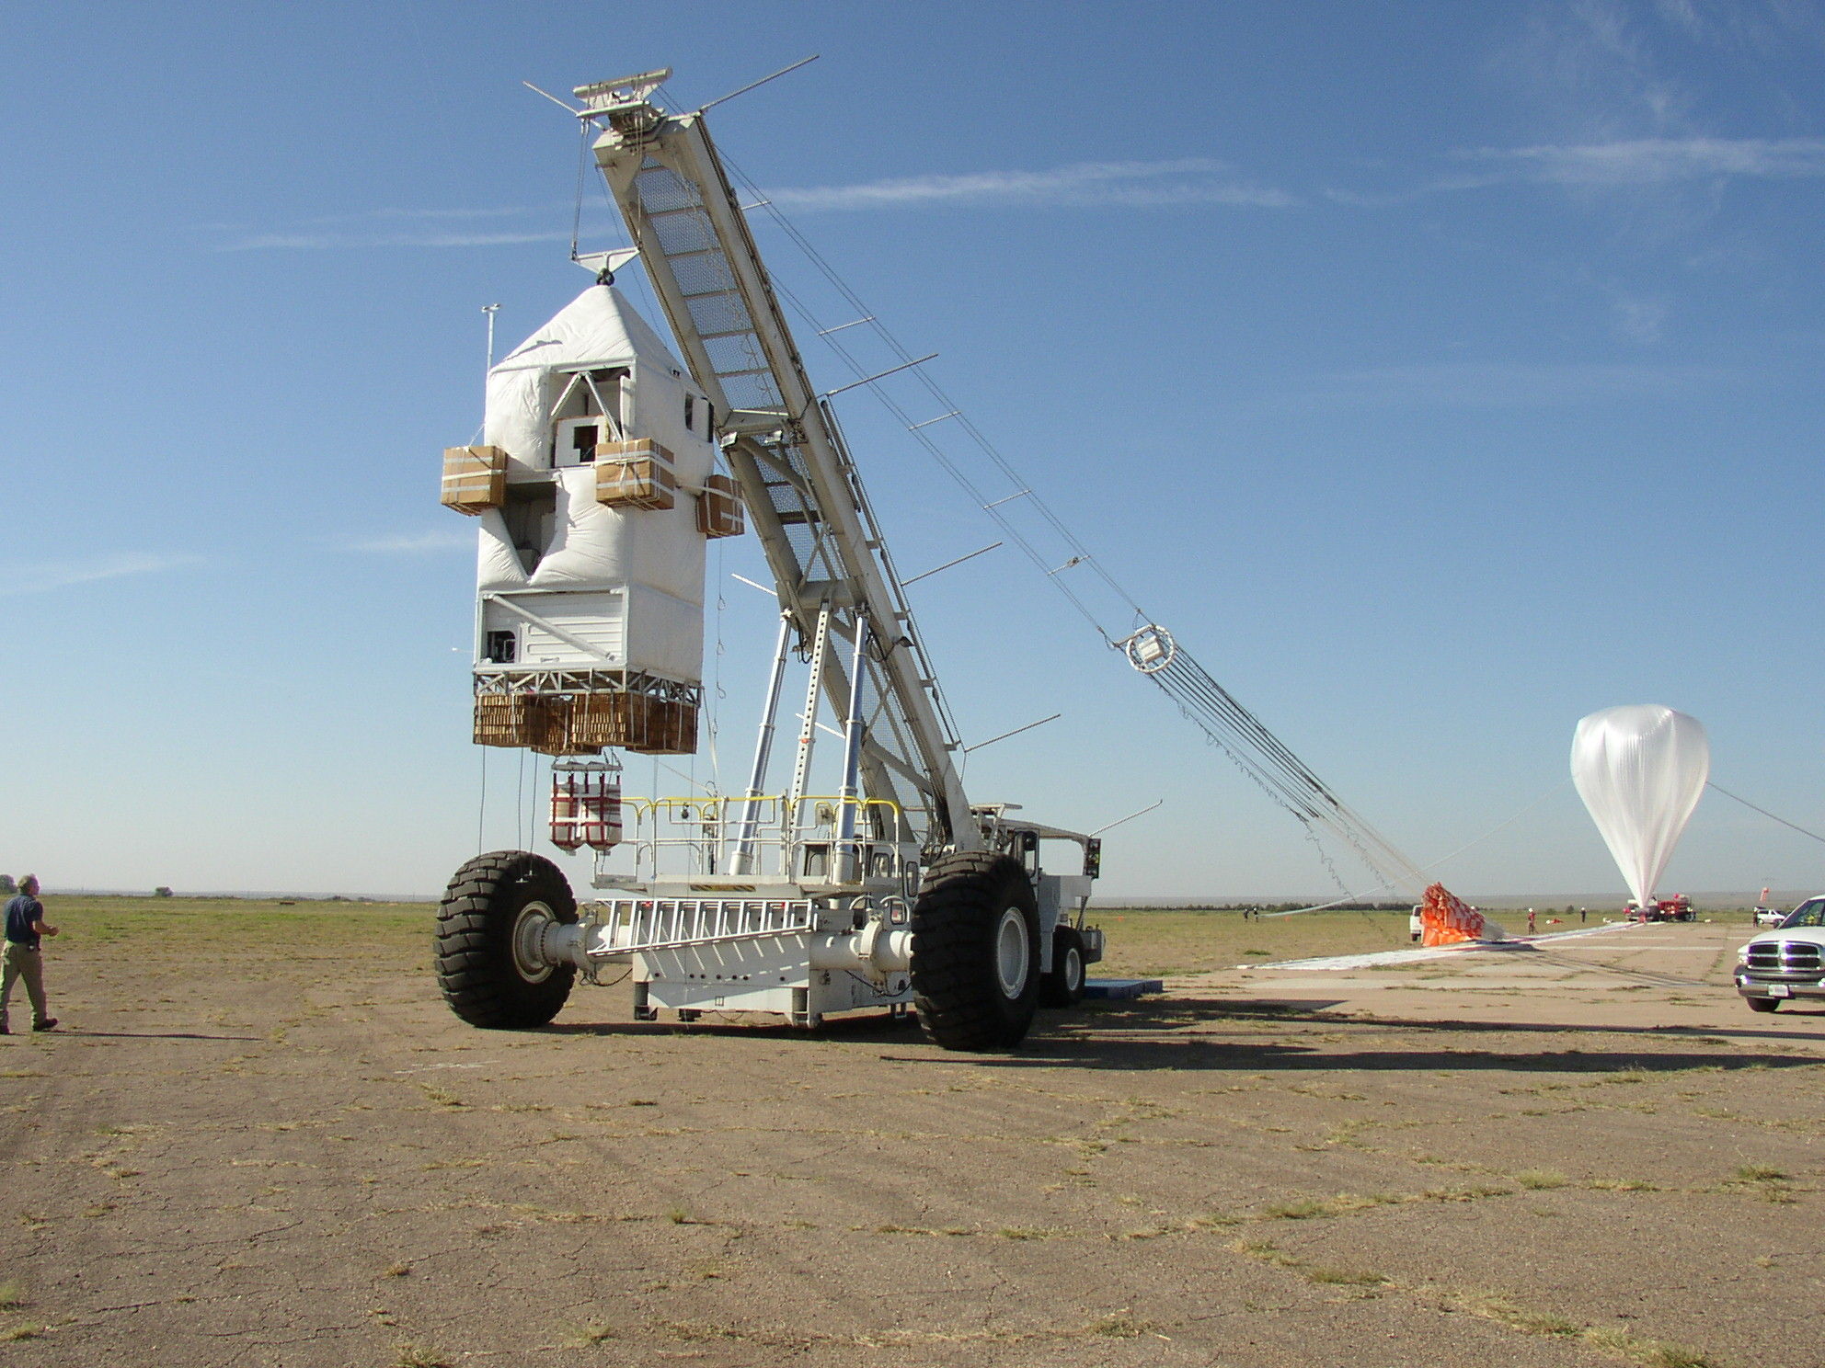
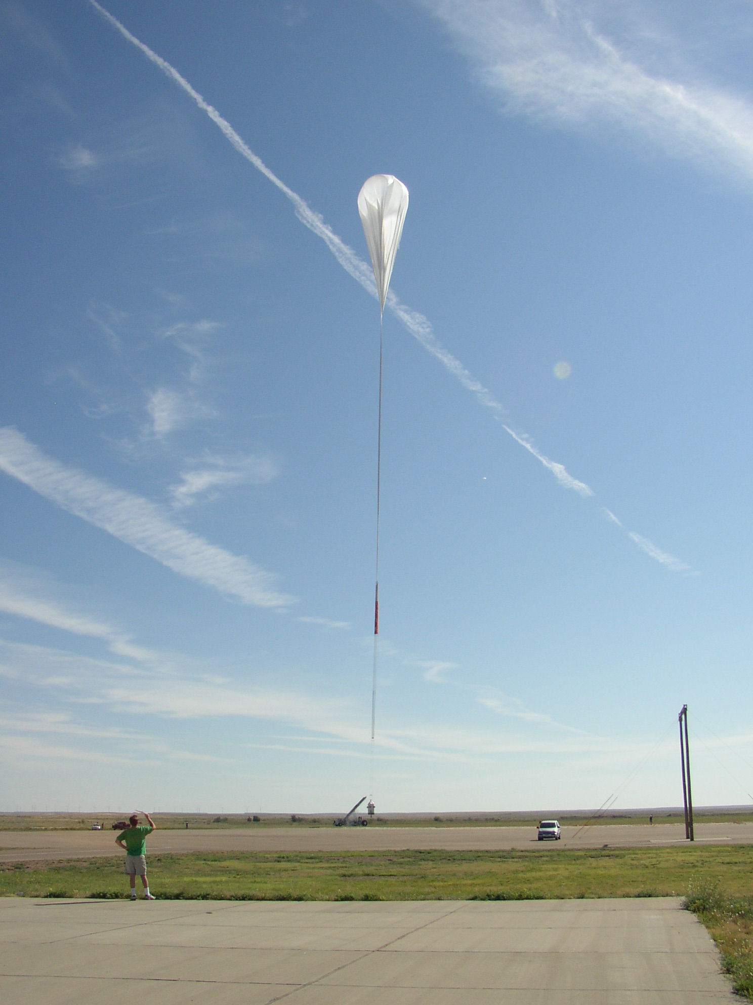
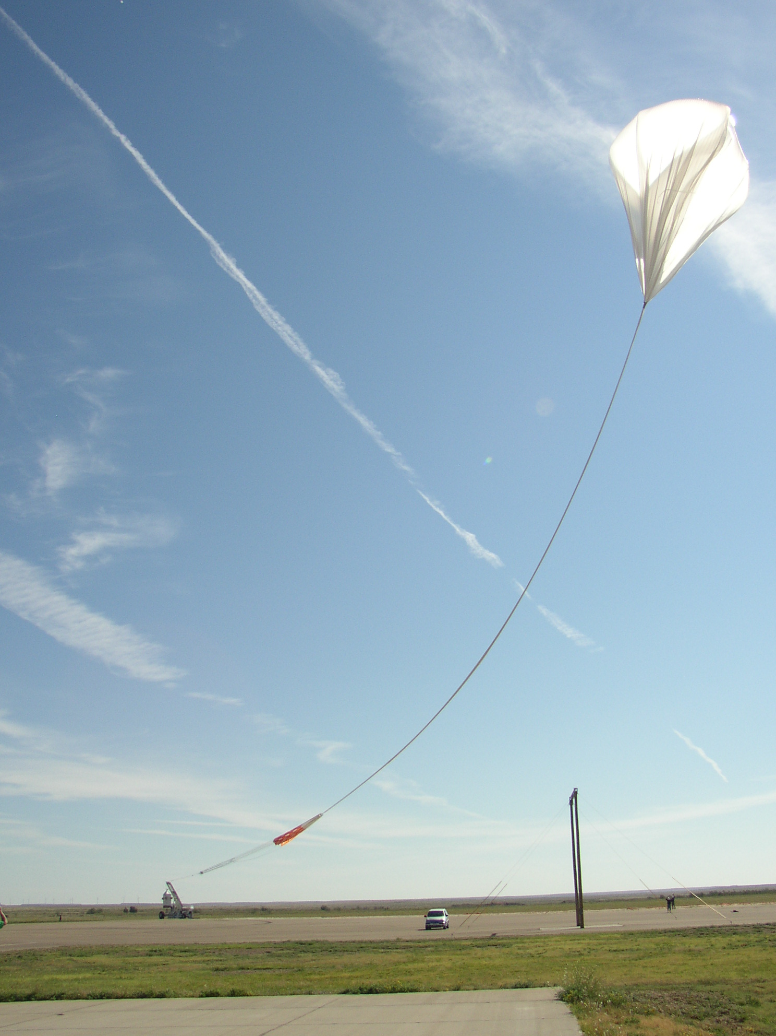
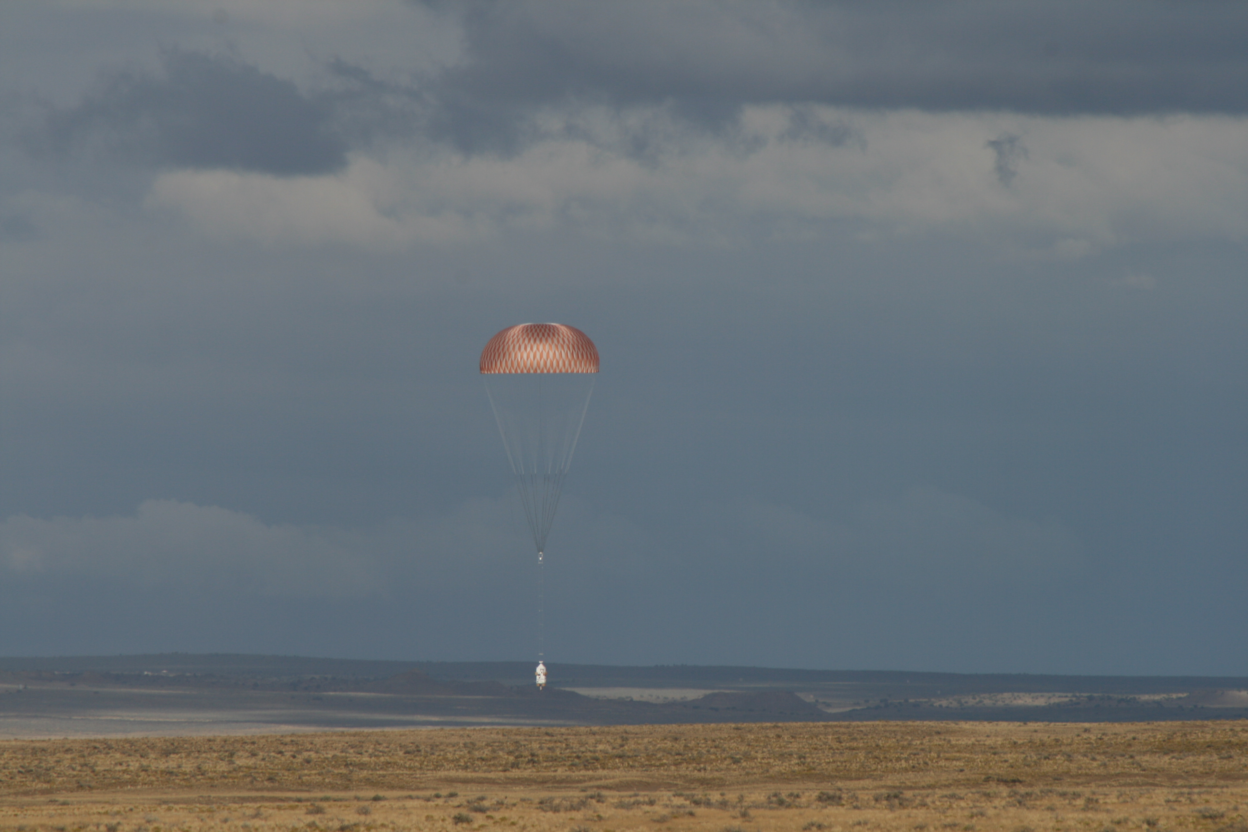

Slide 14
