Slide 1


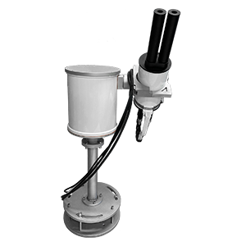
TEMPO/GeoXO ACX Joint Science Team Workshop
SMART-s based retrieval of Aerosol Optical Depth (AOD) from Pandora-2S
at Arlington
Mahesh Bade¹, Ukkyo Jeong², Seongyoung Kim², Si-Chee Tsay³, and Yang Li^{1,*}
¹Department of Environmental Science, Baylor University, Waco, TX-76706, USA
²Division of Earth Environmental System Science, Major of Spatial Information Engineering, Pukyong National University, Busan, Republic of Korea
³NASA Goddard Space Flight Center, Greenbelt, MD, USA
08/22/2025
*This research is funded by NASA’s Early Career Research (ECR) Program.

Slide 2
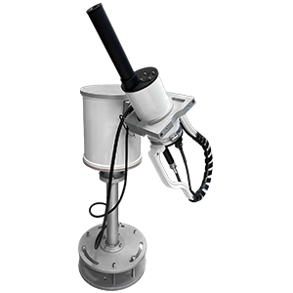
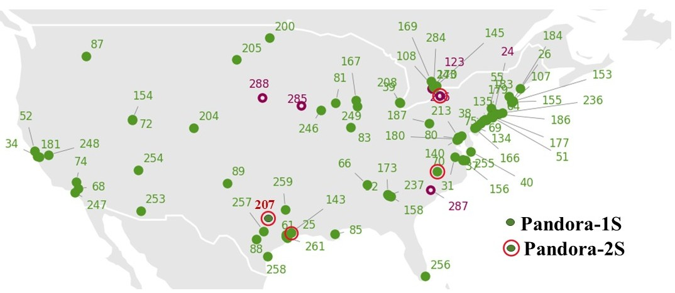
Motivation
Pandora: A ground-based spectrometer (S) available in 1S and 2S, designed to measure trace gases and aerosol optical depth (AOD), supporting air quality research and satellite validation.
Pandora Global Network (PGN): A worldwide network of Pandora spectrometers providing ground-based measurements of trace gases and aerosol optical depth (AOD).
2S
1S
Image source: Google images
The majority of Pandora instruments in the U.S. are 1S, optimized for trace gas retrieval but lacking AOD measurement capability.
AERONET measures aerosol properties (AOD, Angstrom exponent, particle size) but not trace gases.
PGN network showing the locations of Pandora 1S and 2S instruments across the USA (Image source: PGN website)
Collocated aerosol and trace gas measurements are essential for understanding atmospheric processes.
Currently, there are four Pandora 2S instruments in the U.S. are equipped to measure both AOD and trace gases, making them crucial for developing and testing Pandora AOD retrieval algorithms and validating satellite aerosol and gas products.

Slide 3
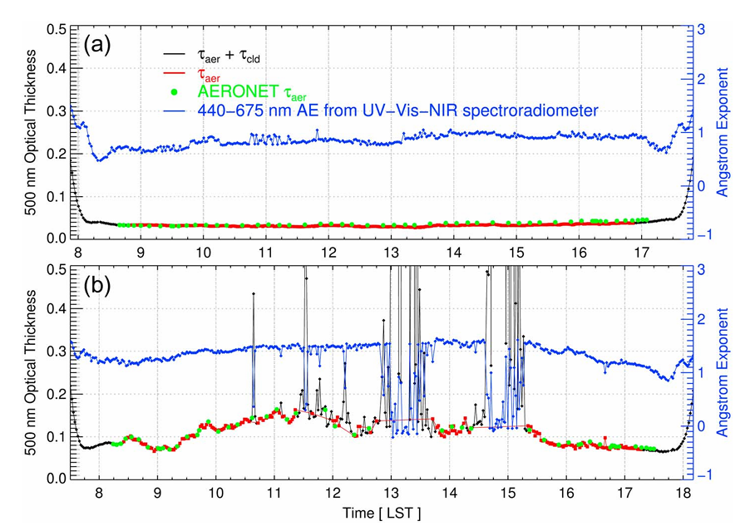
Motivation
Research by Jeong et al. (2018) demonstrates that Pandora instruments, which are ultraviolet-visible-near-infrared (UV-Vis-NIR) spectroradiometers, can reliably retrieve both trace gases and AOD across varied atmospheric conditions.
The developed Spectral Measurements for Atmospheric Radiative Transfer spectroradiometer (SMART‑s) in Jeong et al. (2020) covers a spectral range of 280–820 nm, broader than the standard Pandora spectrometer range (270–530 nm).
SMART‑s can also be extended to retrieve data from Pandora‑2S with a spectral range of 420–800 nanometers.
Temporal variations of 500 nm aerosol/cloud optical thickness and Ångström Exponent on (a) 12 Nov 2016 (clear) and (b) 23 Oct 2016 (partly cloudy) (Jeong et al., 2018)

Slide 4
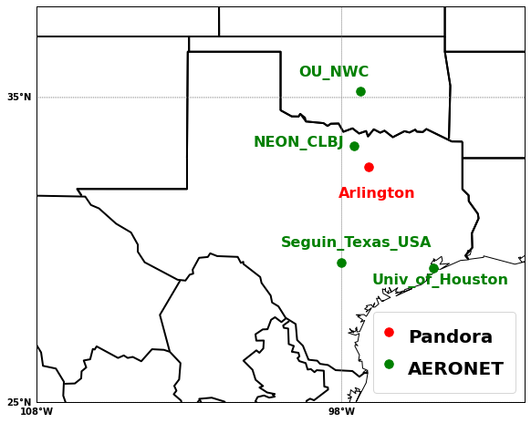
Pandora-2S at Arlington, TX
32.7316°N, 97.114°W
AOD processing: 01/01/2023 – 12/31/2023
Geographical locations of Pandora and AERONET stations
Urban-industrial site in Arlington, within the DFW (Dallas–Fort Worth) metroplex
Major highways (I-20, I-30, I-35W) → Elevated NO₂ & VOCs
Nearby power plants (e.g., Mountain Creek)
Aircraft emissions from DFW Airport
High photochemical activity → O₃, HCHO, SOA formation
Occasional impact from wildfire smoke & regional transport
Column data of AOD, and trace gases (HCHO, NO₂, and O₃) can be obtained through PGN
AERONET stations near the Pandora site provide continuous AOD data, supporting validation

Slide 5
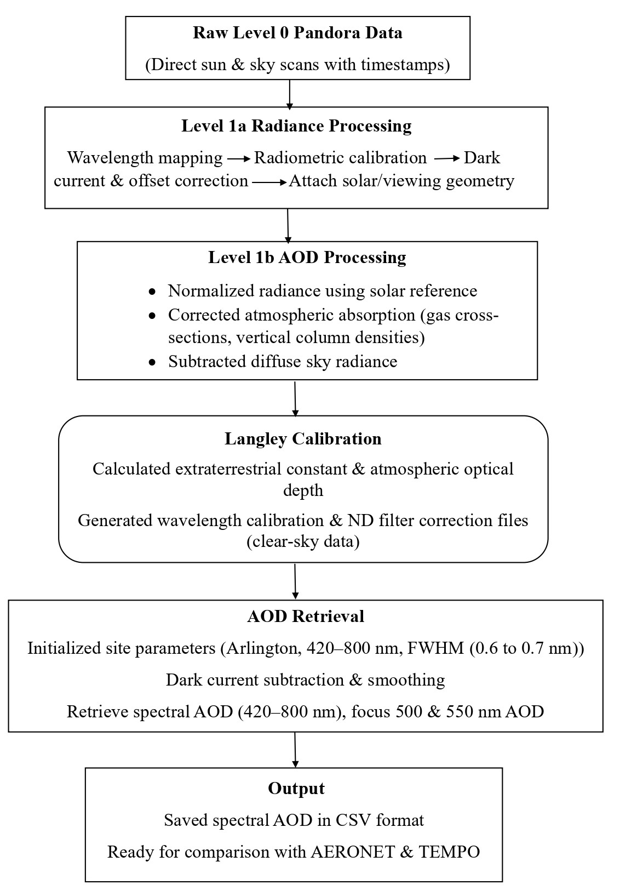
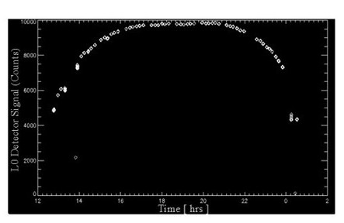
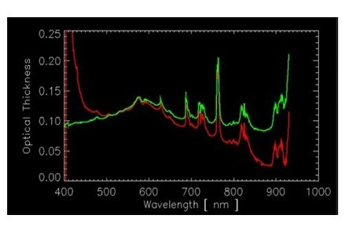
SMART-s (Spectral Measurements for Atmospheric Radiative Transfer- spectroradiometer)
Level 0 SMART-s raw spectral Signal, Arlington, 03/25/2023
Spectral Optical Thickness (400–1000 nm) before (red) and after (green) Neutral Density (ND) filter correction
Jeong et al., 2018

Slide 6
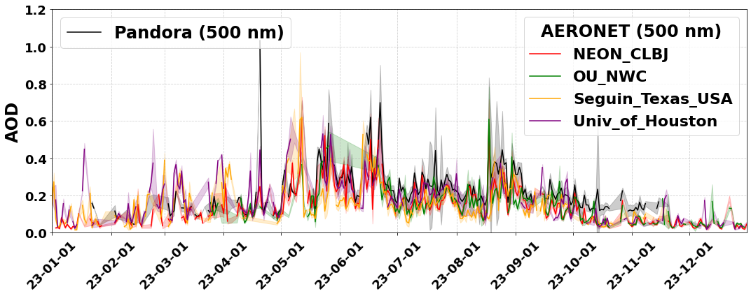



SMART-s processed Pandora AOD and comparison with AERONET
Data retrieval, and processing
Black lines show Pandora AOD at 500 nm, while AERONET stations also show AOD at 500 nm: NEON_CLBJ (red), Seguin_Texas (orange), OU_NWC (green), and Univ_of_Houston (violet).
AOD exhibited notable temporal variability throughout the study period.
AOD ranged from 0.05 to 0.6, with peaks in May and June, driven by summertime photochemistry and wildfires in April–May 2023 (WFCA, 2023; Star-Telegram, 2023).
Arlington’s highest daily mean AOD (>1.0) in mid-April was caused by dust transport under strong winds and smoke from regional wildfires (WFCA, 2023; NOAA, 2023).
Instrument | Data used in this study | Spectral range | Data period
Pandora-2S | AOD (500 and 550 nm) HCHO, NO₂, O₃ | 280-525 nm (1S) 400-900 nm (2S) | 01/01/2023 – 12/31/2023
AERONET | AOD (500 nm) | 340-1020 nm | 01/01/2023 – 12/31/2023
TEMPO | AOD (550 nm), HCHO, NO₂, O₃ | 290-740 nm | 08/02/2023 – 11/30/2023
Daily mean AOD at 500 nm from four AERONET sites with Pandora comparison, 2023

Slide 7
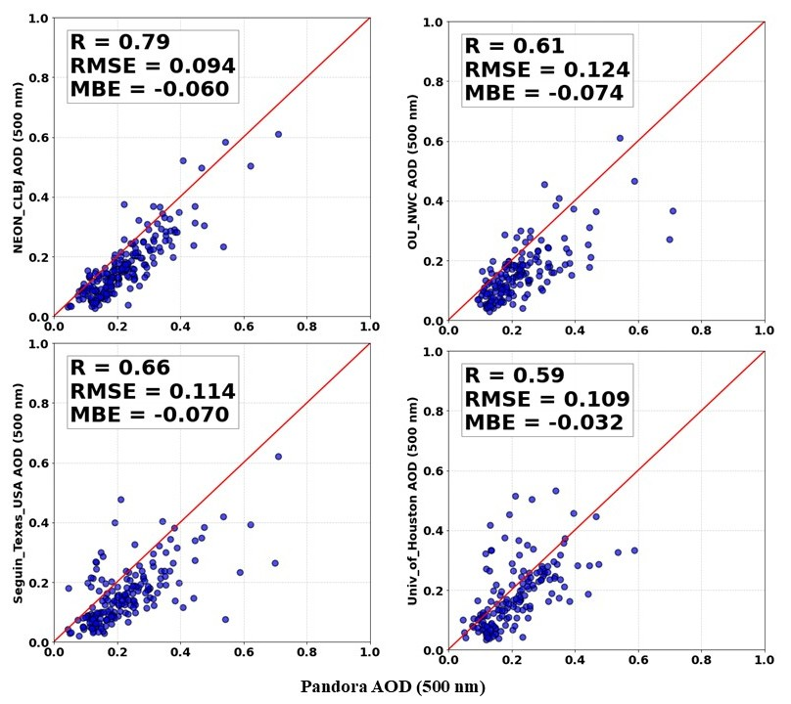
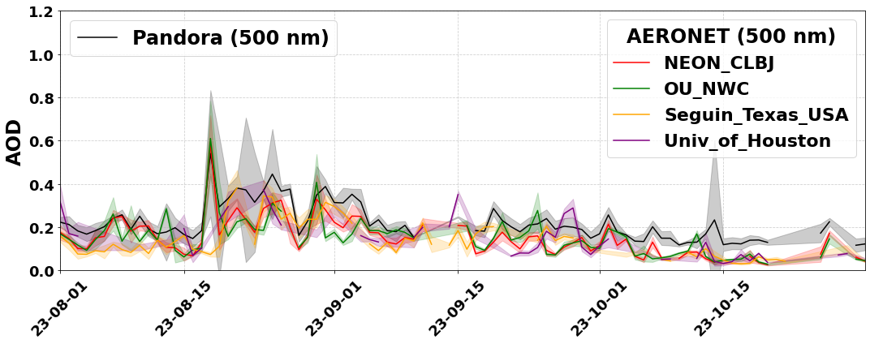
Comparison of Pandora and AERONET AOD during late-summer events, 2023
Daily mean AOD at 500 nm from four AERONET sites compared with Pandora measurements, August-October, 2023
Correlation of daily mean AOD between Pandora and four AERONET sites, 2023
Pandora showed strong agreement with AERONET sites, with NEON_CLBJ (32 km away) and OU_NWC (302 km away) following Arlington’s trends; NEON_CLBJ had the highest correlation (R =0.79).
Seguin_Texas and Univ_of_Houston displayed moderately lower correlations (R = 0.61 and R = 0.59, respectively), with slightly different AOD amplitudes likely due to local sources and meteorological variations.
These results highlight Pandora’s ability to capture regional aerosol variability and complement ground-based networks, though localized AOD peaks show the need for denser monitoring to capture fine-scale variations.

Slide 8
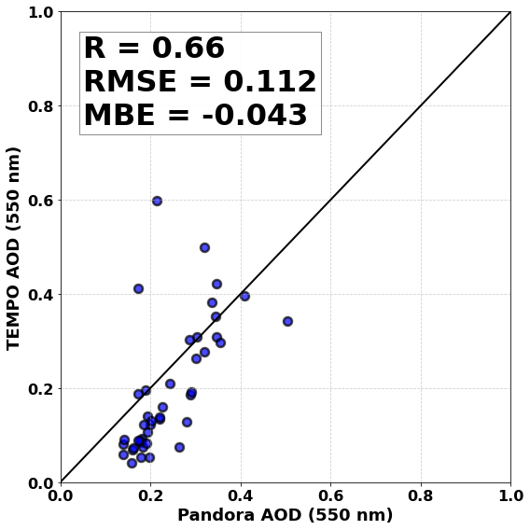
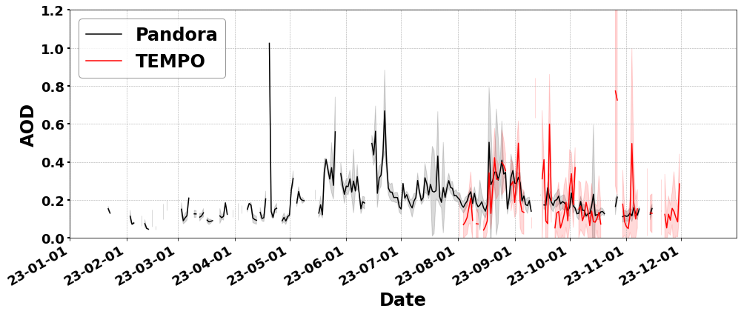
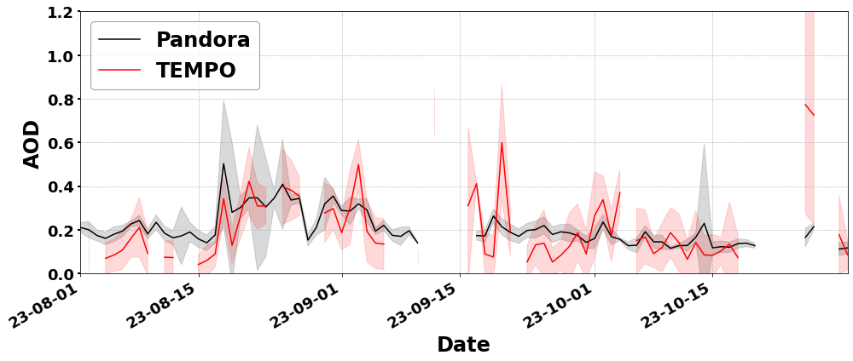



Comparison of Pandora AOD with TEMPO
Correlation of daily mean AOD between Pandora and TEMPO at Arlington, August-October, 2023
Daily mean AOD at 550 nm from TEMPO compared with Pandora measurements at Arlington: (a) January-December 2023, (b) August–October 2023
a)
TEMPO (red) and Pandora (black) AOD at 550 nm generally agree (R = 0.66) with similar seasonal trends.
Notable elevated AOD levels from TEMPO occurred in September and October. Around noon, the sun is nearly behind the satellite, creating a backscattering geometry that increases apparent surface reflectance and cloud contamination, potentially leading to overestimated TEMPO AOD (per communication with Dr. Hai Zhang, NOAA).
b)

Slide 9
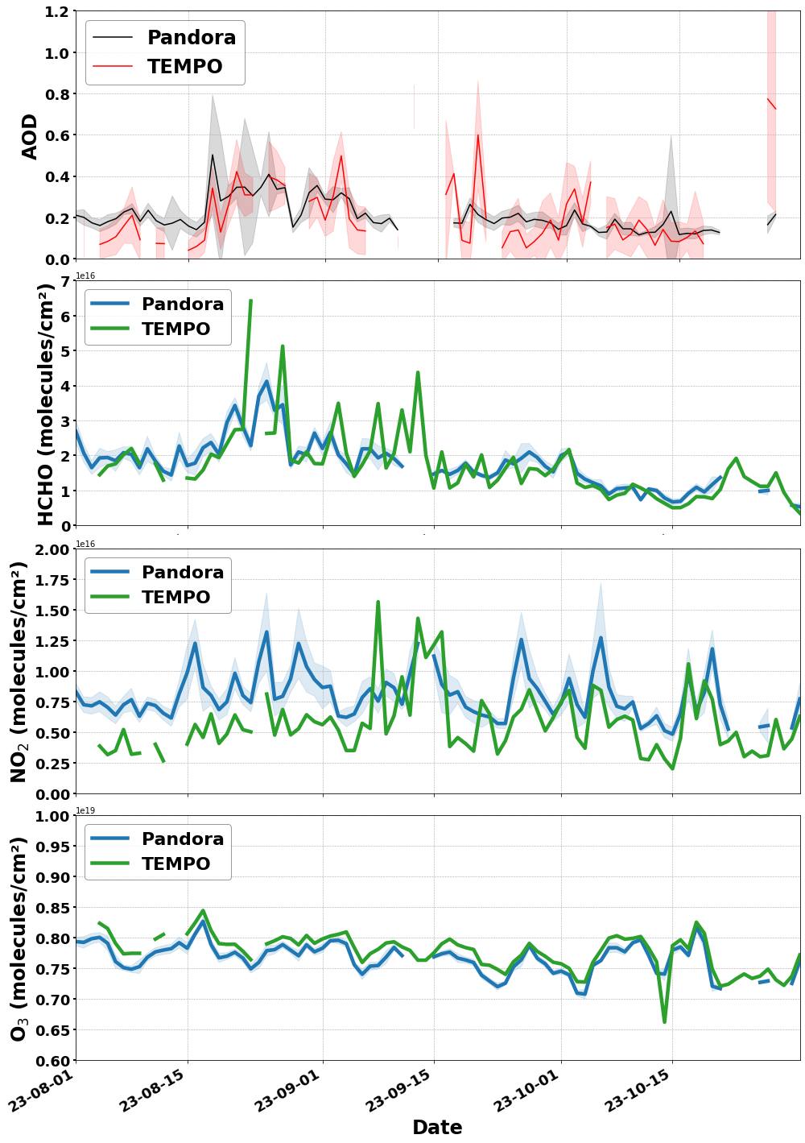
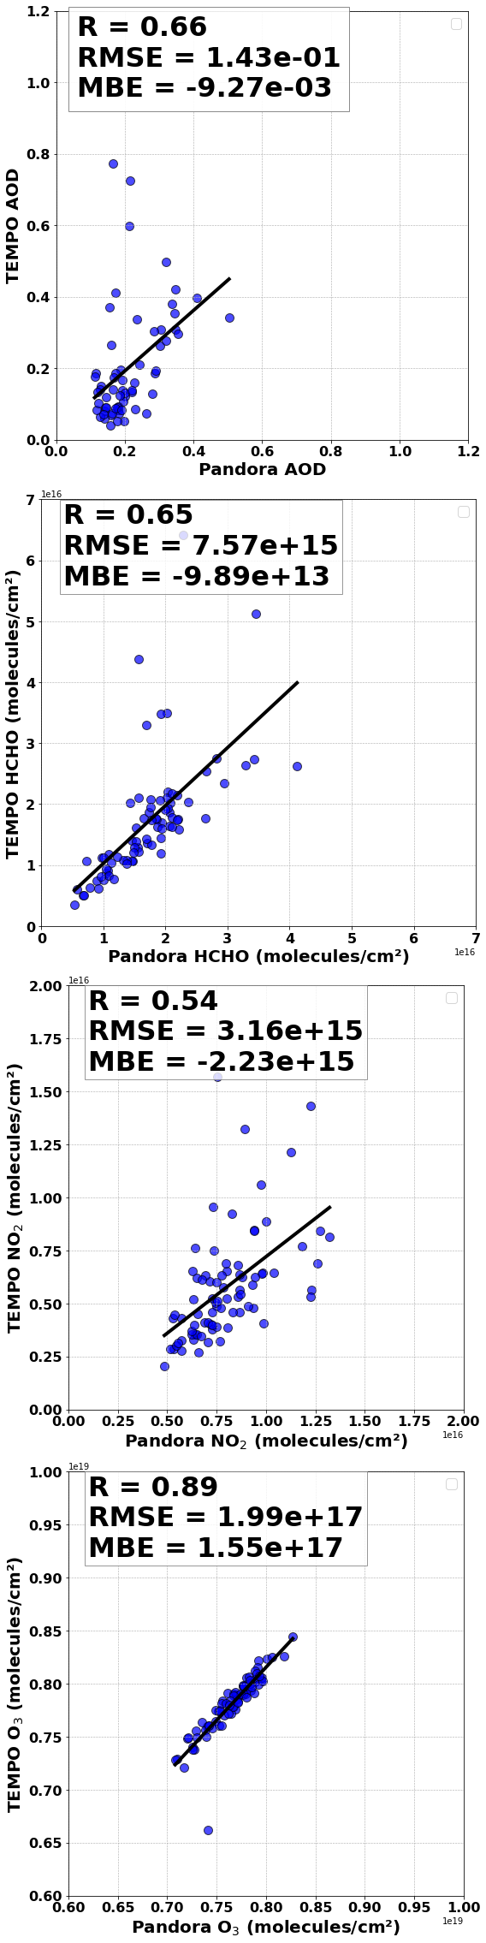
Co-variations of AOD and trace gases observed by Pandora & TEMPO
a)
a)
Pandora AOD and trace gases show good agreement with TEMPO data.
Strong coincident HCHO–AOD peaks with elevated O₃ from mid-August to early September indicate intense VOC oxidation, rapid SOA formation, and VOC-driven ozone production under warm, sunny, stagnant conditions (Chauhan et al., 2025; TCEQ, 2024).
General NO₂–AOD co-variations from September to October could reflect combustion effects and NO₂-driven secondary nitrate aerosol formation (Zhao et al., 2018; Lin et al., 2021).
b)
b)
c)
c)
d)
d)
Daily mean Pandora and TEMPO AOD and trace gases
a) AOD b) HCHO, c) NO₂,
d) O₃

Slide 10
Conclusions
AOD data from the Pandora-2S instrument at the Arlington site were retrieved for January to December 2023 using the SMART-s algorithm and Langley-calibrated, high-resolution spectral data (280–820 nm).
Strong correlations between Pandora and nearby AERONET (NEON_CLBJ (R=0.79)) sites confirm data reliability, with differences highlighting localized processes.
Summer patterns of HCHO, NO₂, and O₃ correlate with aerosol loading, reflecting photochemical processes that influence secondary aerosol formation and also potential contribution from combustion emissions.
TEMPO satellite retrievals show good agreement with Pandora for O₃ and moderate agreement for HCHO and NO₂, as TEMPO’s lower near-surface sensitivity affects NO₂ comparisons.
Pandora AOD retrievals are limited by clear-sky conditions, sparse 2S instrument coverage, and assumptions about aerosol properties, introducing some measurement uncertainties.
A multi-platform approach combining ground-based Pandora 2S, AERONET, and TEMPO satellite data provides a robust framework for validating aerosol and trace gas products, improving atmospheric chemistry understanding and supporting air quality management efforts.
Future work will leverage these observational datasets and WRF-Chem simulations for improved understanding of aerosol–gas interactions, especially under pollution events such as wildfires.

Slide 11




Acknowledgement
Thank You
Dr. Ukkyo Jeong, Pukyong National University, South Korea
Seongyoung Kim, Pukyong National University, South Korea
Dr. Bryan Place, SciGlob, USA
Dr. Si-Chee Tsay, NASA Goddard Space Flight Center, USA
Dr. Shobha Kondragunta, National Oceanic and Atmospheric Administration., Satellite Meteorology and Climatology Division, USA
Dr. Hai Zhang, National Oceanic and Atmospheric Administration., Satellite Meteorology and Climatology Division, USA
Dr. Gonzalez Abad Gonzalo, Harvard and Smithsonian, USA
bade_mahesh@baylor.edu

