Slide 1
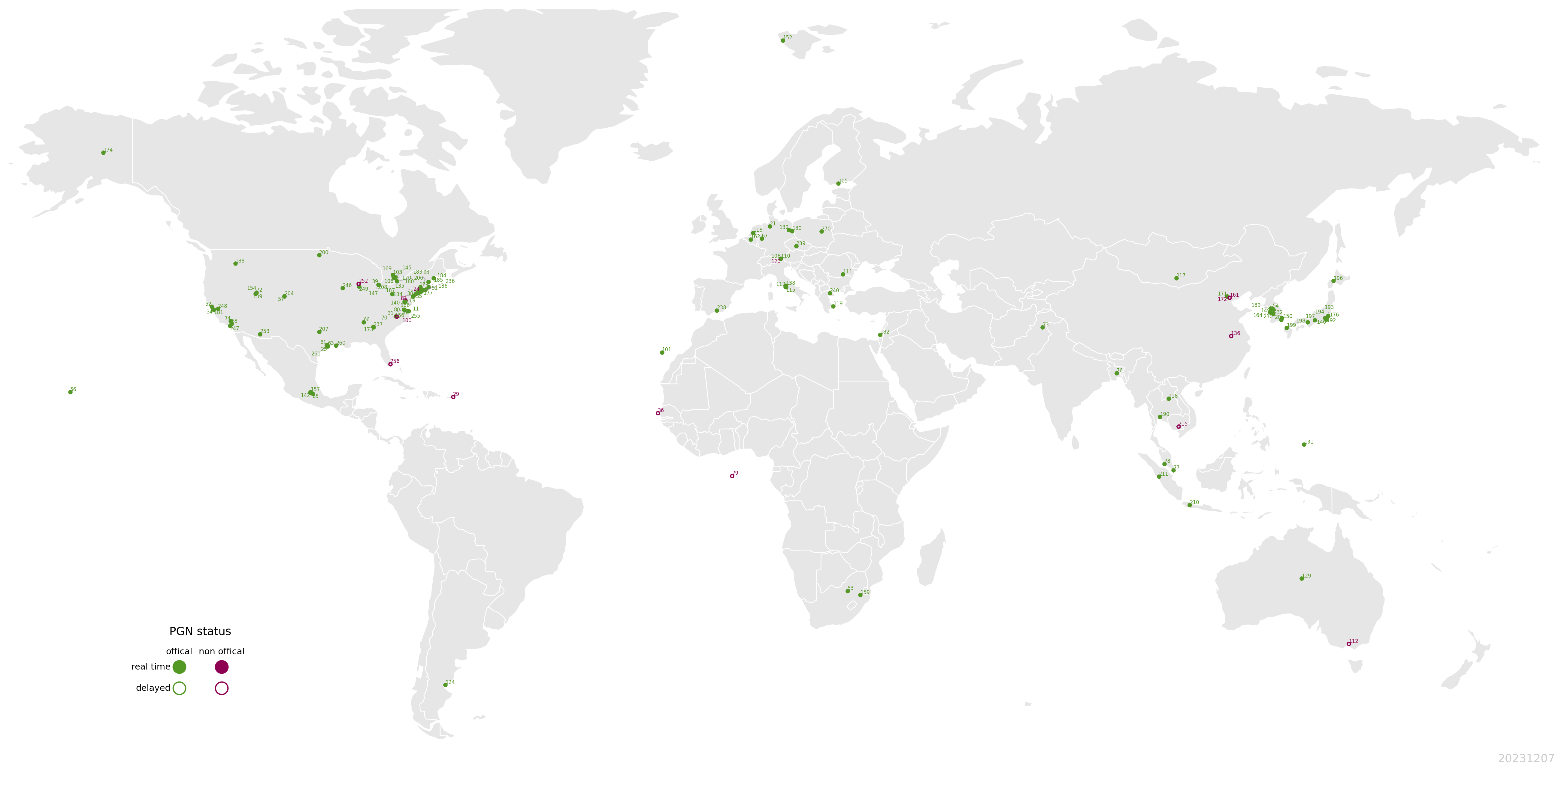






Optimal-Estimation Pandora Multi-Axis Retrievals for Evaluating diurnal cycle of TEMPO HCHO over North America
Tianlang Zhao¹, Jingqiu Mao^{1*}, Xiaoyi Zhao^{2*}, Debora Griffin², Ramina Alwarda³, Kim Strong³, William R Simpson¹, Martina M Friedrich⁴, Martin Tiefengraber⁵, Manuel Gebetsberger⁵, Alexander Cede⁵, Elena Spinei⁶, Apoorva Pandey^{6,7}, Thomas F Hanisco⁶
¹ University of Alaska Fairbanks ² Environment Canada, ³ University of Toronto, ⁴ BIRA-IASB, ⁵ LuftBlick, ⁶ NASA GSFC, ⁷ University of Maryland Baltimore County
* Corresponding authors
This work is supported by UAF Troth Yeddha’ R1 fellowship

Slide 2
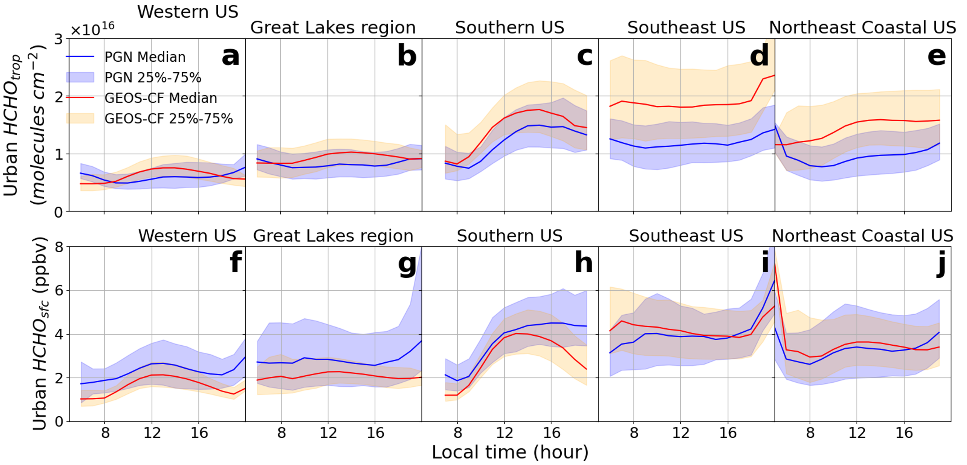

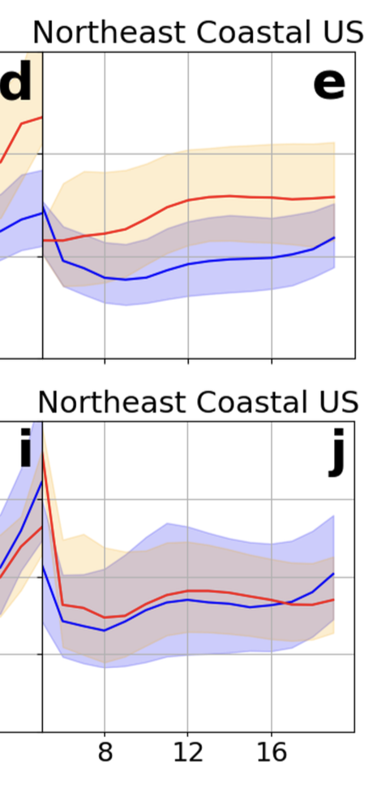
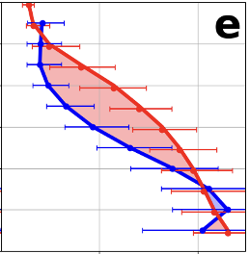



HCHO vertical profile: a key to understand meteorology-chemistry interaction
Eastern US, summer
HCHO column
3
GEOS-CF
GEOS-CF
molecules cm⁻²
2
Different model bias for column and surface
PGN
Altitude (km)
1
PGN
Surface HCHO
0
ppb
2
4
HCHO mixing ratio
(pptv)
Zhao et al., 2025, submitted to GRL, in revision
HCHO profile observation helps reconcile column and surface data
Local hours

Slide 3
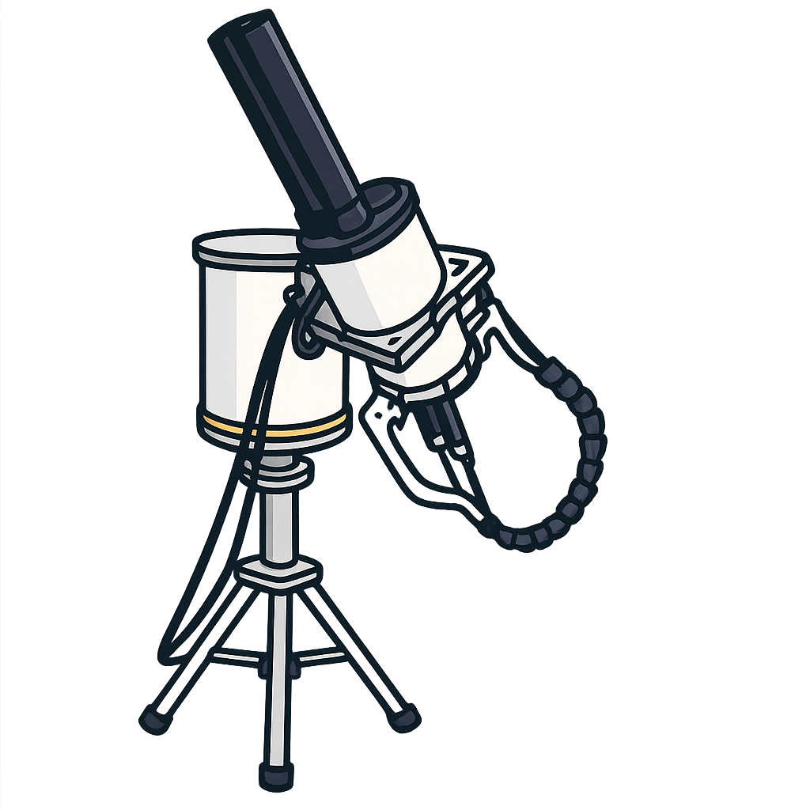
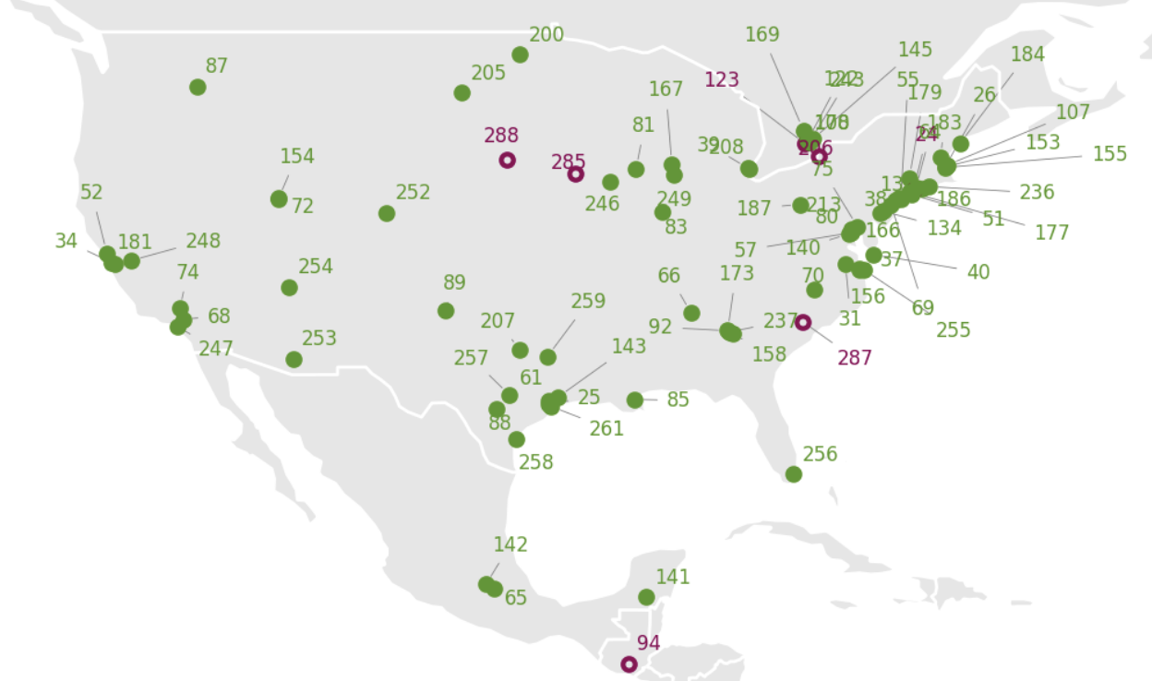
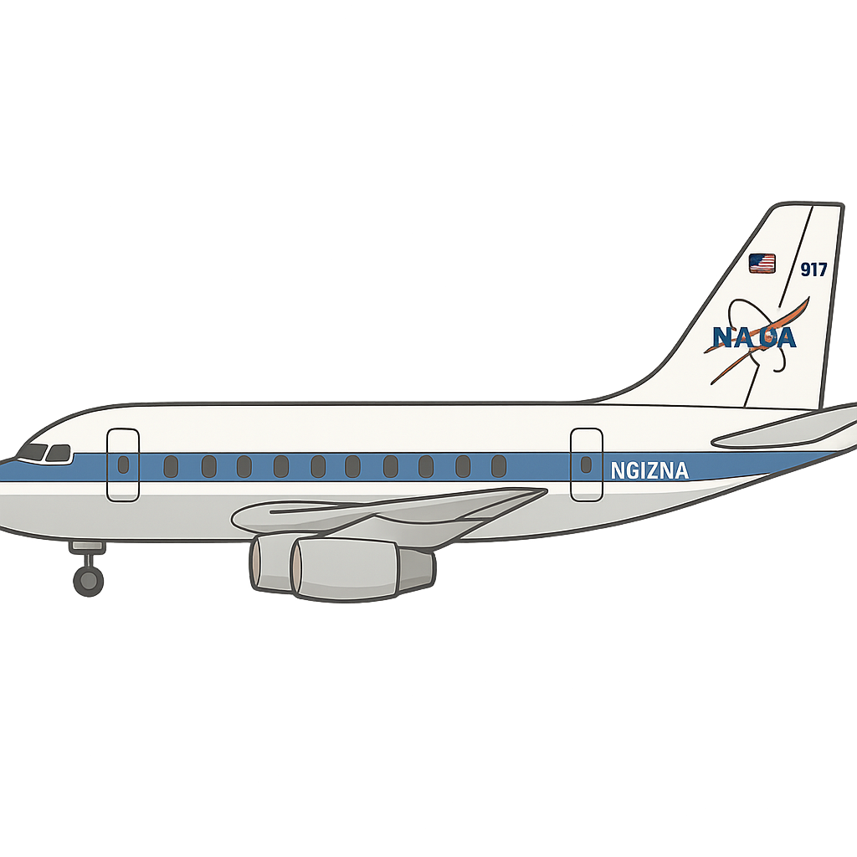

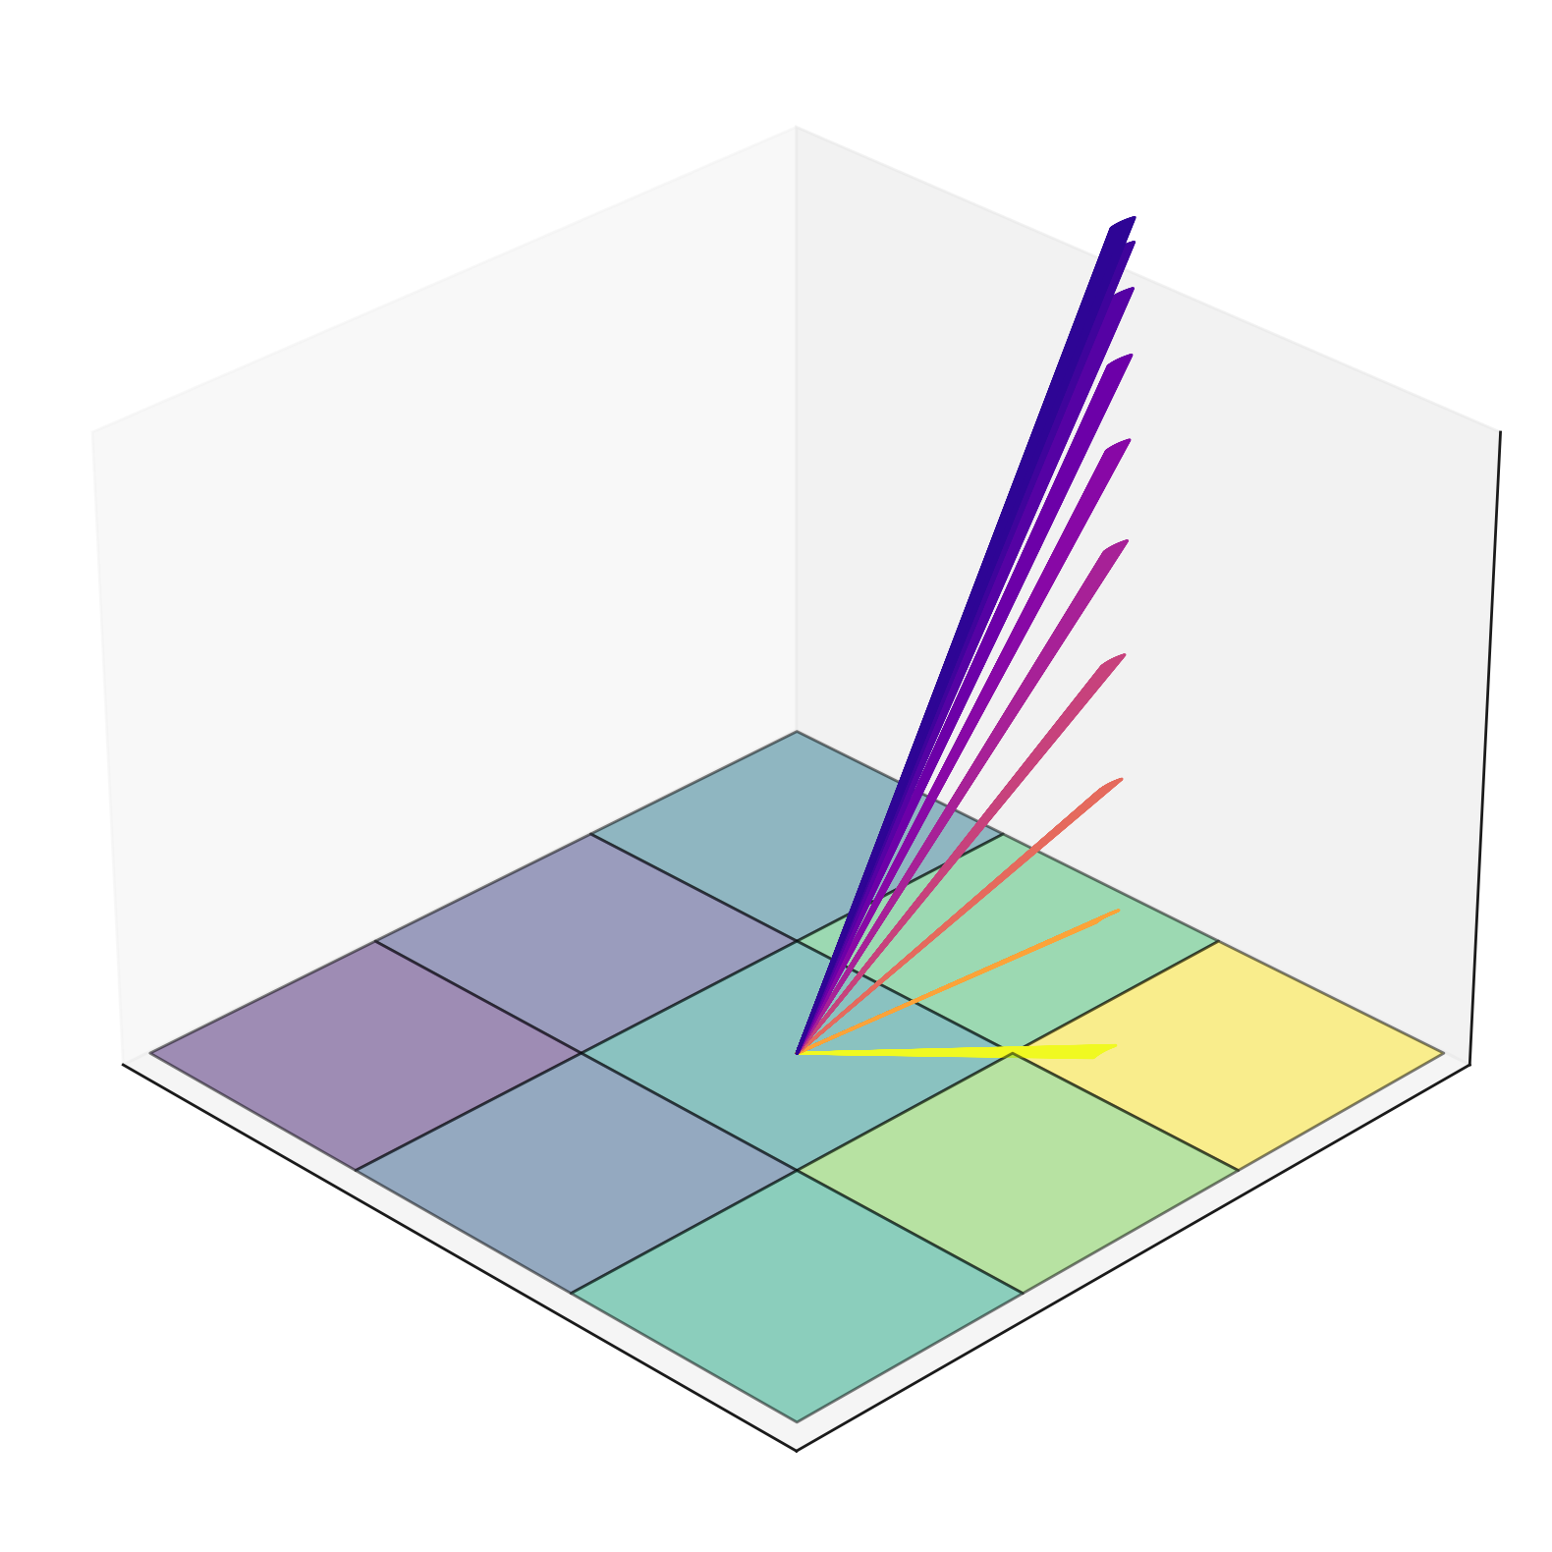
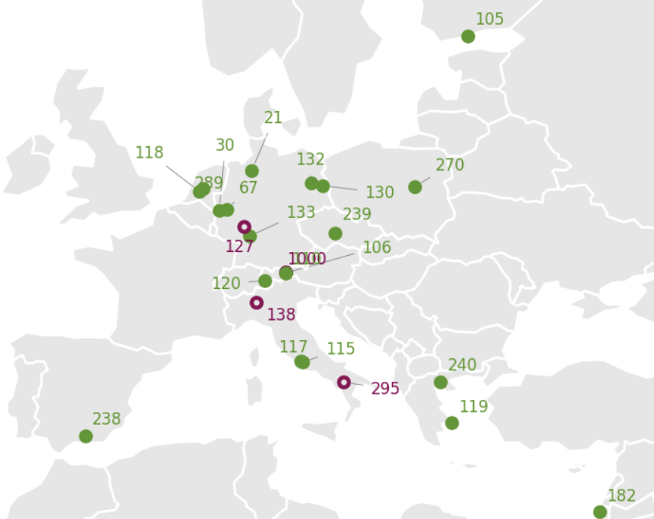
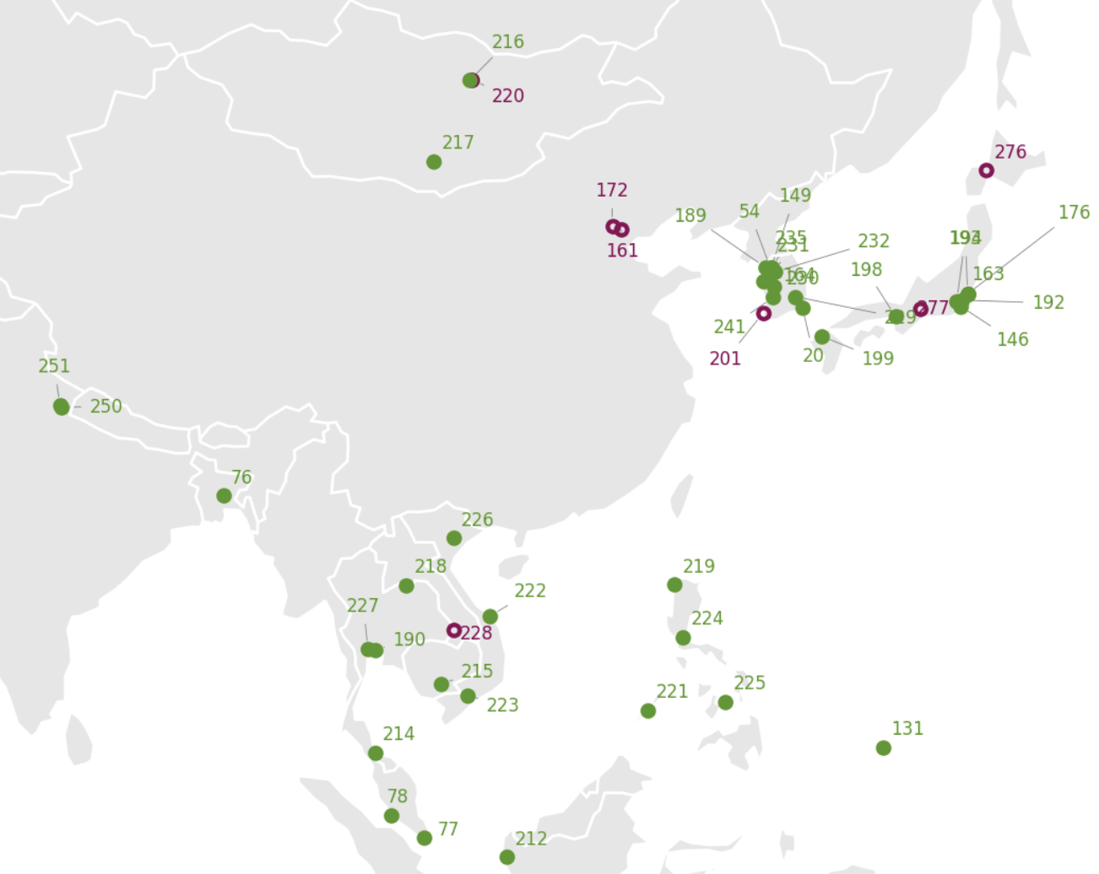
Advantages of PGN* multi-axis mode
Standardized instrument
consistent data process
Intercomparison can be difficult due to different instrument build, scanning routine and
Long-term continuous observations
High temporal resolution
Large and global distributed network
High sensitivity to near-surface trace gases
Altitude
Longer integration time increases Signal-to-Noise Ratio (SNR)
Uniform standard build, calibration, algorithm, centralized data process, easy to download
PGN: Pandonia Global Network

Slide 4
We present a new retrieval of PGN HCHO profiles using MMF* optimal estimation (OE) algorithm
MMF is one of the official OE algorithm for FRM4DOAS* and NDACC MAX-DOAS data.
Advantages of MMF:
OE retrieval provides the averaging kernel, allowing ‘apple-to-apple’ comparisons with other datasets
Using radiative transport model to calculate AMF, which is more reliable under complex aerosol and scattering situations.
MMF offers a better vertical resolution.
MMF is a bit more computation expensive than PGN official profiling, but it has many advantages
MMF: Mexican MAX-DOAS Fit (Friedrich et al., 2019)
FRM4DOAS: https://frm4doas.aeronomie.be/

Slide 5
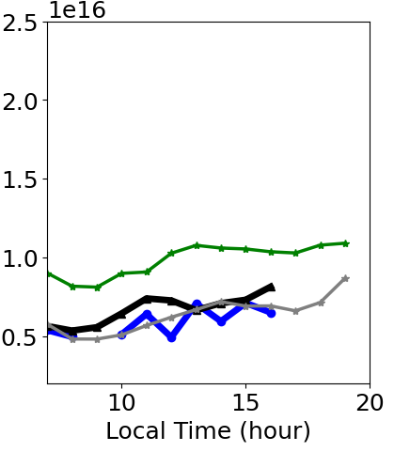
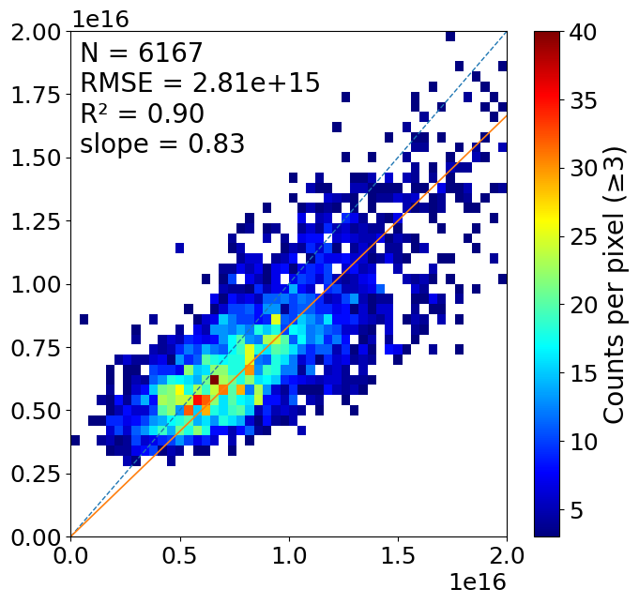
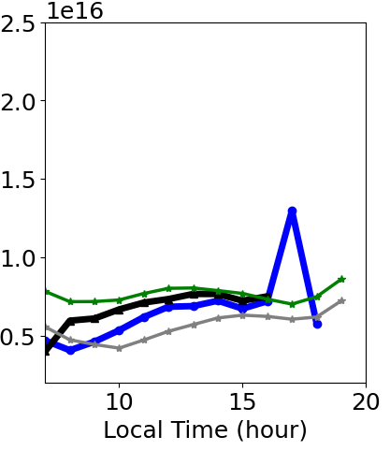
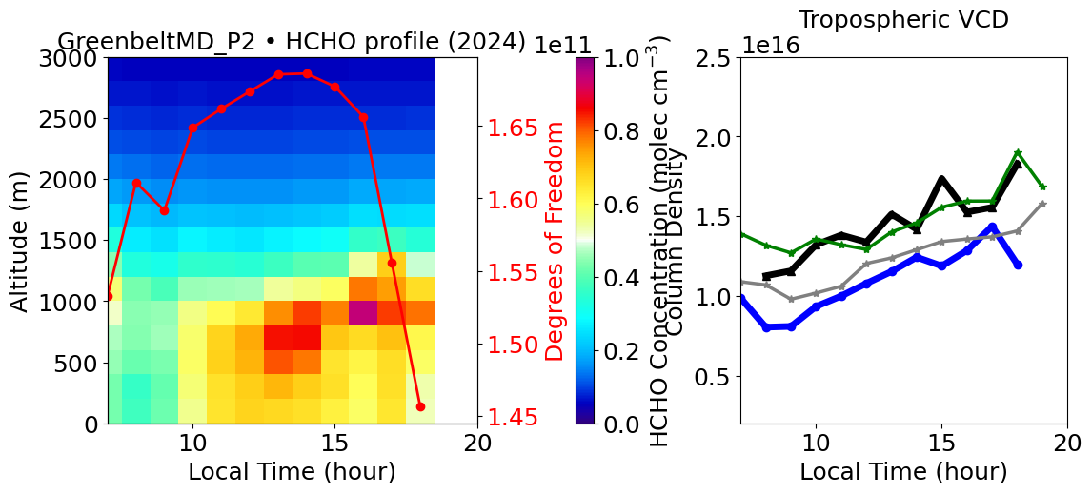
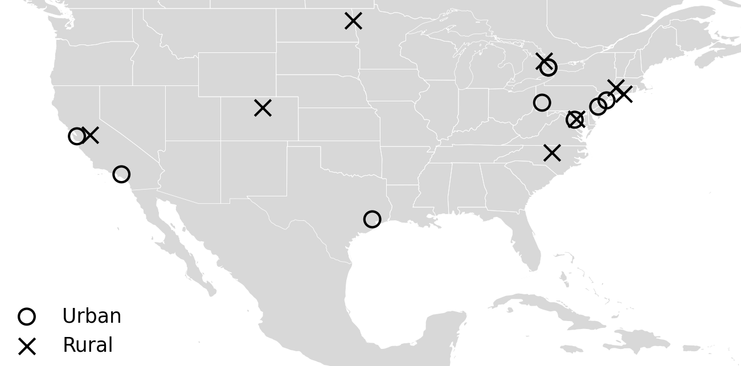
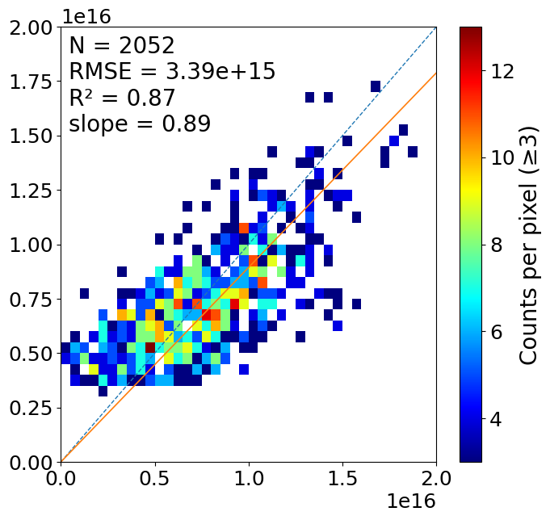
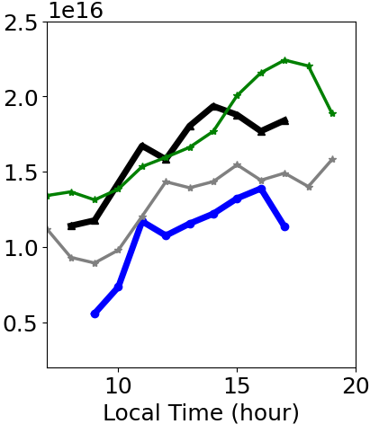
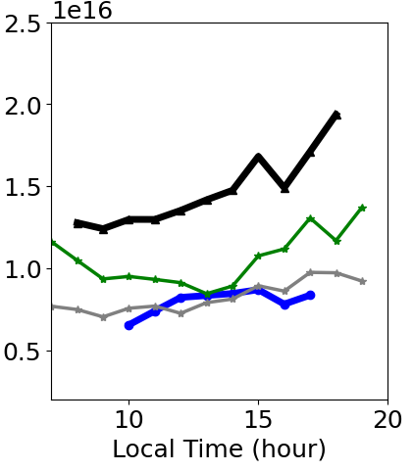
PGN MMF retrieval show good agreement with TEMPO and TROPOMI in North America (17 sites in 2024 summer)
Counts
BoulderCO-NCAR
PGN MMF Trop VCD
MountainView
GreenBelt
TEMPO VCD
Aldine
ChapelHill
PGN direct-sun
PGN MMF Trop VCD
TEMPO VCD
PGN multi-axis
PGN MMF
TROPOMI VCD

Slide 6
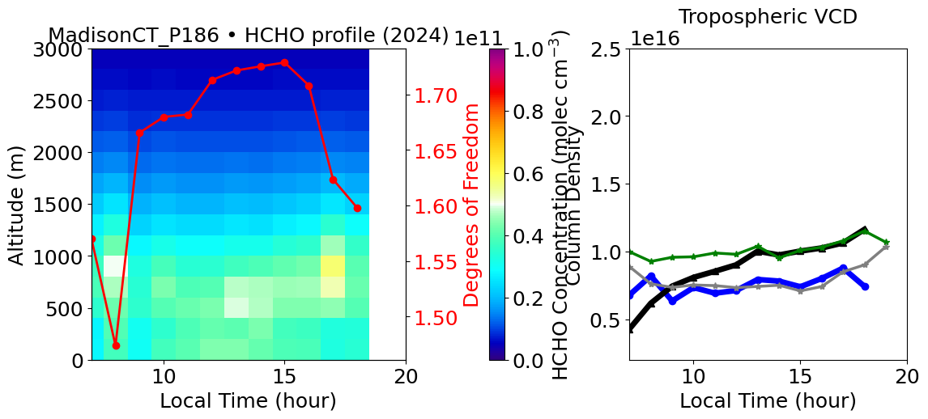
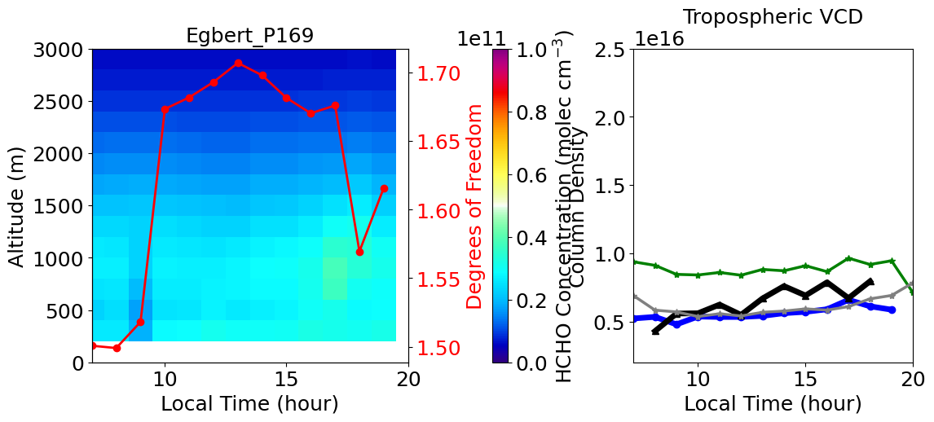

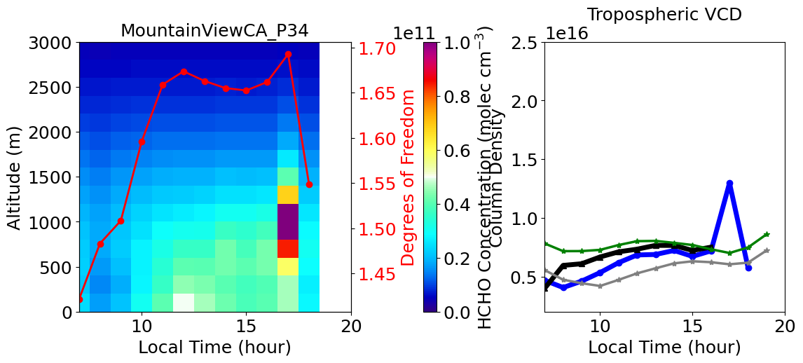
MMF shows an elevated HCHO layer in midday-afternoon at several sites, (2024 summer)
PGN direct-sun
TEMPO VCD
Degree of Freedom
PGN multi-axis
PGN MMF
HCHO concentration
Molecules cm⁻²

Slide 7
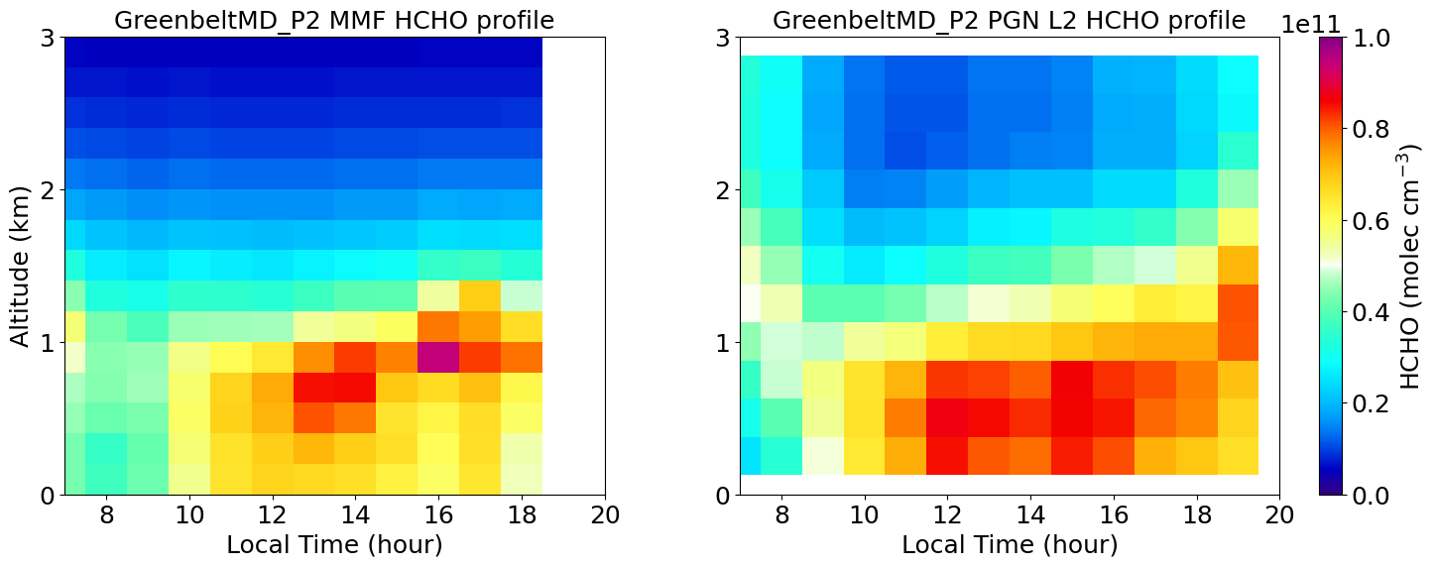
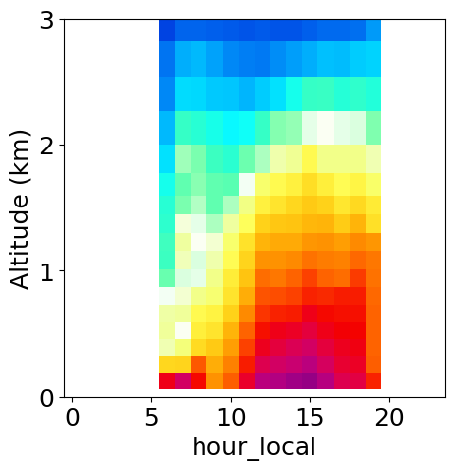
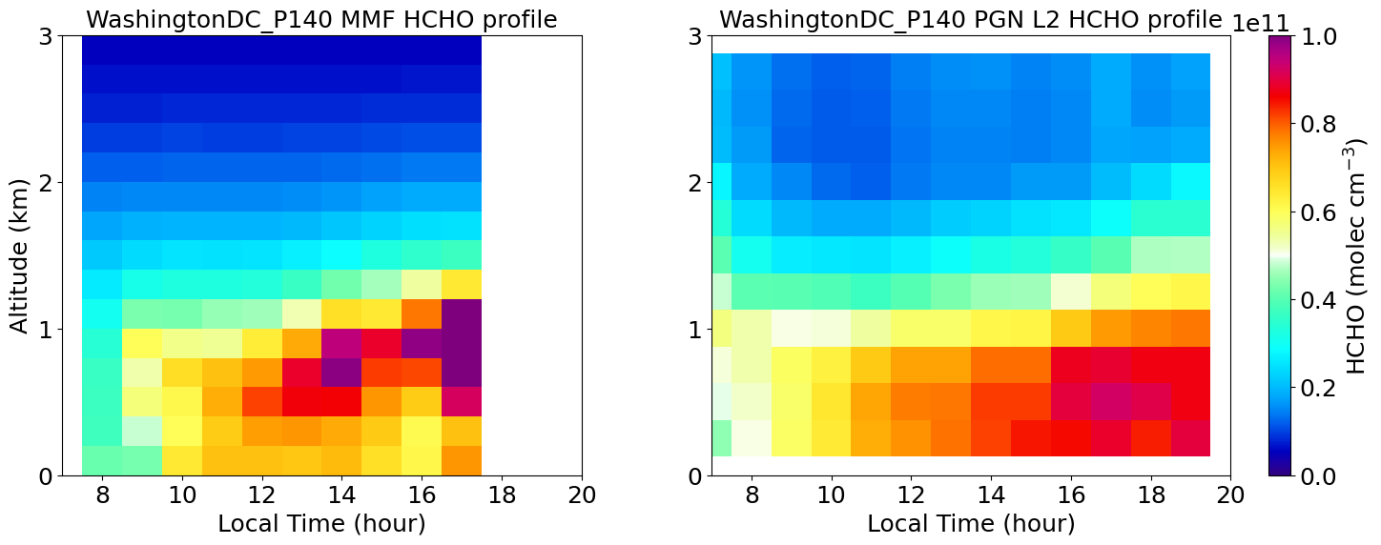
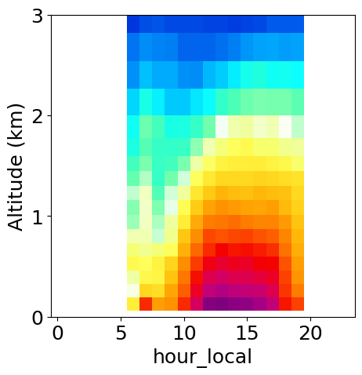
MMF shows some unique HCHO profile features, compared to PGN L2 data and GEOSCF
MMF
PGN L2
GEOS-CF
Greenbelt
WashingtonDC

Slide 8
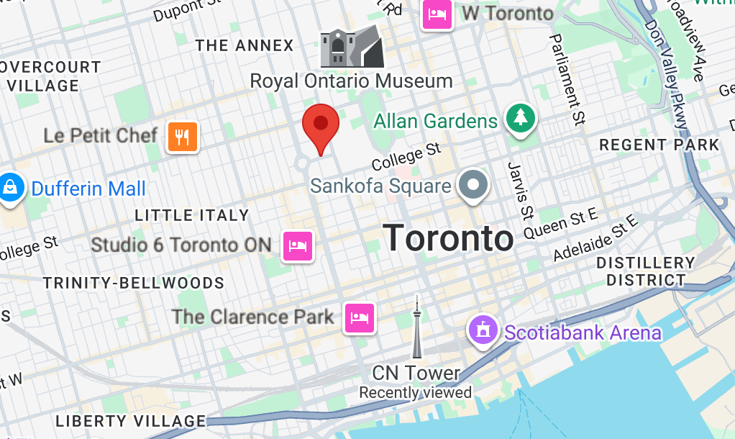
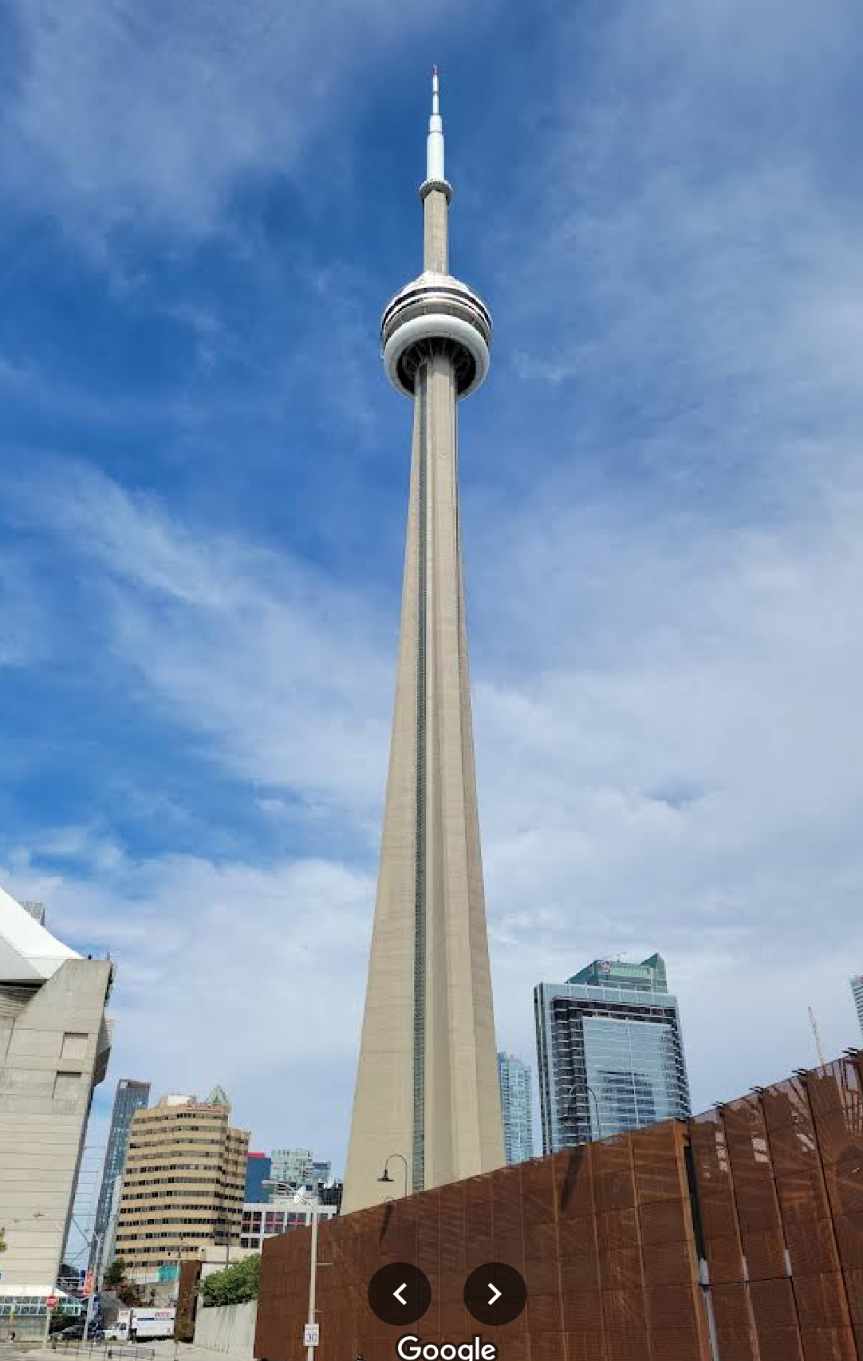
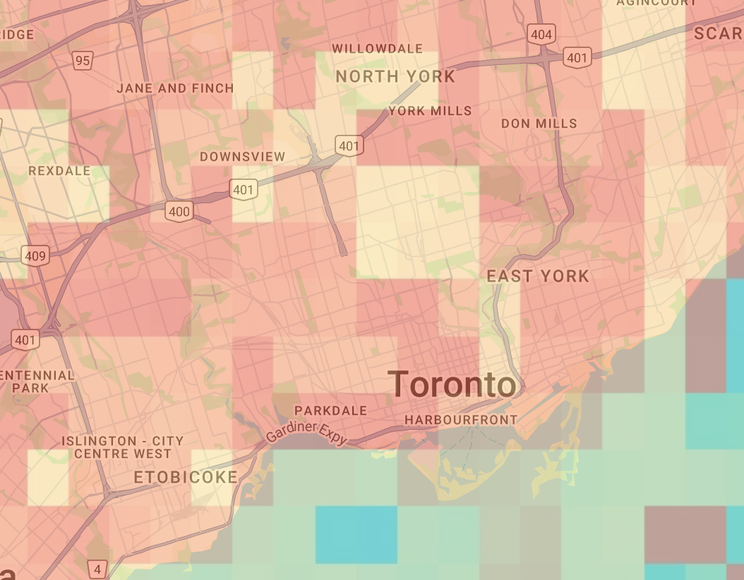
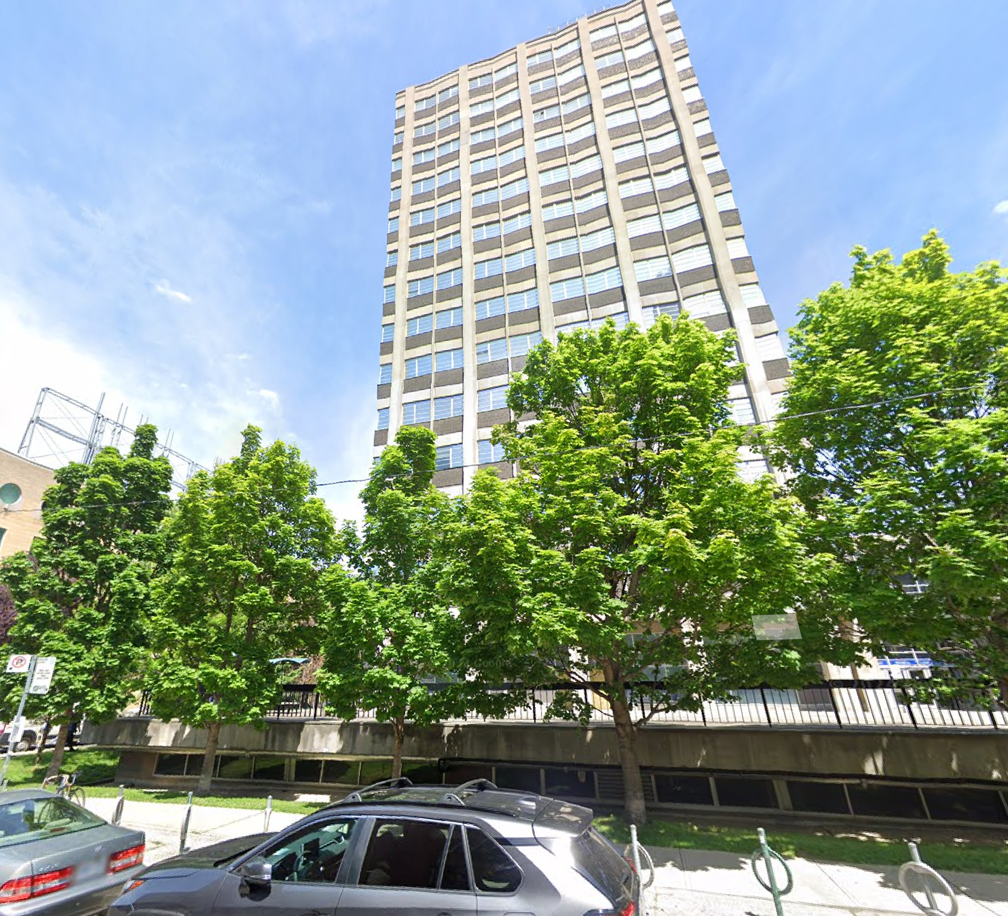
Is the elevated HCHO real? – A case study
Question: Can MMF reproduce the PGN direct-sun HCHO partial column between the two instruments?
Azimuth Viewing Angle
1.3 miles
330m
Toronto
154m
TEMPO median
HCHO column
May 1 - July 30, 2025
176m

Slide 9
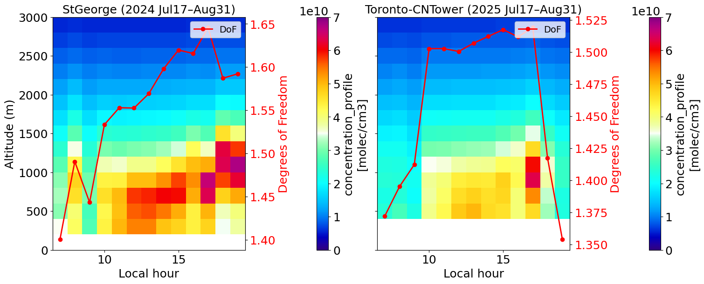
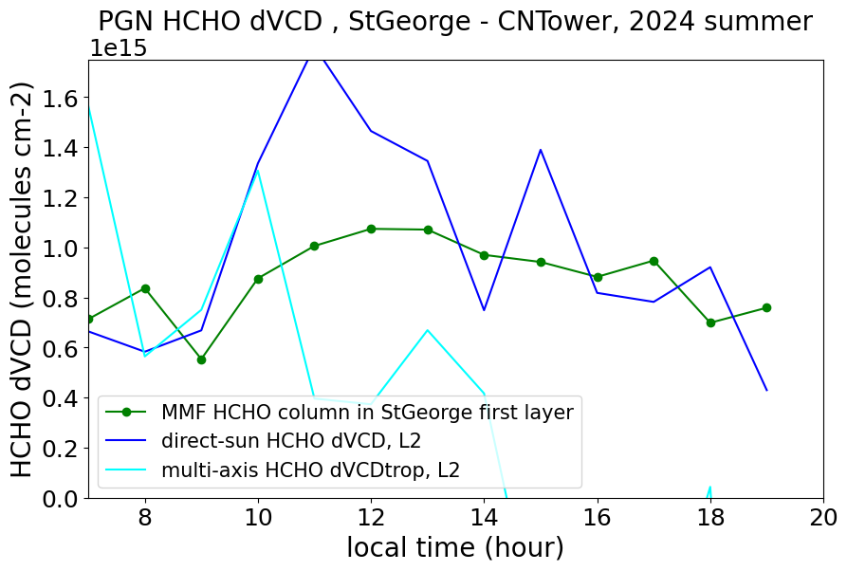
MMF capture a diurnal cycle of HCHO partial column in between the two instruments, which is similar to that direct-sun HCHO column difference shows.
Direct-sun difference
MMF first layer of StGeorge
More observational evidence is needed.

Slide 10
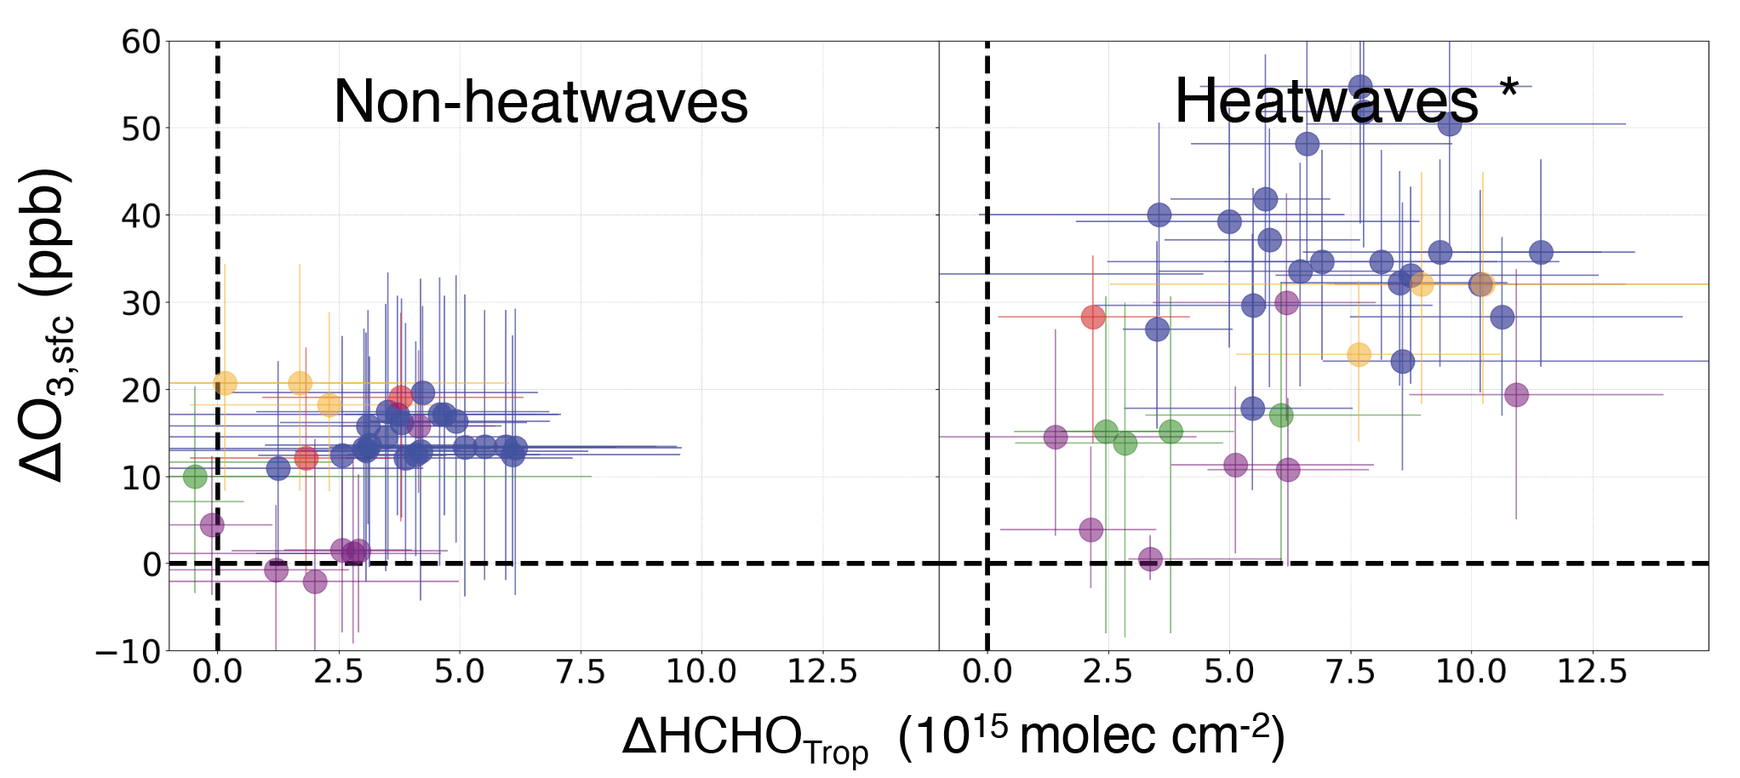
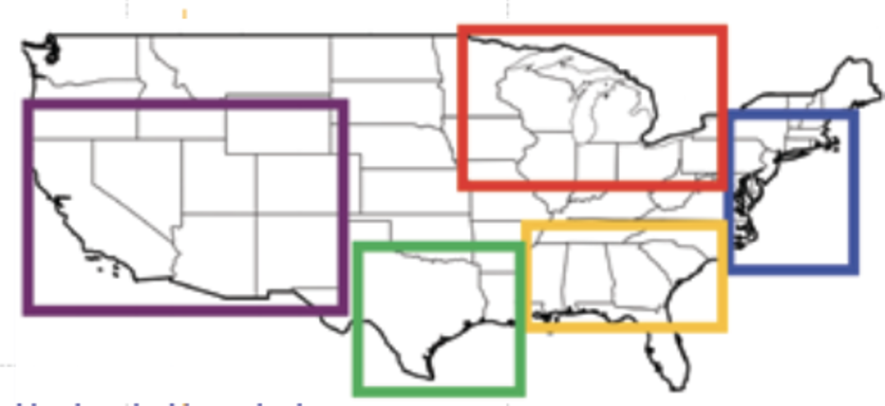
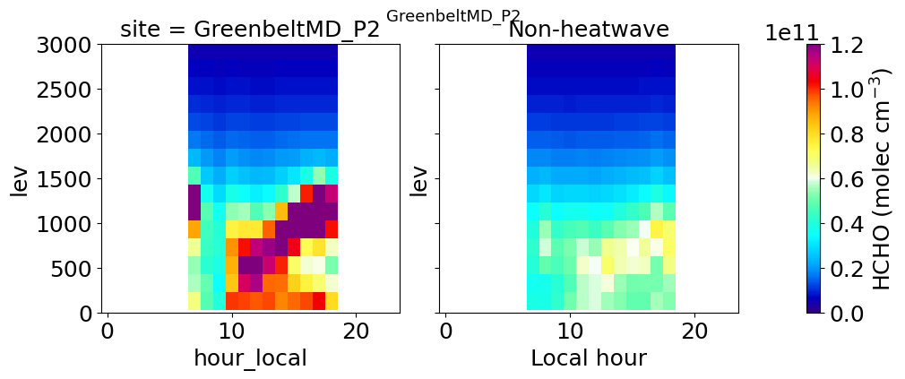
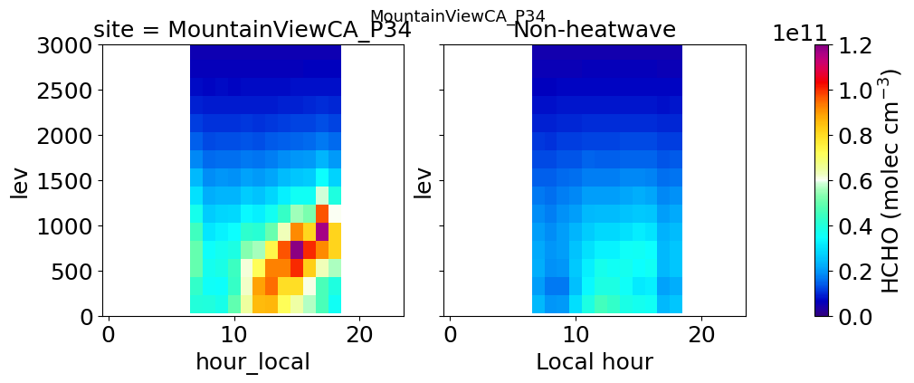
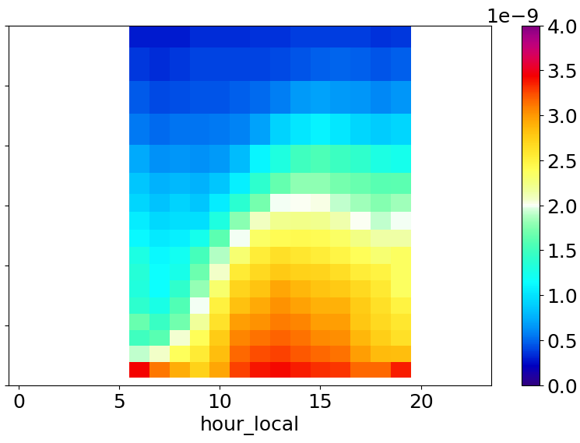
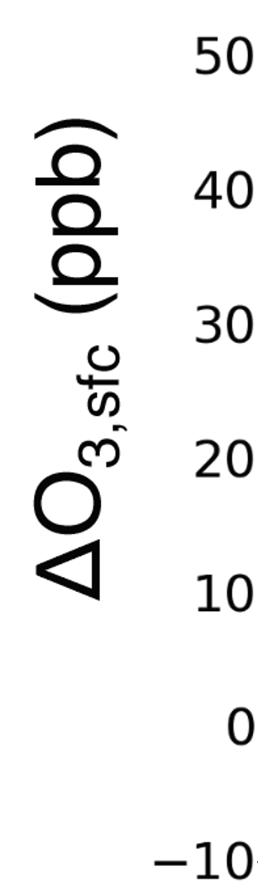
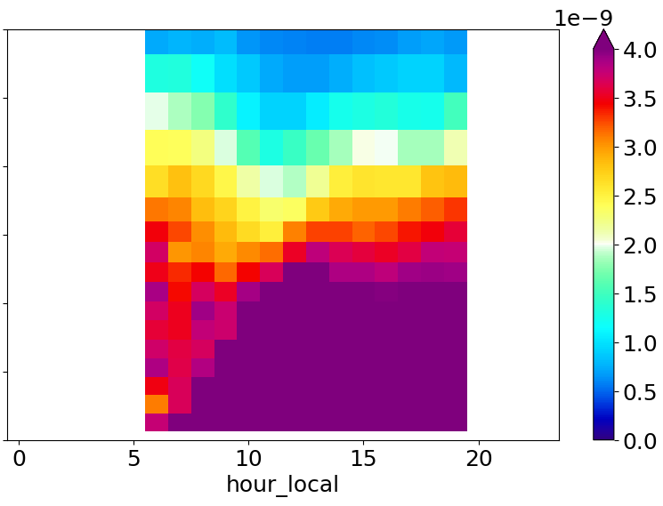
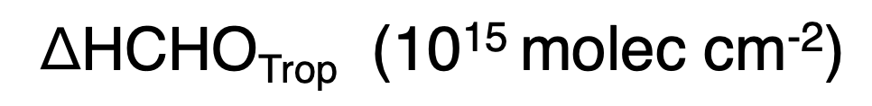
Elevated HCHO layer intensifies during heatwaves
MMF
MMF
GEOS-CF
Altitude
(km)
GreenbeltMD
MountainViewCA
BayonneNJ
mol/mol
3
molec/cm²
2
1
Non-heatwaves
0
3
2
heatwaves
1
0
0
10
20
0
10
20
Local hour
Heatwaves intensify HCHO concentration, especially In the elevated HCHO layer
Model mostly intensify near surface
Consistent with model bias in HCHO column and surface O3 during heatwaves.
Zhao et al , 2025 in prep (presented in AGU24 fall meeting)

Slide 11
Takeaways
We successfully retrieved HCHO profiles at multiple PGN sites in North America using MMF OE algorithm;
MMF HCHO columns show a good agreement with TROPOMI & TEMPO columns, and agree well with TEMPO HCHO diurnal cycle across North America;
Multiple PGN MMF results show an elevated HCHO layer during midday-afternoon; the concentration will be intensified by high temperatures.
Thank you for your attention!
Happy to discuss more details if you are interested! Feel free to contact me: tzhao@alaska.edu

