Slide 1





TEMPO/GeoXO ACX JSTM
Pandora NO₂ and HCHO observations in an urban environment: Implications for satellite validation
August 22, 2025
Jonguk Park, Tom Hanisco, Bryan Place, Apoorva Pandey, Luke Valin, Jim Szykman
and special thanks to TEMPO team and DC DOEE

Slide 2
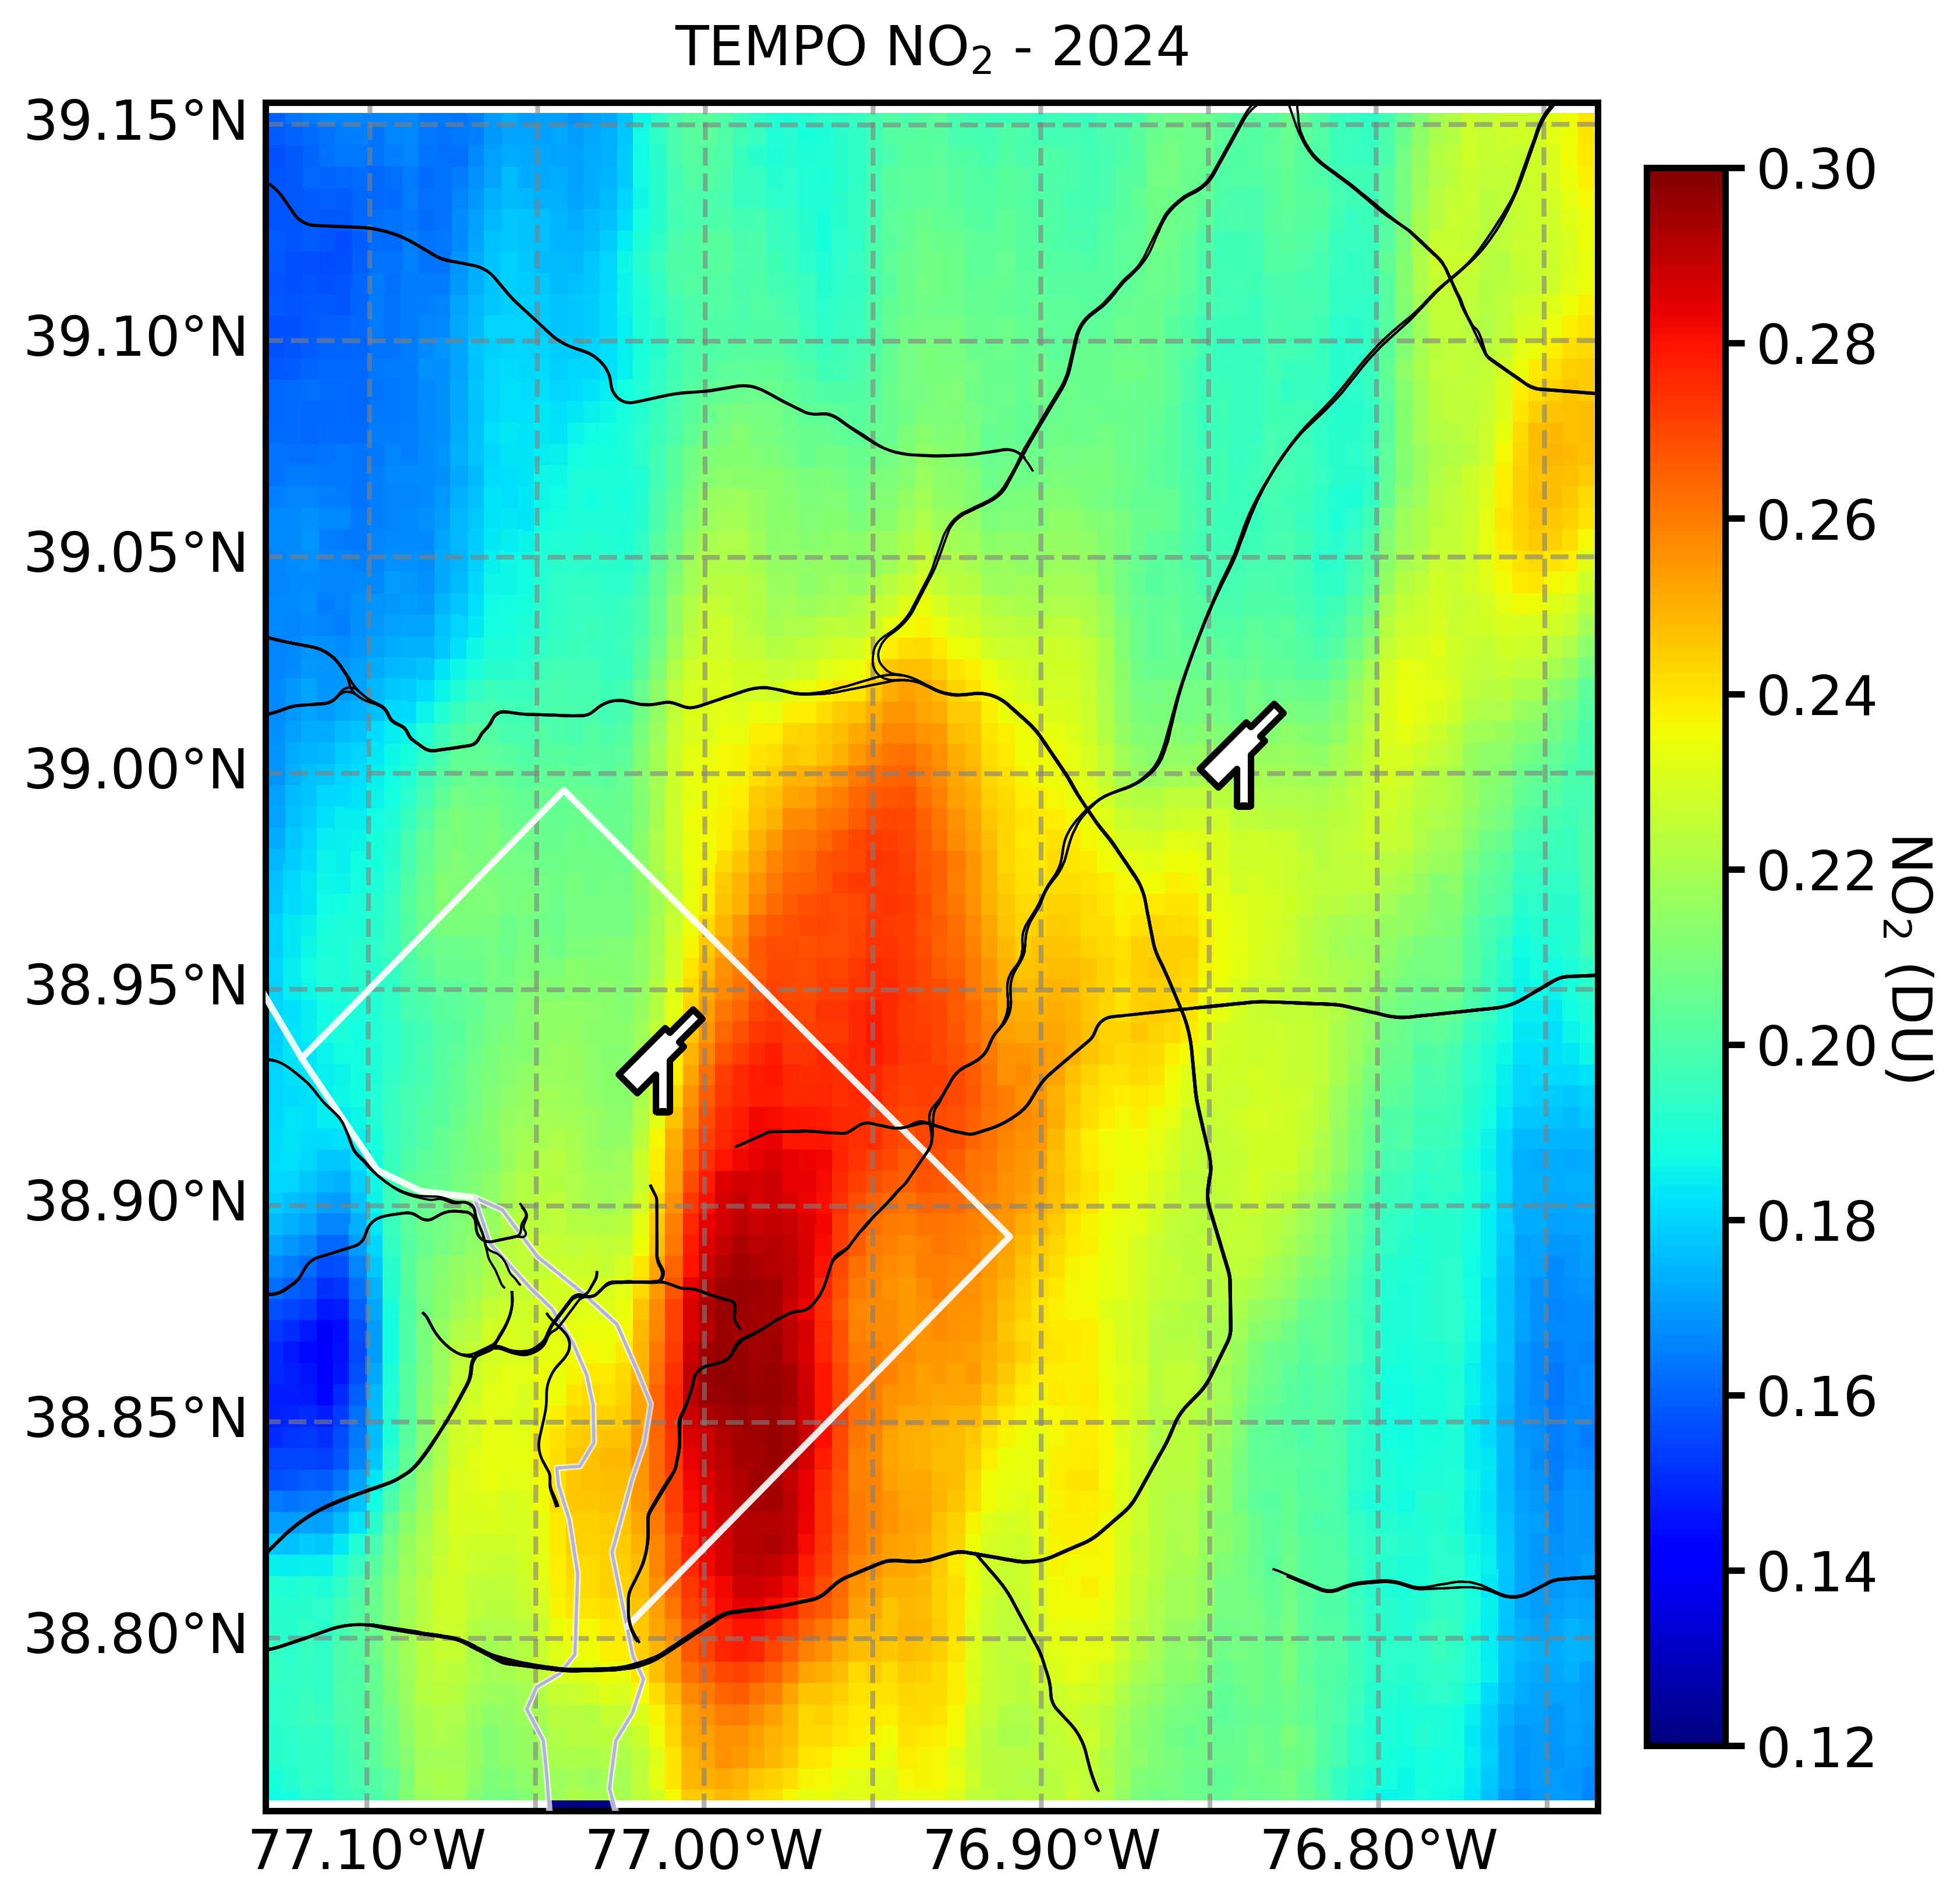
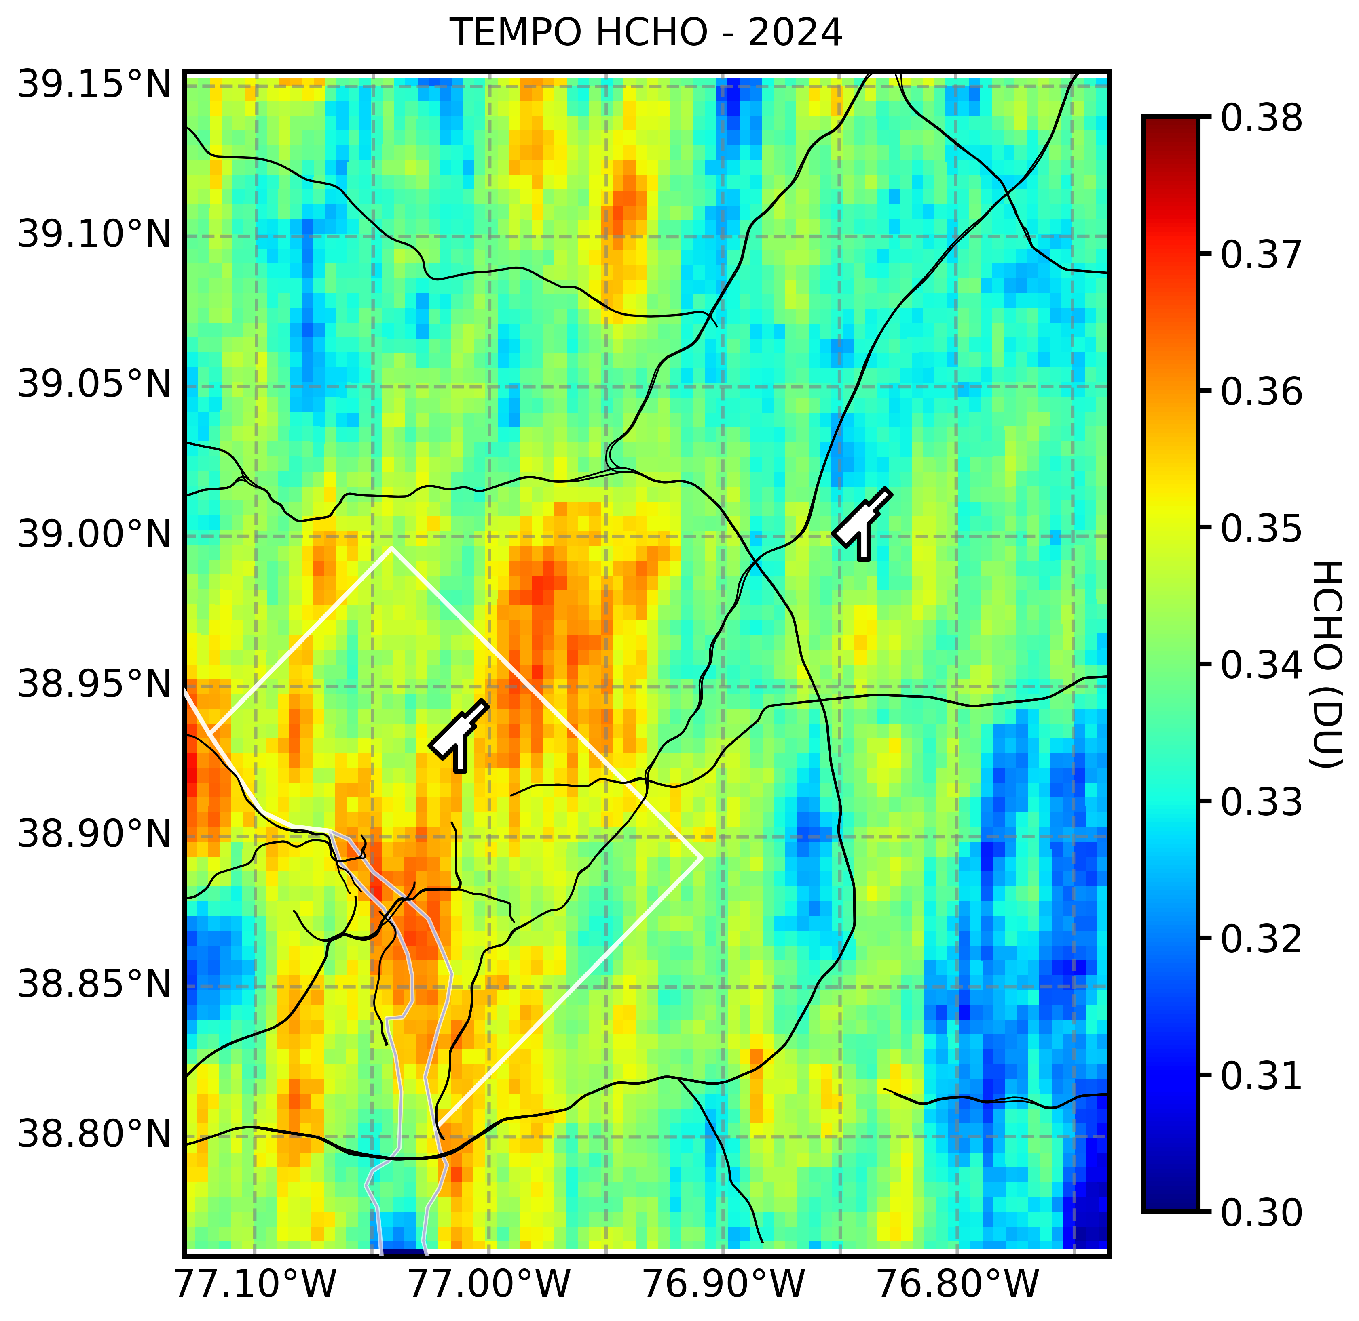
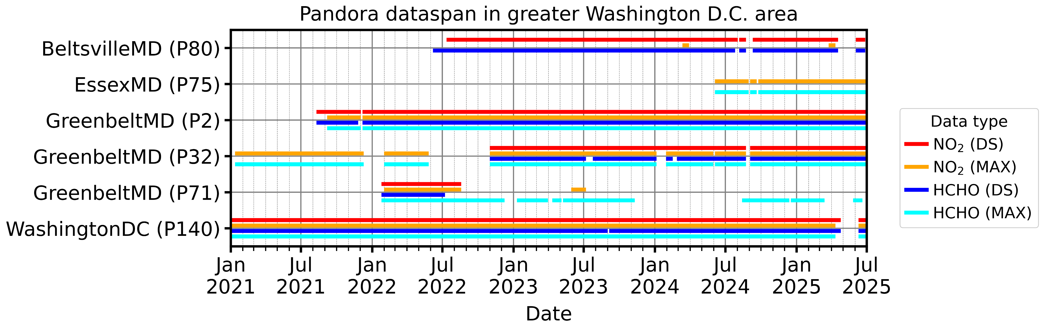
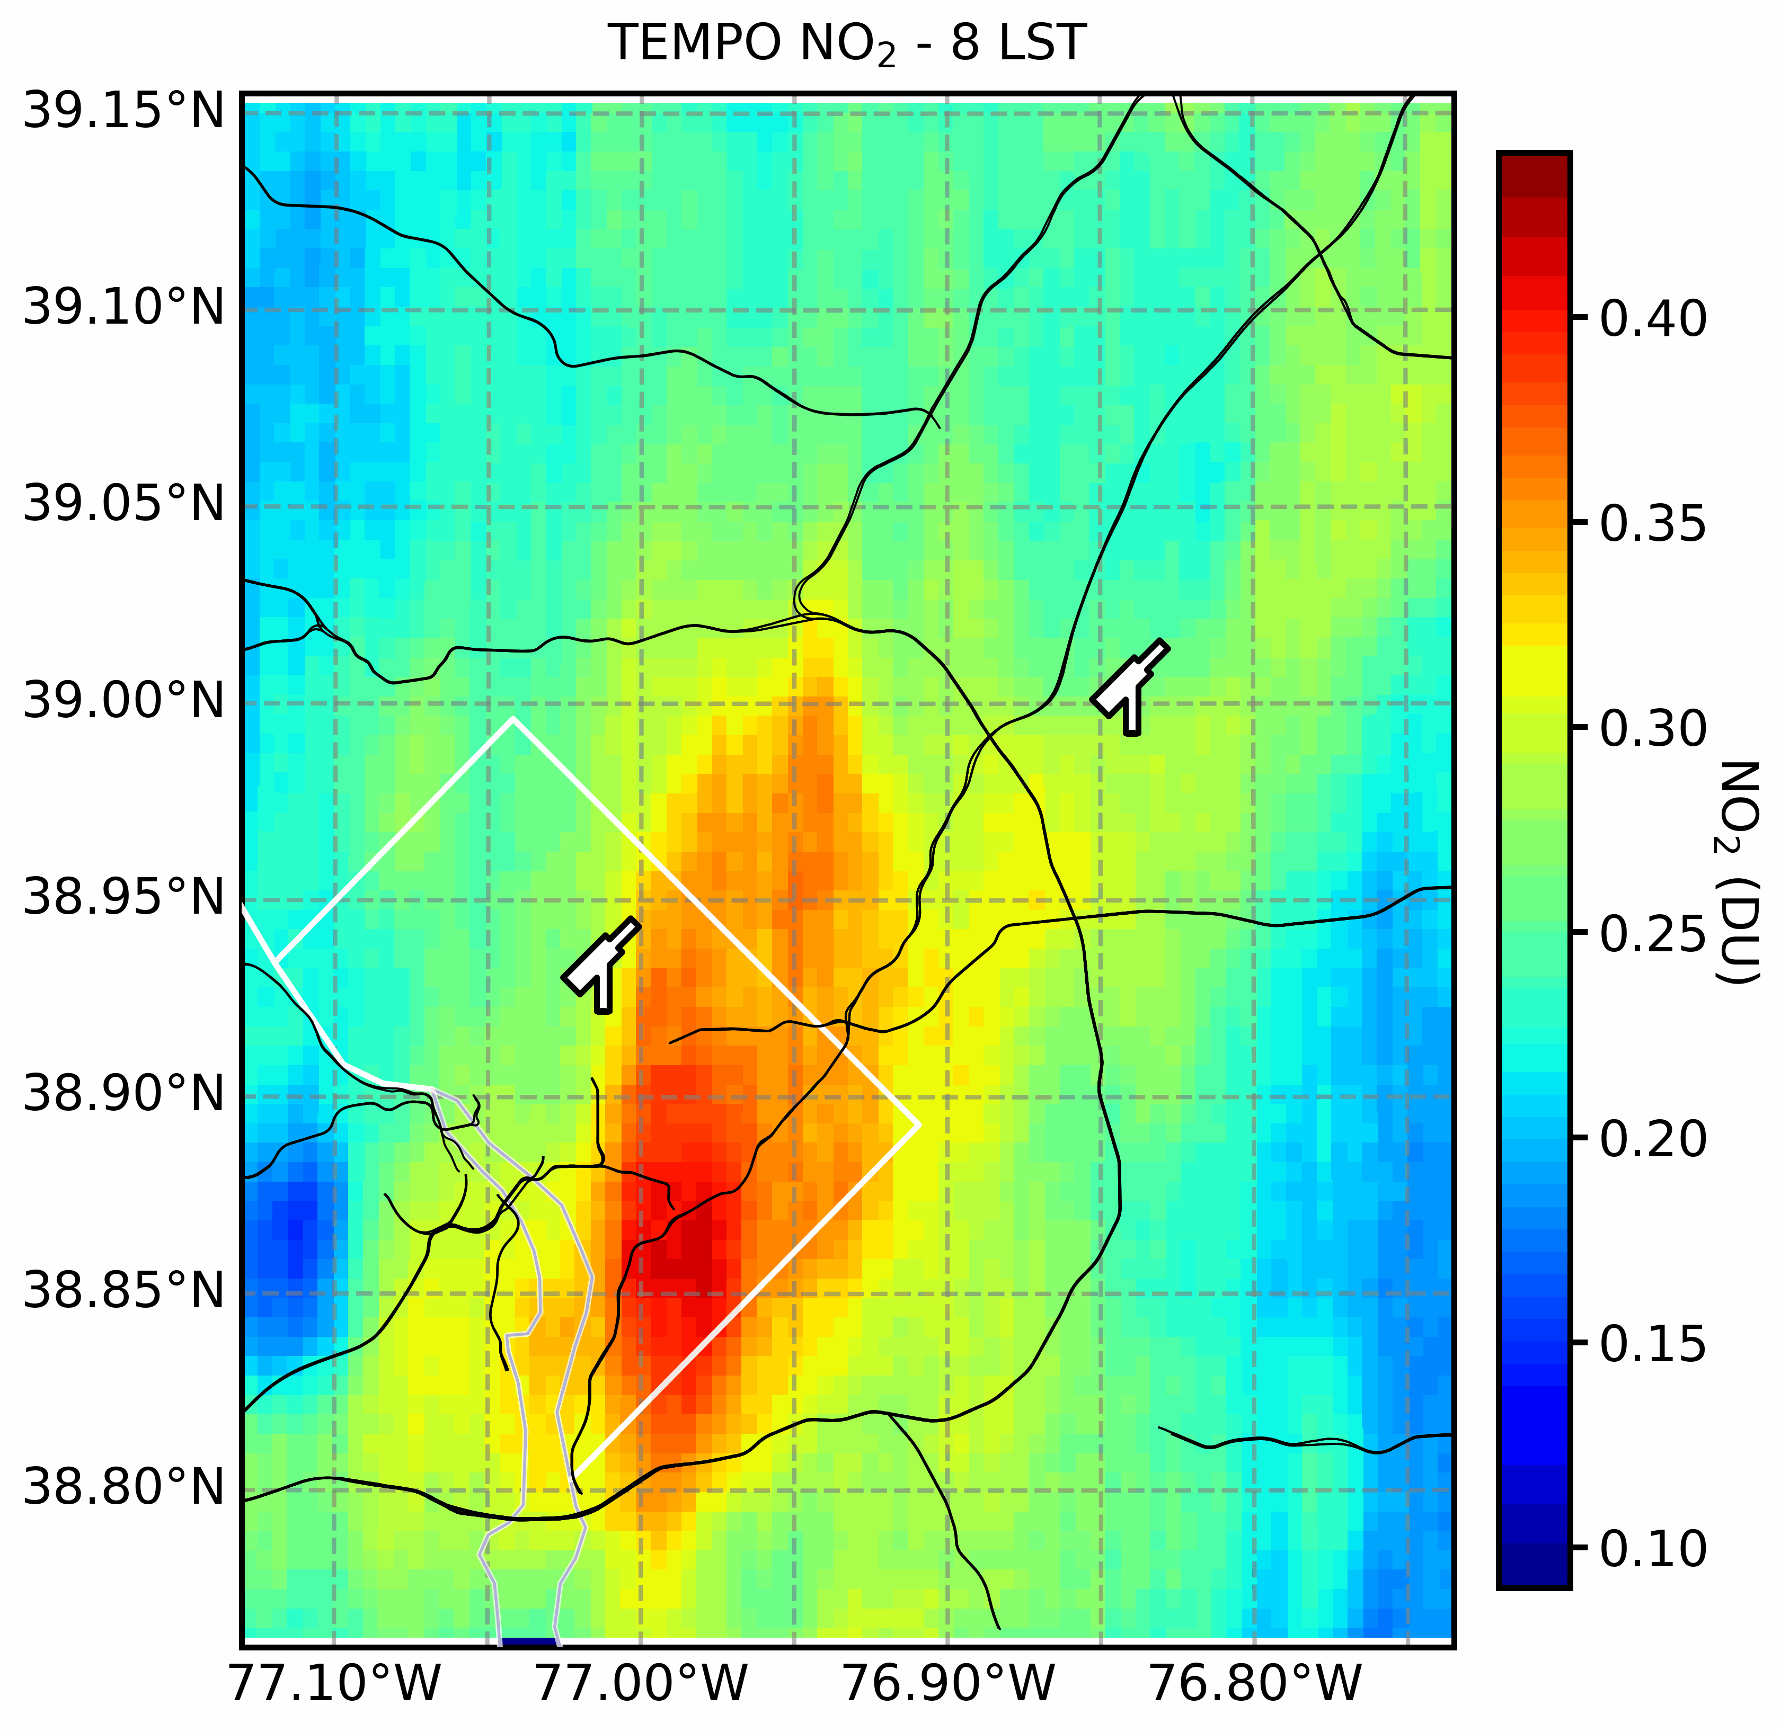
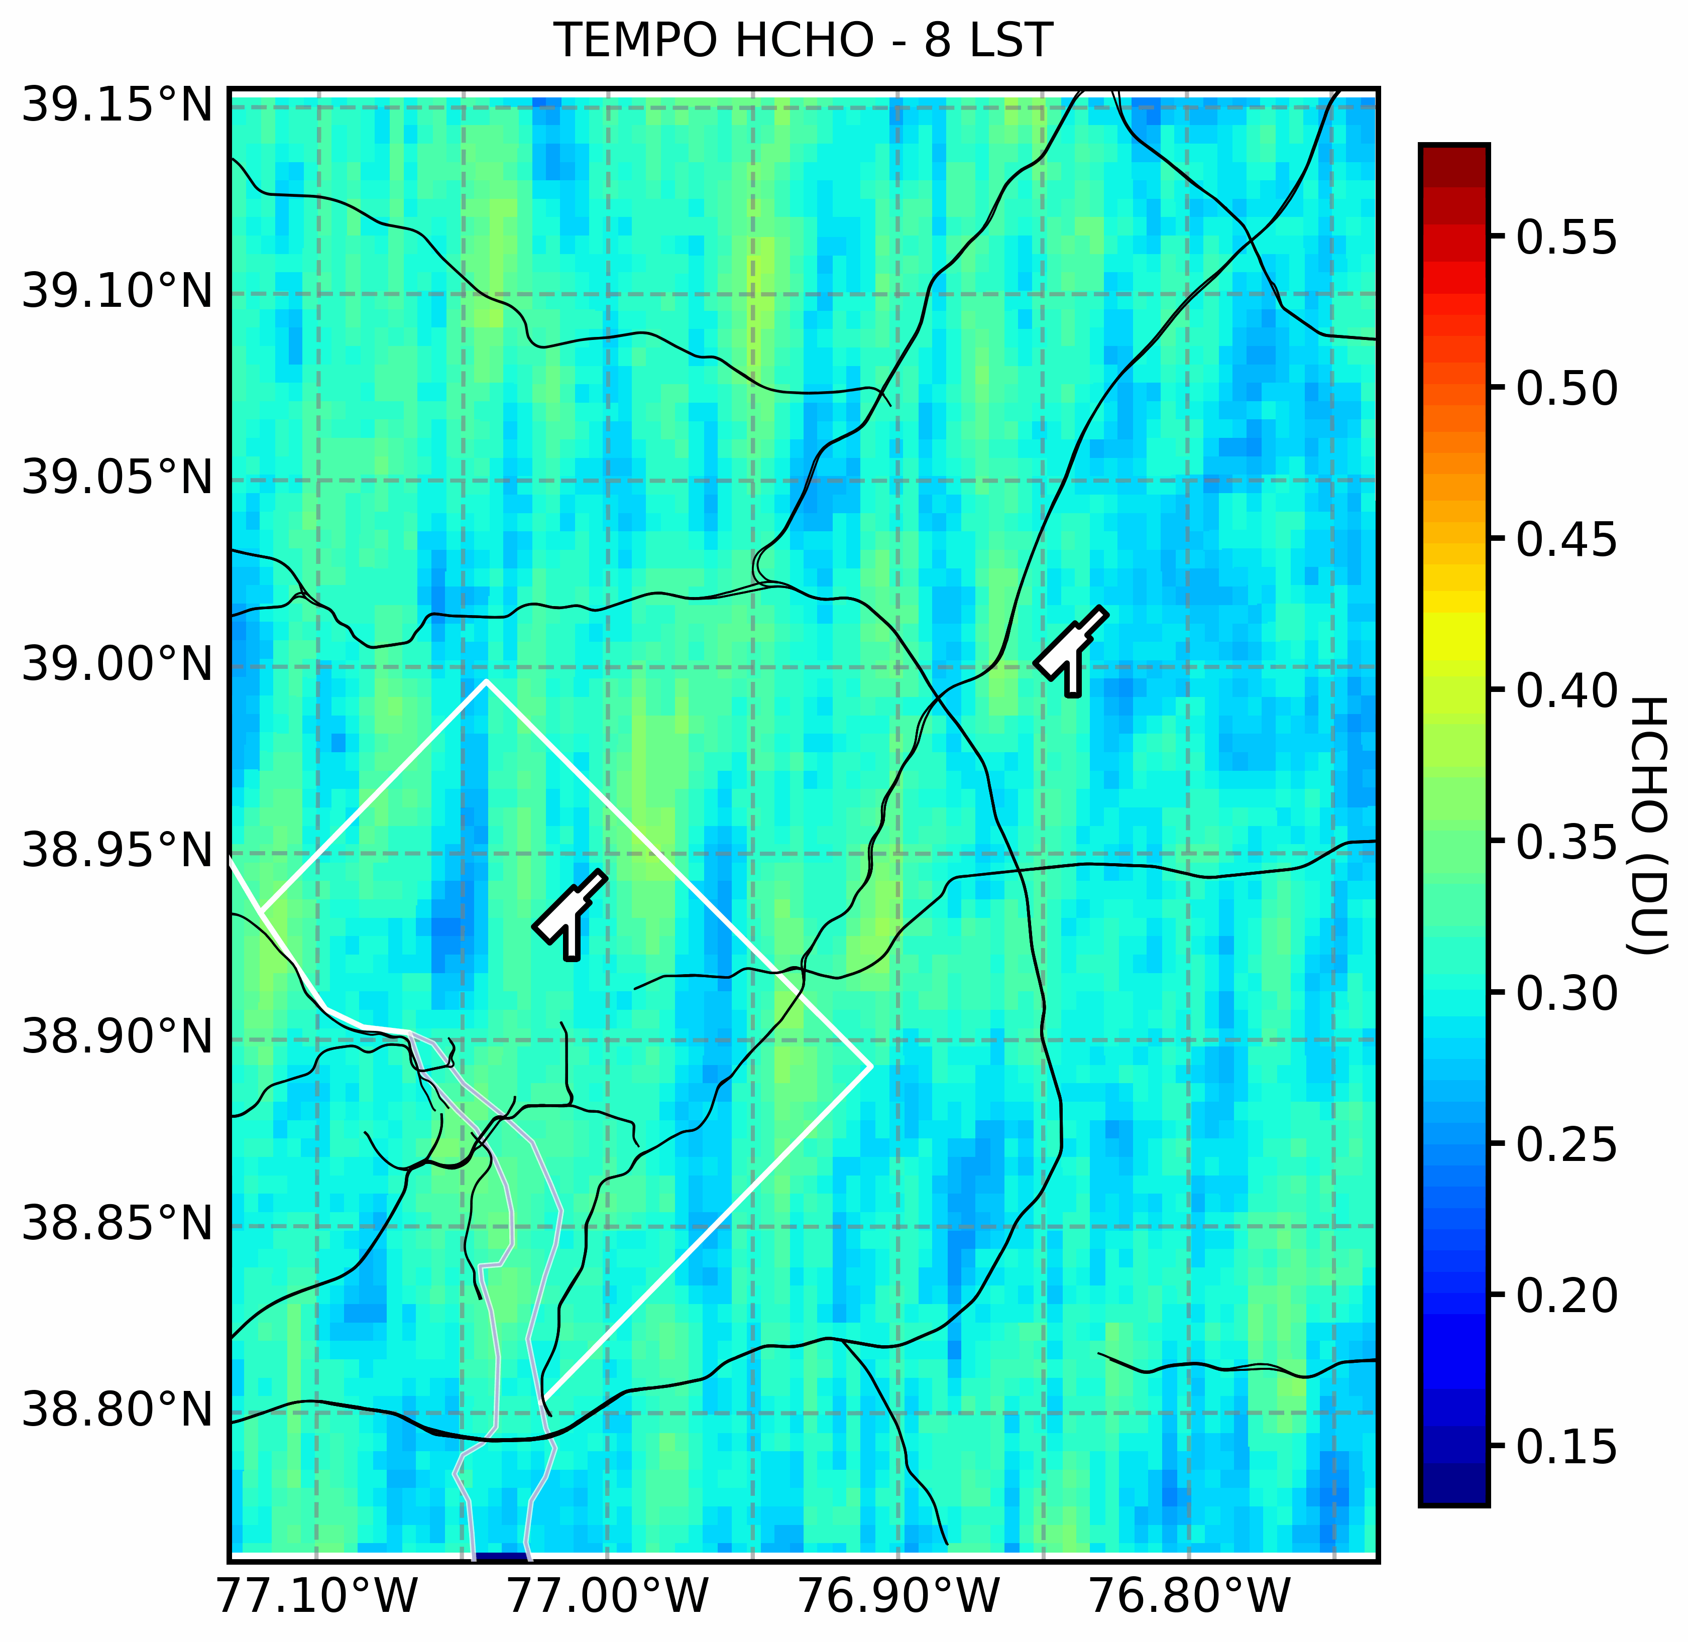
NO₂ and HCHO VCD_{trop} around Washington D.C. area
Pandora observations around DC/Baltimore area
GreenbeltMD (P2)
GreenbeltMD (P2)
WashingtonDC (P140)
WashingtonDC (P140)
Target study period: year 2024
Pandoras with good data span for both direct-sun (DS) and sky-scan (MAX) data*:
GreenbeltMD (P2) & WashingtonDC (P140)
Year-round TEMPO observations show:
Significant spatial gradient of NO₂ VCD
Noisy, but spatially coincident HCHO peaks in D.C. area
* GreenbeltMD (P32) had known issues with instrument stability and sky-scan viewing angle in 2024
Notes:
TEMPO Version 03 (V03) Level 2 data

Slide 3
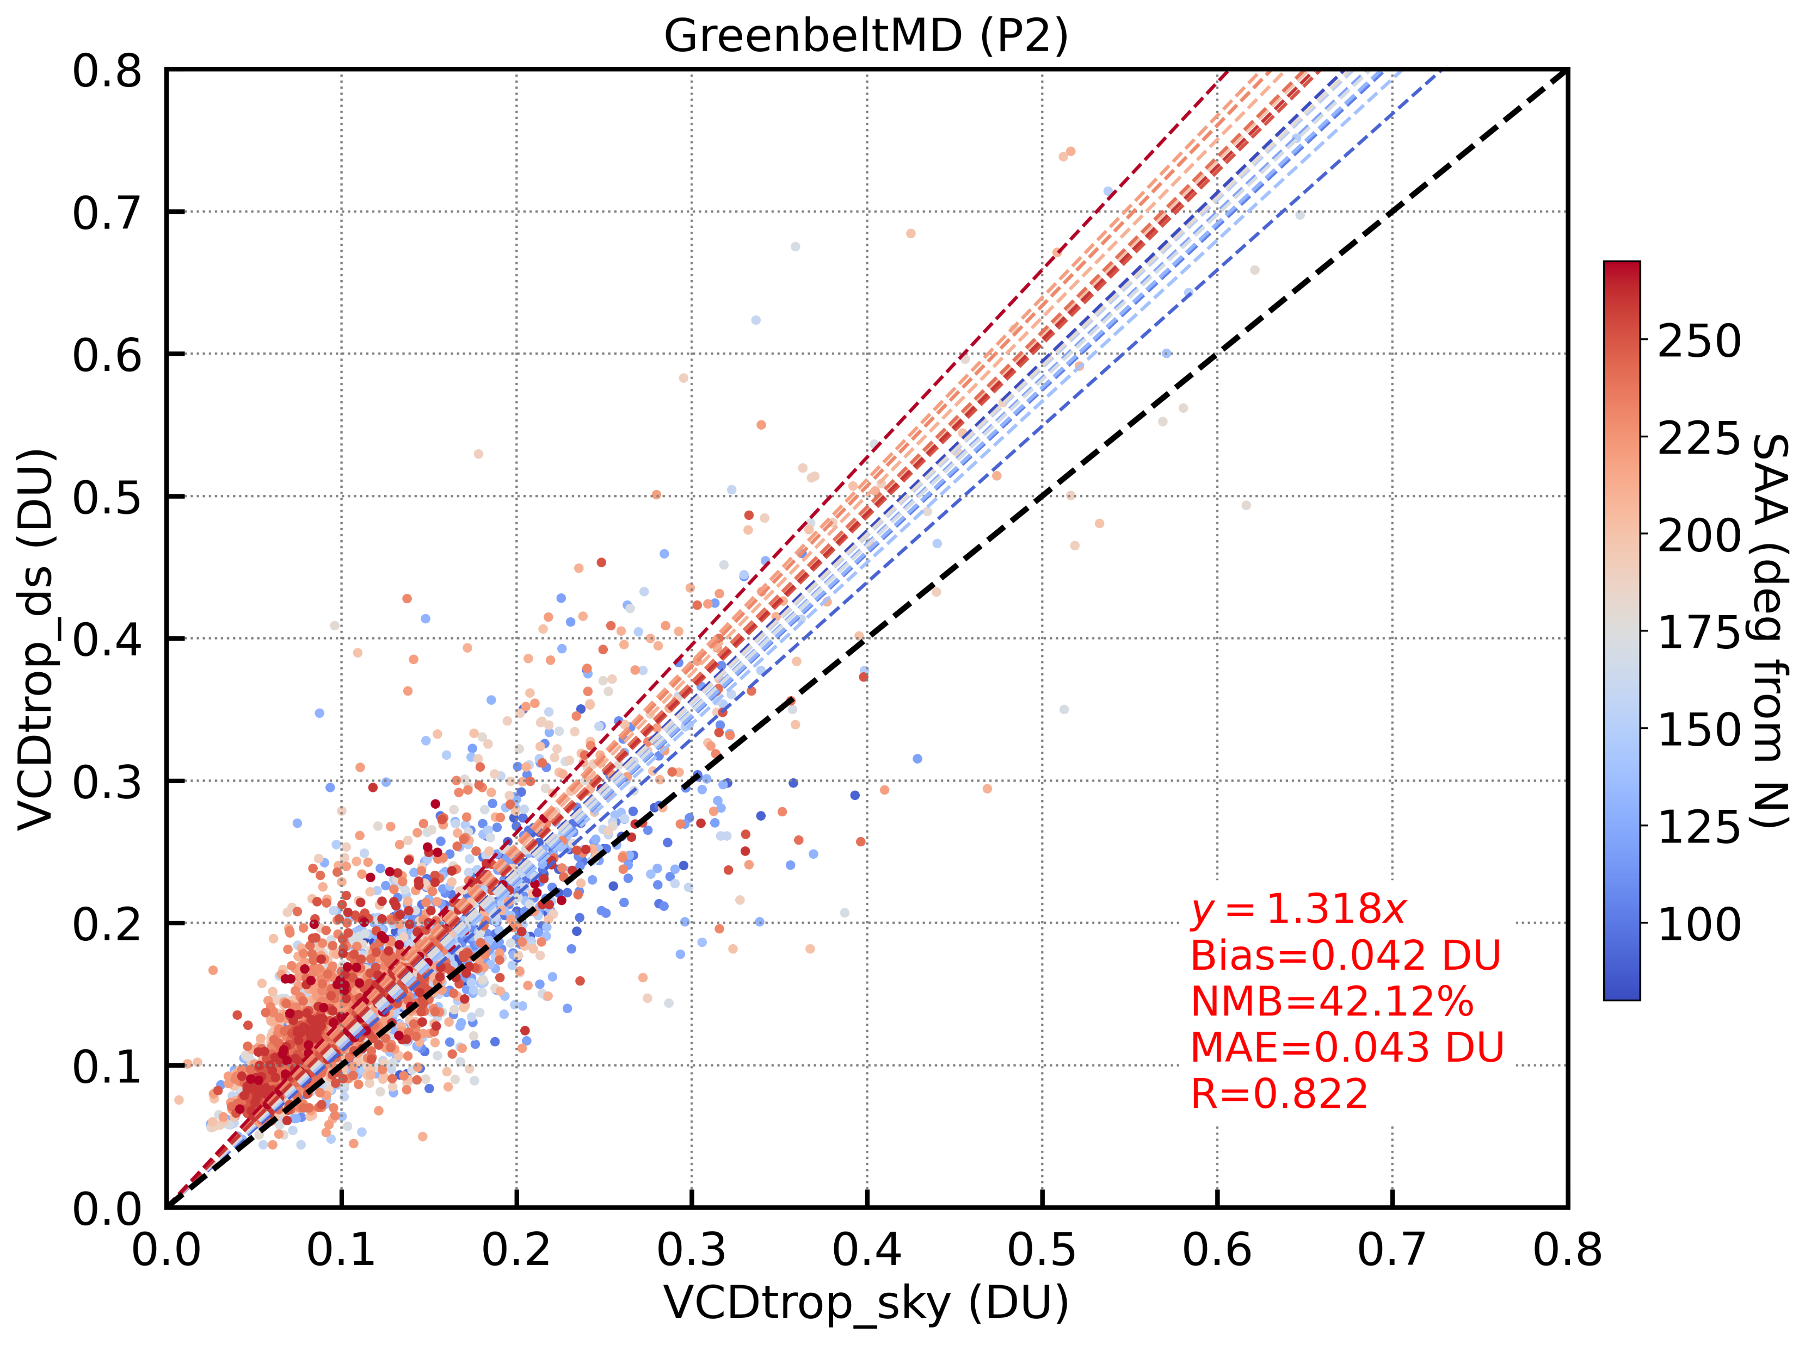
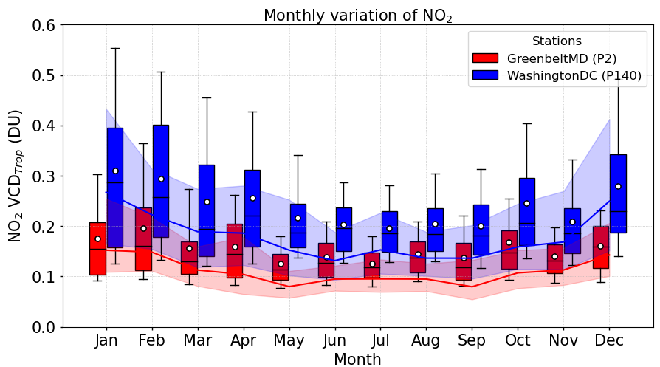
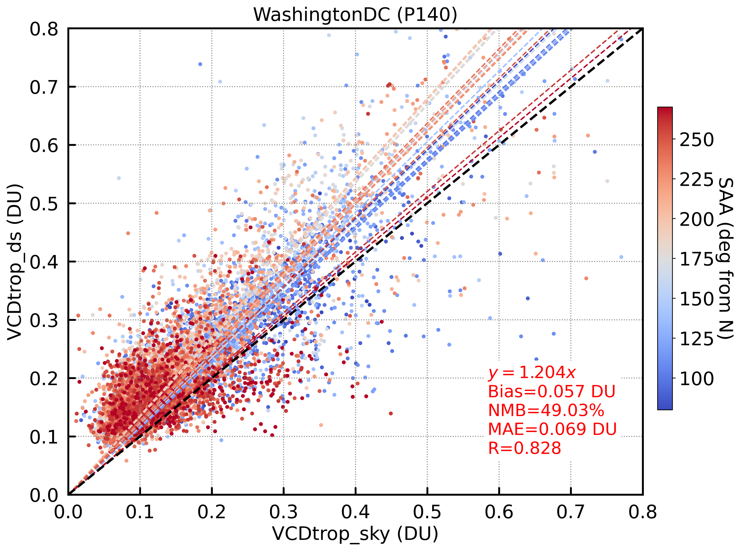
Pandora Direct-Sun _{(DS)} and Sky _{(MAX-DOAS)} NO₂ VCD_{trop}
Greenbelt (P2)
Direct-Sun (DS) VCD_{trop} (DU)
Shade_{(25 – 75th)}
VCD_{trop, sky (MAX-DOAS)}
Sky_{(MAX-DOAS)} VCD_{trop} (DU)
WashingtonDC (P140)
Box_{(25–75th)}-whisker_{(10–90th)}
VCD_{trop, direct-sun}
(=VCD_{total} – VCD_{strat, clim})
NO₂ VCD_{trop} shows relatively good agreement between direct-sun and sky data, but with some:
Random biases
→ due to inhomogeneous NO₂ distribution (especially in urban areas)
DS > Sky in general
→ sky measurements may miss some fraction of NO₂ in the upper troposphere
Direct-Sun (DS) VCD_{trop} (DU)
Sky_{(MAX-DOAS)} VCD_{trop} (DU)
Temporally collocated: ±10 min window

Slide 4
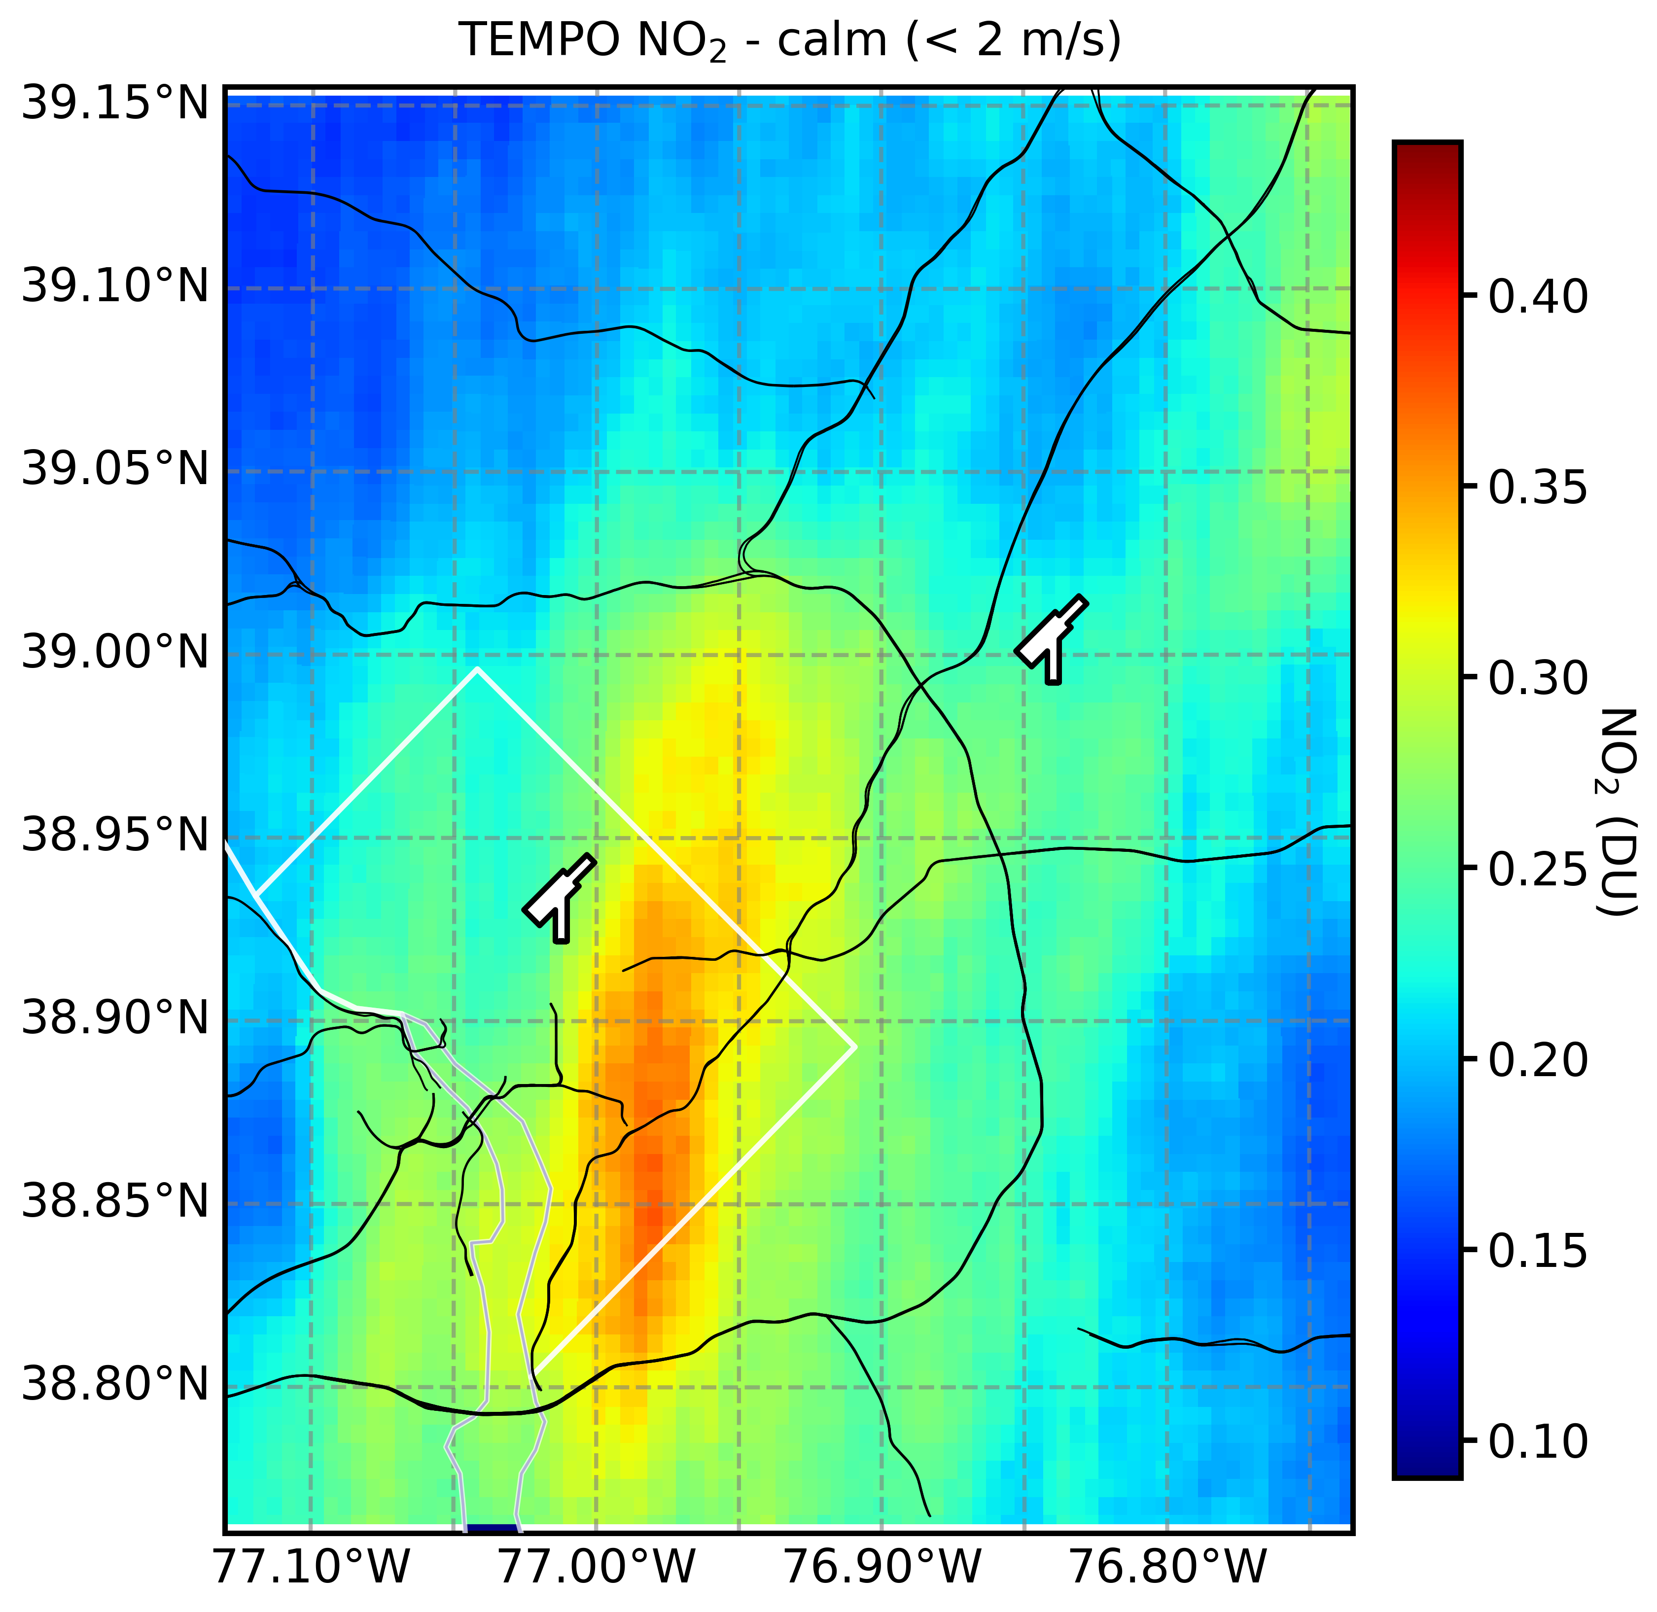
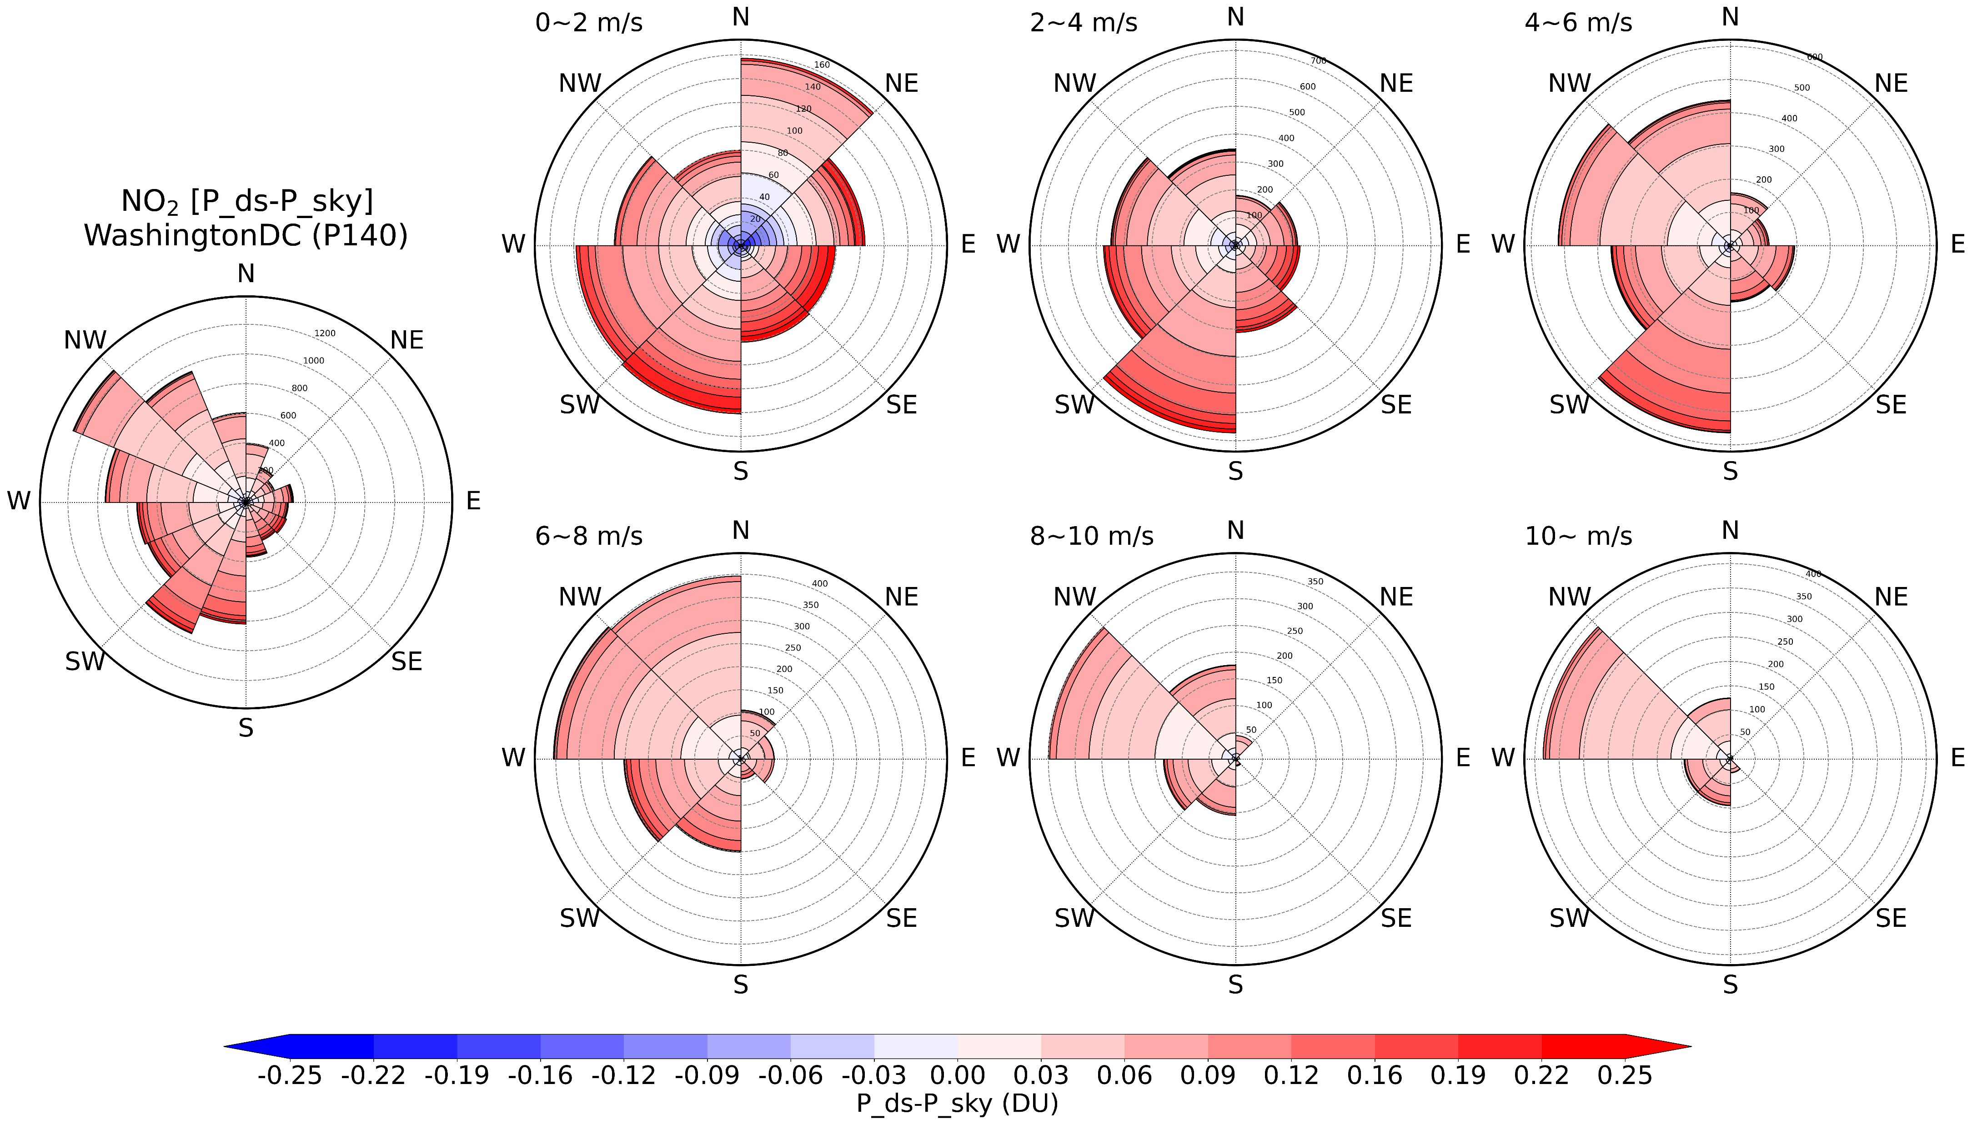
Pronounced NO₂ VCD spatial gradient under calm wind : WashingtonDC
Calm
Sky scan VAA
Sky-scan ↑
Direct-Sun ↑
Direct-sun viewing area (approx. up to PBLH)
Wind speed ↓ (Calm): Greater variance in NO₂ VCD bias between direct-sun and sky measurements
NO₂ VCD_{trop, sky} showing higher value even under general tendency of DS overestimation
→ Sky VAA heading downtown D.C. area
Notes:
Pronounced spatial gradient at WashingtonDC (P140) → sky-scan towards downtown area yields relatively higher NO2 under calm wind condition (more pronounced spatial gradient)

Slide 5
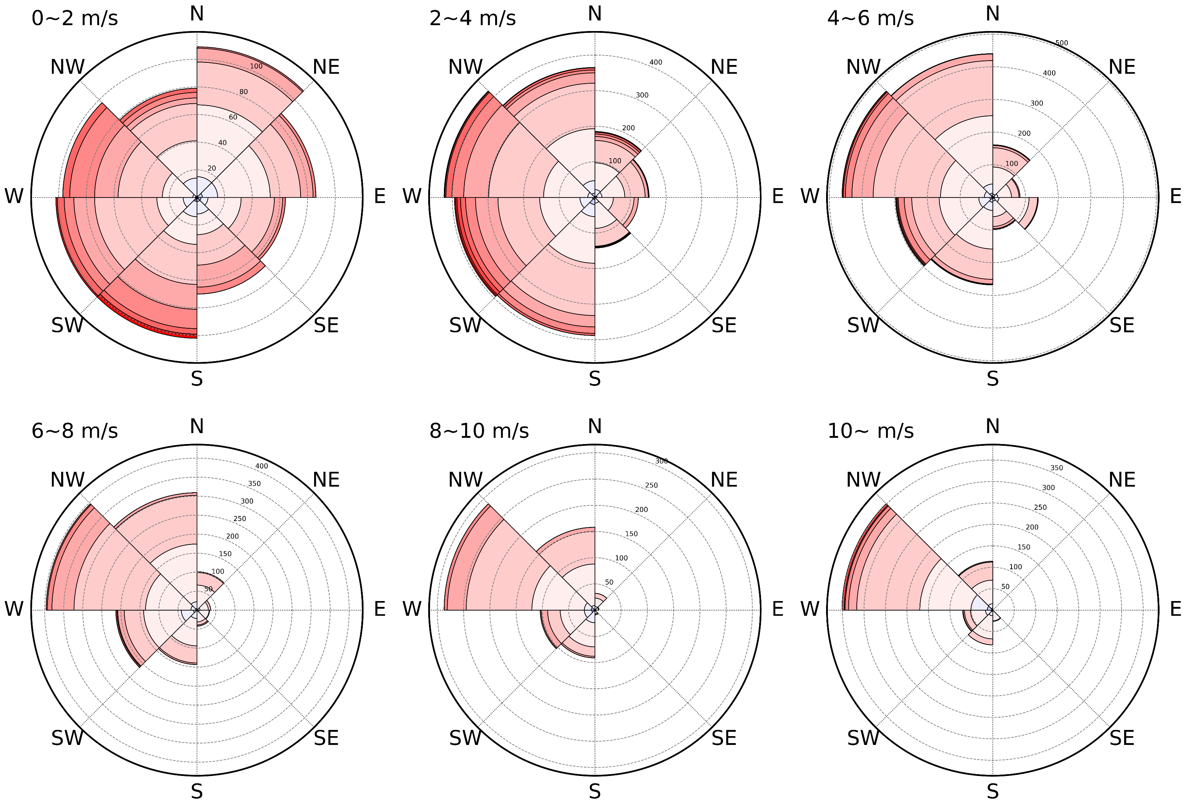
NO₂ VCD spatial gradient under calm wind : GreenbeltMD
Sky scan VAA
Sky-scan ↑
Direct-Sun ↑
Direct-sun viewing area (approx. up to PBLH)
VAA of sky scan at GreenbeltMD (P2) is toward north (rural) → DS>sky always
Calm wind condition still yields greater variability in biases due to less spatial mixing (steeper gradient)
Notes:
GreenbeltMD (P2) at relatively rural area → but still can see that the sky scan is yielding lower NO2 compared to direct-sun under calm wind condition b/c less spatial mixing (steeper gradient) / but less pronounced compared to D.C.

Slide 6
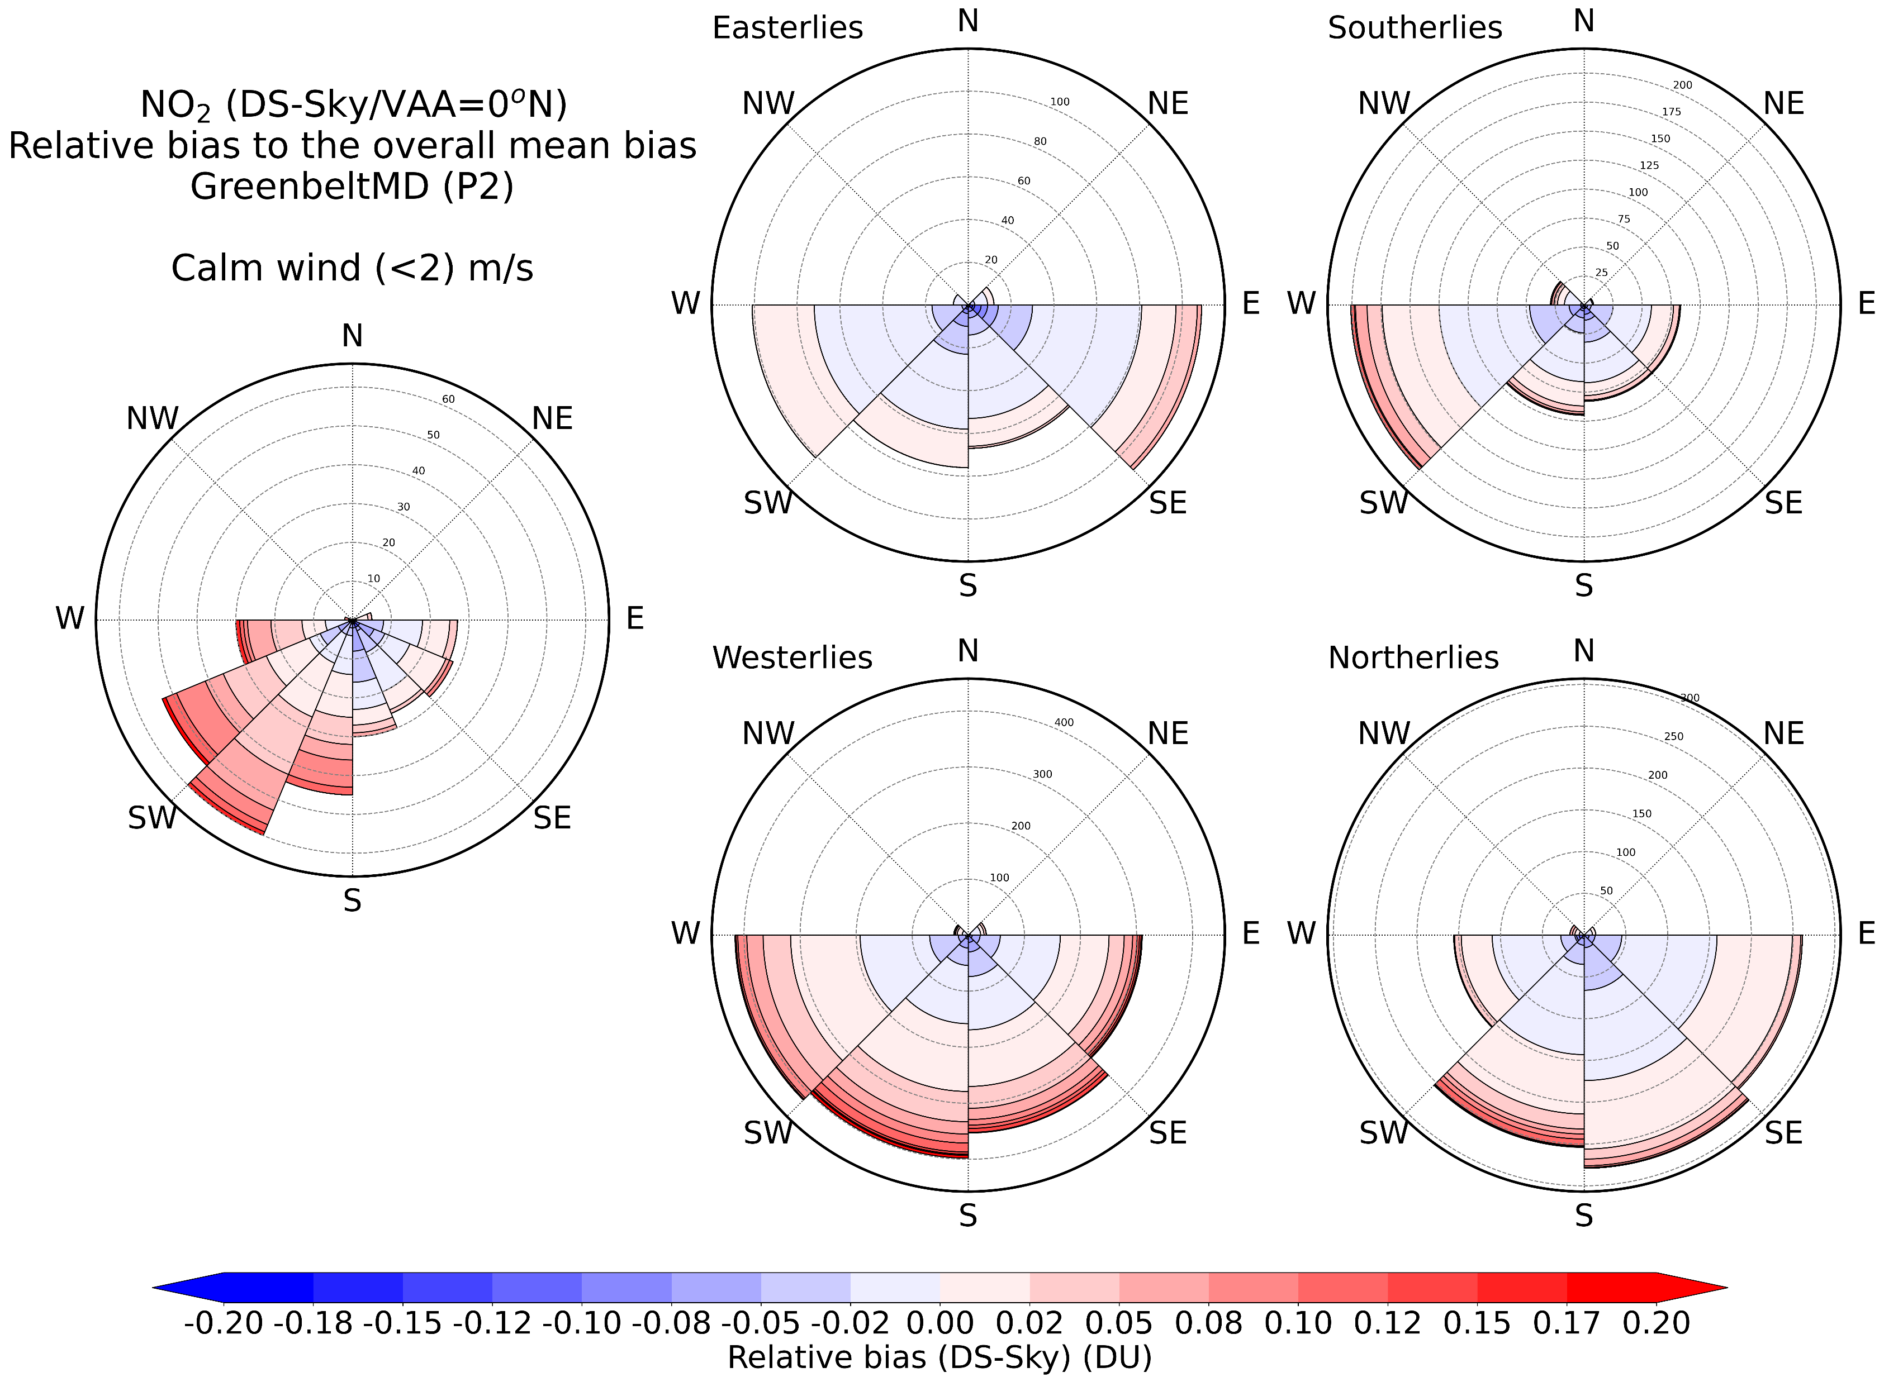
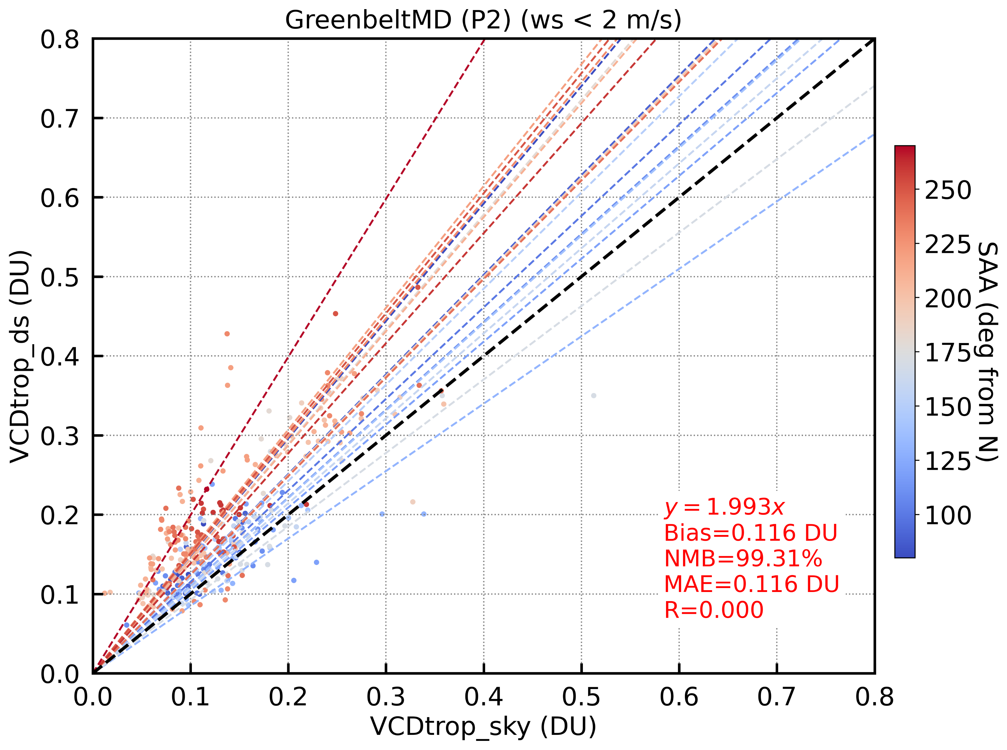
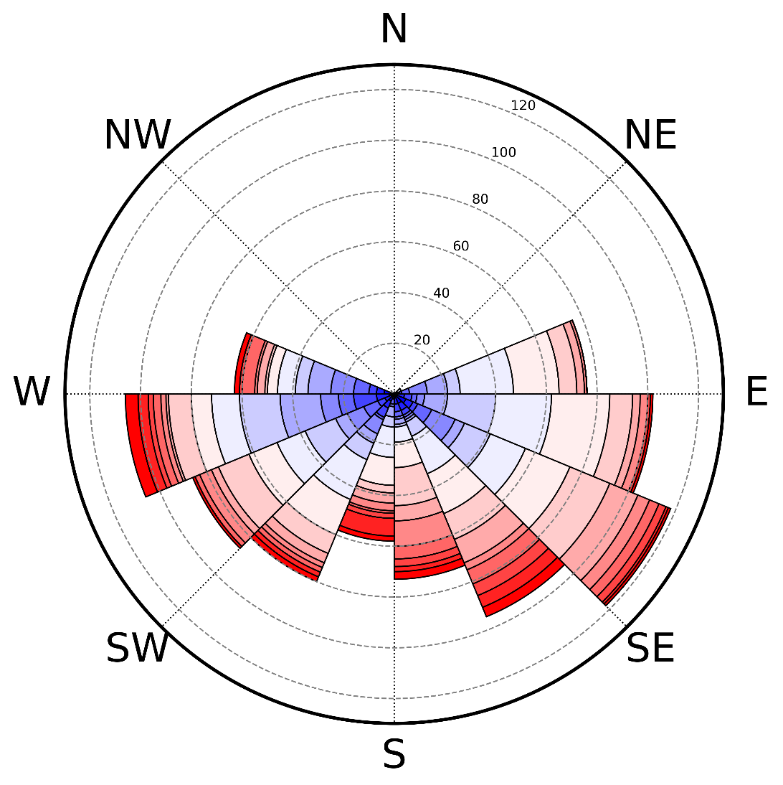
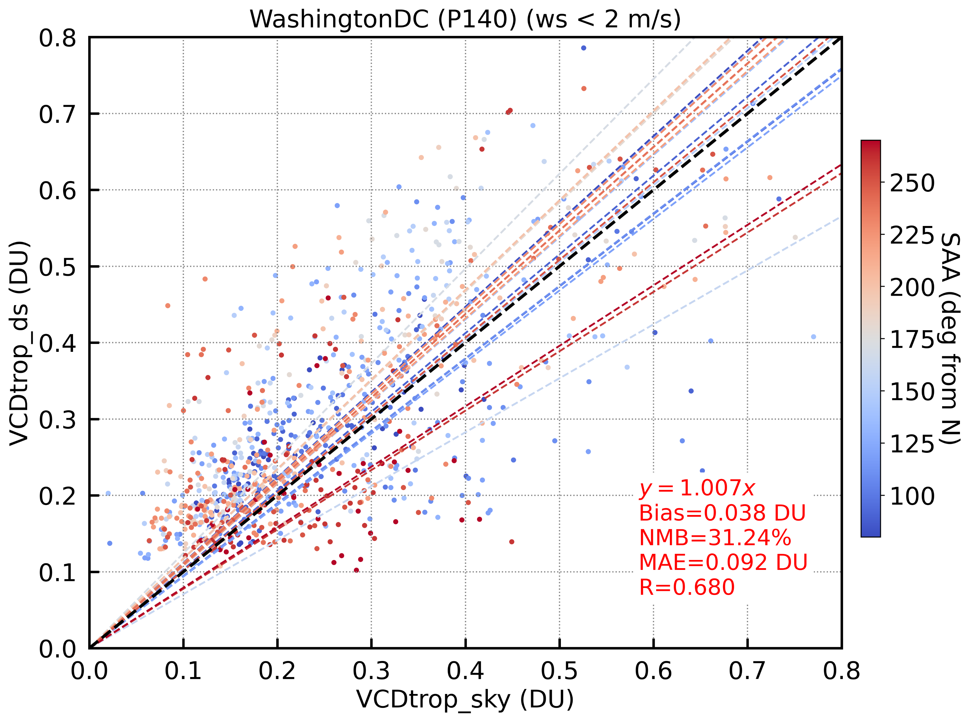
Direct-sun (DS) VAA-dependence showing spatial gradient of NO₂ VCD
GreenbeltMD (P2)
All data points
Calm wind (< 2 m/s)
Calm wind (< 2 m/s)
Afternoon
Calm wind (< 2 m/s)
DS VCD_{trop} (DU)
Afternoon
West (DS)
Morning
East (DS)
Morning
GreenbeltMD (P2)
Sky VCD_{trop} (DU)
Direct-Sun ↓
Direct-Sun ↑
→ Pronounced spatial gradient (E→W) of NO₂
WashingtonDC (P140)
WashingtonDC (P140)
All data points
Calm wind (< 2 m/s)
Calm wind (< 2 m/s)
DS VCD_{trop} (DU)
Direct-sun viewing area (approx. up to PBLH)
Sky scan VAA
Sky VCD_{trop} (DU)
→ More randomly inhomogeneous NO₂ at D.C.
Notes:
Clear DS VAA-dependency on outskirts where there are pronounced E-W spatial gradient (GreenbeltMD)!
+ Greater variability of DS-sky VCDs @ urban environment (WashingtonDC) – under calm wind condition

Slide 7



Methods: TEMPO and Pandora collocation for an intercomparison
1 pixel collocation (conventional):
Comparing ground-based measurements (i.e., Pandora) with satellite (TEMPO) pixel data that contains Pandora ground-location
Raytracing:
Calculating weighted average of satellite (TEMPO) data along the line of sight of Pandora Direct-sun measurements
It is more intuitive to compare ground-based Pandora observations with raytraced-average satellite data
Raytracing can significantly improve satellite validation results, especially for TEMPO
TEMPO has unprecedentedly high spatial resolution
TEMPO is GEO (observations under high SZA)
Notes:
Used number densities of target species along the sight to calculate weights → based on a priori model profiles used in TEMPO retrievals

Slide 8
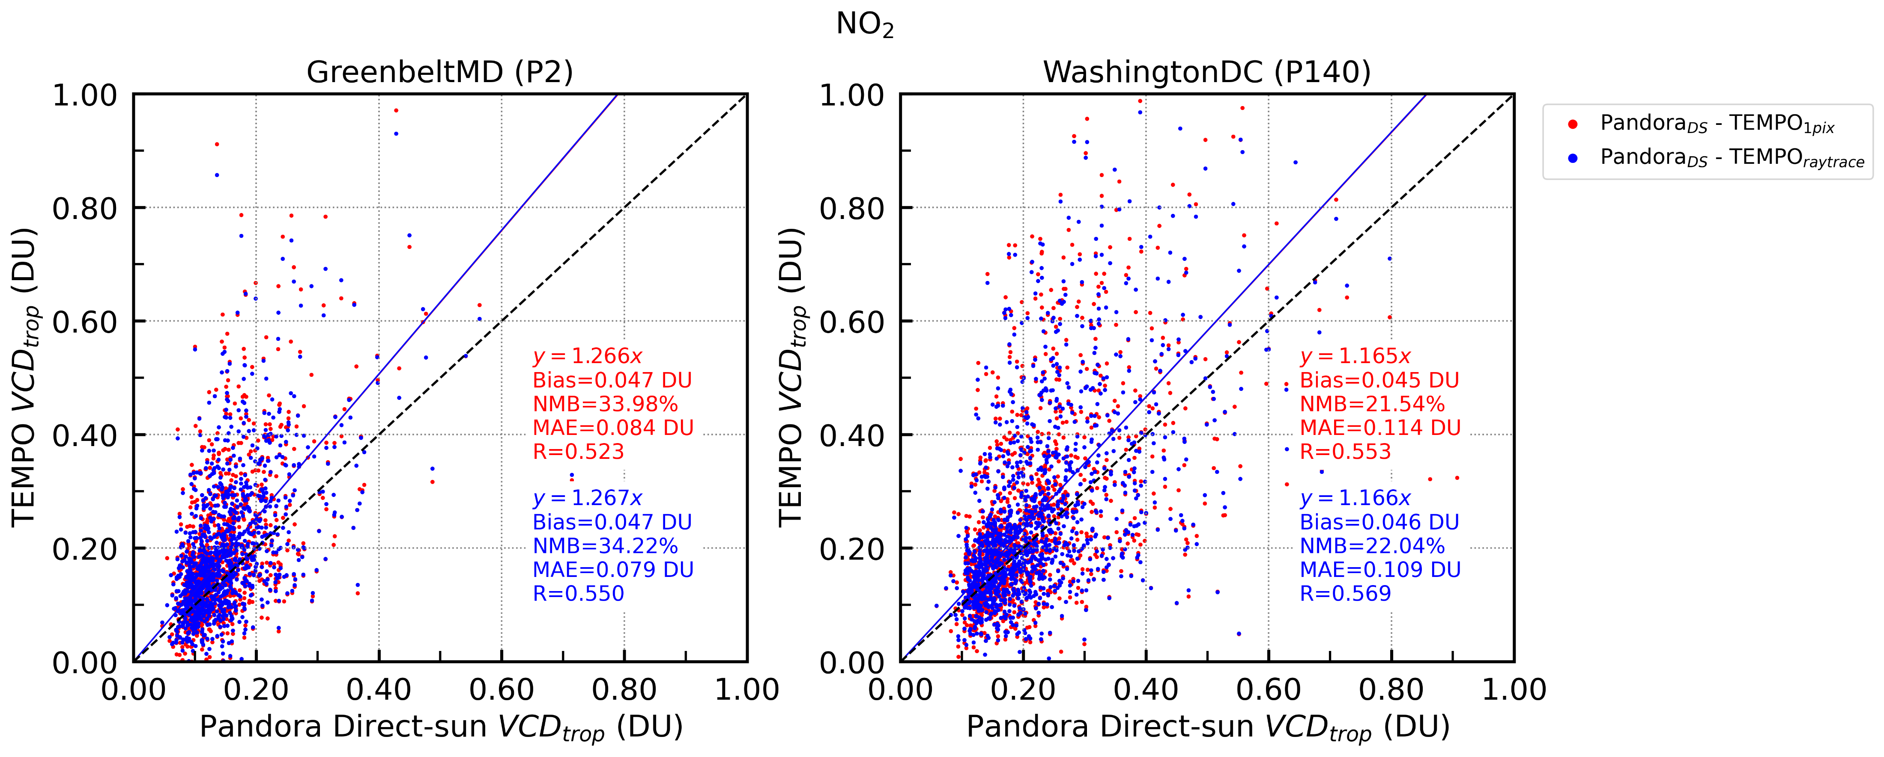
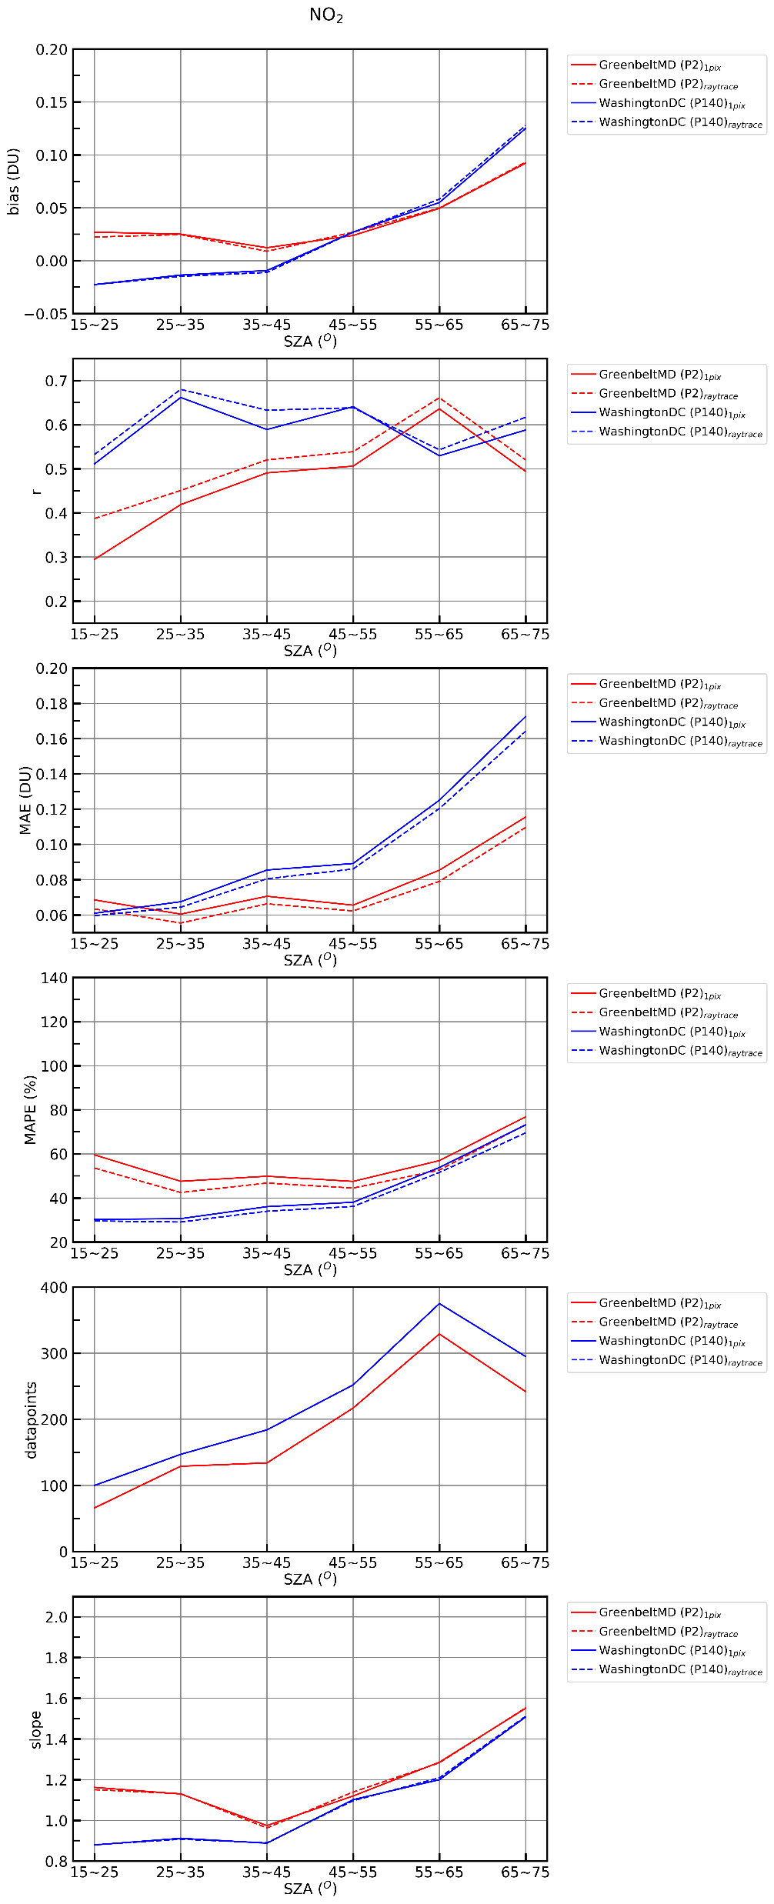
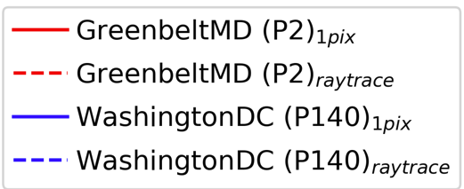
TEMPO vs Pandora (direct-sun) NO₂ VCDs: Simple vs Raytraced
Slope
Correlation (r)
MAE (DU)
WashingtonDC (P140)
WashingtonDC (P140)
GreenbeltMD (P2)
GreenbeltMD (P2)
SZA (º)
SZA (º)
SZA (º)
Notes:
Pandora DS NO2 and TEMPO NO2 shows good agreement.
Raytracing has no effect on mean biases or the slope.
Slight, but systematically improved correlation and lower random error when comparing Pandora DS NO2 with raytracing-averaged TEMPO data.

Slide 9
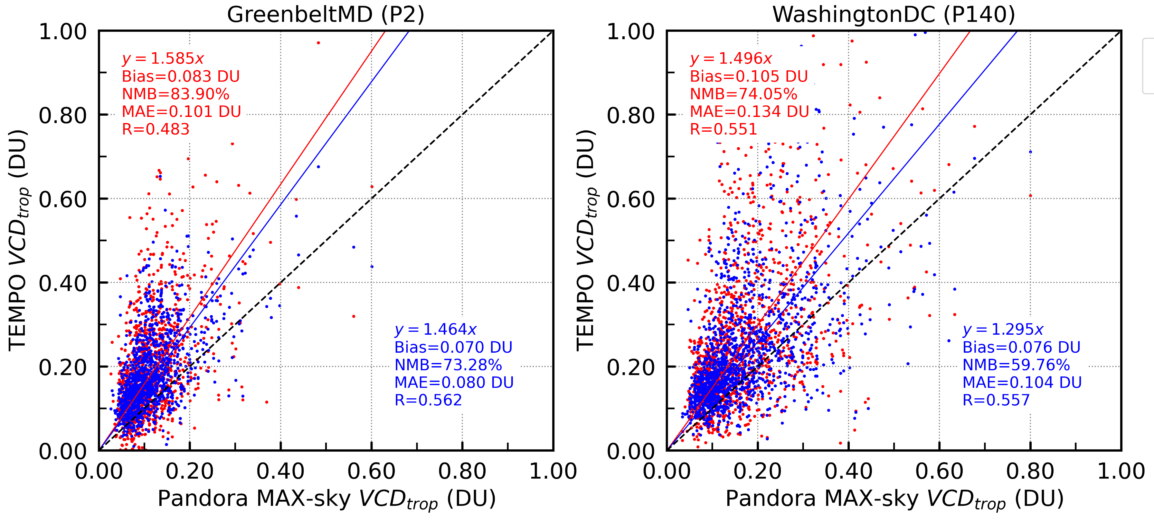
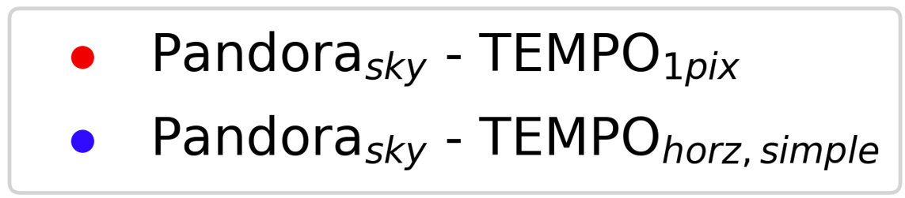
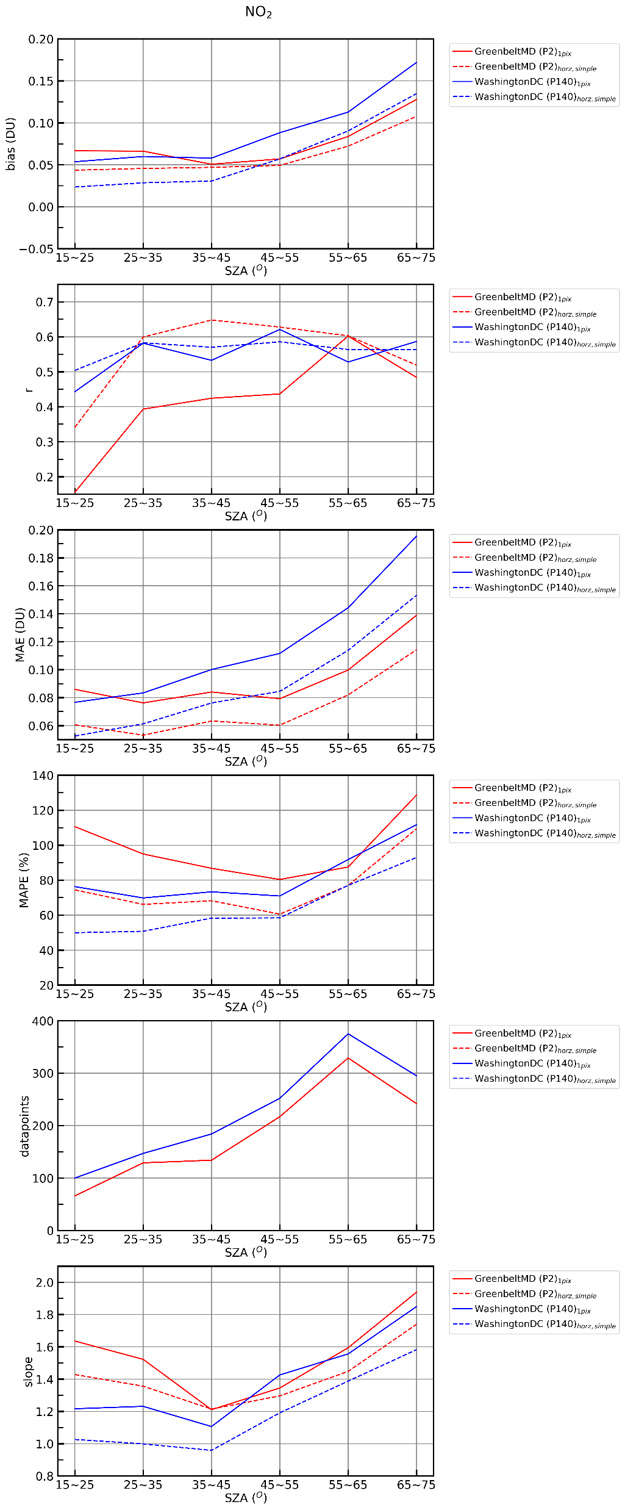
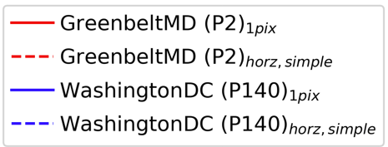
TEMPO vs Pandora (sky-scan) NO₂ VCDs: Simple vs Raytraced
Slope
Correlation (r)
MAE (DU)
GreenbeltMD (P2)
WashingtonDC (P140)
SZA (º)
SZA (º)
SZA (º)
Notes:
More pronounced improvement when averaging TEMPO pixel along the viewing direction (VAA) of Pandora sky-scan.
In general, Pandora MAX-DOAS NO2 shows lower value – considering VAA significantly affects the slope (reduces mean bias) since Pandora sky-scan actually represents larger area along VAA.

Slide 10
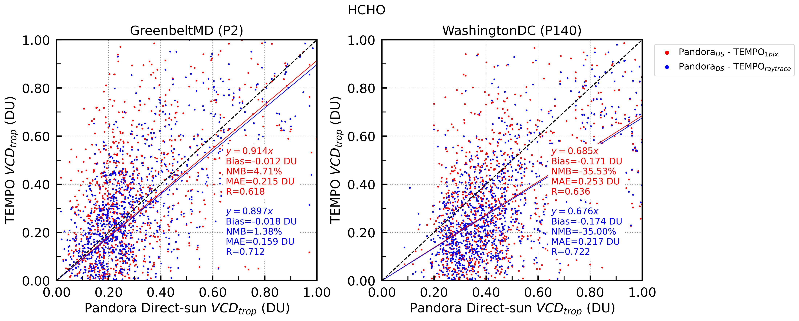
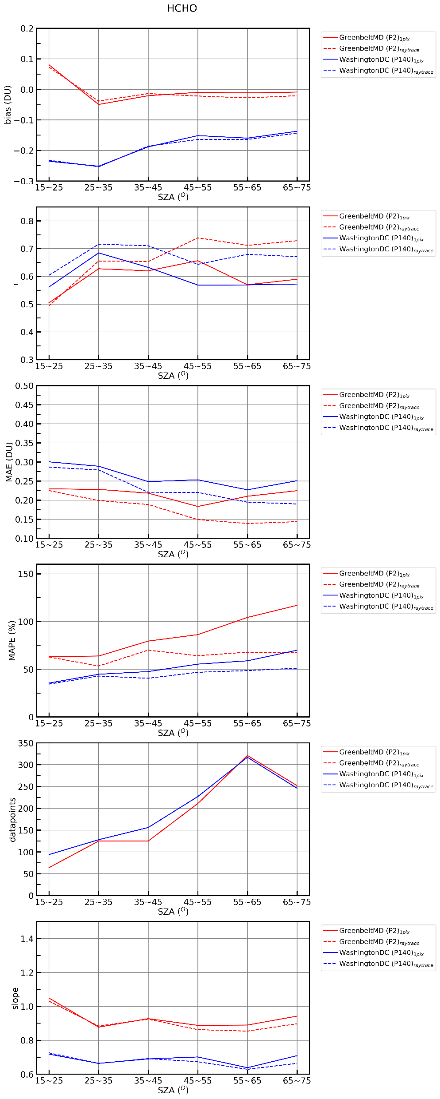
TEMPO vs Pandora (direct-sun) HCHO VCDs: Simple vs Raytraced
Slope
Correlation (r)
MAE (DU)
SZA (º)
SZA (º)
SZA (º)
Notes:
Pandora direct-sun HCHO retrievals are susceptible to calibration accuracy (e.g., resolution change)
→ Potentially (positively or negatively) biased

Slide 11
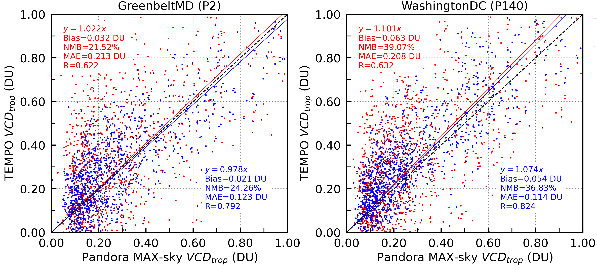
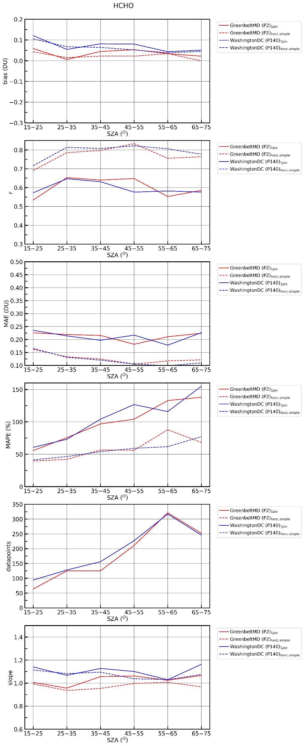
TEMPO vs Pandora (sky-scan) HCHO VCDs: Simple vs Raytraced
Slope
Correlation (r)
MAE (DU)
WashingtonDC (P140)
GreenbeltMD (P2)
SZA (º)
SZA (º)
SZA (º)
Notes:
Pandora MAX-DOAS HCHO and TEMPO shows relatively small site-by-site difference. (i.e., Greenbelt & DC showing similar results) → may indicate spatial distribution is rather homogeneous / and more affected by uncertainties in the retrieval itself

Slide 12
Summary and Further Steps
Pandora observations (direct-sun, sky) are not really a point-wise observation
→ Observed data is significantly affected by viewing geometry, especially NO₂ with high spatiotemporal variability
Satellite (TEMPO) validation should consider viewing geometry (or effective light path) of ground-based instrument (Pandora)
→ Especially when validating GEO & higher spatial resolution
Demonstrate effectiveness of ray-tracing method by applying same concept on sites with greater spatial inhomogeneity (e.g., NYC, LA, Chicago, Houston, etc.)
Updated TEMPO data should be accessed (i.e., v4 TEMPO products)
Access how effective the ray-tracing method is by comparing Pandora observations with GCAS measurements (may require high-resolution CTM data used in GCAS retrievals)
Should investigate whether the satellite viewing geometry also matters significantly (i.e., satellite is not really observing “vertical column” data from TOA to surface of the Earth)

