Slide 1


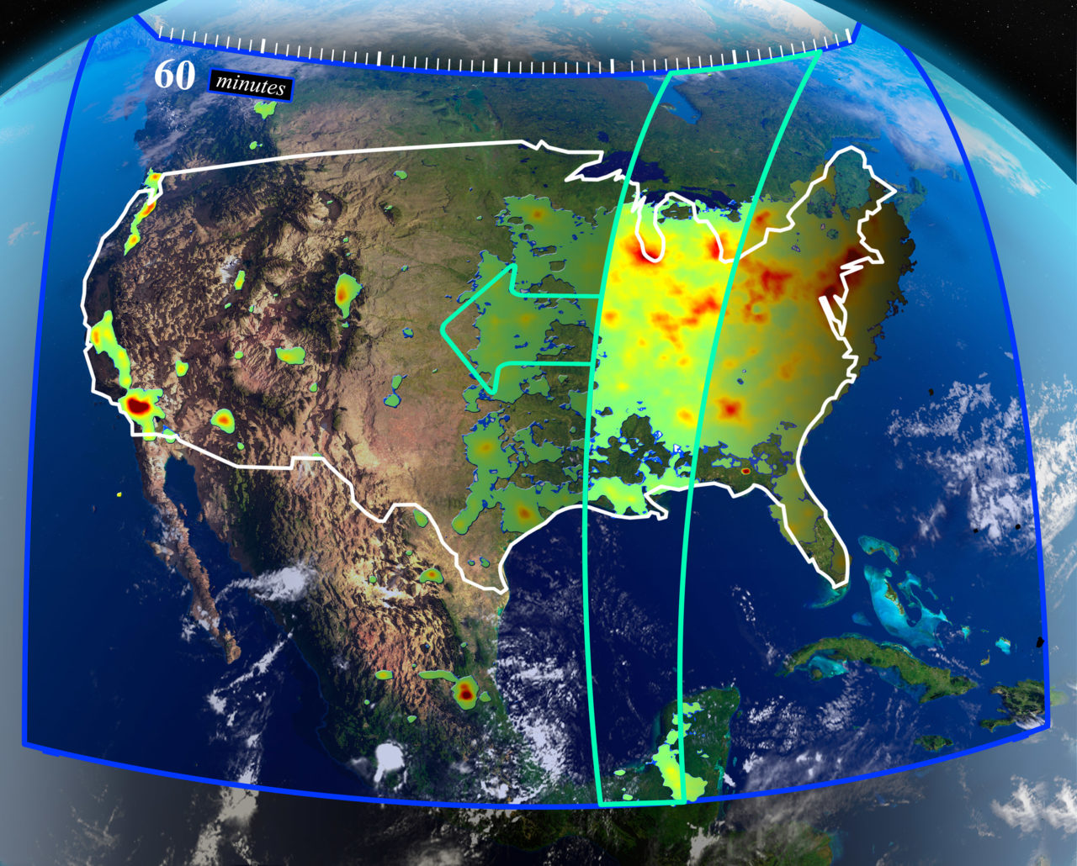



Leveraging Observations of Remotely Sensed HCHO Column to Assess Surface Ozone
Prajjwal Rawat¹, James H. Crawford¹, Katherine R. Travis¹, Laura M. Judd¹, Mary Angelique G. Demetillo¹, Tabitha C. Lee¹, James J. Szykman², Lukas C. Valin², Barron Henderson², Eric Baumann², Thomas F. Hanisco³, Gonzalo Gonzalez Abad⁴
¹NASA Langley Research Center, Hampton, VA, USA
²Environmental Protection Agency, NC, USA
³NASA Goddard Space Flight Center, Greenbelt, MD, USA
⁴Harvard-Smithsonian Center for Astrophysics, Cambridge,
Massachusetts, USA
prajjwal.rawat@nasa.gov

Slide 2

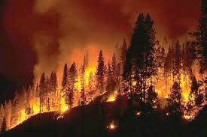

Surface Ozone and Signature/Observations from Space
hν
Ozone (O₃)
hν, H₂O
Nitrogen oxides, CO, VOCs
HO_{x}
Non-linear photochemistry
Anthropogenic, biogenic, fire, etc.
Despite decades of declines in precursors, many U.S. cities still exceed the EPA 8-hour ozone NAAQS.
Emissions
Ground ozone monitors are sparse across many regions and potentially miss small-scale air quality events.
Satellite observations can help fill these gaps in unmonitored regions, but near-surface ozone retrieval remains challenging due to optical interference from clouds, aerosols, and stratospheric ozone.
The formation of peroxy radicals during the secondary production of HCHO makes it a helpful indicator for surface ozone.
[Schroeder et al., 2016]

Slide 3
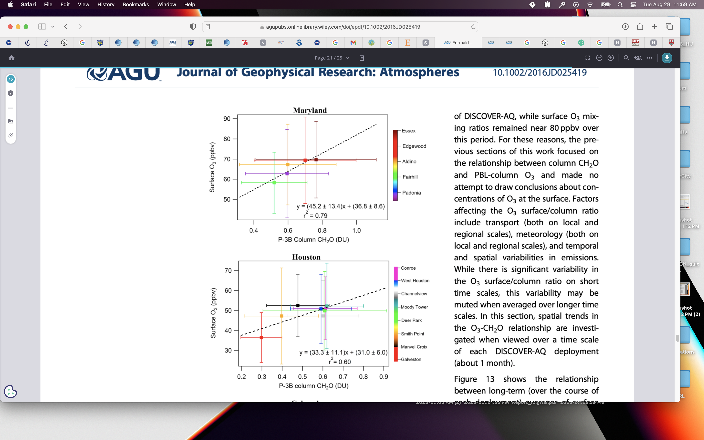
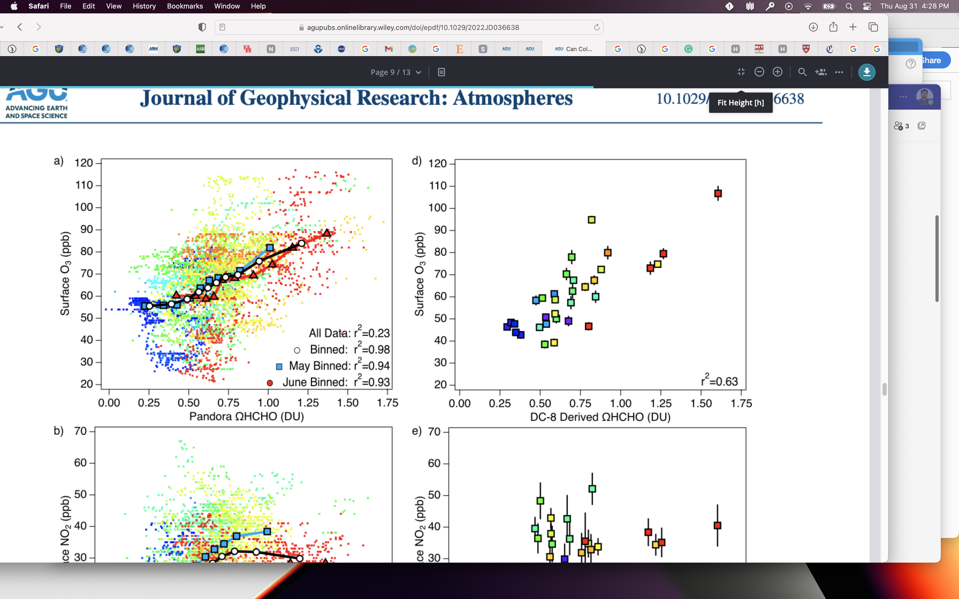
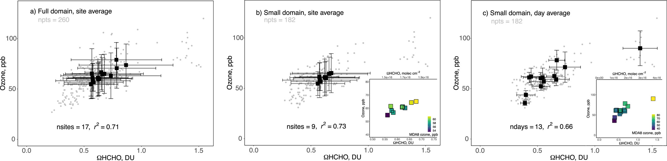
Column HCHO can indicate surface ozone variability/tendencies
Observations of column (Ω) HCHO and surface ozone during different field campaigns show ΩHCHO as a valuable indicator of surface ozone variability.
Maryland
Olympic Park, S Korea
Long Island Sound
GCAS airborne
Ozone (ppb)
Ozone (ppb)
DISCOVER-AQ campaign
KORUS-AQ campaign
LISTOS campaign
[Schroeder et al., 2016]
[Travis et al., 2022]
[Travis et al., 2022]

Slide 4
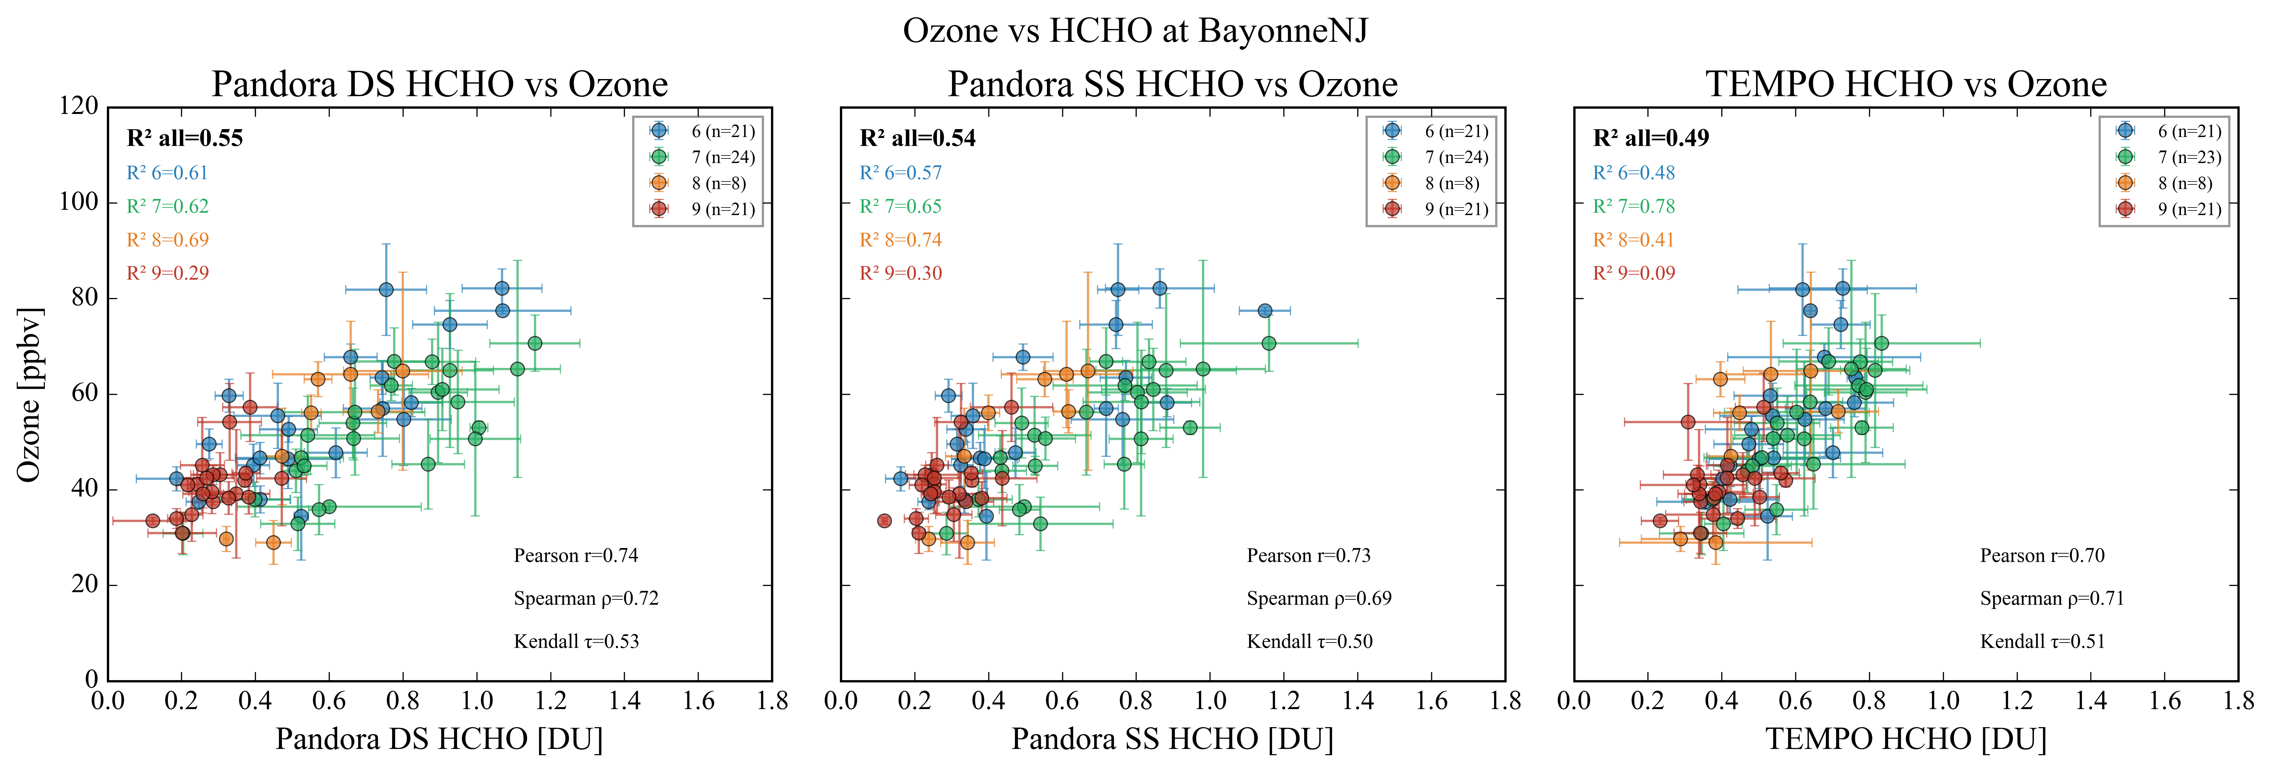
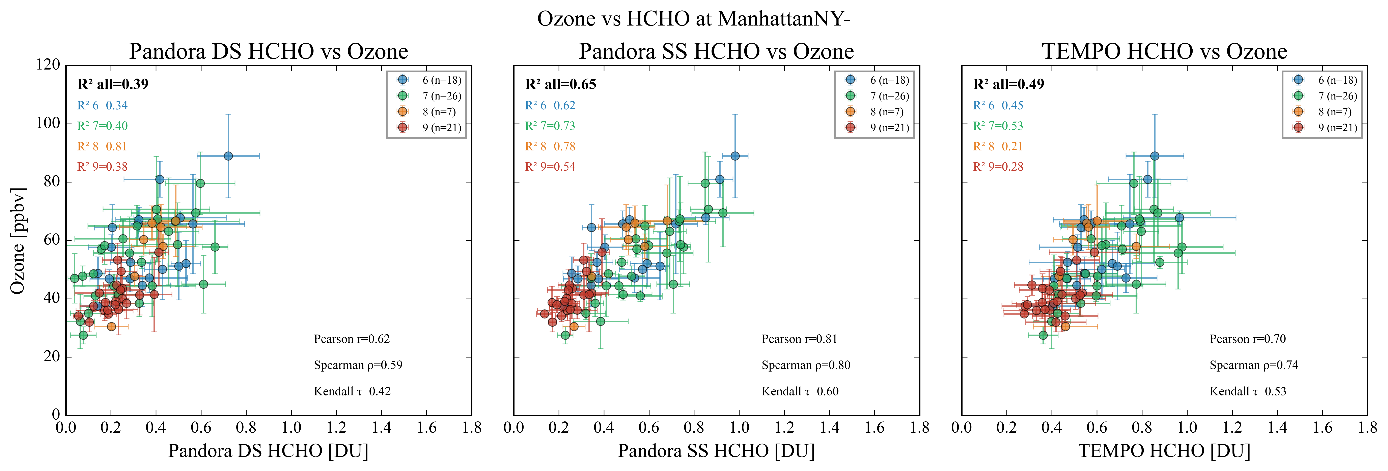
O₃:HCHO Relationship with TEMPO as good as with Pandora in NY- NJ
TEMPO shows similar or stronger O₃–HCHO relationships across other NY ozone monitoring sites.
Pandora DS
Pandora SS
TEMPO
Months
Months
Months
R²=0.45
R²=0.55
Bayonne Pandora site
R²=0.49
DS
SS
TEMPO
Daily average surface ozone and ΩHCHO during Jun to Sep 2024 (10 – 18 LT)
Months
Months
Months
R²=0.65
R²=0.39
Manhattan Pandora site
R²=0.49
Cloud Screened quality flagged data

Slide 5
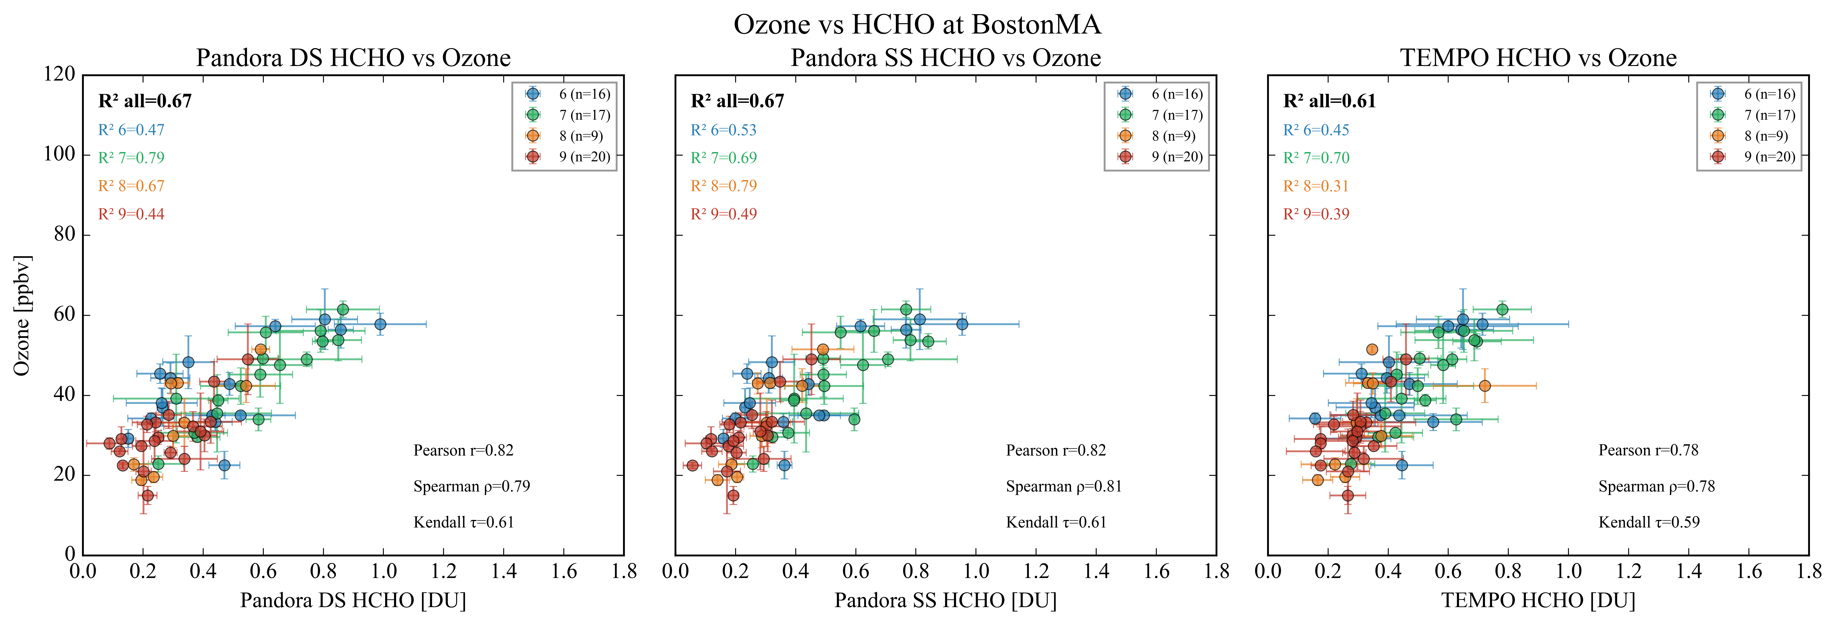
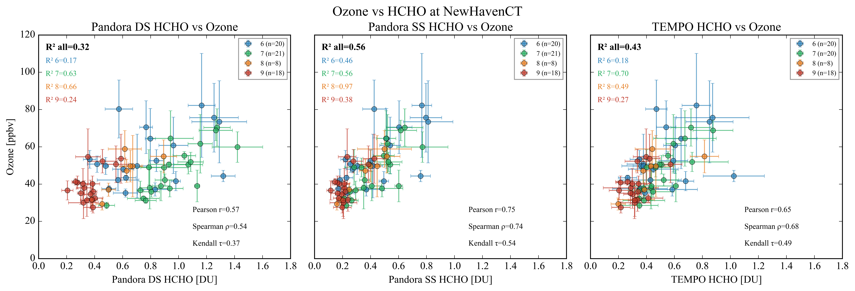
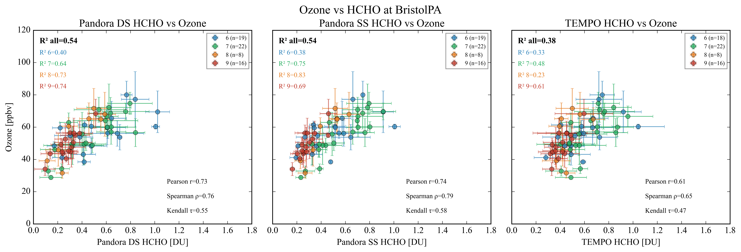
Pandora and TEMPO ΩHCHO relationship with surface ozone over Boston MA, New Haven CT, and Bristol PA
DS
SS
TEMPO
Months
Months
Months
R²=0.67
R²=0.67
R²=0.61
BostonMA Pandora site
DS
SS
TEMPO
Months
Months
Months
Both Pandora and TEMPO capture the O₃–HCHO relationship well, though TEMPO shows slightly lower correlation.
The O₃–HCHO relationship can be used to assess the accuracy and reliability of Pandora DS and SS observations.
R²=0.56
R²=0.32
New HavenCT Pandora site
R²=0.43
DS
SS
TEMPO
Months
Months
Months
R²=0.54
R²=0.54
R²=0.38
BristolPA Pandora site

Slide 6
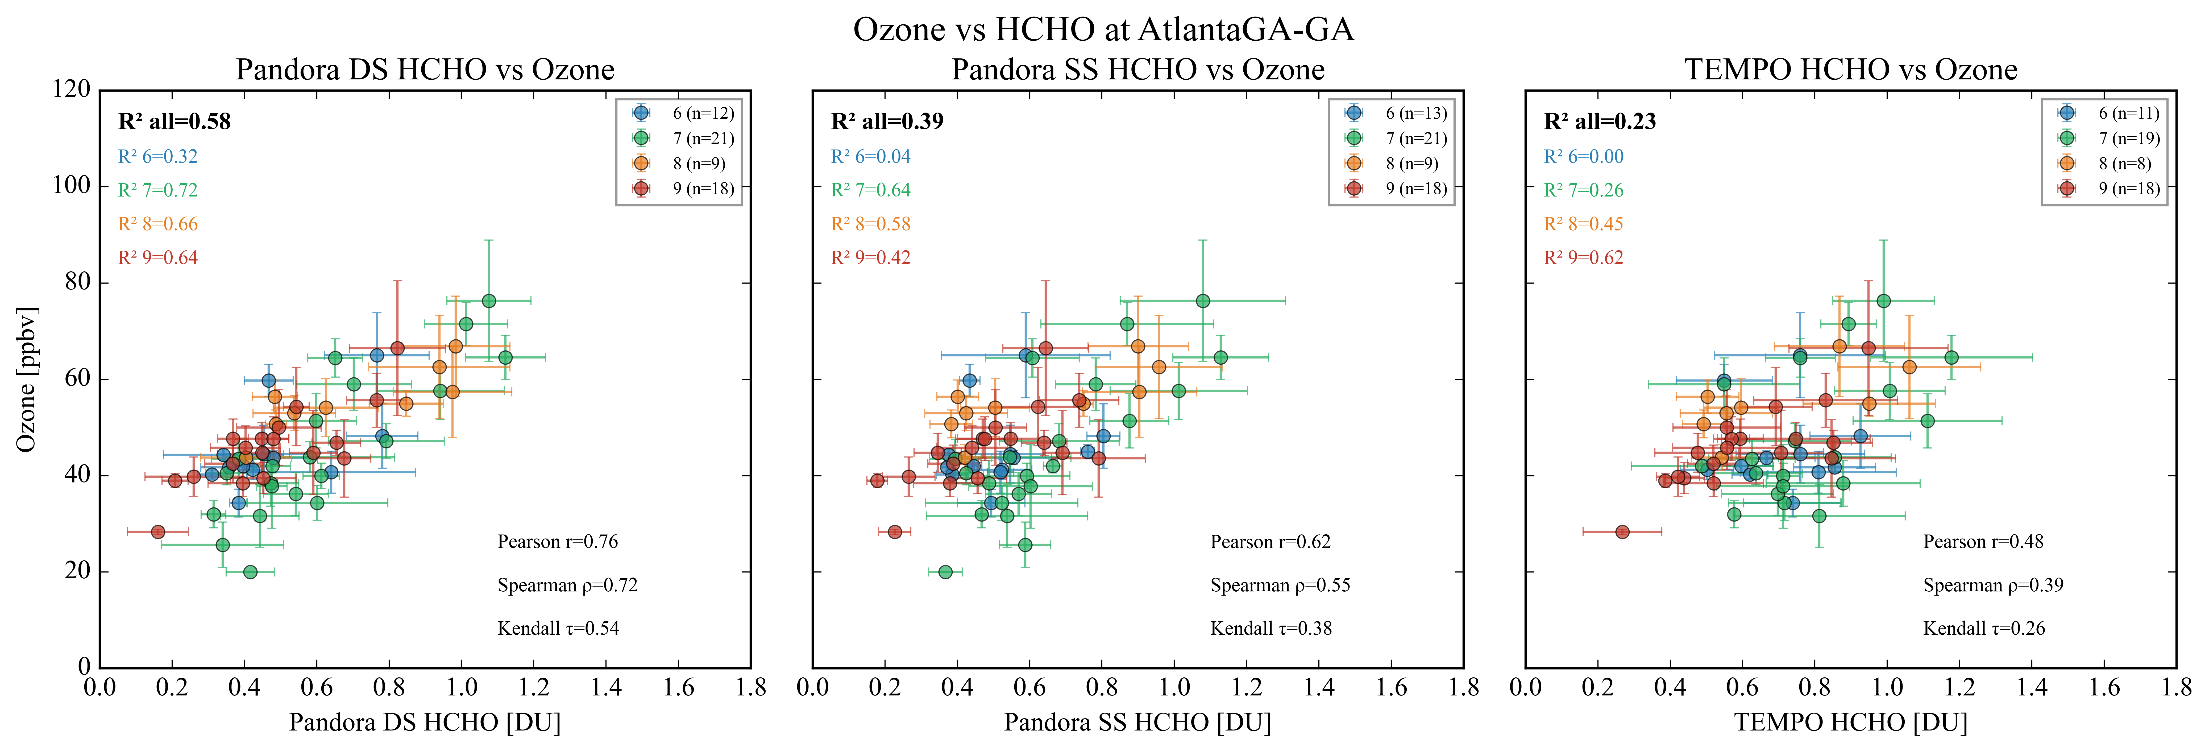
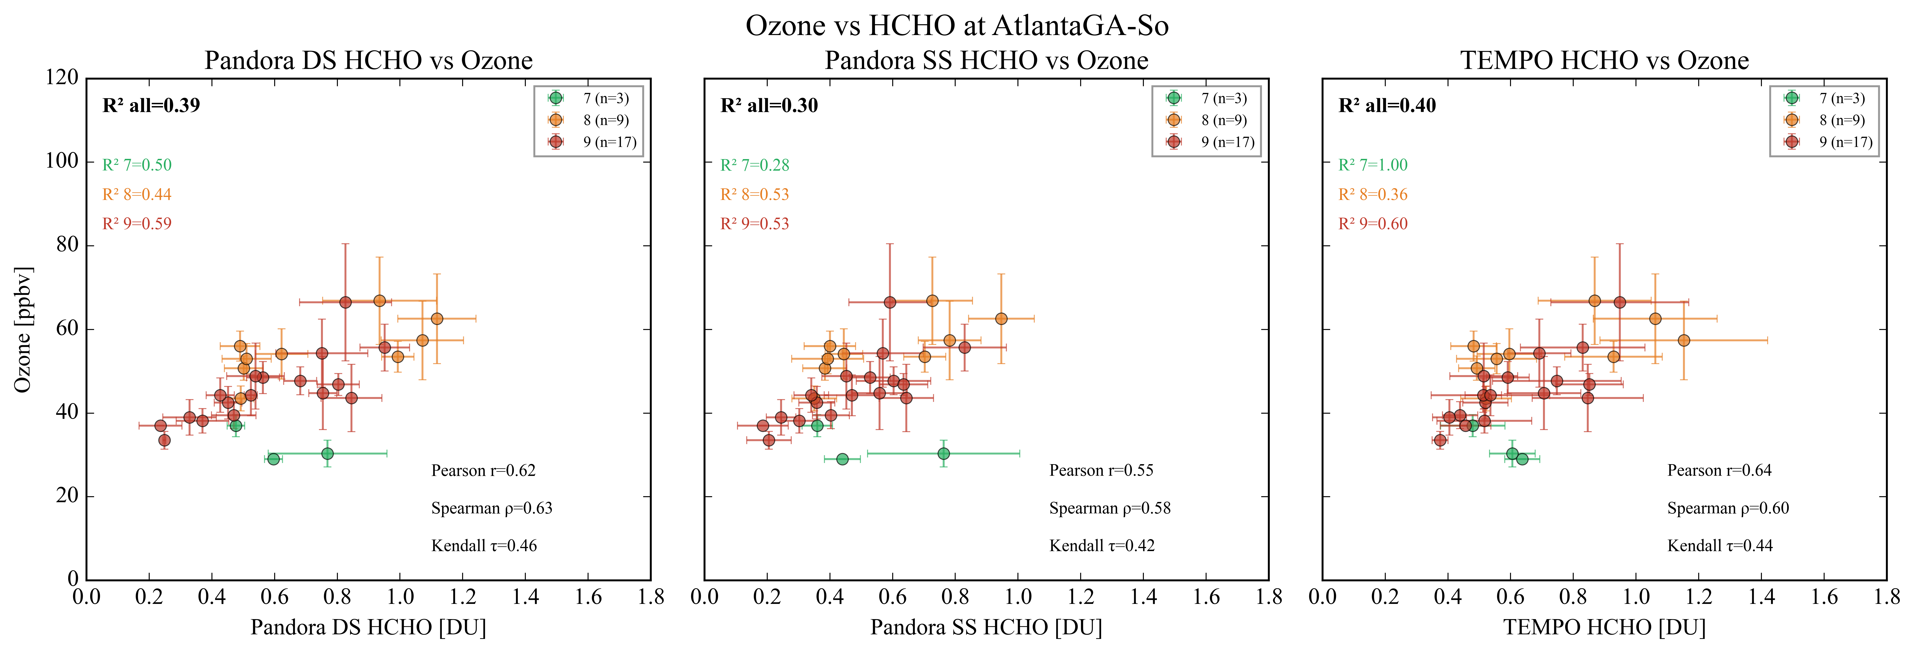
Pandora Shows better O₃–HCHO Relationship than TEMPO in Atlanta
DS
SS
TEMPO
Months
Months
Months
Overall, TEMPO shows difficulty in capturing the ozone–HCHO relationship; however, good correlations are seen in individual months, except June.
R²=0.39
R²=0.58
R²=0.23
Atlanta GT Pandora site
DS
SS
TEMPO
Cloud influence may explain the larger uncertainty, while V4 retrievals could yield improved relationships.
Months
Months
Months
R²=0.30
R²=0.39
R²=0.40
Atlanta SD Pandora site

Slide 7
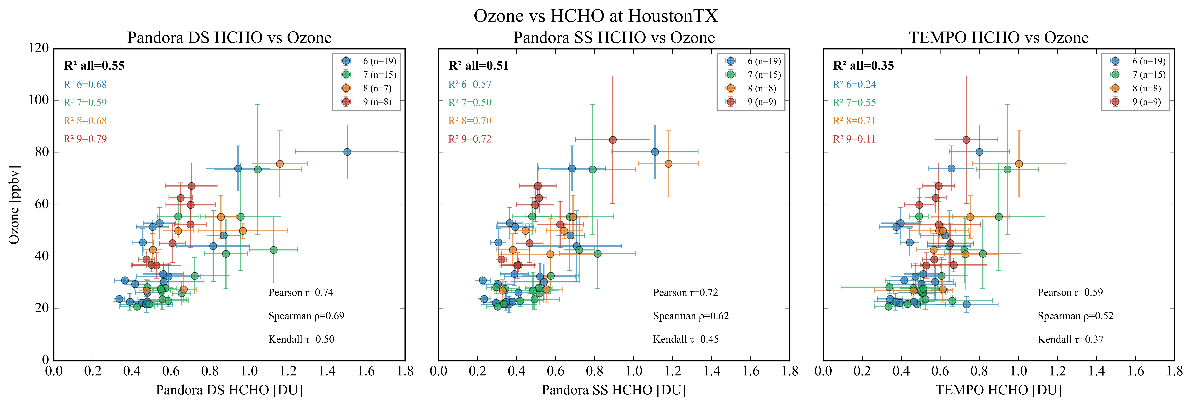
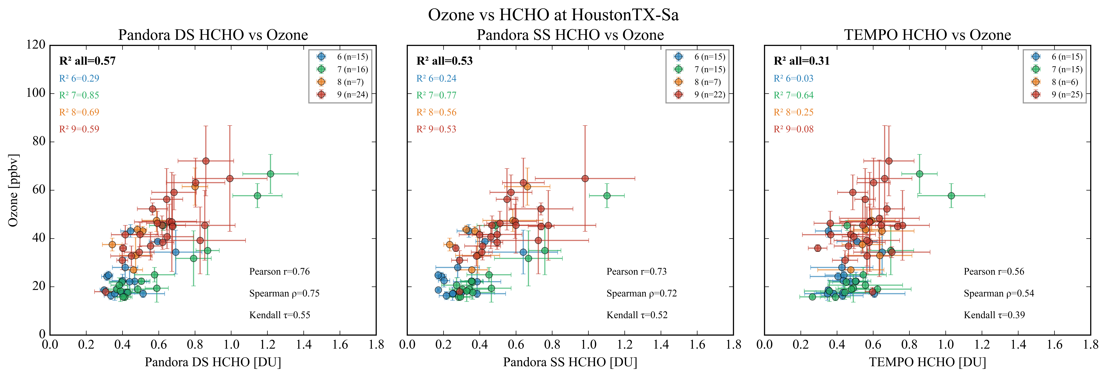
TEMPO Underestimation at Higher Columns Likely Reduces Correlation
DS
SS
TEMPO
Months
Months
Months
TEMPO underestimates (-20%) at higher columns, weakening the ozone–HCHO relationship at elevated ozone levels, whereas Pandora captures the full dynamic range.
R² =0.51
R² =0.55
R² =0.35
HoustonTX Pandora site
DS
SS
TEMPO
Months
Months
Months
R² =0.53
Validation Results Presented in our Poster
R² =0.57
R² =0.31
Houston-SanJacinto Pandora site

Slide 8
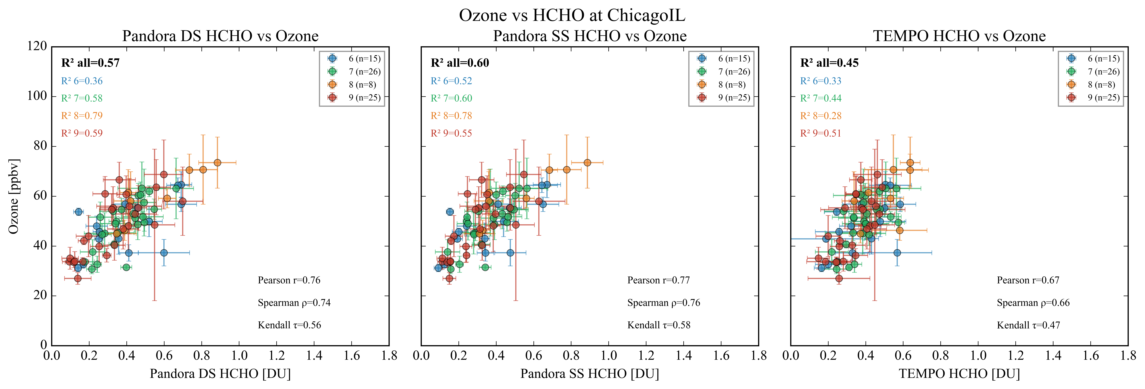
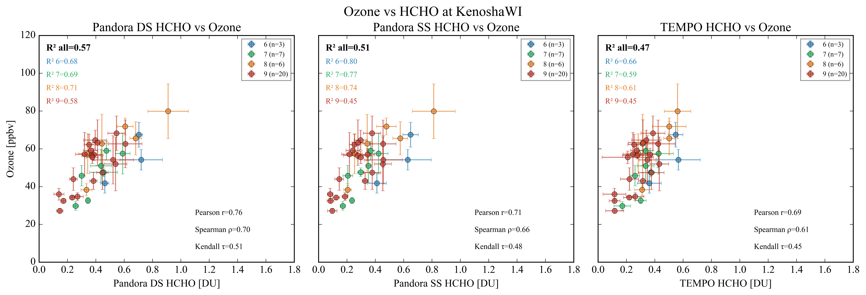
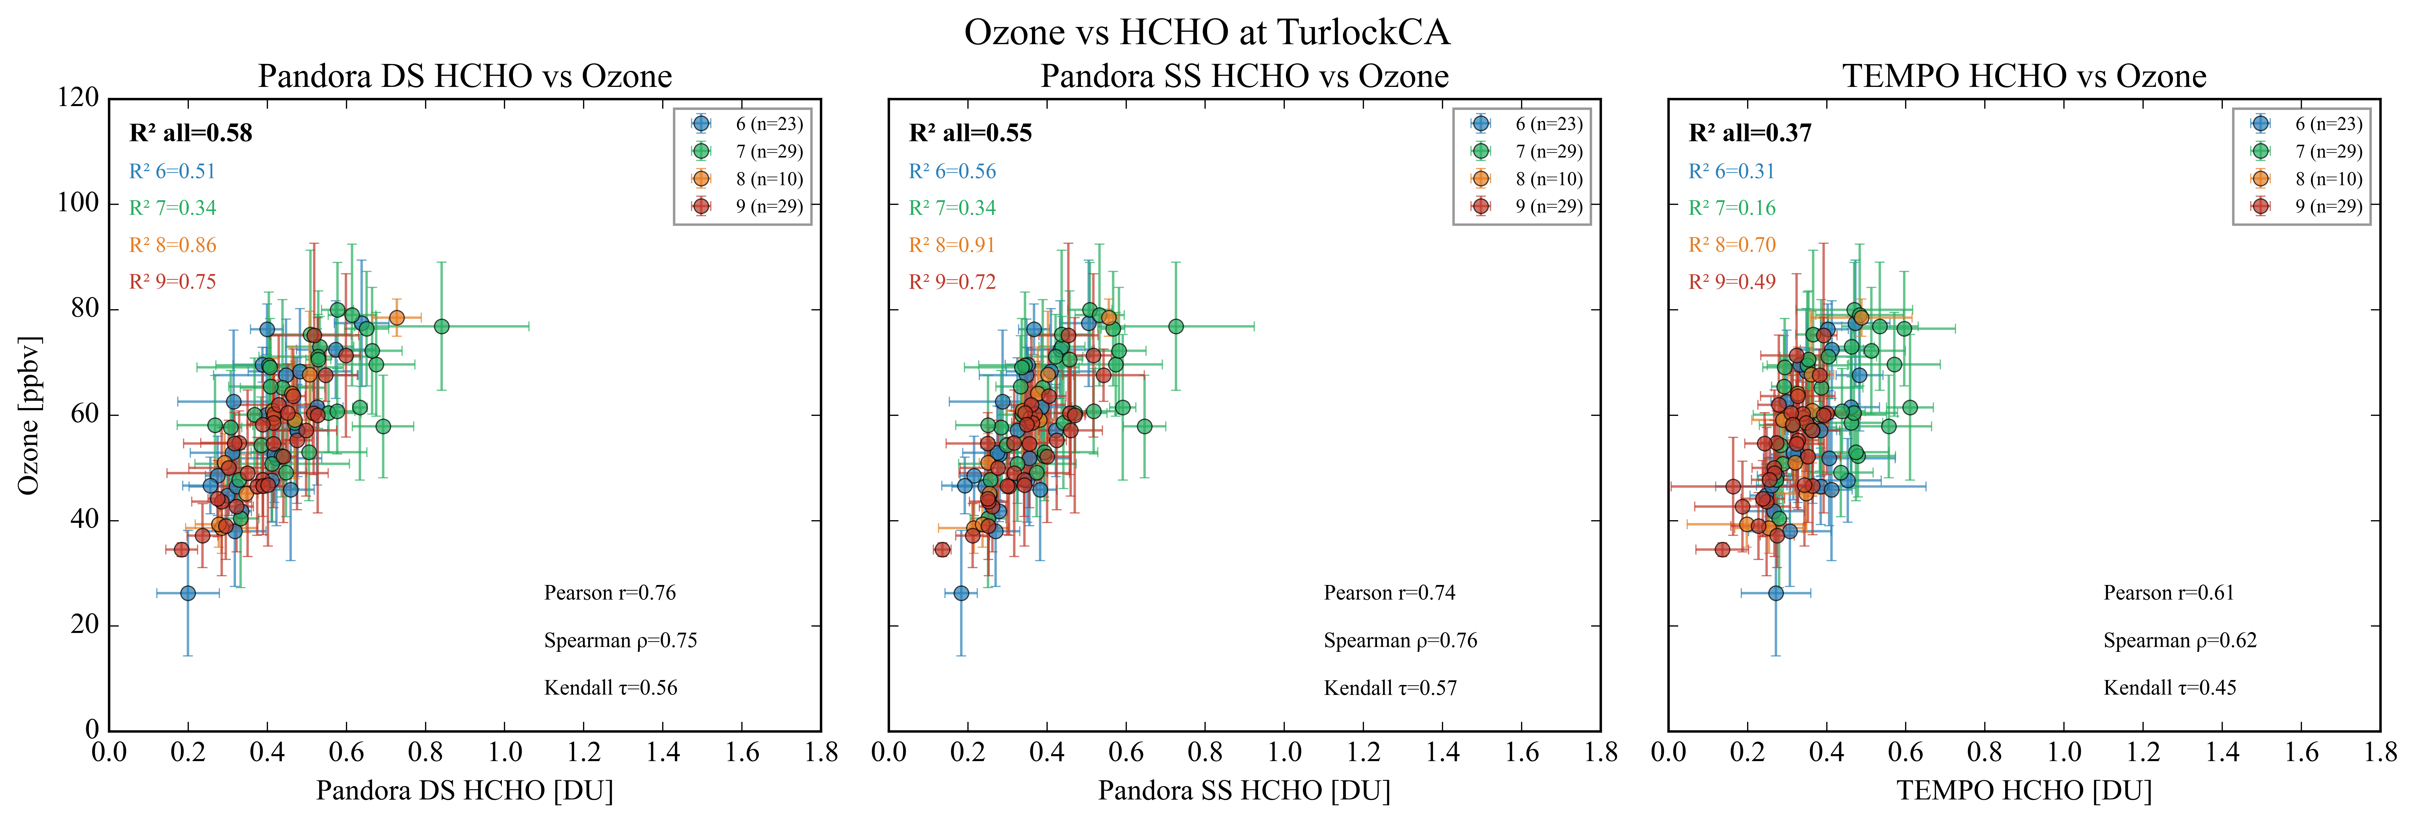
Pandora and TEMPO ΩHCHO relationship with surface ozone over Chicago-Kenosha and Turlock
DS
SS
TEMPO
Months
Months
Months
R²=0.60
R²=0.57
ChicagoIL Pandora site
R²=0.45
Pandora and TEMPO HCHO capture surface ozone dynamics well.
Daily TEMPO ΩHCHO offers great potential for mapping ozone exceedance days.
Long-term HCHO averages can reveal photochemical hotspots: Useful for identifying potential high-ozone regions and guiding monitoring and air quality strategies within cities.
DS
SS
TEMPO
R²=0.51
R²=0.57
KenoshaWI Pandora site
R²=0.47
DS
SS
TEMPO
R² =0.55
R² =0.58
TurlockCA Pandora site
R² =0.37

Slide 9
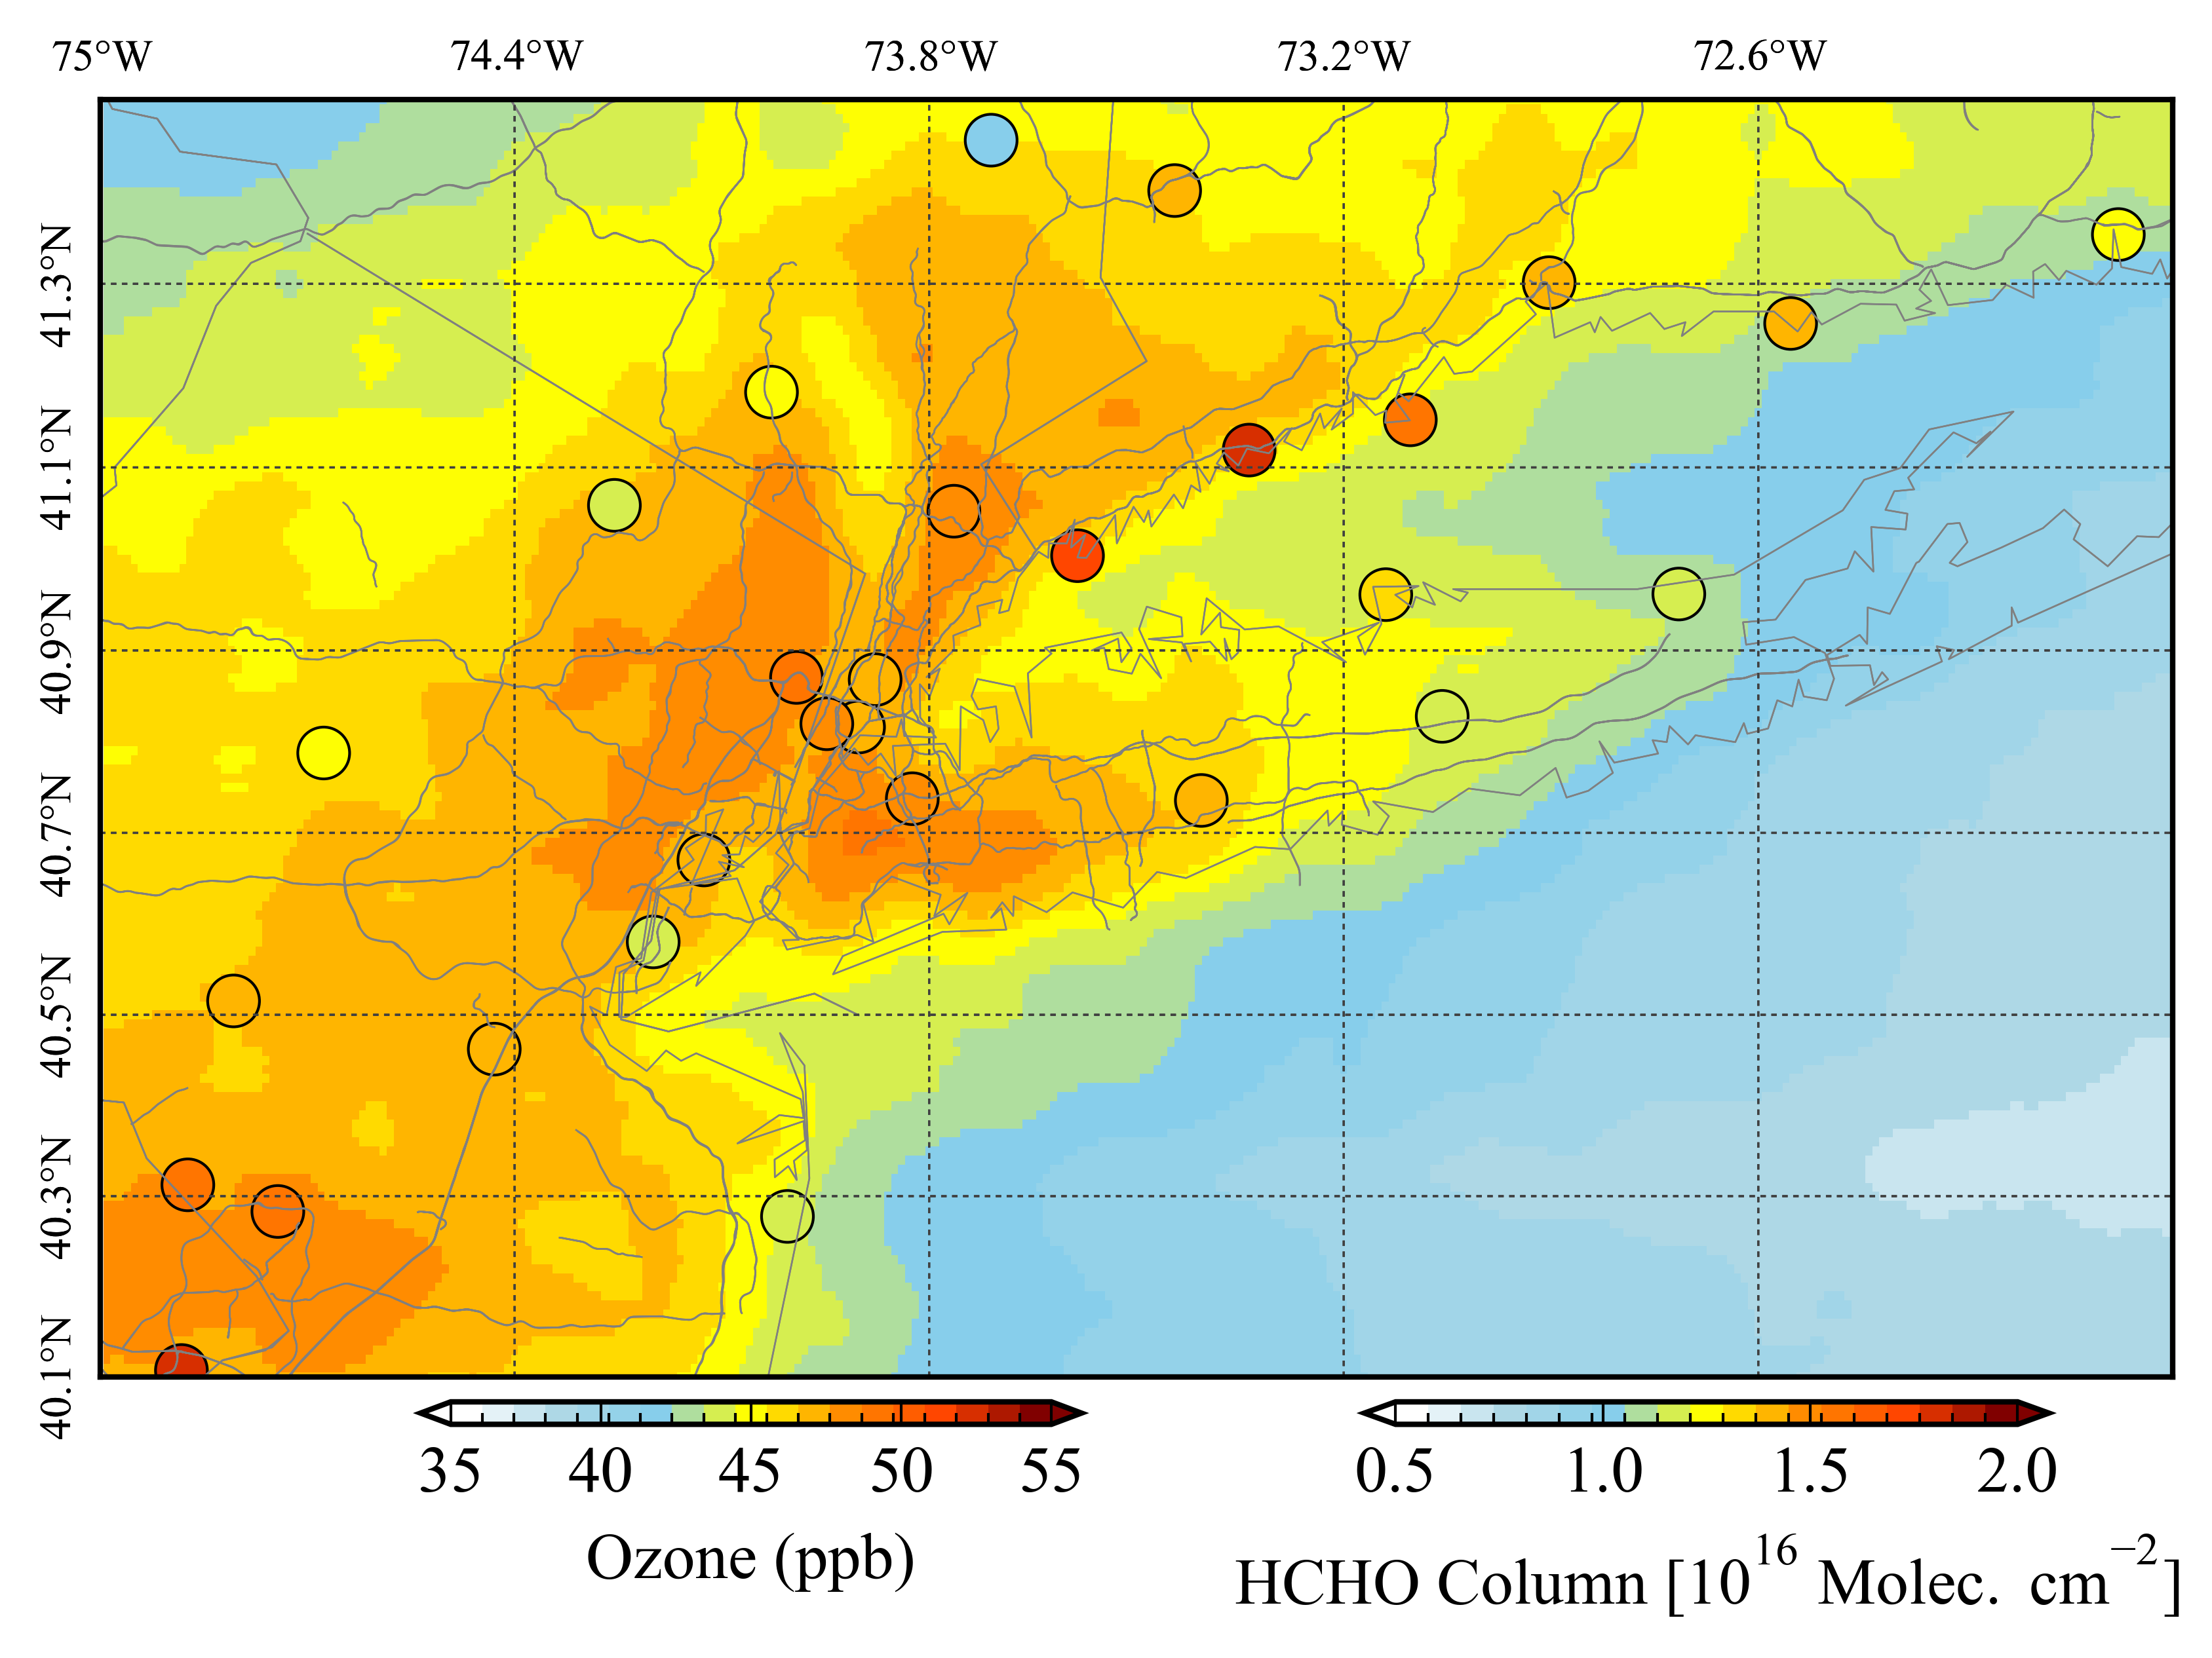
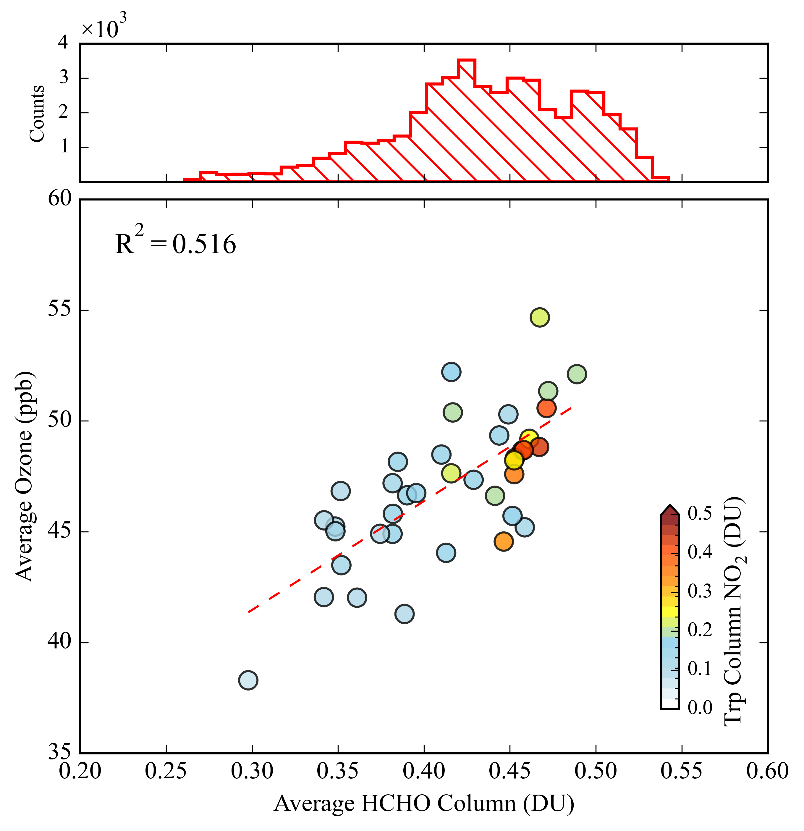
TEMPO Observations Highlight a Strong Spatial O₃–HCHO Link in New York
TEMPO HCHO distribution
Spatial relationship
Jun to Sep
1✕1km² map
0.7 DU
It shows how well the ozone monitoring network covers the possible ozone exceedance regions.
NO₂ reveals emission hotspots, while TEMPO HCHO captures ozone tendency well.
Over the NY region, ΩHCHO shows a good spatial link to ozone (r² ≈ 0.5), and monitoring strategies capture photochemical hotspots well.

Slide 10
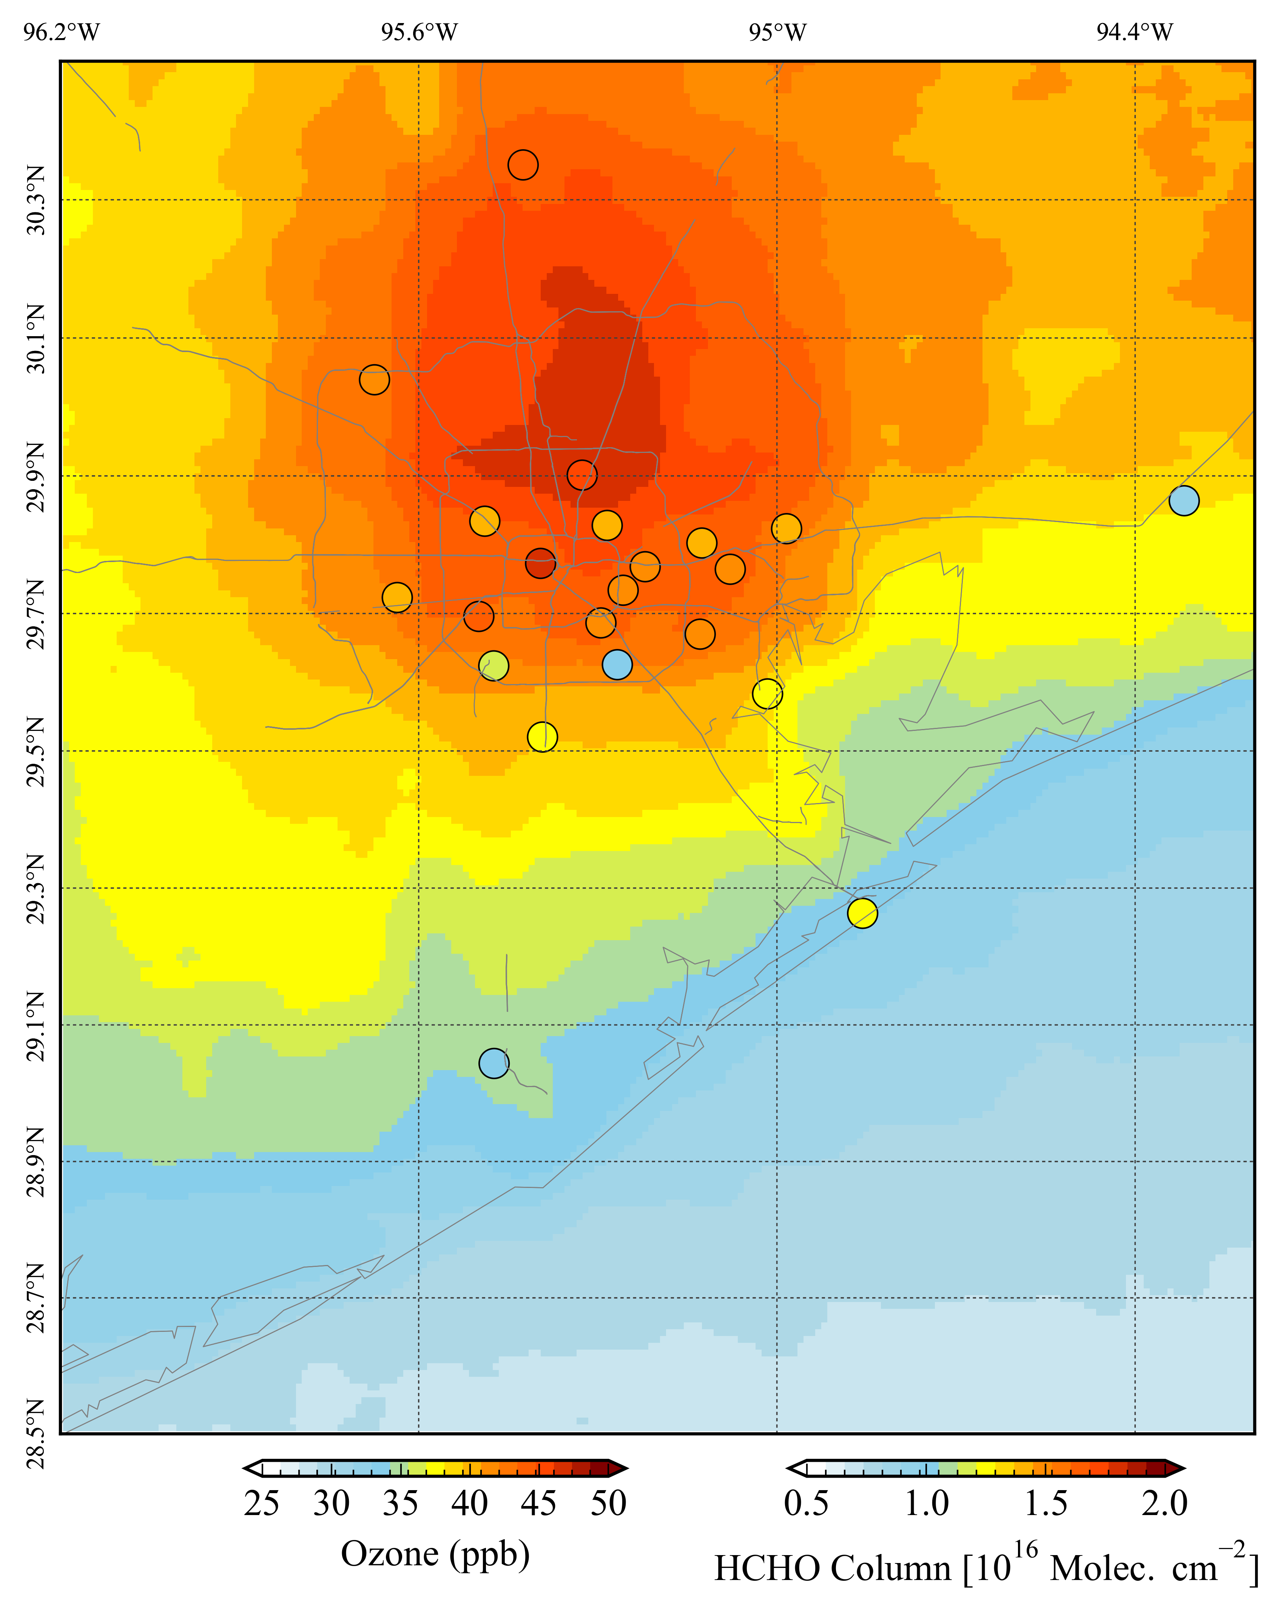
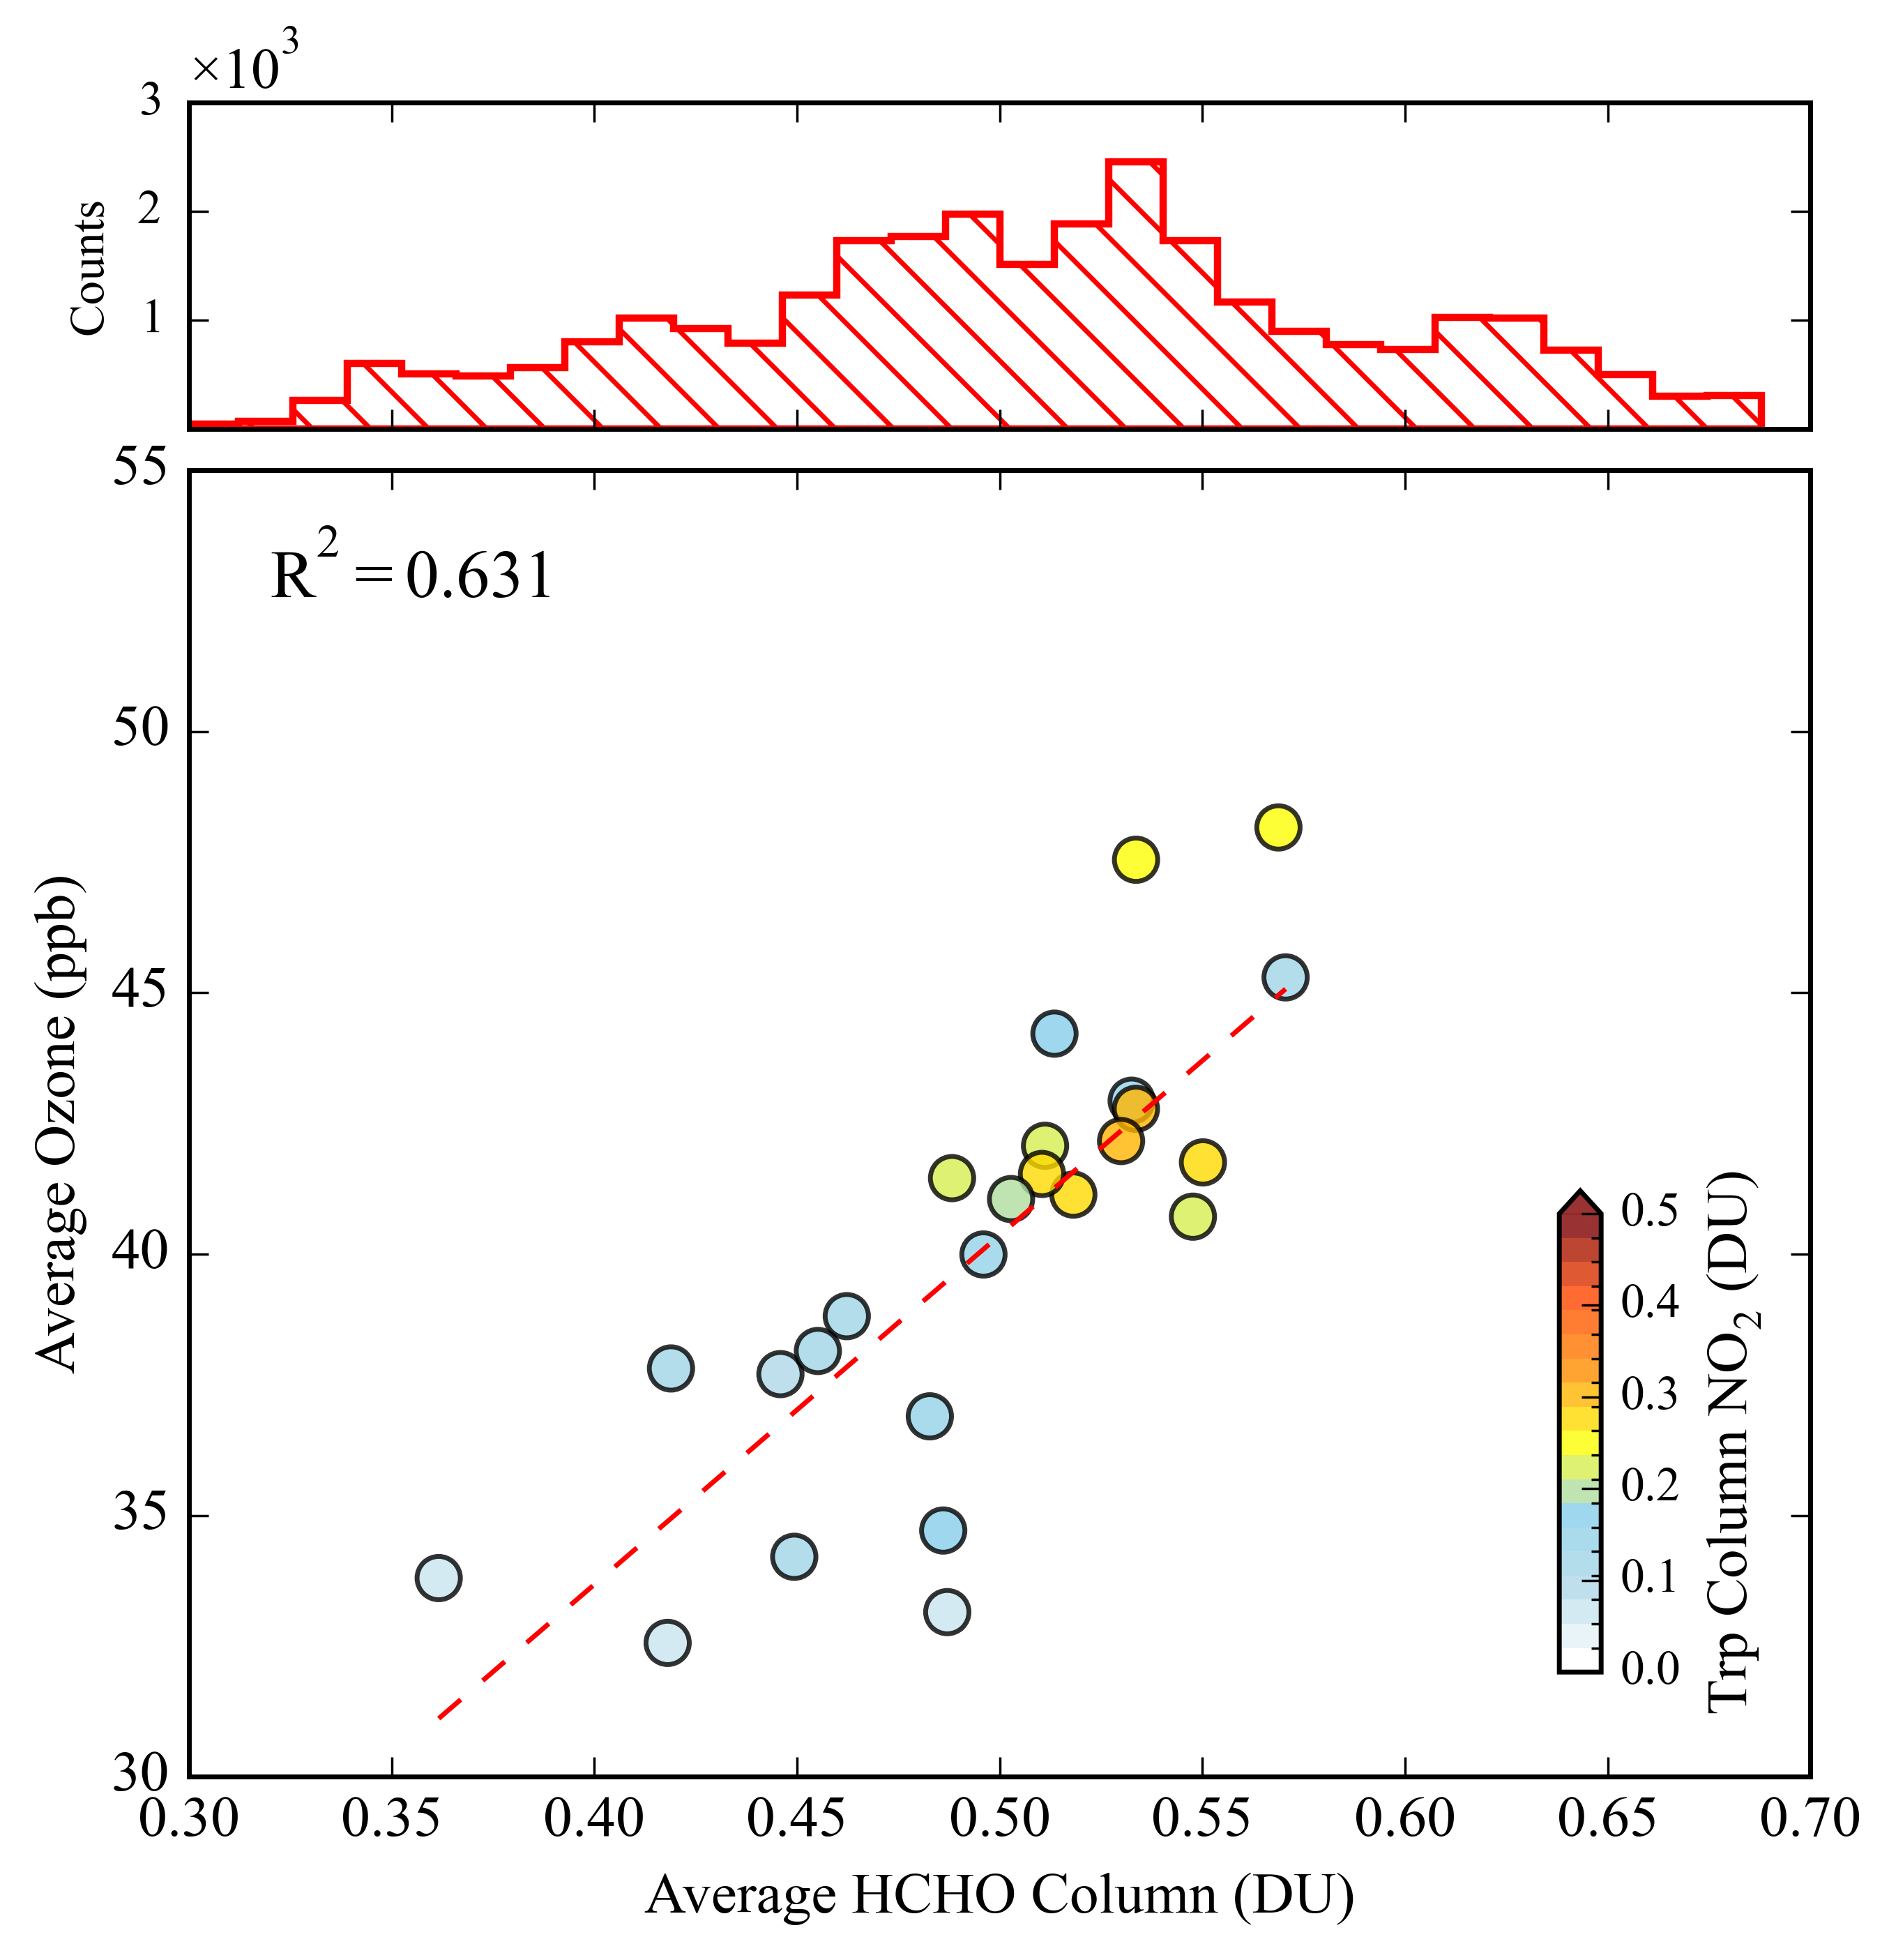
Houston Shows Robust O₃–HCHO Relationship, Yet Some High HCHO Areas Are Unmonitored
TEMPO HCHO distribution
Unmonitored region
Over the Houston region, ΩHCHO shows a good spatial link to ozone (r² ≈ 0.63), However monitoring strategies missing some photochemical hotspots or potential high ozone regions.
Spatial relationship
Jun to Sep
1✕1km² map
0.7 DU

Slide 11
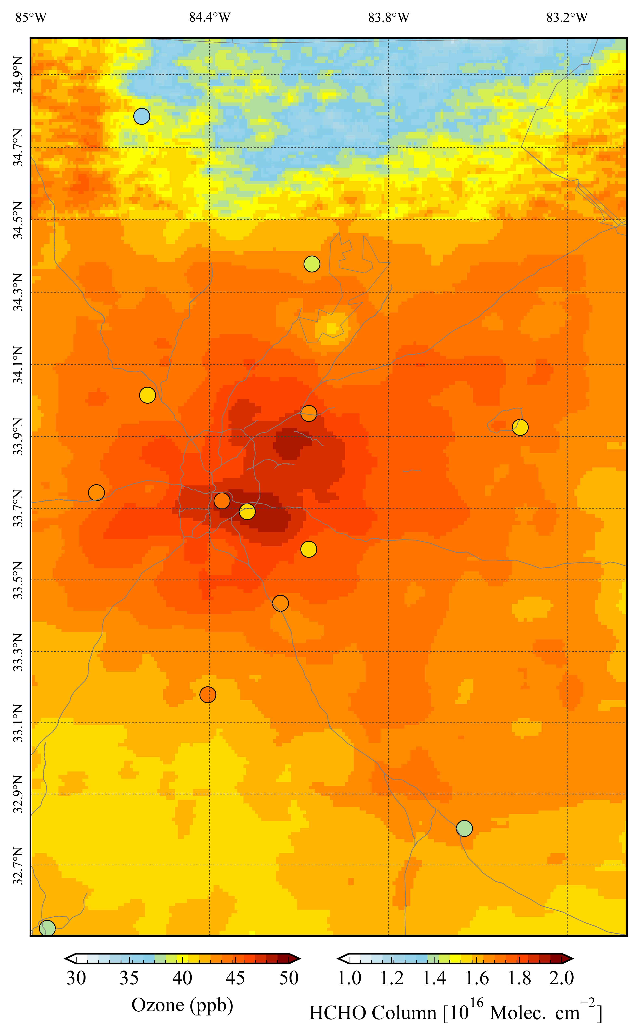
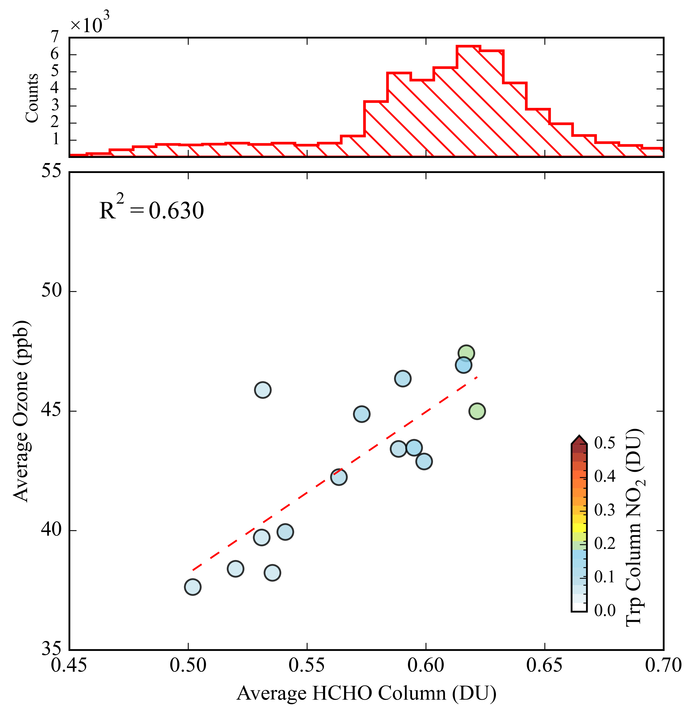
Strong O₃–HCHO Correlation Despite Small HCHO Variability in Atlanta
TEMPO HCHO distribution
Over the Atlanta region, ΩHCHO shows a good spatial link to ozone (r² ≈ 0.6), and monitoring strategies capture photochemical hotspots well.
Atlanta shows lower NO₂ column and HCHO column are relatively uniform.
Spatial relationship
Jun to Sep
1✕1km² map
0.6 DU
0.7 DU

Slide 12
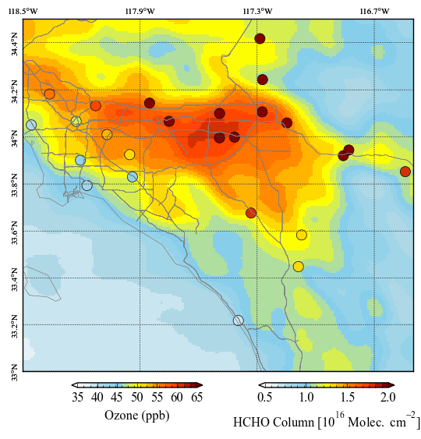
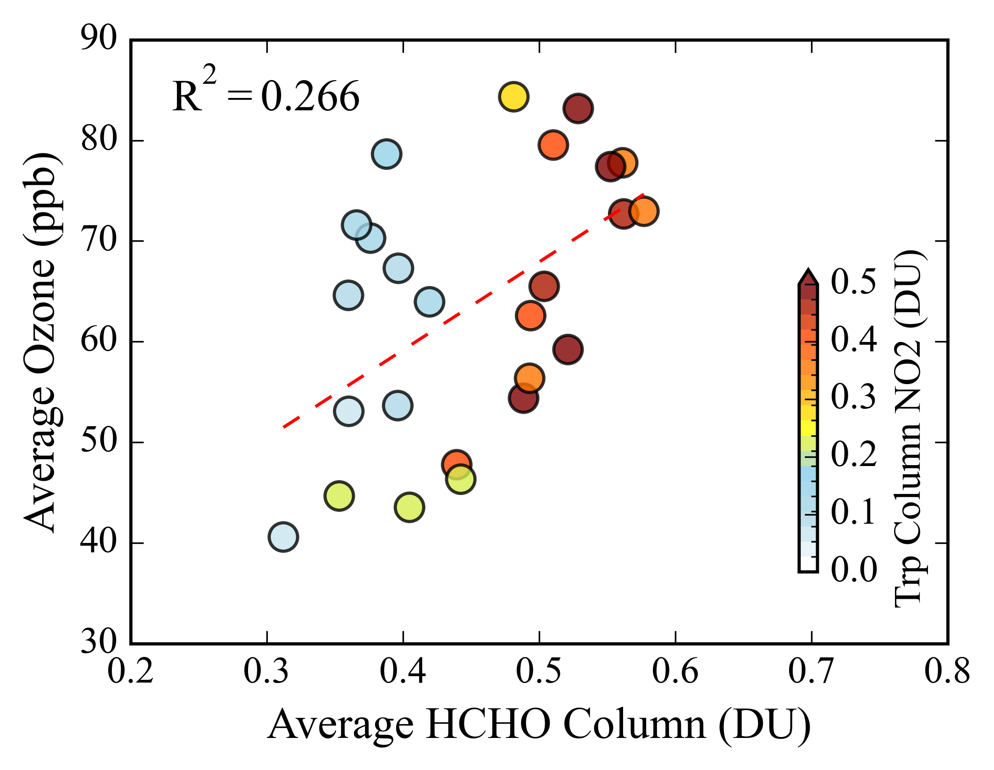
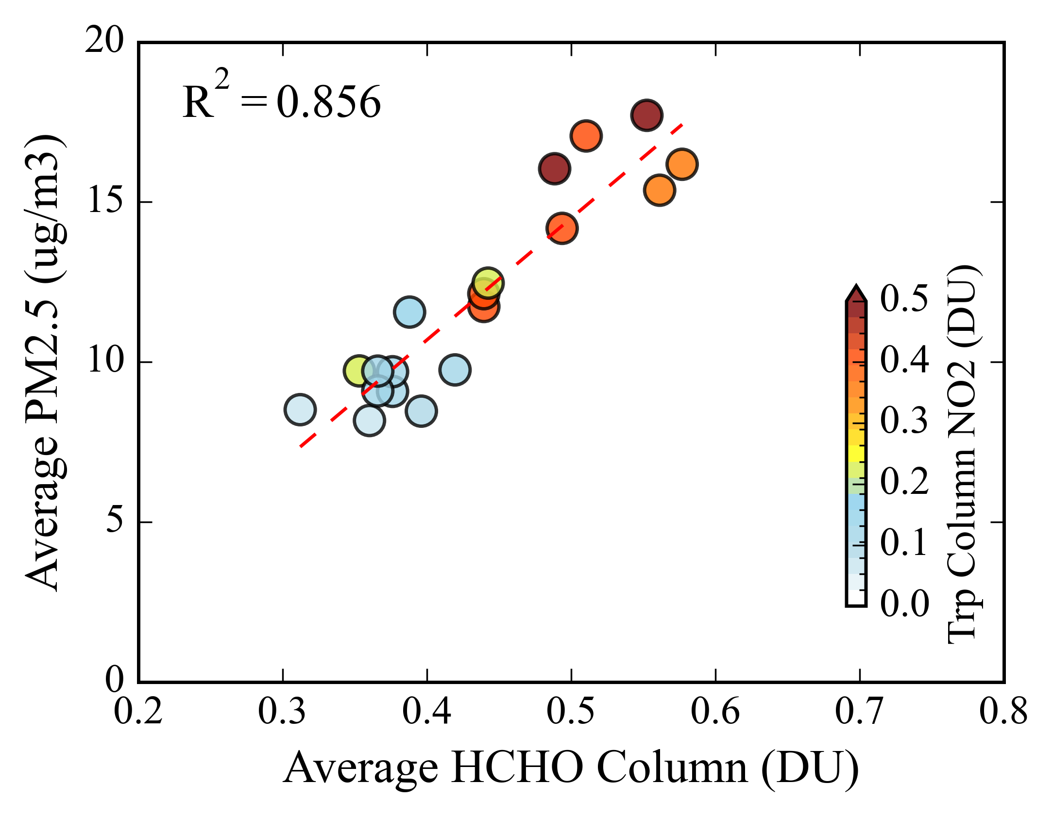
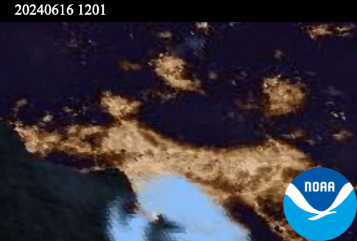
Frequent Fire Events Disrupt O₃–HCHO Linkage in LA, While PM₂.₅ shows Good Correlation Spatially
Frequent fire events disrupt the relationship between ozone and ΩHCHO due to ozone titration, primary HCHO emissions, lesser photochemistry but PM2.5 correlates well.
Ozone
PM2.5
Monitoring strategies capture high ozone hotspots well.

Slide 13

Summary
Pandora and TEMPO ΩHCHO observations show strong spatial and temporal relationships with surface ozone.
Daily TEMPO ΩHCHO offers great potential for mapping ozone exceedance days.
The spatial–temporal correlation will improve understanding of surface ozone distribution in air quality models.
The ozone–HCHO relationship further validates the scientific value of TEMPO ΩHCHO.
Findings have important implications for air quality monitoring and policy at local and regional scales.
Future work
TEMPO sub-column ozone retrievals will be evaluated against surface ozone observations, with a focus on their coherence with TEMPO ΩHCHO in active urban photochemical regions.
Thank You
prajjwal.rawat@nasa.gov

Slide 14
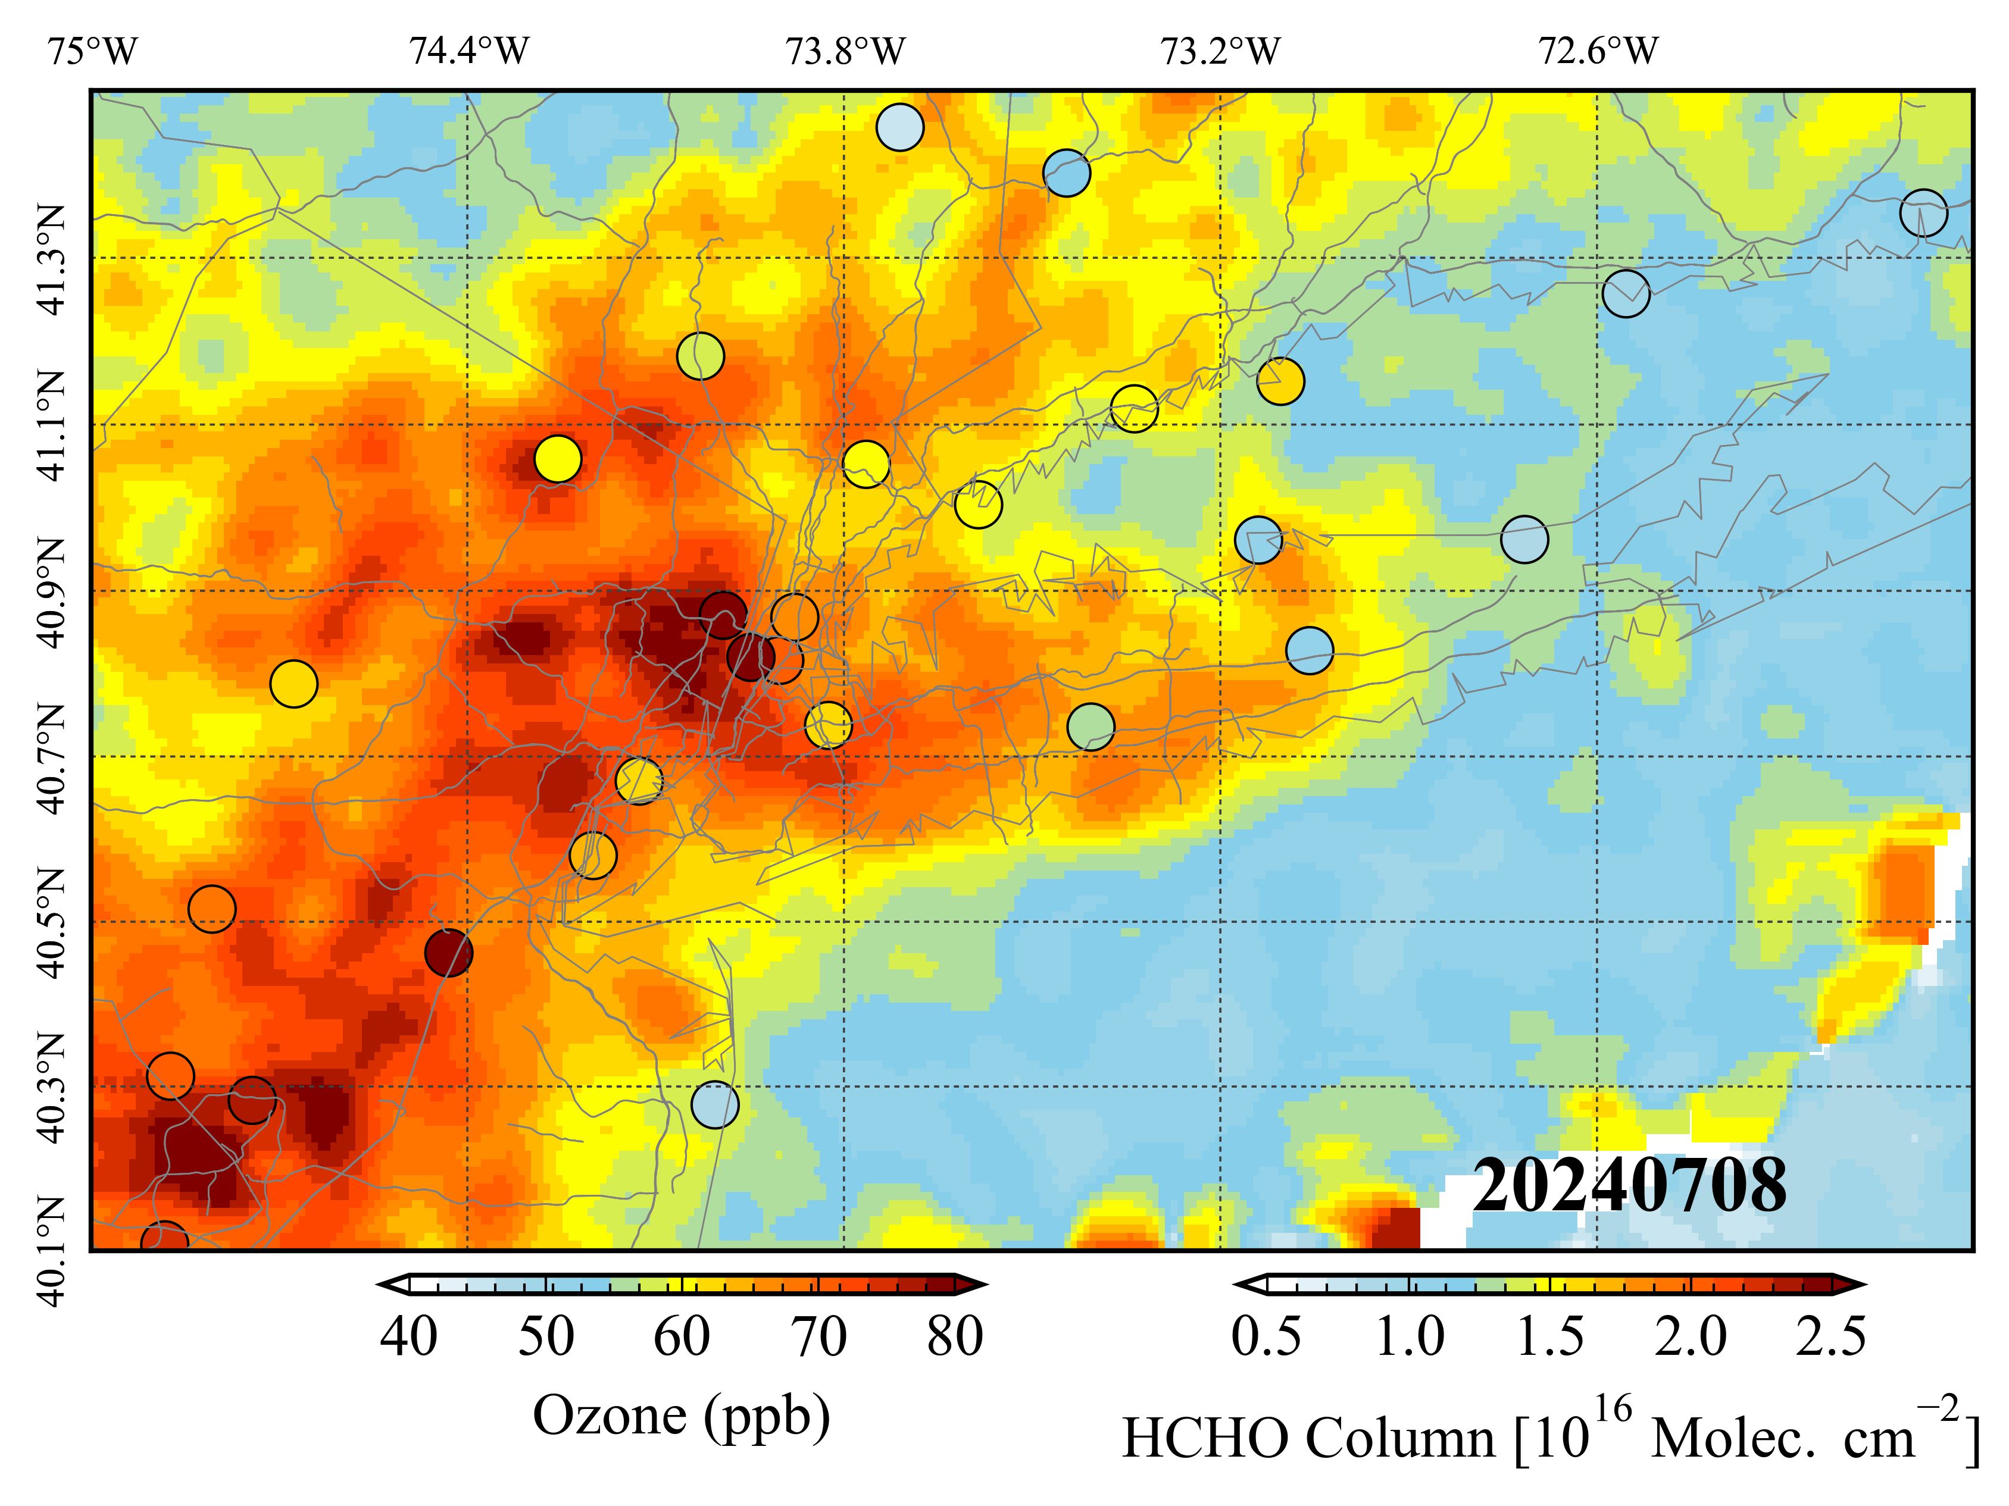
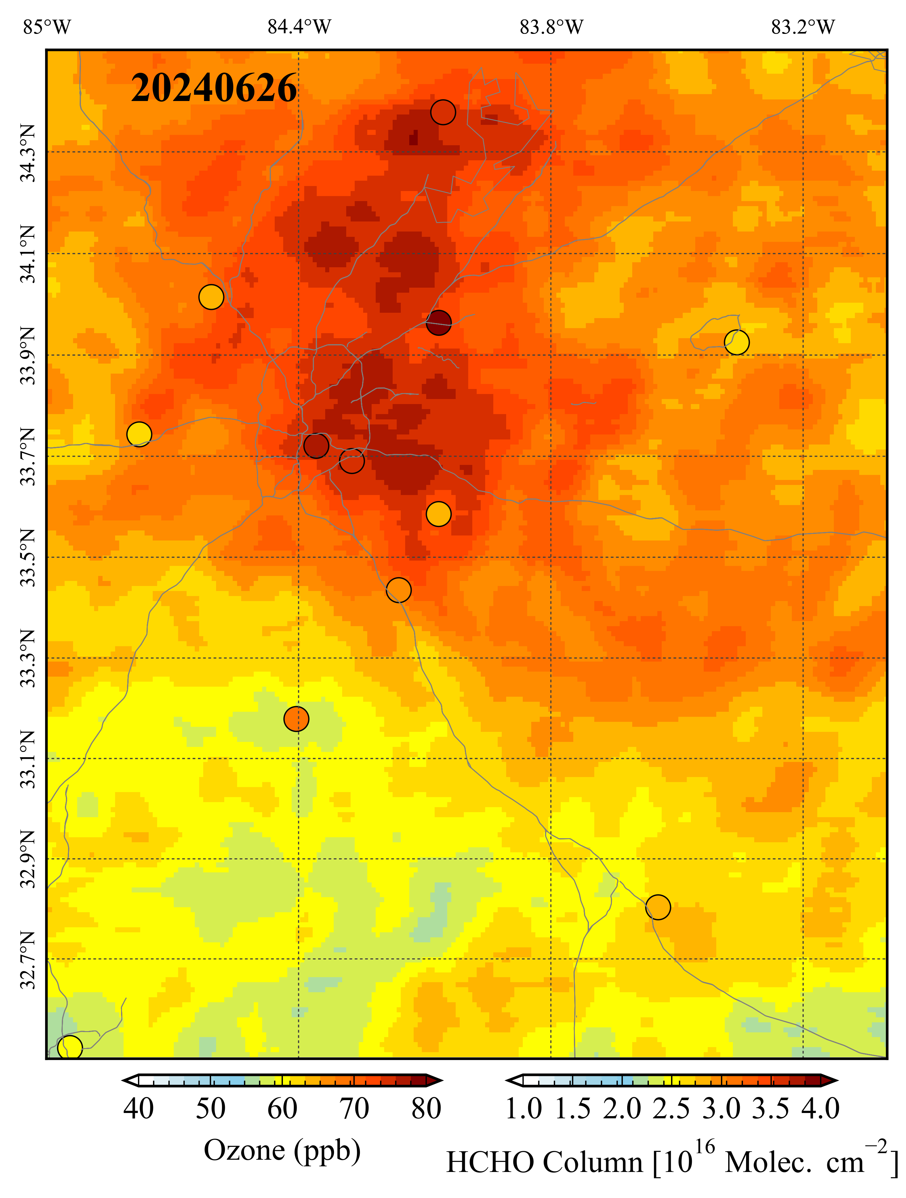
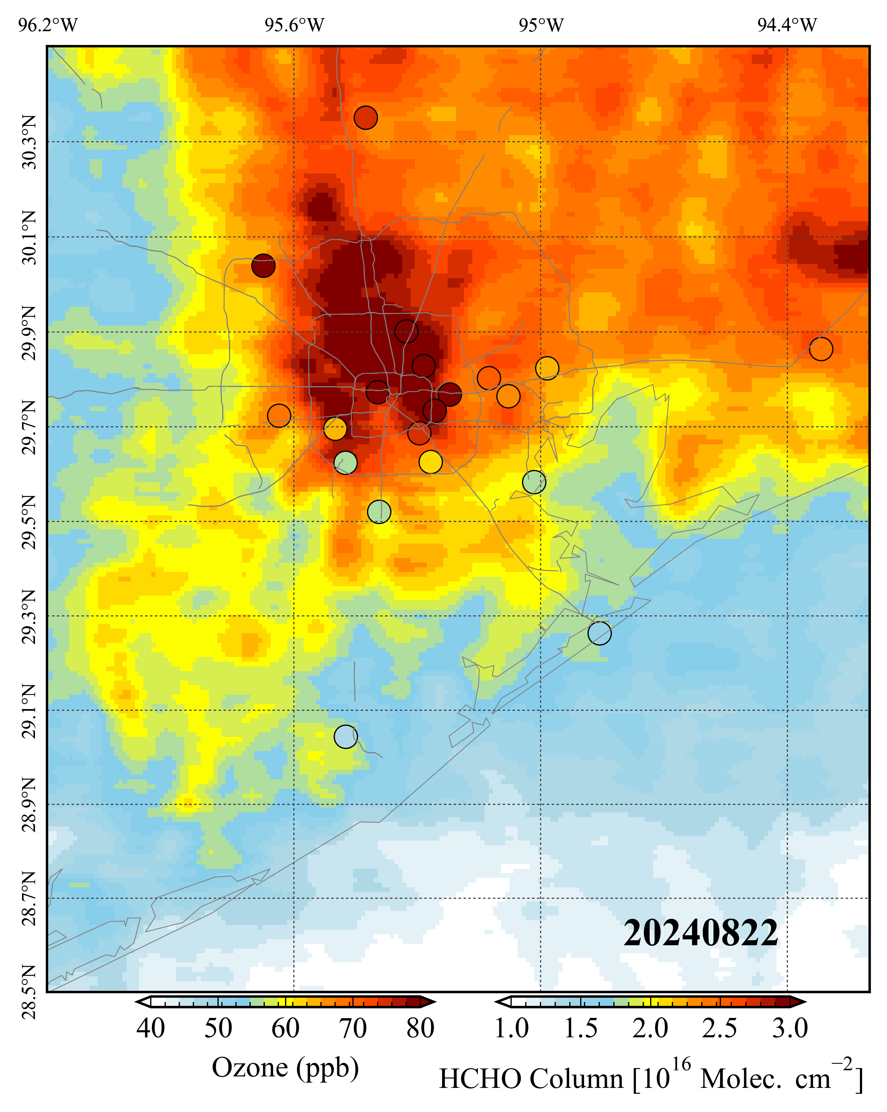
Mapping potential surface ozone exceedances using daily TEMPO ΩHCHO observations.
New York
Atlanta
Houston
Higher ozone over different regions is associated with higher ΩHCHO as seen by TEMPO.
Intensity of ΩHCHO increases along with ozone and shows the regions of active photochemical activity.
Many regions with high HCHO, indicating potential high ozone, remain unmonitored.
CloudF<0.2

Slide 15
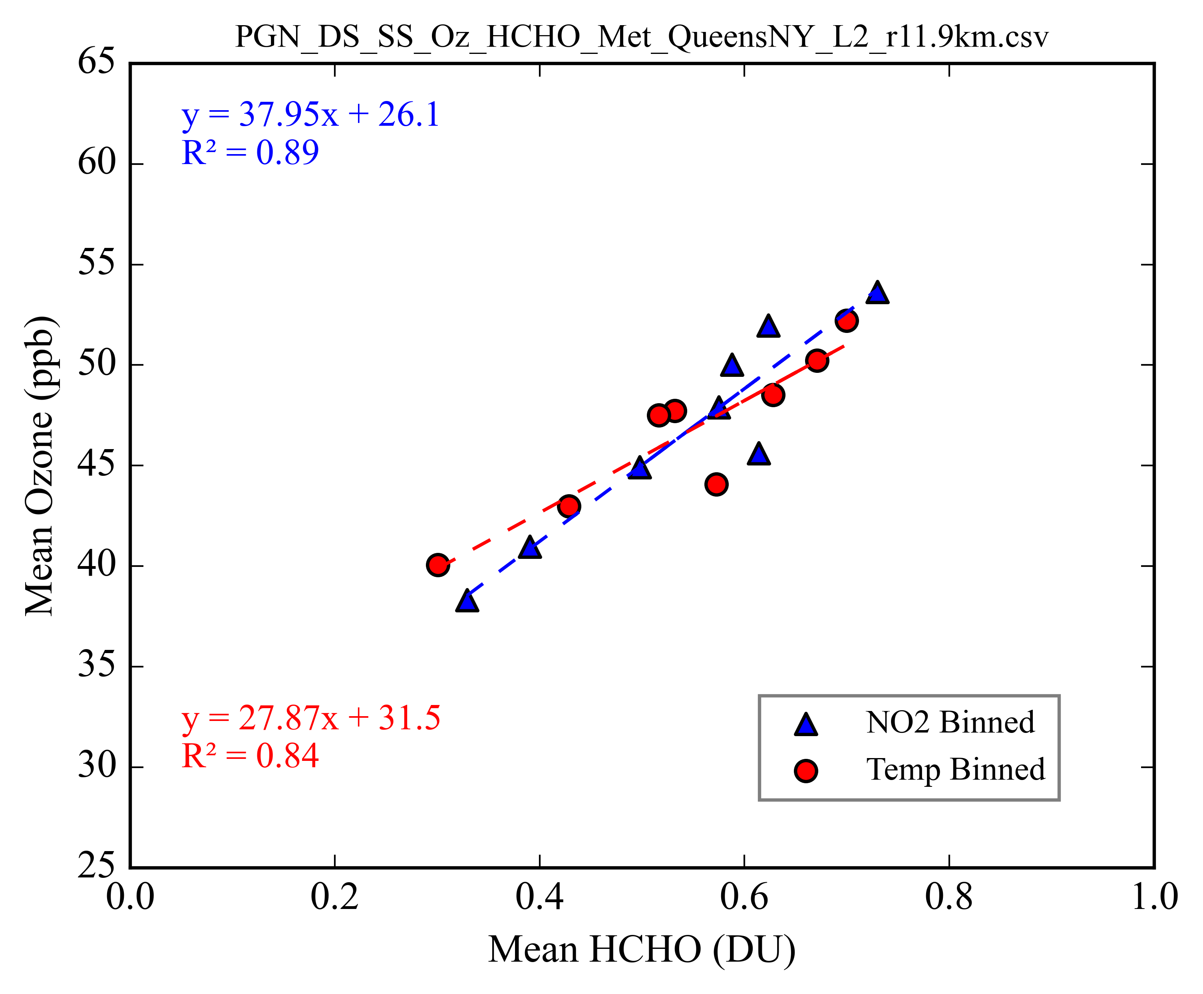
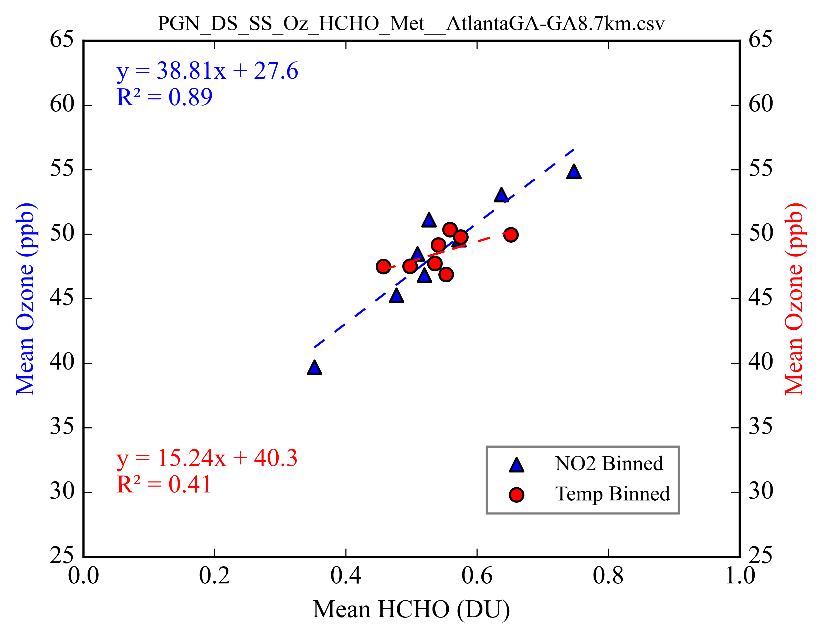
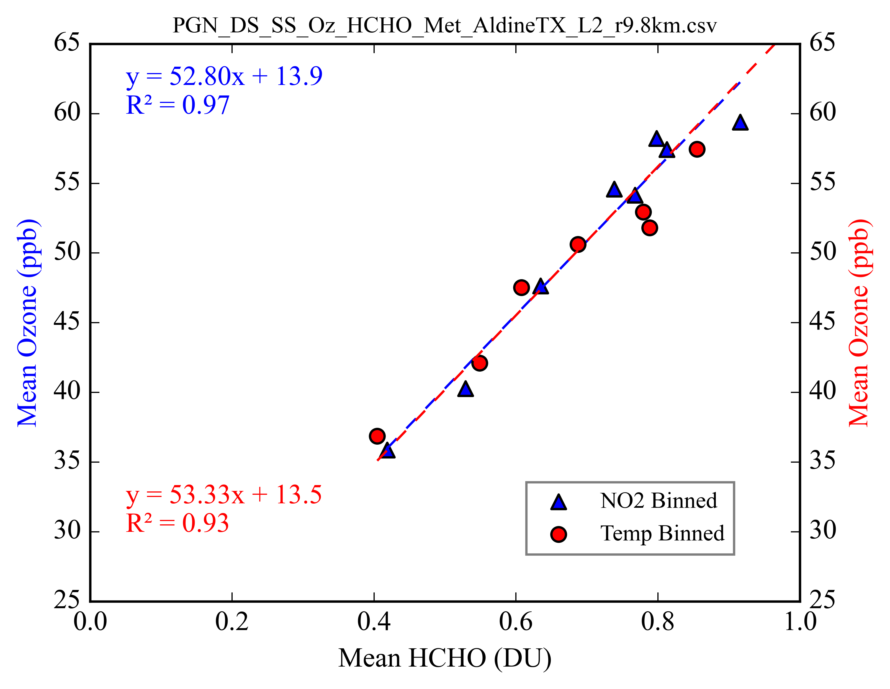

Slide 16
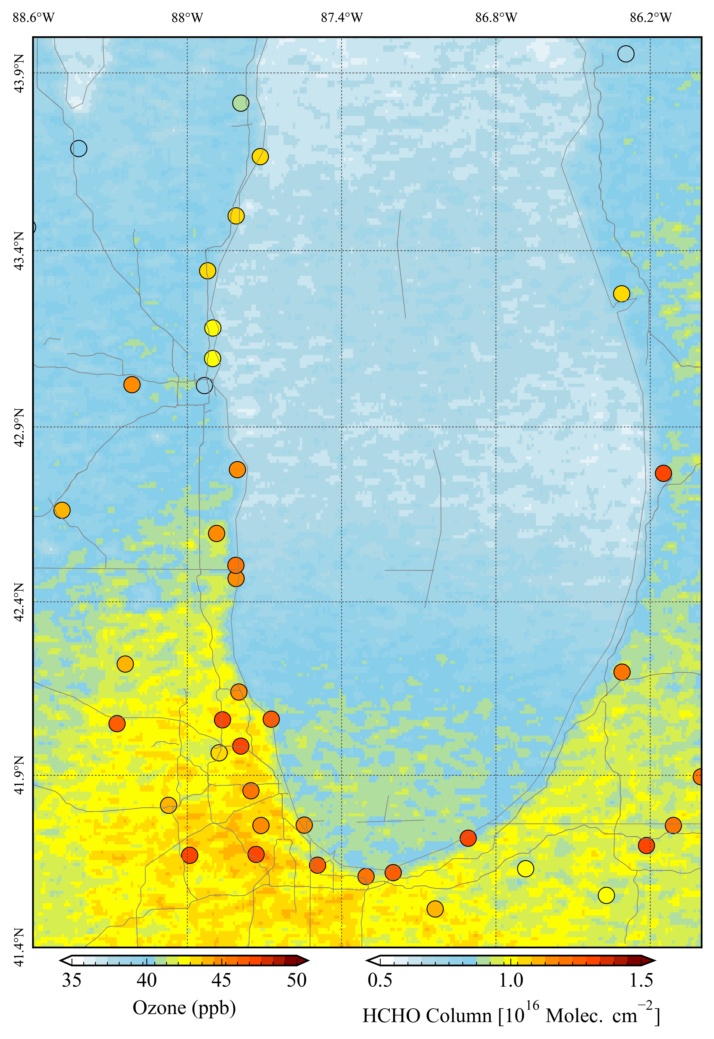
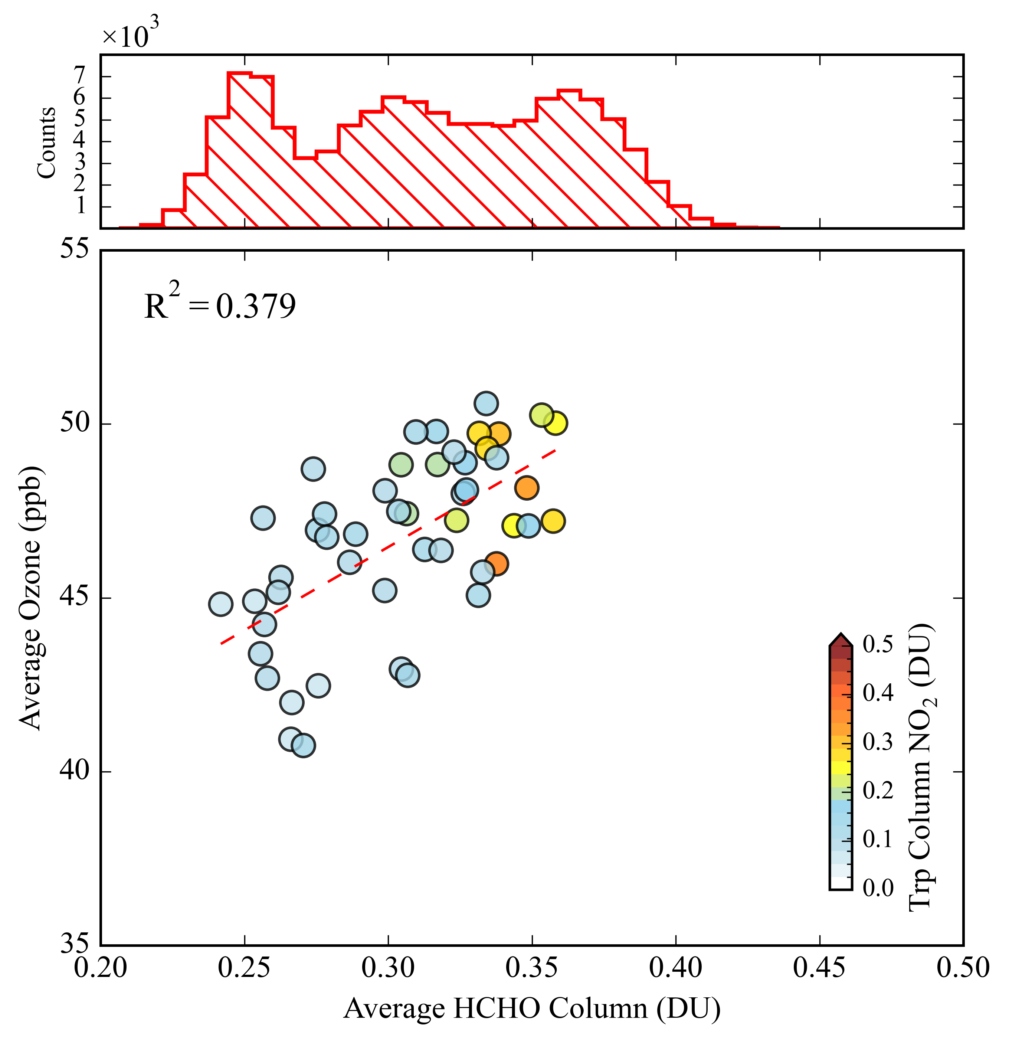
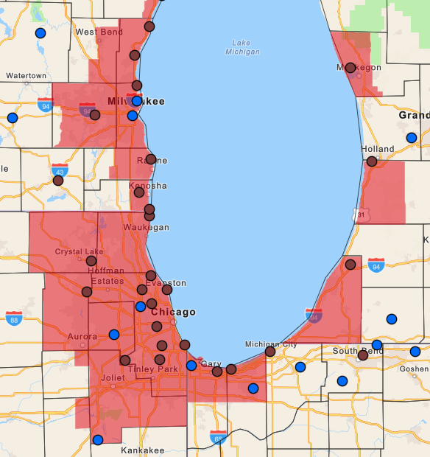
Michigan Lake area, HCHO column and surface ozone during Jun – Sep 2024
TEMPO HCHO distribution
Over the Michigan Lake region, ΩHCHO shows a moderate spatial link to ozone (r ≈ 0.38), and monitoring strategies capture photochemical hotspots well.
Spatial relationship
O₃ nonattainment areas

Slide 17
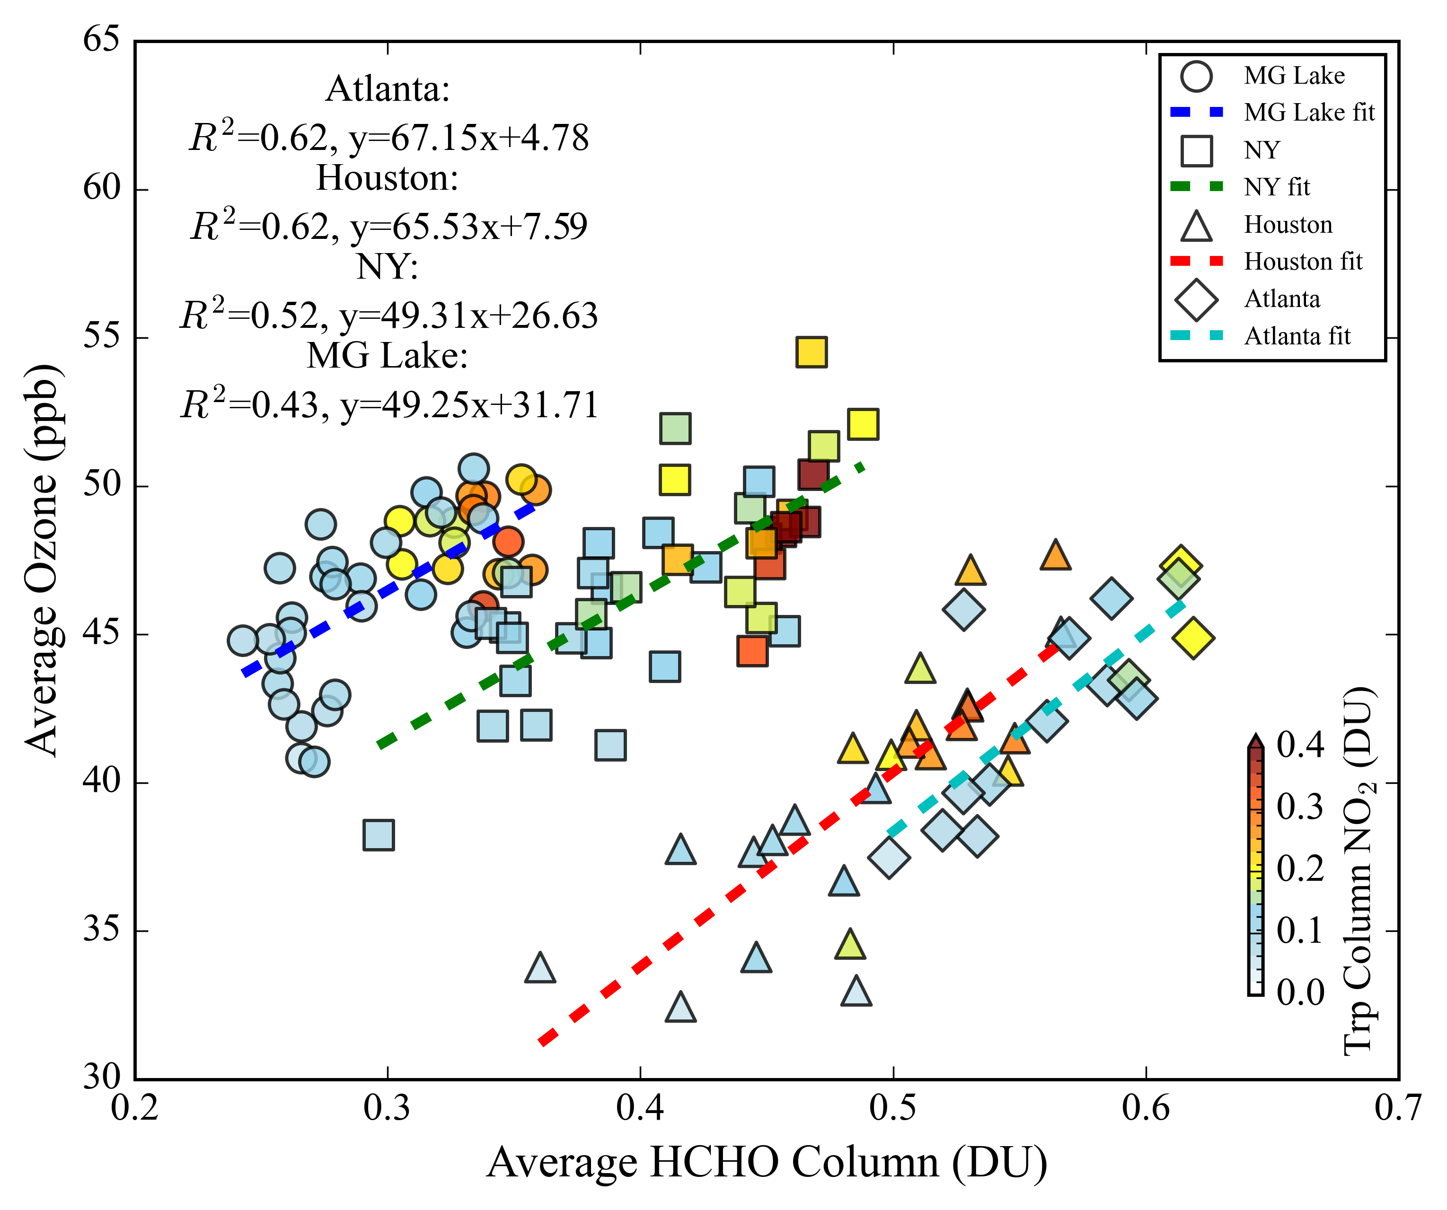
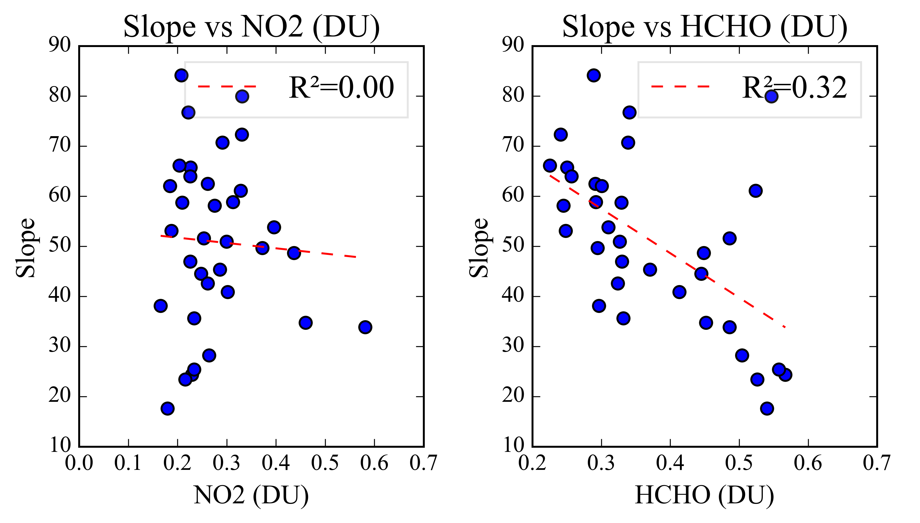

Slide 18
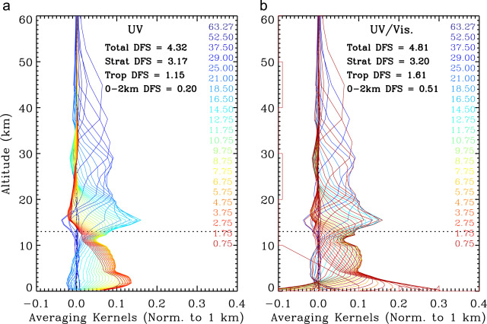
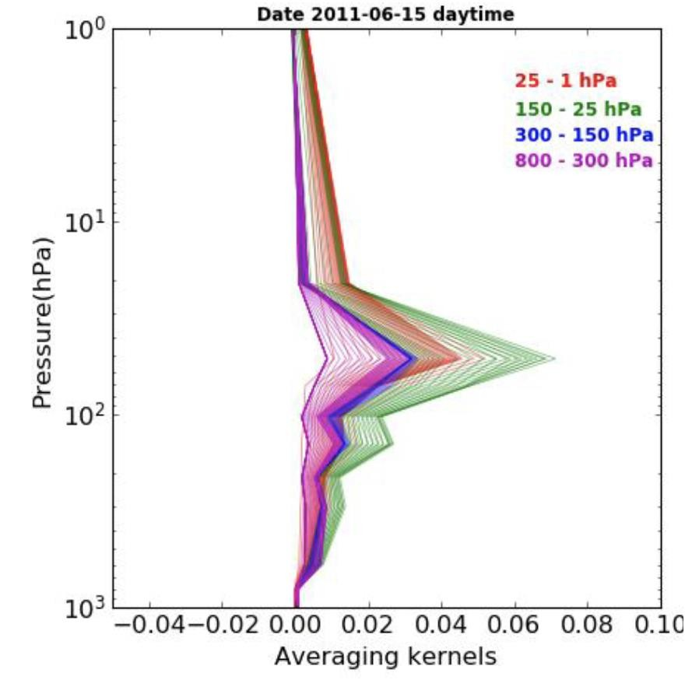
Surface Ozone Signature/Observations from Space: utilization of Geostationary satellite
Efforts to observe near-surface ozone directly from space are hindered by the limited sensitivity of ozone satellite retrievals to the lower troposphere.
Ozone sensitivity
TEMPO UV and UV-VIS
Ozone sensitivity NASA
AIRS/Aqua satellite
InfraRed
Lower stratosphere

Slide 19
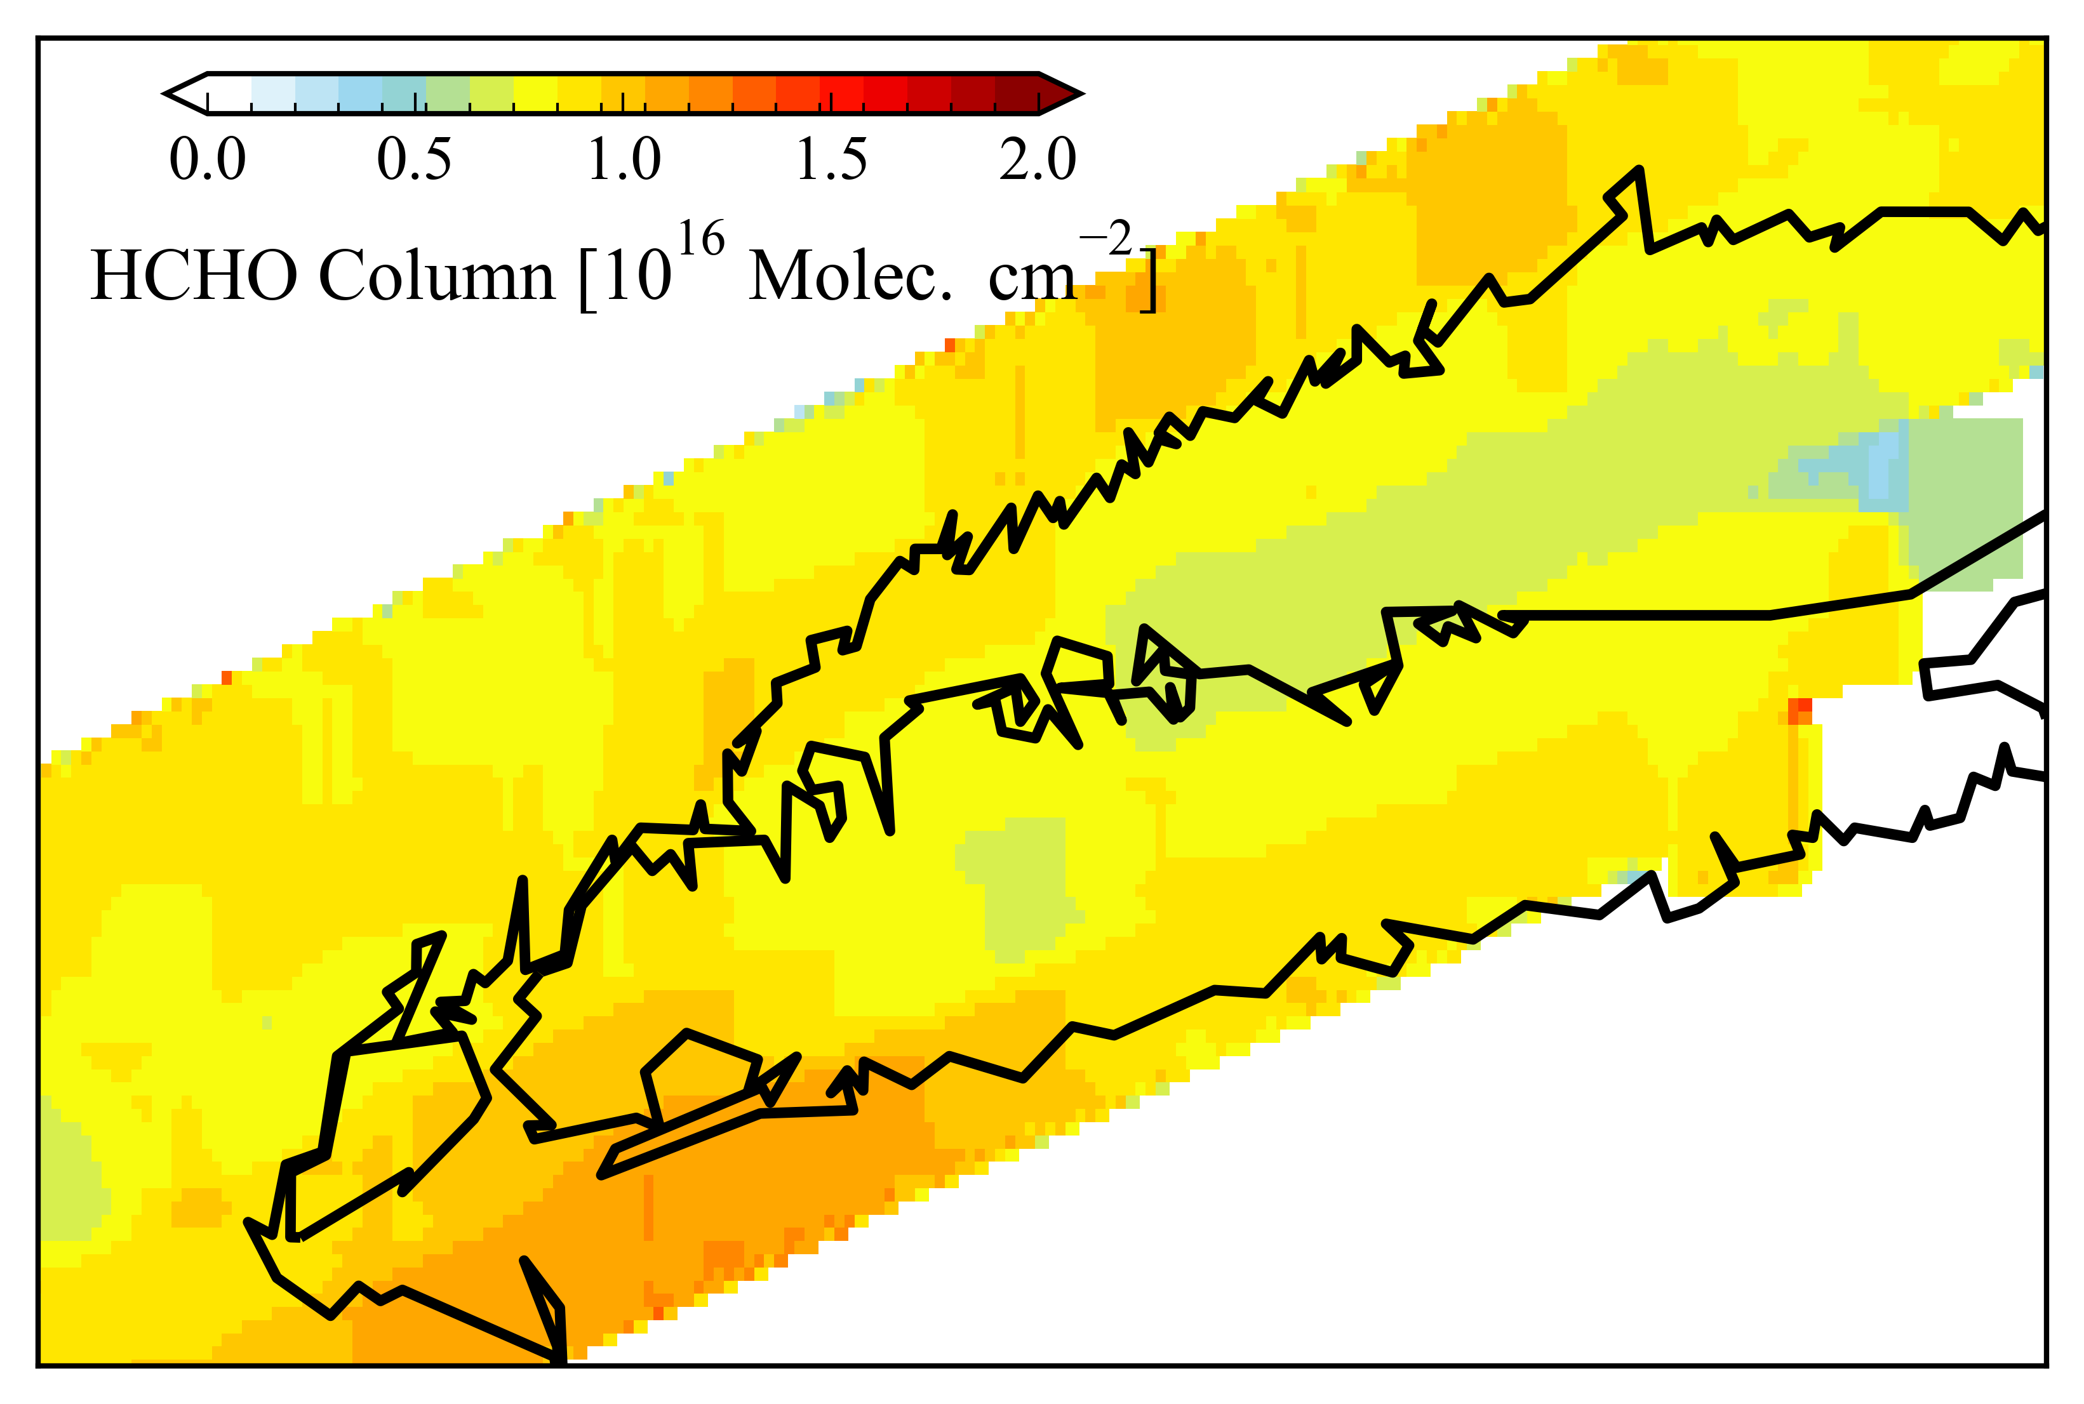
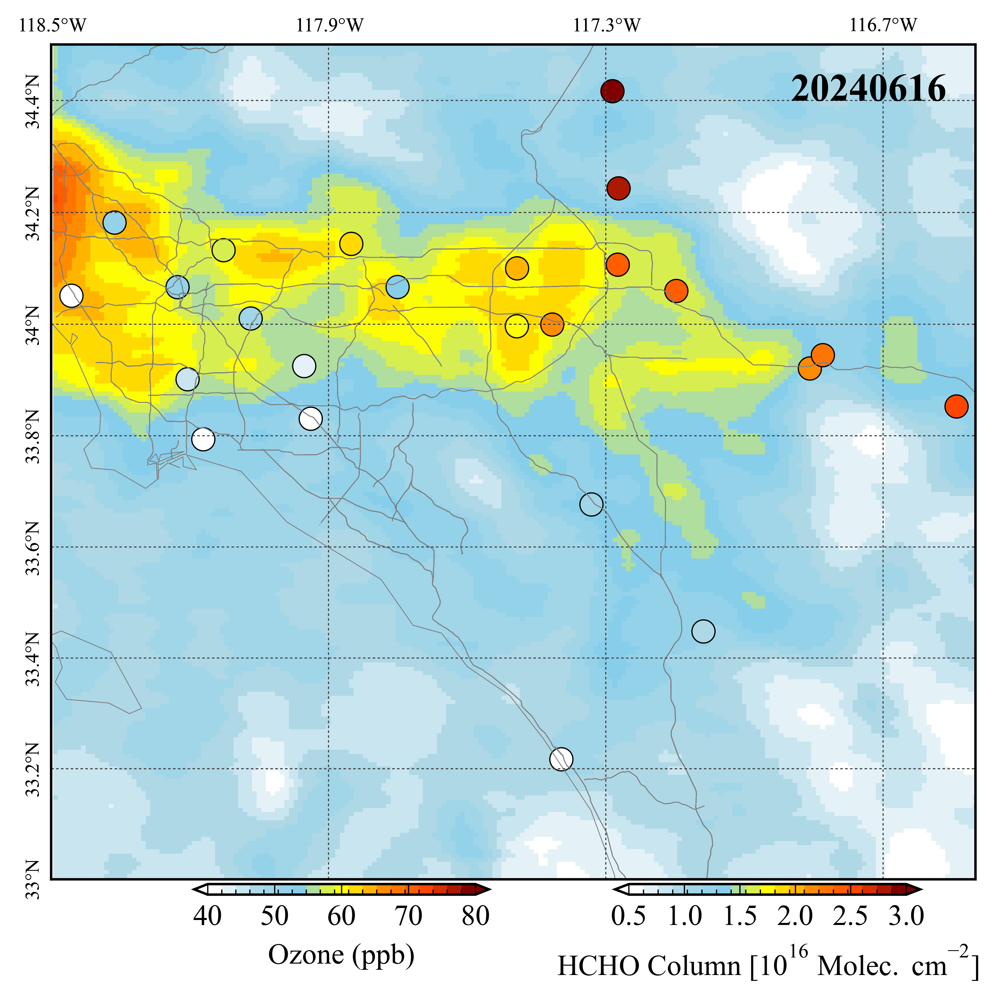
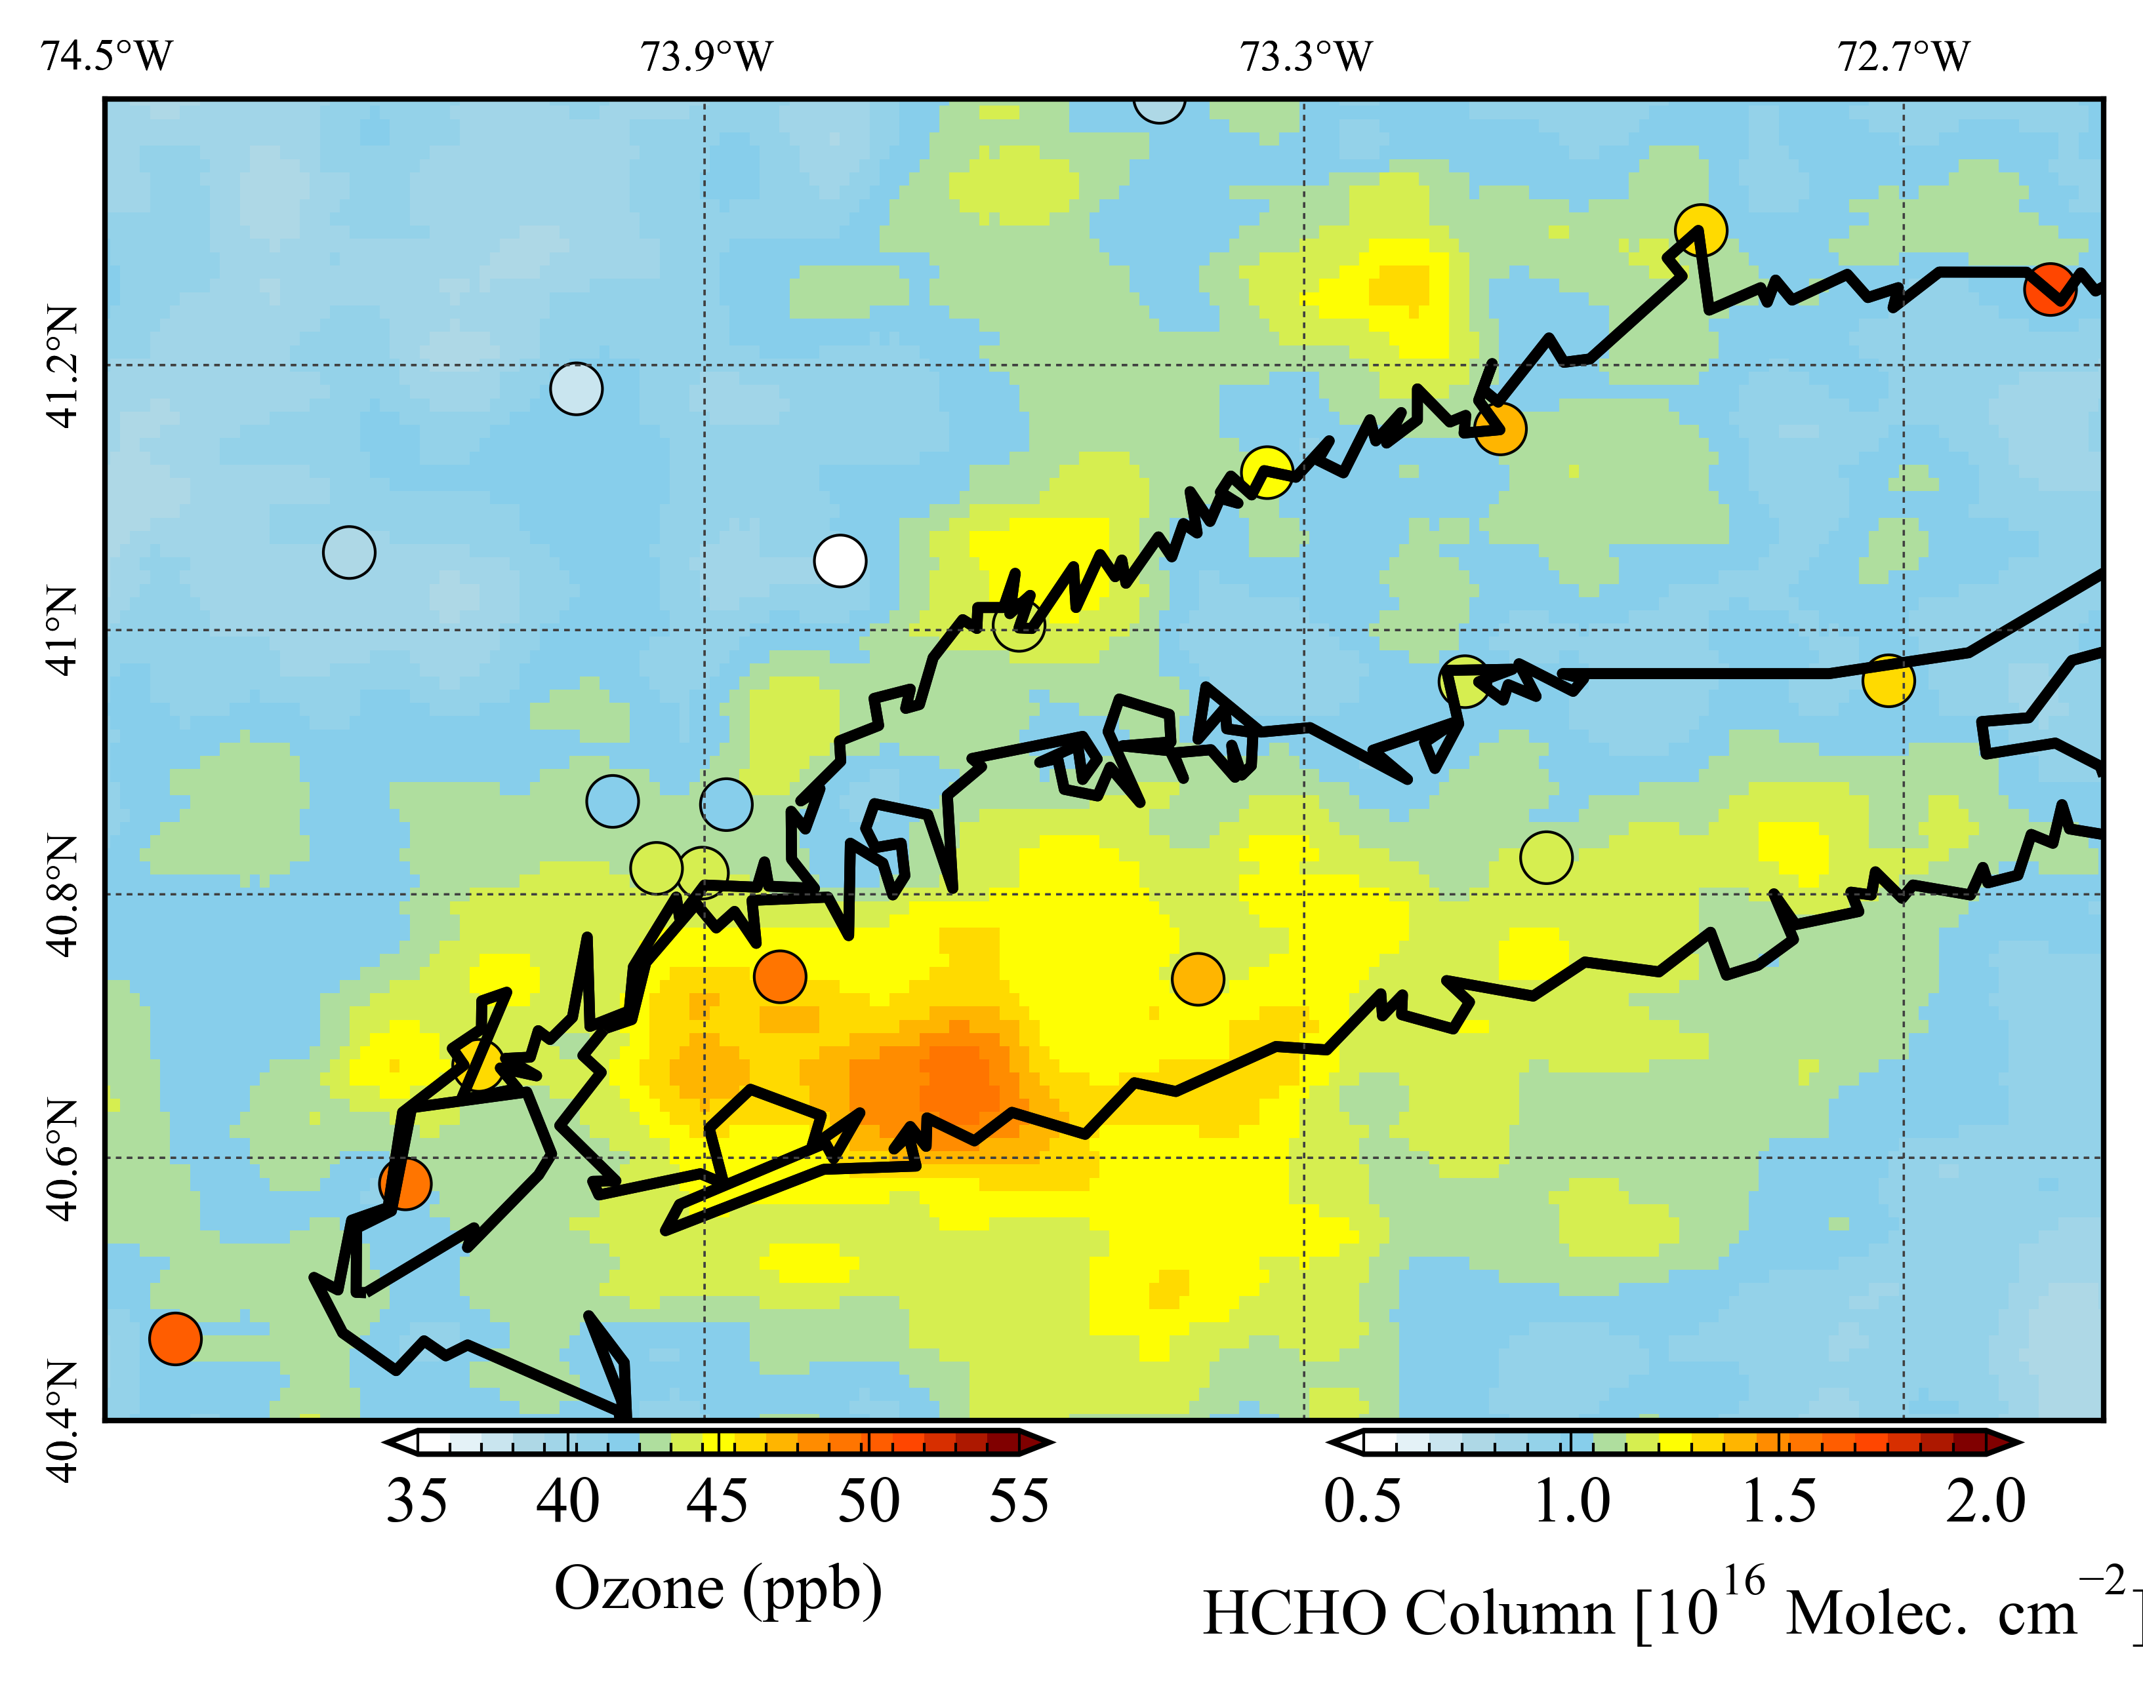
05, 09 Aug GCAS
05, 09 Aug TEMPO

Slide 20
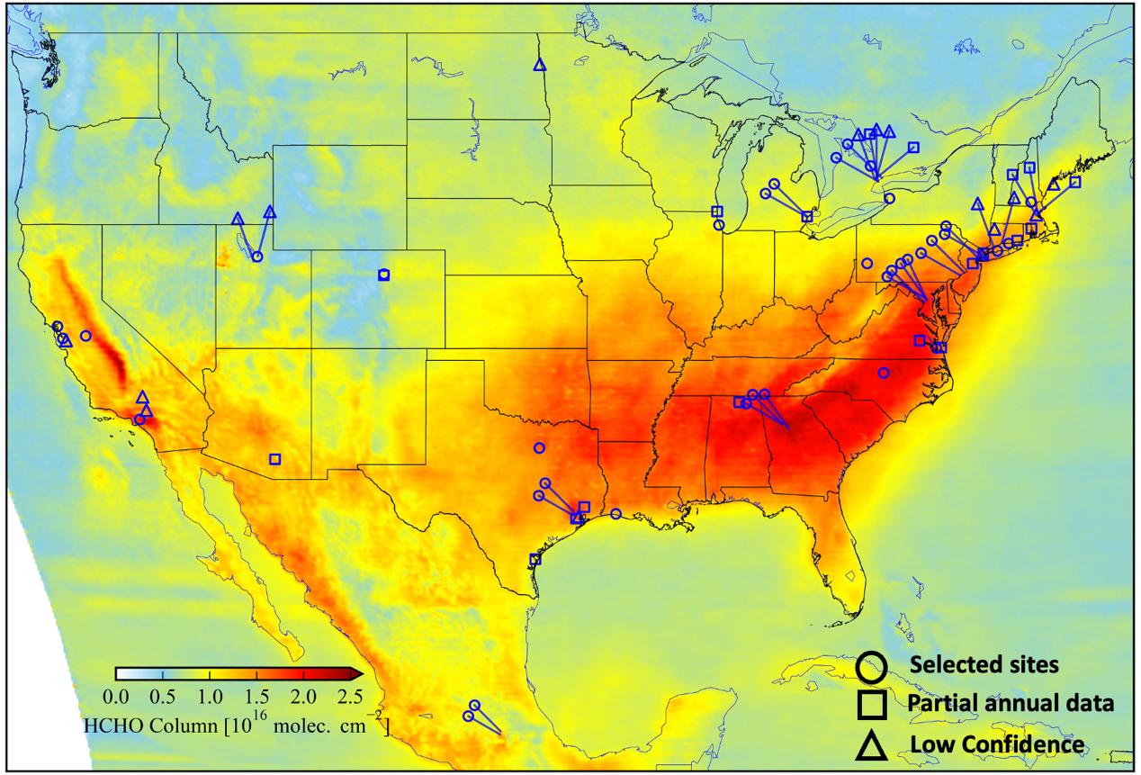
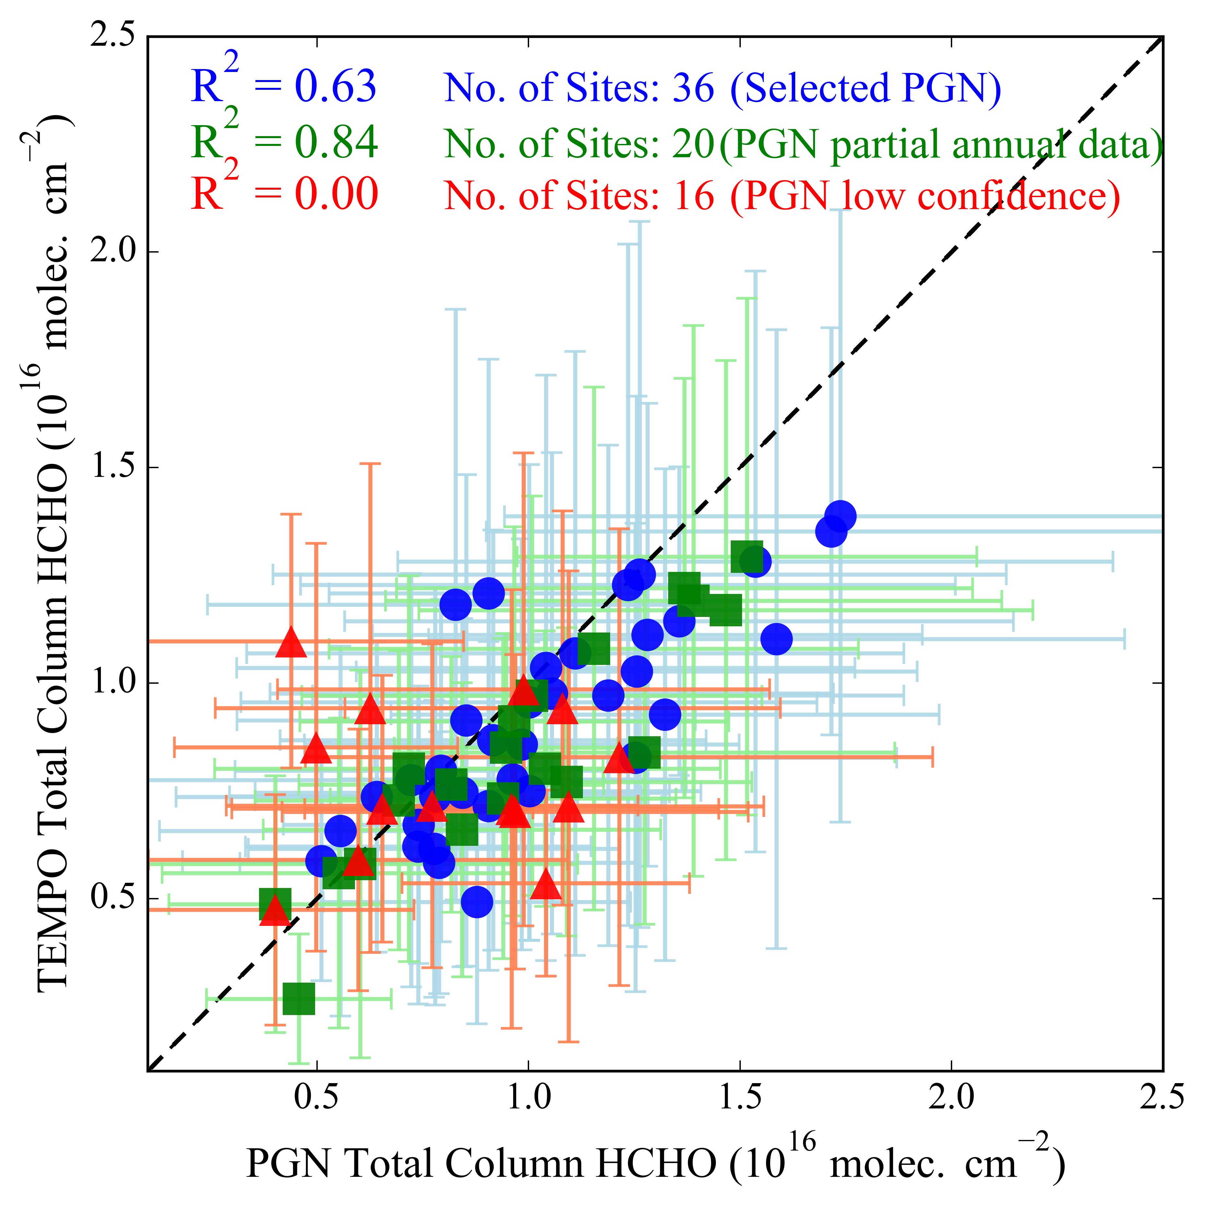
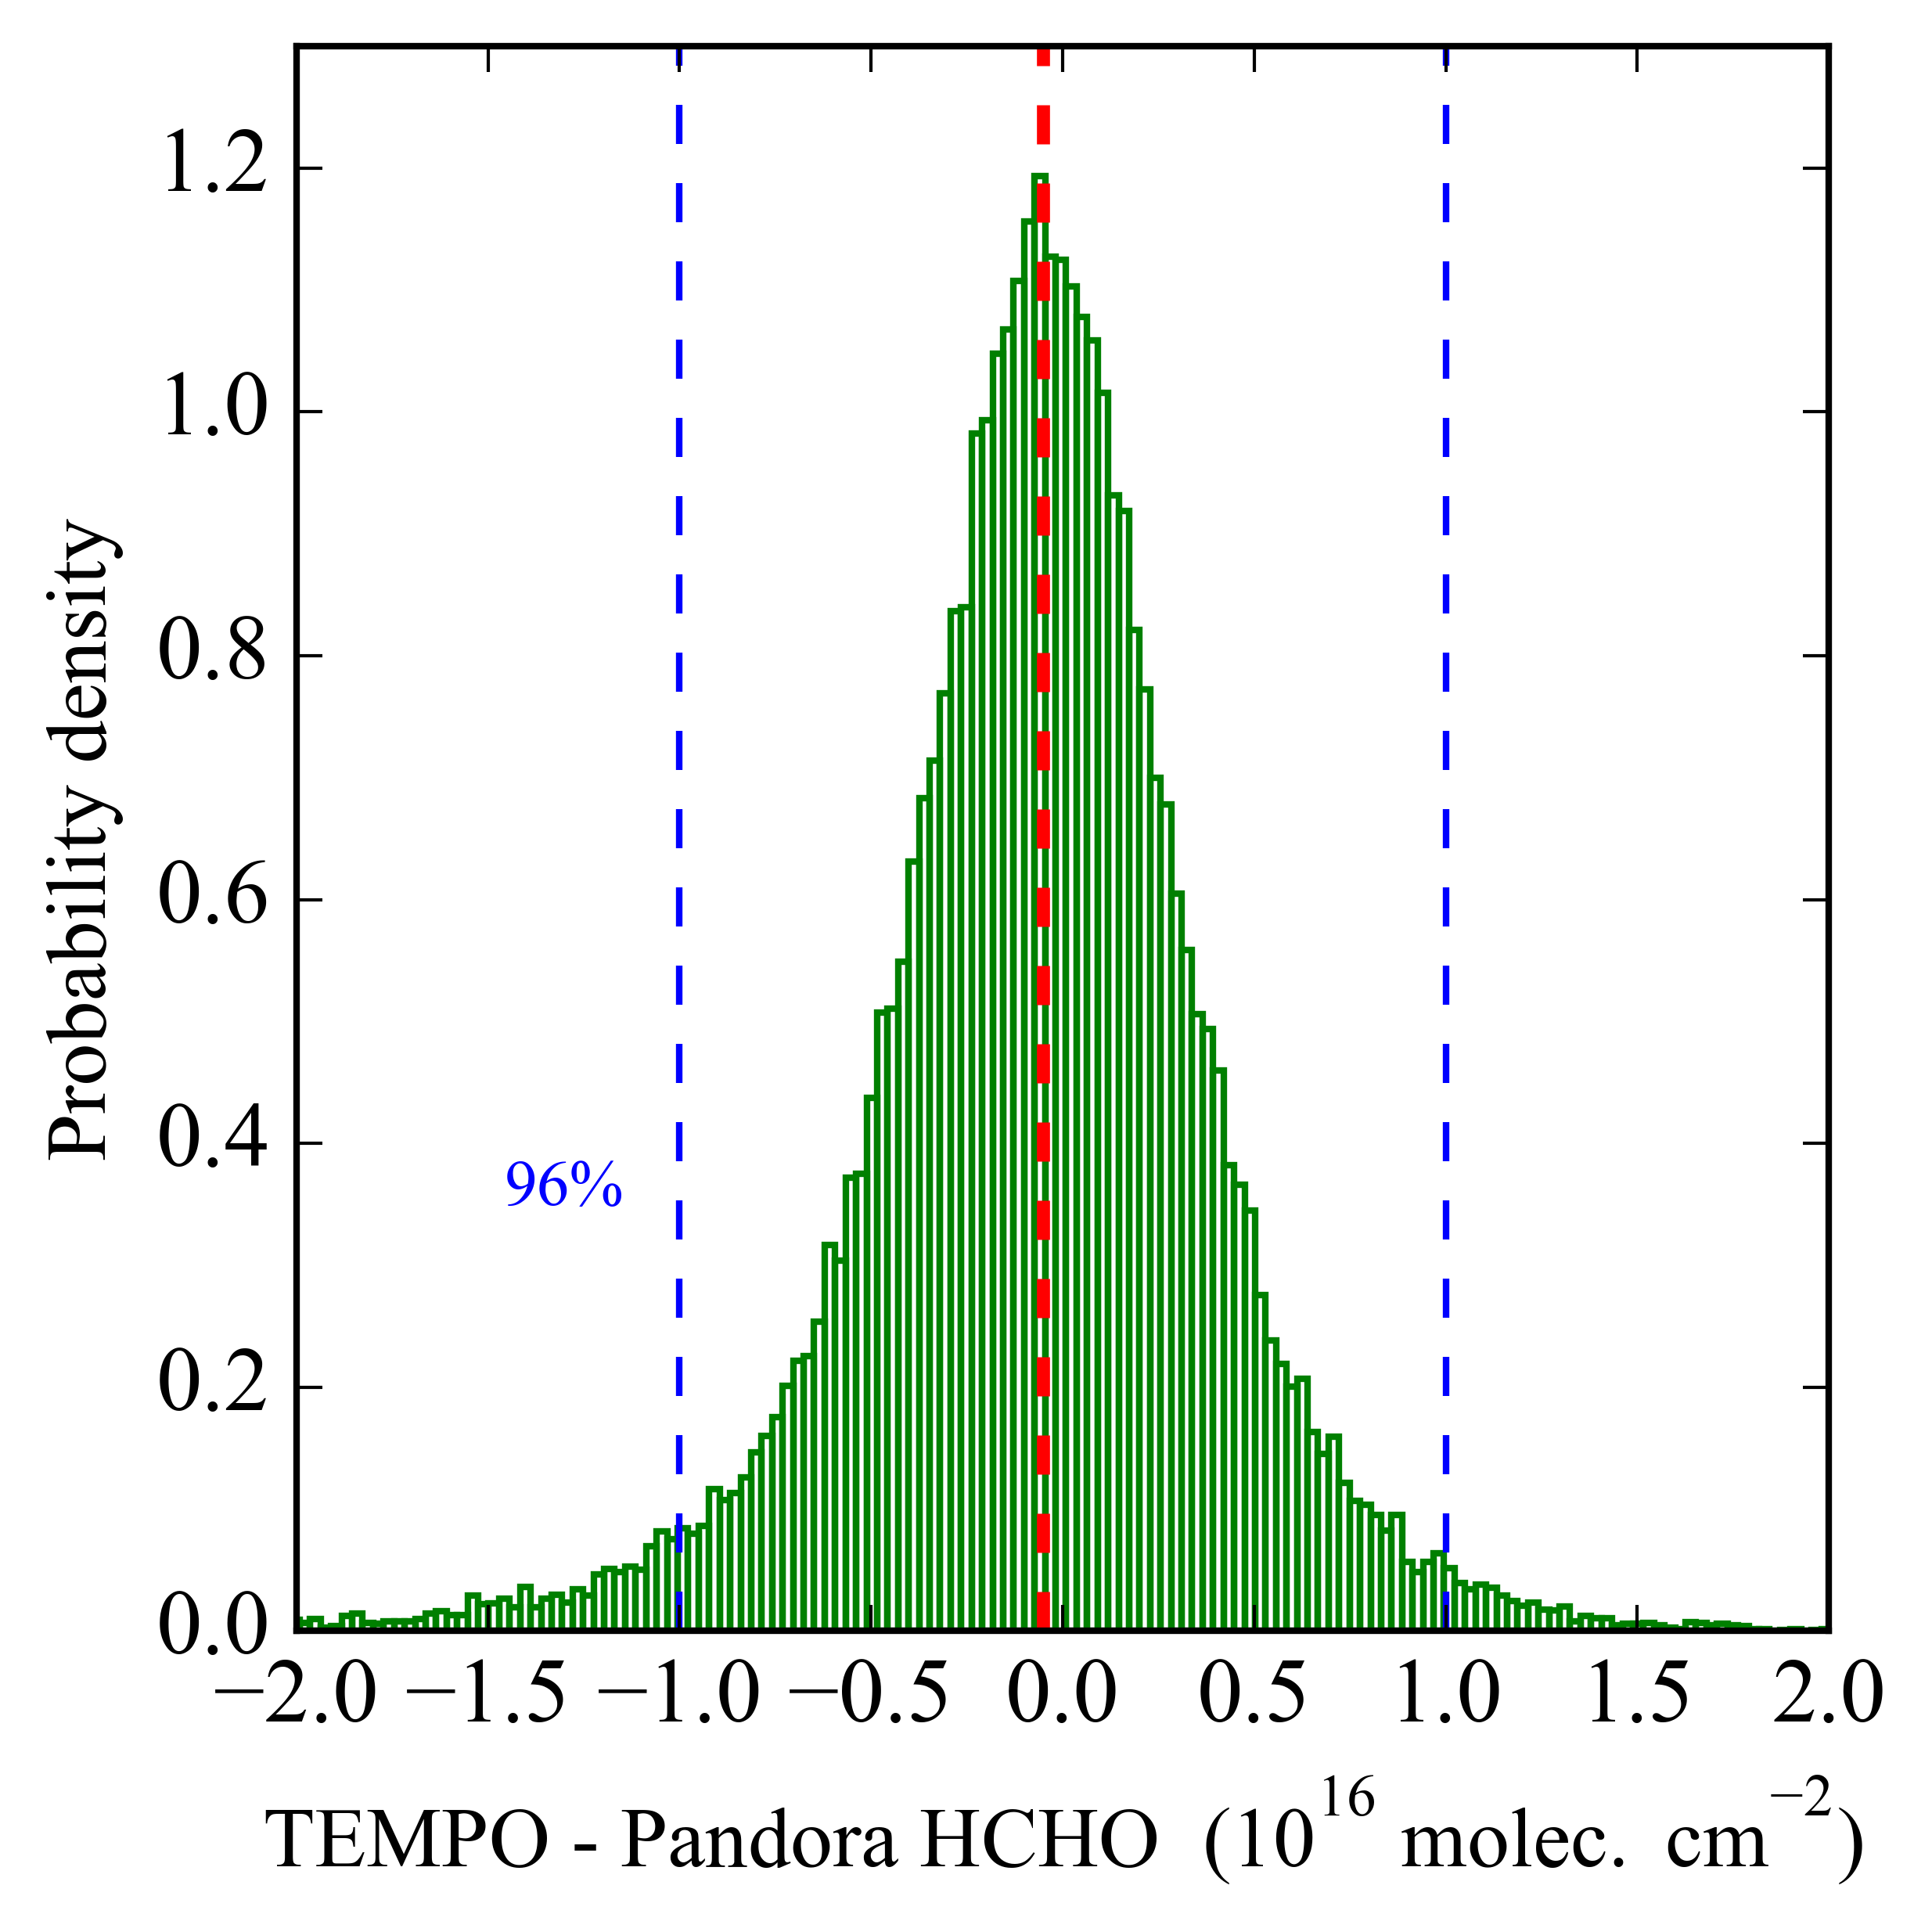
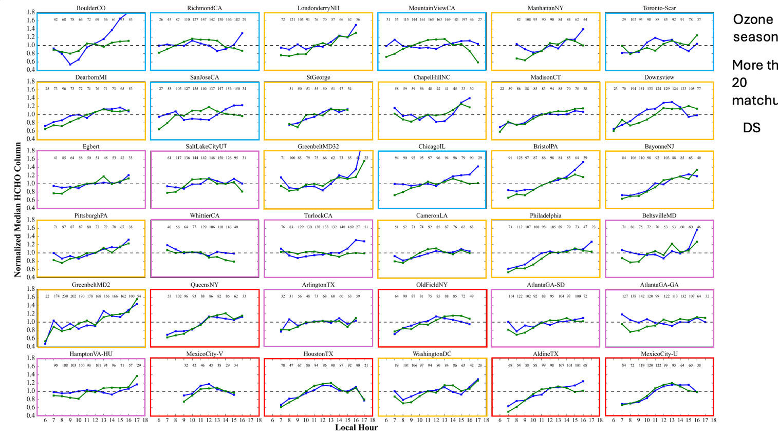
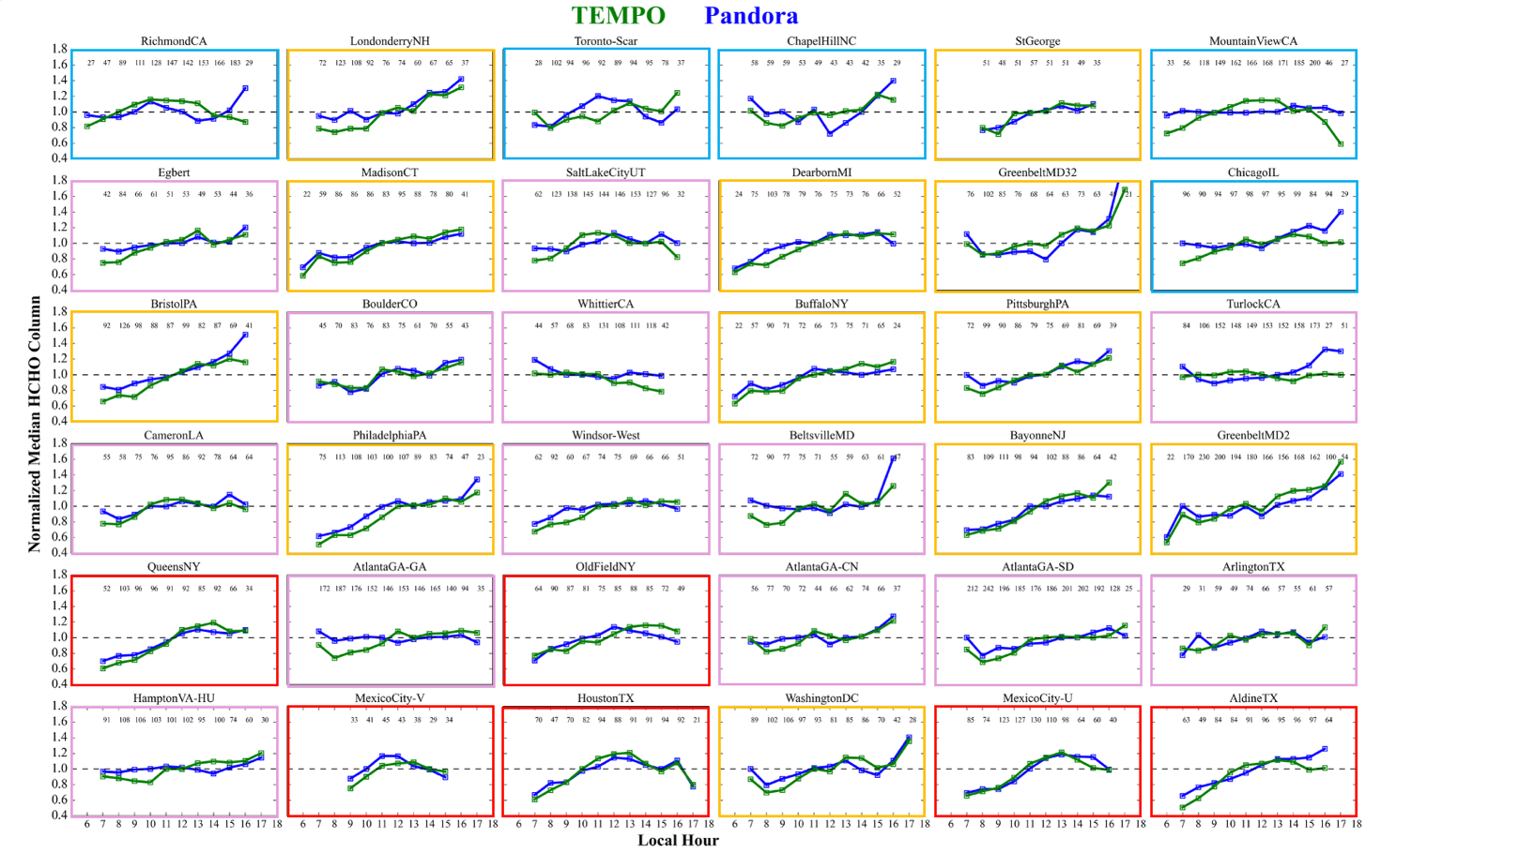
TEMPO v3 HCHO column agrees well with Pandora
Histogram of difference between TEMPO and Pandora HCHO column.
Oversampled Map of TEMPO
Pandora DS shows R² about 0.63 to 0.84.
TEMPO required precision
(1 × 10¹⁶)
Direct sun
TEMPO and Pandora HCHO Columns Exhibit Similar Diurnal Patterns
TEMPO PANDORA
Normalized Median
At most PGN sites, TEMPO and Pandora HCHO show similar diurnal patterns.
Normalized Total Column HCHO
Robust agreement between TEMPO and Pandora ΩHCHO highlights its value for investigating surface ozone dynamics and other air quality studies.
Local time

