Slide 1
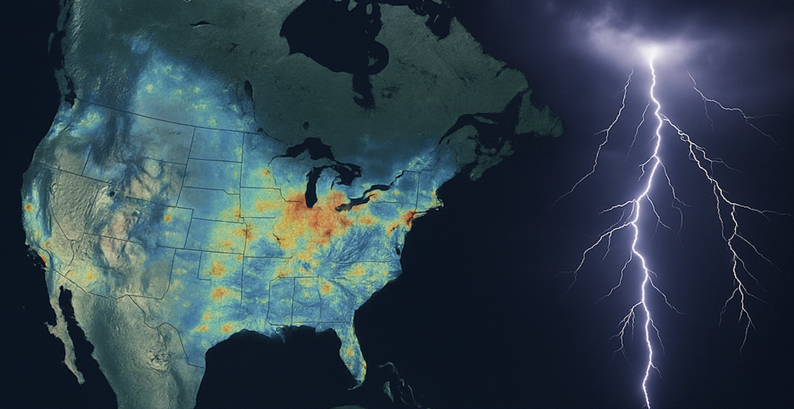


TEMPO cloud-sliced NO₂ observations：
Implications for sources and chemistry of free tropospheric NO_{x}
Ruijun Dang
Harvard University
Daniel J. Jacob, Yujin Oak, Laura Yang (ACMG, Harvard)
Helen Wang, Caroline R. Nowlan, Gonzalo Gonzalez Abad, Heesung Chong, Xiong Liu (Harvard-SAO)
Viral Shah (NASA GMAO), Drew W. Rollins (NOAA CSL), James H. Crawford (NASA Langley)
Eloise A. Marais, Rebekah P. Horner (UCL)
TEMPO/GeoXO ACX, August 22, 2025

Slide 2

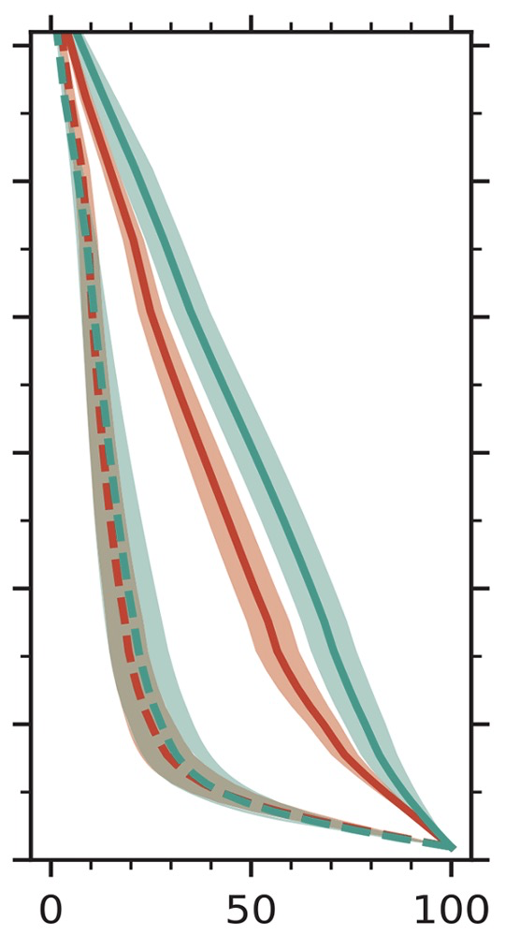
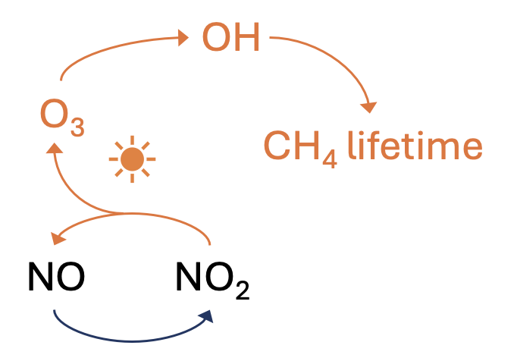
The importance of Free Tropospheric (FT) NO_{x}
Tropopause
FT NO_{x} is a major driver of global oxidant chemistry.
North America
65% in summer
25% in winter
Free Troposphere
FT NO₂ contributes a background column that must be accounted for when interpreting satellite data for surface NO_{x} emissions.
Nitrate
reservoirs
Lightning, Aviation
Surface uplift
Uncertainties remain in lightning source and organic nitrate reservoirs
But we lack observations!
winter
summer
~2 km
Boundary layer
Shah et al. (2023)

Slide 3






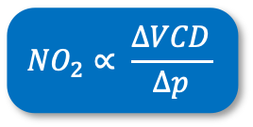
Using cloud-slicing technique to derive FT NO₂ for TEMPO
Observing columns over adjacent fully cloudy scenes with different cloud pressures
Inferring NO₂ concentration from the regression slope between NO₂ VCD and cloud pressure
Measured above-cloud NO₂ VCD
TOA
TOA
$${NO}_{2}∝ \frac{∆VCD}{∆p}$$
Cloud pressure
300 hPa
Cloud pressure
$$∆p$$
450 hPa
$$∆VCD$$
Above cloud NO₂ VCD
700 hPa
High observation density from TEMPO enables effective cloud slicing
50km
50km

Slide 4
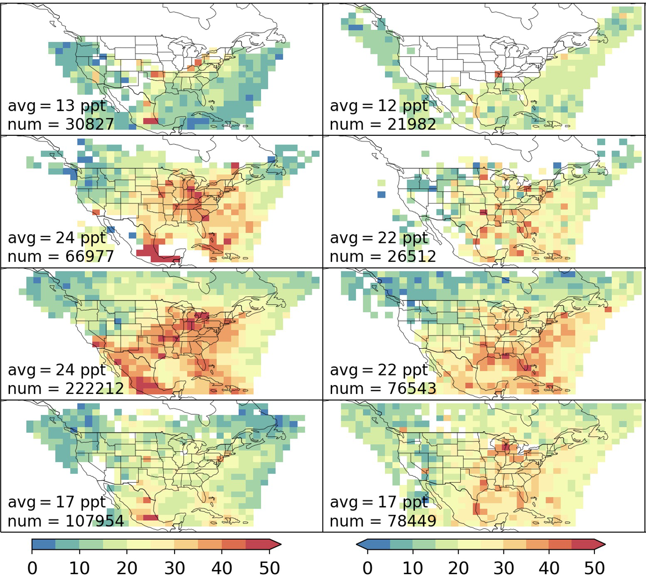
Free tropospheric NO₂ from TEMPO: comparison to TROPOMI
TEMPO (2023-2024, 1-year)
TROPOMI (2018-2021, 4-year)
Seasonal 700-300 hPa NO₂ on 2° x 2.5° grid
seasonal: reversed pattern compared to the surface
spatial: weaker gradient than at surface
DJF
MAM
Consistency between the two products
correlation coefficient (r): 0.30-0.73
regression slope: 1.1-1.3
TEMPO - with denser sampling - provides
significantly more data samples (3x more)
a smoother background
a better coverage (e.g., western US; winter)
with only 1 year of data
JJA
SON
FT NO₂ (ppt)
Dang et al., (in review)
FT NO₂ (ppt)

Slide 5
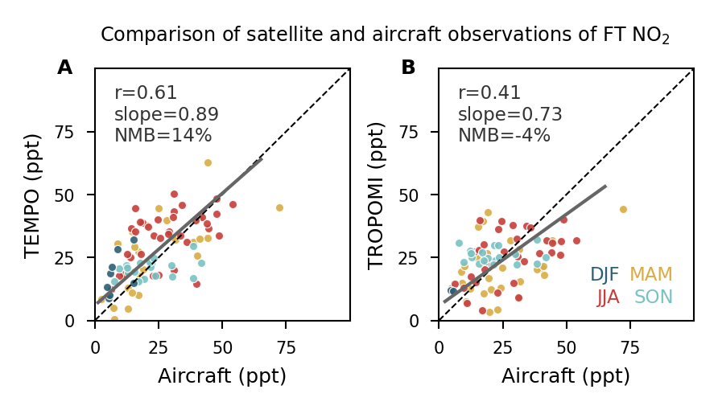
Validation with vertical profiles from aircraft campaigns
Aircraft campaigns averaged on the 2° x 2.5° grid:
INTEX-B, ARCTAS, DC-3, SEAC4RS, DISCOVER-AQ, FRAPPE, WINTER, AEROMMA campaigns
PSS NO₂ inferred from observations of NO, O₃, J(NO₂), HO₂
TEMPO vs. aircraft
TROPOMI vs. aircraft
Aircraft observations show:
higher values in spring and summer over the eastern US
TEMPO captures the observed variability
does better than TROPOMI
Conservative error estimation
14% accuracy and 50% precision in TEMPO product
Dang et al., (in review)

Slide 6
TEMPO enables the first diurnal observations of FT NO₂
Diurnal variation of FT NO₂ over North America
TEMPO diurnal FT NO₂ (700-300 hPa)
TEMPO
DJF
MAM
Sampled GEOS-CF
Flat in winter
A midday minimum in spring-fall
JJA
SON
Local time
Local time
Dang et al., (in review)

Slide 7
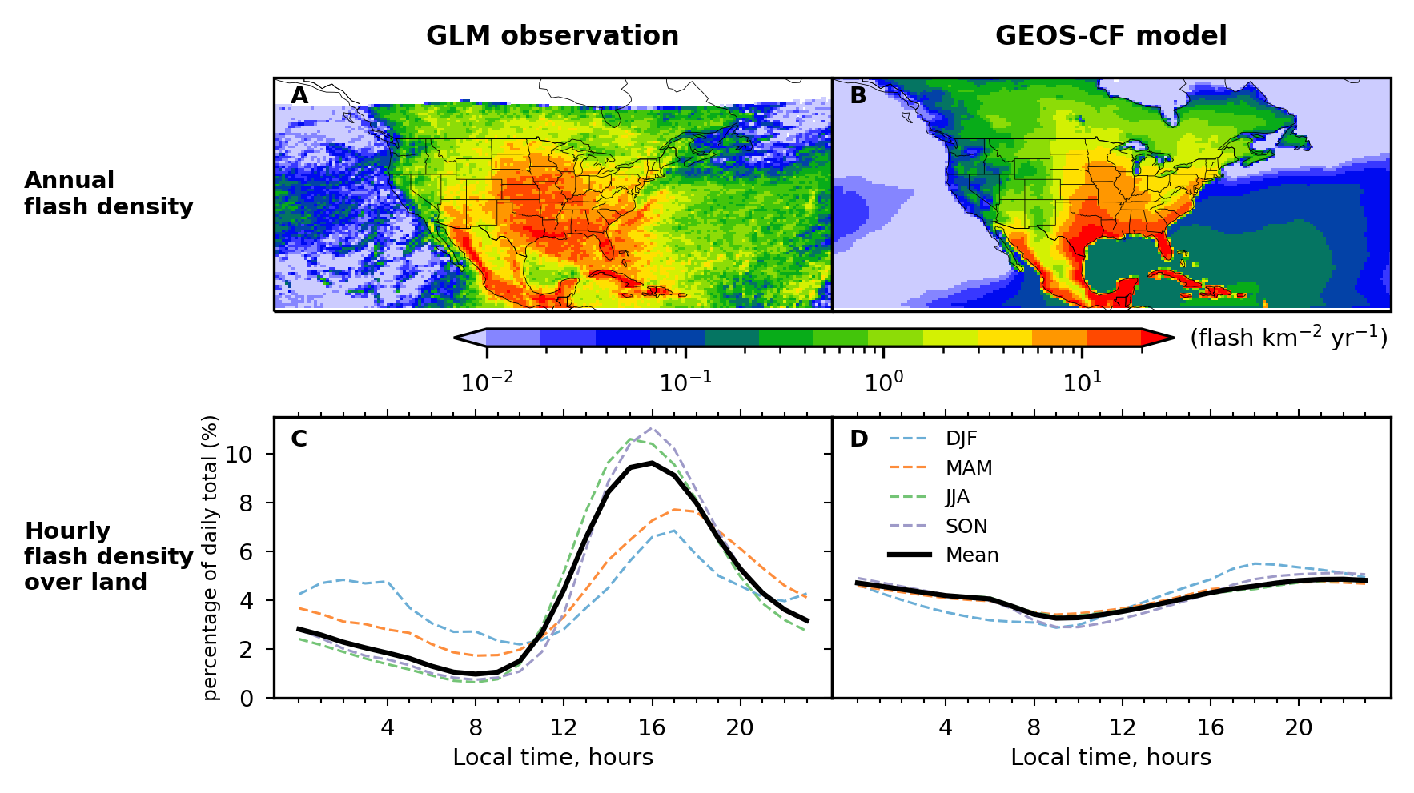
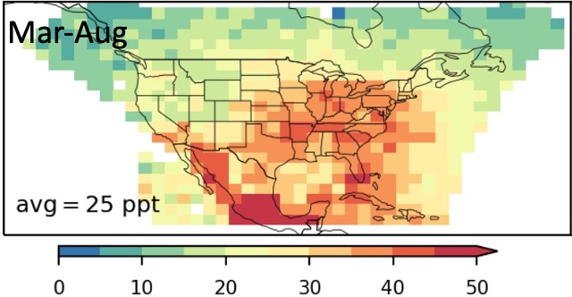
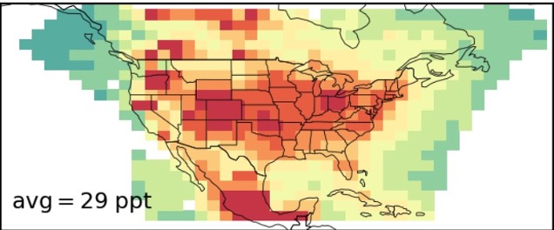
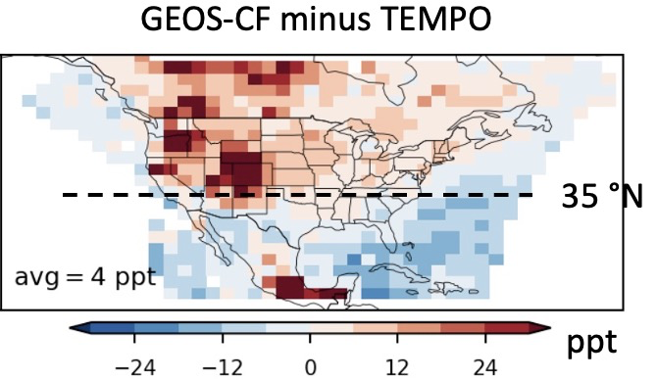
TEMPO + Geostationary Lightning Mapper (GLM)
reveal large errors in GEOS-CF lightning NO_{x} emissions
1. CTH-based flash rate parameterization needs improvement
land-ocean contrast and diurnal variation
2. NO_{x}-yield per flash needs to be lowered
TEMPO
FT NO₂
GEOS-CF
FT NO₂
500 mol N flash⁻¹
260 mol N flash⁻¹
Dang et al., (in review)

Slide 8
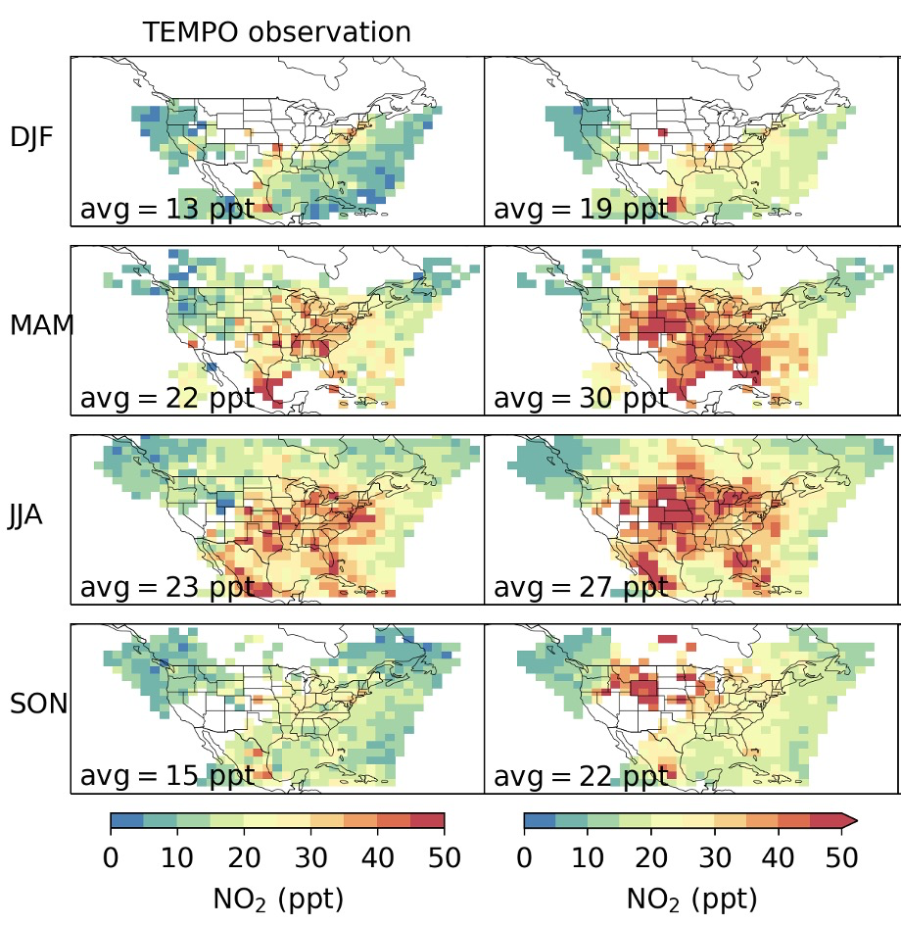
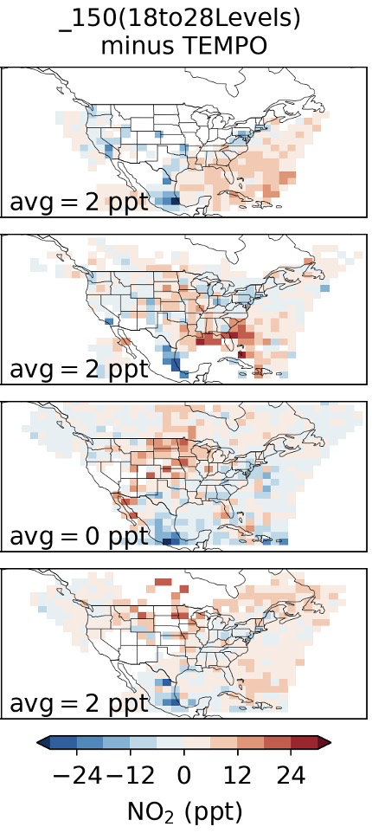
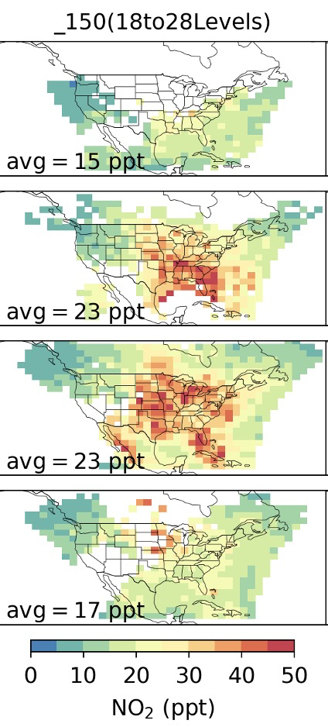
Constraining lightning NO_{x} emissions using TEMPO and GLM
TEMPO
GEOS-Chem Yield_150
DJF
Constraining lightning emissions
For flash rates ⇢ prescribed hourly GLM
For NO_{x} yield per flash ⇢ adjust yield to best match TEMPO FT NO₂ observations
MAM
A yield of 150 mol N flash⁻¹ appears most reasonable for North America
JJA
TEMPO-model difference has been reduced to 0-2 ppt
Good agreement in diurnal cycle
SON
FT NO₂ (ppt)
FT NO₂ (ppt)
Dang et al., (in prep.)

Slide 9
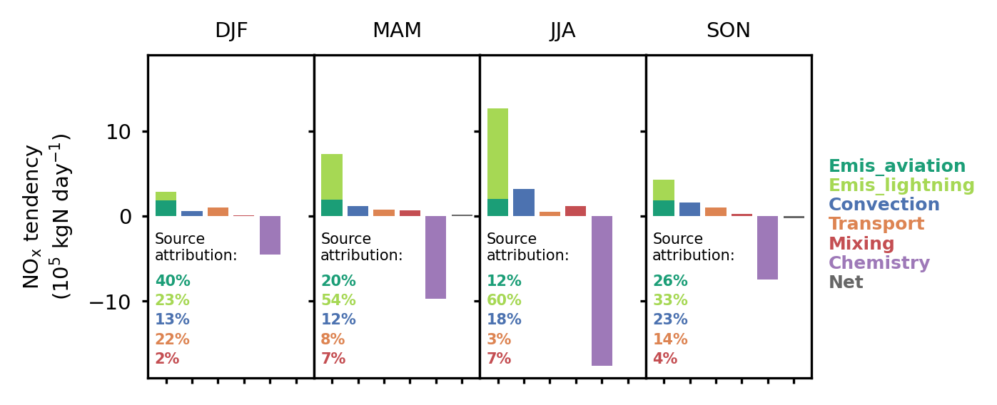
Budget analysis – contributions of individual processes to FT NO_{x}
NO_{x} family: NO + NO₂ + NO₃ + 2N₂O₅ + HONO + HNO₄
Emission (70%) + convection (10-20%) account for 80-90% of total FT NO_{x} sources.
Aviation dominants in winter (up to 40%);
Lightning dominants in other seasons (up to 60% in summer).
Convection contribution is strongest in summer
For entire TEMPO FOV
Dang et al., (in prep.)

Slide 10
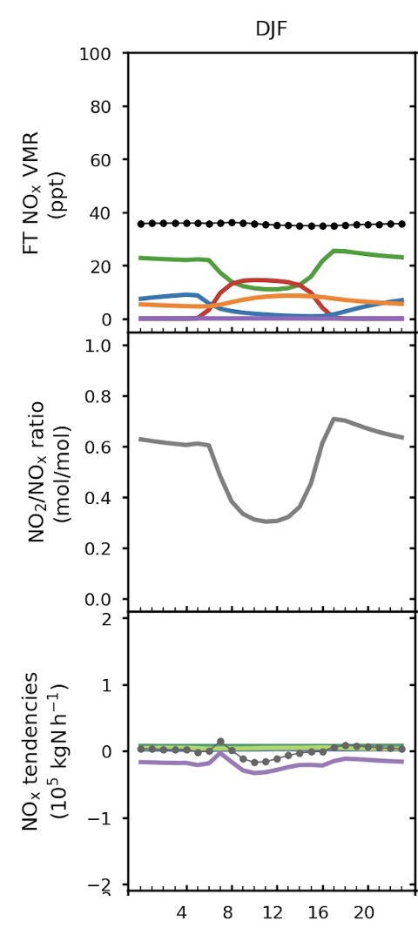
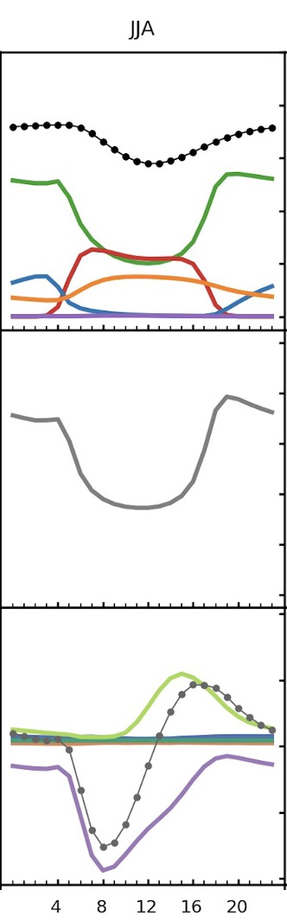
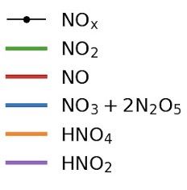
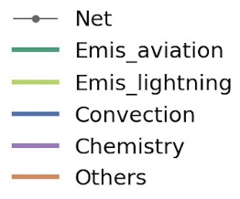
Budget analysis – what drives the FT NO₂ diurnal shape
DJF
JJA
Winter FT NO₂:
- NO_{x} is flat;
- NO₂/NO_{x} is the main driver (changes in NO-NO₂-O₃ PSS throughout the day)
Summer FT NO₂:
- Both NO_{x} and NO₂/NO_{x} contribute
- Chemical loss together with lightning emissions drives a noontime NO_{x} minimum
- NO₂+OH → HNO₃ is the major NO_{x} chemical loss
FT NO_{x} conc. (ppt)
NO₂/NO_{x} (mol/mol)
NO_{x} tendencies
(10⁵ kgN h⁻¹)
For entire TEMPO FOV
(Transport + mixing)
Dang et al., (in prep.)
Local time, hours
Local time, hours
Notes:
More active photochemistry in summer than in winter

Slide 11
Takeaways
We develop a new TEMPO cloud-sliced FT (700-300 hPa) NO₂ product
with unique diurnal resolution.
TEMPO product shows improved performance than TROPOMI.
TEMPO + GLM reveal large errors in modeled lightning NO_{x} emissions.
We use improved GEOS-Chem to better understand sources and chemistry of FT NO_{x}.
A NO_{x} yield of 150 mol N flash⁻¹ enables model to best match the TEMPO FT NO₂ observations
Lightning is the leading FT NO_{x} source in all seasons except winter.
The diurnal variation of FT NO₂ is mainly driven by NO-NO₂-O₃ photochemical steady state, with additional contribution from midday NO_{x} loss in summer (NO₂+OH).
Contact: rjdang@g.harvard.edu

