Slide 1
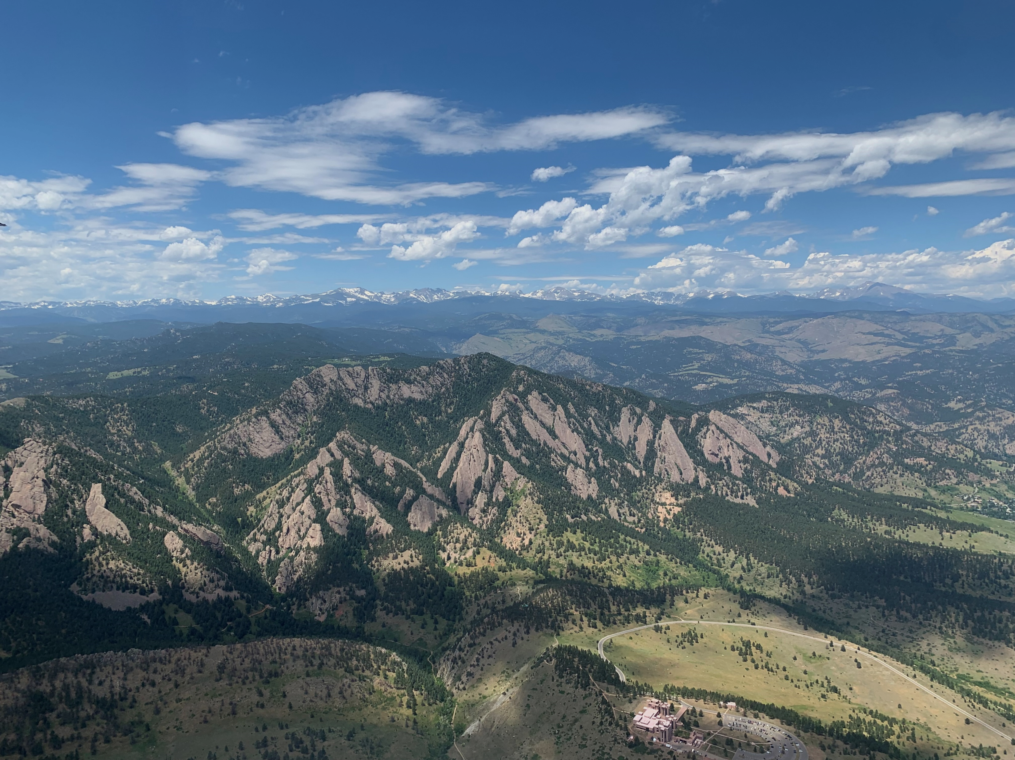



Evaluating TEMPO and quantifying NO_{x} with
AMAX-DOAS in the Colorado Front Range
Clara Lietzke*, Sunil Baidar, Jan-Lukas Tirpitz, Ruby Burgess, Robert G. Ryan, Alan Brewer, Steve Brown, Xinrong Ren, Rainer Volkamer*
*Dept. of Chemistry & CIRES, CU Boulder
TEMPO/GeoXO ACX Joint Science Team Workshop – Aug 2025

Slide 2


Outline
Ozone formation and NO_{x} sensitivity in the Colorado Front Range
AMMBEC 2024 aircraft campaign
CU AMAX-DOAS measurements and mass balance approach
NO_{x} emissions
  Concentrated animal feeding operation (CAFO)
  Oil and gas basin (Denver-Julesburg Basin)
TEMPO NO₂ over Denver
Outlook and synergies with TEMPO

Slide 3
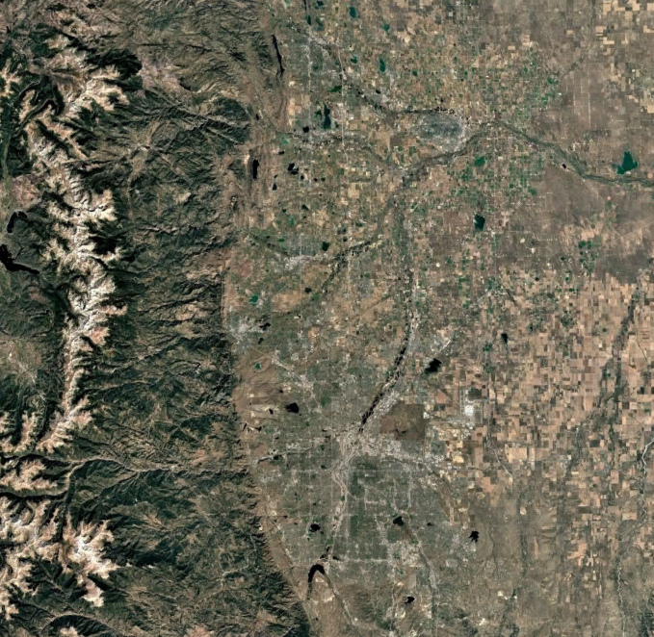


Ozone formation in the CO Front Range
O₃
N
High summertime ozone with “serious” classification by EPA
Much of the region is
NO_{x}-sensitive¹
Necessary to quantify and reduce NO_{x} emissions from shared land use (O&G, agriculture, transportation)
Previous work found that concentrated animal feeding operations (CAFOs) have the potential to double NO_{x} in remote areas²
Denver-Julesburg oil & gas basin
+ agriculture
NO
NO₂
Rural area, NO_{x}-sensitive
RO₂
RO
Boulder
RH
Denver
Urban area, NO_{x}-saturated
OH
HO₂
20 km
Image Landsat/Copernicus

Slide 4
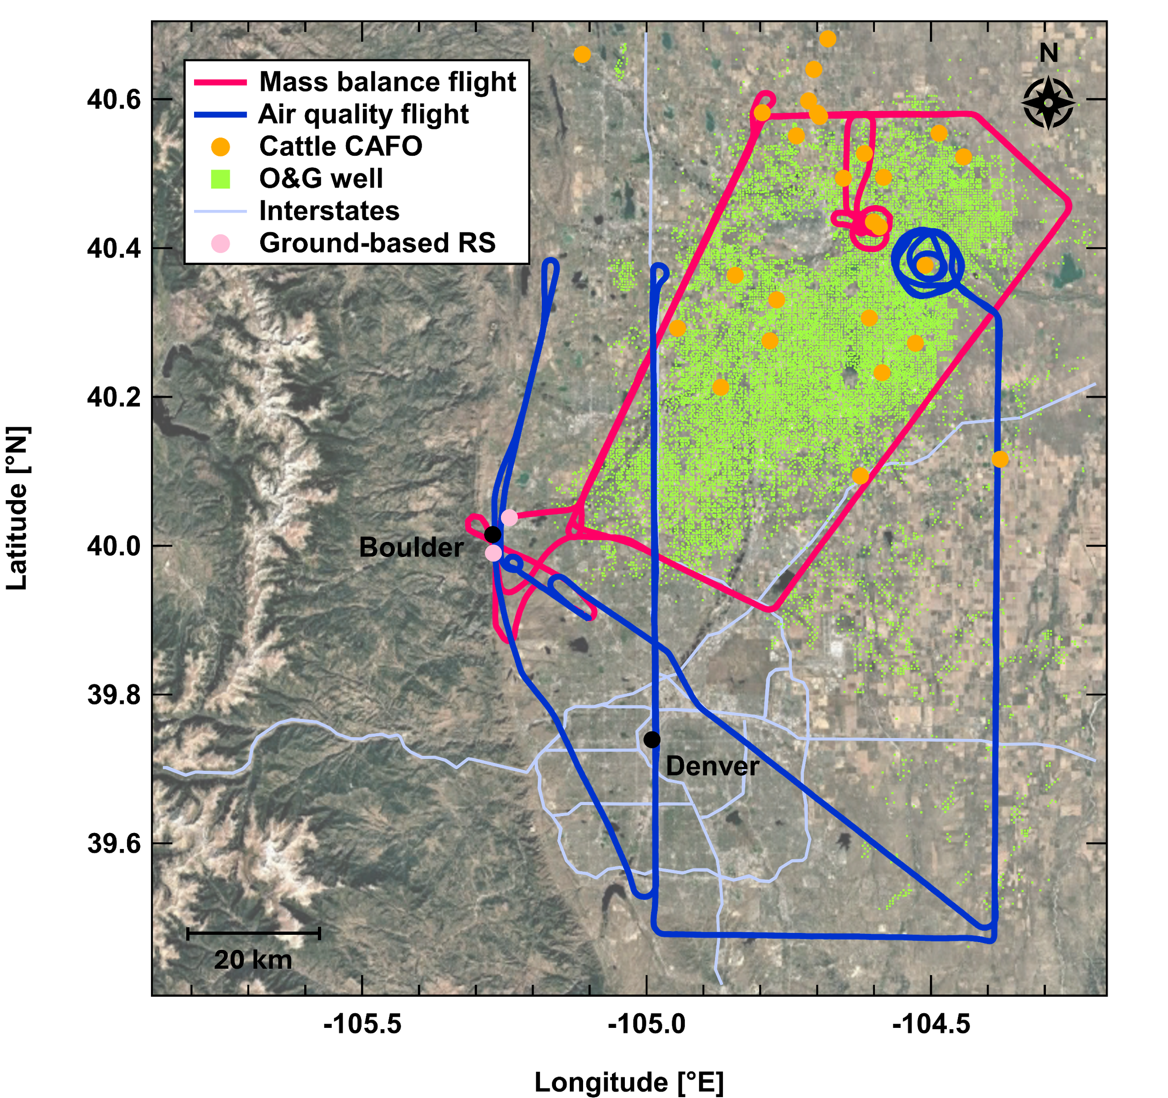
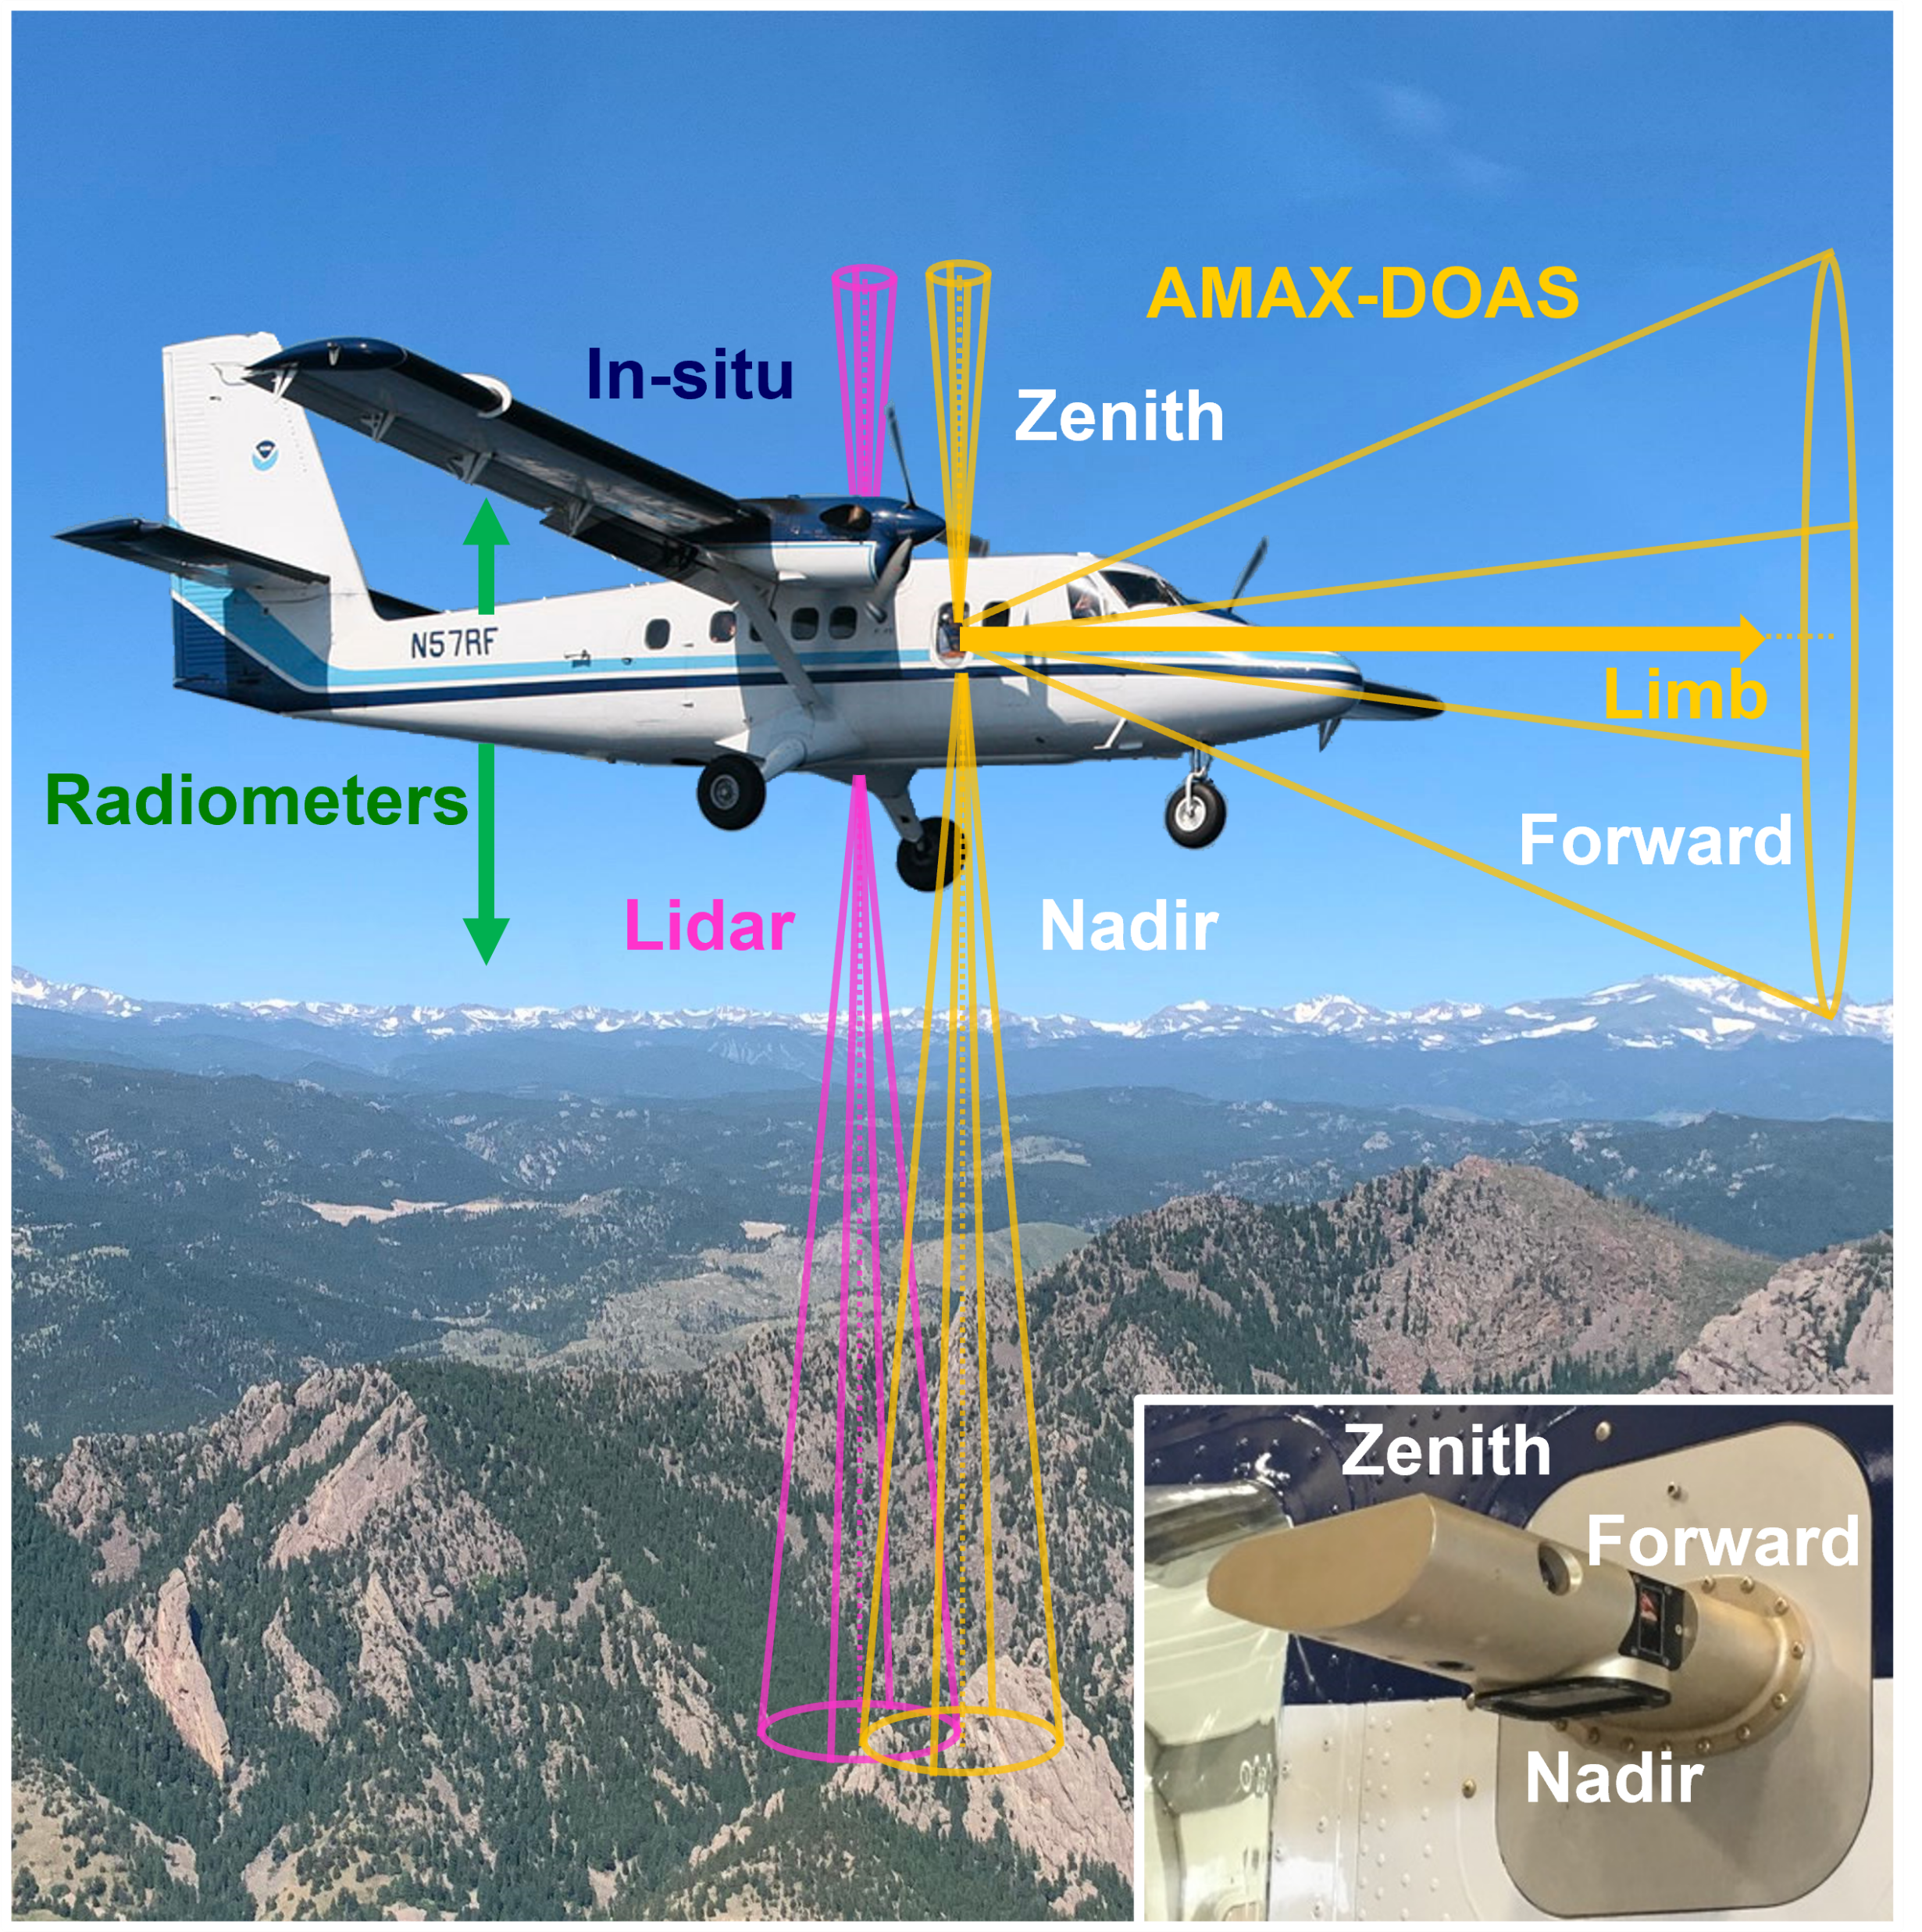
Airborne Methane Mass Balance Emissions in Colorado (AMMBEC) campaign in summer 2024
Radiometers: surface albedo
In situ monitors:
NO₂, NO_{y} (+ O₃, GHGs)
AMAX-DOAS: NO₂, HCHO, O₄ columns
Scanning Doppler lidar: 3-D wind and aerosol profiles, boundary layer height
NOAA Twin Otter aircraft payload

Slide 5


CU AMAX-DOAS
Airborne Multi-AXis Differential Optical Absorption Spectroscopy
NO₂ fit window (425 – 490 nm)
Cross sections:
  NO₂ (298 K; Vandaele et al., 1998)
  O₃ (223 K; Serdyuchenko et al., 2014)
  O₂-O₂ (293 K; Thalman & Volkamer, 2013)
  H₂O (296 K; HITEMP 2010; Rothman et al., 2010)
  Rotational Raman (250 K; Chance & Kurucz, 2010)
5th order polynomial and constant intensity offset
Motion stabilized, rotated prism telescope
Fixed, cloud-free, high-altitude (~2200 m agl; above boundary layer) zenith reference spectrum recorded during the same flight
Stratospheric NO₂ correction
Geometric air mass factor^{1,2}
TEMPO
HCHO fit window (328.5 – 346 nm)
Cross sections:
  HCHO (297 K; Meller & Moortgat, 2000)
  O₃ (223 K; Serdyuchenko et al., 2014)
  O₂-O₂ (293 K; Finkenzeller & Volkamer, 2022)
  NO₂ (298 K; Vandaele et al., 1998)
  Rotational Raman (250 K; Chance & Kurucz, 2010)
5th order polynomial and constant intensity offset
Top of atmosphere
AMAX-DOAS
Boundary layer
Surface
We measure in the same geometry as TEMPO
Albedo, forward off-axis angles support RTM and are well-suited to evaluate TEMPO measurements and a priori!

Slide 6

AMAX-DOAS measurements & mass balance approach
Measurements used for mass balance analysis meet the following criteria:
Nadir spectra measuring columns below the aircraft
  Apply geometric AMF to convert slant columns to VCDs
SZA < 60°
  Suitable for stratospheric NO₂ correction and geometric AMF approximation
Measurements used for TEMPO evaluation include additional criteria:
Within 30 minutes of TEMPO overpass
Legs above the boundary layer (>1500 m agl)
  Free tropospheric column above the aircraft (determined from TEMPO a priori) is added
DOAS VCD
& Lidar wind
or
In-situ conc.
& Lidar wind + BLH
F₁
F₂
F₃ …
F_{n}
source area
S
Sum NO₂ flux, F, along a closed path, S, to get emission rate, Q

Slide 7
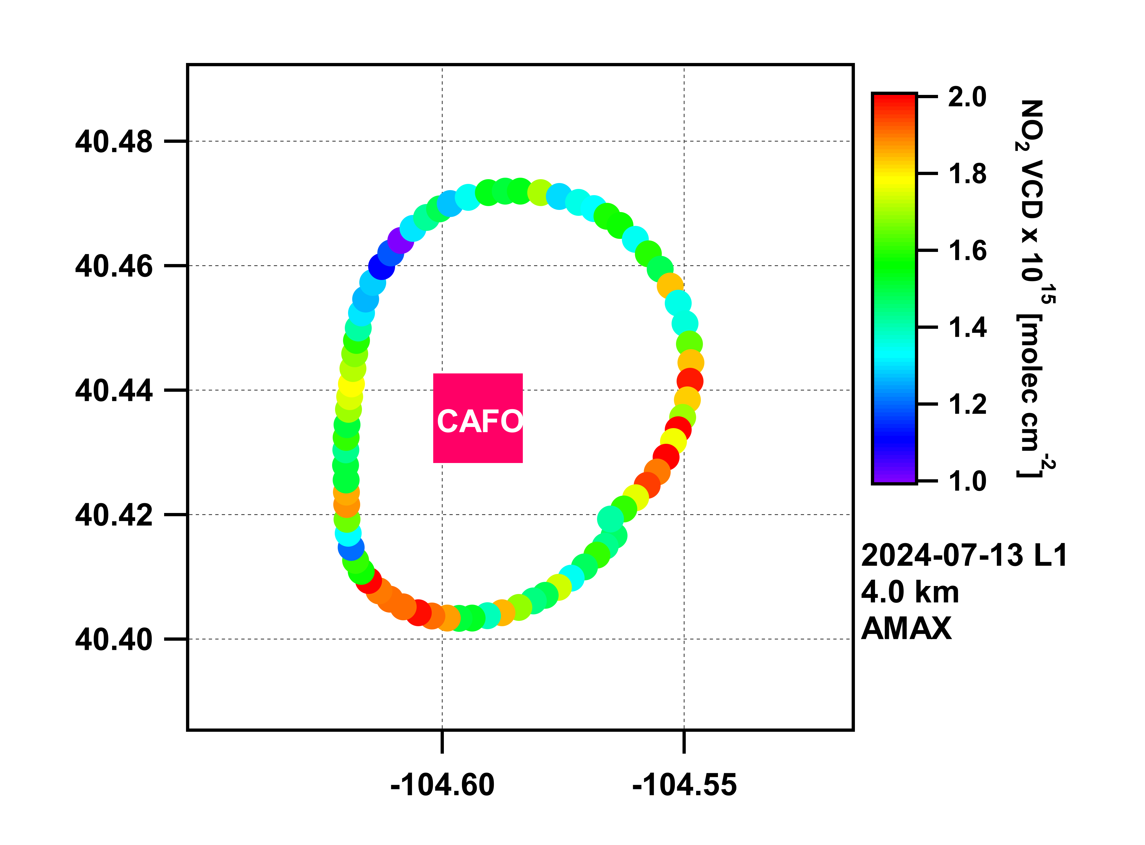
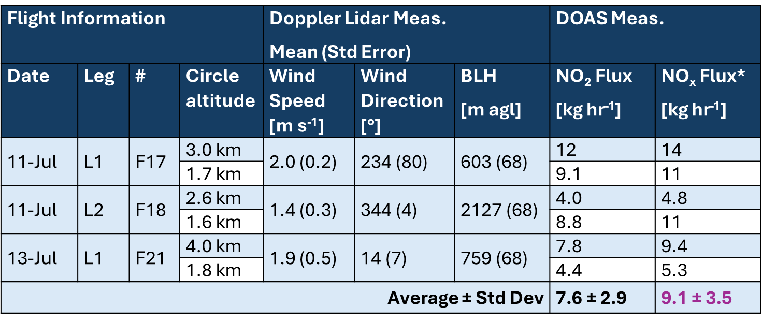
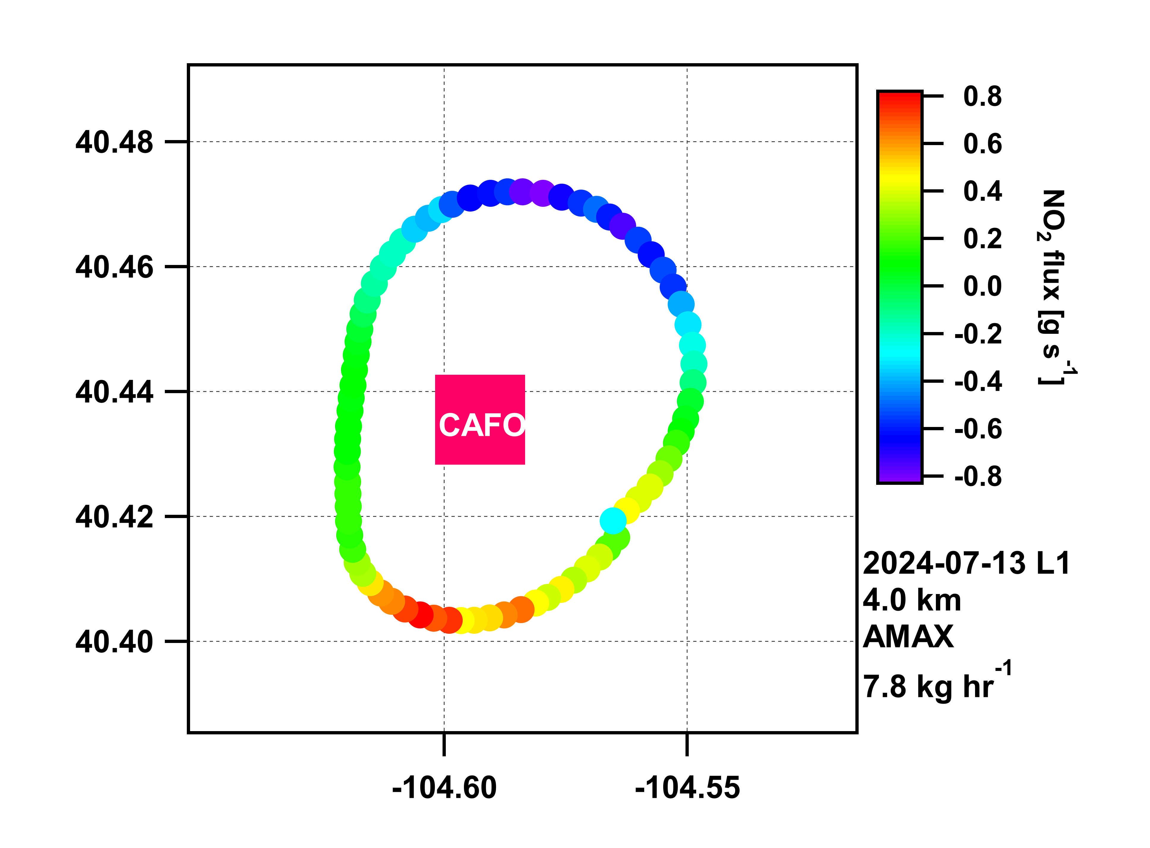
NO_{x} emissions from a CAFO
AMAX-DOAS NO₂ VCDs
wind
Only some CAFOs are explicitly included in emissions inventories
Between 3 flights and 6 loops, we observe an average NO_{x} emission rate of 9 kg hr⁻¹
NO₂ flux around CAFO
Factor of 1.2 to account for NO_{x} (NO + NO₂) photostationary state

Slide 8
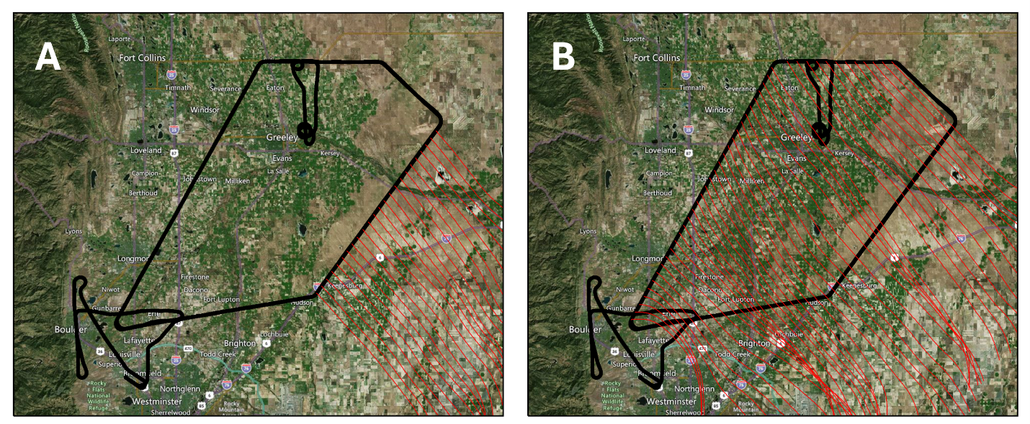
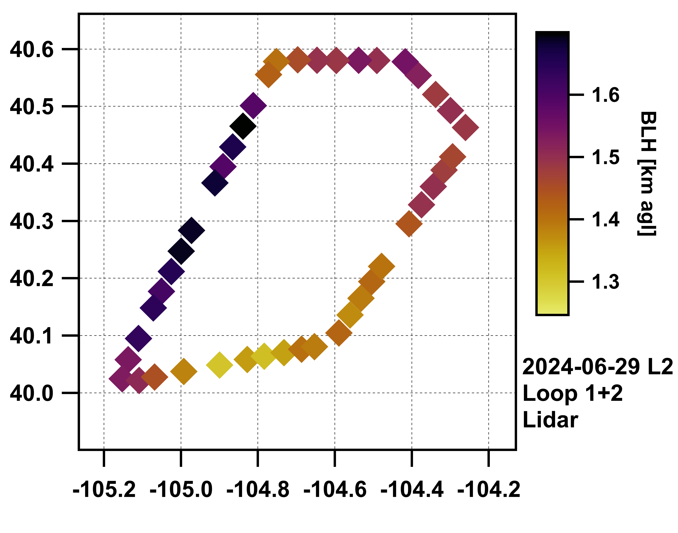
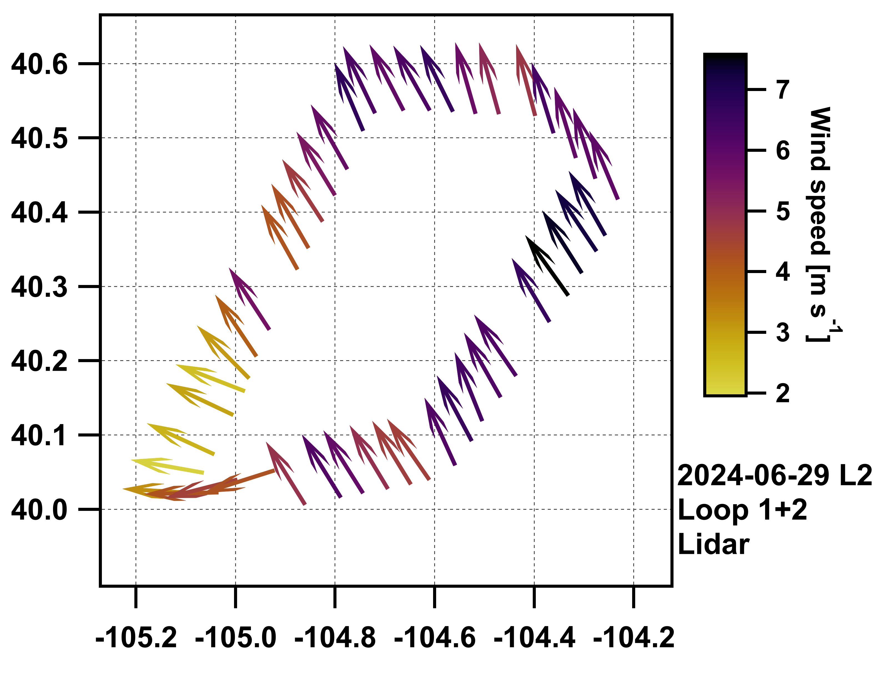
NO_{x} emissions from an O&G basin
6-hr Hysplit backtrajectories
Suitable wind conditions + accounting for NO_{x} photostationary state and NO_{y} chemistry¹
Between 2 flights and 4 loops, we observe average NO_{x} emissions of 2.5 – 3.6 MT hr⁻¹
30-90% higher than in state-of-the-art GRA2PES emission inventory
Doppler lidar boundary layer and wind

Slide 9
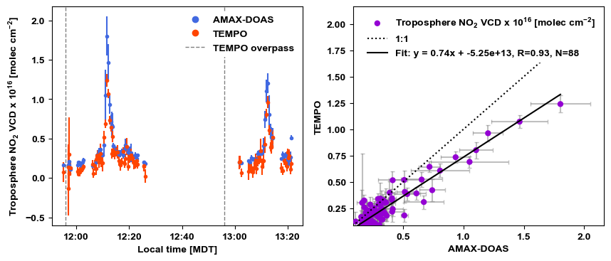
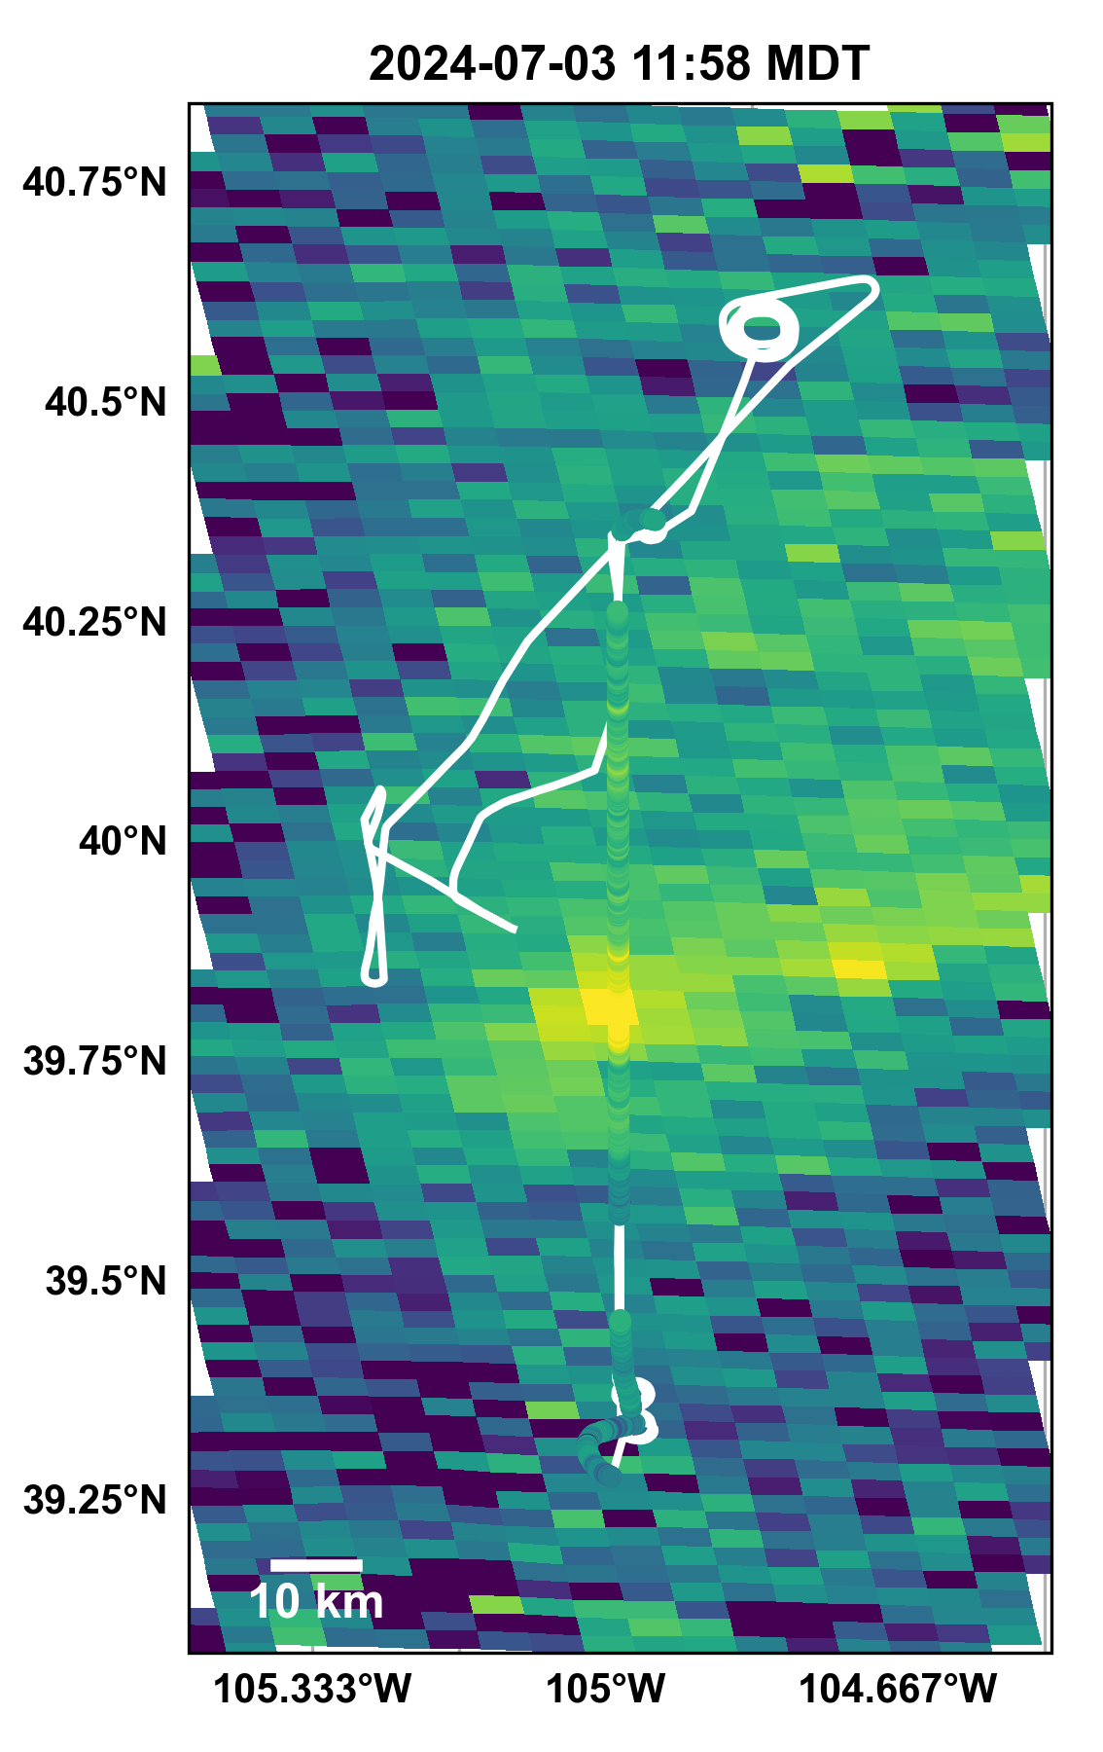
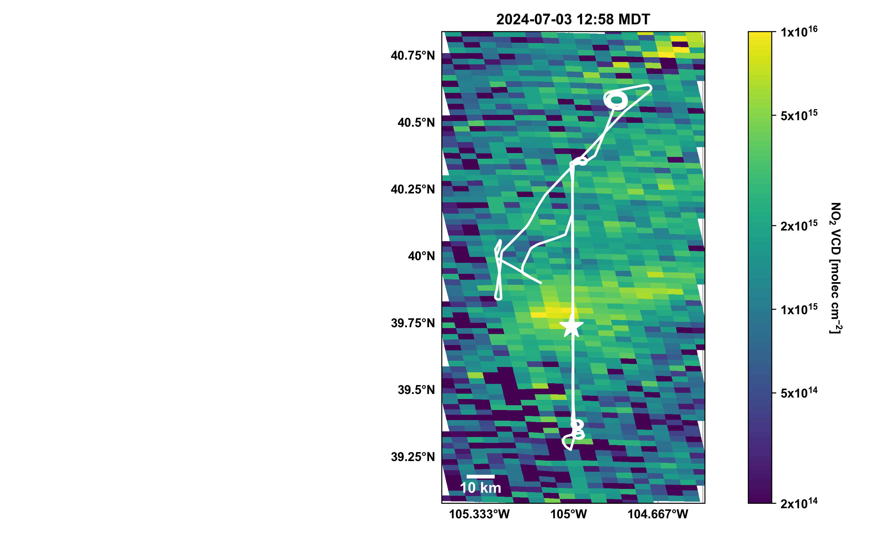


TEMPO captures NO₂ plumes over Denver

Slide 10
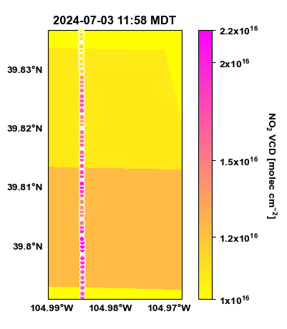
TEMPO captures NO₂ plumes over Denver
Sub-pixel
variability

Slide 11
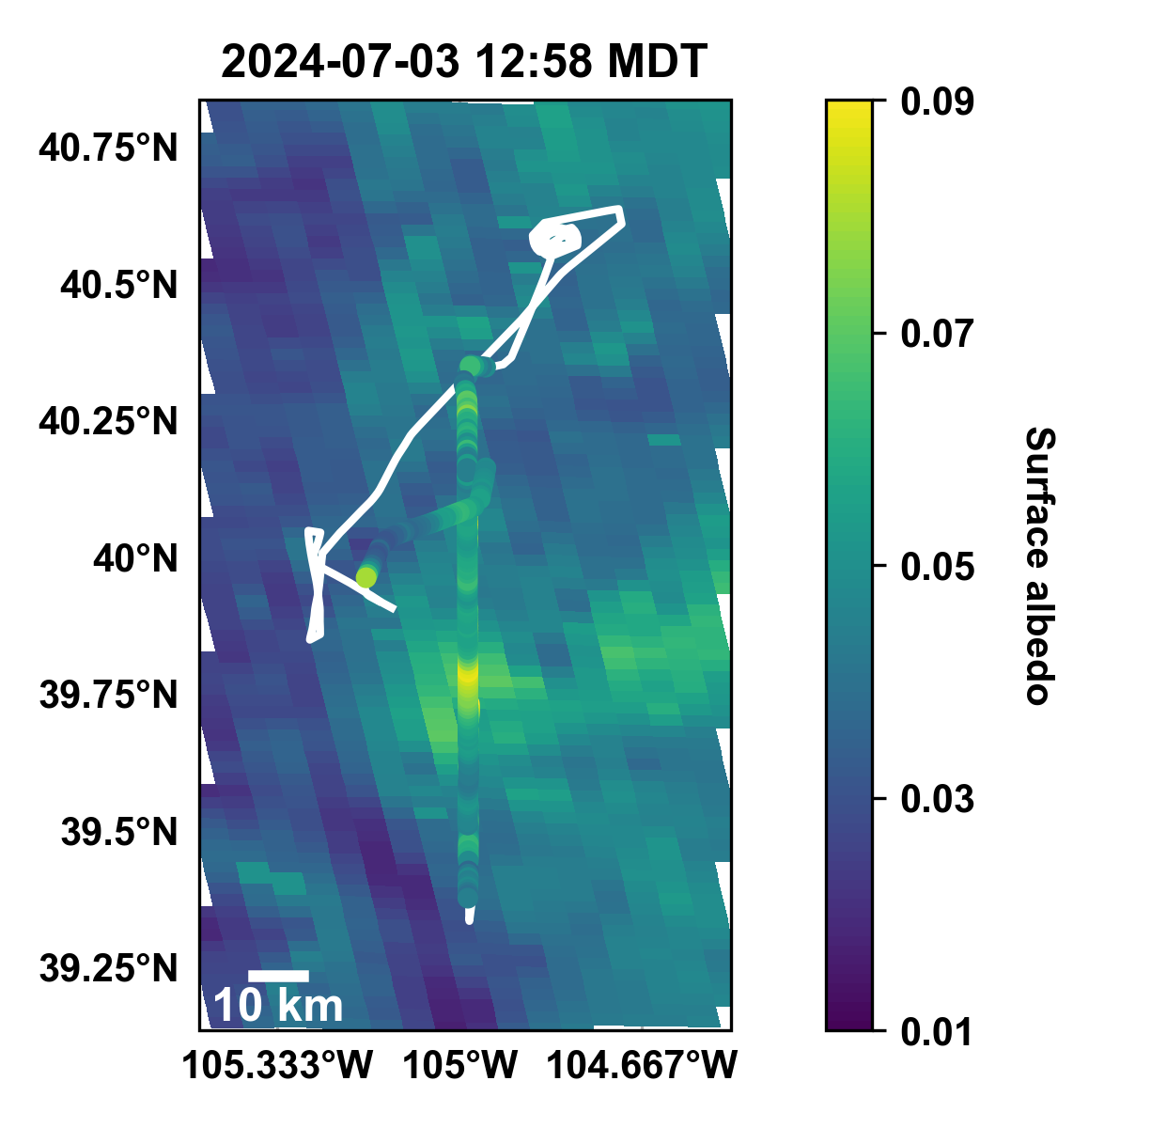
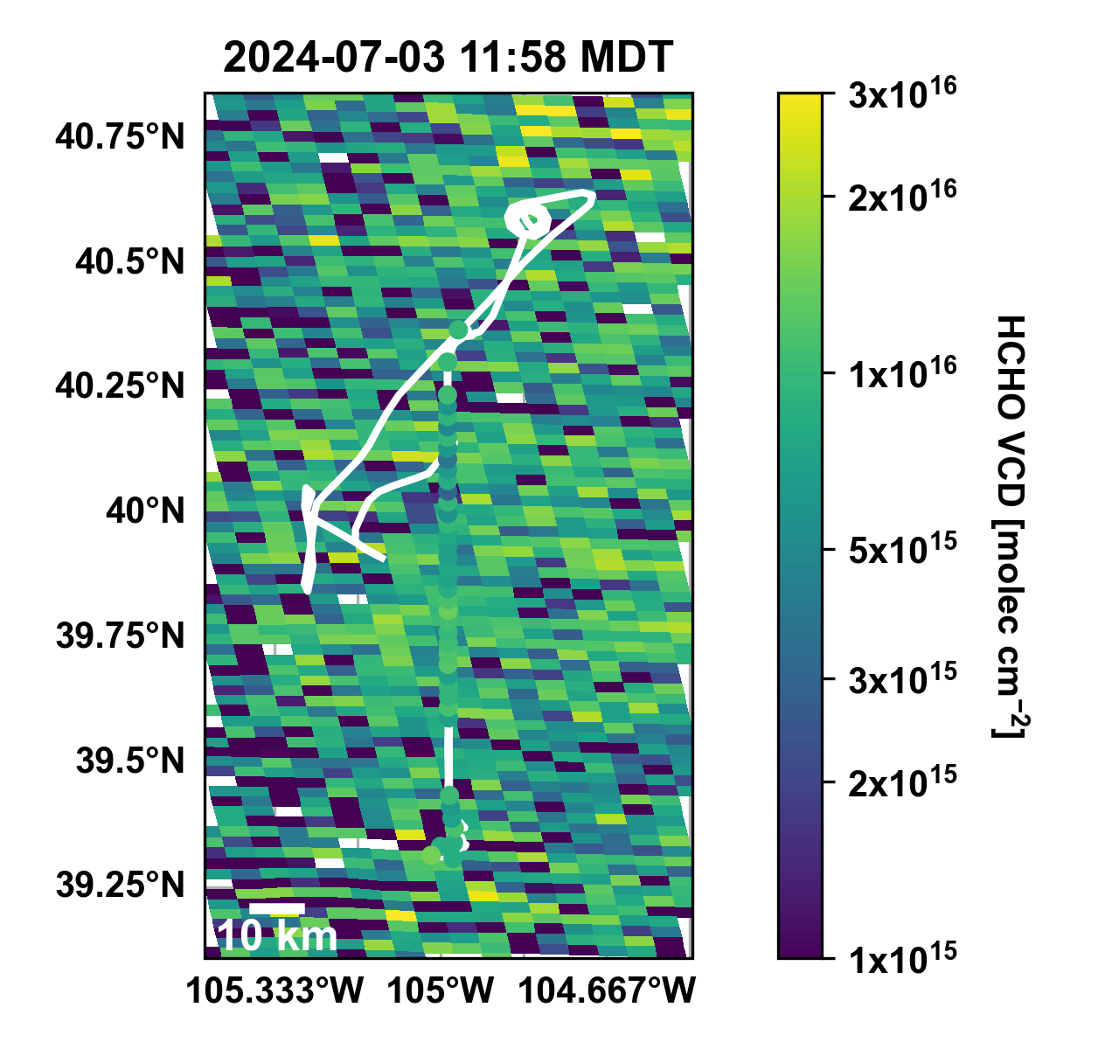
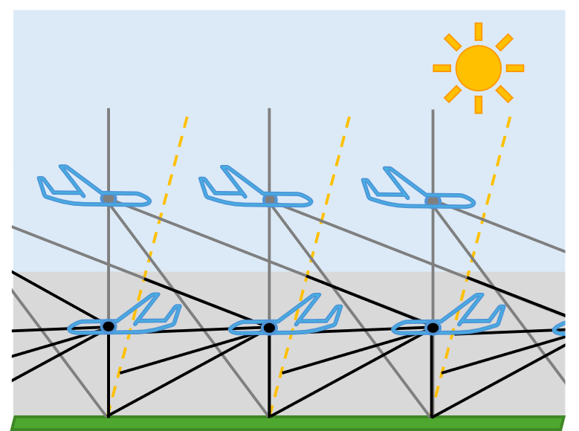

Summary & Outlook
Synergies between DOAS, Doppler lidar, and in situ measurements allow for quantification of NO_{x} emissions from small (individual CAFO) and large (basin-wide) source areas
NO_{x} emissions are underestimated in emissions inventories
TEMPO captures NO₂ plumes over Denver
Synergies with TEMPO & future opportunities
  Evaluate TEMPO’s ability to quantify NO_{x} emissions
  RTM using albedo and off-axis angles
  (+ expand to low altitude legs)
  Evaluate TEMPO a priori
  Evaluate TEMPO HCHO
  RFN and O₃ photochemistry
Surface albdeo
HCHO VCD [molec cm⁻²]
Forward off-axis angles supporting RTM
State of Colorado contract #2025*0297

Slide 12
Extra slides

Slide 13

Mass balance approach
Assume negligible change in pollutant concentration and chemistry (or apply correction factor)
Net source strength $Q$ $= \oint_{ }^{ }{F}∙dS + \int_{ }^{ }{\frac{∂C}{∂t}dV}$
$= \oint_{ }^{ }{u_{avg}^{∗}\left(S\right)∙column\left(S\right)∙dS}$ (1)
$= \oint_{ }^{ }{\int_{ 0}^{ BLH}{conc\left(z\right)}}∙u^{∗}\left(z\right)∙dz∙dS$ (2)
F₁
F₂
F₃ …
F_{n}
Doppler lidar wind perpendicular to flight path
DOAS VCD
source area
S
Doppler lidar
in situ
Sum NO₂ flux, F, along a closed path, S, to get emission rate, Q
Need to assume steady-state winds and negligible wind divergence (choose suitable flights for analysis or apply correction)

Slide 14
Between 2 flights and 4 loops, we observe average NO_{x} emissions of 2.5 – 3.6 MT hr⁻¹
Flight Information |  |  | Doppler Lidar Meas. Mean (Std Dev) |  |  | DOAS NO₂ Meas.
Date Leg | # | Loop | Wind Speed [m s⁻¹] | Wind Direction [°] | BLH [m agl] | NO₂ Flux [MT hr⁻¹] | NO_{x} Flux [MT hr⁻¹] | NO_{x} Flux [MT hr⁻¹]
29-Jun L2 | F03 | 1+2 | 5.0 (1.5) | 146 (15) | 1558 (117) | 1.95 | 2.34 | 3.34
 |  | 2 | 5.1 (1.3) | 140 (13) | 1615 (78) | 2.25 | 2.70 | 3.86
02-Jul L2 | F05 | 1 | 5.7 (2.9) | 258 (75) | 1575 (439) | 1.75 | 2.10 | 3.0
 |  | 1+2 | 6.0 (2.3) | 279 (54) | 1766 (481) | 2.34 | 2.81 | 4.0
Average ± Std Dev |  |  |  |  |  | 2.1 ± 0.3 | 2.5 ± 0.3 | 3.6 ± 0.5
Flight Information |  |  | Doppler Lidar Meas. Mean (Std Dev) |  |  | DOAS NO₂ Meas. |  |  | In situ NO_{y} Meas.
Date Leg | # | Loop | Wind Speed [m s⁻¹] | Wind Direction [°] | BLH [m agl] | NO₂ Flux [MT hr⁻¹] | NO_{x} Flux [MT hr⁻¹] | NO_{x} Flux [MT hr⁻¹] | NO_{x} Flux [MT hr⁻¹]
29-Jun L2 | F03 | 1+2 | 5.0 (1.5) | 146 (15) | 1558 (117) | 1.95 | 2.34 | 3.34 | 2.18 – 2.63
 |  | 2 | 5.1 (1.3) | 140 (13) | 1615 (78) | 2.25 | 2.70 | 3.86 | 2.98 – 3.57
02-Jul L2 | F05 | 1 | 5.7 (2.9) | 258 (75) | 1575 (439) | 1.75 | 2.10 | 3.0 | 2.22 – 3.12
 |  | 1+2 | 6.0 (2.3) | 279 (54) | 1766 (481) | 2.34 | 2.81 | 4.0 | 2.36 – 3.01
Average ± Std Dev |  |  |  |  |  | 2.1 ± 0.3 | 2.5 ± 0.3 | 3.6 ± 0.5 | 2.4 – 3.1 (± 0.4)
Flight Information |  |  | Doppler Lidar Meas. Mean (Std Dev) |  |  | DOAS NO₂ Meas. |  |  | In situ NO_{y} Meas. | GRA2PES
Date Leg | # | Loop | Wind Speed [m s⁻¹] | Wind Direction [°] | BLH [m agl] | NO₂ Flux [MT hr⁻¹] | NO_{x} Flux [MT hr⁻¹] | NO_{x} Flux [MT hr⁻¹] | NO_{x} Flux [MT hr⁻¹] | NO_{x} Flux [MT hr⁻¹]
29-Jun L2 | F03 | 1+2 | 5.0 (1.5) | 146 (15) | 1558 (117) | 1.95 | 2.34 | 3.34 | 2.18 – 2.63 | 1.63
 |  | 2 | 5.1 (1.3) | 140 (13) | 1615 (78) | 2.25 | 2.70 | 3.86 | 2.98 – 3.57
02-Jul L2 | F05 | 1 | 5.7 (2.9) | 258 (75) | 1575 (439) | 1.75 | 2.10 | 3.0 | 2.22 – 3.12 | 2.17
 |  | 1+2 | 6.0 (2.3) | 279 (54) | 1766 (481) | 2.34 | 2.81 | 4.0 | 2.36 – 3.01
Average ± Std Dev |  |  |  |  |  | 2.1 ± 0.3 | 2.5 ± 0.3 | 3.6 ± 0.5 | 2.4 – 3.1 (± 0.4) | 1.9 ± 0.3
Correction for bkgd NO_{y}
(0.2 – 0.8 ppb) in airflux
State of the art emission inventory
NO_{x} (NO + NO₂) photostationary state
Loss to NO_{y}¹
Our measurements of NO_{x} emissions are 30-90% higher than in the inventory
Notes:
Dix et al – using TROPOMI, NOx lifetime ~4.5 hr

Slide 15
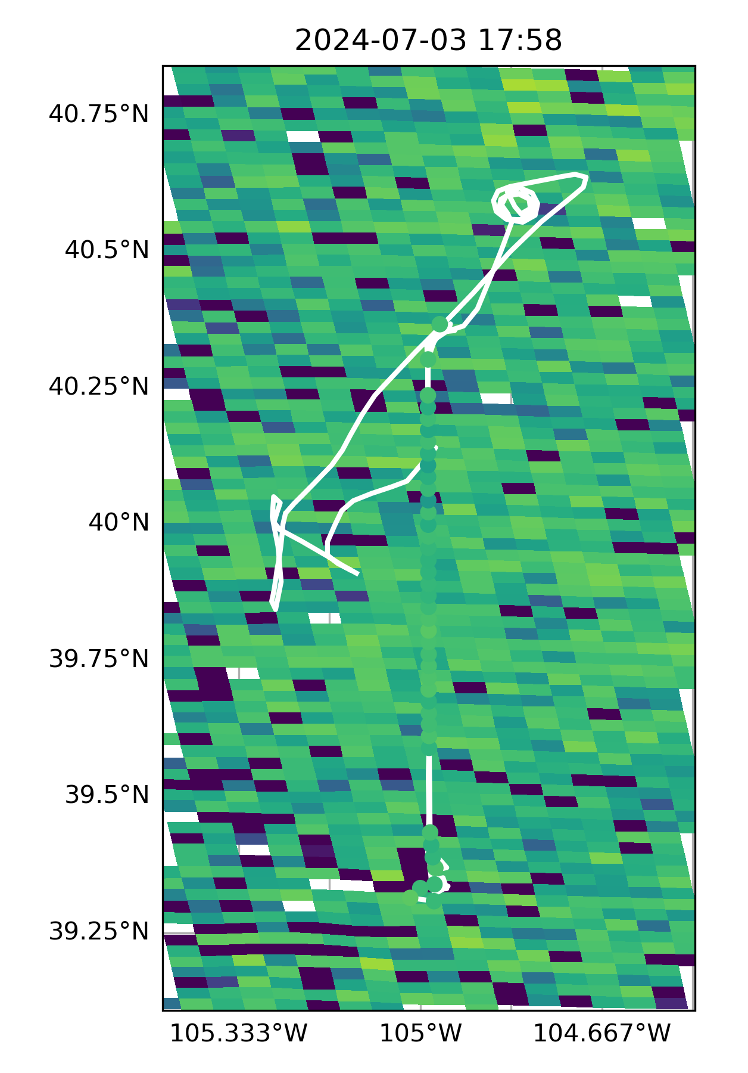
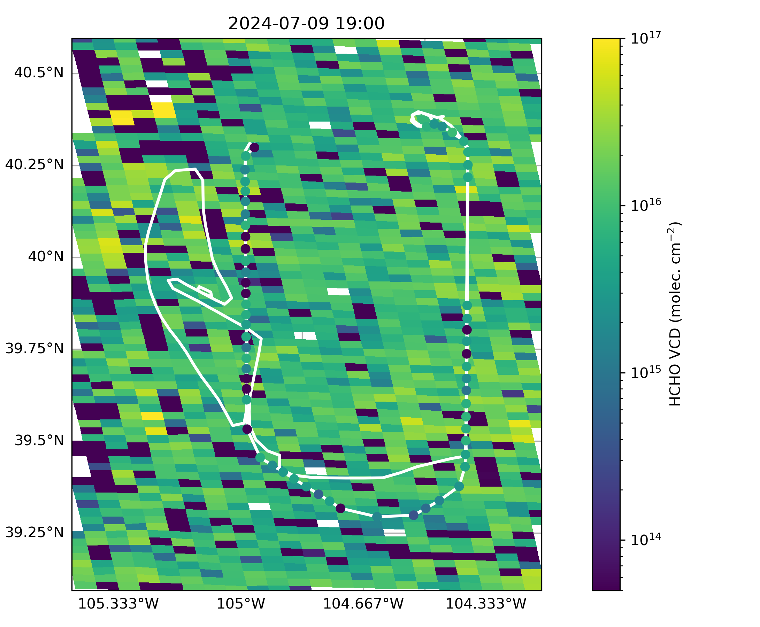
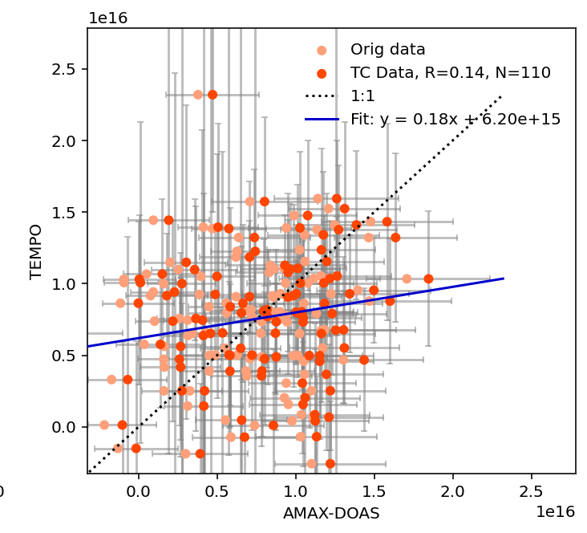
Ongoing work: evaluating TEMPO HCHO

