Slide 1



Assessing Ozone Dynamics During the 2023 Summer STAQS Field Campaign Using Synergistic Observations and Model Simulations
TEMPO/GeoXO ACX Joint Science Workshop
August 2025
Claudia M. Bernier
NASA Ames Center, Earth Science Division

Slide 2
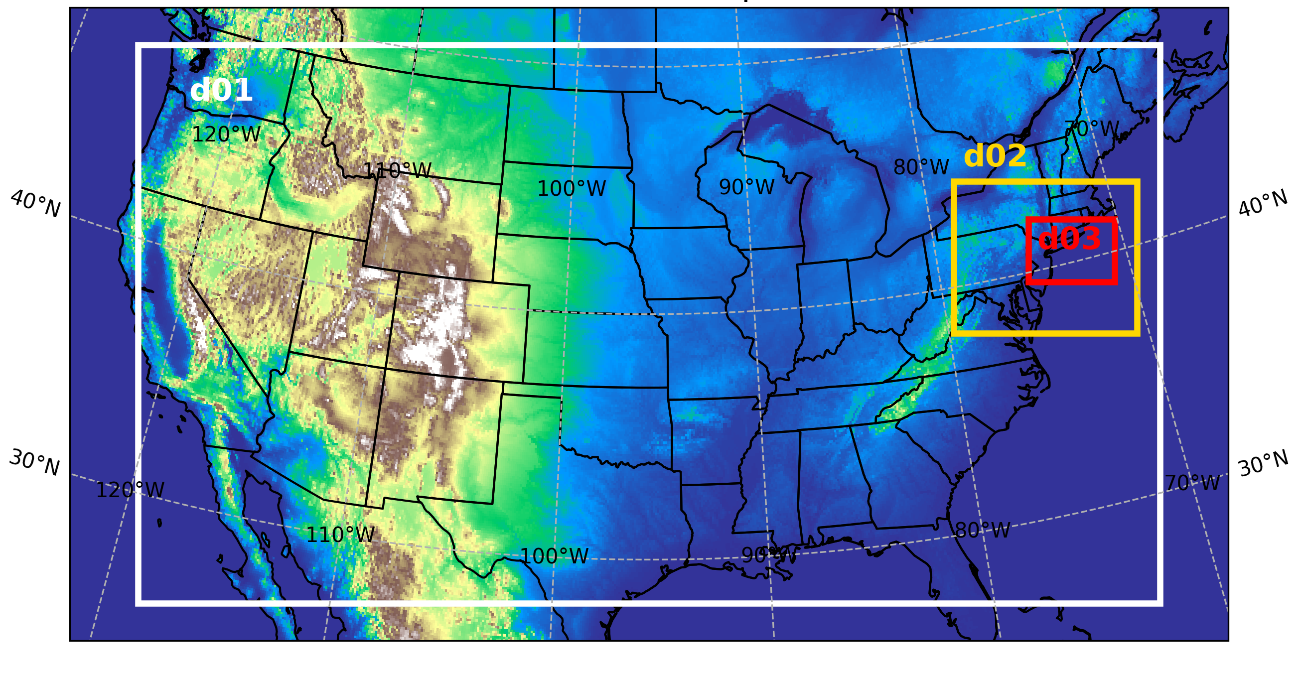
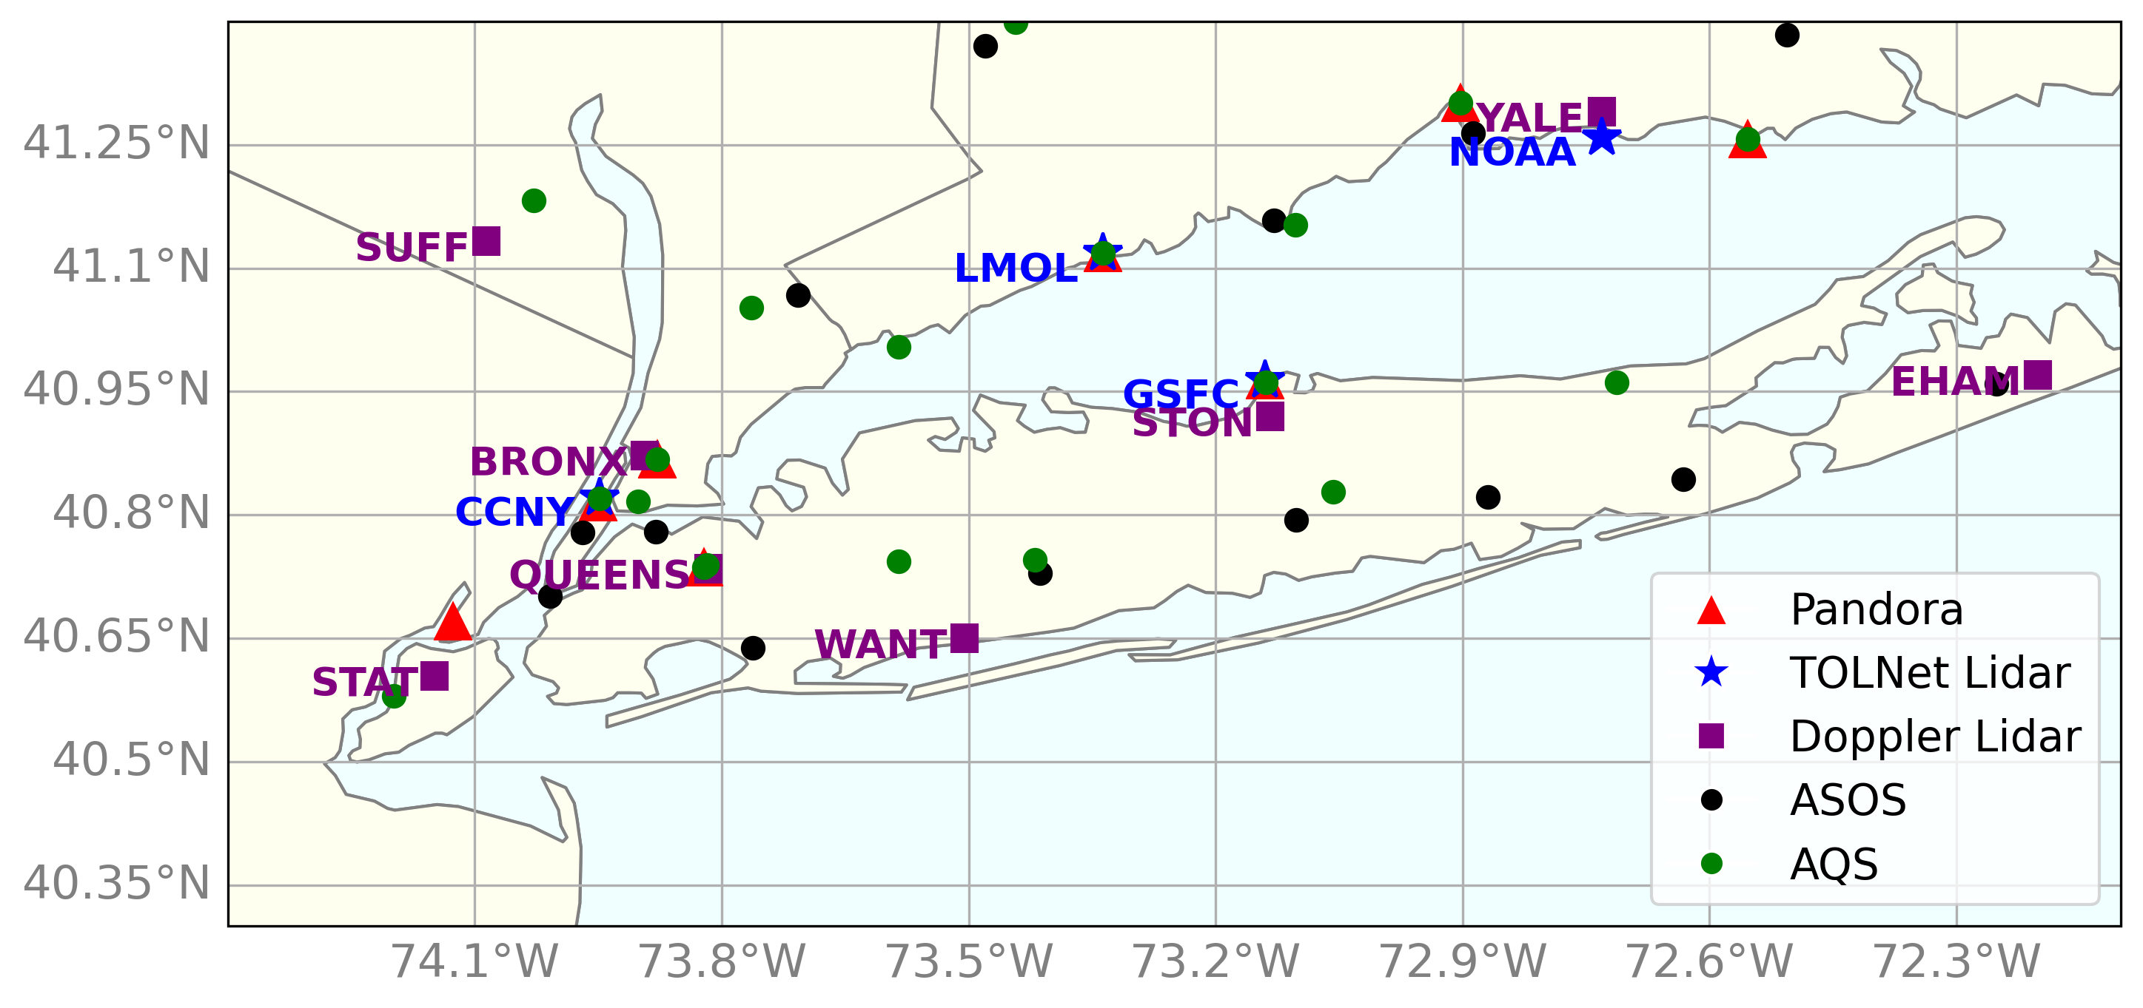
AGES+ campaign & model setup
Domain setup:
Key Configurations for WRF-Chem v4.2 Simulation
Period ran | 2023-07-23 00:00 – 2023-08-18 00:00 UTC
Horizontal | nested domains: 12, 4, 1.33 km
Vertical | 47 levels; surface - 50 hPa
Anthropogenic | NEMO based on US EPA NEI 2019 (1 km)
Initial/boundary | Meteorology: GFS (0.25°), Chemical: WACCM (1° x 1°)
Chemistry | Gas scheme: MOZART-T1, Aerosol scheme: GOCART
Other emissions | Fire: FINNv2.5, Biogenic: MEGAN
Parameterizations | Thompson, Modified Tiedtke, RRTMG, YSU, revised Monin-Obukhov, Noah, full TUV, Lightning-NOx
Instruments used:
subregions: urban, Long Island coastal, CT coastal

Slide 3
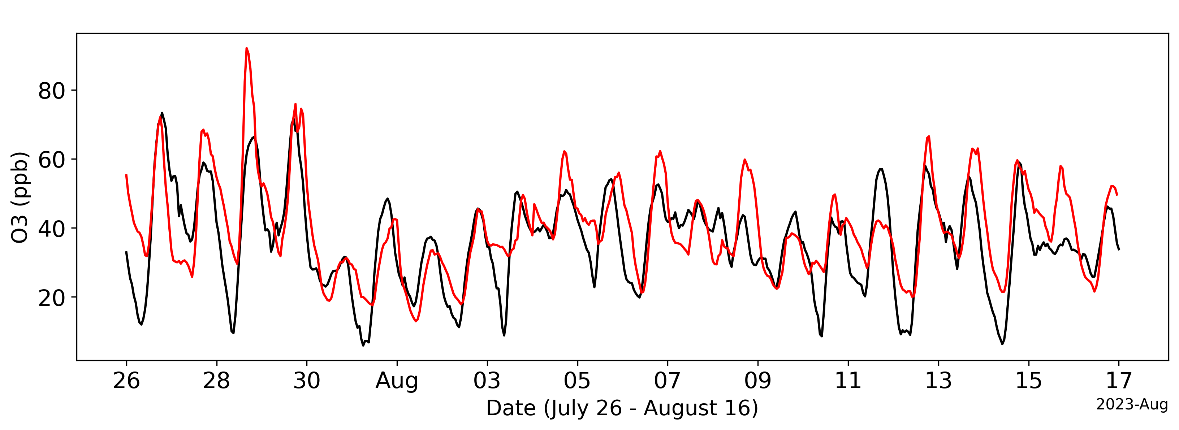
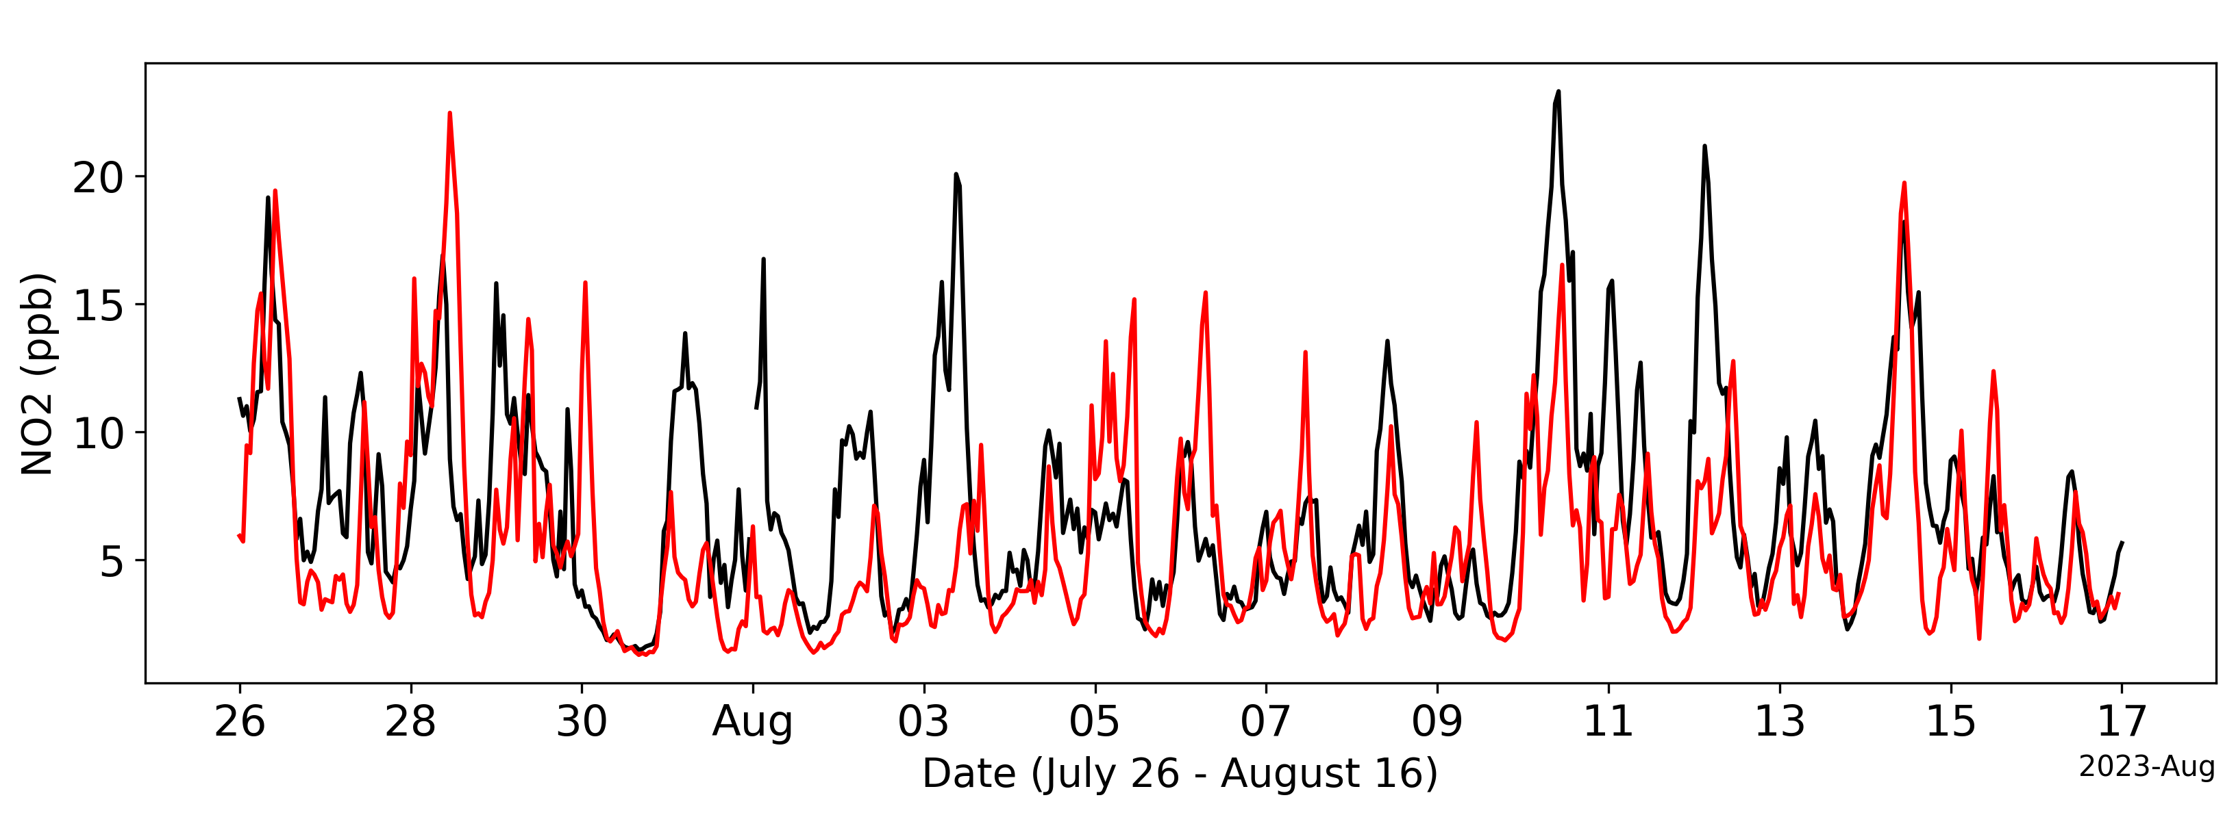
Evaluating model performance
Surface model vs. observations: O₃ & NO₂
O₃: higher biases overnight & daytime peaks
  R = 0.74, MB = 4.4 ppb, NMB = 12.5%
NO₂ : underestimated peaks
  R = 0.56, MB = -1.4 ppb, NMB = -19.1%
Subregions:
  Urban region: best performance (higher correlation, lowest biases)
  LI & CT coastal: moderate - low correlation, higher biases (especially CT coastal)
Wind speed:
  R = 0.68, MB = 0.7 m/s, NMB = 27.0%
Wind direction:
  R = 0.73, MB = -5.2°, NMB = 4.7 %
Subregions:
  Urban region: weaker correlation, higher RMSE due to calmer/more variable winds
  LI & CT coastal: slightly better performance

Slide 4
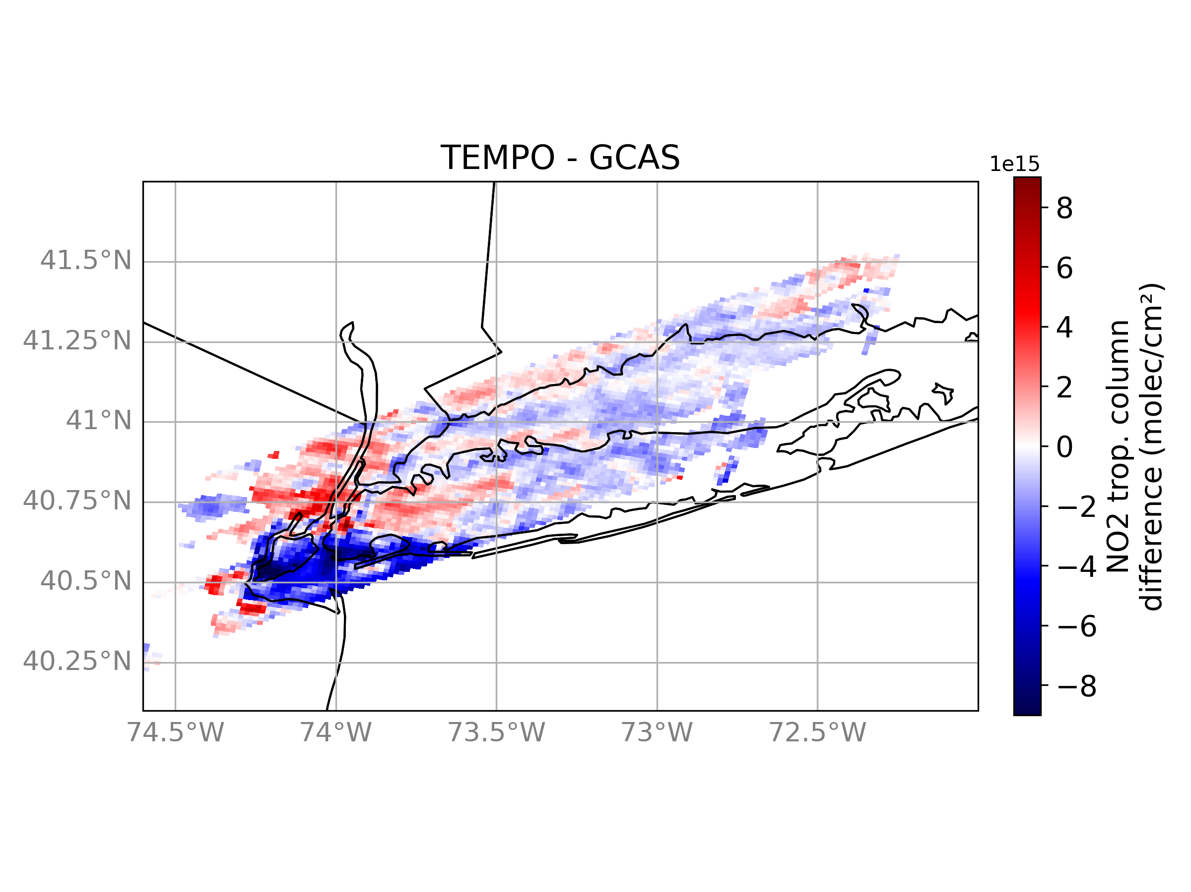
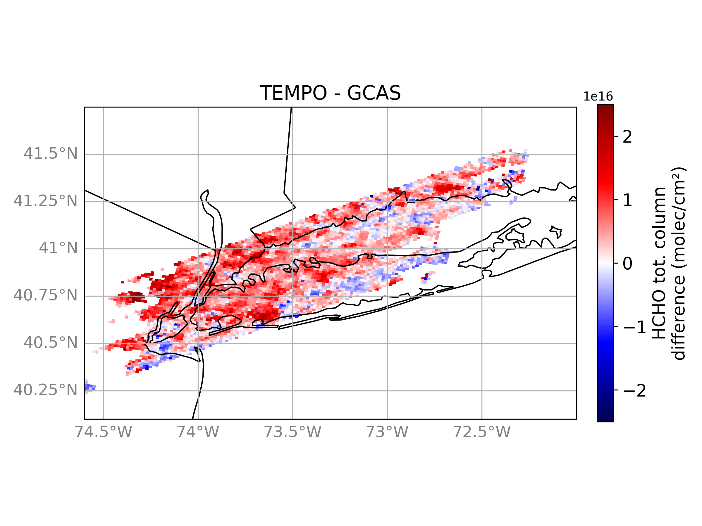
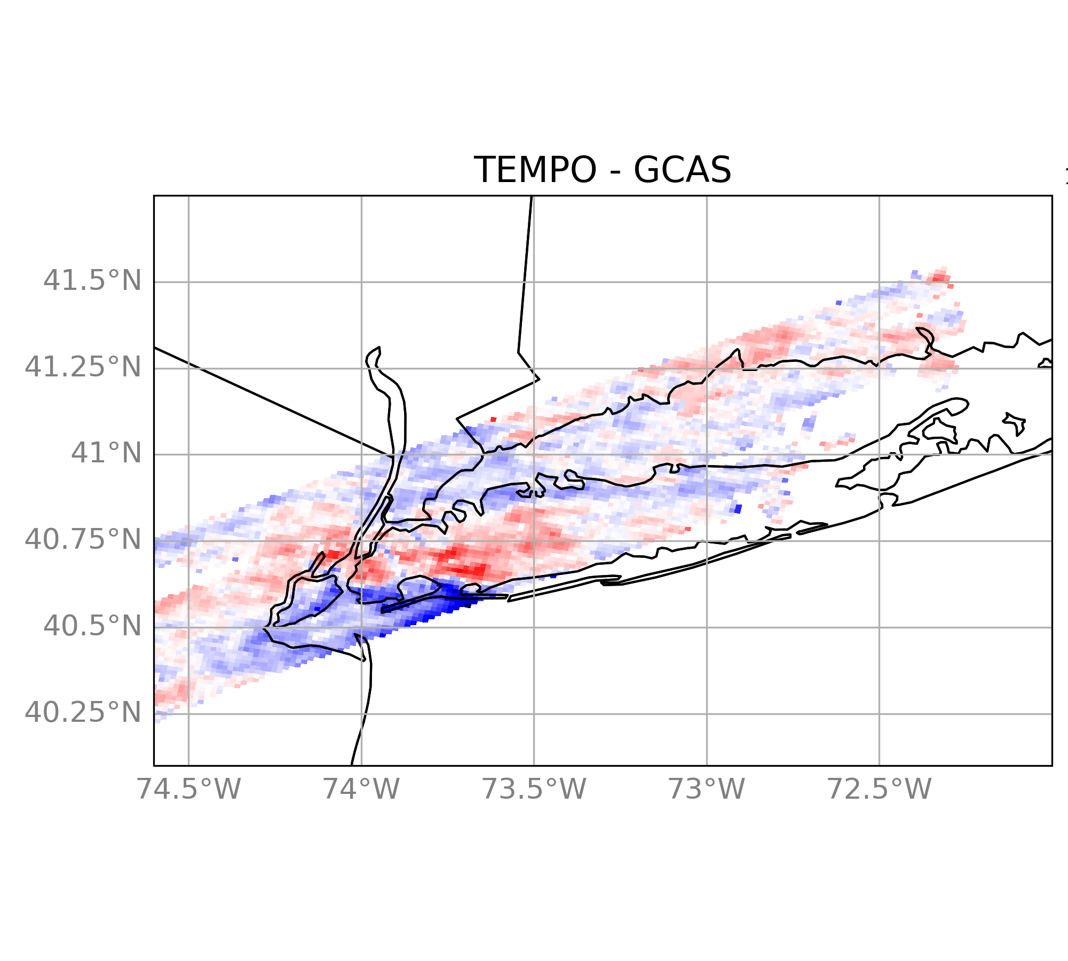
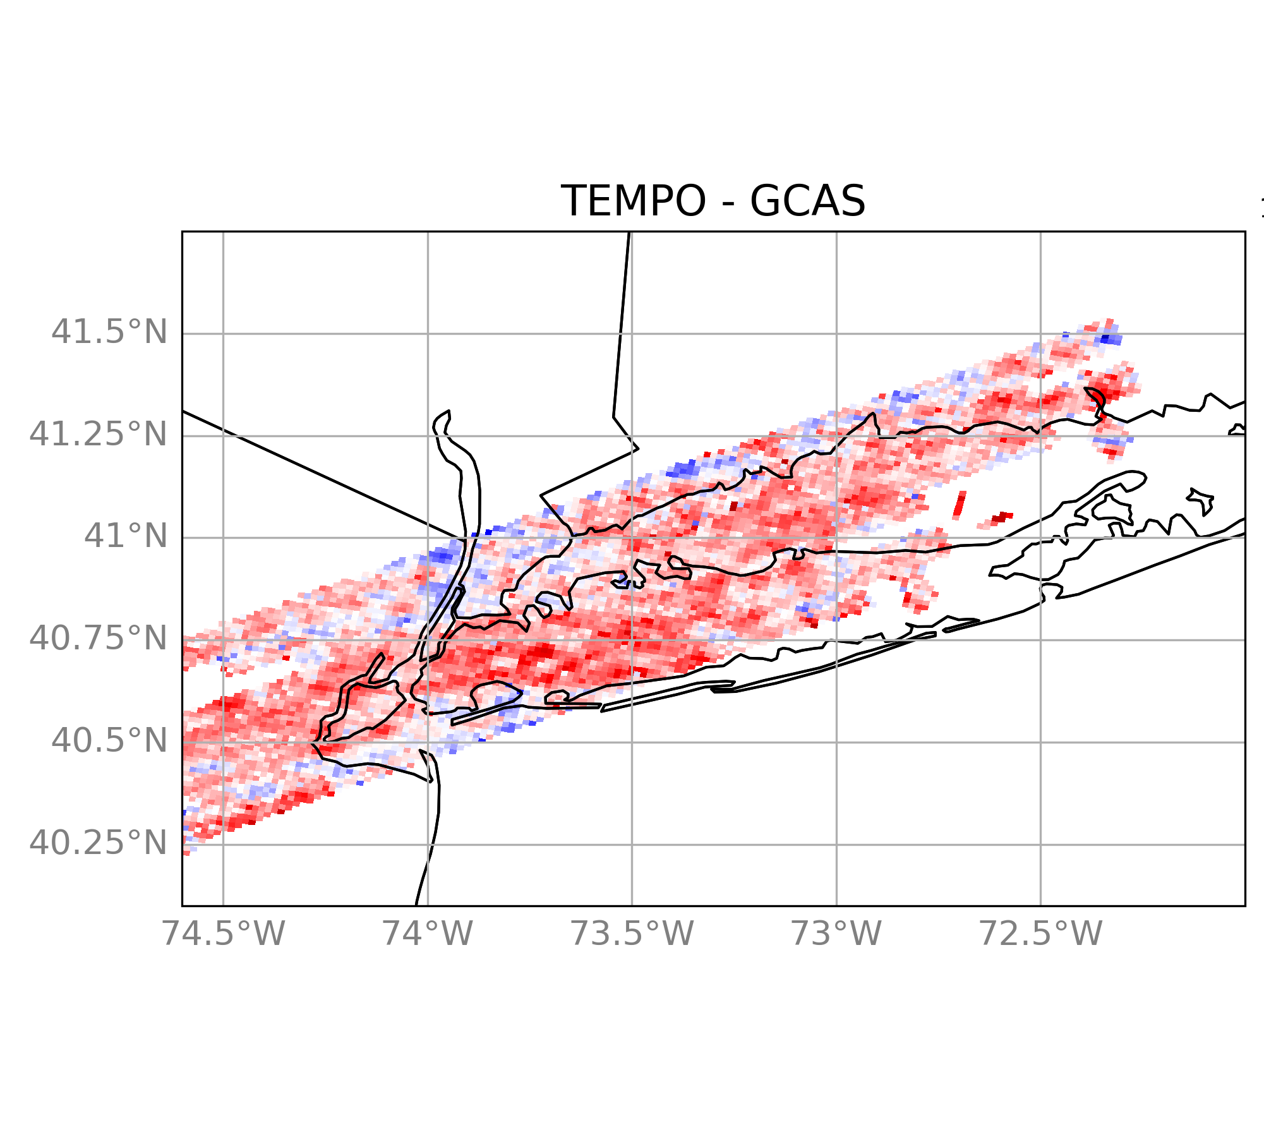
Evaluating TEMPO with GCAS data
08/05
08/05
NO₂
  TEMPO generally agrees with GCAS
  Largest underestimation over Staten Island & overestimation over Manhattan & west LI (Queens/Brooklyn)
    Could be due to retrieval over water/land, reflectivity assumptions
HCHO:
  TEMPO shows poor spatial correlation & high bias due to background noise sensitivity
R: 0.81, NMB:-14.5%
R: 0.10, NMB: 46.1%
08/09
08/09
R: 0.80, NMB:-3.6%
R: 0.03, NMB: 38.4%

Slide 5
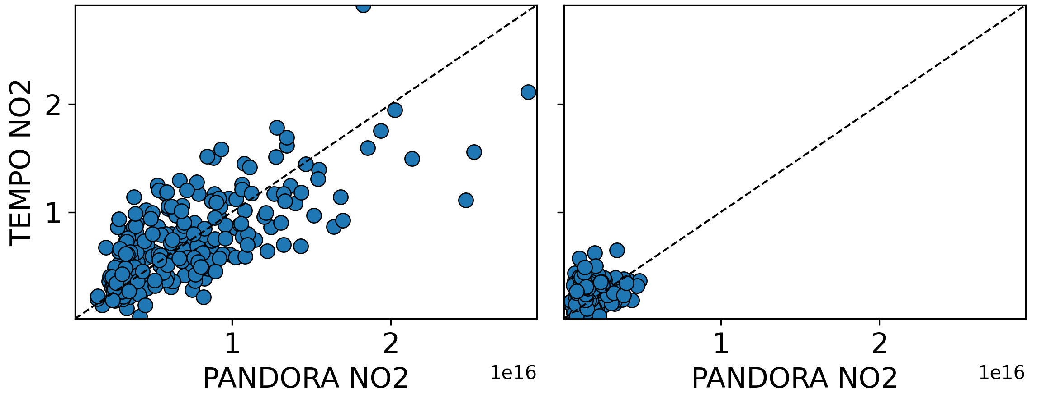
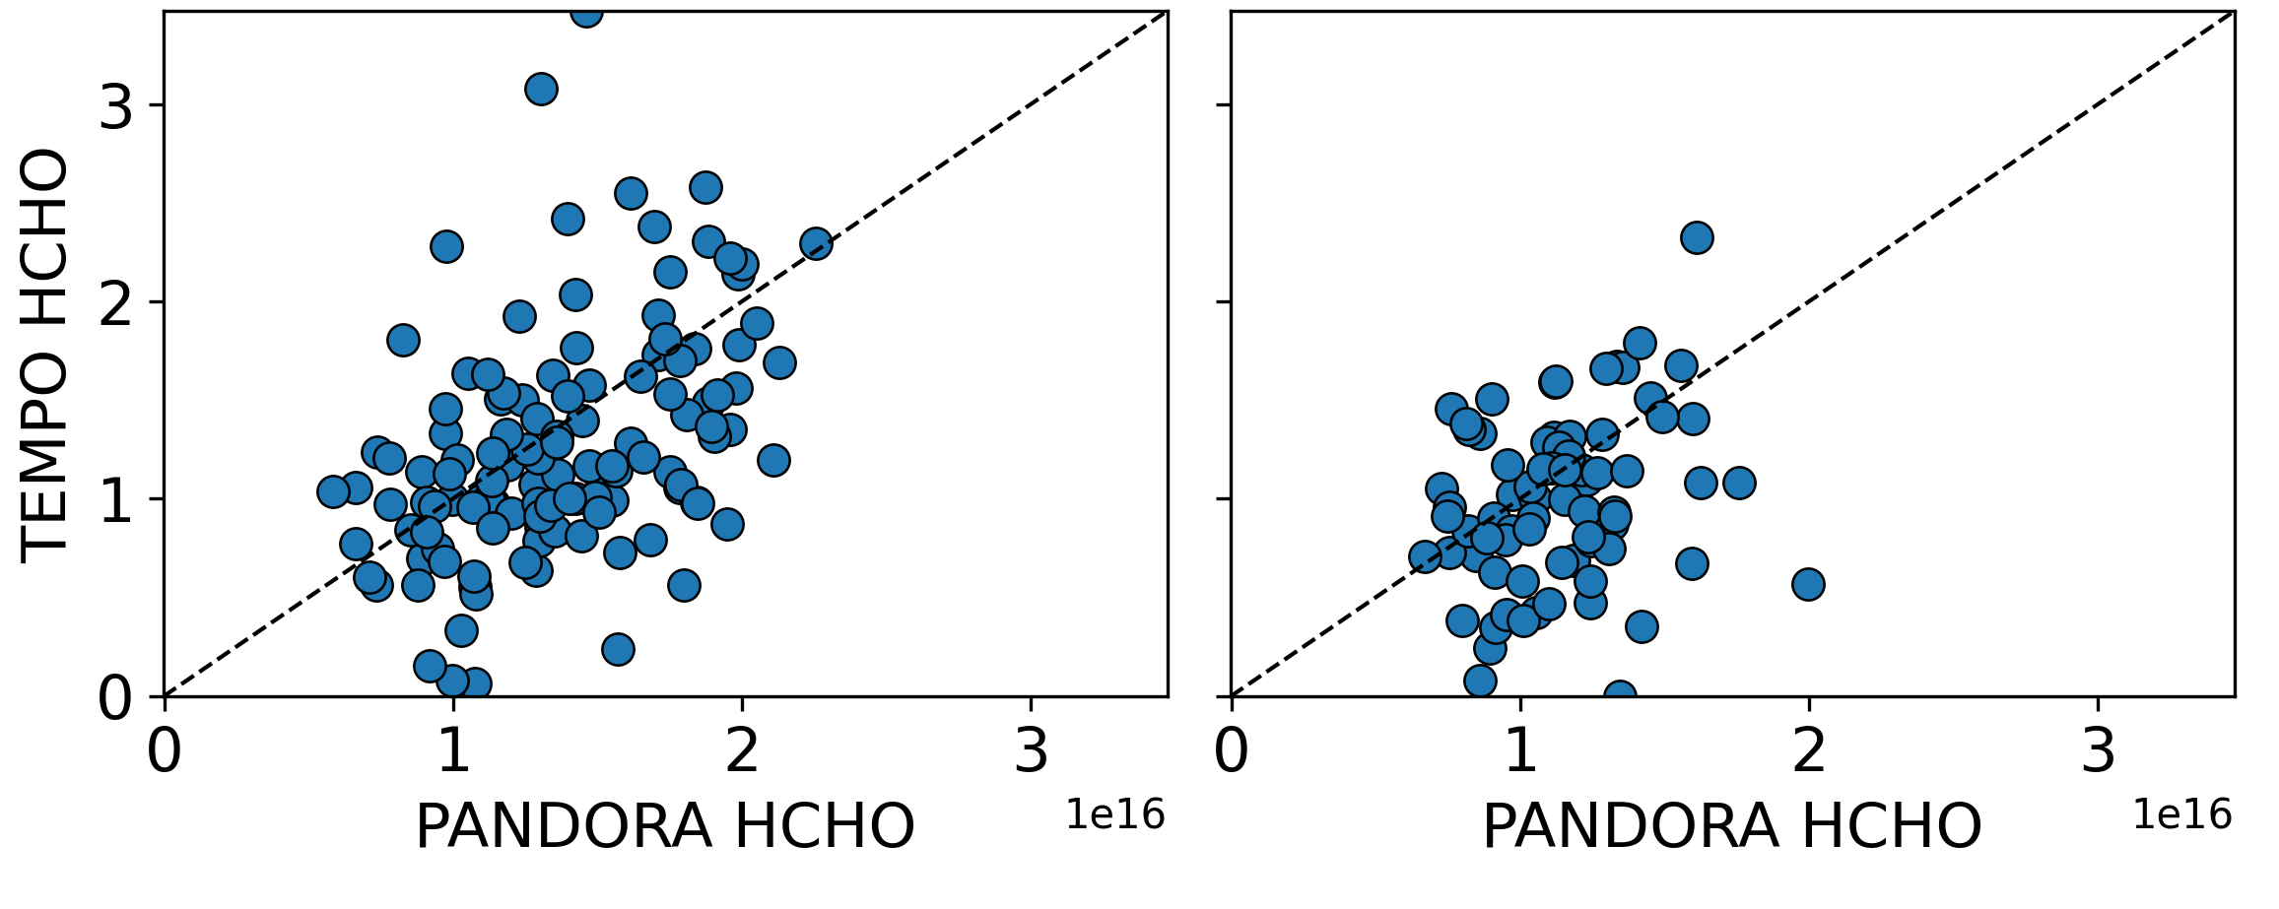
Evaluating TEMPO at Pandora sites
Urban Sites
Coastal Sites
Urban Sites
  Good agreement/moderate - strong correlation overall
  NO₂ by sites:
    All positive biases except New Brunswick & Bayonne (transitional urban/rural sites)
    TEMPO can resolve urban fringes to some extent but overestimates how steeply NO₂ decreases between areas
    TEMPO retrieval may be overestimating background NO₂
NO₂
R = 0.71
NMB = 2.9%
RMSE = 3.3e+15 (molec/cm²)
R =. 0.17
NMB = 43.2%
RMSE = 1.5e+15 (molec/cm²)
Coastal Sites
  Weaker agreement/correlation overall
  NO₂ by sites:
    Positive biases
    Lower/background NO₂ concentrations => lower signal
    Poorer performances due to retrieval accuracy at land-water interfaces
  HCHO by sites:
    weaker correlations & negative biases
    more missing data
    correlations vary
HCHO
R = 0.43
NMB = -8.0%
RMSE = 5.5e+15 (molec/cm²)
R = 0.25
NMB = -12.6%
RMSE = 4.7e+15 (molec/cm²)
Retrieval challenges:
  Vertical sensitivity
  A priori vertical profiles
  Clouds, aerosols, & surface reflectance

Slide 6
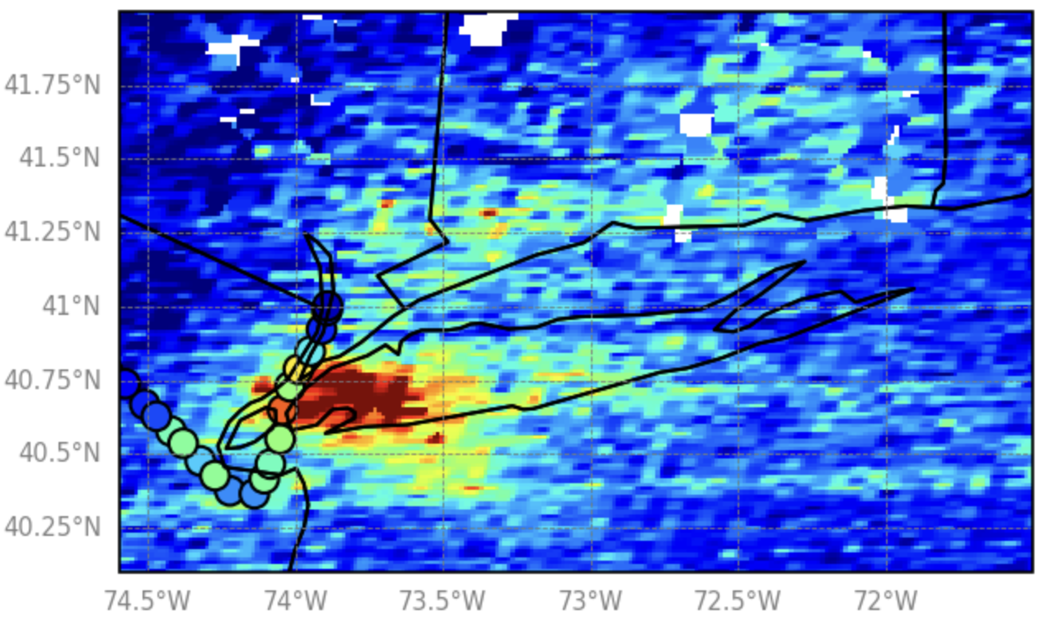
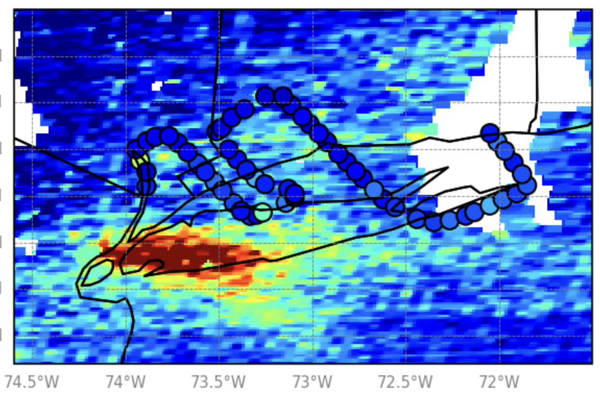
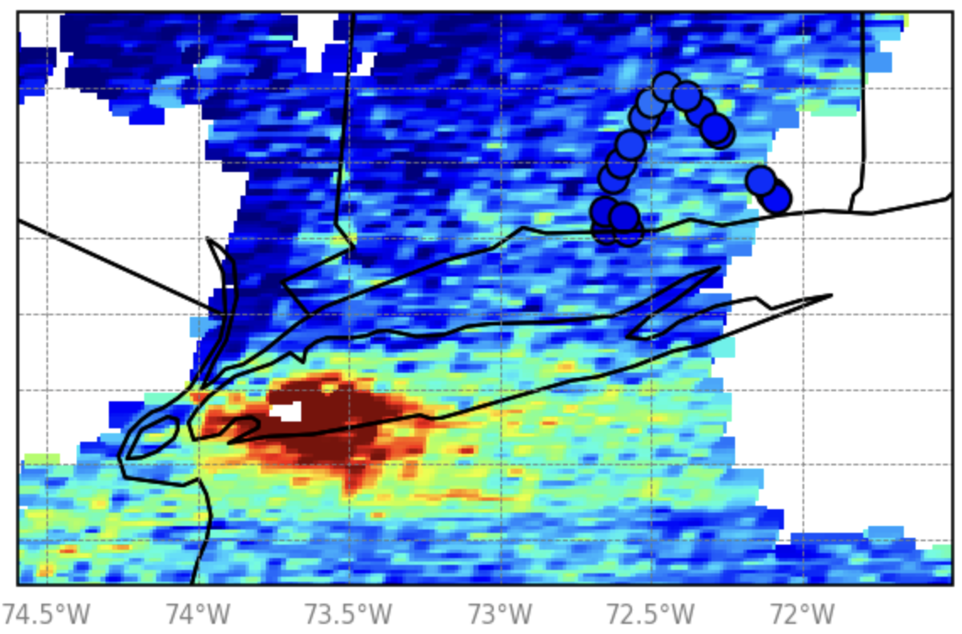
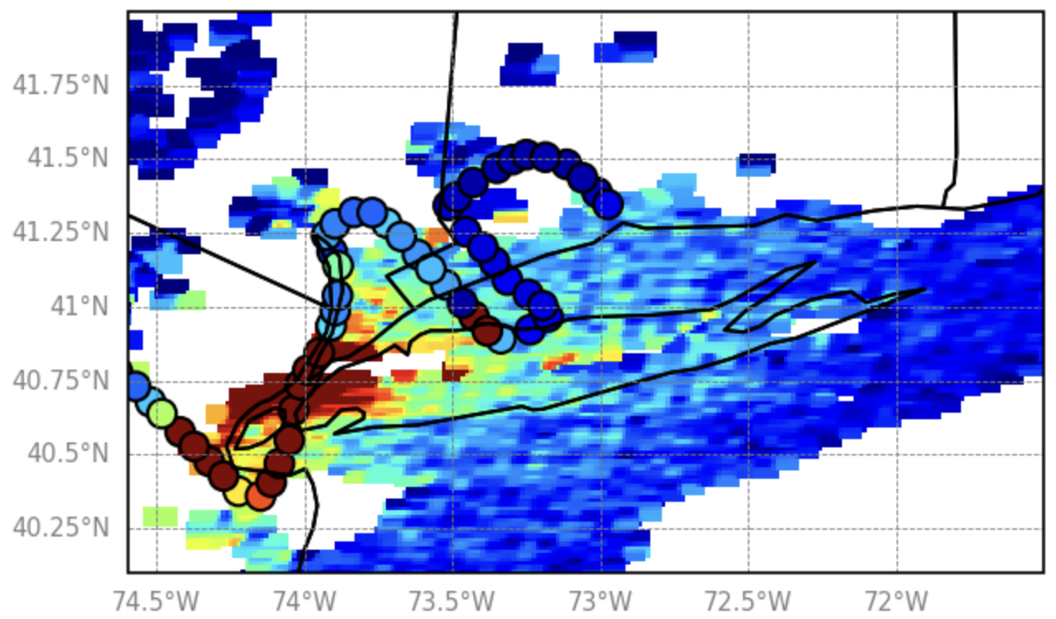
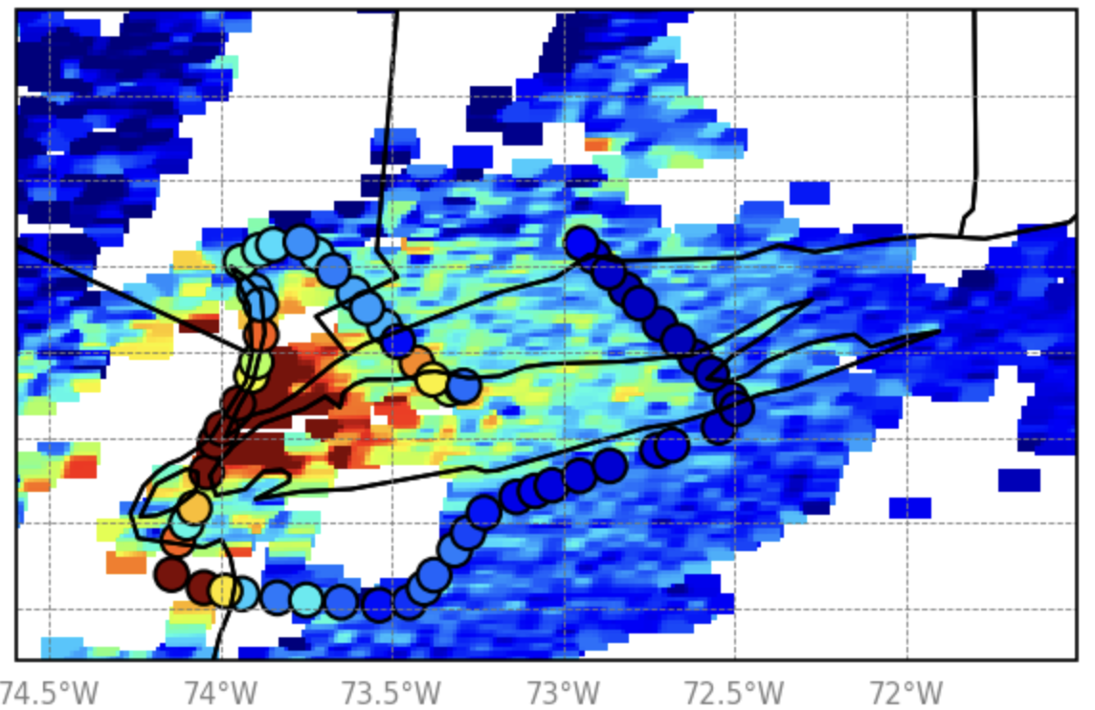
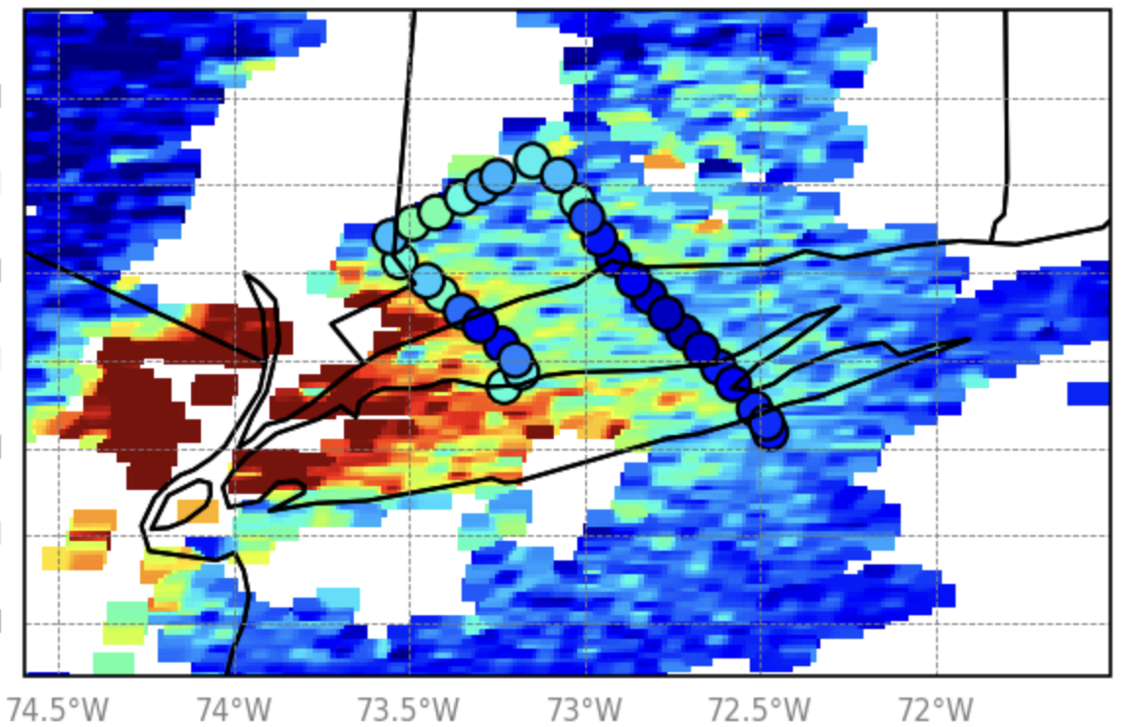
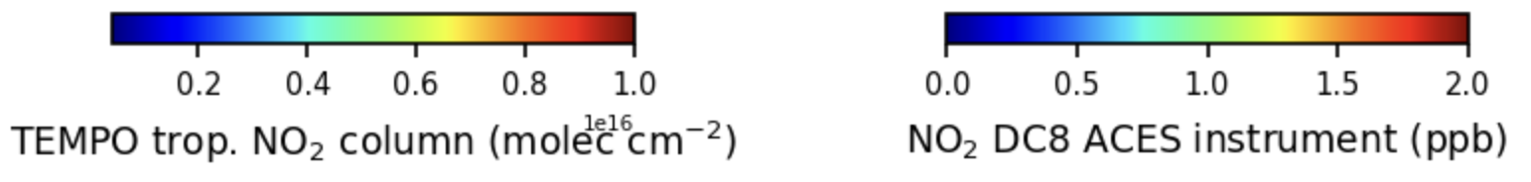
DC8 Instrument Flight Path Overlayed on TEMPO retrieval
08/09
19:00
20:00
21:00
08/16
19:00
20:00
21:00
General agreement, especially over urban NYC, further evidence TEMPO can capture urban/rural or coastal gradients
Some discrepancies (e.g., near Flax Pond on Aug 16) highlight how rapid plume evolution & vertical distribution differences can affect alignment between column & in situ measurements

Slide 7
Integrated multi-platform analysis of pollution events during STAQS
Use integrated approach from multiple observational platforms to analyze O₃ dynamics & chemical characteristics during STAQS:
  TOLNet lidars stationed along the LIS
  Doppler wind lidars co-located at select sites
  Satellite, airborne, & ground-based column measurements of NO₂ & HCHO from TEMPO & GCAS
  Use WRF-Chem outputs to bridge gaps between measurements
Focus on unique cases during high, moderate, & low pollution conditions:
    July 26 & 28
    August 5, 9, 11, & 12

Slide 8
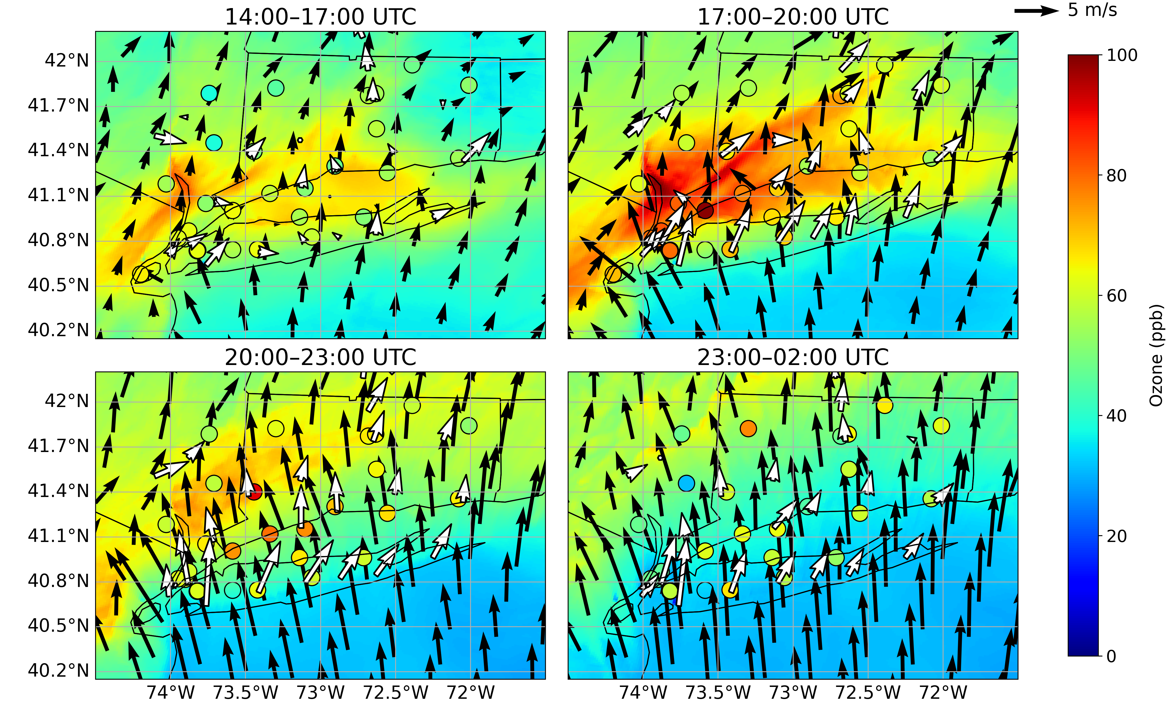
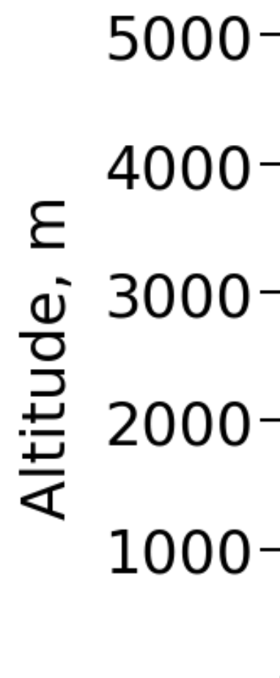
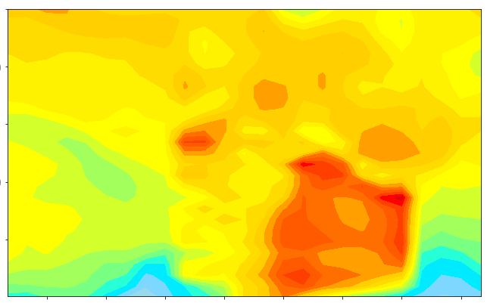
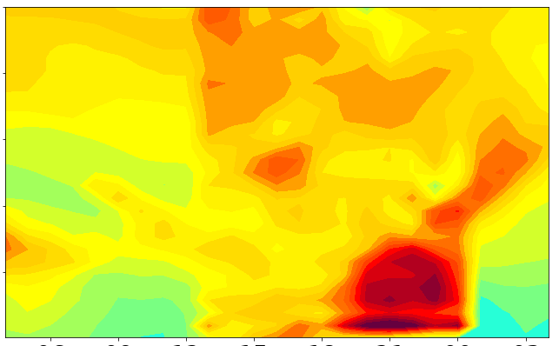
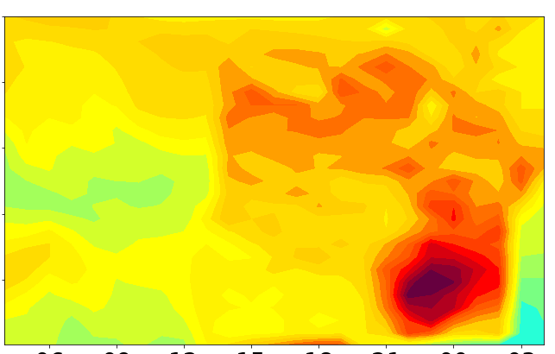
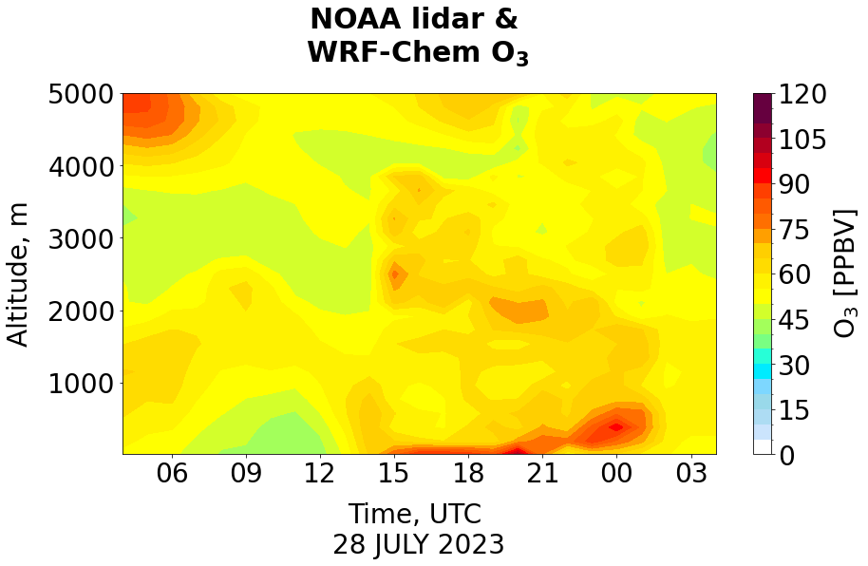
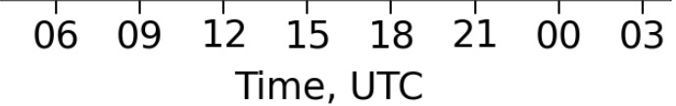
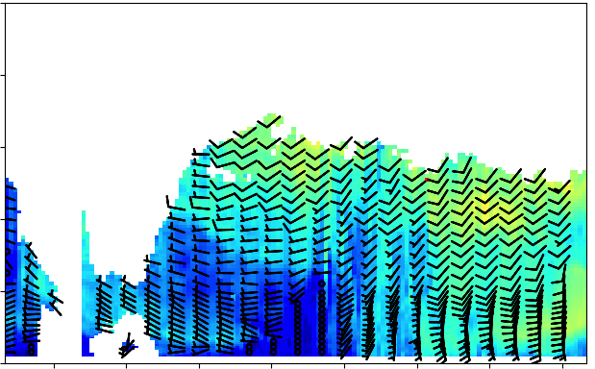
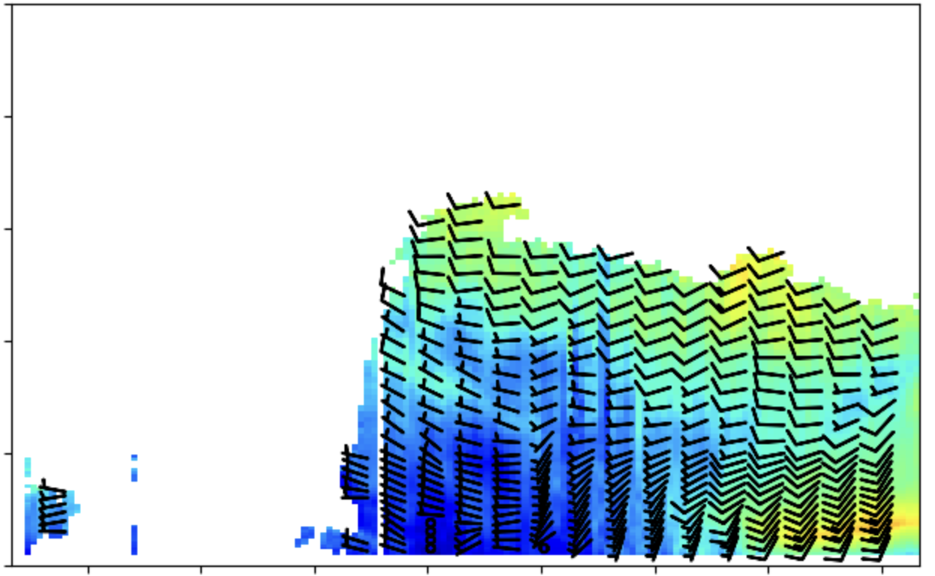
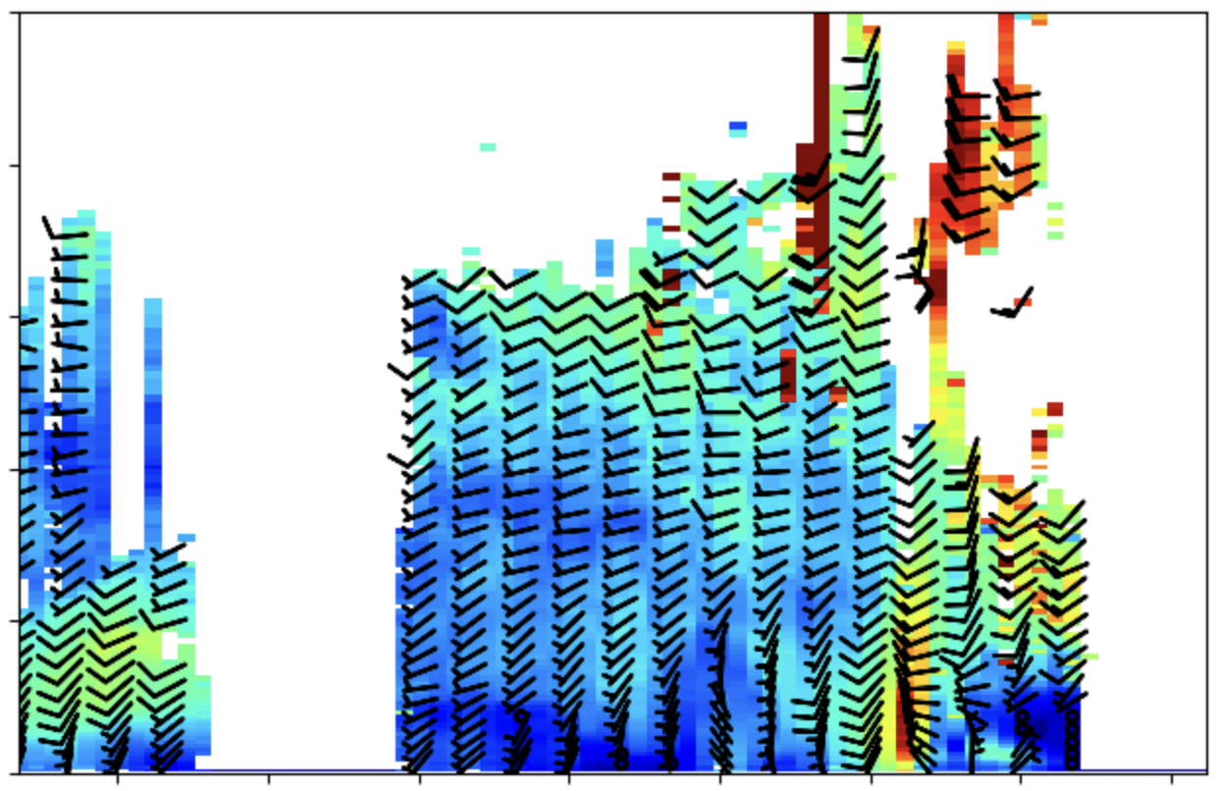
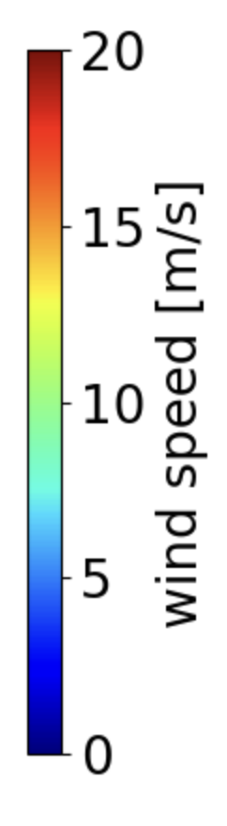
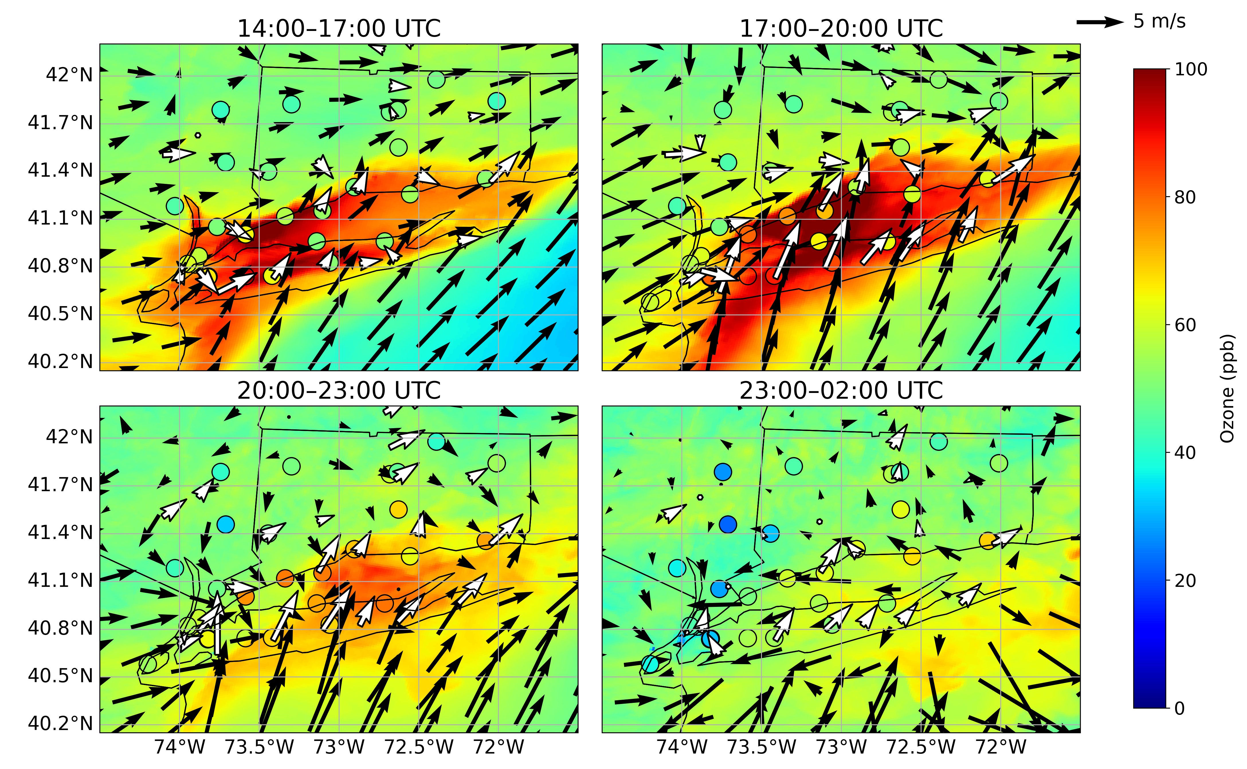
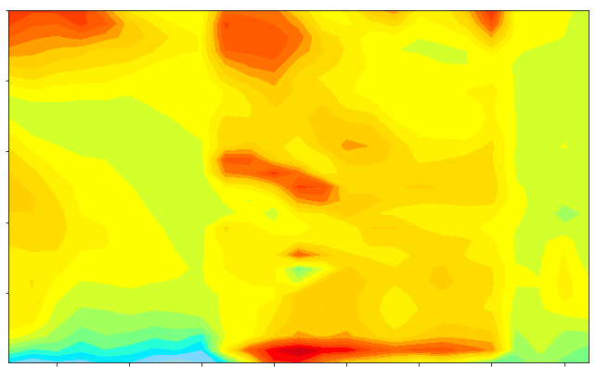
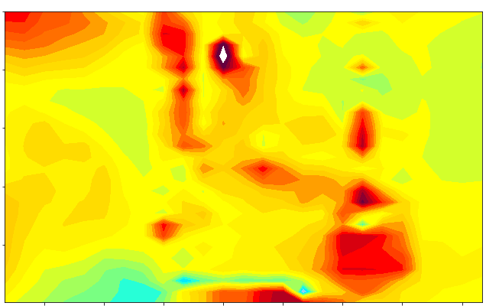
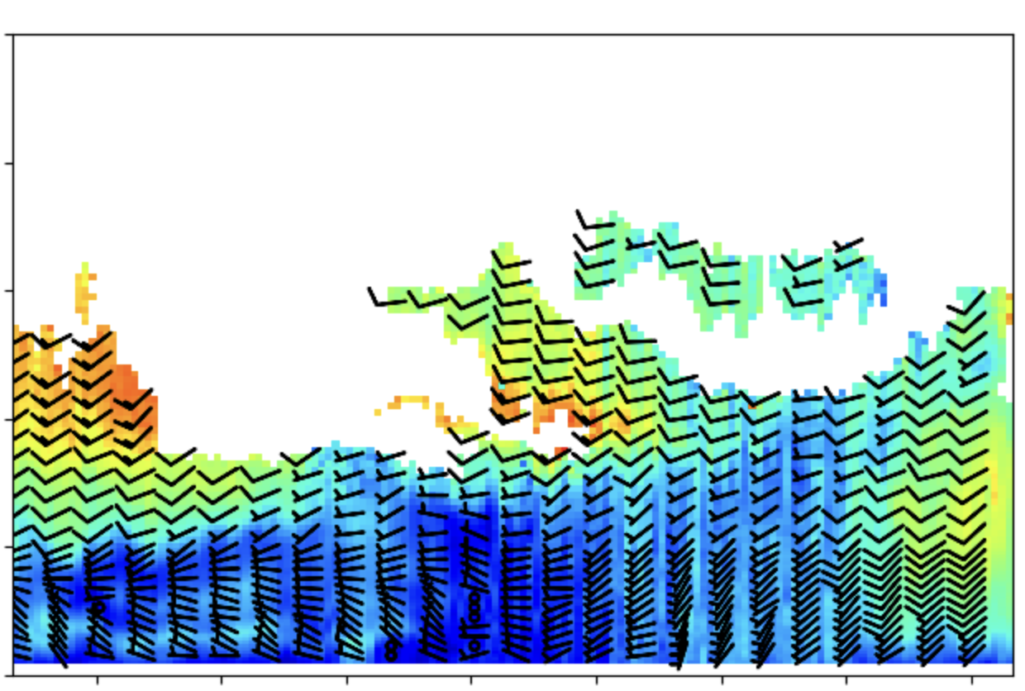
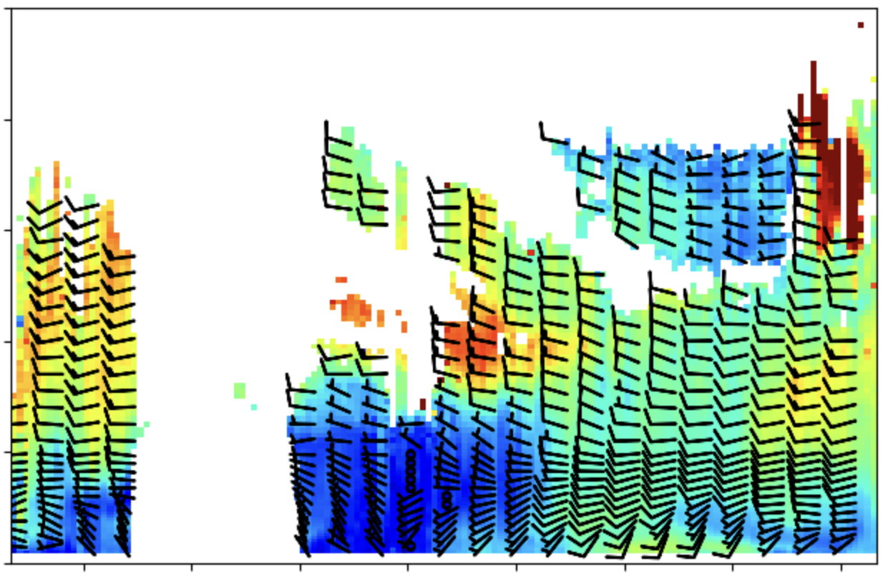
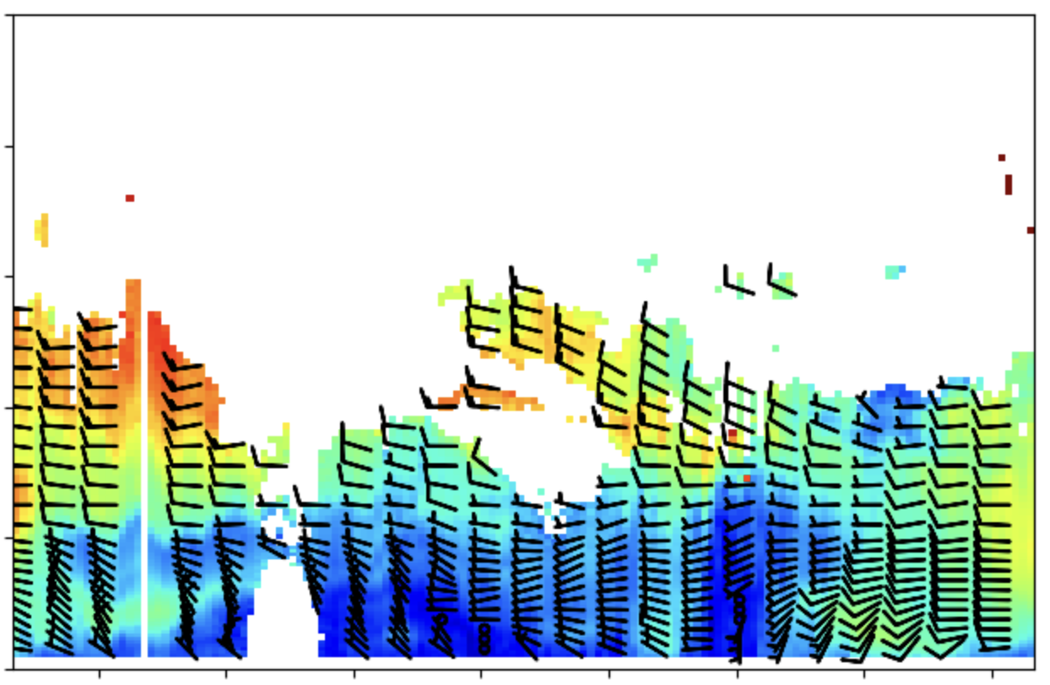
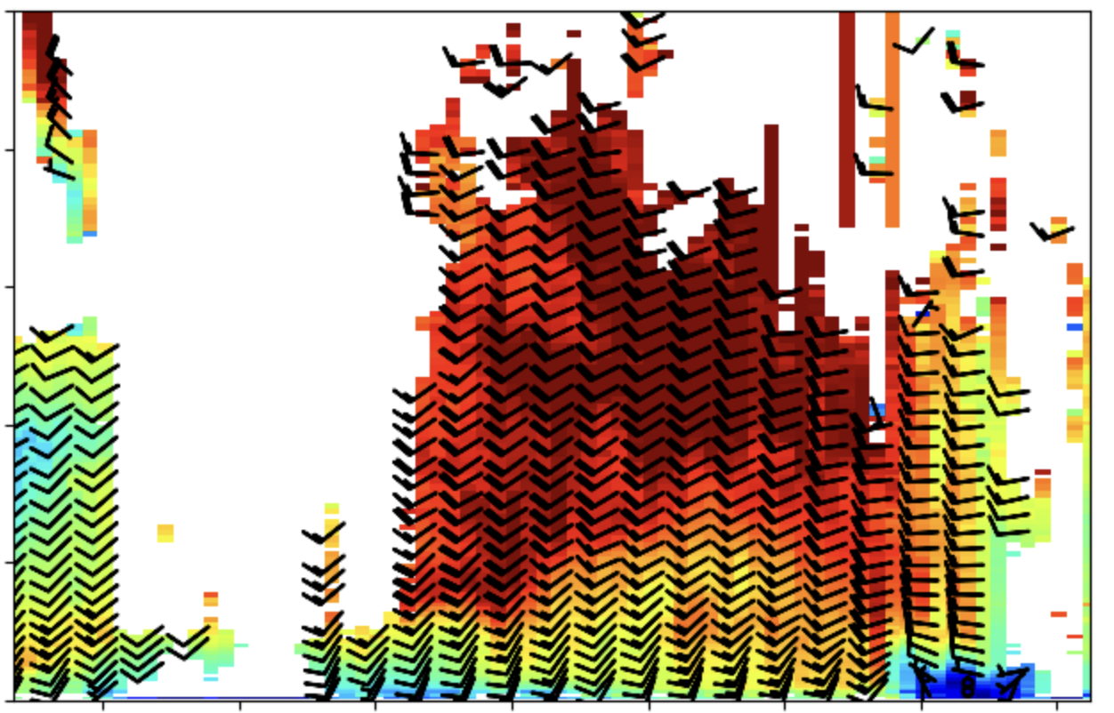
Defining O₃ Dynamics: high pollution days
07/26: surface O₃ & winds
07/26: lidars
NYTOLS lidar
TROPOZ lidar
TOPAZ lidar
Max O₃ (104 ppb) at 19 UTC on CT coastline
Land/sea breeze circulation: W → S shift
Lower early urban O₃ (< 65 ppb)
Max O₃ (94 ppb) at 17 UTC along southern LI coast
Land/sea breeze circulation: NW/W → SW/S shift
BRONX
STONY BROOK
YALE COASTAL
07/28: surface O₃ & winds
07/28: lidars
NYTOLS lidar
TROPOZ lidar
TOPAZ lidar
BRONX
WANTAGH
STONY BROOK
YALE COASTAL

Slide 9
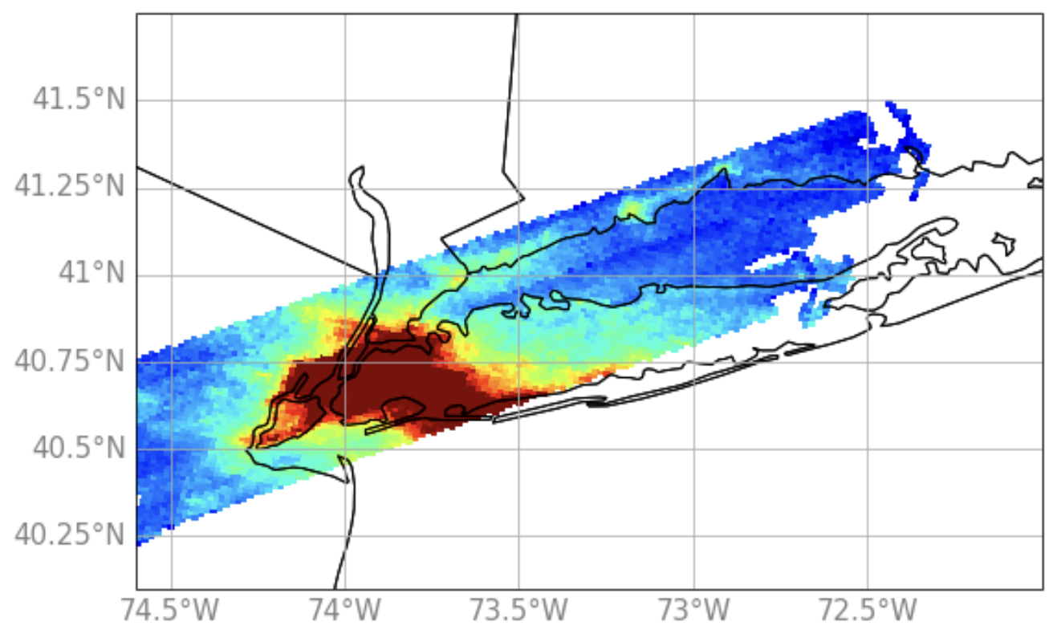
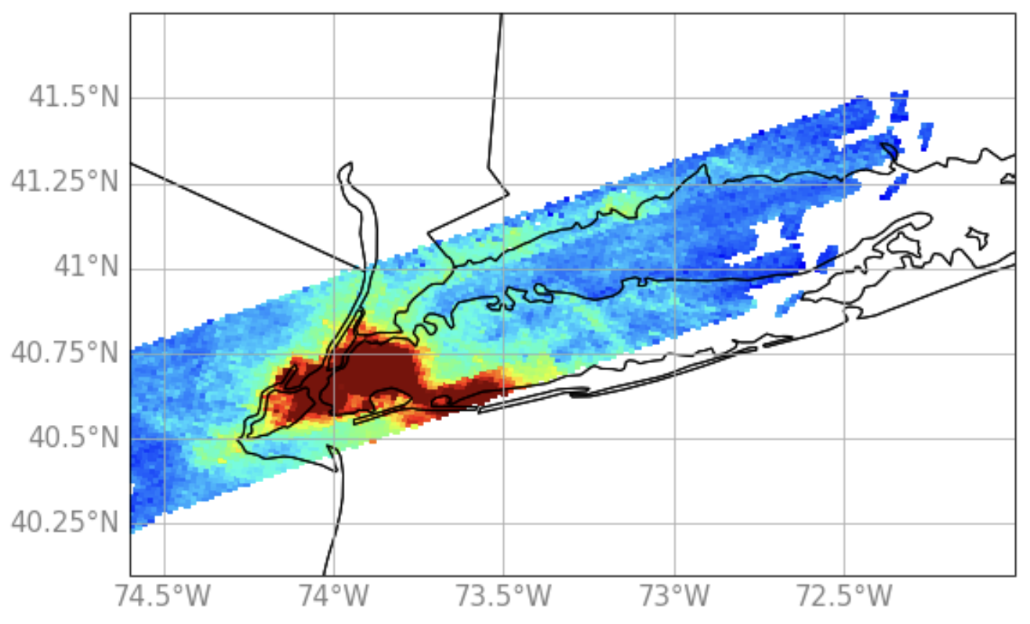
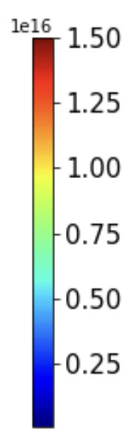

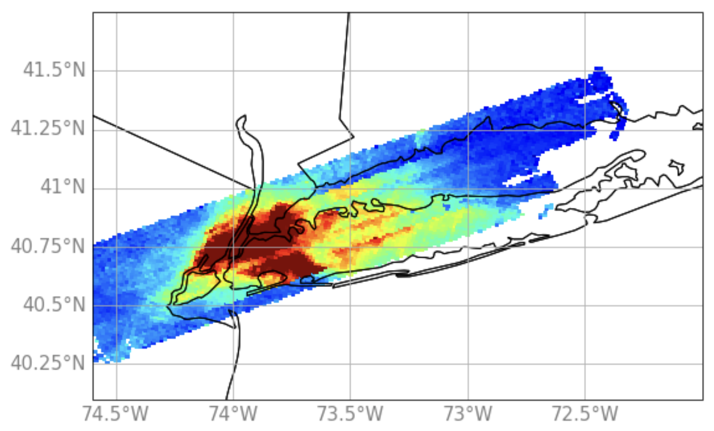
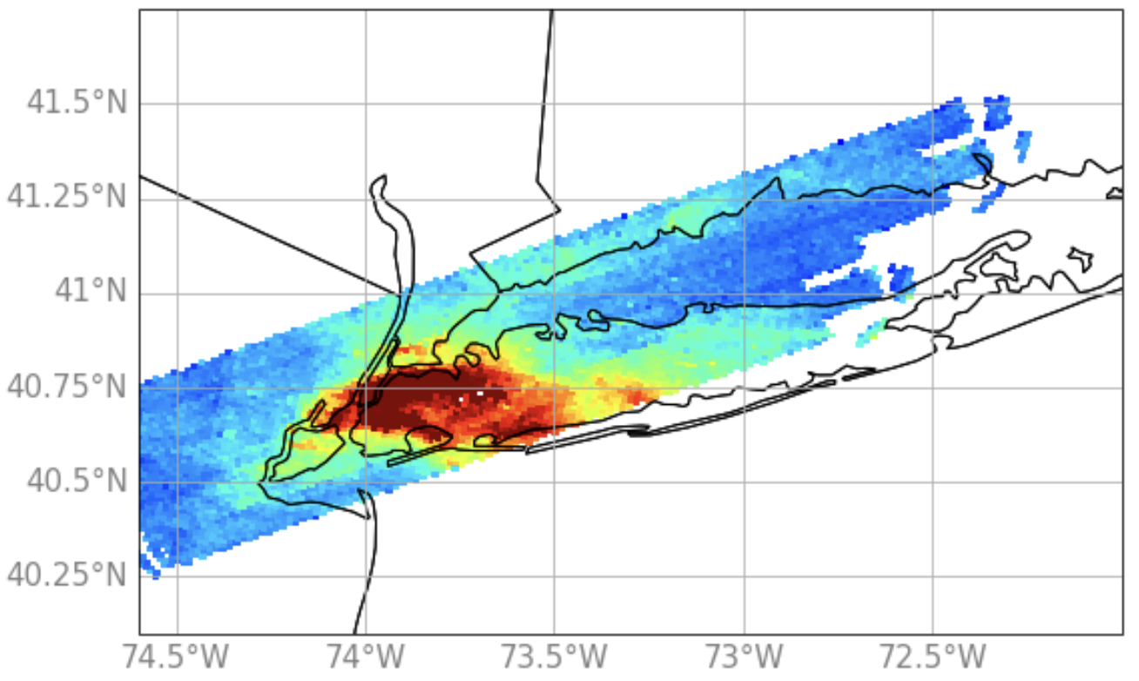
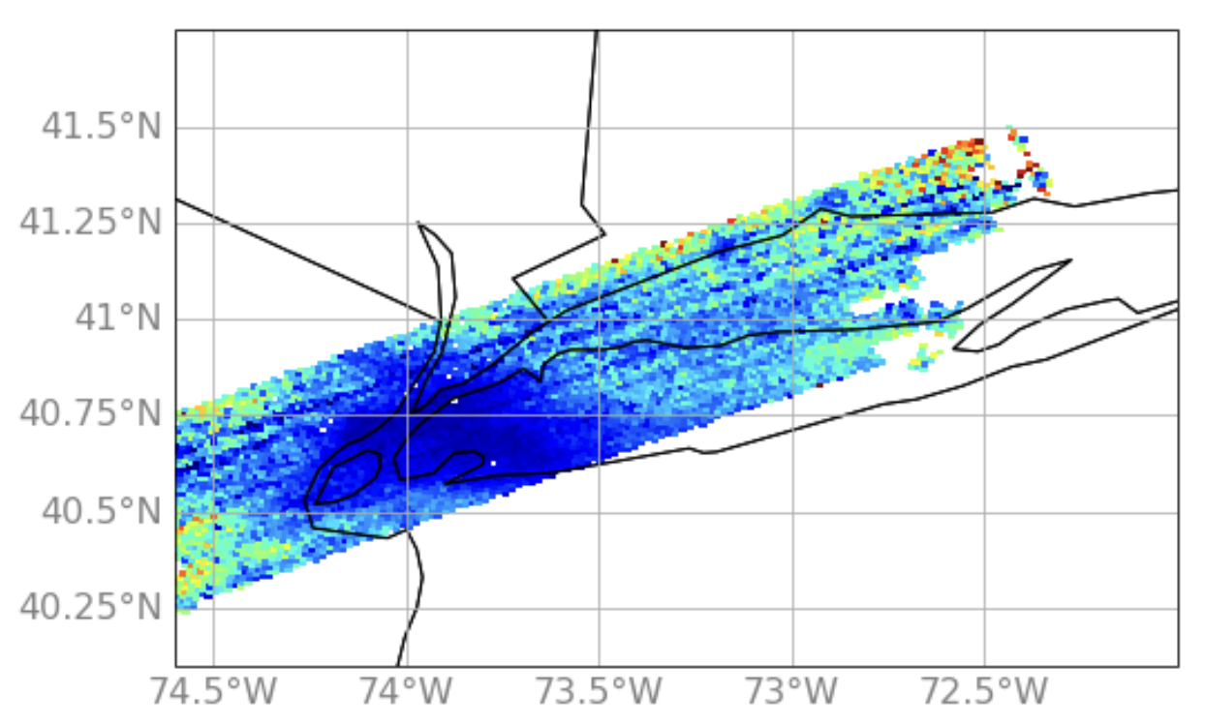
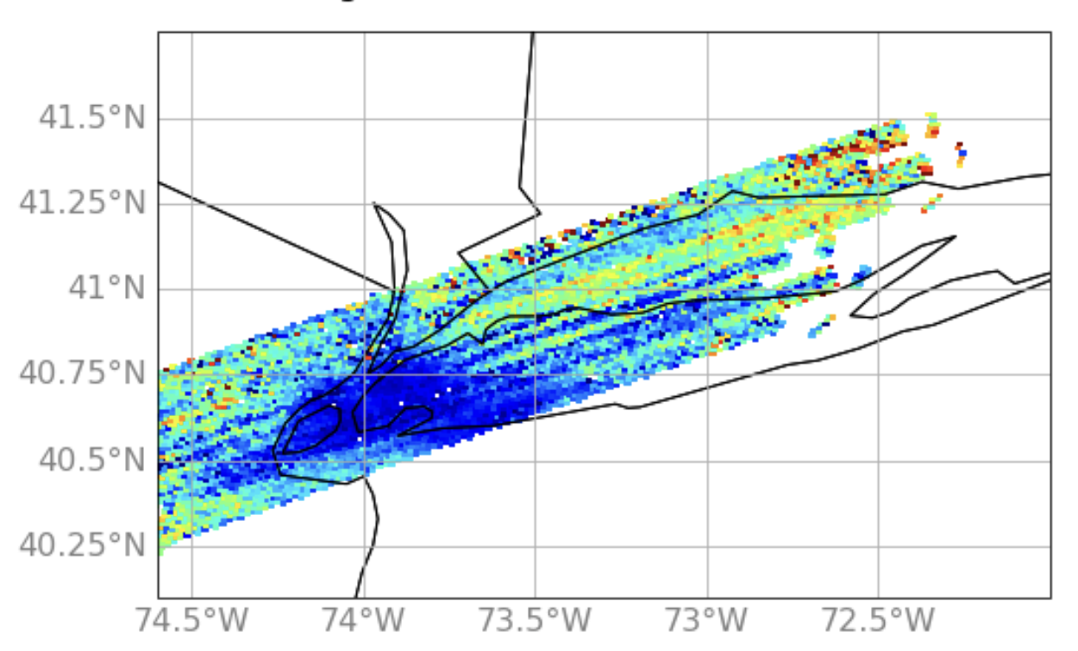
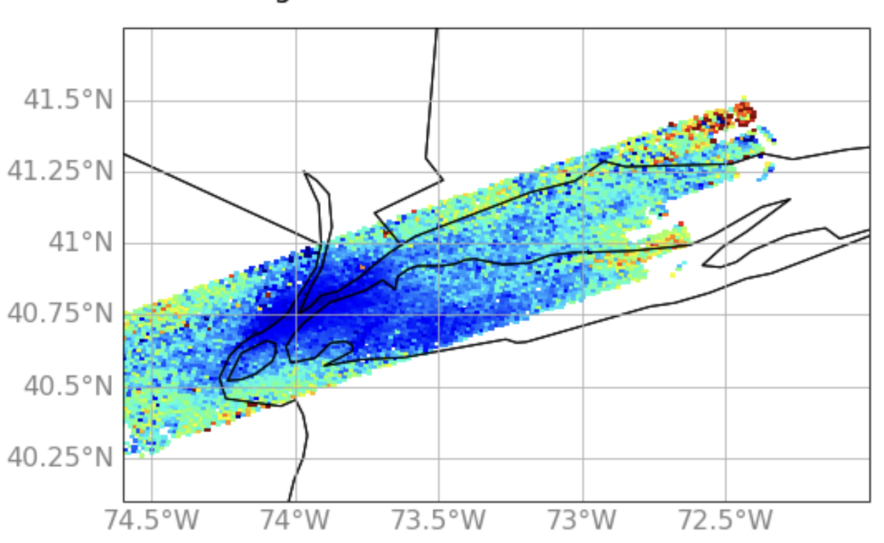
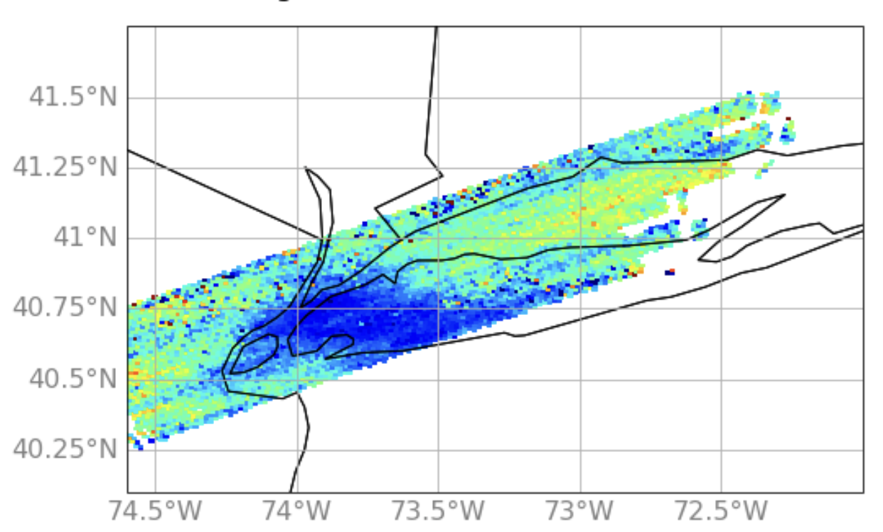
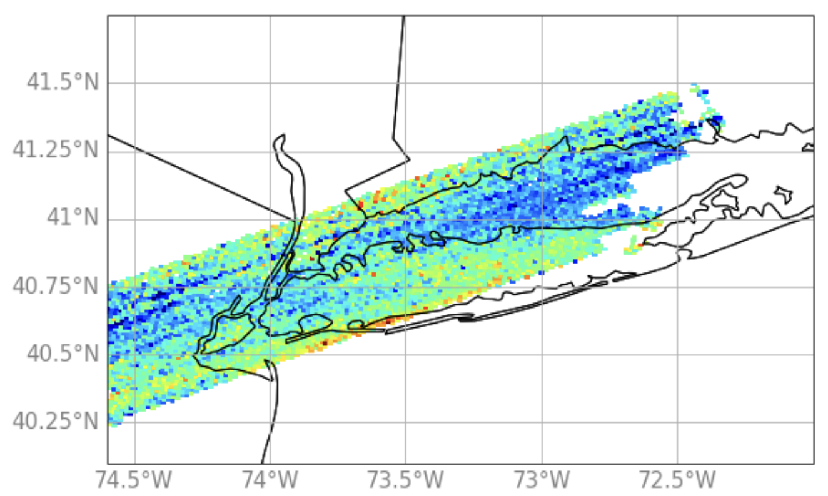
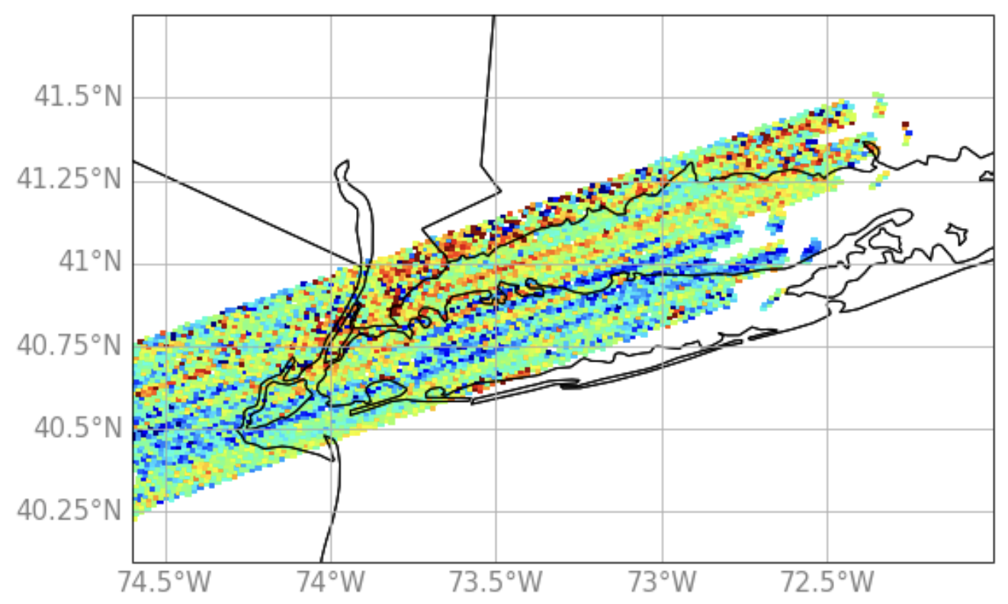
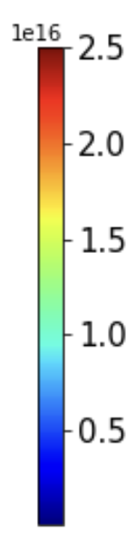

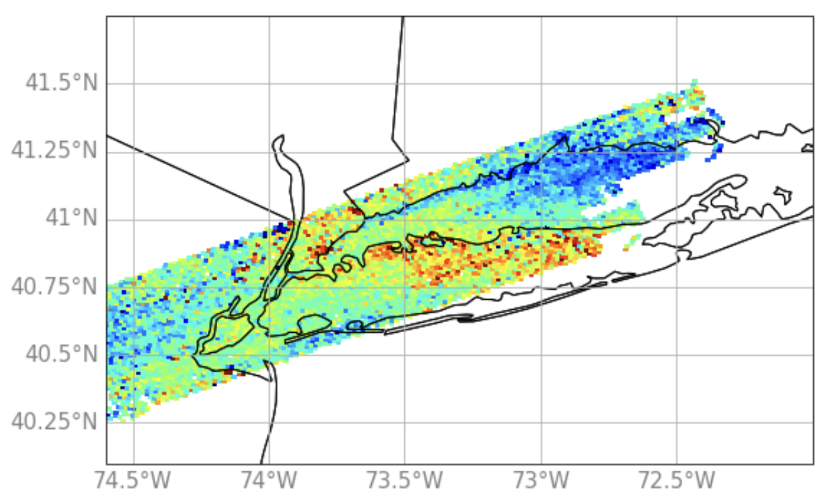
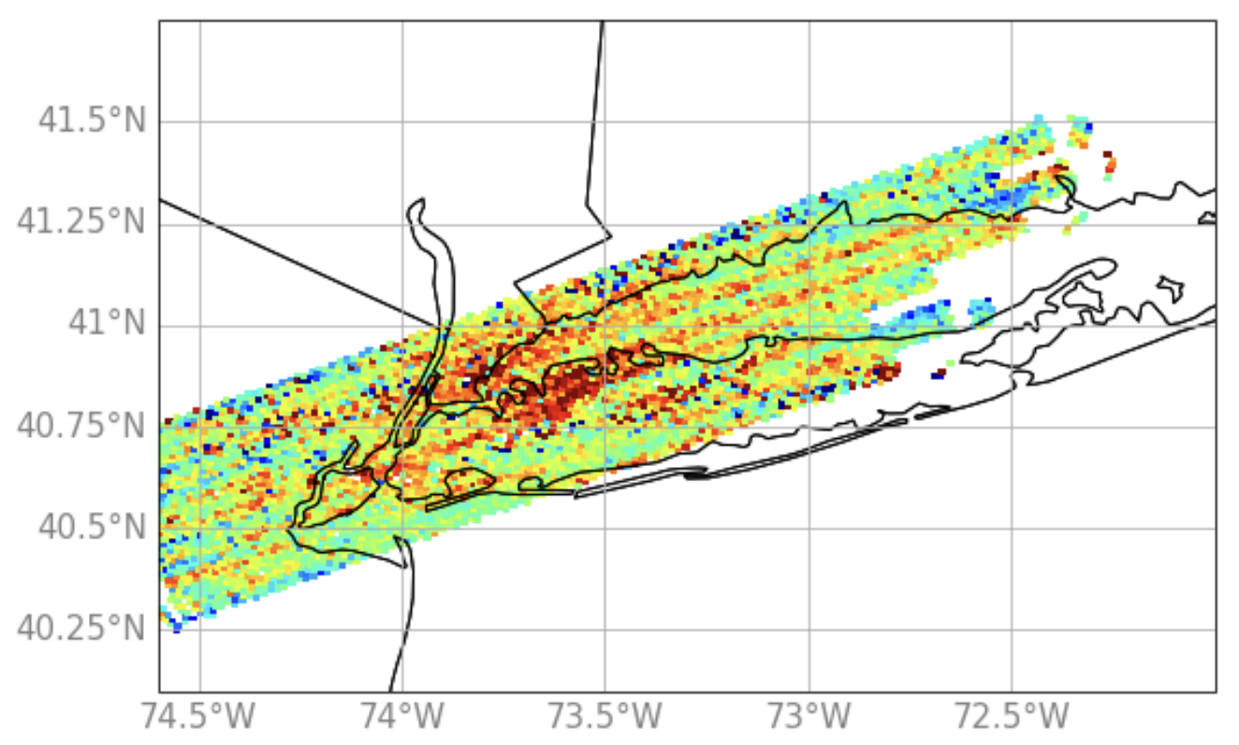
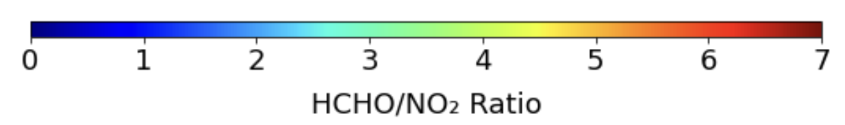
Spatiotemporal ozone precursor characterization
GCAS
NO₂ VCDs
07/26
07/28
14:00 – 17:00 UTC
GCAS HCHO / NO₂
07/26
07/28
17:00 – 22:00 UTC
14:00 – 17:00 UTC
GCAS
HCHO VCDs
07/26
07/28
14:00 – 17:00 UTC
17:00 – 20:00 UTC
17:00 – 20:00 UTC

Slide 10















Defining O₃ Dynamics: moderate & low pollution days
08/05: surface O₃ & winds
08/05: lidars
NYTOLS lidar
TROPOZ lidar
TOPAZ lidar
Max daily observed O₃ reaching 72/76 ppb at 18:00/19:00 UTC on Staten Island
STATEN ISLAND
BRONX
YALE COASTAL
08/09: surface O₃ & winds
08/09: lidars
NYTOLS lidar
TROPOZ lidar
LMOL lidar
TOPAZ lidar
BRONX
STONY BROOK
YALE COASTAL
Max daily observed O₃ reached only 49 ppb

Slide 11
























Spatiotemporal ozone precursor characterization
GCAS & TEMPO HCHO / NO₂
GCAS & TEMPO
NO₂ VCDs
GCAS & TEMPO
HCHO VCDs
08/05
08/09
08/05
08/09
08/05
08/09
14:00 – 17:00 UTC
14:00 – 17:00 UTC
14:00 – 17:00 UTC
GCAS
GCAS
GCAS
17:00 – 20:00 UTC
17:00 – 22:00 UTC
17:00 – 20:00 UTC
14:00 – 17:00 UTC
14:00 – 17:00 UTC
14:00 – 17:00 UTC
TEMPO
TEMPO
TEMPO
17:00 – 22:00 UTC
17:00 – 20:00 UTC
17:00 – 20:00 UTC

Slide 12












Defining O₃ Dynamics: moderate pollution days
08/11: surface O₃ & winds
08/11: lidars
NYTOLS lidar
TROPOZ lidar
LMOL lidar
TOPAZ lidar
STONY BROOK
YALE COASTAL
Max daily observed O₃ reaching 77 ppb in afternoon
> 70 ppb for 4 consecutive hours after along CT coastline
08/12: surface O₃ & winds
08/12: lidars
TROPOZ lidar
TOPAZ lidar
Max daily observed O₃ reaching 78/ 73 ppb at 18/19 UTC north of NYC
~ 69 ppb in Manhattan at 17 UTC
BRONX
SUFFERN

Slide 13












Spatiotemporal ozone precursor characterization
08/11
08/12
TEMPO HCHO / NO₂
14:00 – 17:00 UTC
TEMPO
NO₂ VCDs
08/11
08/12
14:00 – 17:00 UTC
17:00 – 22:00 UTC
08/11
08/12
17:00 – 20:00 UTC
TEMPO
HCHO VCDs
14:00 – 17:00 UTC
17:00 – 20:00 UTC

Slide 14
Conclusions & Future Work
STAQS campaign captured wide range of pollution events (high, moderate, low) driven by varying meteorological & chemical conditions across NYC/LIS region
Multi-platform approach (surface monitors, lidar profiles, model output, Pandora, GCAS, TEMPO) provided comprehensive understanding of O₃ dynamics
Intercomparisons between datasets filled temporal/spatial gaps & emphasized importance of resolving sub-grid variability in complex coastal and urban–rural interface regions
GCAS & TEMPO VCDs revealed key insights into NO₂ & HCHO influences on coastal O₃ formation
Although TEMPO not operational during highest O₃ days, GCAS showed value of high-resolution VCDs for diagnosing coastal pollution accumulations
When available, TEMPO effectively captured sharp spatial/temporal gradients in NO₂ & HCHO, supporting its value for forecasting and air quality mitigation planning
Future work:
  incorporate TEMPO O₃ products (0 – 2km), assess performance at urban–rural & land–water interfaces
  evaluate effects of a priori profiles
  further investigation impact of land cover, land use maps, urban heating as drivers of BL evolution, sea breeze development, & O₃ formation in modeling (WRF)
contact: claudia.m.bernier@nasa.gov

Slide 15
Extra slides/info

Slide 16
Evaluating model performance
Table S2. Mean surface statistics model vs. observations
a) full domain
 | R | MB (ppb) | NMB (%) | RMSE (ppb)
O₃ | 0.73 | 4.4 | 12.5 | 10.6
NO₂ | 0.56 | -1.4 | -19.1 | 4.0
 | R | MB (m/s, °) | NMB (%) | RMSE (m/s, °)
wind speed | 0.68 | 0.7 | 27.0 | 1.4
wind direction | 0.73 | -5.2 | 4.7 | 57.8
By sub regions
 | R | MB (ppb) |  | NMB (%) |  | RMSE (ppb)
O₃
urban | 0.74 | 1.8 |  | 5.0 |  | 10.3
LI coastal | 0.60 | 3.5 |  | 9.2 |  | 12.0
CT coastal | 0.66 | 5.0 |  | 13.6 |  | 13.0
NO₂
urban | 0.55 | -0.2 |  | -2.4 |  | 5.3
LI coastal | 0.39 | -0.6 |  | -27.5 |  | 1.6
CT coastal | 0.26 | -4.2 |  | -62.8 |  | 6.4
 | R | MB (m/s, °) |  | NMB (%) |  | RMSE (m/s, °)
wind speed
urban | 0.52 | 0.5 |  | 13.4 |  | 1.82
LI coastal | 0.63 | 0.9 |  | 31.9 |  | 1.78
CT coastal | 0.55 | 0.9 |  | 35.5 |  | 1.76
wind direction
urban | 0.68 | -4.1 |  | -1.1 |  | 65.5°
LI coastal | 0.77 | -5.7 |  | -1.6 |  | 54.1°
CT coastal | 0.76 | 0.2 |  | 0.0 |  | 56.1°

Slide 17




Evaluating model performance across domain resolutions
 | R |  |  | MB |  |  | NMB (%) |  |  | RMSE |  |  | MAE
 | d01 | d02 | d03 | d01 | d02 | d03 | d01 | d02 | d03 | d01 | d02 | d03 | d01 | d02 | d03
a) Domain average full campaign period: 0726 – 0816 (11 – 23 UTC)
O₃ | 0.77 | 0.76 | 0.75 | 4.8 | 4.2 | 4.5 | 14.2 | 12.4 | 13.4 | 10.0 | 9.4 | 9.7 | 8.0 | 7.6 | 2.8
NO₂ | 0.64 | 0.62 | 0.57 | -0.1 | -0.1 | -0.1 | -2.0 | -1.4 | -1.1 | 3.5 | 3.9 | 4.2 | 2.5 | 7.7 | 2.9
Domain average one day: 0726 (11 – 23 UTC)
O₃ | 0.92 | 0.88 | 0.86 | 4.7 | 0.6 | 0.3 | 9.4 | 1.3 | 0.7 | 10.2 | 10.4 | 11.3 | 8.5 | 9.7 | 10.4
NO₂ | 0.95 | 0.96 | 0.92 | 0.4 | 0.1 | 0.2 | 4.6 | 1.4 | 2.4 | 2.6 | 3.0 | 2.9 | 2.1 | 2.6 | 2.3
Domain average one day: 0802 (11 – 23 UTC)
O₃ | 0.99 | 0.99 | 0.98 | 1.8 | 1.1 | 1.1 | 5.4 | 3.3 | 3.5 | 2.3 | 1.8 | 1.9 | 1.9 | 1.3 | 1.3
NO₂ | 0.86 | 0.91 | 0.91 | 0.6 | 0.5 | 0.1 | 14.1 | 10.6 | 2.9 | 1.4 | 1.0 | 0.83 | 1.0 | 0.8 | 0.7
Benefit of higher resolution not necessarily linear finer grid sizes & also varies by day
Resolution might not significantly improve predictions, but better captures spatial distributions
Detailed spatiotemporal info important in complex regions with fine meteorological processes & emissions
d01
d02
d03
O₃ 0802 (19:00 UTC)

Slide 18









Evaluating model performance across domain resolutions
Domain average winds overall stations: 07/26 – 08/16 (11:00 – 23:00 UTC)
D01
WSPD
WDIR
D01
 | WSPD | WDIR
Mean Bias | 0.7 | -6.6
Normalized Mean Bias | 30.1 | 5.9
R Correlation | 0.63 | 0.69
Root Mean Squared Error | 1.5 | 60.3
Mean Absolute Error: | 1.2 | 41.8
WSPD > 3
WSPD < 3
Statistically wind speed & direction improve with finer simulations
Winds tend to be more variable at lower speeds
If we filter out winds less than 3 m/s we get a better correlation
This shows how the model is better able to capture wind direction at higher speeds
D02
D02
 | WSPD | WDIR
Mean Bias | 0.7 | -5.7
Normalized Mean Bias | 25.5 | 5.1
R Correlation | 0.67 | 0.72
Root Mean Squared Error | 1.4 | 58.5
Mean Absolute Error: | 1.2 | 40.0
WSPD > 3
WSPD < 3
D03
D03
 | WSPD | WDIR
Mean Bias | 0.7 | -5.2
Normalized Mean Bias | 27.0 | 4.7
R Correlation | 0.68 | 0.73
Root Mean Squared Error | 1.4 | 57.8
Mean Absolute Error: | 1.1 | 39.4
WSPD > 3
WSPD < 3

Slide 19











Evaluating model spatiotemporal performance
~ using TOLNet
07/26:
model - NYTOLS lidar
model - TROPOZ lidar
model - TOPAZ lidar
Different results depending on the type of pollution day
07/26: high pollution day (sea breeze) model peaks earlier than observed
08/05: moderate pollution day better but mixed model performance
08/09: low pollution day good model performance in lower 2000 m (except right at surface for NYTOLS lidar)
08/05:
model - NYTOLS lidar
model - TROPOZ lidar
model - TOPAZ lidar
08/09:
model - NYTOLS lidar
model - TROPOZ lidar
model - TOPAZ lidar
model - LMOL lidar

Slide 20
Evaluating TEMPO performance
Table 1. Pandora vs. TEMPO average campaign VCD statistics
 | NO₂ |  |  |  | HCHO
Site | R | NMB (%) | RMSE (molec/cm²) | Mean Pandora (molec/cm²) | R | NMB (%) | RMSE (molec/cm²) | Mean Pandora (molec/cm²)
New Brunswick | 0.58 | -6.9 | 2.0e+15 | 4.0e+15 | 0.29 | -1.6 | 6.2e+15 | 1.3e+16
Bayonne | 0.63 | -5.4 | 4.6e+15 | 1.0e+16 | 0.42 | -8.4 | 5.1e+15 | 1.3e+16
Queens | 0.64 | 0.8 | 3.2e+15 | 7.9e+15 | 0.51 | -13.3 | 5.5e+15 | 1.5e+16
Manhattan-CCNY | 0.73 | 3.8 | 2.8e+15 | 7.5e+15 | 0.82 | 6.2 | 5.8e+15 | 1.3e+16
Bronx | 0.55 | 26.0 | 3.3e+15 | 5.6e+15 | -- | -- | -- | --
Old Field | -0.04 | 77.7 | 1.8.e+15 | 1.6e+15 | -- | -- | -- | --
Westport | 0.16 | 49.5 | 1.6e+15 | 1.9e+15 | 0.23 | -17.4 | 5.2e+15 | 1.3e+16
New Haven | 0.20 | 16.9 | 1.3e+15 | 2.2e+15 | -- | -- | -- | --
Madison | 0.17 | 41.6 | 1.3e+15 | 1.4e+15 | 0.14 | -7.6 | 4.3e+15 | 1.0e+16

Slide 21








Average O₃ by cases
a) 07/26: O₃ averages
b) 07/28: O₃ averages
c) 08/05: O₃ averages
d) 08/06: O₃ averages
e) 08/11: O₃ averages
f) 08/12: O₃ averages
g) 08/02: O₃ averages
h) 08/09: O₃ averages

Slide 22








Average winds by cases
a) 07/26: Wind averages
b) 07/28: Wind averages
c) 08/05: Wind averages
d) 08/06: Wind averages
urban
urban
LI coastal
LI coastal
CT coastal
CT coastal
e) 08/11: Wind averages
f) 08/12: Wind averages
g) 08/02: Wind averages
h) 08/09: Wind averages
urban
urban
LI coastal
LI coastal
CT coastal
CT coastal

