Slide 1
SMOL deployments during Summer 25
Overview and first results
Fernando Chouza¹, Thierry Leblanc¹, Maurice Roots^{2,3}, John Sullivan²
¹Jet Propulsion Laboratory, California Institute of Technology, Wrightwood, CA, USA
²Atmospheric Chemistry and Dynamics Laboratory, NASA Goddard Space Flight Center (GSFC), Greenbelt, MD 20771, USA
³NASA Postdoctoral Program (NPP), Columbia, MD, USA
© 2025 California Institute of Technology. Government sponsorship acknowledged.

Slide 2
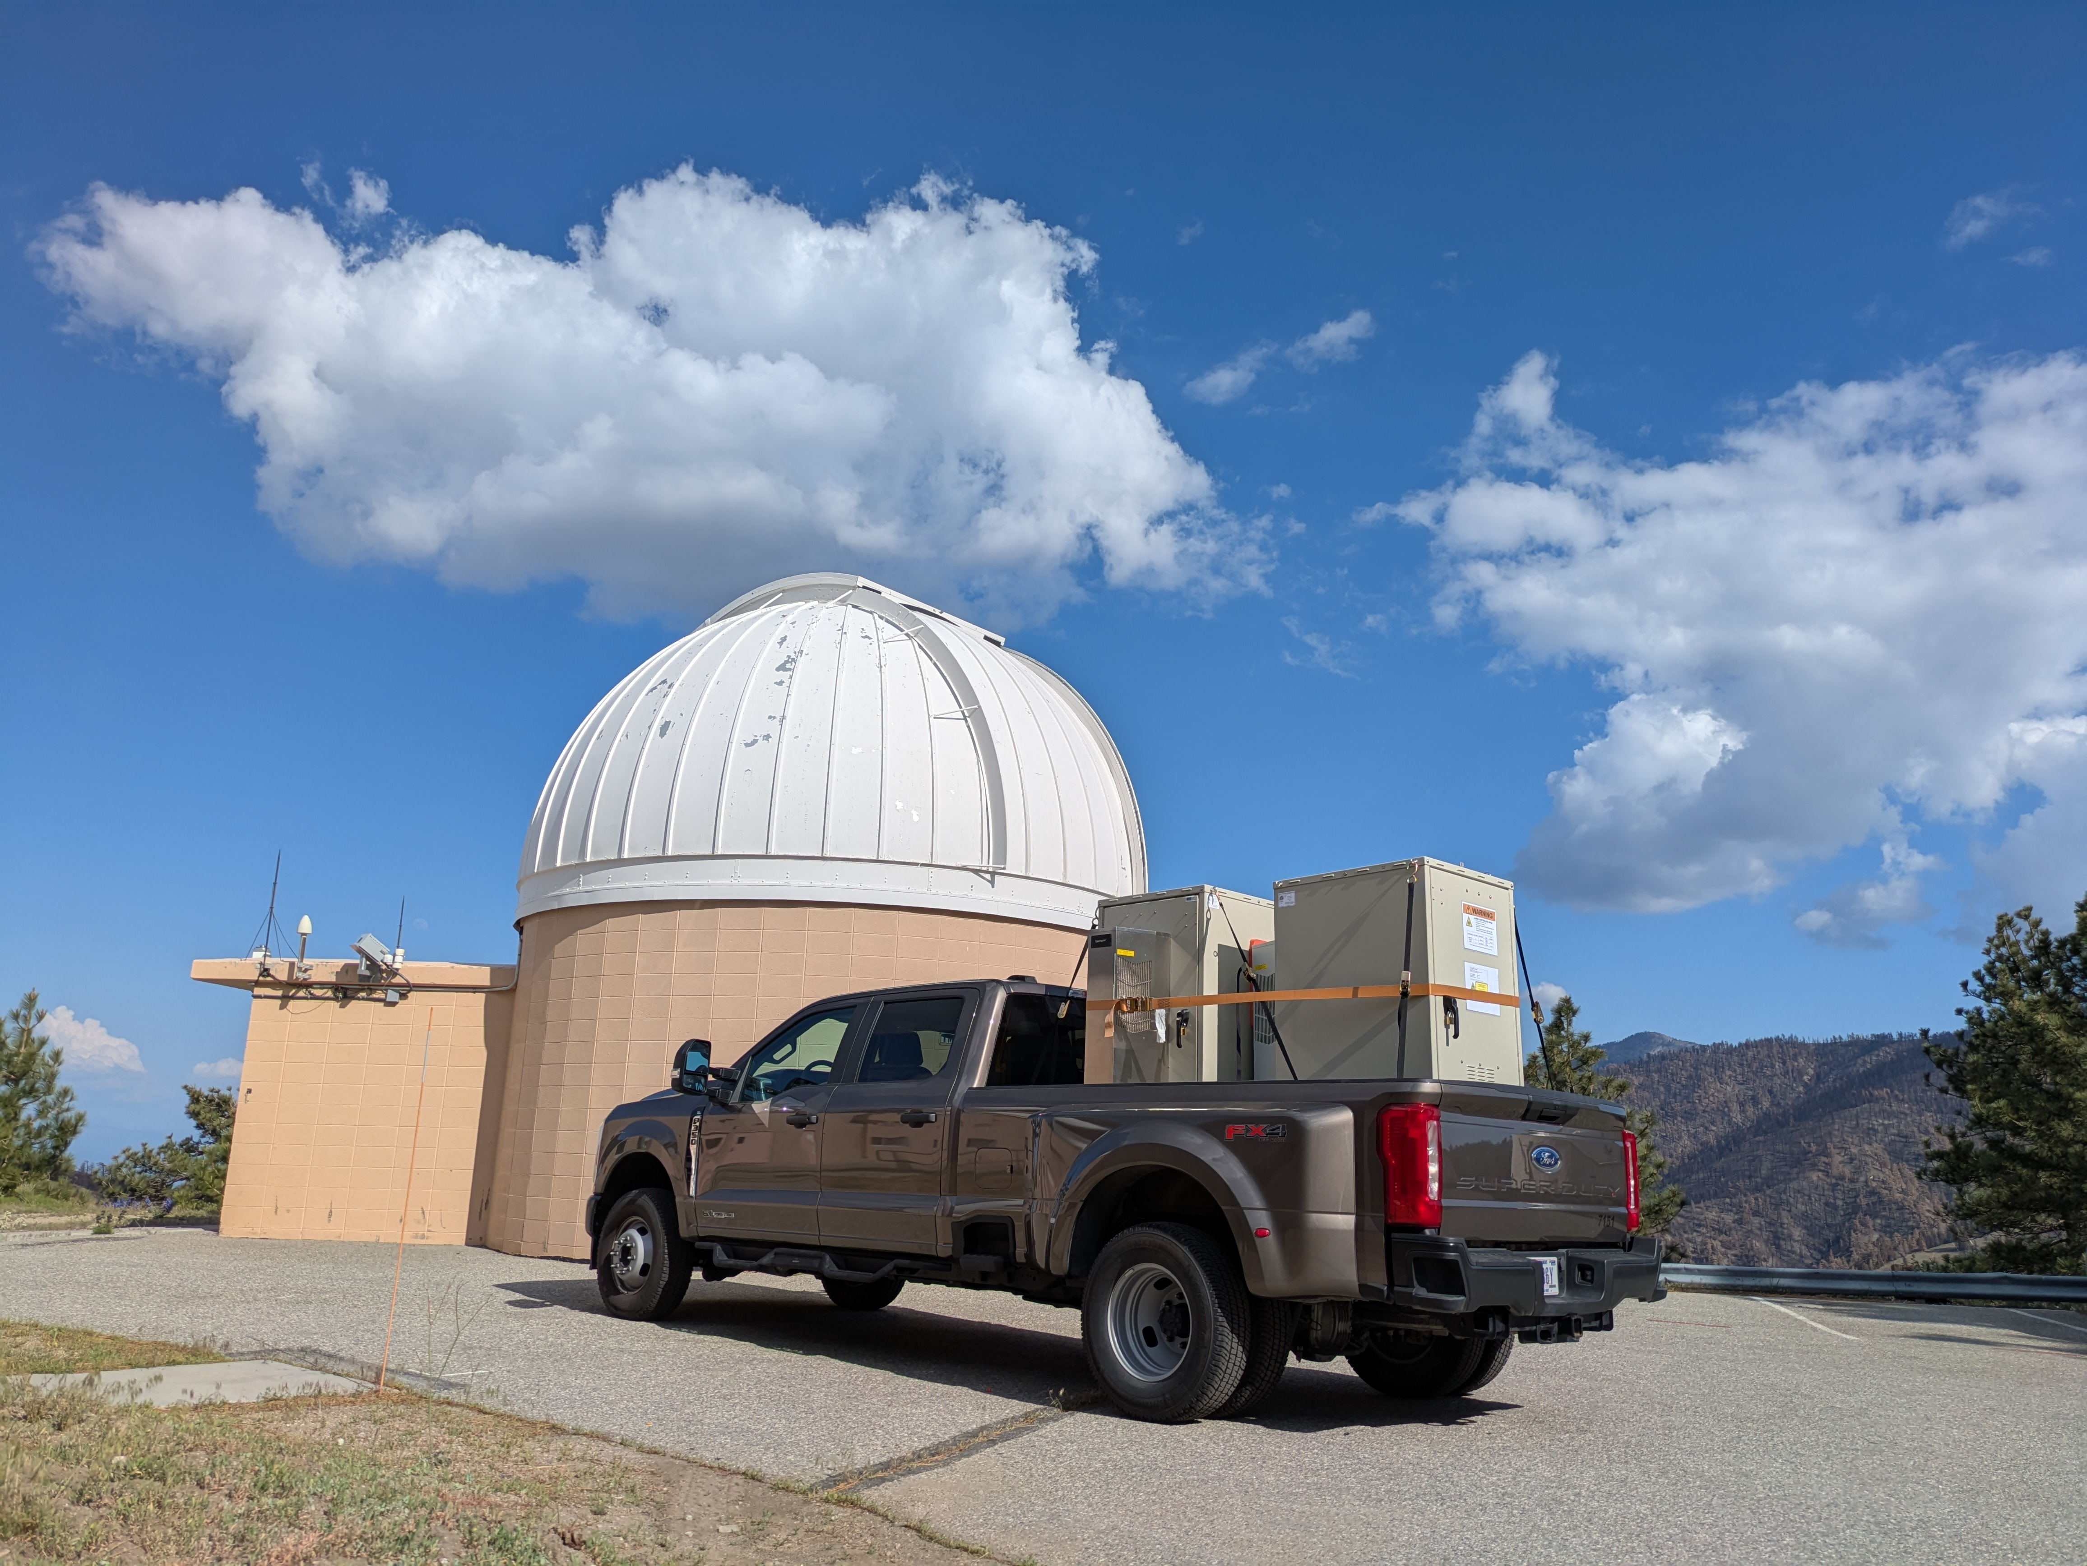
The Small Mobile Ozone Lidar (SMOL) - Overview
Transmitter
Nd:YAG with 4th harmonic generator.
Raman cell conversion to 289 nm and 299 nm.
Remote alignment capability.
Receiver
Three receiver pairs (two 299/289, one 289/266).
Coverage between 150 m and ~10 km a.g.l.
General specs
Footprint 3x4’
Weight ~700 lb
Power requirement ~2kW
Fully remote operation

Slide 3
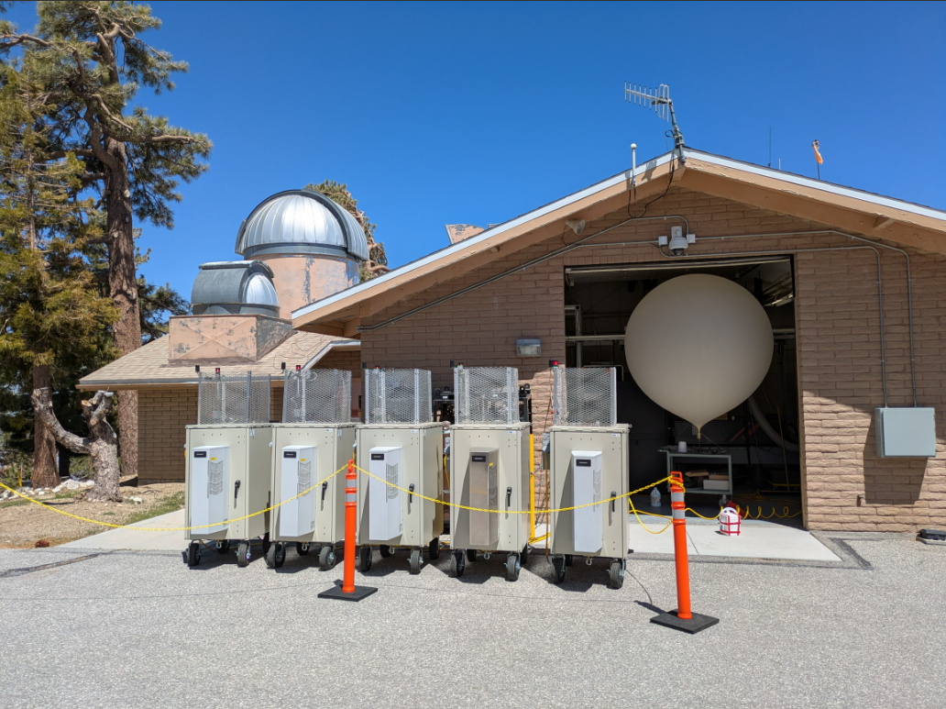
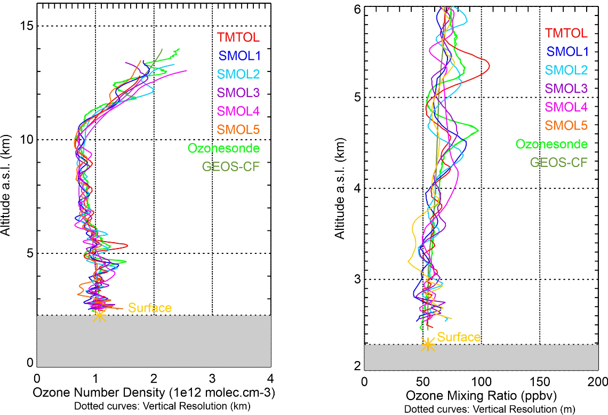
The Small Mobile Ozone Lidar (SMOL) - Validation
Conducted a multi-day validation effort (5 SMOLs + TMTOL + Ozonesondes)

Slide 4
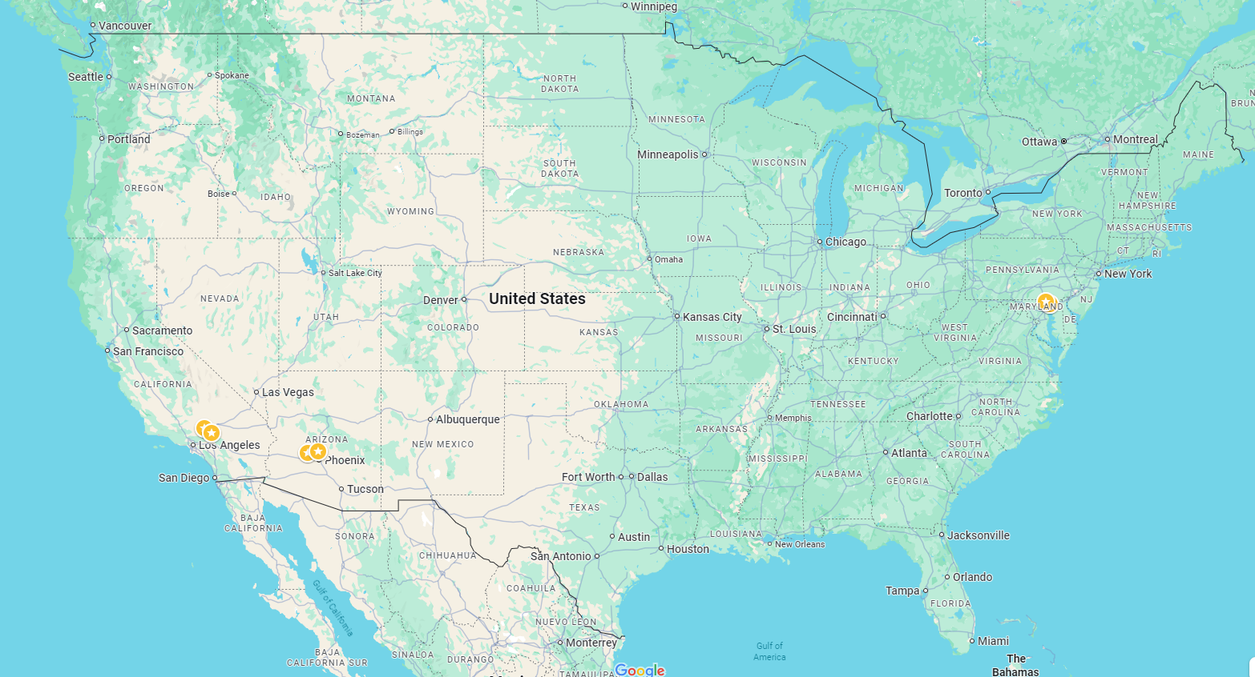



Summer 25 deployments
SMOL1 (AMF1)
SMOL2 (HMI)
TMTOL (TMF)
SMOL3 (CSUSB)
SMOL4 (Buckeye)
SMOL5 (Durango)

Slide 5
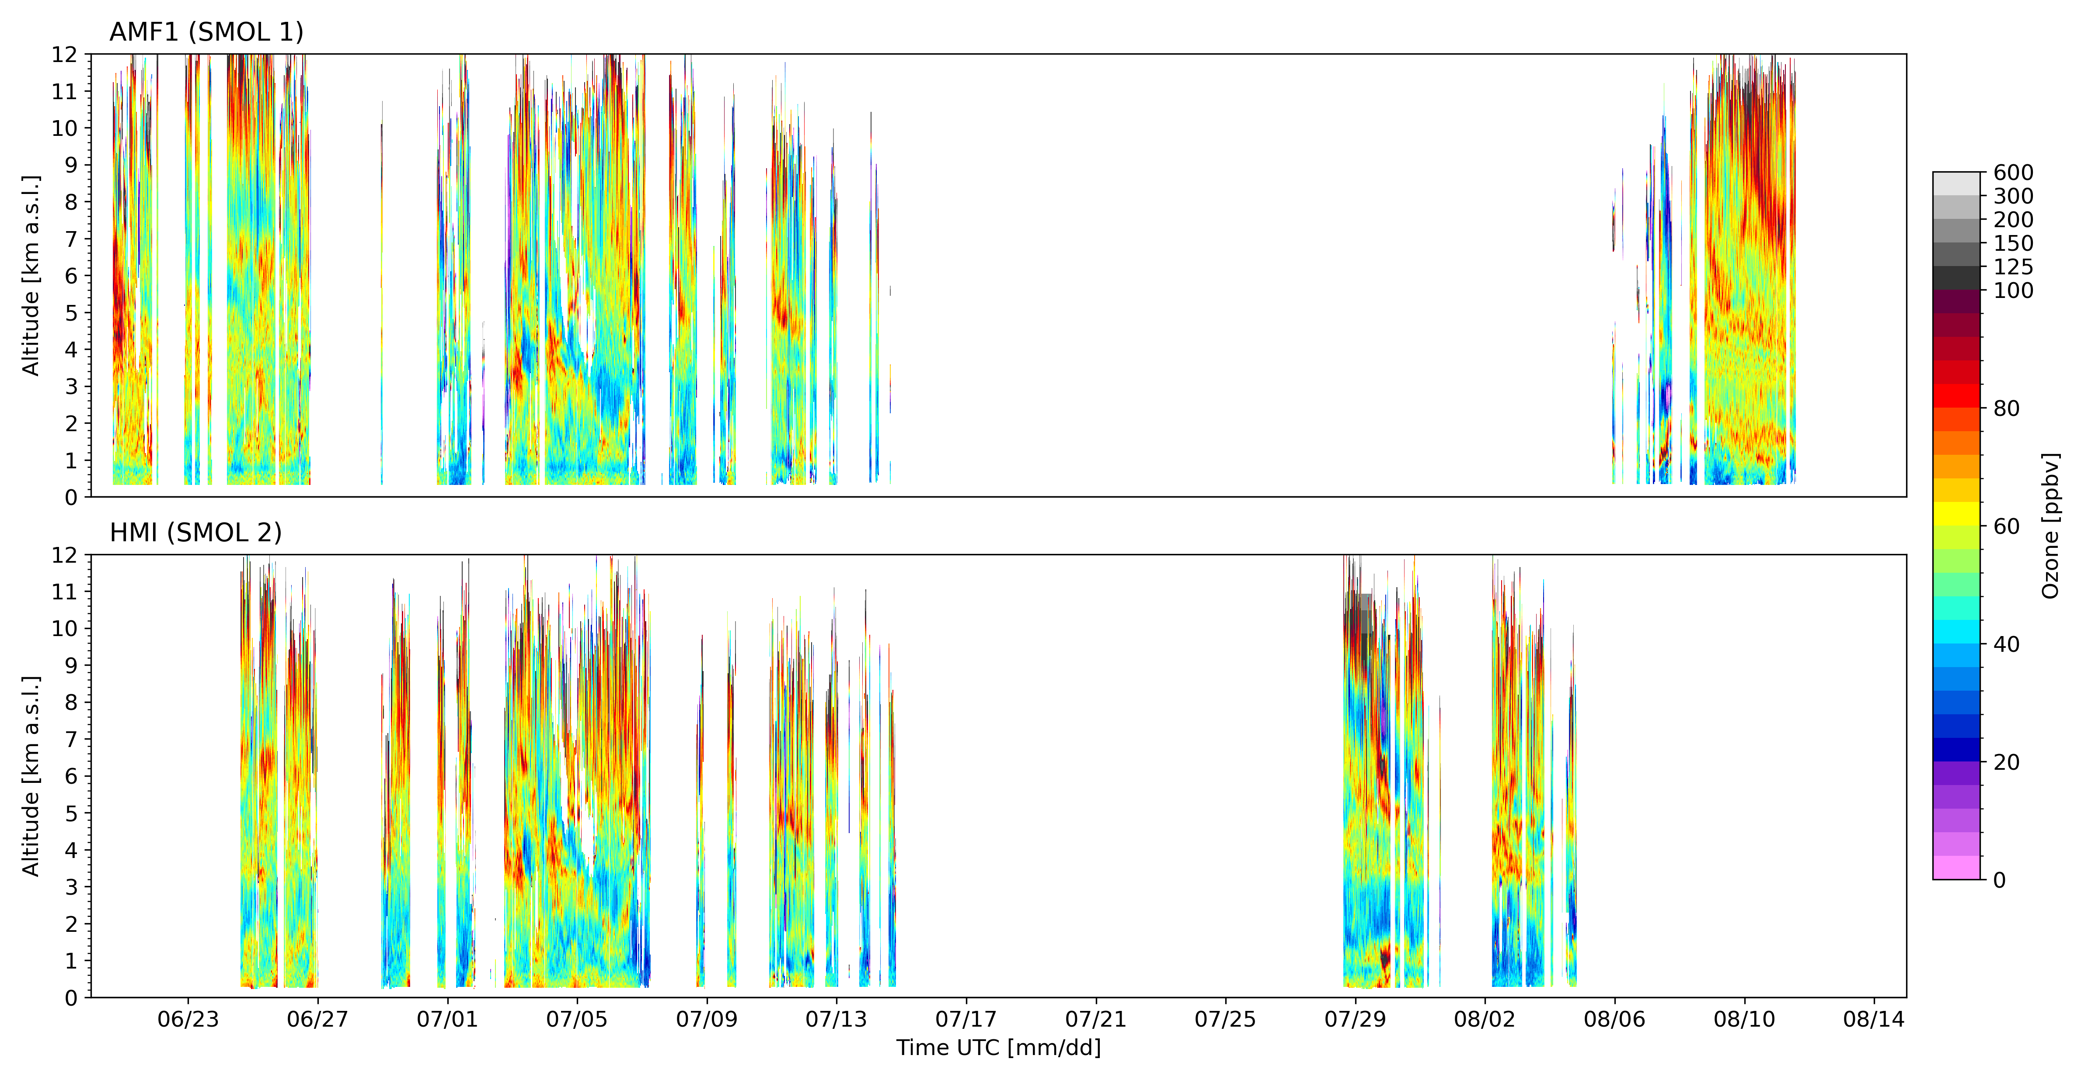
CoURAGE – SMOL 1 and SMOL 2

Slide 6
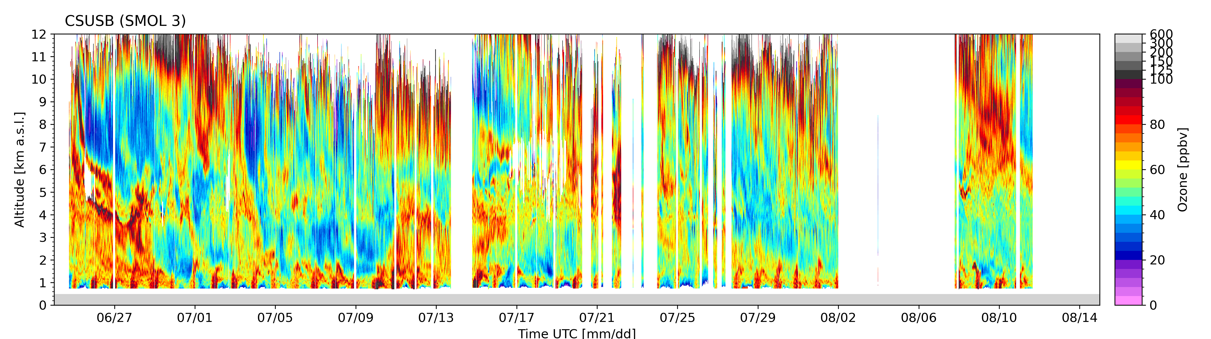
CSUSB – SMOL 3
San Bernardino county has ~150 high ozone days, ranked among the worst regarding air pollution.
Good ‘lidar weather’.
Close to TMF / easy to service.
Valuable for TEMPO validation.

Slide 7
Ground Level Ozone Research (GLOR)
GLOR focuses on ozone transport and formation for the 2025 ozone season: May-October
The hypotheses explore seven critical questions:
The impact of increasing wildfire activity on background and exceedance ozone levels,
The potential underestimation of ozone precursor emissions in current inventories,
The role of biogenic emissions counteracting reductions in human-caused precursors,
How changes in atmospheric chemistry might impact the effectiveness of emission reductions,
The influence of transported ozone from outside the region,
The significant role of meteorological and climatological factors, including heat,
Whether regional factors across the Intermountain West dominate ozone exceedances over local emissions.

Slide 8
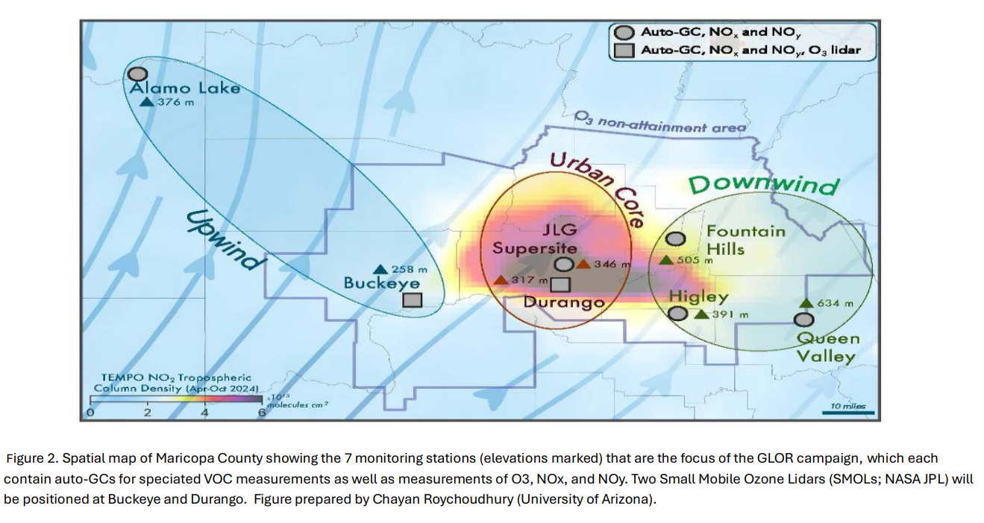
Ground Level Ozone Research (GLOR)
SMOL4
SMOL5

Slide 9
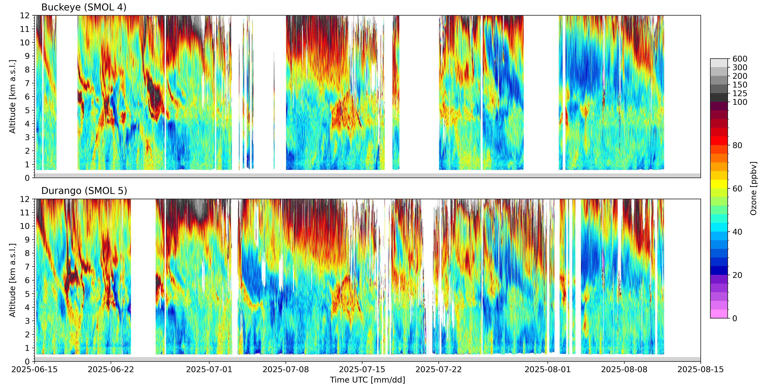
GLOR – SMOL 4 and SMOL 5
STE/Smoke
Smoke

Slide 10
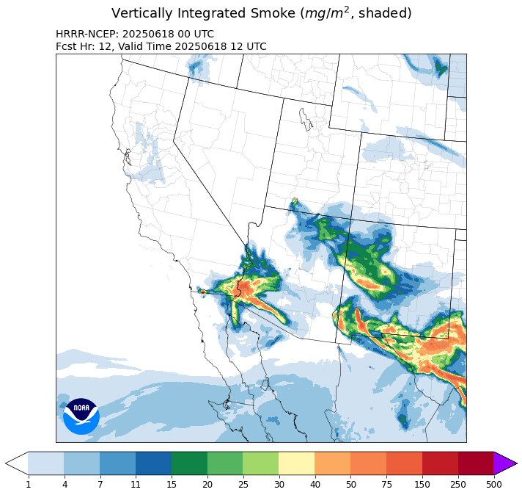
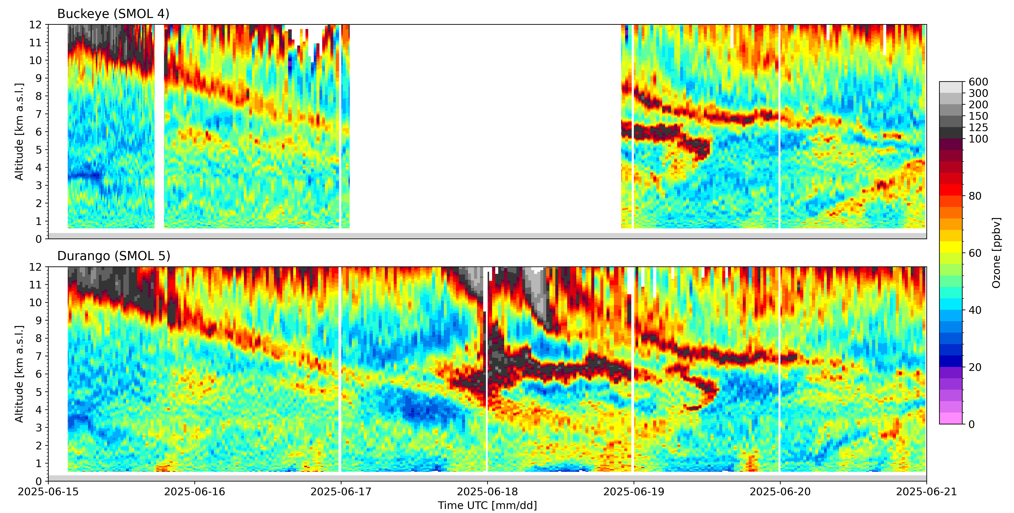
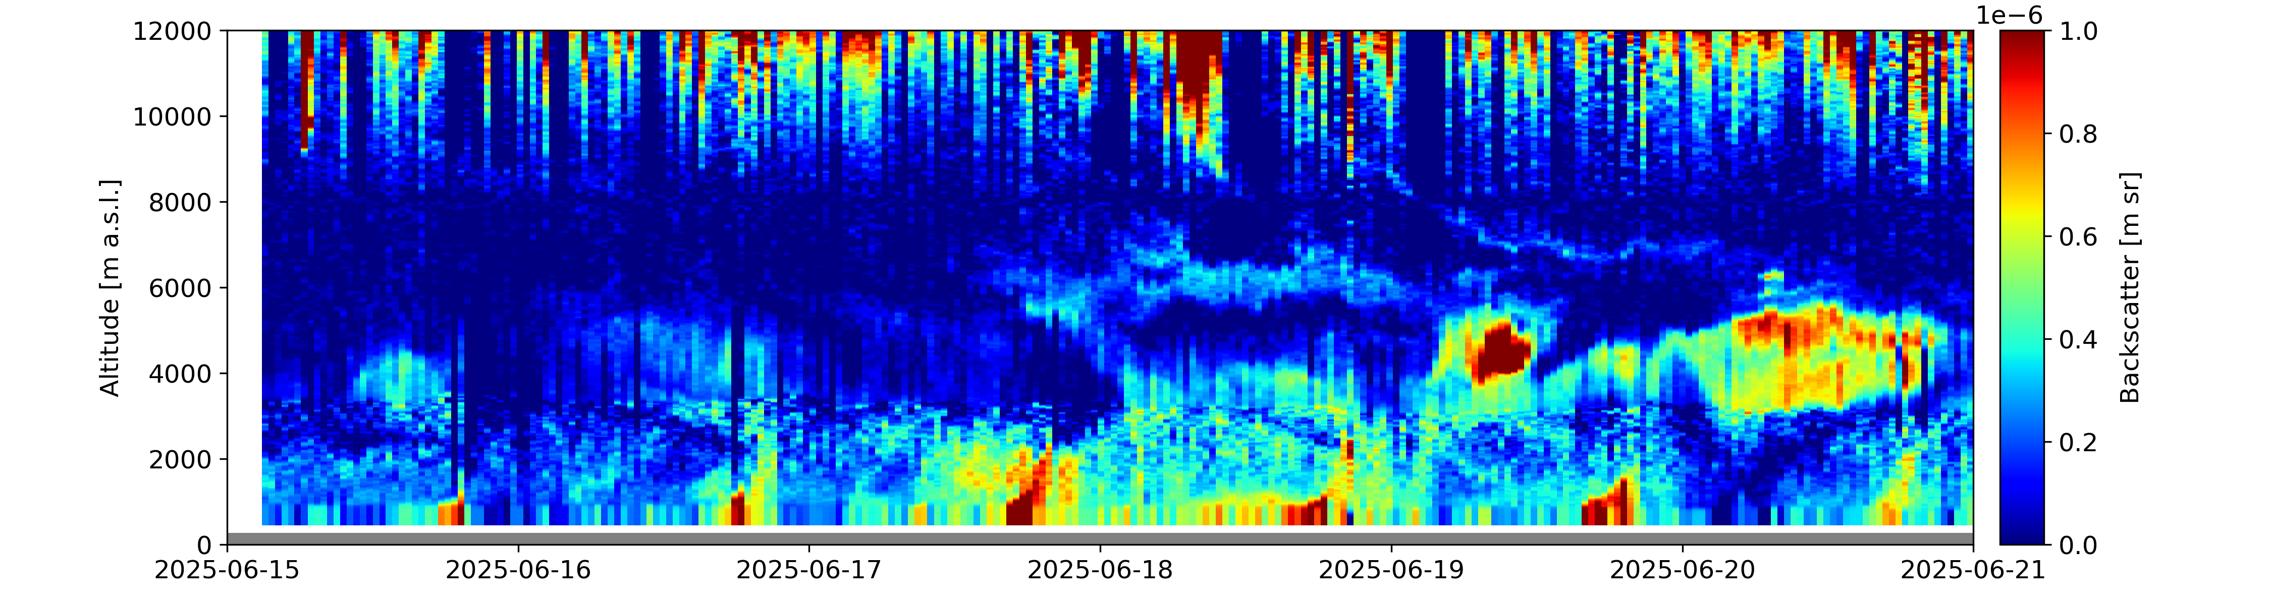
GLOR – STE/smoke impact on surface air quality?
Tech issues
Smoke
STE
O3 exceedance

Slide 11
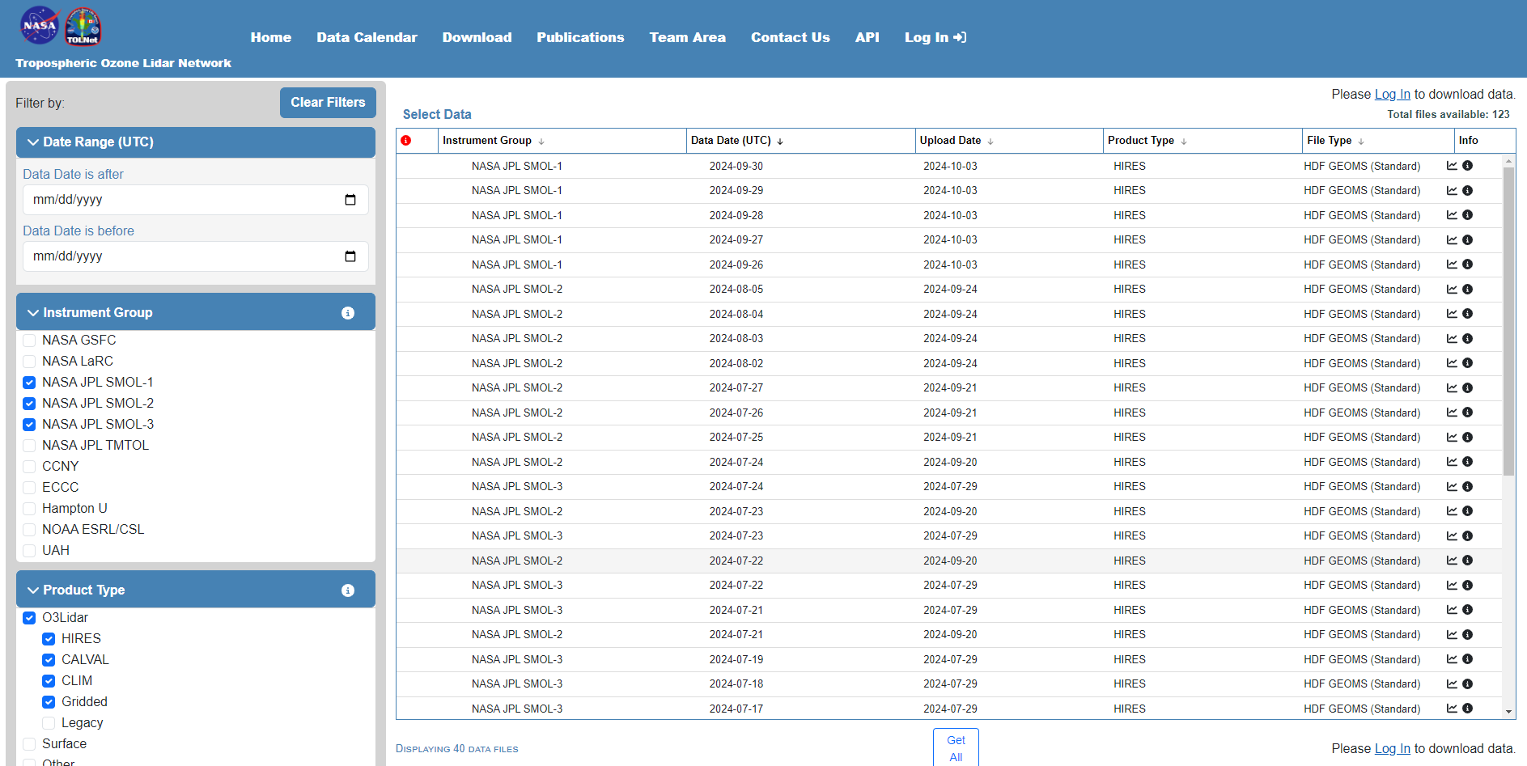
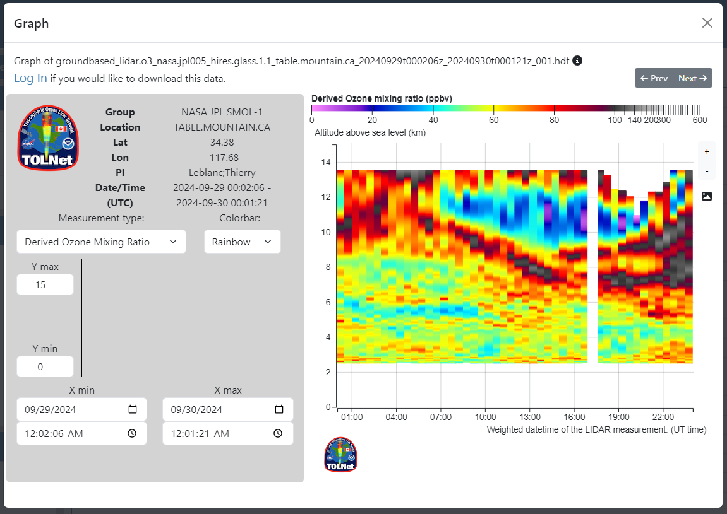
Data access
https://tolnet.larc.nasa.gov/download

Slide 12
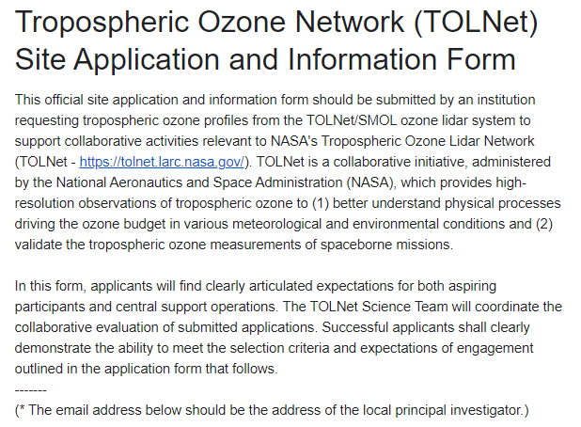

SMOL deployment request form
https://forms.gle/9gJeDSF8rns75GAo6

Slide 13
Conclusions
High resolution vertical ozone/aerosol profiling is very useful to understand air quality events and validate TEMPO ozone profiles.
SMOL up time (1.5 – 2 months continuous ops):
  SMOL1 (~40%), SMOL2 (~40%), SMOL3 (~90%), SMOL4 (~80%), SMOL5 (~90%)
Costs:
  ~110k per additional unit + labor.
Outlook:
  Improve and possibly extend aerosol measurement capabilities (6-12 months).
  Improve laser reliability and improve enclosure humidity control hoping to reduce operational cost (6-12 months).
  Replace the laser with a DPSS to reduce SMOL SWaP (size, weight and power) to ~1/4 (TBD).
  Test the concept for an NO₂ SMOL (TBD).
The cost information contained in this document is of a budgetary and planning nature and is intended for informational purposes only. It does not constitute a commitment on the part of JPL and/or Caltech.

