Slide 1
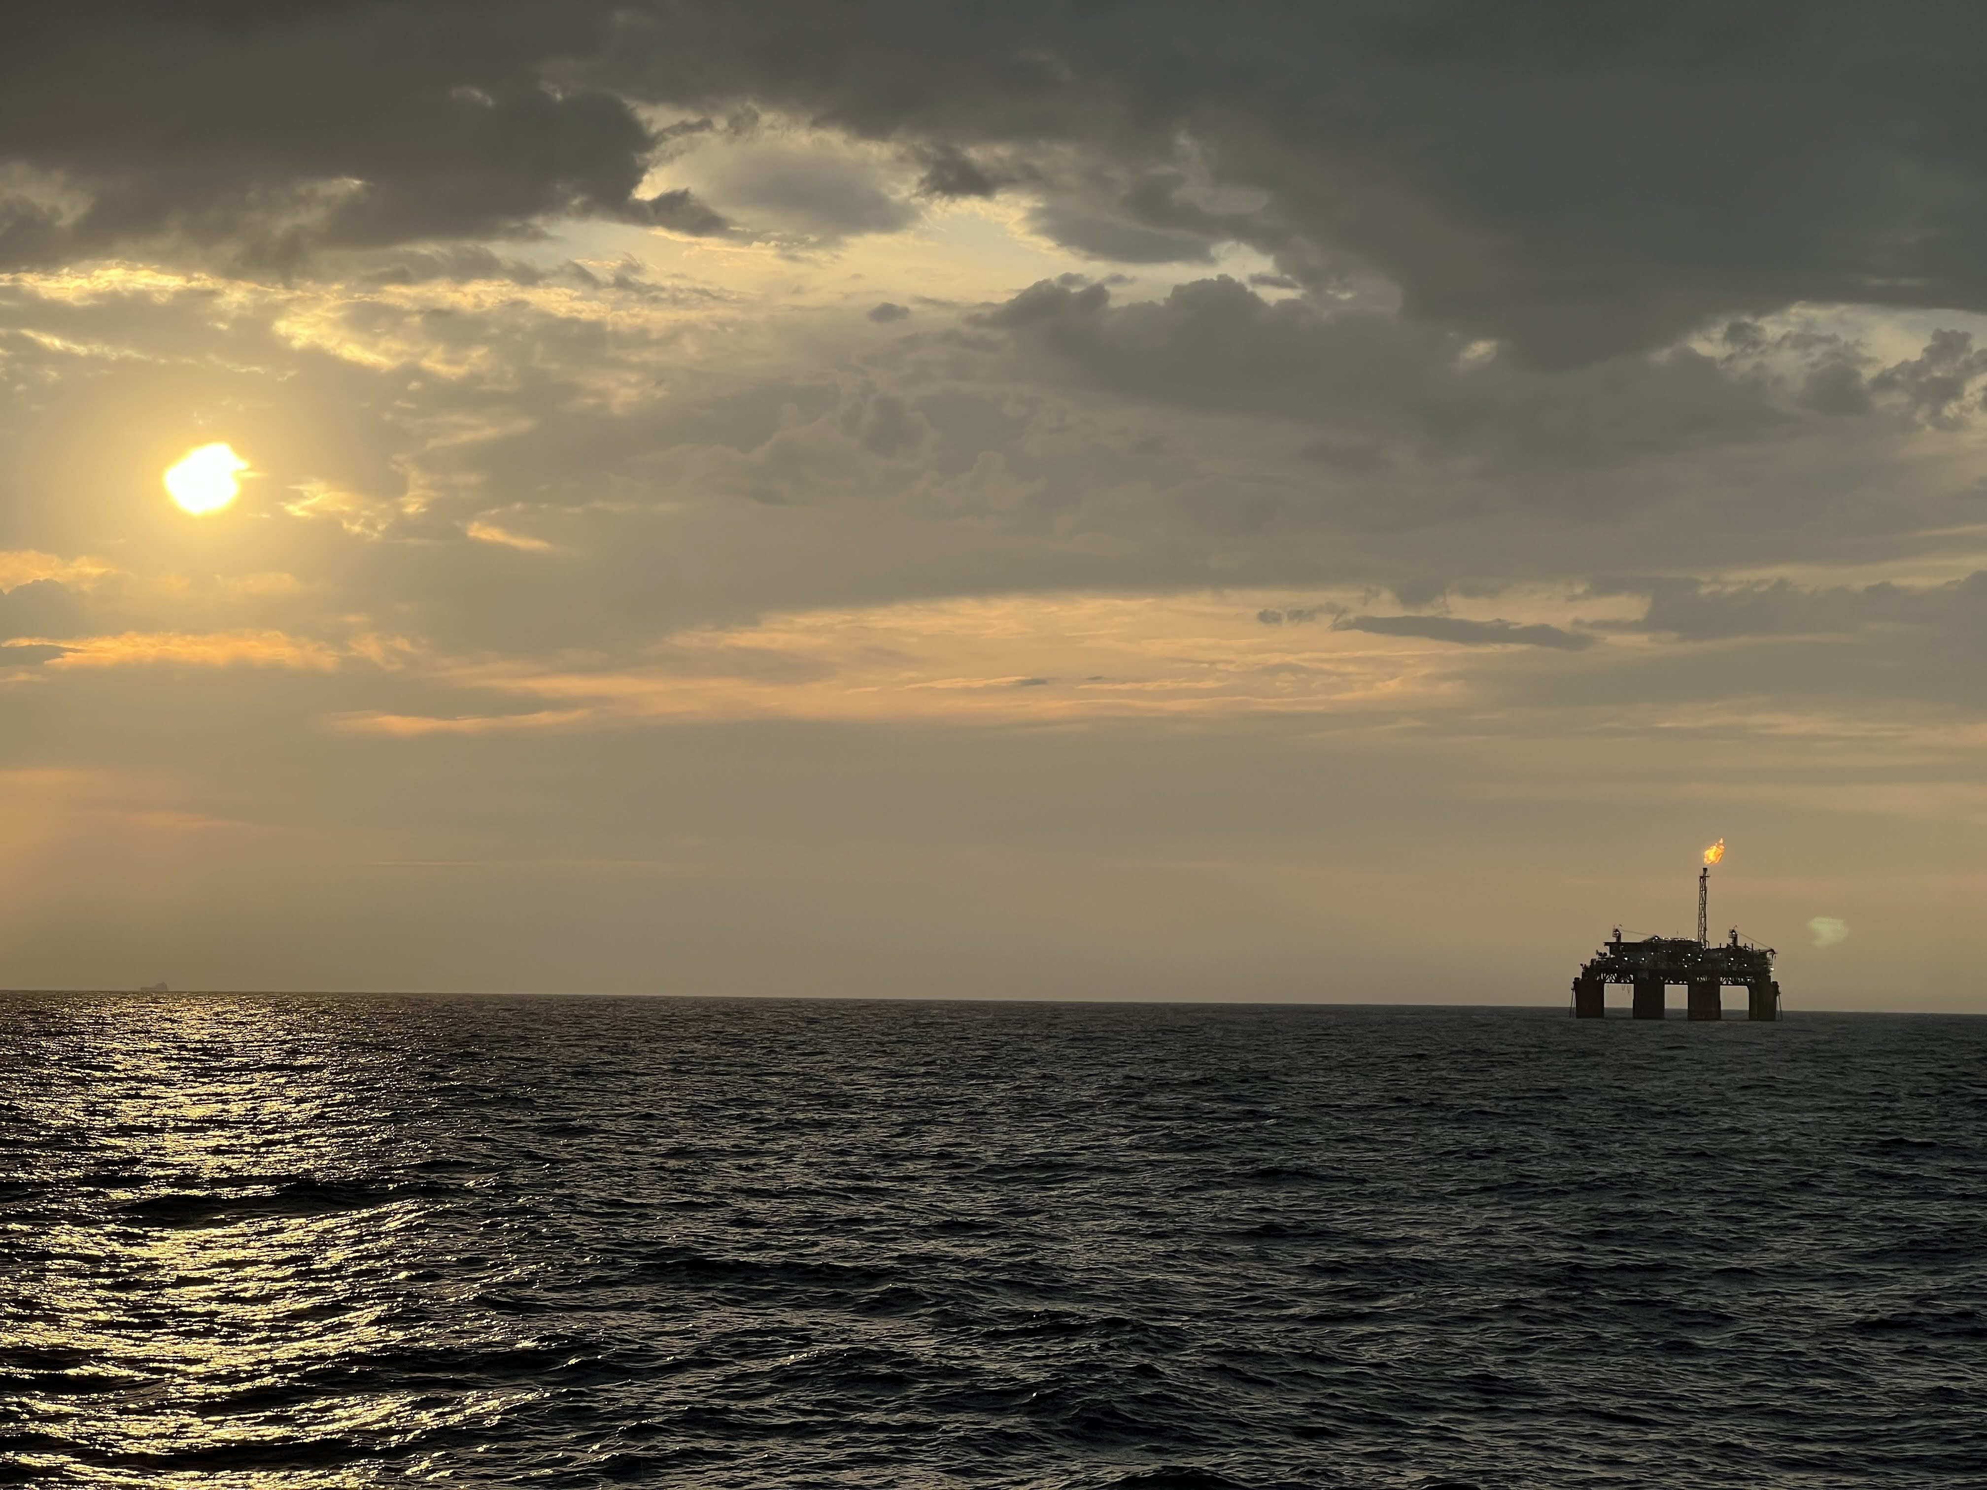




Satellite NO₂ Views and Validation During the 2024 SCOAPE-II Campaign
Niko Fedkin
Co-authors: Ryan Stauffer (NASA-GSFC), Anne Thompson (UMBC/NASA), Debra Kollonige (SSAI/NASA) , Holli Wecht (BOEM), Lok Lamsal (BOEM), Laura Judd (NASA-LaRC), Scott Janz (NASA-GSFC), Bryan Place (SciGLOB), Jonathan Gallegos (SciGLOB), Thomas Hanisco (NASA-GSFC)
TEMPO/GeoXO Joint Science Team Workshop
19-22 Aug 2025

Slide 2

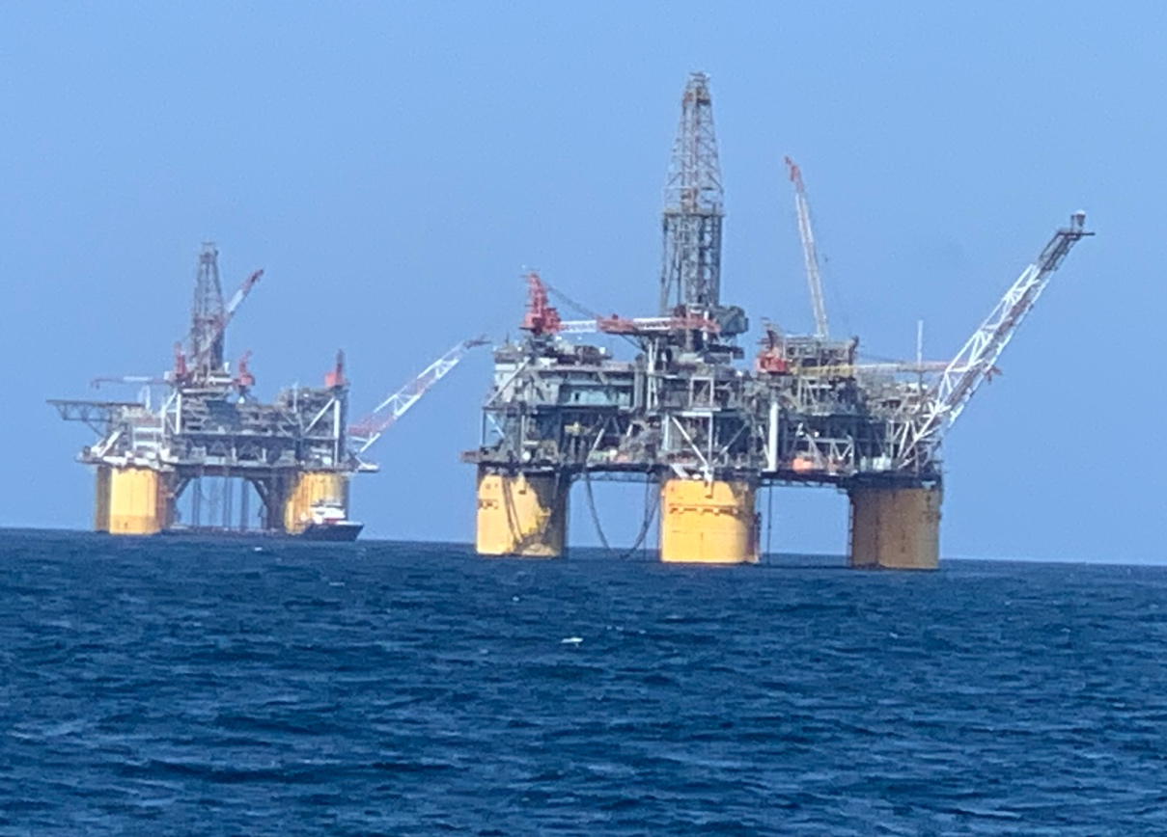
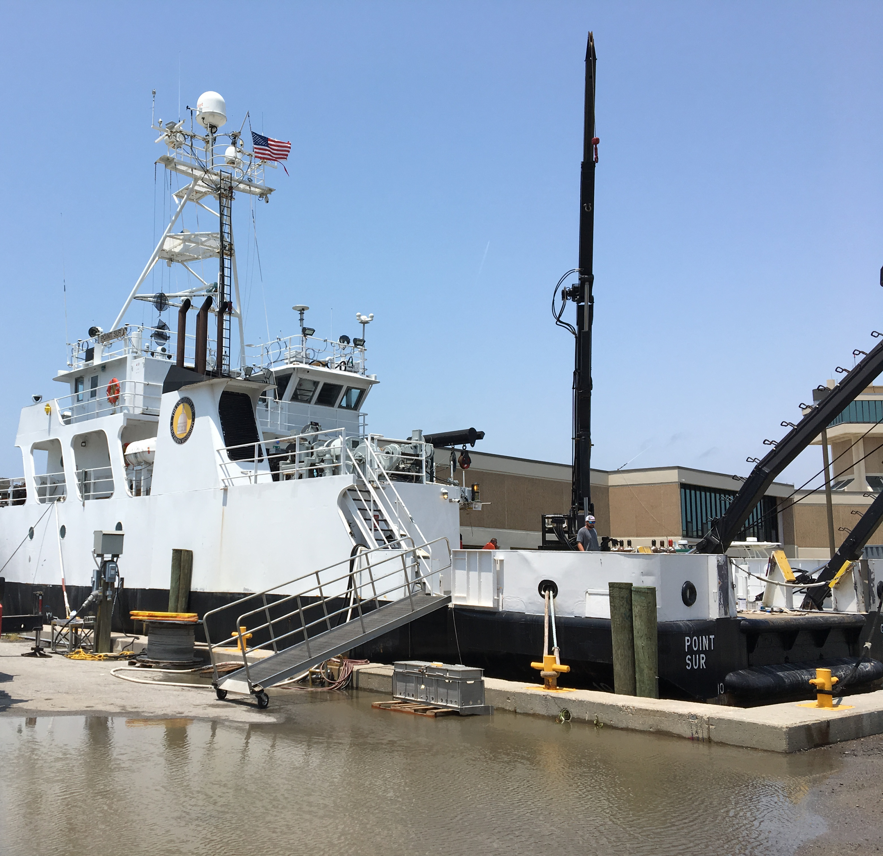
NASA-BOEM Collaboration
An interagency agreement between NASA and the Bureau of Ocean Energy Management (BOEM) has resulted in two ship campaigns (SCOAPE-I and II) in the Gulf of America (GOA)
  BOEM has air quality jurisdiction for emissions from the oil and gas (ONG) industry in the Outer Continental Shelf of the GOA, west of 87.5 W)
  The first SCOAPE campaign (SCOAPE-I in May 2019) assessed the feasibility of using satellites to monitor oil and gas offshore emissions (i.e., TROPOMI and OMI)
  SCOAPE-II (June 2024) continued this objective with an opportunity to do the same with TEMPO
TROPOMI is able to detect hotspots from large deep-water platforms (Fedkin et al., 2024); can TEMPO do the the same?
  TROPOMI and OMI showed reasonable agreement with Pandora during SCOAPE-I (15% over land and 25% over water)
What additional information can TEMPO’s hourly scans provide for BOEM’s goals for monitoring AQ over the GOA?

Slide 3
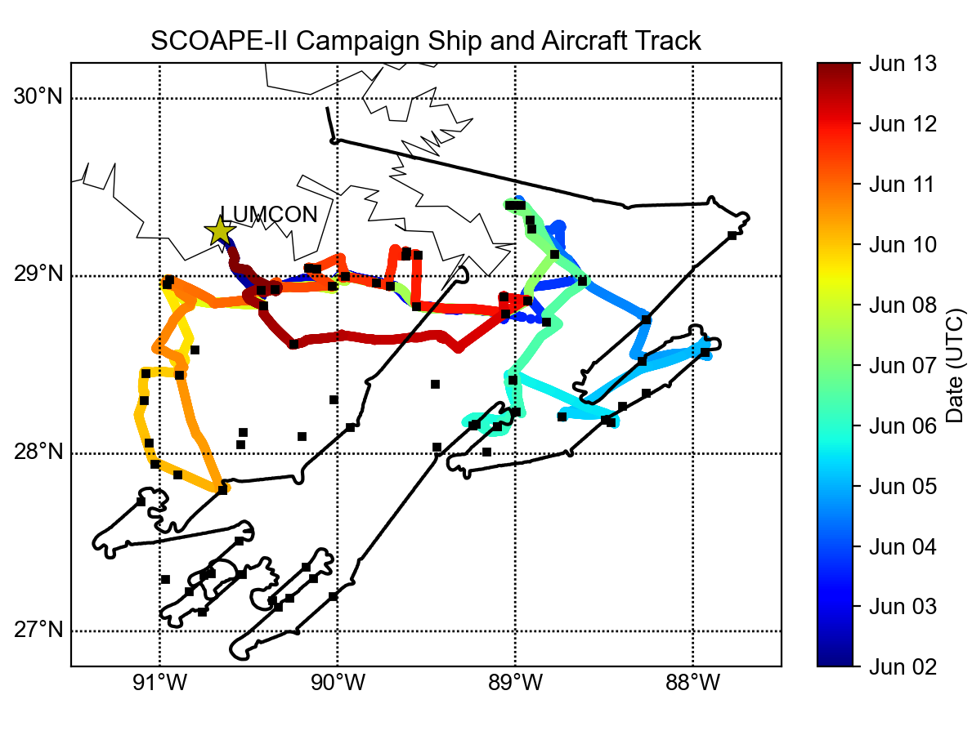
SCOAPE-II Campaign (2024)
Eleven-day ship cruise (June 2-13th) from Louisiana in the GOA onboard the Point Sur Research Vessel, targeting both NO_{x} and CH₄ ONG targets
Instrumentation on the cruise (see table) was similar to SCOAPE-I but with the addition of aircraft measurements (GCAS and CHAPS-D for NO₂ and AVIRIS-3 for CH₄)
Measurement | Instrument
Continuous (1-sec) CH₄, CO₂, CO, H₂O | Picarro G-2301 and G-2307
Continuous (1-min) NO₂ | Teledyne API T500U
Continuous (1-min) O₃ | Thermo 49i
Total Column NO₂ | Pandora Spectrometer
Balloon-borne ozonesondes | En-Sci, Intermet radiosondes
Aerosol backscatter profiles, mixed layer height | Lufft CHM-8k Ceilometer
Dozens of VOC species | VOC canister samples
Aerosol Optical Depth | MicroTops-II Sunphotometer
T, RH, p, winds, GPS location | RMYoung, Trimble ABX GPS
CH₄ Column Enhancement | AVIRIS-3 (B200 Aircraft)
NO₂ Column Amount | GCAS (B200 Aircraft Oct 2024)
black line = B200/GCAS flight track from Oct 13, 2024

Slide 4
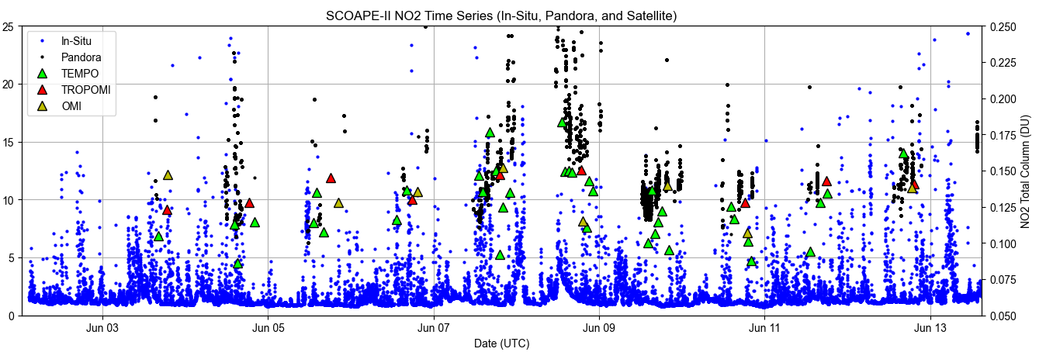
NO₂ Ship Measurements during SCOAPE-II
NO₂ in-situ instrument (Teledyne T500U) measured minute averaged NO₂ concentrations throughout the cruise (blue dots)
Pandora onboard the ship for satellite validation (black dots)
Overpasses/scans from OMI, TROPOMI and TEMPO (triangles)
In-situ NO₂ (ppb)
0.1 DU = 2.69 x 10¹⁵ molecules/cm²

Slide 5
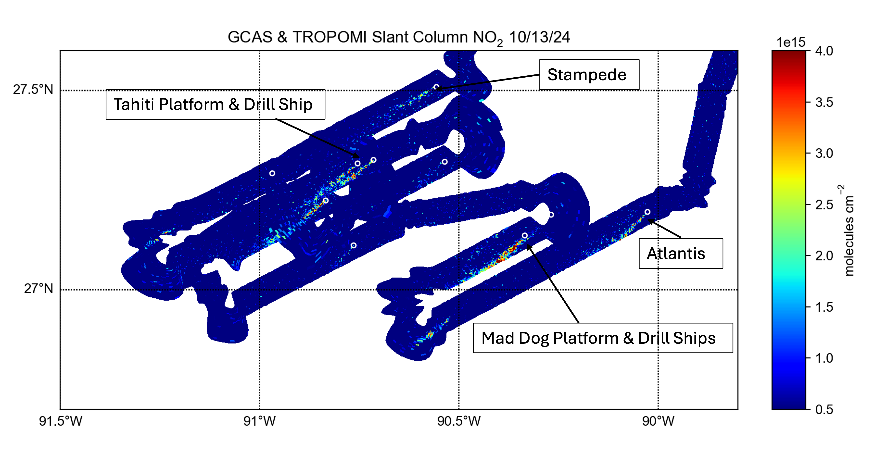
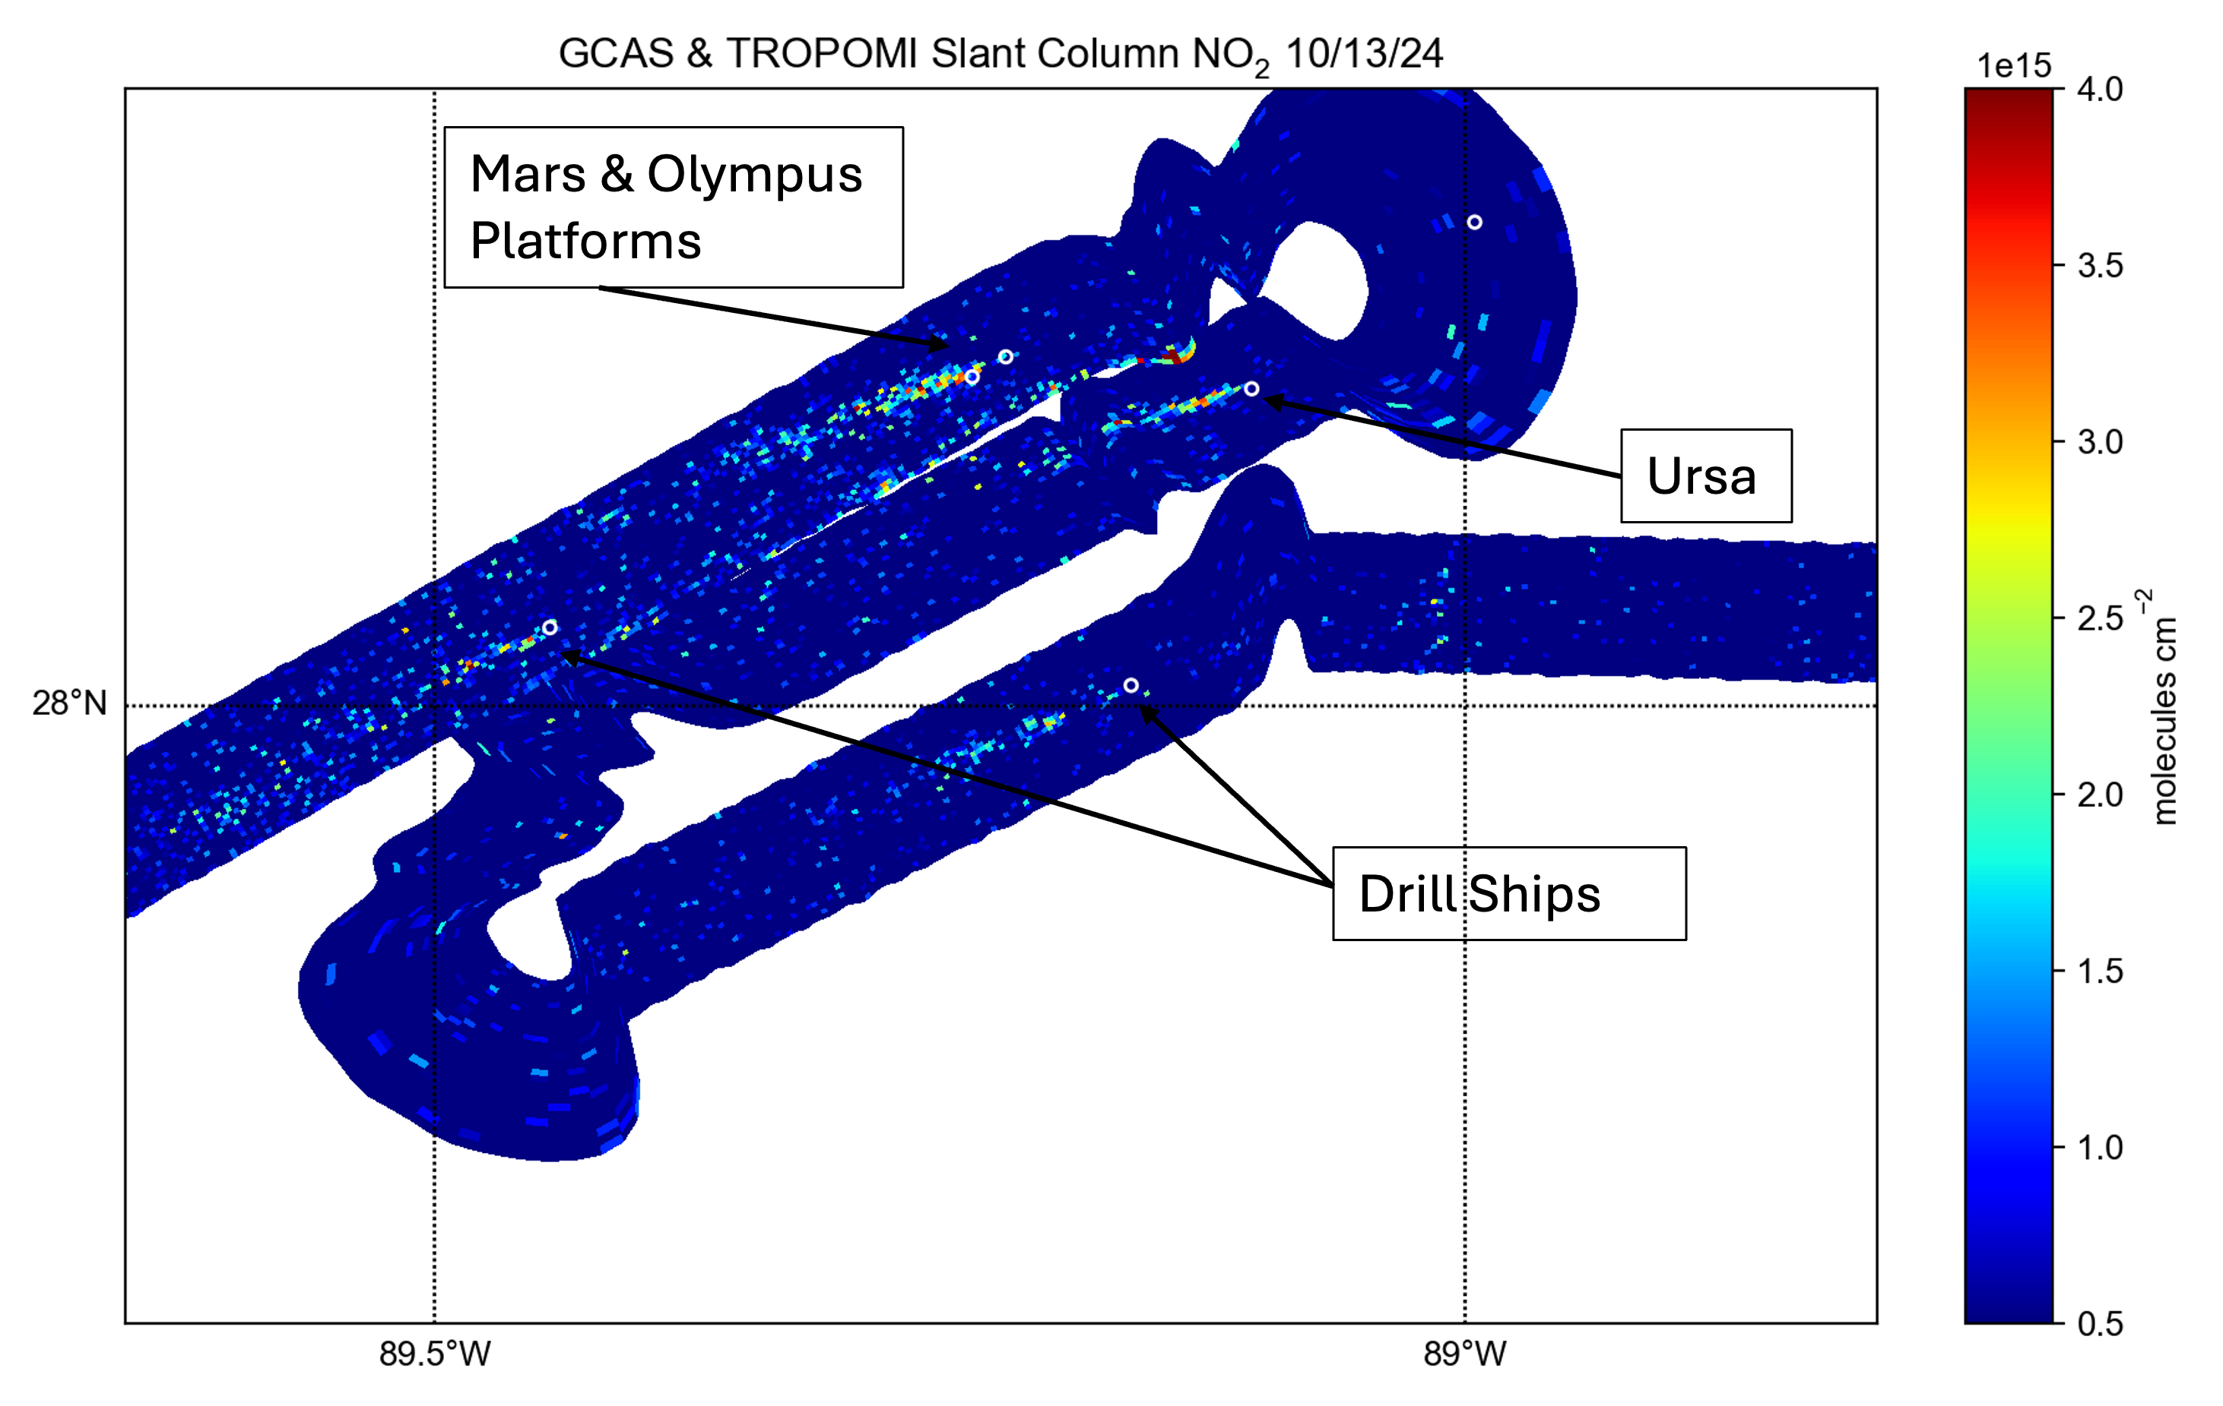
NO₂ Emission Sources from GCAS Slant Columns
NO₂ plumes were detected from both large platforms and drill ships
The biggest plumes are from areas with platforms and drill ships such near the “Mad Dog” and “Tahiti” platforms
Vertical columns (once processed) will allow for a direct comparison with TEMPO

Slide 6
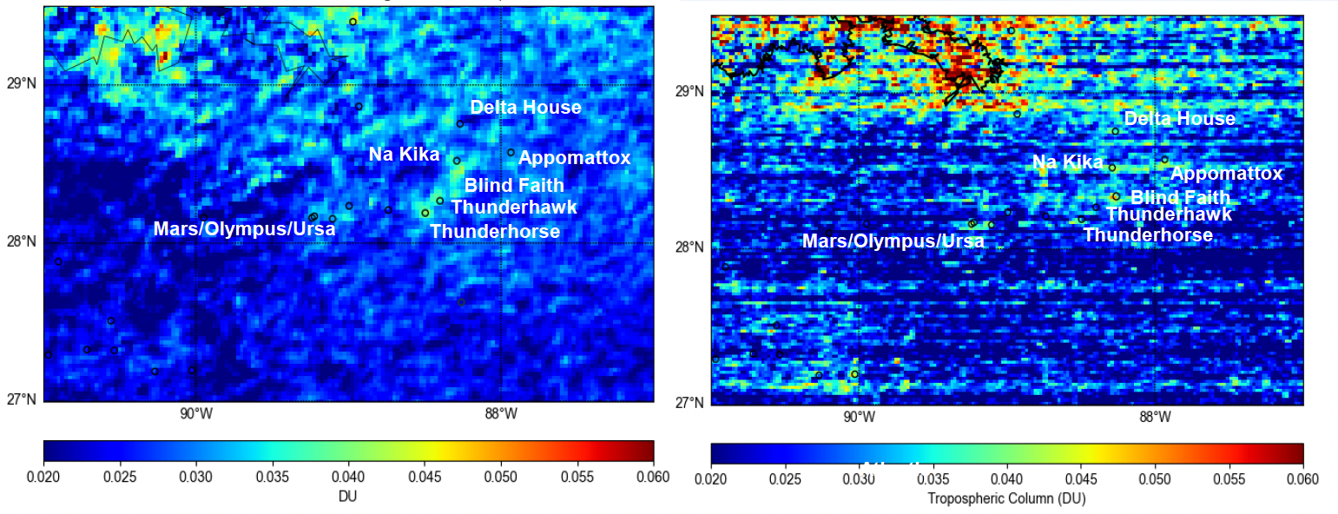
TROPOMI & TEMPO during SCOAPE-II
TROPOMI 3-12 June SCOAPE-II Average
TEMPO 3-12 June SCOAPE-II Average @ 1130 CDT
0.1 DU = 2.69 x 10¹⁵ molecules/cm²

Slide 7
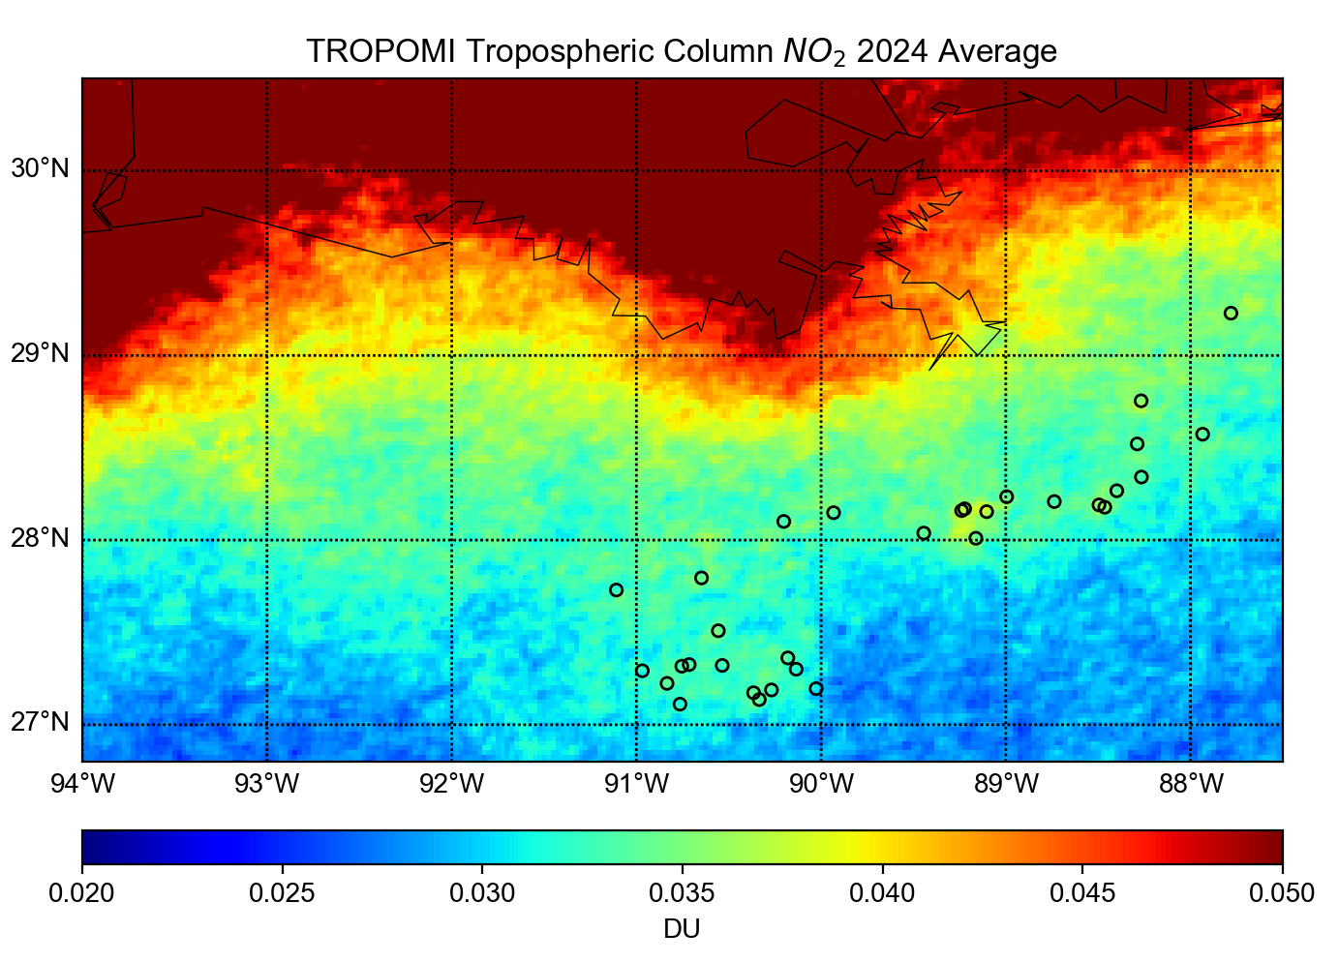
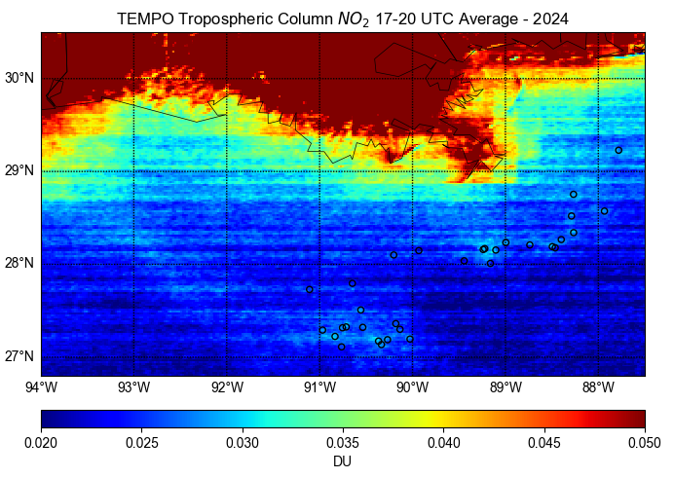
Long Term Satellite Trop. Col NO₂ Averages (2024)
Annual 2024 Tropospheric NO₂ averages from TROPOMI (left) and TEMPO (right) were calculated
  For more direct comparison only TEMPO 17-20 UTC scans were used in the average
  TROPOMI L2 data were regridded to the same resolution as TEMPO’s L3 gridded files (0.02x0.02)
Several areas of NO₂ enhancement from ONG platforms appear over deep-water platforms in the GOA
Several artifacts in the TEMPO retrieval – striping (known issue in V3) and sharper gradients along the coast

Slide 8
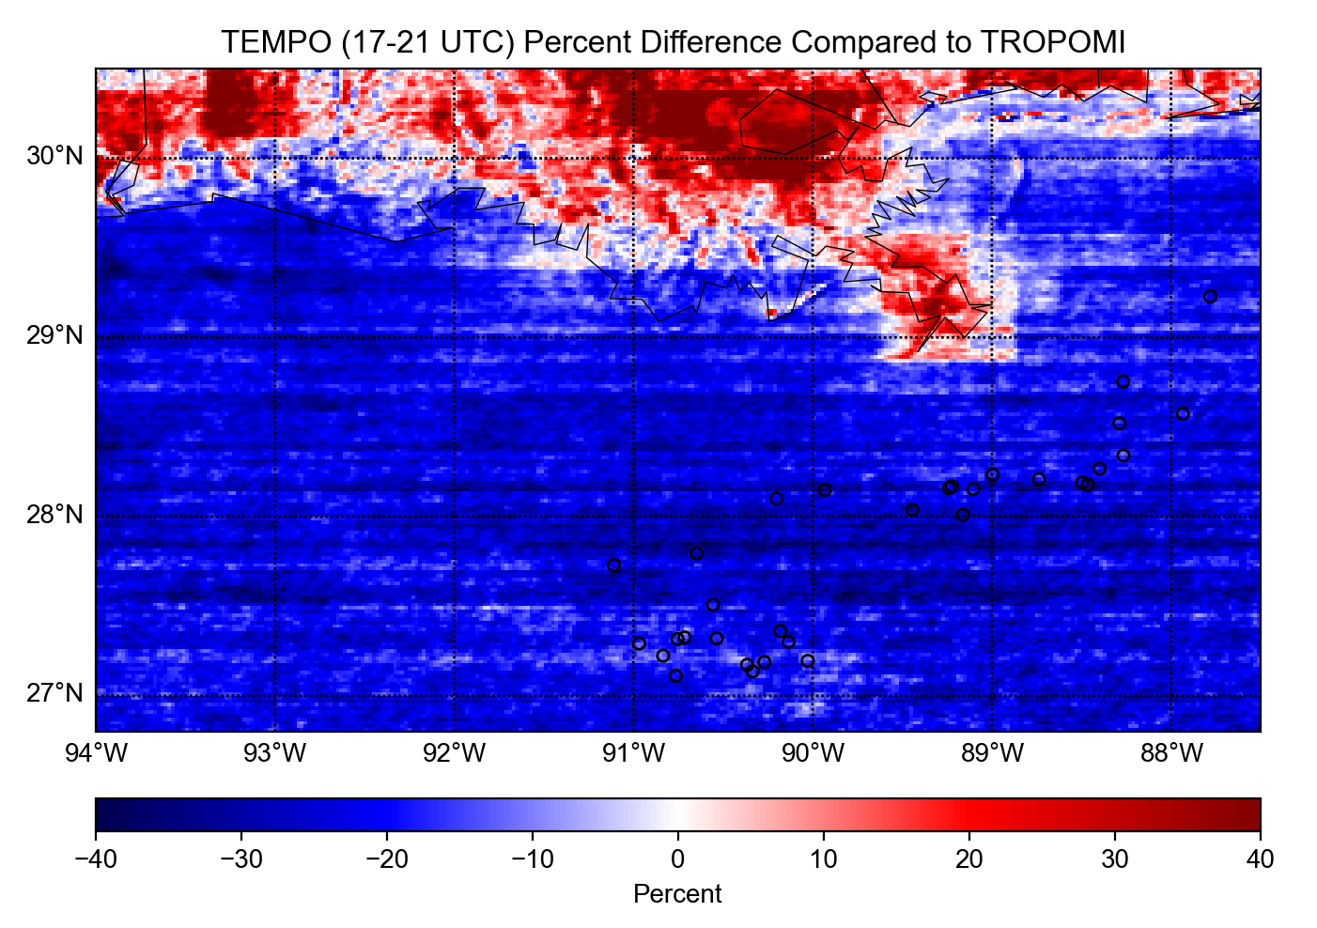
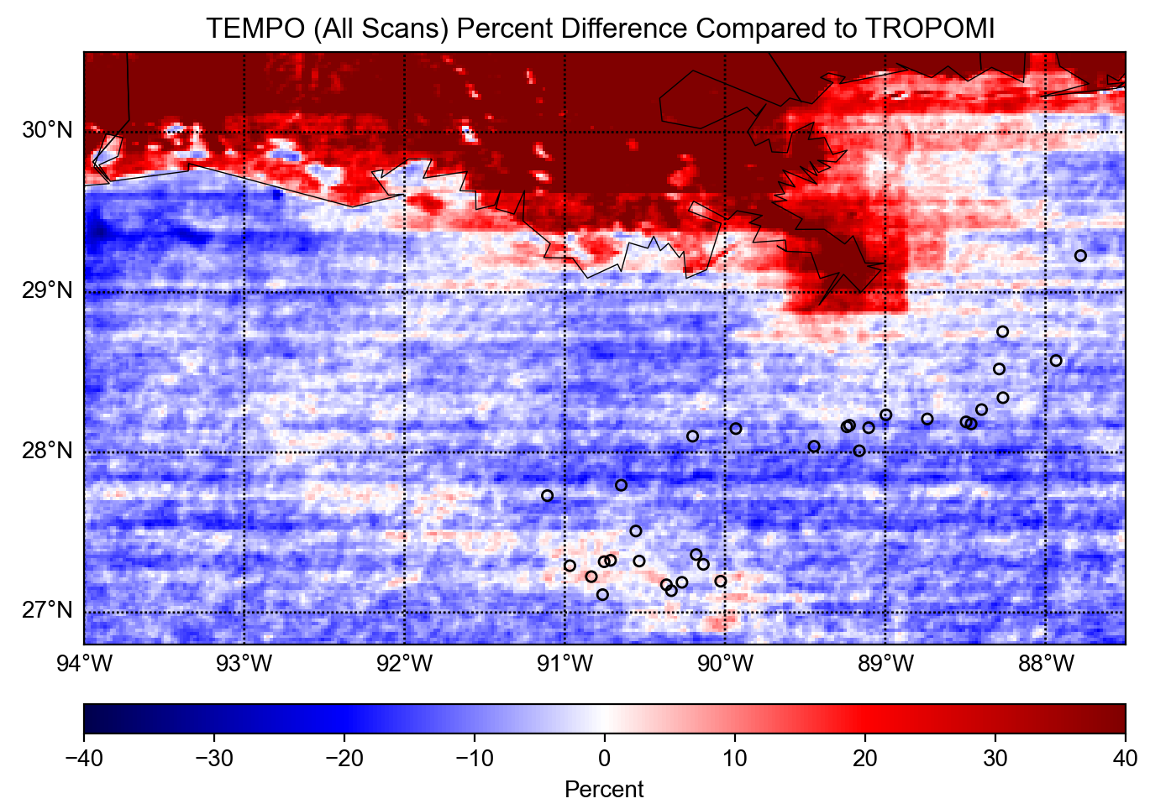
Trop Col. NO₂ Percent Difference (2024)
Blue colors on the maps indicate where TEMPO is lower than TROPOMI; red is higher
Comparing the early-mid afternoon (17-21 UTC; left) TEMPO average with TROPOMI, TEMPO is generally lower over water and higher over land
TEMPO midday scans have lower background than morning and evening scans – causes increase in the daily TEMPO average (right)

Slide 9
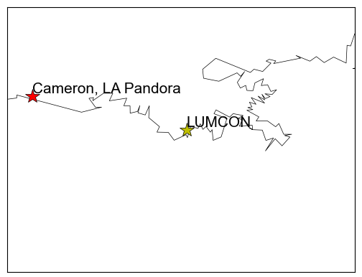
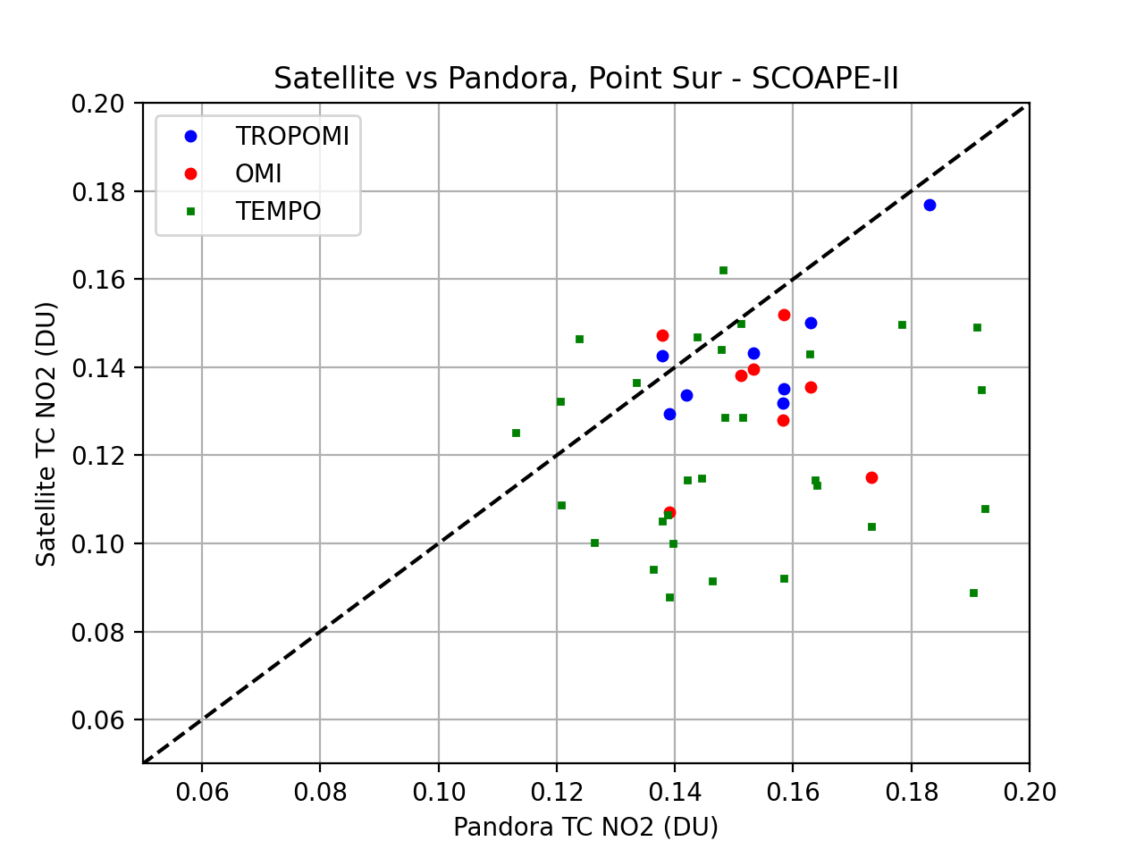
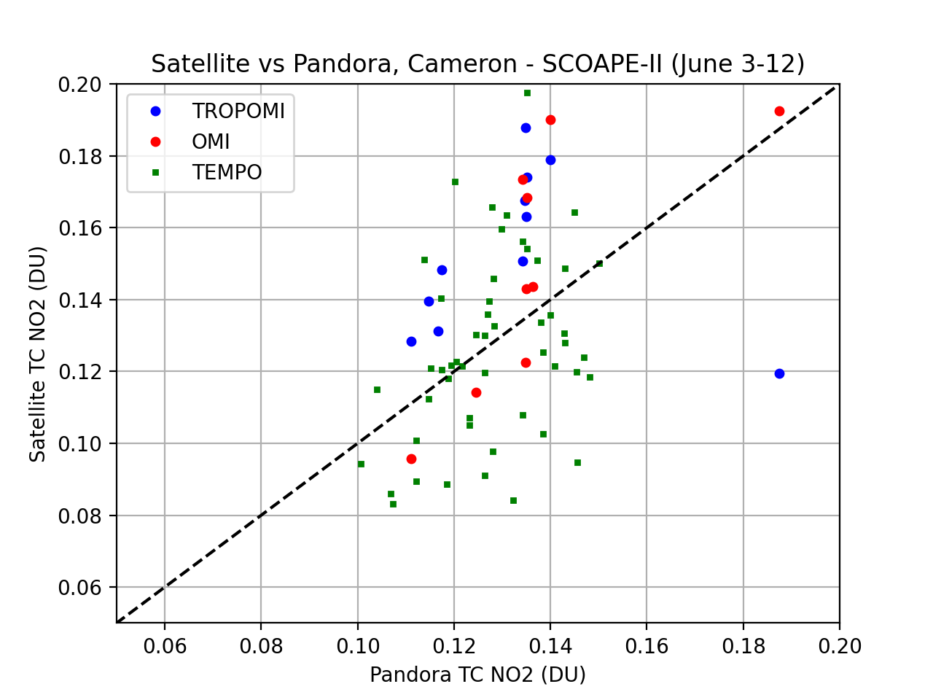
Pandora vs Satellite Comparisons
During SCOAPE-II (June 3rd – June 12th)
The land reference is the Pandora at BOEM’s monitoring site in Cameron, LA (west Louisiana coast; right)
  This is a generally non-polluted coastal area but is susceptible to transport of plumes from further away
TEMPO shows a weak correlation to Pandora over water (left) with large low bias; slightly better agreement on land - mean absolute biases of 25% (water) and 17% (land)
TROPOMI is within 10% over water and 24% over land
  TROPOMI has slight low bias over water and high bias over land compared to Pandora (similar to SCOAPE-I findings).
Spike captured by Pandora but not TROPOMI
TEMPO: r = 0.39
MAPB = 25%
TEMPO: r = 0.33
MAPB = 17%

Slide 10
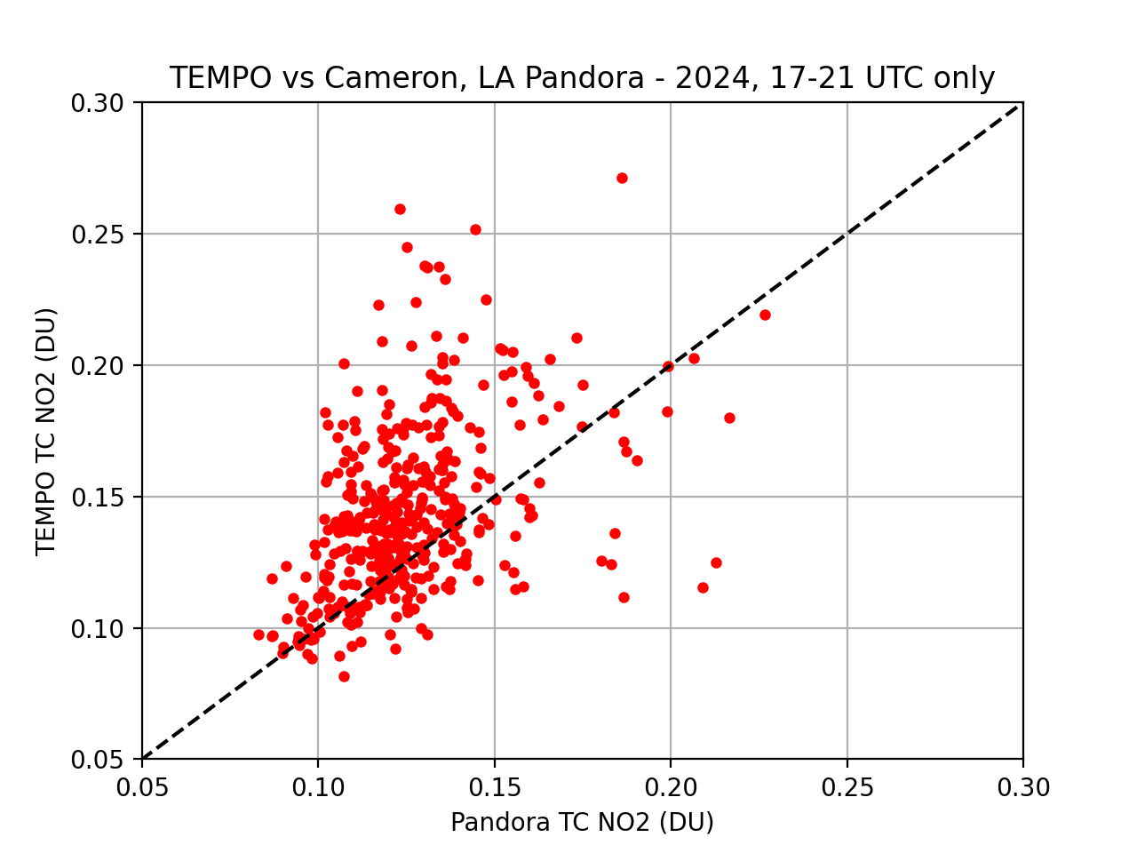
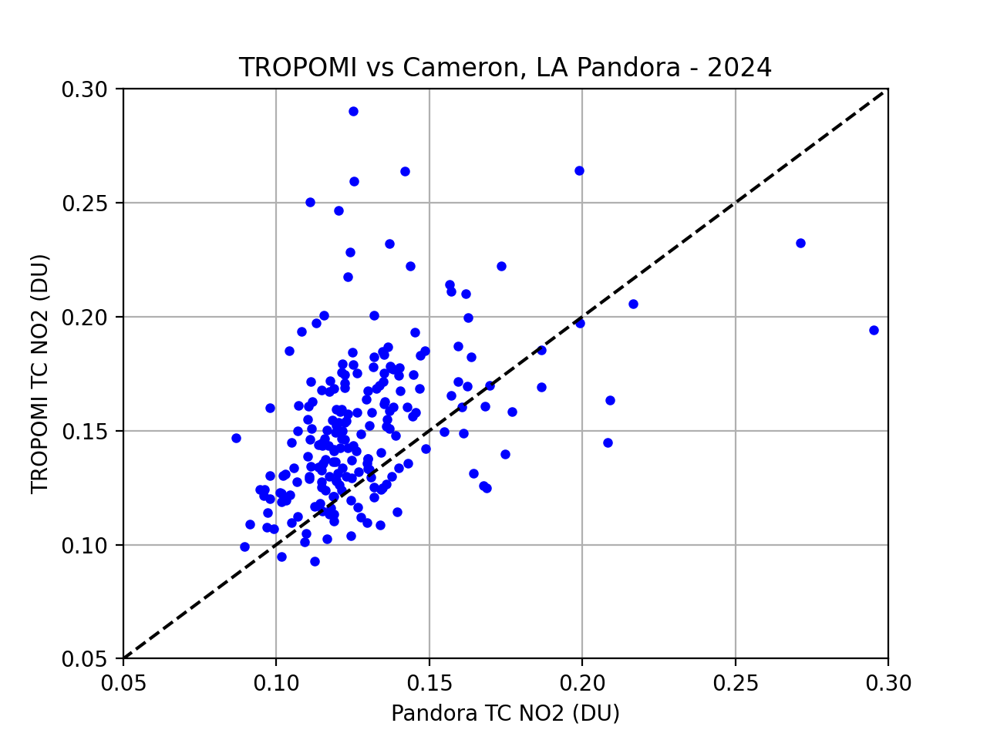
2024 TEMPO & TROPOMI vs. Cameron Pandora
R = 0.50
MAPB = 21%
R = 0.44
MAPB = 22%

Slide 11
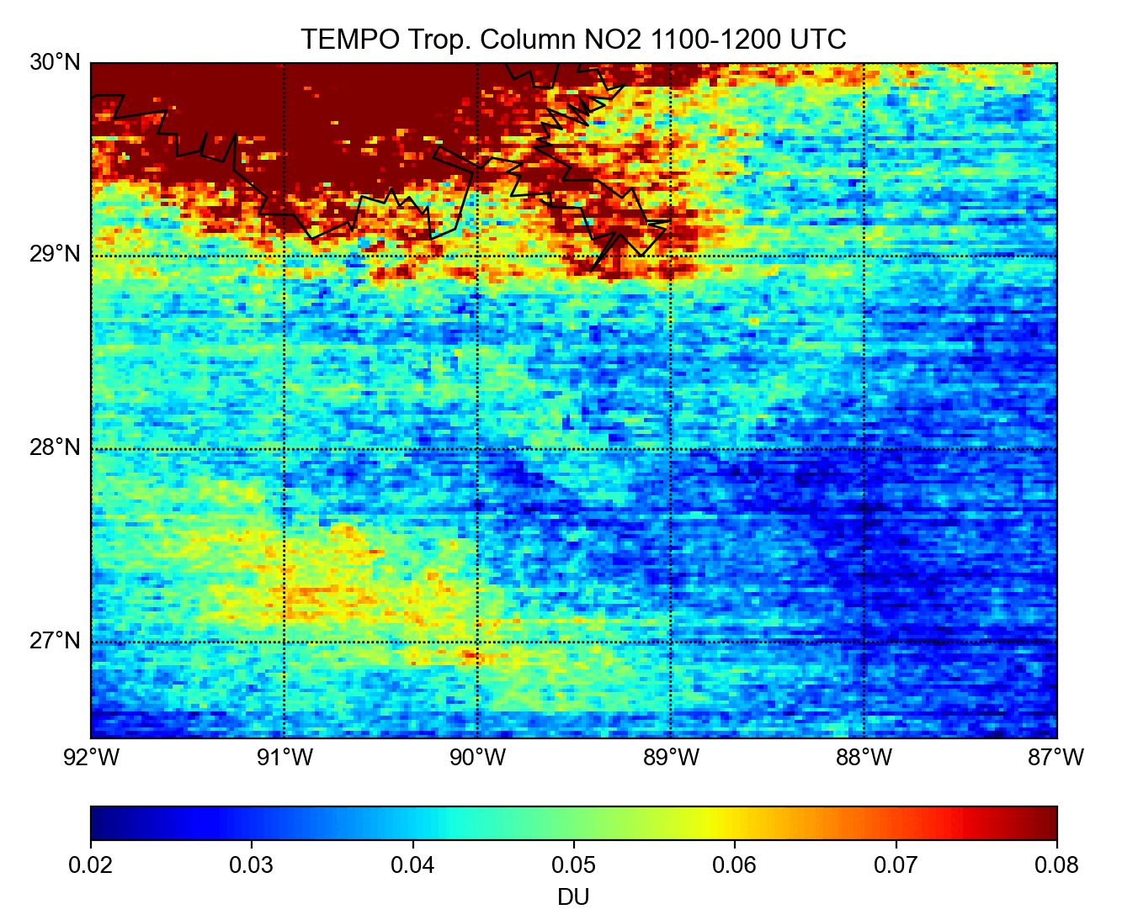
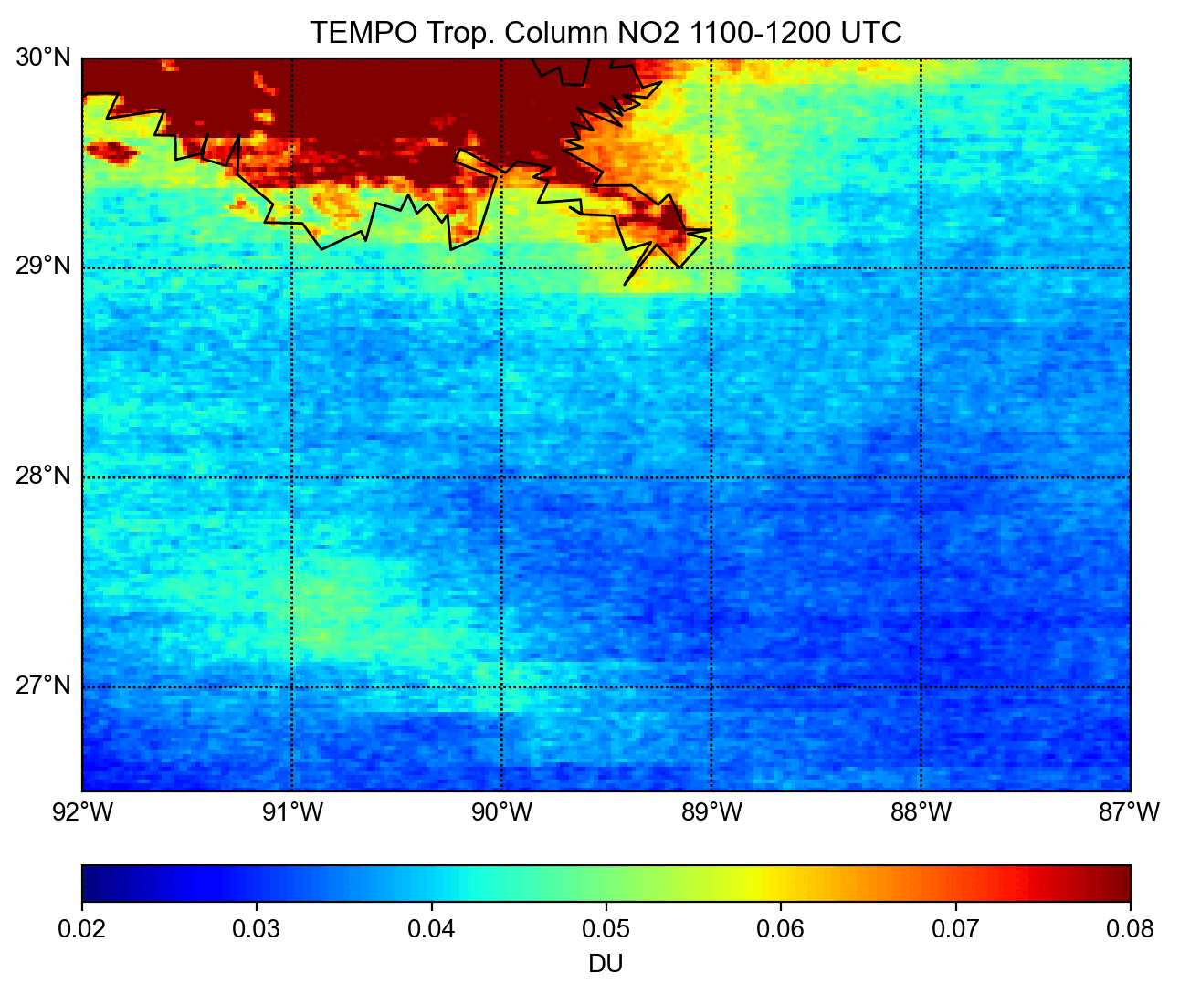
Diurnal Daytime TEMPO NO₂
SCOAPE-II Period (June 2nd-13th)
All of 2024

Slide 12
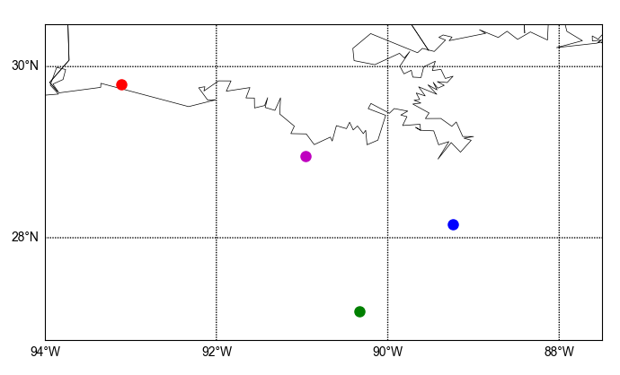
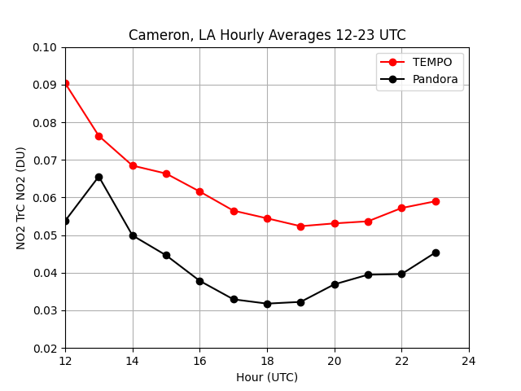
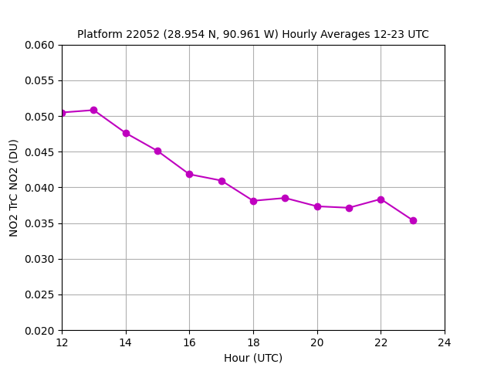
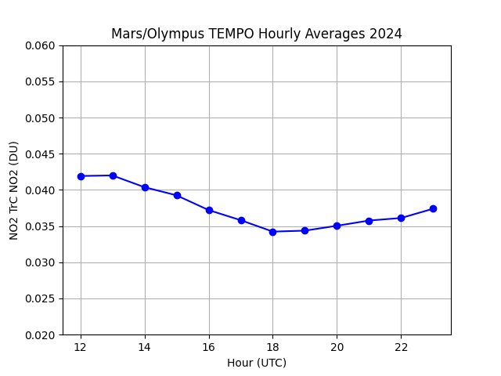
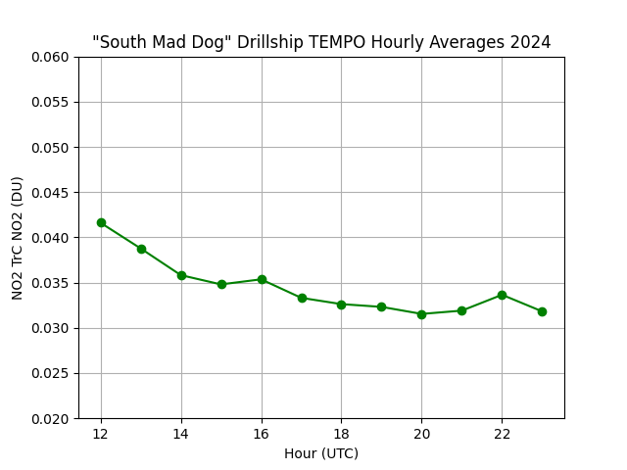
2024 Diurnal TEMPO Trop. Col NO₂
Colored dots on the map correspond to line color of each TEMPO time series →
TEMPO’s diurnal pattern agrees with Pandora at Cameron but is 47% higher on average (top left)
Aside from slightly differing amounts, all locations over water exhibit higher NO₂ in the morning that decreases throughout the day
  Mars/Olympus closest to the diurnal pattern exhibited by TEMPO on land (bottom left)
Earliest scan of the day is biased high – possibly due to high SZA

Slide 13
Summary
TEMPO can detect over-water NO₂ hotspots but striping in V3 somewhat reduces effectiveness – challenging retrieval, especially for emissions estimates
Daytime diurnal pattern of TEMPO at Cameron follows Pandora although it overestimates tropospheric column by ~50%
TEMPO’s correlation with Pandora during the SCOAPE-II period is low (R < 0.4) for both on the ship and the Cameron site; slightly higher R-value for full 2024 comparisons at Cameron
GCAS revealed that non-platform sources (especially drill ships) show similar plumes to platforms
Future work: We look forward to TEMPO V4 and assessing any improvements compared to the current version; Will also evaluate TEMPO with GCAS vertical columns and explore impact of wind regimes and source regions on Pandora-TEMPO NO₂ column comparisons
This study was funded by the U.S. Department of Interior, Bureau of Ocean Energy Management, Environmental Studies Program, Washington, DC through Inter-Agency Agreement Number A2501-014-080-073354
niko.m.fedkin@nasa.gov

