Slide 1

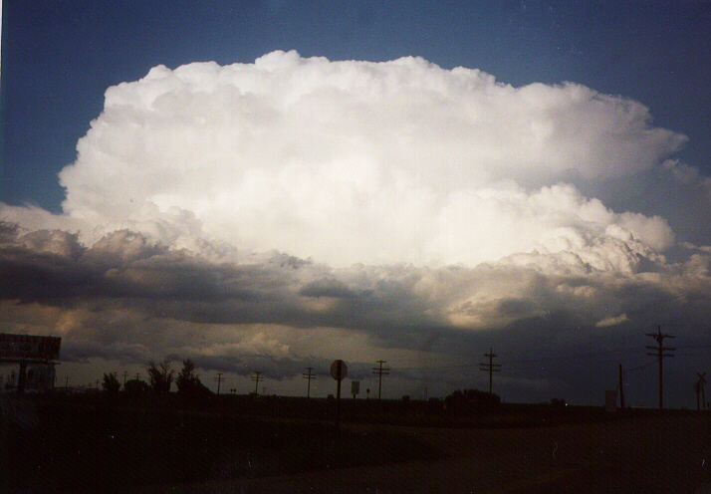
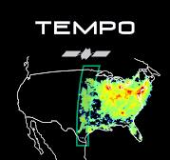


Observations of Lightning NO_{x} Production
from TEMPO Case Studies over the U.S.
Dale Allen¹
Kenneth Pickering¹, Eric Bucsela²,
Katrina Virts³, and Caroline Nowlan⁴
¹University of Maryland, College Park
²Science Systems and Applications Inc (SSAI)
³NASA Marshall Space Flight Center Impact
⁴Center for Astrophysics, Harvard & Smithsonian
TEMPO/GeoXO ACX STM (August 2025)
Photo of northeast Colorado STEREO storm
Courtesy of K. Pickering

Slide 2
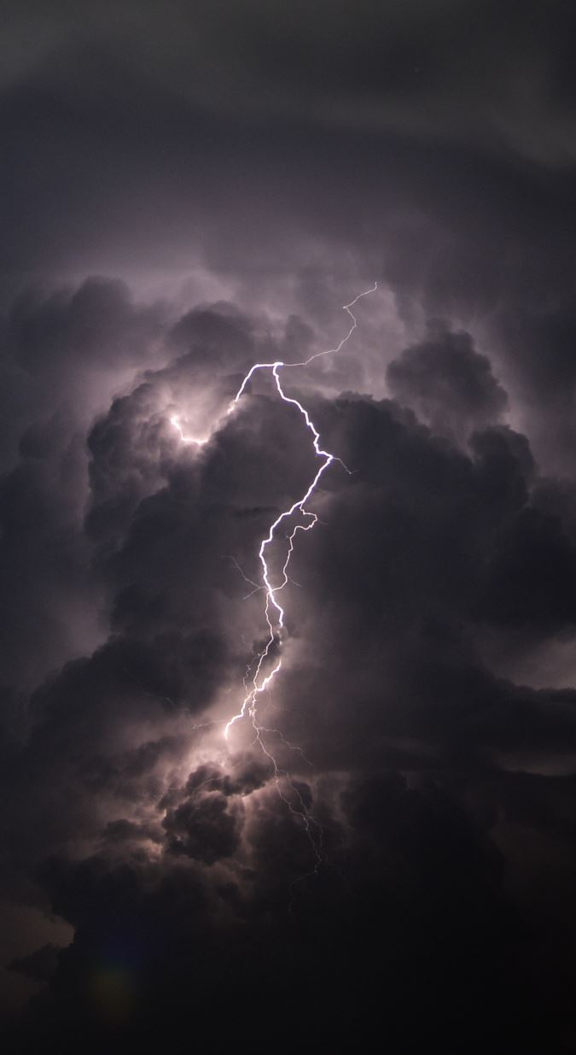
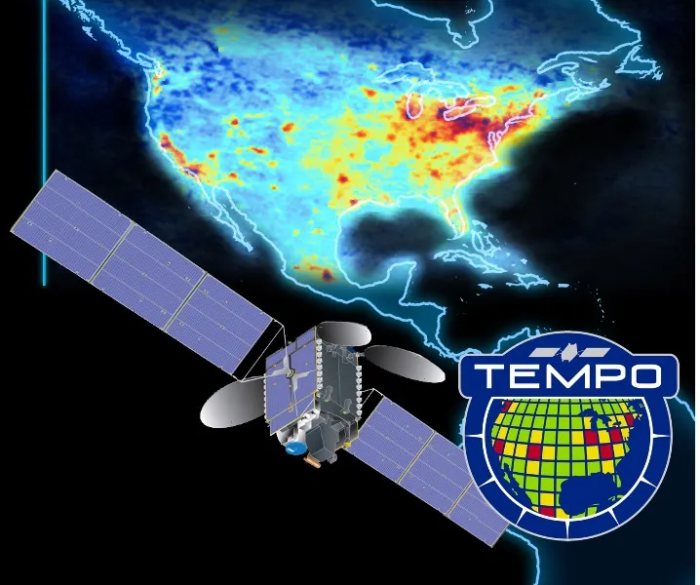
Introduction
Lightning produces NO because the extreme temperatures in lightning channels (> 1800 K) dissociate O₂ and N₂, which then combine to form NO, which quickly reacts with O₃ to form NO₂.
Lightning-NO_{x} (LNO_{x}) accounts for 10-15% of NO_{x} production globally; however, it has a relatively large impact on atmospheric composition and climate because much of it is injected into the mid- and upper-troposphere.
LNO_{x} enhances NO_{y}, OH, and O₃ while decreasing CH₄ and thus contributes to enhanced longwave radiation absorption by O₃ and decreased longwave radiation absorption by CH₄.
In this TEMPO-funded project, we will estimate the moles of NO_{x} produced per flash using flash counts from Geostationary Lightning Mappers (GLMs) and the ground-based Earth Networks Total Lightning Network (ENTLN) and NO₂ and cloud products from TEMPO.
\

Slide 3
Methodology
Identify convective systems with lightning flashes and a TEMPO NO₂ signal.
Extract TEMPO products for pixels over deep convective scenes, i.e., pixels with optical cloud pressures < 500 hPa, and cloud radiance fractions > 0.97.
Examine differences in TEMPO products (SCDs, VCDs, cloud pressures, and AMFs) between retrievals that have and have not been exposed to recent lightning.
Exploit these differences and NO_{x} / NO₂ ratios from GEOS-CF to estimate the moles of NO_{x} produced per flash.

Slide 4
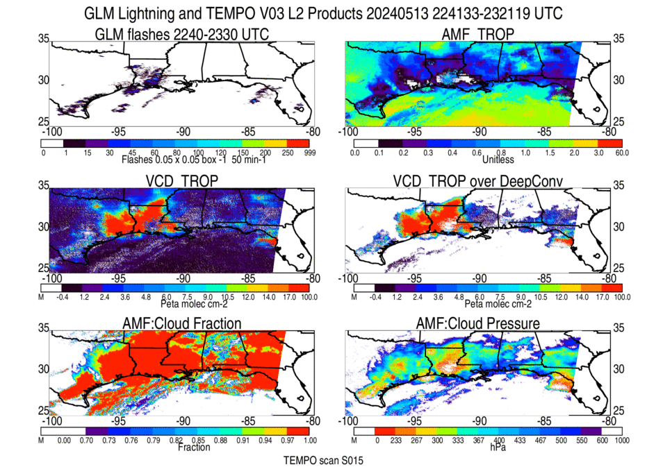
Tropospheric AMFs
(VCD = SCD / TropAMF)
are needed to obtain VCD
However, TropAMFs
are small and uncertain
over deep convection
Lightning flash counts
during time of scan
Tropospheric VCD of
NO₂ over all scenes
Transparent when
saturated, of
suspect quality,
or outside of scan
Tropospheric VCD of
NO₂ over deep
convective pixels
Cloud radiative
fraction at 440 nm
>0.97 (red) →
Deep convection
Optical Cloud Pressure
< 500 hPa →
Deep convection
NO₂ columns are unavailable over bright scenes. For this May 13 case study, scans 3-6 and 13-15 used to estimate PE.

Slide 5
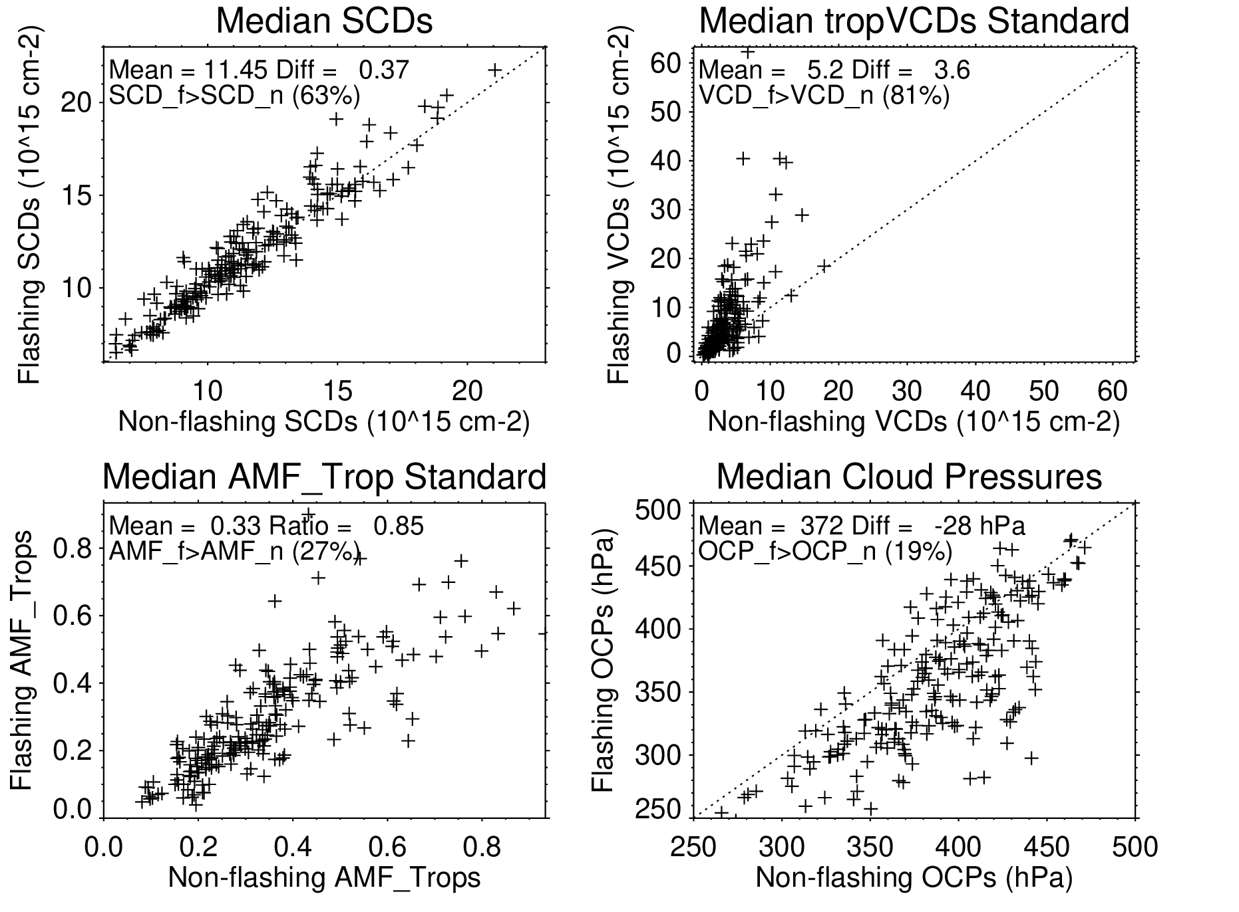
Scatterplot showing median differences in TEMPO products between flashing and non-flashing retrievals (based on 213 scans)
VCDs over flashing deep convective pixels
are usually greater than those over non-flashing deep convective pixels. These differences can be exploited to estimate the molecules of NO_{x} due to recent lightning.
However, care is needed because smaller AMFs associated with lower cloud pressures are also observed over flashing
scenes explaining much of the differences.

Slide 6
How will mean moles of NO_{x} produced per lightning flash (PE)
PE = [V_{tropLNOx} × Σ Area_{i}] / [N_{A} × Σ (Flash_{i} × exp(-t_{i} / 𝝉) )]
V_{tropLNOx} ≡ Difference in median trop. VCD of NO₂ between flashing and non-flashing pixels multiplied by the ratio of NO_{x} to NO₂ columns from GEOS-CF
Σ Area_{i} ≡ Area of deep convective pixels within region-of-interest (ROI)
Flash_{i} ≡ # of flashes an individual GLM flash represents (1 if no DE adjustment)
t_{i} ≡ Age of individual flash at time of scan (hours)
𝝉 ≡ Assumed lifetime of NO_{x} in near field of convection (𝝉 = 1,2,3,4,5,6,8,10,12, & ∞ hours) (Nault et al., 2016, 2017)
Summation should be performed from time that storm began until scan-time
Insights into the value of t can be obtained from high temporal resolution (10-minute) scans with TEMPO

Slide 7
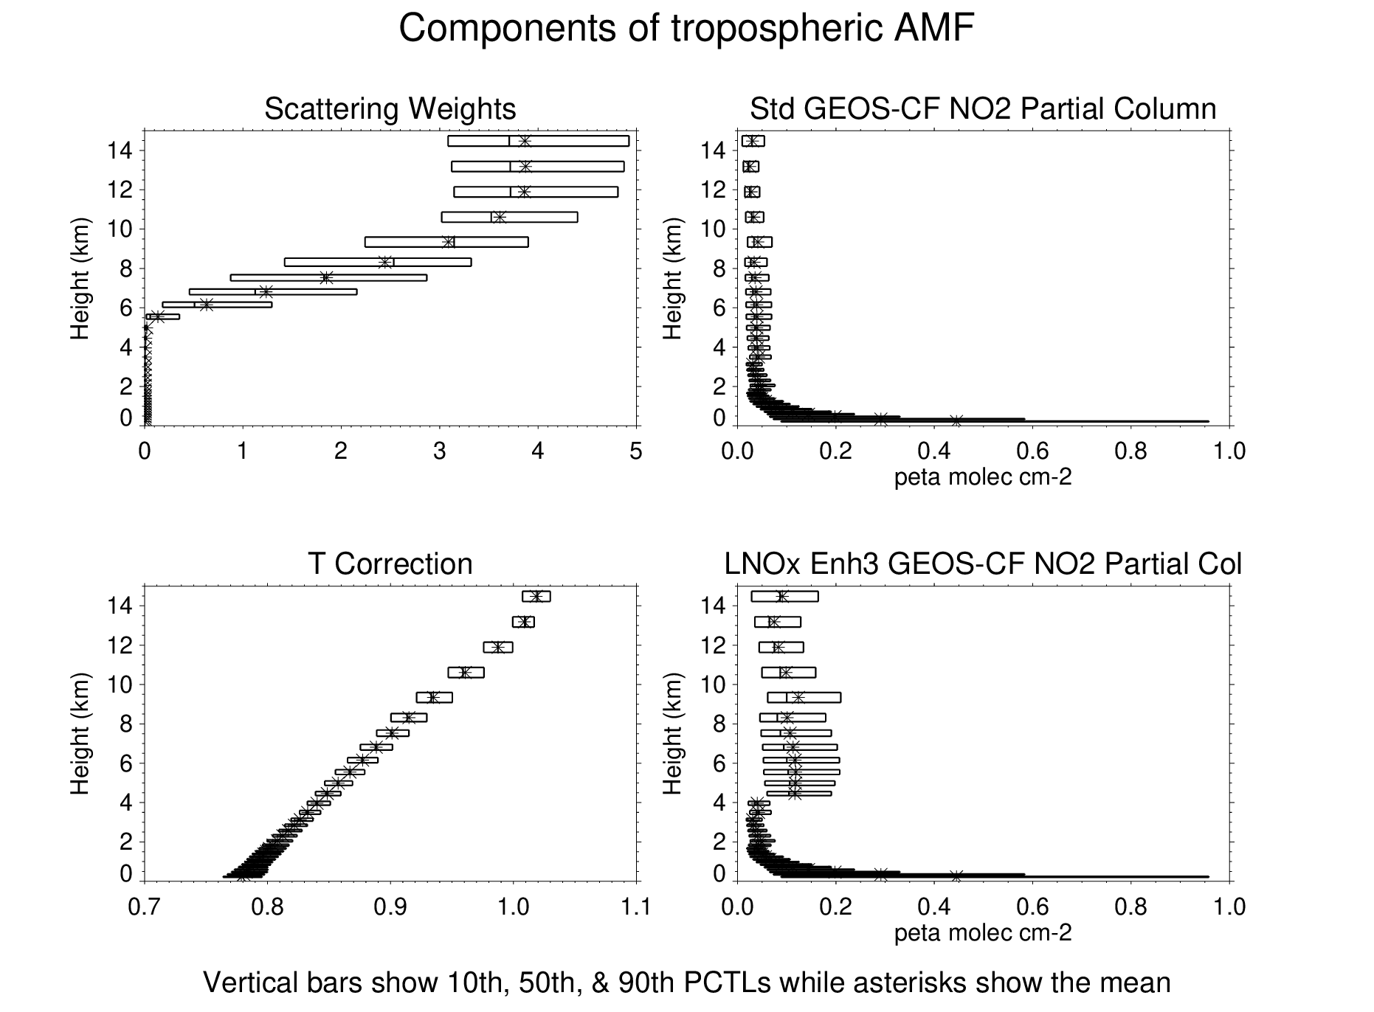
Tropospheric VCD of NO₂ is sensitive to a priori NO₂ profile (Ω) via AMF_{trop}
VCD_Trop = SCD_Trop / AMF_{trop},
where AMF_{trop} = Σ_{I} W_{i} Ω_{I} α_{I} / Σ_{I} Ω_{I}
(integration over layers in troposphere)
W_{i} ≡ scattering weight, Ω_{I} ≡ a priori trace gas partial column from GEOS-CF, α_{i} ≡ temperature correction (Note: shape function ≡ Ω_{I} / Σ_{I} Ω_{I})
Values of AMF_{trop} are unreliable and likely biased
high when much of the NO_{x} is located below
the OCP and invisible to TEMPO. This could happen if deep convection in the GEOS-CF is misplaced or mistimed.
W_{i}
Ωi
α_{i}
Ωi (enh)
×3
for P < 600 hPa
Percentiles of W_{i}, Ω_{I} (std), α_{I}, & , Ω_{I} (UT enh) for deep
convective retrievals over the regions of interest for
the 213 scans used in estimating PE.

Slide 8
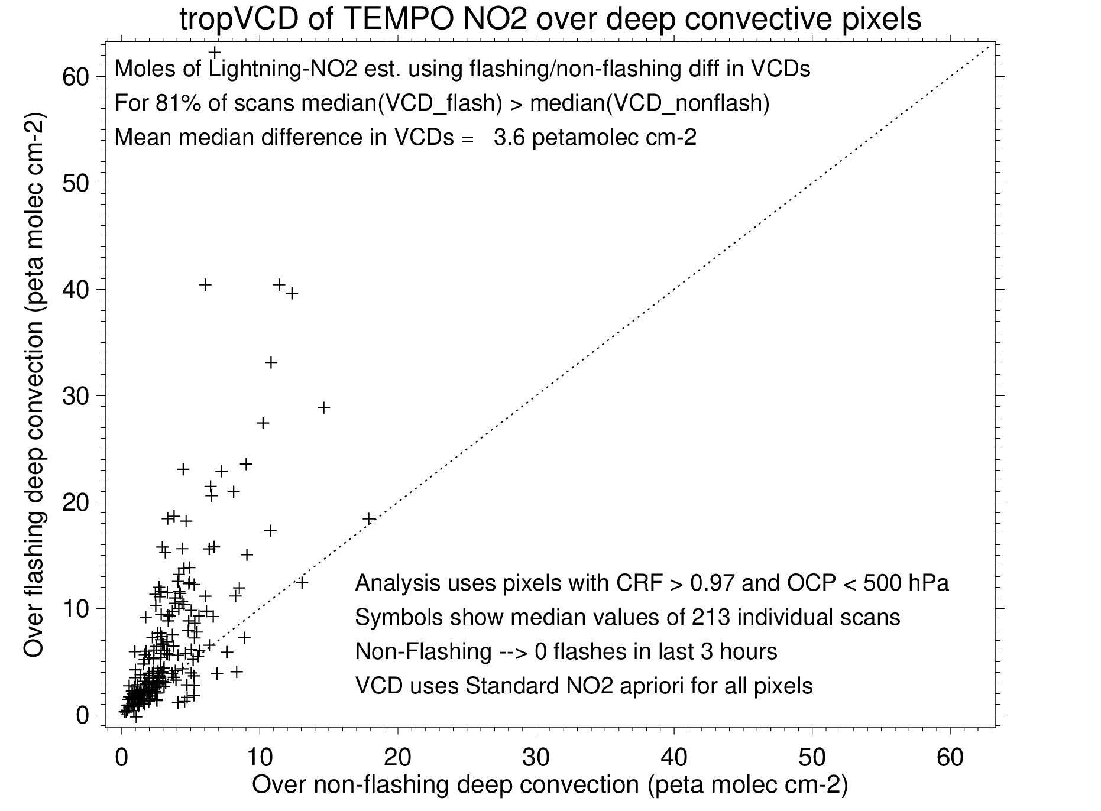
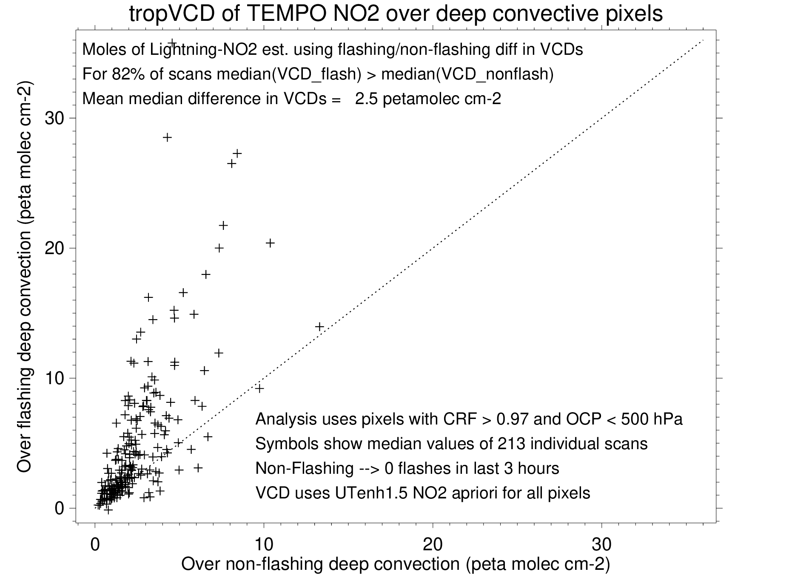
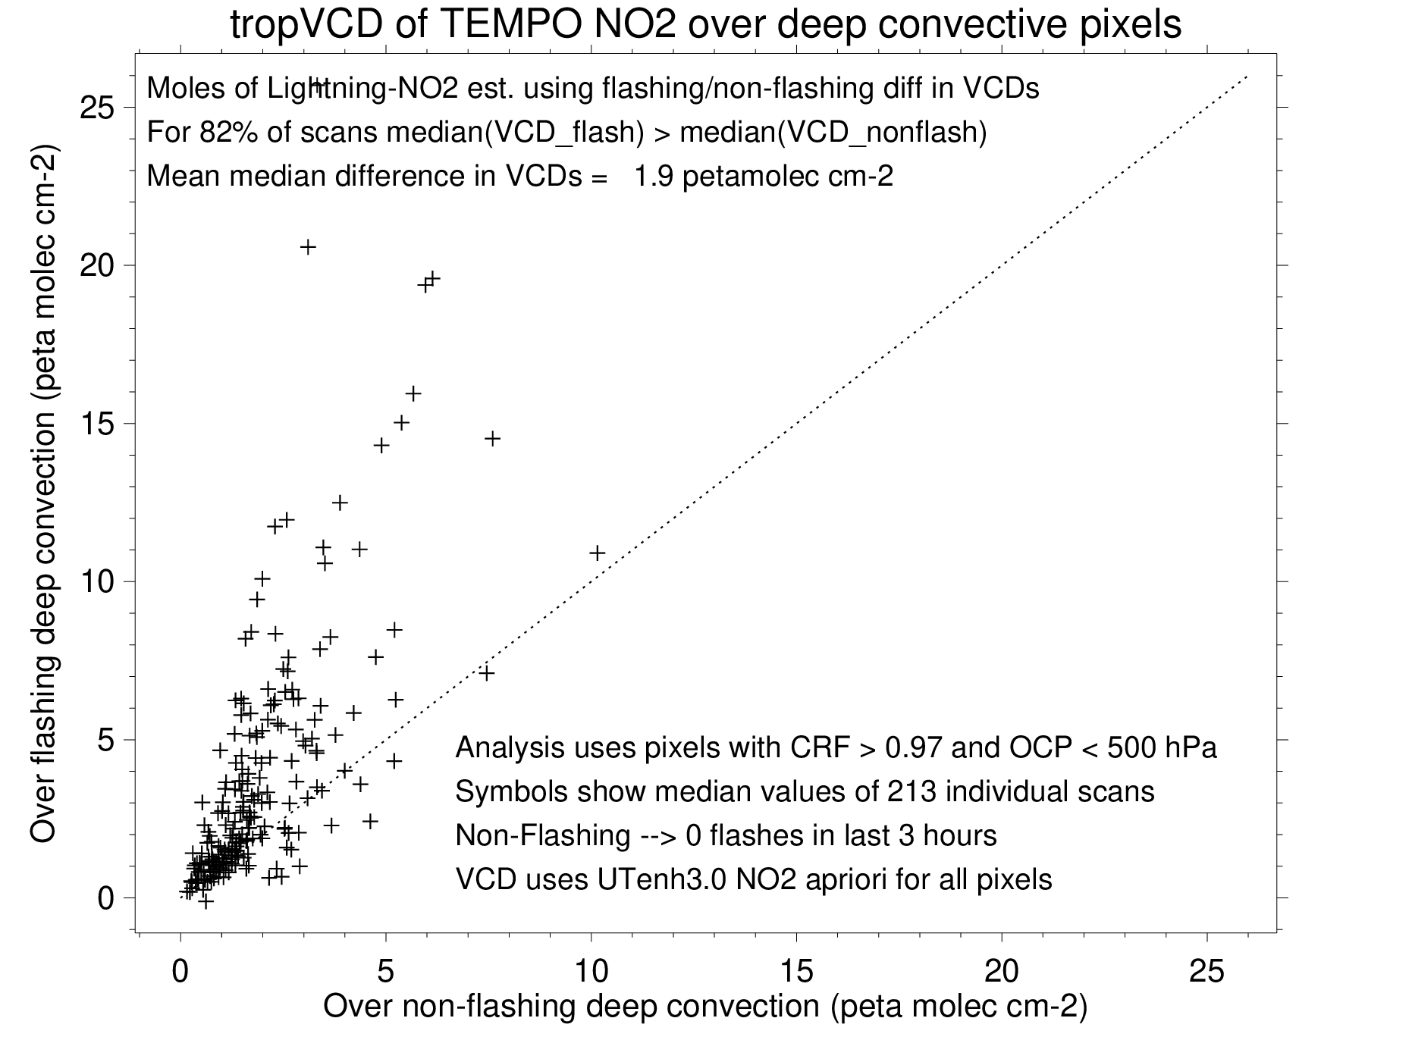
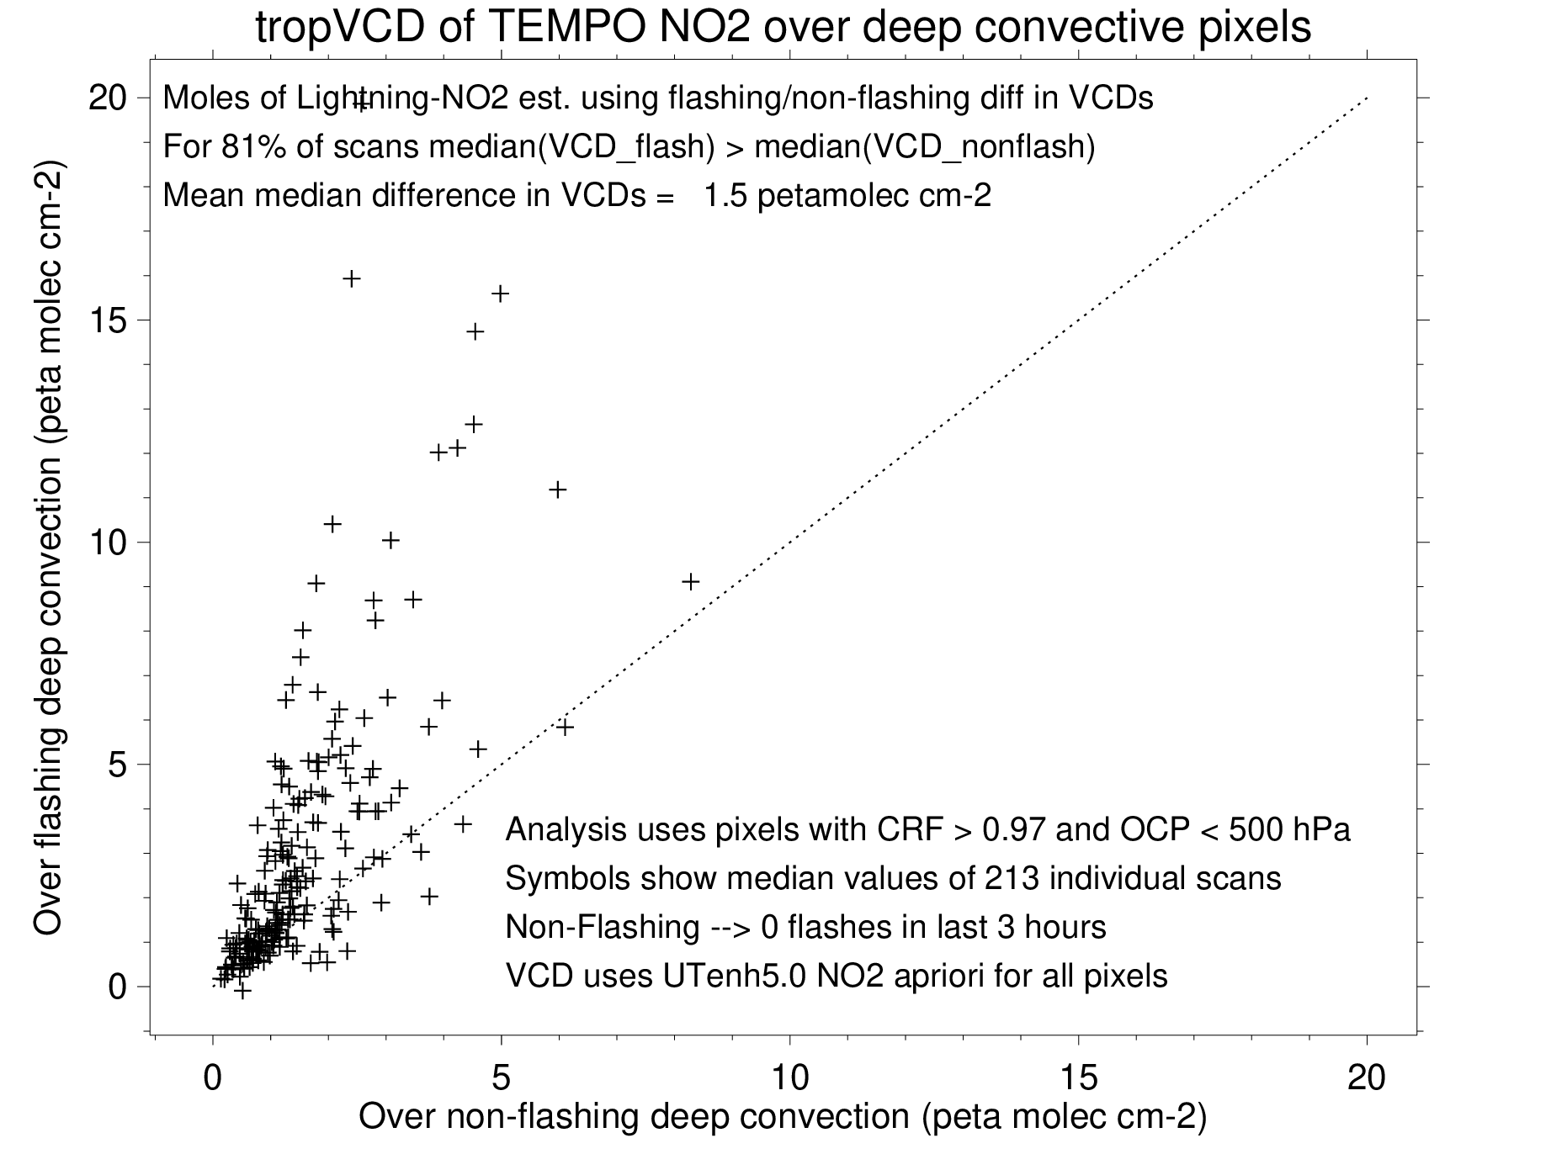
60
Scatterplots showing median tropVCD
over non-flashing (x-axis) and
flashing (y-axis) scenes as
a function of upper tropospheric
LNOx enhancement assumed in
a priori trace gas partial column (Ω_{I})
An NO₂ shape function with more NO₂ in the upper troposphere leads to a larger AMF_{trop} and smaller NO₂ VCD.
30
UT_enh1.0
UT_enh1.5
25
20
UT_enh3.0
UT_enh5.0

Slide 9
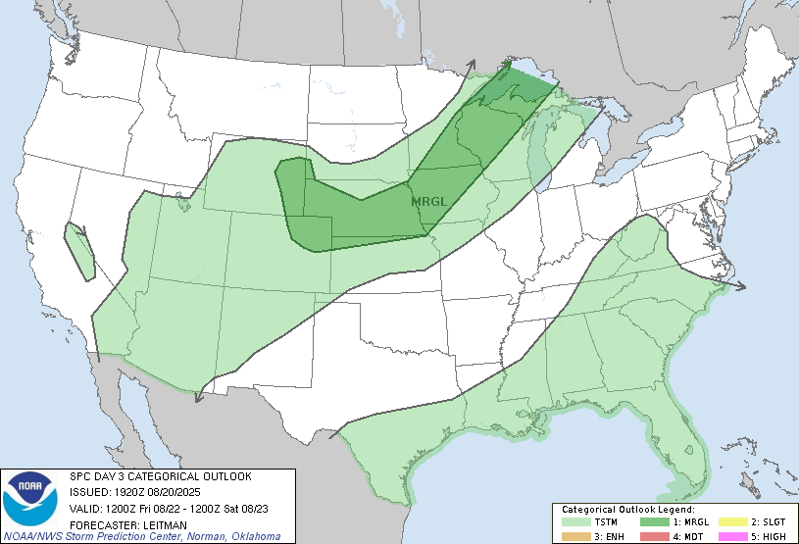
TEMPO High-Resolution Lagrangian Lightning NO_{x} (LNO_{x}) Experiment
Because of saturation issues, only three to four snap shots of LNO_{x} from convective systems are available from standard scans. However, 12 to 20 snap shots are possible when 10-minute special operations are performed.
These scans cover approximately 10-degree wide longitude bins centered on a longitude chosen using medium-range convective outlooks and / or climatology.
To date, high temporal resolution NO₂ data are available for at least 3 days (June 19th, June 20th, and July 25th). Future cases will become available as we request additional special experiment or piggyback on other experiments. Our goal is to sample a variety of storm types (individual air mass cells, multi-cellular storms, squall lines, supercells) with a wide range of flash rates
Lagrangian data will allow analysis of decay of NO_{x} as it moves downwind for obtaining estimates of chemical lifetime. Examine evolution in non-flashing cells to aid background estimate.
Concurrent in-situ aircraft or balloon NO & NO₂ profiles (e.g., M. Newchurch & B. Lynn) would be useful for AMF calculation, converting NO₂ to NO_{x}, and evaluating TEMPO LNO_{x} estimates
SPC day 3 convective outlook

Slide 10
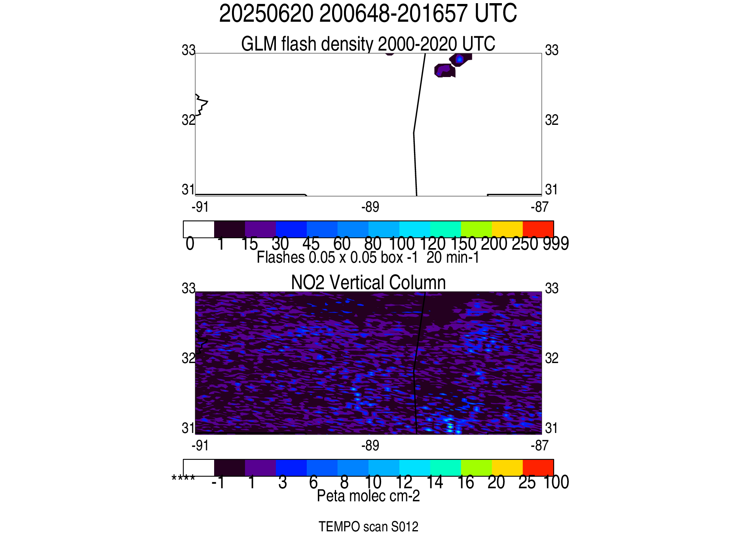
On June 20th, TEMPO was run
in a special operation mode
This animation shows
10-minute variations in
Flash rate and NO₂ VCD.

Slide 11
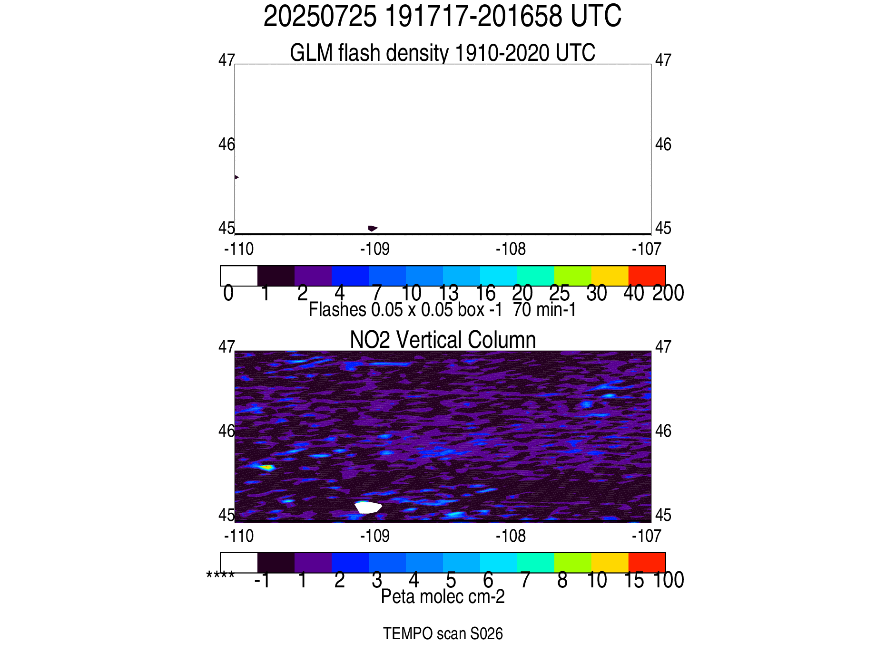

Slide 12
Summary
TEMPO spectra saturate over very bright clouds, esp. between 10 AM and 4 PM LT.
Tropospheric SCDs (VCDs) of NO₂ are slightly (considerably) larger over deep convective pixels with recent lightning than over other deep convective pixels enabling estimation of LNO_{x} PE.
TEMPO LNO₂ signal is exaggerated due to low-biases in a priori AMF over deep convection associated with NO2 below the optical cloud pressure or misplacement and/or mistiming of convective systems by GEOS-CF.
High resolution (10-minute) temporal scans with TEMPO will be useful for constraining the lifetime of NOx in the near field of deep convection and for examining variations in NOx production per flash with flash rate/length.

