Slide 1
PM_{2.5} estimation using machine learning from GOES-R and TEMPO over CONUS
Seohui Park,
Alqamah Sayeed, Junhyeon Seo, Barron H. Henderson, Aaron R. Naeger, and Pawan Gupta

Slide 2


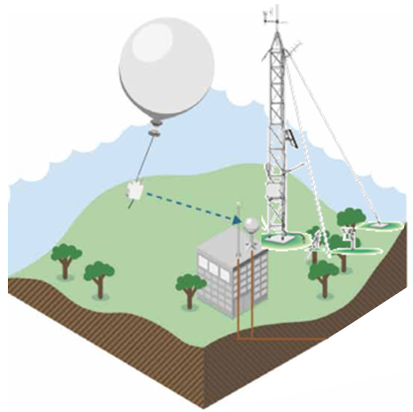

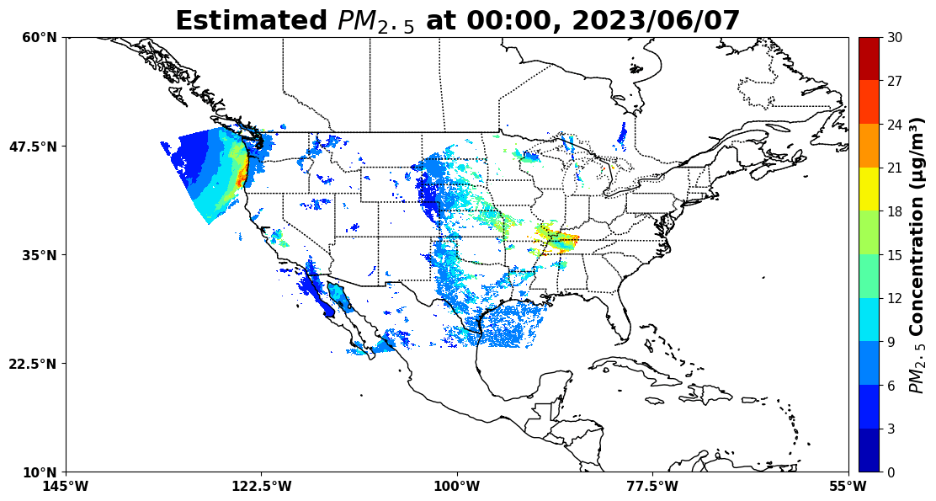



PM_{2.5} estimation using machine learning from GOES-R and TEMPO over CONUS
Data fusion for hourly PM_{2.5} variations
Ground-based monitoring is traditional method for measuring PM_{2.5} concentrations.
Fusion of ground measurement and Satellite products through AI
(i.e., machine learning, deep learning)
Spatial limitation
Not sufficient to represent large area
Artificial Intelligence (AI)
Satellites provide aerosol optical depth (AOD) with high spatial coverage, enabling monitoring of large area.
Not available ground-level aerosol information
Hourly PM_{2.5} concentration evolutions
Notes:
The core idea of this study is data fusion.
Ground-based monitors give us accurate PM measurements. But only in limited locations.
Satellite cover large areas, but they provide atmospheric total columns information.
To bridge this gap, we used machine learning.
The model learns the relationship between satellite data and ground measurements where both exist, then applies it to other areas
The goal is to combine the strengths of both data sources — broad coverage and local accuracy —to produce hourly PM2.5 estimates.

Slide 3
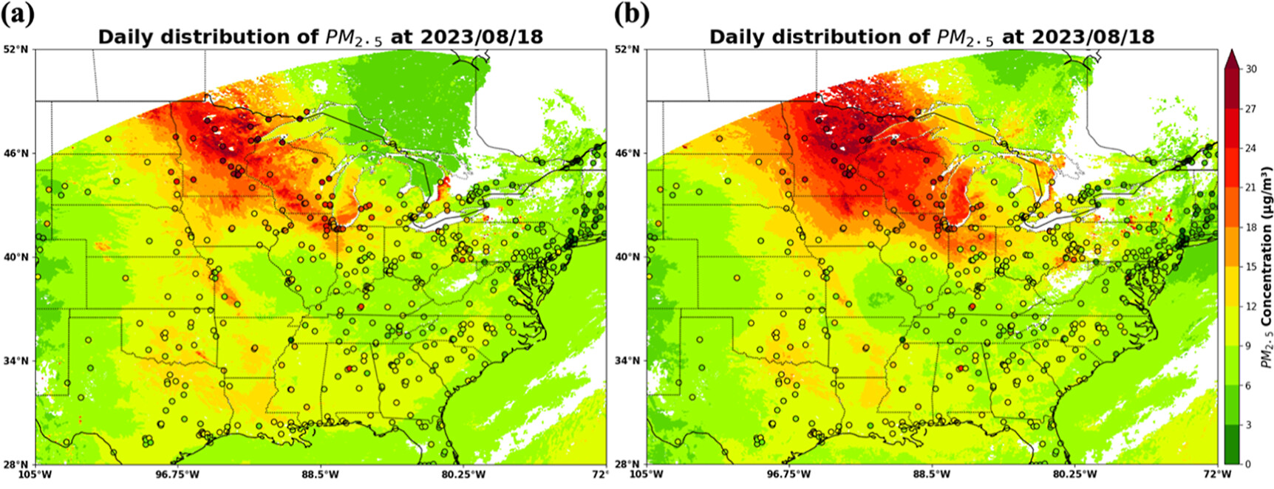
PM_{2.5} estimation using machine learning from GOES-R and TEMPO over CONUS
5 Months → 1 Year
2023.08
2023.12
2024.07
Park et al., 2025
Improved !
Study period extended to 1 year
→ broader trend capture
Model stability improved
→reduced short-term noise
FRP variable added
→ impact evaluation included
Seasonality analysis enabled
  → recurring patterns identified
Without TEMPO
With TEMPO
Notes:
In the first stage, we used five months of data, from August to December 2023, and published those results in a paper.

Slide 4
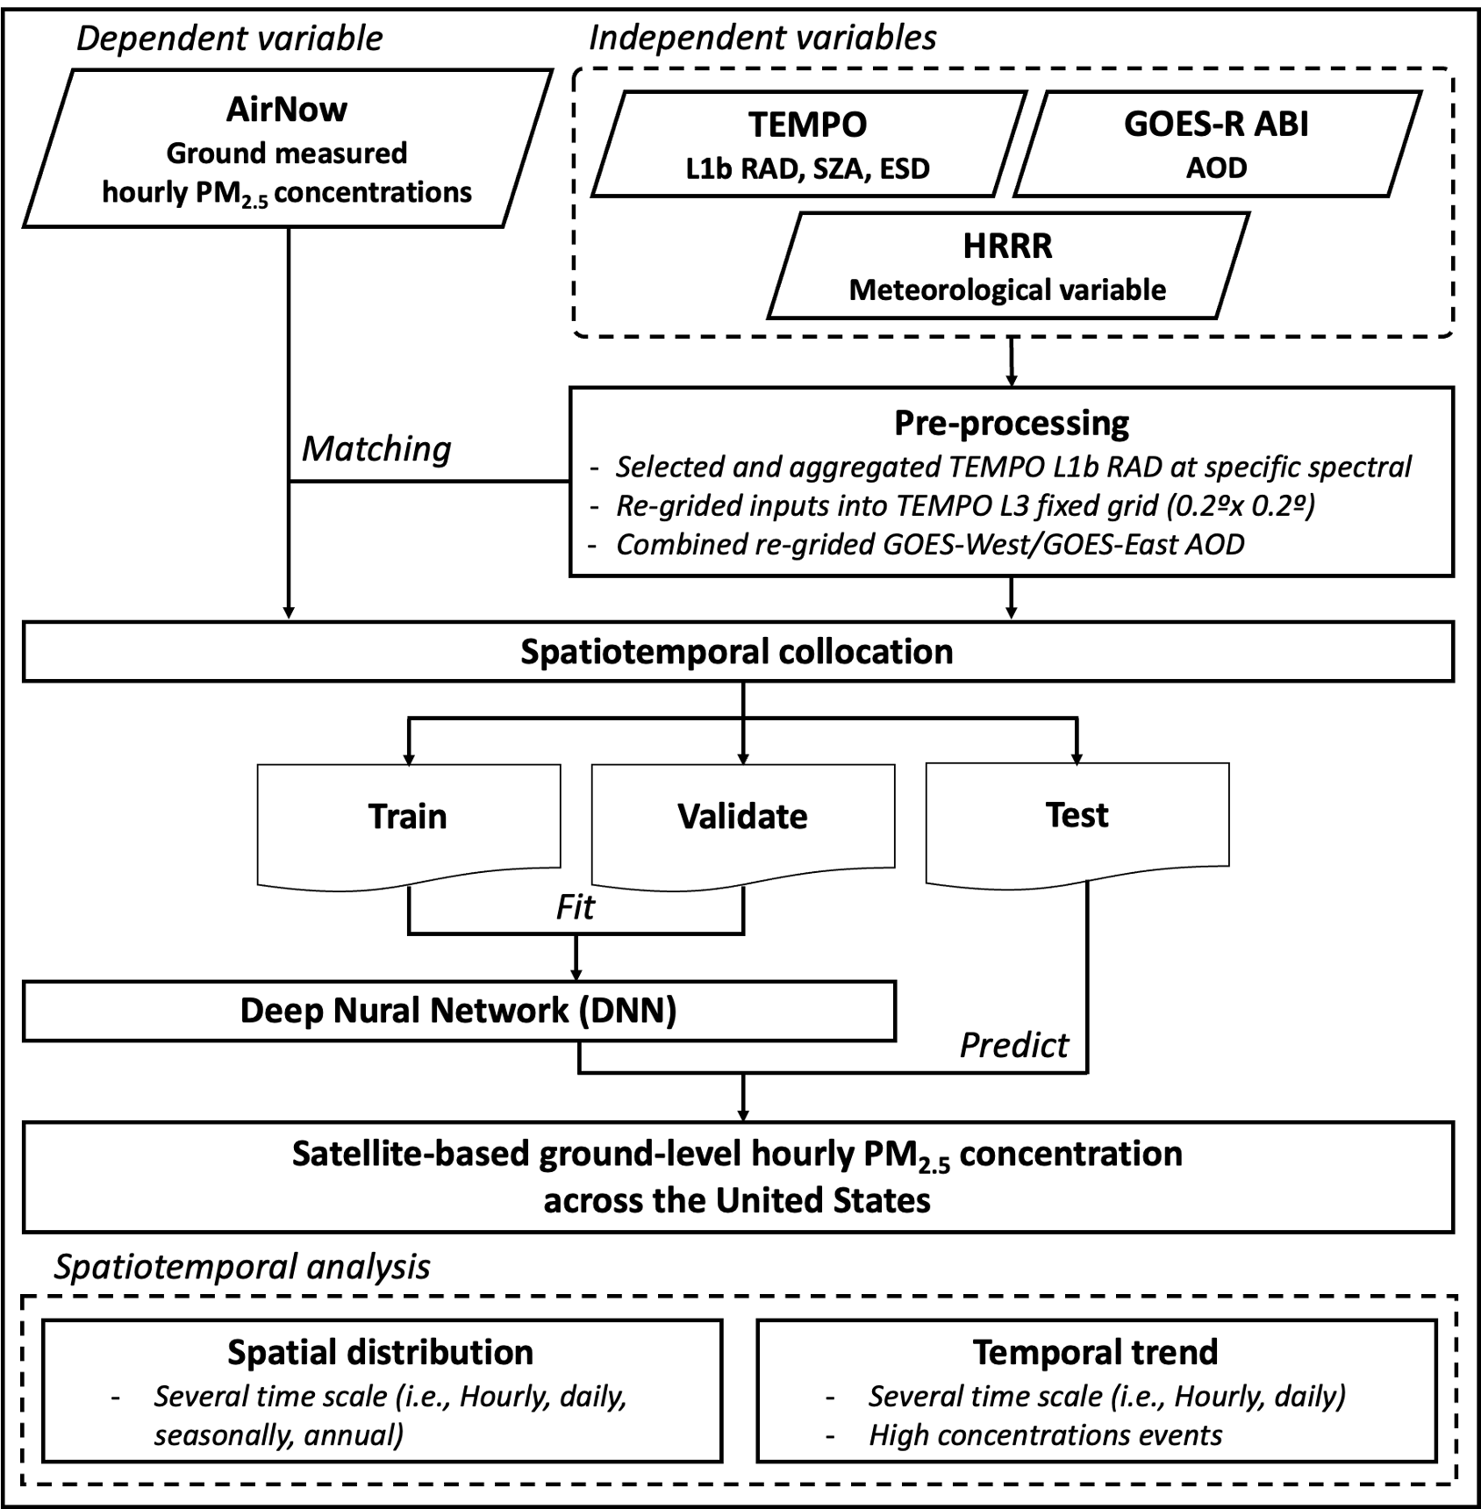
PM_{2.5} estimation using machine learning from GOES-R and TEMPO over CONUS
Schematic diagram
Data collocation
1-year (2023.08.02 – 2024.07.31) data were used for this study
TEMPO radiance: 354nm, 388nm, 412nm, 443nm, 490nm, 550nm, 670nm
Additionally used ABI FRP data as input
Model development
Dataset were randomly divided 80%, 20%, and 10% for training, validation, and test sets
Deep Nural Network (DNN) were used as main model
Spatiotemporal analysis
High PM_{2.5} concentration cases

Slide 5
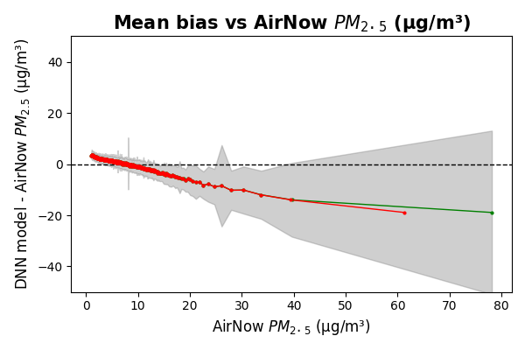
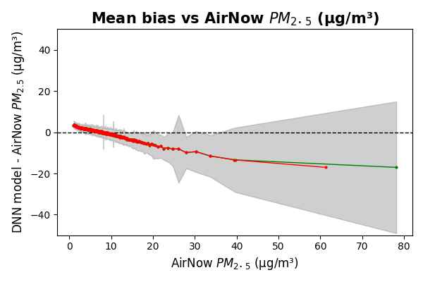
PM_{2.5} estimation using machine learning from GOES-R and TEMPO over CONUS
Overall Model performance
Training
Validation
Test
Without FRP
Without FRP
With FRP
With FRP

Slide 6
PM_{2.5} estimation using machine learning from GOES-R and TEMPO over CONUS
Overall Model performance
Notes:
I compared model performance in areas with and without FRP values.

Slide 7
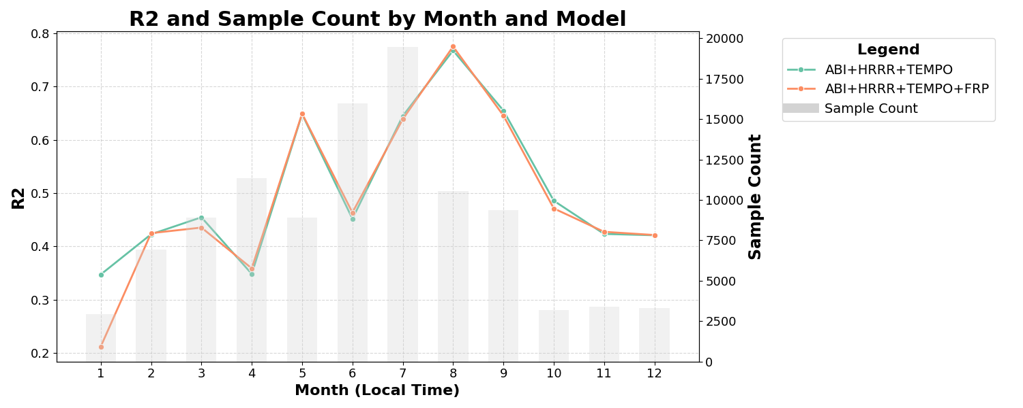
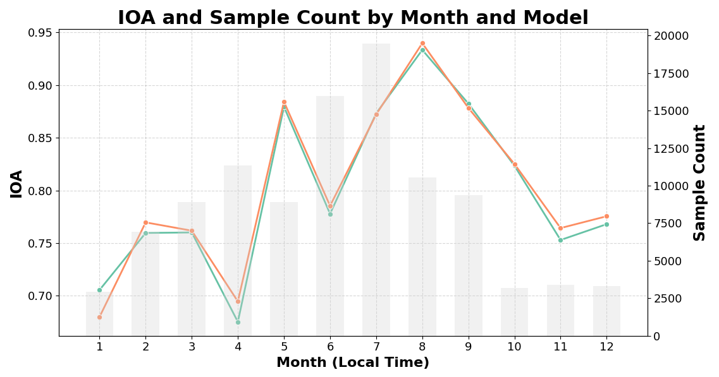
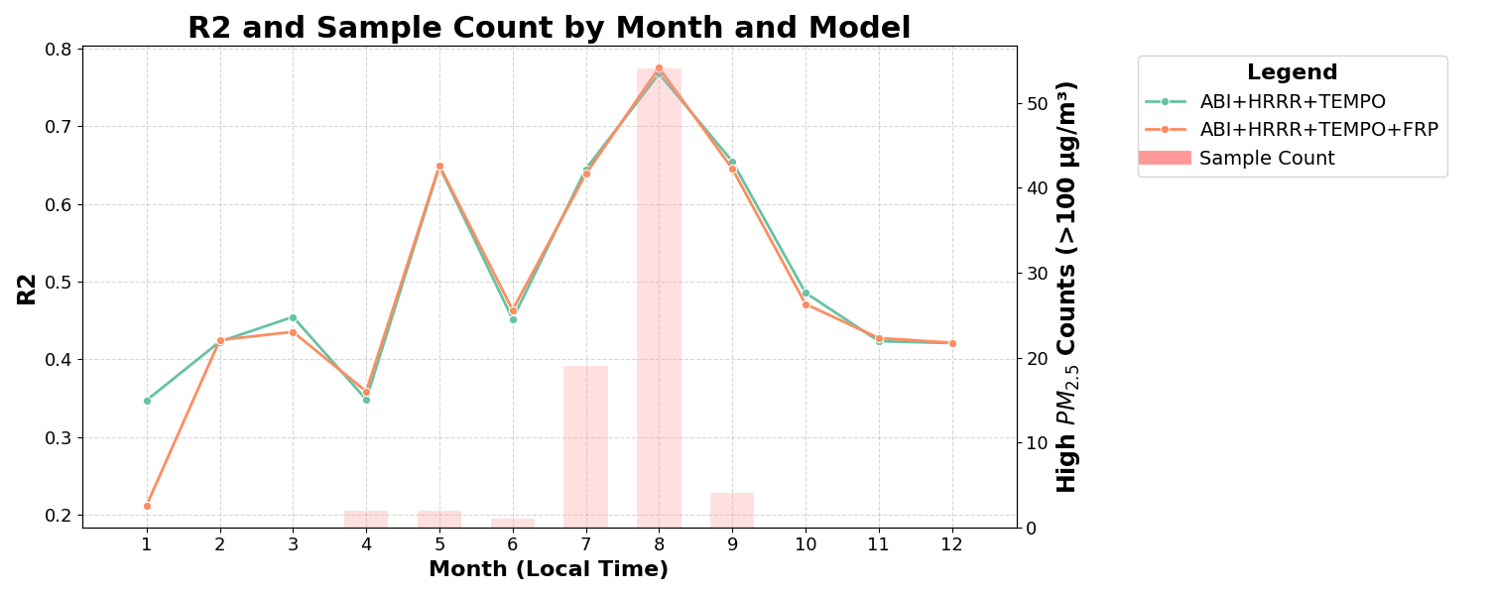
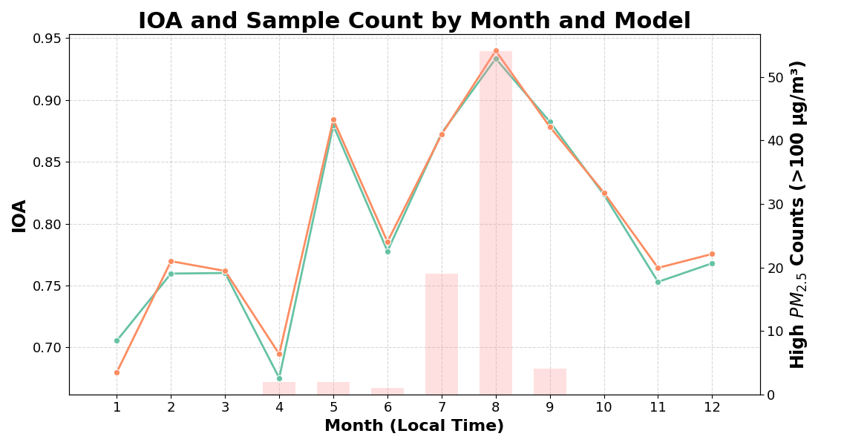
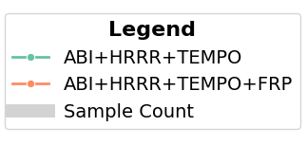
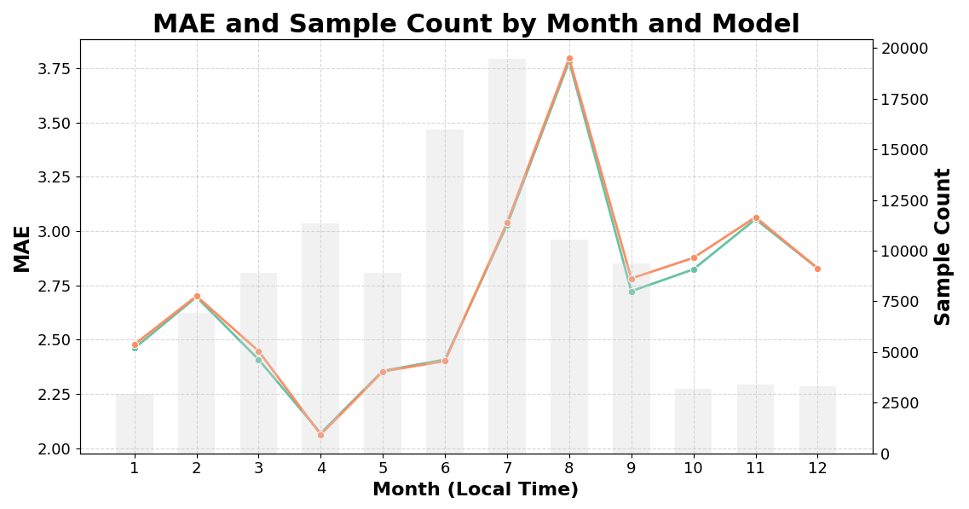
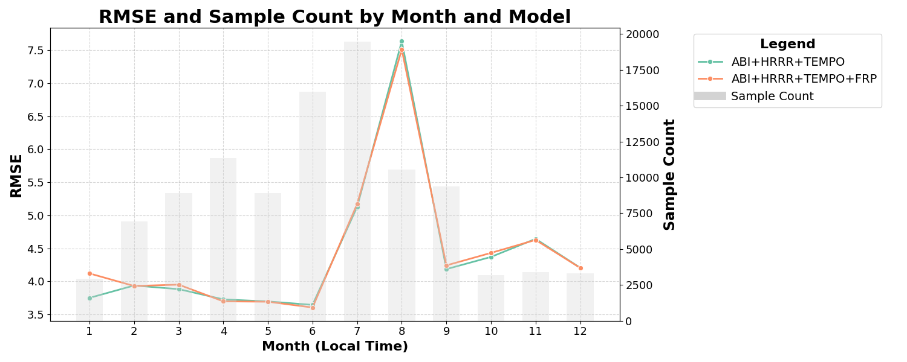
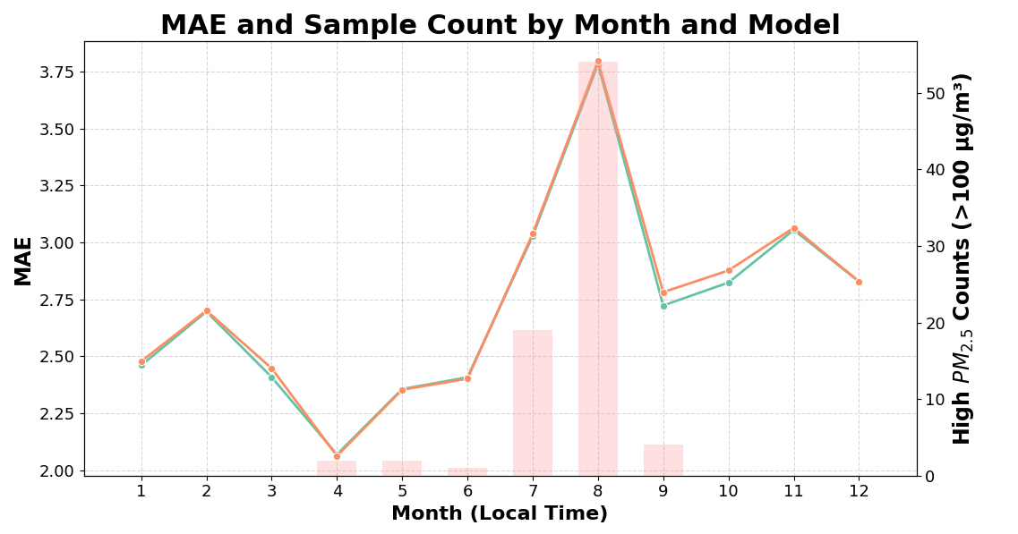
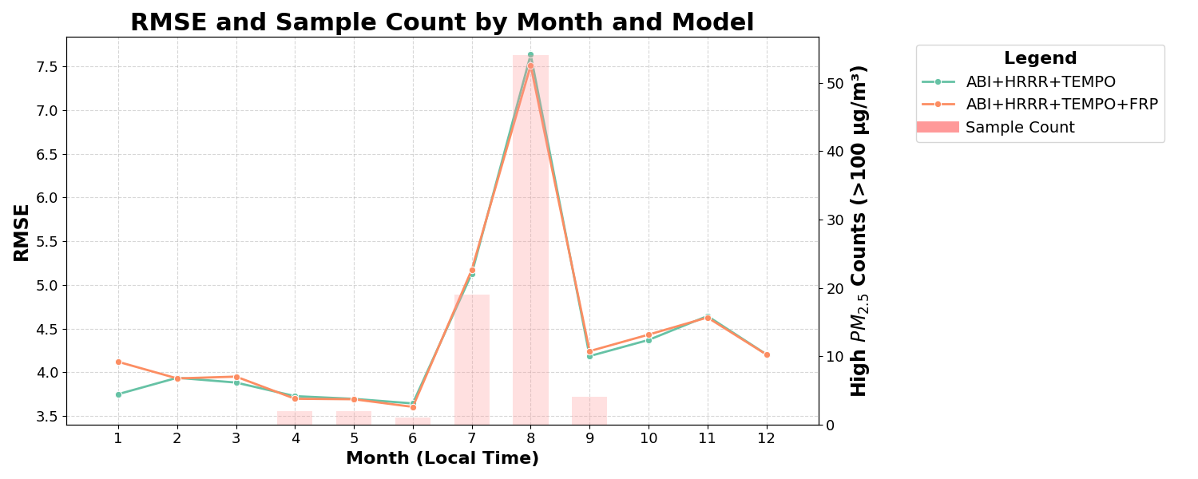
PM_{2.5} estimation using machine learning from GOES-R and TEMPO over CONUS
Model performance by month
For test set

Slide 8
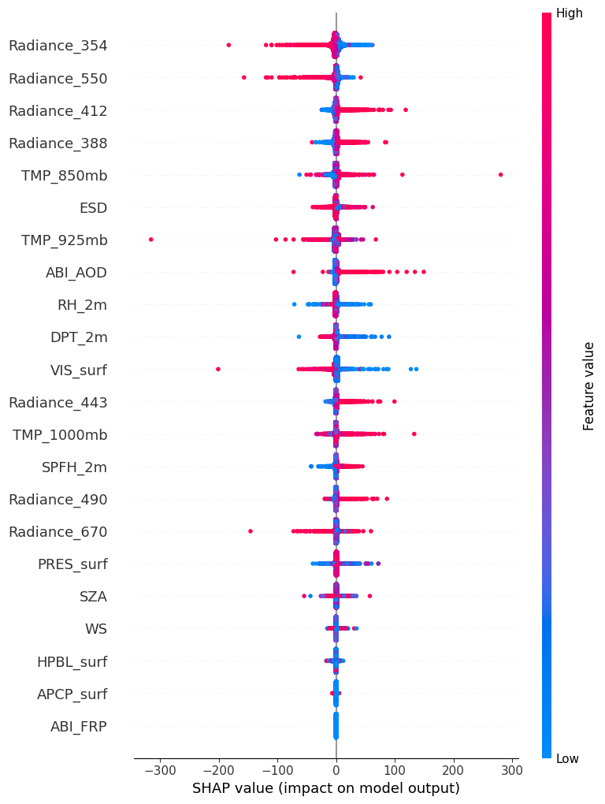
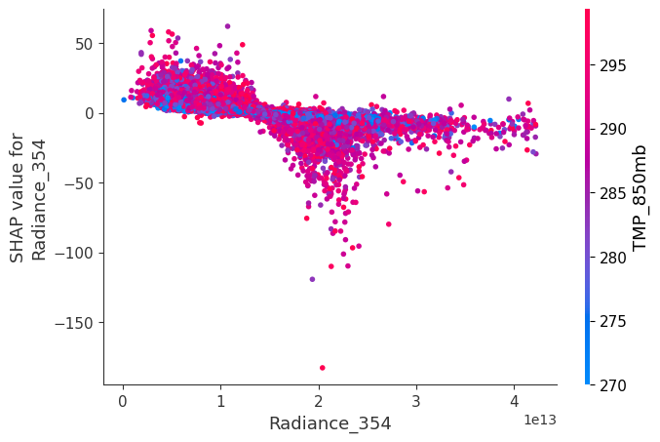
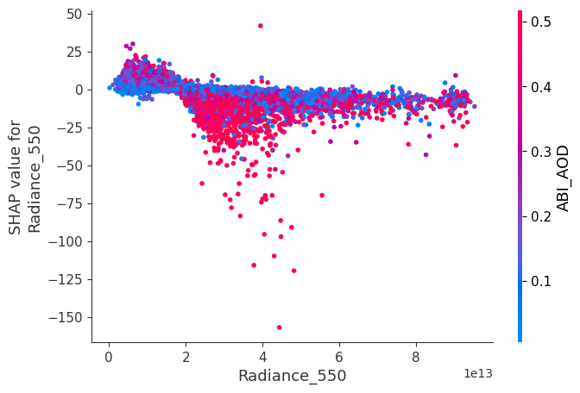
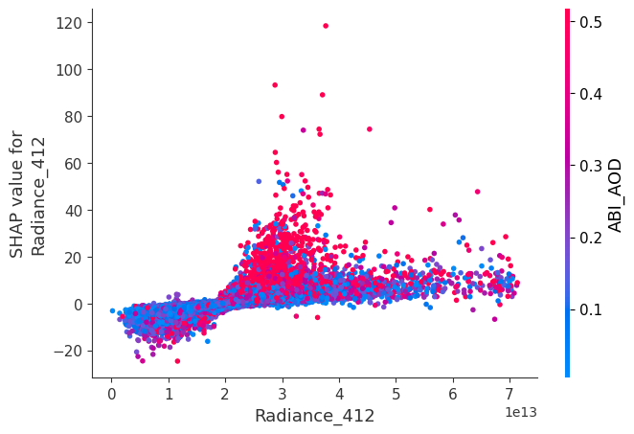
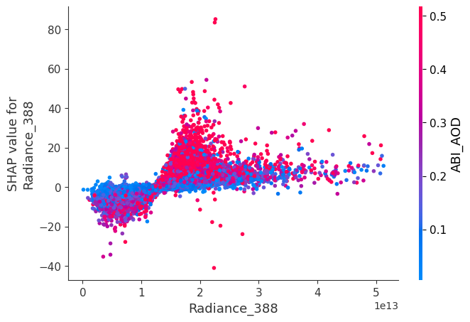
PM_{2.5} estimation using machine learning from GOES-R and TEMPO over CONUS
Variable importance using SHAP (XAI)
Dependence plot
Negative effects
Negative effects
The top four most important features were all TEMPO radiance variables, highlighting their dominant role in the model.
Positive effects
Positive effects
Notes:
And indeed, when we look at variable importance, the 354nm radiance in UV range shows the highest contribution to model performance.
This is clearly shown in the bar graph, which ranks features by their overall impact on the model's predictions.
You can see that several radiance variables play key roles. Among the top 10 most important features, five are radiance data.
The dependence plots here illustrate how different radiance channels influence the predictions.
Interestingly, the most important variable — the 354 nm radiance — shows a negative effect on PM2.5 estimation.
This means that as the radiance increases, the estimated PM2.5 tends to decrease.
This reflects the characteristic absorption behavior of UV radiation.

Slide 9
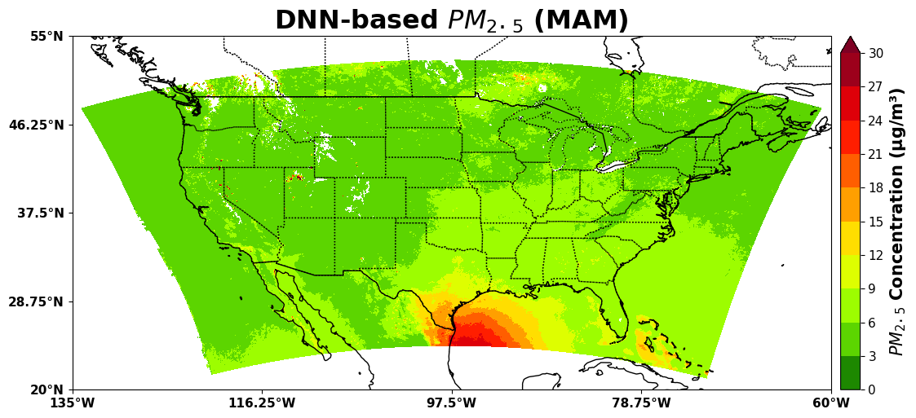
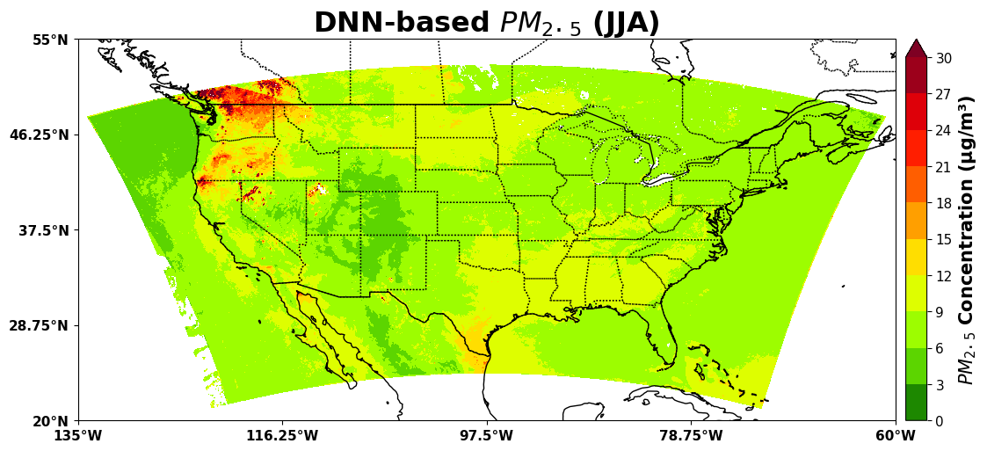
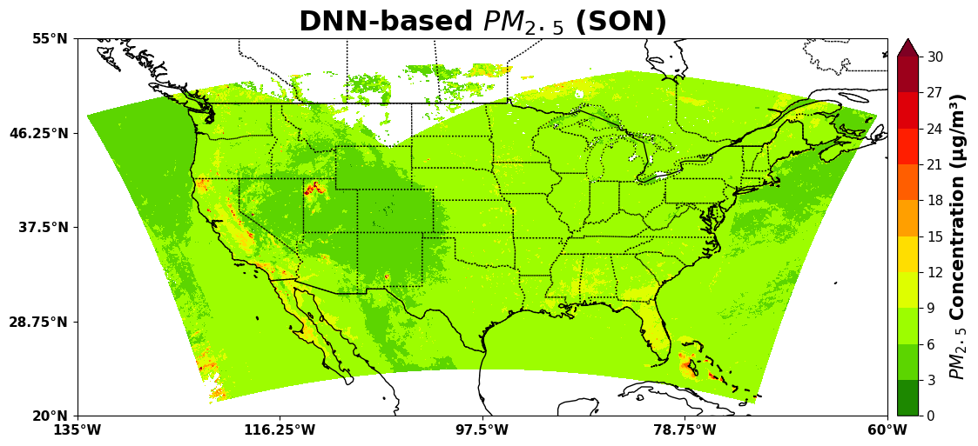
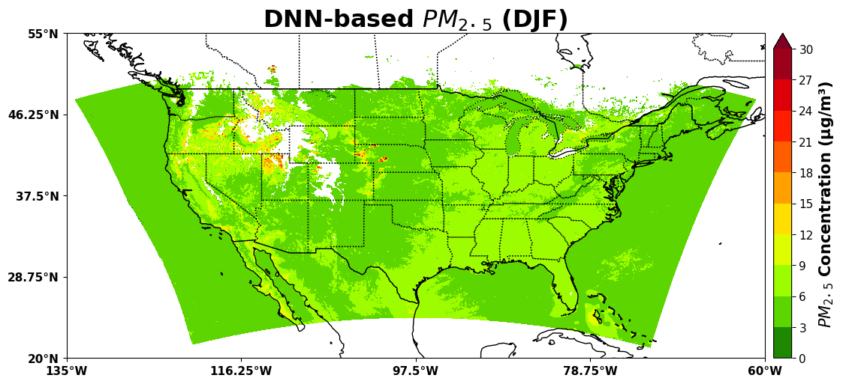
PM_{2.5} estimation using machine learning from GOES-R and TEMPO over CONUS
Seasonal distribution
Notes:
Summer : Washington wildfire

Slide 10
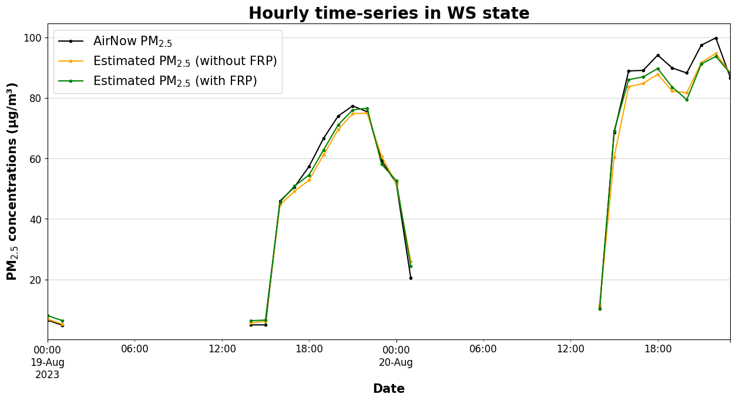
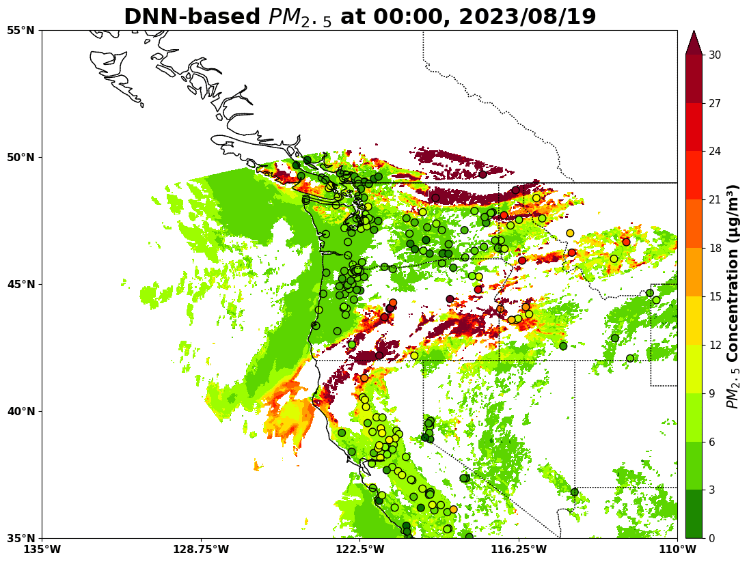
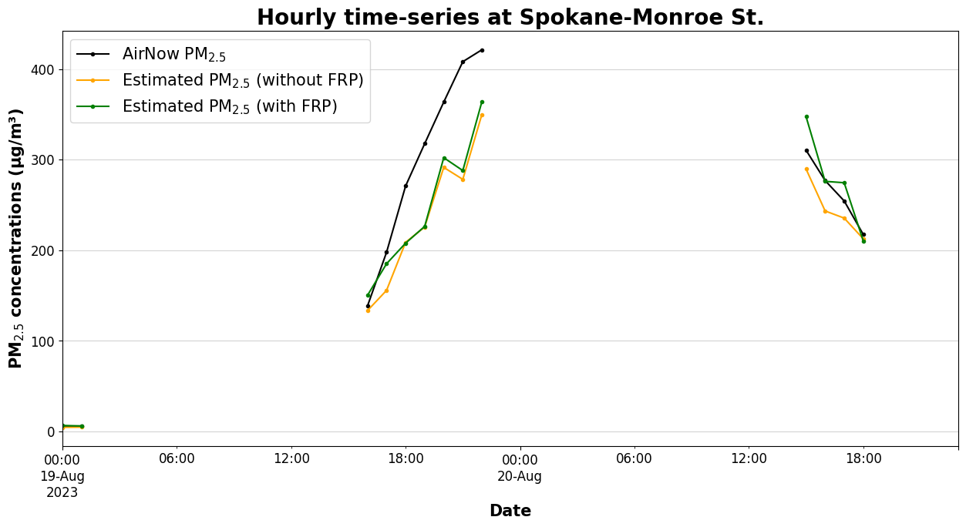
PM_{2.5} estimation using machine learning from GOES-R and TEMPO over CONUS
Case study (August 19-20, 2023; WA state)
Hourly spatial distribution (with FRP)

Slide 11
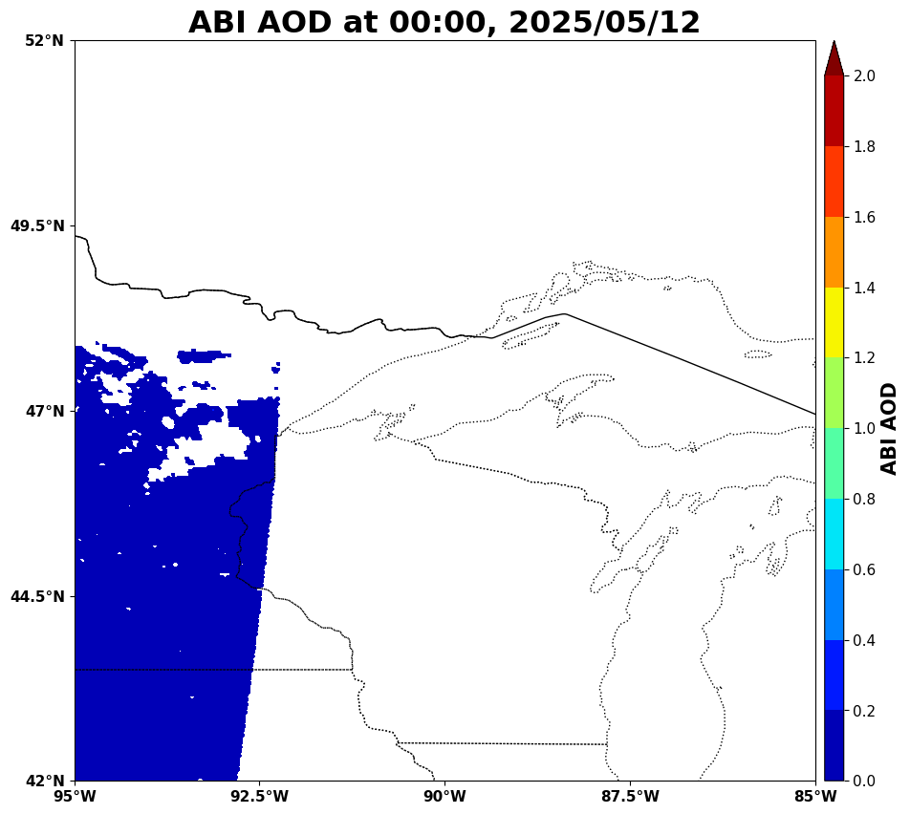
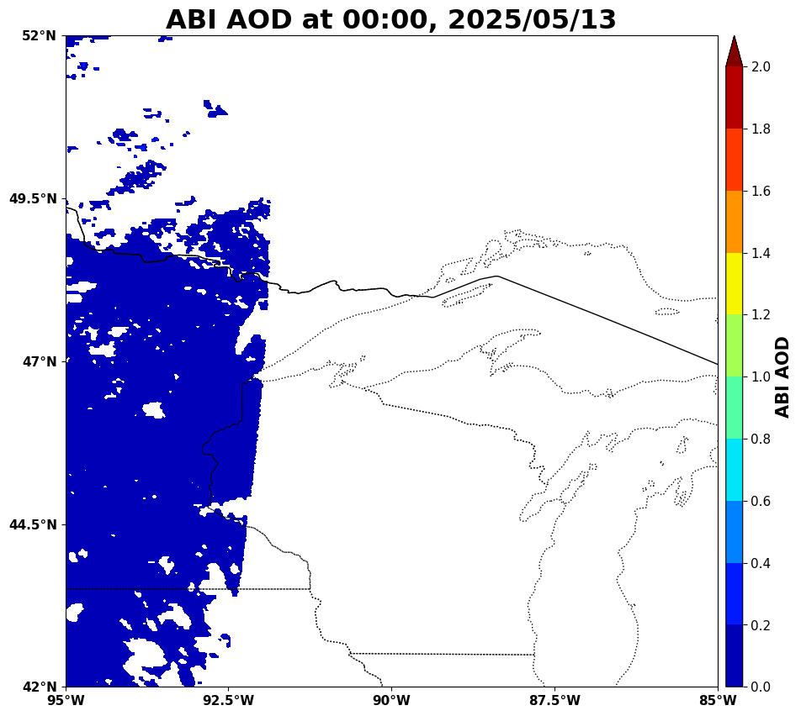
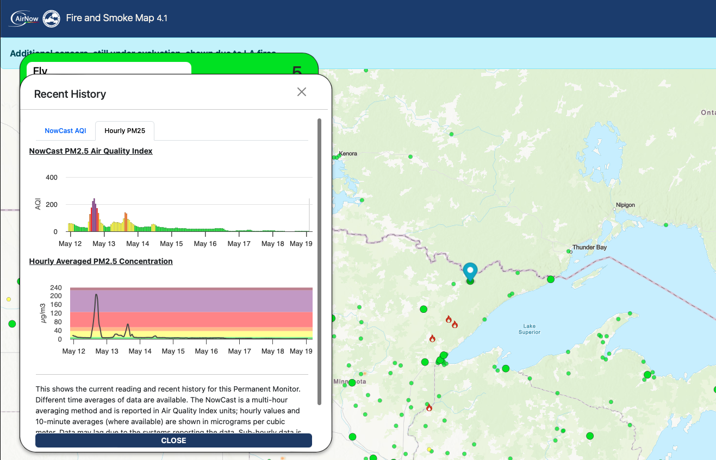
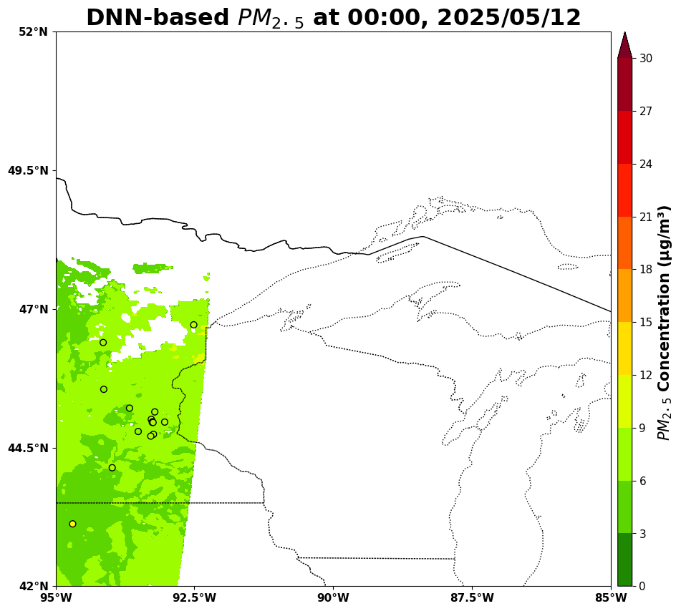
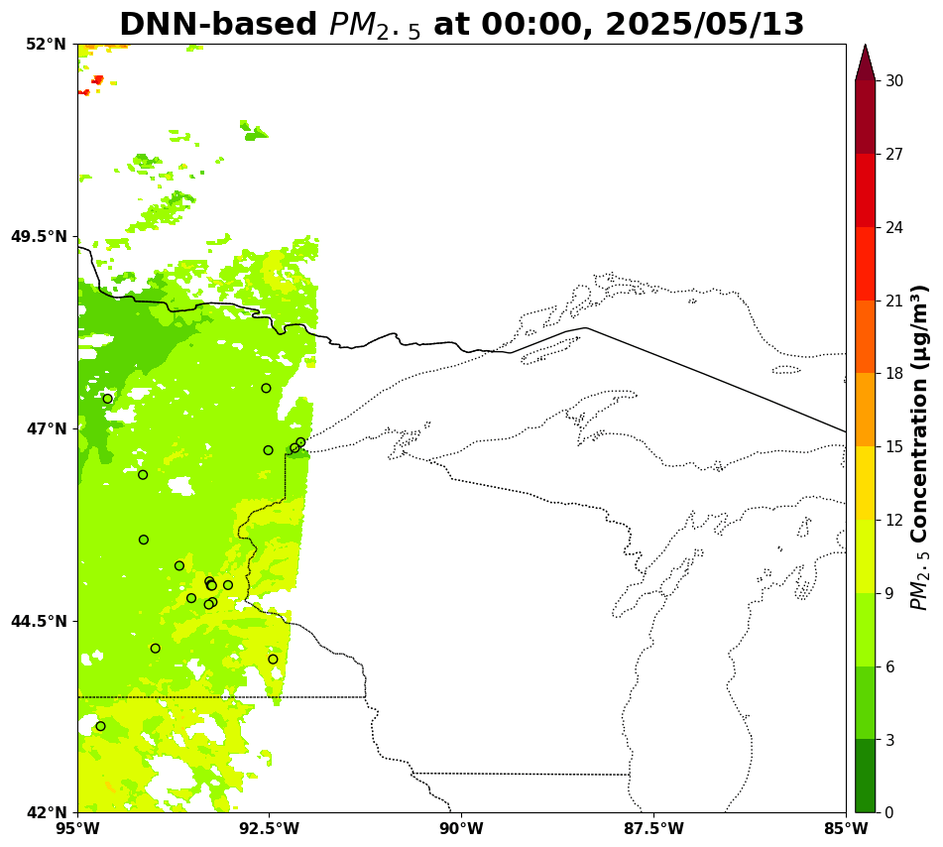
PM_{2.5} estimation using machine learning from GOES-R and TEMPO over CONUS
May 12-13, 2025
Camp House Fires in Minnesota

Slide 12
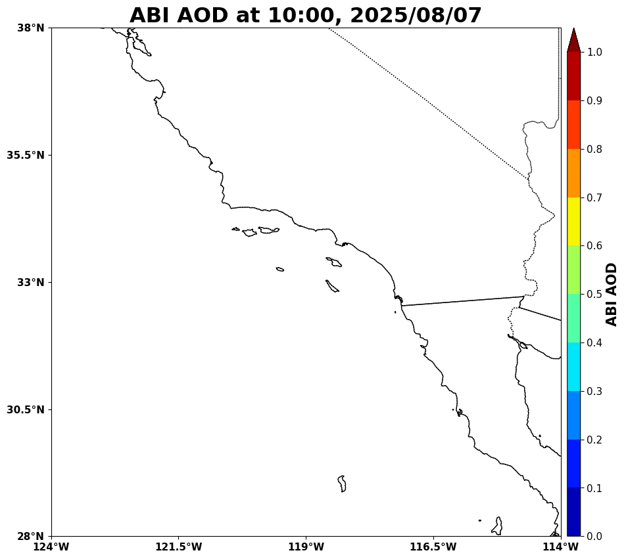
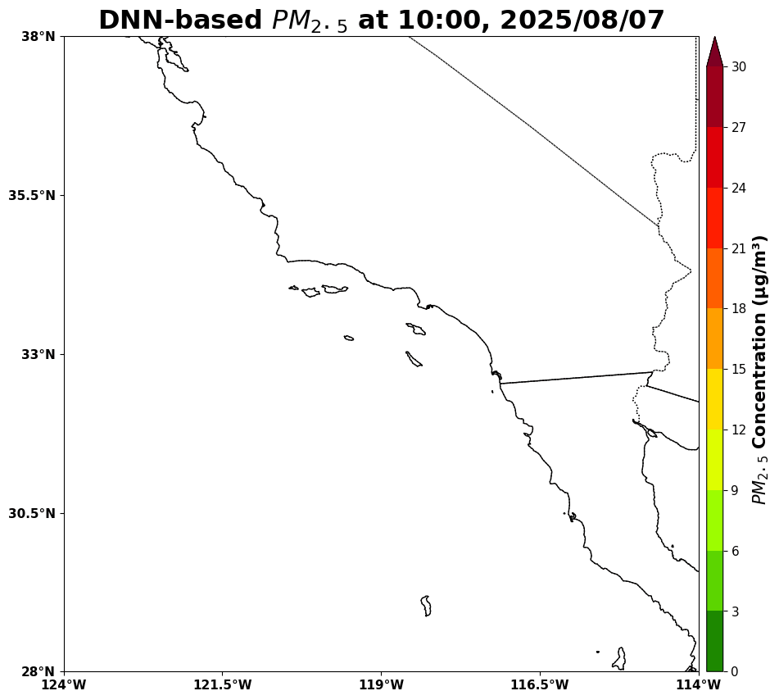
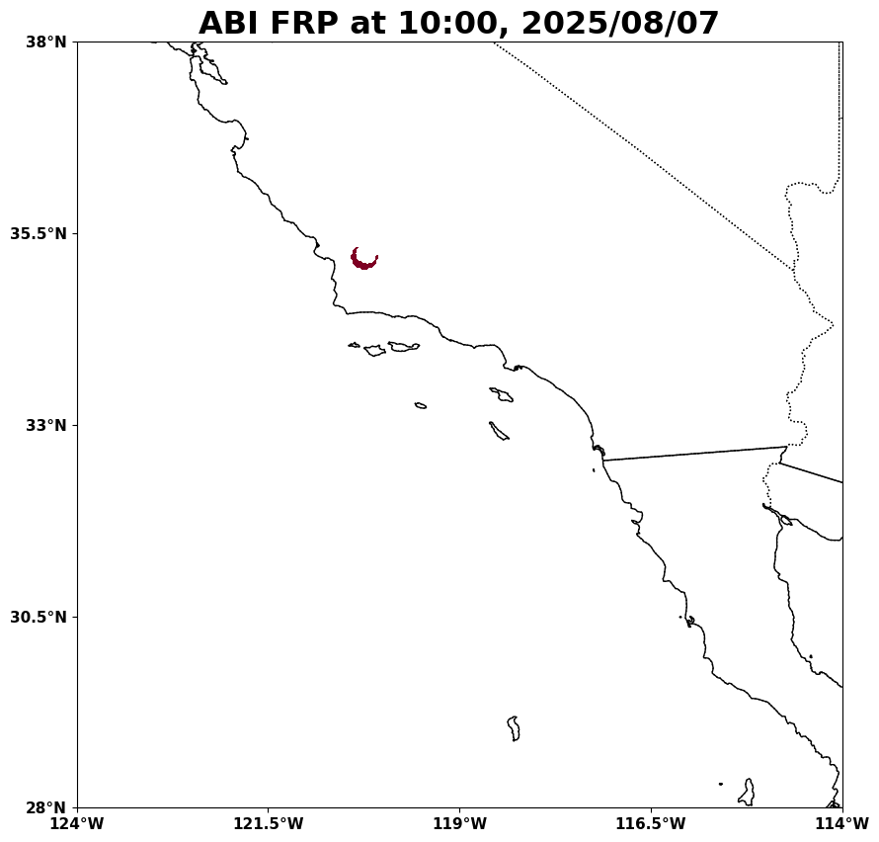
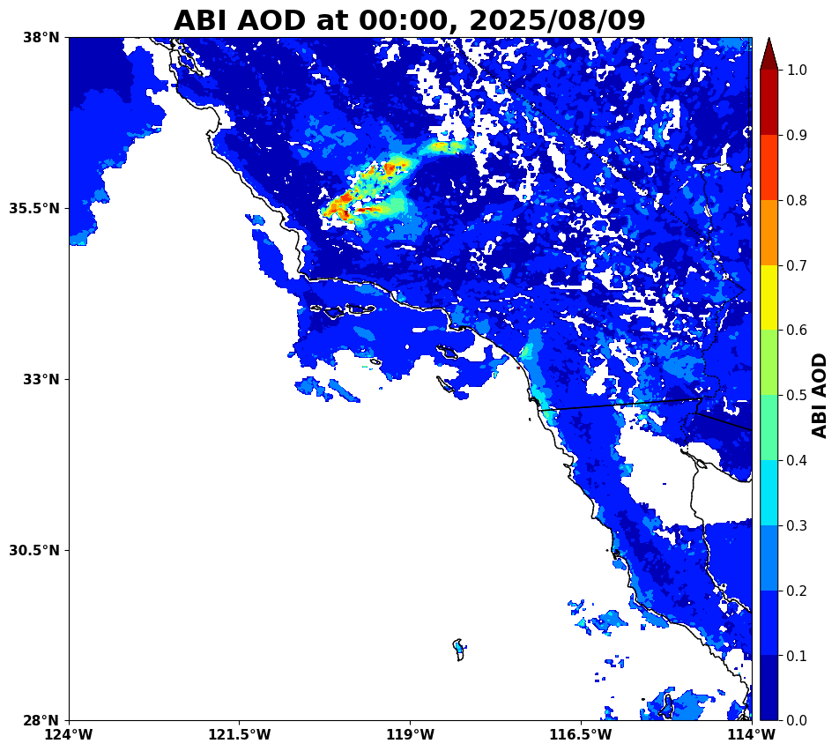
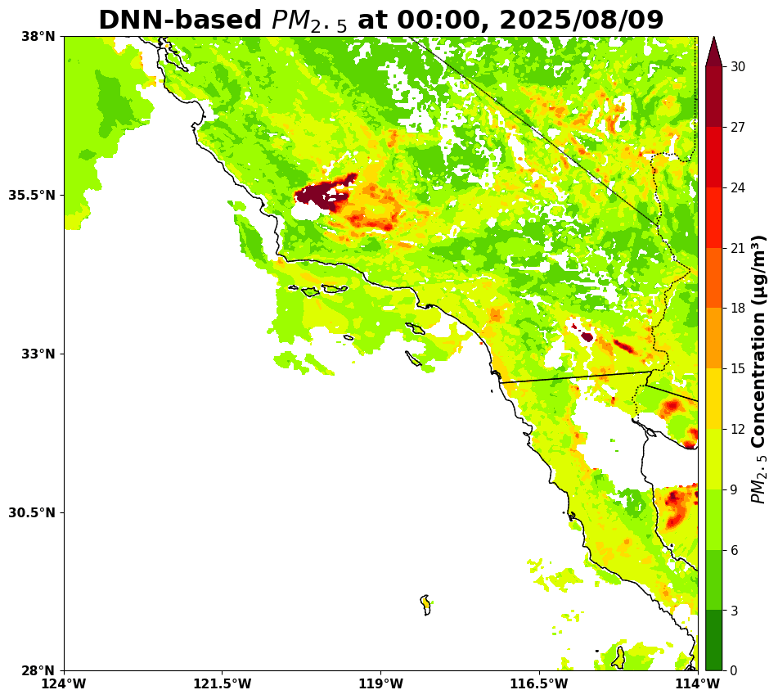
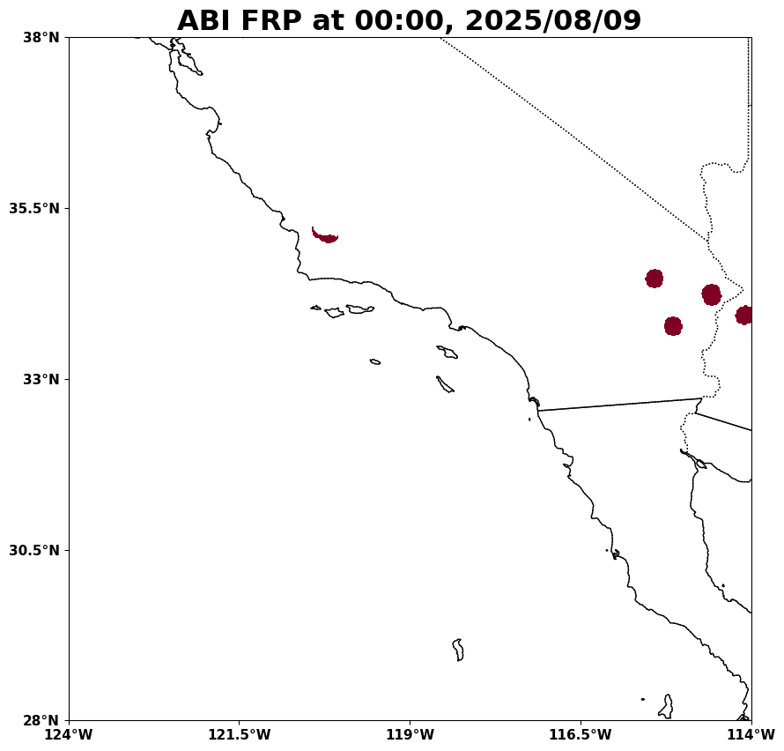
PM_{2.5} estimation using machine learning from GOES-R and TEMPO over CONUS
Case study (August 09, 2025)
Gifford fire case

Slide 13

PM_{2.5} estimation using machine learning from GOES-R and TEMPO over CONUS
Next step !
42
12
Concatenation
…
42
Surface
PM_{2.5}
ABI FRP
HRRR meteorological data
We continuously update the model !
ABI AOD
TEMPO data (radiance, SZA, ESD)
Notes:
We continuously update the model

Slide 14
PM_{2.5} estimation using machine learning from GOES-R and TEMPO over CONUS
Summary
Hourly PM_{2.5} estimations are continuously being generated through pipeline system.
(If anyone wants data, we will be happy to run some cases or provide already processed data)
By extending the study period to a full year, the model achieved greater stability and became less sensitive to short-term fluctuations. This also enabled us to capture and analyze seasonal distribution patterns.
In addition, by incorporating FRP data as an input variable, the model demonstrated improved capability in estimating ground-level PM₂.₅ concentrations, particularly in regions affected by wildfires.

Slide 15

Thank you!
Seohui Park (seohui.park@nasa.gov, Seohui.park@morgan.edu)
Pawan Gupta (pawan.gupta@nasa.gov)

